Slide 1

HI-ECN3
Design coordination
Jean-Louis Grenard WP4
04/09/2024

Slide 2
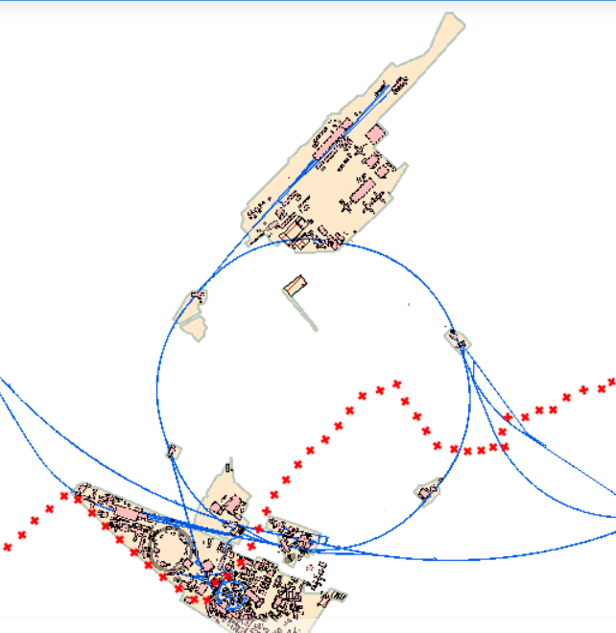
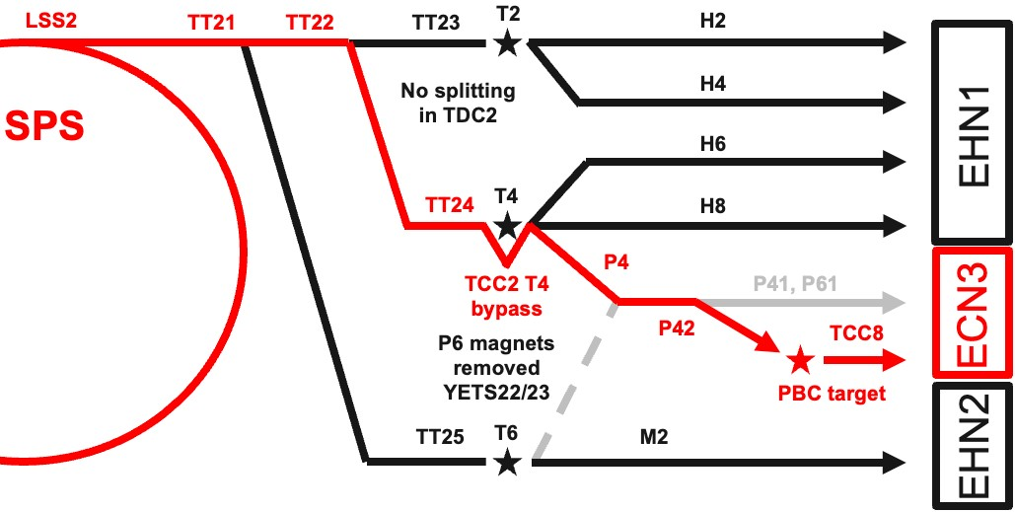
BDF-SHiP in an existing facility
ECN3
Implementation in the SPS North Area ECN3 designed at construction in 70’s for a High Intensity (NAHIF)
Currently used by NA62 experiment
SPS North Area beam lines and associated infrastructure being currently consolidated
Require the dismantling fraction of current P42 beam line, target station, the NA62 experiment
SPS extraction
towards North Area
CERN
Prevessin site
SPS
ring
CERN
Meyrin site

Slide 3
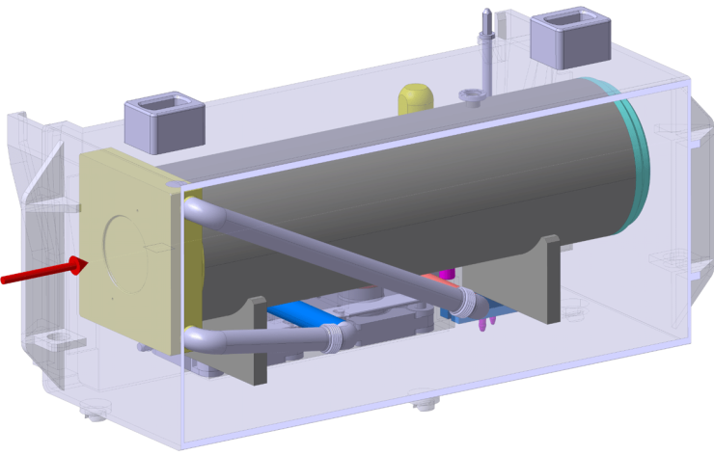
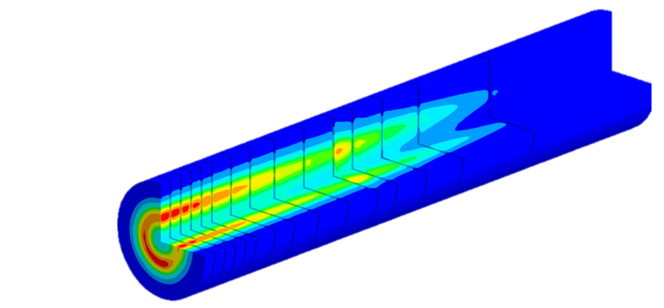
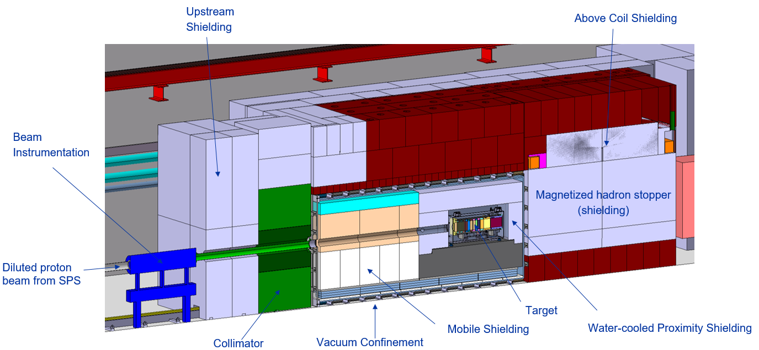
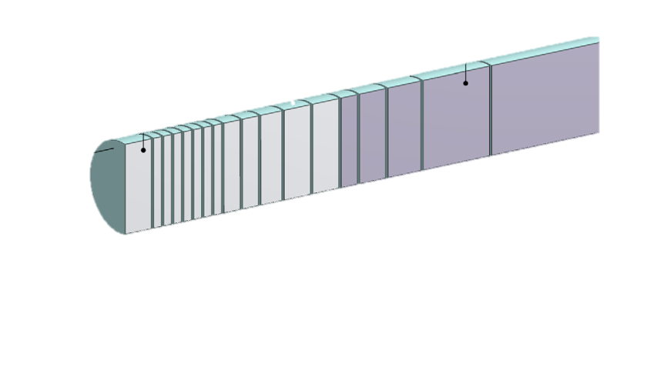
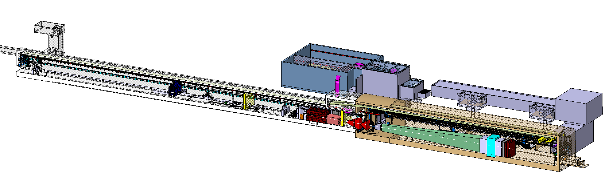
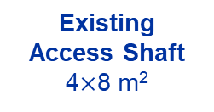
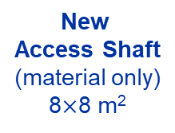
BDF/SHiP complex
Baseline Design → To be improved during TDR
WP4
WP3
13 x TZM blocks (580 mm)
5x W blocks (780 mm)
New
Service Building
~ 700 – 1000 m²
New
Access Shaft
(material only)
8$×$8 m²
Existing
Access Shaft
4$×$8 m²
WP4
B911
B918
Beam Dilution System
TCC8
WP2
WP4
ECN3
WP6,WP7 +al.
New Target Complex
containing the Beam Dump Target
WP5+SHiP

Slide 4
Project Team
Matt’s slides at 345th IEFC
HI-ECN3 Study Project Team
Project Leader (PL):
Matthew FRASER
Deputy Project Leader (DPL):
Claudia AHDIDA
Project Safety Officer (PSO):
Melenia AVERNA
Project Radiation Safety Officer (PRSO):
TBC
Project Budget Officer:
Sylvie PRODON
Project Planning Officer (PPO):
Fernando PEDROSA
Configuration & Quality Assurance Manager:
Giulia ROMAGNOLI
Integration Support via ICEA:
Michael LAZZARONI
North Area Operation & Experiment Liason:
Dipanwita BANERJEE
SHiP Experiment Contact Person:
Richard JACOBSSON
SHiP Experiment Safety Correspondant:
Letizia DI GIULIO
Project & Experiment Safety Support (PESS) Correspondant :
James CURRIE
Admin Support:
Katarina SIGERUD & Ane-Mona BRANZA
+ WPLs
WP8 – Radiation field and R2E & R2M effects
Luigi ESPOSITO
WP1 – Project Management
Matthew FRASER
WP2 – Beam Extraction, Transfer and Delivery
Francesco VELOTTI
Deputy Laurie NEVAY
WP3 – Target & Beam Intercepting Devices
Rui XIMENES
WP4 – Target Complex
Jean-Louis GRENARD
WP5 – Exp. Area, Interface & Integration
Francois BUTIN
WP6 – Radiation Protection & Safety
Claudia AHDIDA
WP7 – Infrastructure, Services & Civil Eng.
Fernando PEDROSA

Slide 5
Introduction
TDR aimed to be completed by end of 2025
TDR phase is not implementation phase
  CE on the critical path
    Need to define the envelops by end of 2024
    Constrains by existing CE structures (911 shaft, 918 and TCC8 soil retaining wall)
But need to already foresee modifications of existing structures in 2024 and 2025 (ie new 911 doors, trench) to optimize CE work during LS3
NA-CONS activities foreseen during LS3 in TCC8 and ECN3 (fire doors, fire detection) integrated in HI-ECN3 taking in consideration new requirements

Slide 6
TDR phase - integration
Definition of the new layout
Integration of new beam line equipment
  Magnets
  Beam instrumentation
  Target station
Integration of the new experiment
Integration of the new buildings and access shaft
Integration of structures modification
  ECN3 and TCC8 floor excavations
  New compartmentation of TCC8

Slide 7
TDR phase - integration
Integration of the associated utilities
  Cooling and Ventilation
  Handling
  Electricity distribution
  Control system distribution
  Safety systems (fire detection, fire doors, access system)
Integration of volumes for installation and maintenance tasks
  Target replacement
  Dismountable shielding
  Experiment maintenance volumes
  Handling volumes

Slide 8
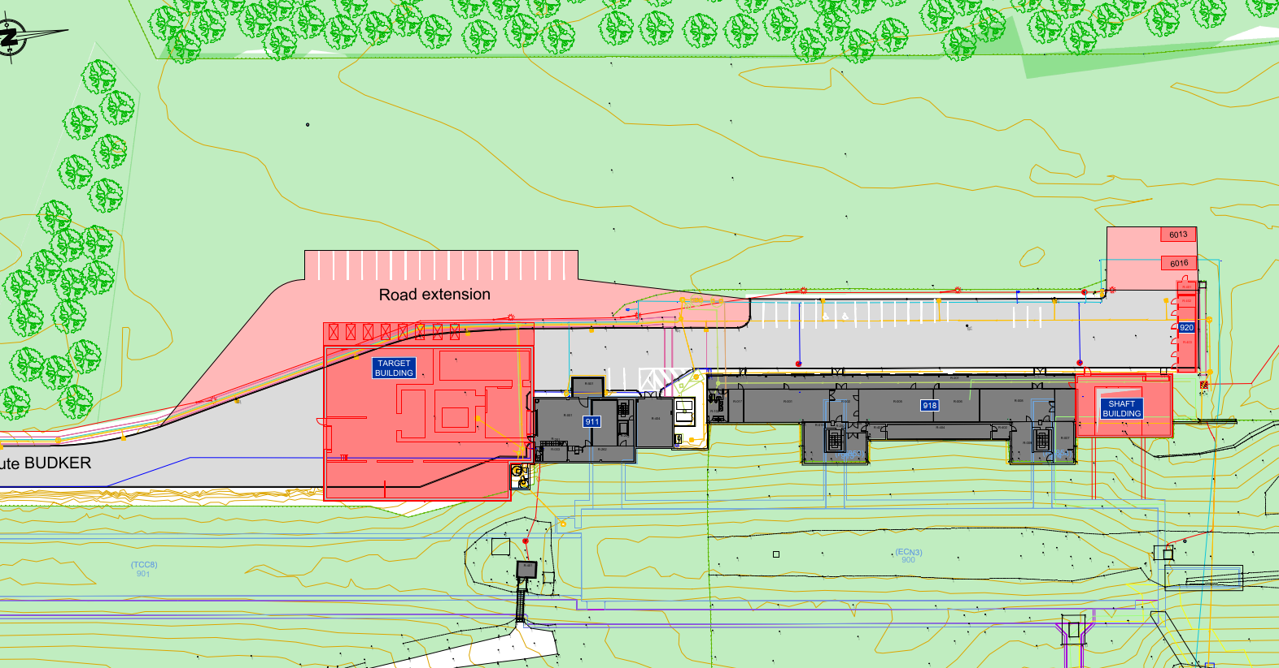
New buildings – draft layout
754, 718, 728
BA90, PA90, TA90
754
BB85

Slide 9
3d Integration methodology
HI-ECN3 complex centralized integration via BE-EA integration team
CATIA model
New service buildings
Once we agree on volumes in CATIA design will be performed with REVIT mainly managed by SCE and EN-CV to take full benefit of BIM system
Will be migrated regularly to CATIA to check and validate interfaces and keep general TCC8/ECN3 integration manged by BE-EA integration team UpToDate
ICEA role
Presentation of design progress to ensure coherence with NA-CONS
Validation of designs before ECRs
Defined: https://edms.cern.ch/ui/file/3018359/1.0/SPS-XPM-MEMO-0001-1.0.pdf

Slide 10
3d models responsabilities
Target station models: SY-STI Christophe
EL systems (cable tray, racks): EN-EL Jean-Pierre
CV systems: EN-CV Mathieu
Handling systems: EN-HE Cristina
Safety system (access, fire safety system, RP monitoring): BE-EA Beatriz, Sylvain
Civil engineering structures: SCE-SAM Amine
Beam line including skeleton including experiment: Beatriz, Sylvain
Experiment integration model to be defined
Service building integration for definition of volumes SY-STI Christophe
General integration models BE-EA Beatriz, Sylvain
Are we missing someone?

Slide 11
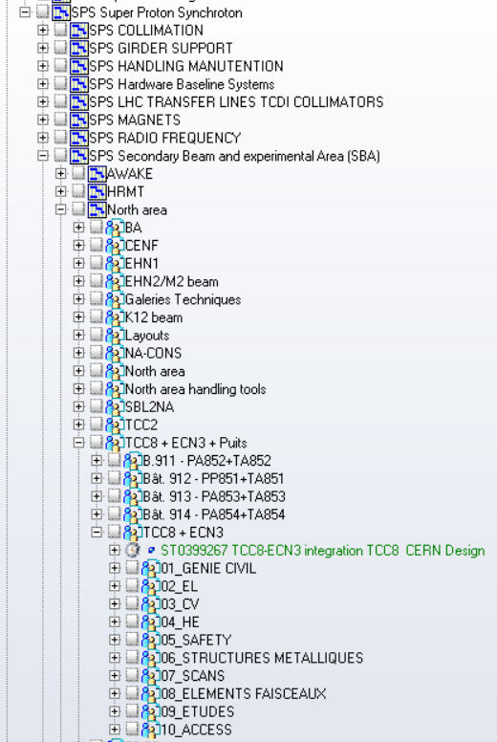
SMARTEAM - PLM structure
To be created
Should be coherant with NA structure
Duplication of TCC8-ECN3 existing structure?

Slide 12
Exchange of models CATIA - REVIT
Storage of REVIT models? SCE/CV to organize and share folder?
Exchange frequency? Every month?

Slide 13
Questions?

