Slide 1
The African School of Physics
Lecture : Object Identification and Data Analysis
Version 2012
Slides from ASP2010 (Ketevi Assamagan, Daniel Froidevaux, Simon Connell)

Slide 2
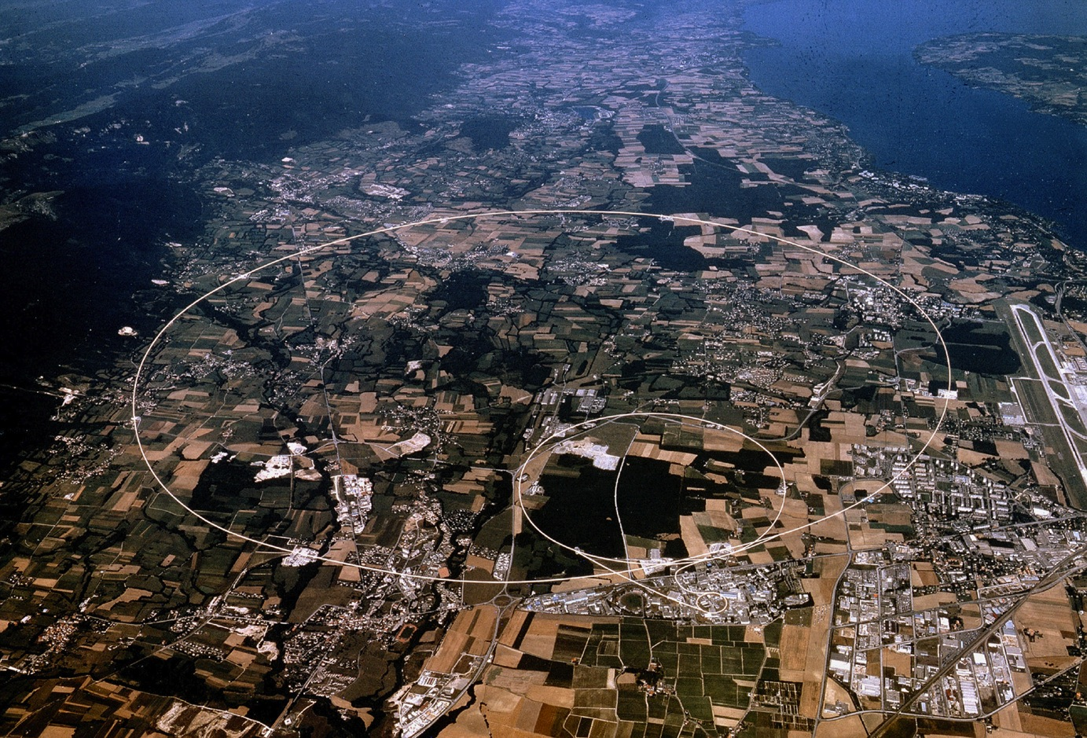
The LHC Project
Large Hadron Collider
27 km circumference
Lake Geneva
CMS
LHCb
ALICE
ATLAS
On July 4th, CERN announced the discovery of a Higgs-like boson.
What are its properties … ? What else is out there … ?

Slide 3
pp √s = 14 TeV L_{design} = 10³⁴ cm⁻² s⁻¹ (after 2013)
7 TeV L_{initial} < few x 10³³ cm⁻² s⁻¹ (2011)
8 TeV L_{initial} < 6 x 10³³ cm⁻² s⁻¹ (2012)
Heavy ions (e.g. Pb-Pb at ~ 1150 TeV)
ATLAS and CMS:
general purpose
TOTEM
LHC 27 km ring (previously
used for the LEP e⁺e⁻ collider)
Plus 3 much smaller
experiments with very
forward detectors at
Point-1: LHCf
Point-5: Totem
…
ALICE:
Heavy Ions
LHCb:
B-physics, CP-violation

Slide 4
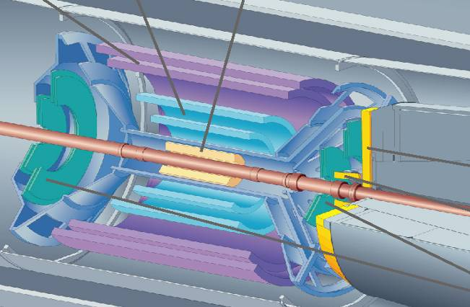
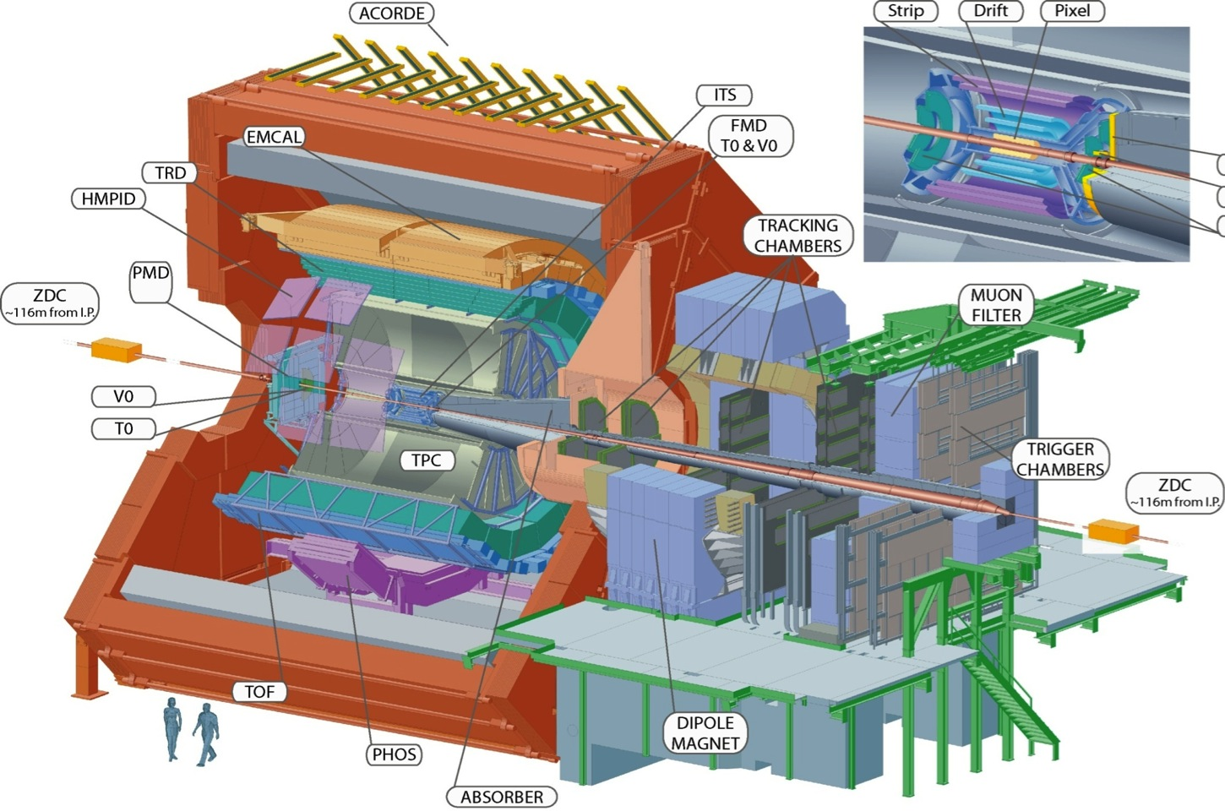
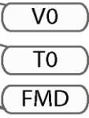

ALICE: study of quark-gluon plasma
- L3 solenoid
- Large TPC
- Si microstrip, drift and pixels detectors
- Particle identification: RICH, TRD, TOF
- PbWO₄ crystals + Pb/scintillator ecal
- Single arm forward muon system
Size: 16 x 26 meters
Weight: 10,000 tons

Slide 5
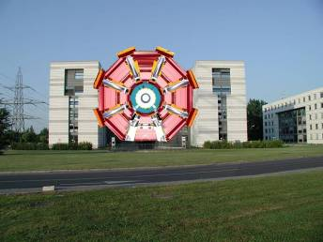

ATLAS Detector
45 m
ATLAS superimposed to
the 5 floors of building 40
24 m
7000 Tons

Slide 6
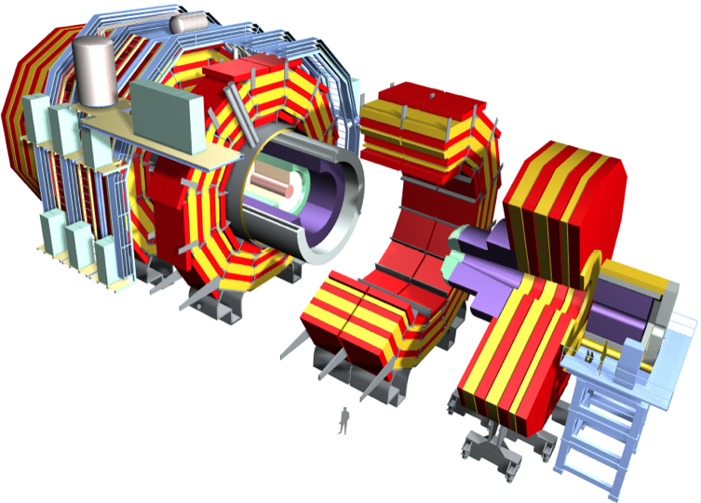
CMS Detector
Superconducting Coil, 4 Tesla
CALORIMETERS
ECAL
HCAL
76k scintillating
PbWO4 crystals
Plastic scintillator/brass
sandwich
Steel YOKE
Level-1 Trigger Output
Today: 50 kHz
(eventually100 kHz)
Directly feeds Higher Level Trigger CPU farm
TRACKER
Pixels
Silicon Microstrips
210 m² of silicon sensors
9.6M (Str) & 66M (Pix) channels
MUON
ENDCAPS
MUON BARREL
Drift Tube
Resistive Plate
Cathode Strip Chambers (CSC)
Chambers (DT)
Chambers (RPC)
Resistive Plate Chambers (RPC)

Slide 7
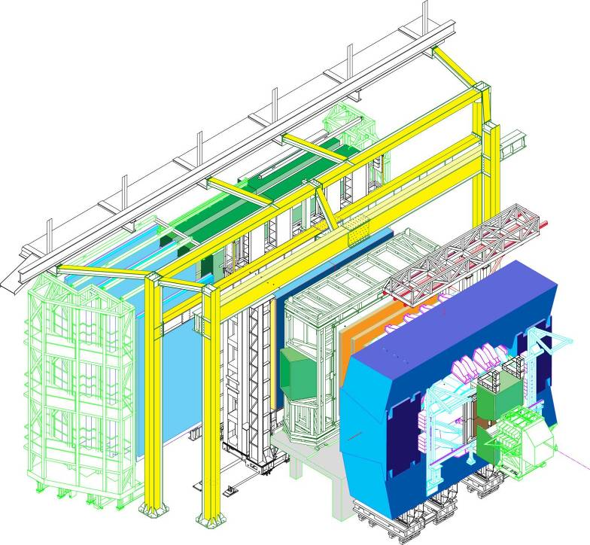
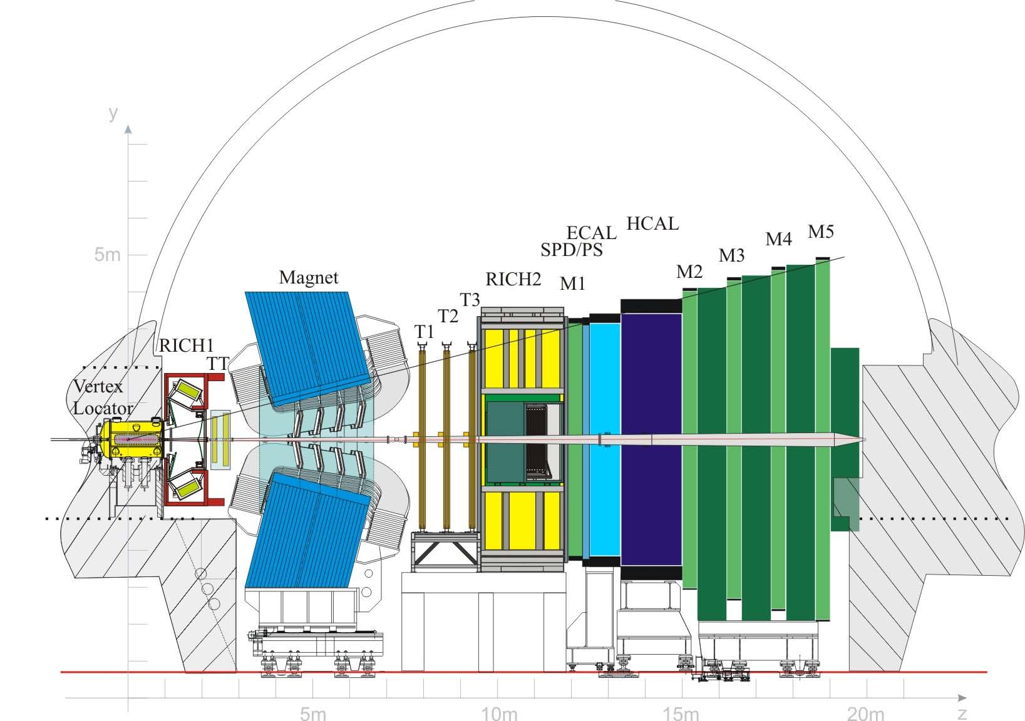
LHCb:
Study of B decays and CP Violation
(indirect search for New Physics)
- Dipole magnet (4 T.m)
- Particle Identification (2 RICH)
- 21 layer of Si microstrip vertex locator (VELO)
- Tracking: Silicon + long straw tubes
- Shashlik (Pb/scint) em calorimeter
- HCAL (Fe/scint),
- MWPC muon system
Beam 1
Beam 2
VELO

Slide 8
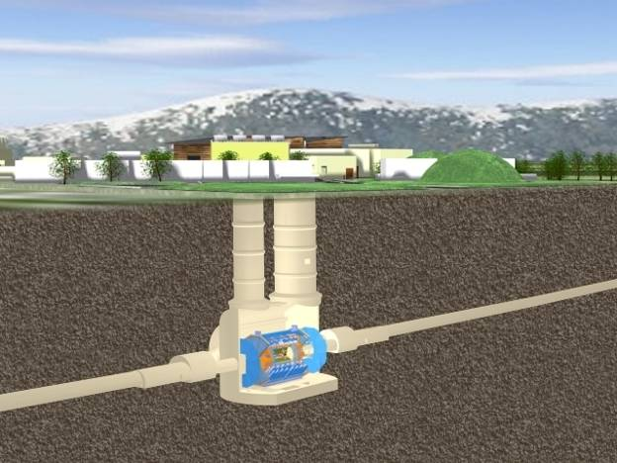
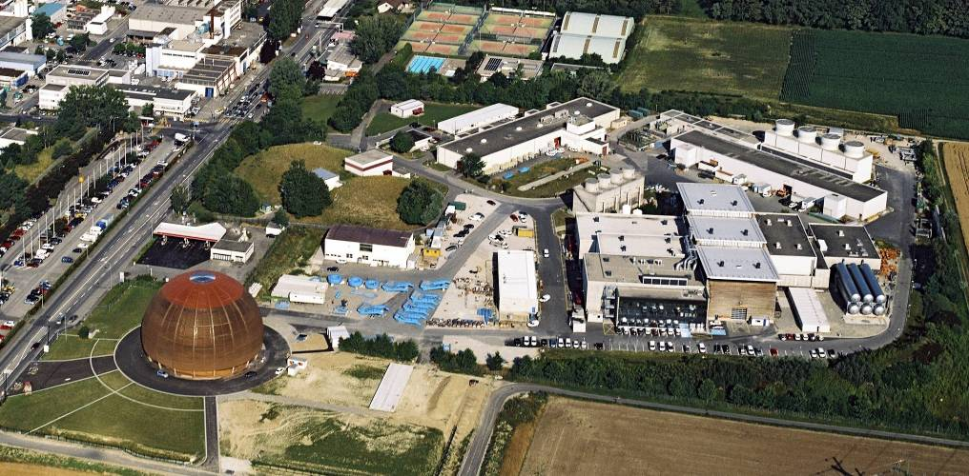
The Underground
Cavern at Point-1 for
the ATLAS Detector
Length = 55 m
Width = 32 m
Height = 35 m
Side C
Side C
Side A
Side A

Slide 9
25 ns
Event rate:
N = L x σ (pp) ≈ 10⁹ interactions/s
Mostly soft (low p_{T}) events
Interesting hard (high-p_{T}) events are rare
→ very powerful detectors needed

Slide 10
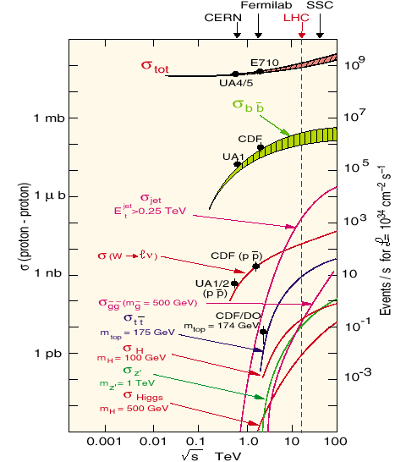
Physics at the LHC: the challenge
Small x-sections
need highest luminosity
L= 10³⁴⁻³⁵ cm⁻²s⁻¹
Orders of magnitude of event rates
for various physics channels:
• Inelastic : 10¹⁰ Hz
• W -> lν : 10³ Hz
• tt production : 10² Hz
• Higgs (m=100 GeV) : 1 Hz
• Higgs (m=600 GeV) : 10⁻¹ Hz
(and include branching ratios: ~ 10⁻²)
Selection power for
Higgs discovery ≈ 10¹⁴⁻¹⁵
i.e. 100 000 times better than achieved at Tevatron so far for high-p_{T} leptons!

Slide 11
Physics at the LHC: the challenge
LHC is a “factory” for top, W/Z, Higgs, SUSY, black holes ...
Expected event rates for representative (known and new) physics processes at “low” luminosity (L=10³³ cm⁻² s⁻¹) in ATLAS/CMS
Process Events/s Events for 10 fb⁻¹ Total statistics collected
(one year) elsewhere by 2008 (?)
W→ eν 30 10⁸ 10⁴ LEP / 10⁷ Tevatron
Z→ ee 3 10⁷ 10⁶ LEP
Top 2 10⁷ 10⁴ Tevatron
Beauty 10⁶ 10¹² – 10¹³ 10⁹ Belle/BaBar
H (m=130 GeV) 0.04 10⁵
Gluino 0.002 10⁴
(m= 1 TeV)
Black holes 0.0002 10³
m > 3 TeV

Slide 12
Physics at the LHC: the environment
What do we mean by particle reconstruction and identification at LHC?
Elementary constituents interact as such in “hard processes”, namely:
Quarks and leptons as matter particles, and
Leptons | e (0.0005) | μ (0.105) | τ (1.777)
 | ν_{e} | ν_{μ} | ν_{τ}
Quarks | u (< 0.005) | c (~ 1.25) | t (~ 175)
 | d (< 0.005) | s (~ 0.1) | b (~ 4.2)
All
masses
in GeV
Gluons and EW bosons as gauge particles
Gluon(0) Colour octet | Photon(0) | W⁺,W⁻ (80.42) | Z (91.188)
e, ν, γ : only rigorously stable particles
μ : at collider energies, do not decay in the detector
τ, c, b : Live long enough to travel a short distance, can see separated vertexes.
All other particles can only be seen through their stable decay products

Slide 13
Physics at the LHC: the environment
Which type of particles does one actually see in the final state?
LHC physics processes are dominated by strong interactions (QCD) :
Jets : hard processes: quarks and gluons materialise as hadronic jets, which
consist mostly of charged and neutral hadrons (pions, kaons, and to a
lesser extent protons and neutrons, which at these energies can be all
considered as stable).
“soup” : soft processes: non-perturbative QCD processes with soft gluons
materialising as almost uniform soup of charged and neutral π, K, etc.
Heavy quarks with “long” lifetime are produced abundantly also
High-p_{T} (above ~ 10 GeV) leptons are produced mostly in c, b decays.
High-p_{T} isolated leptons may be found in fraction of J/ψ and Υ decays
For p_{T} > 25 GeV, dominant source of high-p_{T} leptons: W/Z/tt decays
Main challenge at LHC : find e, γ, μ, τ, b amidst q/g soup

Slide 14
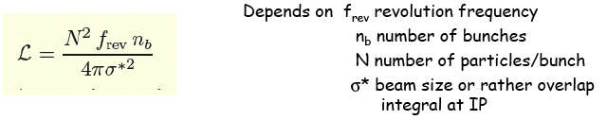
Cross section, Luminosity, Reaction Rate
Fixed target experiment
R = rate of reaction
I_{a}A
Incident flux x Area
= Incident rate
N_{t} = Number/area
Collider experiment
Nf_{rev}n_{b}
= Incident rate
N/4πσ*² = Number/area
R = rate of reaction

Slide 15



Luminosity
In scattering theory and accelerator physics, luminosity is the number of particles per unit area per unit time times the opacity of the target, usually expressed in cm−2 s−1. The integrated luminosity is the integral of the luminosity with respect to time. The luminosity is an important value to characterize the performance of an accelerator.
The following relations hold
Number of measured events
Rate
1000 evts (1fb⁻¹@7TeV)
Differential cross section

Slide 16
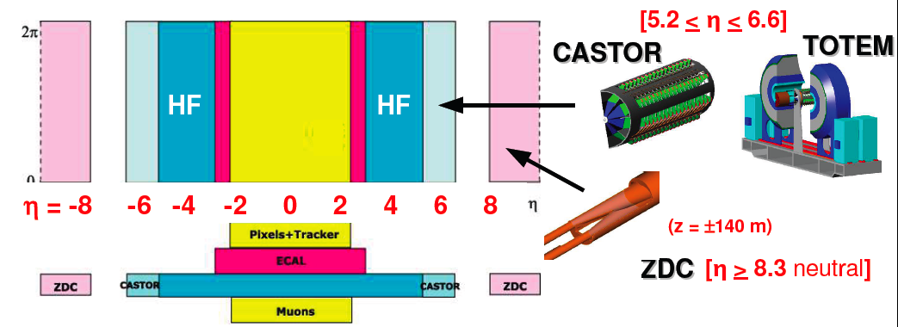
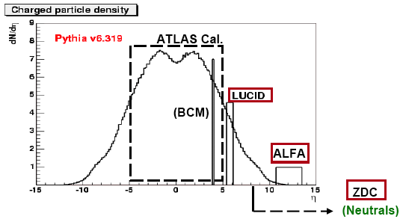
Luminosity measurements …
CMS/TOTEM and ATLAS forward detectors for forward physics, heavy ion, … and
luminosity measurements … forward / high η physics (elastic scattering, diffractive processes …)
Initially from machine parameters
  Precision ~10-15%
Medium term from physics processes: W/Z & μμ/ee
  Precision ~5-10%
>= 2011 from Roman Pot detectors
  Precision ~2-3%

Slide 17
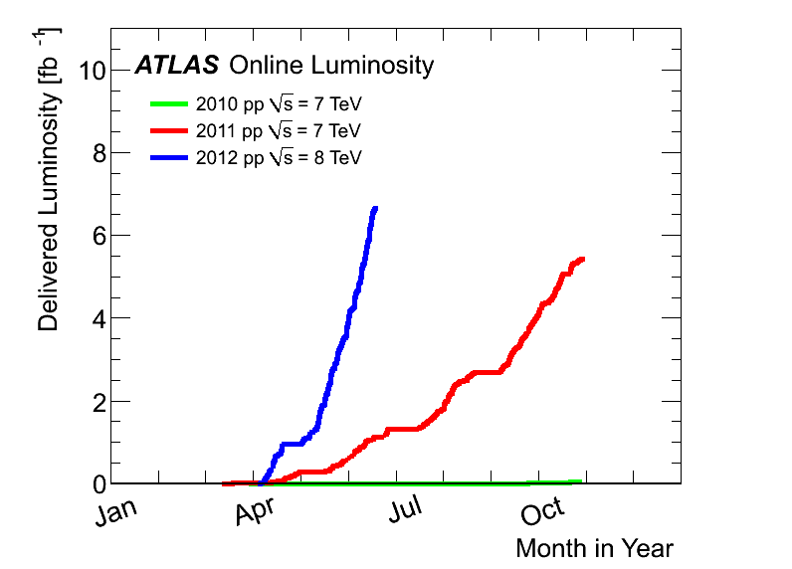
Luminosity delivered to ATLAS since the beginning
2012:
6.6 fb⁻¹
at 8 TeV
2011
5.6 fb⁻¹
at 7 TeV
2010
0.05 fb⁻¹
at 7 TeV

Slide 18
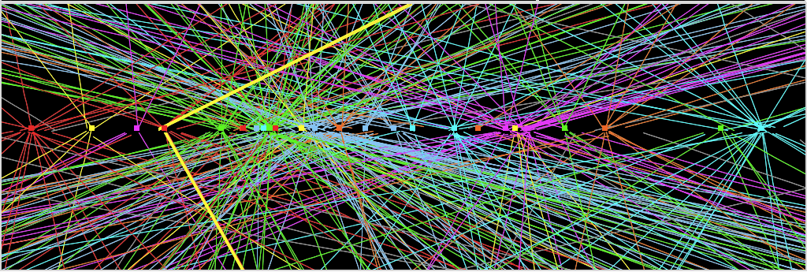
Physics at the LHC: the environment
Extract number of inelastic collisions per bunch crossing
<n> = σ_{inel} x L x Δt / ε_{bunch}
LHC: <n> = 70 mb x 10³⁴ cm⁻²s⁻¹ x 25 ns / 0.8 = 23
Big change compared to recent and current machines:
LEP: Δt = 22 μs and <n> << 1
SppS: Δt = 3.3 μs and <n> ≈ 3
HERA: Δt = 96 ns and <n> << 1
Tevatron: Δt = 0.4 μs and <n> ≈ 2

Slide 19
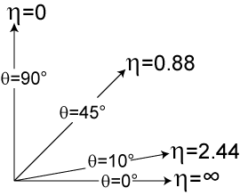



Rapidity, pseudo-rapidity
In experimental particle physics, pseudorapidity, η, is a commonly used spatial coordinate describing the angle of a particle relative to the beam axis. It is defined as
Central region
Detector
where θ is the angle between the particle momentum p and the beam axis. In terms of the momentum, the pseudorapidity variable can be written as
Protons
Protons
Forward Region
In hadron collider physics, the rapidity (or pseudorapidity) is preferred over the polar angle θ because, loosely speaking, particle production is constant as a function of rapidity. One speaks of the forward direction in a hadron collider experiment, which refers to regions of the detector that are close to the beam axis, at high |η|.
In the limit where the particle is travelling close to the speed of light, or in the approximation that the mass of the particle is nearly zero, pseudorapidity is numerically close to the experimental particle physicist's definition of rapidity,

Slide 20
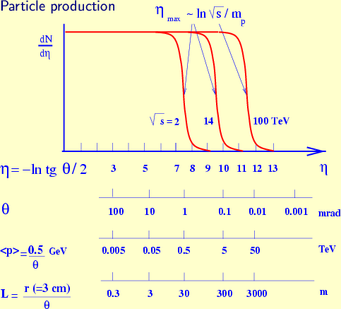
Physics at the LHC: the environment
p
p_{T}
θ
dσ/dp_{T}dy is
Lorentz-invariant
η = y for m ≈ 0
Physics is ~ constant
versus η at fixed p_{T}

Slide 21
ATLAS/CMS: from design to reality
One word about neutrinos in hadron colliders:
  since most of the energy of the colliding protons
  escapes down the beam pipe, one can only use
  the energy-momentum balance in the transverse plane
  → concepts such as E_{T}^{miss}, missing transverse momentum
  and mass are often used (only missing component is E_{z}^{miss})
  → reconstruct “fully” certain topologies with neutrinos,
  e.g. W → lν and even better H → ττ → lν_{l}ν_{τ} hν_{τ}
  the detector must therefore be quite hermetic
  → transverse energy flow fully measured with reasonable accuracy
  → no neutrino escapes undetected
  → no human enters without major effort
  (fast access to some parts of ATLAS/CMS quite difficult)

Slide 22
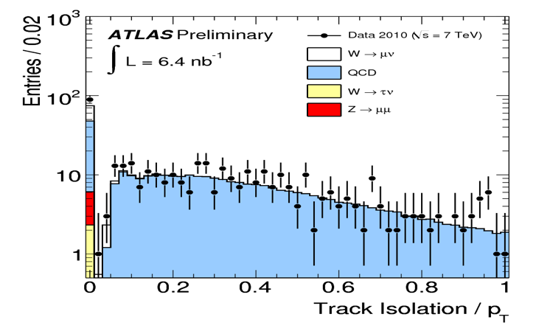
Isolation
φ
Isolated Particle
Isolation: track density
or energy deposit in the
vicinity of a particle of
Interest. Important for
Particle identification because
Isolated particles are easier to
Indentify.
Non Isolated Particle
inside a jet
Protons
η
Protons
The vicinity: ΔR = √ (Δη² + Δφ²)
Isolated Particle
= pseudorapidity
= azimuthal angle
p_{T}= transverse momentum= √(p_{X}²+p_{Y}²)
p_{Z} or p_{L} = longitudinal momentum
4-momentum (p_{X}, p_{Y}, p_{Z}, E)
Track Isolation: summed p_{T} of tracks in the specified ΔR
Calo isolation: summed calorimeter energy deposits in ΔR

Slide 23
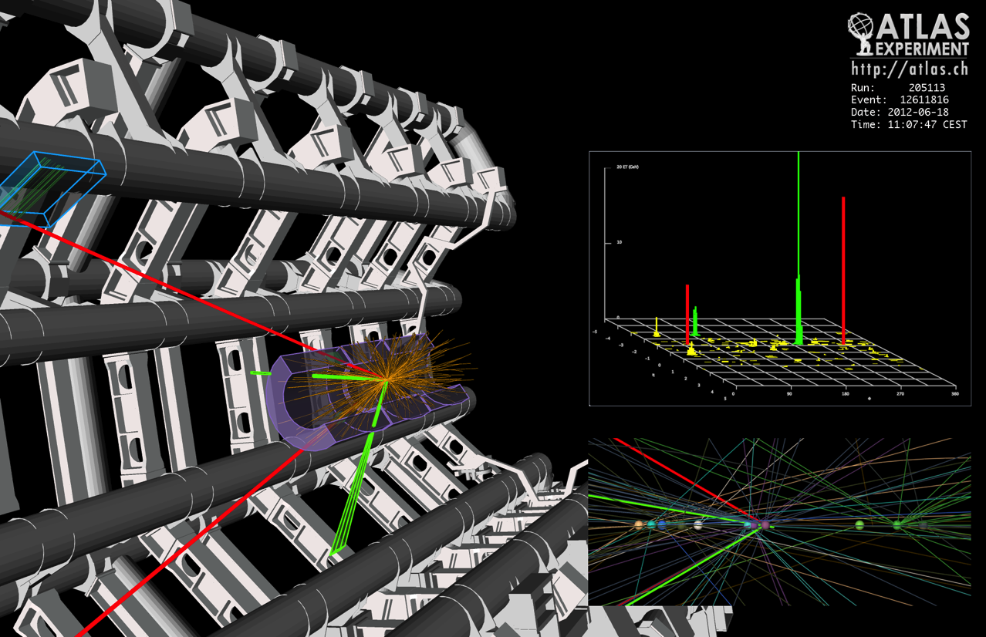
An example from the ATLAS detector
Reconstruction of a 2e2μ candidate for the Higgs boson - with m_{2e2μ}= 123.9 GeV
We need to understand the interaction of particles with matter in order to understand the design and operation of this detector, and the analysis of the data.

Slide 24
The ATLAS Inner Detector (barrel)

Slide 25
The ATLAS Inner Detector (one end-cap)
η | 0 | 0.9 | 1.4 | 1.7 | 2.5 | 3.7 | 5
θ | 90° | 44° | 28° | 21° | 9.4° | 2.8° | 0.8°

Slide 26
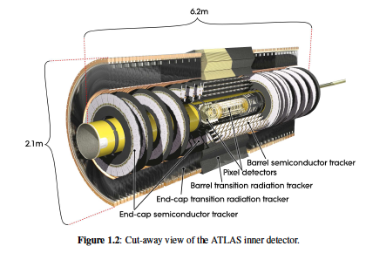
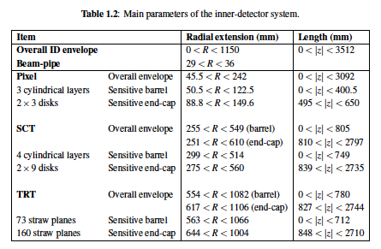
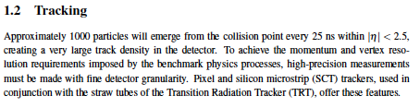
ATLAS Inner Detector
The Inner Detector is immersed in 2T magnetic field generated by a central
Solenoid which extends over a length of 5.3 m with a diameter of 2.5 m

Slide 27
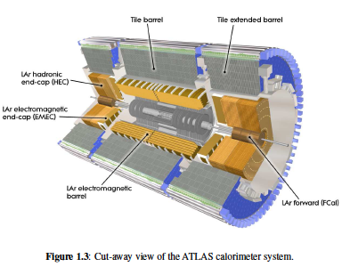
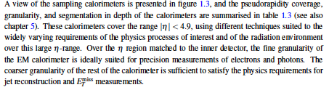
ATLAS Calorimeter

Slide 28
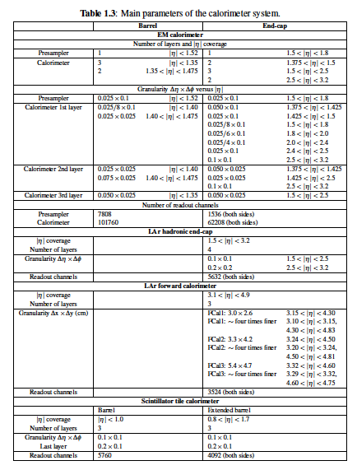

Slide 29
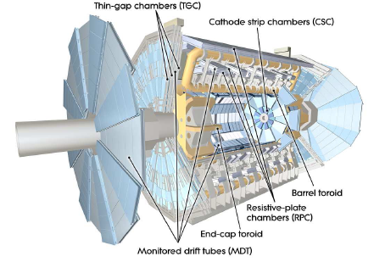
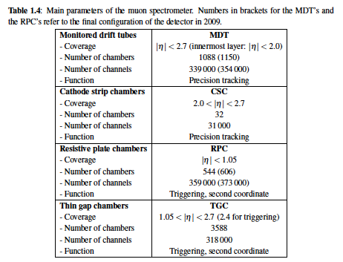
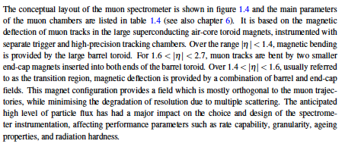
Muon Spectrometer

Slide 30
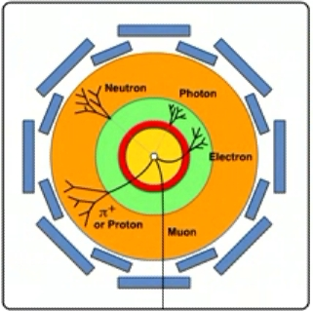
Particle ID and Kinematics
Tracking detector
Measure charge and momentum of charged particles in magnetic field
Electro-magnetic calorimeter
Measure energy of electrons, positrons and photons
Hadronic calorimeter
Measure energy of hadrons (particles containing quarks), such as protons, neutrons, pions, etc.
Neutrinos are only detected indirectly via ‘missing energy’ not recorded in the calorimeters
Muon detector
Measure charge and momentum of muons

Slide 31
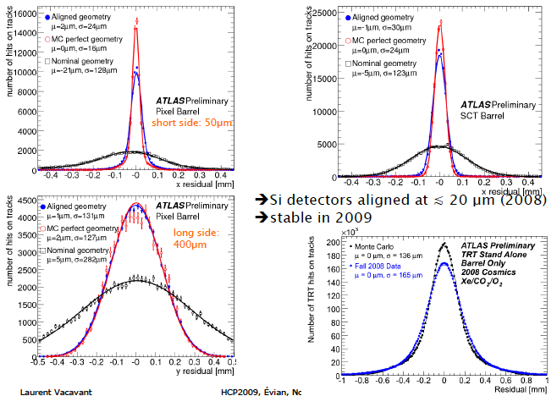
Alignment

Slide 32
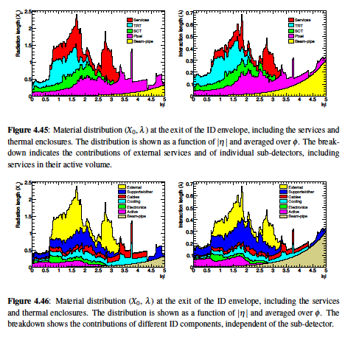
Materials in the front of the ATLAS calorimeter

Slide 33
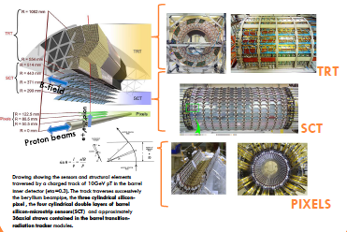
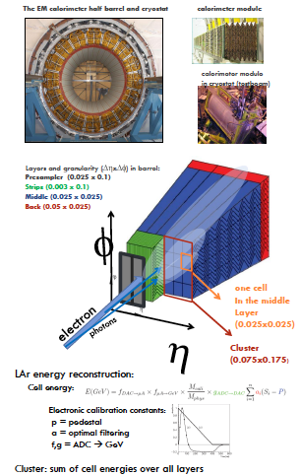
Electron identification: Track/Cluster matching
Electron = track in the Inner Detector (direction measurement)
Matched to an EM cluster in the calorimeter (energy measurement). Need to know:
- material distribution in the Inner detector in the front of
the EM calorimeter
- calibration of the energy response of the calorimeter
- rejection against jet faking electrons

Slide 34
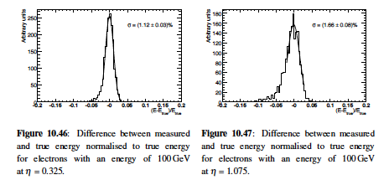
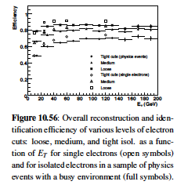
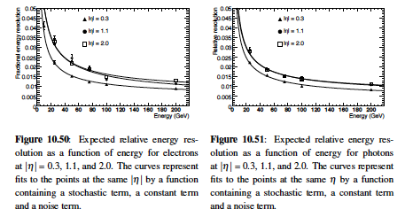
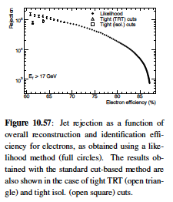
Electron identification

Slide 35
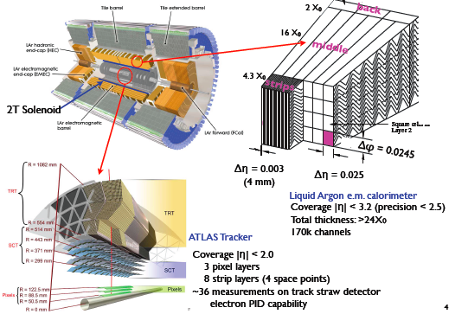
Photon identification
Photon = no track in the Inner Detector and an EM cluster in the calorimeter
However: because of materials in the Inner Detector and in front of the calorimeter,
Photon may convert into e-e+ pair. → photon may be reconstructed as single or double
Track conversion

Slide 36
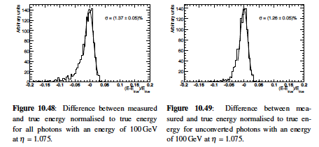
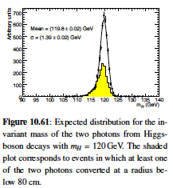
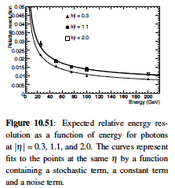
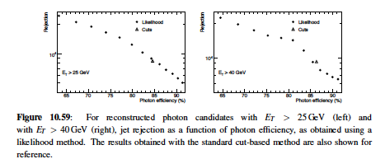
Photon identification

Slide 37
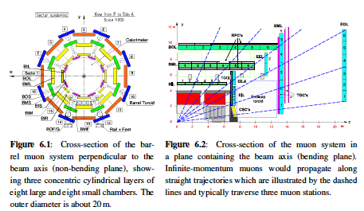
Muon identification
Muon: identified as tracks in the
Inner Detector and the Muon Spectrometer.
For muon with enough energy to pass
through the calorimeter, then energy loss
in the calorimeter must be corrected for.
Internal alignment of Muon chambers
important and relative alignment of the
inner Detector and Muon Spectrometer
also important to match track segments
From both detectors.
Magnetic field mapping also
important

Slide 38
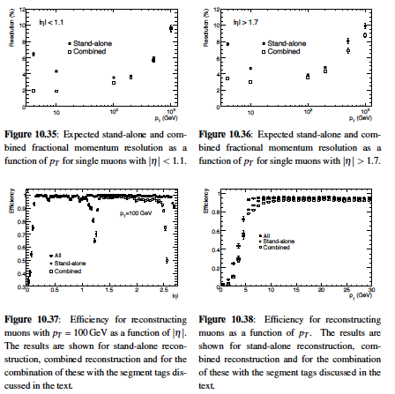
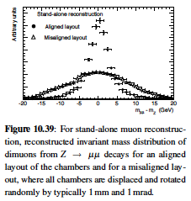
Muon Identification

Slide 39
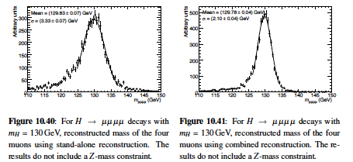
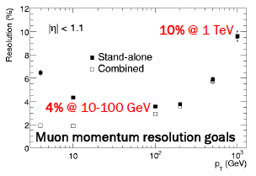

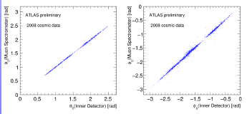
Muon Identification

Slide 40
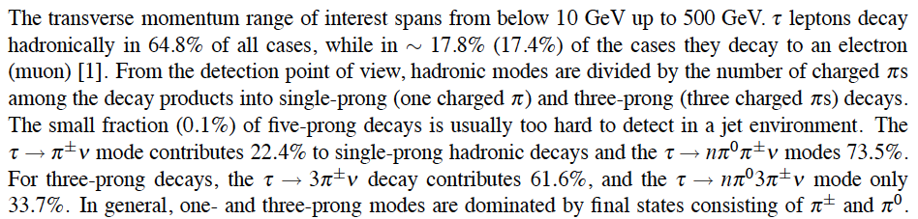


Hadronic tau identification
Thus also needs the tracks (Inner Detector) associated to a narrow Cluster. Need a strong
rejection against jets, electrons, while maintaining high tau-jet reconstruction
efficiency

Slide 41




Hadronic tau identification

Slide 42

Jet and Missing ET identification

Slide 43

Jet and Missing ET identification

Slide 44

Jet Reconstruction
Track jets use tracks as input to the jet finding and reconstruction. This would
Miss the neutral component of the jet. However track jets are useful in a
Number of applications

Slide 45

Missing ET Reconstruction

Slide 46

Fake Missing ET

Slide 47

Fake Missing ET

Slide 48

Jet energy scale

Slide 49


Jet Reconstruction

Slide 50

Missing ET Reconstruction

Slide 51

Missing ET performance

Slide 52

Flavor tagging
For example:
tt → wb wb → jjb eνb
You want to tag these
jets a b-jet to reduce
backgrounds

Slide 53


Vertexing and b-jet tagging
The innermost silicon detector must provide the required b-tagging efficiency
Good vertex resolution is achieved by placing the innermost (B) layer close to the beam pipe, and the next layer farer to it (lever arm), and by an excellent B-layer resolution
Expected transverse IP resolution ~13 μm for
100 GeV track
Small multiple scattering term:
Jet axis
b-jet
Secondary vertex
Jet cone
light-q jet
B
Primary vertex
R_{q-light}~ 600 for ε_{b} = 0.5
y
Decay length significance
x

Slide 54

Simpler b-taggers

Slide 55

Simpler b-taggers

Slide 56


Combining Tracking with PID: the ATLAS TRT
e/π separation via transition radiation: polymer (PP) fibres/foils interleaved with DTs
Radiator
Total: 370k straws
Barrel (|η| < 0.7): 36 r-φ measurements / track Resolution ~130 μm / straw
18 end-cap wheels (|η| < 2.5): 40 or less z-φ points
Fibres or foils
Transition radiation
TR increases signal
Cathode (HV–)
Straws
Anode wire (HV+)
Barrel TRT Module
Noble Gas
144 cm
51 cm
Charged particle
Electrons radiate → higher signal
PID info by counting
high-threshold hits
The ATLAS Inner Tracking System

Slide 57



Momentum Measurement in Tracking Device
Charged particles deflection in magnetic field:
  Lorentz force ⊥ to B-field and to particle direction
  Particle trajectory projected onto plane ⊥ to B-field is circle with radius:
  For p_{T} = 10 … 1000 GeV and B = 2 T → R = 17 … 1700 m (cf, R_{ID} ~ 1 m)
  … and if p_{T} < 0.5 GeV, the particle is trapped in solenoid → “loopers”
Si clusters / drift circles
Track fit
Obtain r and p_{T} from measurement of sagitta:
s
Track fitting in LHC environment challenging
  Must handle ambiguities, hit overlaps, multiple
  scattering, bremsstrahlung, multiple vertices, …
  Track fitters take Gaussian noise (Kalman)
  and non-Gaussian noise (GSF) into account
  Fitter must be fast, used in high-level trigger
L
r
r
B-field map accuracy ~10^{–4}

Slide 58

The ATLAS Muon Spectrometer (Active Material)
MWP Thin Gap Chambers (TGC) / Fast (4 ns) z and φ trigger chambers 1.1 < |η| < 2.4
Resistive Plate Chambers (RPC)
Fast (2 ns) z and φ trigger chambers |η| < 1.1
Cathode Strip Chambers (CSC)
MWPCs with cathodes segmented in strips, z (precise) and φ info 2.0 < |η| < 2.7
Sectors overlap in φ
Monitored Drift Tubes (MDT)
3 layers (stations) in each barrel and end-cap
Precision z measurements (80 μm / DT), |η| < 2.0

Slide 59

The ATLAS Muon Spectrometer
Outer layer of LHC detectors, only reached by WI(M)Ps (ν, χ) or EM MIPs (μ)
  Good containment of jets requires ~11 λ before muon systems
  ATLAS opted for good stand-alone tracking if too high-backgrounds in ID
Huge magnetic volume
  ATLAS has 8 (barrel) 3 T_{max} and 2×8 (endcap) 6 T_{max} superconducting toroid magnets
Huge active detectors area
  Open structure minimises multiple scattering
  Dedicated trigger chambers
Huge mechanical structure
  Challenging tolerances for mechanical stability, positioning and alignment (optical sensors)

Slide 60

ATLAS Toroid Fields
B (T)
Y (m)
X (m)

Slide 61
Momentum Measurement
Toroid fields bend tracks in z direction, instead of R -φ as in the inner detector
  σ(z) = 35 μm per chamber → σ(s)  (3/2)^{1/2} ·σ(z) = 43 μm → 1 TeV track has s = 500 μm at η  0 → < 10 % precision on momentum measurement
Muon momentum:
3 Barrel MDT stations
4 GeV
20 GeV
r
z

Slide 62

Triggering Muons
Ultra-fast L1 trigger requires coincident hits in 3 RPC (barrel) or 3 TGC (end-caps) layers within “roads” corresponding to predefined momenta (thresholds)

Slide 63



Cosmic Commissioning of ATLAS, CMS, ALICE and LHC-b

Slide 64



















Commissioning Example: CMS – 25 Performance papers published

Slide 65




Collisions at 7 and 8 TeV!

Slide 66





LHC Detectors are well-described in simulation e.g. Tracking - Material
Pixel 1
RF foils of both halves ~ touching
Pixel 2
Pixel 3
Beam pipe
SCT 1
sensor
SCT 2

Slide 67




Commissioning with Beam : Tracking- Resonances
D_{s}/D⁺ to Kπ π
ALICE
Magnetic field, momentum scale, track reconstruction efficiency;
all remarkably well understood

Slide 68





Commissioning with Beam : Tracking-ECALs
Electromagnetic calorimeters “out of the box” calibration at >≈ 1%

Slide 69





Commissioning with Beam:
Understanding Muons, b-tagging, Triggers
LVL1 jet trigger efficiency
Muons remarkably well understood, b-tagging progressing well,
newer triggers being rapidly understood as luminosity increases

Slide 70

Combining All Information: Particle Flow
Candidate Multi Jet Event at 2.36 TeV

Slide 71

Combining Calorimetry and Tracking
Particle Flow -reconstruct all stable particles in the event
Charged hadrons
Neutral hadrons
Photons
PFMET (1.9 GeV)

Slide 72

Analysing Complex Events
PFJet 1
pT 41.5 GeV/c
PFJet 2
pT 37.5 GeV/c
PFJet 3
pT 21.8 GeV/c
PFMET (1.9 GeV)
(η,φ) view of a particle-flow reconstructed event. Reconstructed particles are represented as circles
with a radius proportional to their pT. The direction of the MET computed from all particles is drawn
as a solid horizontal straight line. Particle-based jets with pT> 20 GeV/c are shown as thinner circles
representing the extension of the jet in the (η,φ) coordinates.

Slide 73




Beam Commissioning: Calorimetry
Calibrated
MET distributions exponential over >5 orders of magnitude;
augurs well for searches

Slide 74






50 Years of Particle Physics; e.g. CMS
Ω⁻
π⁰
N
N
Top
J/psi
W
N
N
Sophisticated software and computing systems in place and functioning

Slide 75



Rediscovering the SM and Beyond

Slide 76


Slide 77

Putting it all together…

Slide 78

Z→ μμ
Z→ μμ event from 2012 data with 25 reconstructed vertices

Slide 79


SM Higgs production and decay modes
√s=7 → 8 TeV:

Slide 80


Slide 81

H → γγ

Slide 82

4μ candidate with m_{4μ}= 125.1 GeV
p_{T} (muons)= 36.1, 47.5, 26.4, 71 .7GeV m₁₂= 86.3 GeV, m₃₄= 31.6 GeV
15 reconstructed vertices

Slide 83

4e candidate with m_{4e}= 124.6 GeV
p_{T} (electrons)= 24.9, 53.9, 61.9, 17.8 GeV m₁₂= 70.6 GeV, m₃₄= 44.7 GeV
12 reconstructed vertices

Slide 84

2e2μ candidate with m_{2e2μ}= 123.9 GeV
p_{T} (e,e,μ,μ)= 18.7, 76, 19.6, 7.9 GeV, m (e⁺e⁻)= 87.9 GeV, m(μ⁺μ⁻) =19.6 GeV
12 reconstructed vertices

Slide 85

H → 4 leptons combined results

Slide 86

ATLAS “Excess”

Slide 87

5σ Confidence limit --- DISCOVERY !

Slide 88








Slide 89





Slide 90
SA-CERN Programme
SA-CERN would like to receive applications for students.
There are a limited number of positions available within SA-CERN for applications originating from Africa.
Please send
1. Letter of Motivation
2. CV
3. Degree Transcripts
4. Two Referee Reports in support of the application.
SA-CERN has groups involved in
1. Theory (Particle Physics, Nuclear Physics) contact Steven Karataglides <stevenka@uj.ac.za>
2. ISOLDE (Materials Science), ISOLDE (Nuclear Physics) contact Krish Bharuth-Ram <kbr@tlabs.ac.za>
3. ALICE contact Jean Cleymans <Jean.Cleymans@uct.ac.za>
4. ATLAS contact Simon Connell <shconnell@uj.ac.za>

