Slide 1
Nucleon Form Factors
99% of the content of this talk is courtesy of Mark Jones (JLab)

Slide 2
Overview of nucleon form factor measurements
Review articles
C. F. Perdrisat, V. Punjabi, M. VanderhaeghenProg.Part.Nucl.Phys.59:694,2007
J. Arrington, C. D. Roberts, J. M. Zanotti, J.Phys.G34:S23-S52,2007

Slide 3
Nucleon Form Factors
Nucleon form factors describe the distribution of charge and magnetization in the nucleon
  This is naturally related to the fact that nucleons are made of quarks
Why measure nucleon form factors?
  Understand structure of the nucleon at short and long distances
  Understand the nature of the strong interaction (Quantum Chromodynoamics) at different distance scales

Slide 4
Strong Interactions – the right theory
Strong interactions → Quantum Chromodynamics (QCD)
Protons and neutrons made of quarks (mostly up and down)
  Quarks carry “color” charge
  Gluons are the mediators of the strong force
3 important points about QCD
  We cannot solve QCD “exactly”
  We can solve QCD approximately but only in certain special circumstances
  We can solve QCD numerically. Eventually. If we had a lot of computing power.
    We need more and faster computers

Slide 5
QCD and “Asymptotic freedom”
The forces we are familiar with on a day-to-day basis (gravity, EM) have one thing in common:
  They get weaker as things get further apart!
The strong force (QCD) is not like that!
  The force between quarks gets weaker as they get closer together → they are “asymptotically free”
  As you pull quarks apart the force gets stronger – so strong in fact that particles are created out of the vacuum as you pull two quarks apart: you’ll never find a “free quark”

Slide 6
QCD vs. QED
Quantum Electrodynamics:
  Relatively weak coupling lends itself to study using perturbative calculations
QED
QCD
Quantum Chromodynamics:
  Interactions get stronger as you get further away! → “confinement”
  Perturbative techniques only work at small distance scales

Slide 7
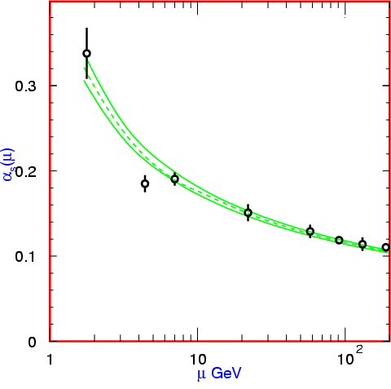
QCD at Short and Long Distances
Short distances
→ Quarks behave as if they are almost unbound
  asymptotic freedom
→ Quark-quark interaction relatively weak
  perturbative QCD
  (pQCD)
Long distances
→ Quarks are strongly bound and QCD calculations difficult
→ Effective models often used
→ ”Exact” numerical techniques
  Lattice QCD
Running of α_{s}
from Particle Data Group

Slide 8
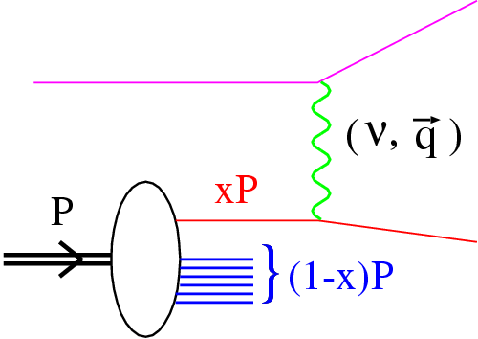
Electron Scattering and QCD
Goal:
Understand the transition from confinement (strongly interacting quarks) to the perturbative regime (weakly interacting quarks)
Tool → electron scattering
  → Well understood probe (QED!)
e-
e-

Slide 9
Electron Scattering and QCD
Goal:
Understand the transition from confinement (strongly interacting quarks) to the perturbative regime (weakly interacting quarks)
Tool → electron scattering
  → Well understood probe (QED!)
  → More powerful tool with
  development of intense,
  CW beams in 1990’s
e-
e-
Luminosity:
(SLAC, 1978) ~ 8 x 10³¹ cm⁻²-s⁻¹
(JLab, 2000) ~ 4 x 10³⁸ cm⁻²-s⁻¹
Observables:
Form factors → nucleons and mesons stay intact
Structure functions → excited, inelastic response

Slide 10
Elastic Form Factors
Elastic scattering cross section from an extended target:
In the example of a heavy, spin-0 nucleus, the form factor is the Fourier transform of the charge distribution
Spin 0 particles (π⁺,K⁺) have only charge form factor (F)
Spin ½ particles (nucleon) have electric (G_{E}) and magnetic (G_{M}) form factors

Slide 11
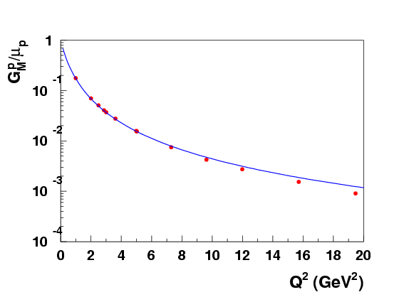
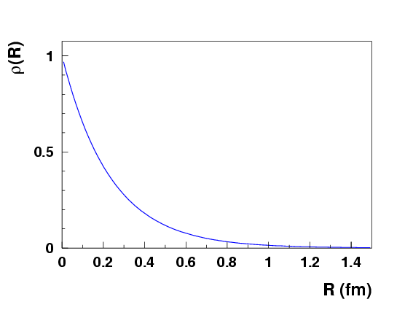
Example: Proton G_{M}
Proton magnetic form-factor consistent with dipole form
SLAC data
Inverse Fourier transform gives

Slide 12
Brief history
1918, Rutherford discovers the proton
1932, Chadwick discovers the neutron and measures the mass as 938 +/- 1.8 MeV
1933, Frisch and Stern measure the proton’s magnetic moment = 2.6 +/- 0.3 μ_{B} = 1 + κ_{p}
1940, Alvarez and Bloch measure the neutron’s magnetic moment = 1.93 +/- 0.02 μ_{B} = κ_{n}

Slide 13
Brief history
1918, Rutherford discovers the proton
1932, Chadwick discovers the neutron and measures the mass as 938 +/- 1.8 MeV
1933, Frisch and Stern measure the proton’s magnetic moment = 2.6 +/- 0.3 μ_{B} = 1 + κ_{p}
1940, Alvarez and Bloch measure the neutron’s magnetic moment = 1.93 +/- 0.02 μ_{B} = κ_{n}
Proton and neutron have anomalous magnetic moments a finite size.

Slide 14
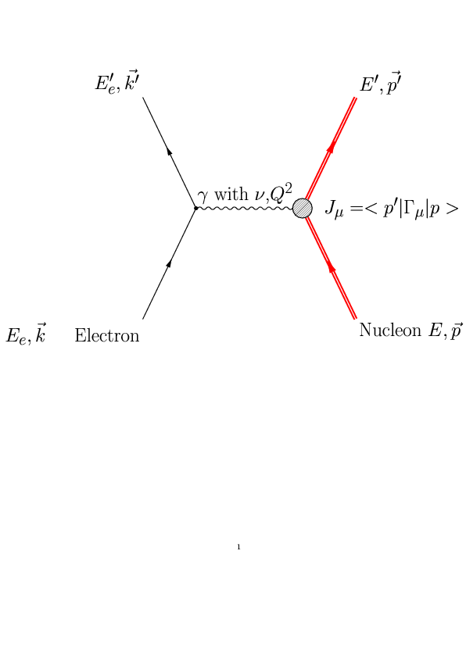
Electron as probe of nucleon elastic form factors
Known QED coupling

Slide 15
Electron as probe of nucleon elastic form factors
Unknown γ∗Ν
coupling
Known QED coupling

Slide 16

Electron as probe of nucleon elastic form factors
Unknown γ∗Ν
coupling
Known QED coupling
Nucleon vertex:
Elastic Form Factors:
F₁ is helicity conserving (no spin flip)
F₂ is helicity non-conserving (spin flip)

Slide 17
Electron-Nucleon Scattering kinematics
Scattered electron
Incident
Electron beam
Θ_{e}
γ∗
Fixed nucleon target with mass M
Ν
Virtual photon kinematics
m_{e} = 0

Slide 18
Electron-Nucleon Scattering kinematics
Scattered electron
Incident
Electron beam
Θ_{e}
γ∗
Fixed nucleon target with mass M
Ν
Virtual photon kinematics
m_{e} = 0
γ∗Ν center of mass energy

Slide 19
Electron-Nucleon Scattering kinematics
Scattered electron
Incident
Electron beam
Θ_{e}
Elastic
scattering
W = M
W
Final
States
Inelastic
scattering
W > M + m_{π}
Resonance
scattering
W = M_{R}
Virtual photon kinematics
m_{e} = 0
γ∗Ν center of mass energy

Slide 20
Electron-Nucleon Cross Section
Single photon exchange (Born) approximation
Low Q²

Slide 21
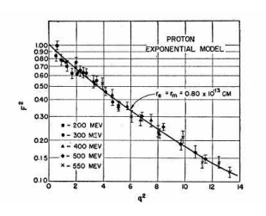
Early Form Factor Measurements
Proton is an extended charge potential
Proton has a
radius of 0.80 x 10⁻¹³ cm
“Dipole” shape
fm⁻²
Q² = 0.5 GeV²

Slide 22


Sach’s Electric and Magnetic Form Factors
In center of mass of the eN system (Breit frame),
no energy transfer ν_{CM} = 0 so
= charge distribution
= magnetization distribution

Slide 23
Electron-Nucleon Cross Section
Single photon exchange (Born) approximation

Slide 24
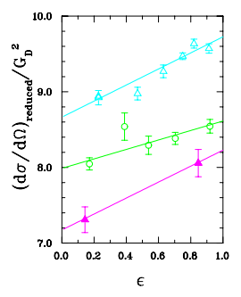


Elastic cross section in G_{E} and G_{M}
Slope
Intercept

Slide 25
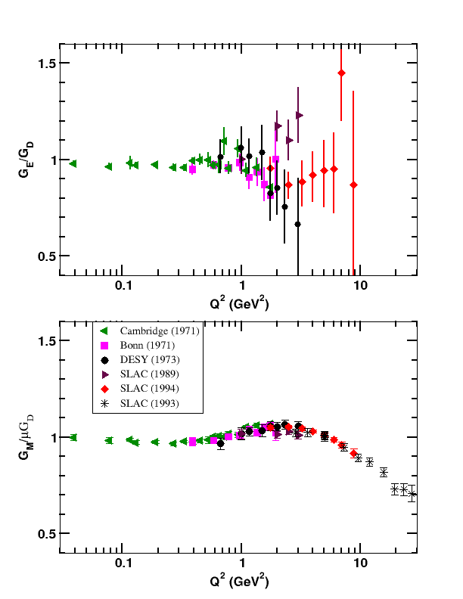
Proton Form Factors: G_{Mp} and G_{Ep}
Experiments from the 1960s to 1990s gave a cumulative data set

Slide 26
Proton Form Factors: G_{Mp} and G_{Ep}
G_{E} contribution to σ is
small then large error bars
Experiments from the 1960s to 1990s gave a cumulative data set
At large Q², G_{E} contribution is smaller so difficult to extract

Slide 27
Proton Form Factors: G_{Mp} and G_{Ep}
GE > 1 then large error bars and spread in data.
Experiments from the 1960s to 1990s gave a cumulative data set
At large Q², G_{E} contribution is smaller so difficult to extract
G_{M} measured to Q² = 30
G_{E} measured well only to Q²= 1

Slide 28
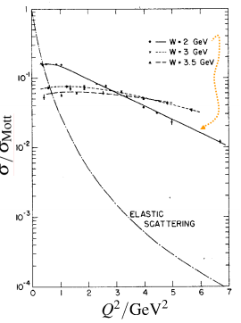
Q² dependence of elastic and inelastic cross sections
As Q² increases
σ_{elastic} /σ_{Mott} drops dramatically
At W = 2 GeV
  σ_{inel}/σ_{Mott} drops less steeply
At W=3 and 3.5
  σ_{inel}/σ_{Mott} almost constant
Point object inside the proton

Slide 29
Asymptotic freedom to confinement
“point-like” objects in the nucleon are eventually identified as quarks
Theory of Quantum Chromodynamics (QCD) with gluons mediating the strong force.
At high energies , the quarks are asymptotically free and perturbative QCD approaches can be used.

Slide 30
Asymptotic freedom to confinement
“point-like” objects in the nucleon are eventually identified as quarks
Theory of Quantum Chromodynamics (QCD) with gluons mediating the strong force.
At high energies , the quarks are asymptotically free and perturbative QCD approaches can be used.
No free quarks
Confinement
The QCD strong coupling increases as the quarks separate from each other
Quantatitive QCD description of nucleon’s properties remains a puzzle
Study of nucleon elastic form factors is a window see how the QCD strong coupling changes

Slide 31
Elastic FF in perturbative QCD
Infinite momentum frame
Nucleon looks like three massless quarks
Energy shared by two hard gluon exchanges
Gluon coupling is 1/Q²
γ∗
u
u
gluon
u
u
d
gluon
d
F₂ requires an helicity flip the spin of the quark. Assuming the L = 0
Proton
Proton

Slide 32
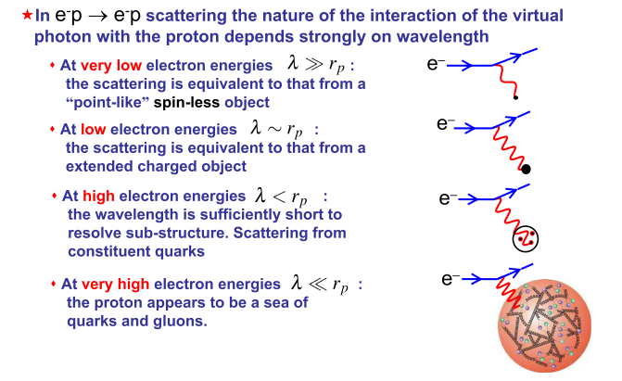
Electron as probe of nucleon structure

Slide 33
Neutron Form Factors
No free neutron target - use the deuteron (proton + neutron)
Θ_{e}
Incident
Electron beam
γ∗
p
n
Measure eD → eX cross section
Detect only electron at E_{e}′ and θ_{e}
when W = M or Q² = 2Mν , Quasi-elastic kinematics

Slide 34
d(e,e’) Inclusive Cross Section
R_{T} and R_{L} are the transverse and longitudinal response functions
Assume Plane Wave Impulse Approximation

Slide 35
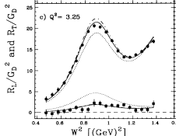
Extracting G_{Mn}
Measure cross sections at several energies
Separate R_{T} and R_{L} as function of W²
Solid line is fit
μG_{Mn}/G_{D} = 0.967 ± 0.03
(G_{En}/G_{D})²= 0.164 ± 0.154
G_{M}
Dotted line shows sensitivity to Neutron form factor
Reduce G_{Mn} by80%
Set (G_{En}/G_{D})=1.5
G_{E}

Slide 36
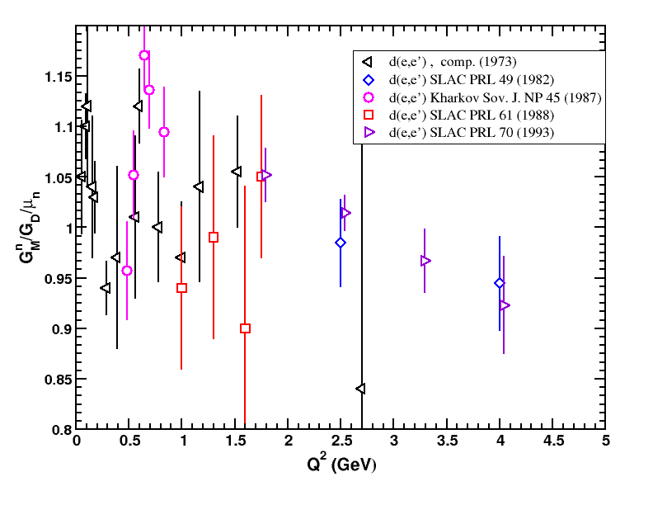
Neutron Magnetic Form Factor: G_{Mn}
Extract G_{Mn} from inclusive d(e,e’) quasielastic scattering cross section data
Difficulties:
Subtraction of large proton contribution
Sensitive to deuteron model

Slide 37
How to improve FF measurements?
High current continuous-wave electron beams
• Double arm detection
• Reduces random background so coincidence quasi-free deuteron experiments are possible
• Polarized electron beams
• Recoil polarization from ¹H and ²H
• Highly polarized, dense ³He, ²H and ¹H targets
•Beam-Target Asymmetry
• Polarized ³He, ²H as polarized neutron target.

Slide 38
How to improve FF measurements?
Theory of electron quasi-free scattering on ³He and ²H
Determine kinematics which reduce sensitivity to nuclear effects
Determine which observables are sensitive to form factors
→ Use model to extract form factors

Slide 39
Neutron G_{M} using d(e,e’n) reaction
Detect neutron in coincidence with electron
Detect neutron at energy and angle expected for a “free” neutron.
Sensitive to detection efficiency
In same experimental setup measure d(e,e’p)
Theory predicts that
R = σ(e,e’n)/σ(e,e’p)
is less sensitive to deuteron wavefunction model and final state interactions compared predictions of σ(e,e’n)
R_{PWIA} = σ_{en}/σ_{ep} = R(1-D)
D is calculated from theory

Slide 40
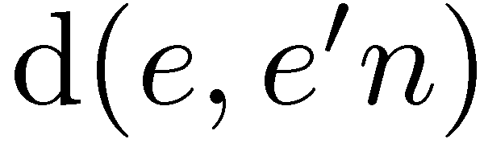
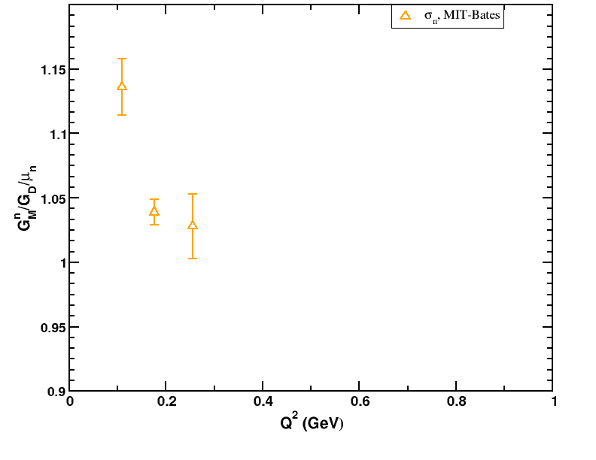
Neutron Magnetic Form Factor: G_{Mn}
Detect neutron in coincidence
But still sensitive to the deuteron model
Need to know absolute neutron cross section efficiency

Slide 41
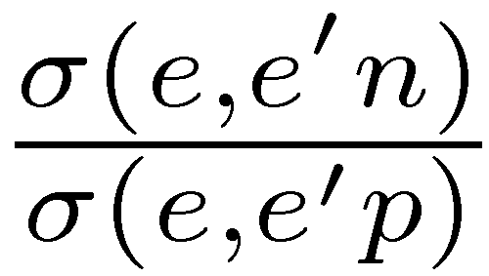
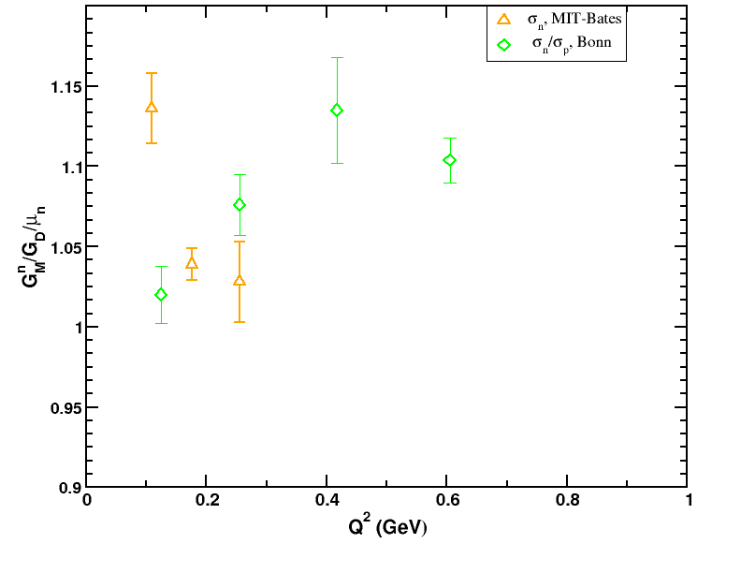
Neutron Magnetic Form Factor: G_{Mn}
Measure ratio of quasi-elastic n/p from deuterium
Sensitivity to deuteron model cancels in the ratio
Proton and neutron detected in same detector simultaneously
Need to know absolute neutron detection efficiency
Bonn used p(γ,π+)n

Slide 42
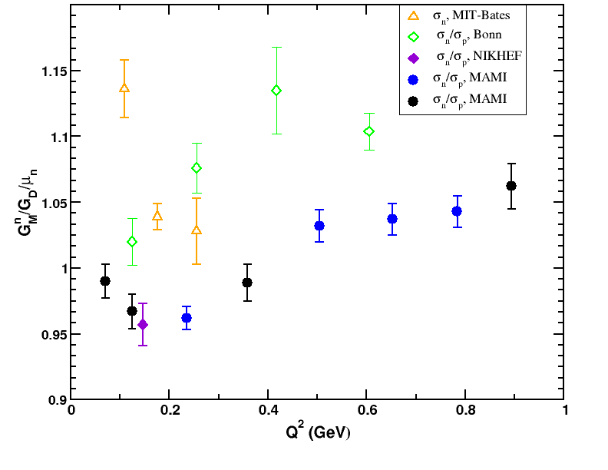
Neutron Magnetic Form Factor: G_{Mn}
Measure
Sensitivity to deuteron model cancels in the ratio
Proton and neutron detected in same detector simultaneously
Need to know absolute neutron detection efficiency
Bonn used p(γ,π+)n
NIKHEF and Mainz used p(n,p)n
with tagged neutron beam at PSI

Slide 43
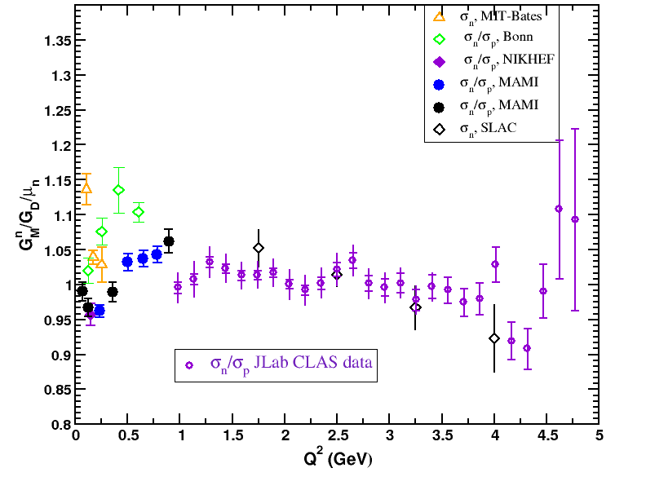
Neutron Magnetic Form Factor: G_{Mn}
Measured with CLAS in Hall B at JLab
Simultaneously have ¹H and ²H targets
CLAS data from W. Brooks and J. Lachniet, NPA 755 (2005)

Slide 44
Form Factors from Cross Sections
Focused on cross section measurements to extract proton and neutron form factors.
  Proton G_{M} measured to Q² = 30 GeV²
  Neutron G_{M} measured to Q² = 4.5 GeV²
  Discrepancy in neutron G_{M} near Q² = 1.0 GeV²
Need new experimental observable to make better measurements of neutron electric form factor and proton electric form factor above Q² = 1 GeV²
  Spin observables sensitive to G_{E}xG_{M} and G_{M}
  Get the relative sign of G_{E} and G_{M}

Slide 45
Form Factors from Spin Observables
Polarized beam on polarized nucleon (Beam-Target Asymmetries)
  Polarized proton target
  Polarized neutron target using polarized ³He and deuterium
  Electron storage rings use internal gas target (windowless). Target polarized by atomic beam source method or spin exchange optical pumping.
  Linear electron accelerators use external gas target (window)
    3He gas targets by spin exchange or metastability optical pumping
    Solid polarized deuterium or hydrogen
Polarized beam on unpolarized target
  Spin of scattered nucleon measured by secondary scattering
  Linear electron accelerators on high density hydrogen and deuterium targets

Slide 46
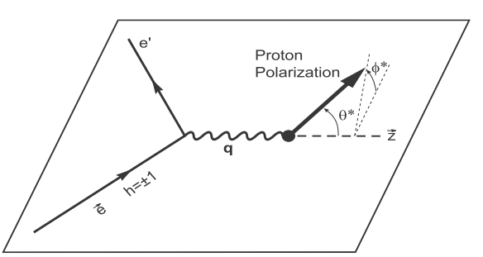
Beam-Target Spin Asymmetry
Nucleon polarized at θ* and φ*
relative to the momentum transfer
Helicity flipped periodically (rapidly)
h⁺
h⁻
85% longitudinally polarized electron beam

Slide 47
Beam-Target Spin Asymmetry
Nucleon polarized at θ* and φ*
relative to the momentum transfer
Helicity flipped periodically (rapidly)
h⁺
h⁻
85% longitudinally polarized electron beam

Slide 48
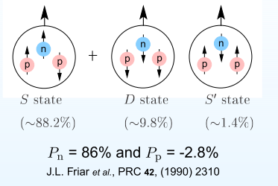
Polarized ³He as a polarized neutron target

Slide 49



A_{T} in quasi-elastic ³He(e,e’)
In PWIA
In ³He polarization of the neutron is larger than the proton
P_{n} >> P_{p}

Slide 50
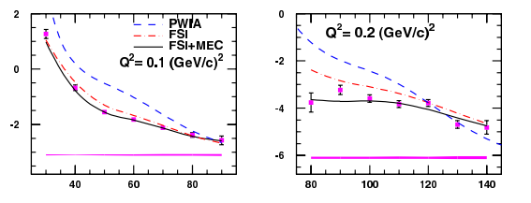
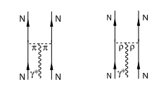
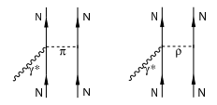
Extracting G_{Mn} from A_{T} in ³He(e,e)
A_{T} %
υ ( MeV)
υ ( MeV)
Meson Exchange Coupling
Coupling to correlated nucleon pairs
Coupling to in-flight mesons

Slide 51
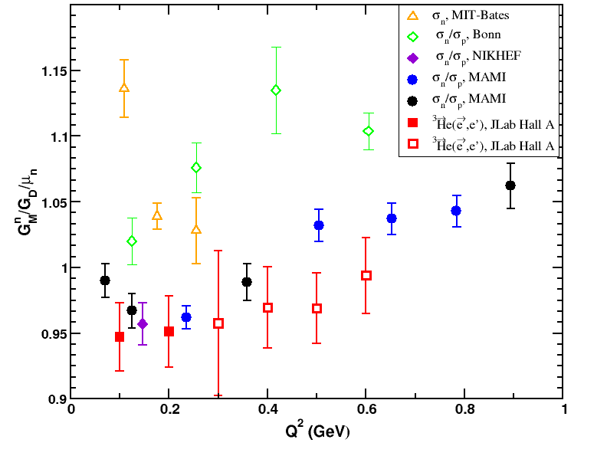
Neutron Magnetic Form Factor: G_{Mn}

Slide 52
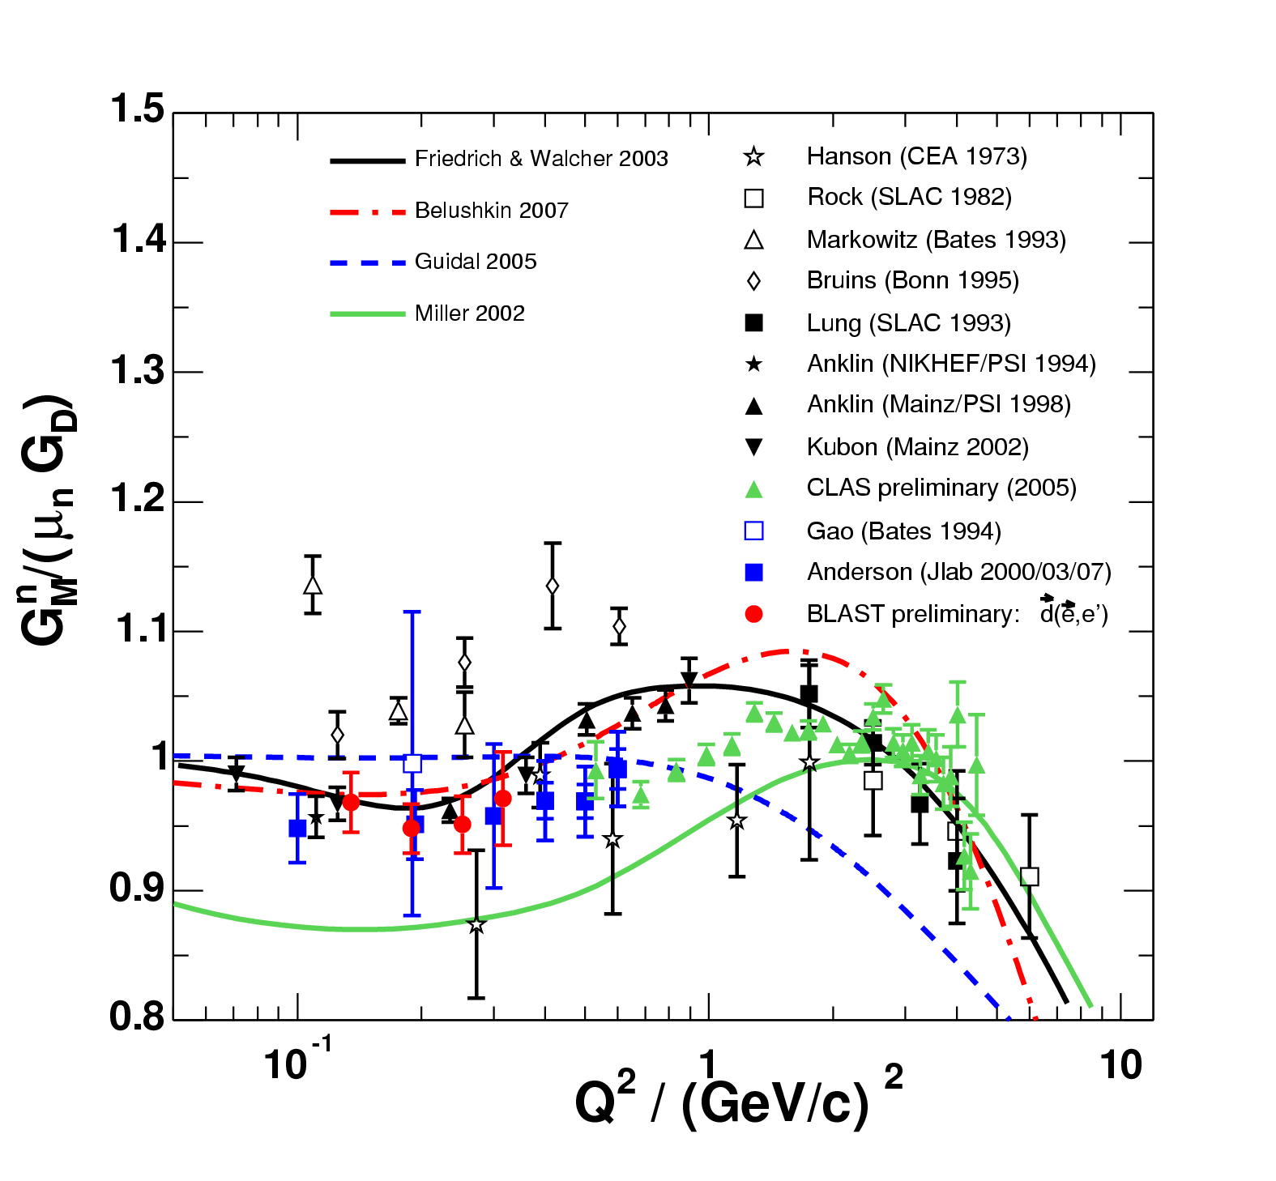
Neutron Magnetic Form Factor: G_{Mn}
New results using the BLAST detector at MIT-Bates
Electron ring and internal gas target
Use inclusive
which is sensitive to
G_{Mn}/G_{Mp}

Slide 53
G_{En} from quasielastic
θ∗=90^{ο}
θ∗=0^{ο}

Slide 54
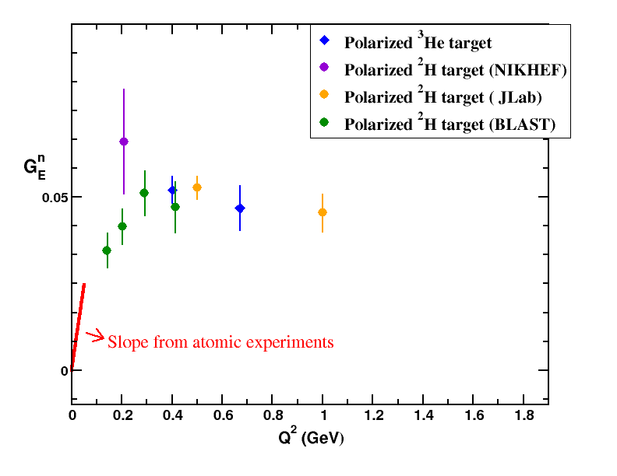
Neutron Electric Form Factor: G_{En}
Quasi-free Helium-3 and Deuterium
In PWIA with Θ* = 90º
NIKHEF used electron storage ring with internal gas target.
JLab used solid ¹⁵ND₃ target
Measured to Q² = 1
MIT-Bates used internal gas target and large acceptance BLAST detector

Slide 55
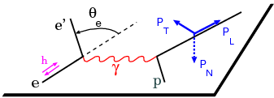
Recoil Polarization
Components of
One-photon exchange (Born) approximation: P_{N} = 0

Slide 56
Polarimetry basics
Measure proton spin by secondary scattering on a nucleus ( ¹²C, CH₂, H₂ …)
An asymmetry in the scattering is caused by the spin-orbit part of the nucleon-nucleon potential
Only components of S that perpendicular to the momentum vector produce an asymmetry
A is the analyzer power of the scattering material.

Slide 57
Spin rotation in magnetic field
Neutron traveling through a magnet field
Analyzer
Spin precesses relative to momentum
Target
Magnetic field into page
P_{T}
P_{L}
Top view

Slide 58
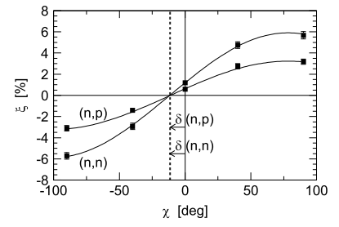
Extracting Neutron G_{E}/G_{M}
Measure asymmetry Σ at different precession angles χ by varying magnet field.
Σ %

Slide 59
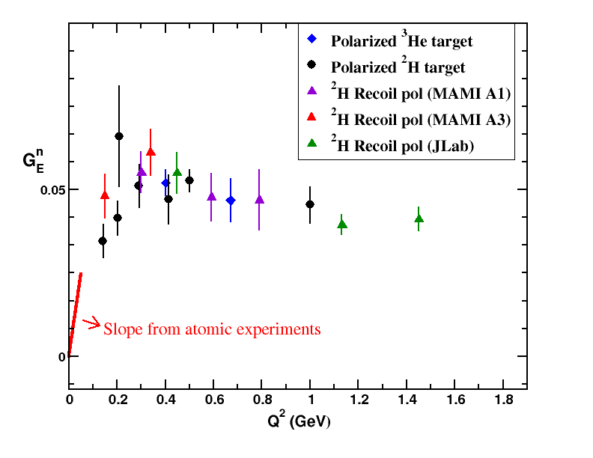
Neutron Electric Form Factor: G_{En}
Recoil Polarization
Quasi-free
In PWIA
At Mainz,
Q² = 0.15 to 0.8
At JLab,
Q²= 0.45, 1.13, 1.45

Slide 60
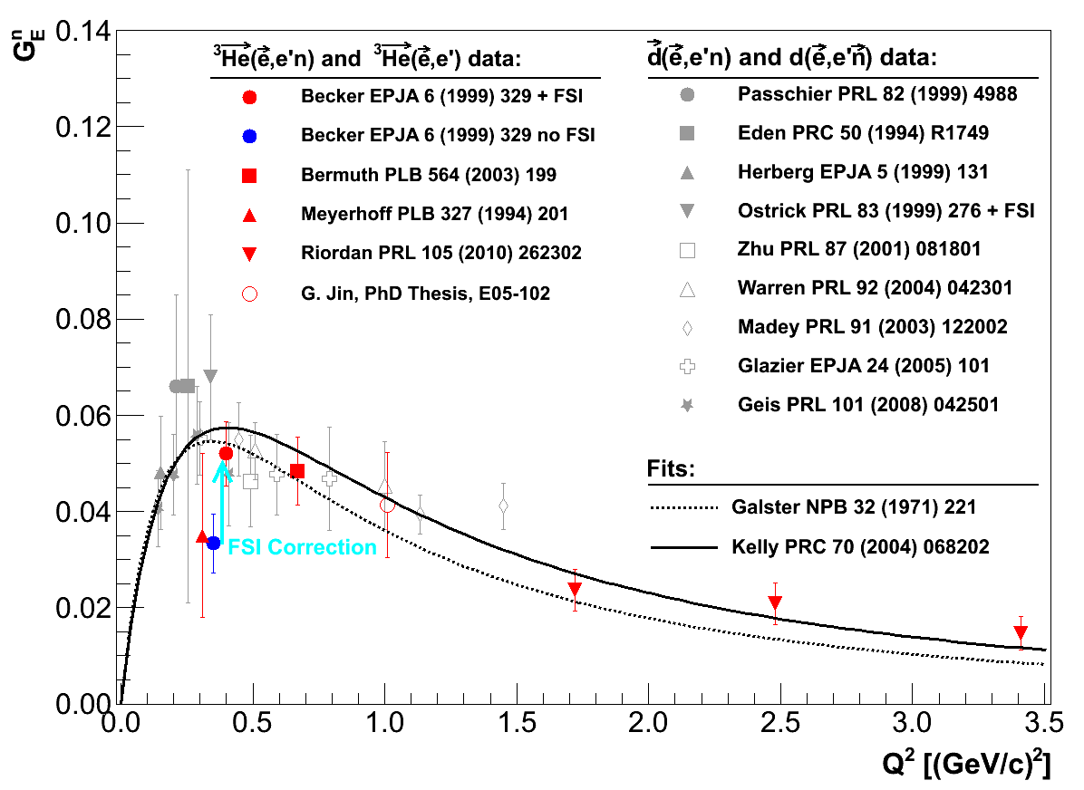
Neutron Form Factors
G_{Mn}
G_{En}
Additional polarized target data at large Q² (Hall A at JLab)

Slide 61
Recoil Polarization and Proton
Recall: proton GE not terribly well measured at large Q² using cross sections
Like the neutron – polarization techniques can be used to increase precision
→ In particular, recoil polarization techniques pursued in the case of the proton

Slide 62
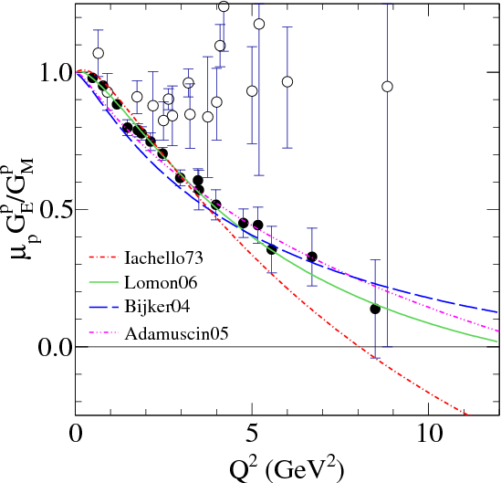
Proton G_{E}/G_{M}

Slide 63
Proton G_{E}/G_{M}
Cross section measurements
Recoil polarization measurements

Slide 64
Proton G_{E}/G_{M}
Why the discrepancy between cross section extraction and recoil polarization?
?
Recoil polarization data from different experiments, different experimental halls (A and C) → technique robust and consistent
Cross section technique checked with dedicated experiment in Hall A

Slide 65
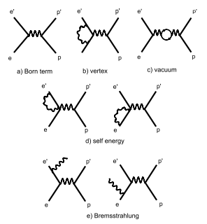
Radiative contributions to ep elastic cross sections
Electron side contributions
Born term, Single virtual photon exchange
Virtual photon exchange between beam and scattered electron
Virtual photon self energy
Virtual photon loop in beam or scattered electron
Internal radiation of a real photon by the beam or scattered electron

Slide 66
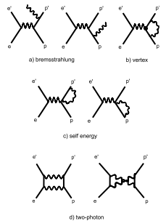
Radiative contributions to ep elastic cross sections
Proton side contributions
Internal real photon emission
Virtual photon exchange between incoming and outgoing proton
Virtual photon loop in incoming or outgoing proton
Two virtual or multi-photon exchange between electron and proton

Slide 67
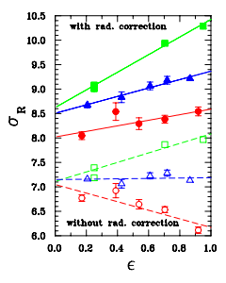
Radiative contributions to ep elastic cross sections
σ_{Born} after
radiative corrections for
Q² = 1.75, 3.25 and 5 GeV²
σ_{Measured} before
radiative corrections for
Q² = 1.75, 3.25 and 5 GeV²
Possible missing element: 2-photon exchange

Slide 68
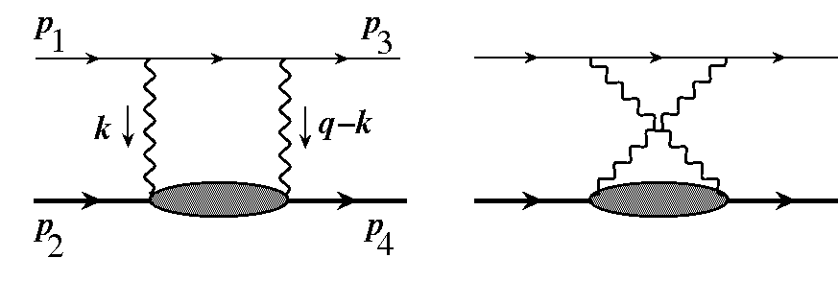
Why the discrepancy in G_{E}/G_{M}?
Neglected 2γ contributions to the ep elastic cross section could explain the difference

Slide 69
Calculations of 2γ effects
Effects predicted to change cross sections but small effect on polarization observables:
        Hadronic Model of Blunden, Melnitchouk and Tjon
        GPD model of Chen, Afanasev, Brodsky, Carlson and Vanderhaeghen
But no significant 2γ effect predicted in calculation of Y. Bystritskiy, E. Kureav and E. Tomasi-Gustafsson

Slide 70
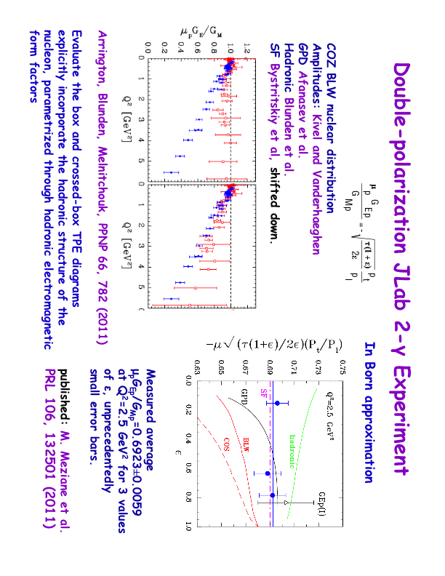
Measuring Two Photon Exchange
Measure G_{E}/G_{M} as function of ε using polarization transfer technique
Look for deviations from a constant
Experiment completed in Jan 08
M. Meziane et al. PRL 106, 132501 (2011)
No evidence for any deviation from 1-photon exchange picture within experimental uncertainties

Slide 71
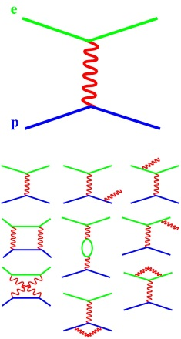
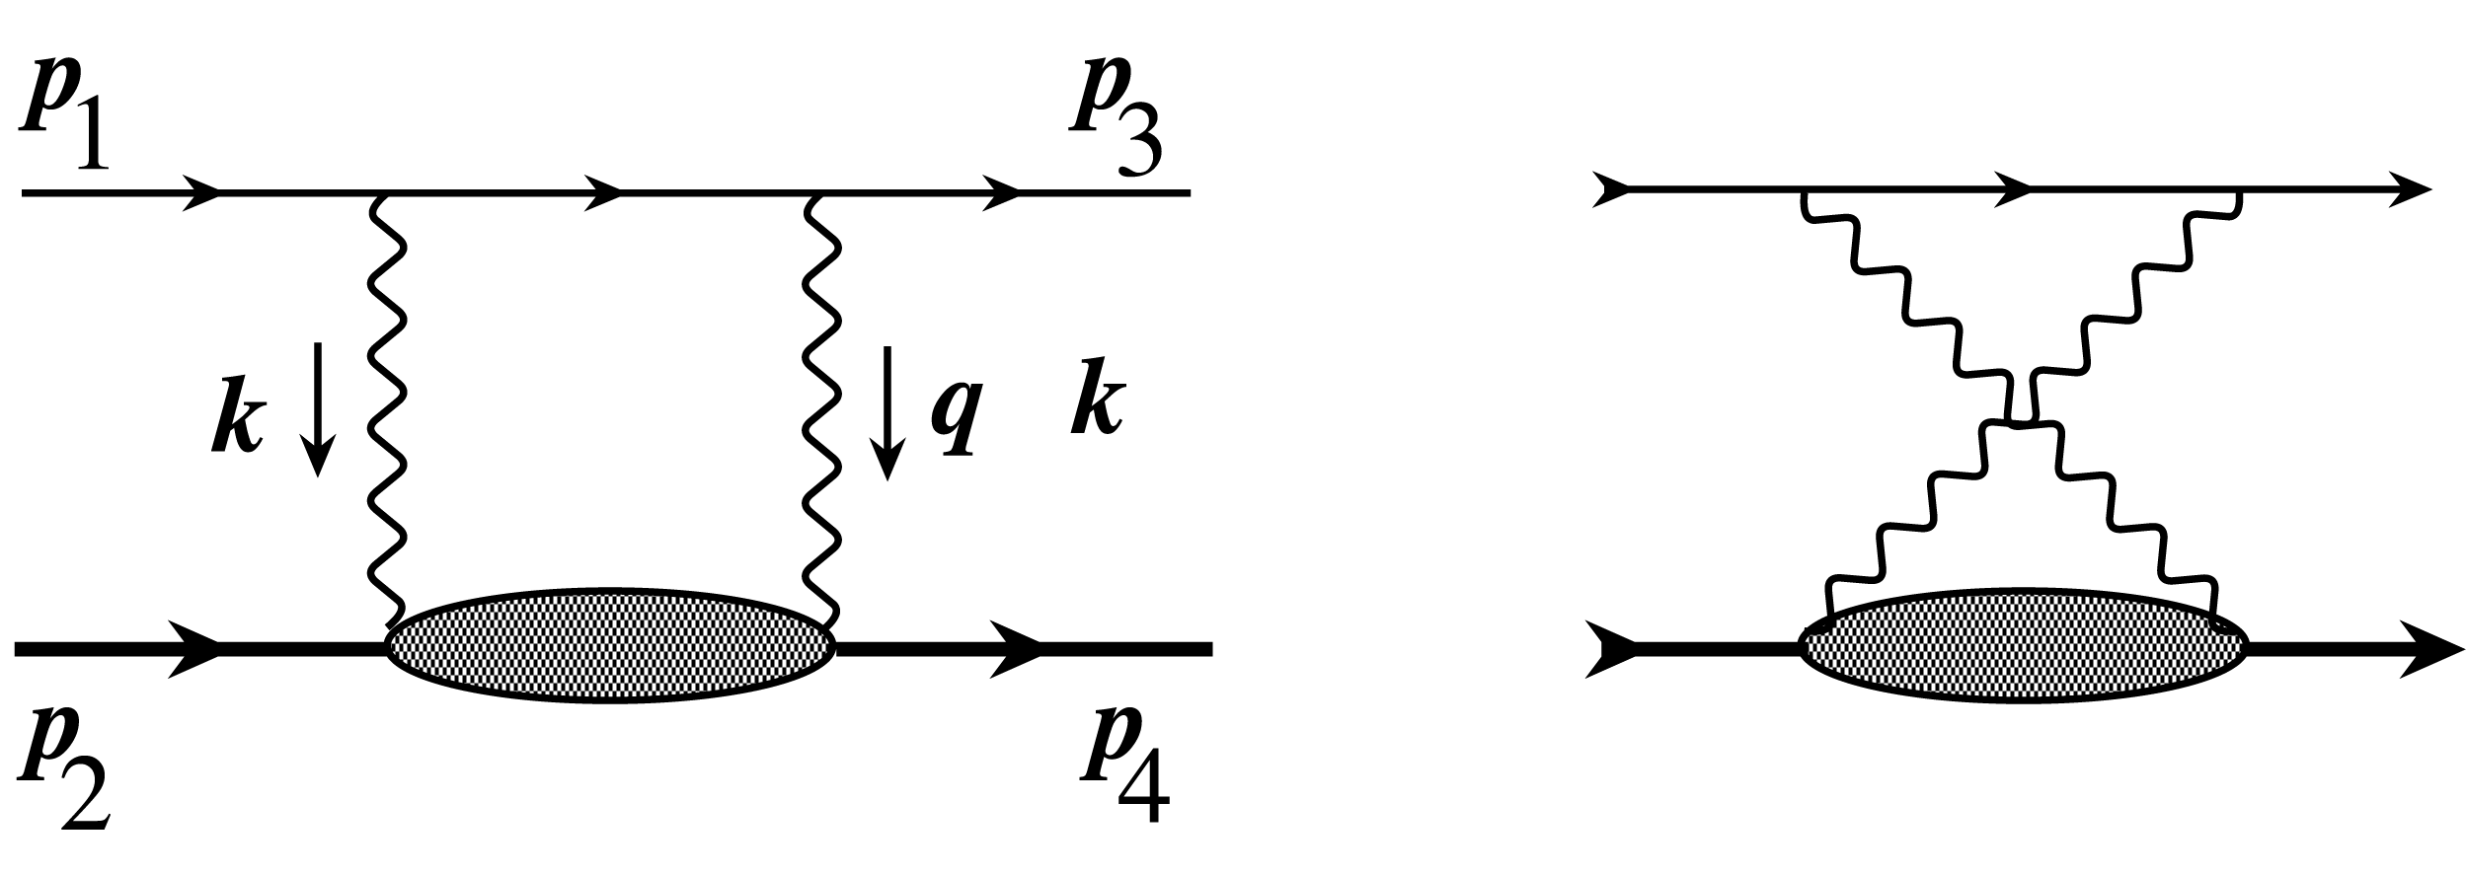
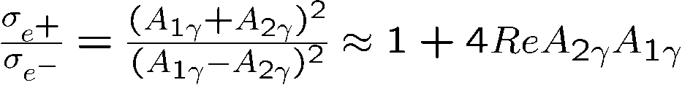
Measuring Two Photon Exchange
Compare positron and electron elastic scattering:
e⁺-p vs. e⁻-p elastic scattering
Three new e+/e- experiments
BINP Novosibirsk – internal target
JLab – mixed e+/e- beam, CLAS
DESY (OLYMPUS) - internal target

Slide 72
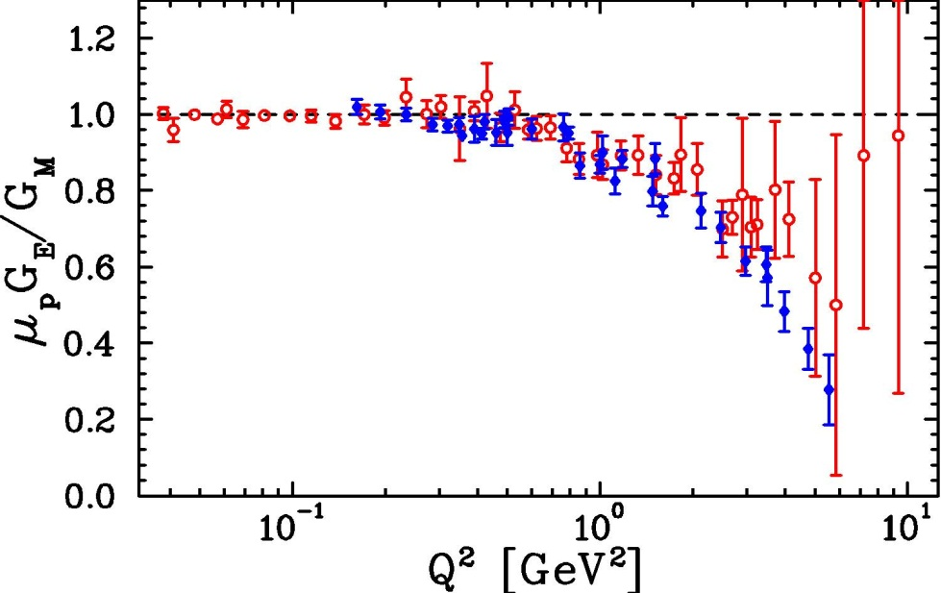
Measuring Two Photon Exchange
IF TPE corrections fully explain the discrepancy, THEN they are constrained well enough that they do not limit our extractions of the form factor
Rosenbluth data with TPE correction
Polarization transfer
Still awaiting experimental verification…

Slide 73
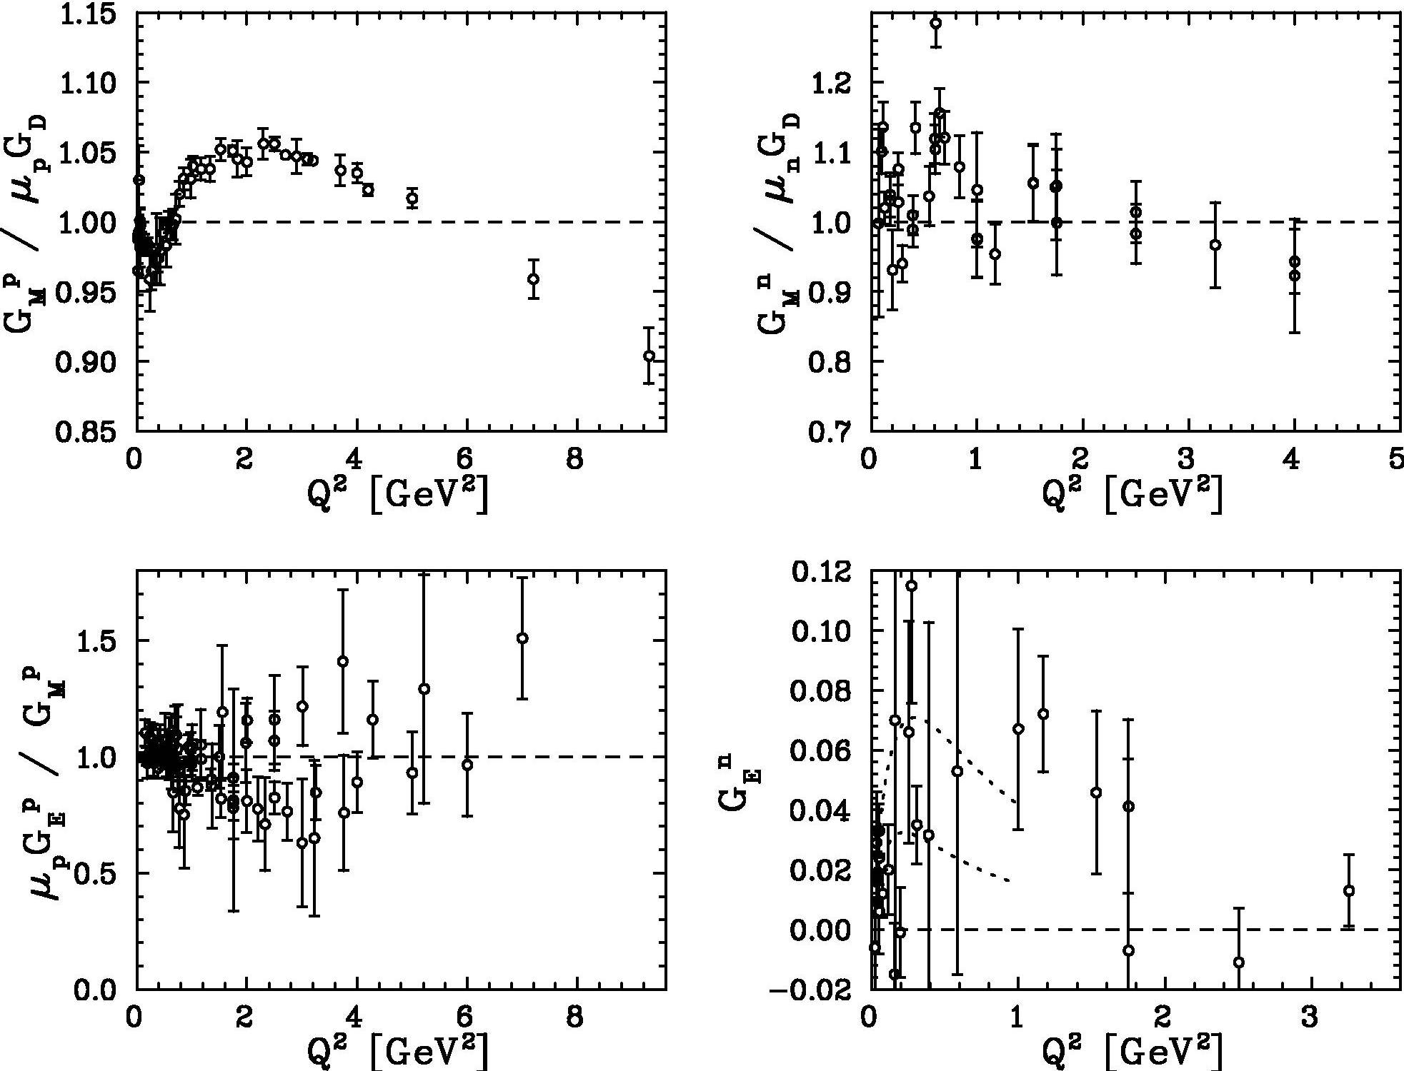
Nucleon Form Factors: 15 years ago
Proton
Neutron

Slide 74
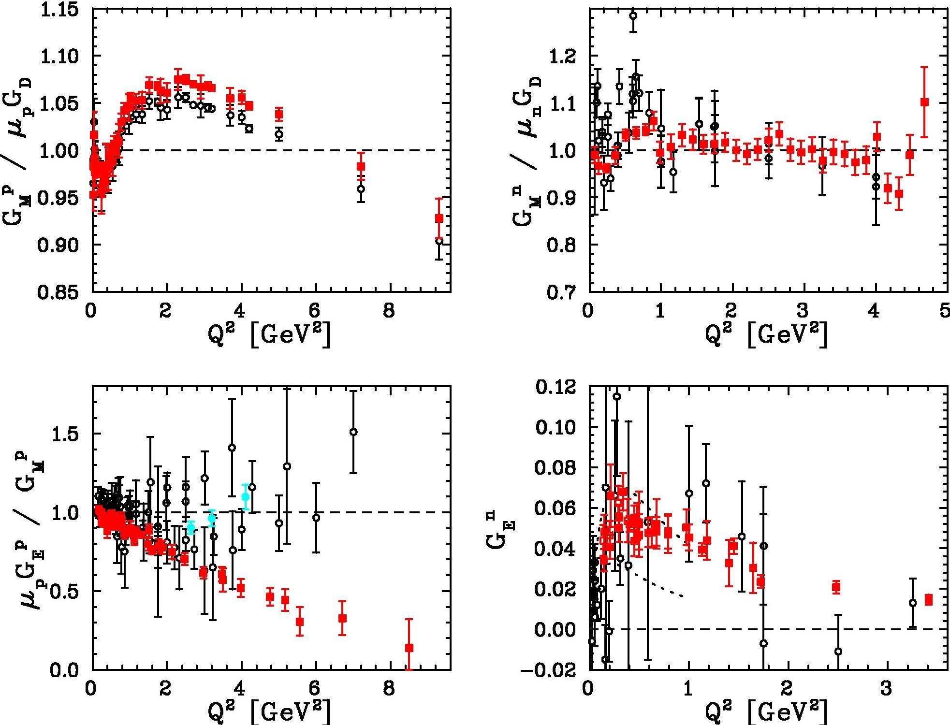
Nucleon Form Factors: Present status
Proton
Neutron

Slide 75
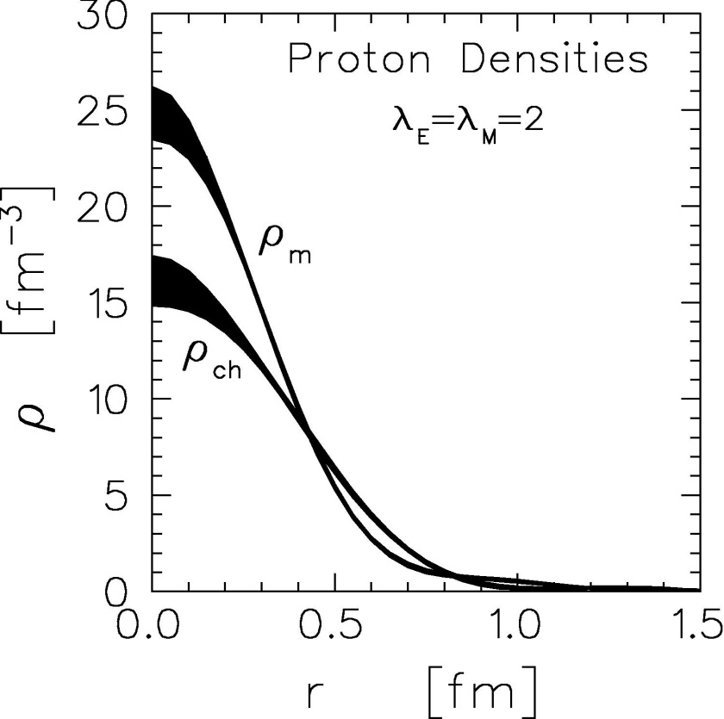
What have we learned from new form factor data?
New information on proton structure
  G_{E}(Q²) ≠ G_{M}(Q²) → different charge, magnetization distributions
Model-dependent extraction of charge, magnetization distribution of proton:
J. Kelly, Phys. Rev. C 66, 065203 (2002)

Slide 76
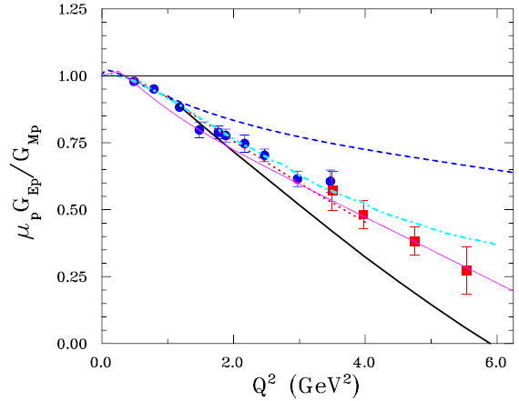
What have we learned from new form factor data?
Quark Orbital Angular Momentum
Many calculations able to reproduce the falloff in G_{E}/G_{M}
  Descriptions differ in details, but nearly all were directly or indirectly related to quark angular momentum
S. Boffi, et al.
F. Cardarelli, et al.
P. Chung, F. Coester
F. Gross, P. Agbakpe
G.A. Miller, M. Frank
C. Perdrisat, V. Punjabi, and M. Vanderhaeghen, PPNP 59 (2007)

Slide 77
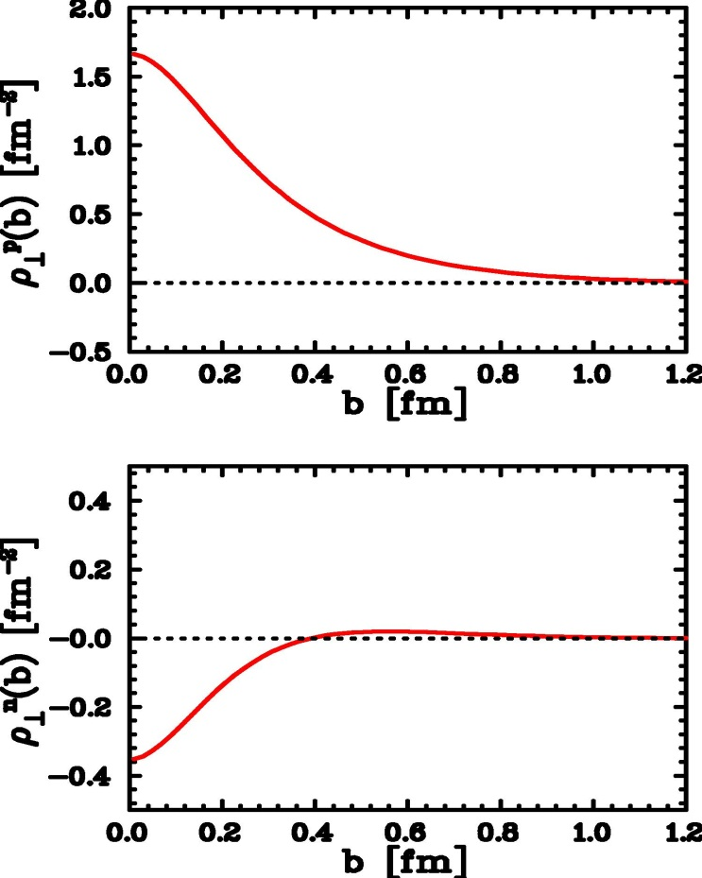
What have we learned from new form factor data?
Transverse Spatial Distributions
Simple picture: Fourier transform of the spatial distribution
  Relativistic case: model dependent “boost” corrections
Model-independent relation found between form factors and transverse spatial distribution
proton
neutron
  ρ⊥(b,x) = ∑ e_{q} ∫ dx q(x,b) = transverse density distribution in infinite momentum frame (IMF) for quarks with momentum x

Slide 78
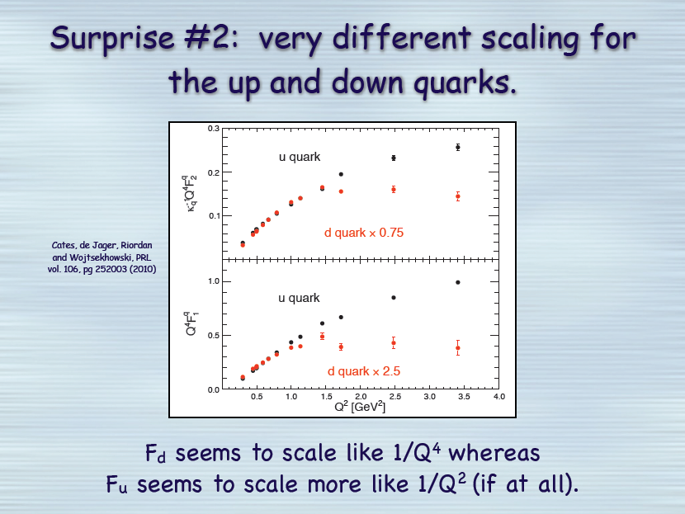
Q⁴F₂^{q}/κ
Q⁴ F₁^{q}
Slide from G. Cates

Slide 79
Future form factor measurements
Proton
Neutron
JLab 12 GeV Upgrade will allow us to extend form factor measurements to even larger Q²
4.5 → 13.5+ GeV²
3.5 → 10.5 GeV²
8.5 → 14.5 GeV²

