Slide 1
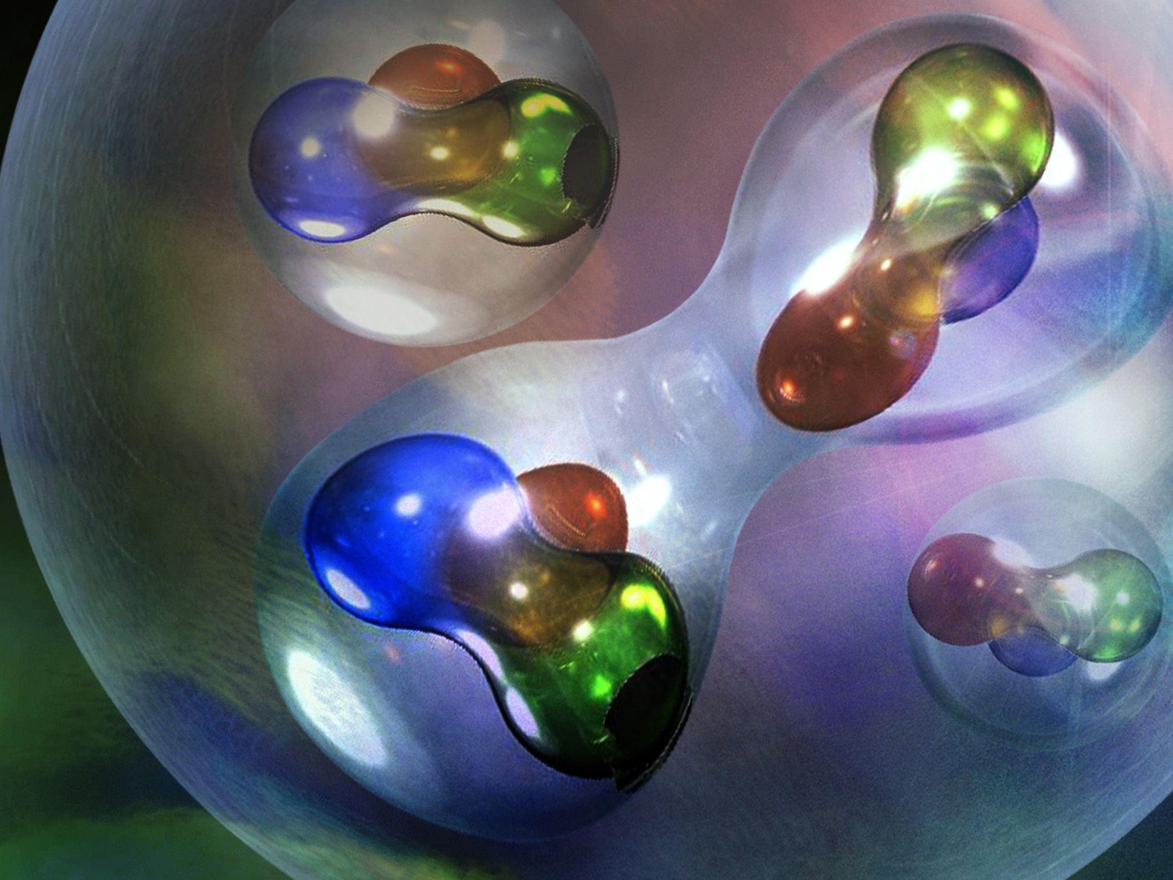
Connecting the SRC & EMC Effects
by

Slide 2
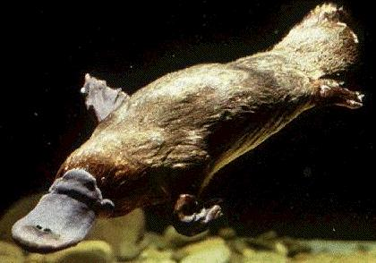
“When the explore returned from Australia, the good people of England, having seen all the animals in the world, demanded to know if it was a duck or a beaver. They were asking the wrong question!”
– Rolf G. Winter, Introduction to Quantum Physics

Slide 3
Electron Scattering Kinematics
p
scattering plane
e'
θ_{pq}
reaction plane
e
(ω,q)
p_{A–1}
φ_{x}
“out-of-plane” angle
Four-momentum transfer: Q² ≡ – q_{μ}q ^{μ} = q² –ω ²
Missing momentum: p_{m} = q – p = p_{A–1}
Missing energy: ω = e – e’
Bjorken x: x_{B} = Q²/2mω (just kinematics!)

Slide 4
A(e,e’) at Fixed Q² vs. ω
Elastic
Deep Inelastic
Δ
Quasielastic
N*
Nucleus
ω
Elastic
Δ
Deep Inelastic
N*
Proton
ω

Slide 5
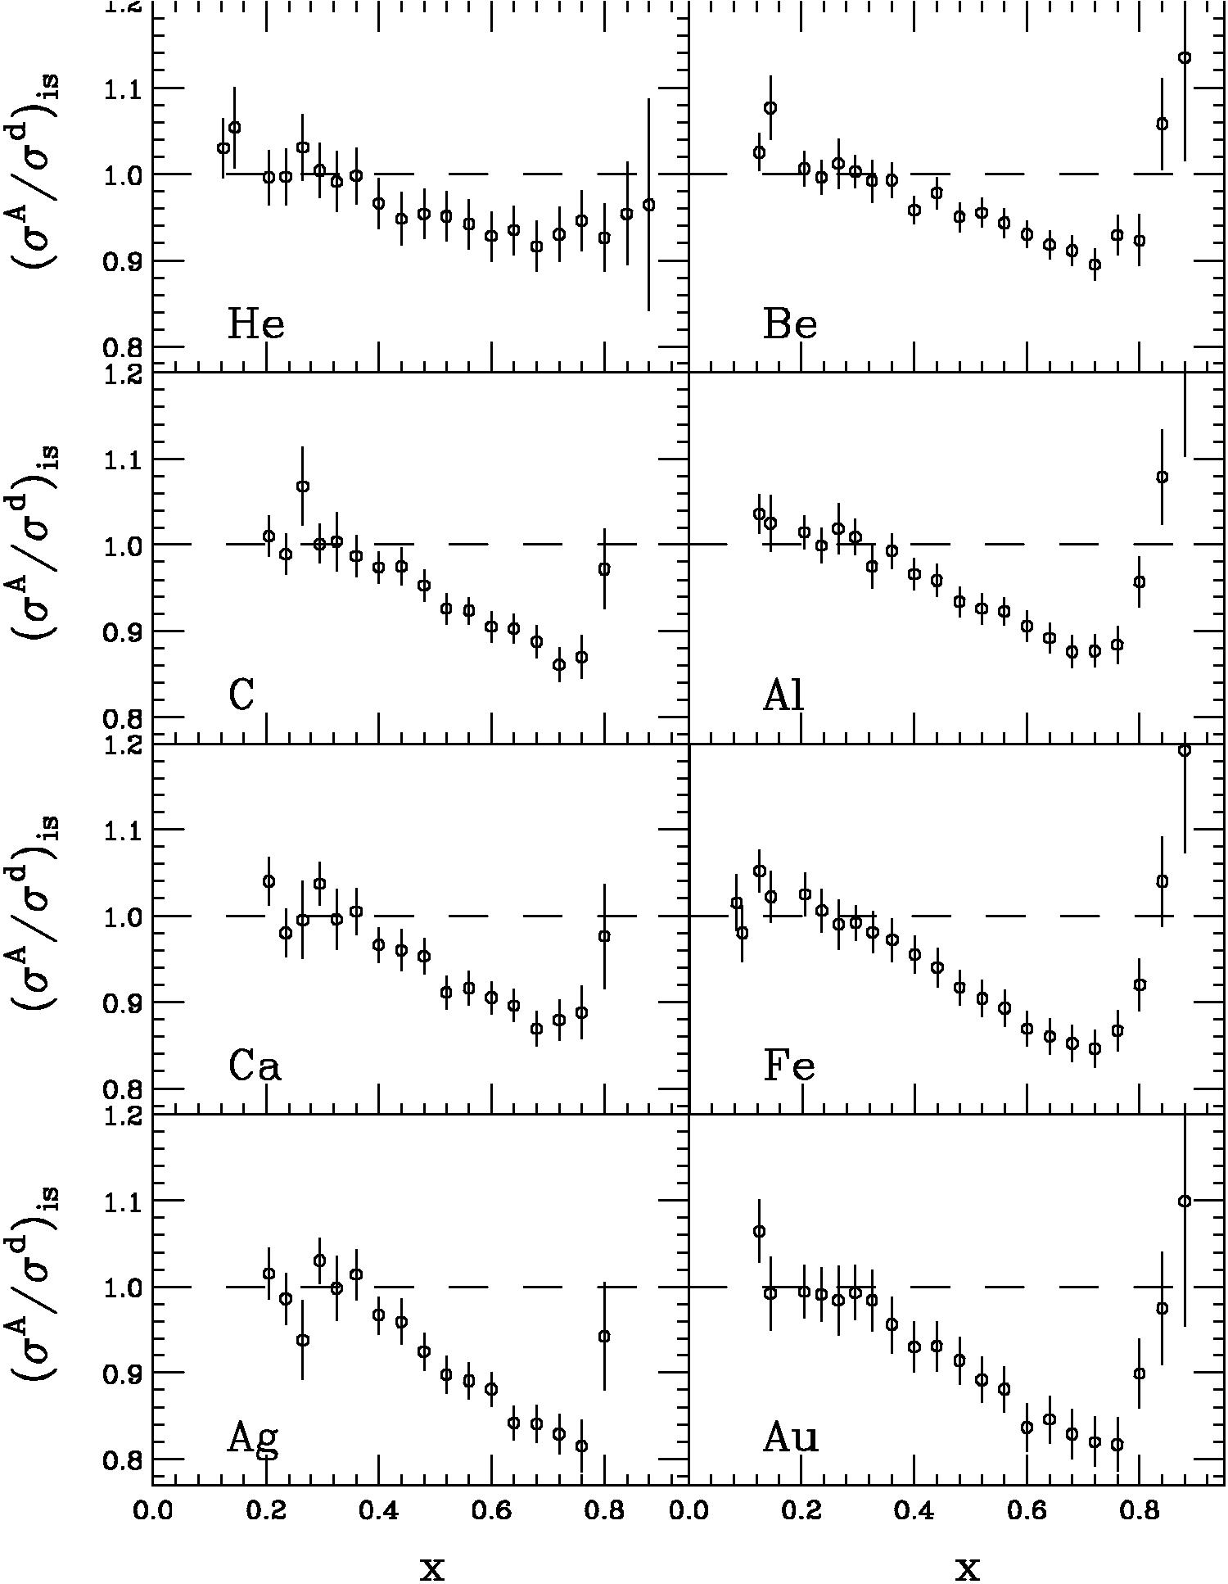
What is the EMC Effect?
EMC effect is simply the fact the ratio of DIS cross sections is not one
  J.J. Aubert et al. PLB 123 (1983) 275.
  Simple Parton Counting Expects One
  MANY Explanations
SLAC E139
  J. Gomez et al., PRD 49 (1994) 4348.
  Precise large-x data
  Nuclei from A=4 to 197
Conclusions from SLAC data
  Q²-independent
  Universal x-dependence (shape)
  Magnitude varies with A
  Average Nuclear Density Effect

Slide 6
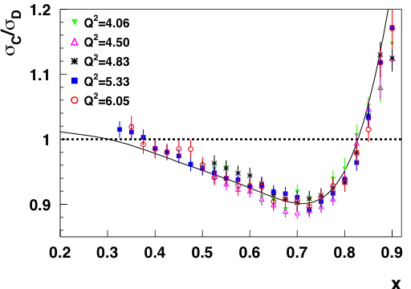
New Jefferson Lab EMC Effect Data
J. Seely et al., Phys, Rev. Lett. 103 (2009) 202301.

Slide 7
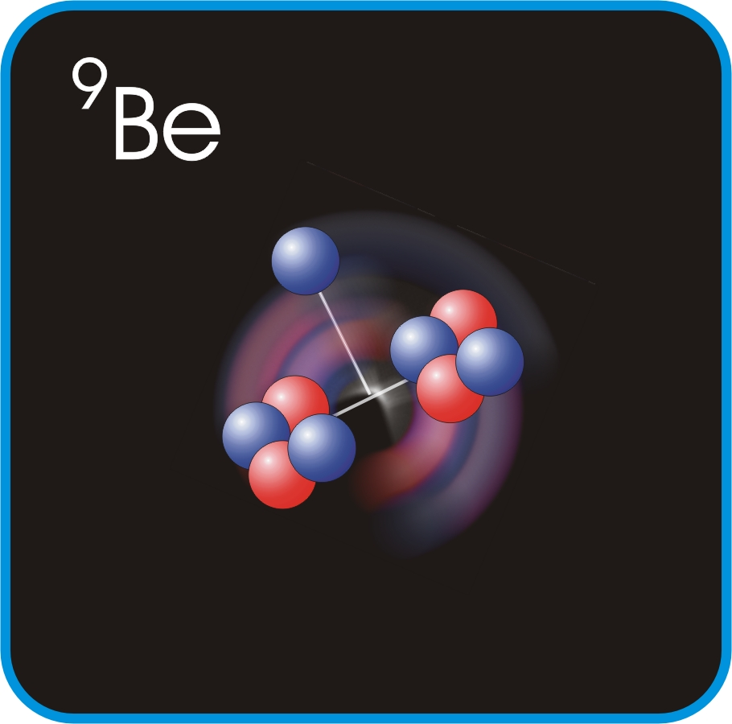
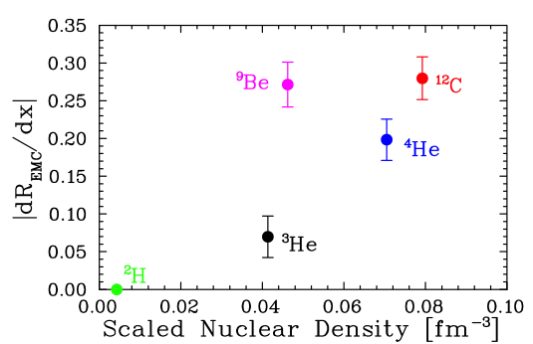
New Jefferson Lab EMC Effect Data
J. Seely et al., Phys, Rev. Lett. 103 (2009) 202301.
Plot shows slope of ratio σA/σD at EMC region.
EMC effect correlated with local density not average density.

Slide 8
If the EMC effect is a local density effect, then it seems reasonable to look for connections to other local density effects.

Slide 9
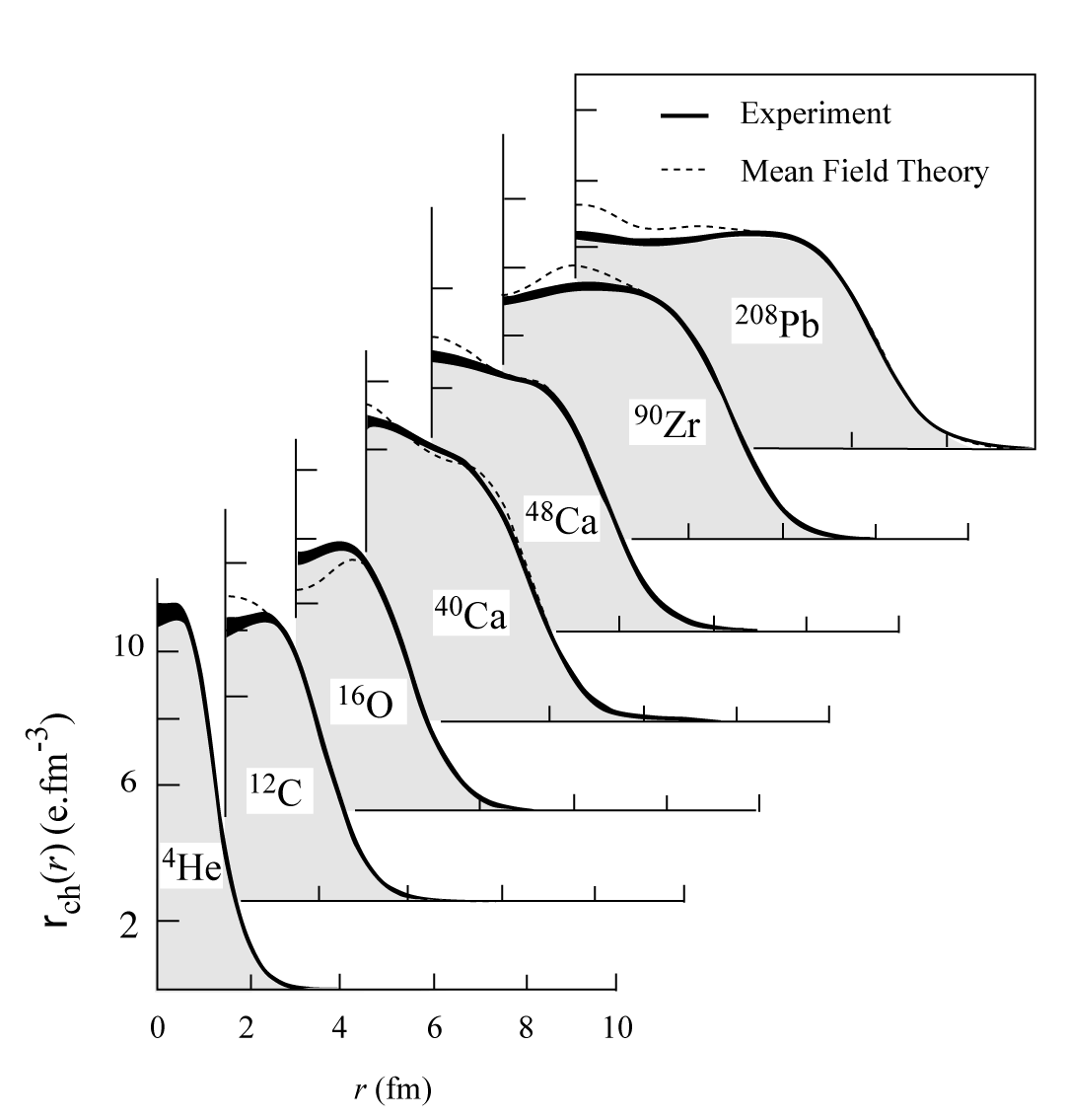
Nuclear Charge Distributions
In ‘70s large data set was acquired on elastic electron scattering (mainly at Saclay) over large Q²-range and for variety of nuclei.

Slide 10
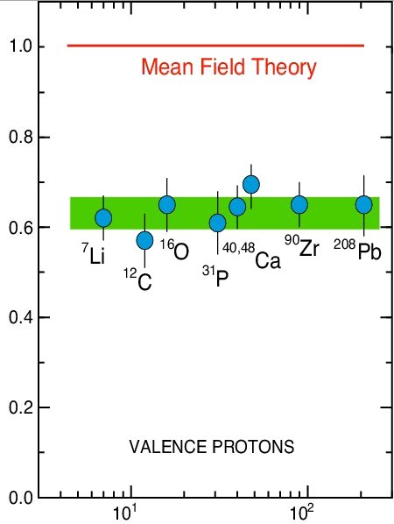
Classic (e,e’p) Results
L. Lapikas, Nucl. Phys. A553 (1993) 297.
Independent-Particle Shell-Model
is based upon the assumption that
each nucleon moves independently
in an average potential (mean field)
induced by the surrounding nucleons
SPECTROSCOPIC STRENGTH
The (e,e'p) data for knockout of valence and deeply bound orbits in nuclei gives spectroscopic factors that are 60 – 70% of the mean field prediction.
Solution: Correlations Between Nucleons
Target Mass

Slide 11
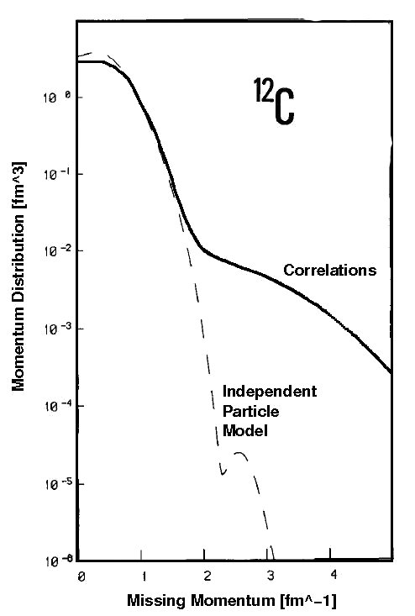
Realistic Momentum Distribution
Benhar et al., Phys. Lett. B 177 (1986) 135.

Slide 12
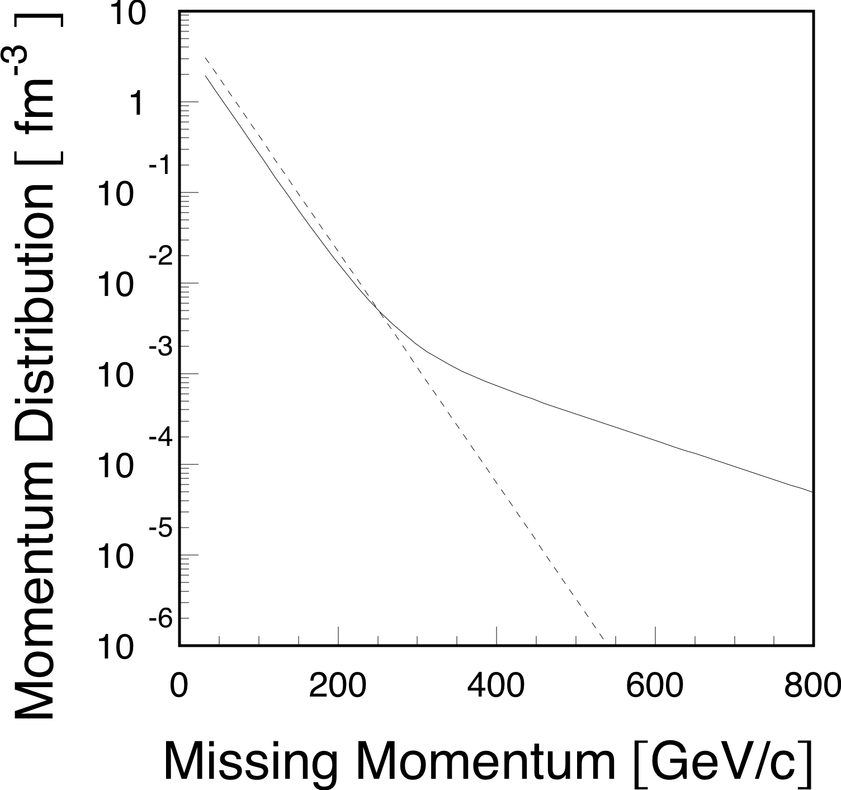
A Toy Model Momentum Distribution
By Uncertainty Principle High Momentum Region Dominated by Short Distance Phenomena

Slide 13
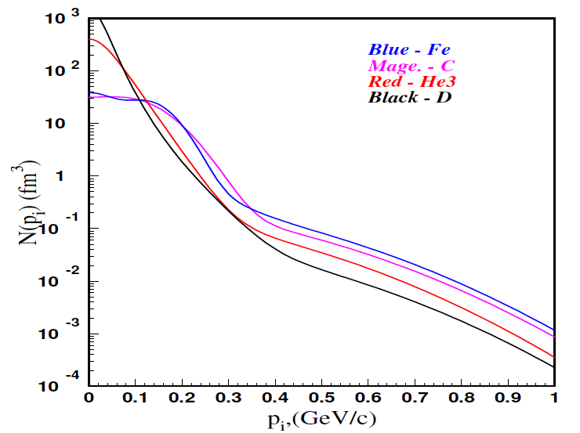
Momentum Distributions
C. Ciofi degli Att and S. Simula, Phys. Rev. C 53 (1996) 1689.
At high initial momentums n_{A}(p) = a_{2n} n_{D}(p)

Slide 14
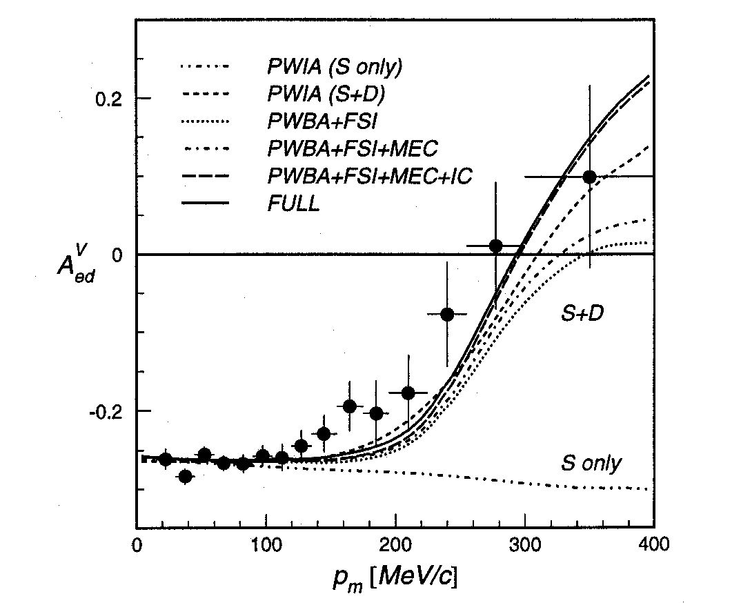
Deuteron Asymmetry Data
I. Passchier et al., Phys. Rev. Lett. 88 (2002)102302.
Q² = 0.2 GeV/c
x_{B} = 1

Slide 15
Example of Nuclear Scaling Plateaus
K. Sh. Egiyan et al., Phys. Rev. C 68 (2003) 014313.
Originally done with SLAC data by D.B. Day et al., Phys. Rev. Lett. 59 (1987) 427.

Slide 16
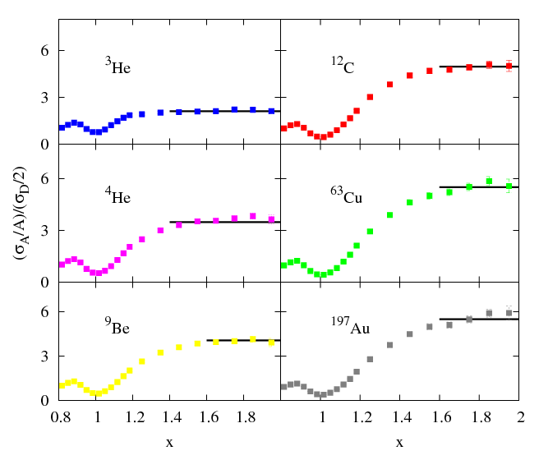
Preliminary Results From JLab Hall-C
N. Fomin, Ph.D Thesis (2008) [Goto APS Meeting Session E2 for details!]
Q²=2.5 [GeV/c]²

Slide 17
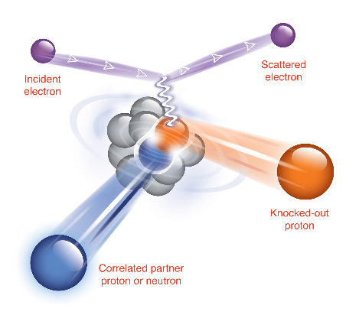
¹²C(e,e’pN) Measurement
To study nucleon pairs at close proximity and their contributions to the large momentum tail of nucleons in nuclei.
A pair with “large” relative
momentum between the nucleons
and small center of mass momentum
high Q2 to minimize MEC
x>1 to suppress isobar contributions
parallel kinematics to suppress FSI

Slide 18
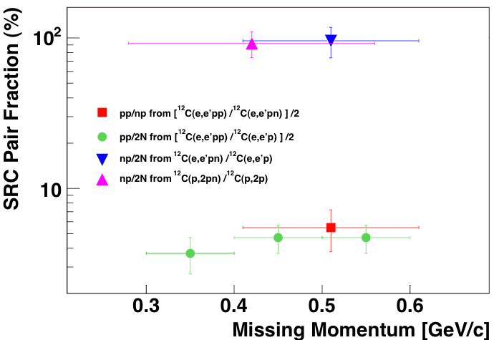
SRC Pair Factions
R. Subedi et al., Science 320 (2008) 1476.

Slide 19
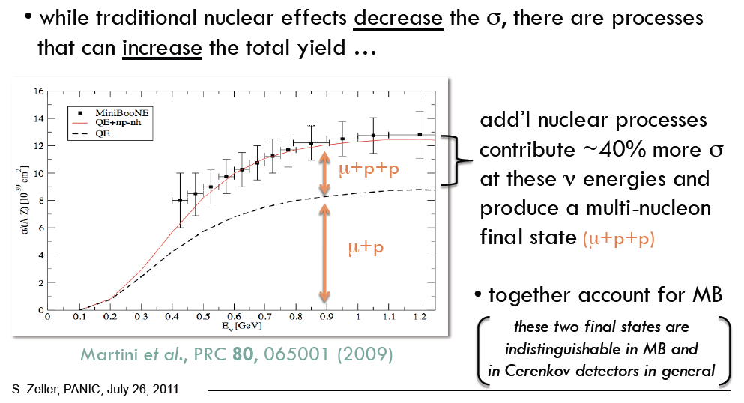
Modern Neutrino Example
Correlations Effecting The Result of Neutrino Scattering Data

Slide 20


So How These “Nuclear” Results Relate To The “Deep Inelastic” EMC Effect Results?!

Slide 21
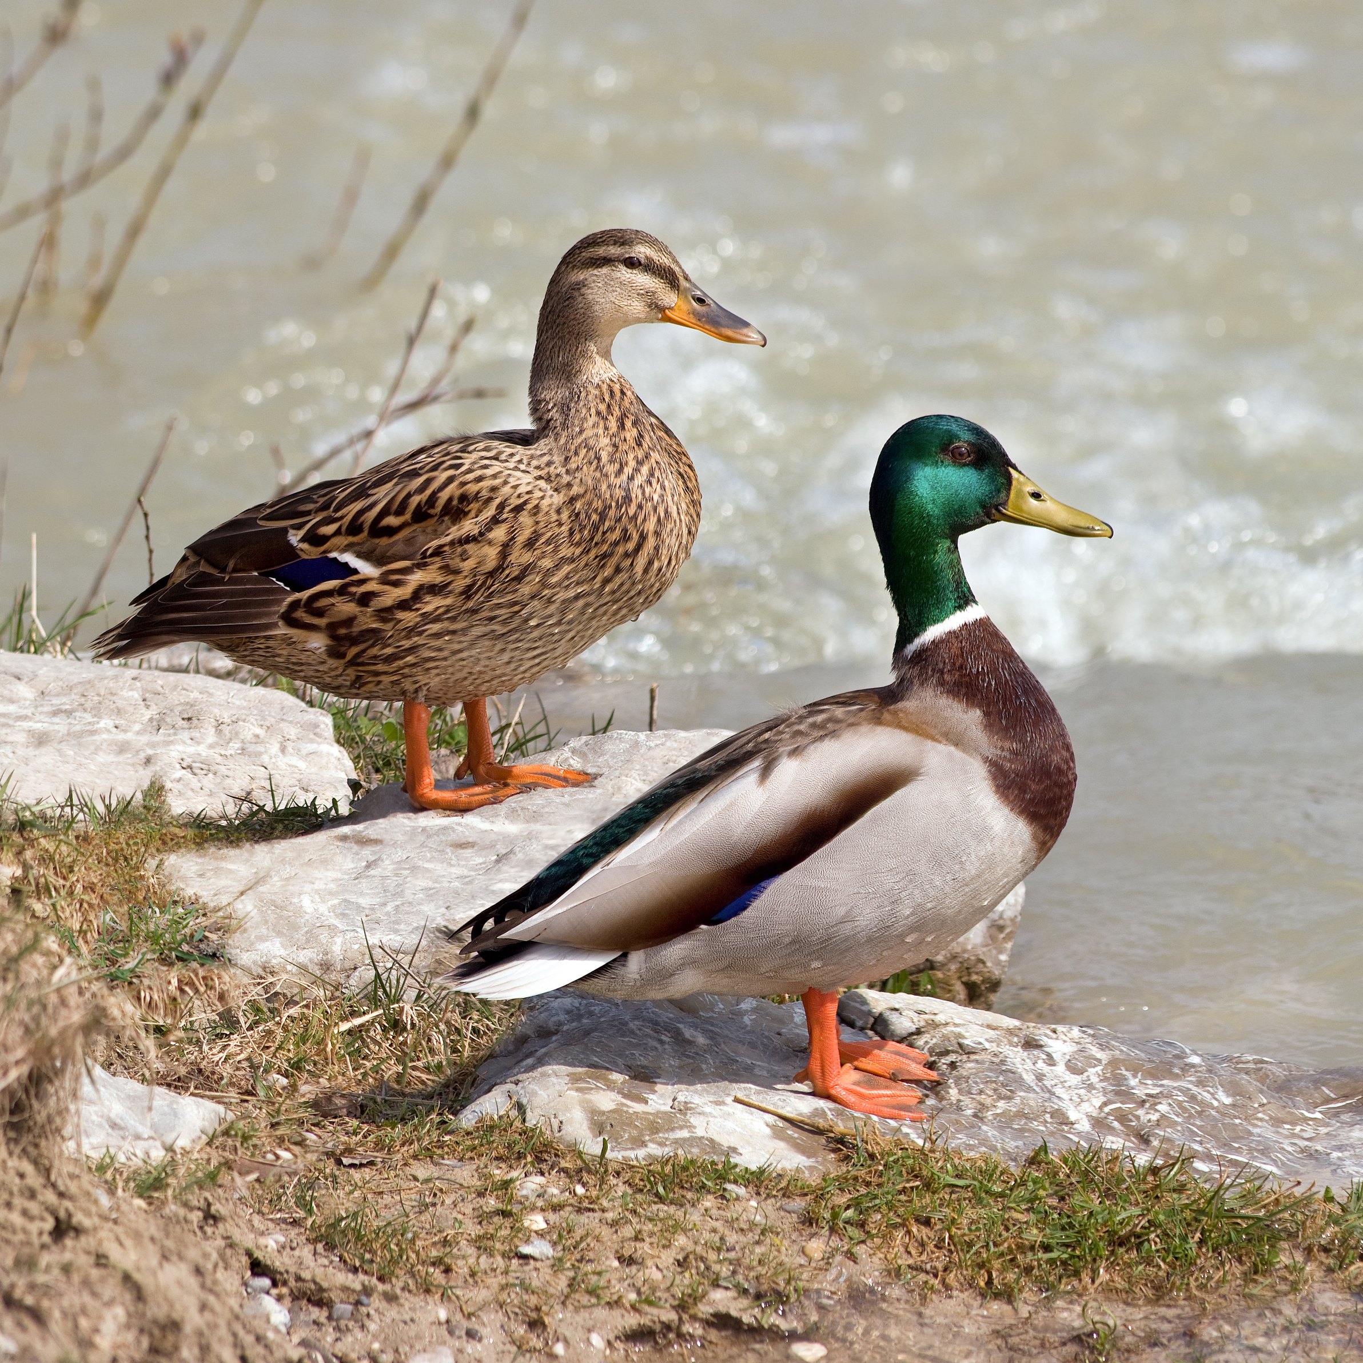

So How These “Nuclear” Results Relate To The “Deep Inelastic” EMC Effect Results?!

Slide 22
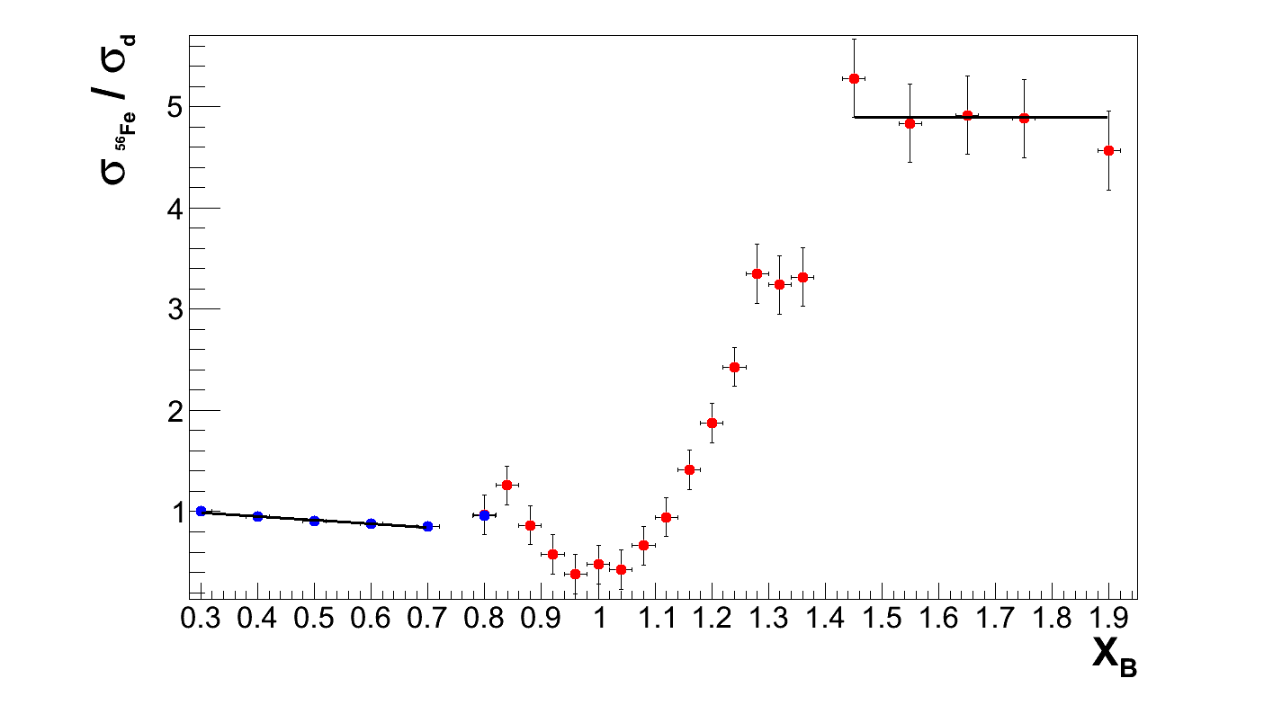
Holistic View of the EMC & SRC Data
D. Higinbotham et al., arXiv:1003.4497.
Q² = 2.5 [GeV/c]²
a_{2N}
dR_{EMC}/dx
Scaling plateaus (a_{2N}) are due to proton-nucleon local density correlations
R. Subedi et al., Science 320 (2008) 1476-1478.
So are the EMC slopes (x_{B}<0.7) and a_{2N} (x_{B}>1.5) correlated?!

Slide 23
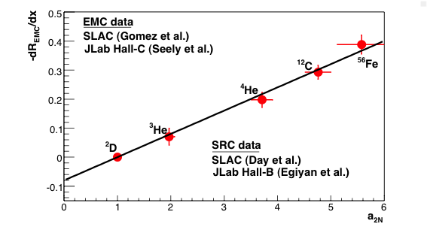
SRC and EMC Correlation
L. Weinstein et al., Phys. Rev. Lett. 106 (2011) 052301.

Slide 24
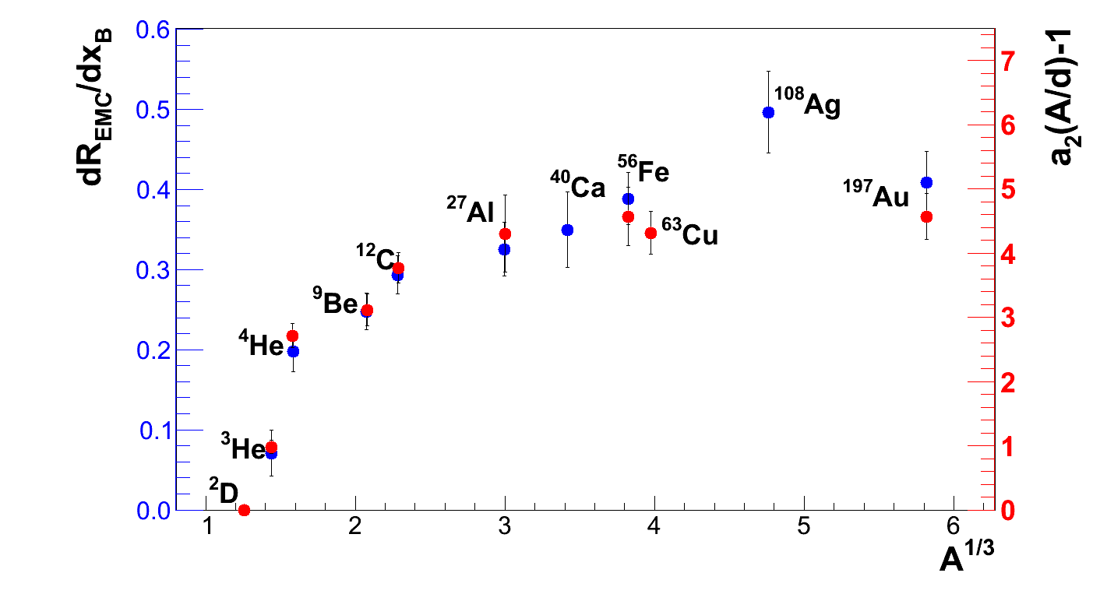
EMC Slopes & SRC Plateaus

Slide 25
Revisiting the bag model.
Work of A. Kerman et al. with artwork by Joanne Griffen (Jefferson Lab)

Slide 26
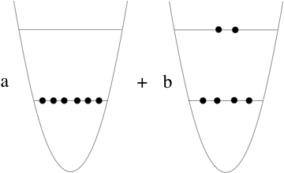
Quark State of Overlapping Nucleons
l=1
l =0
l =0

Slide 27
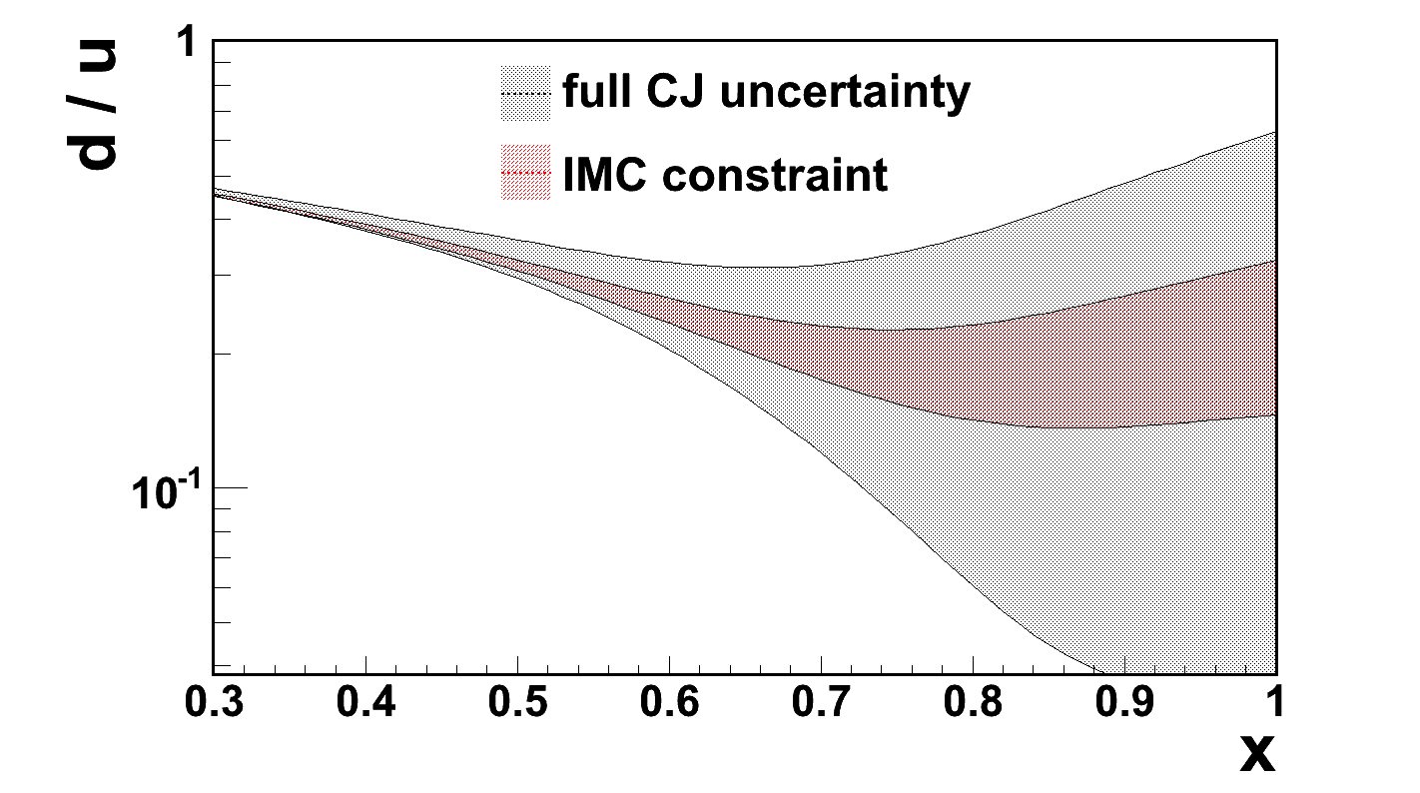
Using SRC & EMC to get d/u ratios!
CTEQ-Jefferson Lab (CJ): A. Accardi et al., Phys. Rev. D 84, 014008 (2011).
In-Medium Correction (IMC): O. Hen et al., Phys. Rev. D 84 (2012) 117501.
Result is between the SU(6) symmetry limit of ½ and the scalar di-quark dominance limit of 0.

Slide 28
Summary
New data points to EMC effect being a local density effect.
x_{B}>1 nuclear scaling plateaus are likely a local density effect.
Data shows the two effects to be strongly correlated.
Open Questions
  What exactly is this UNIVERSAL high momentum tail?!
  ( i.e. for k > k_{fermi} p_{A}(k) = N * p_{D}(k) )
  Is it hadronic, partonic , or some combination both?!
  Can we use this correlation to make even more insights?!
Many New EMC (x<1) and SRC (x>1) Experiments Coming with 12GeV Jefferson Lab, including ³H & ³He.

Slide 29
So the good experimentalists and theorists finally agreed it wasn’t just protons and a neutrons. It was a nucleus!

