Slide 1
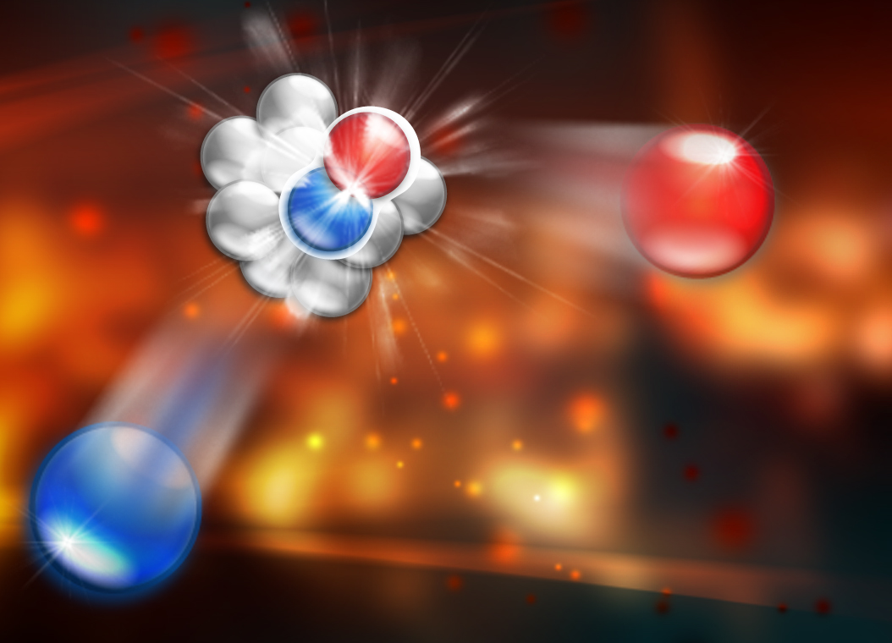
Short-Distance Structure of Nuclei

Slide 2
Kinematics
p
scattering plane
e'
θ_{pq}
reaction plane
e
(ω,q)
p_{A–1}
φ_{x}
“out-of-plane” angle
Four-momentum transfer: Q² ≡ – q_{μ}q ^{μ} = q² –ω ² = 4ee' sin²θ/2
Missing momentum: p_{m} = q – p = p_{A–1}= – p₀
Missing energy: ε_{m} = ω –T_{p} – T_{A–1}
PWIA

Slide 3
Electron Scattering at Fixed Q²
Elastic
Deep Inelastic
Δ
Quasielastic
N*
Nucleus
ω
Elastic
Δ
Deep Inelastic
N*
Proton
ω

Slide 4

Simple Theory Of Nucleon Knock-out
Plane Wave Impulse Approximation (PWIA)
spectator
A–1
e'
p
p₀
A-1
q
p₀
e
A
q – p = p_{A-1}= p_{m}= – p₀

Slide 5
Spectral Function
In nonrelativistic PWIA:
e-p cross section
nuclear spectral function
For bound state of recoil system:
proton momentum distribution

Slide 6
Reaction Mechanisms
Example: Final State Interactions (FSI)
FSI
p
A–1
e'
p_{0'}
q
e
p₀
A

Slide 7
Improve Theory
Distorted Wave Impulse Approximation (DWIA)
“Distorted” spectral function

Slide 8
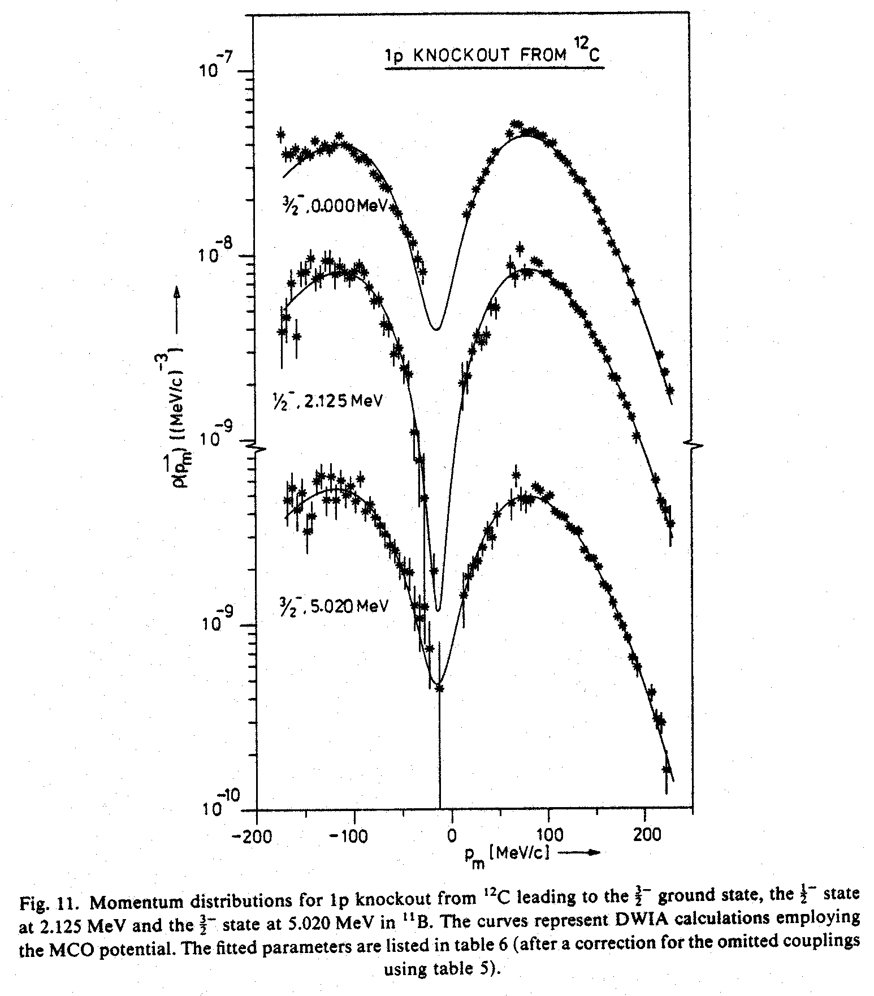
1p knockout from ¹²C
¹²C(e,e'p)¹¹B
DWIA calculations give correct shapes, but:
Missing strength observed.
ρ(p_{m}) [(MeV/c)⁻³]
NIKHEF
p_{m} [MeV/c]
G. van der Steenhoven, et al., Nucl. Phys. A480, 547 (1988).

Slide 9
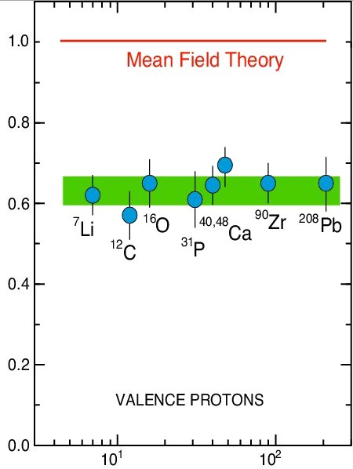
Results from (e,e’p) Measurements
Independent-Particle Shell-Model
is based upon the assumption that
each nucleon moves independently
in an average potential (mean field)
induced by the surrounding nucleons
SPECTROSCOPIC STRENGTH
The (e,e'p) data for knockout of valence and deeply bound orbits in nuclei gives spectroscopic factors that are 60 – 70% of the mean field prediction.
Target Mass

Slide 10
Short-Range Correlations
2N-SRC
ρ ≈ 5ρ_{o}
1.7fermi
ρ_{o} = 0.17 GeV/fermi³
Nucleons

Slide 11
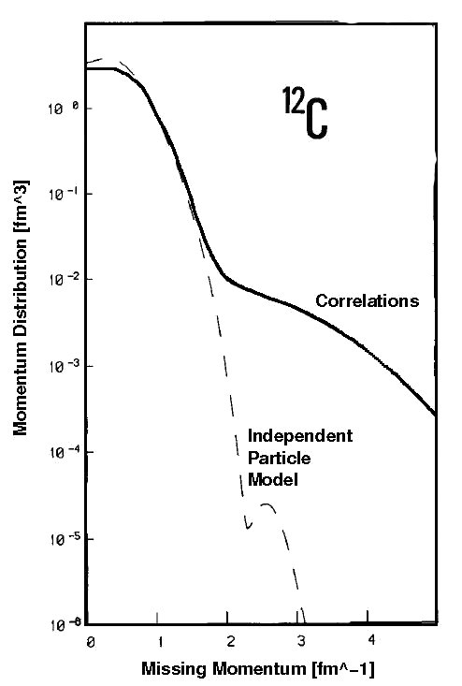
Questions
Benhar et al., Phys. Lett. B 177 (1986) 135.
What fraction of the momentum distribution is due to 2N-SRC?
What is the relative momentum between the nucleons in the pair?
What is the ratio of pp to pn pairs?
Are these nucleons different from free nucleons (e.g. size)?

Slide 12
Questions
Benhar et al., Phys. Lett. B 177 (1986) 135.
What fraction of the momentum distribution is due to 2N-SRC?
What is the relative momentum between the nucleons in the pair?
What is the ratio of pp to pn pairs?
Are these nucleons different from free nucleons (e.g. size)?

Slide 13
Questions
Benhar et al., Phys. Lett. B 177 (1986) 135.
What fraction of the momentum distribution is due to 2N-SRC?
What is the relative momentum between the nucleons in the pair?
What is the ratio of pp to pn pairs?
Are these nucleons different from free nucleons (e.g. size)?
BUT Other Effects Such As A Final State Rescattering
Can Mask The Signal…

Slide 14
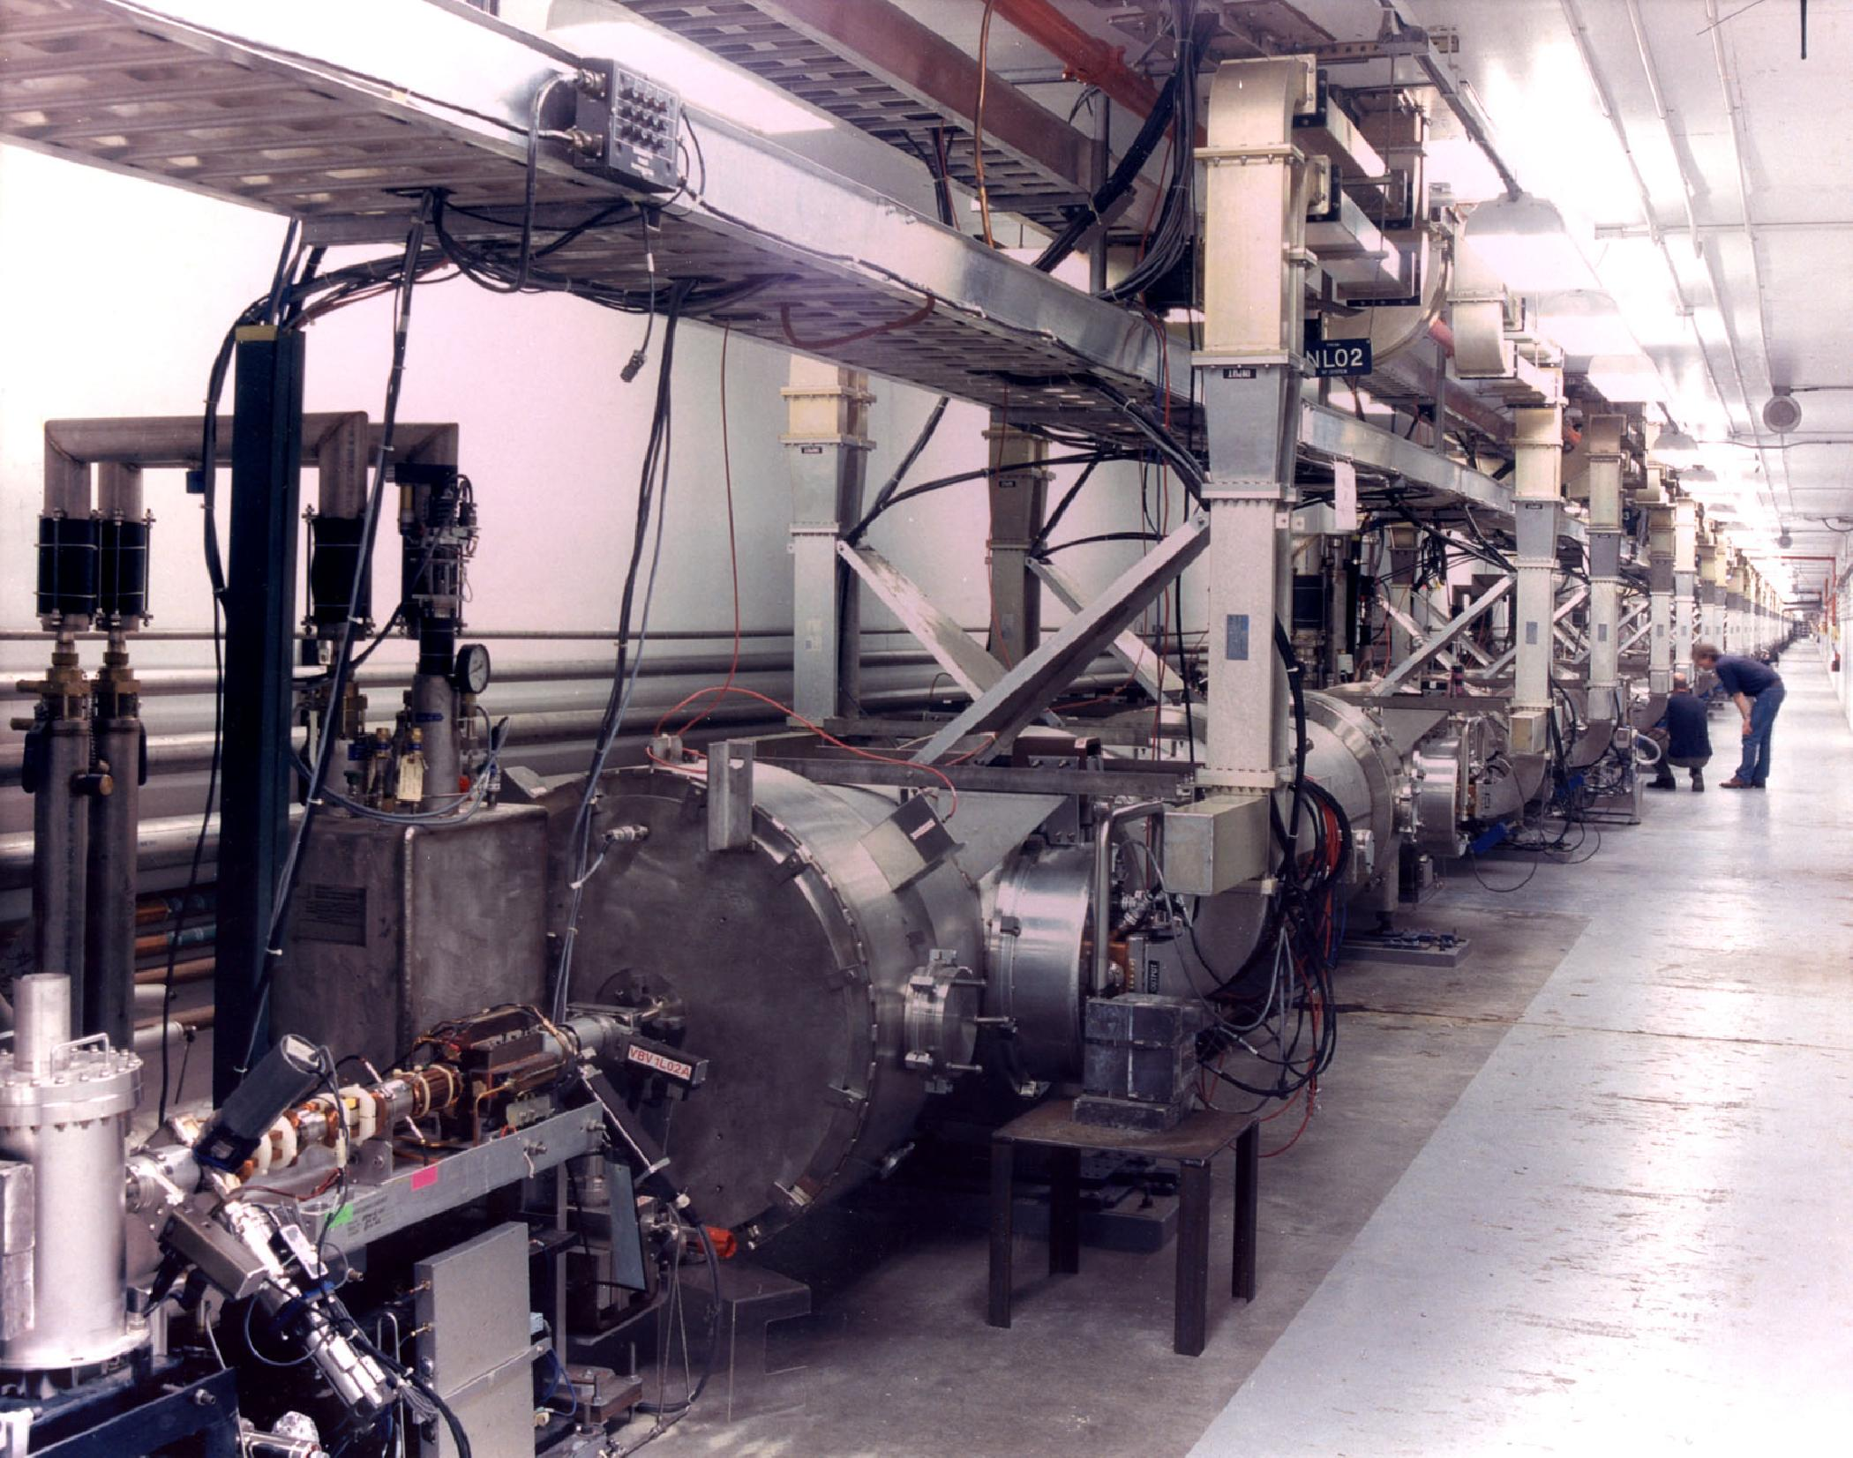
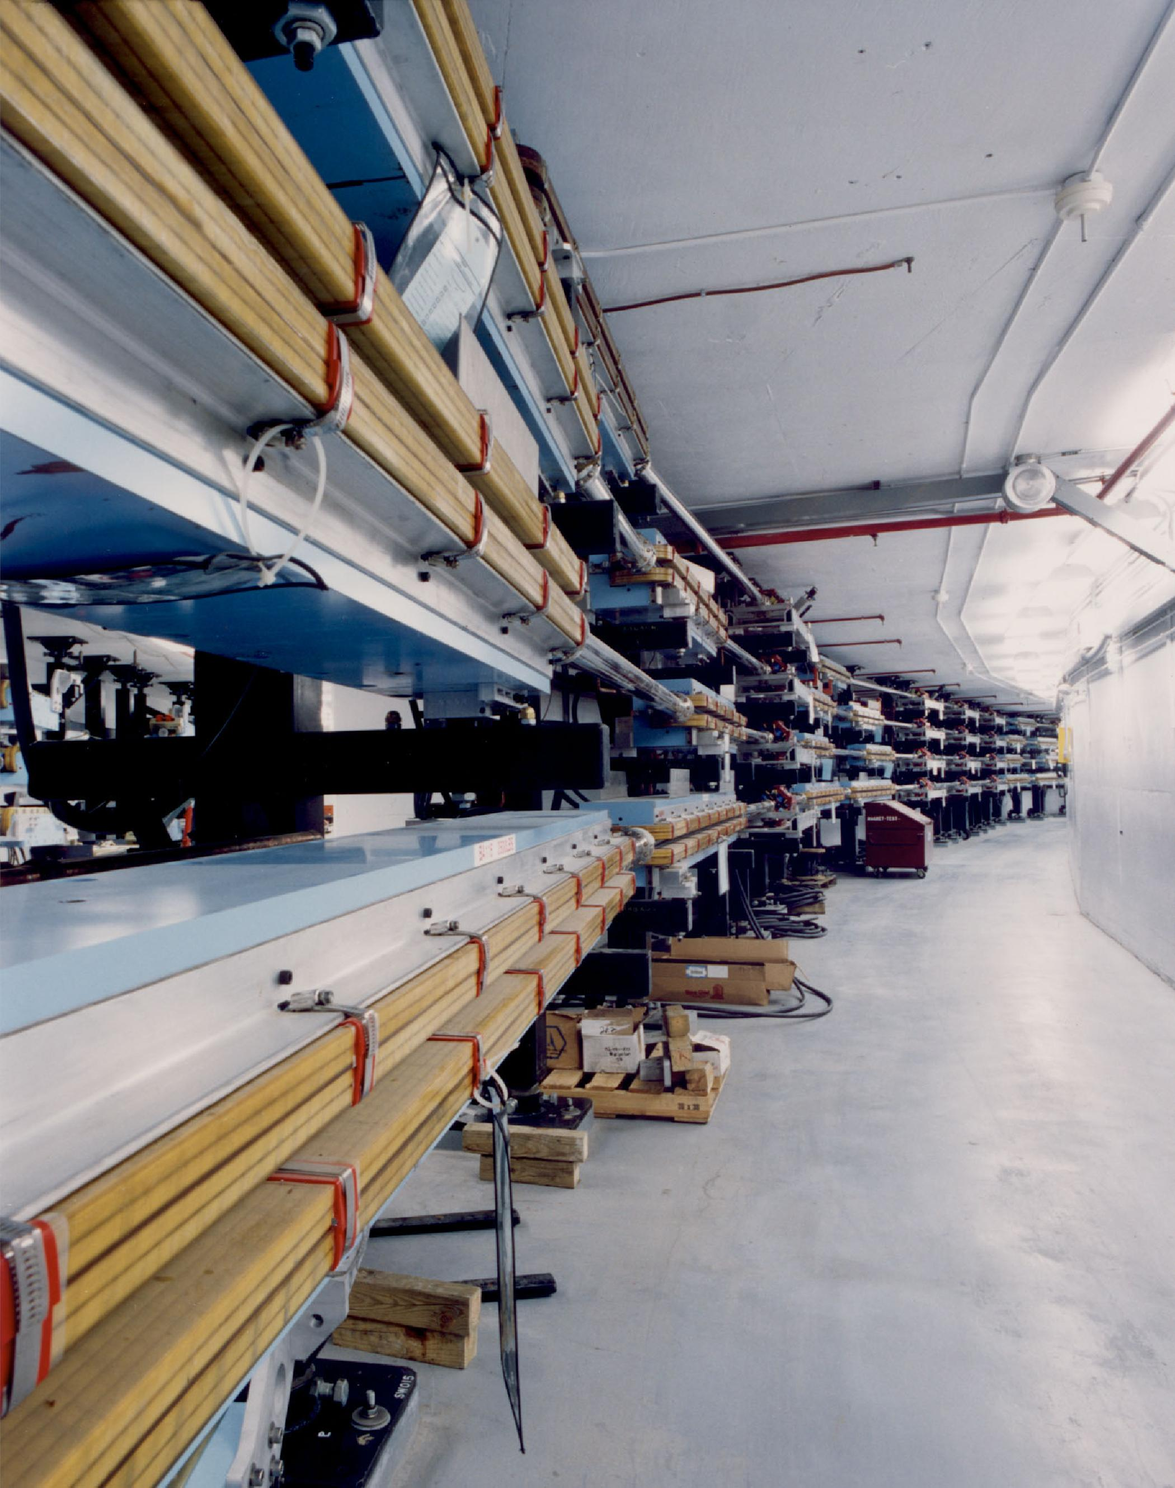
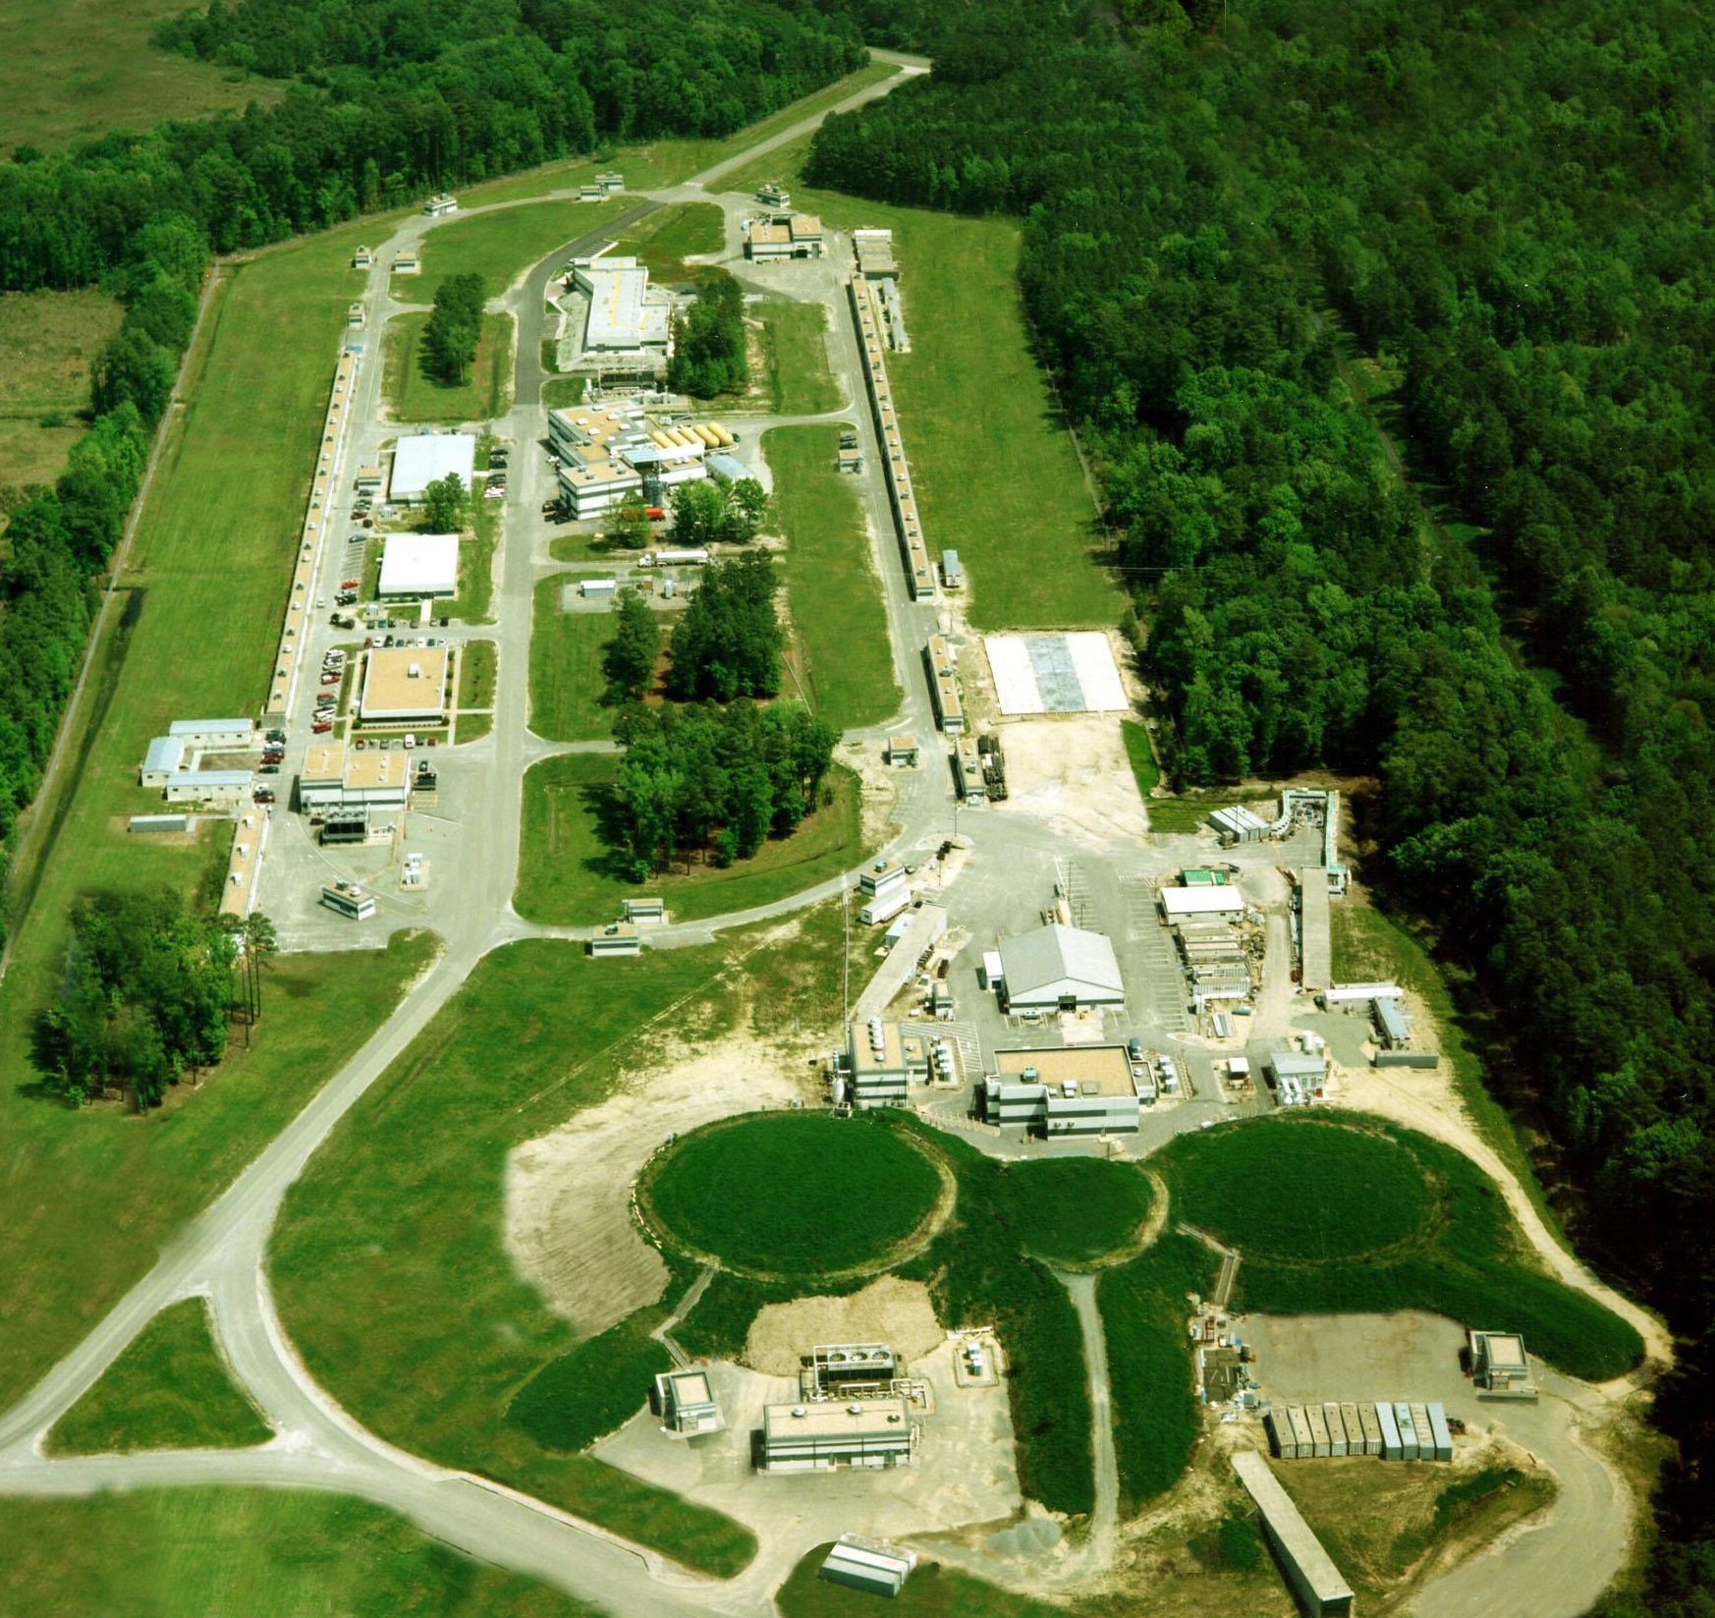
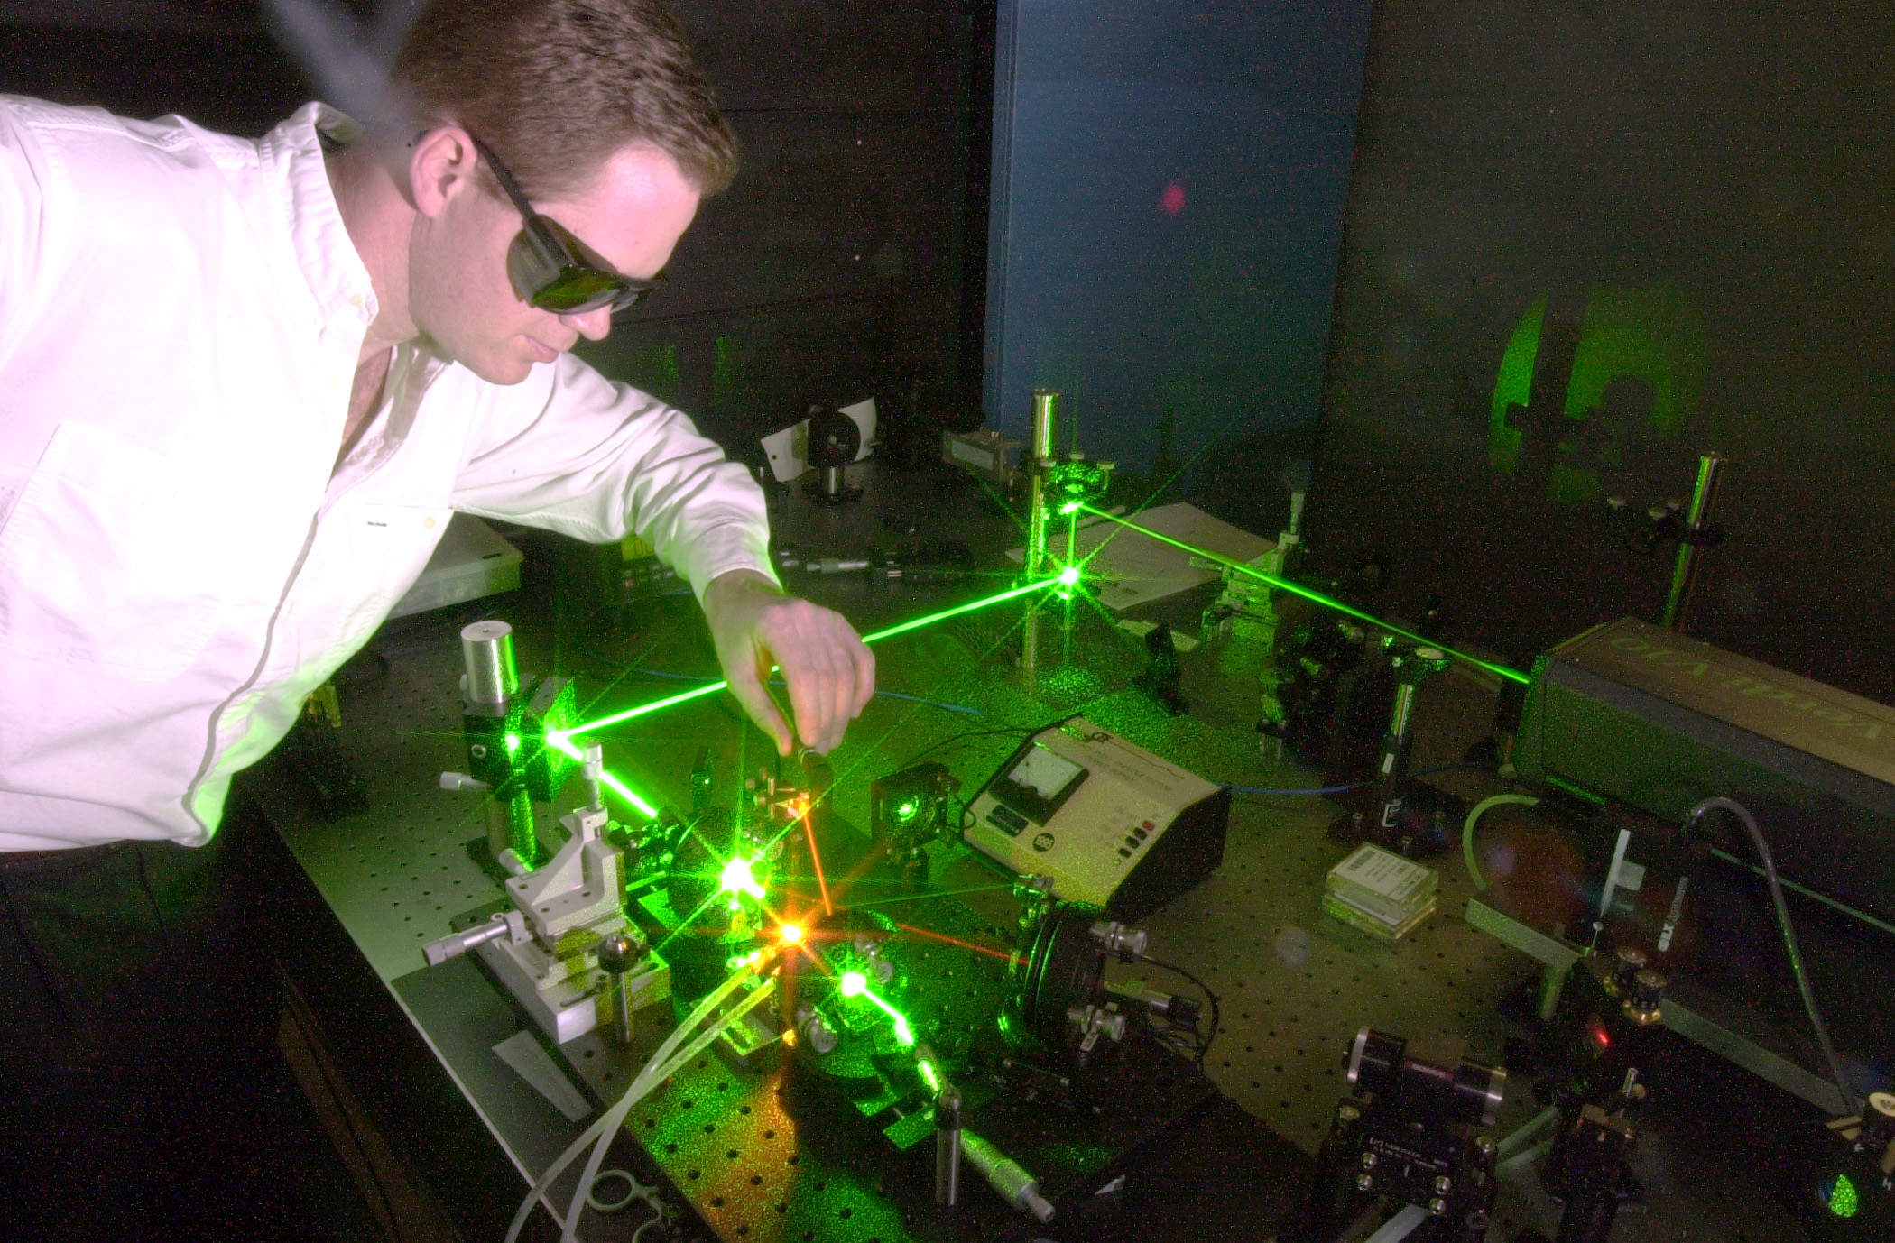
Jefferson Lab CEBAF

Slide 15
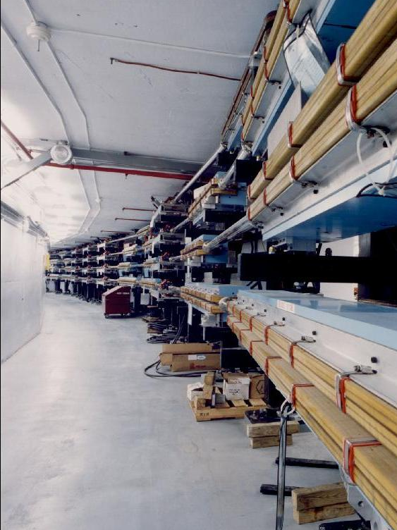
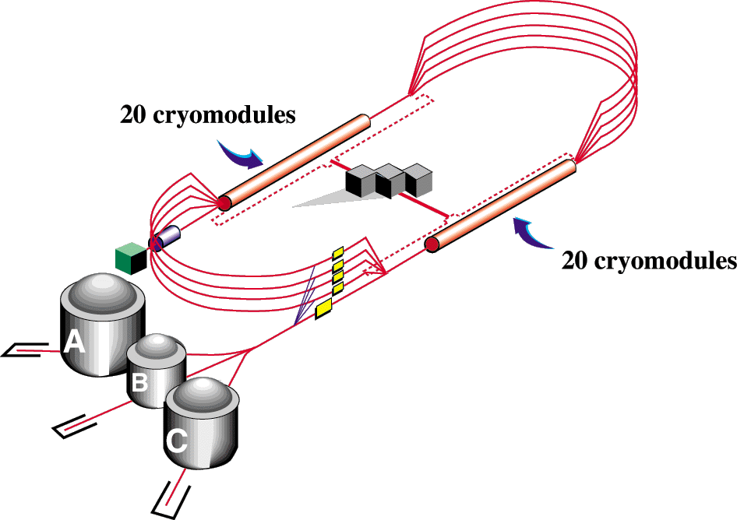

CEBAF: Continuous Electron Beam Accelerator Facility
Properties
E_{max} 5.8 GeV
I_{max} 200μA
P_{e} 85%
Beam To 3 Halls
recirculating arcs
accelerating
structures
CHL
RF separators

Slide 16
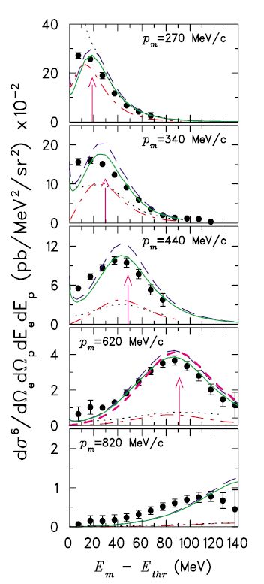
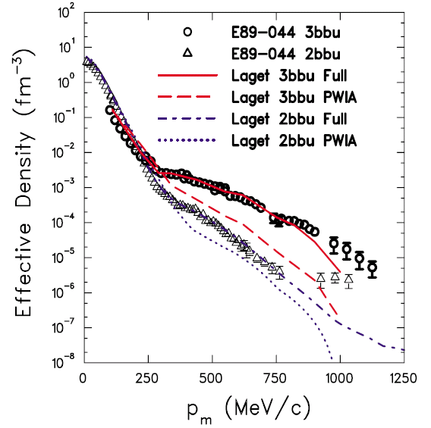
E89-044 ³He(e,e'p)pn Results (HallA)
F. Benmokhtar et al., Phys. Rev. Lett. 94 (2005) 082305.

Slide 17
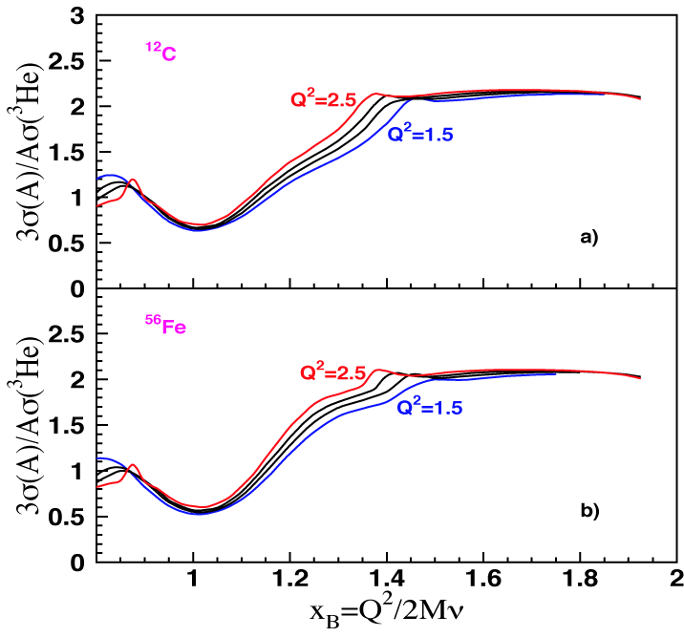
Inclusive scattering at large x
Define y as the x_{B}-value at which the minimum p_{miss} exceeds p_{Fermi}
SRC model predicts:
Scaling for x_{B} > y and Q² > 1.5 GeV²
No scaling for Q² < 1 GeV²
In scaling regime ratio Q²-independent and only weakly A-dependent
Glauber Approximation predicts:
No scaling for x_{B} < 2 and Q² > 1 GeV²
Nuclear ratios should vary with A and Q²

Slide 18
CLAS A(e,e’) Data
K. Sh. Egiyan et al., Phys. Rev. C 68 (2003) 014313.
Originally done with SLAC data by D.B. Day et al., Phys. Rev. Lett. 59 (1987) 427.
and
then
r(A,³He) = a_{2n}(A)/a_{2n}(³He)
The observed scaling means that the electrons probe the high-momentum nucleons in the 2N-SRC phase, and the scaling factors determine the per-nucleon probability of the 2N-SRC phase in nuclei with A>3 relative to ³He

Slide 19
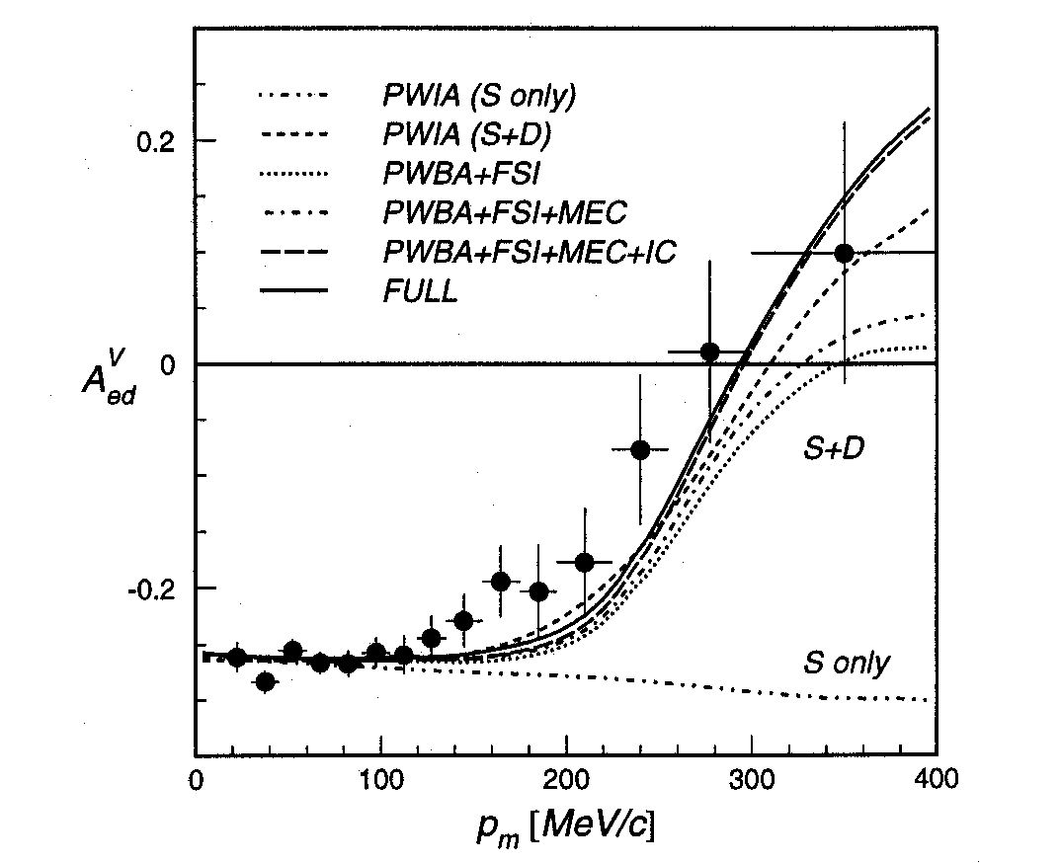
Deuteron Asymmetry Data
Observables: We Measure Cross Sections and Asymmetries.
Sensitive to D-state
AmPS NIKHEF-K
I. Passchier et al., Phys. Rev. Lett. 88, 102302 (2002).

Slide 20
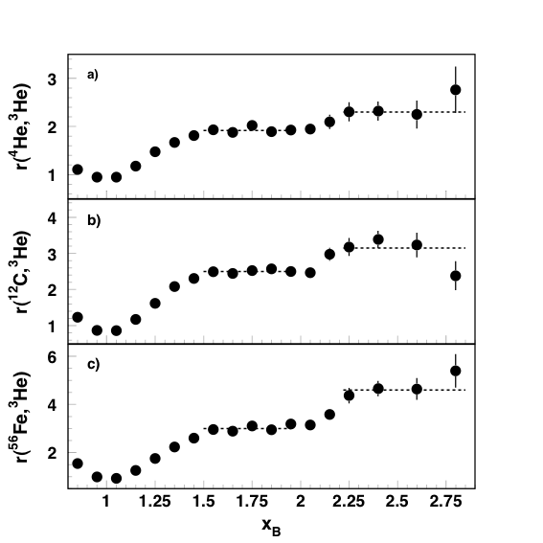
Estimate of ¹²C Two and Three Nucleon SRC
K. Sh. Egiyan et al., Phys. Rev. Lett. 96 (2006) 082501.
K. Egiyan et al. related the known correlations in deuterium and previous r(³He,D) results to find:
¹²C 20% two nucleon SRC
¹²C <1% three nucleon SRC

Slide 21
From the (e,e’) and (e,e’p), and Results
80 +/- 5% single particles moving in an average potential
  60 – 70% independent single particle in a shell model potential
  10 – 20% shell model long range correlations
20 +/- 5% two-nucleon short-range correlations
Less than 1% multi-nucleon correlations

Slide 22
Brookhaven EVA Collaboration Result
A. Tang et al., Phys. Rev. Lett. 90 (2003) 042301.
¹²C(p,2p+n) Reaction
p_{f}
γ
p_{n}
p_{f} = p₁ + p₂ - p₀
p₀ = incident proton
p1 and p2 are detected

Slide 23
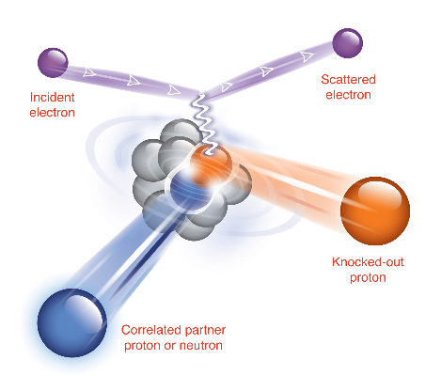
Customized (e,e’pN) Measurement
To study nucleon pairs at close proximity and their contributions to the large momentum tail of nucleons in nuclei.
A pair with “large” relative
momentum between the nucleons
and small center of mass momentum
high Q2 to minimize MEC
x>1 to suppress isobar contributions
parallel kinematics to suppress FSI

Slide 24
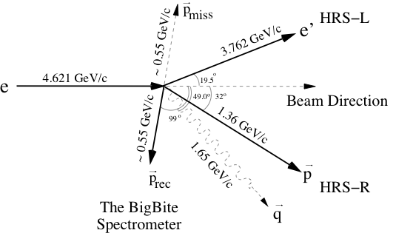
Kinematics
and
Neutron Detector

Slide 25
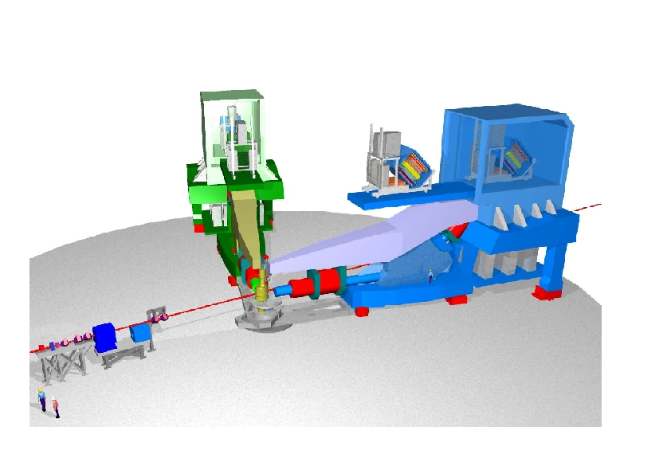
Jefferson Lab’s Hall A

Slide 26
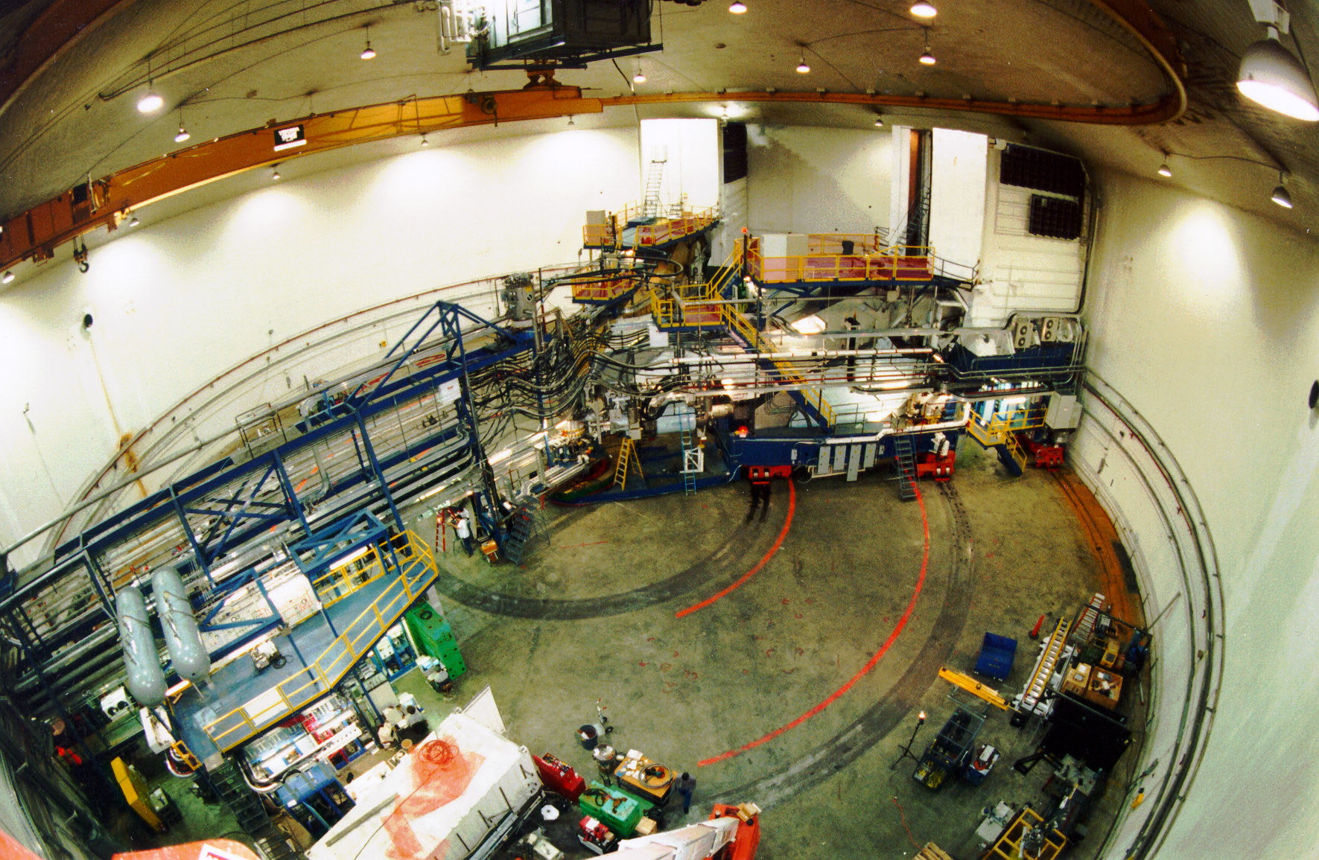
Jefferson Lab’s Hall A

Slide 27
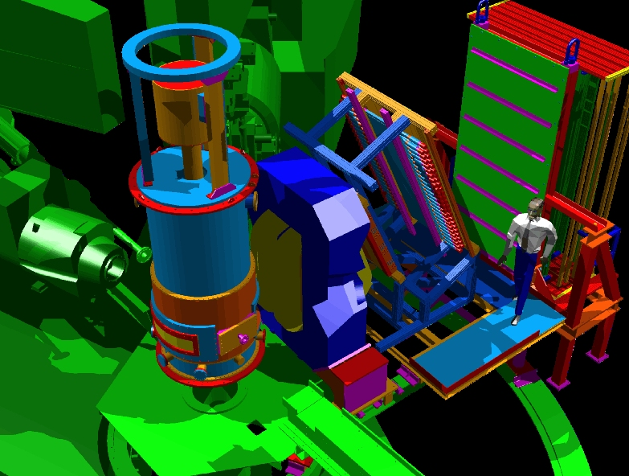
New Equipment

Slide 28
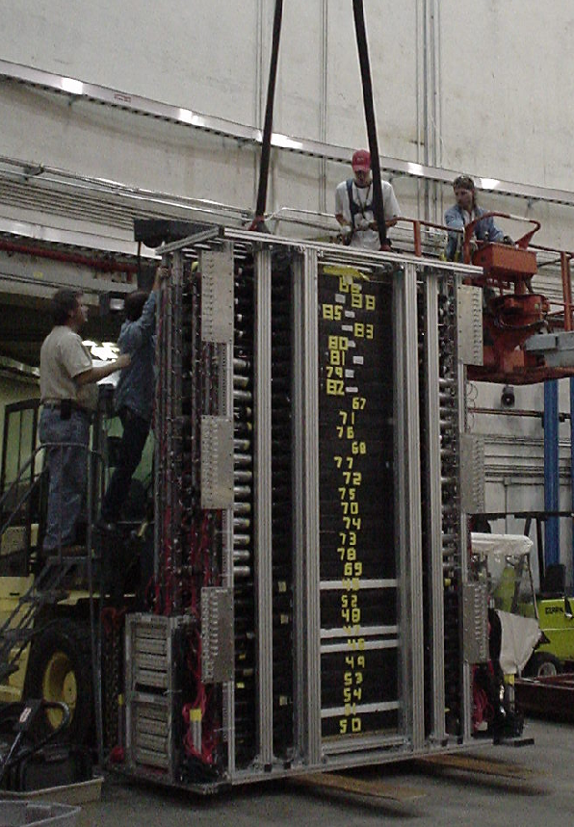
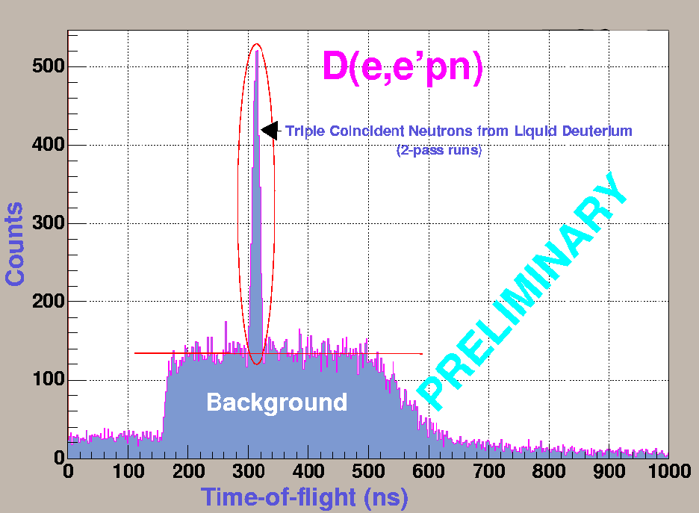
HAND
Hall A Neutron Detector
First Neutron Detector in Hall A
Measuring D(e,e'p) and detecting the neutron, the detector was tested and calibrated.

Slide 29
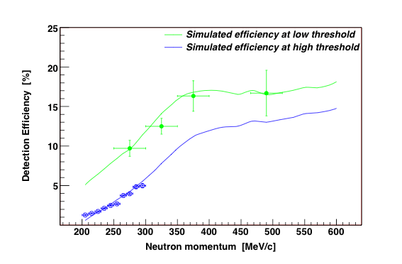
(e,e’n): Absolute Neutron Detector Efficiency
Used HRS quasi-elastic D(e,e’p)n to tag neutrons
Tested Result Against Neutron Efficiency Code
  R. A. Cecil, B. D. Anderson, R. Madey, Nucl. Instrum. Meth. 161 (1979) 430.
  Blue data using 2.3 GeV beam, Green data with 4.6 GeV beam

Slide 30
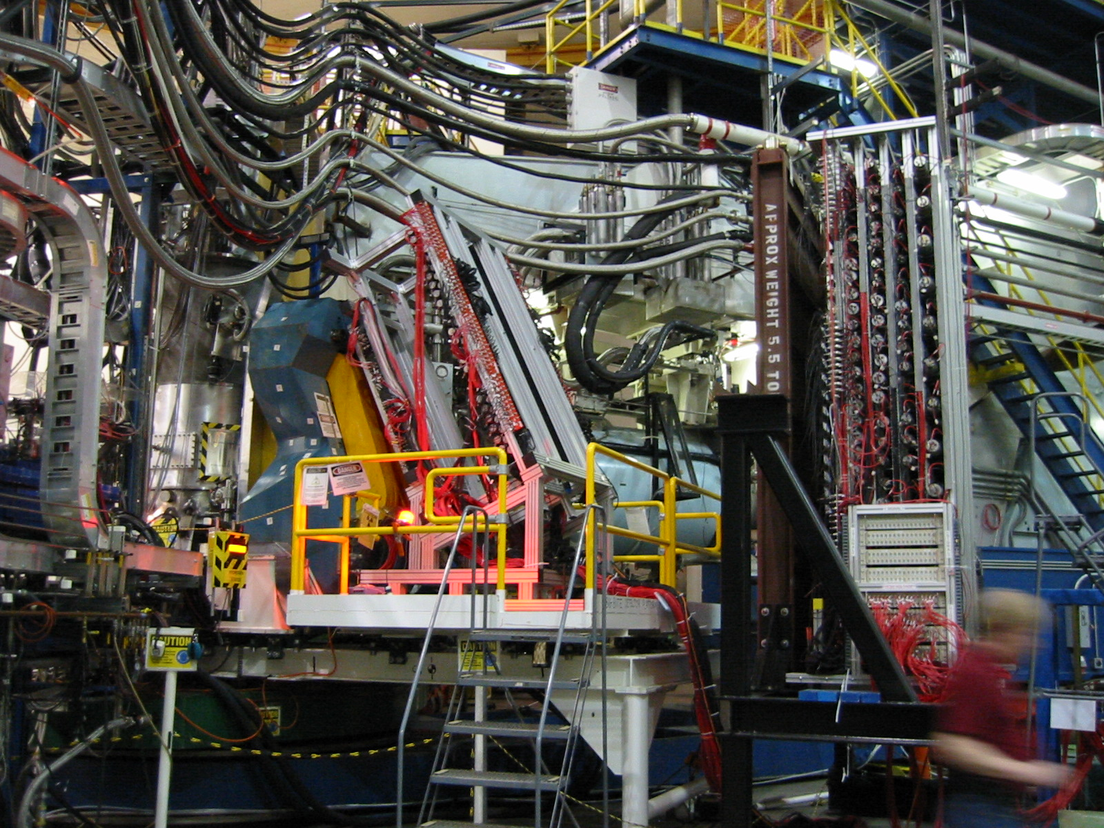
BigBite and Neutron Detector

Slide 31
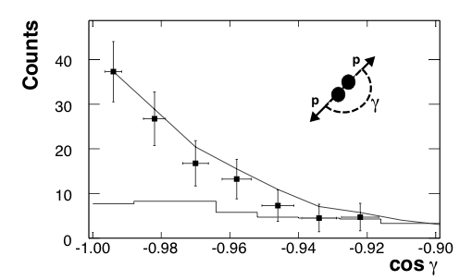
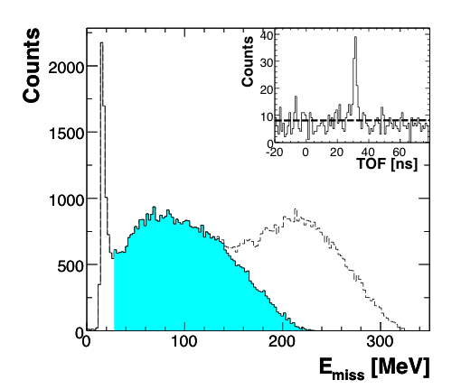
(e,e’p) & (e,e’pp) Data
R. Shneor et al., Phys. Rev. Lett. 99 (2007) 072501.
(e,e’pp)
(e,e’p)
Strong back-to-back correlation!
¹²C(e,e’p)
Quasi-Elastic Shaded In Blue
Resonance Even at x_{B}>1

Slide 32
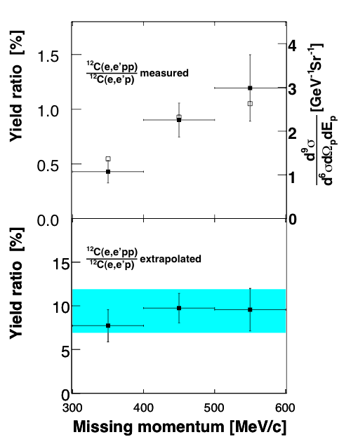
Ratio of ¹²C(e,e’pp) to ¹²C(e,e’p)
R. Shneor et al., Phys. Rev. Lett. 99 (2007) 072501.
Top plot shows the raw measured ratio
Bottom plot shows the extrapolated where the finite acceptance of BigBite and pair center of mass motion has been taken into account.
Determined pair cm motion to be 136+/-20 MeV/c and blue band indication two-sigma around this value.
Note Brookhaven found 143+/-17 MeV/c

Slide 33
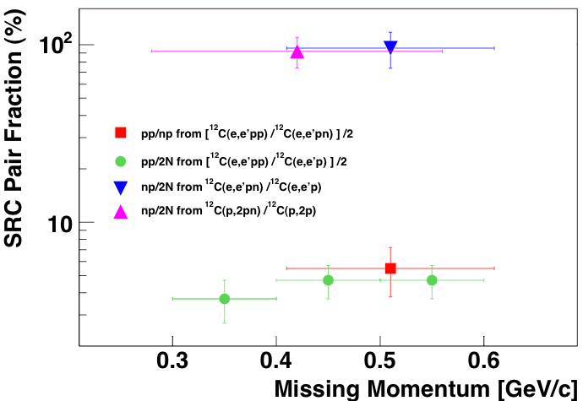
SRC Pair Factions
R. Subedi et al., Science 320, 1476 (2008), published online 29 May 2008 (0.1126/science.1156675).

Slide 34
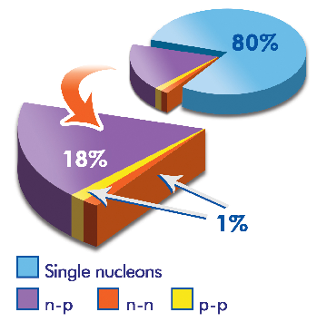
From the (e,e’), (e,e’p), and (e,e’pN) Results
80 +/- 5% single particles moving in an average potential
  60 – 70% independent single particle in a shell model potential
  10 – 20% shell model long range correlations
20 +/- 5% two-nucleon short-range correlations
  18% np pairs
  1% np pairs
  1% nn pairs (from isospin symmetry)
Less than 1% multi-nucleon correlations

Slide 35
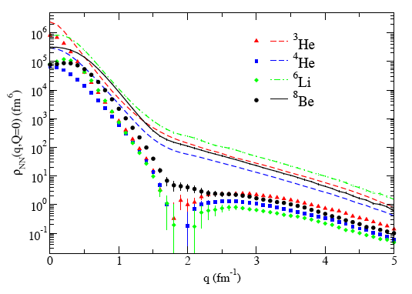
Importance of Tensor Correlations
np
pp
R. Schiavilla et al., Phys. Rev. Lett. 98 (2007) 132501. [shown above]
M. Sargsian et al., Phys. Rev. C (2005) 044615.
M. Alvioli, C. Ciofi degli Atti, and H. Morita, Phys. Rev. Lett. 100 (2008) 162503.

