Slide 1

Use of Computing Grid in HEP
ASP12 Grid School
KNUST, Kumasi, Ghana
Aug. 6, 2012
Jaehoon Yu
University of Texas at Arlington

Slide 2
Outline
What is High Energy Physics?
The problem
A solution, the Grid Computing
The little grid that could
Conclusions
What are we going to learn?

Slide 3
We always wonder…
What is the universe made of?
How does the universe work?
What are the things that holds the universe together?
What are the governing principles of the universe?
How can we live in the universe well?
Where do we come from?
High Energy Physics looks into smallest possible things for answers to these….

Slide 4
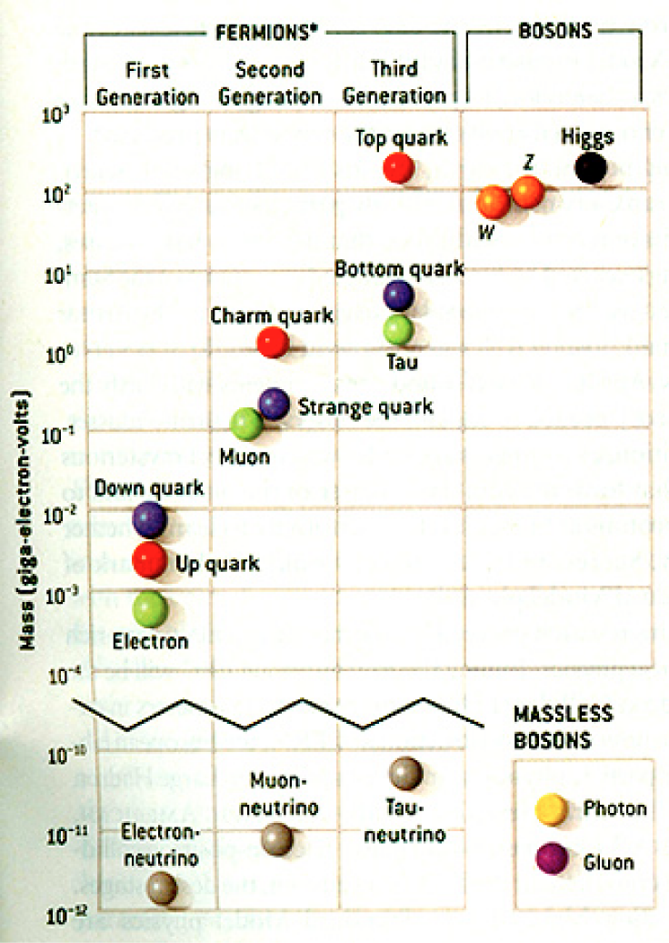
The Standard Model
Discovered in 1995, ~175m_{p}
Make up most ordinary matters ~0.1m_{p}
Total of 16 particles make up the matter in the universe! ➔ Simple and elegant!!!
Tested to a precision of 1 part per million!

Slide 5
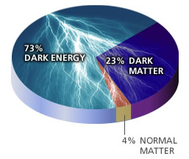
Still A Lot We Don’t Know!
Why are there three families of quarks and leptons?
Why is the mass range so large (0.1m_{p} – 175 m_{p})?
How do matters acquire mass?
  Higgs mechanism! Have we finally seen the Higgs, the God particle?
Why is the matter in the universe made only of particles?
  What happened to anti-particles? Or anti-matters?
Do neutrinos have mass& what are the mixing parameters?
Why are there only three apparent forces?
Is the picture we present the real thing?
  What makes up the 96% of the universe?
  How about extra-dimensions?
How is the universe created?
Are there any other theories that describe the universe better?
Many more questions to be answered!!

Slide 6
What are the roles of particle accelerators?
Act as a probing tool
  The higher the energy ➔The shorter the wavelength
  Smaller distance to probe
Two method of accelerator based experiments:
  Collider Experiments: pbar-p, pp, e⁺e⁻, ep
    CMS Energy = 2sqrt(E₁E₂)
  Fixed Target Experiments: Particles on a target
    CMS Energy = sqrt(2EM_{p})
  Each probes different kinematic phase space

Slide 7
Accelerators are Powerful Microscopes.
They make high energy particle beams
that allow us to see small things.
seen by
low energy beam
(poorer resolution)
seen by
high energy beam
(better resolution)

Slide 8
Accelerators are also Time Machines.
They make particles last seen
in the earliest moments of the universe.
Energy
particle beam
energy
anti-particle beam
energy
Particle and anti-particle annihilate.
E = mc²

Slide 9
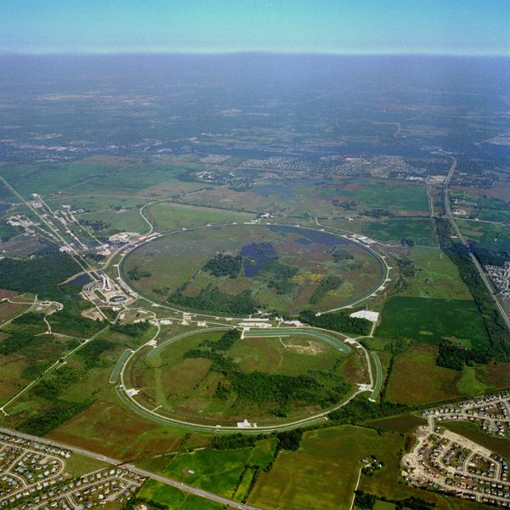
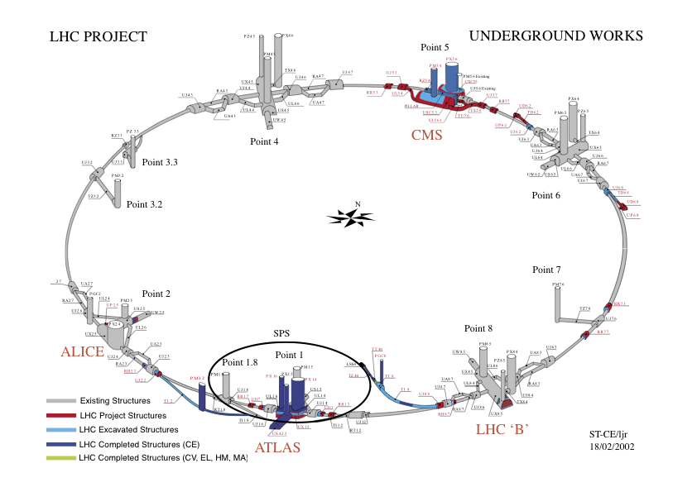
Fermilab Tevatron and LHC at CERN
World’s Highest Energy proton-anti-proton collider
  4km circumference
  E_{cm}=1.96 TeV (=6.3x10⁻⁷J/p➔ 13M Joules on the area smaller than 10⁻⁴m²)
  Equivalent to the kinetic energy of a 20t truck at the speed 81mi/hr➔ 130km/hr
    ~100,000 times the energy density at the ground 0 of the Hiroshima atom bomb
  Was shut down at 2pm CDT, Sept. 30, 2011
  Vibrant other programs running!!
World’s Highest Energy p-p collider
  27km circumference, 100m underground
  Design E_{cm}=14 TeV (=44x10⁻⁷J/p➔ 362M Joules on the area smaller than 10⁻⁴m²)
  Equivalent to the kinetic energy of a B727 (80tons) at the speed 193mi/hr ➔ 312km/hr
    ~3M times the energy density at the ground 0 of the Hiroshima atom bomb
First 7TeV collisions on 3/30/10 ➔ The highest energy humans ever achieved!!
First 8TeV collisions in 2012 on April 5, 2012
Chicago
CDF
p
DØ
Tevatron
p

Slide 10
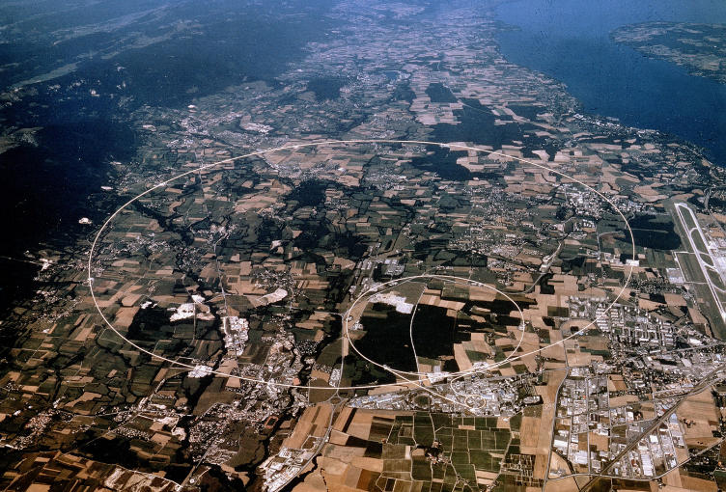
LHC @ CERN Aerial View
CMS
France
Geneva Airport
ATLAS
Swizerland

Slide 11
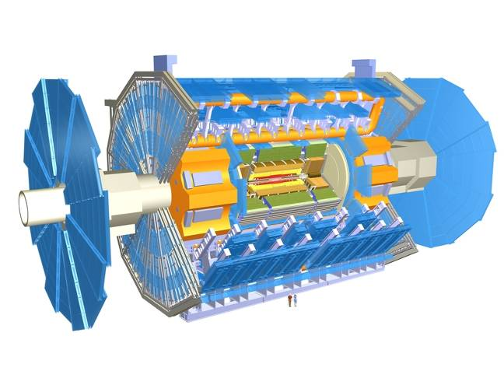
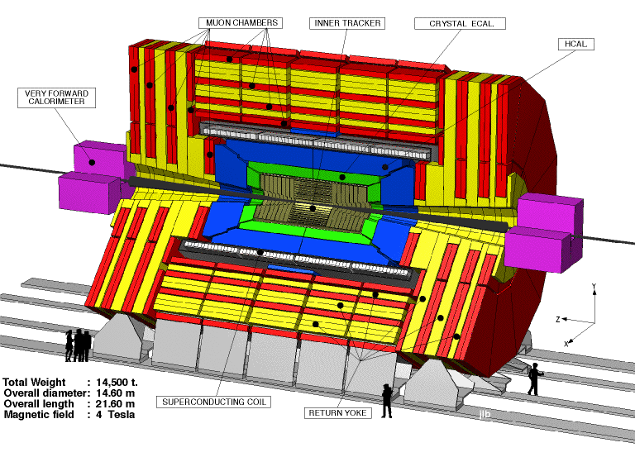
The ATLAS and CMS Detectors
Fully multi-purpose detectors with emphasis on lepton ID & precision E & P
Weighs 7000 tons and 10 story tall
Records 200 – 400 collisions/second
Records approximately 350 MB/second
Record over 2 PB per year ➔ 200*Printed material of the US Lib. of Congress

Slide 12
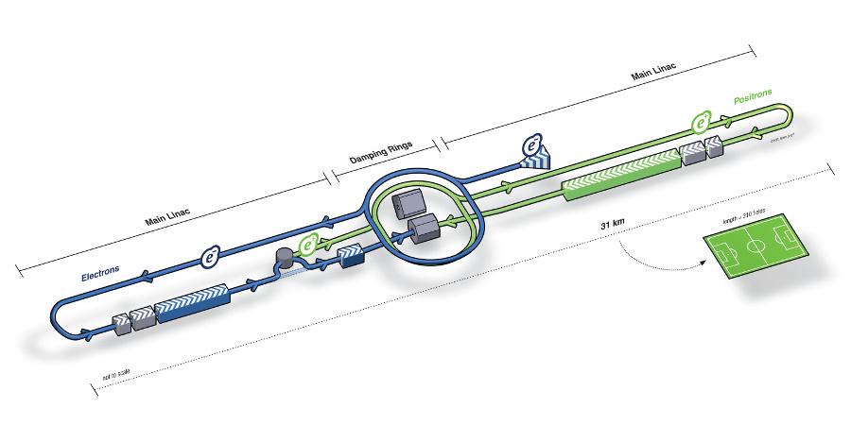
What next? Future Linear Collider
Now that we have found a new boson, precision measurement of the particle’s properties becomes important
An electron-positron collider on a straight line for precision measurements
10~15 years from now (In Dec. 2011, Japanese PM announced that they would bid for a LC in Japan)
Takes 10 years to build the detector
L~31km
Circumference ~6.6km
~300 soccer fields

Slide 13
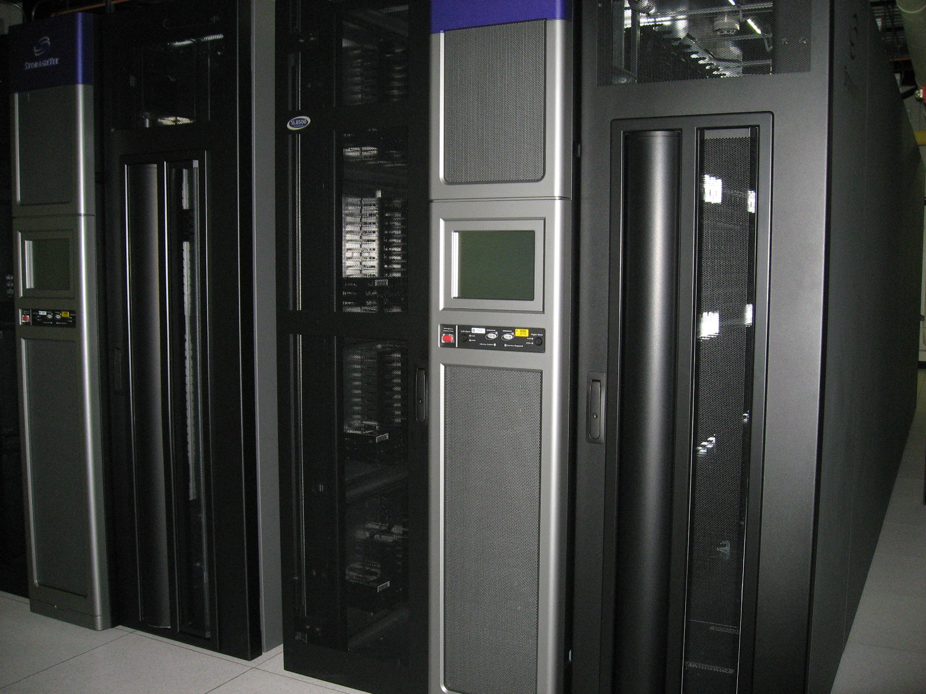
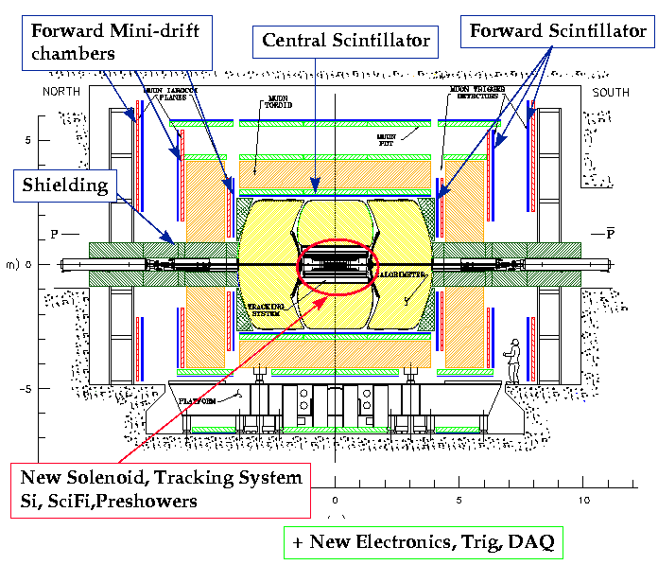
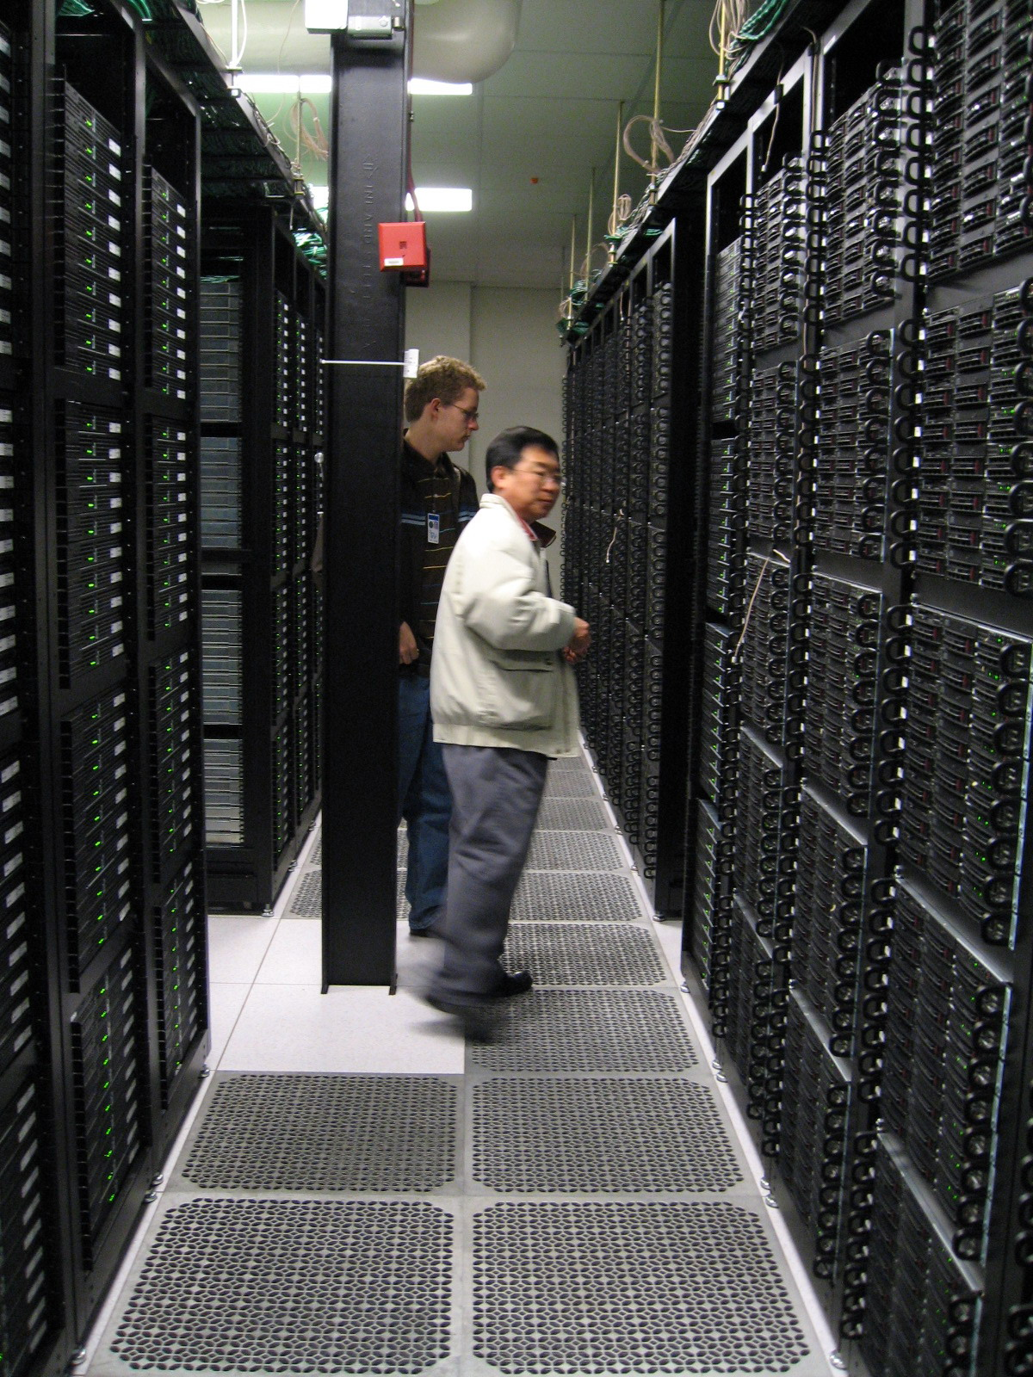
Computers put together a picture
Digital data
p
‾p
Data Reconstruction

Slide 14
How does an Event Look in a HEP Detector?
CH
Highest E_{T} dijet event at DØ
“calorimeter jet”
hadrons
FH
γ
EM
“particle jet”
Time
“parton jet”
Notes:
RECO [Slide 1]
Very briefly mention RECO version used.
Mention that these are fixed-cone jets of R=0.7 found by iterative algorithm, Et is the scalar Et sum of the towers.
List corrections we apply (basically) to RECO. No more is needed for AIDA restoration or Ht-revertexing at this point, but following three slides will be about eta bias -- so just briefly prepare listeners for this!

Slide 15
The Problem
Detectors are complicated and large ➔ Need large number of collaborators
  They are scattered all over the world!

Slide 16
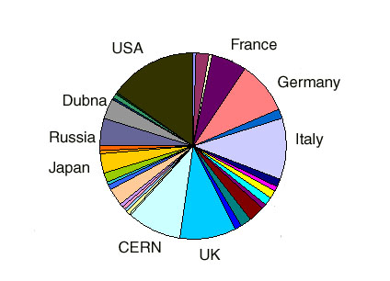
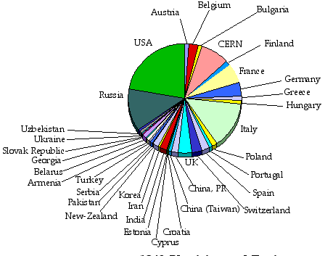
LHC Collaborations
ATLAS
CMS
ATLAS+CMS 6000 Physicists and Engineers
Over 60 Countries, 250 Institutions

Slide 17
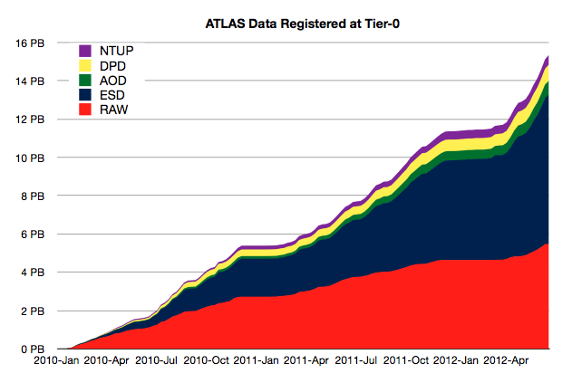
The Problem
Detectors are complicated and large ➔ Need large number of collaborators
  They are scattered all over the world!
  How do we get them communicate quickly and efficiently?
  How do we leverage collaborators’ capabilities?
  How do we get all the compute resources?
Data size is large ~ Few PB per year for raw data only
  Entire data set 15+PB already
  Where and how to store the large amount of data?
  How do we allow collaborators scattered all over the world to access data in an efficient fashion?
ATLAS Data at CERN 2010-Jun 2012
15+ PBytes

Slide 18
The Problem, cont’d
How do we allow people’s analysis jobs to access data and make progress rapidly and securely?
  What is the most efficient way to get jobs’ requirements matched with resources?
  Should jobs go to data or data go to jobs?
  What level of security should there be?
How do we allow experiments to reconstruct data and generate the large amount of simulated events quickly?
  How do we garner the necessary compute and storage resources?
  What network capabilities do we need in the world?
How do we get people to analyze at their desktops?

Slide 19
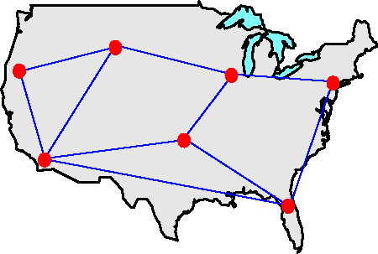
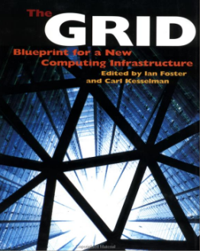
What is a Computing Grid?
Grid: Geographically distributed computing resources configured for coordinated use
Physical resources & good network provide hardware capability
The “Middleware” software ties it together
I.Foster and C.Kesselman

Slide 20
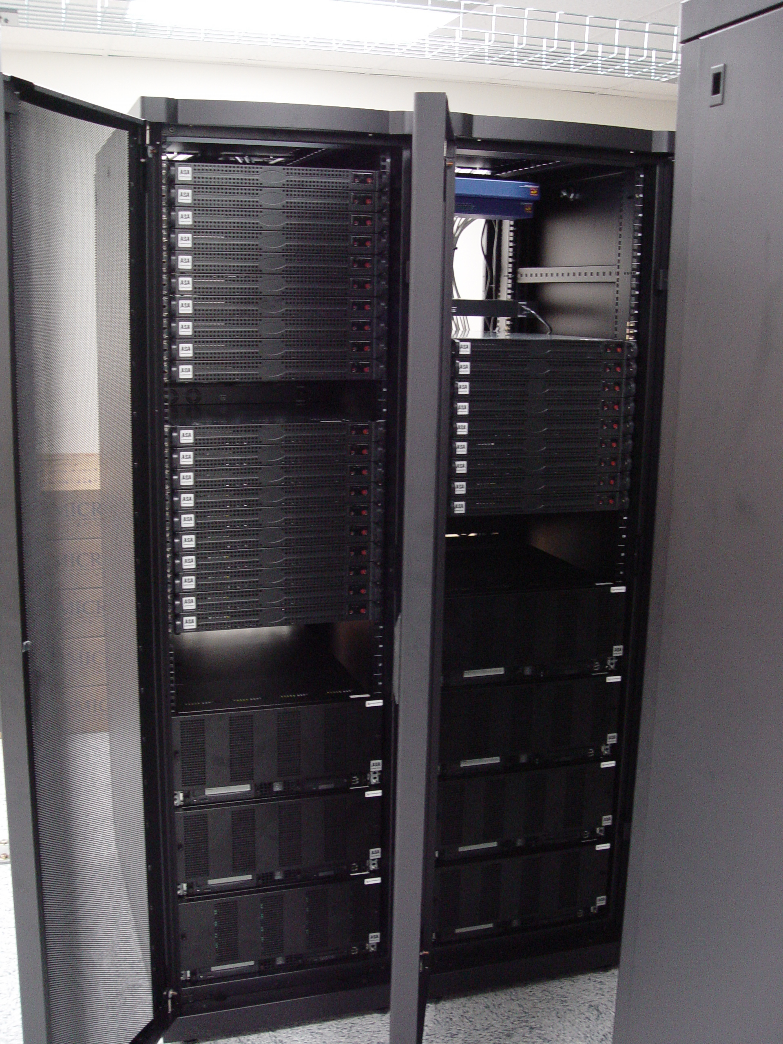
How does a computing Grid work?
JDL
Grid
Ded. Clst.
Desktop. Clst.
Client Site
Ded. Clst.
Desktop. Clst.
Sub. Sites
Exe. Sites
Reg. Grids
DDM

Slide 21
Initial Idea of HEP Computing Model
Cloud
Tier 0
CERN
Normal Interaction
Communication Path
Occasional Interaction
Communication Path
….
Tier 1 Centers
Tier 1
Tier 1
Data and Resource hub
MC Production
Data processing
Tier 2 Centers
...
…
Reduced data
MC Production
Data processing
Tier 2
Tier 2
Tier 2
Tier 2
Tier 3 Centers
Tier 3
….
Tier 3
Tier 3
….
Tier 3
User data analysis

Slide 22
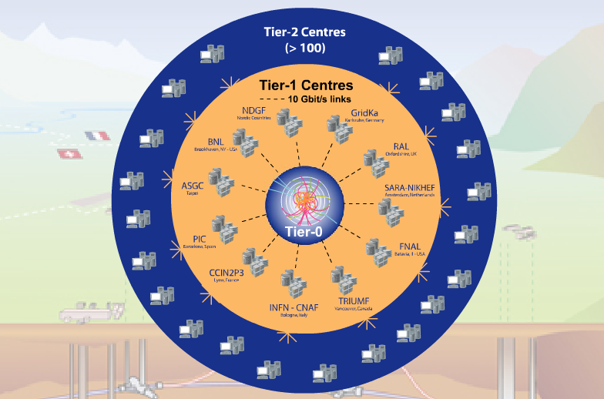





Implemented ATLAS Grid Structure
Tier-0 (CERN): (15%)
  Data recording
  Initial data reconstruction
  Data distribution
Tier-1 (11 centres): (40%)
Permanent storage
Re-processing
Analysis
Connected by direct 10 Gb/s network links
Tier-2 (~200 centres): (45%)
Simulation
End-user analysis
15%
45%
40%
Notes:
The Tier 0 centre at CERN stores the primary copy of all the data. A second copy is distributed between the 11 so-called Tier 1 centres. These are large computer centres in different geographical regions of the world, that also have a responsibility for long term guardianship of the data. The data is sent from CERN to the Tier 1s in real time over dedicated network connections.
In order to keep up with the data coming from the experiments this transfer must be capable of running at around 1.3 GB/s continuously. This is equivalent to a full DVD every 3 seconds.
The Tier 1 sites also provide the second level of data processing and produce data sets which can be used to perform the physics analysis. These data sets are sent from the Tier 1 sites to the around 130 Tier 2 sites.
A Tier 2 is typically a university department or physics laboratories and are located all over the world in most of the countries that participate in the LHC experiments. Often, Tier 2s are associated to a Tier 1 site in their region. It is at the Tier 2s that the real physics analysis is performed.

Slide 23
Tiered Example – US Cloud
BNL T1
MW T2
UC, IU
NE T2
BU, HU
SW T2
UTA, OU
SLAC T2
GL T2
UM, MSU
IU OSG
UTA T3
OU Oscer
Tier 3’s
Wisconsin
UC Teraport
UTD
LTU
Many more T3s
SMU/UTD

Slide 24

ATLAS Production and Distributed Analysis System, Panda
Designed for analysis as well as production
Work both with OSG and EGEE/LCG
A single task queue and pilots
  Apache-based Central Server
  Pilots retrieve jobs from the server as soon as CPU is available low latency
Highly automated, has an integrated monitoring system, and requires low operation manpower
Integrated with ATLAS Distributed Data Management (DDM) system
Not exclusively ATLAS: has its first OSG user CHARMM

Slide 25
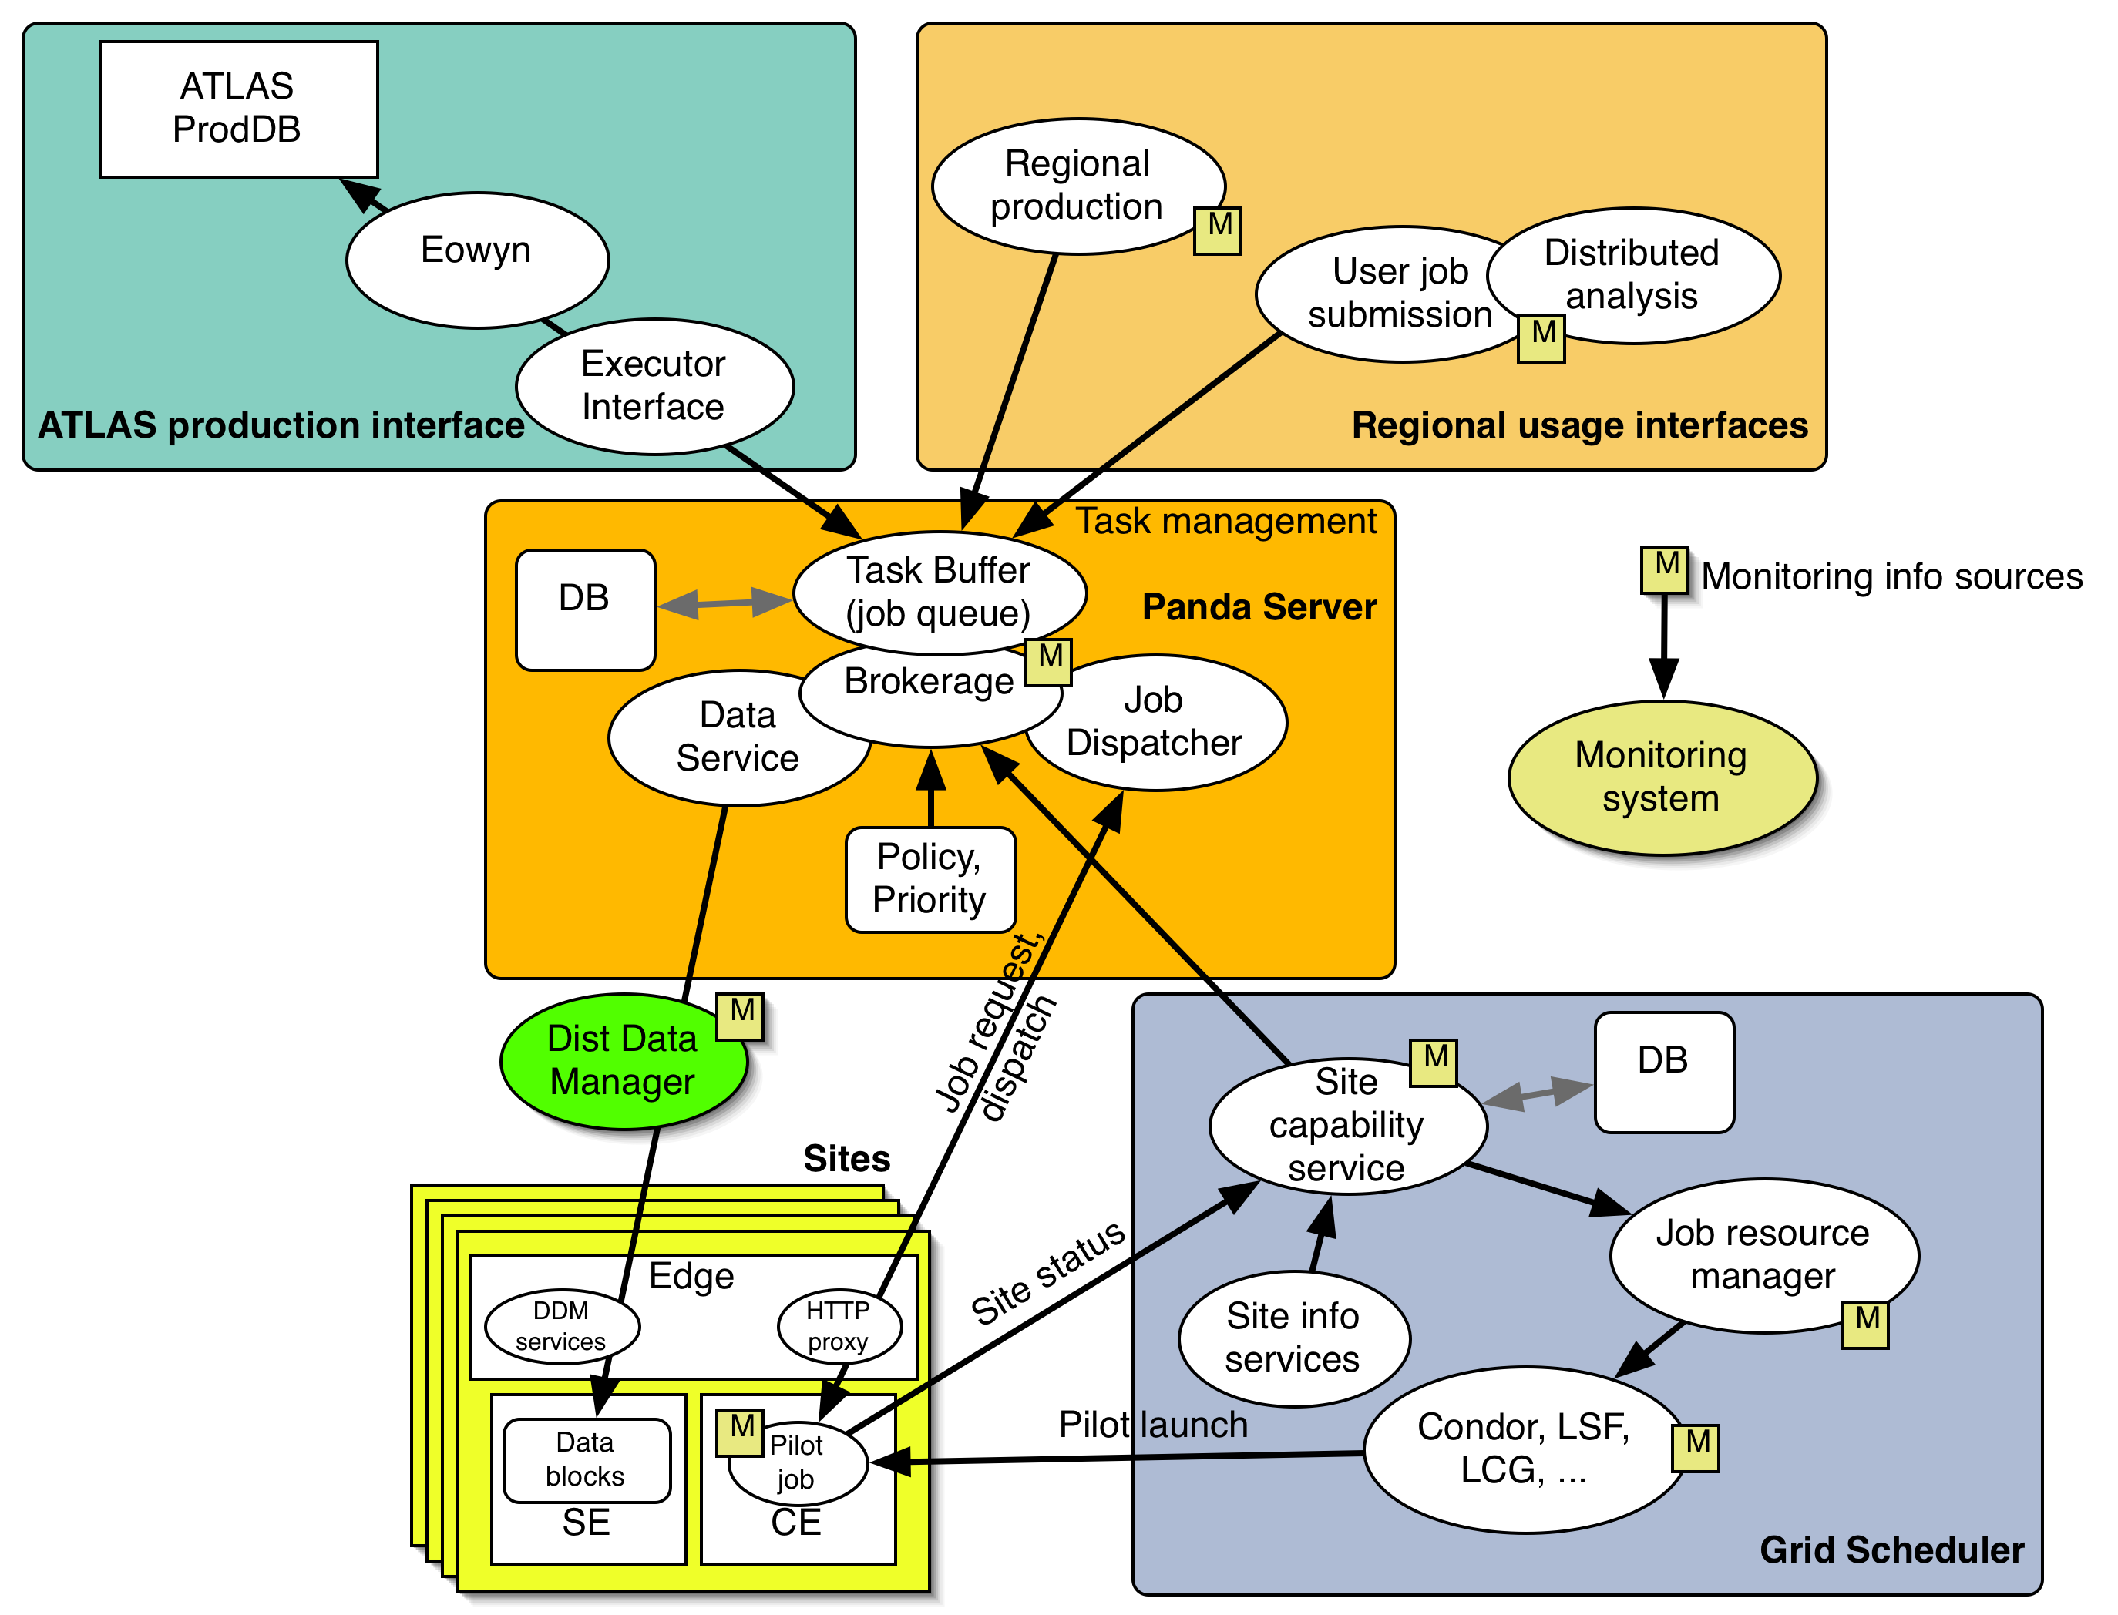
ATLAS Panda Architecture

Slide 26
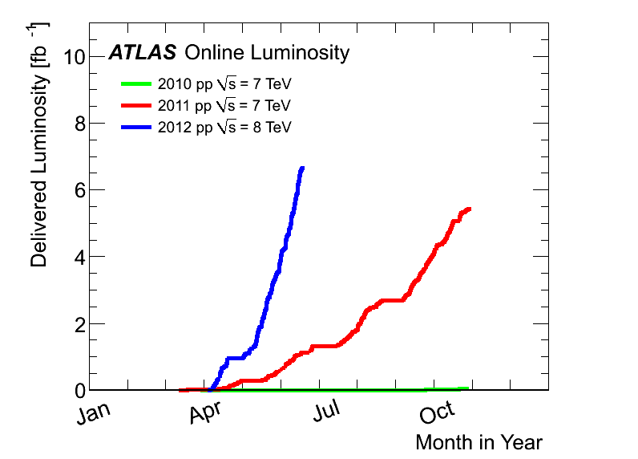
Amount of ATLAS Data
Total Data Size Increased by 200 folds in 2 yrs!!
Puts big demand on computing!!
2012:
6.6 fb⁻¹
at 8 TeV
2011
5.6 fb⁻¹
at 7 TeV
2010
0.05 fb⁻¹
at 7 TeV

Slide 27
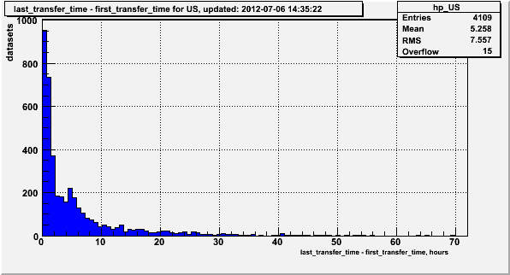
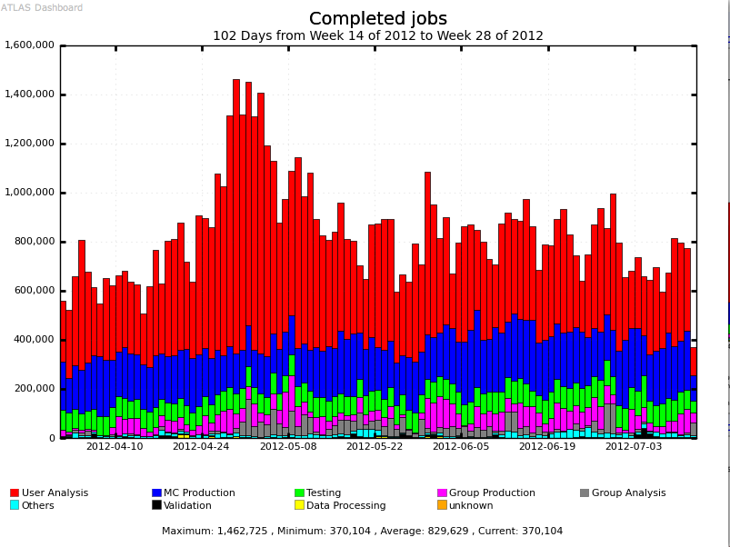
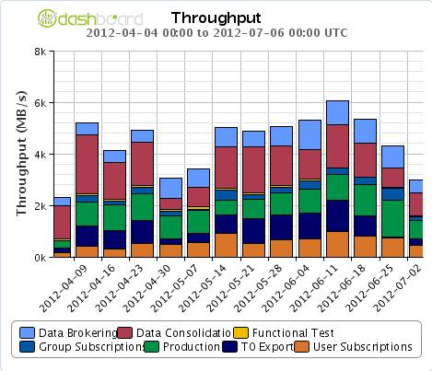
The Little Grid that could…
ATLAS Distributed Computing on the Grid : 10 Tier-1s + CERN + ~70 Tier-2s +…(more than 80 Production sites)
High volume, high throughput process through fast network!!
ATLAS 2012 dataset transfer time.
Apr 1 – Jul 12 2012 Completed Grid Jobs
5h
Data available for Physics analysis in ~ 5h
~830K daily average
completed ATLAS Grid jobs
Analysis
MC prod
Apr 1 – Jul 4 2012 Data Transfer Throughput (MB/s)
All ATLAS sites
Up to 6GB/s week average

Slide 28
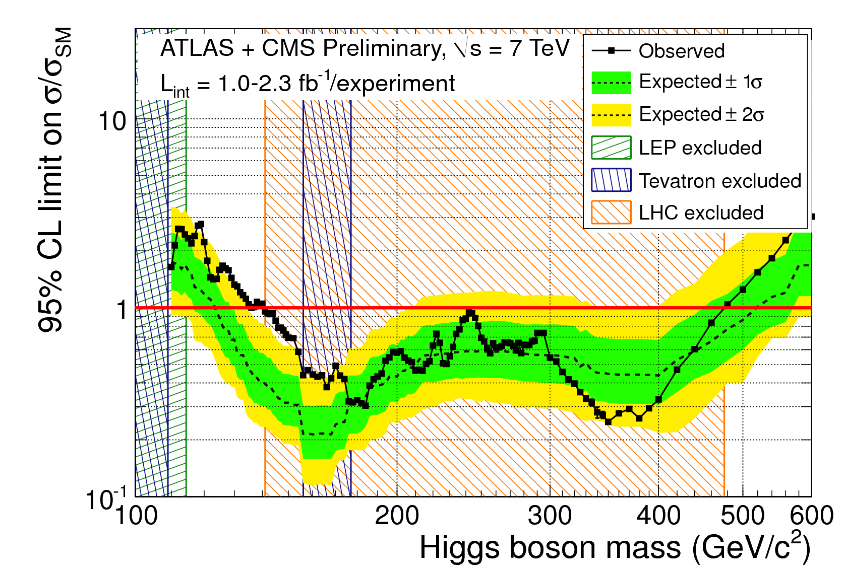
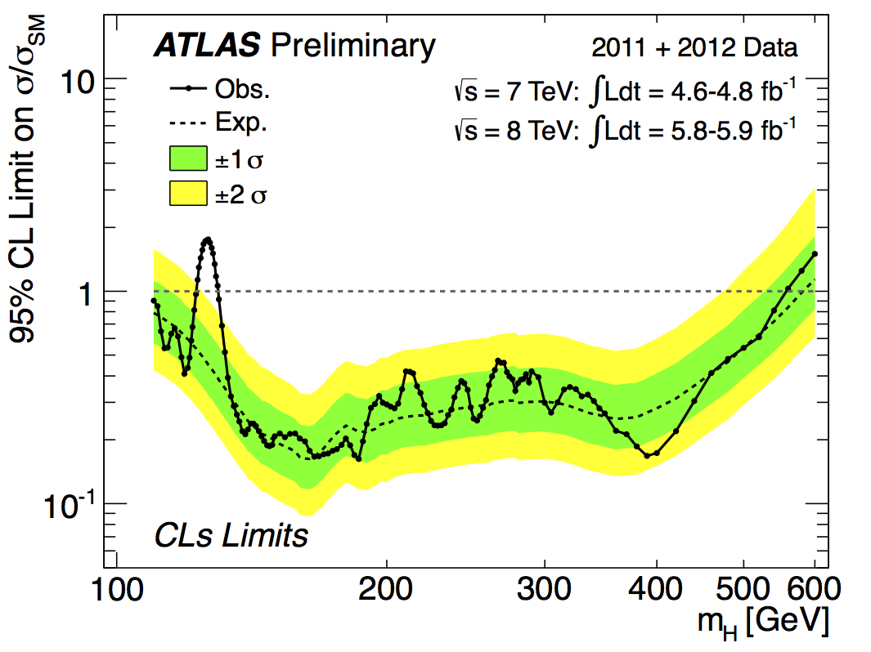
From elimination!!
ATLAS

Slide 29
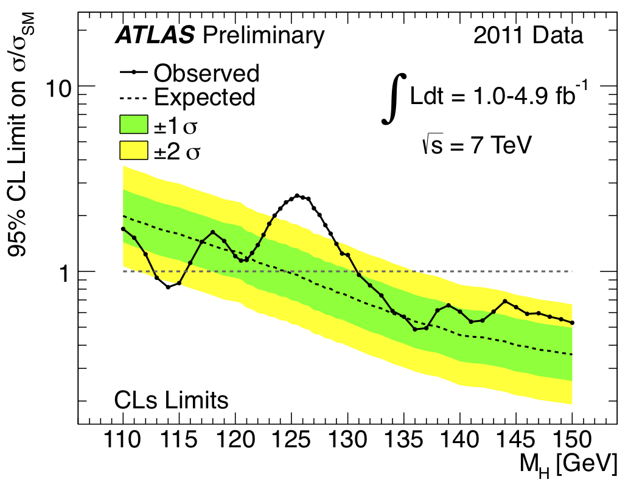
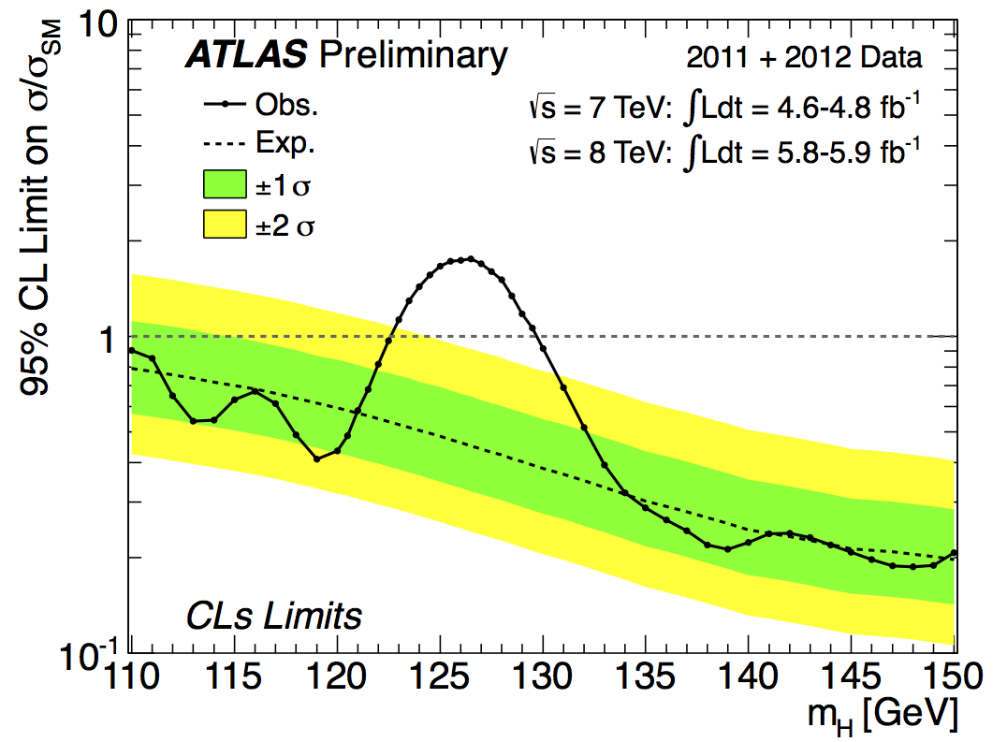
And onto the discovery!!
ATLAS
July 2012
ATLAS Dec. 2011
F. Gianoti “It would have been impossible to release physics results so quickly without outstanding performance of the Grid”

Slide 30
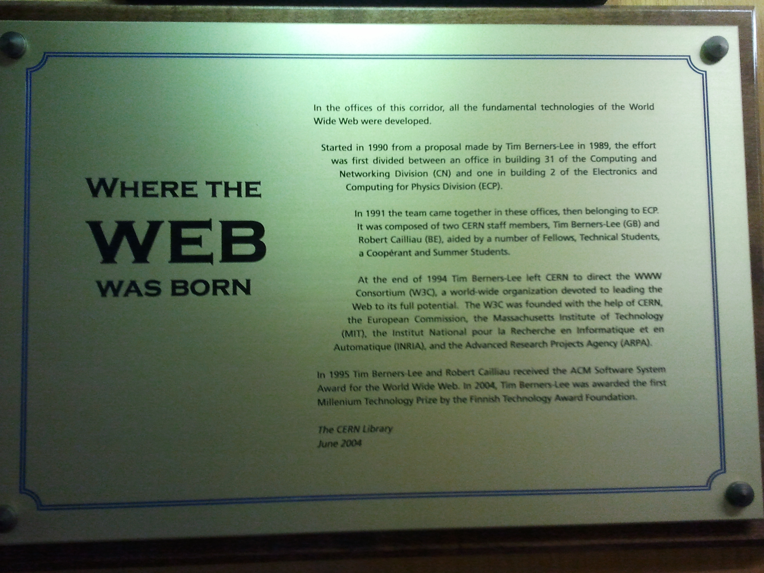



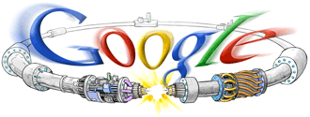



Now the commercial world picking up..
Early 90’s
2004
1996
2006
1998
Amazon EC2
Many private entities fully utilized the internet communication we’ve developed to multi-trillion dollar venture!!
Now the concept of cloud being picked up, though not exactly the same idea behind it…

Slide 31
So are we done with the grid?
LHC has been performing very well
Data size will quadruple through the remainder of 2012
  Computing will be under stress
Grid computing infrastructure has served well thus far
  1500s ATLAS users process PBs of data & billion of jobs
…but we start hitting some limits :
  Databases scalability, CPU resources, storage utilization
Time to plan for the future in HEP
And the use of the technology in true and real sense

Slide 32
Conclusions
In the quest for the origin of the universe, High Energy Physics
  Uses accelerators to look into extremely small distances
  Uses large detectors to explore nature and unveil secretes of universe
  Uses large number of computers to process
  Large amount of data gets accumulated ➔ need computing grid to perform expeditious data analysis
HEP is an exciting endeavor in understanding nature
Physics analyses at one’s own desktop using computing grid has happened!!
Computing grid needed for other disciplines with large data sets
Computing grid now going outside of HEP into everyday lives
A true computing grid will revolutionize everyday lives soon…

Slide 33
What will you learn?
From the underlying computing grid software infrastructure to the practical use of computing grid
Today
  High Throughput Grid Computing Infrastructure, CONDOR – Scott Kronenfeld
Tomorrow
  Remote Job Submission and Execution, glidein – Rob Quick
  Security – Rob Quick
  Distributed Storage System – Horst Severini
Last day
  Practical Use of Grid – Julia, Pat, Dick and Jae
Field commissioned helping hands: Tetteh Addy

