Slide 1
From Röntgen to X-ray Free-electron Lasers
The Evolution of X-ray Sources & Science over 115 Years
Herman Winick – Part1
Stanford Synchrotron Radiation Lightsource (SSRL)
SLAC National Accelerator Laboratory
Stanford University, USA
winick@slac.stanford.edu
African School of Fundamental Physics
KNUST, Kumasi, Ghana; July-August, 2012
July 31, 2012; 11am

Slide 2
International Henry Moseley School and Workshop on X-ray Science
June 14 - 23, 2012
ITAP, Turunç, Marmaris, TURKEY
http://itap-tthv.org/moseley_2012/index.html
Outstanding lectures by eminent X-ray scientists, for example
http://itap-tthv.org/moseley_2012/pdf/day.09_june.22.2012_e.alp.pdf
http://itap-tthv.org/moseley_2012/pdf/day.01_june.14.2012_g.shenoy.pdf

Slide 3
Two pamphlets relevant to accelerators and a future African light source
Photon Science for Renewable Energy At Light-Source Facilities of Today and Tomorrow: Published by the Advanced Light Source at LBNL. Available at
www.als.gov/als/publications/genpubs.html
2. Accelerators and Beams
Published by the American Physical Society Division of Physics of Beams (DPB). Available at:
www.aps.org/units/dpb
Note that Page 21 of this brochure, "Accelerators boost international cooperation" is about SESAME.

Slide 4
Selected References
Articles (compiled by Gopal Shenoy, Argonne, National Lab.)
M. L. Perlman, E. M. Rowe & R. E. Watson, “Synch Rad—Light Fantastic,” Physics Today 27, No.7 (1974) 30.
G. C. Baldwin, “Origin of Synchrotron Radiation,” Physics Today 28, No. 1 (1975) 9.
K. R. Lea, “Highlights of Synchrotron Radiation,” Phys. Rep. (Phys. Lett. C) 43, No. 8 (1978) 337.
C. Kunz, “Introduction—Properties of Synchrotron Radiation,” in Synchrotron Radiation Techniques and Applications, C. Kunz, ed., Springer-Verlag, Berlin, 1979, pp. 1-23.
H. Winick and S. Doniach, “An Overview of Synchrotron Radiation Research,” in Synchrotron Radiation Research, H. Winick and S. Doniach, eds., Plenum Press, New York and London, 1980, pp. 1-10.
E. Rowe, “Synchrotron Radiation: Facilities in the United States, Physics Today 34, No. 5 (1981) 28.
H. Winick, G. Brown, K. Halbach, & J. Harris, “Synch Rad: Wiggler & Undulator Magnets,” Physics Today 34, No. 5 (1981) 50.
H. C. Pollock, “The Discovery of Synchrotron Radiation,” Am J. Phys. 51, No. 3 (1983) 278.
E.-E. Koch, D. E. Eastman, and Y. Farges, “Synchrotron Radiation—A Powerful Tool in Science,” in
Handbook on Synch Rad, Vol 1a, E.-E. Koch, ed., North-Holland Pub Co; Amsterdam, 1983, pp. 1-63.
G. N. Kulipanov and A. N. Skrinksy, “Early Work on Synch Rad,” Synch Rad News 1, No. 3 (1988) 32.
P. L. Hartman, “Early Experimental Work on Synchrotron Radiation,” Synch Rad News 1, No. 4 (1988) 28.
T. Sasaki, “A Prospect and Retrospect—the Japanese Case,” J. Synch. Rad 4, Part 6 (1997) 359.
J. A. Clarke, The Science & Technology of Undulators & Wigglers, Oxford University Press, 2004
Books
H. Winick, ed; “Synchrotron Radiation Sources, A Primer”, World Scientific 1994
D. Attwood; “Soft X-Rays & Extreme Ultraviolet Radiation”, Cambridge Univ. Press, 1999
A. Hofmann; “The Physics of Synchrotron Radiation” Cambridge Univ. Press, 2004

Slide 5
Gopal Shenoy: 1st International Henry Moseley X-Ray Science Summer School and Workshop, June 14-23, 2012, Turunç, Marmaris, Turkey
References:
1. Classical Electrodynamics
Author: John David Jackson
Publisher: Wiley; 3rd Edition
2. Synchrotron Radiation Sources: A Primer
Editor: Herman Winick
Publisher: World Scientific Publishing Company
3. Elements of Modern X-ray Physics
Author: Jens Als-Nielson & Des McMorrow
Publisher: John Wiley and Sons, 2nd Edition, Apr 8, 2011 - 432 pages
4. Insertion Devices For Synchrotron Radiation And Free Electron Laser
Authors: F Ciocci, G Dattoli, A Torre & A Renieri
Publisher: World Scientific Publishing Company
5. Soft X-Rays and Extreme Ultraviolet Radiation : Principles and Applications
Author: David Attwood
Publisher: Cambridge University Press
6. Synchrotron Radiation Sources and Their Applications (Scottish Universities Summer School in Physics)
Author: N. Greaves
Publisher: Scottish Universities Gopal Shenoy 1st International Henry Moseley X-Ray Science Summer School
and Workshop, June 14-23, 2012, Turunç, Marmaris, Turkey

Slide 6
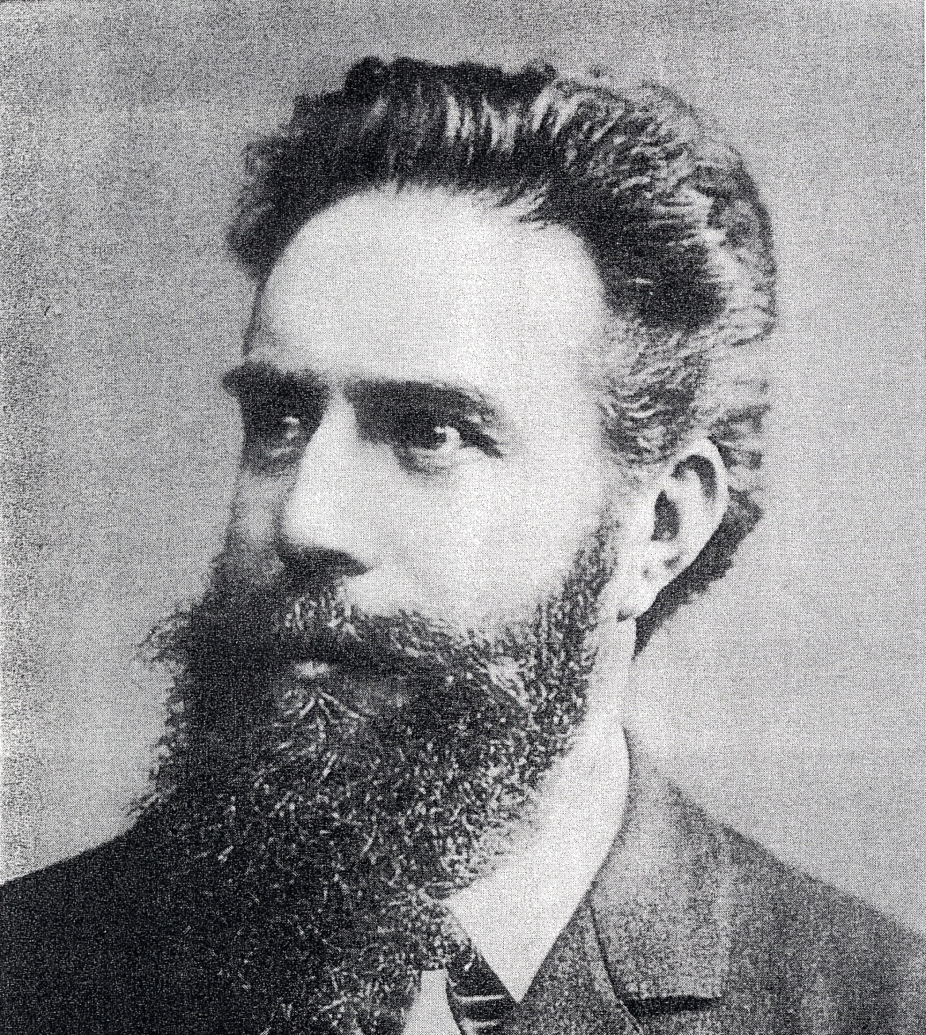
Wilhelm Röntgen 1845-1923 Discovered X-rays in 1895
Curiosity Driven Research!!

Slide 7
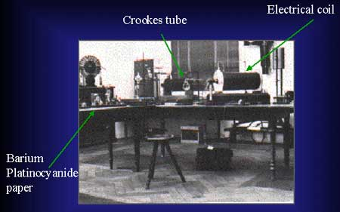
Röntgen’s Laboratory in Wurzburg, Germany - 1895

Slide 8
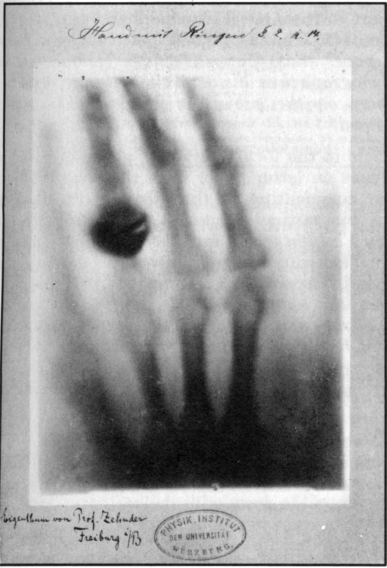
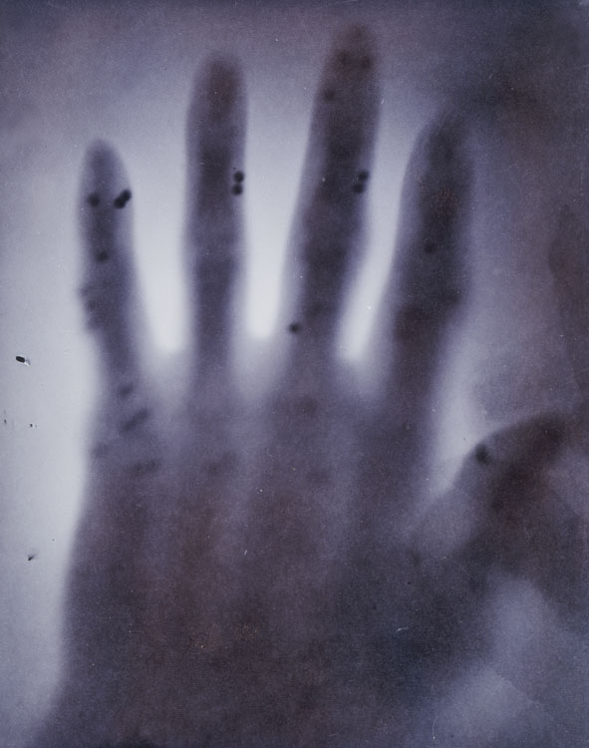
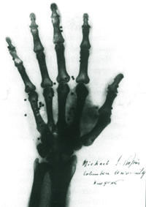
Michael Pupin
Columbia University/New York
Feb. 1896
Wilhelm Röntgen
Universität Würzburg
Dec. 1895
“This is of the hand of a gentleman resident in New York, who, while on a hunting trip in England a few months ago, was so unfortunate as to discharge his gun into his right hand, no less than forty shot lodging in the palm and fingers. The hand has since healed completely; but the shot remain in it, the doctors being unable to remove them, because unable to determine their exact location. The result is that the hand is almost useless, and often painful.” - Cleveland Moffett, McClure’s Magazine, April 1896

Slide 9
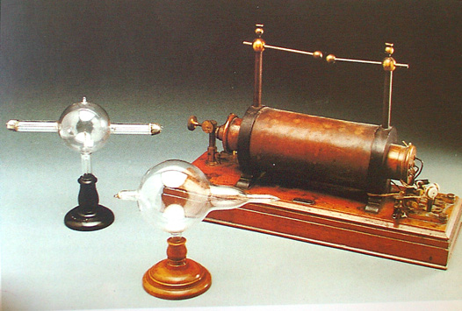

Slide 10
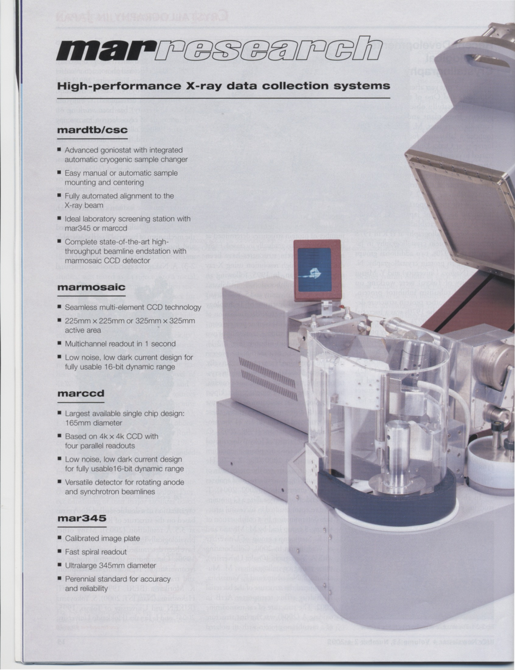
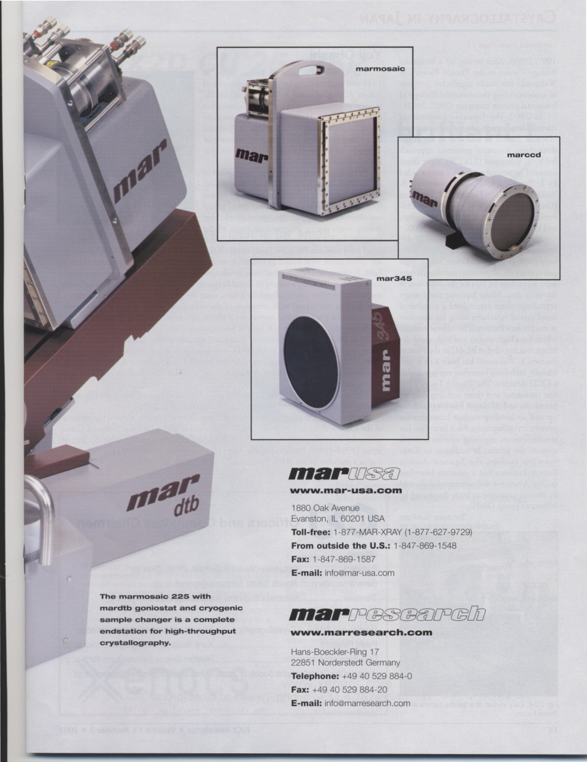

Slide 11
WHY ARE X-RAYS SO IMPORTANT?
X-RAYS ARE A UBIQUITOUS TOOL FOR BASIC AND APPLIED RESEARCH, TECHNOLOGY AND MEDICAL APPLICATIONS
INTENSE X-RAYS FROM SYNCHROTRONS REVOLUTIONIZE OUR ABILITY TO UNDERSTAND THE PROPERTIES, STRUCTURE AND FUNCTION OF MATERIALS
X-RAYS ARE NOW BEING USED TO DEVELOP NEW MATERIALS WITH DESIRED PROPERTIES
SHORT PULSES OF X-RAYS ENABLE US TO FOLLOW CHEMICAL AND BIOLOGICAL PROCESS ON A TIME SCALE RANGING FROM MICROSECONDS TO FEMTOSECONDS.

Slide 12
X-rays Have Enabled Seminal Scientific Discoveries
20 Nobel Prizes Based on X-ray Work
Physics
1901: WILHELM RÖNTGEN
1914: MAX VON LAUE
1915: SIR WILLIAM HENRY BRAGG
and SIR WILLIAM LAWRENCE BRAGG
1917: CHARLES BARKLA
1924: KARL MANNE SIEGBAHN
1927: ARTHUR COMPTON
1981: KAI SIEGBAHN
Chemistry
1936: PETER DEBYE
1962: MAX PERUTZ and SIR JOHN KENDREW
1964: DOROTHY HODGKIN
1976: WILLIAM LIPSCOMB
1985: HERBERT HAUPTMAN and JEROME KARLE
1988: JOHANN DEISENHOFER,
ROBERT HUBER and HARTMUT MICHEL
1997: PAUL D. BOYER and JOHN E. WALKER
2003: PETER AGRE and RODERICK MACKINNON
2006: ROGER KORNBERG
2009: VENTKATRAMAN RAMAKRISHNAN,
THOMAS STEITZ, ADA YONATH
Medicine
1946: HERMANN JOSEPH MULLER
1962: FRANCIS CRICK, JAMES WATSON
and MAURICE WILKINS
1979: ALAN M. CORMACK and
SIR GODFREY N. HOUNSFIELD
Notes:
12

Slide 13
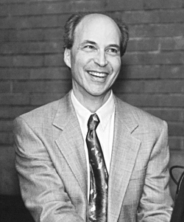
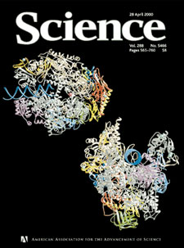
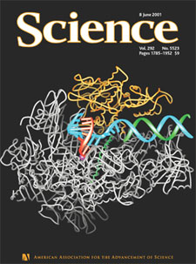
Roger Kornberg, Stanford University
Nobel Prize in Chemistry, 2006
RNA Polymerase
Required Synchrotron Radiation

Slide 14
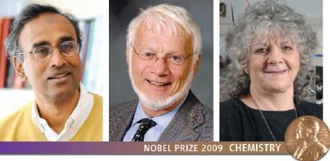
Ventkatraman Ramakrishnan Thomas Steitz Ada Yonath
The 2009 Nobel Prize in Chemistry was shared by Venkatraman Ramakrishnan, Thomas A. Steitz and Ada E. Yonath for showing what the ribosome looks like and how it functions at the atomic level. They used synchrotron radiation X-rays to map the position for each and every one of the hundreds of thousands of atoms that make up the ribosome.

Slide 15
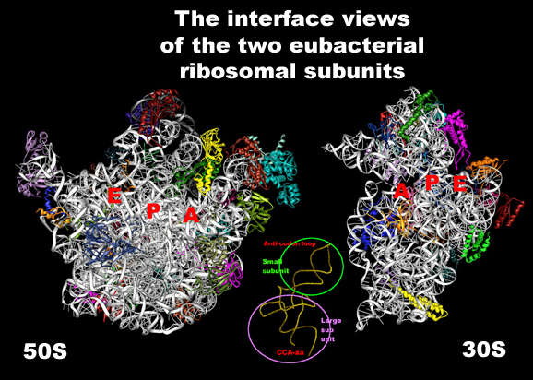

For detailed explanation, figures, movies see:
http://www.weizmann.ac.il/sb/faculty_pages/Yonath/home.html

Slide 16

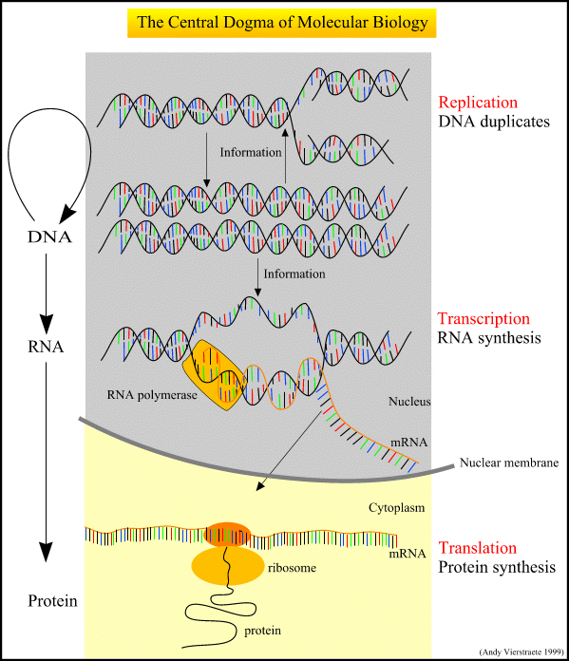
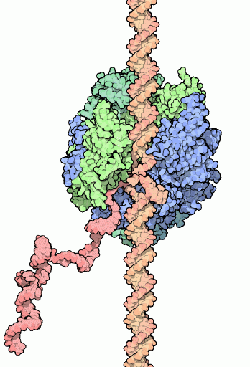
Central Dogma of Life

Slide 17
Synchrotron radiation from Storage Rings is a very powerful tool for the study of material on the atomic and molecular scale
Although the pulses of light from storage rings, particularly from wigglers and undulators, are very intense, their pulse length is measured in tens of picoseconds.
To study processes on a faster time scale, typical of atomic and molecular processes, an intense source with a shorter pulse duration is needed.
The Free-Electron Laser provides this.
Femtosecond pulses with >10¹² photons per pulse

Slide 18
Looking back:
A brief history of synchrotron radiation

Slide 19
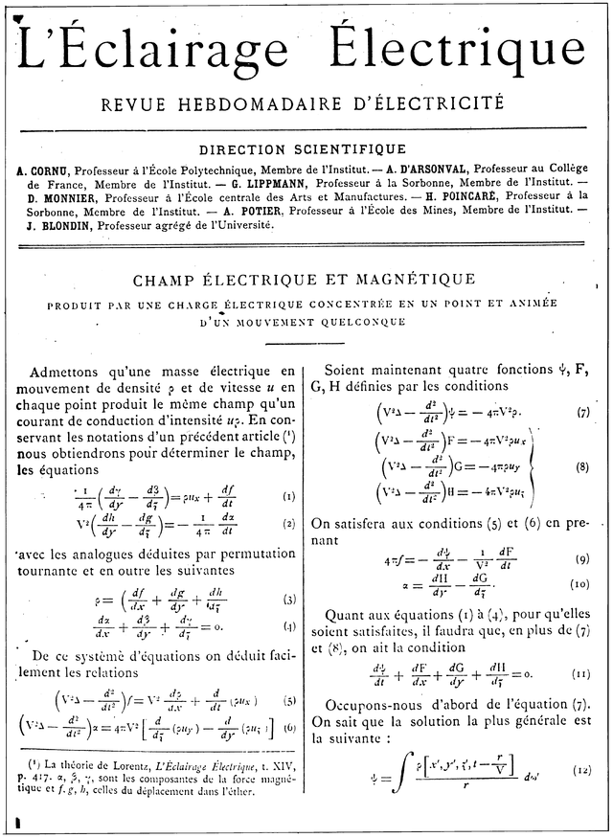
Early publication on radiation by accelerated particles
Liénard, A. (1898). L’Éclairage Électrique 16, 5

Slide 20
A SHORT HISTORY OF SYNCHROTRON RADIATION SOURCES
1945 First (indirect) observation of SR; J. Blewett, G.E. 100 MeV betatron
1947 1st visual observation; G.E. 70 MeV synchrotron
ZEROth GENERATION SOURCES
1950’s-60’s: ELECTRON SYNCHROTRONS (cyclic accelerators)
FIRST GENERATION SOURCES (storage rings)
1970’s: e+/e- COLLIDERS (Mostly Parasitic on High Energy Physics programs)
SECOND GENERATION SOURCES
1980’s: NEW RINGS and DEDICATED USE OF e+/e- COLLIDERS,
USE OF INSERTION DEVICES (IDs); WIGGLERS & UNDULATORS
THIRD GENERATION SOURCES
1990’s: RINGS OPTIMIZED FOR IDs; Low emittance, many straight sections
FOURTH GENERATION SOURCES
2000’s: LINAC-BASED SOURCES
  Free-electron laser (FEL)
  Energy Recovery Linac (ERL)
2010’s: 3rd & 4th Generations Sources & Ultimate Storage Rings reaching Diffraction limits at X-ray Wavelenghts. NEW IDEAS

Slide 21
FIRST GENERATION SOURCES
RINGS BUILT FOR HIGH ENERGY PHYSICS
RESEARCH.
Synchrotron radiation programs usually started in a parasitic or partly dedicated mode.
Many have developed to become fully dedicated sources.
In several cases a low emittance optics has been developed, reducing the emittance to about 100 nm-radians.
Large e+e- colliders (PEP, PETRA, TRISTAN) are first generation rings which, operated at low energy, can reach extremely low emittance. Also, they have long straight sections for long insertion devices.

Slide 22
SECOND GENERATION SOURCES
RINGS BUILT FROM THE START AS FULLY
DEDICATED LIGHT SOURCES
The primary sources on these rings are the bending magnets. Typically there is space for 2-6 wiggler and undulator insertion devices sources.
The emittance of these rings is typically in the 50-200 nm-radian range.
NSLS and the Photon Factory each serve more than 2000 Users annually

Slide 23
THIRD GENERATION SOURCES
LOWER EMITTANCE RINGS WITH MANY
STRAIGHT SECTIONS FOR INSERTION DEVICES
Typical emittance is 2-20 nm-radians. Latest ones go below 1nm.
2-3 orders of magnitude higher brightness and coherence than 1st and 2nd generation rings
1-2 GeV rings produce high brightness VUV/soft x-rays from ~10 eV to 2 keV. SC devices extend to higher energy
6-8 GeV rings extend high brightness to 20 keV and beyond
Advances in technology of IDs and accelerators now enable rings with E~2.5-3.5 GeV to produce hard x-rays with brightness approaching the higher energy, more expensive rings. Such an intermediate energy ring would be a good choice for Africa.

Slide 24
FOURTH GENERATION SOURCES
•Ultra-low emittance rings
- higher brightness, coherence
•Quasi-isochronous rings
- picosecond bunches
•FELs using rings and linacs
- full coherence, high power, sub-picosecond bunches
•Large e+/e- colliders
-long straights, low emittance
•Novel insertion devices
•New ideas

Slide 25
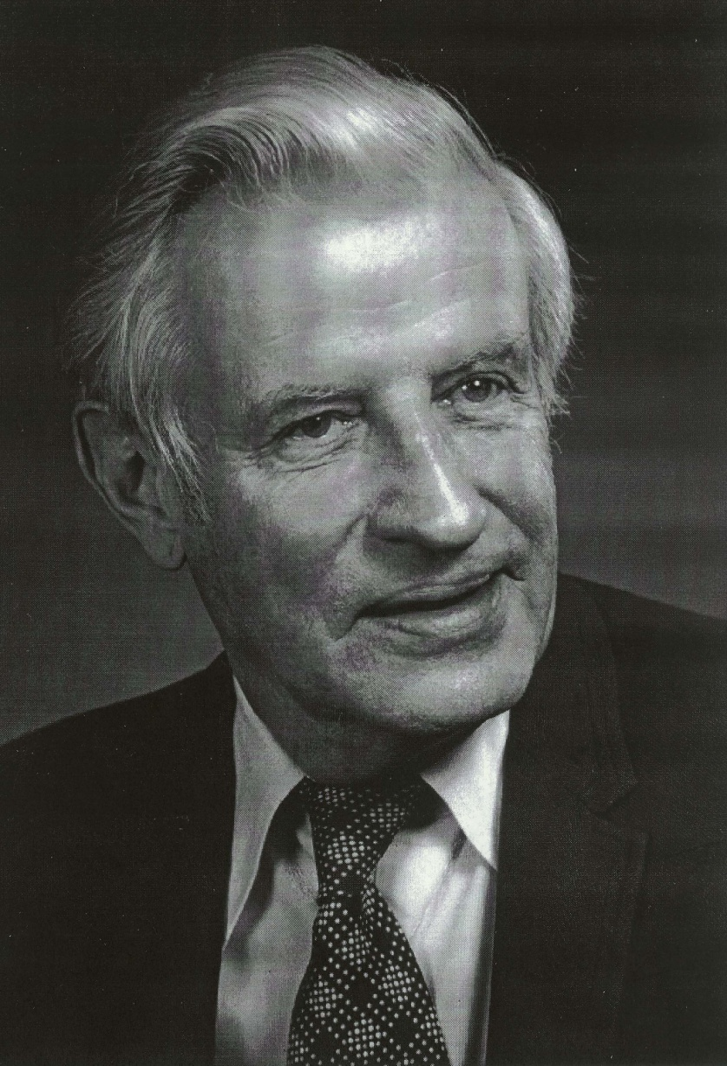
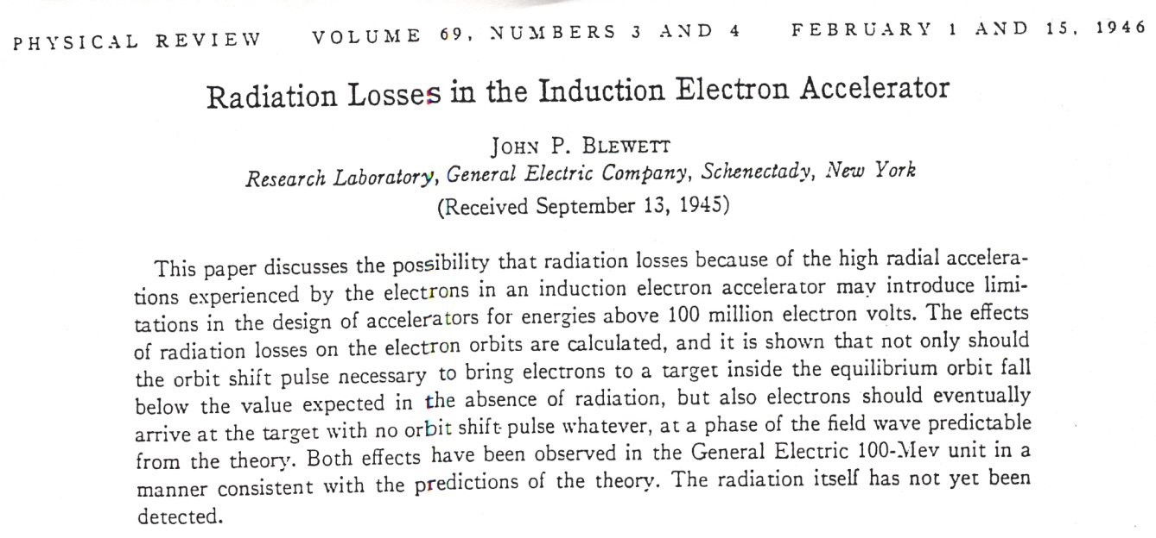
John Blewett
Observed Effects of Synchrotron Radiation in General Electric 100 MeV Betatron - 1945

Slide 26
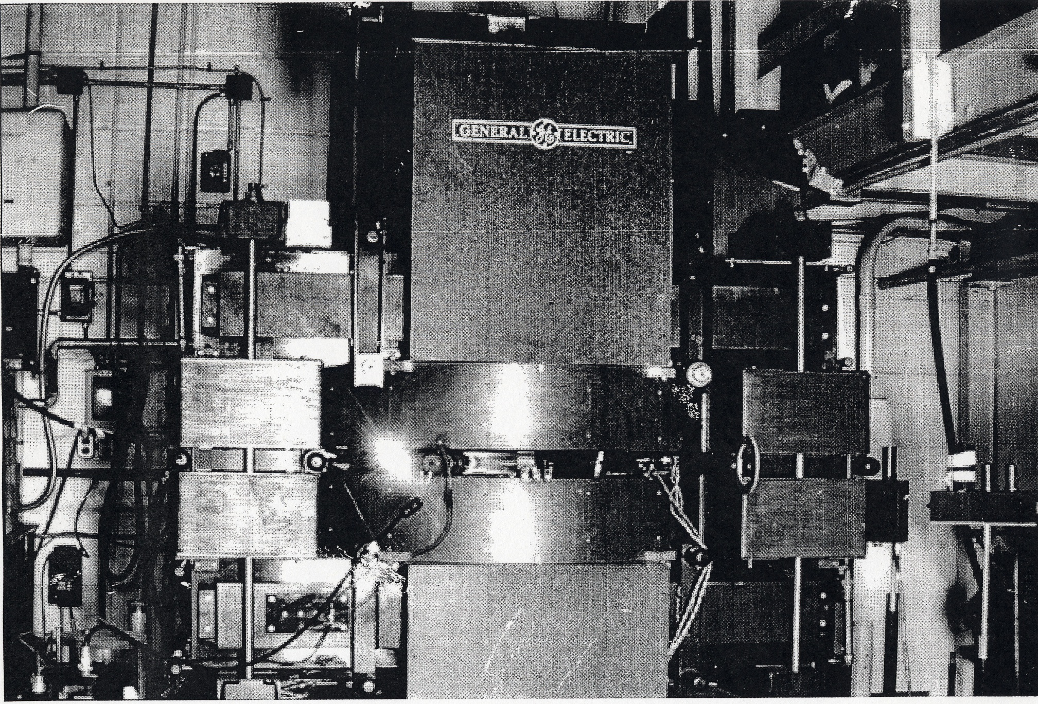
First visual observation of synchrotron light at the General Electric 70 MeV synchrotron in 1947

Slide 27
SYNCHROTRON RADIATION SOURCES – 1973
SYNCHROTRONS (Cyclic) GeV
DESY – Hamburg 7.5
NINA – Daresbury 5.0
ARUS – Yerevan 4.5
BONN I 2.5
SIRIUS – Tomsk 1.36
INS-ES – Tokyo 1.3
PAKHRA – Moscow 1.3
LUSY – Lund 1.2
FIAN C-60 – Moscow 0.68
BONN II 0.5
NBS – Washington 0.18
STORAGE RINGS (Constant )
CEA – Cambridge MA 3.5
VEPP2M – Novosibirsk 0.67
ACO – Orsay 0.54
TANTALUS – Wisconsin 0.24

Slide 28
Comparison of Synchrotron Radiation from Synchrotrons and Storage Rings
Synchrotron
Storage Ring
Spectrum
Intensity
Source Position
High Energy Radiation Background (Bremsstrahlung + e⁻)
Varies as e⁻ energy changes during each cycle
Varies as e⁻ energy changes during each cycle. Also cycle to cycle variations
Varies during the acceleration cycle
High – due to loss of all particles on each cycle
Constant
Decays slowly over many hours
Constant within a few microns
Low – same particles are stored for many hours

Slide 29
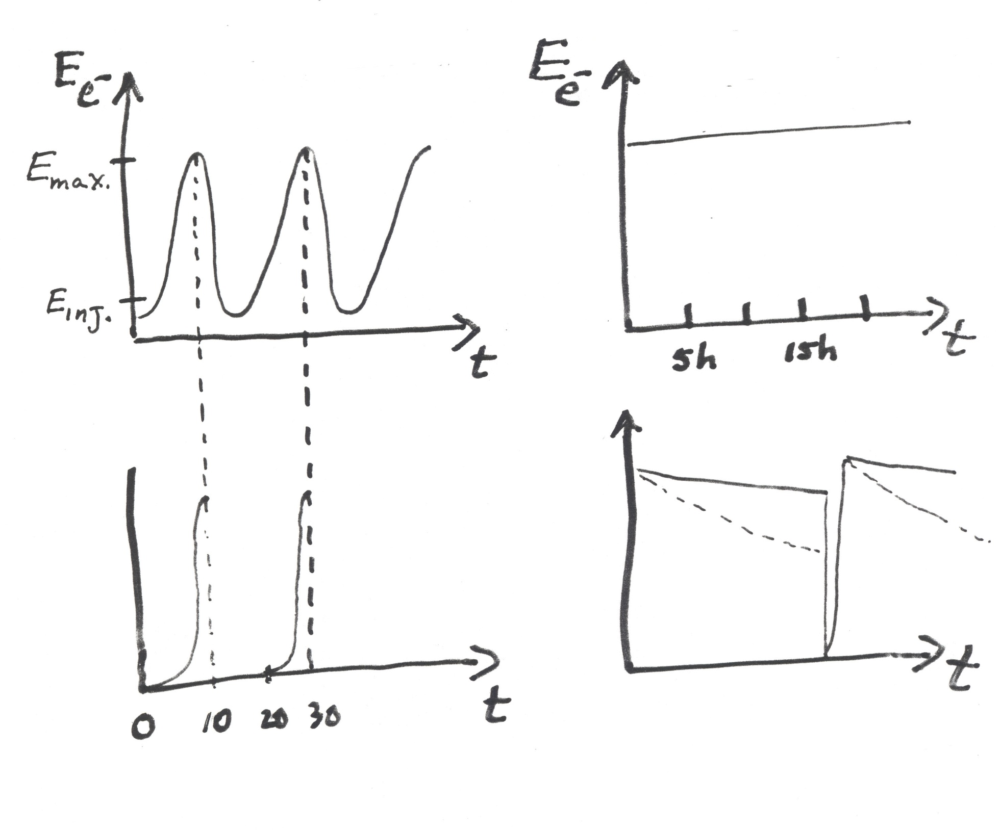
Synchrotron
Storage Ring
Flux
Flux
(h)
(ms)

Slide 30
Synchrotron Radiation Facilities Around the World
>60 in operation; 20 countries; >30,000 Users
In many technologically advanced countries plus
Brazil, Korea, Taiwan, Thailand
Recently completed or in construction
Armenia, Australia, Brazil, China, France, Japan, Jordan, Korea, Poland, Russia, Spain, Taiwan, UK, US
More in design/planning
For a links to SR facilities around the world see
www.lightsources.org

Slide 31
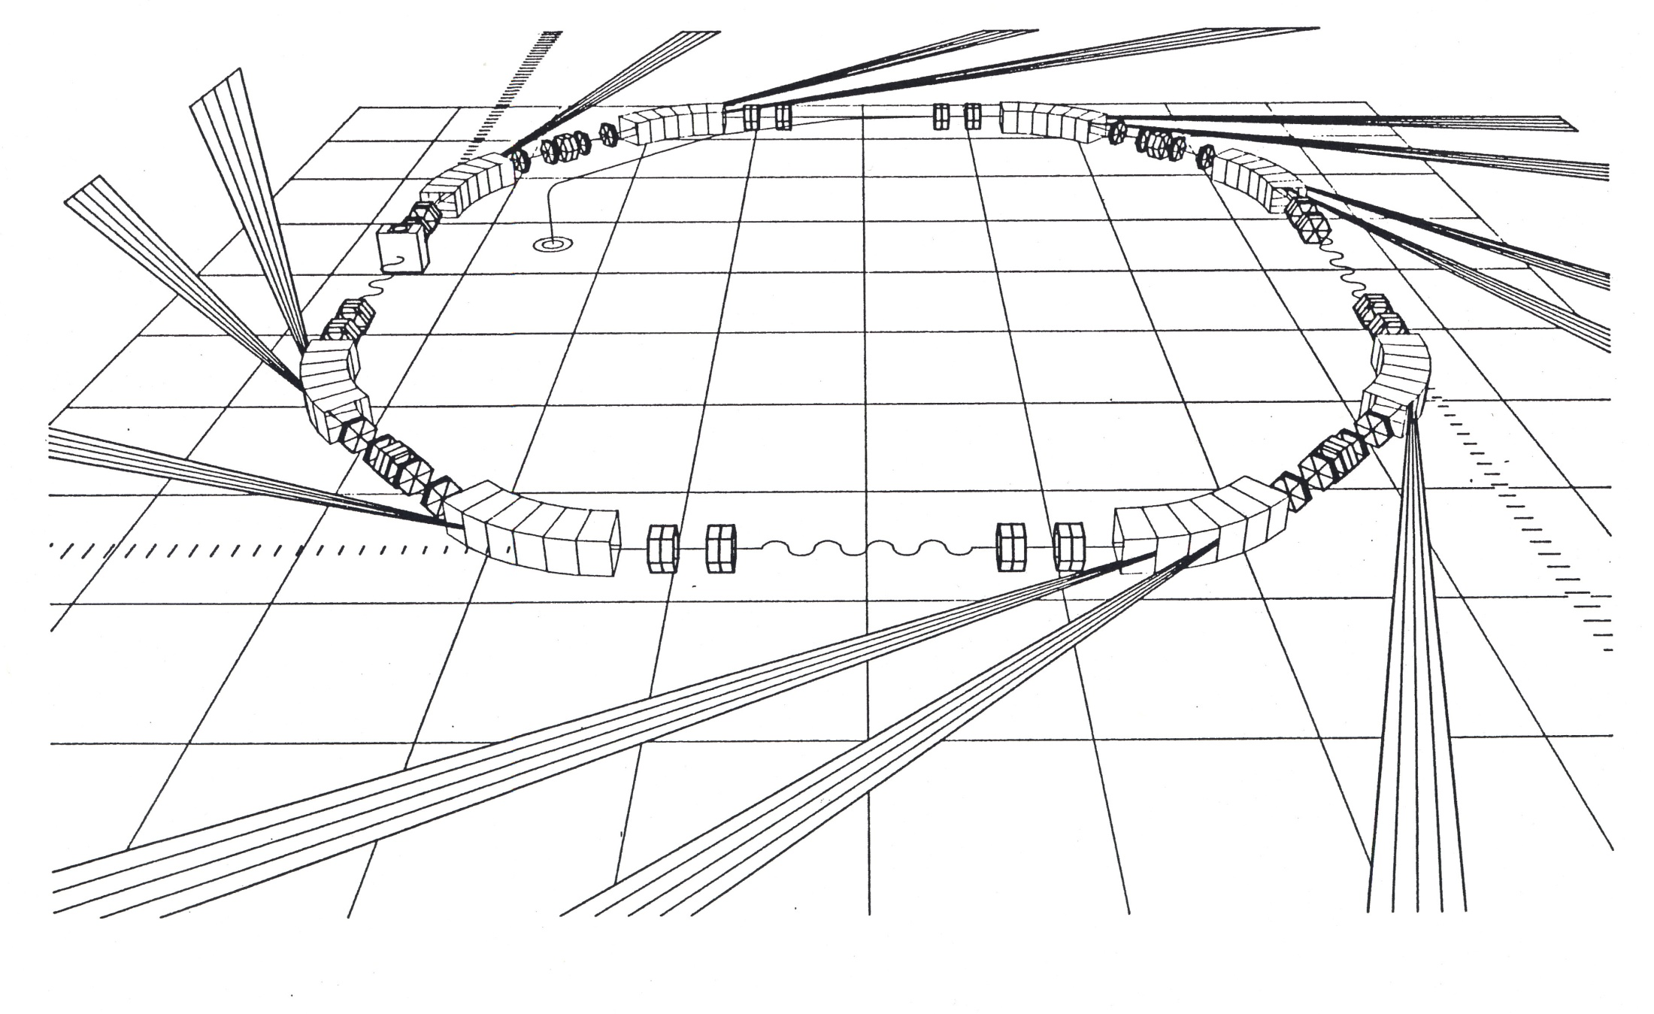
A small storage ring at Louisiana State University
wiggler

Slide 32
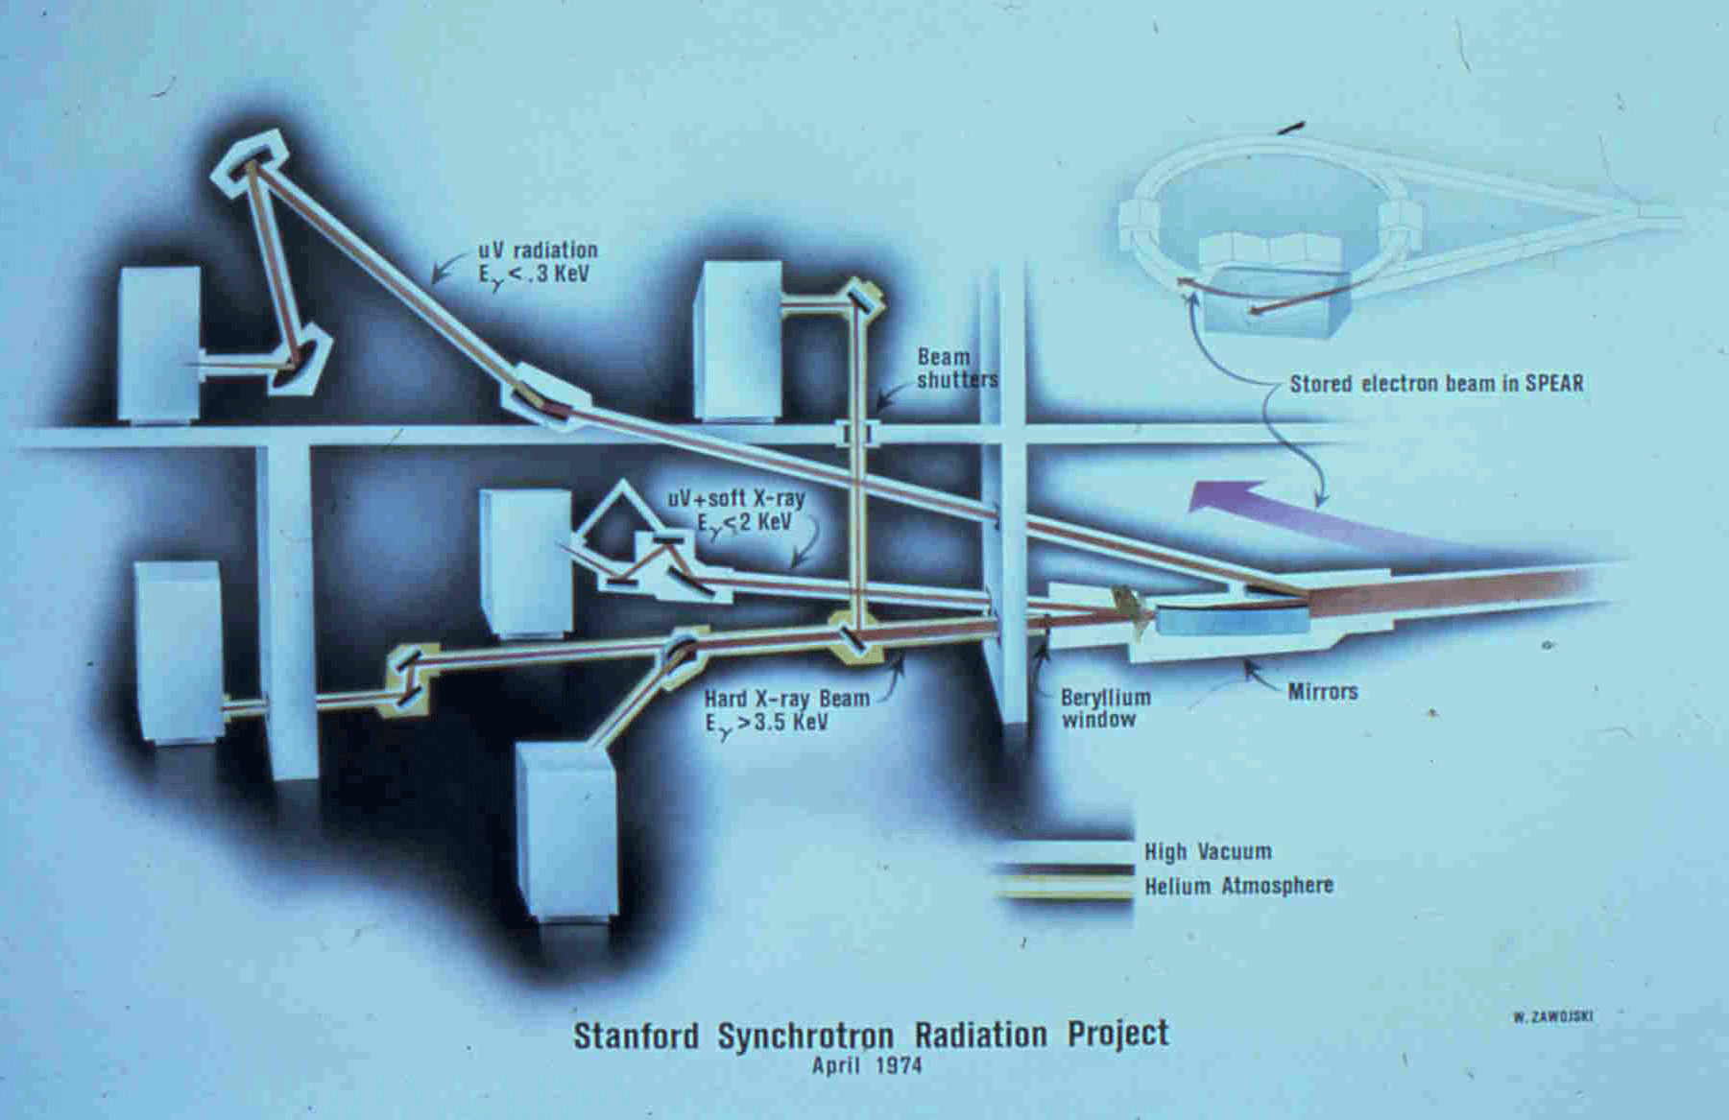
HUTCH
EXAFS I with Channel-cut crystal
SSRP in 1974; funded by $1.2M from NSF; Main beam line, 5 stations, controls, etc.

Slide 33
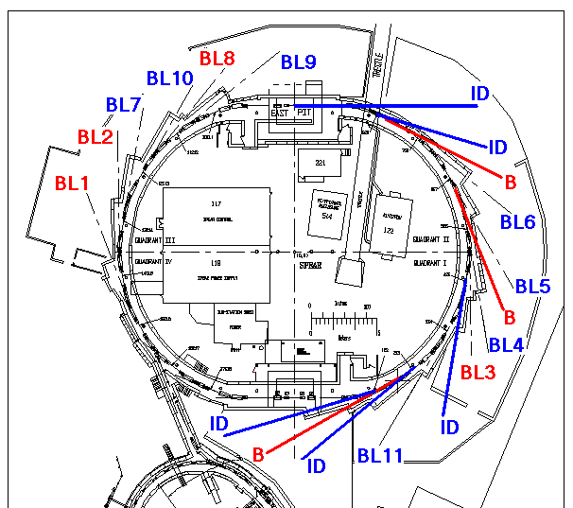
SPEAR3: 13 Existing and 7 Future Source points
7 future source points:
BL 12
1x 1.5 m straight
“East Pit”
1x 3.8m “matching straight”
2x 2.3m “standard straight”
BL 13
3x bend magnets
BL 14
BL 4

Slide 34
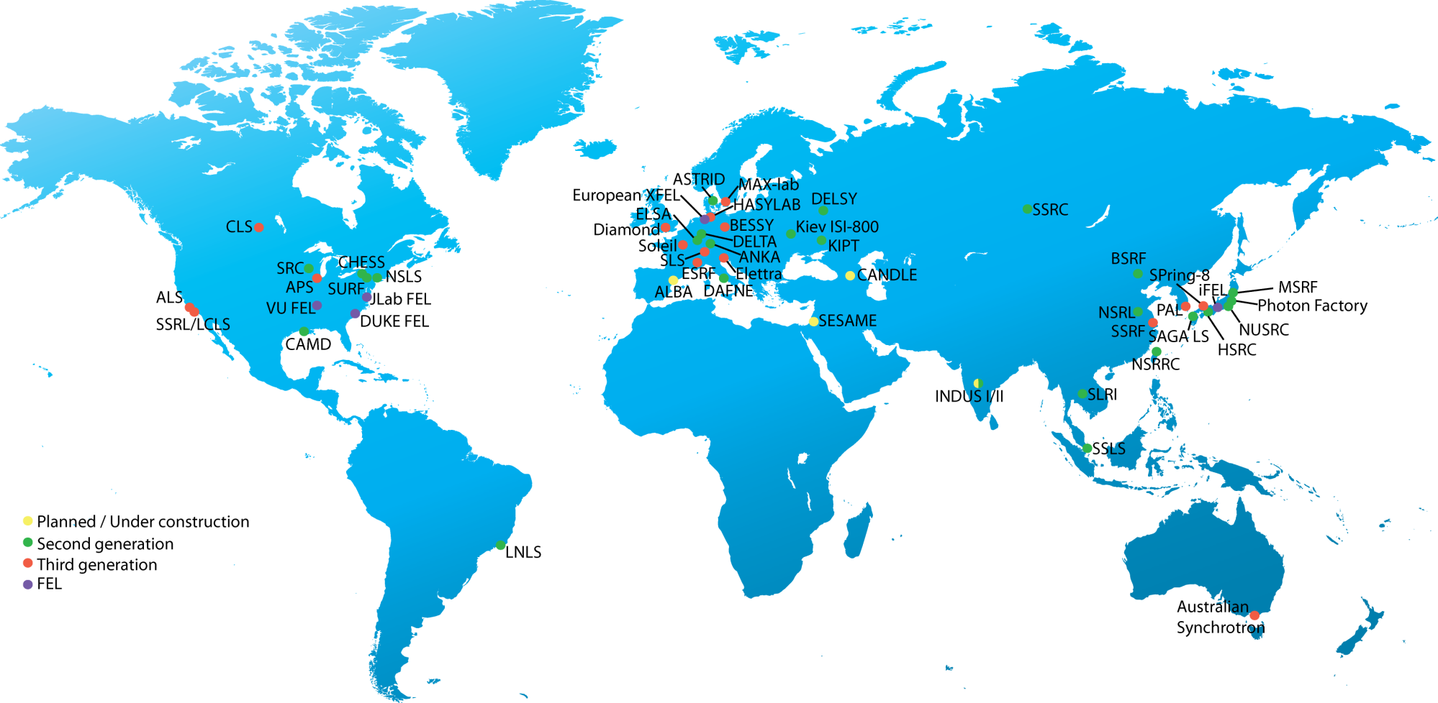
Synchrotron sources around the world
SLRI (Synchrotron Light Research Institute) is located in Nakhon Ratchasima, Thailand

Slide 35
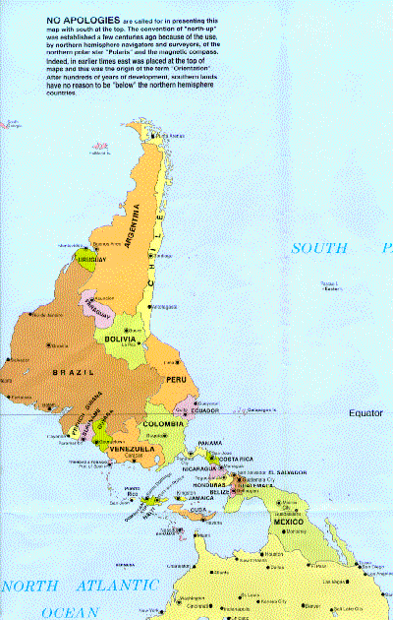
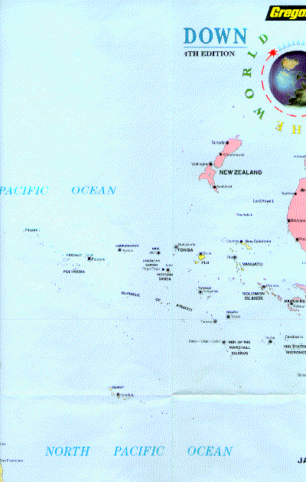
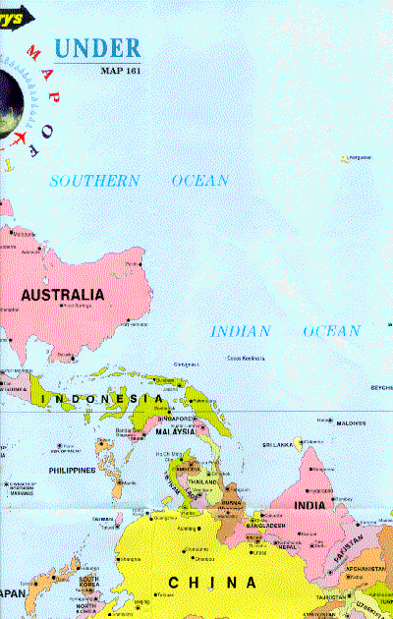
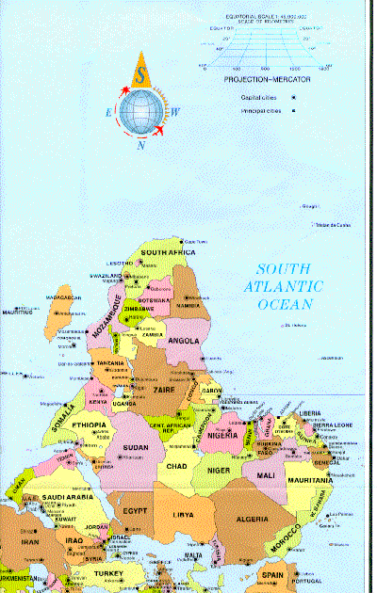
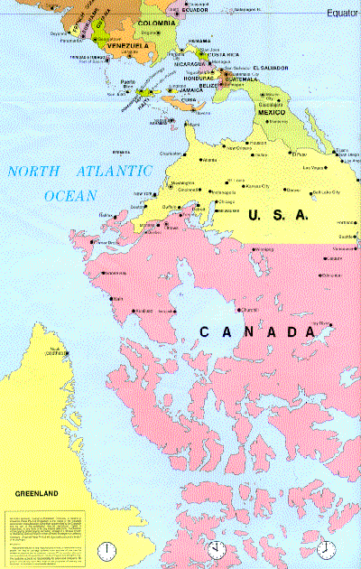
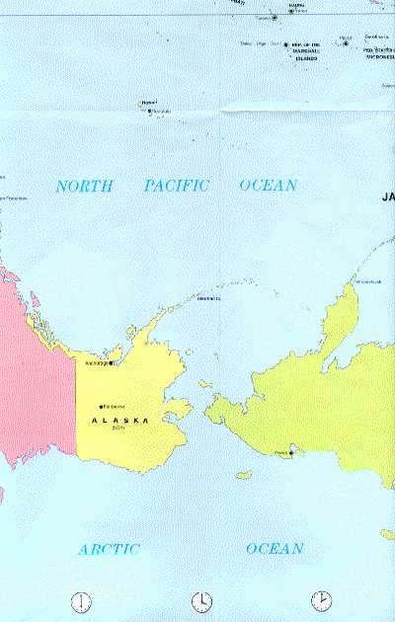

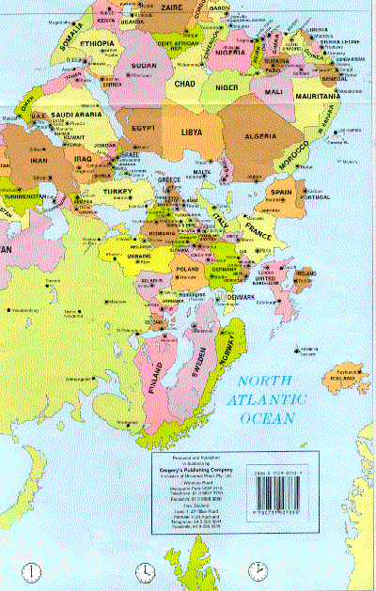
^{IF-USP San Paulo}
LNLS-Campinas
Equator

Slide 36
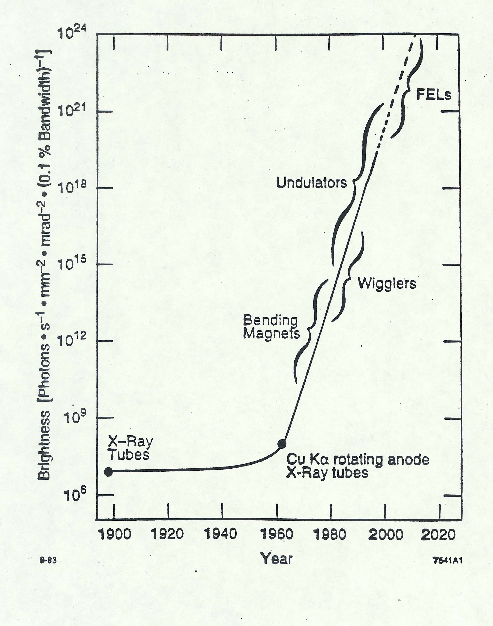
X-Ray Brightness vs. Time

Slide 37
Growth in X-ray Brightness compared to growth in computing speed
10²³
10²²
10²¹
10²⁰
10¹⁹
10¹⁸
10¹⁷
10¹⁶
10¹⁵
10¹⁴
10¹³
10¹²
10¹¹
10¹⁰
10⁹
10⁸
10⁷
10¹⁵
10¹⁴
10¹³
10¹²
10¹¹
10¹⁰
10⁹
10⁸
10⁷
10⁶
10⁵
10⁴
10³
10²
10¹
10⁰
10⁻¹
A million more
X-ray Brightness
Computing speed
X-rays
One billion
One million
Computing speed
1960 1970 1980 1990 2000
X-ray Brightness
Computing speed

Slide 38
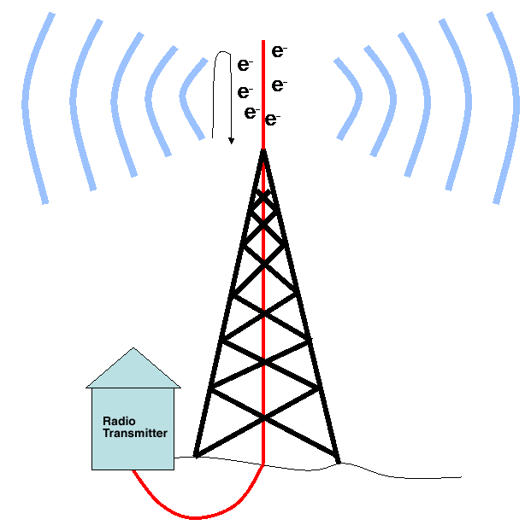
Electromagnetic Radiation
Electrons accelerating by running up and down in a radio antenna emit radio waves
Radio waves are nothing more than Long Wavelength Light

Slide 39
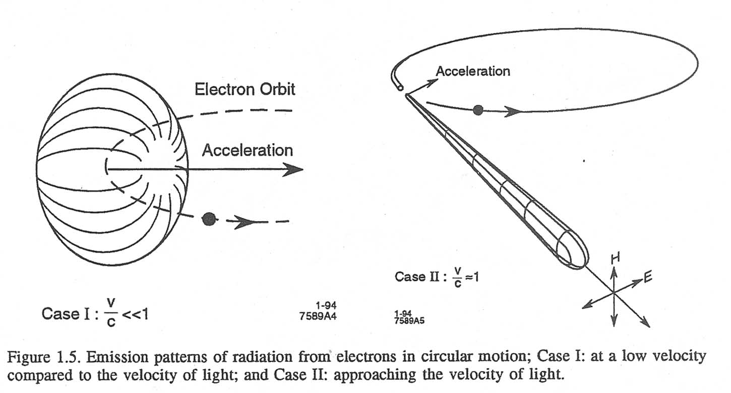
Radiation Fundamentals
When electrons are accelerated (e.g. linear acceleration in a radio transmitter antenna) they emit electromagnetic radiation (i.e., radio waves) in a rather non-directional pattern
Electrons in circular motion are also undergoing acceleration (centripetal)
Opening angle
Θ = mc²/E = γ⁻¹
At low electron velocity (non-relativistic case) the radiation is emitted in a non-directional pattern
When the electron velocity approaches the velocity of light, the emission pattern is folded sharply forward. Also the radiated power goes up dramatically

Slide 40
SYNCHROTRON RADIATION
BASIC PROPERTIES
1. HIGH FLUX, BRIGHTNESS, STABILITY
2. BROAD SPECTRAL RANGE - Tunability
3. POLARIZATION (linear, elliptical, circular)
4. PULSED TIME STRUCTURE (0.01 - 1 nsec)
5. SMALL SOURCE SIZE (< mm)
PARTIAL COHERENCE
7. HIGH VACUUM ENVIRONMENT
Flux = No. of Photons at given λ within a given Δλ/λ
s, mrad Θ
Brightness = No. of Photons at given λ within a given Δλ/λ
s, mrad Θ, mrad φ, mm²
(a measure of the concentration of the radiation)

Slide 41
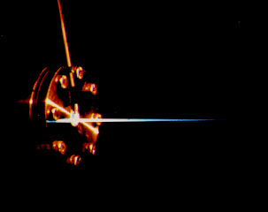
Focused x-ray beam from the Cambridge Electron Accelerator – 1972 (Paul Horowitz, Harvard University)

Slide 42
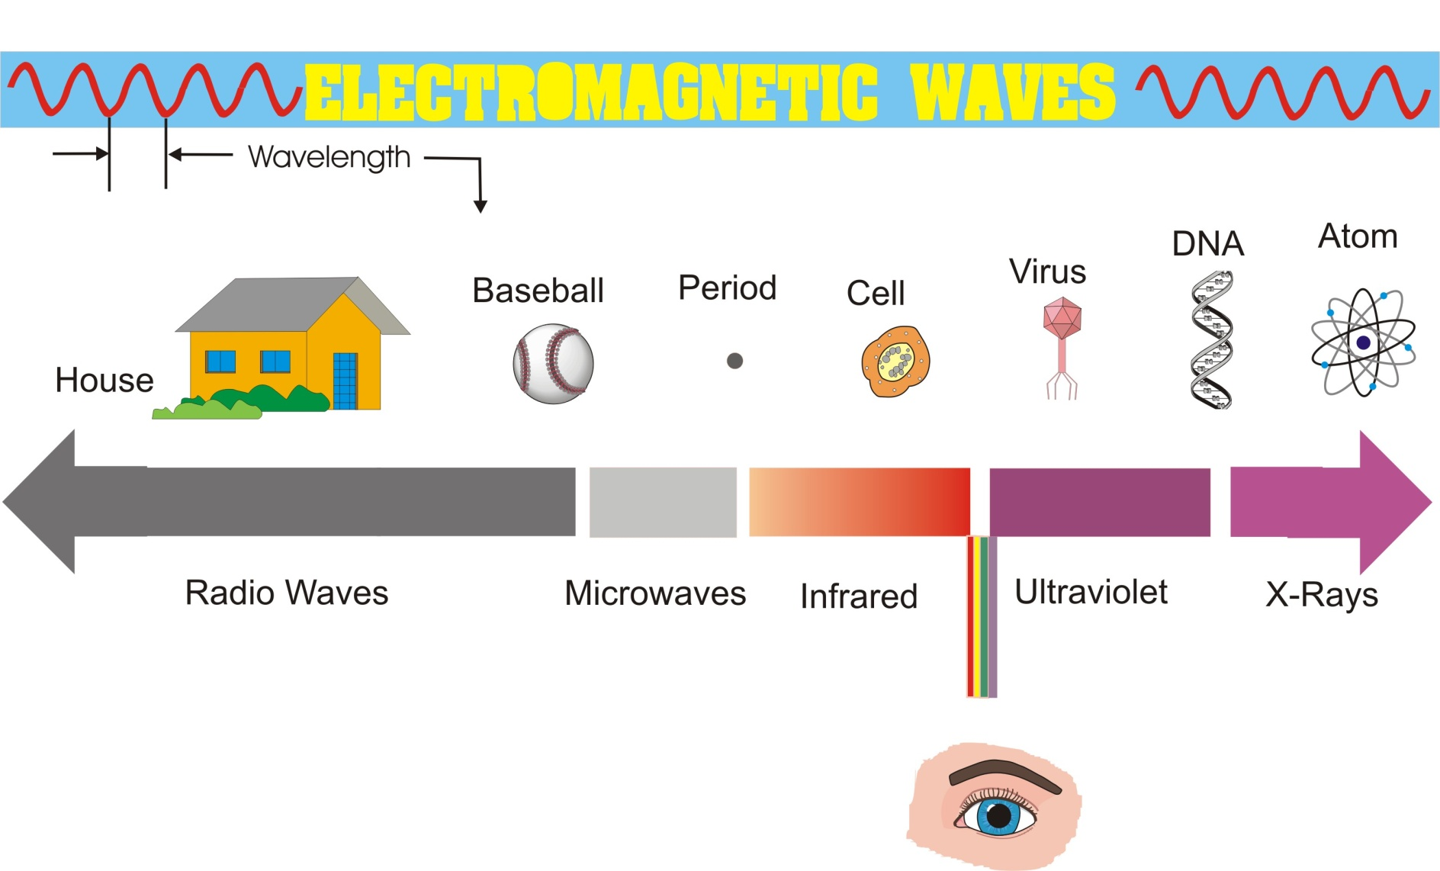
Electromagnetic Radiation - How It Relates to the World We Know
Synchrotron radiation is used for experiments typically over this region

Slide 43
Approaches to Reducing Emittance in Storage Rings
1. Reduce emission of radiation in bending magnets → lower electron energy and weaker field → larger circumference (PetraIII) for a given energy. Radiated Energy ~ E²B²
2. Reduce length of bending magnet to reduce separation of orbits of electrons with different energies.
Above considerations lead to designs with small angular deflections in each bending magnet. Quadrupoles between bends refocus the beam before it gets too large.
Emittance ε ~ Ε²Θ³
Ε = electron energy
Θ = angular deflection in each bending magnet
Emittance in rings can also be reduced using strong wiggler magnets, so called “Damping Wigglers”
Importance of low emittance in a light source first emphasized by
R. Chasman and K. Green at BNL in 1976.

Slide 44
Large circumference required for low electron beam emittance
ESRF, APS, SPring-8; 0.8-1.5 km
PEP, PETRA, TRISTAN; 2-3 km
LEP (now LHC); 27 km

Slide 45
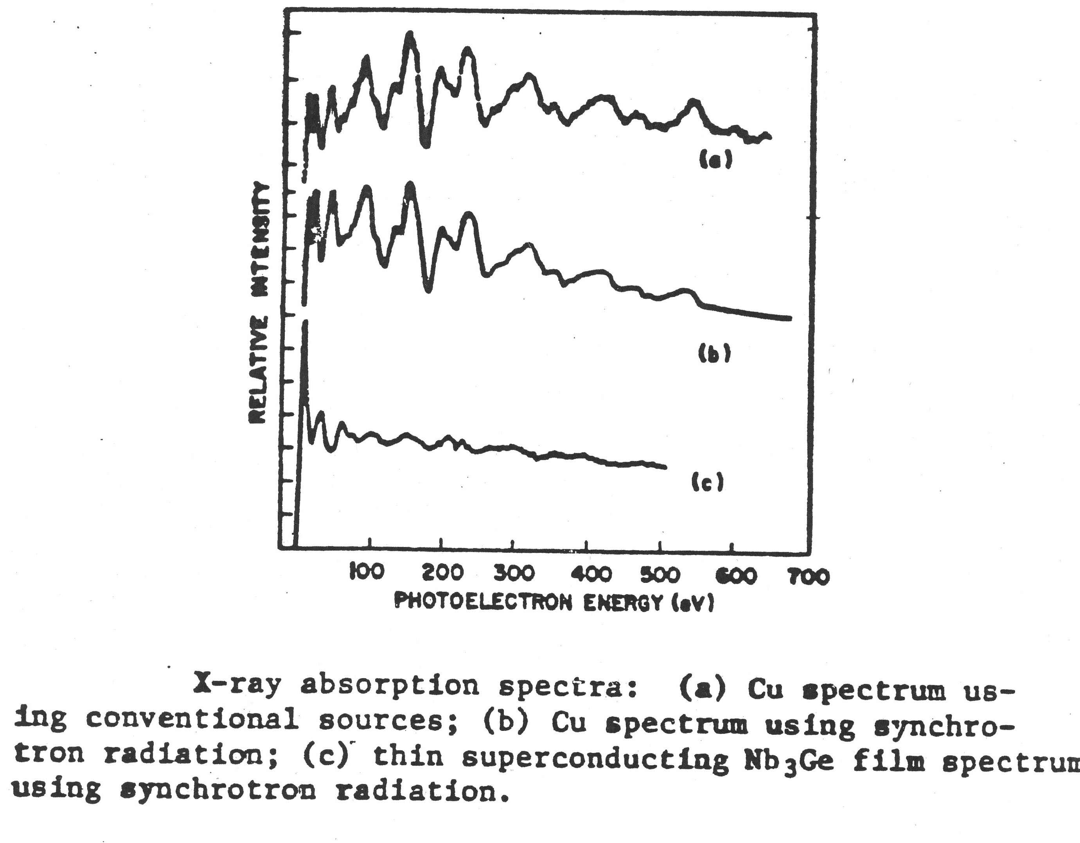
EXAFS 1974 – Parasitic Operation on a First Generation Ring
~ 10 days using rotating anode X-Ray tube
Cu EXAFS
~ 20 minutes using synch. rad. from SPEAR bending magnet
Ratio of intensity;
SR/X-Ray Tube ~100,000
P. Eisenberger, B. Kincaid

Slide 46
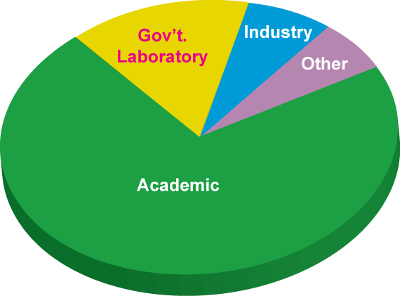
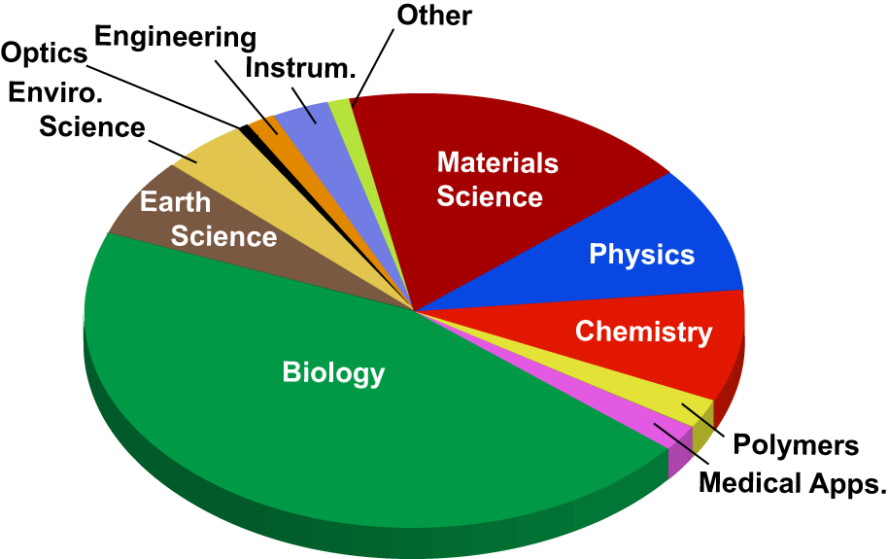
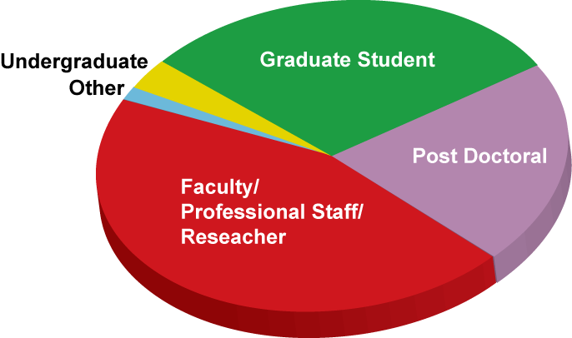
APS users – who are they and what do they do?
Notes:
Rotate the one on the right

Slide 48
Report of the Synch. Rad. Light Source Working Group of the Basic Energy Sciences Advisory Comm. of the US Department of Energy- Oct. 8-9, 1998
R. Birgeneau (MIT) - Chairman
Z.-X. Shen (Stanford) - Vice-Chairman
from the Executive Summary:
“The most straightforward and most important conclusion of this study is that over the past 20 years in the United States synchrotron radiation research has evolved from an esoteric endeavor practiced by a small number of scientists primarily from the fields of solid state physics and surface science to a mainstream activity which provides essential information in the materials and chemical sciences, the life sciences, molecular environmental science, the geosciences, nascent technology and defense-related research among other fields.”

Slide 49
Sources of Synchrotron Radiation
Bending magnets
Wigglers
Undulators

Slide 50
INSERTION DEVICES (WIGGLERS & UNDULATORS)
Extending performance of photon sources beyond bending magnets
Higher flux
Higher brightness
Higher coherence
Flexible polarization
Extended spectral range (e.g. SC wigglers)
Quasi-monochromatic beams (undulators)

Slide 51
Opening angle
Θ = mc²/E = γ⁻¹
mc² = 0.5 MeV (electron rest mass)
For E = 5 GeV, Θ = 10⁻⁴ radians = .006º

Slide 52
Bending Magnets & Insertion Devices on Storage Rings
Continuous spectrum characterized by ε_{c} = critical energy
ε_{c}(keV) = 0.665 B(T)E²(GeV)
eg: for B = 2T E = 3GeV ε_{c} = 12keV
(bending magnet fields are usually lower ~ 1 – 1.5T)
bending magnet - a “sweeping searchlight”
wiggler - incoherent superposition
Quasi-monochromatic spectrum with peaks at lower energy than a wiggler
λ_{u}
K²
λ_{U}
λ₁ =
(1 + ) ~ (fundamental)
2γ²
2
γ²
+ harmonics at higher energy
undulator - coherent interference
0.95 E² (GeV)
ε₁ (keV) =
K²
γ=E/mc² =6,000 @ 3 GeV
λ_{u} ^{(cm)} (1 + )
2
K = γθ θ=angular deflection in each pole

Slide 53
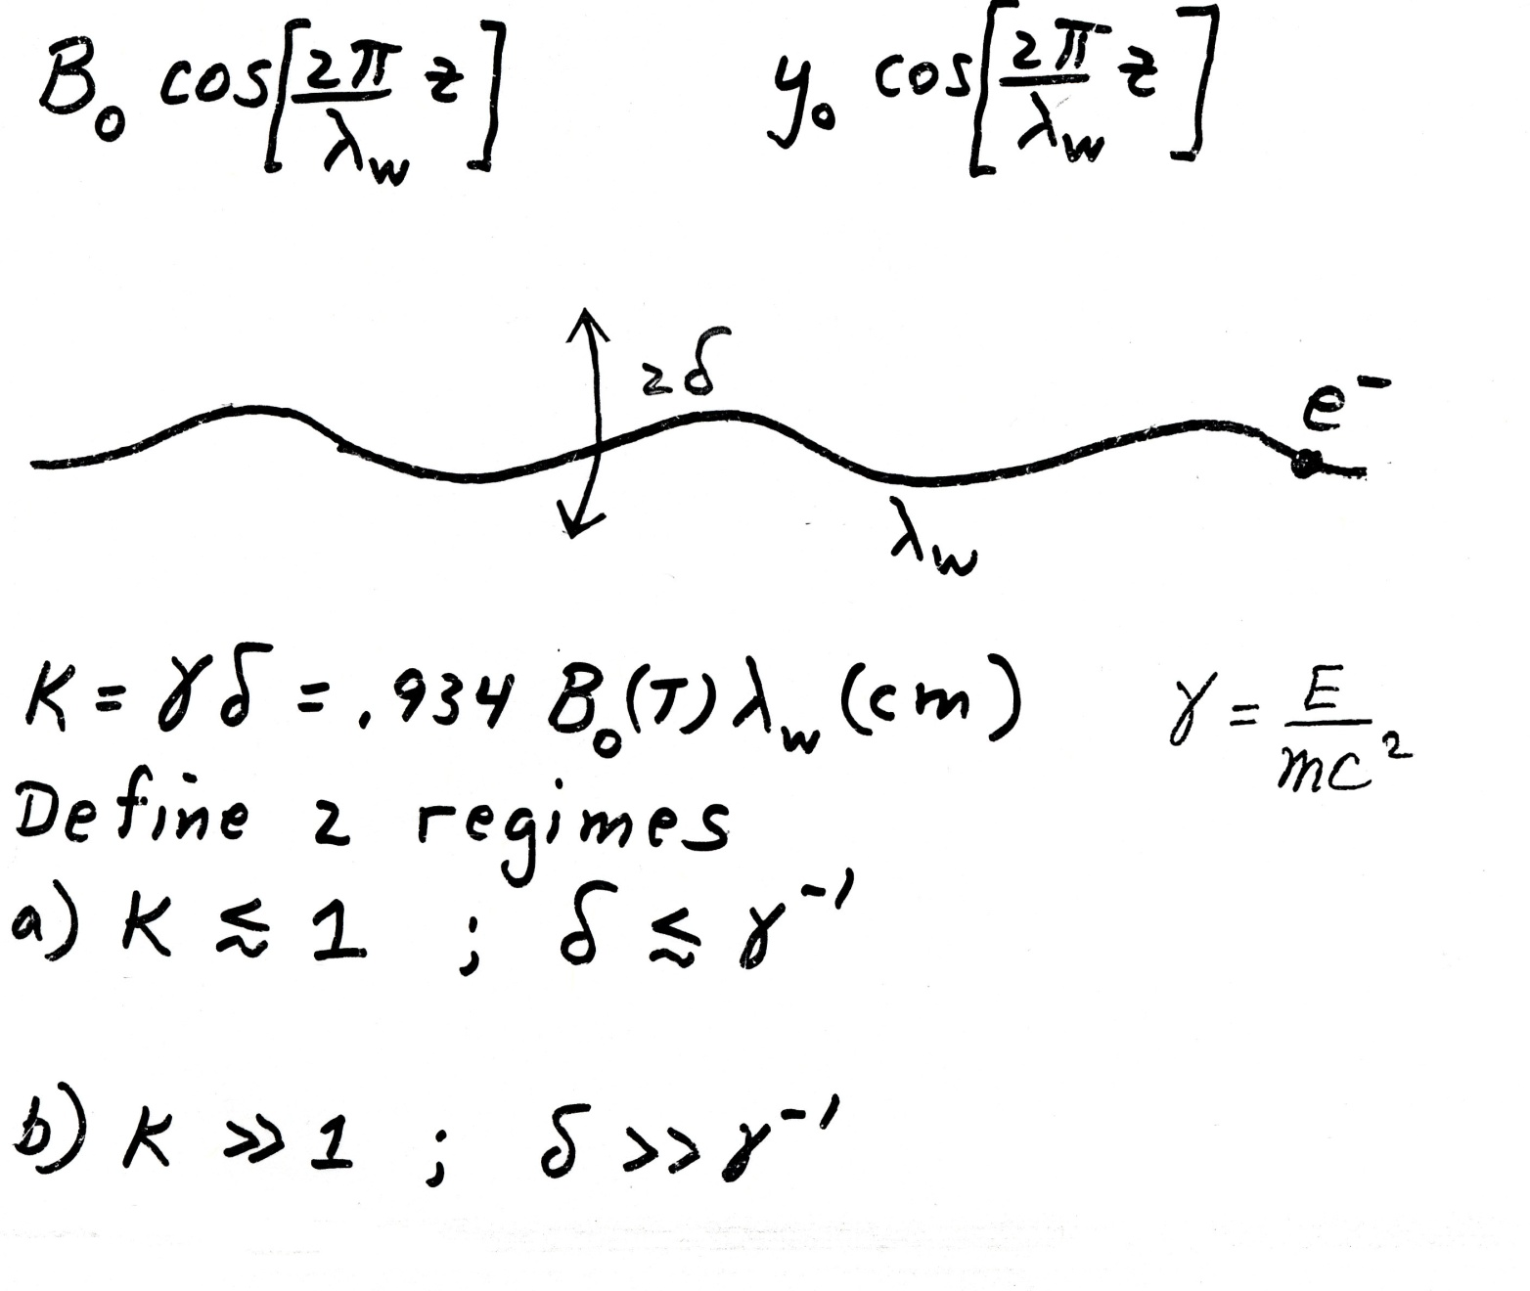
Wigglers & Undulators
(Undulator)
(Wiggler)

Slide 54
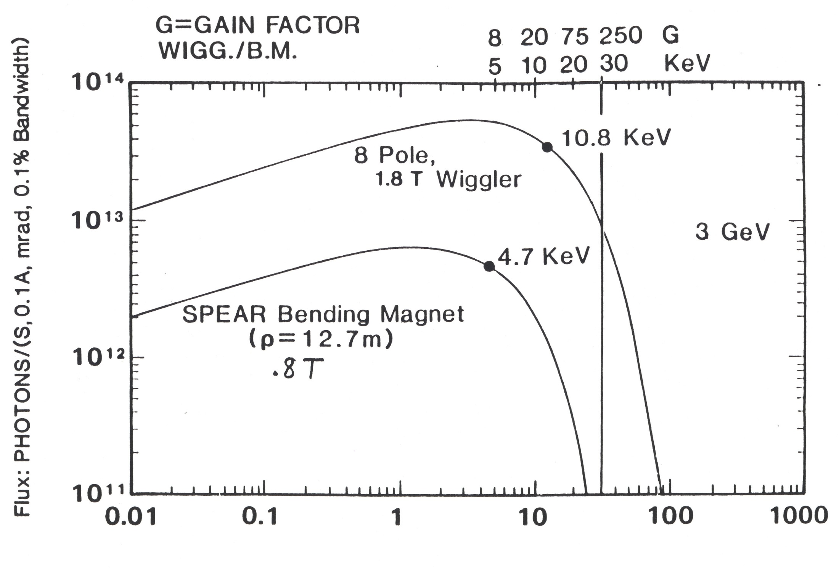
PHOTON ENERGY (KeV)
ε_{c}(keV) = 0.665 B(T)E²(GeV)
for B = 0.8T E = 3GeV ε_{c} = 4.7keV
for B = 1.8T E = 3GeV ε_{c} = 10.8 keV

Slide 55
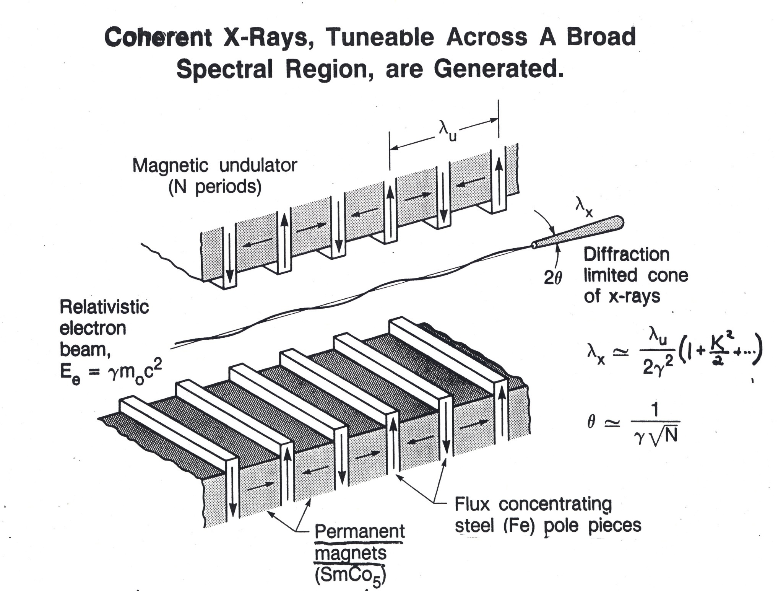
Hybrid Design; K. Halbach & N. Vinokurov

Slide 56
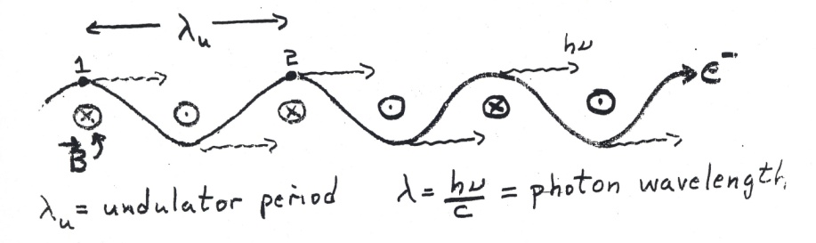
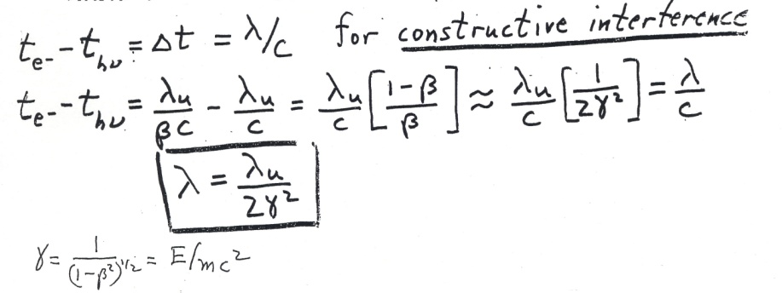
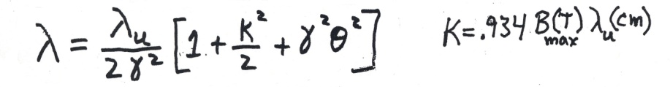
Undulator Radiation
Interference effects in the radiation by an electron in a periodic field
Simple case to illustrate basis Physics
Weak field approximation & radiation on axis only
Electron takes longer than photon to go from 1-2 because electron travels at BC rather than C.
All the radiation occurs at this wavelength in the weak field approximation
If we take into account the extra distance traveled by the electron & also the angle of emission of the radiation (0) we get
Correlation between photon wavelength and emission angle

Slide 57
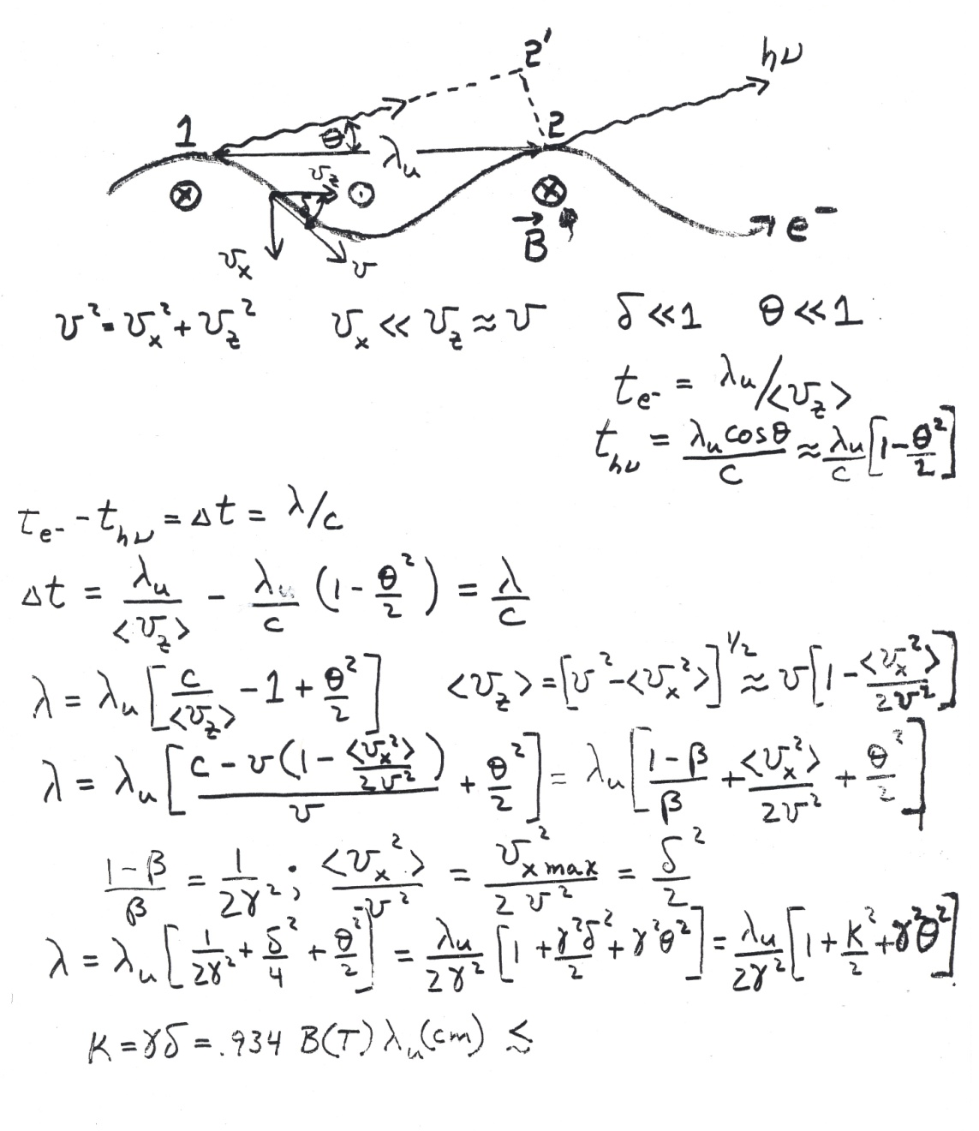
Undulator Radiation
More realistic treatment: Take into account sinusoidal electron motion & off axis radiation
Electron flight time from 1 to 2:
Photon flight time from 1 to 2:
for constructive interference
Correlation between wavelength & viewing angle
1 or 2

Slide 58
Resonance Condition
Resonance: In the time it takes an electron to travel the length of one undulator period, the light wavefront travels one light wavelength further.
This gives constructive interference, enhances the probability of emission of light at that wavelength.

Slide 59
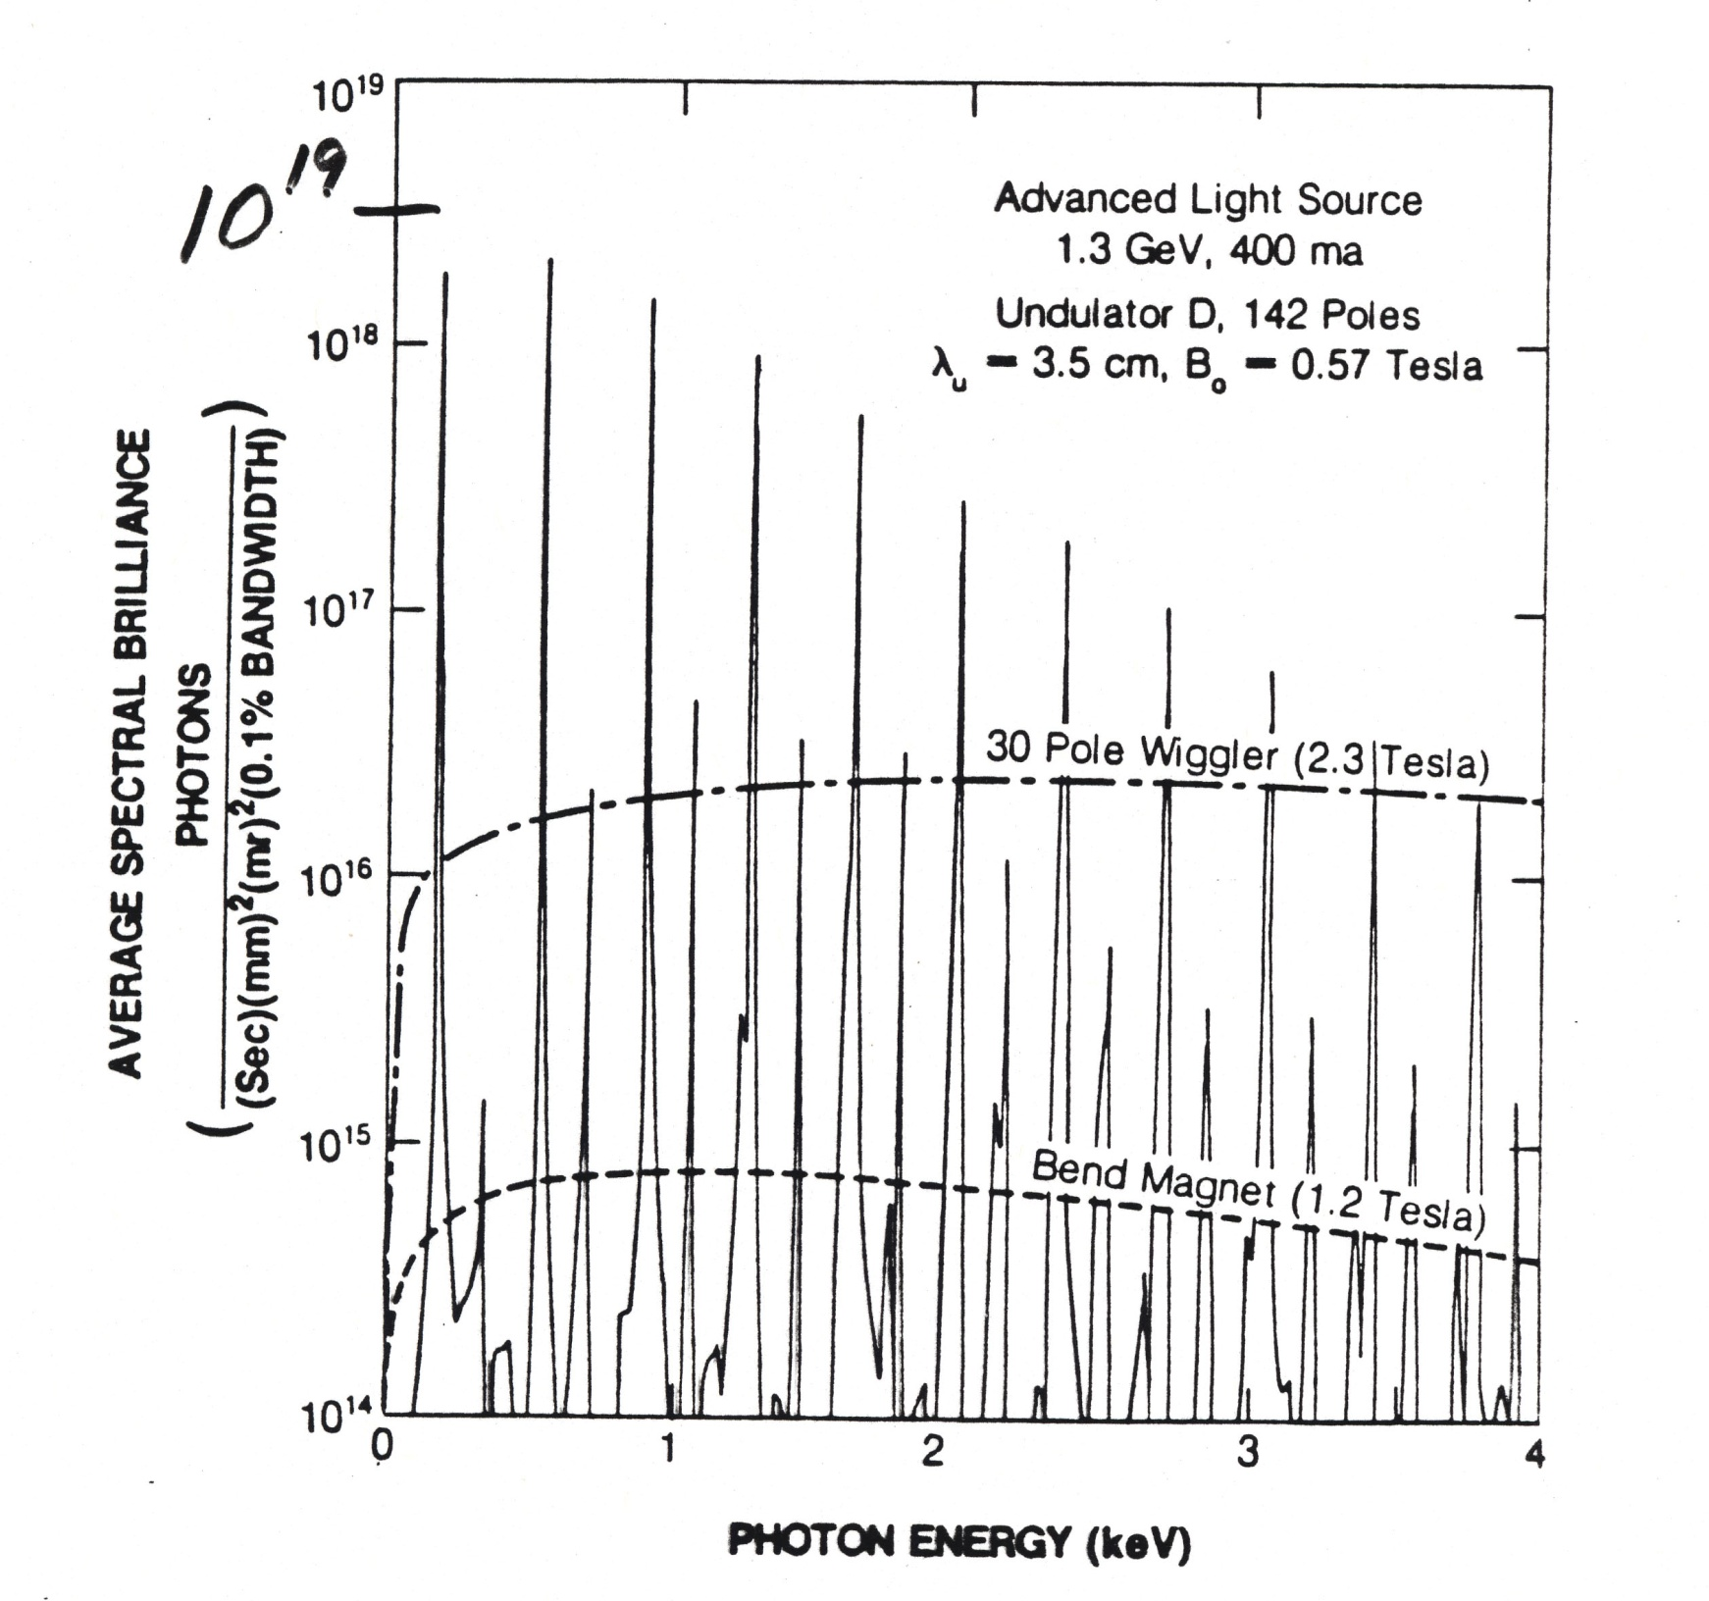
K.-J. Kim

Slide 60
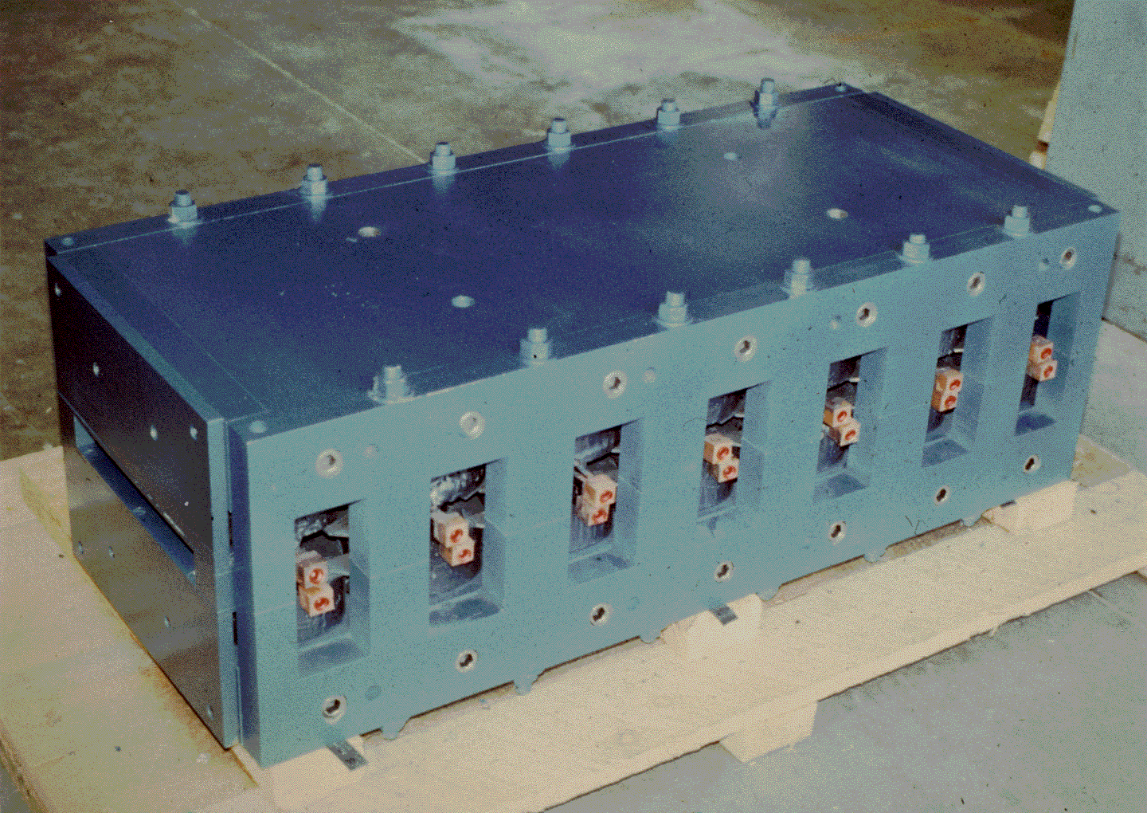
SSRL 6 pole Electromagnet Wiggler 1978

Slide 61
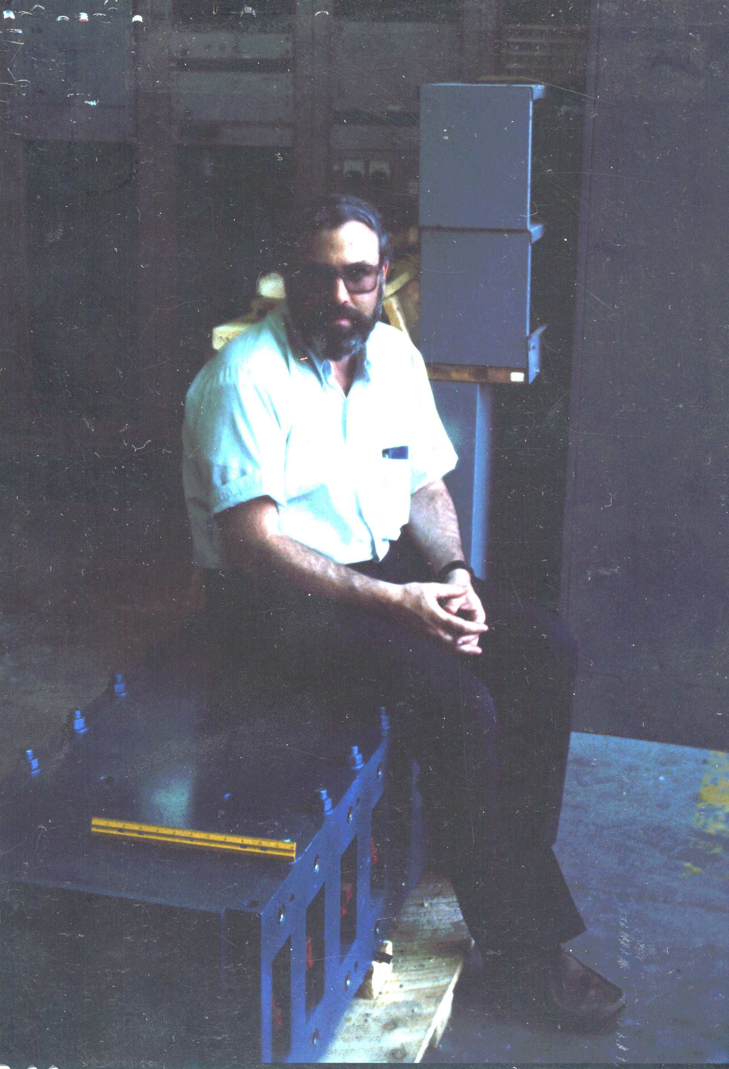
First SSRL Wiggler - 1978

Slide 62

Display of 1st Wiggler at SSRL/SLAC

Slide 63

SSRL 9-Pole Electromagnet Wiggler - 1980

Slide 64

Daresbury SRS Superconducting Wiggler – Wavelength Shifter
Wide fan – Served 7 experimental stations

Slide 65
Opening angle
Θ = mc²/E = γ⁻¹
mc² = 0.5 MeV (electron rest mass)
For E = 5 GeV, Θ = 10⁻⁴ radians = .006º

Slide 66

Coils for a superconducting undulator in Orsay; ~1980

Slide 67

Halbach; Vinokurov 1979

Slide 68

2 m
1980

Slide 69

LBL/SSRL 30 Period Permanent Magnet Undulator -1980

Slide 70

First X-ray Undulator Spectrum; SSRL, 1980
500
3rd harmonic
Peaks tuned by varying the magnet gap
K = 0.78
400
0.70
FLUX
300
4th harmonic
0.63
200
5th harmonic
100
6th harmonic
0
3
4
5
6
7
PHOTON ENERGY (keV)
Higher-harmonic spectrum produced by 3-GeV electrons in the LBL-SSRL 30-period permanent-magnet undulator. Slits were used to define a very small angular acceptance (18 x 10⁻⁶ radians horiz, 8.8 x 10⁻⁶ radians vertical).

Slide 71

Changing the direction for synchrotron radiation sources; 1978-80
500
3rd harmonic
K = 0.78
400
0.70
FLUX
300
4th harmonic
0.63
200
5th harmonic
100
6th harmonic
0
3
4
5
6
7
PHOTON ENERGY (keV)

Slide 72

Elliptical Undulator, Photon Factory, Japan
H. Kitamura, S. Yamamoto

Slide 73


Slide 74

In-Vacuum Permanent Magnet Undulator in SPring-8 – H. Kitamura

Slide 75

APPLE Undulator Magnetic Structure
S. Sasaki

Slide 76

Steps in producing an insertion device
Al keeper + high permeability steel pole

Slide 77

Adding magnetic material to each unit

Slide 78

Assembling the individual units on a strongback

Slide 79

LBL/SSRL 54 Pole Permanent Magnet Hybrid Wiggler ~1985

Slide 80

Completed wiggler in support frame; ready for installation of the vacuum chamber

Slide 81

Nicolai Vinokurov & Klaus Halbach receiving the first Compton Award at APS; October, 1995
Pioneers in permanent magnet technology for insertion devices

Slide 82

An Inspirational Wiggler

Slide 83
Using X-rays
Techniques, Applications, etc.

Slide 84

These Techniques Provide Very Valuable Information

Slide 85

Photons Enable a Range of Modern Techniques to Study Matter
For Example, Modern X-ray Based Techniques Include

Slide 86

X-rays have opened the ultra-small world
visible
x-ray

Slide 87

In addition to the Ultra-Small world, we’d like to explore the Ultra-Fast
synchrotron source
new territory

Slide 88
To explore the ultra-fast regime, one needs an ultra-fast, pulsed x-ray source. Ideally, it would produce a lot of x-rays in each fast pulse.
To go much beyond what today’s synchrotron source can provide, one needs a new type of source. The best candidate is the Free-Electron Laser

Slide 89



Examples of Synchrotron Science:
X-Rays Illuminate Ancient Secrets
Archimedes’ exceptionally advanced ideas have been lost and found several times throughout the ages. Now scientists are employing modern technology, including x-ray fluorescence, to completely read the Archimedes Palimpsest, the only source for at least two previously unknown treatises.
A photograph of one page of the Archimedes Palimpsest. Visible and UV light cannot see Archimedes' text under the gold painting done by a 20th Century forger.
(Images provided by Will Noel, The Walters Art Museum)
X-ray fluorescence imaging revealed the hidden text. This x-ray image shows the lower left corner of the page.
Synchrotron studies at the Advanced Photon Source reveal massive amounts of lead in bone fragments from skull of Beethoven.
These findings confirm studies of Beethoven hair samples.
Researchers believe this confirms lead poisoning as cause of composer’s chronic illness.
Intensity of Pb x-ray fluorescence from a standard hair (SN-1) with 6 ppm of lead compared to that of a hair from Beethoven (LVB) as determined at APS.
SSRL

