Slide 1
The First Storage Rings

Slide 2
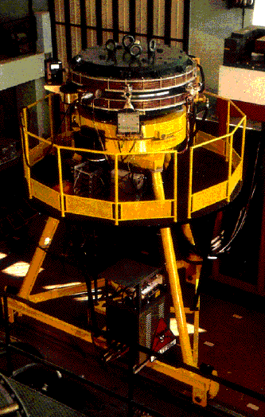
AdA (Frascati, Italy ~1960)

Slide 3
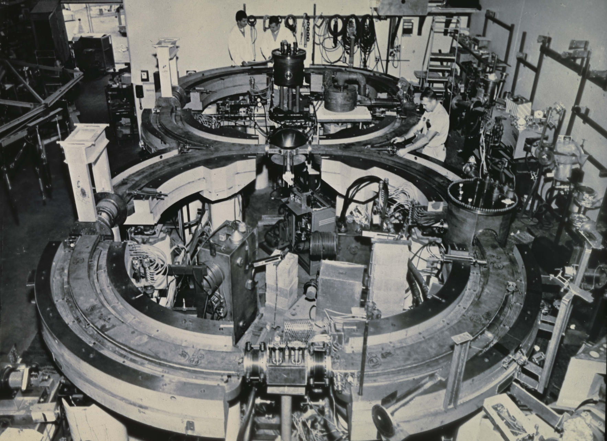
Early Storage Rings at Stanford
Princeton-Stanford colliding beam storage rings - 1960

Slide 4
VEP-1 Collider - Novosibirsk
E = 90 MeV - 320 MeV (total); L= 5*10 ²⁷ cm⁻²s⁻¹
Exps 1965-1967 - parallel to Princeton-Stanford Rings:
electron-electron elastic scattering,
double bremsstrahlung (first observation and study)
3
1 meter
1
2
1. Storage rings
2. Compensating systems
3. Synchrotron B-2S
G.I.Budker at al., "Check on Quantum Electrodynamics by Electron-Electron Scattering ”
Yadernaya Fizika (1967) v.6, numb. 6, pp 1221-1225;
translation: SOVIET JOURNAL OF NUCLEAR PHYSICS, JUNE 1968, VOLUME 6, NUMBER 6, pp. 889-892

Slide 5
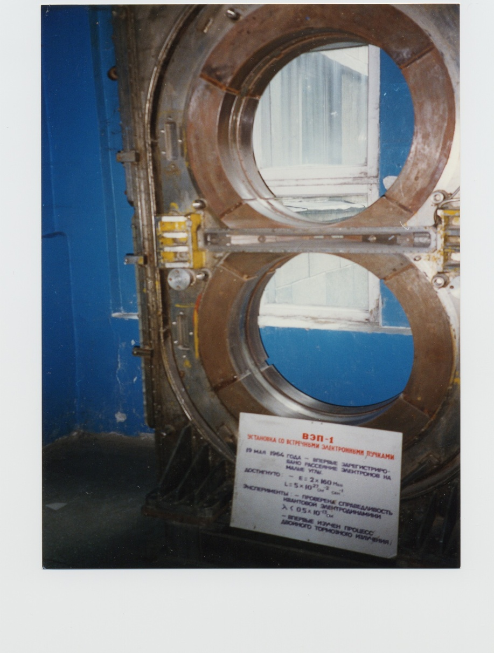
VEPP-1 Storage Rings Novosibirsk

Slide 6
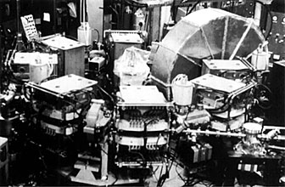
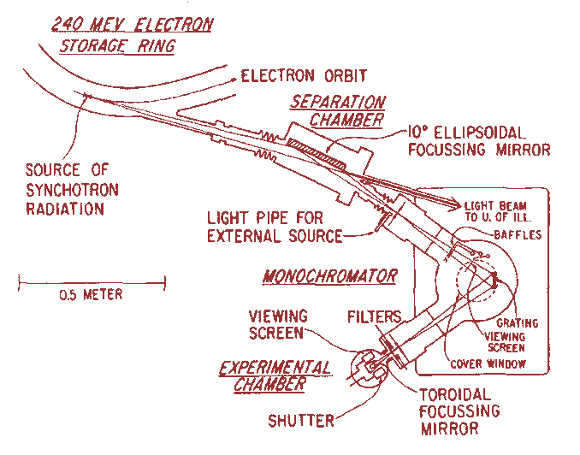
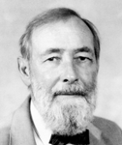
TANTALUS 240 MeV
First dedicated storage ring light source
Circumference ~10m
Ed Rowe; 1968
See; article by Giorgio Margaritondo in May 2008 issue of Physics Today

Slide 7
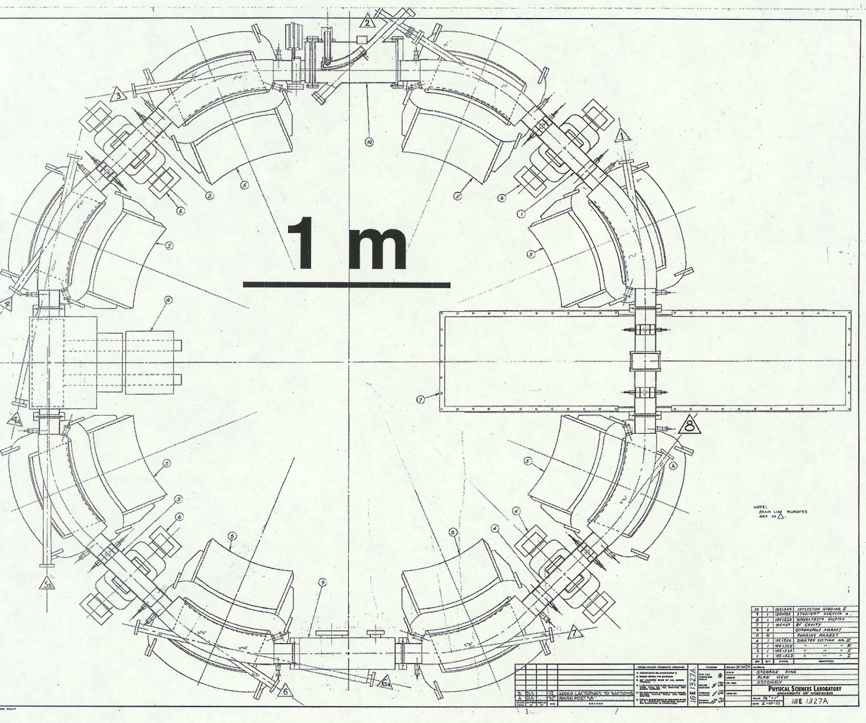
First Storage Ring used as a Light Source
Tantalus 240 MeV storage ring built for high energy physics r&d. Converted to dedicated light source in 1968 (Ed Rowe)

Slide 8
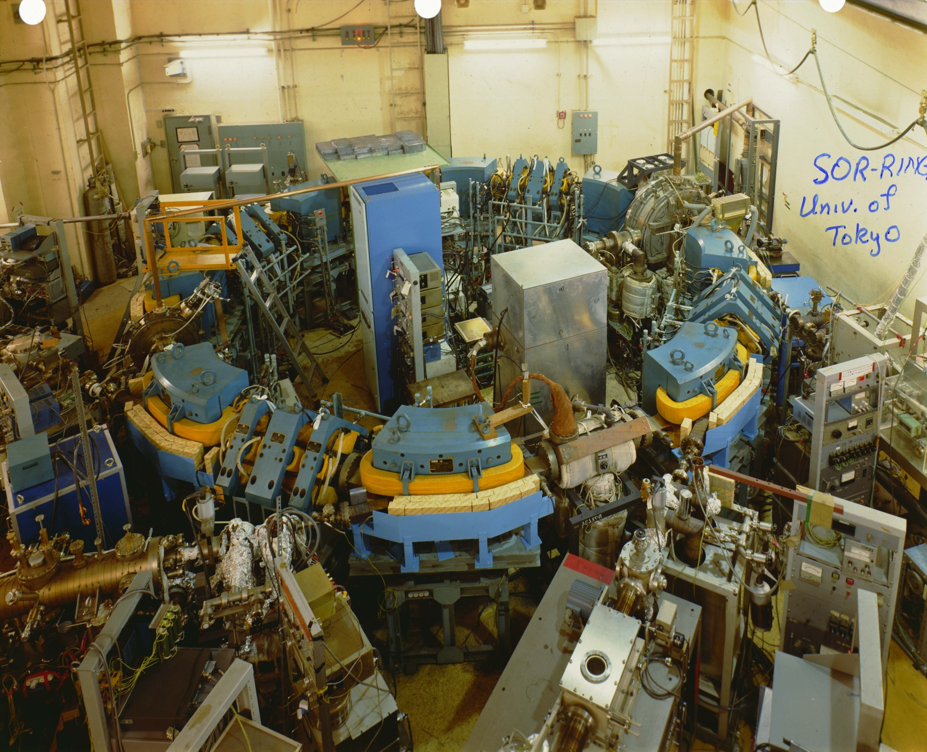
SOR-ring
Univ. of Tokyo
0.4 GeV
(1974)
First “purpose-built” SR source; T. Sasaki, T. Ishii, et al

Slide 9
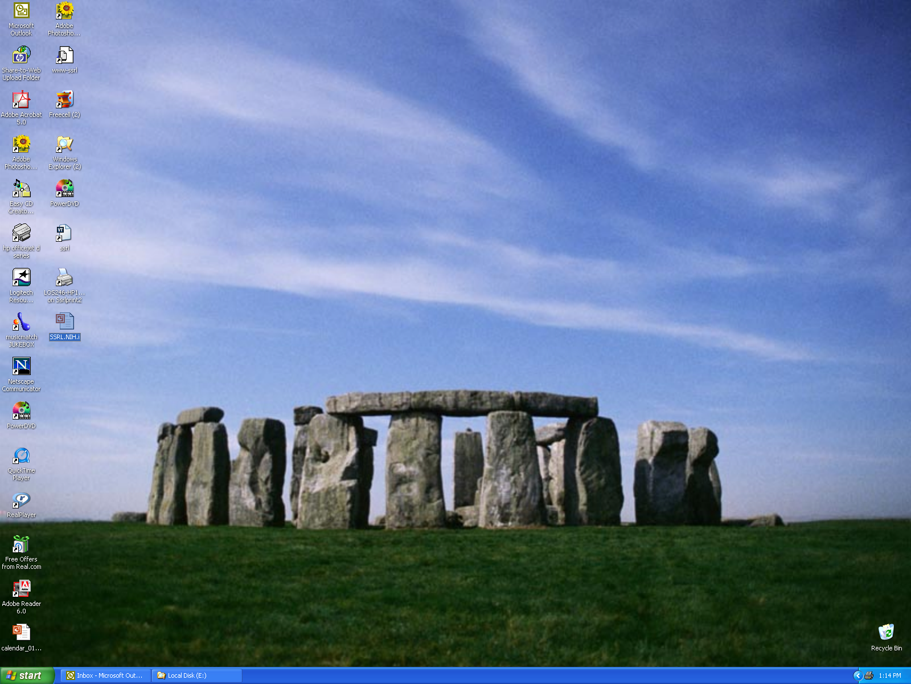
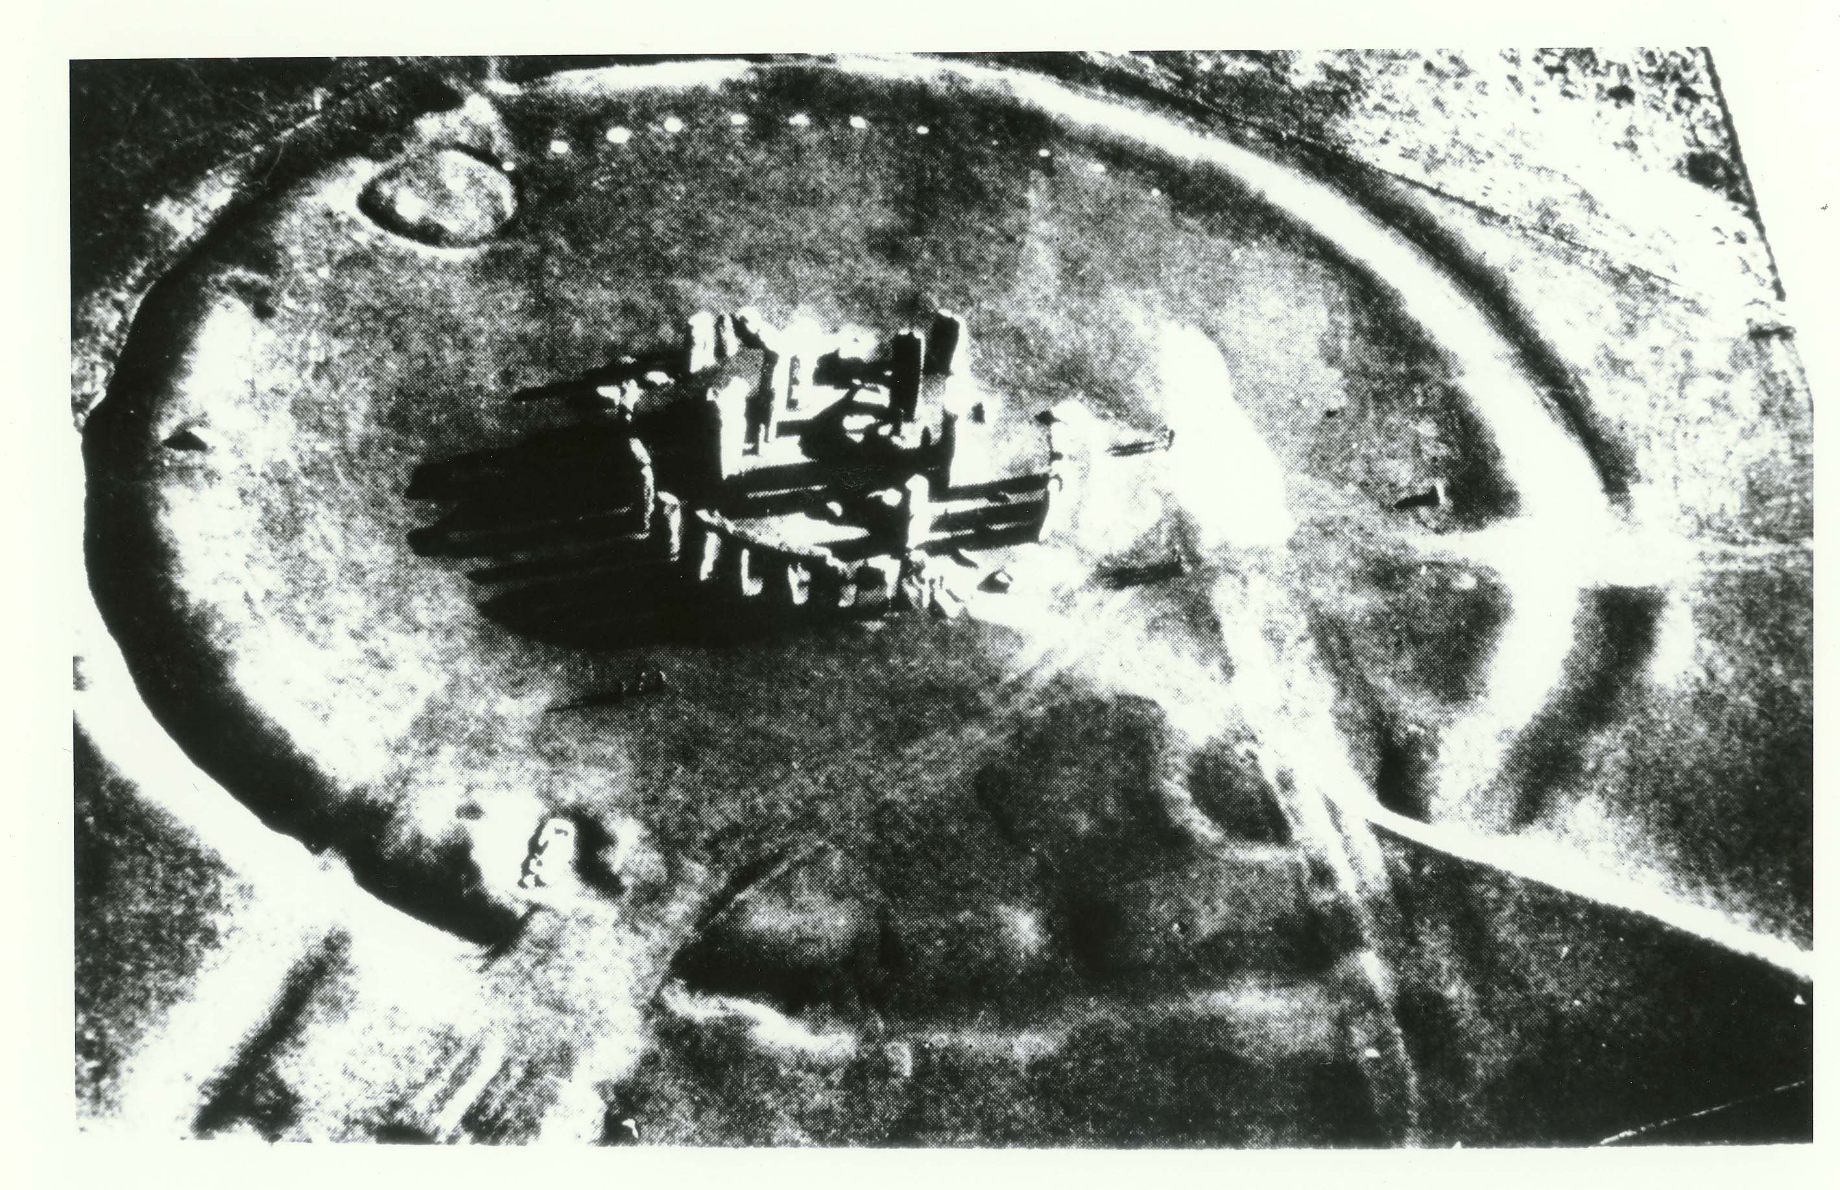
STONEHENGE
The first synchrotron light source?
A bit of history

Slide 10
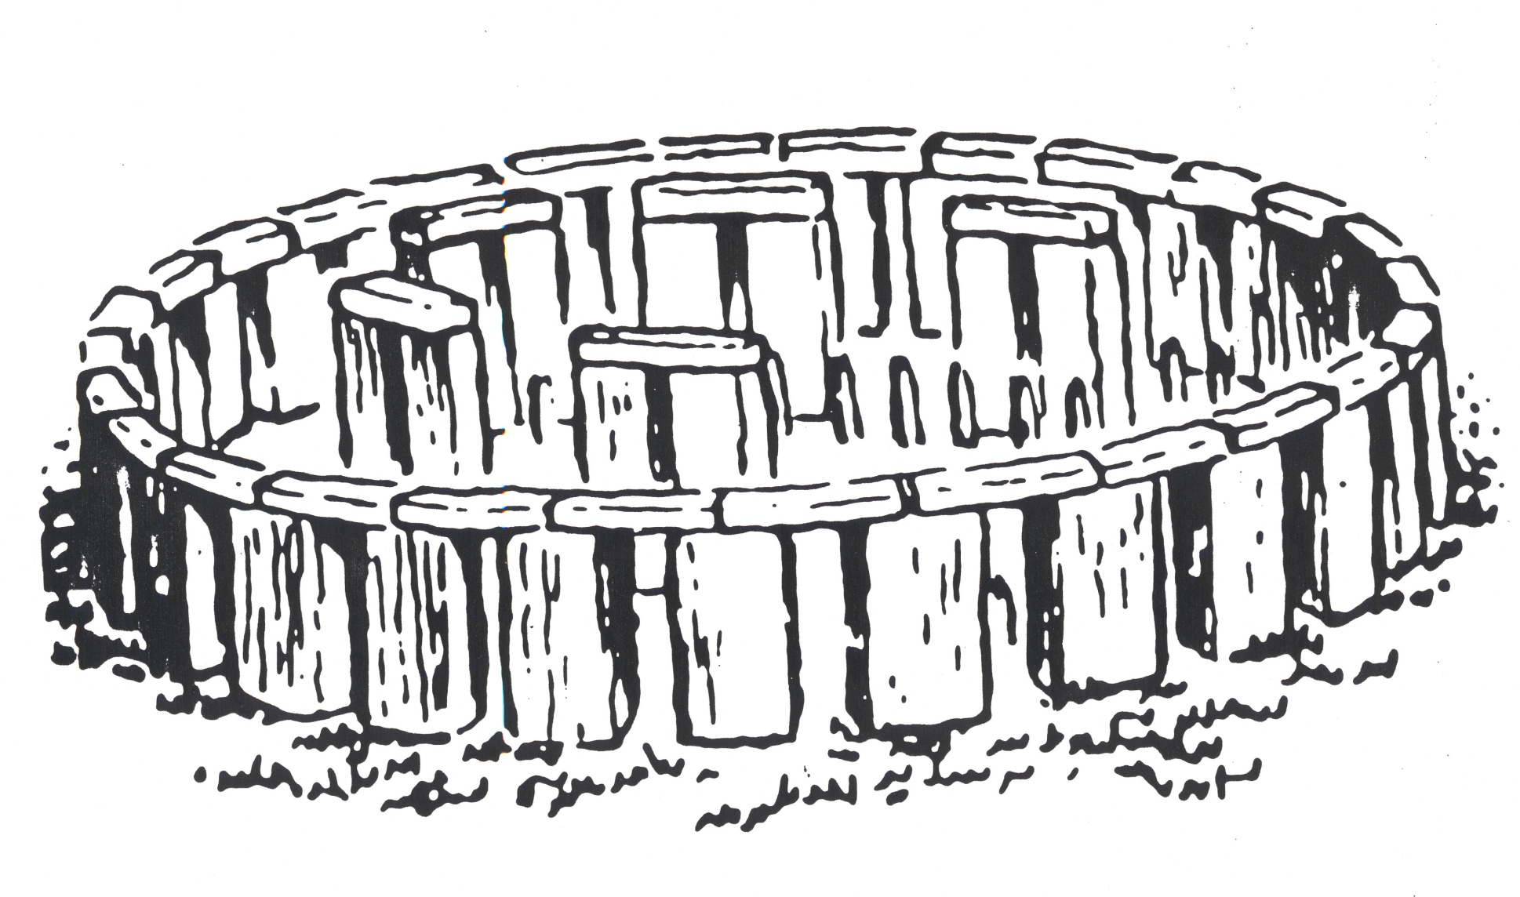
A reconstructed view

Slide 11
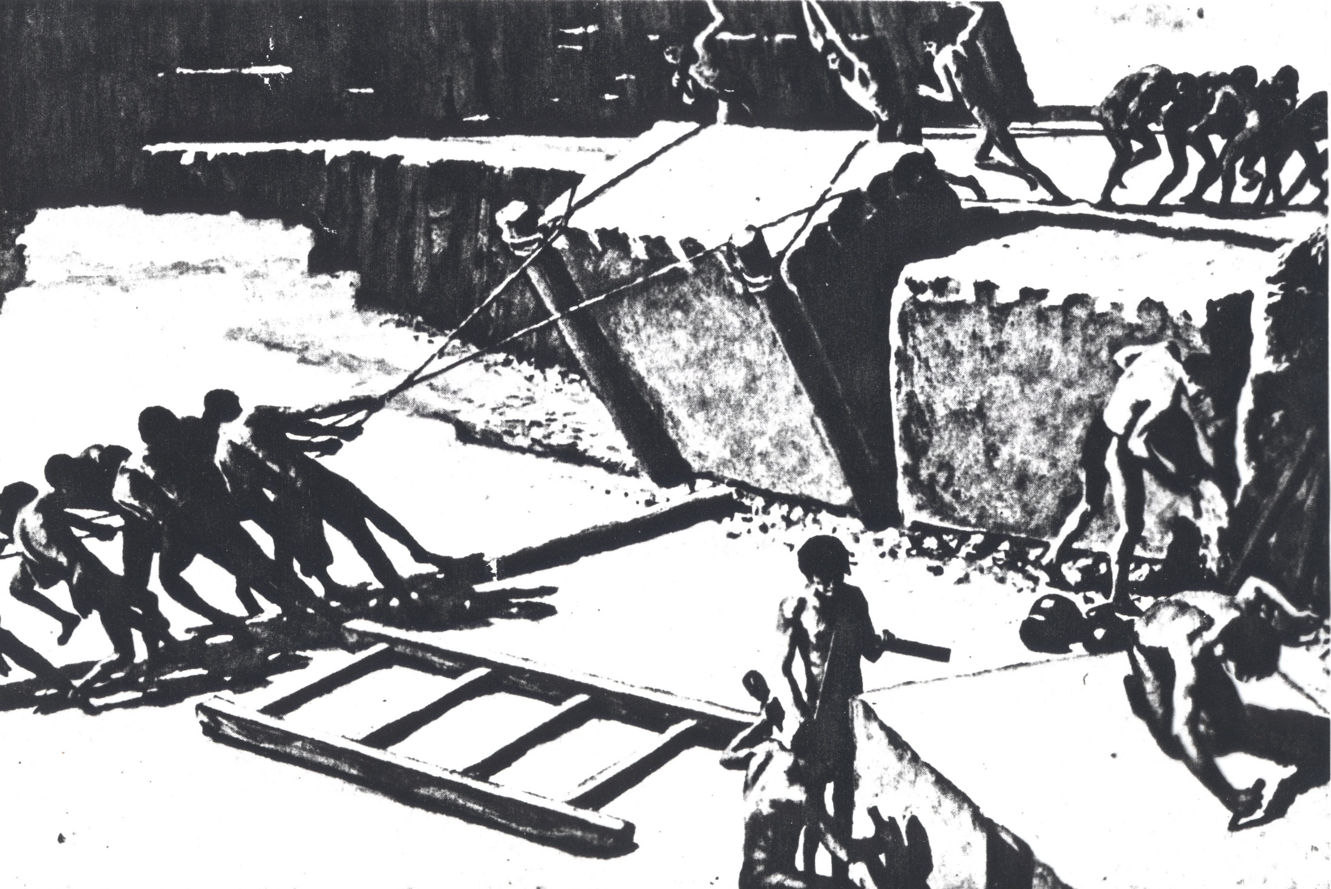

Slide 12
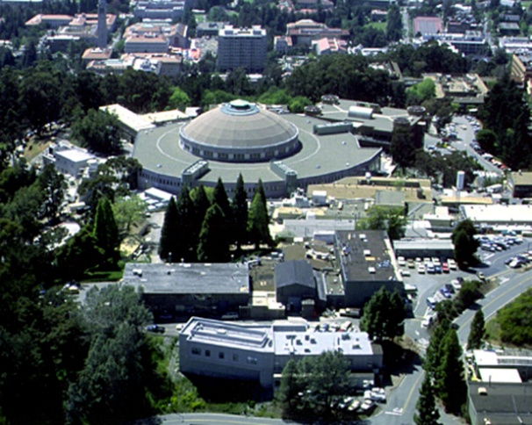
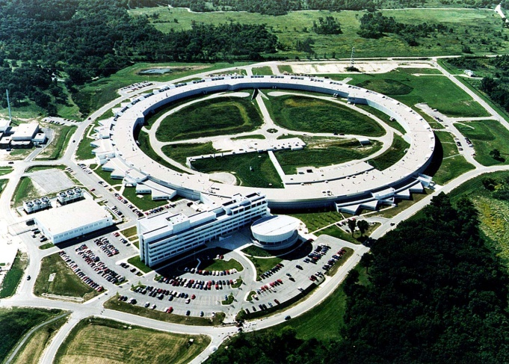
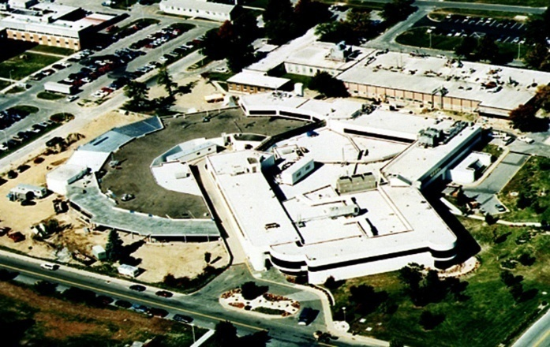
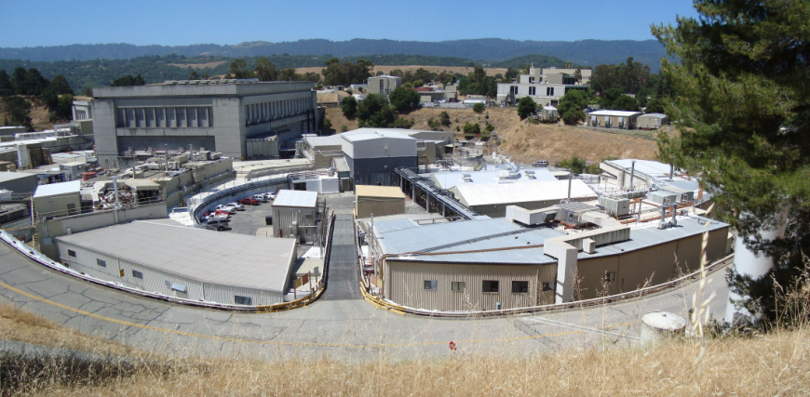
The Four Largest US Light Sources –
supported by the Dept. of Energy (DOE)
Advanced Light Source (ALS),
Lawrence Berkeley National Laboratory (1993)
Advanced Photon Source (APS),
Argonne National Laboratory (1996)
National Synchrotron Light Source (NSLS), Brookhaven National Laboratory (1982)
Stanford Synchrotron Radiation Lightsource(SSRL),
SLAC National Accelerator Laboratory (1974)

Slide 13
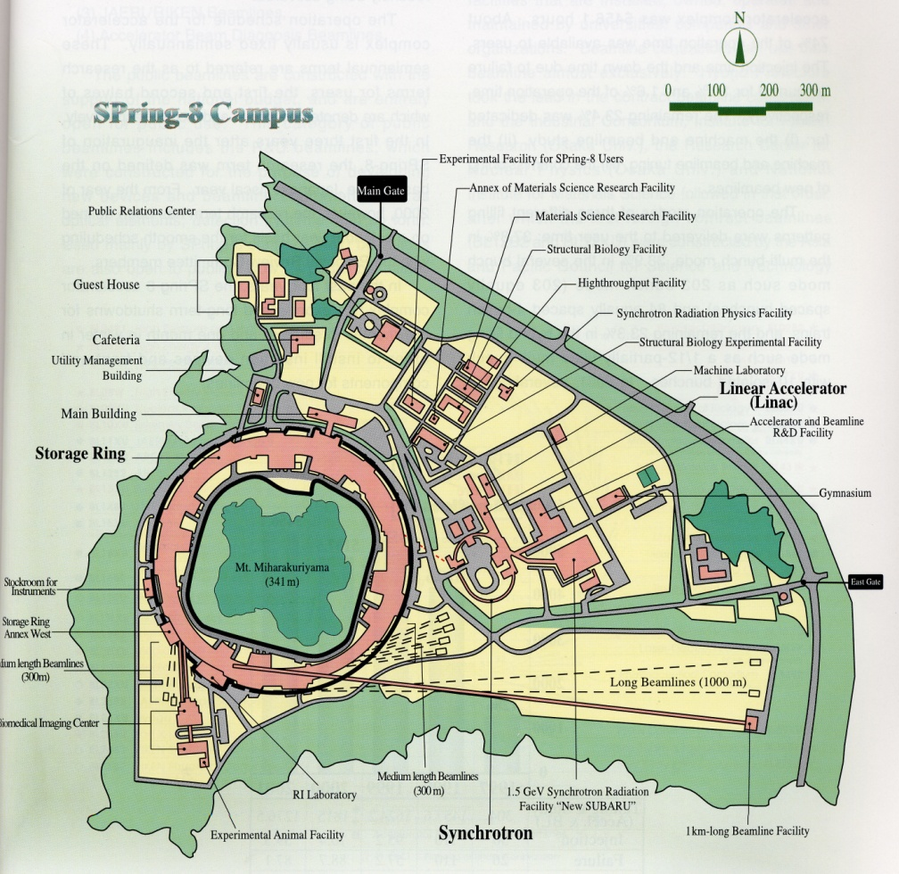
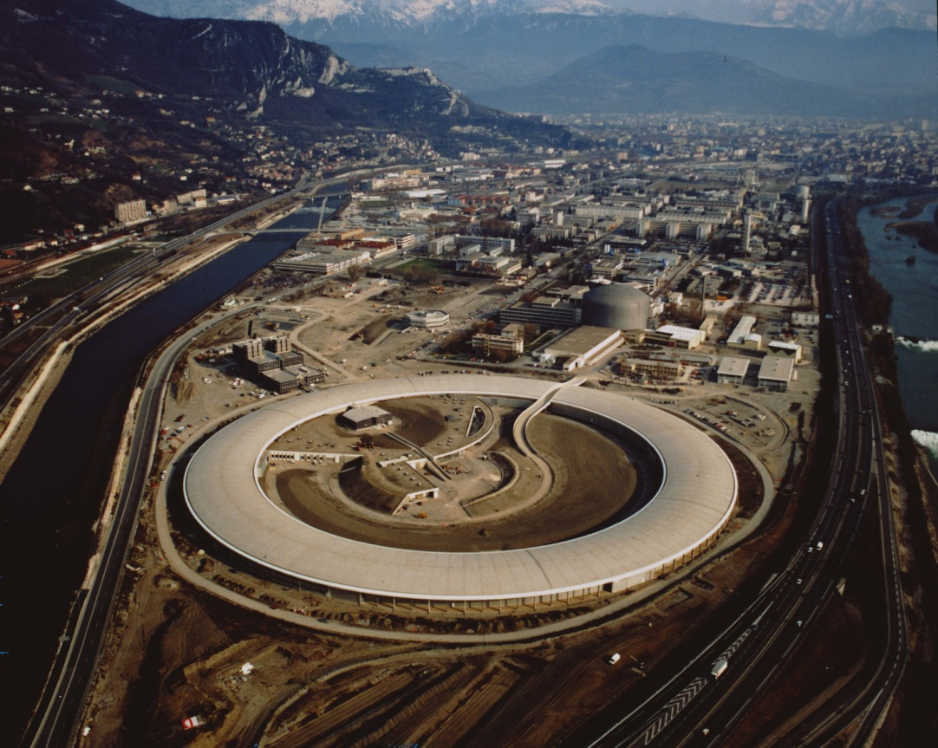
Major Synchrotron Radiation Research Centers
JAPAN (8 GeV)
The 6 GeV European Synchrotron Radiation Facility (in France)
Spring – 8 facility

Slide 14
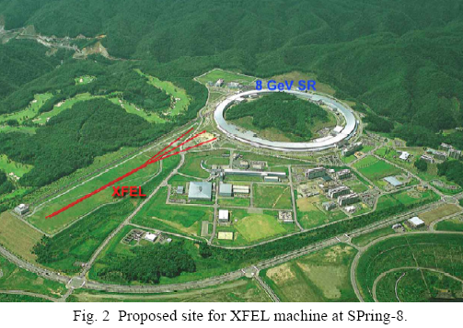

Slide 15
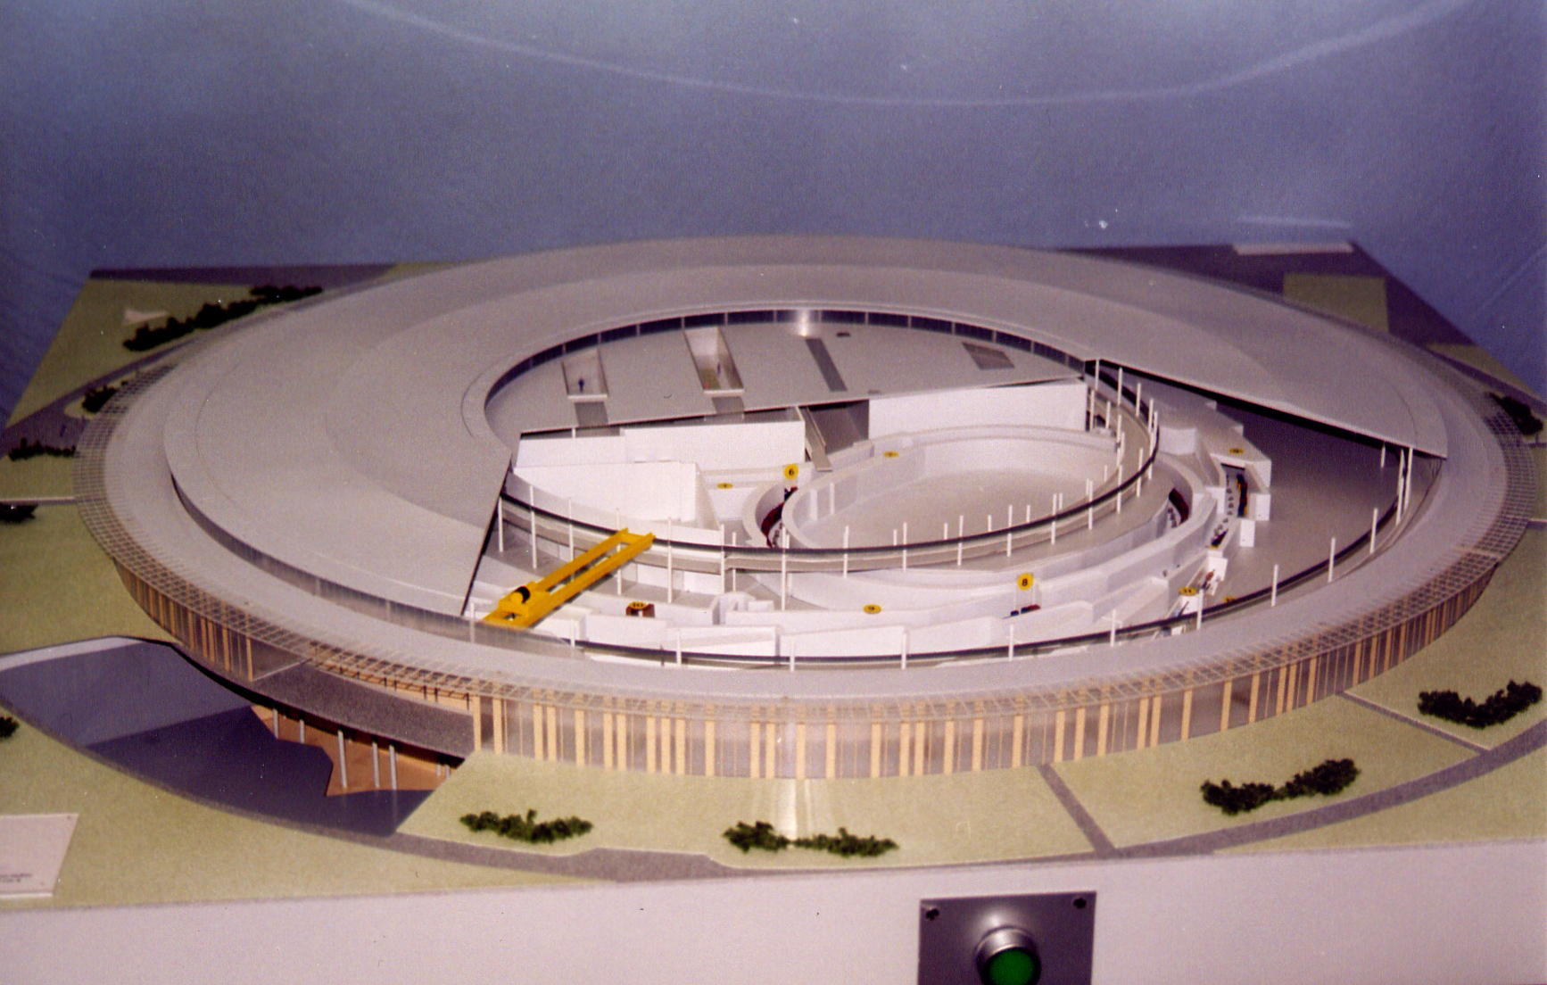
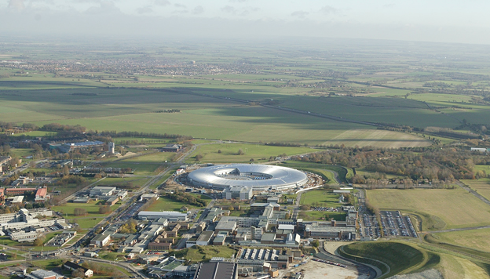
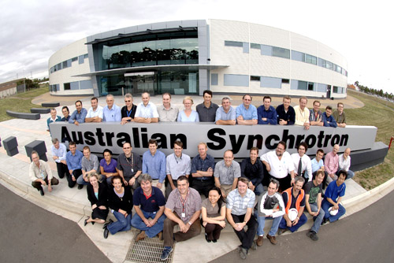
Soleil; Orsay, France; 2.75 GeV, 354 m
DIAMOND; 3 GeV, 561 m
Rutherford Accelerator Lab, Oxford UK
Recently completed facilities
2006
^{3GeV}
^{216 m}

Slide 16
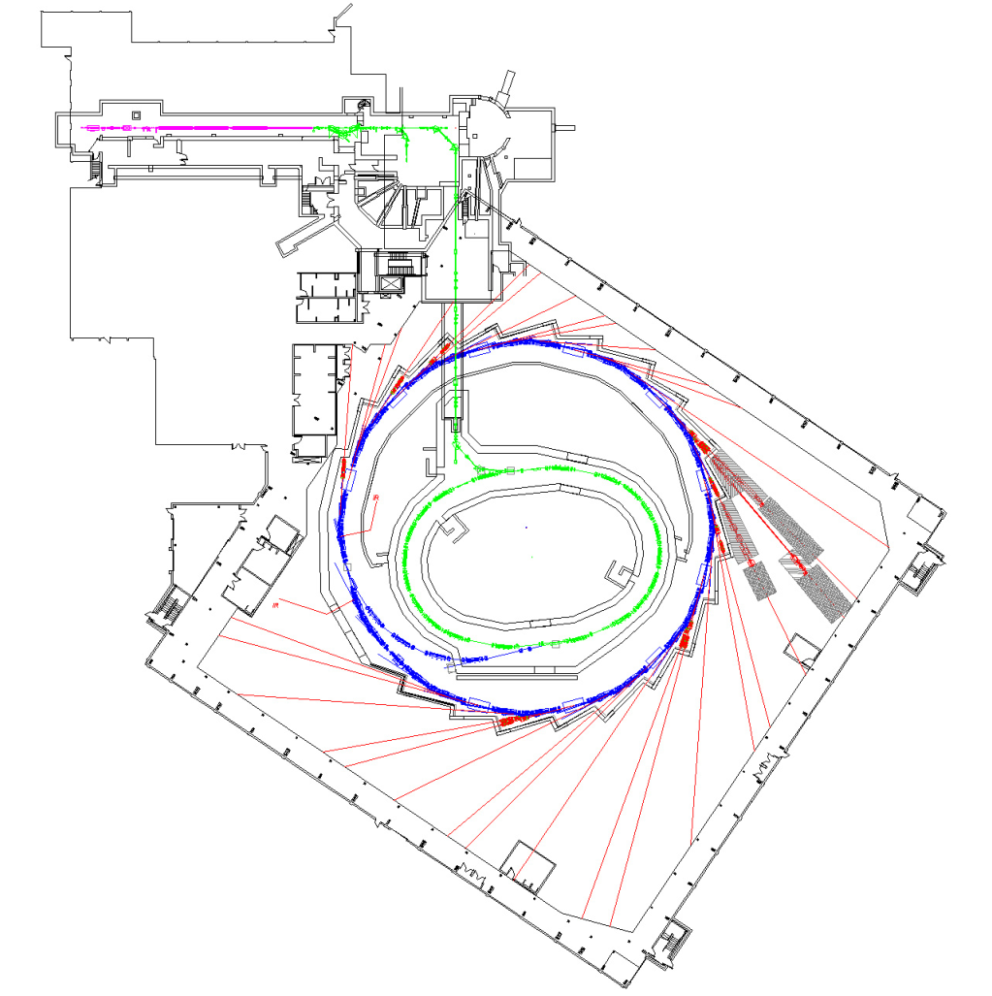
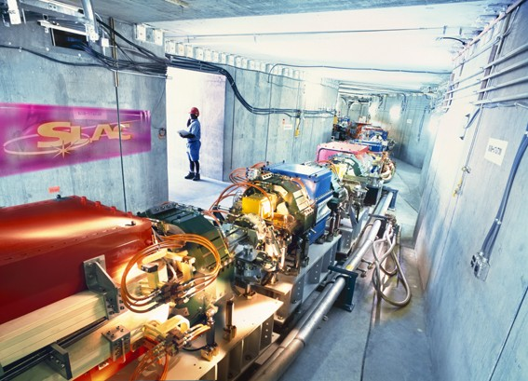
SPEAR 3, SLAC 3 GeV, 235 m
Facilities completed within past few years
Canadian Light Source
Saskatoon; 2.9 GeV, 171 m

Slide 17
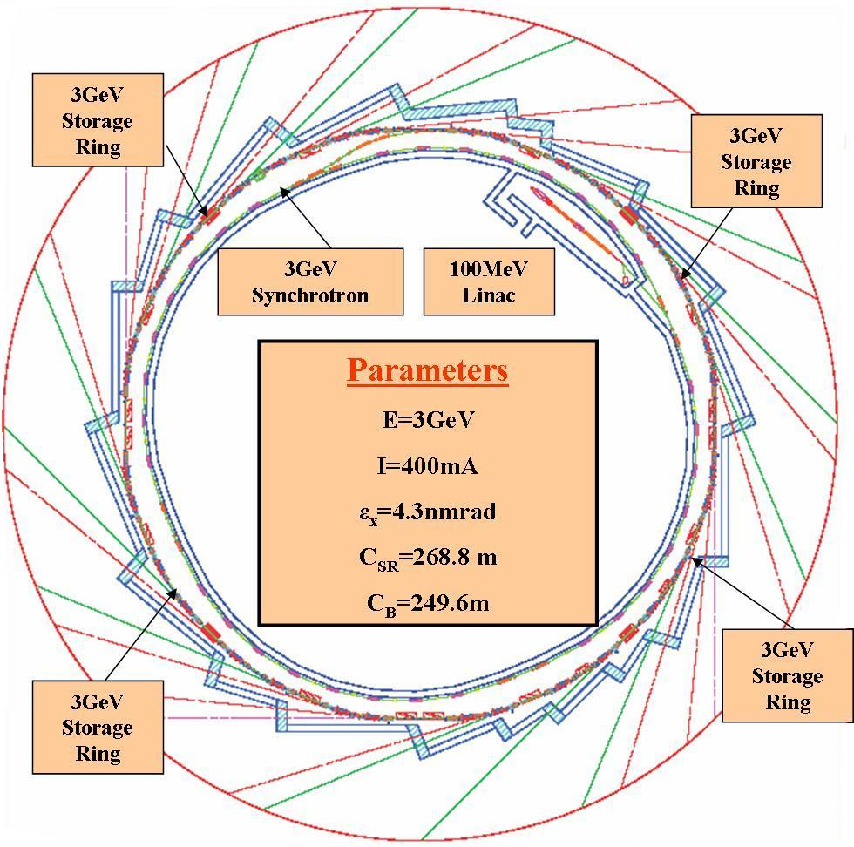
Alba Light Source; Barcelona, Spain; 1st operation, March 2011

Slide 18
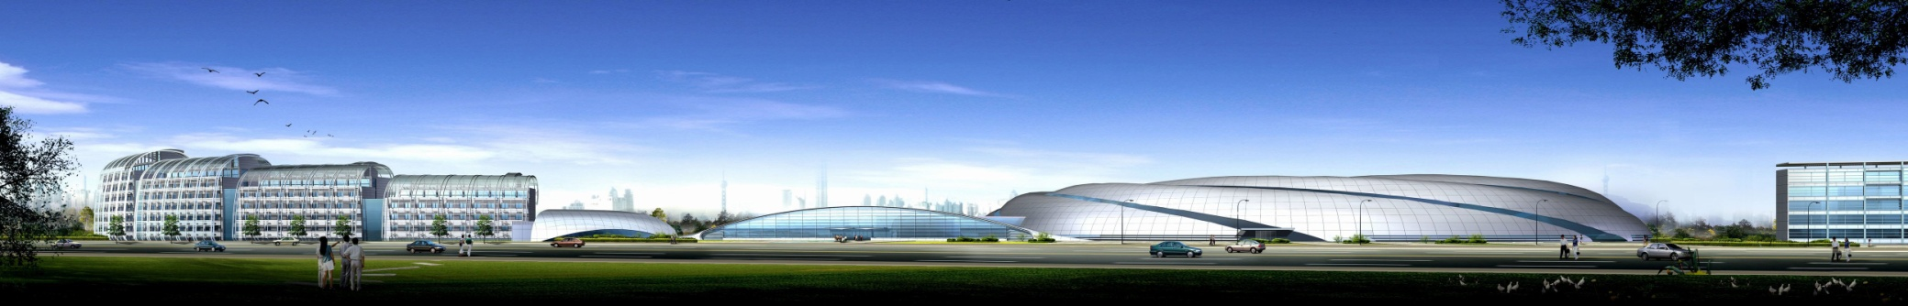
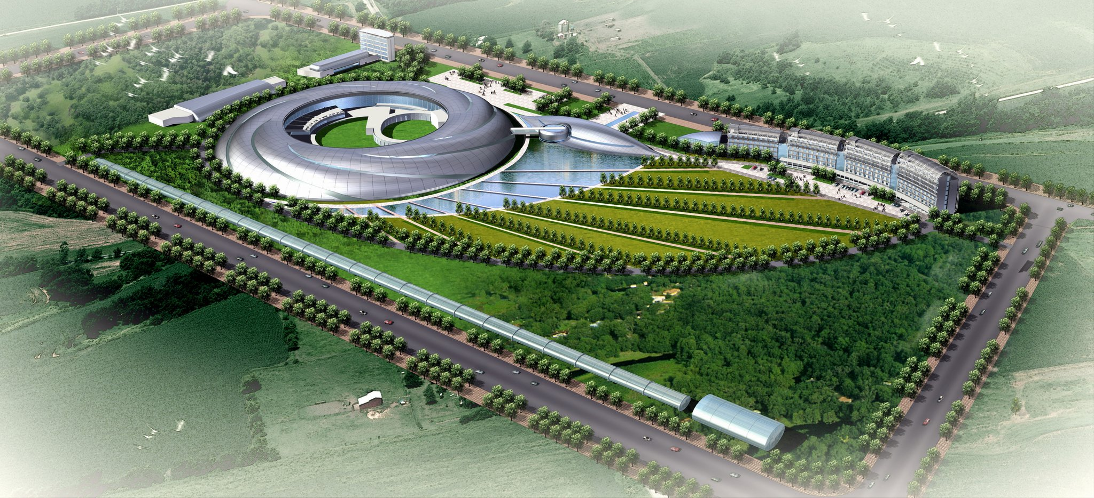
Shanghai light source; 3.5 GeV, 432m, 3 nm-rad

Slide 19
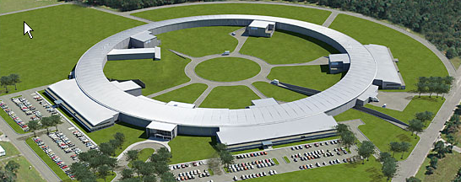
NSLS II – a new, state of the art ring for Brookhaven National Lab
In Construction
3 GeV, 792 m, 0.4 nm-rad
Operation, 2014

Slide 20
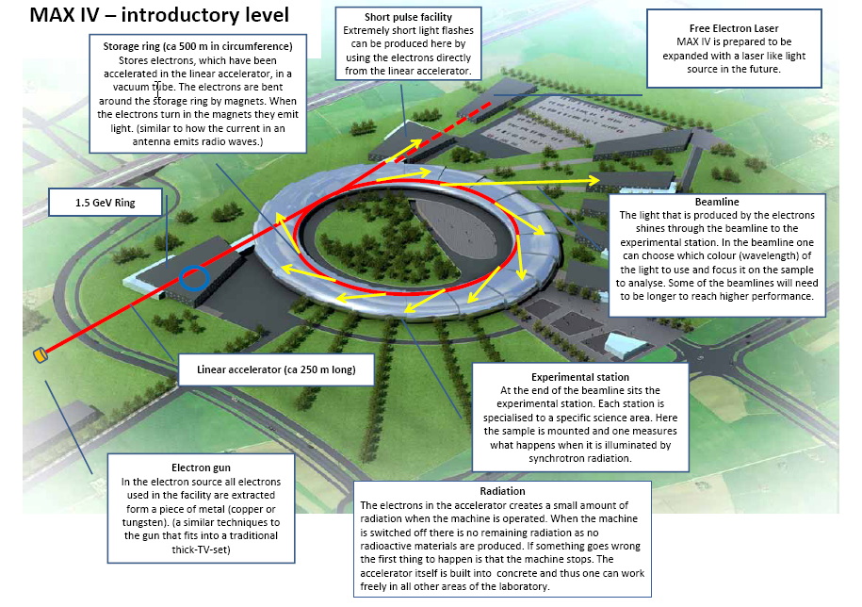
3 GeV, 500m, 0.24 nm-rad
http://www.maxlab.lu.se/

Slide 21
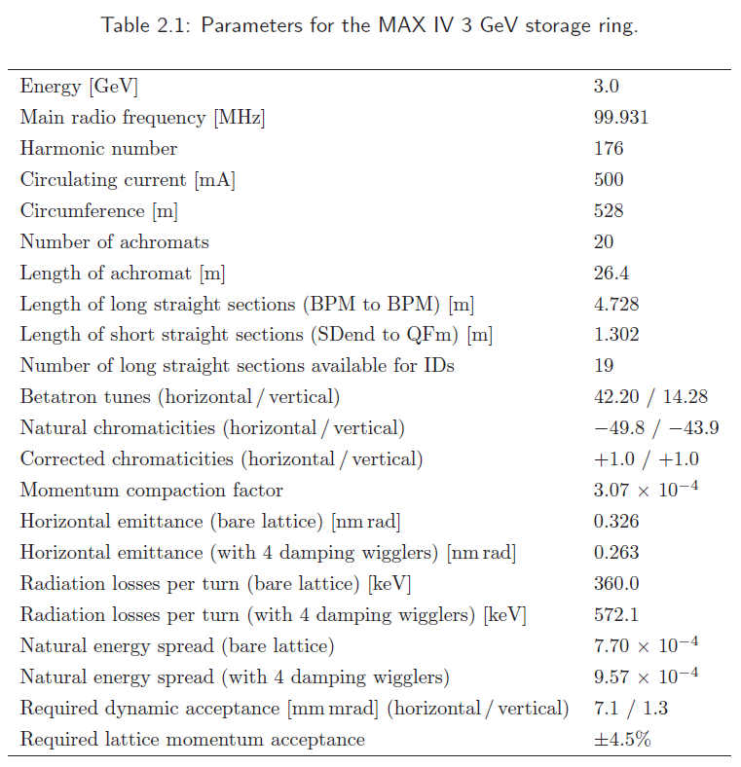

Slide 22
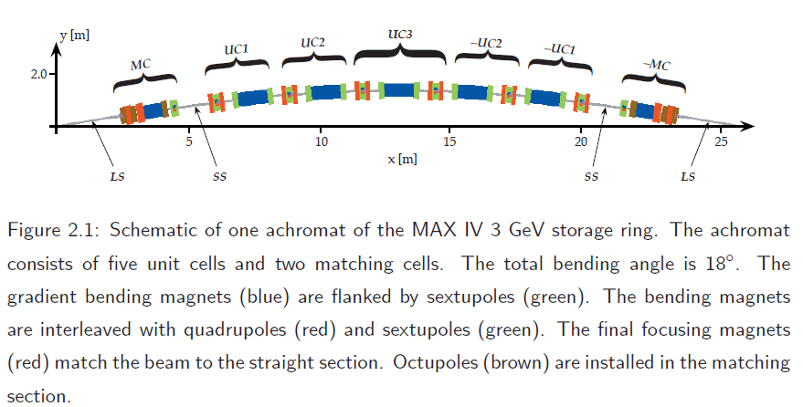

Slide 23
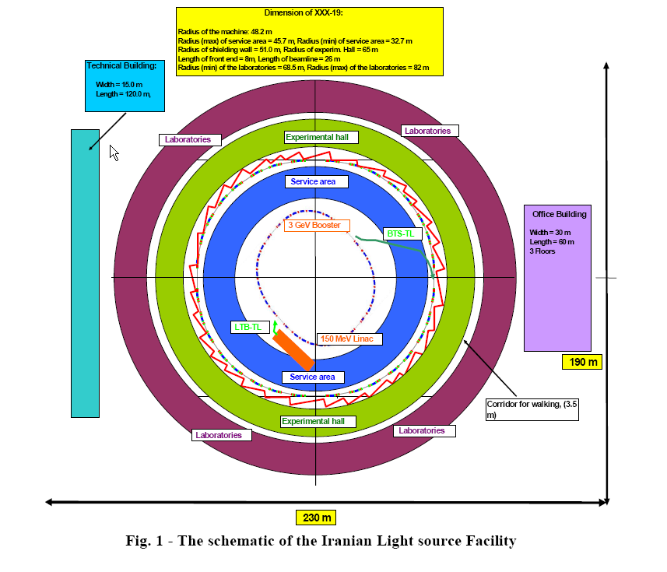
http://accelerator.ipm.ac.ir/ http://ilsf.ipm.ac.ir/AboutUs/ILSF-Project.pdf
presented by Javad Rahighi at IPAC 2010 in Japan
http://accelconf.web.cern.ch/Accelconf/IPAC10/papers/wepea023.pdf

Slide 24

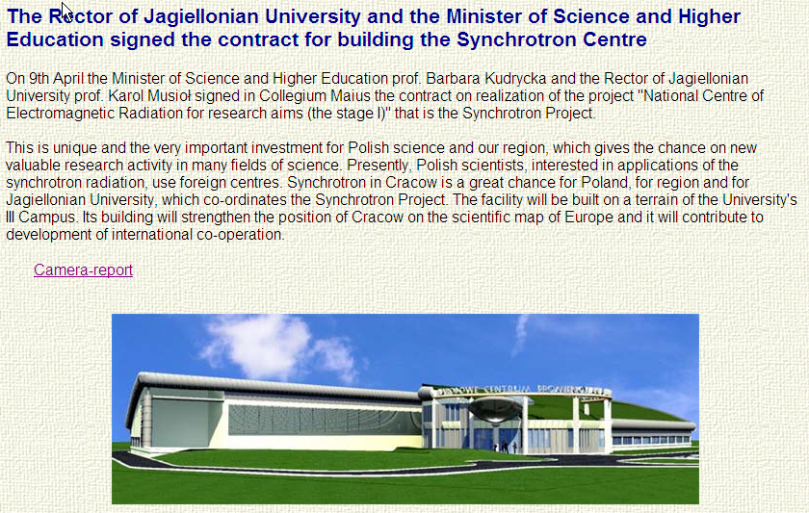
circumference: ca. 95 m, energy of electrons: 0.7 - 1.5 GeV.
http://www.synchrotron.uj.edu.pl/ In Construction

Slide 25
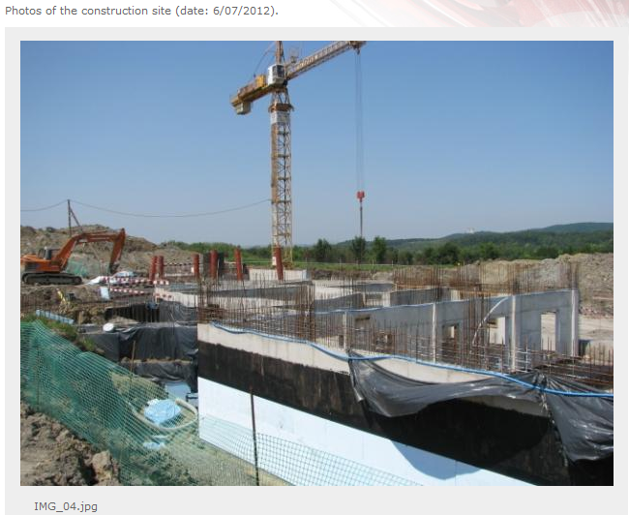
SOLARIS Synchrotron Radiation Facility; under construction in Poland

Slide 26
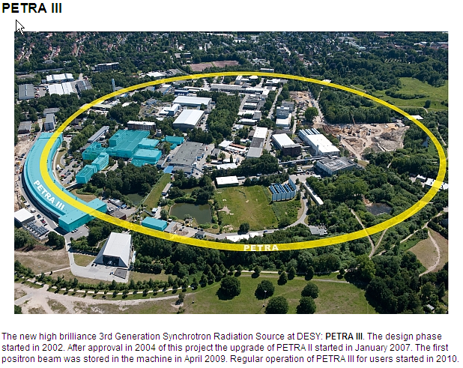
Petra III, DESY; 2.3 km, 6 GeV, 100 mA, 1 nm-rad

Slide 27
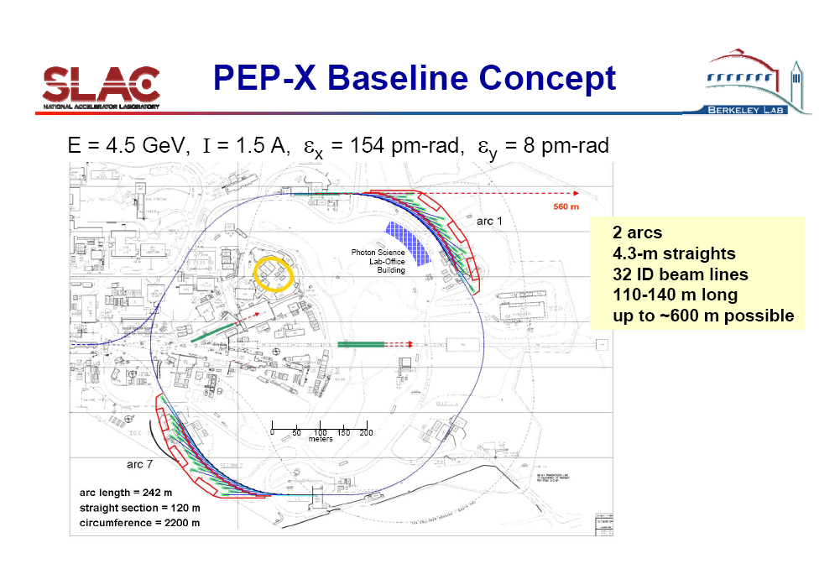

Slide 28
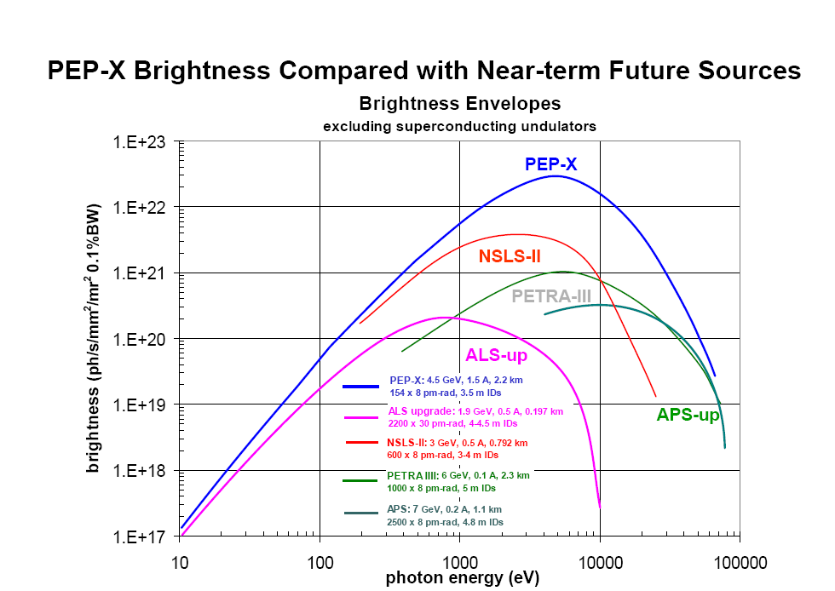

Slide 29
Why a Synchrotron Radiation Facility in the Developing World?
World-class basic & applied research
Train graduate students who will no longer have to go abroad
Attract scientists working abroad to return (reverse the brain drain)
Address regional biomedical & environmental issues/concerns
Promote development of high-tech industry (capacity building)
Use scientific cooperation to promote peace & understanding between people from different traditions, religions, races, & political systems.

Slide 30
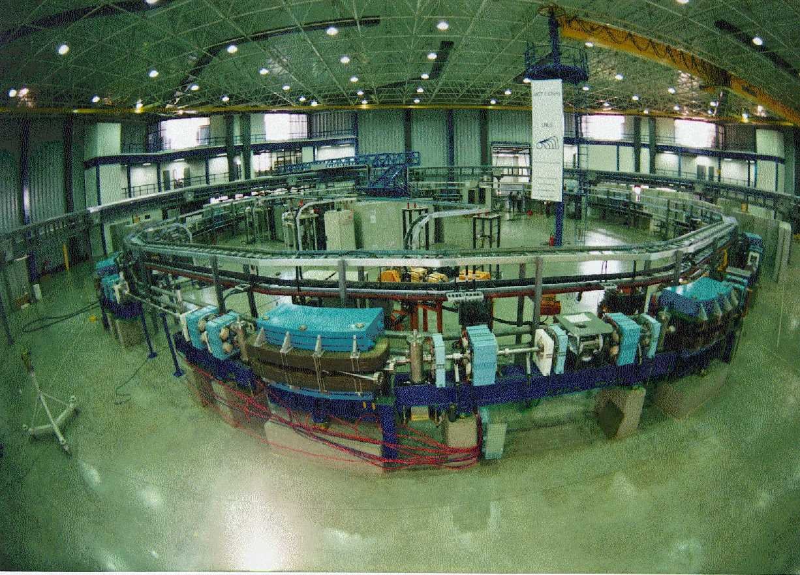
Brazilian Synchrotron Radiation Source 1.37 GeV 250 mA
12 Dipoles B=1.67 Tesla Injector: LINAC 120 MeV Booster: 500 MeV

Slide 31
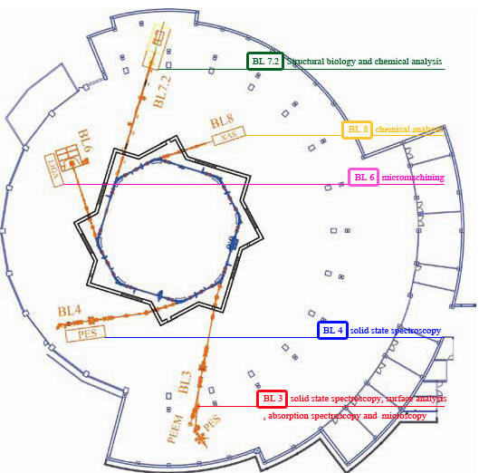
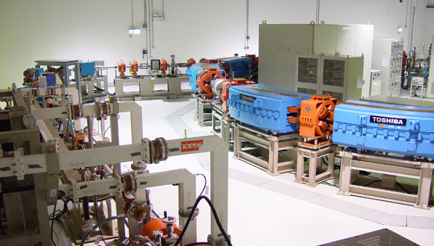
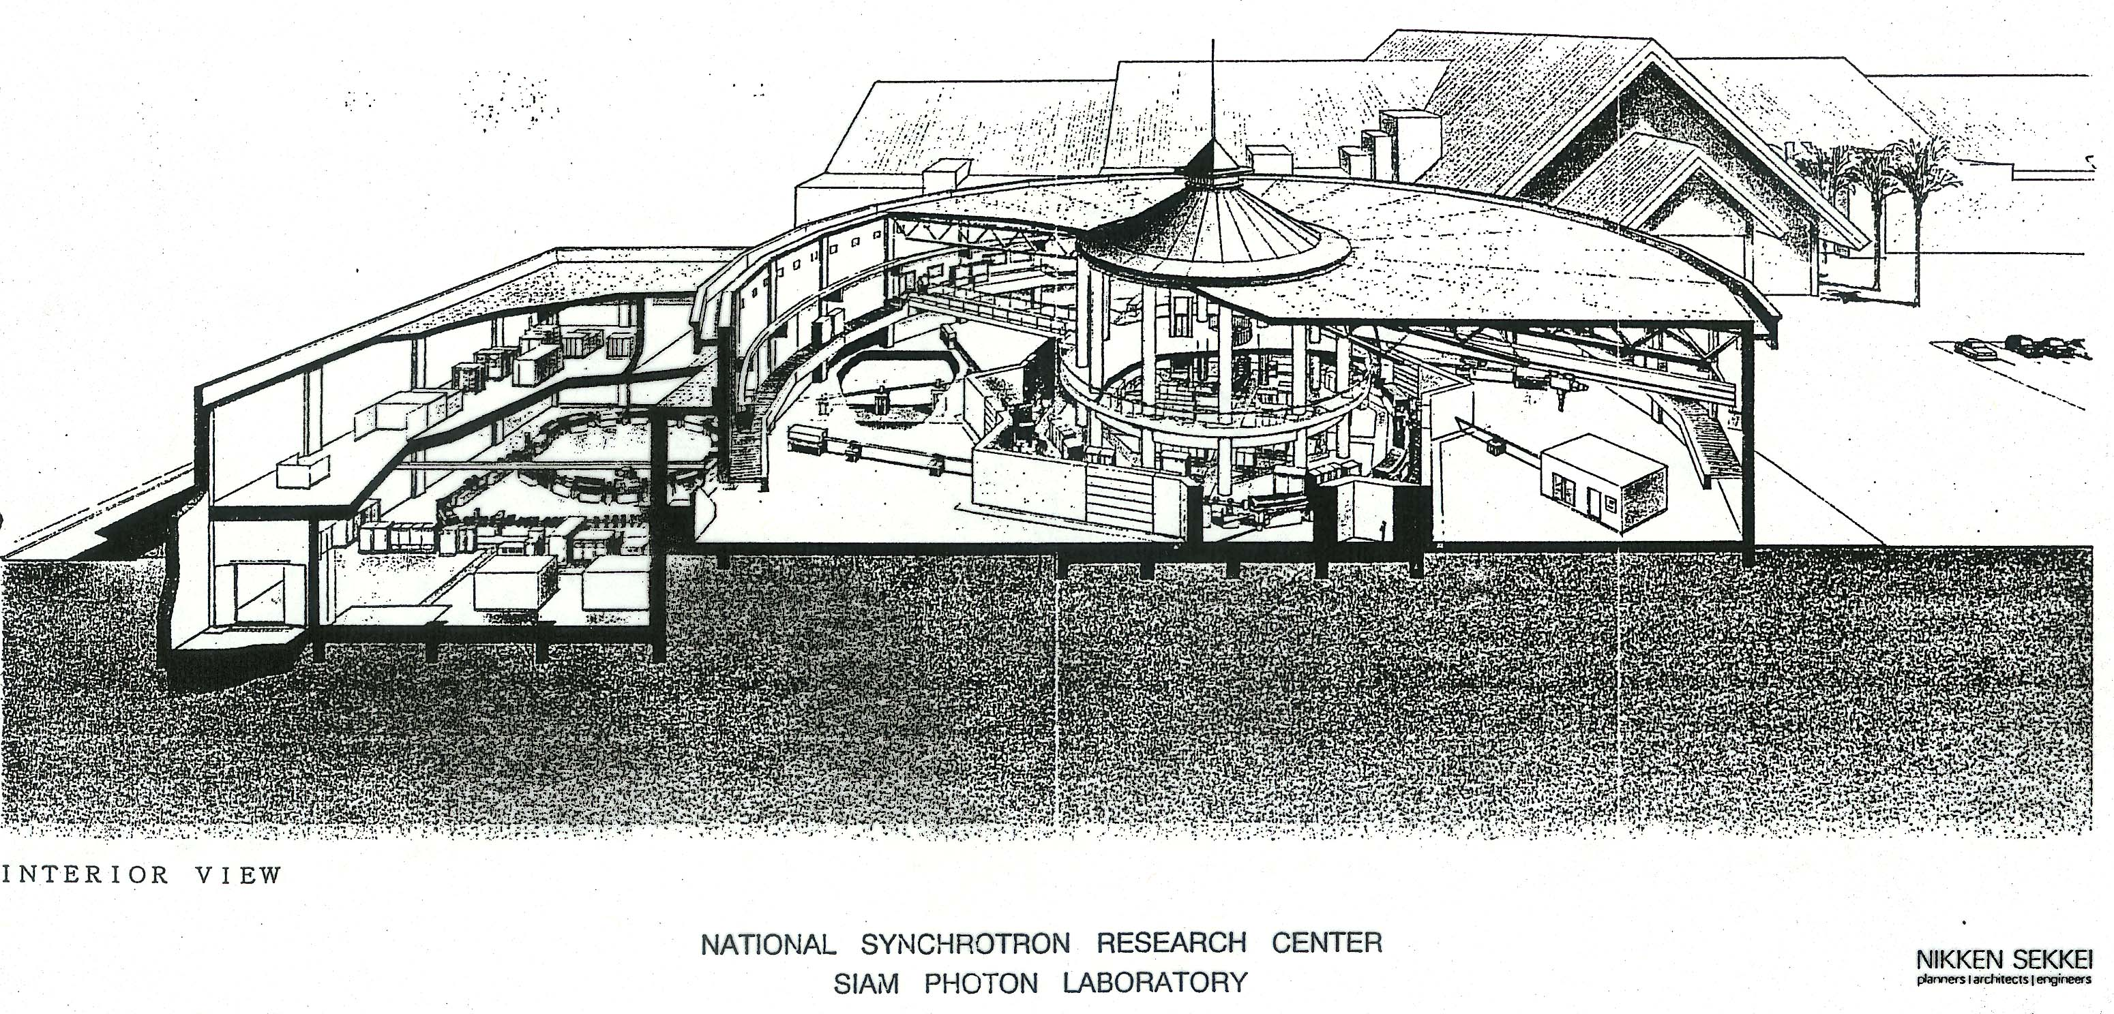
Synchrotron light in Thailand
SIAM facility; gift by Japan of 1 GeV SOR-Tech facility
An initiative by Takehiko Ishii

Slide 32
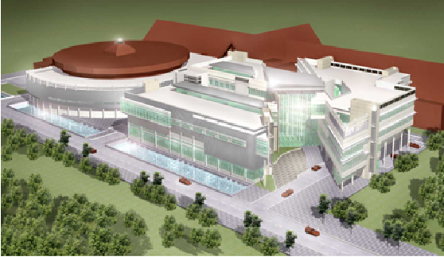
National Synchrotron Research Center (NSRC); Thailand

Slide 33
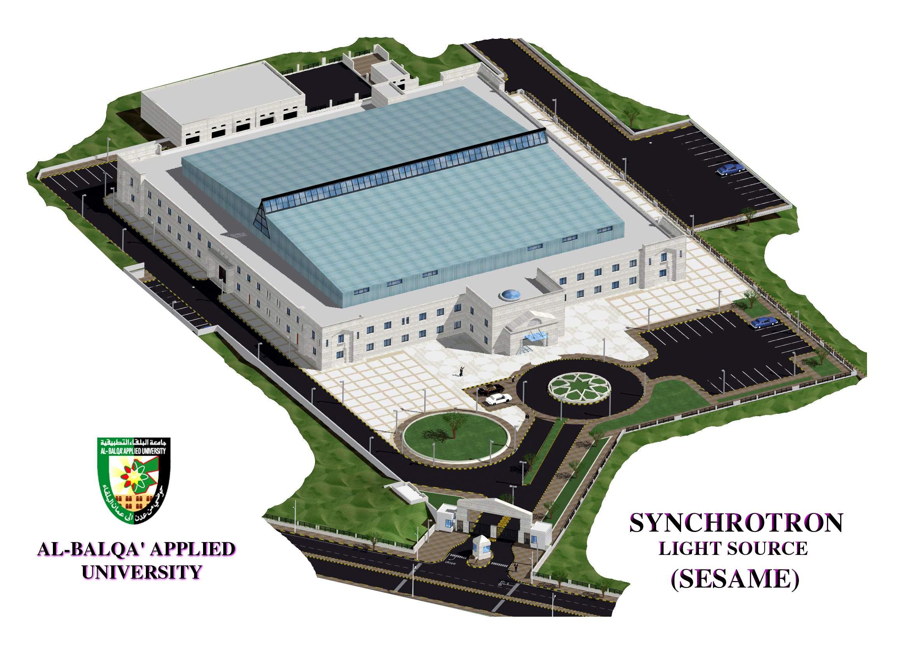
Synchrotron-Light for Experimental Science
and
Applications in the Middle East
Bahrain, Cyprus, Egypt, Iran, Israel, Jordan, Pakistan, Palestinian Authority, Turkey
www.sesame.org.jo

Slide 34
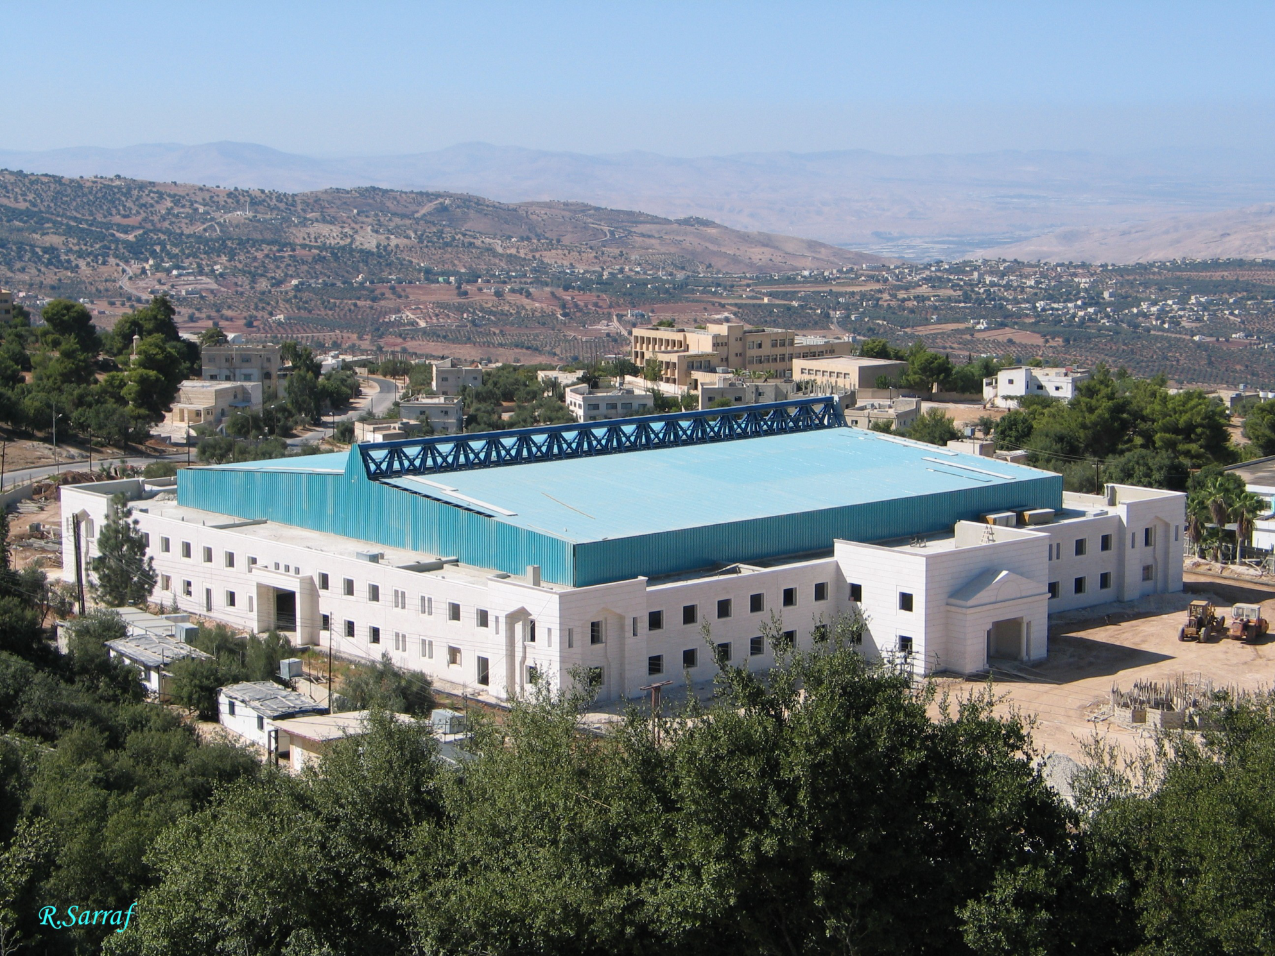

Slide 35
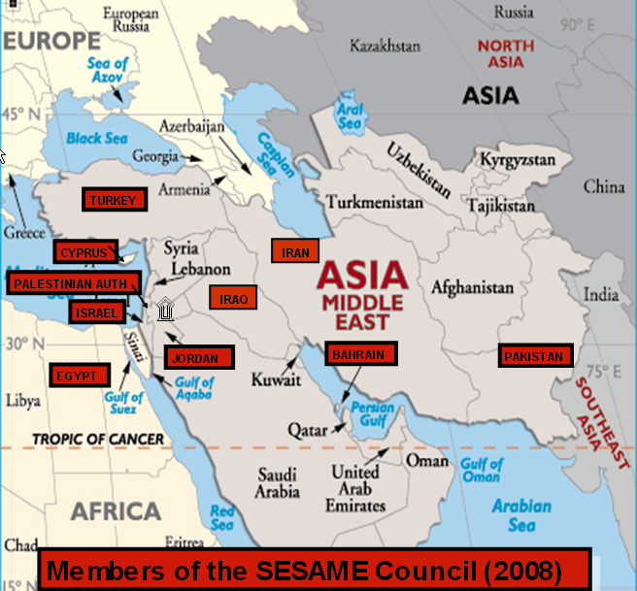
SESAME = Synchrotron-light for Experimental Science and Applications in the Middle East
A 2.5 GeV light source facility, under construction near Amman, Jordan
Under UNESCO Auspices, Modelled on CERN
SESAME
Members: Bahrain, Cyprus, Egypt, Israel, Iran, Jordan, Pakistan, Palestinian Authority, Turkey.
Pending: Iraq
Observers: France, Germany, Greece, Italy, Japan, Kuwait, Portugal, Russia, Sweden, Switzerland, UK and USA.
Purpose: Foster excellent science and technology in the Middle East (and prevent or reverse the brain drain)
  + Build bridges between diverse societies

Slide 36
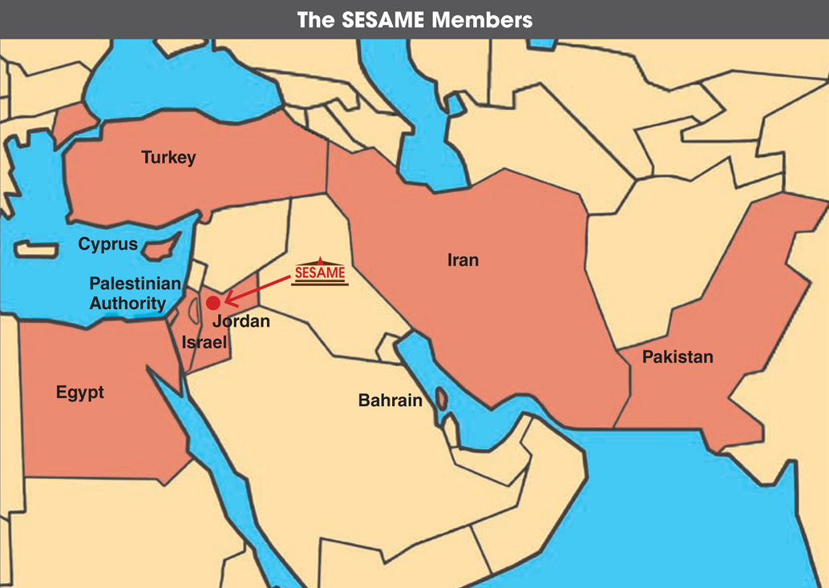

Slide 37
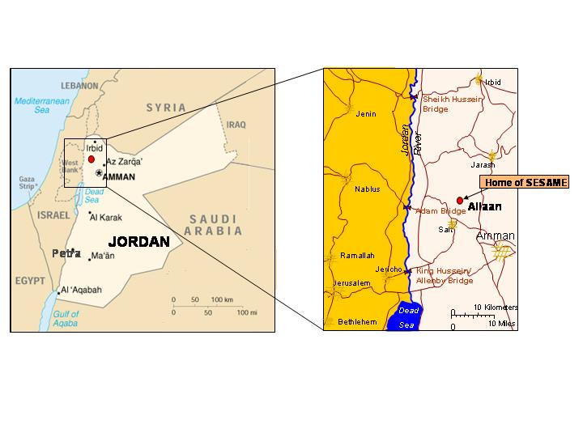
SESAME location in Allaan, Jordan

Slide 38
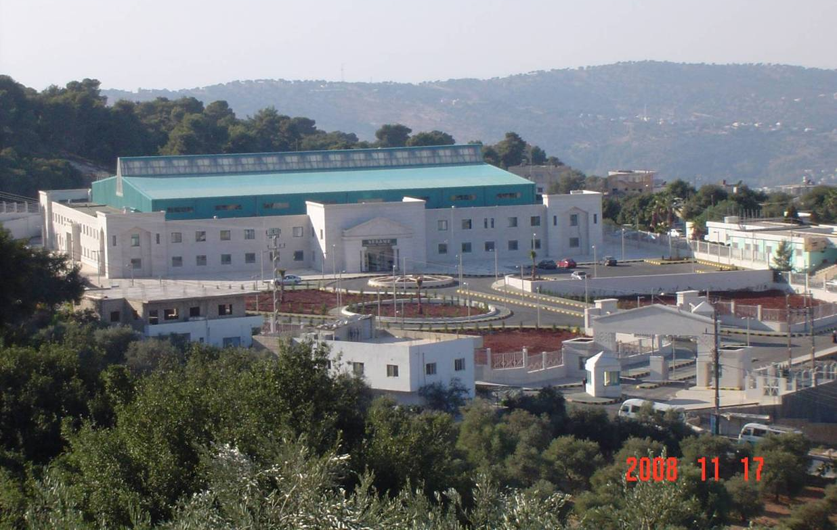
SESAME Building in Allan, Jordan

Slide 39
SESAME; in construction in Jordan www.sesame.org.jo
2.5 Gev
400 mA
C = 133 m
Emitt; 26 nm
12 spaces for wigglers or undulators
16 bend magnet lines
Beam lines up to 36 m long
Space for future full energy injector in main ring tunnel
Operational in 2015

Slide 40
The Evolution of SESAME
1980’s: Nobel Laureate Abdus Salam suggests a light source for the Middle East
1990’s: Individuals and groups promote scientific cooperation between Israel and Arab countries.
In particular, Middle East Scientific Cooperation (MESC) group, based at CERN (Sergio Fubini, Eliezer Rabinovici, Herwig Schopper, Tord Ekelof…)
My own involvement; BESSY II Machine Advisory Committee meeting, September 1997
I asked, “What will become of BESSY I?”

Slide 41
Brief History of SESAME
1997 – Original idea (Voss, Winick); Upgrade/rebuild BESSY 1(0.8 GeV) in the Middle East, as centerpice for a new international research center. Voss presents the concept to a MESC meeting in Turino. Very positive response from Middle East scientists.
1998 – Voss presents concept to MESC meeting in Uppsala. MESC endorses SESAME
1999 - 1st meeting at UNESCO; (Interim) Council established – Herwig Schopper, President; form international advisory committees
2000 – Begin workshops, schools; Growing community interest
2002 - Decision to build a new 2.5 GeV ring (still using BESSY injector)
2003 - Ground breaking for building; completion in 2008
2008 – Chris Llewellyn-Smith takes over as Council President
Vigorous training programme and growing potential user community
First experiments in 2015, assuming funding for main ring & beamlines is secured. (new beamlines plus adapting/upgrading donated beamlines)

Slide 42
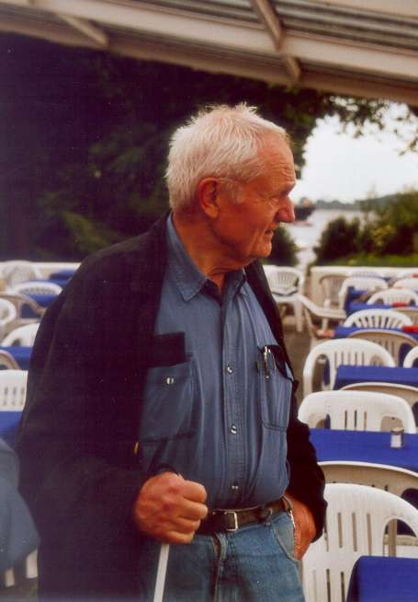
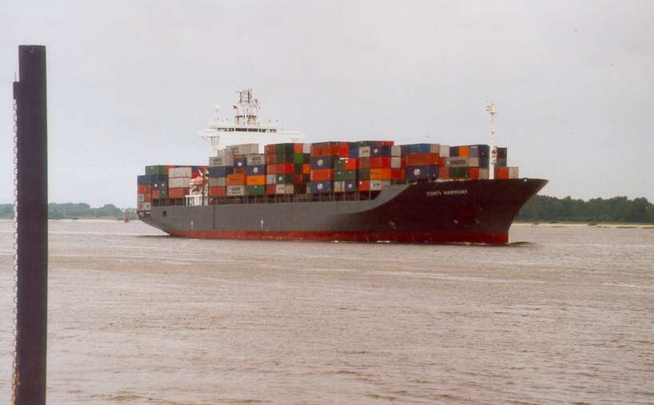
Gus Voss (DESY) watching the boat leave Hamburg harbor on its way to Aqaba, Jordan with BESSY I on board; June 7, 2002

Slide 43

Inside the SESAME building; May 2008

Slide 44

BESSY I 0.8 GeV Booster Synchrotron set up in SESAME building for “soft” inauguration on November 3, 2008
Mayor of Salt, Mr. Salameh, and Herman Winick

Slide 45




SESAME
Tests of the MICROTRON Subsystems
45

Slide 46

Microtron (injector to BESSY 1) at SESAME, November 2008

Slide 47

Shielding Completed, May 2011

Slide 48
UNESCO Press Release; March 13, 2012
(Available at www.sesame.org.jo)
Major Capital Funding Agreed for SESAME
At a meeting in Amman on 8 March 2012, representatives of four SESAME Members (Iran, Israel, Jordan and Turkey) agreed to make voluntary contributions of US$5 million each towards the construction of SESAME over the four years 2012-15.
Construction of SESAME is progressing well, on a schedule which will allow commissioning with four ‘day-one’ beamlines in 2015. The remaining sum of some $15 million that is still required for procurement is being sought from other SESAME Members (Egypt was preparing to join this initiative, and is still expressing great interest, but this has so far proved difficult due to changes in the government; Pakistan and the Palestinian Authority have offered to provide up to $5 million and $2 million respectively in-kind) and from outside sources, including the EU (which has already contributed $4.5 million), the USA (which has recognised SESAME as ‘an initiative that supports the diplomatic interests of the USA’), and major charitable foundations. The manpower costs will be provided collectively by the SESAME Members.
Following the first of the newly-agreed voluntary contributions (totaling US$5 million) in 2012, Iran, Israel, Jordan and Turkey will review their commitments if another SESAME member does not join this initiative later this year.
The representatives of Iran, Israel, Jordan and Turkey present at the meeting expressed their satisfaction at this major step forward for the SESAME project and for scientific cooperation in the region. The Director of SESAME, H.E. Dr Khaled Toukan, stated that “The agreement on voluntary contributions will allow us to move ahead rapidly with the construction of SESAME and prepare for the first experiments in 2015/16”.
The President of the SESAME Council, Professor Sir Chris Llewellyn Smith FRS, added “The extensive SESAME training programme is already contributing to building scientific and technical capacity in the SESAME Members. The completion of SESAME will provide the region’s growing scientific community with a tool which will enable world-class research in a wide range of scientific disciplines”.

Slide 49

NATURE | NEWS 21 March 2012
Clashing nations back SESAME
Participants put politics aside to find cash for construction of Middle-East synchrotron.
Israel and Iran can agree on little these days, but they have found common ground in a scientific project.
Despite brinkmanship over Iran's nuclear programme, the two nations have joined with Jordan and Turkey to commit crucial funding to the construction of Synchrotron-light for Experimental Science and Applications in the Middle East (SESAME). Under an agreement announced on 13 March, the partners have promised a total of US$20 million towards the construction of the project. SESAME is now looking for a further $15 million from other partner nations to complete the synchrotron's first four beamlines in 2015.
“The fact that we could get such an agreement given the political situation is kind of remarkable,” says Chris Llewellyn Smith, the president of SESAME's governing council and a past director-general of CERN, Europe's particle-physics lab near Geneva, Switzerland.

Slide 50
UNESCO has played a key role in the development of SESAME
(as it has in the creation of CERN)
Financial support, particularly for the first meetings
Experienced staff and leadership
A neutral umbrella under which scientists can work cooperatively in spite of
tensions among governments, cultural and religious differences, etc.
The UNESCO Executive Board & General Assembly referred to SESAME as
“a model project for other regions” and
“a quintessential UNESCO project combining capacity building with
vital peace-building through science”
Key UNESCO staff; Gretchen Kalonji, Maciej Nalecz, Clarissa Formosa-Gauci
The SESAME concept is attracting attention around the world

Slide 51

Nobel Laureates visit SESAME site in June, 2008
45 Laureates endorse SESAME “as a beacon, demonstrating how shared scientific initiatives can help light the way towards peace”.

Slide 53
SESAME location in Allaan, Jordan

Slide 54

Heman Winick
Dincer Ulku
Javad Rahigi
Zehra Sayers
    3rd SESAME User Meeting
    October 11-13, 2004, Antalya, Turkey
    9th Users’ meeting in Amman November 2009

Slide 55

JSPS-SESAME-Sabanci Univ. SCHOOL; Turkey, March 1-5, 2010

Slide 56

Hands-on Session at SESAME-JSPS School for Synchrotron Sciences; Cairo, Egypt; Nov. 17-23, 2008

Slide 57

12th Meeting of SESAME Council; Uppsala Sweden, June 9-10, 2008
Dinçer Ülkü; Vice President of the SESAME Council
Chris Llewellyn-Smith; Council President starting in November, 2008
Yasser Khalil; Administrative Director
Khaled Toukan; Sesame Director
Herwig Schopper; Council President 1999-2008
Hafeez Hoorani; Scientific Director
Amor Nadji; Technical Director
Albin Wrulich; Chair of SESAME Technical Advisory Comm.
Missing; Zahid Hussain (Chair, Beamlines Comm.) Zehra Sayers (Chair, Scientific Comm.) Javad Rahighi (Chair, Training Comm.)

Slide 58



King Abdullah II (Jordan) & Koïchiro Matsuura (Director-General of UNESCO) at SESAME Ground Breaking Ceremony on January 6, 2003
Herwig Schopper (SESAME Council President) receiving Al Istiklal medal from King Abdullah II at Jan. 6, ‘03 ground breaking ceremony
Visit to SESAME site by IAEA D-G Mohamed ElBaradei; April 14, 2007

Slide 59

SESAME Accelerator Group; August 14, 2007
First row left to right: Yara Zreikat, Mechanical Designer (Jordan), Adel Amro, Vacuum Assistant Engineer (Jordan), Adli Hamad, Radiation Officer (Jordan)
Second row Left to Right; Darweesh Foudeh, RF Engineer (Jordan), Firas Makahleh, Mechanical Engineer (Jordan), Mohammad Alnajdawi, Mechanical Designer (Jordan), Maher Shehab, Mechanical Engineer (Jordan), Hamed Tarawneh, Accelerator Physicist (Jordan), Maher Attal, Accelerator Physicist (Palestine), Ahed Aladwan, Control Engineer (Jordan), Arash Kaftoosian, RF Engineer (Iran) Seadat Varnasseri, Diagnostics Engineer (Iran)

Slide 60


Slide 61

Israeli-Arab students from Ben-Gurion University at NSLS (Brookhaven Lab) for one month, summer 2005. Funded by the US Department of Energy
Lisa Miller, Vivian Stojanoff, Zhong Zhong, Avraham Dilmanian, Mahmoud Simri, Herman Winick, Brenda Laster, Ebrahim Mahajna, Sami Khoury-Salameh

Slide 62
SESAME
Tests of the MICROTRON Subsystems
62
K. Toukan The Royal Swedish Academy of Sciences, Stockholm, Sweden, June 10° ,2008

Slide 63

3D View of the New Shielding
SESAME
63
K. Toukan The Royal Swedish Academy of Sciences, Stockholm, Sweden, June 10° ,2008

Slide 64

Shielding complete for SESAME injector and storage ring; May 2011

Slide 65
SESAME Scientific Collaborations
Human Histone Deacetylases are flexible enzymes: insights from solution structural analysis of human apo-histone deacetylase 8 (HDAC8 )
Authors:
Tzvia Selzer¹, Brian Vash², Said Ali³, Rotem Sertchook¹, Guenter Grossmann⁴, Peter Atadja², Travis Stams², Dalia Cohen², and Irit Sagi¹*
1. Dept of Structural Biology, the Weizmann Inst. of Science, Rehovot, Israel.
2. Novartis Institutes for Biomedical Research, Cambridge, MA USA.
3. Department of Biophysics, Cairo University, Giza, Egypt.
4. Molecular Biophysics Group, CCLRC Daresbury Lab, Warrington, UK
*Corresponding author
Ph: 972 8 9342130 Fax: 972 8 9344154 irit.sagi@weizmann.ac.il

Slide 66
Photodynamic Therapy of Human Melanoma Cells by Indocyanine Green Induced Rapid Apoptosis through Activation of Caspases & Cytochrome C & Inhibition of Histone Deacetylases & NF-KB P65
Amira M. Gamal–Eldeen (a), Meghan E. Ruppel (b), Randy J. Smith (c), Thomas Tsang (d), Lisa M. Miller (b,c), and Abdel-Megid Mamoon (e)
(a) Cancer Biology Laboratory, Center of Excellence for Advanced Sciences, National Research Center, Dokki 12622, Cairo, Egypt
(b) Department of Biomedical Engineering, Stony Brook University, Stony Brook, NY 11794 USA
(c) National Synchrotron Light Source, Brookhaven National Laboratory, Upton NY, 11973 USA
(d) Instrumentation Division, Brookhaven National Laboratory, Upton NY, 11973 USA
(e) Egyptian Atomic Energy Authority, Nasr City, Cairo, Egypt

Slide 67
Rapid Assessment of Resource Partitioning in Algae with IR Microspectroscopy
Z. El-Bayyari (1,2,3), M. J. Nasse (2,3), A. Norici (4), S. Ratti (4), C. Hirschmugl (2), and M. Giordano (4)
1 Dept of Basic Sciences, Philadelphia Univ, Amman, Jordan.
2 Department of Physics, Univ of Wisconsin–Milwaukee,USA.
3 Synchrotron Radiation Center, Univ of Wisconsin–Madison, USA.
4 Dipartimento Scienze del Mare, Universitá Politecnica delle Marche, Ancona, 60131 Italy.
We use an IR synchrotron based microscope to address a central problem in cell biology: the strategies adopted by cells (in this case algal cells) to allocate and partition their resources in response to changes in environmental availability. Using FTIR spectroscopy for this scientific problem facilitates an understanding of the related physiological responses in an unperturbed cell environment.

Slide 68
Anton Chekov:
"There is no national science, just as there is no national multiplication table. Science that is national is not science."

Slide 69
Conclusions
SESAME
There are challenges
Stable financial support; attracting new members from the Gulf and the Mahgreb (new members very welcome); compensating differences in the human and financial resources of the members; solving problems involving travel restrictions; remaining funding for main ring and adaptation/upgrading of beamlines
But an enormous amount has been achieved *
* thanks especially to HM King Abdullah II, Director Toukan, UNESCO, IAEA, those who have donated equipment,…
SESAME is working politically and technically, and the training programme is building capacity in the region
The voluntary contributions (shortly to be formally agreed) constitute a major step forward and make it possible for SESAME to come into operation in 2015

Slide 70
ANOTHER WORLD?
“As a string theorist, I work on parallel universes. I was always curious about what a parallel universe was like, and now I know. I’m living in one when I go to SESAME meetings”
Eliezer Rabinovici; Hebrew University and Israeli representative to the SESAME Council
SESAME is Happening!!
www.sesame.org.jo

