Slide 1
THE CYGNO EXPERIMENT
Davide Fiorina
Gran Sasso Science Institute & INFN LNGS
On behalf of the CYGNO collaboration

Slide 2
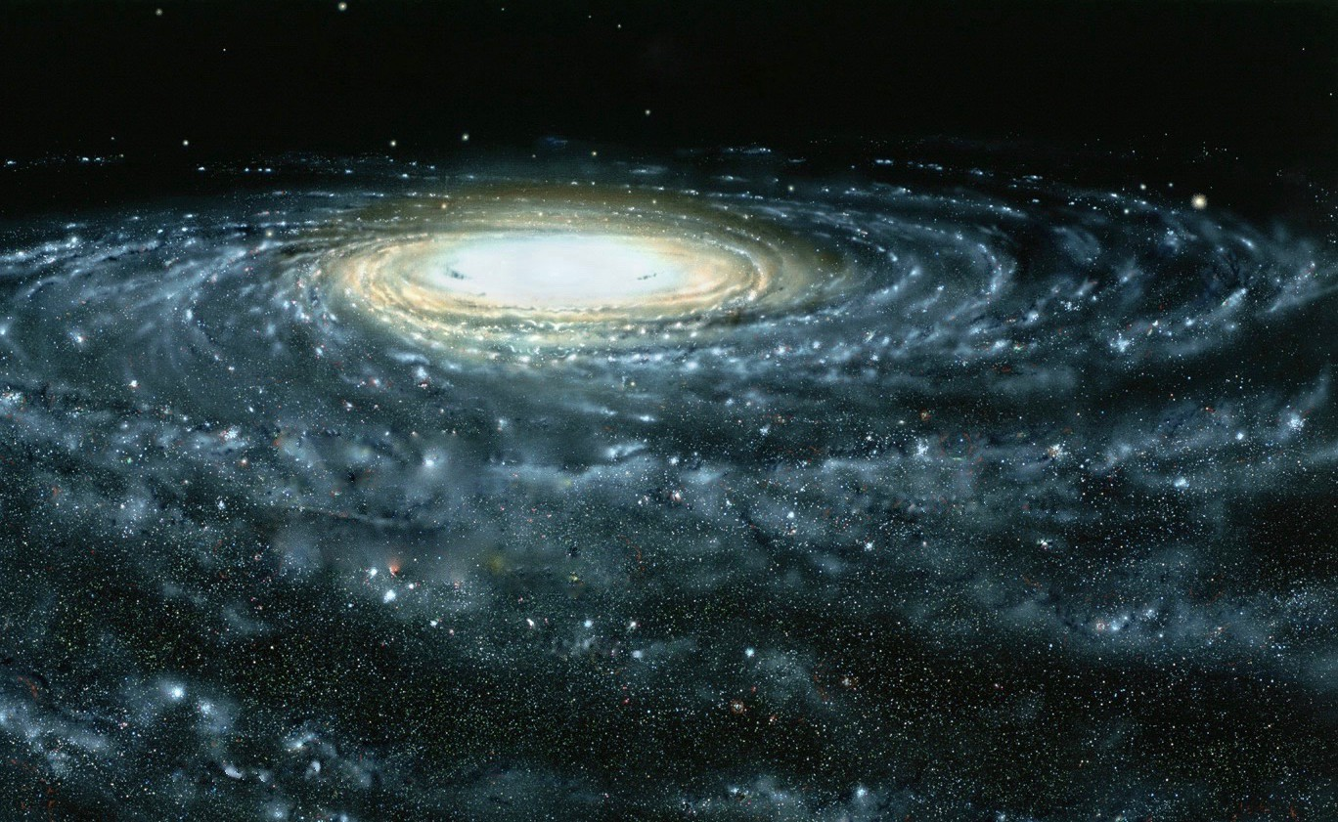




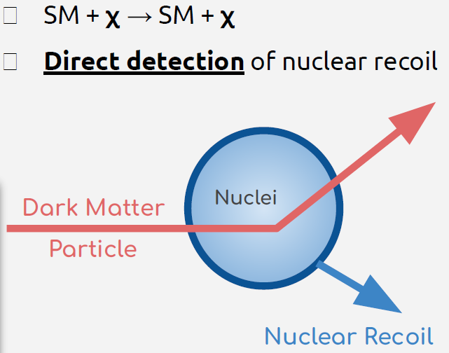



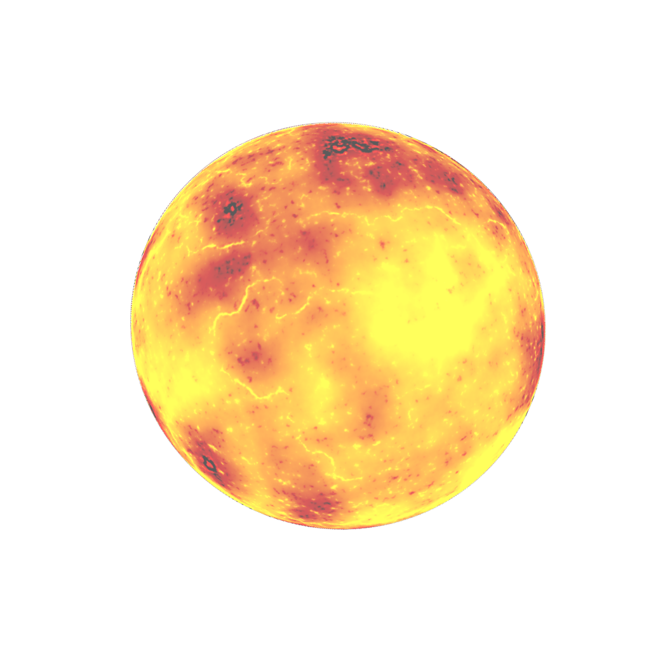
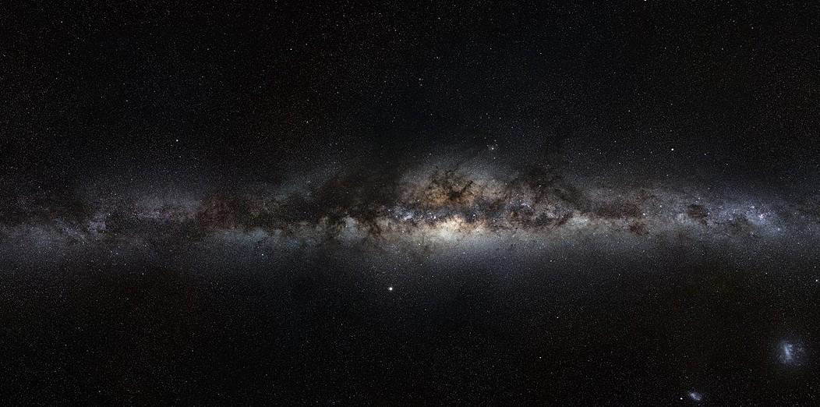



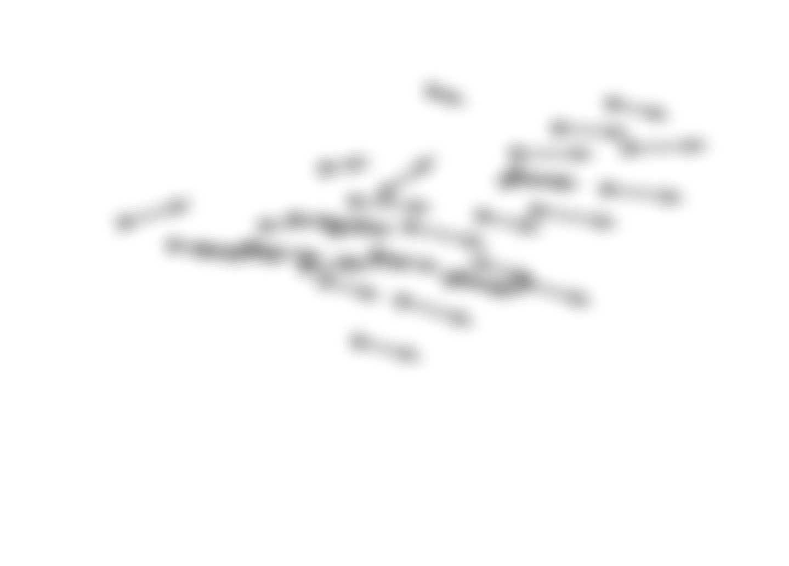
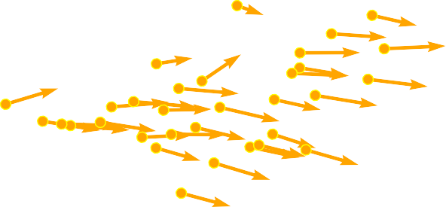


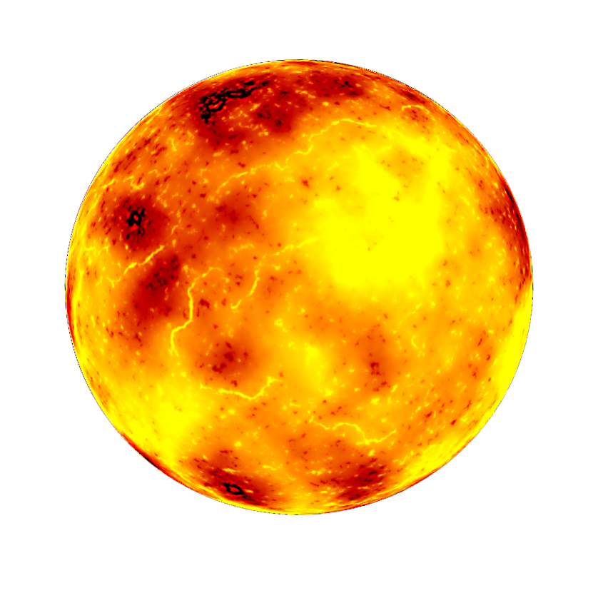

It’s a Dark Universe
Assumption
→ Dark Matter is made of
Weakly Interacting Massive Particles.
ENERGY → Excess would result in falling exponentials.
TIME → Results in a few % annual modulation.

Slide 3
It’s a Dark Universe
Assumption
→ Dark Matter is made of
Weakly Interacting Massive Particles.
Directionality of the DM flux
This is the only generic and unambiguous terrestrial signature of DM that results solely from the assumption that we live inside a DM halo.
The future of directional searches, Ciaran O’Hare
ENERGY → Excess would result in falling exponentials.
TIME → Results in a few % annual modulation.
Only signature of DM halo presence
Rejection of background isotropy
Identification of solar neutrinos
Only way to do DM astronomy

Slide 4
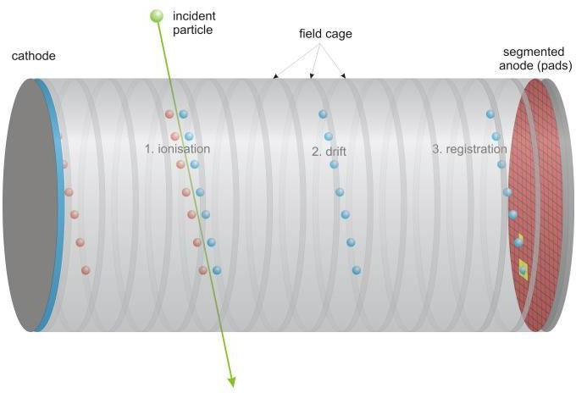
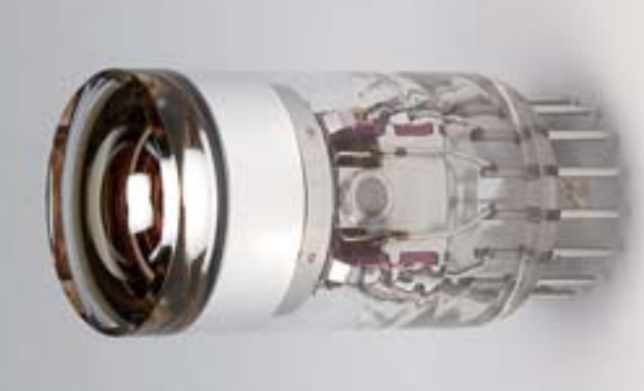
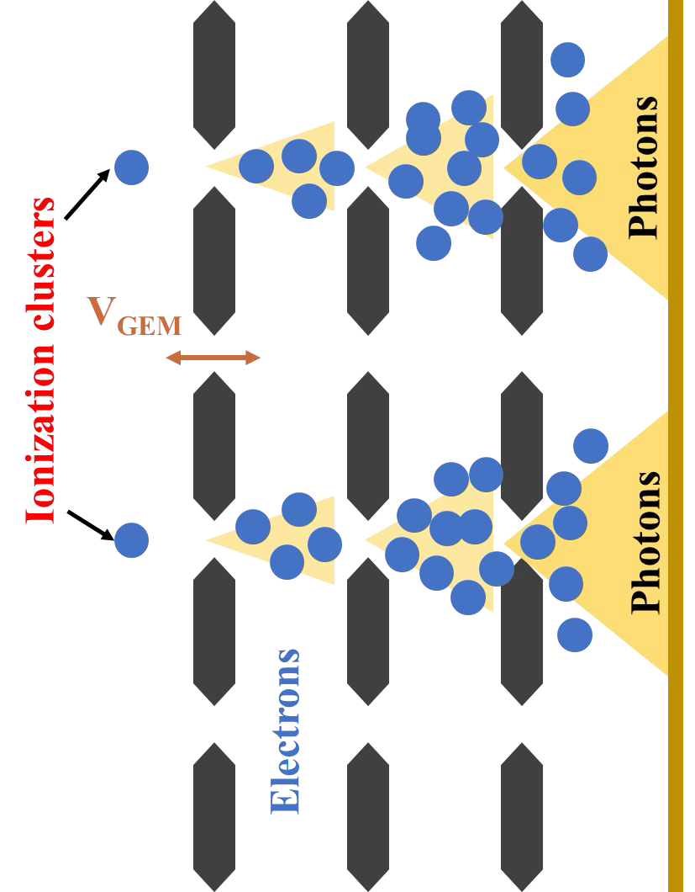
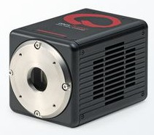
CYGNO paradigm
He/CF₄ 60/40

Slide 5

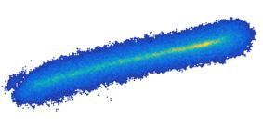
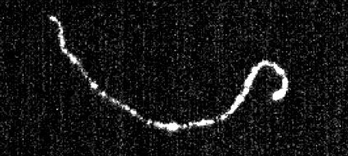
CYGNO paradigm
He/CF₄ 60/40
With the high granularity of the camera, we measure energy + X & Y coordinates

Slide 6

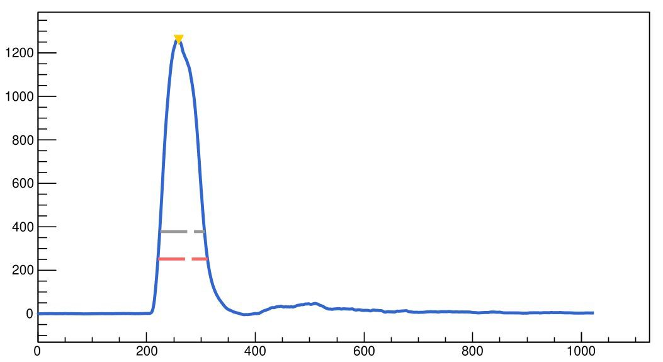

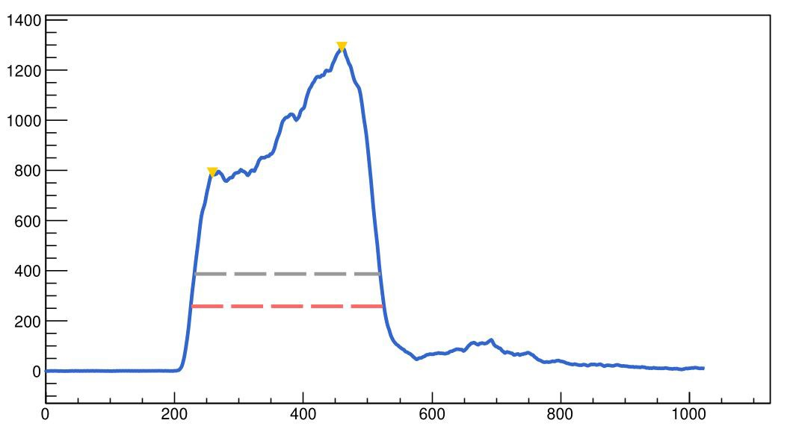
CYGNO paradigm
He/CF₄ 60/40
Independent
energy measurement.
Electrons times of arrival ⇒
dZ coordinate (track’s tilt)
With the high granularity of the camera, we measure energy + X & Y coordinates

Slide 7
CYGNO paradigm
He/CF₄ 60/40
Independent
energy measurement.
Electrons times of arrival ⇒
dZ coordinate (track’s tilt)
With the high granularity of the camera, we measure energy + X & Y coordinates
D.Marques
PMT analysis for Negative Ion Drift and 3D reconstruction

Slide 8
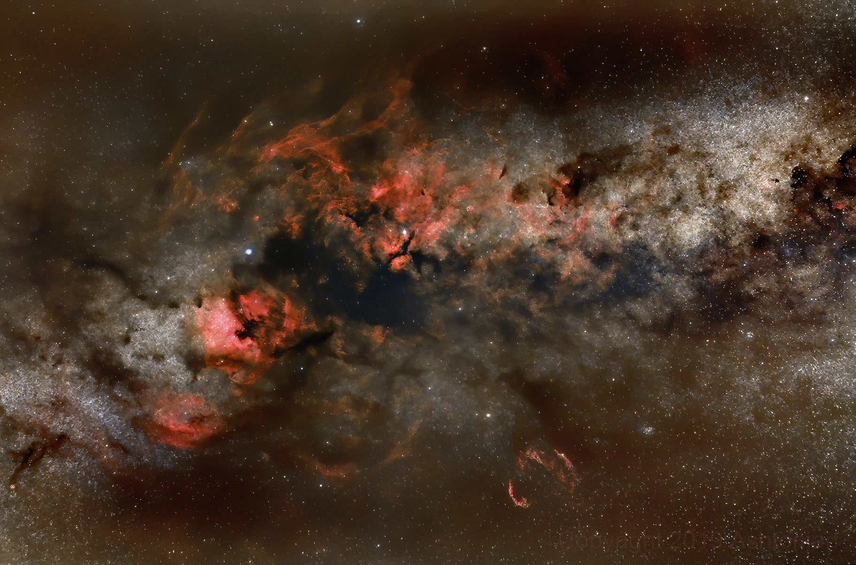
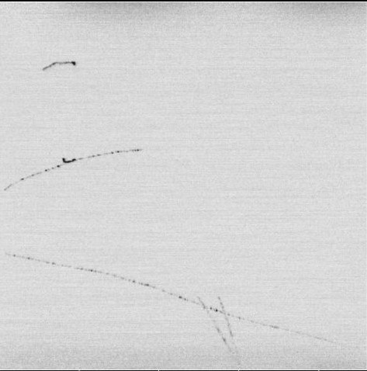
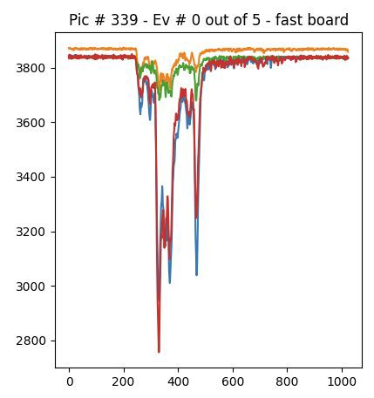
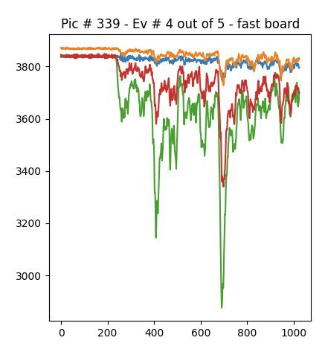
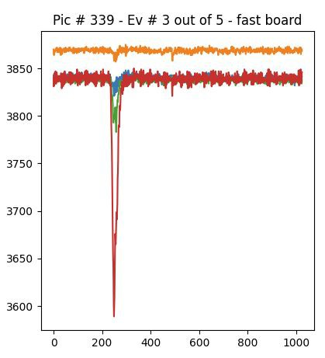
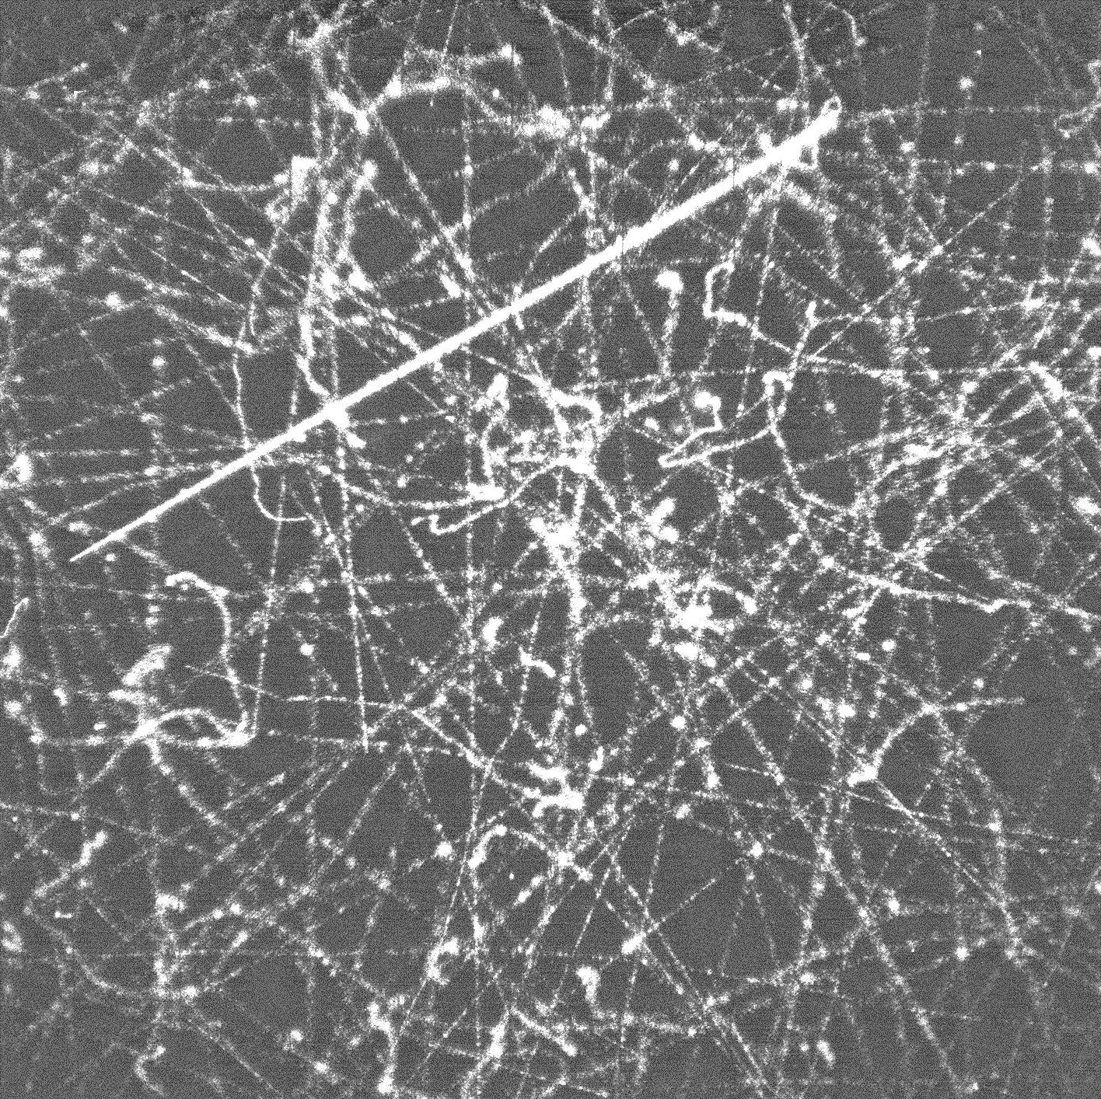
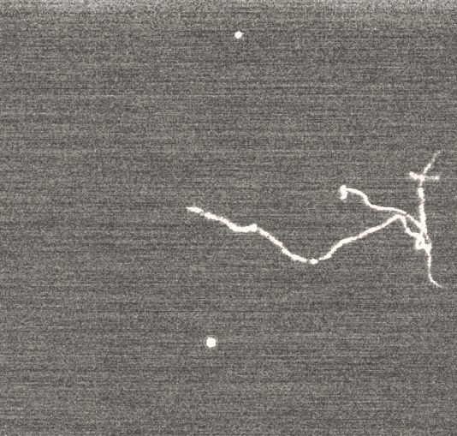
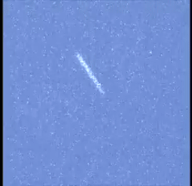
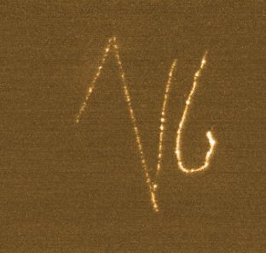
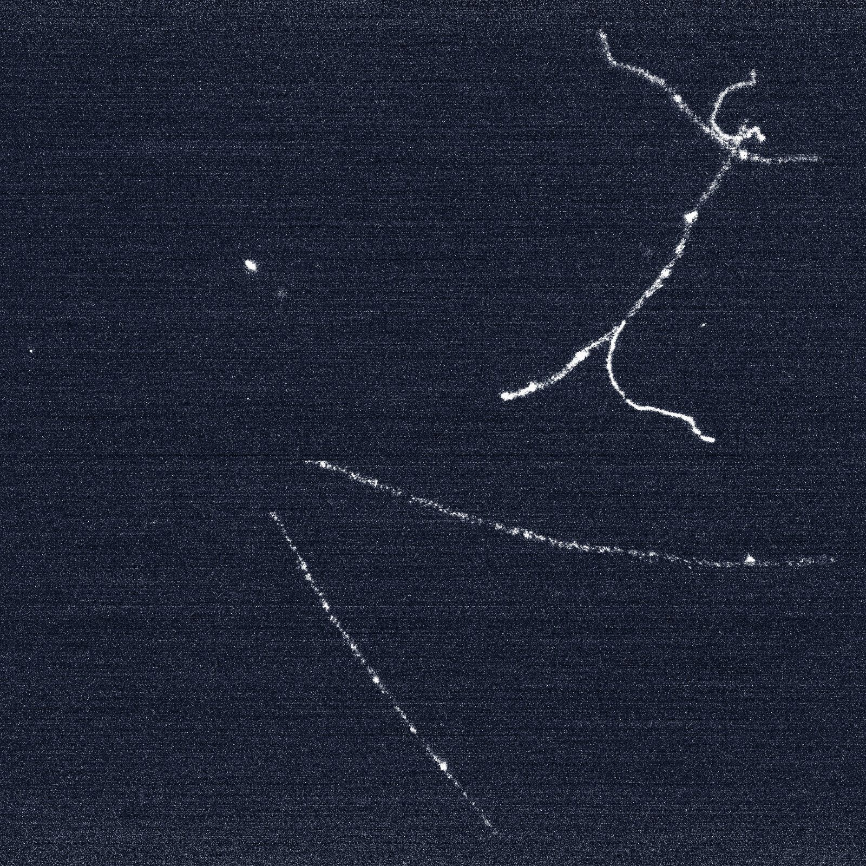
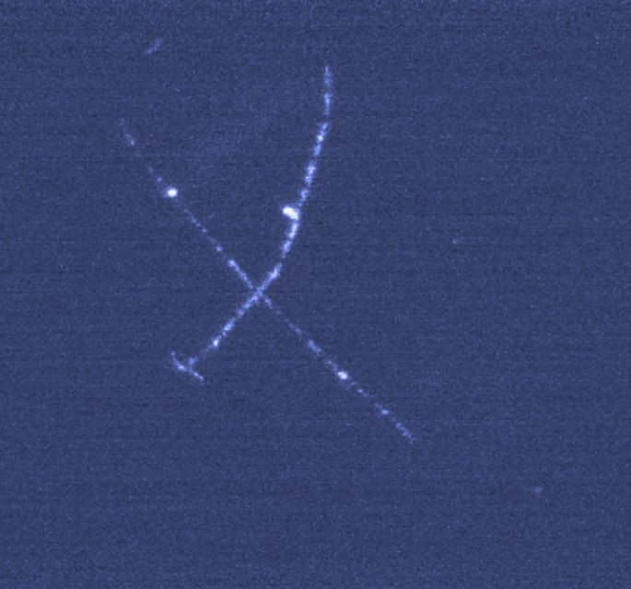
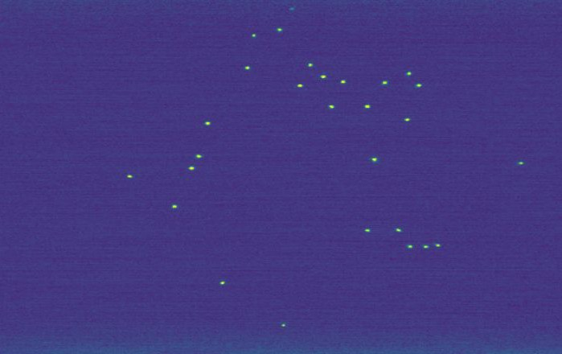
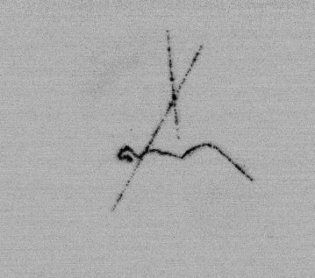
Detector PoV

Slide 9
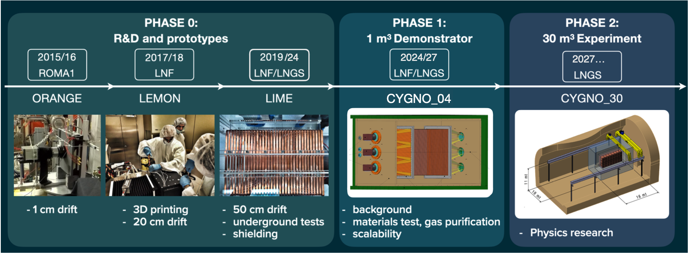
CYGNO roadmap

Slide 10

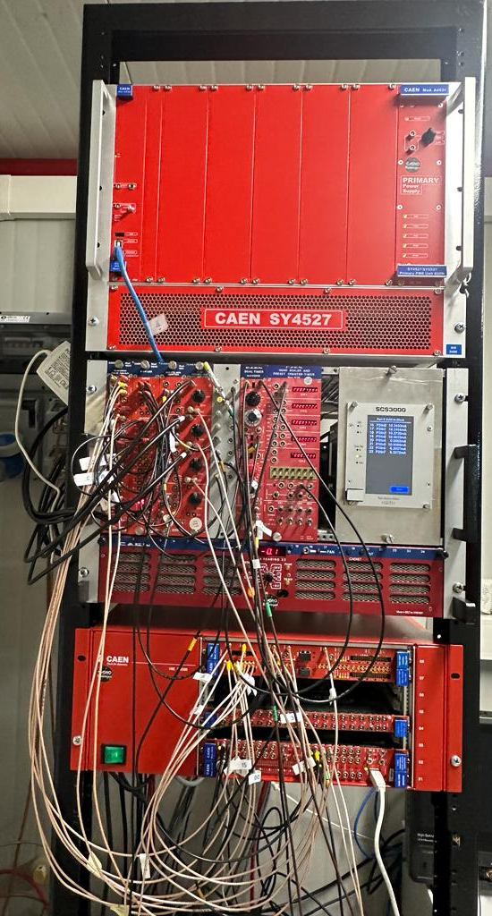
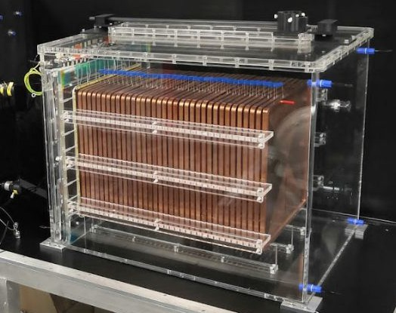

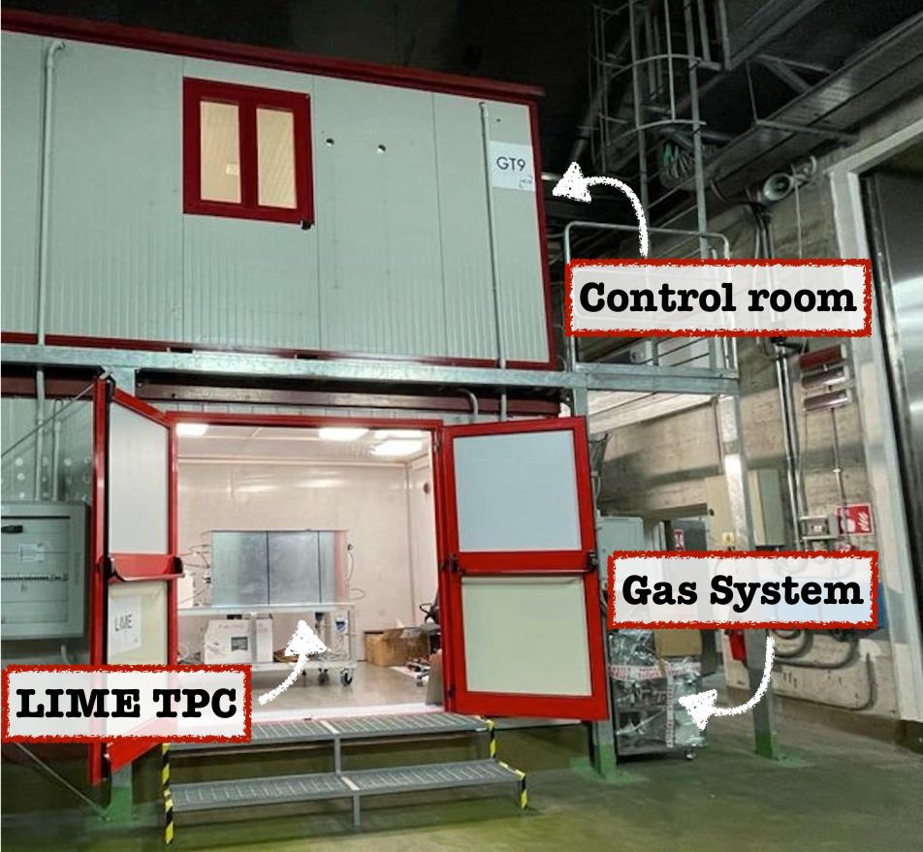
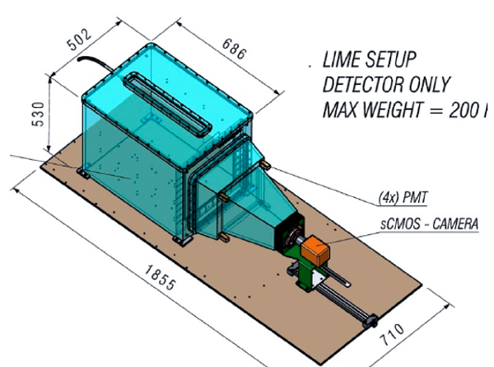

LIME – Long Imaging ModulE
50L single-side TPC
Commissioning done in LNF in 2021/22
33x33 cm² standard triple GEM
D/T1/T2: 500/2/2 mm – 1/2.5/2.5 kV/cm
VGEM: 440V
Imaging:
ORCA FUSION camera 2304x2304 pixel granularity 155 x 155 um²
4 PMTs on the four edges
Schneider Xenon lens (F=0.95, f=25.6mm)
Work at 910 mbar (atmospheric)
He/CF4 60/40 in recirculation mode (5+20 L/h fresh+recirculated)
Oxygen+Nitrogen+Radon filters
DAQ based on MIDAS
Single USB 3.1 readout from camera
Fast+slow VME ADCs for PMTs waveforms
Trigger
>2 PMT over the threshold (FPGA-based)
Save 300ms exposed camera picture
55Fe source stability/calibration
At different drift distances
Standard candle for intrinsic working parameters
$$σ_{T}∝\sqrt{z}$$

Slide 11

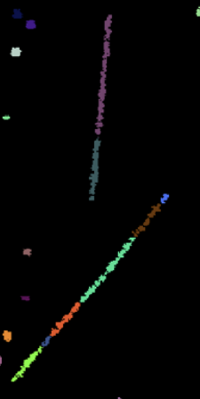
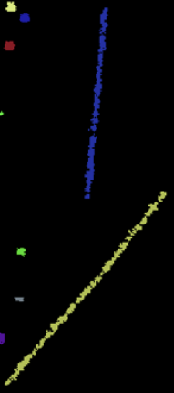
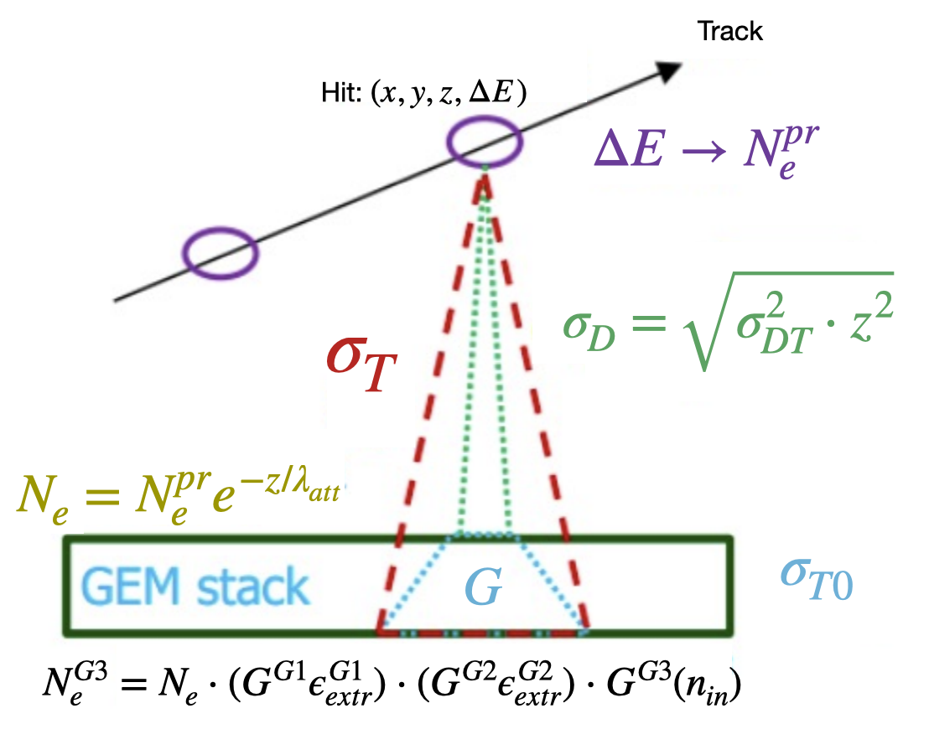
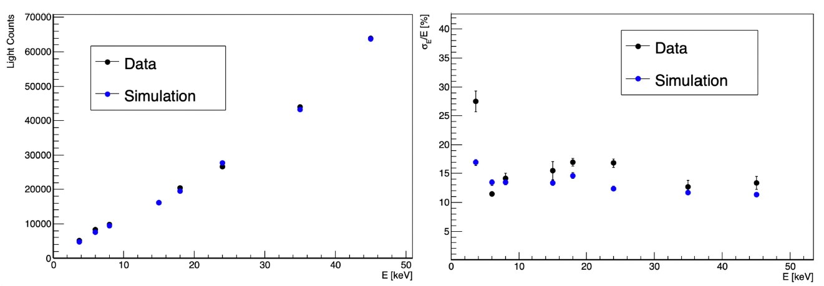
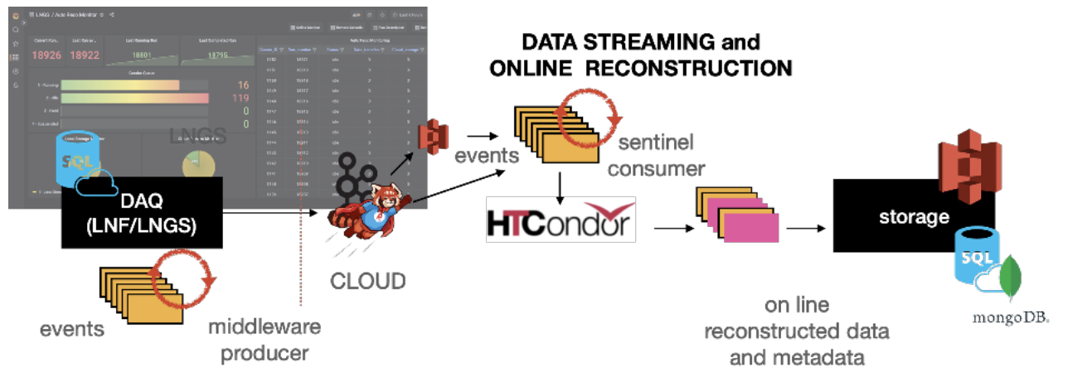
LIME – Long Imaging ModulE
Reconstruction:
Directional iDBSCAN to detect cosmic-ray tracks for the CYGNO experiment – IOPscience
A density-based clustering algorithm for the CYGNO data analysis - IOPscience
Based on the iDBscan algorithm + Directional cluster search
Digitization:
Fast simulation to mimic the response function without a full simulation
CYGNO data managing
Data handling of CYGNO experiment using INFN-Cloud solution (epj-conferences.org)
Beta tester of the INFN-Cloud project
Data streamlined on cloud, where it is reconstructed and stored
Thoughput ≈ 3 Mb/s
Reconstruction queue 40CPUs

Slide 12
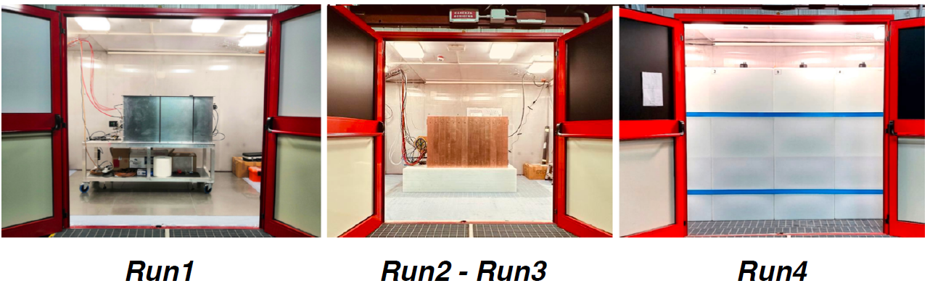
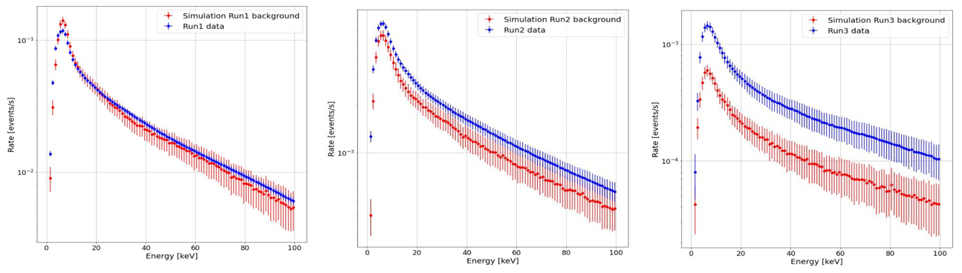
LIME performance
Prove we can operate such a detector underground
Study and improve out MC chain
Phase | Shielding | GEM V [V] | # pictures | Live time [s] | Rate PMTs [Hz]
Run 1 | None | 420 | 285665 | 175627 | 30
Run 2 | 4 cm Cu | 440 | 297992 | 191382 | 3.5
Run 3 | 10 cm Cu | 440 | 171579 | 191471 | 1.6
Run 4 | +40 cm H2O | Great external neutron suppression ⇒ Under analysis…
Main Suspect:
Alpha Contamination by Radon
External background consistent with MC
With increasing shield, we highlight a non-expected background.

Slide 13
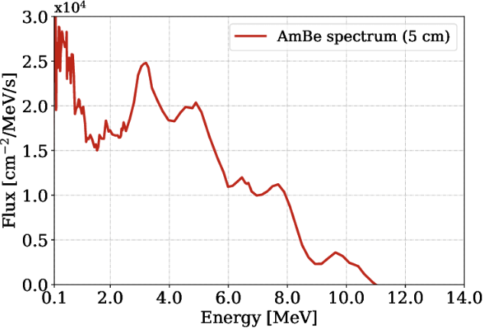
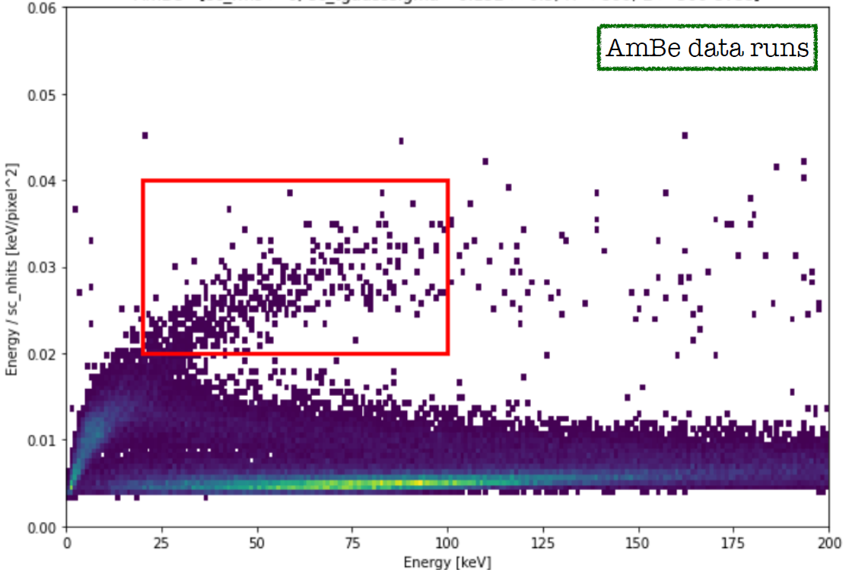
Background Rejection
Data taking with Americium-beryllium source → Neutrons to induce Nuclear Recoil signals
dE/dx

Slide 14
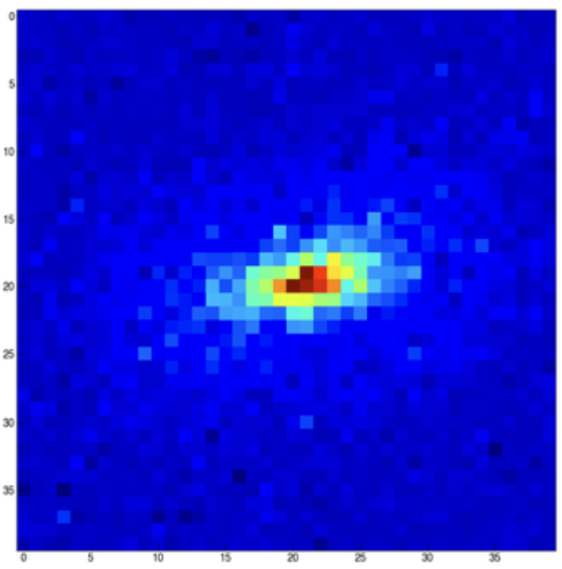
Background Rejection
Data taking with Americium-beryllium source → Neutrons to induce Nuclear Recoil signals
dE/dx
Nuclear Recoils
He⁺⁺ recoil

Slide 15
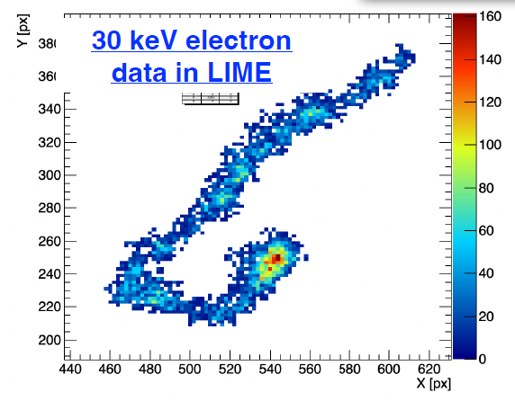
Background Rejection
Data taking with Americium-beryllium source → Neutrons to induce Nuclear Recoil signals
dE/dx
Electron Recoils
Nuclear Recoils

Slide 16
Background Rejection
Data taking with Americium-beryllium source → Neutrons to induce Nuclear Recoil signals
dE/dx
MIP
(muons and high energy electrons)
Electron Recoils
Nuclear Recoils

Slide 17
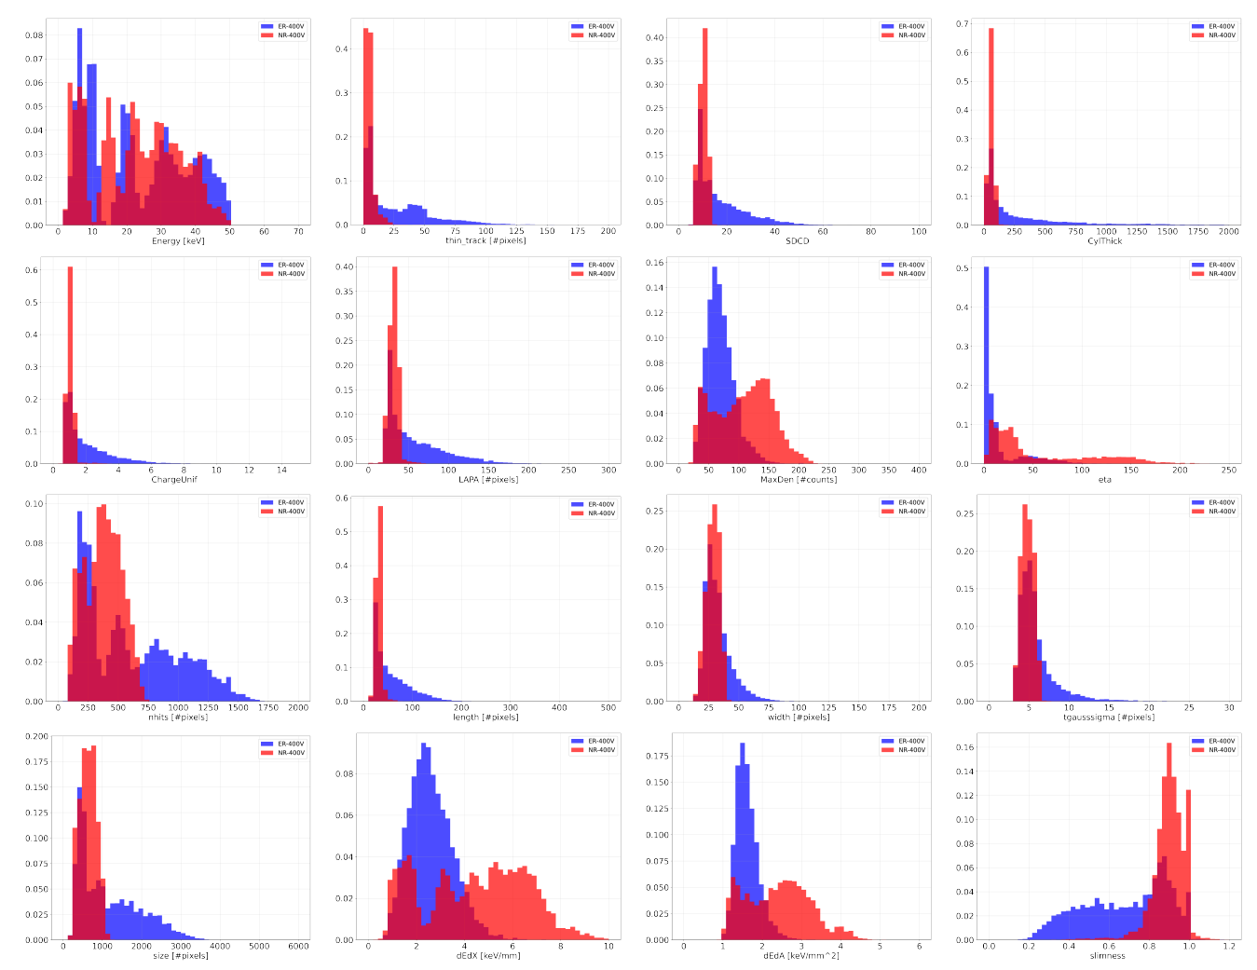
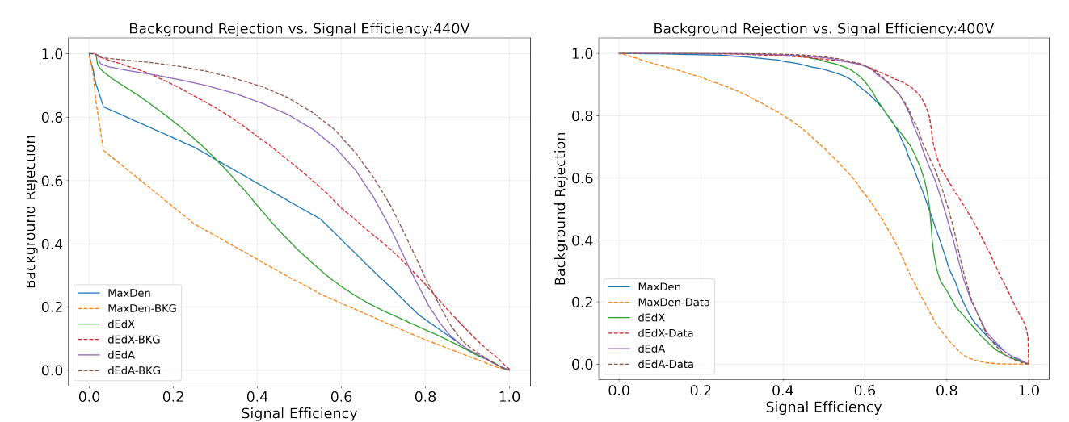
Background rejection
We have access to many variables related to the signal shape!
VGEM: 440V
VGEM: 400V

Slide 18
Background rejection
We have access to many variables related to the signal shape!
VGEM: 440V
VGEM: 400V
G. Dho
Impact of a strong electric field below the GEM on light yield and saturation in a He:CF4 based Time Projection Chamber
Saturation is clearly present in LIME!
And it affects the ER/NR discrimination

Slide 19
Background rejection
We have access to many variables related to the signal shape!
Convolution Neural Network
Atul Prajapati Thesis
Training on MC using multiple shape variables
Promising results beyond traditional analysis
VGEM: 440V
VGEM: 400V
G. Dho
Impact of a strong electric field below the GEM on light yield and saturation in a He:CF4 based Time Projection Chamber
Saturation is clearly present in LIME!
And it affects the ER/NR discrimination

Slide 20
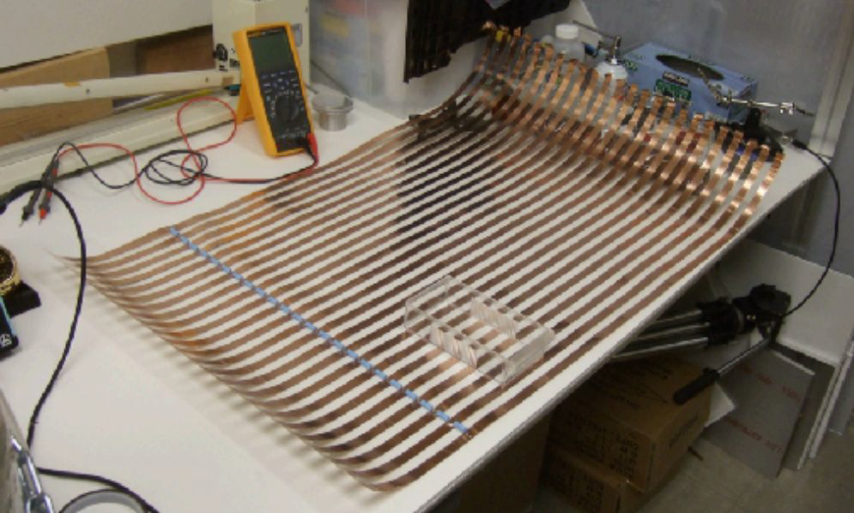
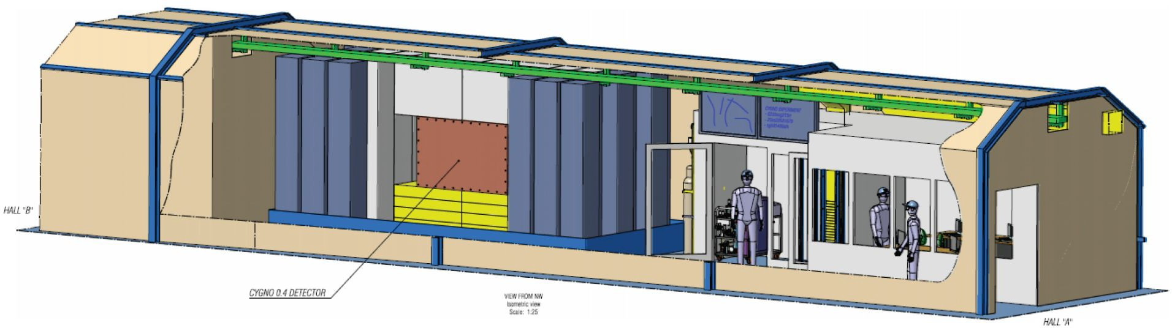
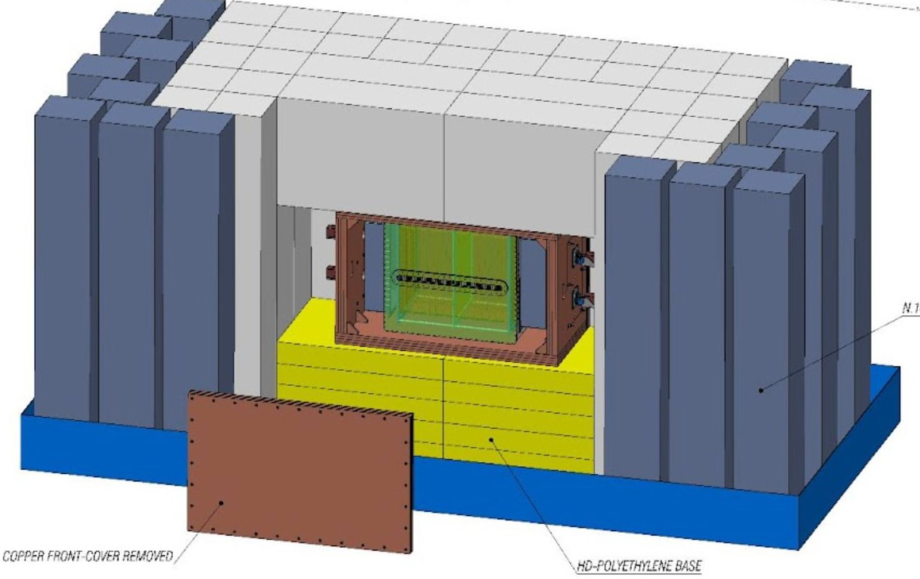
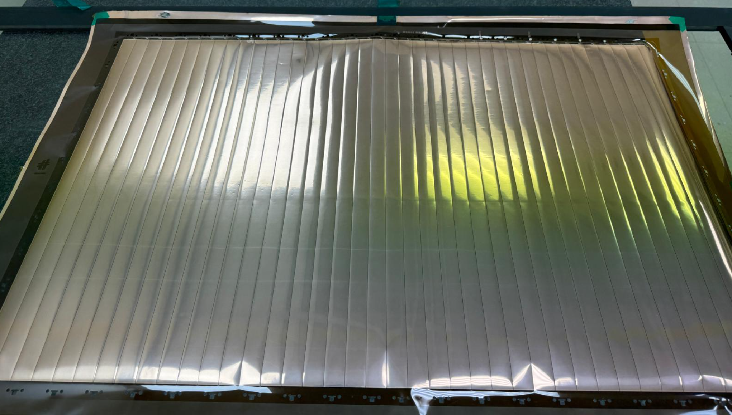

CYGNO_04
Scalability of the Technology
Feasibility for a larger scale detector based on multiple CYGNO_04 modules
Radiopure materials
LNGS Hall F
0.4m3 common cathode TPC
3 ORCA QUEST2 (next-gen) per side
8 PMTs per side
4+6cm copper shielding (radiopure+traditional)
40cm of water
Throughput expected ≈20Mb/s
Computational resources very demanding

Slide 21





CYGNO_04 TDAQ
1° Level Trigger -Trained CNN classificator
Individuate for every image if it contains signals or not
2° Level Trigger+Reco – U-Net CNN
3° Level PMT association – Bayesian FIT
Associate each PMT waveform to the correct camera cluster
Expected Pipeline for commissioned CYGNO_04
Reduce throughput
Imporved reconstruction performance
Possible automatic 3D reco
LIME tested
1to1 association
σ_{X/Y}≈1.5cm

Slide 22
Conclusion
The CYGNO collaboration is developing a high-precision triple-GEM TPC at atmospheric pressure with optical readout.
The main focus is the directional direct search of DM WIMP-like particles in the low mass range (0.5-10 GeV).
  Through nuclear recoil direction, solar neutrinos can be discriminated, and unambiguous conﬁrmation of DM is possible.
  Acceptable Solar neutrino (CNO cycle) for CYGNO_30 (S.Torelli thesis)
LIME demonstrated the feasibility of such a detector for rare event search, validating our MC chain
CYGNO04 will prove the scalability of our detector model for a larger project
R&D activities ongoing

Slide 23
BACKUP

Slide 24




It’s a Dark Universe
Energy, Time, and other widely used methods are not enough to prove that an eventual signal is a Dark Matter signal
Directionality of the DM flux
Dive into the Neutrino Fog
This is the only generic and unambiguous terrestrial signature of DM that results solely from the assumption that we live inside a DM halo.
The future of directional searches, Ciaran O’Hare
[2408.03760] Feasibility of a directional solar neutrino measurement with the CYGNO/INITIUM experiment (arxiv.org)

Slide 25

Background Rejection
Data taking with Americium-beryllium source → Neutrons to induce Nuclear Recoil signals
dE/dx
Nuclear Recoils
Simulation of AmBe gamma spectrum is correctly reproduced when background does not dominate

Slide 26


R&D activities
Hydrogen Rich Gas
Add hydrogen-rich gas is under study to gain sensitivity to lower DM masses iC₄H₁₀ and CH₄ with <10% concentration
Enhanced Light Yield
[2406.05713] Enhancing the light yield of He:CF$_4$ based gaseous detector (arxiv.org)
G. Dho
Impact of a strong electric field below the GEM on light yield and saturation in a He:CF4 based Time Projection Chamber
Negative Ions SF₆
He:CF4:SF6 (59,39.4:1.6)
Reduce diffusion during drift by adding SF₆ (thus negative ions) to the gas mixture.
→ Operation at 900mbar!
Low radioactivity Lens
Building low radioactivity camera sensor and lens together with Hamamatsu/BMI experts

