Slide 1



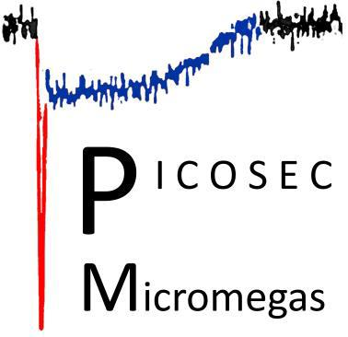

The 8th International Conference on MPGDs
Robust photocathodes and spatial resolution studies of
resistive PICOSEC Micromegas precise-timing detectors
Djunes Janssens and Marta Lisowska
On behalf of the PICOSEC Micromegas Collaboration
djunes.janssens@cern.ch
October 15th, 2024

Slide 2
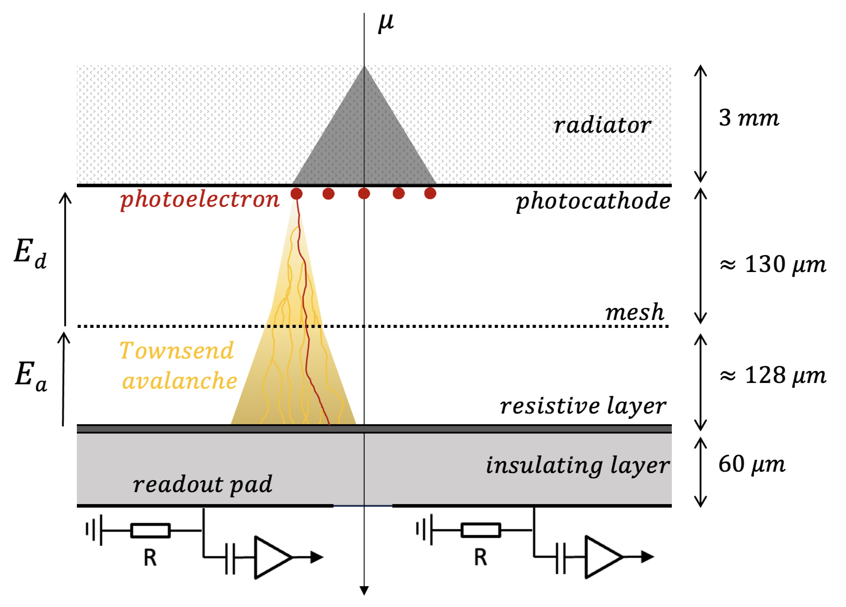
Introduction
  To enable the sub-25 ps PICOSEC Micromegas precise-timing detector to perform effectively under the demanding conditions of physics experiments, we are adapting its design to improve robustness.
  Outline:
  Resistive Plane PICOSEC Micromegas
    Single-Channel Prototype
    Increased Readout Granularity for Spatial Resolution
    Multi-Pad Prototype with Vertical Charge Evacuation
  Robust Photocathodes
    DLC
    B4C
    Graphene
  Towards an Applicable Detector
  Conclusion
The general progress overview can be found in Yue Meng’s presentation of this morning.

Slide 3
Resistive plane PICOSEC Micromegas

Slide 4
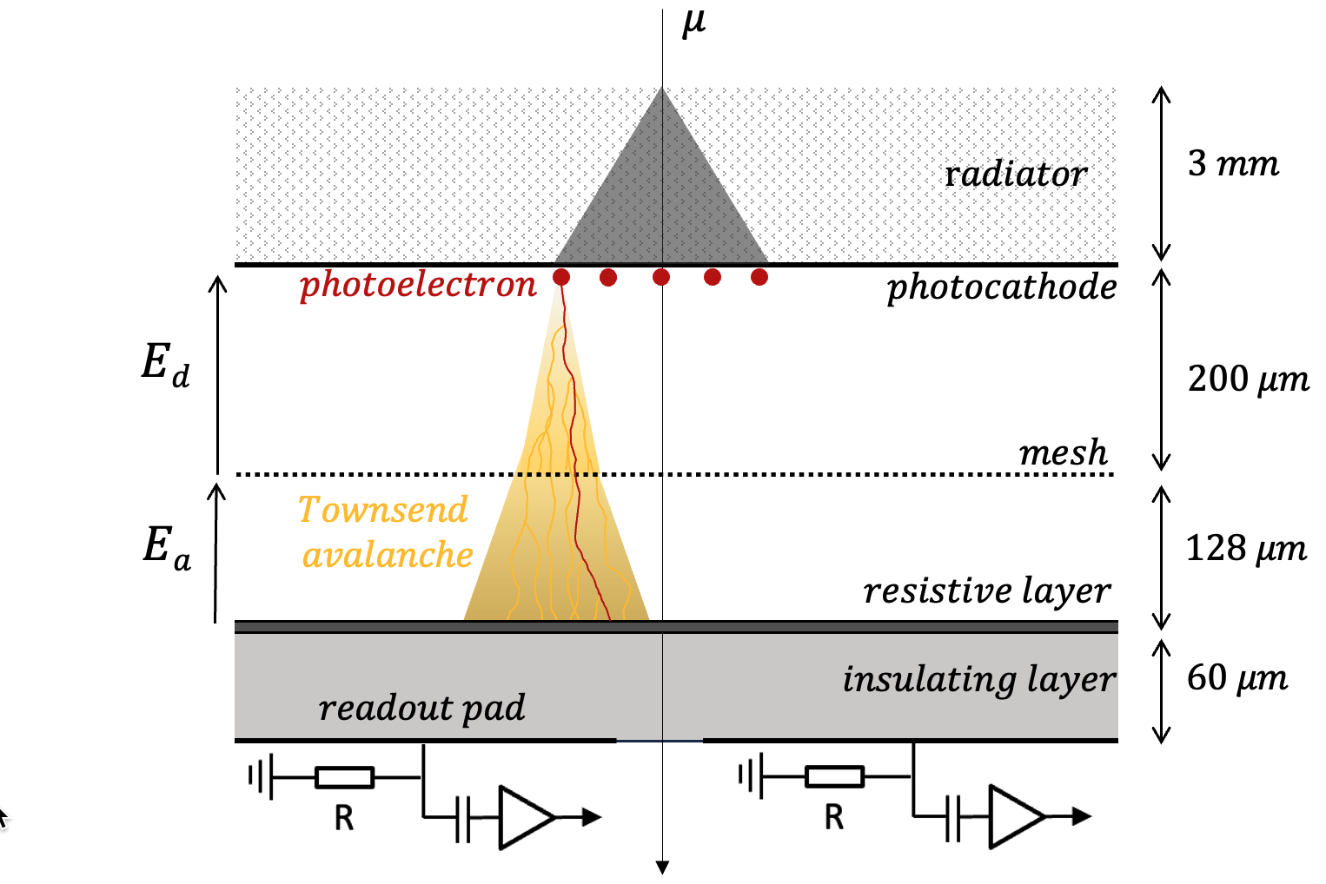
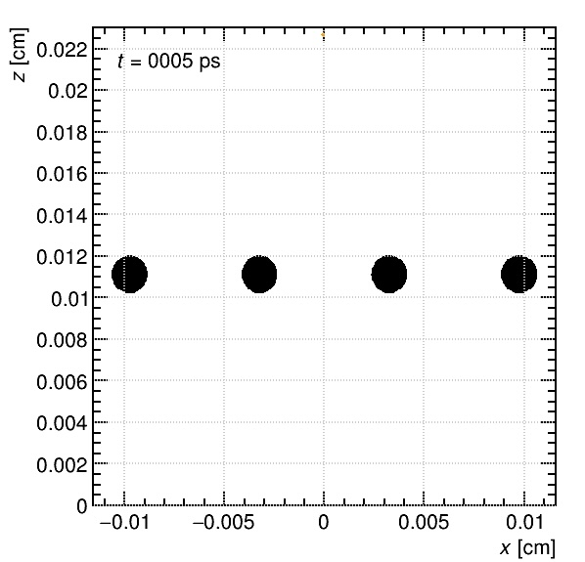







Resistive PICOSEC Micromegas
A resistive layer is introduced in both single- and 100-channel readout structures to enhance the detector's robustness while maintaining a timing resolution of under 25 ps. These slightly conductive materials offer:
More stable operation by quenching discharges
Potentially improved position reconstruction through increased signal sharing
$$photoelectron injection$$
$$photocathode$$
$$electron$$
$$ion$$
$Ne/CF4/C2H6$
$$80/10/10 \%$$
$$mesh$$
$$anode$$
J. Bortfeldt et al., NIM A 903 (2018) 317
A. Utrobicic, RD51 Collaboration meeting (14-06-2022)
A. Utrobicic et al., JINST 18 (2023) C07012 [2304.00056].
M. Lisowska et al., JINST 18 (2023) C07018 [2303.18141].

Slide 5

Resistive PICOSEC Micromegas
A resistive layer is introduced in both single- and 100-channel readout structures to enhance the detector's robustness while maintaining a timing resolution of under 25 ps. These slightly conductive materials offer:
More stable operation by quenching discharges
Potentially improved position reconstruction through increased signal sharing
$$photoelectron injection$$
$$photocathode$$
$$electron$$
$$ion$$
$Ne/CF4/C2H6$
$$80/10/10 \%$$
$$mesh$$
$$anode$$
J. Bortfeldt et al., NIM A 903 (2018) 317
A. Utrobicic, RD51 Collaboration meeting (14-06-2022)
A. Utrobicic et al., JINST 18 (2023) C07012 [2304.00056].
M. Lisowska et al., JINST 18 (2023) C07018 [2303.18141].

Slide 6
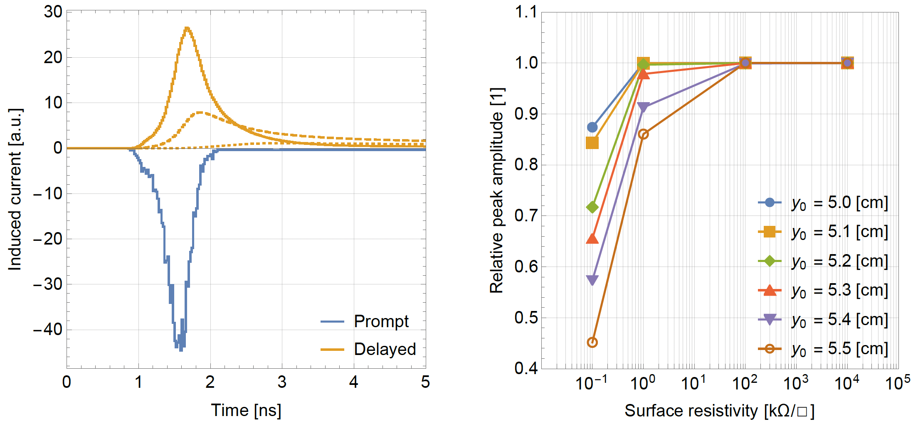
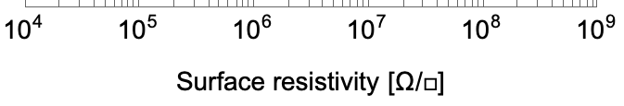



Resistive PICOSEC Micromegas
A surface resistivity of 20 MΩ/□ was chosen to ensure that:
the leading edge of the signal is minimally affected by the delayed component,
the rate capability estimation,
the protection against discharges.
Induced signal on the edge of a 1 x 1 cm² pad
Relative signal amplitude reduction
$$100 Ω/□$$
$$1 kΩ/□$$
pad’s center
$$100 kΩ/□$$
mimimum for protection
mimimum for timing
rate capability
pad’s edge
  Minimum surface resistivity for timing: D. Janssens’ presentation of yesterday
  D. Janssens, PhD dissertation, https://cds.cern.ch/record/2890572

Slide 7
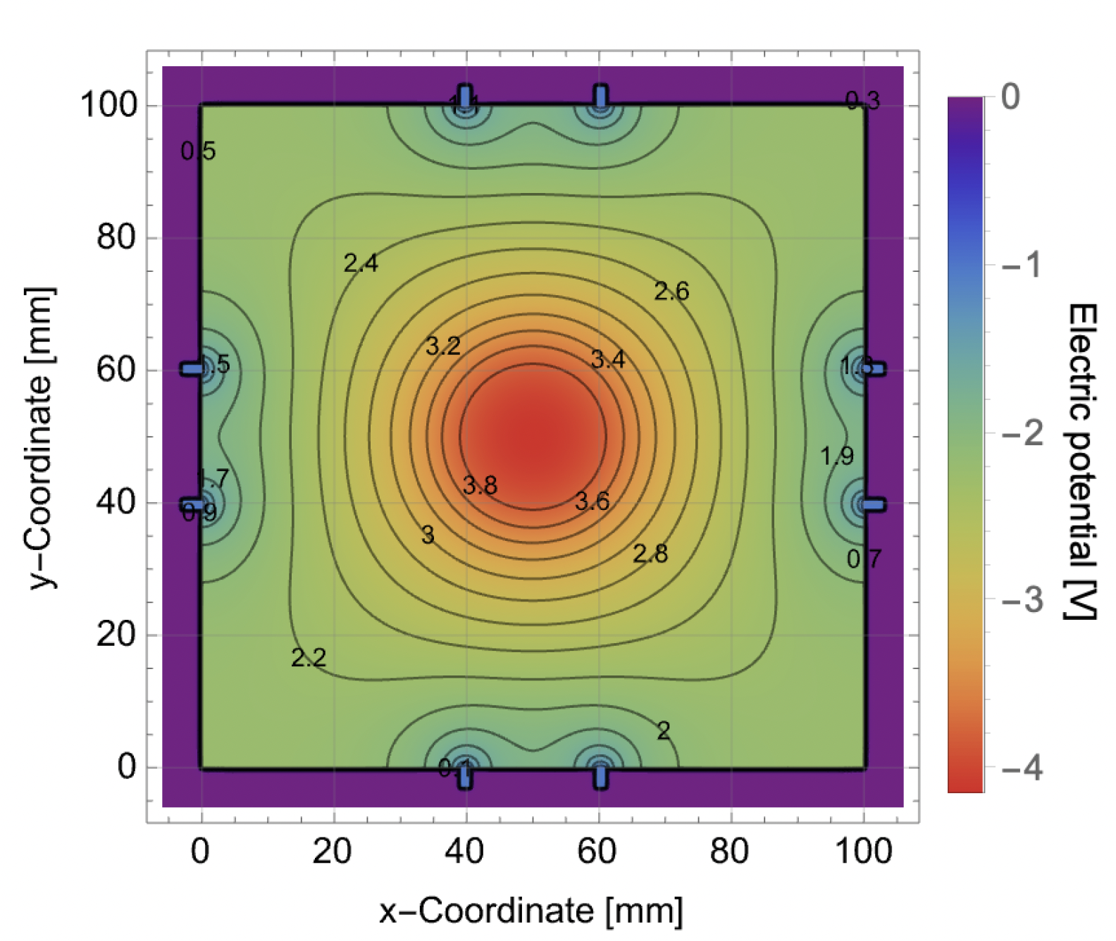
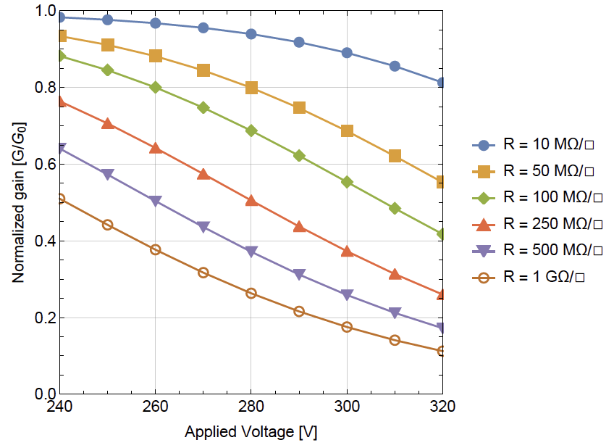
Resistive PICOSEC Micromegas
A surface resistivity of 20 MΩ/□ was chosen to ensure that:
the leading edge of the signal is minimally affected by the delayed component,
the rate capability estimation,
the protection against discharges.
Simulated voltage drop for Φ = 6 · 10⁵ cm⁻²s⁻¹ pion beam
Simulated amplification drop from Φ = 6 · 10⁵ cm⁻²s⁻¹ pion beam
mimimum for protection
mimimum for timing
rate capability
  Minimum surface resistivity for timing: D. Janssens’ presentation of yesterday
  D. Janssens, PhD dissertation, https://cds.cern.ch/record/2890572

Slide 8

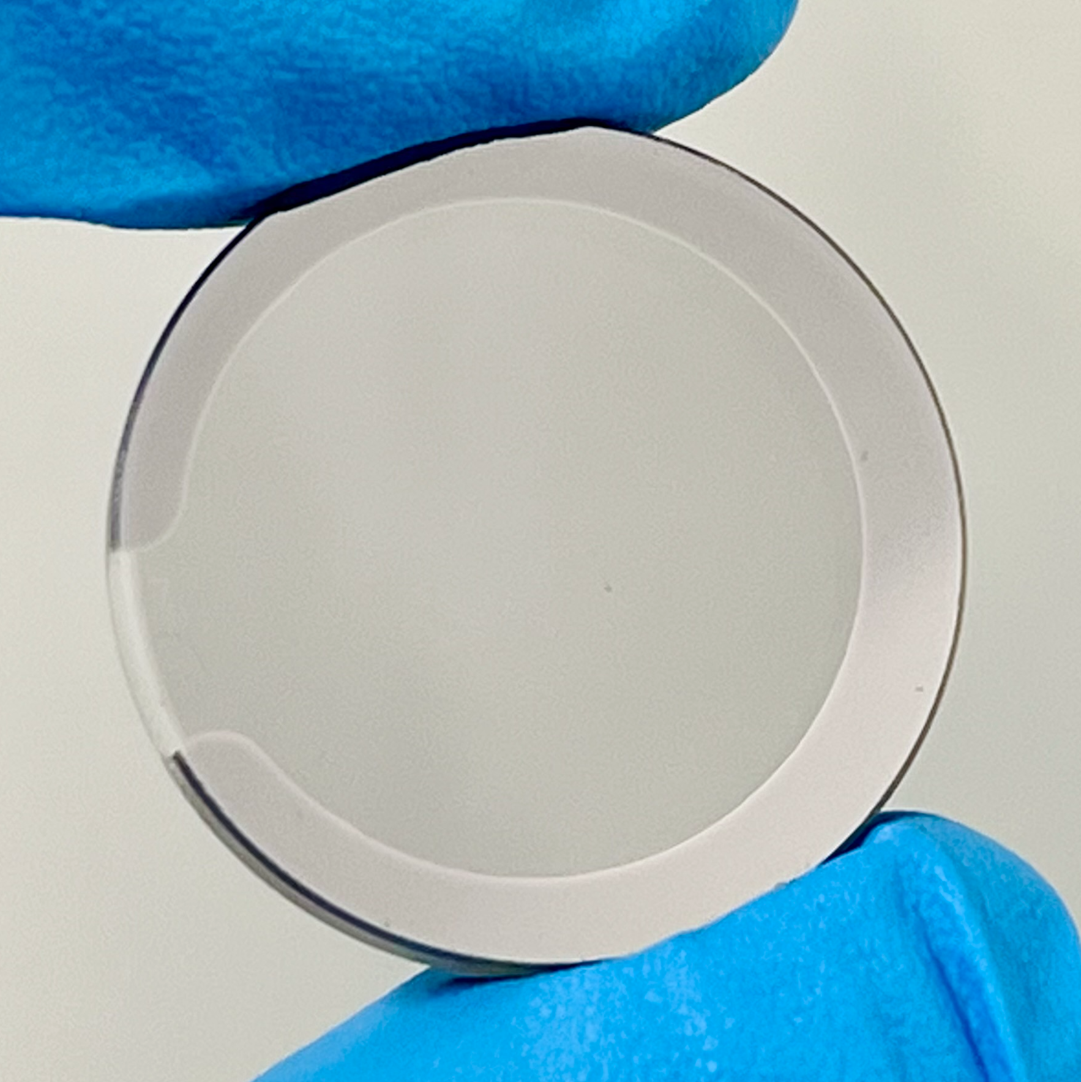
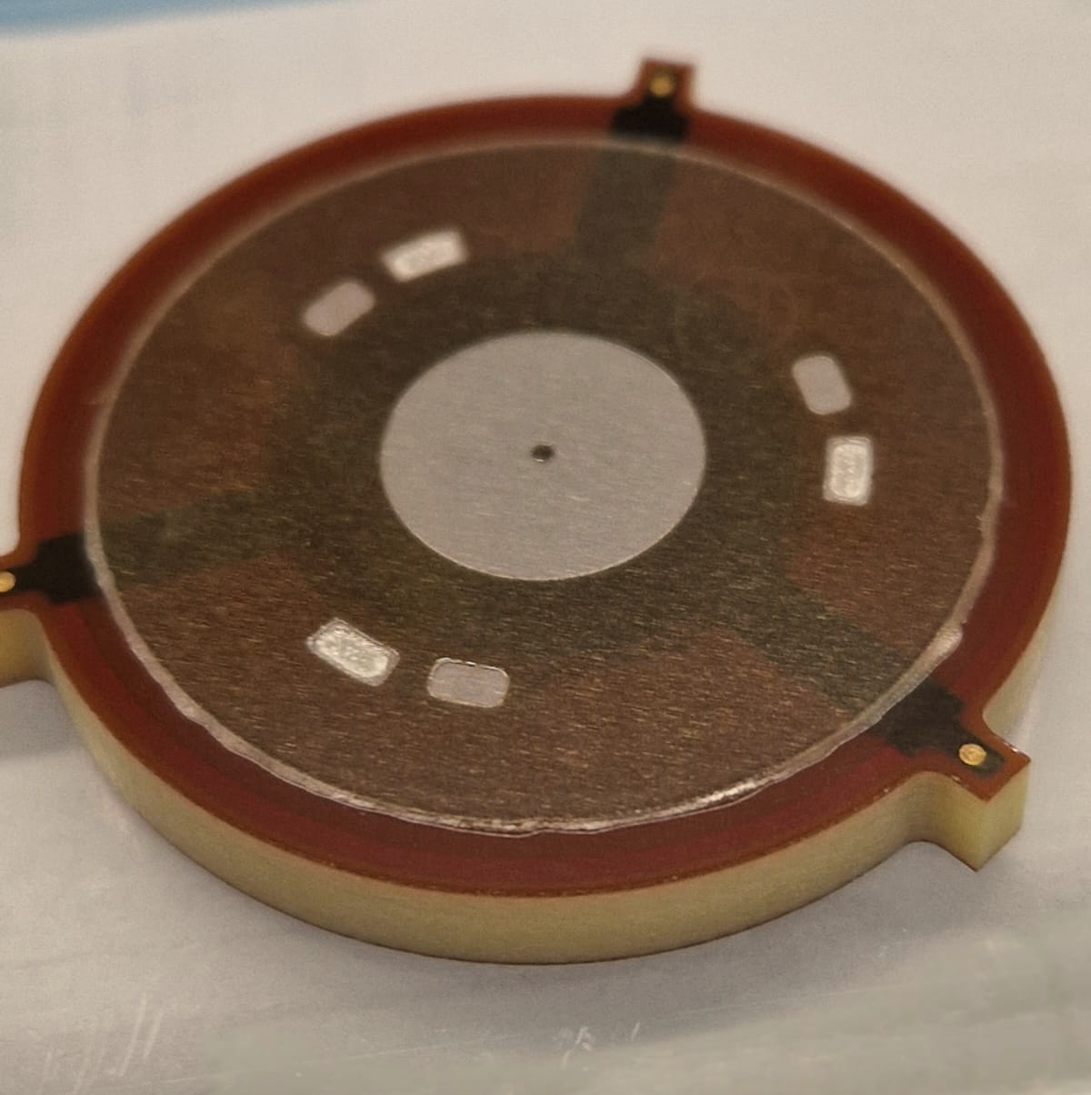
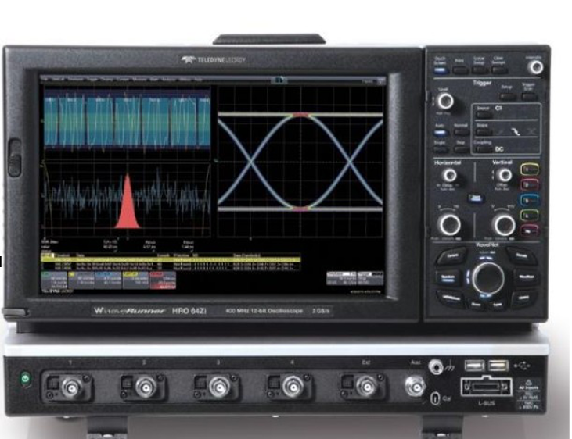
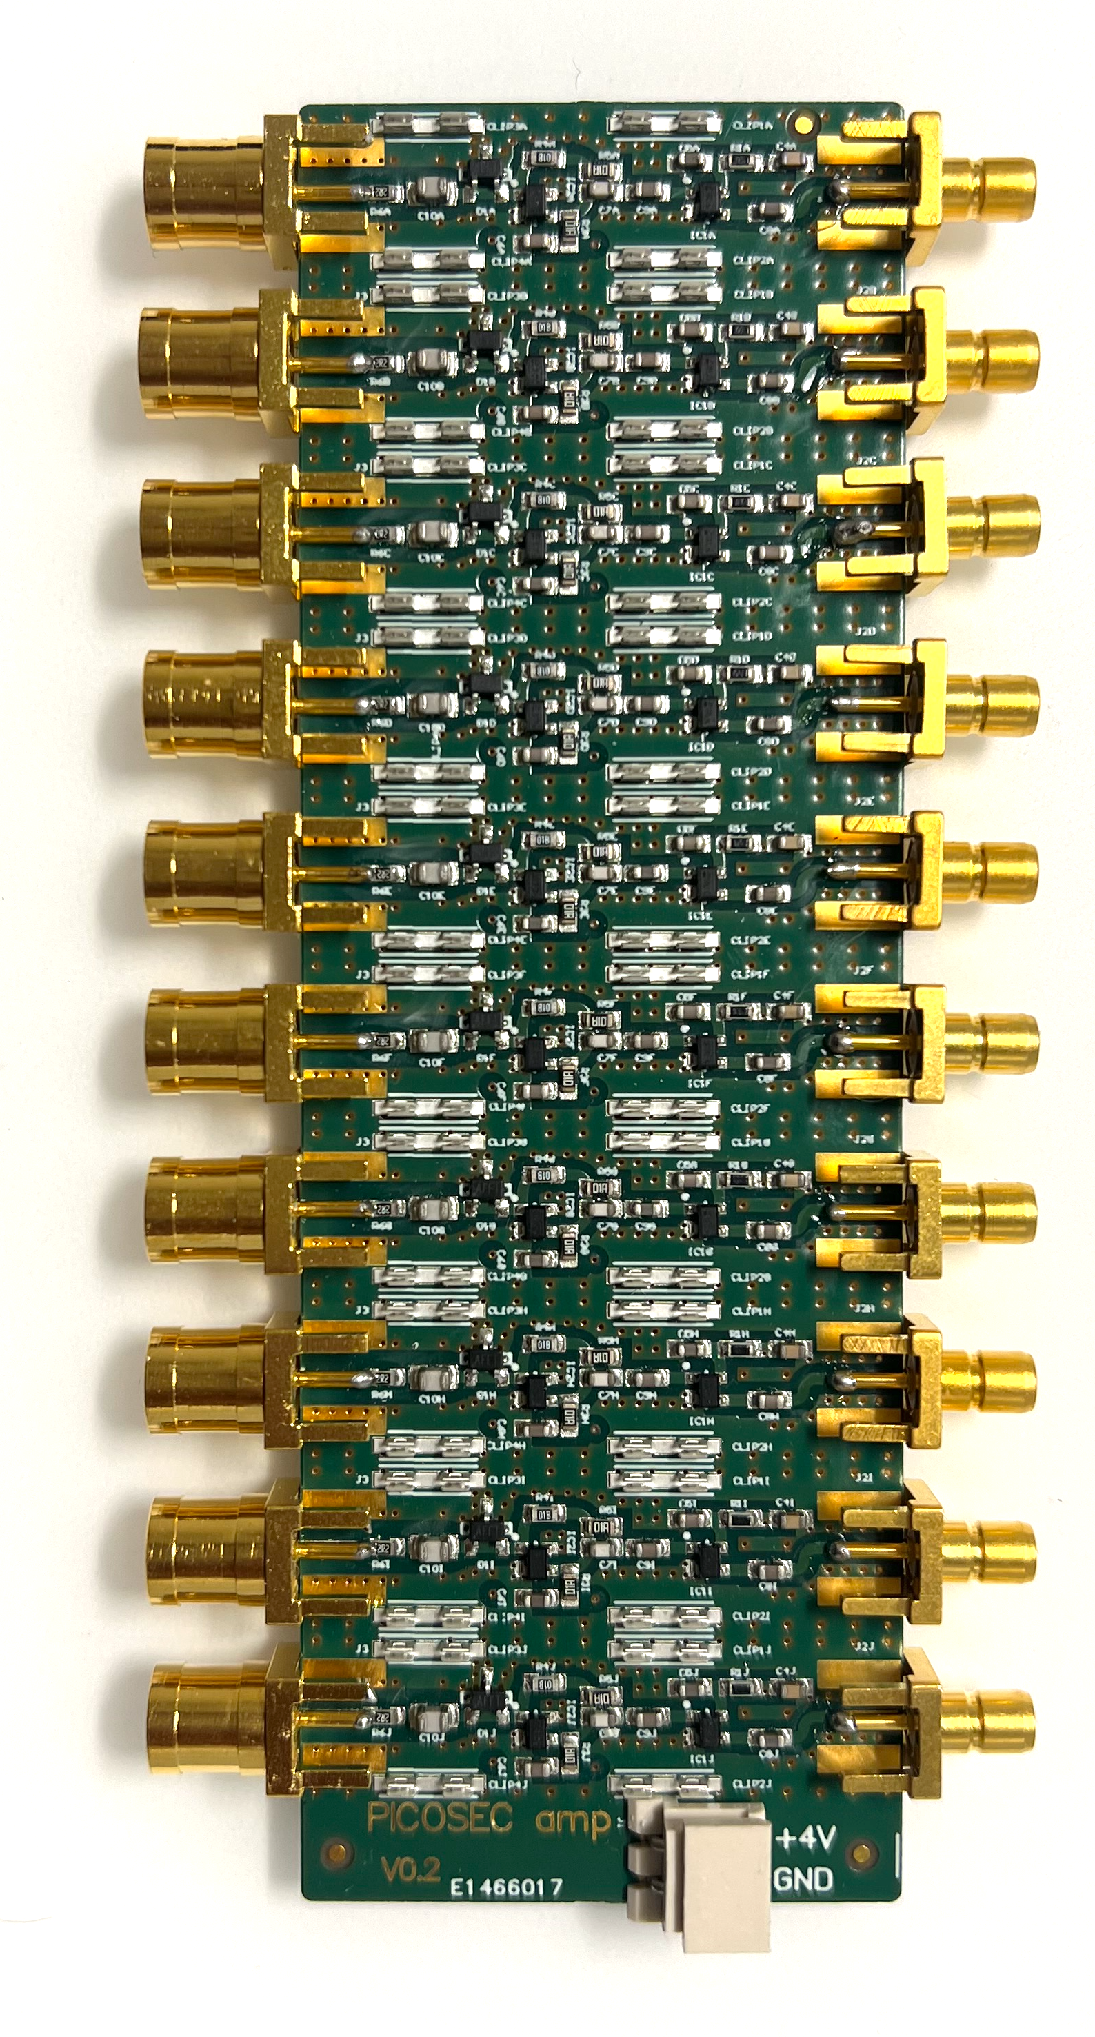
Single channel resistive PICOSEC Micromegas
After production, the timing performance of the resistive single-pad detector for fully contained events was measured using custom-built current amplifiers and a 10 GS/s sampling oscilloscope.
outer board with
spring loaded pins
radiator with a photocathode
Micromegas board
Micromegas board
Single-pad prototype design
RF current amplifier cards
LeCroy WR8104 oscilloscope
spacer
1 cm
radiator with a photocathode
1 inch
PEEK insert
aluminium vessel
quartz window
aluminium flange
PICOSEC amplifier design: A. Utrobičić, et al., JINST 18 (2023) C07012
Based on the RF pulse amplifier: C. Hoarau, et al., JINST 16 (2021) T04005
Chamber and Micromegas board design: A. Utrobičić, et al., arXiv:2406.05657 [physics.ins-det]

Slide 9
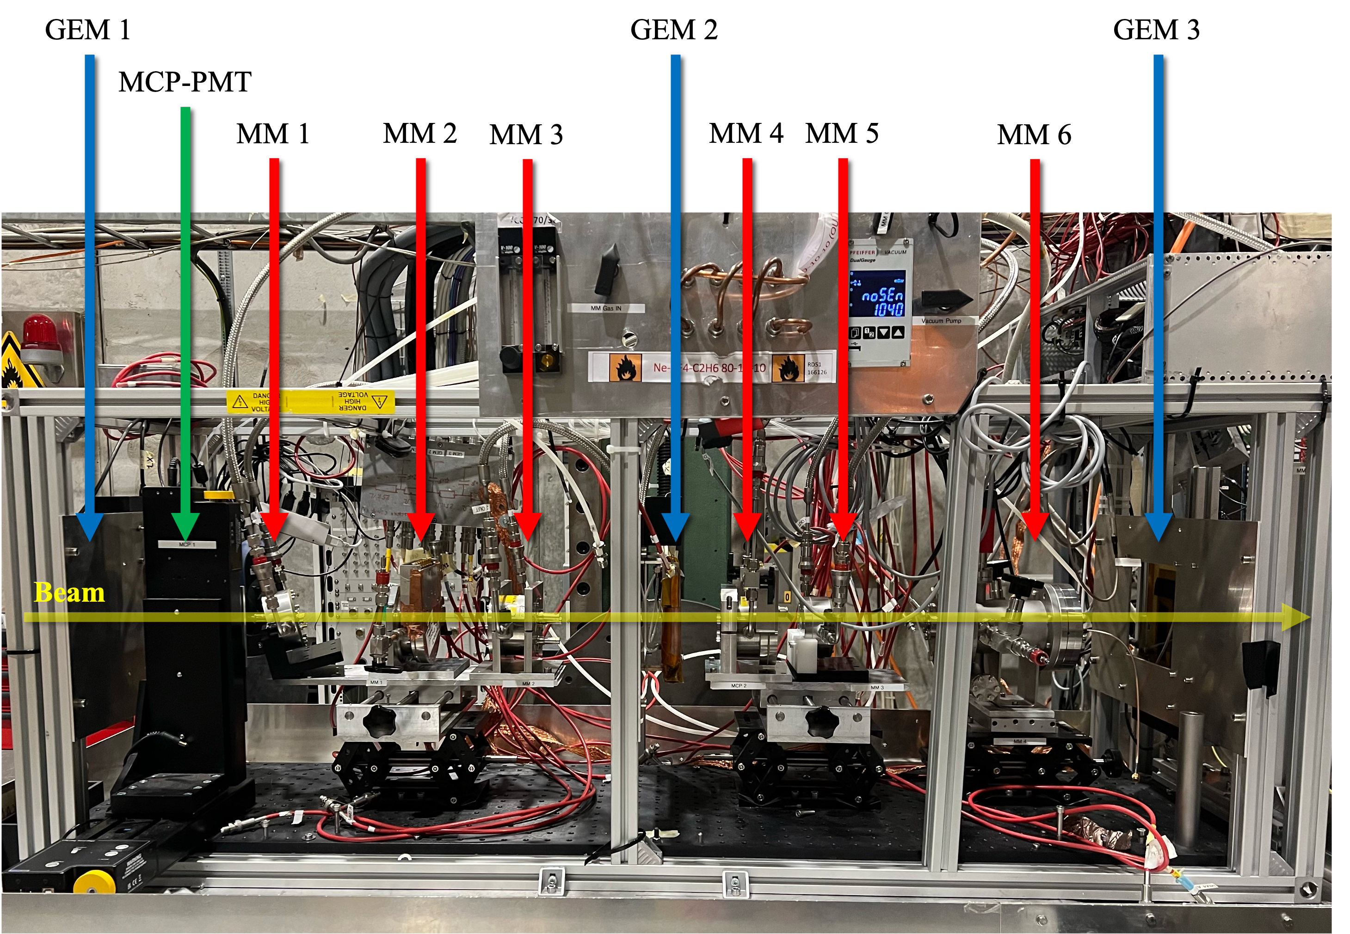
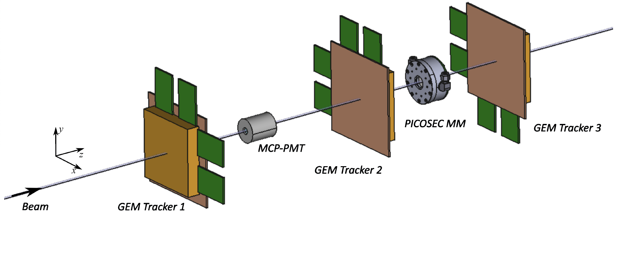
Single channel resistive PICOSEC Micromegas
This prototype, along with several others, was tested in both the lab and the CERN SPS H4 beamline using 150 GeV/c muons.
By utilizing tracking information from GEMs and timing information from MCP-PMTs, the timing performance could be measured.

Slide 10
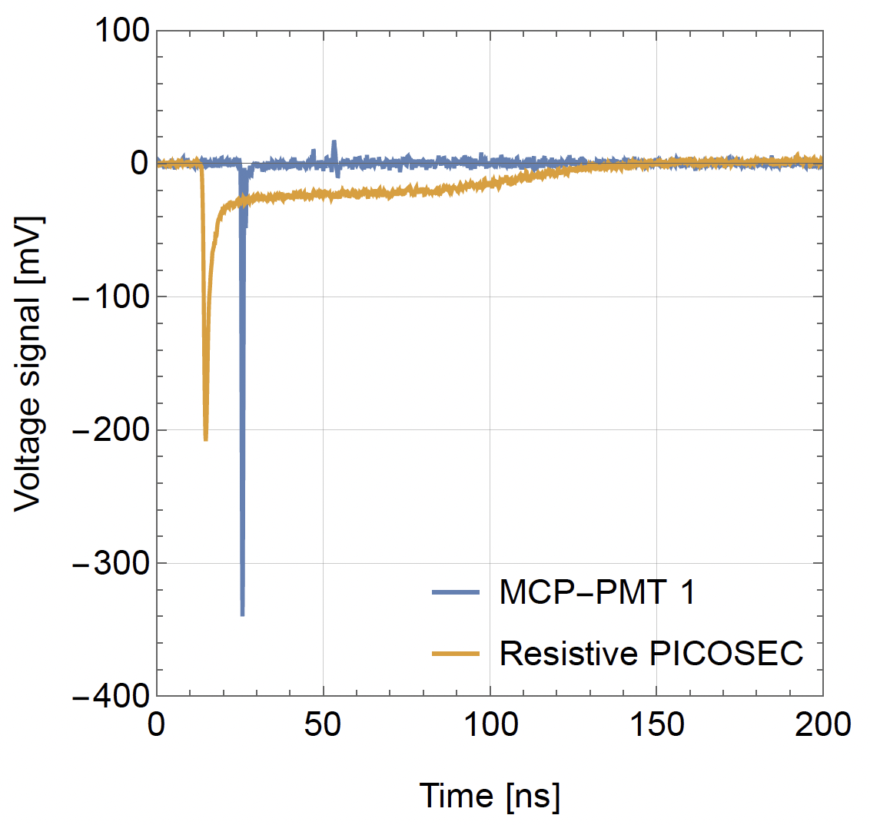
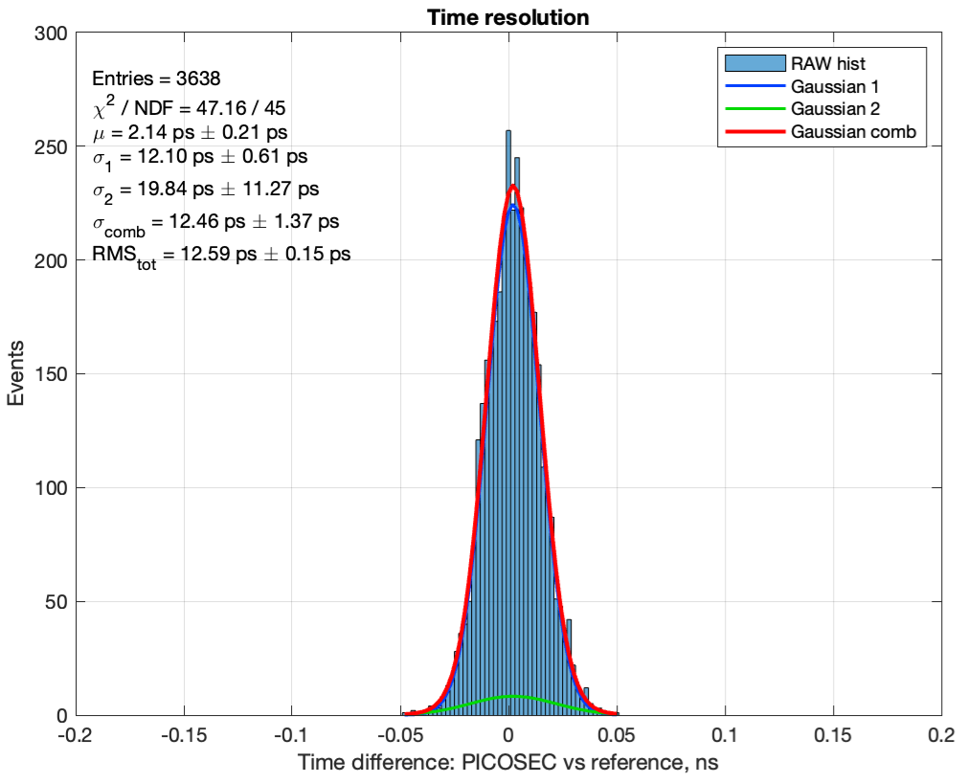
Single channel resistive PICOSEC Micromegas
The detector with 10 mm 𝜙 active area demonstrated equivalent performance compared to a non-resistive prototype, achieving a time resolution of σ = 12.5 ± 1.4 ps.
Signal waveform
Time difference distribution
Single-pad resistive
MM 20 MΩ/□ + Ti + CsI
σ = 12.5 ± 1.4 ps
M. Lisowska, PhD dissertation, (available soon).
D. Janssens, PhD dissertation, https://cds.cern.ch/record/2890572

Slide 11
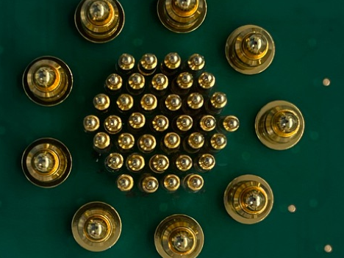
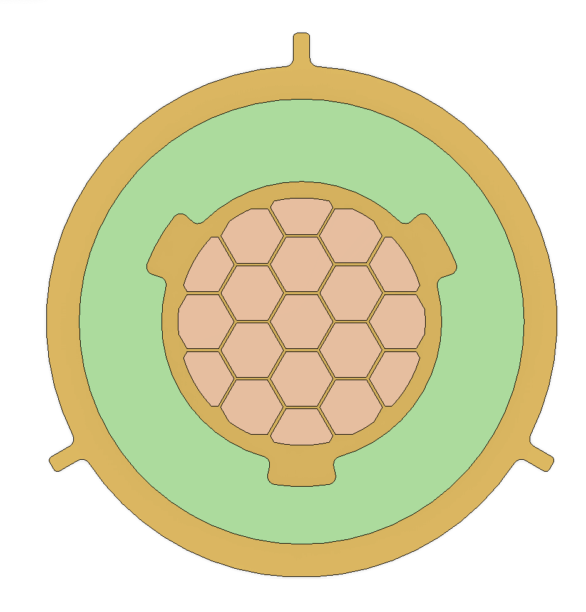
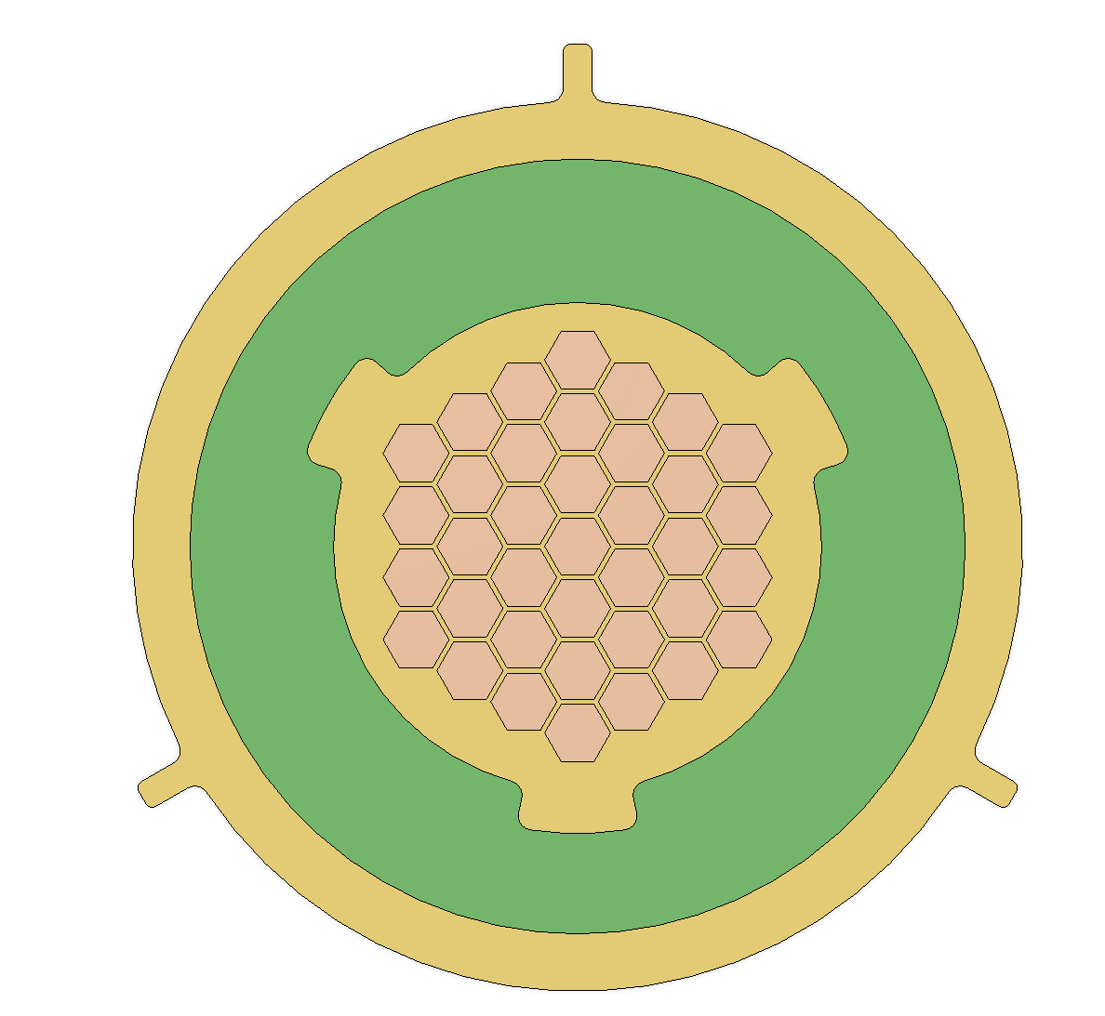
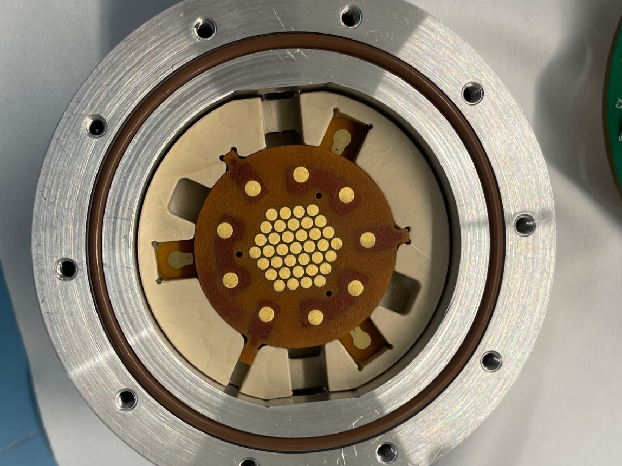
Increase readout granularity for spatial resolution
To investigate potential improvements in spatial resolution, two sets of resistive PICOSEC Micromegas prototypes with increased granularity and a 15 mm active area were produced and tested.
19 pads with 3.5 mm pitch
37 pads with 2.2 mm pitch
Backside contact pads
The pads were read out using a SAMPIC waveform TDC, while an MCP-PMT (timing reference) scanned across the active area (self-triggered in coincidence with the reference).

Slide 12
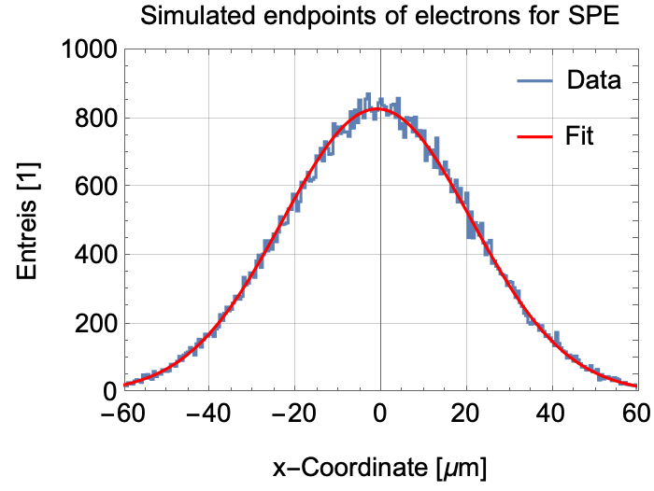
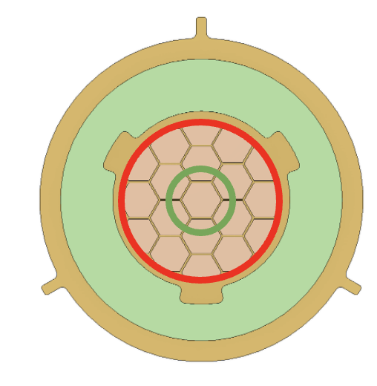
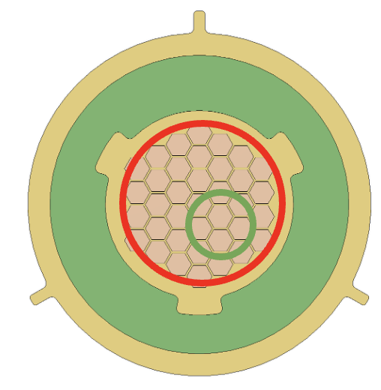
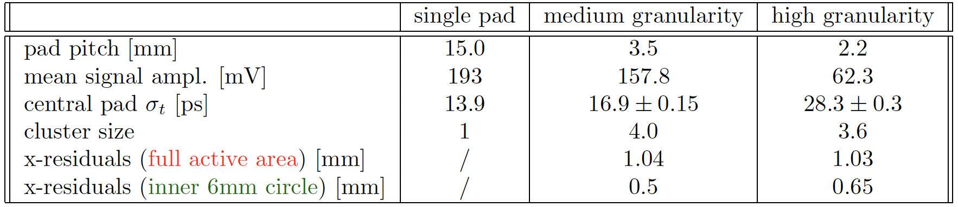
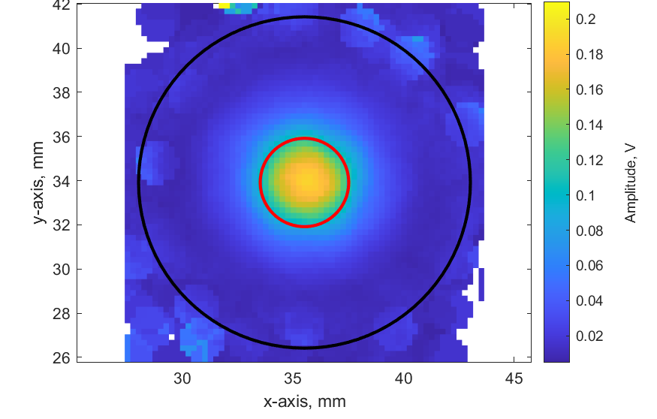

Increase readout granularity for spatial resolution
For the 3.5 mm readout pad pitch, comparable timing performance was observed on the central pad, despite only having partially contained events, with most charge centered around the particle trajectory.
$σ=22.09±0.08$ µm
2D signal amplitude map for 3.5 mm pitch
acceptance region
4 mm
Both timing and spatial resolution are worse for the high granularity readout, most likely due to the smaller signal amplitudes.

Slide 13
Multi-pad prototype with vertical charge evacuation
The rate capability of resistive MPGDs is highly dependent on the charge evacuation scheme used. Various promising 'fast evacuation' configurations can be found within our community.
To enhance the rate capability of the 10 x 10 cm² resistive multi-pad design, a vertical charge evacuation configuration was developed, in contrast to the previous single DLC layer with horizontal evacuation.
mimimum for protection
mimimum for timing
rate capability
G. Bencivenni, et al., JINST 14 (2019) P05014.
M. Iodice et al., Journal of Physics: Conference Series 1498 (2020) 012028.
M. Iodice et al., JINST 15 (2020) C09043.

Slide 14
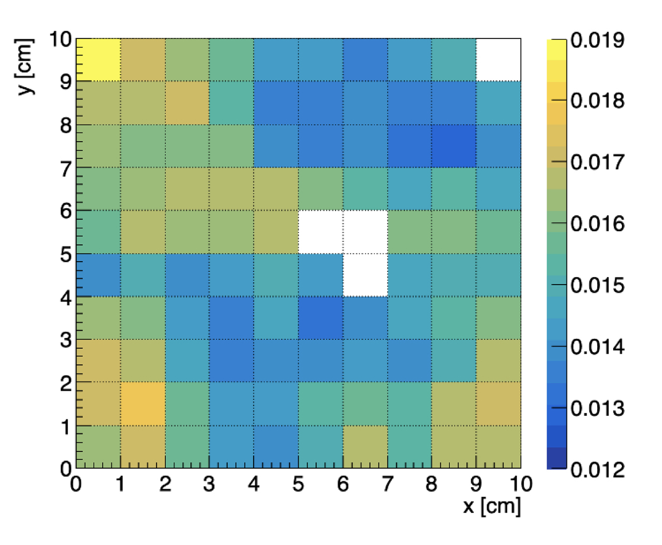
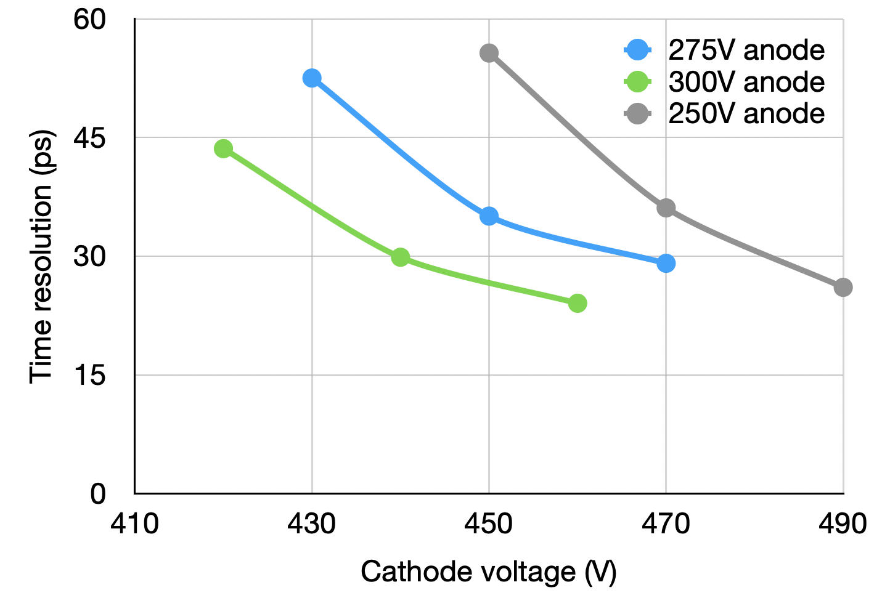
Multi-pad prototype with vertical charge evacuation
Measured quantities for 150 GeV/c muons
While the observed planarity of the MM board was ~ 15 µm after bulking, thowever, his does not fully explain the magnitude of the non-uniform response observed across the active area.
→ Possibly exacerbated by photocathode degradation!
pad 19:
<V> = 91.8 mV
σ_{t} = 22,1 ps
pad 12:
<V> = 97.2 mV
σ_{t} = 21.5 ps
pad 56:
<V> = 50.6 mV
σ_{t} = 29.1 ps
pad 89:
<V> = 99.3 mV
σ_{t} = 19.1 ps
pad 82:
<V> = 104.2 mV
σ_{t} = 19.1 ps
Mean amplitude for SPE [V]
Cathode voltage scan for pad # 56

Slide 15
Robust photocathodes

Slide 16
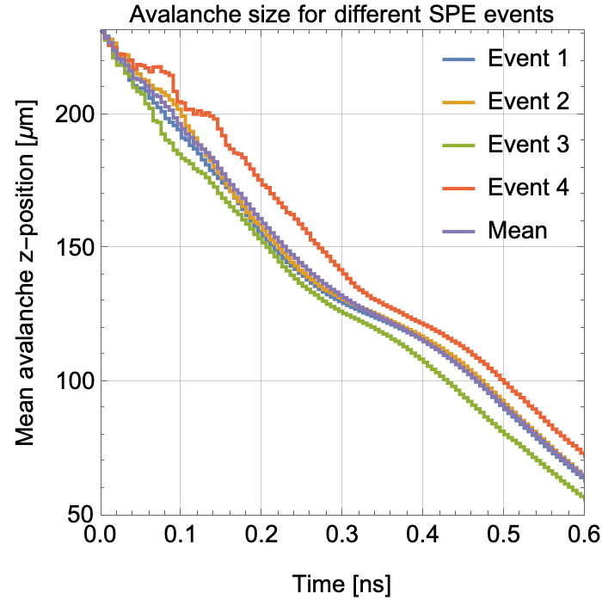
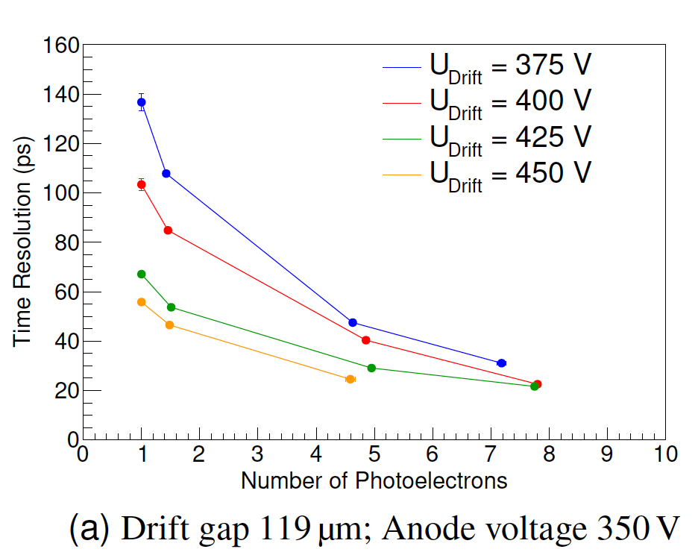
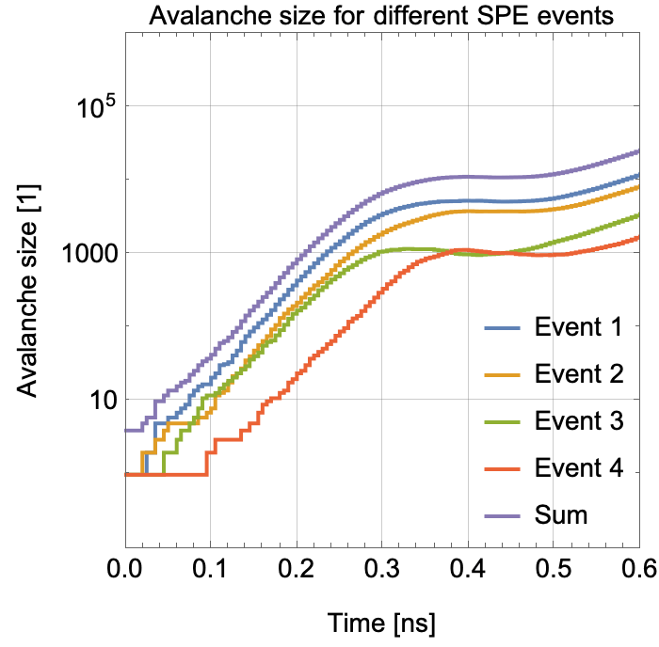

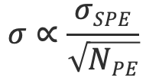
Number of photoelectrons
Given a particle crossing the radiator, the choice of photocathode affects the number of photoelectrons (PEs) produced, which is determined by its quantum efficiency. This, in turn, influences the time resolution, which depends on:
$$σ∝\frac{σSPE}{\sqrt{NPE}}$$
timing resolution for single PE
timing resolution
number of PEs
$$mesh region$$
Right plot and equation: L. Sohl, PhD dissertation, https://universite-paris-saclay.hal.science/tel-03167728/.

Slide 17
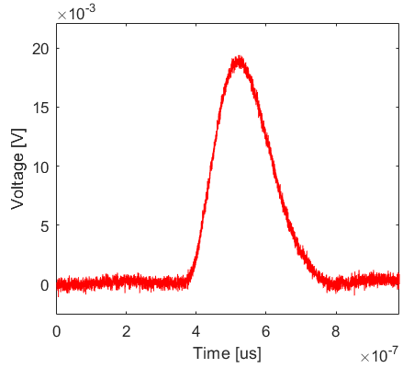
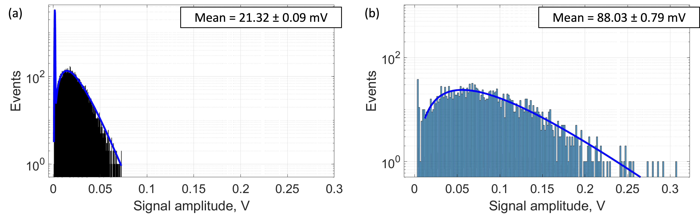
Number of photoelectrons
The average number of photoelectrons (NPE) is obtained by comparing the pulse heights of single photoelectron (SPE) events, measured with a UV LED, to those from multiple photoelectron measurements using a muon beam.
Charge-sensitive amplifier
  SPE PH spectrum
  150 GeV/c muon PH spectrum
  noise spectrum (Gaussian)
pre-trigger
region
amplitude
signal PH spectrum (Pólya)
A photocathode with 3 nm Cr and 18 nm CsI produces over 12 photoelectrons per muon when combined with a 3 mm MgF₂ crystal.
L. Sohl, PhD dissertation, https://universite-paris-saclay.hal.science/tel-03167728/.
M. L. V. Fernandez, summer student seminar, https://indi.to/9RPK3.
M. Lisowska, PhD dissertation, (available soon).

Slide 18
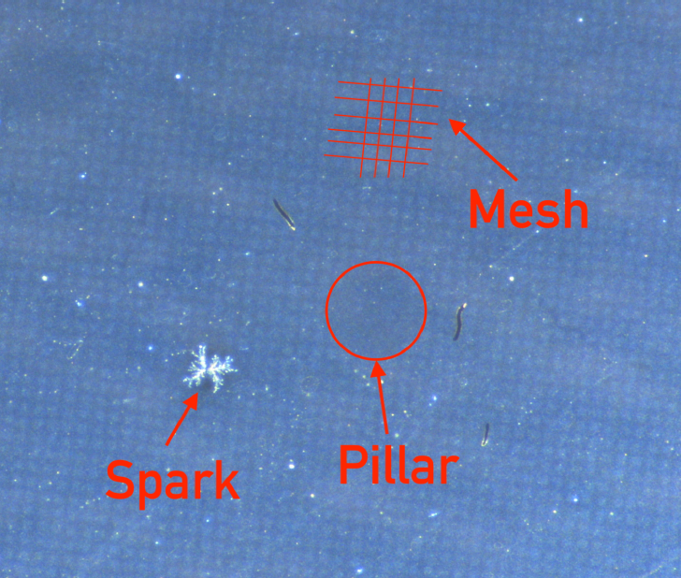
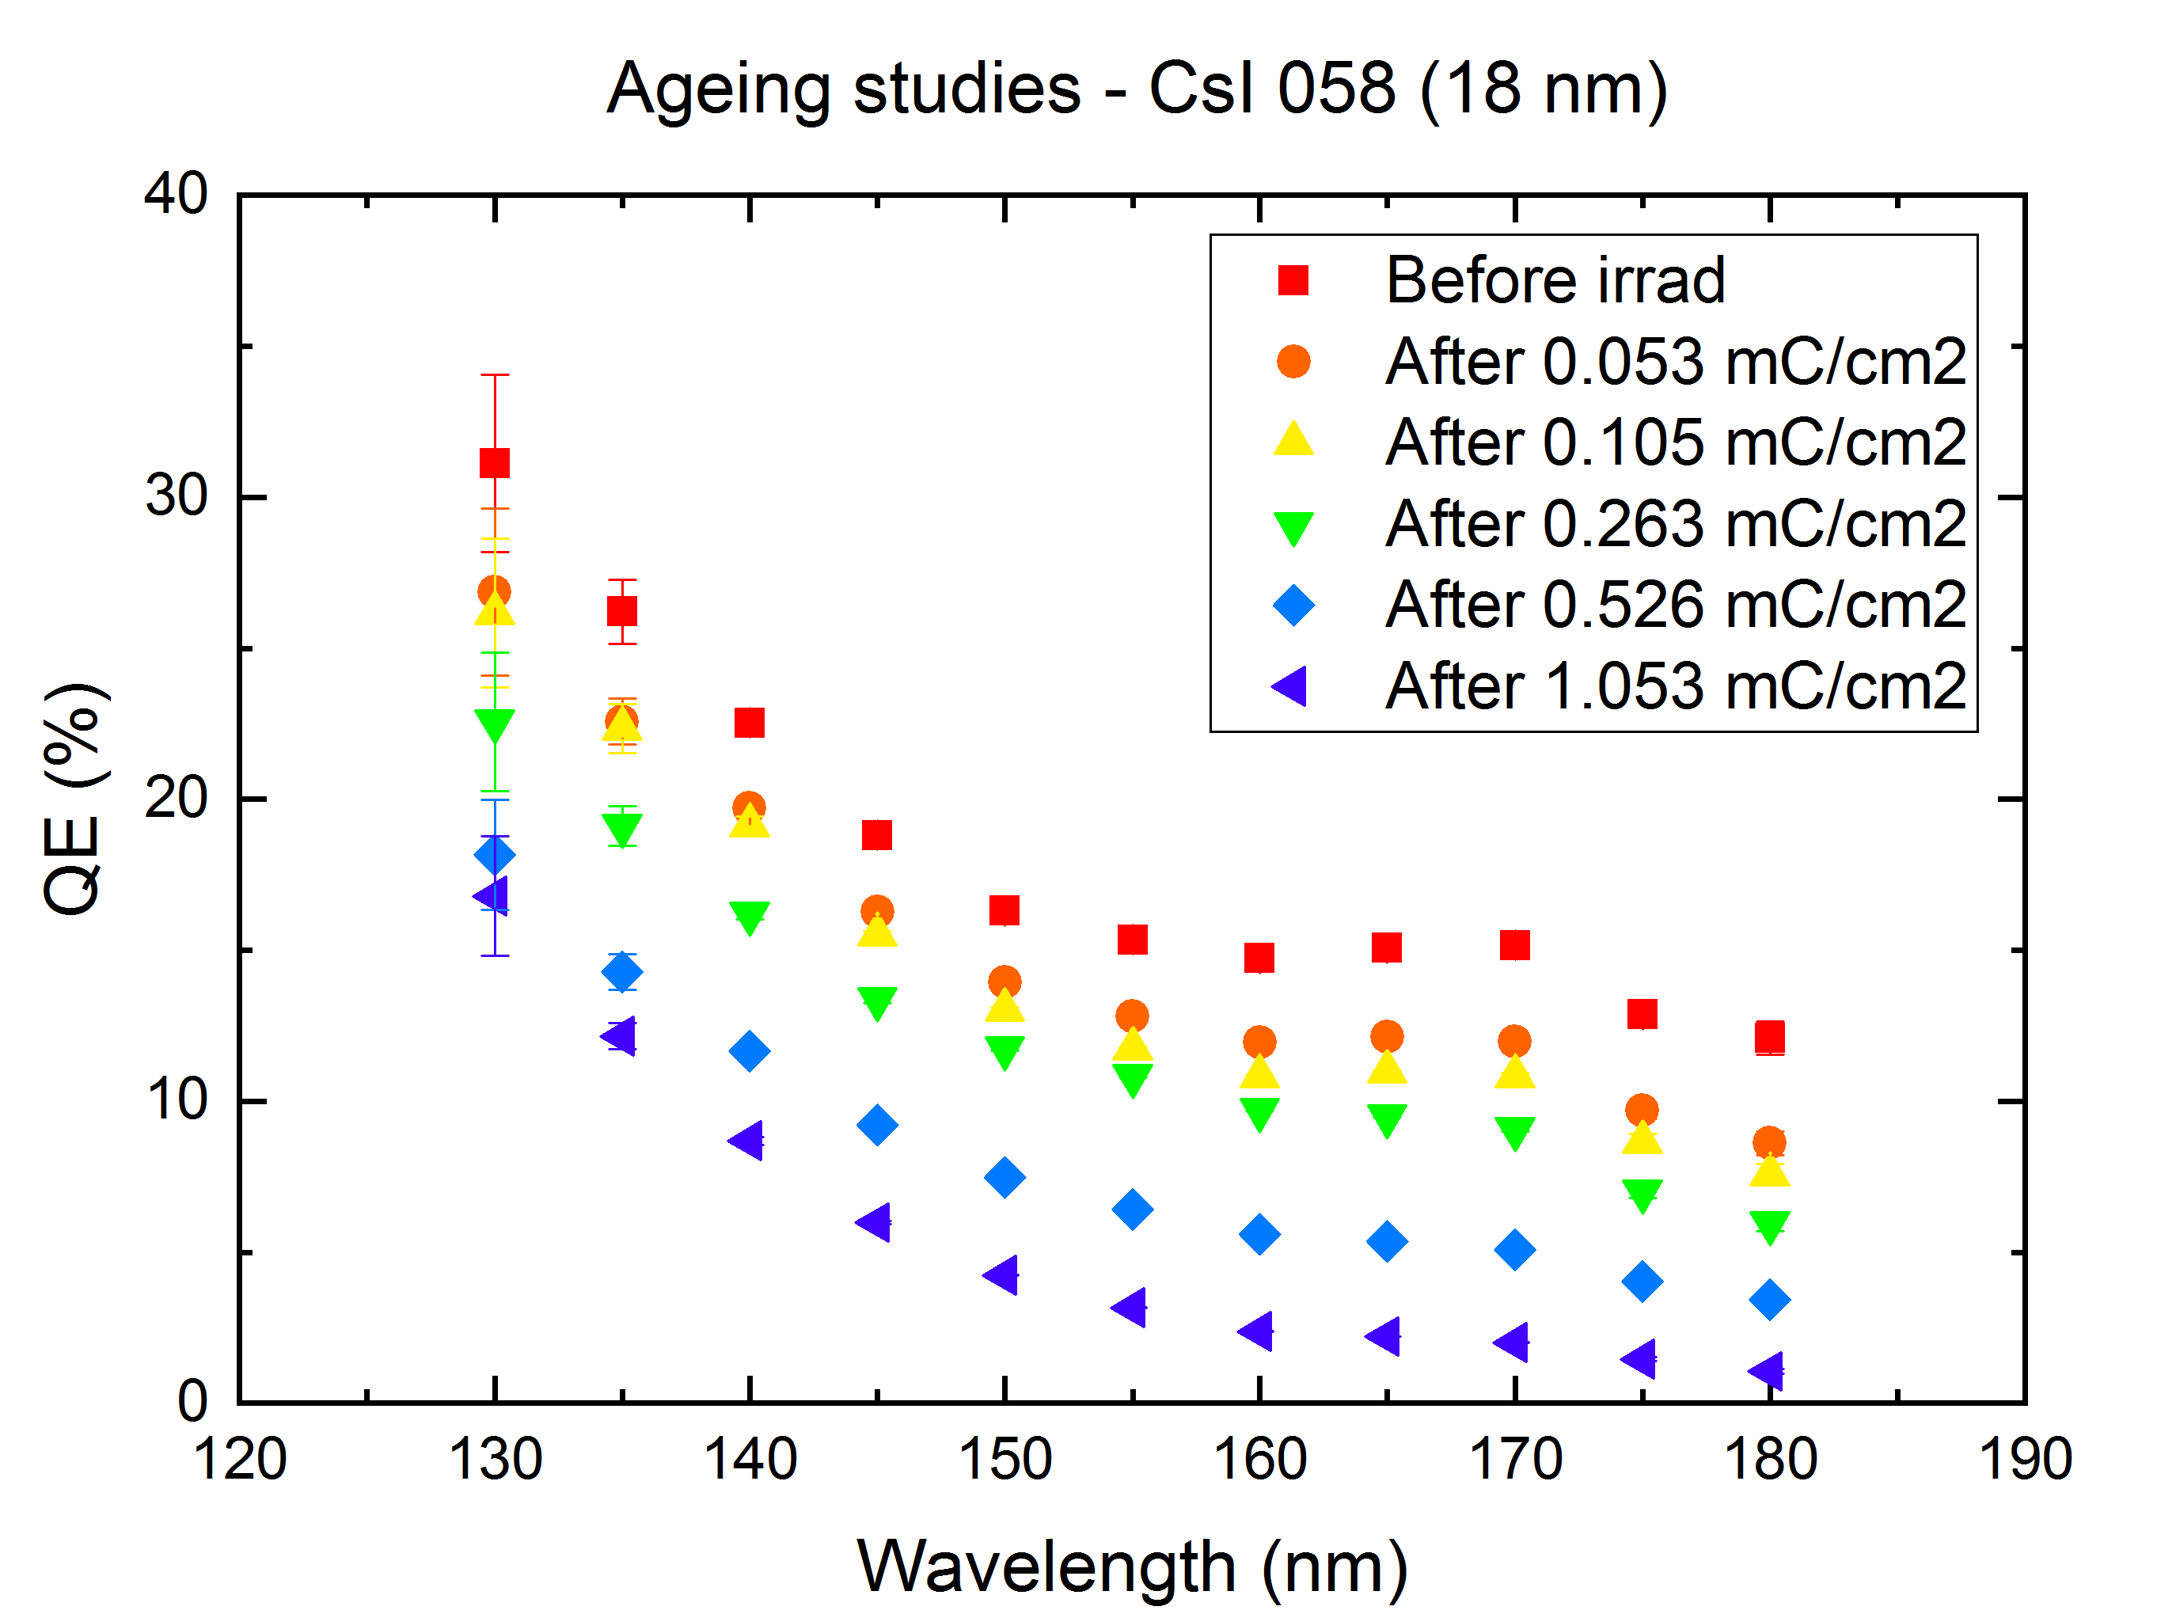
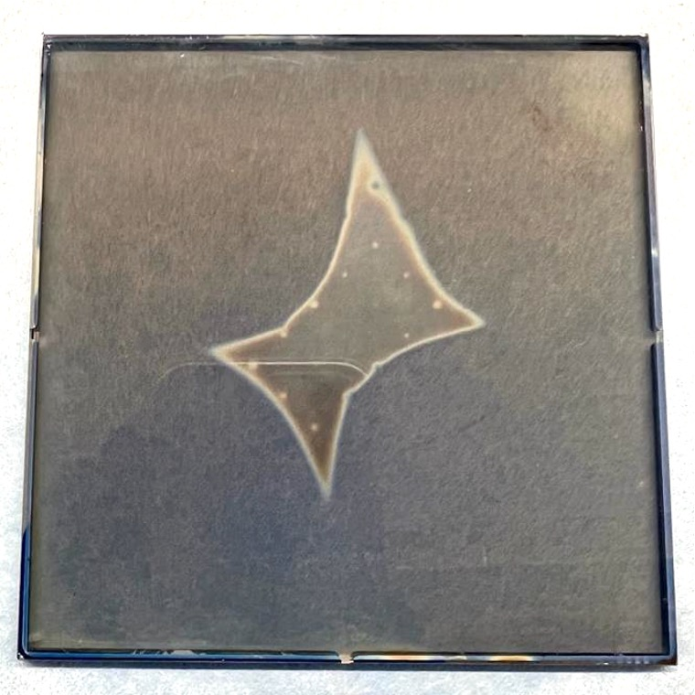
Alternative Photocathodes to CsI
CsI photocathode damaged by IBF
CsI is highly susceptible to degradation from:
humidity from assembly or possible outgassing of materials, e.g., Kapton
ion backflow (IBF)
discharges
To increase robustness, different alternatives to CsI are being investigated:
Ageing studies for CsI
CsI photocathode after air exposure
Diamond-Like Carbon (DLC)
Boron Carbide (B₄C)
Nanodiamonds
Carbon nano-structures
Graphene
IBF and air exposure observations: L. Sohl, PhD dissertation, https://universite-paris-saclay.hal.science/tel-03167728/.
Air exposure observations: M. Lisowska, PhD dissertation, (available soon).
QE ageing studies: M. Lisowska’s master thesis, https://cds.cern.ch/record/2885929.

Slide 19
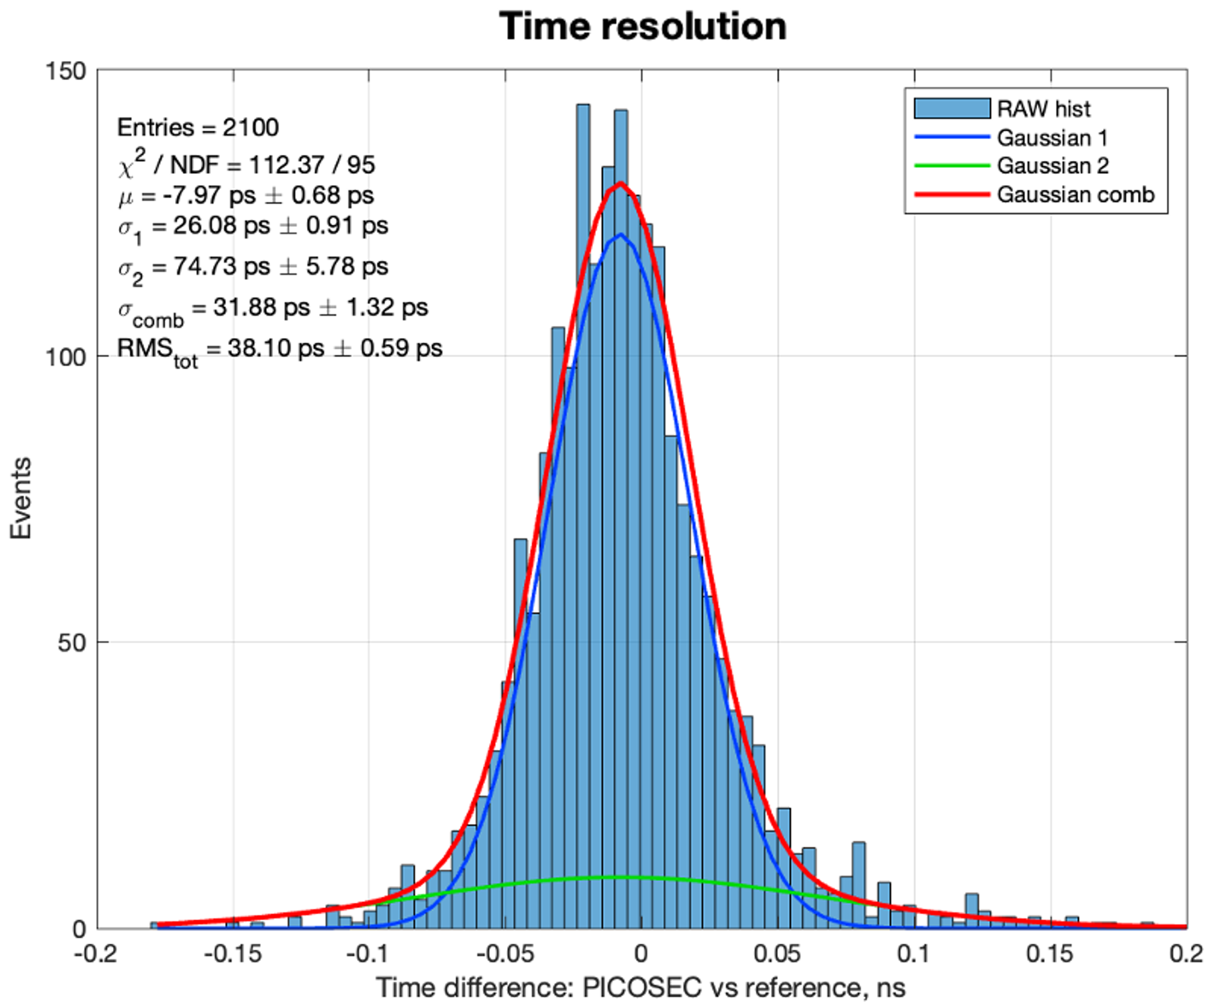
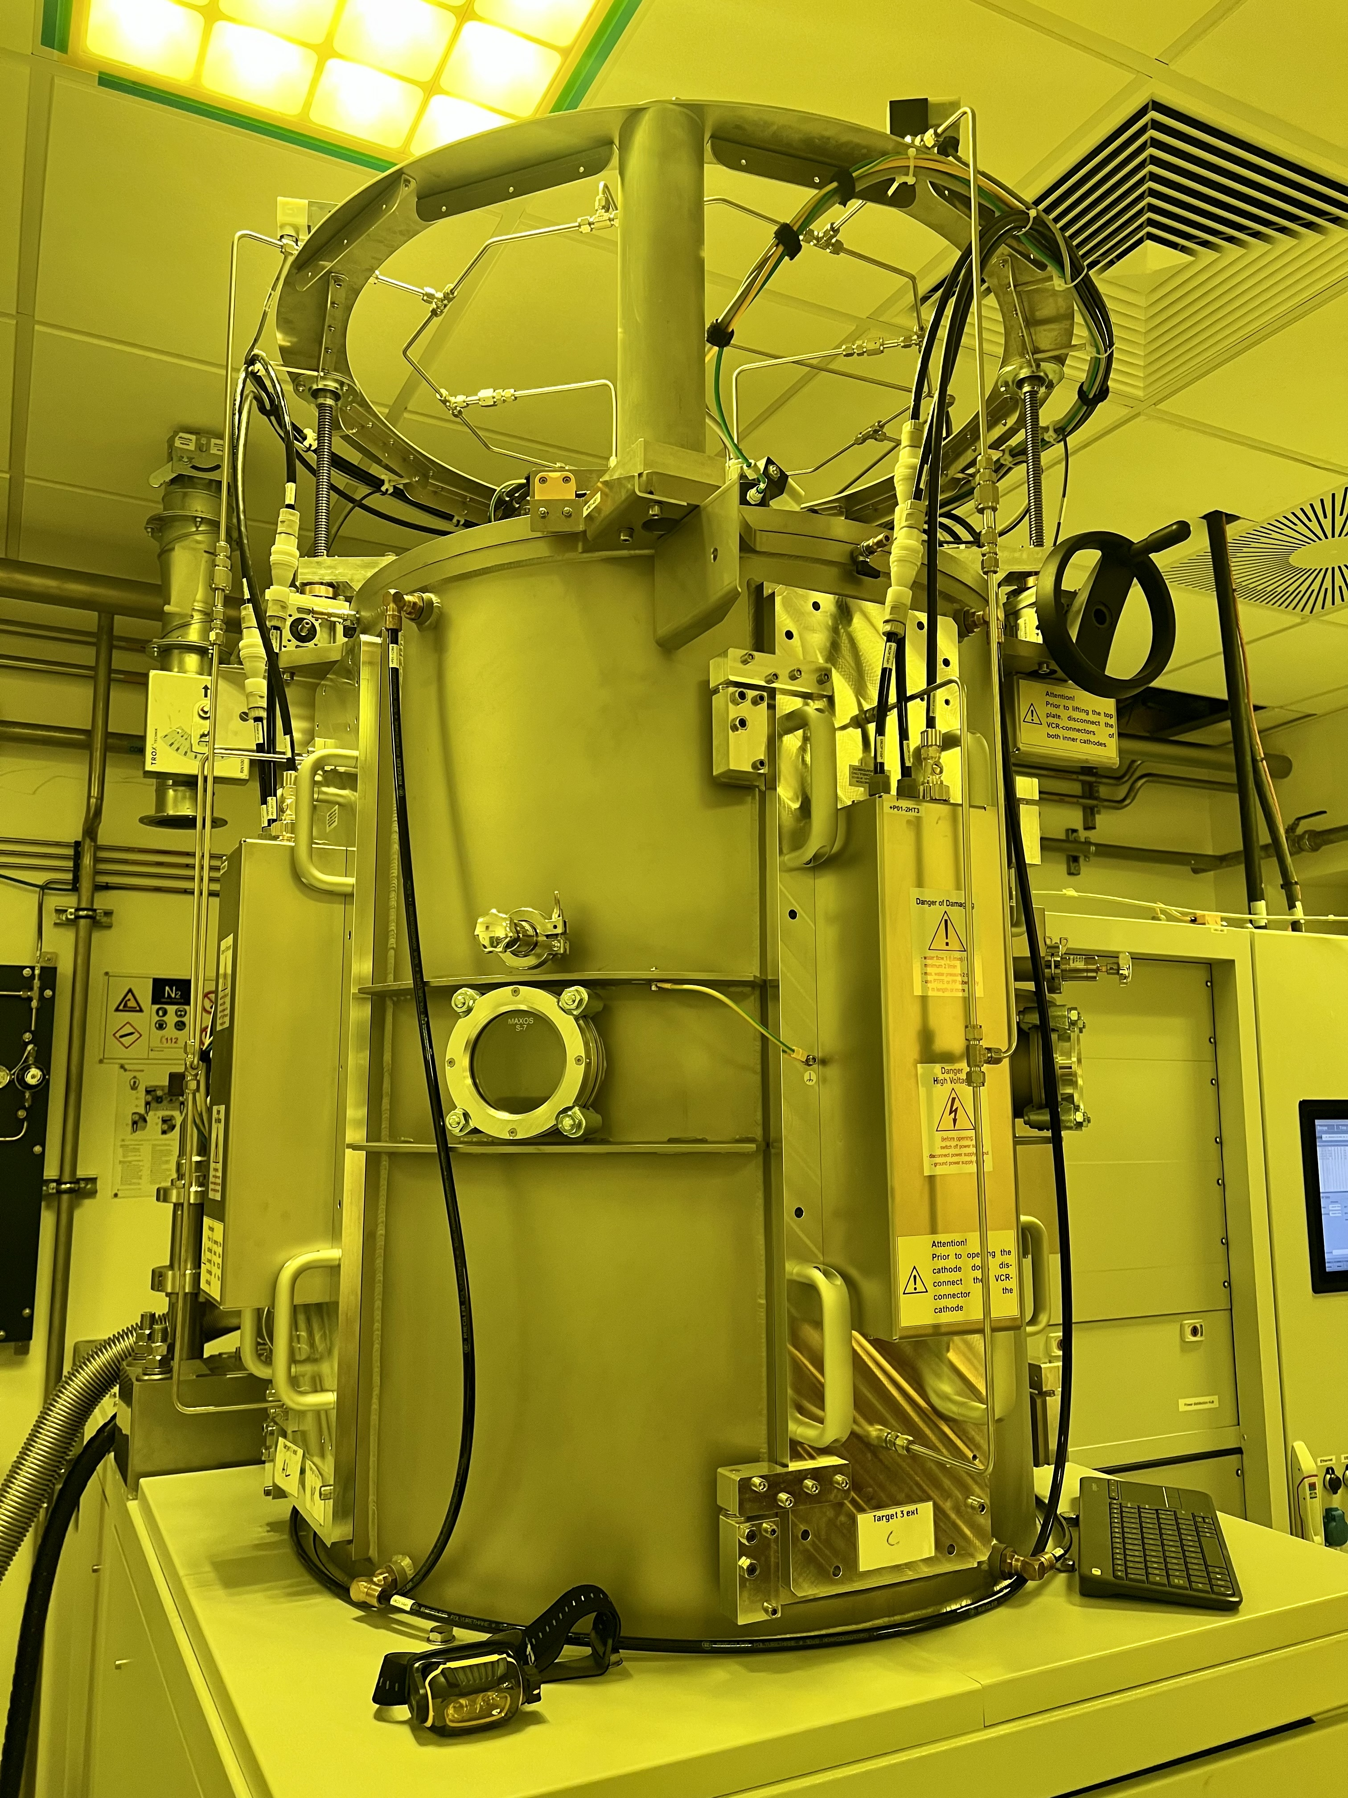
DLC as Alternative Photocathodes
DLC photocathodes, ranging in thickness from 1.5 nm to 3.5 nm, were characterized during the test beam measurements.
The detector with a 1.5 nm DLC layer deposited directly on the radiator exhibited a time resolution of σ = 31.9 ± 1.3 ps, while thicker samples showed approximately 4 ps worse resolution.
Pulsed DC magnetron vacuum deposition machine
Surface resistivity as a function of layer thickness
Time difference distribution
Single-pad MM
3 mm MgF₂
+ 1.5 nm DLC
σ = 31.9 ± 1.3 ps
96.8% efficiency
N_{PE} ≈ 3.0
X. Wang, et al., arXiv:2406.08712.
M. Lisowska, et al., arXiv:2407.09953 [physics.ins-det].
M. Lisowska, PhD dissertation, (available soon).

Slide 20
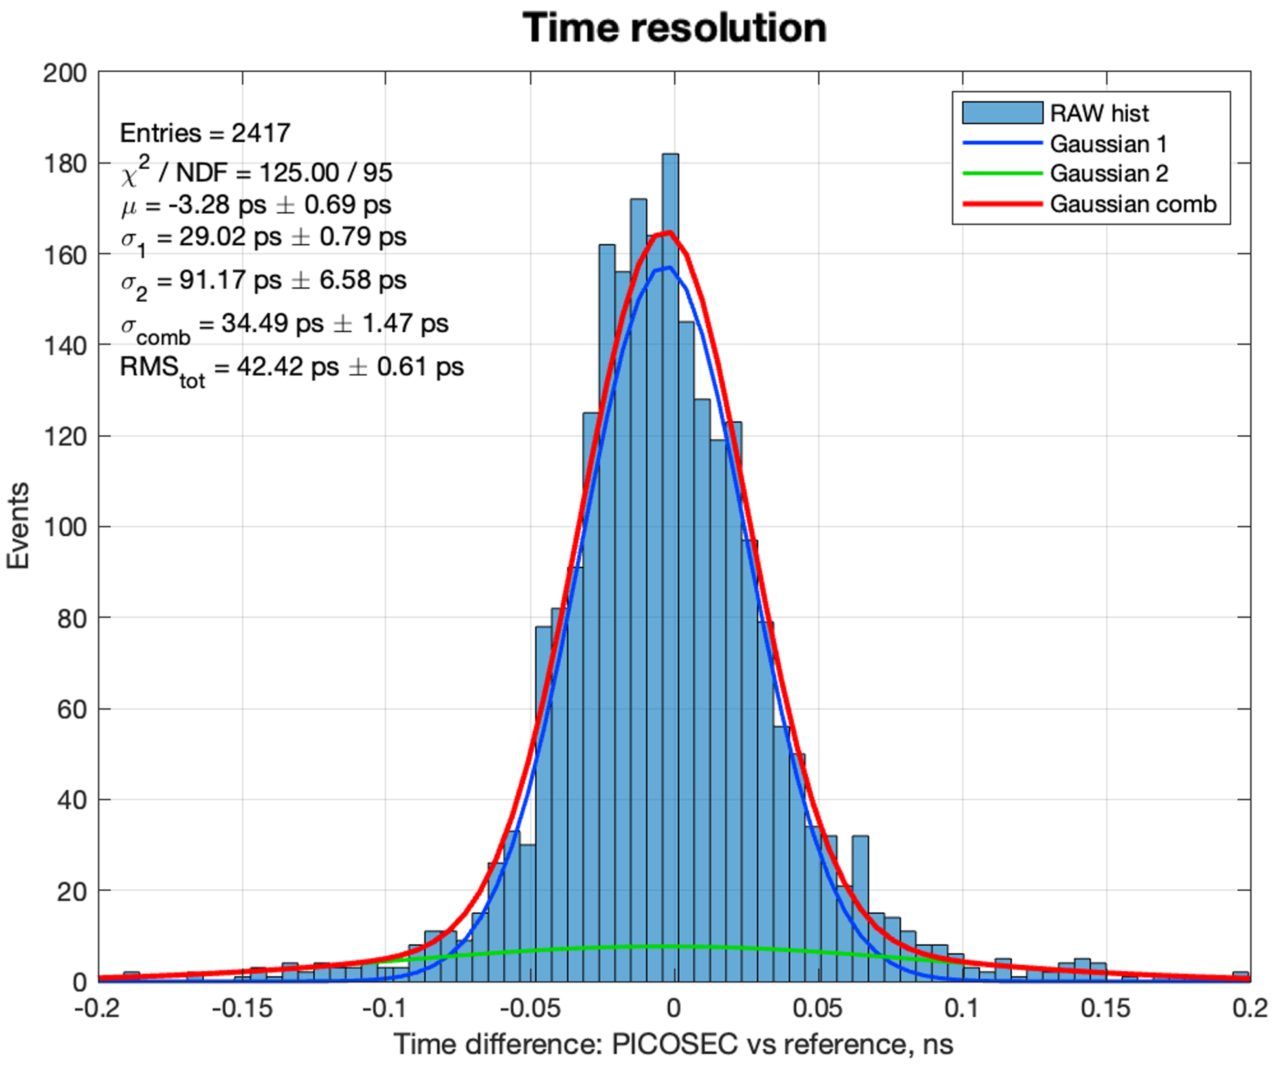
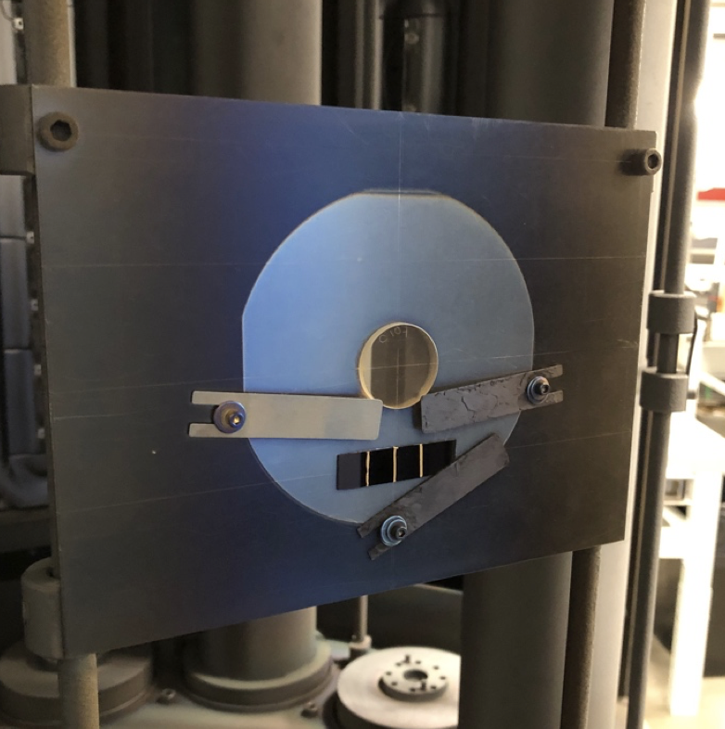
B₄C as Alternative Photocathodes
B4C photocathodes deposited at CEA-Saclay and ESS have demonstrated promising results.
A detector with a 9 nm B4C layer and 3 nm Cr resulted in a time resolution of σ = 34.5 ± 1.5 ps, with thicker samples showing slightly worse resolution by up to ~10 ps.
B₄C sample in the sputtering machine
Time difference distribution
Single-pad MM
3 mm MgF₂ + 3 nm Cr + B₄C 3 mm
σ = 34.5 ± 1.5 ps
95.4% efficiency
N_{PE} ≈ 3.4
C.-C. Lai, ESS
L. Sohl, PhD dissertation, https://universite-paris-saclay.hal.science/tel-03167728/.
M. Lisowska, et al., JINST 18 (2023) C07018.
M. Lisowska, et al., arXiv:2407.09953 [physics.ins-det].
M. Lisowska, PhD dissertation, (available soon).

Slide 21
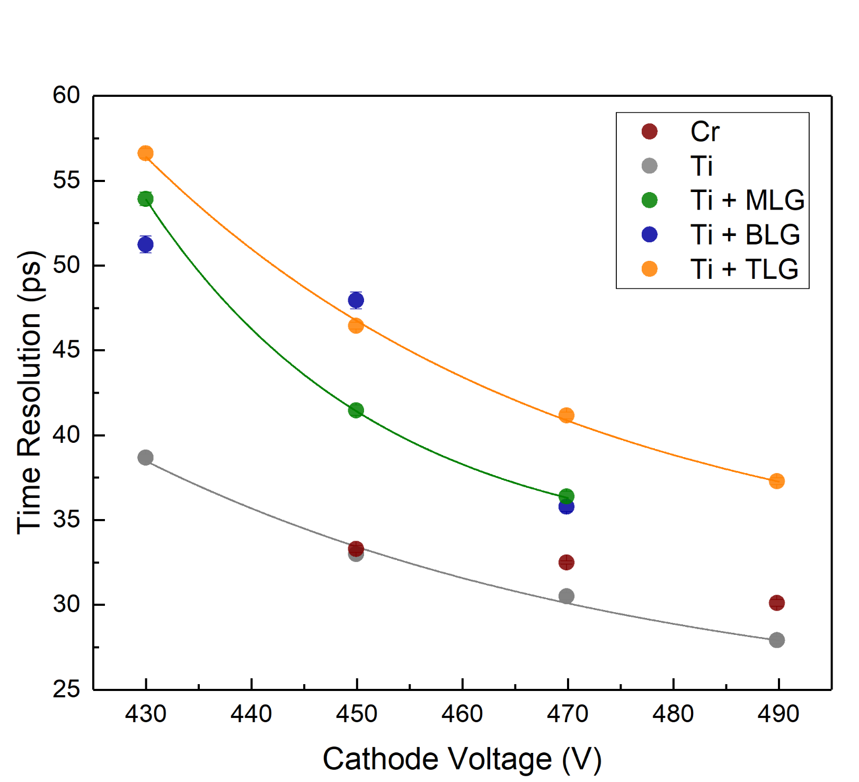
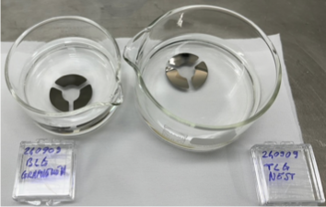
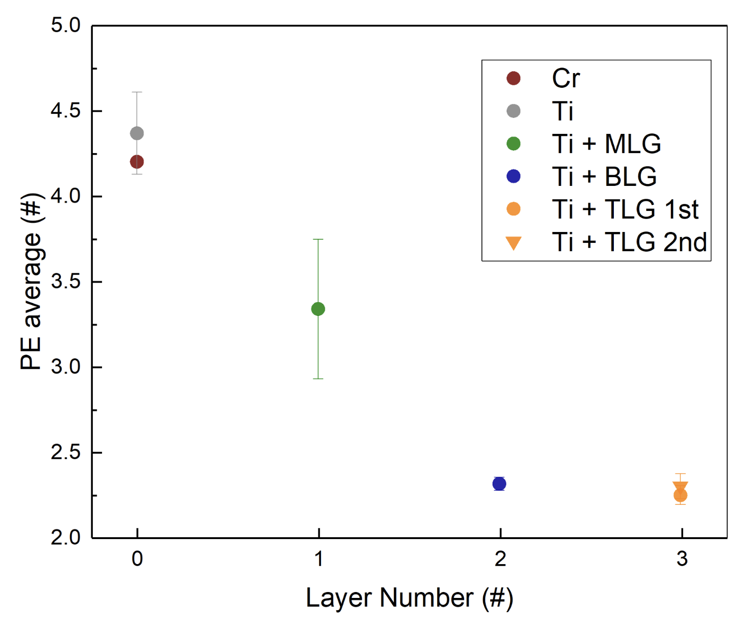
Graphene as Protective Layer
In studies using graphene as a photocathode, a 2.5–3 nm Ti layer produced a surprisingly large number of PEs.
Adding graphene partially screens the photoelectron (PE) emission from the Ti, with the monolayer (ML) screening approximately 30%, and the bilayer (BL) and trilayer (TL) screening about 50% of the PEs.
Cathode voltage scan
Number of photoelectrons per muon crossing
V_{A} = 275 V
→ Graphene could be considered as a protective layer.
More on graphene in MPGDs can be found in G. Orlandini’s MPGD 2022 presention: https://indi.to/rqqnb.

Slide 22
Towards an applicable detector

Slide 23
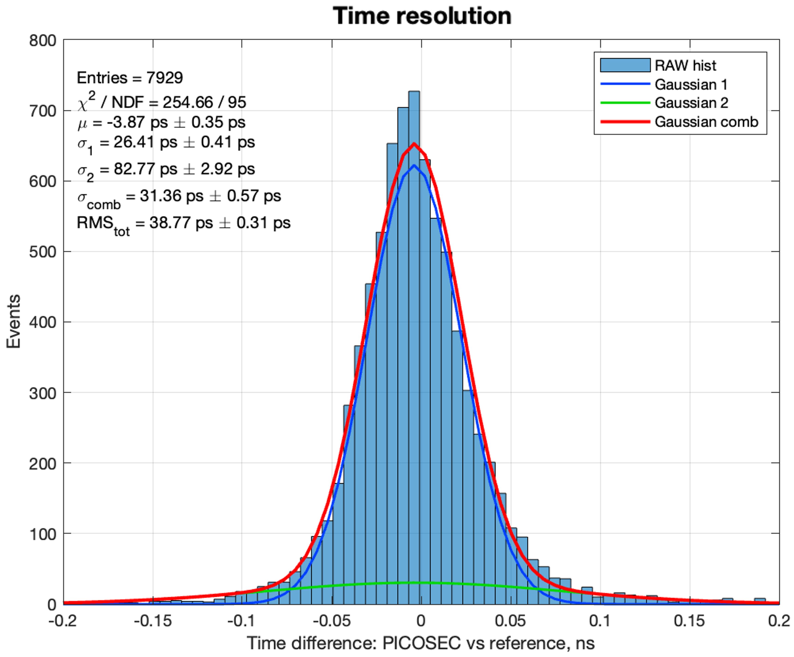
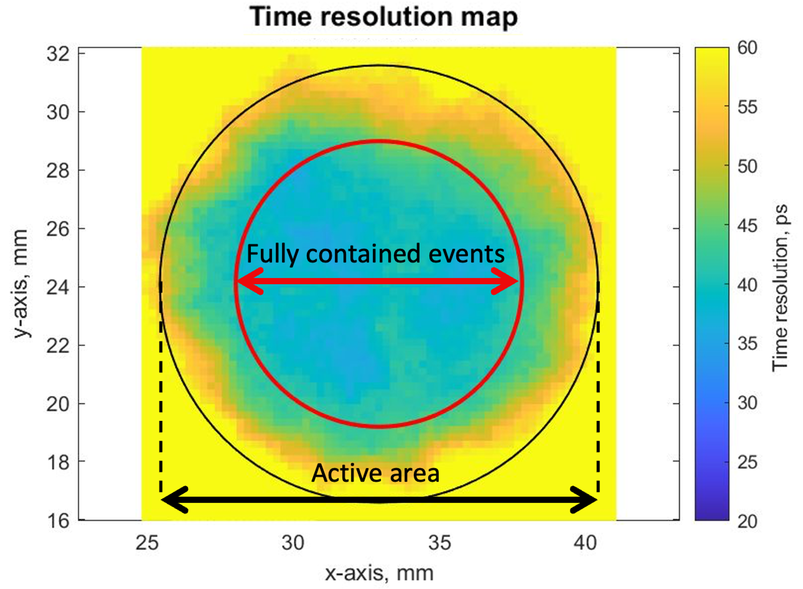
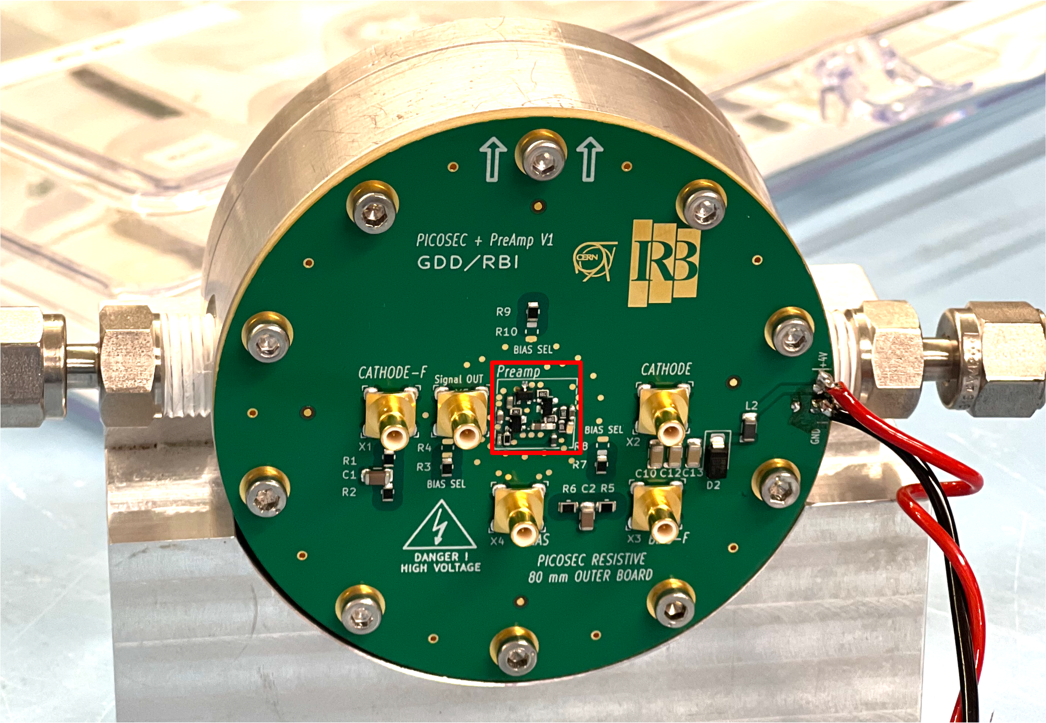
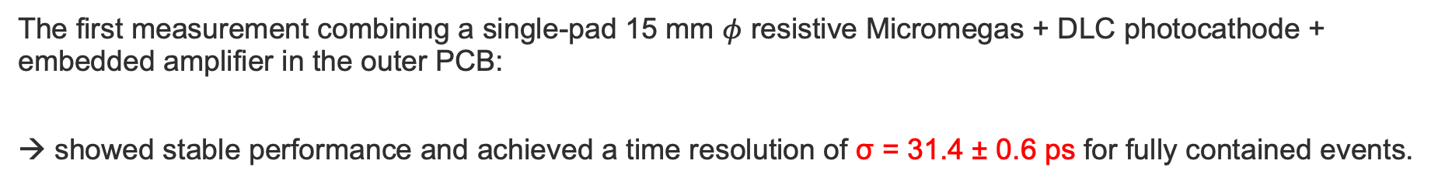
B₄C as an Alternative Photocathodes
The first measurement combining a single-pad 15 mm $φ$ resistive Micromegas + DLC photocathode + embedded amplifier in the outer PCB:
→ showed stable performance and achieved a time resolution of σ = 31.4 ± 0.6 ps for fully contained events.
Single-pad detector with the embedded amplifier
Time difference distribution
Time resolution distribution
V_{C} = -530 V
V_{A} = 275 V
973 mbar
M. Lisowska, PhD dissertation, (available soon).

Slide 24
Summary
  To enable the sub-25 ps PICOSEC Micromegas precise-timing detector to perform effectively under the demanding conditions of physics experiments, we are adapting its design to improve robustness.
  The Resistive Micromegas with a single-pad and 20 MΩ/□ showed equivalent precision to a non-resistive prototype, with time resolution of σ = 12.5 ± 1.4 ps.
  With increasing the granularity of the readout offers the possibility for sub-mm spatial reconstruction, with a pad pitch of 3.5 mm yielding σ = 0.5 mm with minimal timing degradation in the center of the pad.
  The vertical charge evacuation design, while promising (< 20 ps), needs further investigation to work out non-uniform response.
  Intensive studies for alternative photocathodes resulted in achieving a time resolution of σ = 31.9 ± 1.3 ps for DLC, 34.5 ± 1.5 ps for B₄C, and 36.3 ± 0.3 ps for Ti + a monolayer of graphene.
  Outlook:
  Robust photocathodes: ageing studies of the DLC and B₄C, response to IBF
  Rate-capability: double-layer DLC Micromegas for vertical charge evacuation

Slide 25
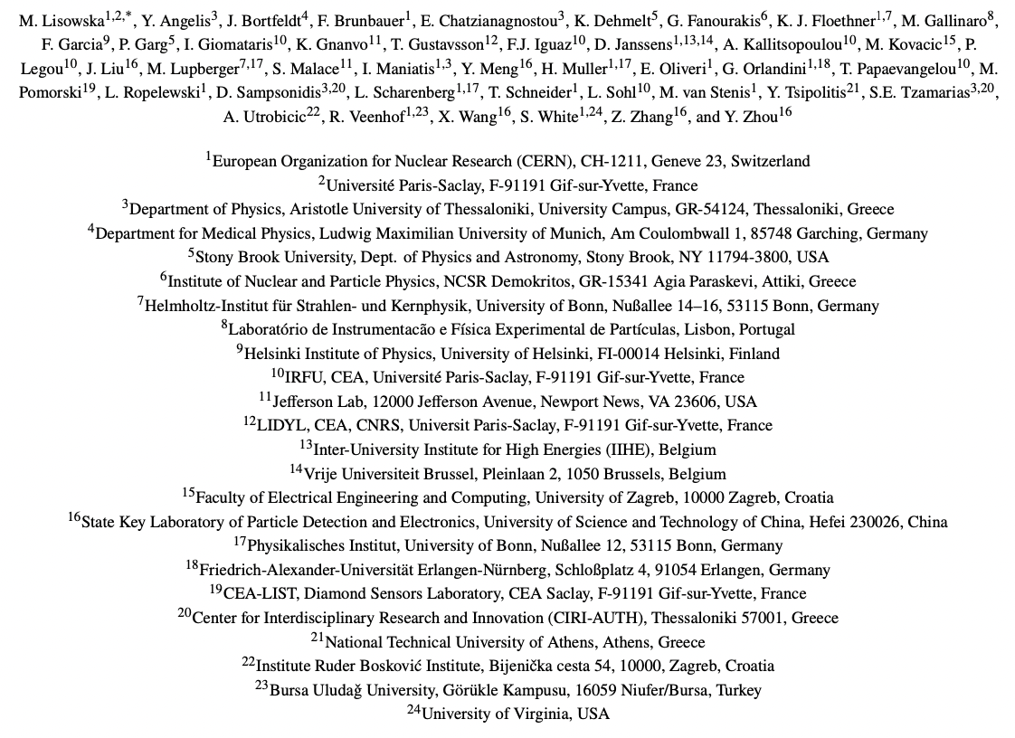
PICOSEC Micromegas Collaboration
PICOSEC micromegas collaboration: https://picosec-mm.web.cern.ch

Slide 26
  Thank you for your attention!

