Slide 1



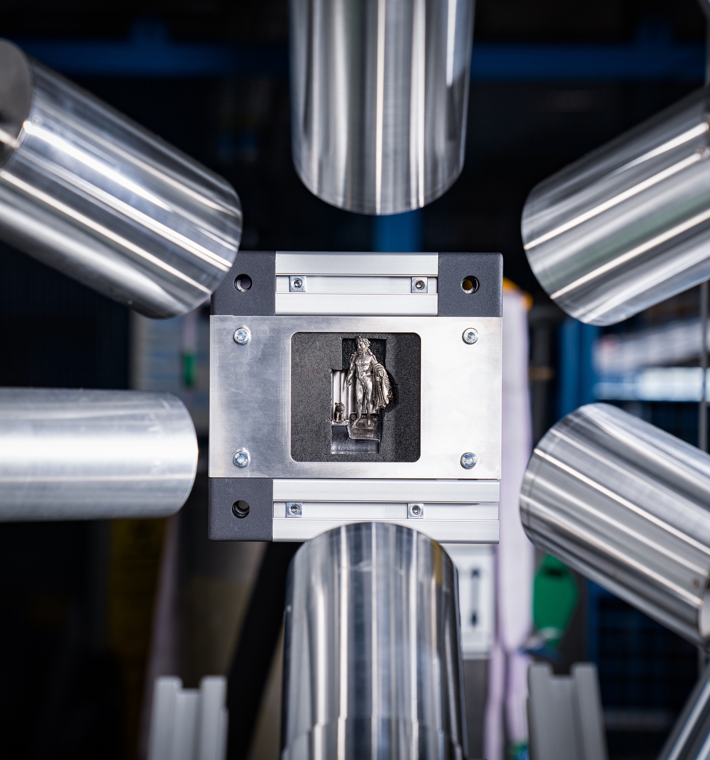
A novel technology for element-sensitive 3D tomography using MIXE
An effort to MIXE-T(omography)
Xiao Zhao on behalf of the MIXE team
Hefei, 16 October 2024

Slide 2
Outline
Introduction to Muon Induced X-ray Emission (MIXE)
MIXE Experimental Setup
  Location
  GIANT
  Efforts toward MIXE-T(omography)
MIXE-T(omography): First Result
Outlook

Slide 3
Introduction to MIXE

Slide 4
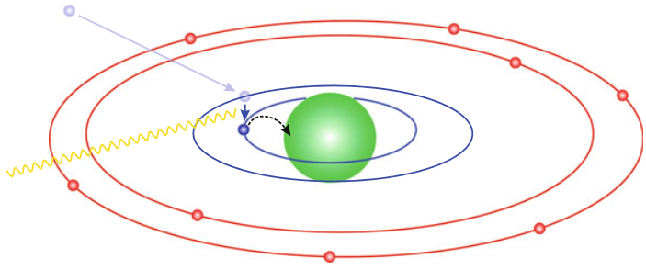
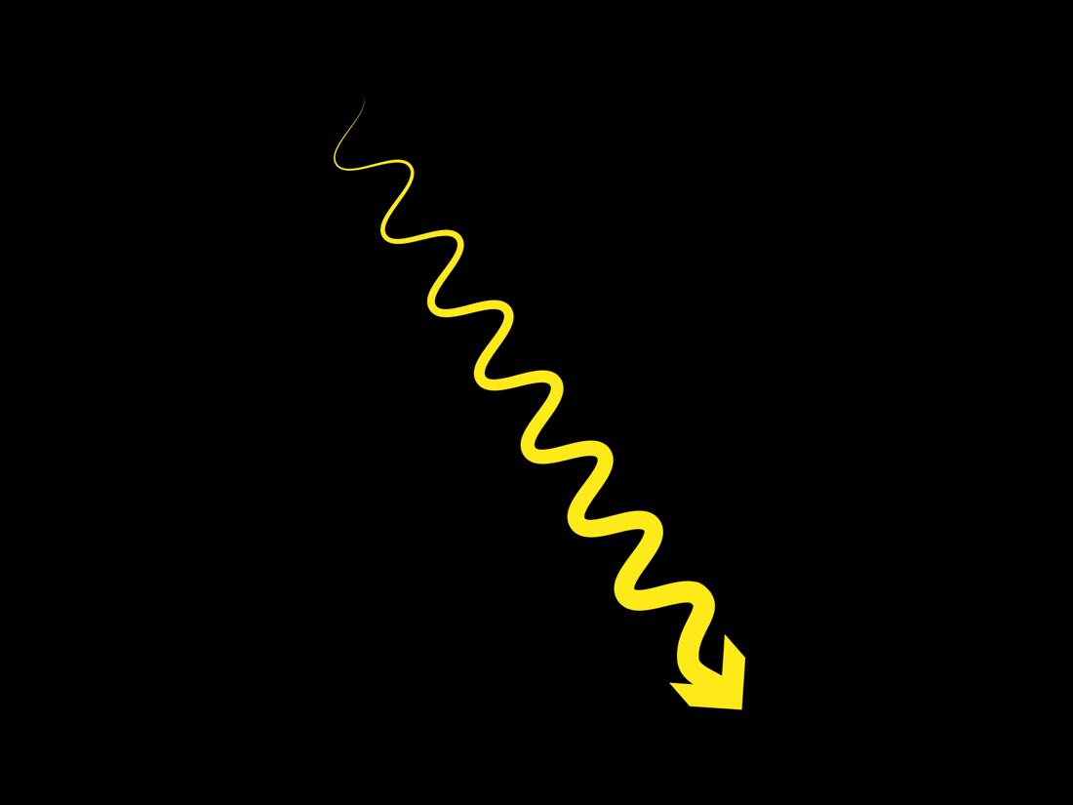





Muon Induced X-ray Emission
  Muon is implanted (depth given mainly by momentum and density of the material)
  Low energy muon is captured by the atom in higher excited states:
    $n_{μ}≈\sqrt{\frac{m_{μ}}{m_{e}}}≈14$
  Cascades down to $n_{μ}=1$ while
  emitting X-rays characteristic to
  the element / isotope
  Muon is unstable and decays
  or
  Muon is captured by nucleus
$μ^{−}+p→ν_{μ}+n$ (+ ~10-20 MeV)
$${{\overline{ν}}_{e} }_{ }$$
n,p,α
$$_{ }u^{−}$$
$$ν_{μ}$$
γ
$$e^{−}$$
  Nucleus loses excess energy by emitting (some combination of) n, p, α, γ
Amato, A., & Morenzoni, E. (2023). Introduction to Muon Spin Spectroscopy. Springer.
Notes:
At the end of the stopping process in the material, i.e., when the velocity of the negative muon becomes similar to the one of the atomic electrons, the muon will interact with the Coulomb field created by the positive charge of a nearby nucleus and will be captured forming a so-called muonic atom. The muonic atom is formed in an excited state and will rapidly (⁠ ns) emit multiple x-rays arising from the steps taken by the muon to cascade down the various energy levels until it reaches its 1s ground state. This process is similar to the well-established x-ray emission spectroscopy (XES) and x-ray fluorescence (XRF) techniques. Differently to an electron, although, at this point, the muon either naturally decays emitting an electron and neutrinos or, in particular, in high-Z elements, it undergoes a nuclear capture followed by neutron and/or gamma-ray emission of the excited daughter nucleus. The energies of the x-rays emitted during the cascade vary enough between elements to differentiate them using precision equipment.
In a first approximation, once negative muons stop in the material, they will be
captured in an excited state, with an equivalent energy and size to the 1S electron
orbital of the corresponding electronic atom. where me is the electron’s mass and mµ is the mass of the µ− muon [33]. Thus, the
muonic atoms are typically formed in an excited state with principal quantum num-
bers of approximately 14. Subsequently they de-excite, on a timescale of ∼ 10−13s
through electromagnetic cascades to the ground state This de-excitation
occurs primarily via Auger processes and radiative transitions, emitting X-rays char-
acteristic of the capturing atom, which are detected by the GermanIum Array for
Non-destructive Testing (GIANT) instrument, positioned around the sample
(see Figure 1.6). Figure 1.4 provides an illustration of this process

Slide 5
Muon Induced X-ray Emission
MIXE is the only elemental analysis method that combines:
  Sensitivity to basically all elements (often even isotopes, indication of chemical states)
  Depth-resolved from surface to bulk (~ μm to ~ cm)
  Completely non-destructive
This makes it an especially unique tool for depth-dependent studies
  Precious samples that cannot be altered (Cultural heritage artifacts, etc.)
  Samples that need to be measured in-situ or in-operando (e.g. Li batteries)
  Other applications

Slide 6
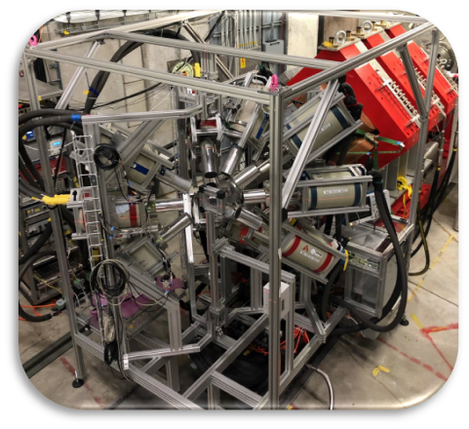
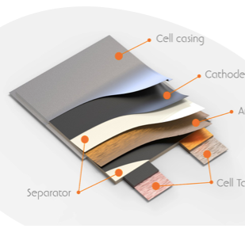

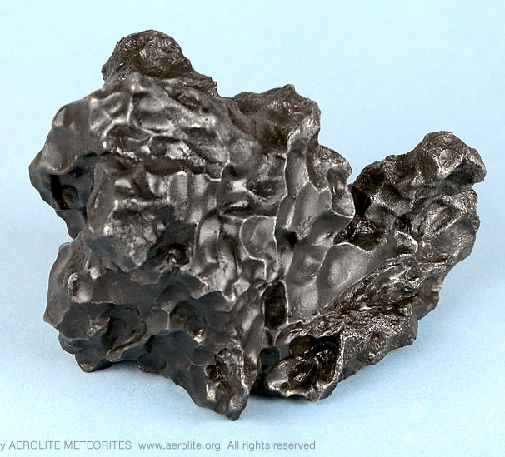


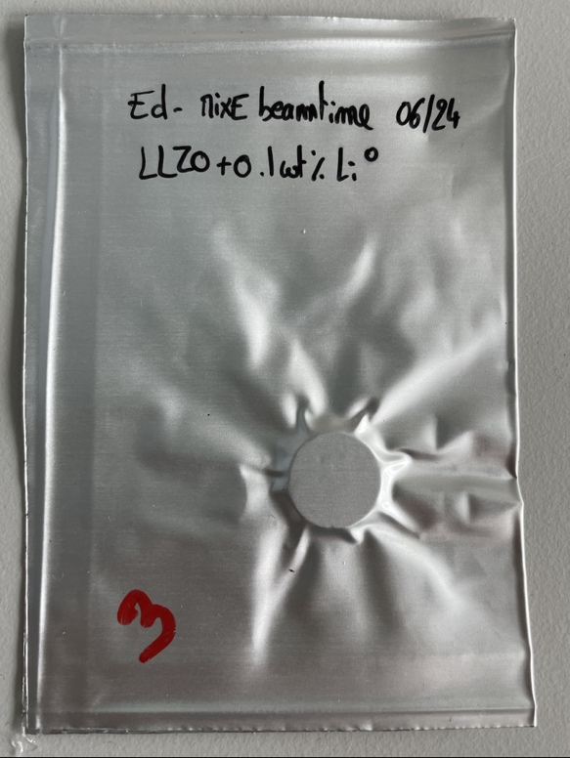
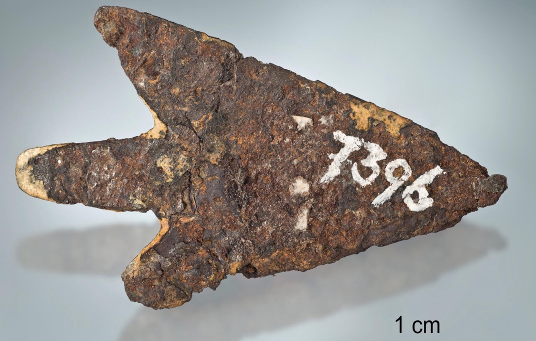
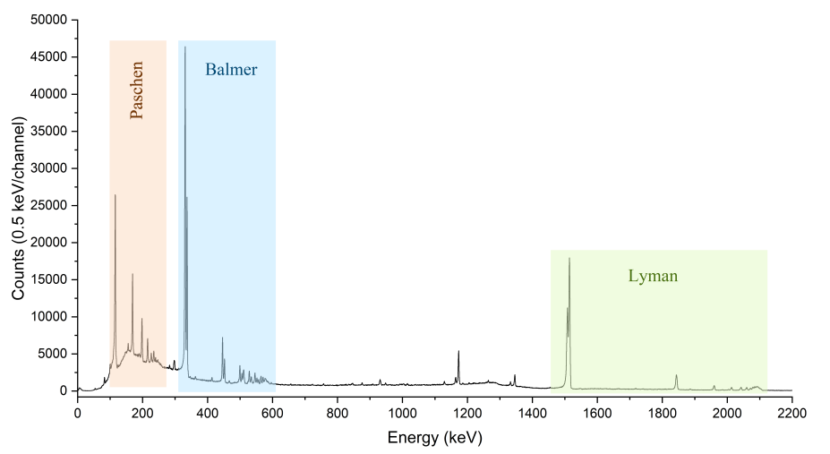

Muon Induced X-ray Emission
Targets: almost all element
np,α
Batteries
µ–
Meteorites
Archeological artifacts
MIXE spectrum of Cu
Notes:
Bohr model energy in analogy to the Moseley law. Quantum number

Slide 7
MIXE Experimental Setup

Slide 8
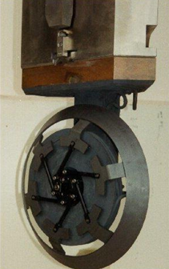
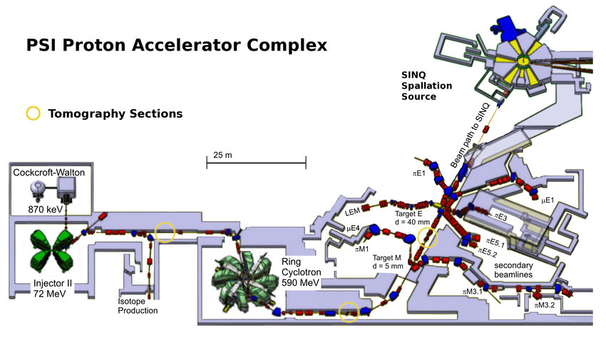
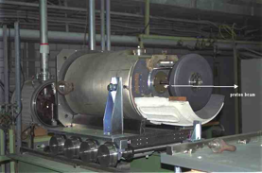


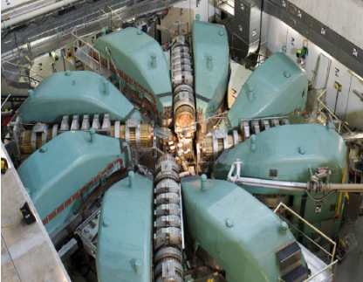
Swiss Muon Source (SµS)
Powered by: High Intensity Proton Accelerator
Operates 6 state-of-the-art µSR instruments
np,α
590 MeV proton ring cyclotron
50 MHz/20ns
Power:1.4 MW
Target M (mince) – 5mm graphite
designed for π production (low rate)
πM3: 10-40 MeV/c (surface) µ⁺ for µSR
πM1: 10-300 MeV/c π → µ/e for tests/PP
Target E (epaisse) – 40mm graphite
designed for π/µ production (high rate)
πE5: 20-120 MeV/c high rate µ for PP
µE4: 10-40 MeV/c µ⁺ for LEM – µSR and PP
πE3: 10-40 MeV/c (surface) µ⁺ for bulk µSR
µE1: 60-120 MeV/c µ for µSR (and MIXE?)
πE1: 10-120 MeV/c µ for µSR, MIXE, PP
Notes:
The Swiss Muon Source (SµS) – powered by the PSI 1.4 MW High Intensity Proton Accelerator (HIPA) is the world’s most intense continuous beam muon source.
protons are first accelerated to 870keV, then boosted to 72MeV, and finally reach 590MeV in the main cyclotron. With proton currents up to 2.4 mA。The proton beam hits two graphite targets, before reaching the spallation neutron source SINQ.
By now, all mixe experiments are hosted by pie1.
It is hoped that the ue1 facility can be used in the future for mixe experiments

Slide 9
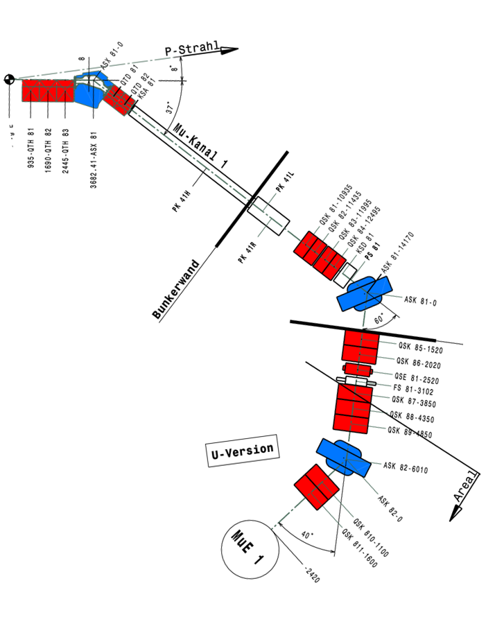
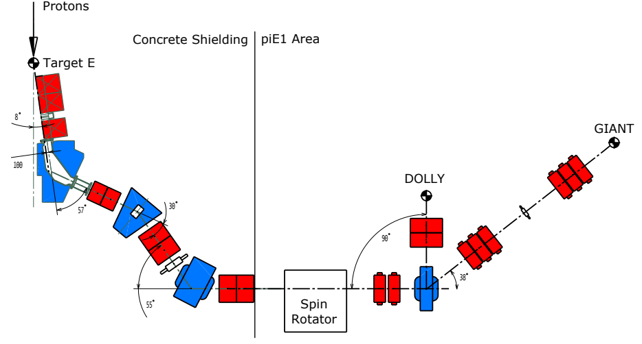
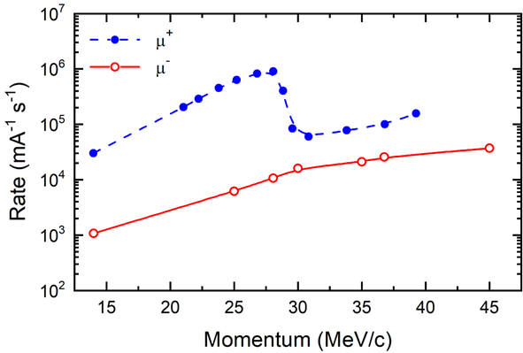
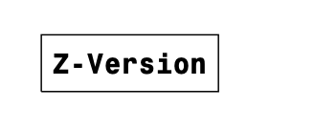
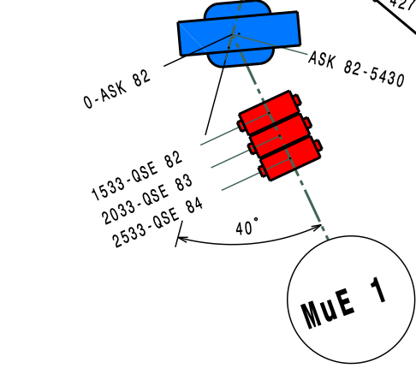
MIXE location
piE1 (host all past MIXE campaigns)
Momenta: 15-60 MeV/c µ⁻ (~10µm - ~cm depth)
Δp/p : 1 ~ 8 % FWHM
Rates: 10³ up to 10⁵ µ – /s on target (fast data collection)
Non-perment setup ~3weeks beamtime
muE1 (hopefully future location of MIXE)
(cold-bore) superconducting decay solenoid
Momenta: 60-120 MeV/c µ- (~mm - ~10cm depth)
Rates: 10⁷ up to 10⁸ µ – /s on target
Dual configuration
  U-version (GPD)
  Z-version (MIXE)
New capabilities for studies much closer to surface
  Warm-bore magnet needed
np,α
GIANT
Notes:
It will focus the beam in the x or y direction.
full width at half maxima

Slide 10
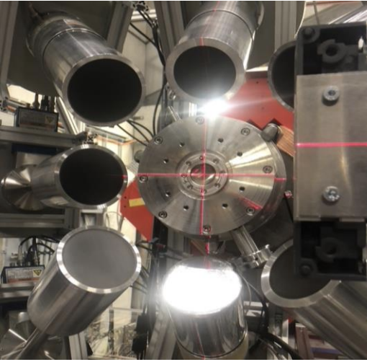
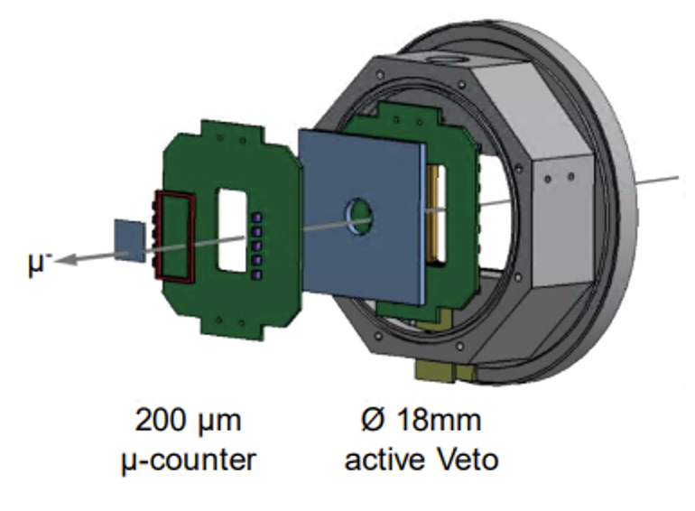
Tagging detector
Tagging Detector (developed for muX experiment)
Reduces uncorrelated BKG
Allows for discrimination of nuclear capture events
BC-400 plastic scintillators (Counter and Veto)
SiPM readout using custom electronics
np,α
Beam Port
10µm titanium foil window
Beam extraction to sample in air
  approx. 10 cm distance
System of collimators available for sample spot measurements
Notes:
Given that the muon beam is continuous, a muon entrance tagging system is required
to record the precise arrival time of each muon. Furthermore, the used scintillators
have a fast response and therefore serve as a start signal for the tracking detector
and the HPGes. Their data can be used to improve the data analysis, for instance
to filter muonic X-rays from nuclear capture events and to reduce uncorrelated
background. This system consists of a BC-400 plastic polyvinyltoluene scintillator
with a thickness of approximately 200 µm and dimensions of 25 mm by 25 mm. It
is positioned upstream of tracking detector and beam-port. In addition, a thicker
muon veto counter (also BC-400) with an 18mm diameter hole (8mm × 10cm ×
10cm) is further upstream to filter for muons, which will not reach the sample. This
setup was originally developed for the muX experiment

Slide 11
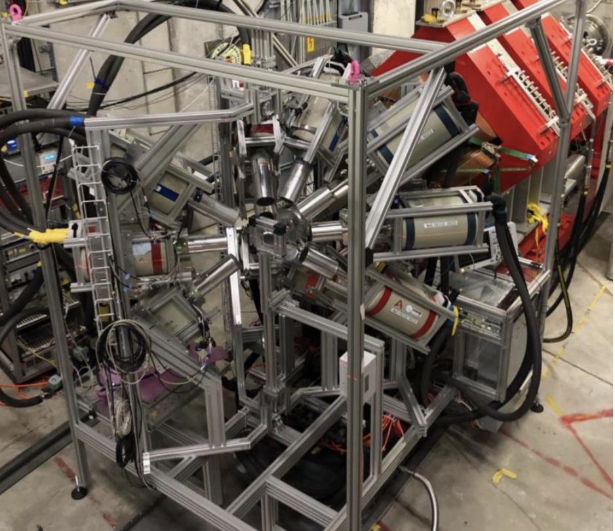
GIANT
GIANT setup
The module
  Up to 8 freely rotating arms (curr. 5)
  Up to 4 BigMac HPGe per arm
  Up to 30 HPGe detectors (curr. ~12)
  HPGes shared with multiple experiments
  Reproducible positions and angles
Fully movable as a unit
Setup time ~6 hours
Fully automatic LN2 refill
Sample station twin in control room
  Reduce time for sample change (~5min)
GermanIum Array for Non-destructive Testing
Notes:
The detectors are positioned nearly isotropically around the target to maximize solid angle coverage
Their distance from the target was chosen to balance the covered solid angle with minimizing pile-up due to multiple X-rays per detector
non-stationary experiment
GIANT can accommodate up to 30 HPGe detectors arranged isotropically around the sample. It also hosts electronics and cabling, which allows for offline preparations prior to the actual beam-times.

Slide 12
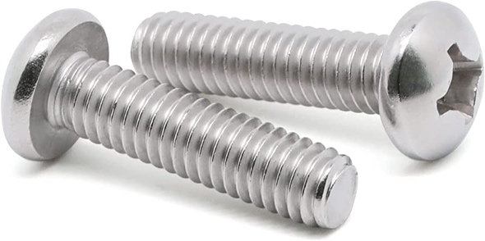


MIXE-T(omography) – Motivation
Elemental Imaging
of the sample
µ⁻
Tomography!
Tracking Chamber

Slide 13
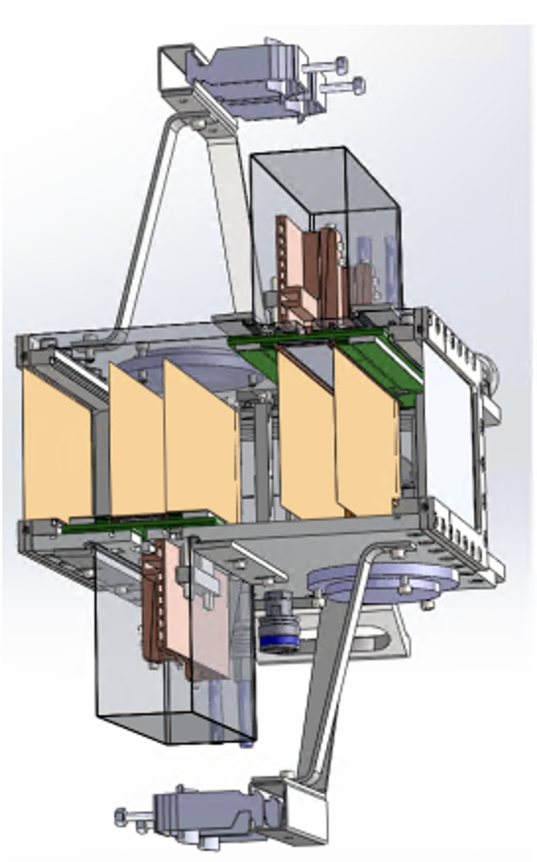
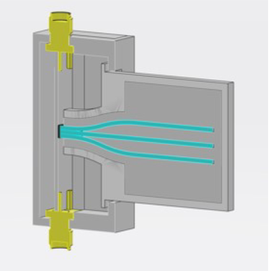
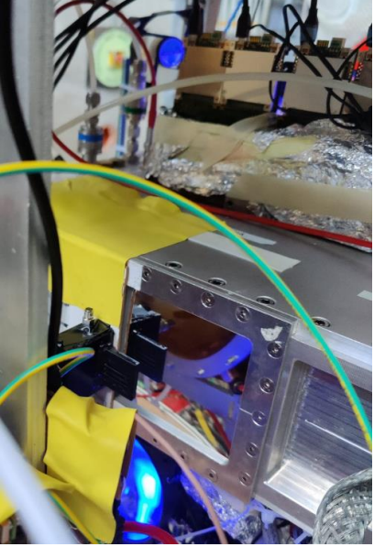
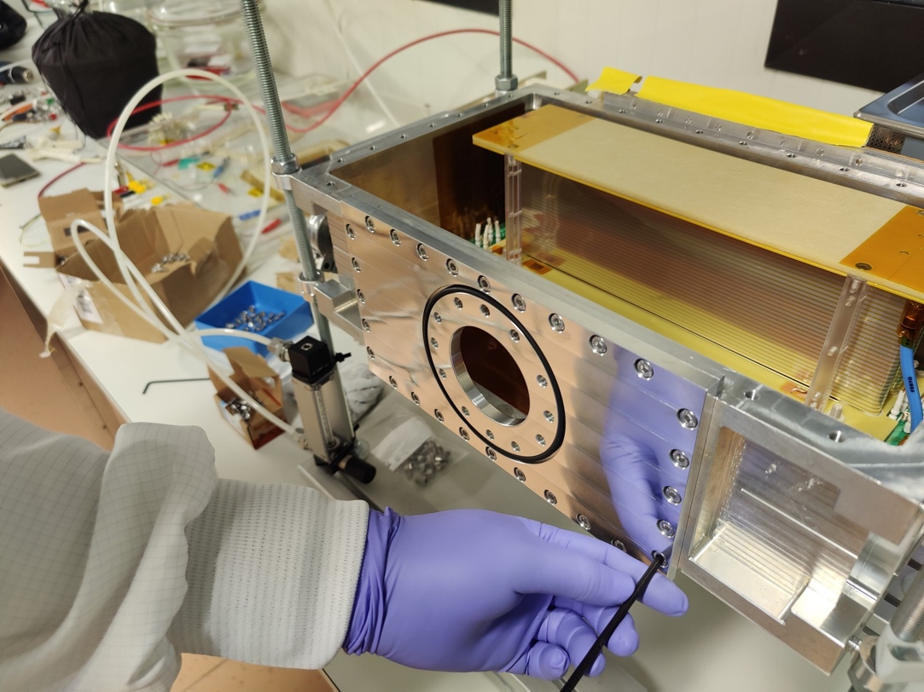
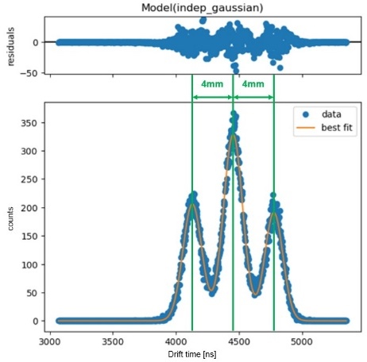
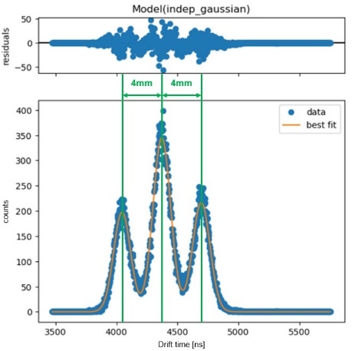


MIXE-T(omography)– Tracker
Twin GEM-TPC Tracking chamber HGB4
Collaboration with F. Garcia (HIP)
Collaboration with GDD lab and DRD1/CERN
Active Area ~20x10 cm²
    Triple GEM stack amplification stage
    1D strip readout – 1024 ch in total – 0.4 mm pitch
    X position given by the projectiopn of cluster on strips
    Y position given by drift time(s)
Fiber Detector for calibration
Placed in front of tracker
3 scintillating fibers in exactly 4mm distance
SiPM as fast readout
Only use parallel tracks
See Francisco’s Talk
GEM2
beam
$$e^{−}$$
$$e^{−}$$
GEM1
GEM1
GEM2
Garcia, F., et al. "The Super-FRS GEM-TPC prototype development-TDR." arXiv preprint arXiv:1612.05045 (2016).
Notes:
The twin GEM-TPC detector utilizes triple GEM amplifyication stages and a twin field cage configuration
the x-coordinates are determined by the cluster
position on the readout plane, and the y-coordinates are calculated by measuring the
respective drift time of the primary ionization charges
its common use for GEM/GEM-TPC
based detector

Slide 14
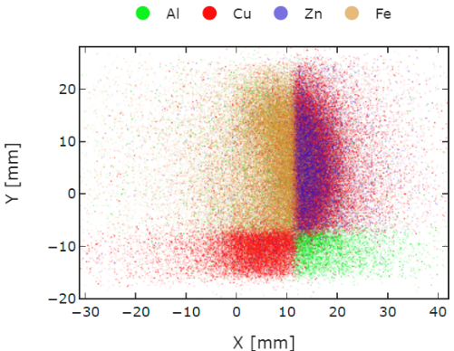
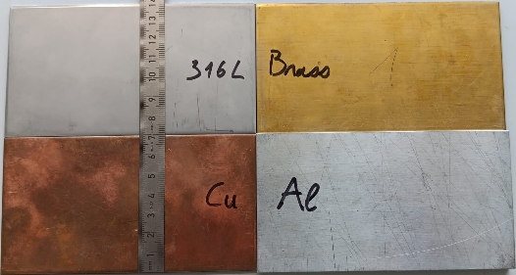
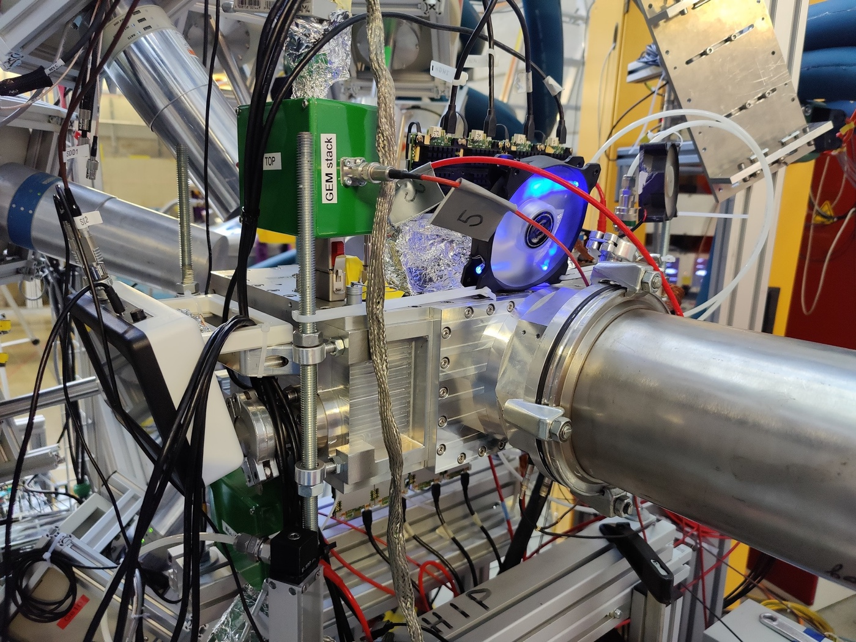
MIXE-T(omography)– Tracker
See Francisco’s Talk
Successful beam tests of adapted detector using GeV muons at CERN/SPS-H4 in May 2023
Successful proof-of-concept elemental imaging using 60 MeV/c muons at πE1 in Jun 2023
First universal elemental imaging/tomography using 50-60 MeV/c muons at πE1 in Sep 2023 (results shown in next section)
Resolution/momenta limited due to multiple scattering in high-density gas (Ar/CO2 75:25)
First operation of a GEM-TPC detector using low density gas mixture (He/CO2 90:10) at CERN/SPS-H4 in Apr 2024 – found performance to be excellent
Tracker with He/CO2 during full Jun 2024 MIXE campaign – analysis ongoing
Target
Entrance
Tracker

Slide 15
MIXE-T(omography): First Result

Slide 16
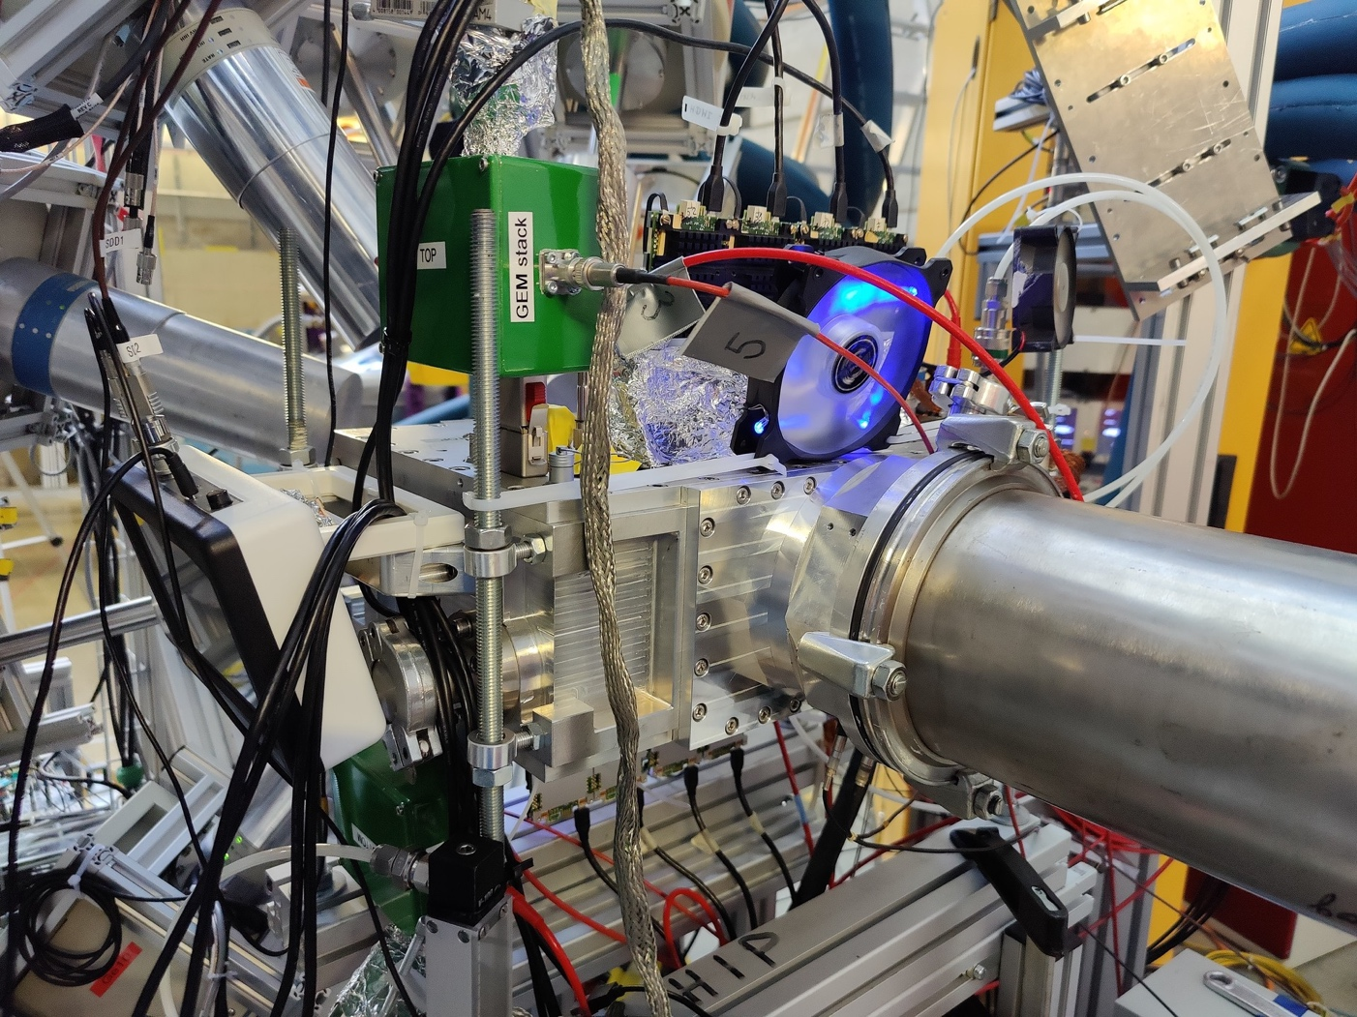
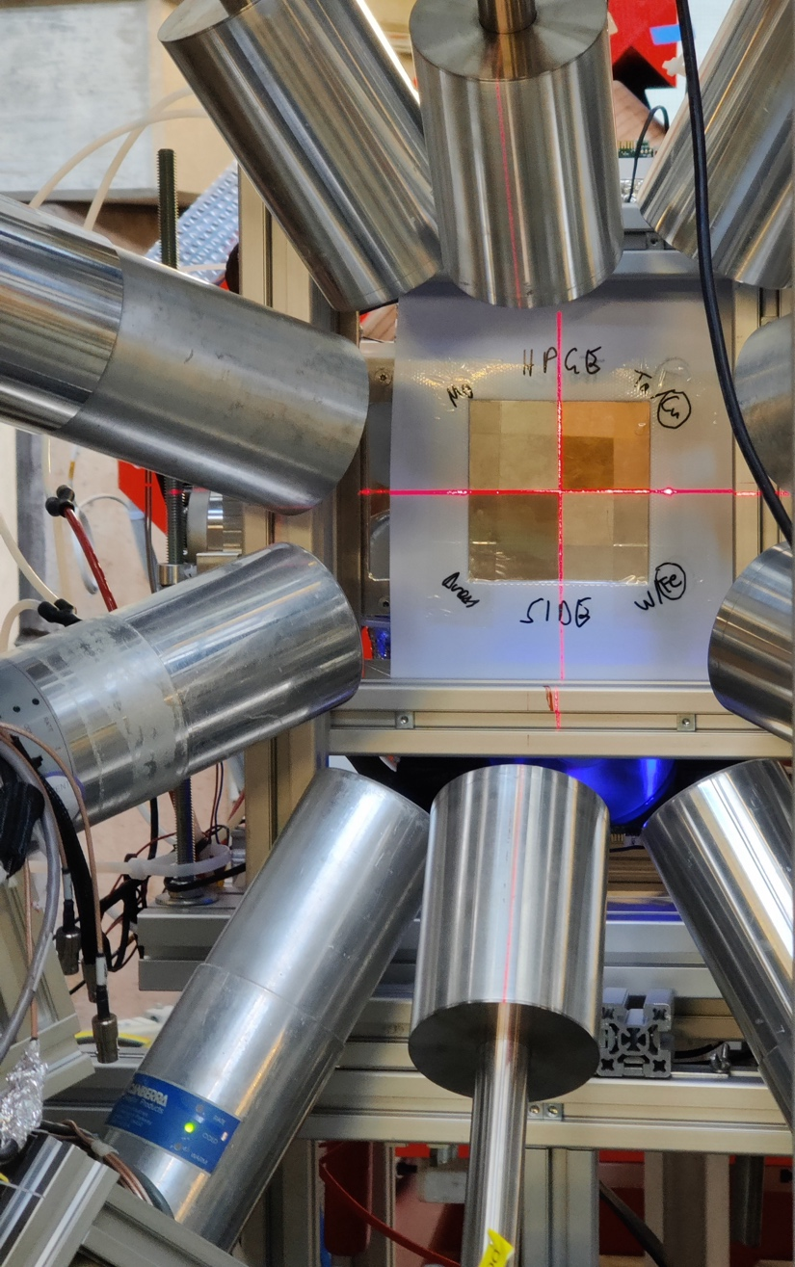
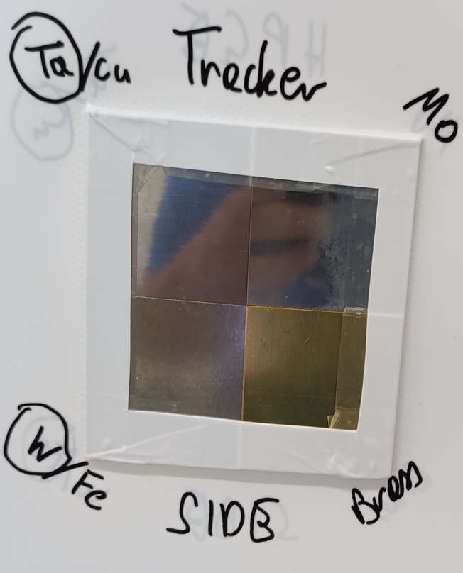
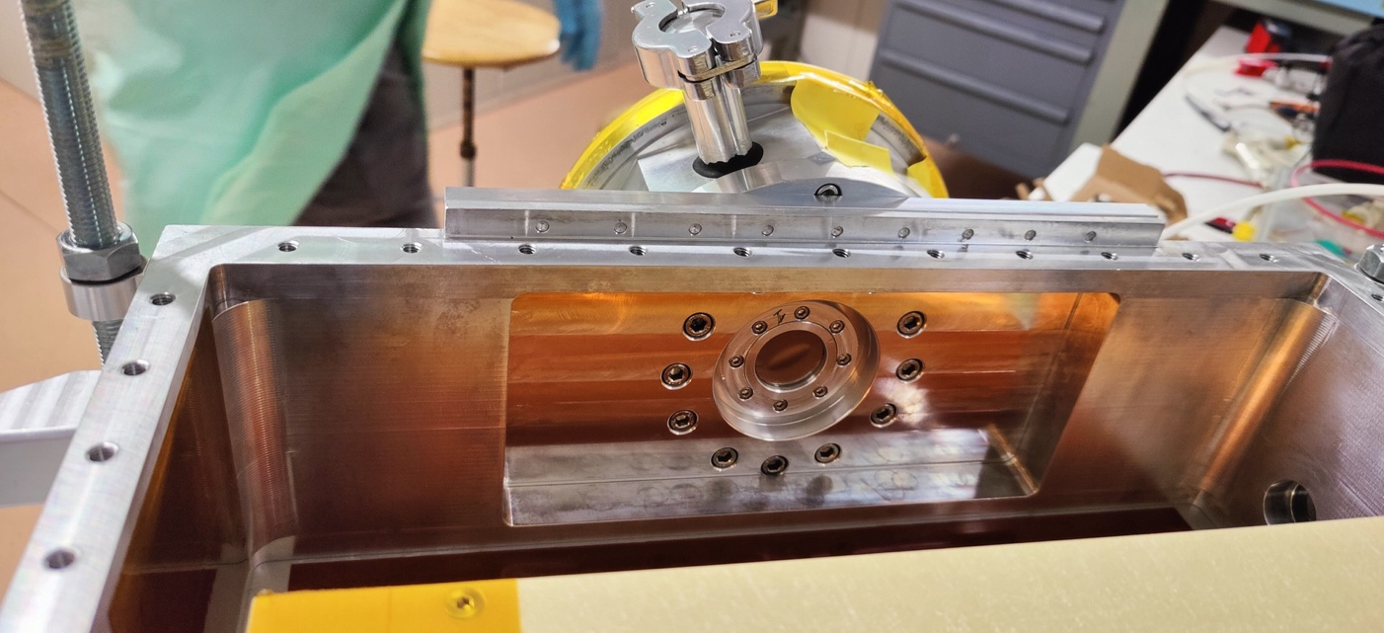
Elemental (isotopic) Imaging: First Result
Reference targets
  Pure metals (except brass: Cu 63% & Zn 37%)
  Layered to check depth resolution (Ta/Cu & W/Fe)
  Optimized thicknesses by muon momentum
  Aligned to beam center
  Scan from 50 MeV/c to 60MeV/c
  Experimental setup
  Tracker flanged directly to beampipe
  Ar/CO2 75:25
  Full array of HPGe detectors (10)

Slide 17
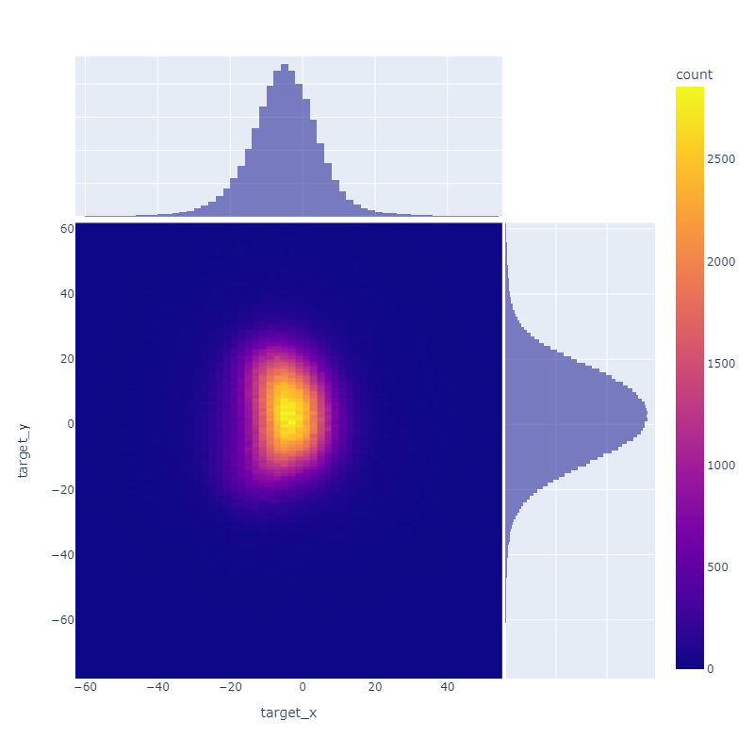
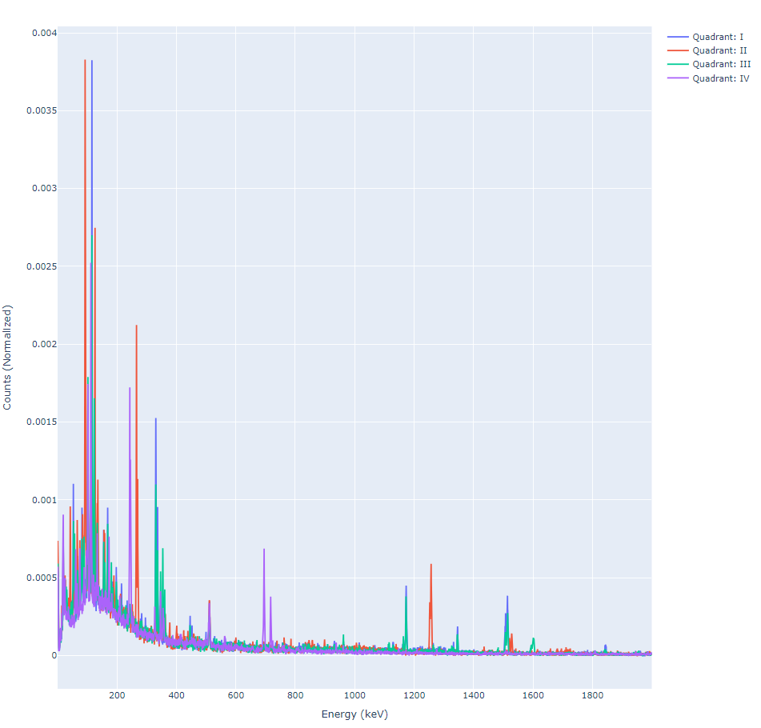
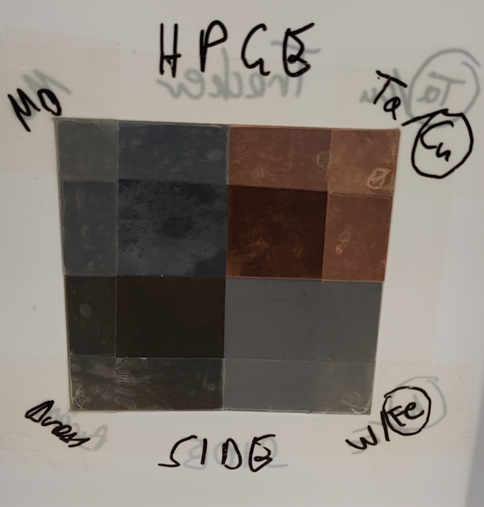
Elemental (isotopic) Imaging: First Result
Result @60MeV/c
IV
I
III
II
IV
I
Fe
Mo
Cu
III
II
Mo
Fe
Cu
Beam spot reconstructed
by tracker
Zn

Slide 18
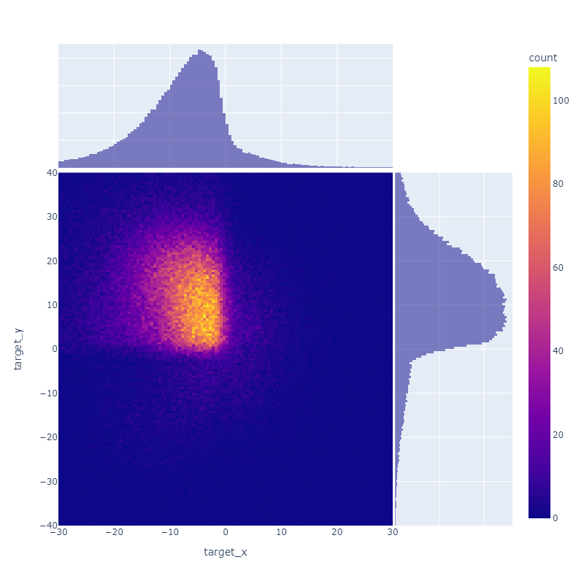
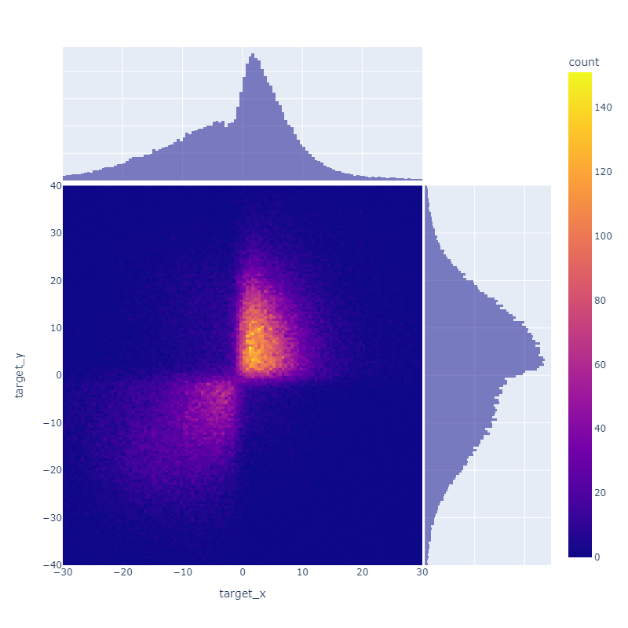
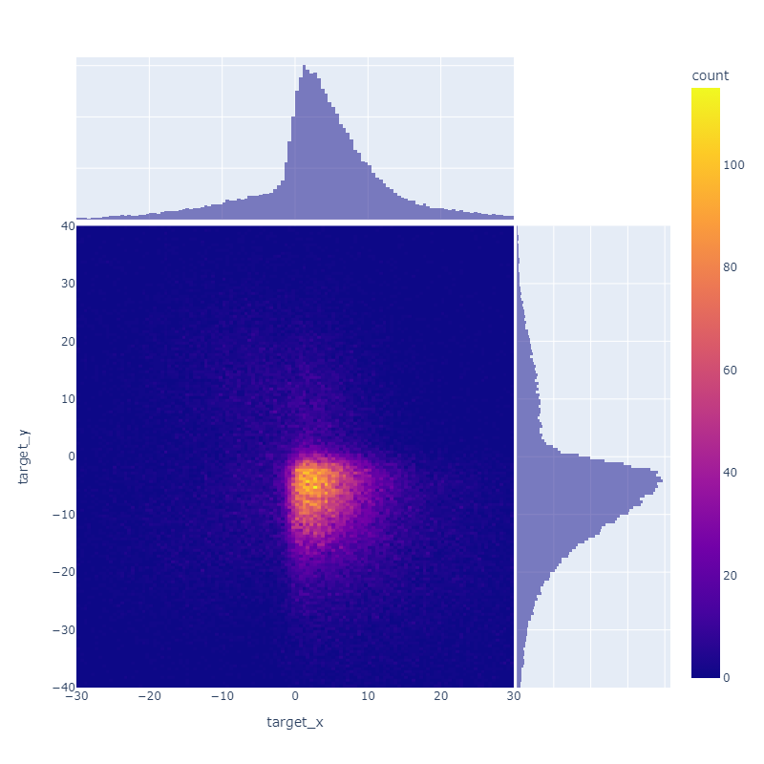
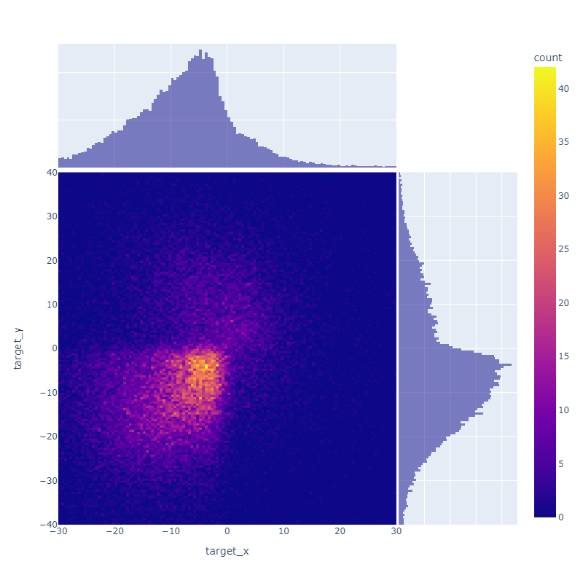
Elemental (isotopic) Imaging: First Result
Result @60MeV/c
Mo
Cu
IV
I
Zn
Fe
III
II
Beam spot reconstructed
by tracker

Slide 19
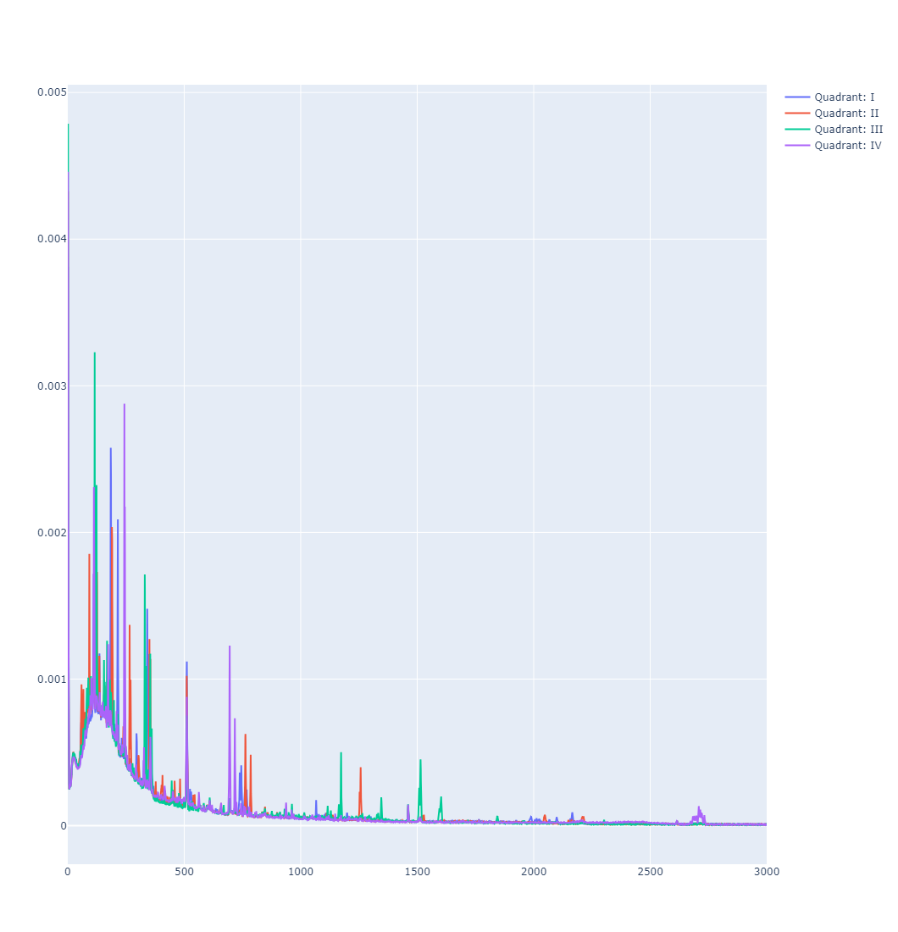
Elemental (isotopic) Imaging: First Result
As the energy increases, the Ta peak disappears, and the intensity of the Fe peak increases.
IV
I
III
II
Fe
Mo
Cu
Mo
Ta
Cu
Mo
Fe
Fe
Cu
Zn
Zn
Result @50MeV/c
Result @60MeV/c

Slide 20
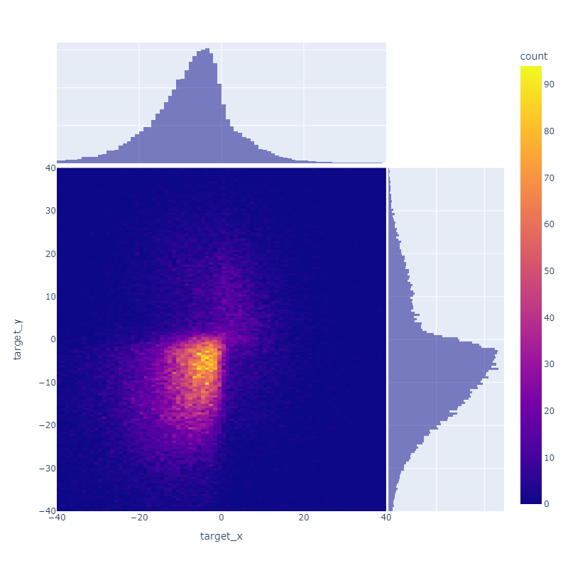
Elemental (isotopic) Imaging: First Result
50 MeV/c
60 MeV/c
Cu
Cu
Brass
Brass

Slide 21
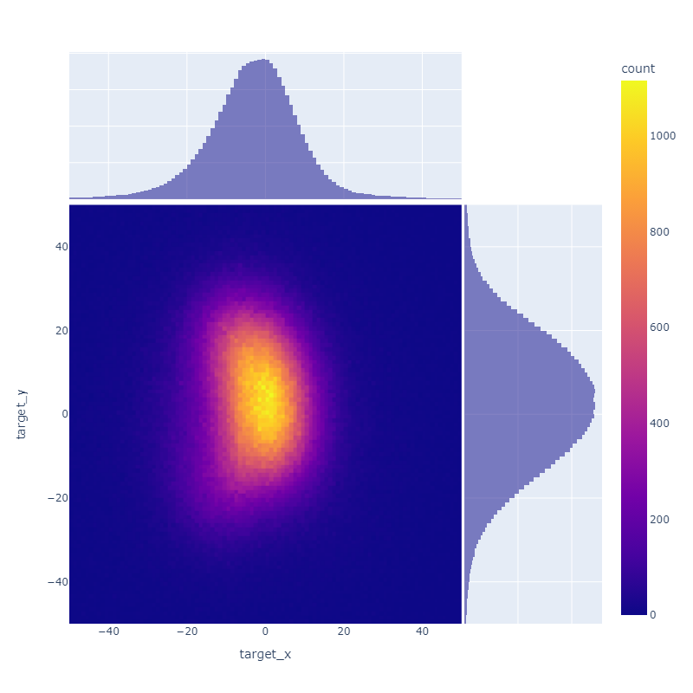
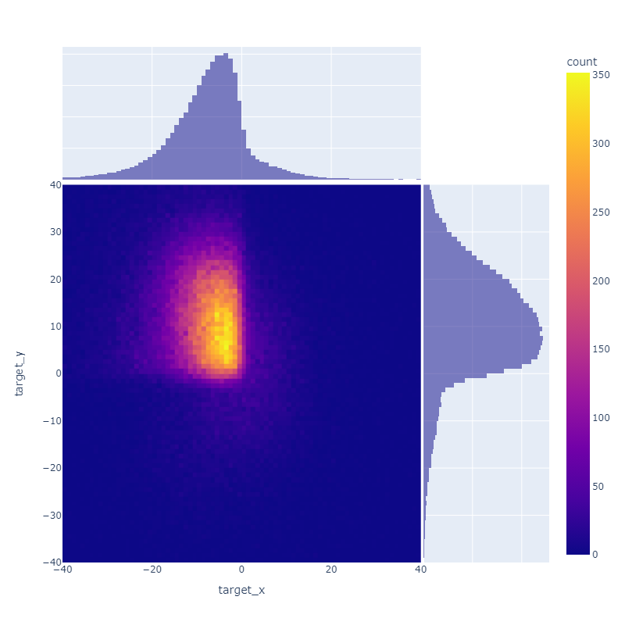

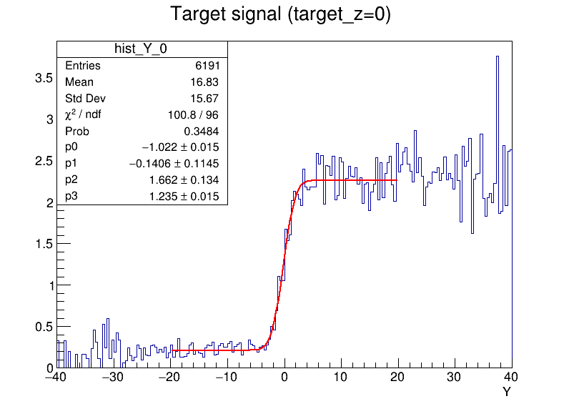
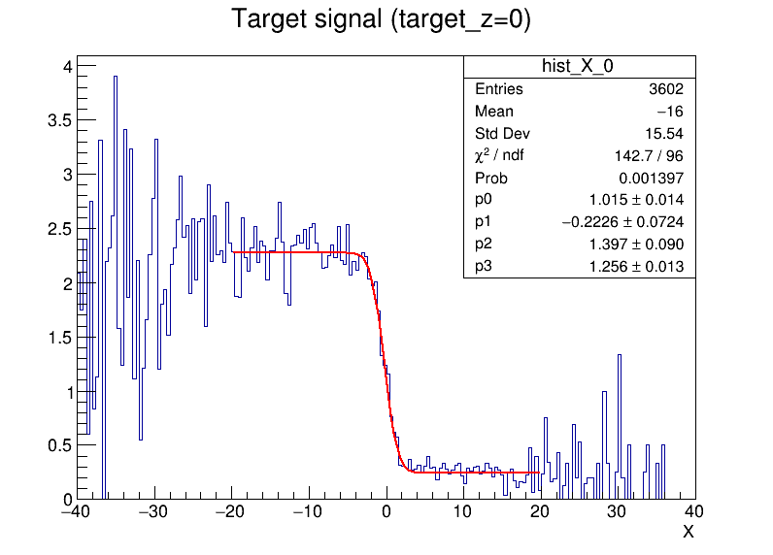
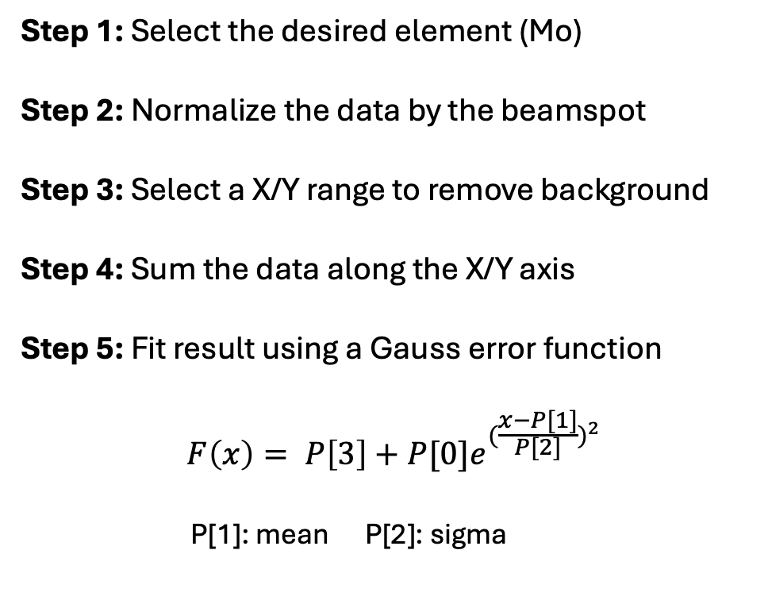
Elemental (isotopic) Imaging: First Result
Step 1: Select the desired element (Mo)
Step 2: Normalize the data by the beamspot
Step 3: Select a X/Y range to remove background
Step 4: Sum the data along the X/Y axis
Step 5: Fit result using a Gauss error function
$$F\left(x\right)= P\left[3\right]+P[0]e^{{(\frac{x−P[1]}{P[2]})}^{2}}$$
P[1]: mean P[2]: sigma

Slide 22

Elemental (isotopic) Imaging: First Result
  Spatial Resolution @ 60MeV/c with Ar/CO2 75:25 HGB4
    X Resolution: 1.083 ± 0.113 mm
    Y Resolution: 1.357 ± 0.172 mm
  Mainly due to the multiple scattering effect in air and materials
  Resolutions should be improved by change to He/CO2 gas
  Problems observed:
    Y resolution is larger than X
    May caused by pressure variations in the tracker chamber, or temperature fluctuations in the experimental hall, affecting drift velocity (Y-coordinate)
    Any suggestions or insights on this issue are welcome. Thanks!

Slide 23
Outlook
First Robust Elemental Imaging/Tomography Demonstration!
  Spatial Resolution: Achieved mm-scale @60 MeV/c with basic analysis
  Key Achievement: Demonstrated depth sensitivity to materials
Ongoing Analysis:
  He/CO₂ Data Analysis: Aimed at reducing multiple scattering in gas
  Lifetime Measurements: Focus on low-Z elements (e.g., Li)
Future Developments:
  Tracker enhancements: Smaller size and pixel-based readout
  muE1 as new site(?): Exploring new capabilities for studies closer to the surface
  Increased MIXE-T sensitivity: Leveraging machine learning and algorithmic advancements
Notes:
Also, the capture probability rises with Z through the weak
absorption interaction
This nuclear capture shortens the muon’s lifetime compared to the decay lifetime of
free muons
Therefore, the muon lifetimes are shortened especially in larger atoms, where the
exact value is specific to the capturing nucleus. These lifetime components can be
measured, providing additional information about the target material, which can be
used in MIXE to improve the quality of the experimental results

Slide 24

Acknowledgement
Special thanks to the MIXE team: Michael Heiss, Issa Briki, Bernhard Josef Zeh, Gianluca Janka, Maxime Lamotte, Thomas Prokscha, Alex Amato...
Thanks to Francisco Garcia (Helsinki Institute of Physics)
Thanks to the GDD lab and DRD1/CERN: Karl Jonathan Flöthner, Lucian Scharenberg, Hans Müller, Eraldo Oliveri…
Thanks to all colleagues:
muX and ReferenceRadii group
Thanks to SNSF & SDSC supporting grant

