Slide 1


Development and Preliminary Results of a Large-Volume Time Projection Chamber for X-ray Polarimetry
Davide Fiorina^{a,b}, Elisabetta Baracchini^{a,b}, Giorgio Dho^{c}, Paolo Soffitta^{d}, Samuele Torelli^{a,b},
David J. G. Marques^{a,b}, Enrico Costa^{d}, Sergio Fabiani^{d}, Fabio Muleri^{d} , Giovanni Mazzitelli ^{c}
ªGran Sasso Science Institute
^{b}INFN Laboratori Nazionali del Gran Sasso
^{c}INFN Laboratori Nazionali di Frascati
^{d}IAPS - INAF Istituto di Astrofisica e Planetologia Spaziali

Slide 2
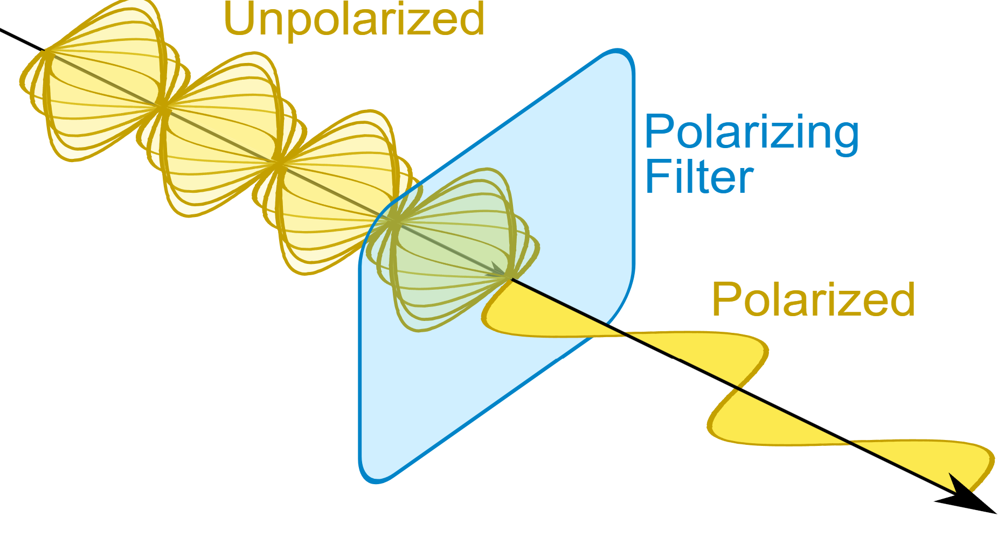
Polarization in Astrophysics
The polarization of a photon refers to the orientation of the oscillating electric field vector perpendicular to its propagation direction.
Polarization of photons has always been an important dimension to study astronomical sources
In around 50 years of Xray astronomy, only one positive detection of X-ray Polarization: the Crab nebula Novick et al. 1972, Weisskopf et al.1976, Weisskopf et al. 1978

Slide 3
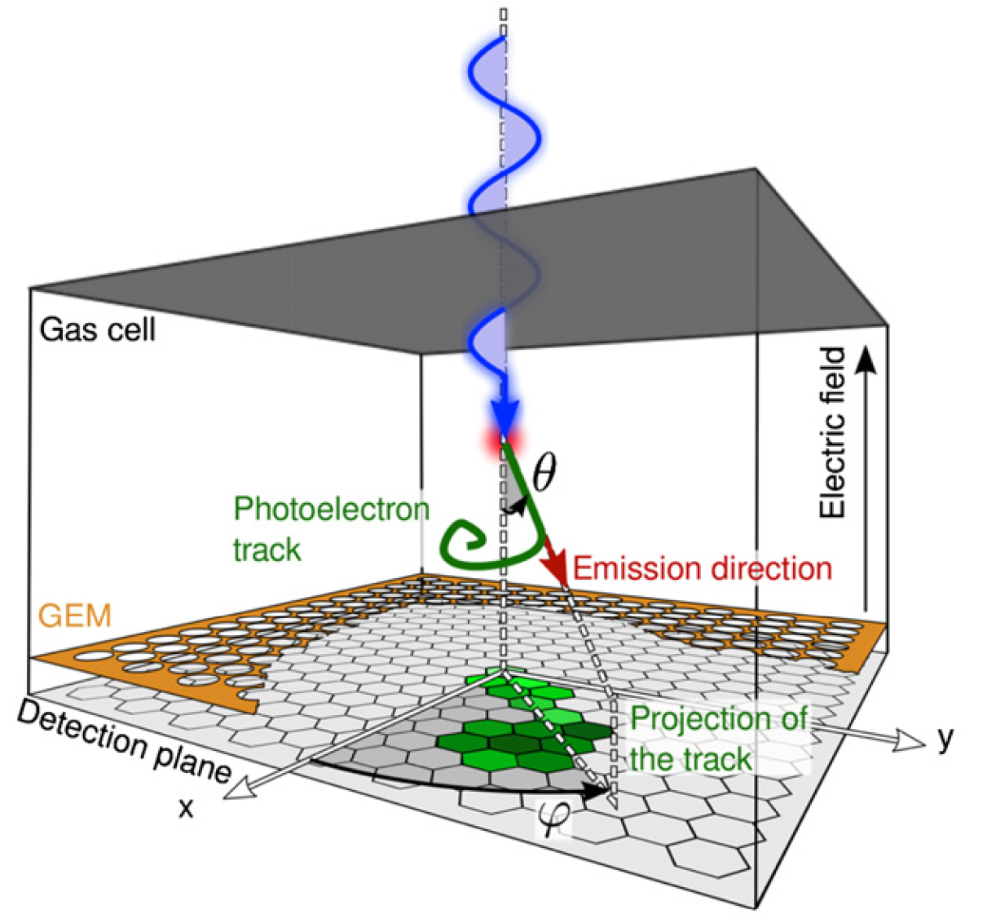
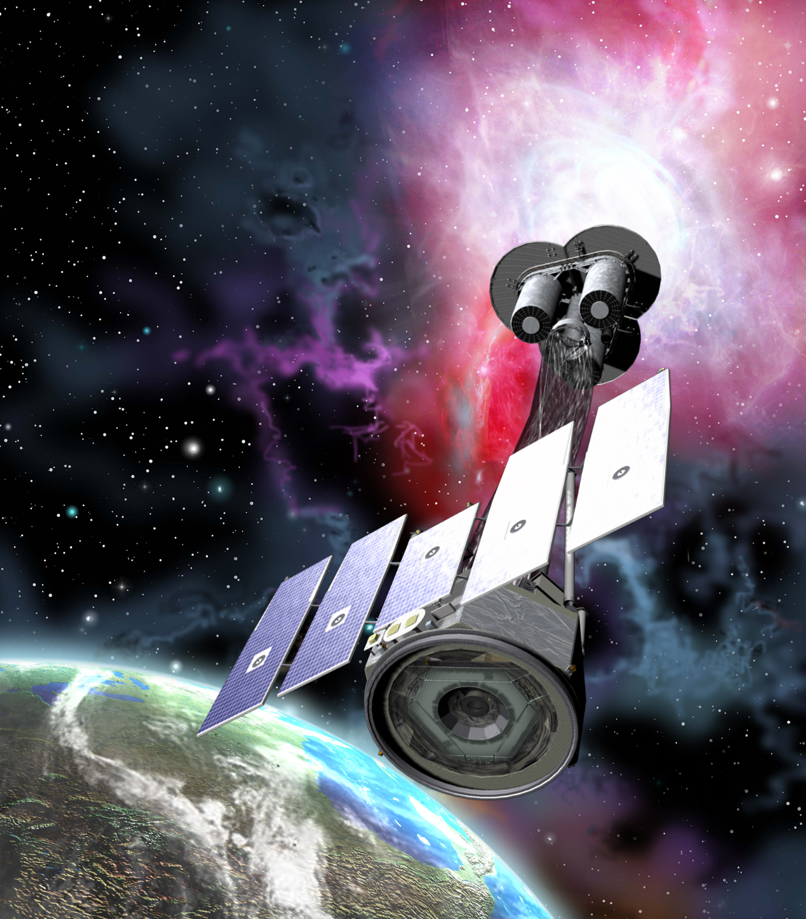
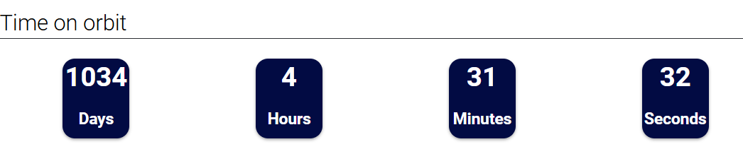
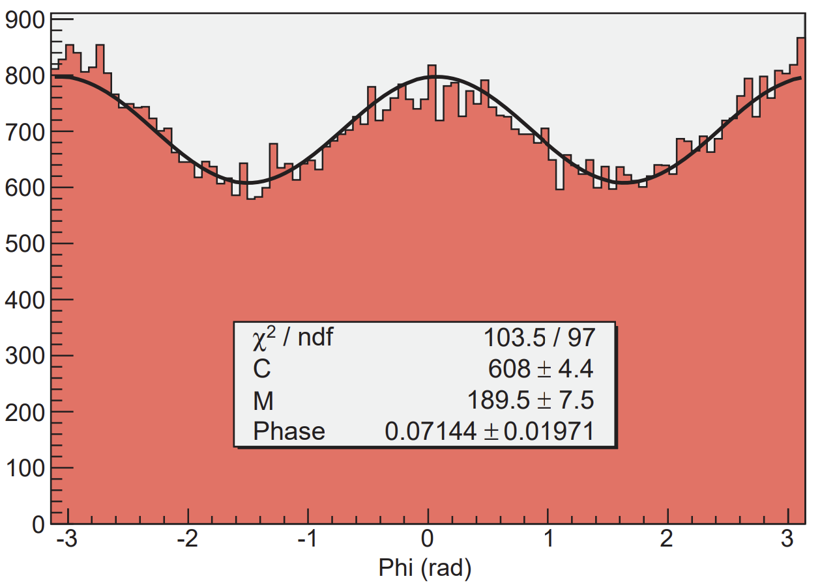
Polarization in Astrophysics
The polarization of a photon refers to the orientation of the oscillating electric field vector perpendicular to its propagation direction.
Polarization of photons has always been an important dimension to study astronomical sources
In around 50 years of Xray astronomy, only one positive detection of X-ray Polarization: the Crab nebula Novick et al. 1972, Weisskopf et al.1976, Weisskopf et al. 1978
Then IXPE arrived equipped with 3x Gas Pixel Detector
10x15x15mm DME 800 mbar
Single GEM – Pad readout
Energy range 2-8 keV
Angular resolution: better than 30 arcsec, field of view larger than 9 arcmin
Energy resolution: better than 25%
Launched 9 Dec 2021 → 164 papers

Slide 4
Physics and polarimetry
Develop a Detector capable of Measure Polarization through photoelectric effect for energies >10keV
XIPE: the x-ray imaging polarimetry explorer (unipa.it)

Slide 5
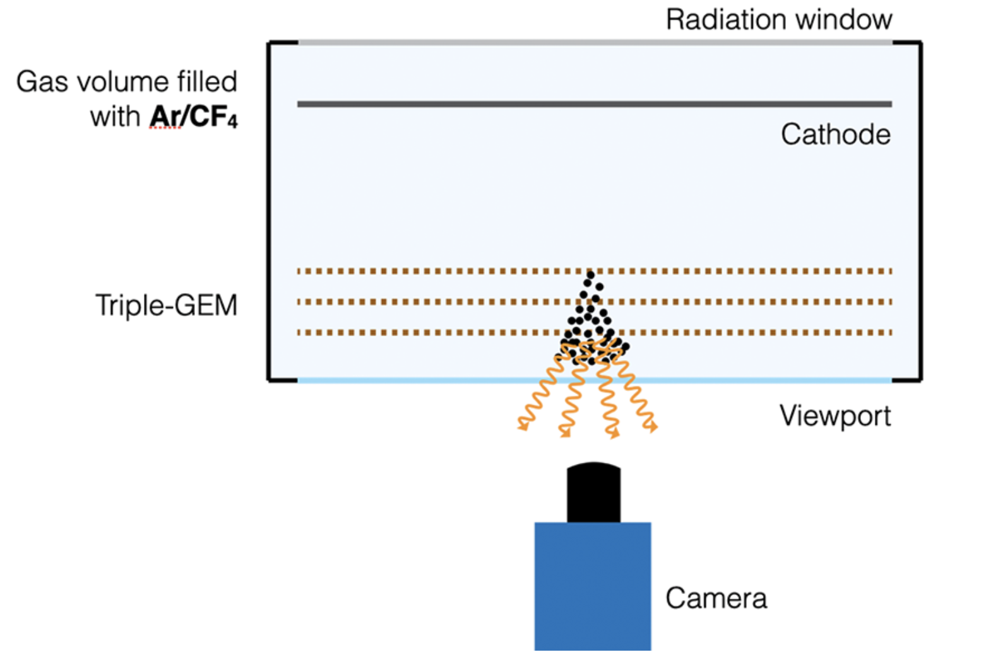
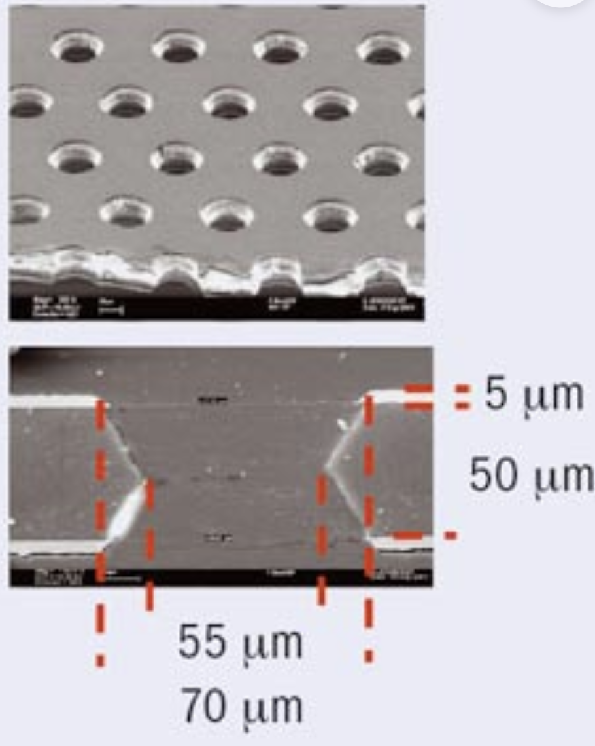
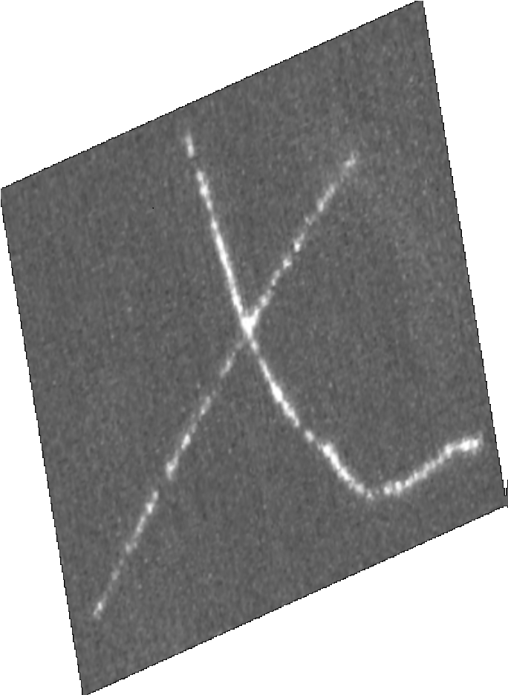
Detector overview
Gas volume filled with He/CF₄ 60/40
1atm
CMOS
Hamamatsu ORCA Quest (2)
High-granularity
X+Y+Energy measurement

Slide 6
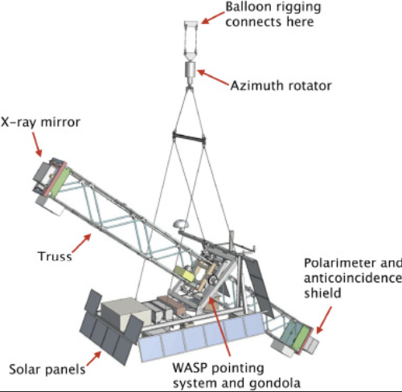
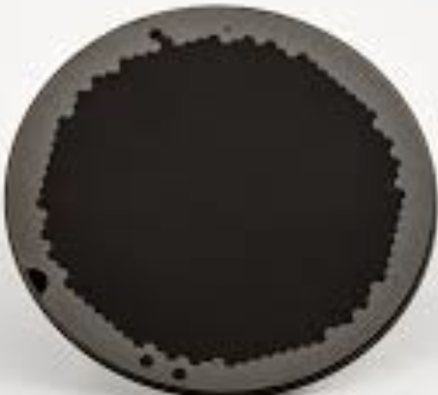
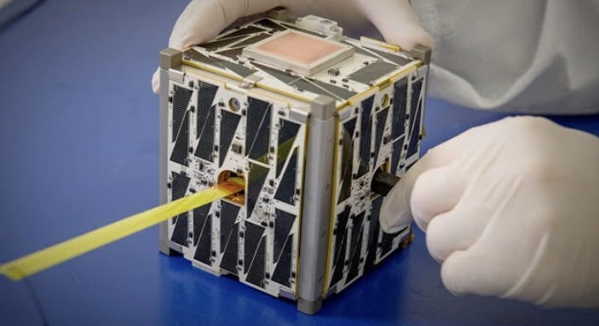
Detector overview
Large FoV up to 25°
Gas volume filled with He/CF₄ 60/40
1atm
Collimator

Slide 7
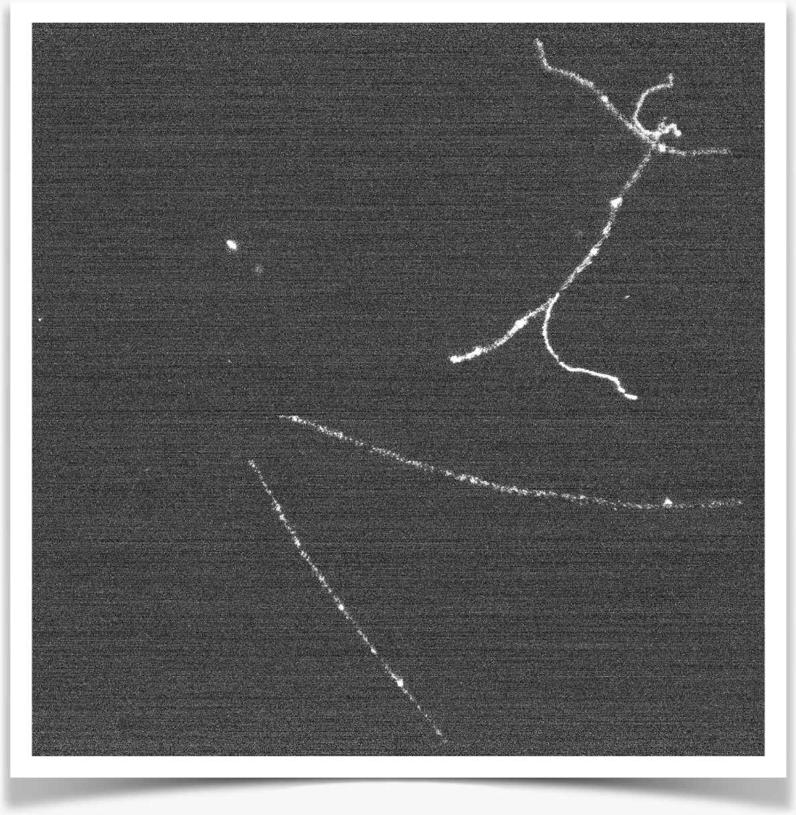
Photographing particle tracks
Notes:
Some photo

Slide 8
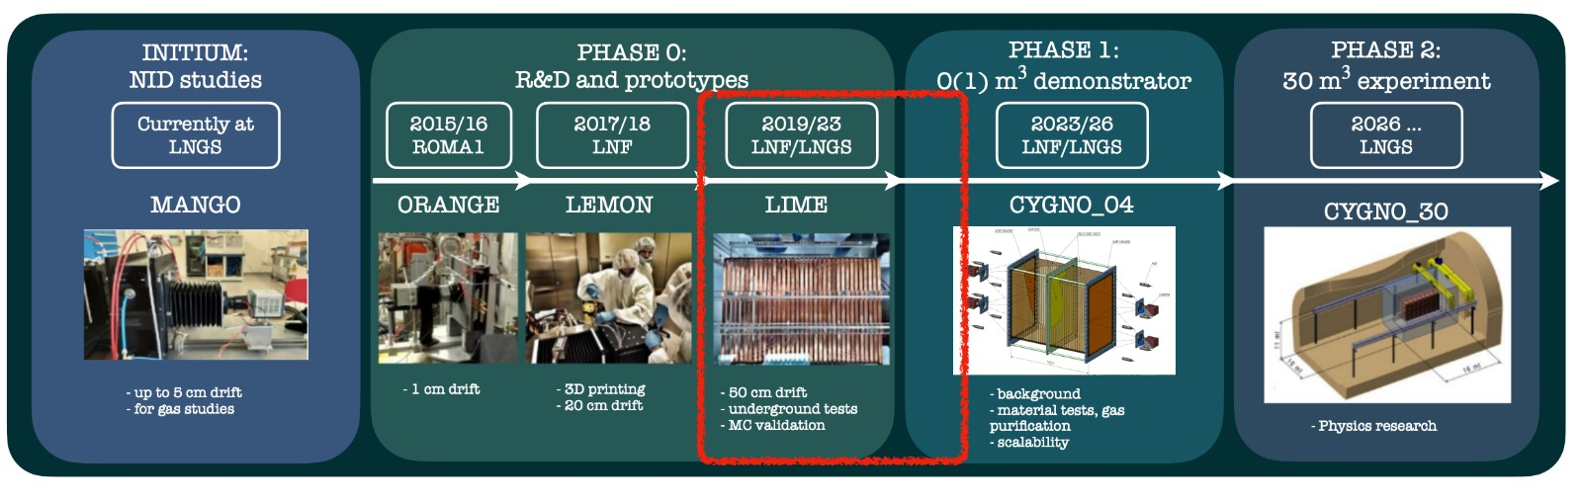
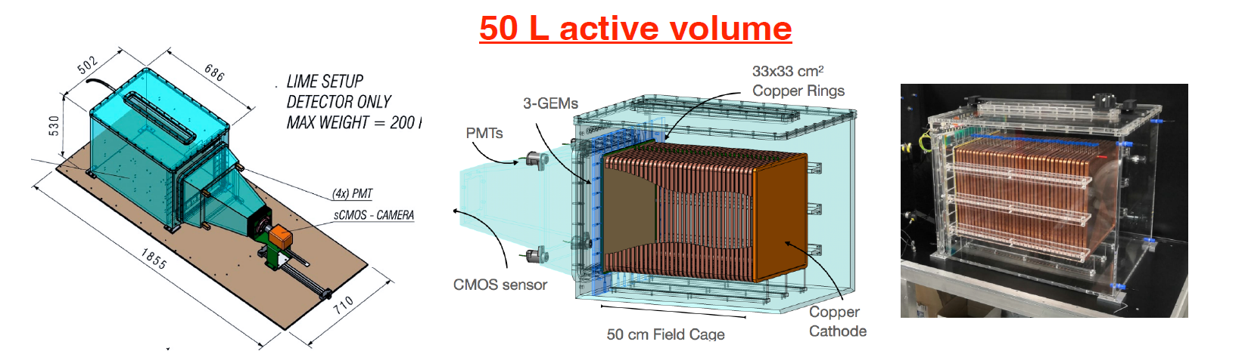
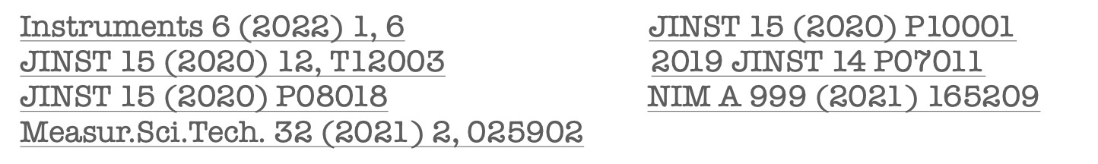
Detectors Timeline
PMT
Integrated
Z + Energy measurement
Drift
direction
Straight track:
D.Fiorina
The CYGNO experiment, a Gaseous TPC for directional Dark Matter searches
Drift
direction
Tilted track:
pixels 2304 x 2304 pixels - Imaging 36 x 36 cm2 area Effective - pixel granularity 155 x 155 um2

Slide 9
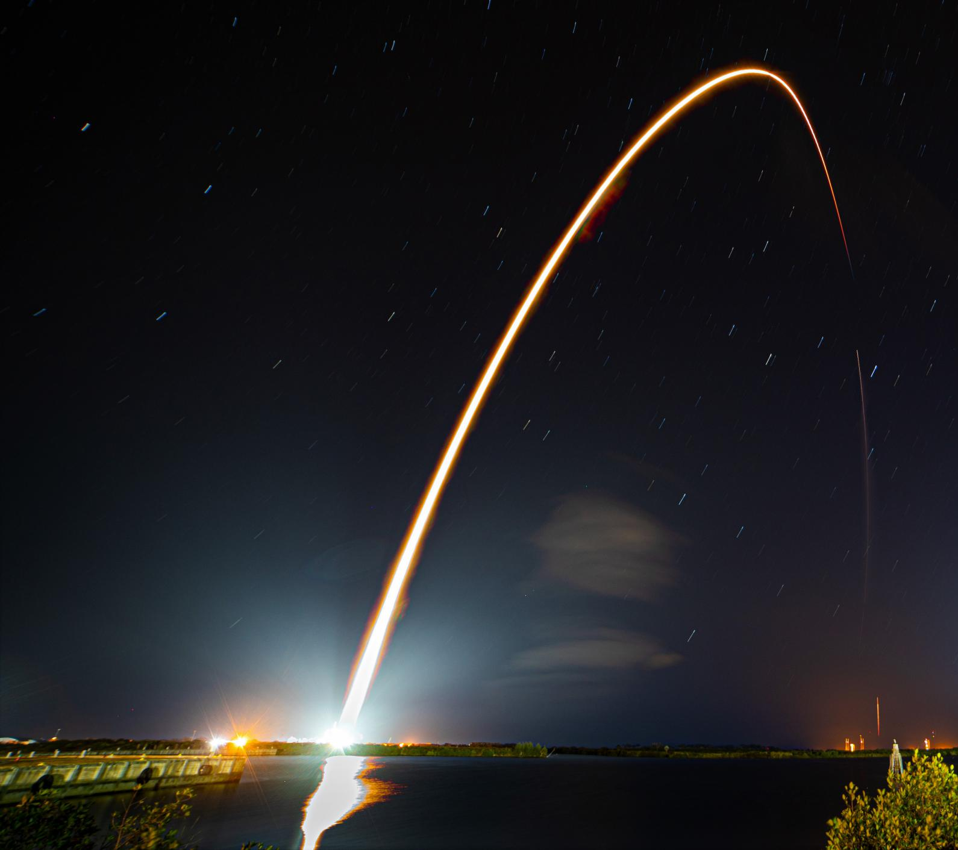
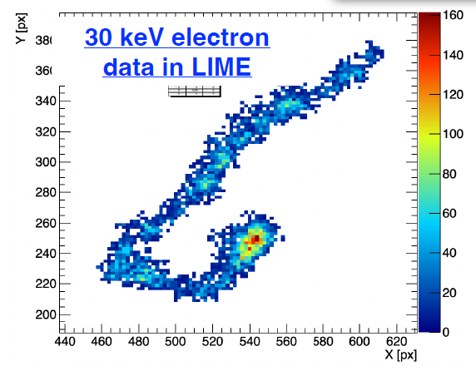
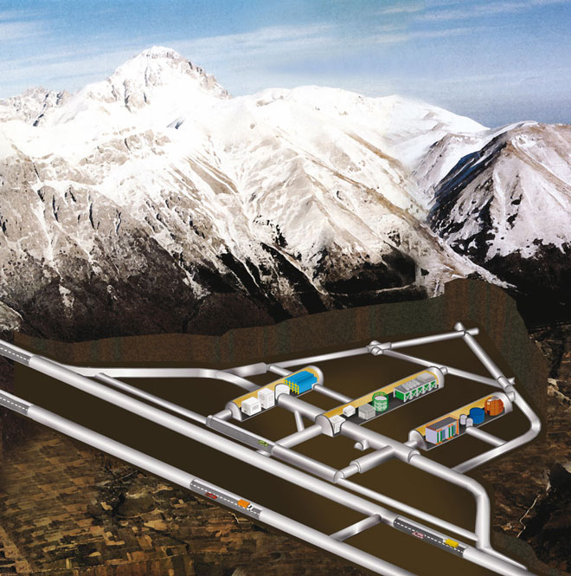

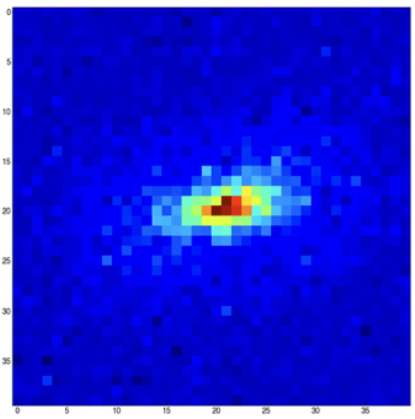
From Underground to Space
To Electron Recoils
X-rays on atoms
He⁺⁺ recoil
From Nuclear Recoils
Dark Matter on nuclei

Slide 10




From Underground to Space
He⁺⁺ recoil

Slide 11
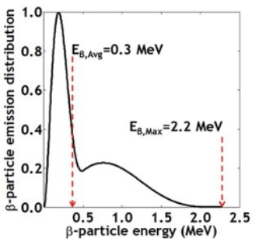
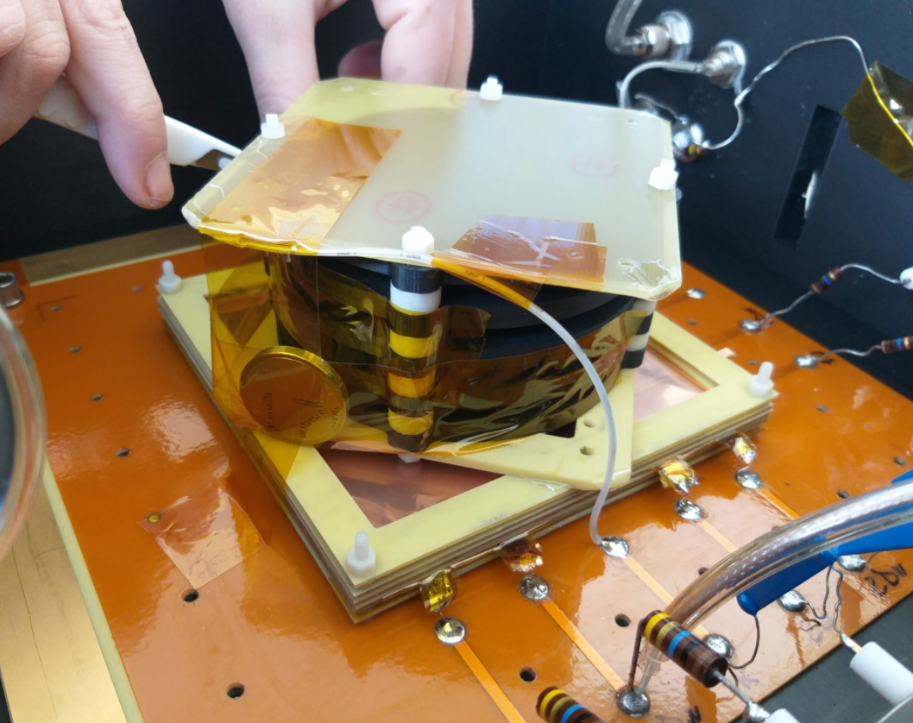
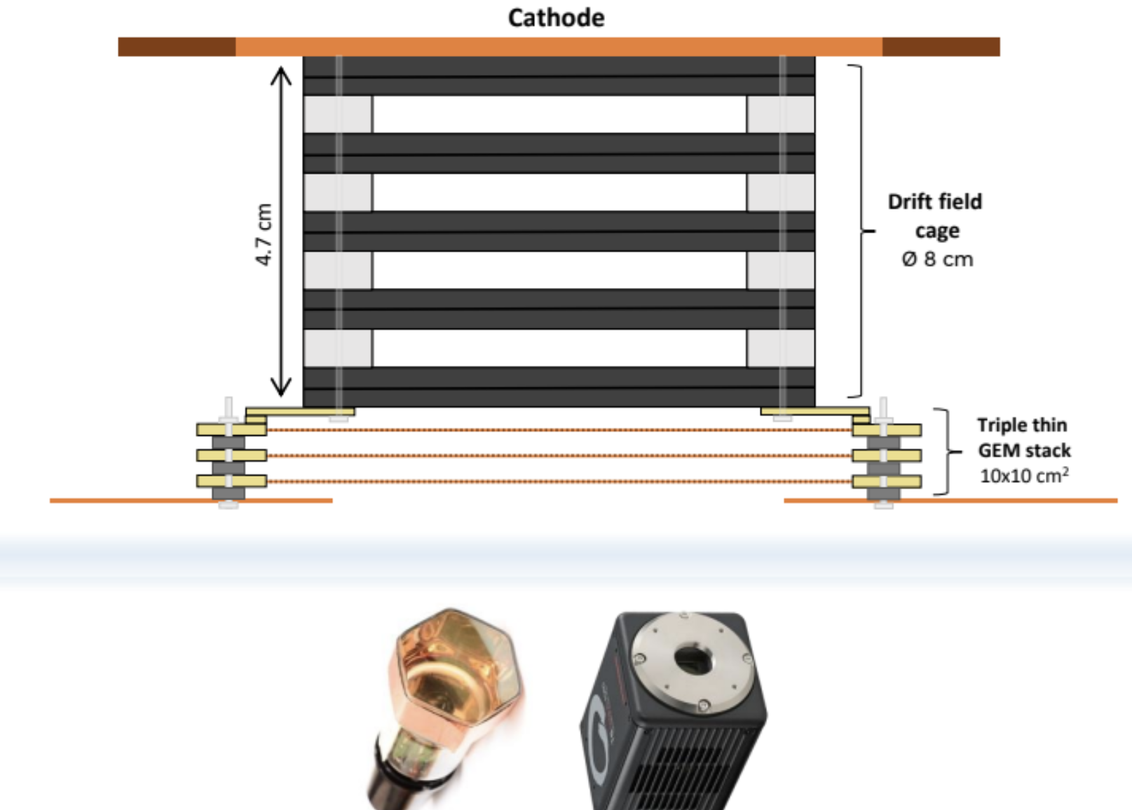
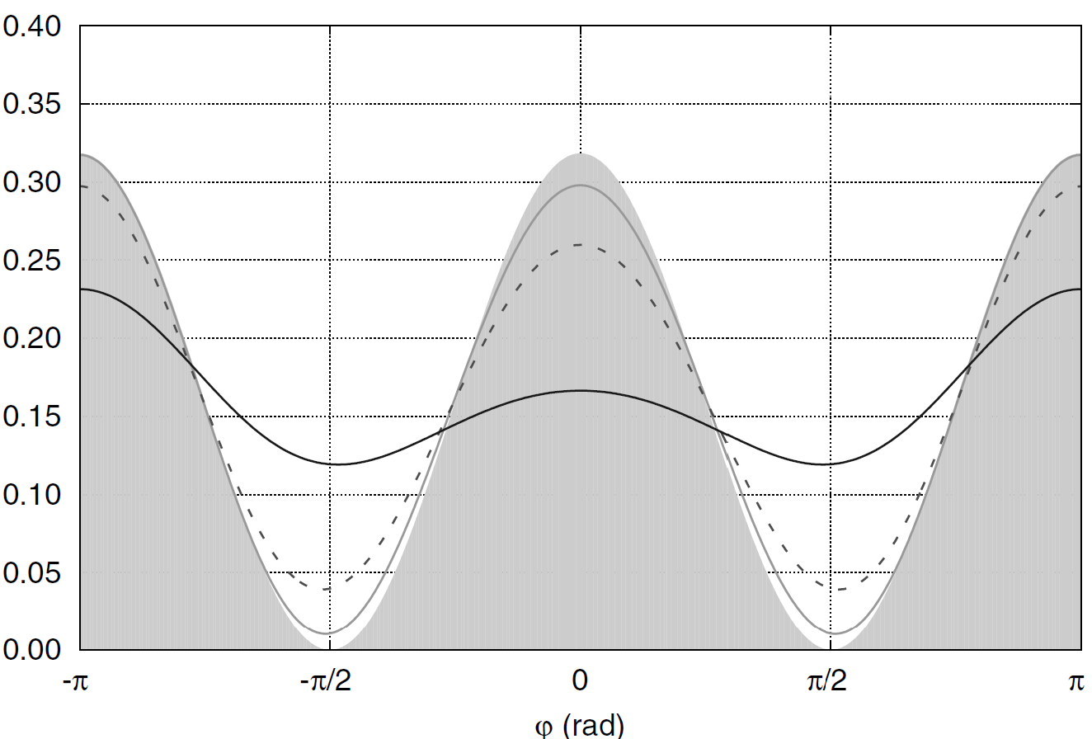
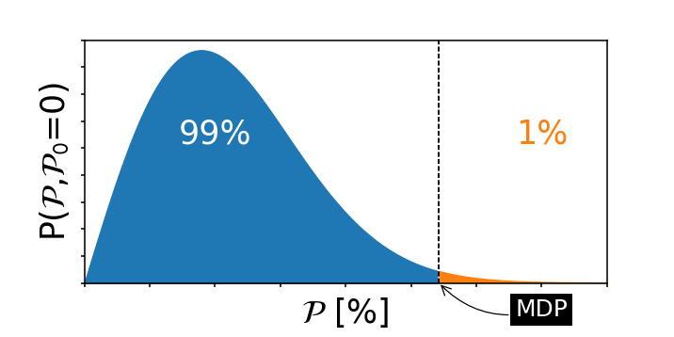

Introduction
Measure the Angular Resolution of our detector to electron
  Collimated 90Sr shooting perpendicularly to the GEM surface (and readout plane)
  2D tracking (possibility to have 3D in future) and energy measurement
Measure the performance of a triple-GEM TPC optically readout for polarimetry in the range [10,60] keV
  Infer the expected modulation factor µ → detector response to a fully polarized source
  Deduce the expected figure-of-merit µ√ε → modulation factor weighted for the efficiency. Related to Minimum Detectable Polarization
Source Position
The modulation factor is the ‘efficiency’ of detecting fully polarized photons
The MDP is the maximum polarization that we
expect to measure with a probability of 99% when the true polarization is zero
N=Flux×efficiency

Slide 12
Conceptual Map
Test @ INAF
90Sr Runs
Reconstruction
Calibrated Data
Directionality Code
(full containment)
55Fe and 109Cd calibration Runs
(5.9 and 8 keV peaks)
Measured Angular Resolution for fully contained e-
Reconstruction
Angular Resolution
Deconvolution to get the Detector Response
90Sr Geant4 Simulation
Intrinsic Angular Resolution for fully contained e-
Cos2 convolution
Photon response Geant4 Simualtion
Efficiency of a 10cm side detector to photons (Photoelectric only)
Modulation Factor
Figure-of-merit
µ√ε

Slide 13
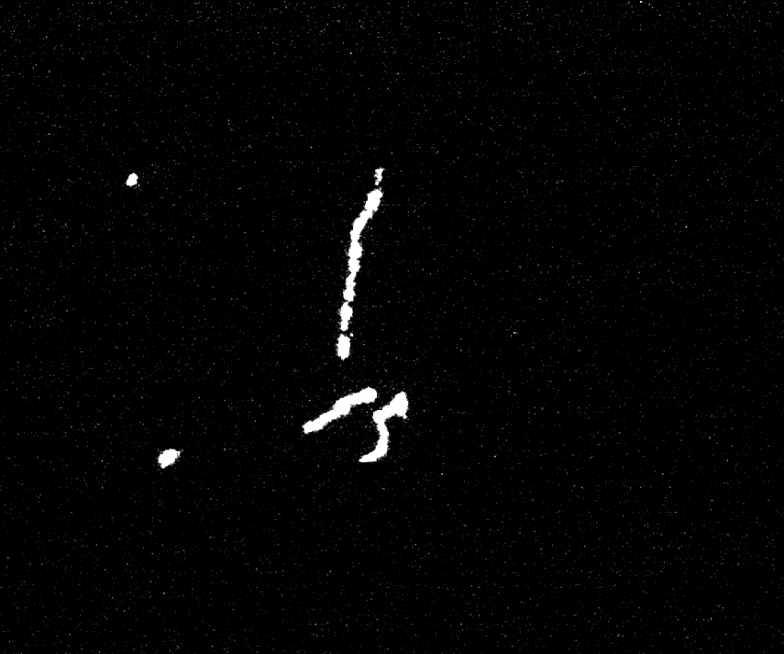
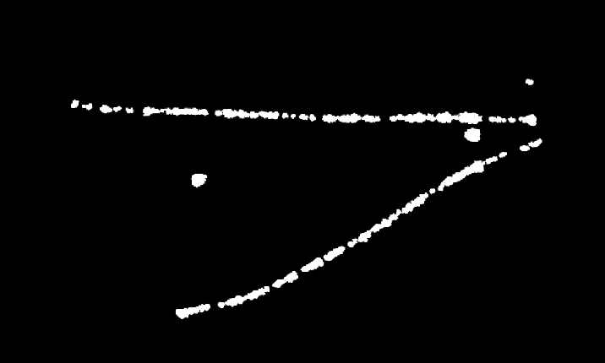
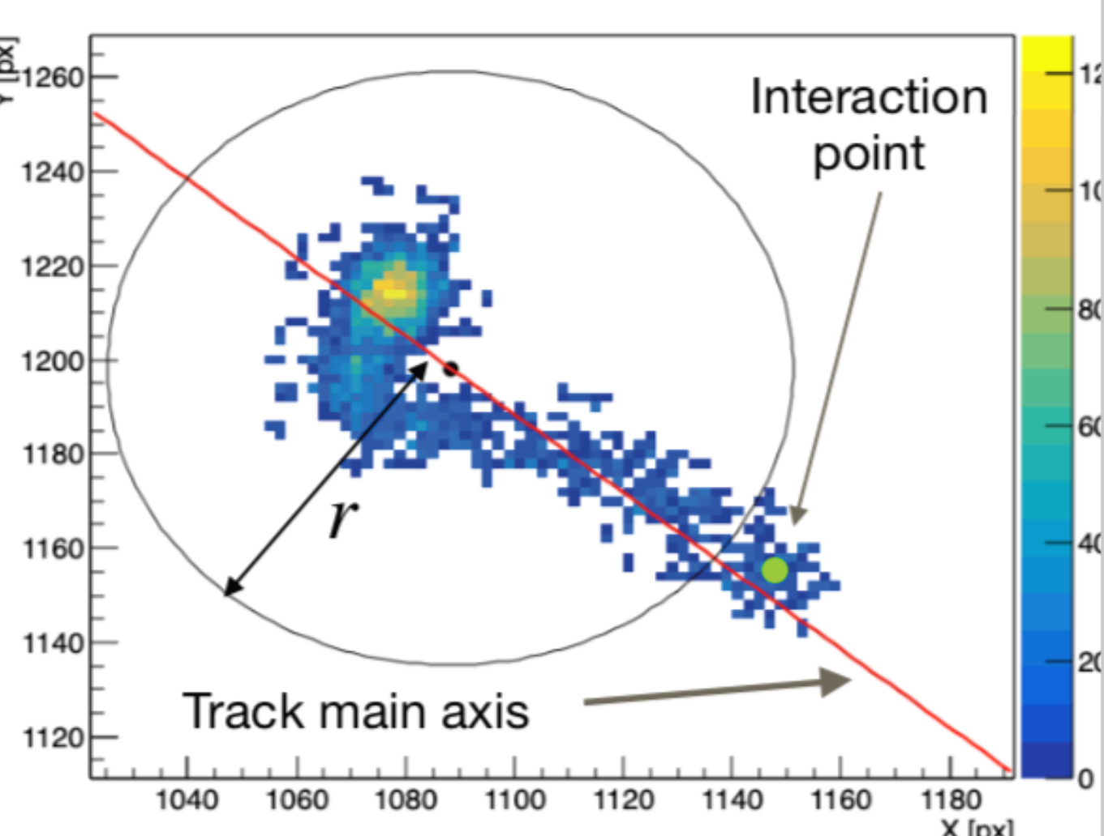
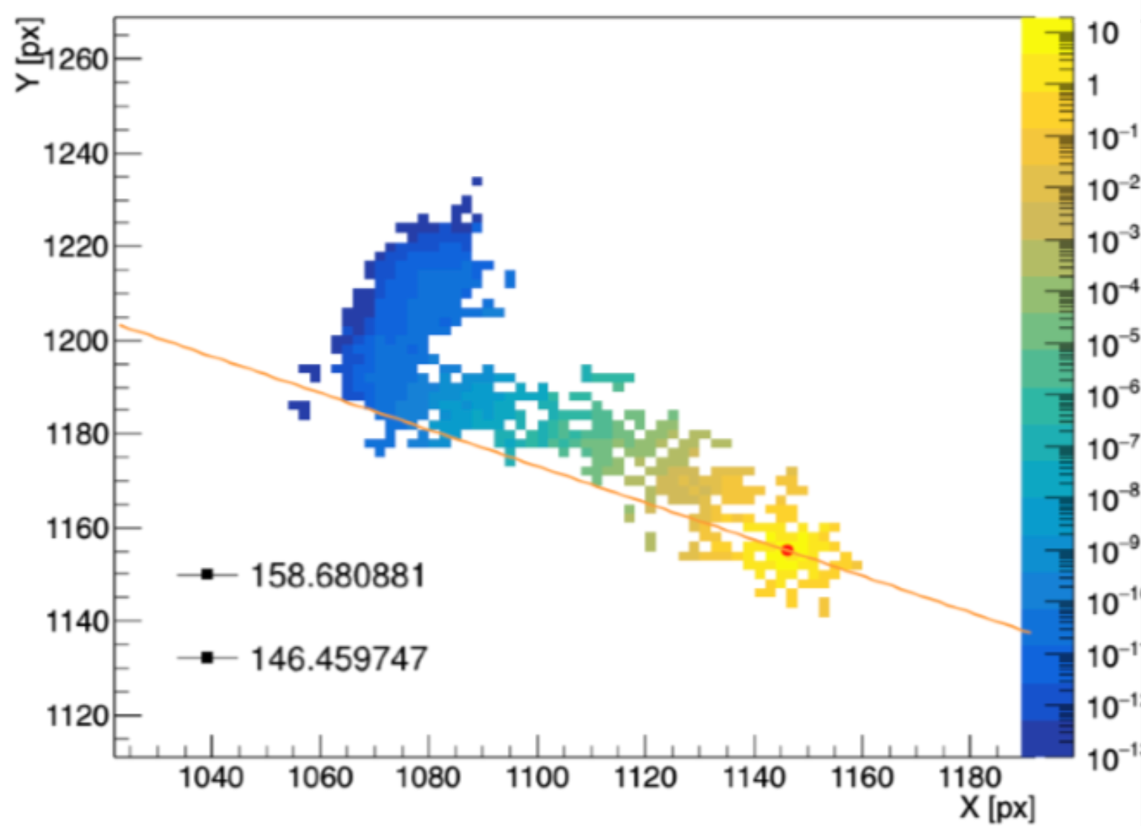
Reconstruction and Direction
Tracks reconstructed with the actual reconstruction code used by the CYGNO collaboration
Low energy electrons <10keV dominated by diffusion in the GEM, limited directionality
e- track
Source Position
8keV photons
5.9keV photons
Source Direction
Compton/photoelectric form 22keV/80keV
-Journal of Instrumentation 15, T12003
-Measurement Science and Technology 34, 125024
8keV photons
The directionality algorithm is inspired from IXPE:
Optimized for our energy range
New strategies under evaluation
Astroparticle Physics 133, 102628 (2021)

Slide 14
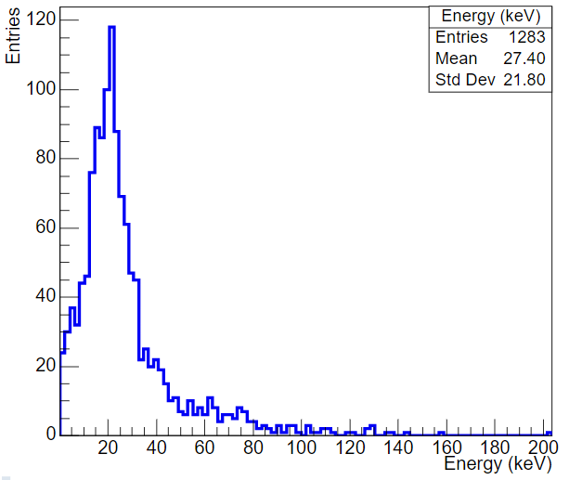
Measurement Results
Calibrated 90Sr Spectrum
Fully contained tracks
Source Position

Slide 15
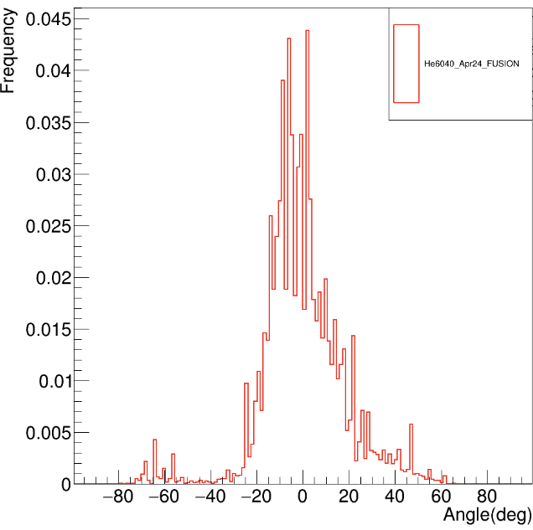
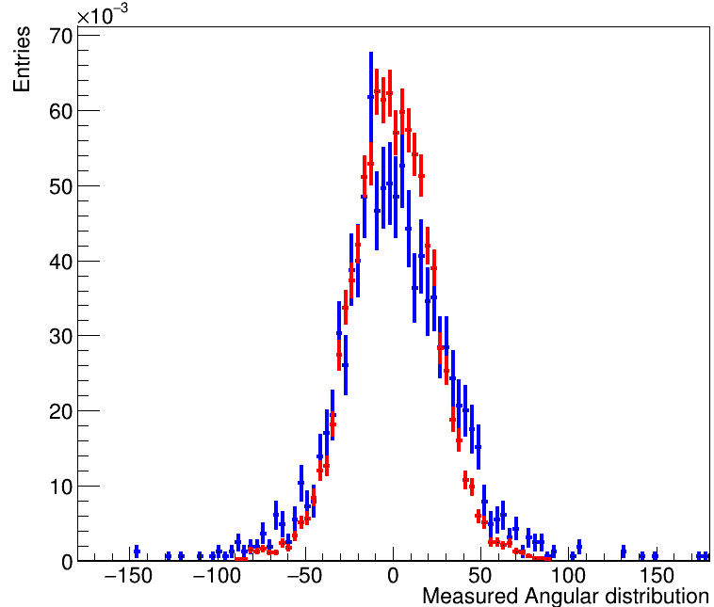
Measurement Results
Calibrated 90Sr Spectrum
Fully contained tracks
Source Position
Measured RMS 32.3°
Simulated RMS 23.6°
Frequency
Deconvolution
RMS of deconvolved RMS is the angular resolution of the detector

Slide 16
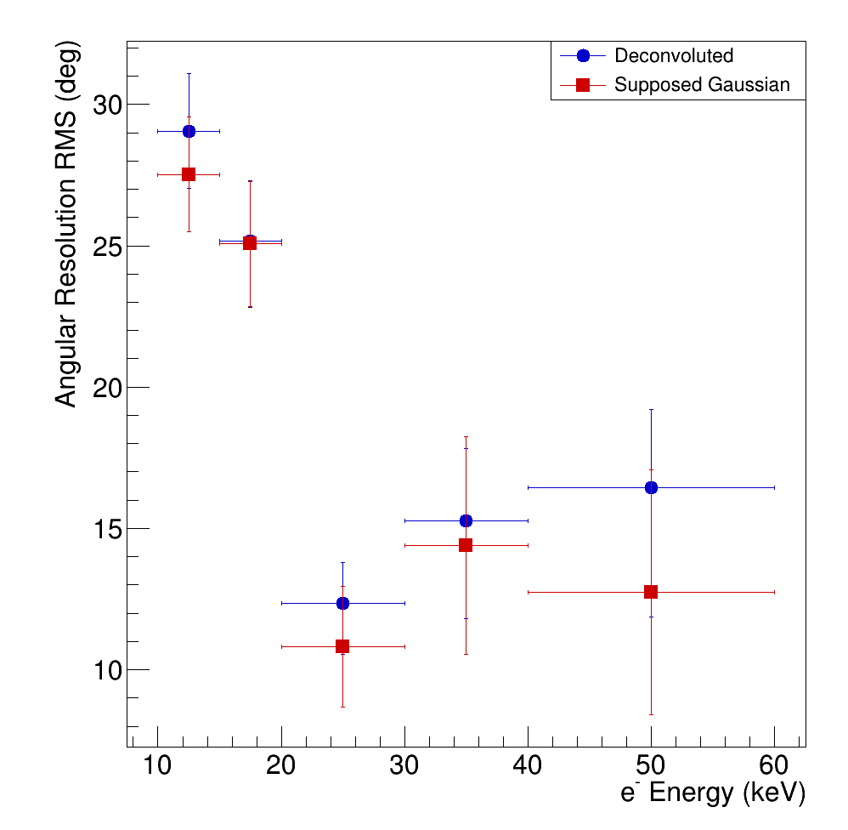
Angular Resolution & Modulation Curve
Using the deconvolved RMS as sigma of a Gaussian, then convolve with a cos²
Distributions are nearly-gaussian

Slide 17
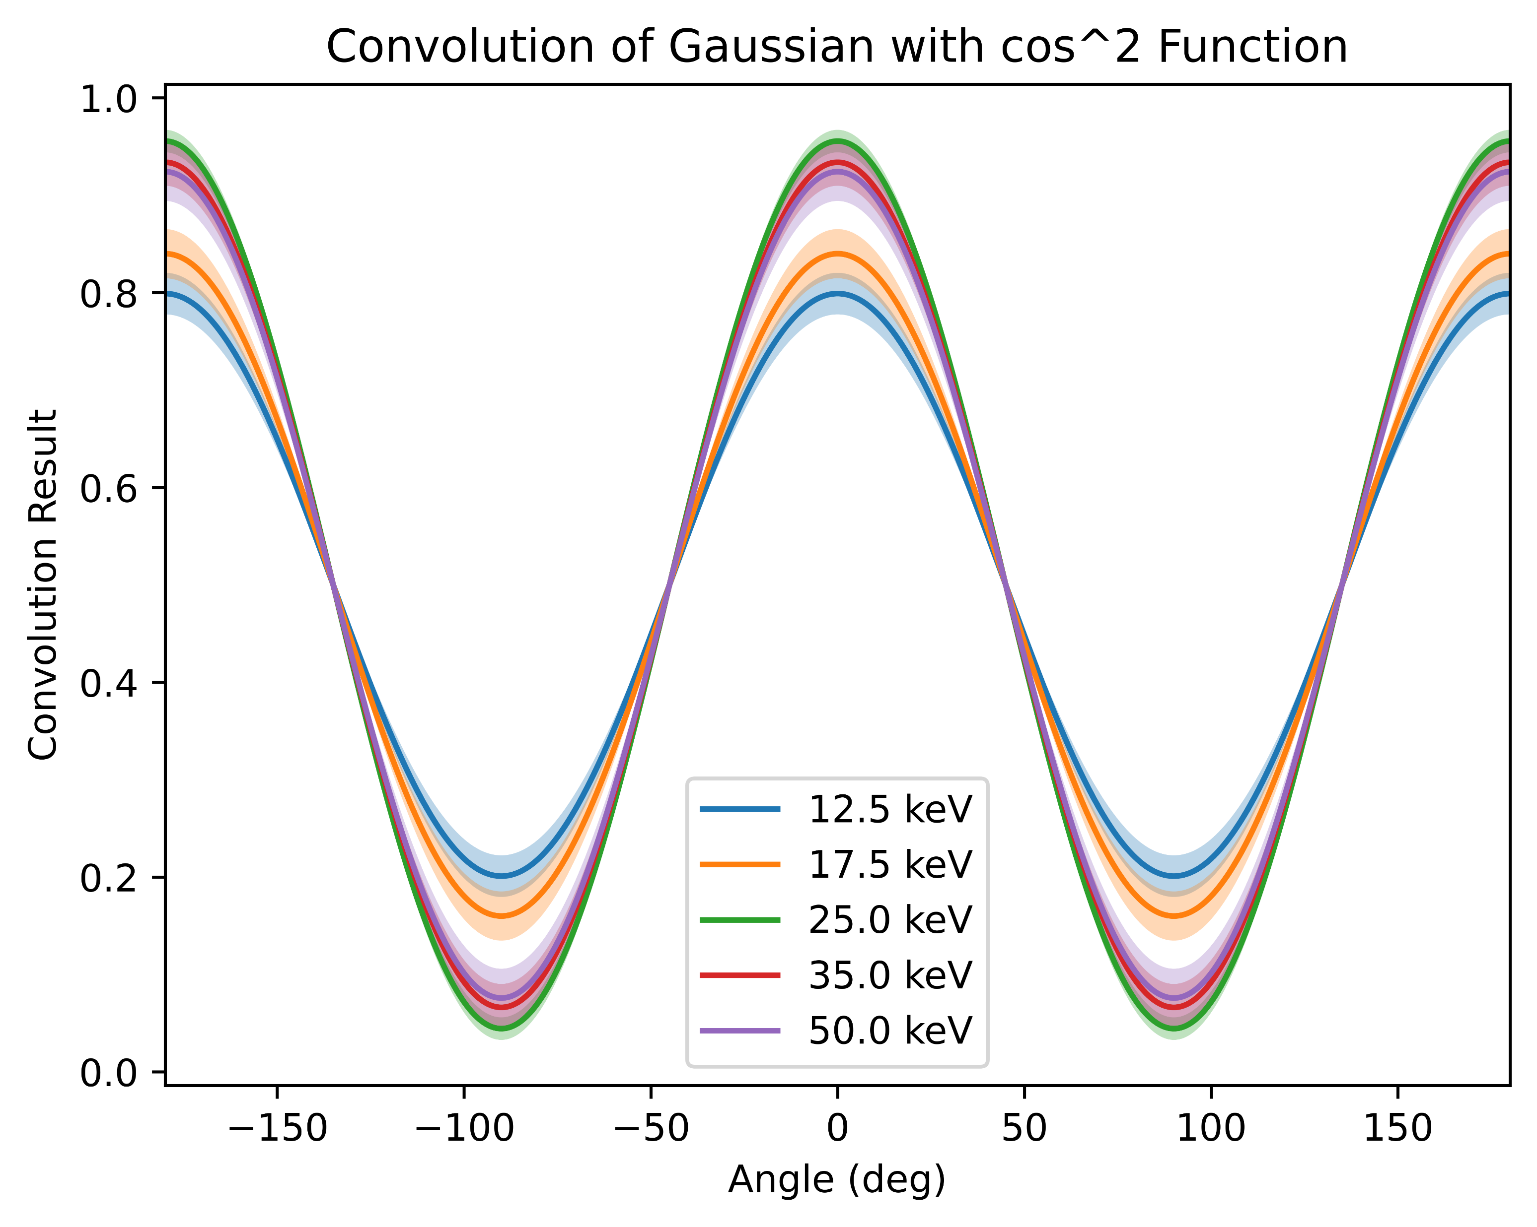

Angular Resolution & Modulation Curve
Using the deconvolved RMS as sigma of a Gaussian, then convolve with a cos²
Expected modulation curves for a fully polarized photon beam if the measured performance is conserved!
Distributions are nearly-gaussian

Slide 18
Modulation Factor

Slide 19
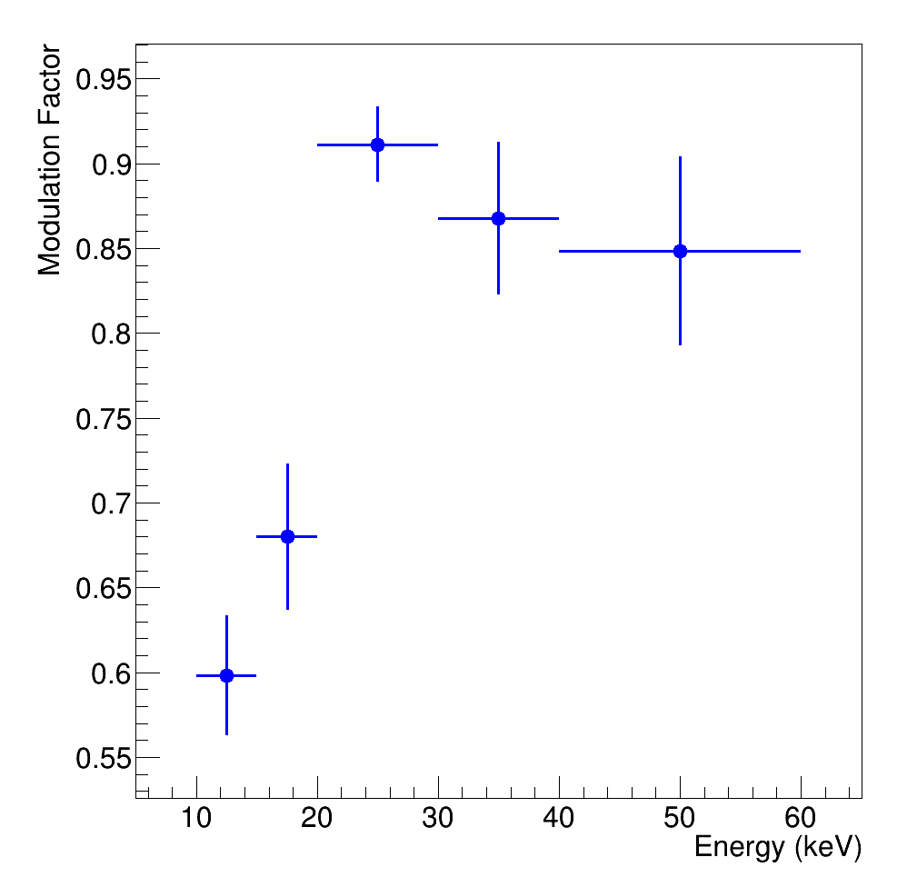
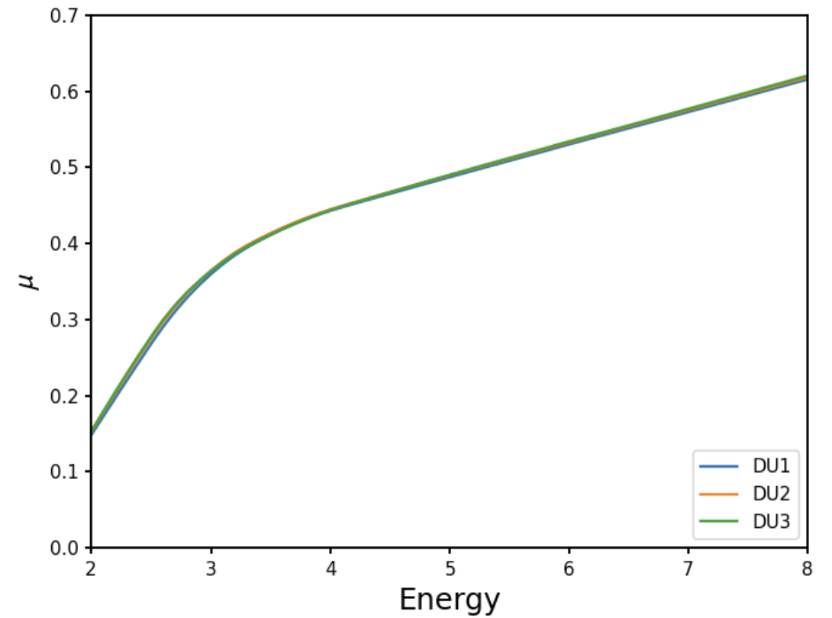
Modulation Factor
IXPE modulation factor (not to be compared)
A good modulation factor is expected!
In particular for energies above 20 keV >0.8

Slide 20
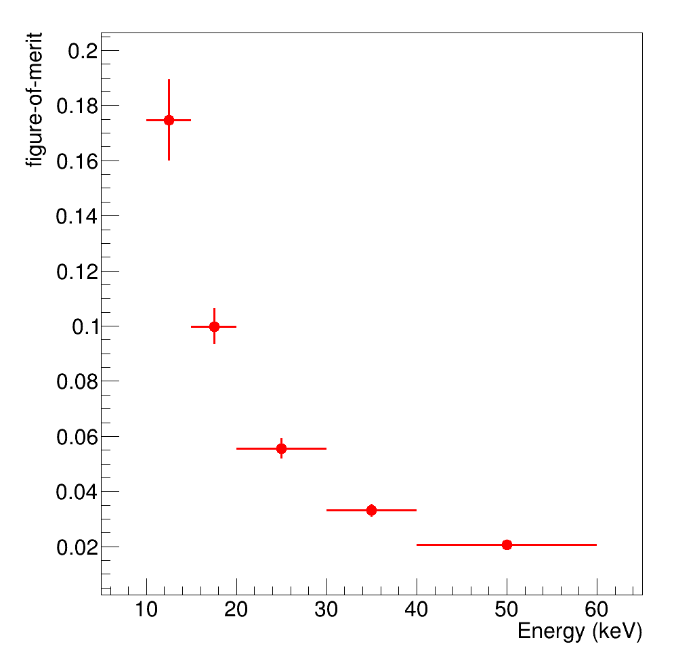
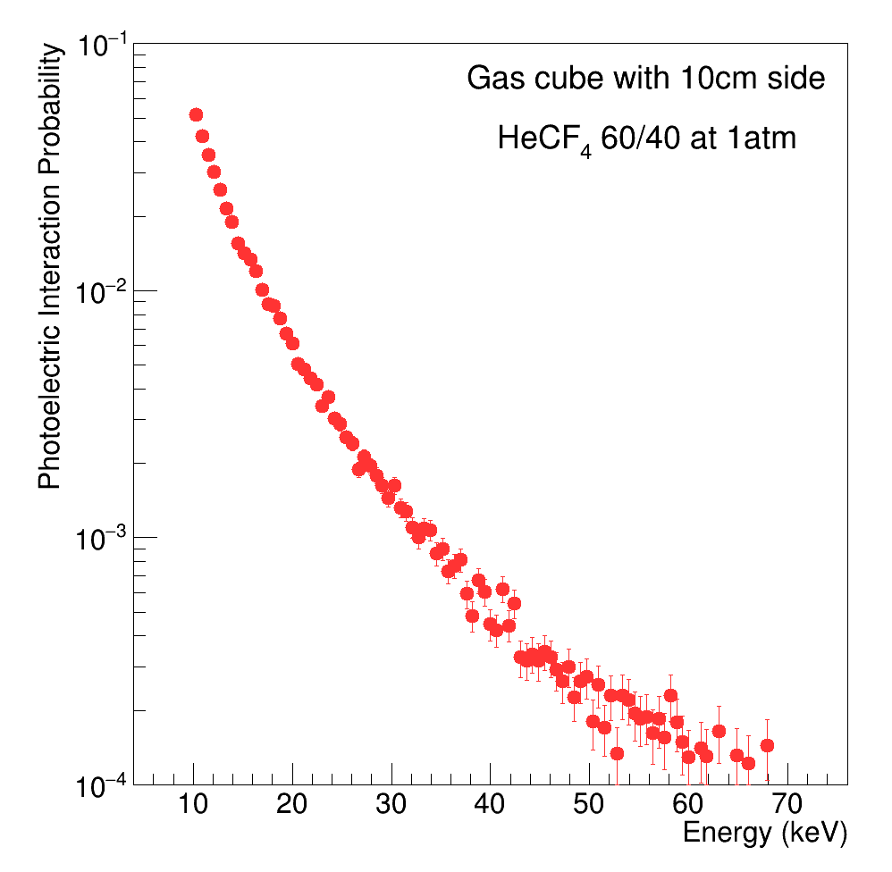

Figure-of-merit
N=Flux×efficiency
$$fom=μ√ε$$
The probability for a photon to interact photoelectrically and be fully contained in the detector

Slide 21
Figure-of-merit
N=Flux×efficiency
$$fom=μ√ε$$
The probability for a photon to interact photoelectrically and be fully contained in the detector
He/CF₄ is a very good mixture for Dark Matter searches, but it may not be the perfect one for X-ray imaging!

Slide 22
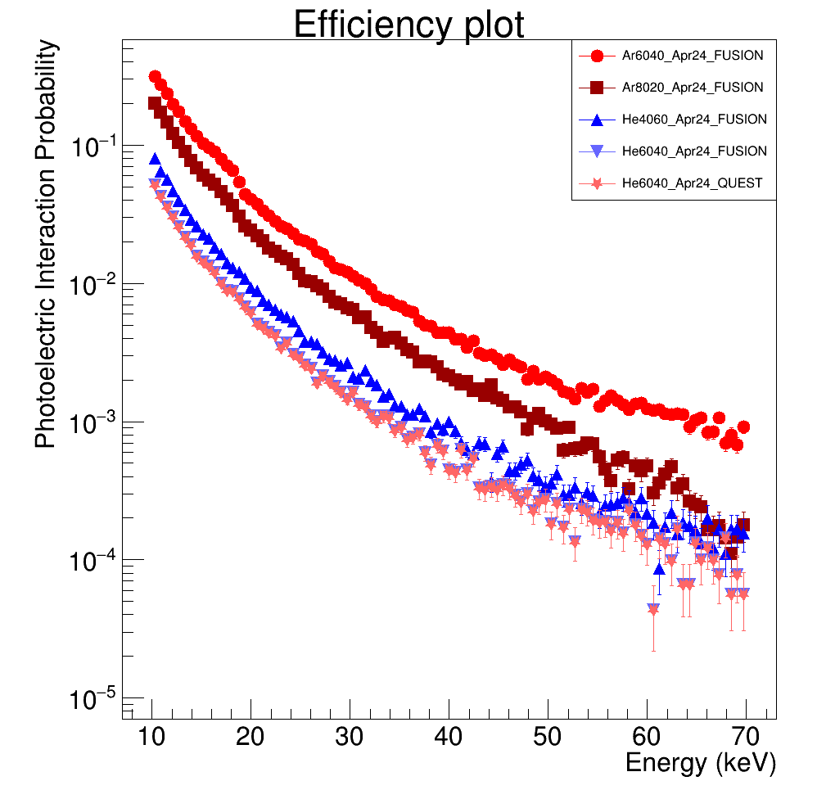
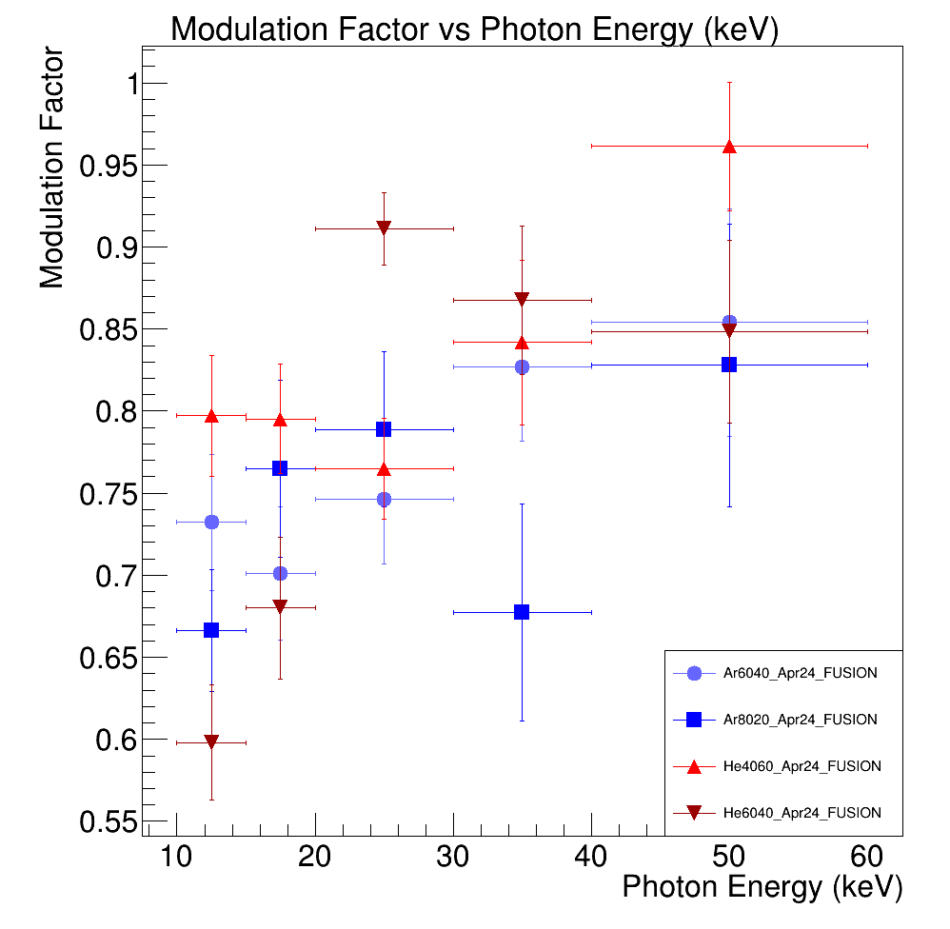
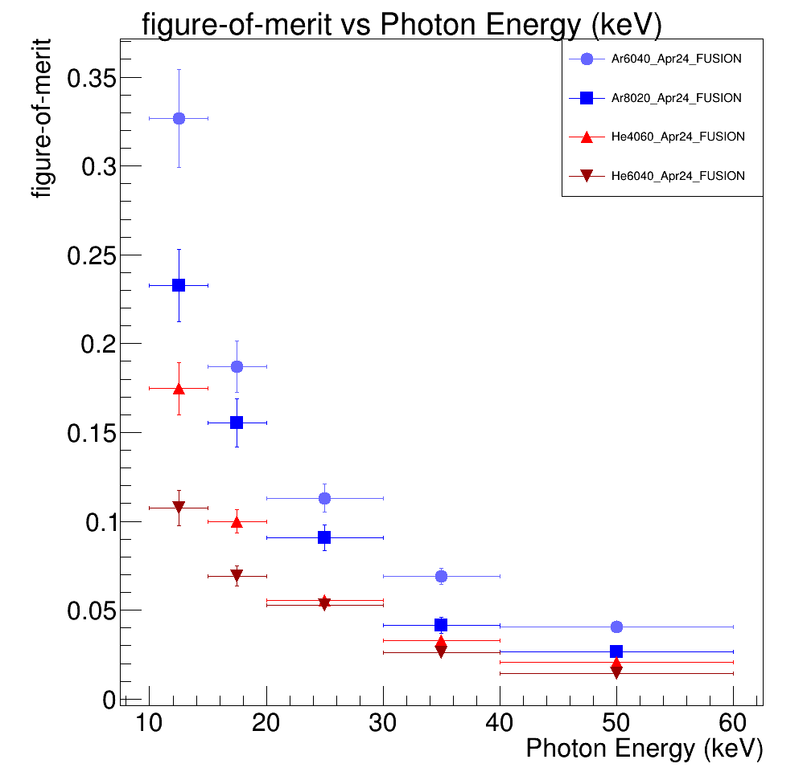
Other Gases
More CF4 helps because of larger density, but photoelectric interaction probability scales linearly with density but scales with Z⁵!!!
While Angular resolution is almost the same (depending on the sCMOS and software), the figure-of-merit can be increased by more than a factor 3-4 in Ar-based mixtures!
He/CF₄ 60/40 - He/CF₄ 40/60 - Ar/CF₄ 60/40 – Ar/CF4 80/20
Other Gases tested!

Slide 23
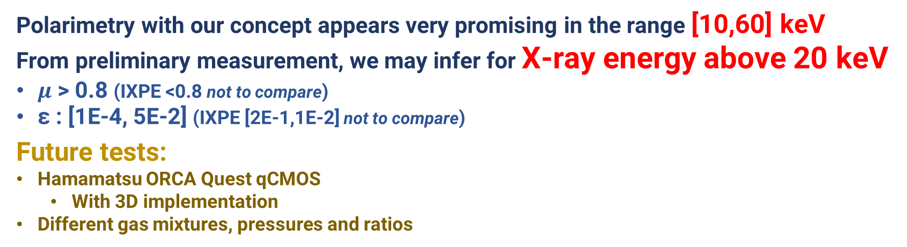
Conclusions
We proudly operate a triple-GEM with optical Readout for Dark Matter Search, and we want to apply our detector concept to X-ray polarimetry.
Polarimetry with our concept appears very promising in the range [10,60] keV
From preliminary measurement, we may infer for X-ray energy above 20 keV
$μ\text{ > 0.8 }$(IXPE <0.8 not to compare)
ε : [1E-4, 5E-2] (IXPE [2E-1,1E-2] not to compare)
Future tests:
Hamamatsu ORCA Quest qCMOS
  With 3D implementation
Different gas mixtures, pressures and ratios

Slide 24
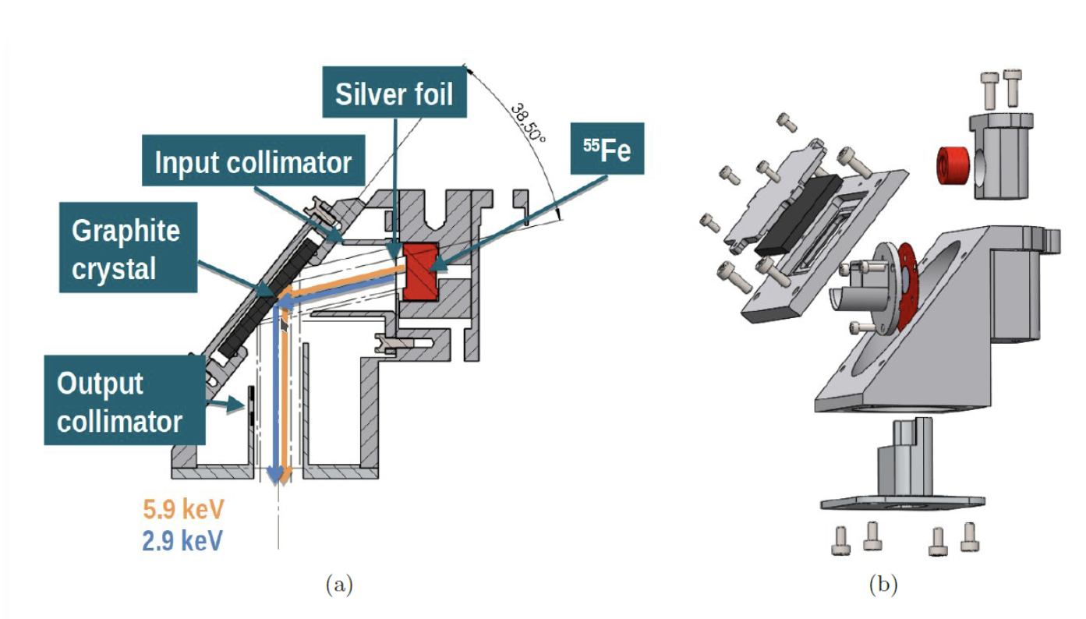

Conclusions
We proudly operate a triple-GEM with optical Readout for Dark Matter Search, and we want to apply our detector concept to X-ray polarimetry.
Polarimetry with our concept appears very promising in the range [10,60] keV
From preliminary measurement, we may infer for X-ray energy above 20 keV
$μ\text{ > 0.8 }$(IXPE <0.8 not to compare)
ε : [1E-4, 5E-2] (IXPE [2E-1,1E-2] not to compare)
Future tests:
Hamamatsu ORCA Quest qCMOS
  With 3D implementation
Different gas mixtures, pressures and ratios
Polarized X-ray Beam test @ INAF TorVergata
  Validate Simulation
  Provide full simulation on an astronomical physics case

Slide 25
BACKUP

Slide 26
High-precision 3D TPC with optical readout via PMT + sCMOS
JINST 13 (2018) no.05, P05001

Slide 27
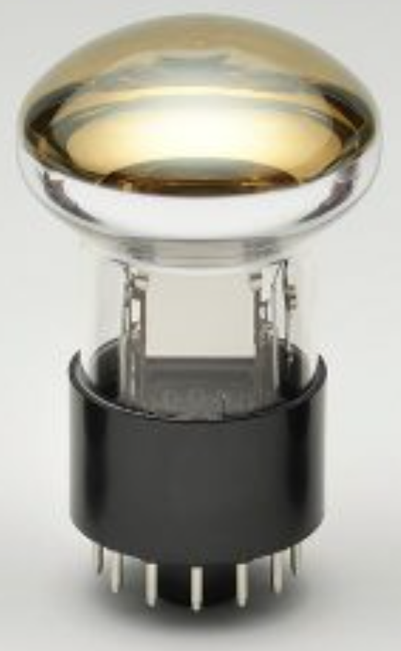
High-precision 3D TPC with optical readout via PMT + sCMOS
JINST 13 (2018) no.05, P05001
PMT
Integrated
Z + Energy measurement
Drift
direction
Straight track:
Drift
direction
Tilted track:

Slide 28
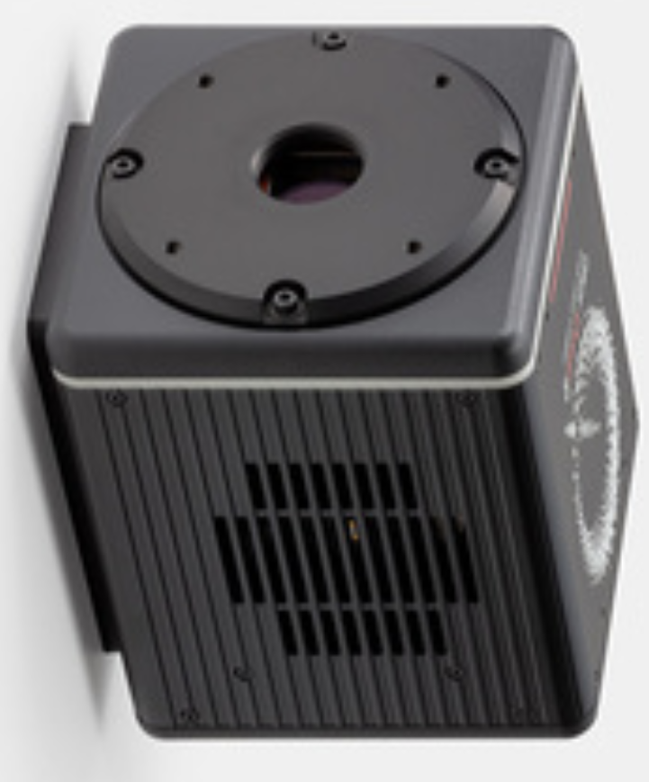
High-precision 3D TPC with optical readout via PMT + sCMOS
sCMOS
High-granularity
X+Y+Energy measurement
JINST 13 (2018) no.05, P05001
PMT
Integrated
Z + Energy measurement
Drift
direction
Straight track:
Drift
direction
Tilted track:

Slide 29
High-precision 3D TPC with optical readout via PMT + sCMOS
sCMOS
High-granularity
X+Y+Energy measurement
JINST 13 (2018) no.05, P05001
PMT
Integrated
Z + Energy measurement
Drift
direction
Straight track:
Drift
direction
Tilted track:

Slide 30
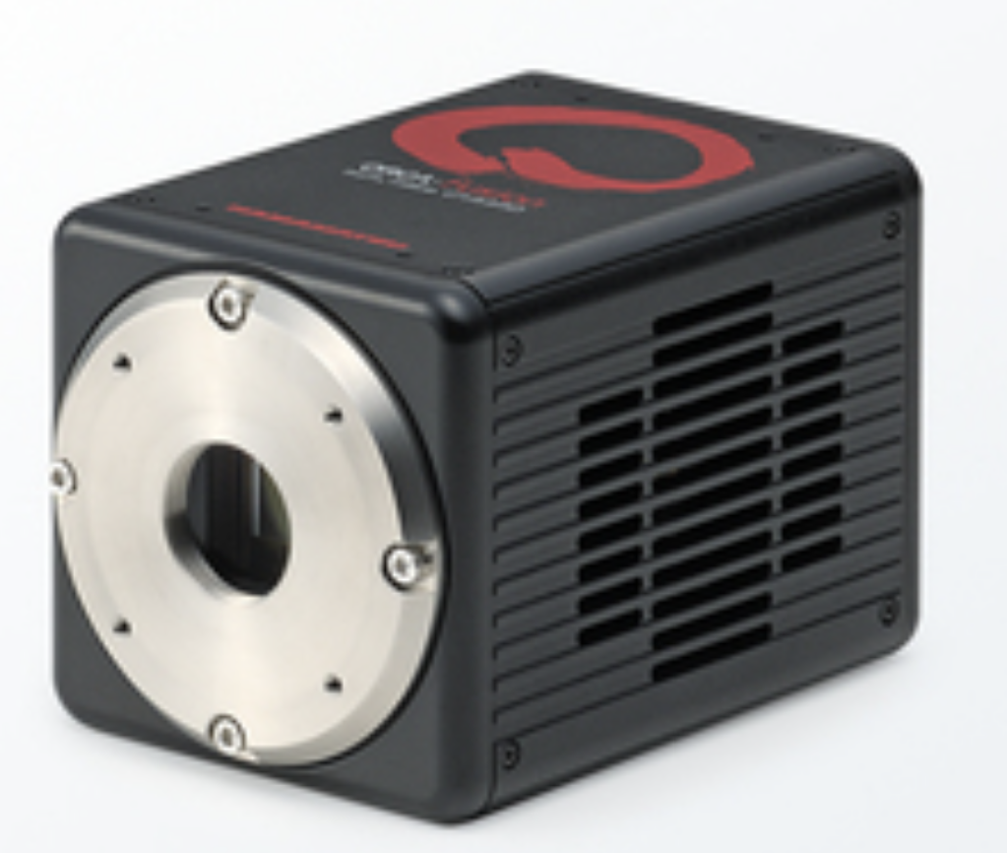
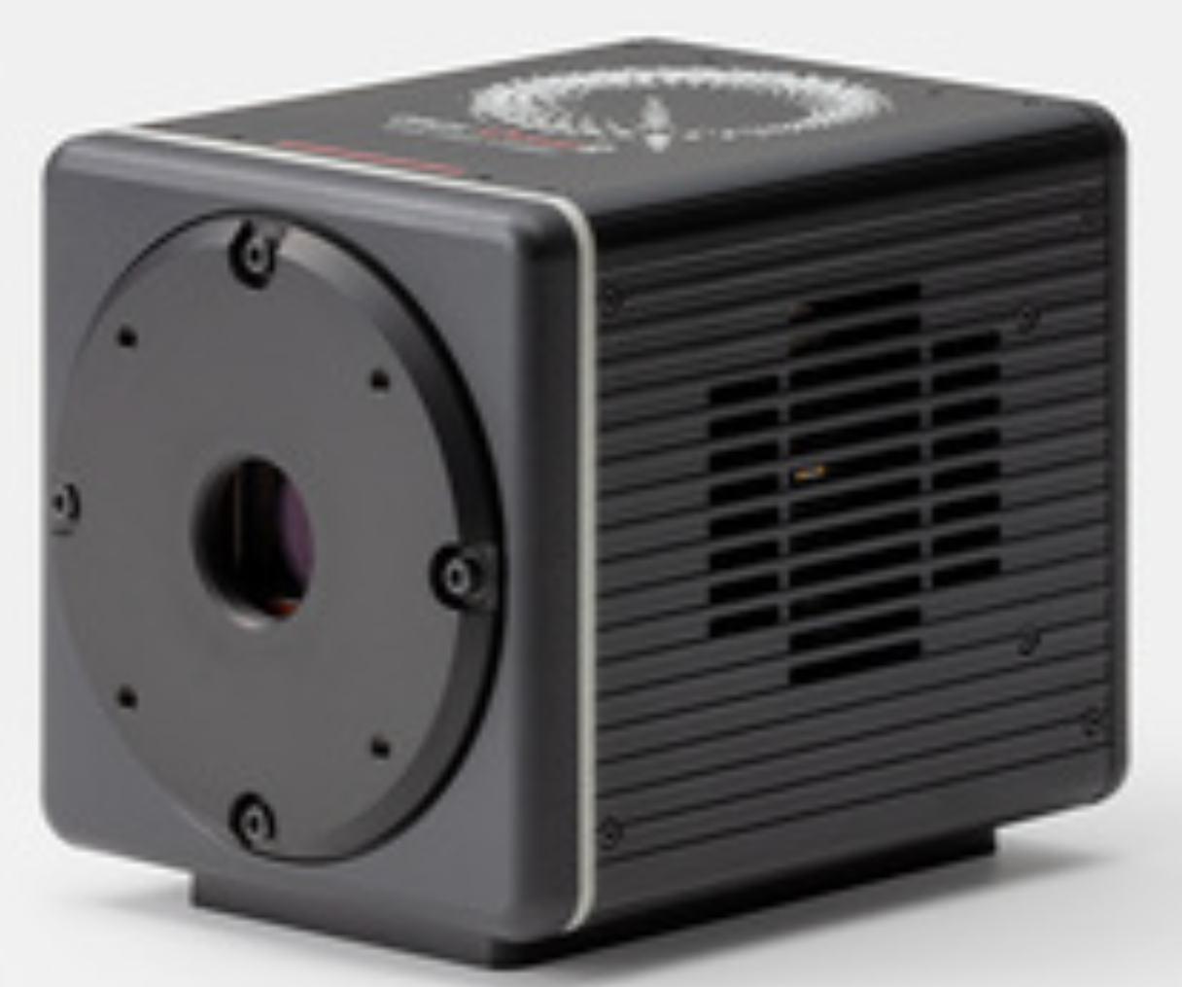
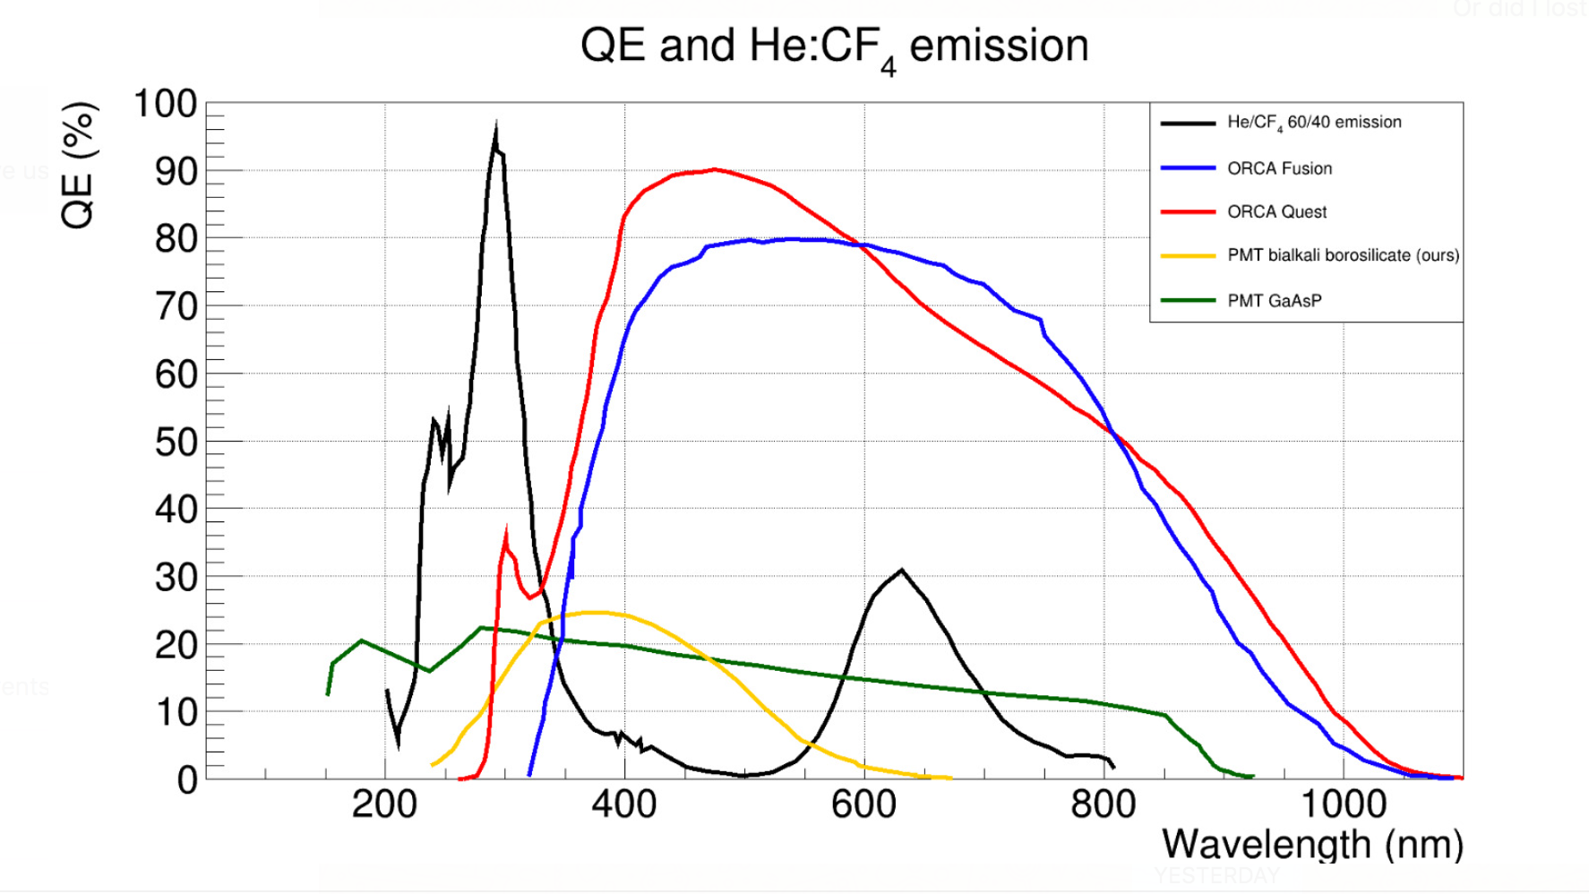
sCMOS characteristics & He/Ar:CF4 emission spectra
Hammamatsu | # of pixels | Pixel size [um] | Sensor area [cm²] | Dynamic range | Readout noise (enc) | Mix exposure
Orca Flash | 2048 x 2048 | 6.5 x 6.5 | 1.33 x 1.33 | 37000:1 | 1.4 (1.6) rms | 33 (10) us
Orca Fusion | 2304 x 2304 | 6.5 x 6.5 | 1.498 x 1.498 | 21400:1 | 0.7 (1.4) rms | 280 (17) us | Used for the reasult shown
Orca Quest | 4096 x 2304 | 4.6 x 4.6 | 1.884 x 1.060 | 25900:1 | 0.27 (0.43) rms | 200 (7.2) us | Tested
Orca Quest2 | 4096 x 2304 | 4.6 x 4.6 | 1.884 x 1.060 | 25900:1 | 0.27 (0.43) rms | 200 (7.2) us | Under Procurament
improving performances
NIM A 504 (2003) 88-92
Notes:
Optical spectrum and cameras

Slide 31


detectors and timeline

Slide 32
detectors and timeline
LIME
- The first large-size prototype
- Currently taking data
CYGNO04
The first detector for physics runs
Currently under design

Slide 33

Long Imaging ModulE
PMT
Integrated
Z + Energy measurement
Drift
direction
Straight track:
Successfully Running since 2022 at the underground laboratory of Gran Sasso, Italy
Drift
direction
Tilted track:
1 sCMOS + 4 PMT + 3 GEMs 33 x 33 cm2 readout area 50 cm drift length
1.498 x 1.498 cm2 sensor 6.5 x 6.5 um2
pixels 2304 x 2304 pixels
Imaging 36 x 36 cm2 area Effective
pixel granularity 155 x 155 um2
Sensor geometrical acceptance Ω =1.1 x 10-4

Slide 34
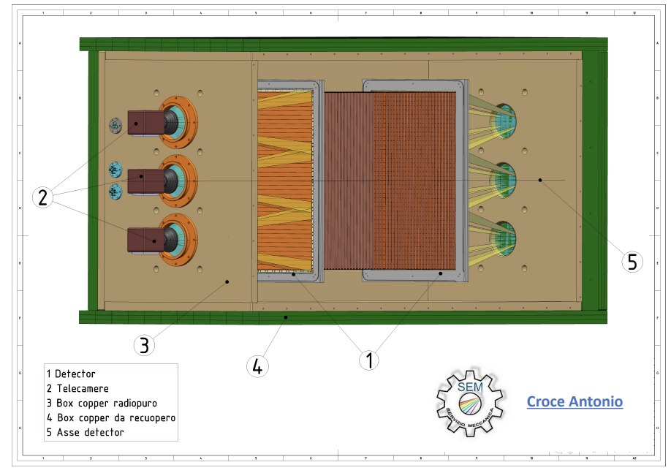
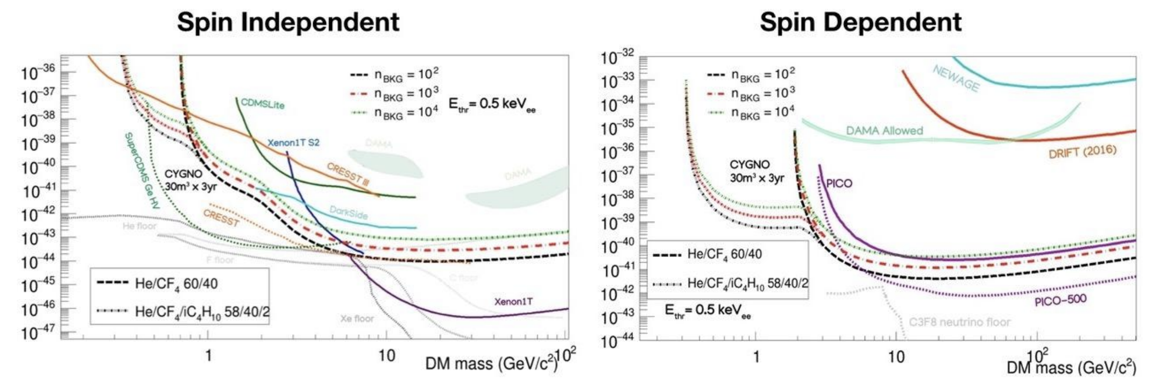
CYGNO04
Common Cathode TPC
2x 3 sCMOS + 8 PMT + 3 GEMs 80 x 50 cm2 readout area 50 cm drift length
0.4m³ Volume
Last generation sCMOS
  Better granularity
  Lower noise
More radiopure materials

Slide 35

Reconstruction and Direction
From LIME (underground detector) Simulation
Tracks reconstructed with the actual reconstruction code used by the CYGNO collaboration
Low energy electrons <10keV dominated by diffusion, limited directionality
e- track
8keV photons
5.9keV photons
Compton/photoelectric form 22keV/80keV
8keV photons
The directionality algorithm is entirely derived from IXPE:
Optimal for short, almost straight track (IXPE energy range)
May fail in case of long zigzaggy tracks
New strategies under evaluation

Slide 36

Introduction
Measure the performance of a triple-GEM TPC optically readout for polarimetry in the range [10,50] keV
  Measure the expected modulation factor µ → detector response to a fully polarized source (if 1 is perfect if 0 is non sensible)
  Measure the expected figure-of-merit µ√ε → modulation factor weighted for the efficiency. Related to Minimum Detectable Polarization
Measure the Angular Resolution of our detector to electron
  Source is 90Sr shooting perpendicularly to the GEM surface (and readout plane)
  Ionization tracks are multiplied by a triple-GEM structure, and the scintillation light from the CF4 gas is read by a CMOS camera
    2D tracking (possibility to have 3D in future) and energy measurement
I will elaborate on the measurement with the standard gas mixture He/CF4 60/40 1atm, but other gases have been tested
N=Flux×efficiency

Slide 37
Conceptual Map
Test @ INAF
90Sr Runs
Reconstruction
Calibrated Data
Directionality Code
(full containment)
55Fe and 109Cd calibration Runs
(5.9 and 8 keV peaks)
Measured Angular Resolution for fully contained e-
Reconstruction
Angular Resolution
Deconvolution to get the Detector Response
90Sr Geant4 Simulation
Intrinsic Angular Resolution for fully contained e-
Cos2 convolution
Photon response Geant4 Simualtion
Efficiency of a 10cm side detector to photons (Photoelectric only)
Modulation Factor
Figure-of-merit

Slide 38



Measurements
Test @ INAF
90Sr Runs
Reconstruction
Calibrated Data
Directionality Code
(full containment)
55Fe and 109Cd calibration Runs
(5.9 and 8 keV peaks)
Measured Angular Resolution for fully contained e-
Reconstruction
Example of e- track from 90Sr
DBSCAN is used to find clusters of pixels over the threshold
Directional DBSCAN is used to aggregate clusters that came from the same track
Source Position
Source Direction
CYGNUS-RD/reconstruction: Camera and scope analysis tools (github.com)

Slide 39
Measurements
Test @ INAF
90Sr Runs
Reconstruction
Calibrated Data
Directionality Code
(full containment)
55Fe and 109Cd calibration Runs
(5.9 and 8 keV peaks)
Measured Angular Resolution for fully contained e-
Reconstruction
e- track
8keV photons
5.9keV photons
Compton/photoelectric form 22keV/80keV
8keV photons

Slide 40


Measurements
Test @ INAF
90Sr Runs
Reconstruction
Calibrated Data
Directionality Code
(full containment)
55Fe and 109Cd calibration Runs
(5.9 and 8 keV peaks)
Measured Angular Resolution for fully contained e-
Reconstruction
The directionality algorithm is entirely derived from IXPE (main developer S.Torelli)
IP→moving circularly where skewness is positive far away from Barycenter
DIR→maximizes RMS of selected points around IP with exponentially scaled intensity
fiorotto8/CygnoAnal (github.com)

Slide 41



Measurements
Test @ INAF
90Sr Runs
Reconstruction
Calibrated Data
Directionality Code
(full containment)
55Fe and 109Cd calibration Runs
(5.9 and 8 keV peaks)
Measured Angular Resolution for fully contained e-
Reconstruction
fiorotto8/Directionality (github.com)
Full containment is defined as:
IP region
  'X_ImpactPoint' > 1700 &
  'X_ImpactPoint' < 1800 &
  'Y_ImpactPoint' > 850 &
  'Y_ImpactPoint' < 1450 &
Camera containment:
  'Ymin' >500 &
  'Ymax' <2304-500 &
  “Xmin">500
IP with direction line
Calibrated 90Sr Spectrum
Fully contained tracks
IP after cut
Angular resolution

Slide 42
Intrinsic Angular spread simualtion
Angular Resolution
Deconvolution to get the Detector Response
90Sr Geant4 Simulation
Intrinsic Angular Resolution for fully contained e-
Simulation with a simple geometry:
Cylindrical gas volume h=5cm, r=3.7cm
Field cage rings, 1cm with SS ring 0.1cm radius
90Sr Source with r=1mm tungsten collimator
90Sr decay, electrons tracked only in the gas volume!
  Deposited energy measurement in sensitive volume
Full containment:
Track without hits in 5mm from the border or the circle
But allowed if the hit is in the +/- 30° region of the entering angle
No containment in cylinder height (we are only 2D for now)
z
fiorotto8/MANGO_RadioactiveSource: Simulation of Cd-109 Radioactive source in MANGO (github.com)
x
90Sr source

Slide 43


Intrinsic Angular spread simualtion
Angular Resolution
Deconvolution to get the Detector Response
90Sr Geant4 Simulation
Intrinsic Angular Resolution for fully contained e-
Fully contained Simulated Tracks!
fiorotto8/Directionality (github.com)

Slide 44
Detector Resolution
Angular Resolution
Deconvolution to get the Detector Response
90Sr Geant4 Simulation
Intrinsic Angular Resolution for fully contained e-
Deconvolved distribution
Richardson-Lucy deconvolution to get the Detector Angular resolution:
Deconvolution and Subtraction in quadrature give very similar results
Errors are calculated by bootstrapping the measured and intrinsic distributions and deconvolving many times
With these bins:
np.linspace(-100, 100, 151)
Detector Angular resolution

Slide 45
Modulation factor and figure-of-merit
Modulation Factor
Angular Resolution
Photon response Geant4 Simualtion
Efficiency of a 10cm side detector to photons (Photoelectric only)
Cos2 convolution
Figure-of-merit
Using the deconvolved RMS as sigma of a Gaussian, then convolve with a cos²

Slide 46

Modulation factor and figure-of-merit
Modulation Factor
Angular Resolution
Photon response Geant4 Simualtion
Efficiency of a 10cm side detector to photons (Photoelectric only)
Cos2 convolution
Figure-of-merit
fiorotto8/Directionality (github.com)

Slide 47

Modulation factor and figure-of-merit
Modulation Factor
Angular Resolution
Photon response Geant4 Simualtion
Efficiency of a 10cm side detector to photons (Photoelectric only)
Cos2 convolution
Figure-of-merit
Geant4 simulation of a gas cube of 10cm side with 2cm of Al shielding
Hole of 10.6mm to put an eventual MCP plate
Shooting photons [10,70]keV through the hole
Photon is considered detected if:
  The total energy deposited is its primary energy (with 200eV clearance)
  It did only one interaction (photoelectric selection) in the gas
fiorotto8/MANGOspaceG4 (github.com)

Slide 48
Modulation factor and figure-of-merit
Modulation Factor
Angular Resolution
Photon response Geant4 Simualtion
Efficiency of a 10cm side detector to photons (Photoelectric only)
Cos2 convolution
Figure-of-merit
N=Flux×efficiency
Huge quenching of the good modulation factor is caused by very low efficiency!
This is the best possible condition! We are not considering the reconstruction efficiency and possible background!!

Slide 49
Other results
He/CF4 at atmospheric pressure is great for DM searches. However, it mayshould be optimized for polarimetry
Argon ensures up to an order of magnitude of efficiency
More CF4 helps because larger density, but photoelectric
Iteraction probability scales linearly with density but scale with Z⁵!!!

Slide 50



Modulation Factors and figure-of-merits

