Slide 1
The UltraLow Material Budget GEM based TPC used for Tracking
Francisco García
Helsinki Institute of Physics

Slide 2
Outline
Introduction & Motivation
Tracking at different facilities
Test beam at the SPS – H4 beamline
Summary
2

Slide 3
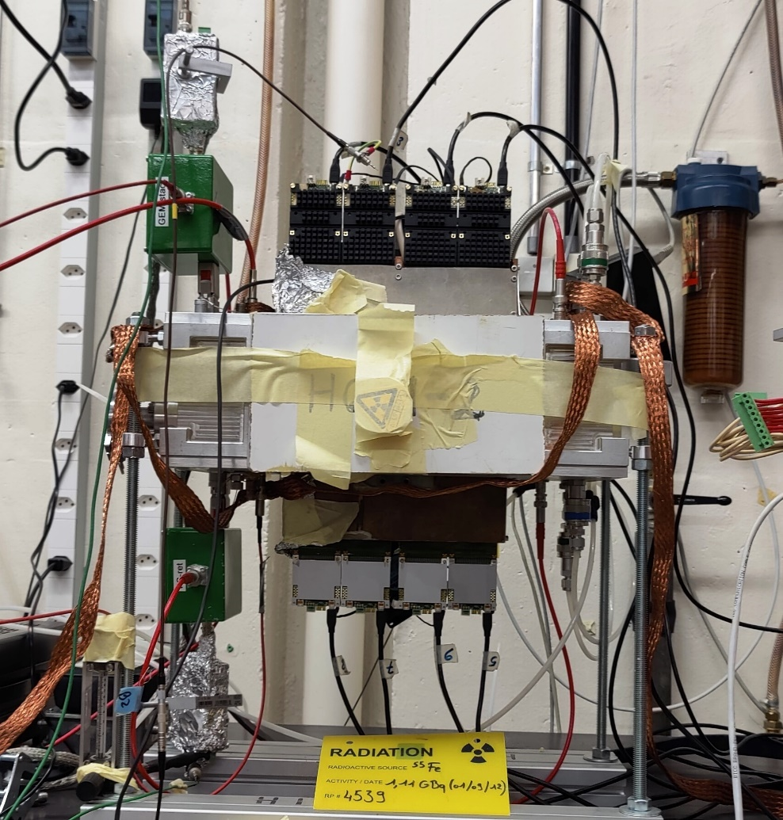
INTRODUCTION
The GEM-TPC in twin configuration consists of two GEM-TPCs inside a single vessel. One of them is rotated 180º on the middle of the horizontal plane w.r.t. the other.
HGB4-2 at CERN GDD lab.
The TWIN concept was introduced in collaboration between the Helsinki and Bratislava group sometime ago to cope with tracking at high rate. By constraining the time of the signals on both GEM-TPCs the ambiguity of association of hits to single track is drastically reduced.
3

Slide 4
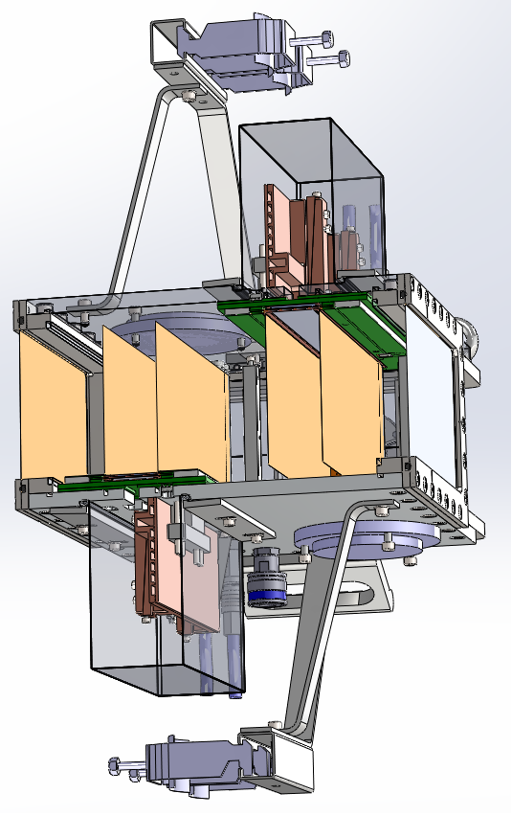
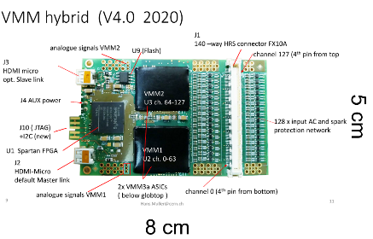
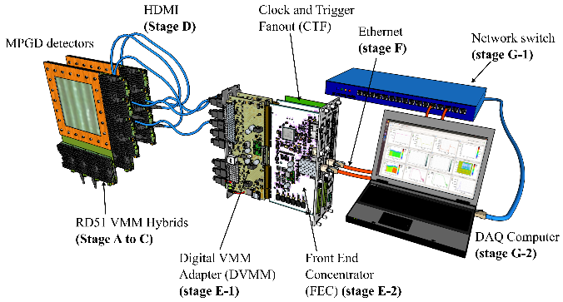
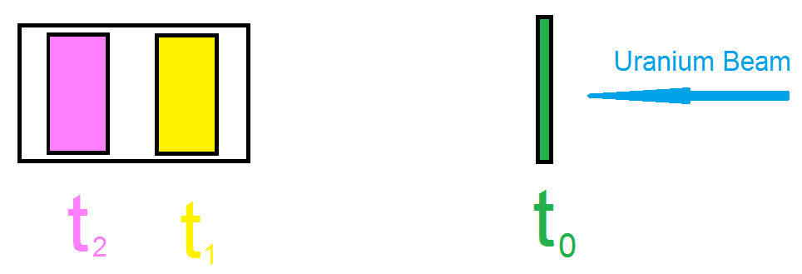
MOTIVATION
To perform tracking of particles with minimal distortions to its trajectory in high rate conditions.
Low material budget
Tracking Reconstruction
The VMM3a-SRS readout
2.81e-3 X/X₀
Main contribution from gas volume
In contrast one triple GEM detector à la TOTEM will have 7.30e-3 x/x₀
Fast readout electronics with ~4 MHz per VMM3a.
Time resolution O(2ns)
Large Dynamic range
The sum of drift time of both field cages represent the total drift, which is called the Control Sum
4

Slide 5
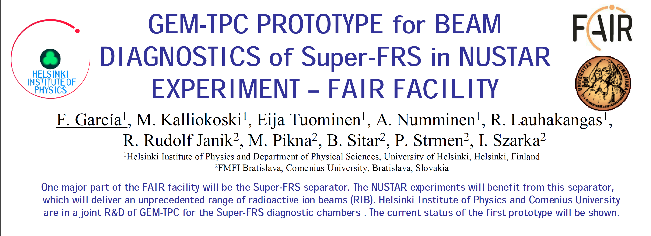
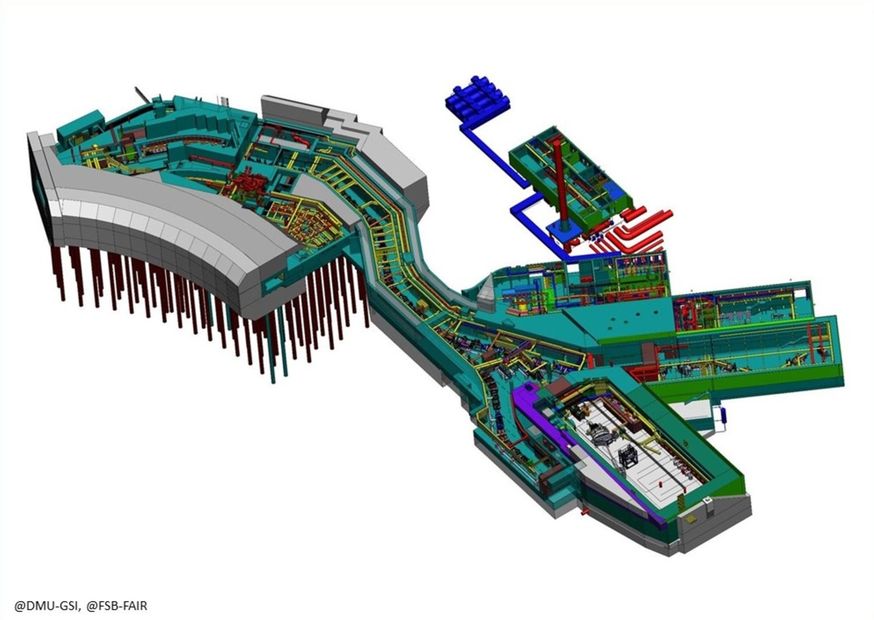
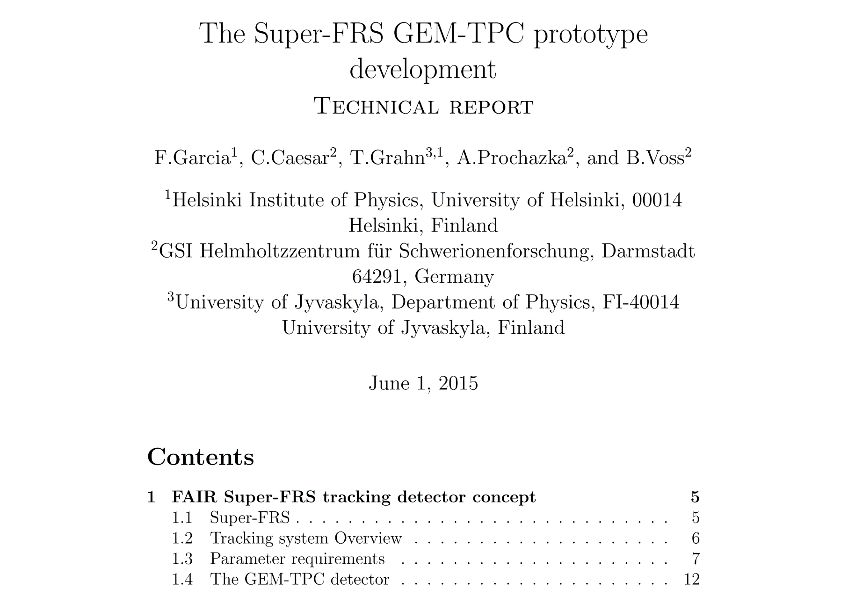
TRACKING at DIFFERENT FACILITIES
At the FRS - GSI
Projectile:
Elements p – U
Energy up to 1.5 GeV/u
Intensity up to 10¹² /spill
The GEM-TPC concept was introduced Presented in the NSS conference 2009 Orlando USA
THE TIMELINE OF THIS PROJECT
The R&D and Design can be finalized by:
Q4/2024
Mass production:
Q1/2025 – Q1/2026
Part of the Finnish Contribution will be in Diagnostic systems, which is a work package dedicated to provide 14 GEM-TPC detectors.
Requirements:
1.- High-rate capability 1 MHz (1 kHz/mm²)
2.- Large dynamic range, from Physics
3.- Spatial Resolution ~ 200 μm in X and Y
4.- Tracking efficiency close to 100%
5.- Operation in Air and Vacuum
5

Slide 6
Most Relevant Results at GSI
Test beam with ⁶⁴Ni ions: Spatial resolution 125 µm in X, 150 µm in Y → FRS S4 (2010)
Test beam with ¹⁹⁷Au ions: Spatial resolution 300 µm in X → FRS S4 (2012)
Test beam with Xe and C ions: Spatial resolution 188 µm in X, 147 µm in Y → FRS S4 (2016)
Test beam with U ions: Spatial resolution 740 µm in X → FRS S4 (2019)
For P10 (ArCH₄ 90/10) the tracking efficiency >95%
6

Slide 7
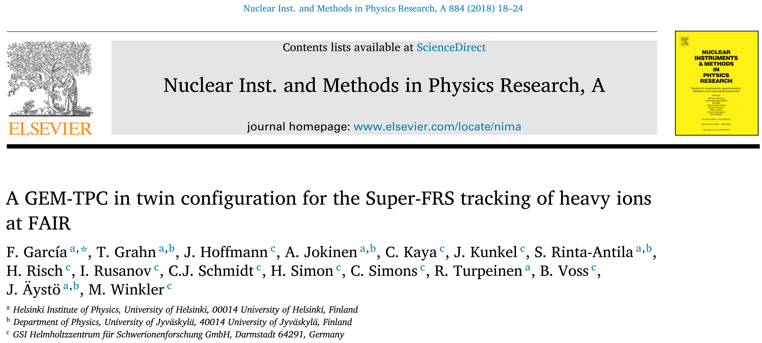
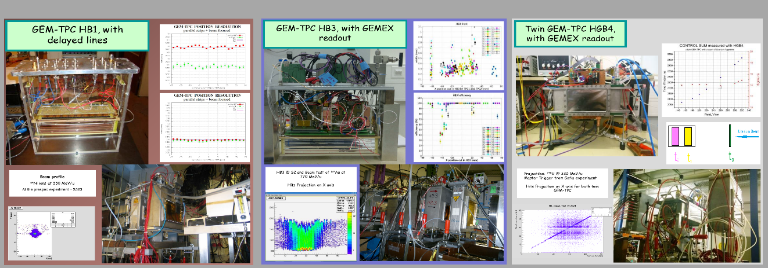
M. Luoma, F. Garcia et al., In-beam test results of the Super-FRS GEM-TPC detector prototype with relativistic uranium ion beam. NIMA, 1052 (2023) 168262.
7

Slide 8
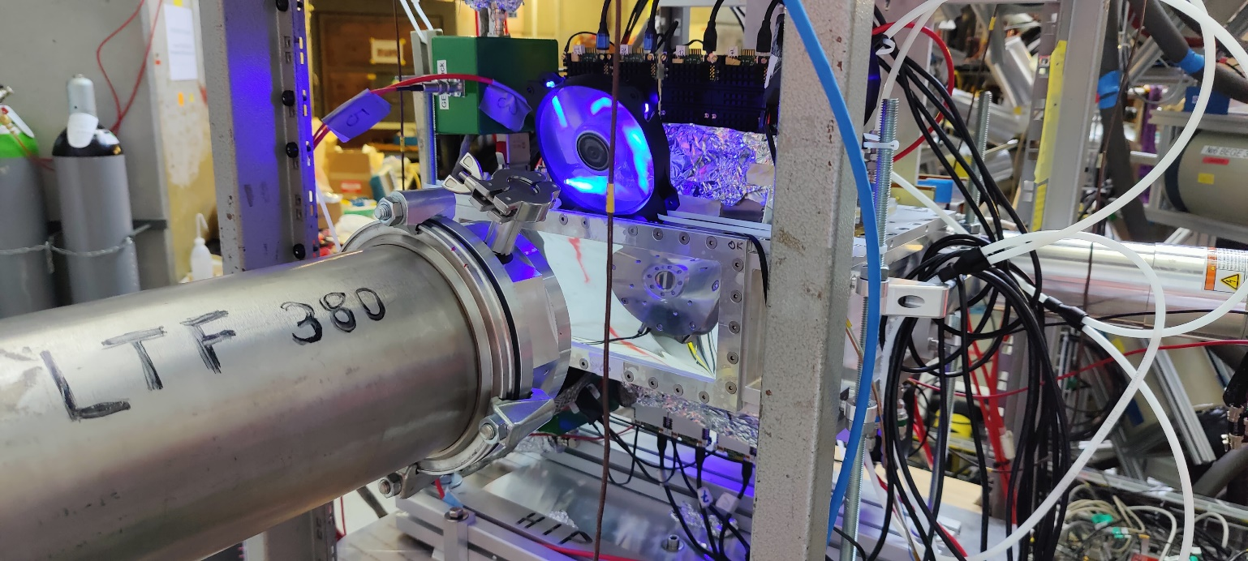
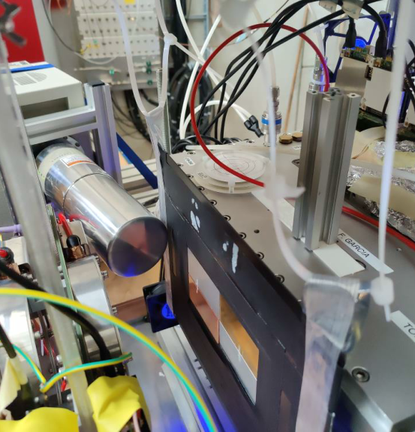
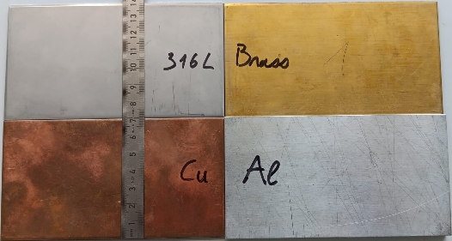
TRACKING at DIFFERENT FACILITIES
Projectile: μ
Momenta up to 60 MeV/c
Intensity up to 10⁵ μ /sec
First campaign at the SμS/πE1 - PSI
HGB4-2 at the SμS/πE1 beamline – beampipe side
HGB4-2 at the SμS/πE1 beamline – Target side
Target with different materials
Successful Operation in:
In the first campaign in ArCO₂ (75/25)
In second campaign in HeCO₂ (90/10)
The Plans are:
Test the GEM-TPC with pixel readout.
Single GEM-TPC configuration.
Design a new miniaturized GEM-TPC for MIXE.
Combined Spatial Resolution:
For ArCO₂ (75/25) @ 40 MeV/c:
  X → 1.083 ± 0.113 mm
  Y → 1.357 ± 0.172 mm
For HeCO₂ (90/10): Analysis ongoing
Talk by: Xiao Zhao, A novel technology for element-sensitive 3D tomography
8

Slide 9
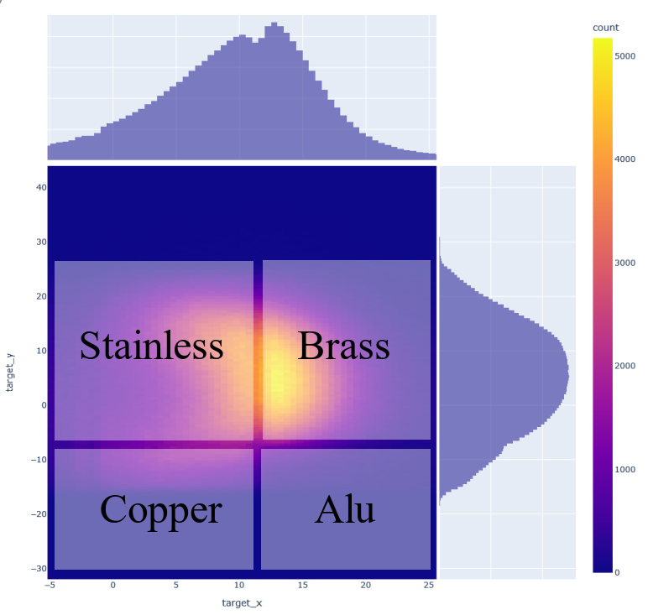
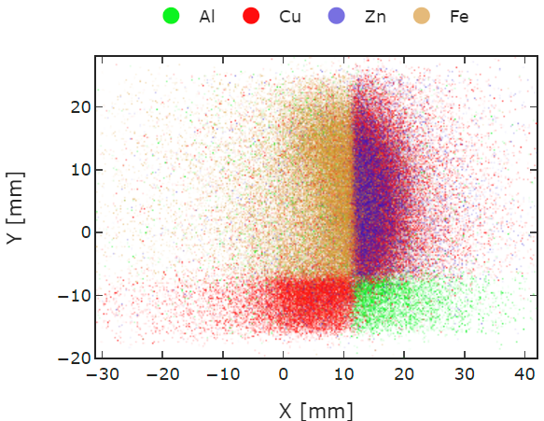
The first campaign for GEM-TPC – HGB4 at the S SμS/πE1 - PSI
First campaign target Configuration:
Stainless: Fe (66%), Cr (18%), Ni (12%)
Brass: Cu (63%), Zn (37%)
Copper (ETP): Cu (100%)
Anticorodal: Al (97%)
Talk by: Xiao Zhao, A novel technology for element-sensitive 3D tomography
9

Slide 10
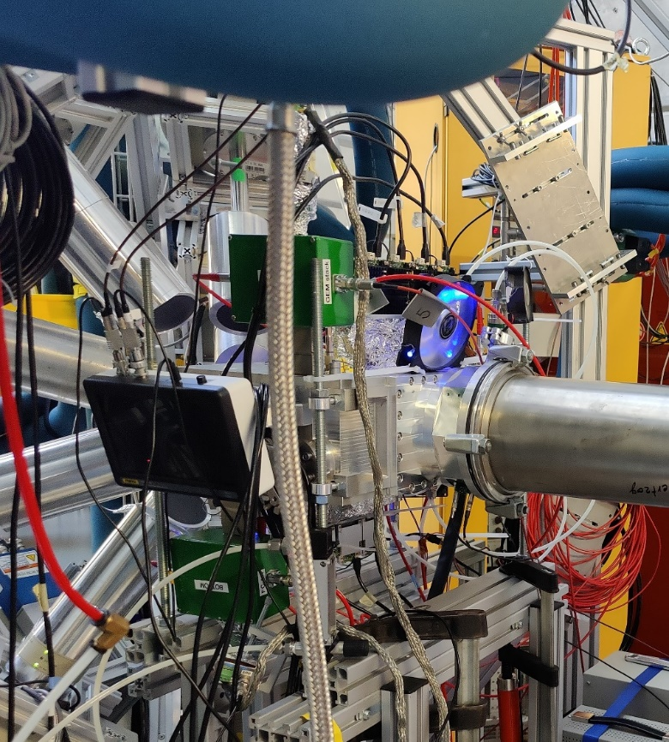
The second campaign for GEM-TPC – HGB4 at SμS/πE1 - PSI
The gas was changed by HeC0₂ (90/10).
The GEM-TPC in twin configuration (HGB4-2) was flagged to the beam pipe.
The target was refurbished.
Ten (10) high purity Germanium detectors were added to the setup.
10

Slide 11
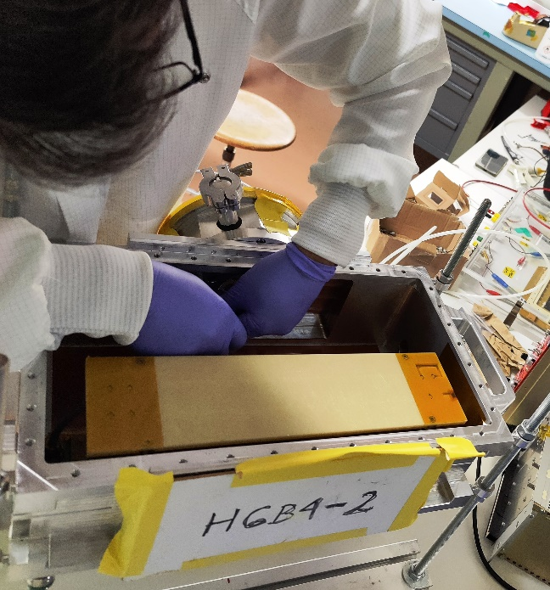
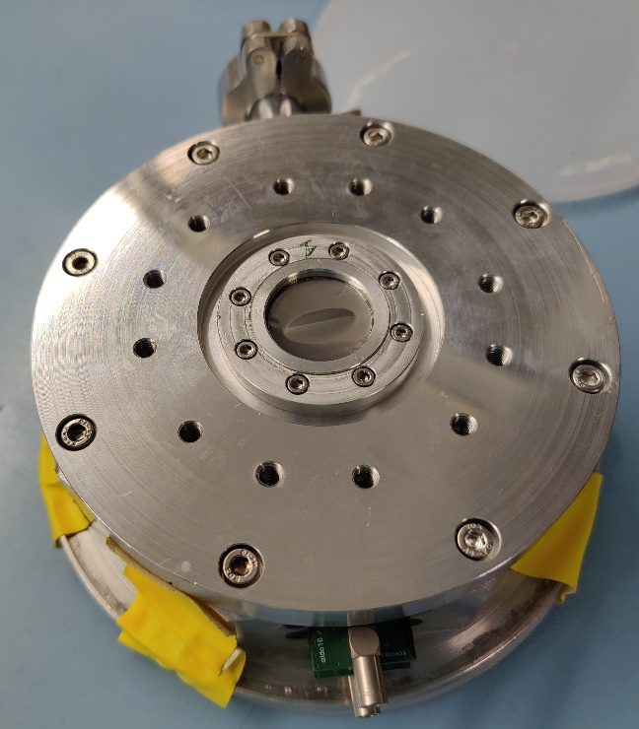
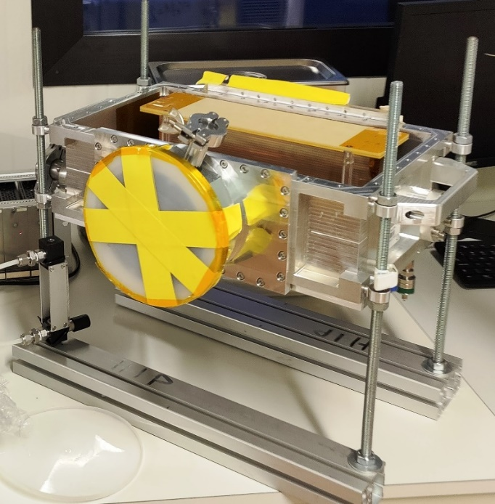
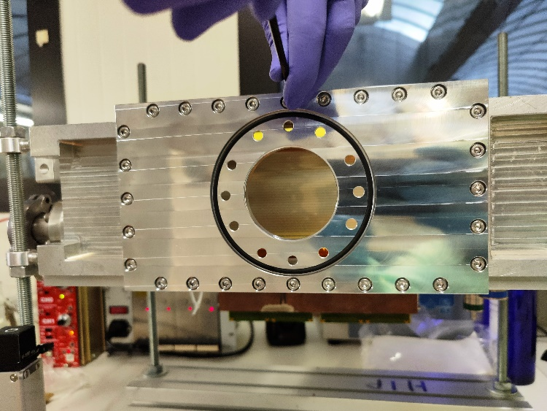
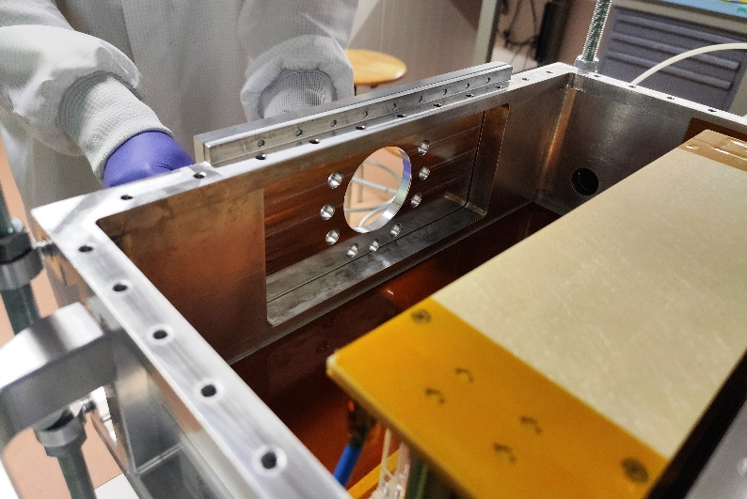
The second campaign for GEM-TPC – HGB4 at SμS/πE1 - PSI
Procedure to flange the GEM-TPC in twin configuration (HGB4-2) to the beam pipe at SμS/πE1 - PSI .
11

Slide 12
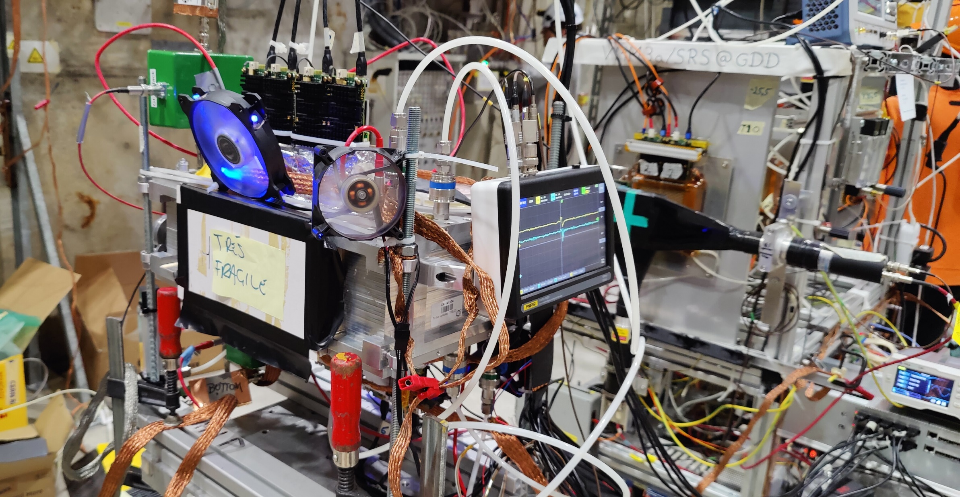
TEST BEAM at the SPS – H4 Beamline
Particles: μ and π at 180 GeV/c
Beam spot: for μ 10cm in X and Y
for π 6 mm in X and Y
Intensity: for μ → 80k/spill
for π → 80k – 10M/spill
Working gas:
ArCO₂ (70/30)
HeCO₂ (90/10)
HeCO₂ (70/30)
Readout Electronics:
VMM3a/SRS
2024
HGB4-2 at the SPS H4 beamline
12

Slide 13
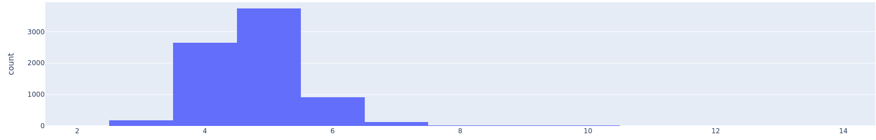
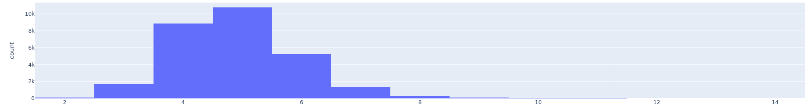
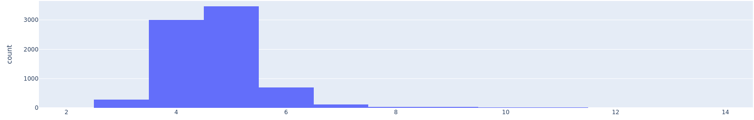
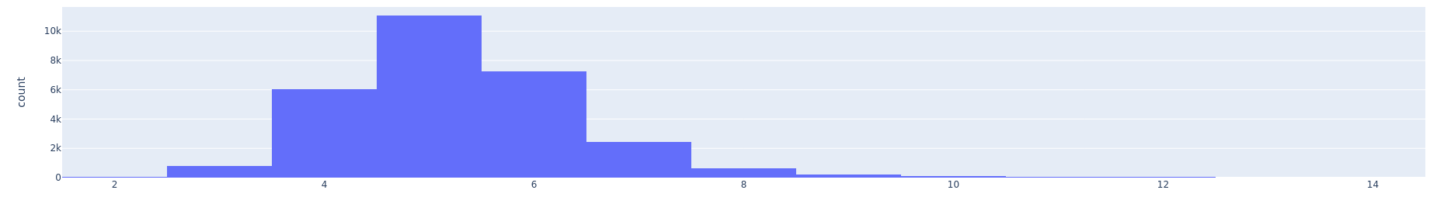
TEST BEAM at the SPS – H4 Beamline
Cluster Strip multiplicity on ArCO₂ (70/30)
Cluster Strip multiplicity on HeCO₂ (90/10)
For Muons
For Muons
GEM-TPC, Top
strips
GEM-TPC, Top
strips
GEM-TPC, Bottom
strips
GEM-TPC, Bottom
strips
Cluster strip multiplicity is the quantity of strips fired in one reconstructed cluster
GEM-TPC Top:
Voltage at the Cathode: 6780 V
Voltage at the GEM Stack: 3200 V
Field in the Field Cage: 358 V/cm
GEM-TPC Bottom:
Voltage at the Cathode: 6680 V
Voltage at the GEM Stack: 3100 V
Field in the Field Cage: 358 V/cm
GEM-TPC Top:
Voltage at the Cathode: 5550 V
Voltage at the GEM Stack: 2150 V
Field in the Field Cage: 340 V/cm
GEM-TPC Bottom:
Voltage at the Cathode: 5560 V
Voltage at the GEM Stack: 2160 V
Field in the Field Cage: 340 V/cm
13

Slide 14
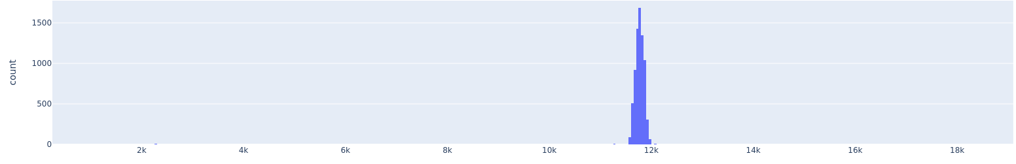
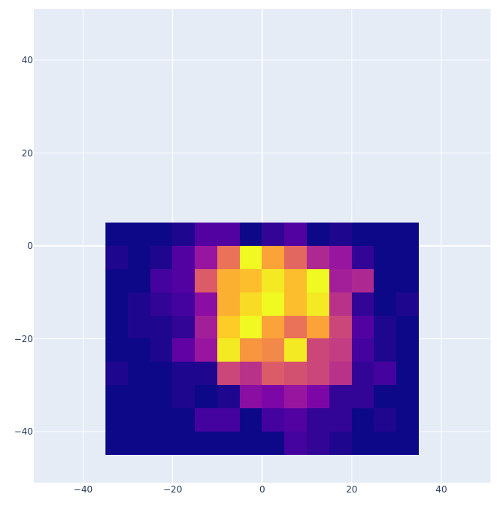
TEST BEAM at the SPS – H4 Beamline
Cluster multiplicity
Total Drift Time – Control Sum
The cluster Multiplicity is the quantity of cluster within a full drift time
ns
GEM-TPC, Top
GEM-TPC, Bottom
Beam Track Map
Multiplicity | Amount
0 1 2 3 4 5 | 0.345 0.407 0.157 0.045 0.018 0.029
Multiplicity | Amount
0 1 2 3 4 5 | 0.351 0.406 0.153 0.043 0.016 0.031
GEM-TPC Y axis, mm
GEM-TPC X axis, mm
14

Slide 15
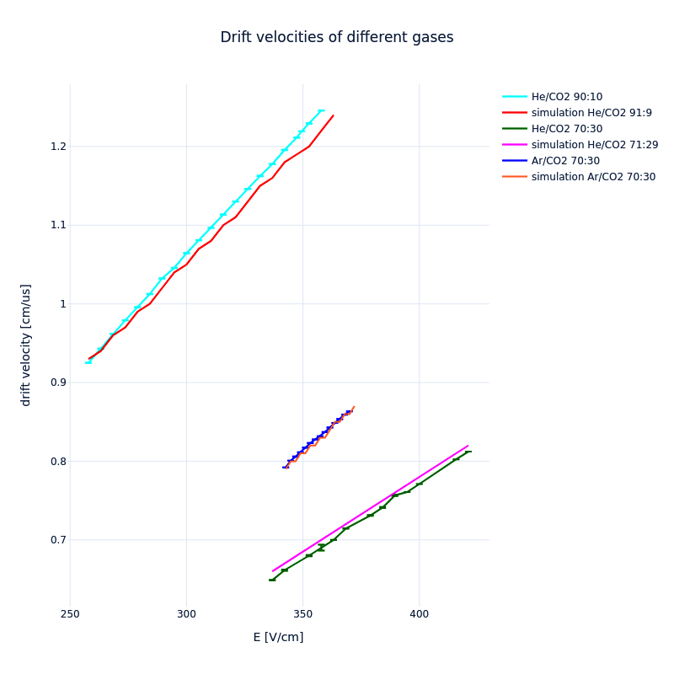
TEST BEAM at the SPS – H4 Beamline
Drift Velocity Calibration
GEM-TPC Drift Velocities
By the use of scintillation grid detector:
By the correlation of the hits from the tracker:
  Prealigment.
  Selection straight tracks (small χ²).
  Fine alignment.
  Correlation of the GEM-TPC clusters to the first reference tracker plane in X and Y.
Field cage, V/cm
15

Slide 16
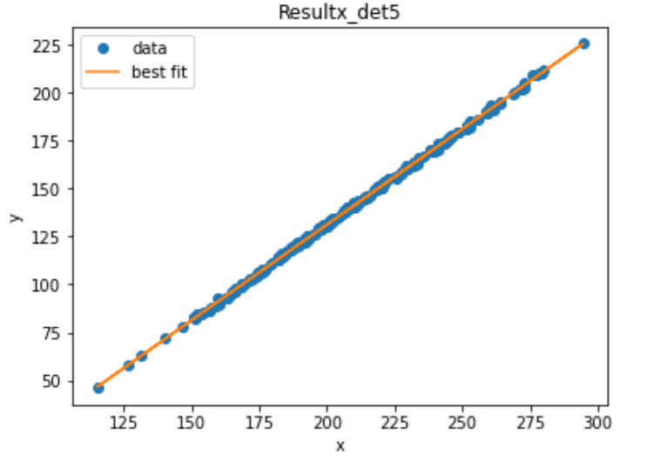
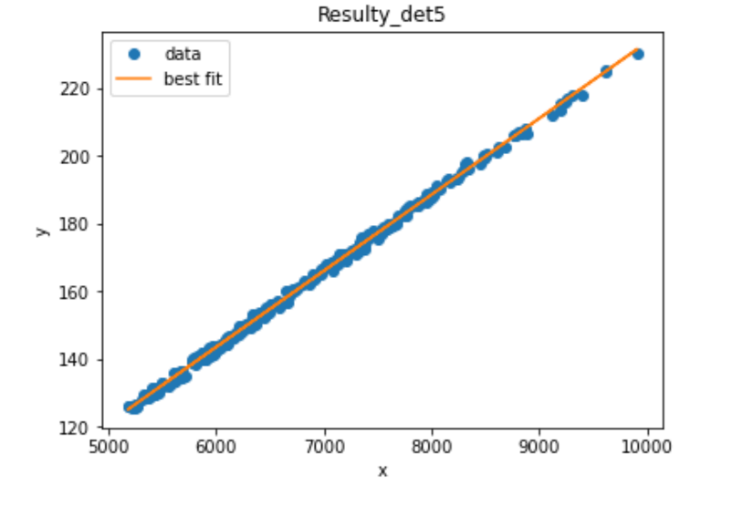
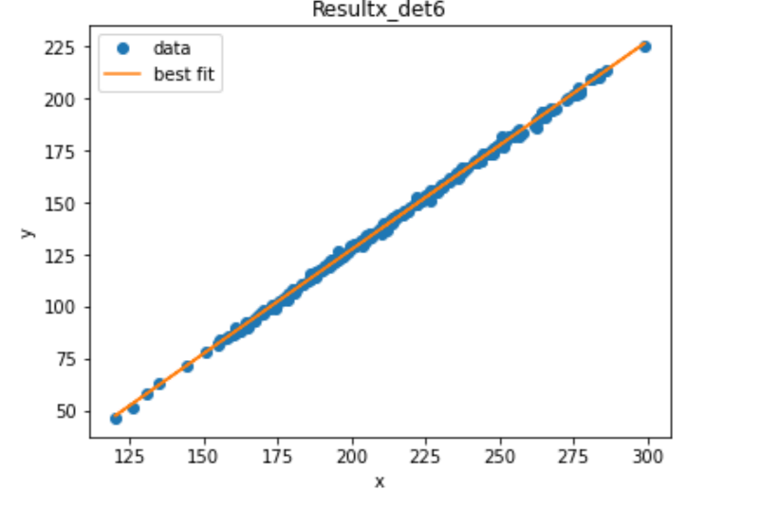
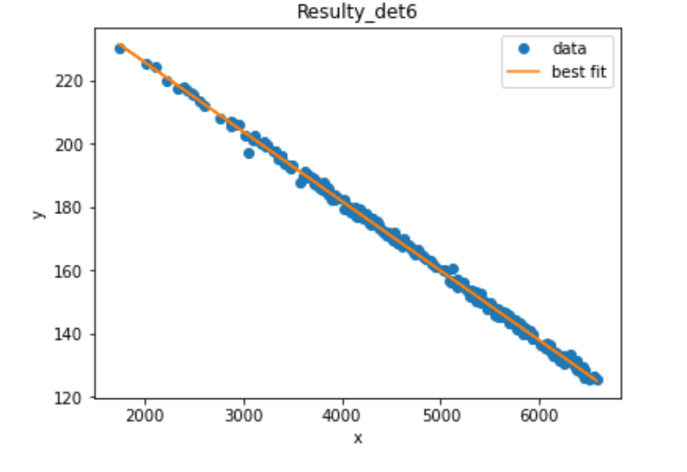
TEST BEAM at the SPS – H4 Beamline
Correlation plot of the GEM-TPC Top vs Tracker:
GEM-TPC Top Correlation
GEM-TPC Top Correlation
Tracker X axis, strips
Tracker Y axis, strips
y = a + b*x
Intercept: -67.86463 ± 1.3239
Slope: 0.99865 ± 0.00644
y = a + b*x
Intercept: 8.04337 ± 0.64695
Slope: 0.02262 ± 8.66882E-5
GEM-TPC X axis, strips
GEM-TPC Y axis, strips
Correlation plot of the GEM-TPC Bottom vs Tracker:
GEM-TPC Bottom Correlation
GEM-TPC Bottom Correlation
y = a + b*x
Intercept: 269.07909 ± 0.78277
Slope: -0.0219 ± 1.77989E-4
Tracker X axis, strips
y = a + b*x
Intercept: -73.53846 ± 0.73487
Slope: 1.00722 ± 0.00366
Tracker X axis, strips
GEM-TPC X axis, strips
GEM-TPC Y axis, strips
16

Slide 17
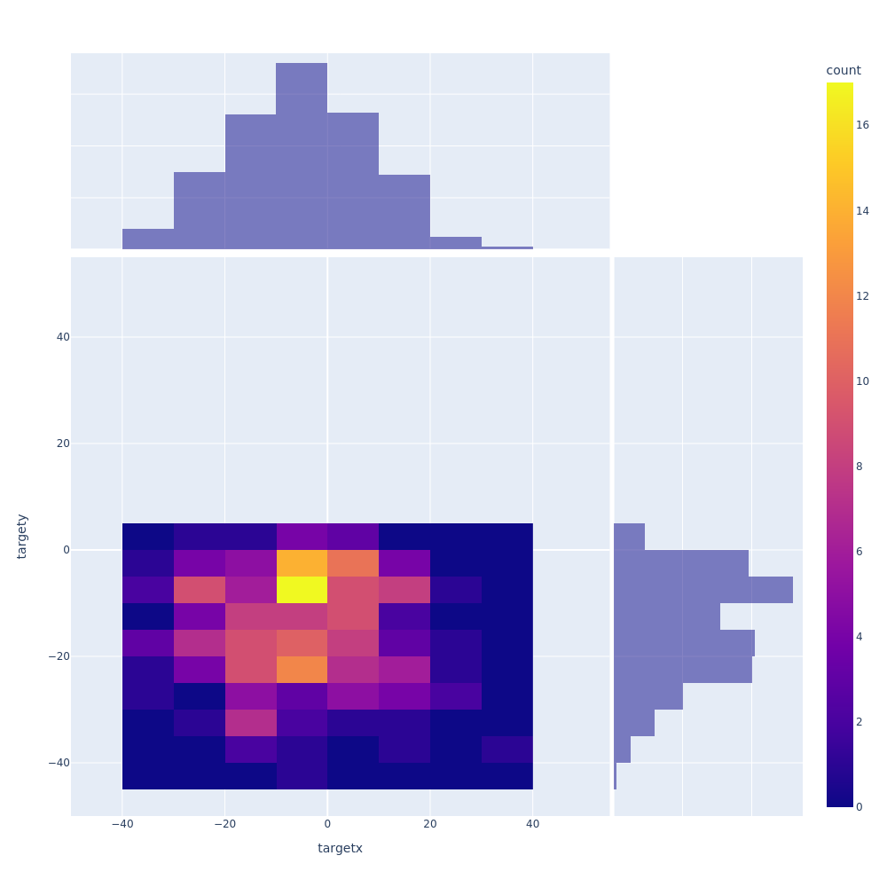
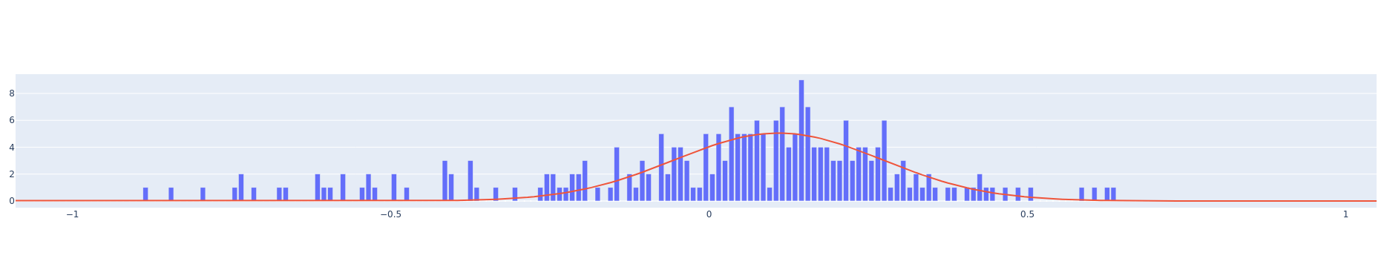
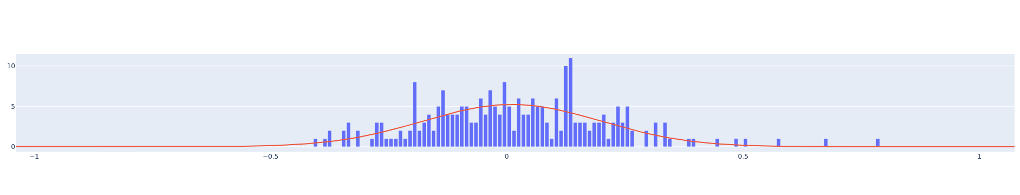
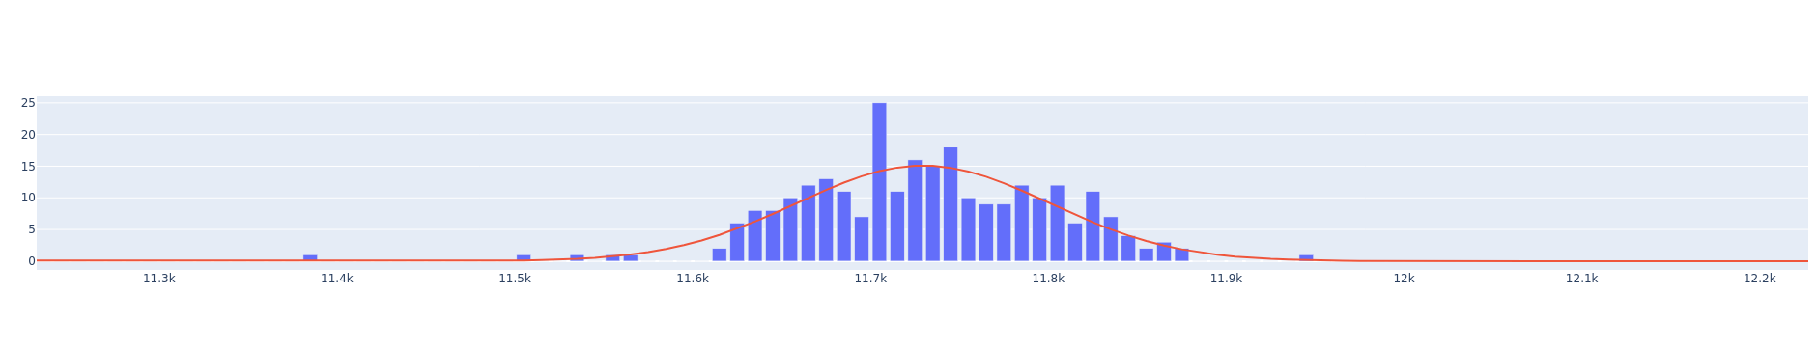
TEST BEAM at the SPS – H4 Beamline
The hit map, residuals and the Control Sum for muons.
Projection of hits in X
σ=0.188 mm ± 0.007
Projection of hits in Y
mm
mm
Residual Distribution X axis
GEM-TPC Y axis, mm
σ=0.163 mm ± 0.006
mm
mm
Residual Distribution Y axis
GEM-TPC X axis, mm
σ=71.15 ns ± 1.96
Counts
Drift time, ns
17

Slide 18
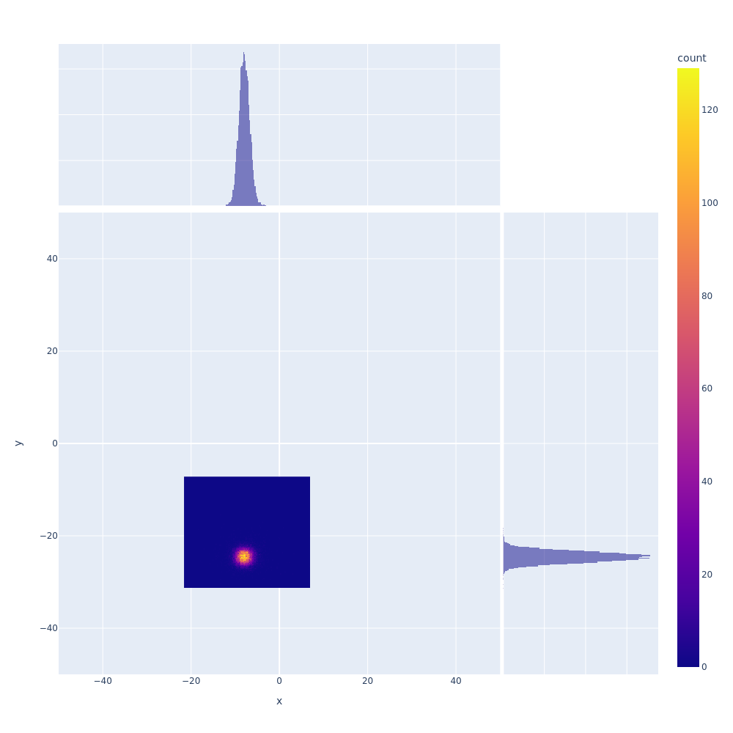
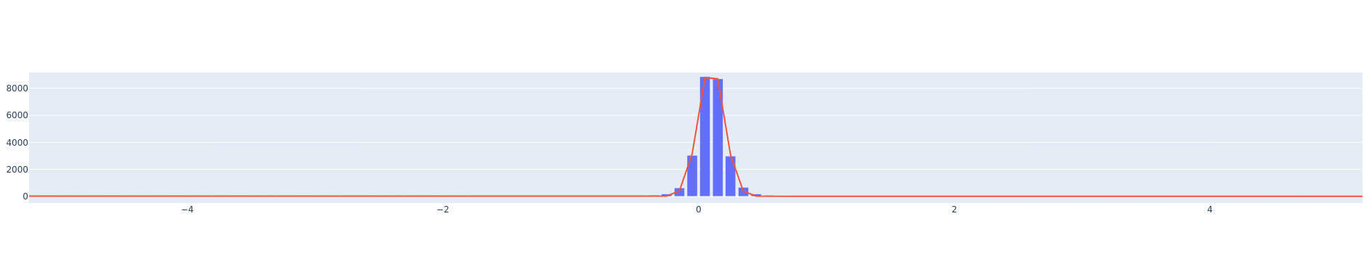
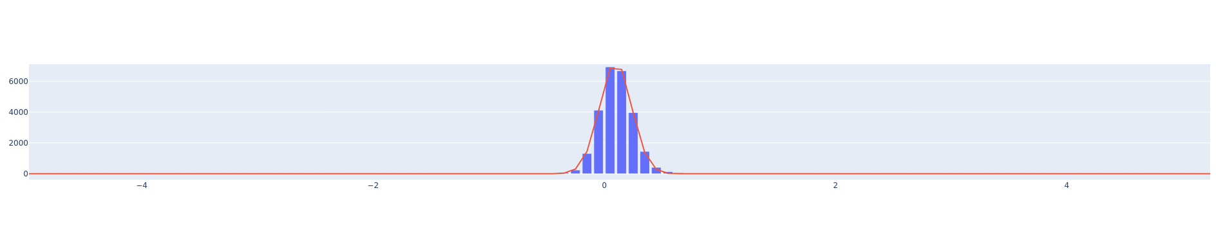
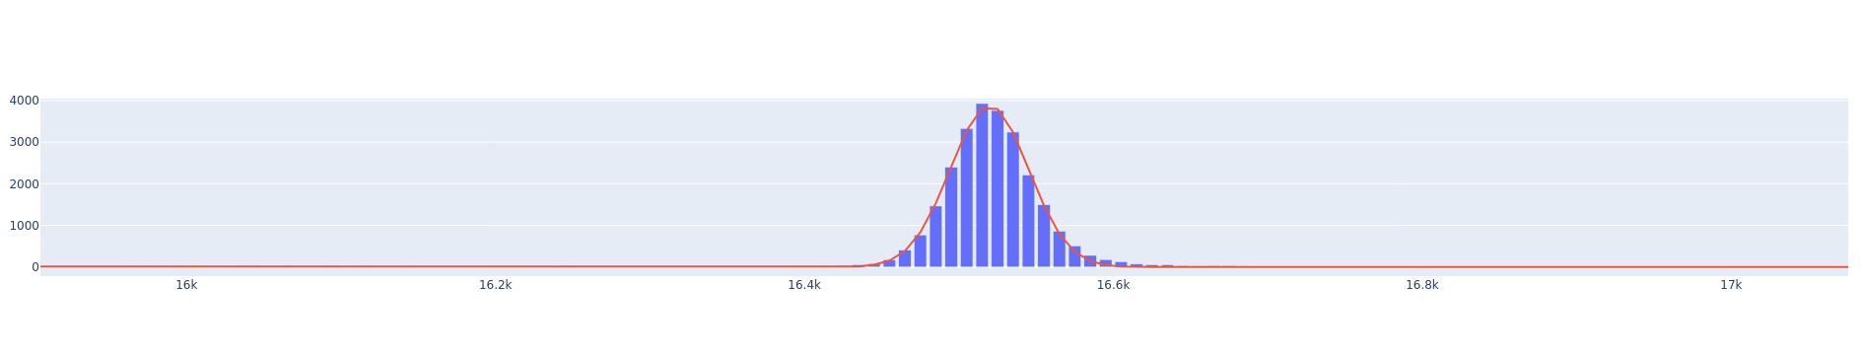
TEST BEAM at the SPS – H4 Beamline
The hit map, residuals and the control sum for pions .
Projection of hits in X
σ=0.098 mm ± 0.001
Projection of hits in Y
mm
mm
Residual Distribution X axis
GEM-TPC Y axis, mm
σ=0.138 mm ± 0.07e-03
mm
mm
Residual Distribution Y axis
GEM-TPC X axis, mm
σ=25.45 ns ± 0.04
Counts
Drift time, ns
18

Slide 19
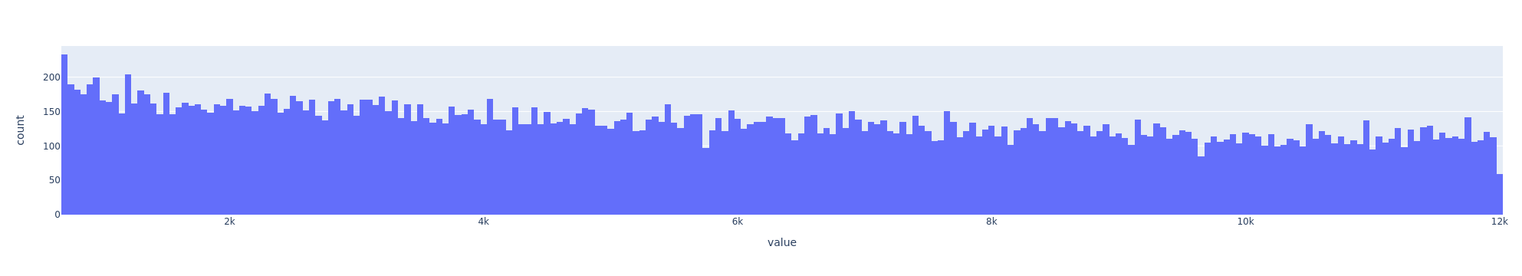
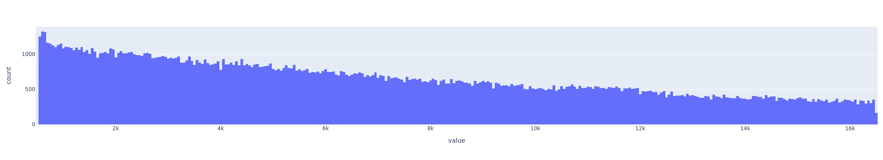
TEST BEAM at the SPS – H4 Beamline
Indications of rate capability by looking at the instantaneous peak rate on ArCO₂ (70/30)
At ~ 677.66 ns → 1.48 MHz, O(10%) of the tracks
ΔT₀, ns
Indications of rate capability by looking at the instantaneous peak rate on HeCO₂ (70/30)
At ~ 524.44 ns → 1.91 MHz, O(10%) of the tracks
ΔT₀, ns
19

Slide 20
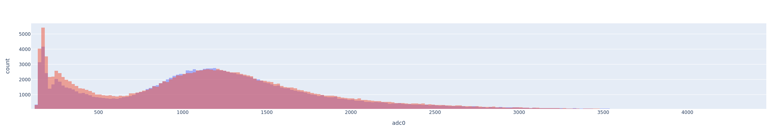
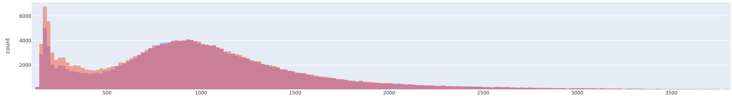
Cluster Charge Distribution
GEM-TPC, Muons
ArCO₂ (70/30)
ADC counts
GEM-TPC, Muons
HeCO₂ (90/10)
ADC counts
20

Slide 21
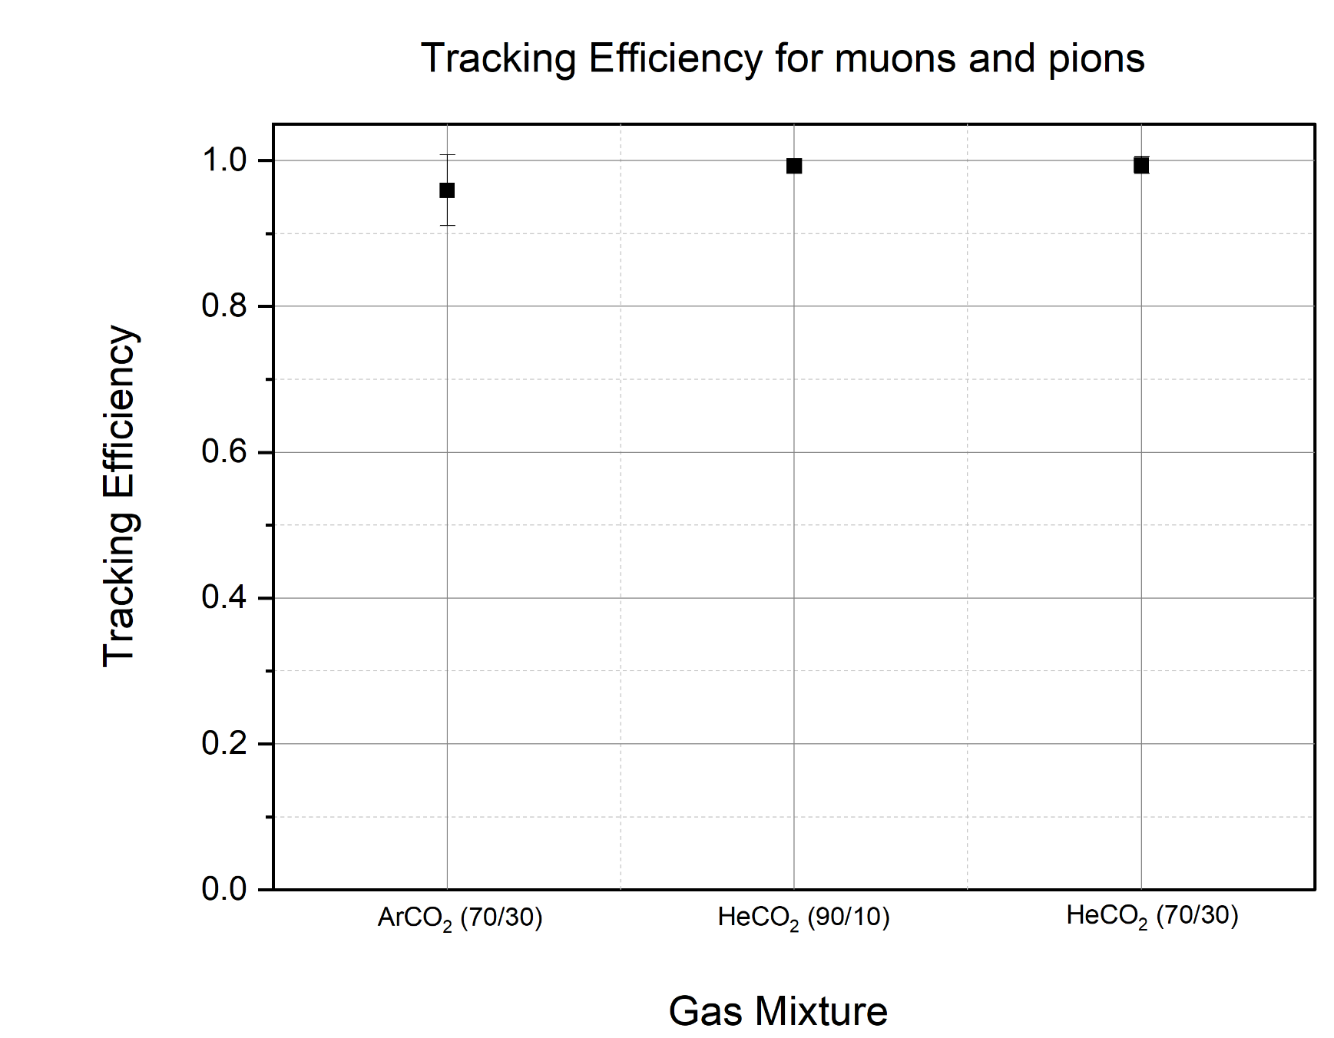

TEST BEAM at the SPS – H4 Beamline
Efficiency with fiducialization:
$ $_{HGB4-2} $=\frac{\# Tracks reco GEM−TPC}{\# Tracks reco Tracker}$
small χ² cut
Fine alignment.
Fiducialization:
2 cm in X
1 cm in Y
21

Slide 22
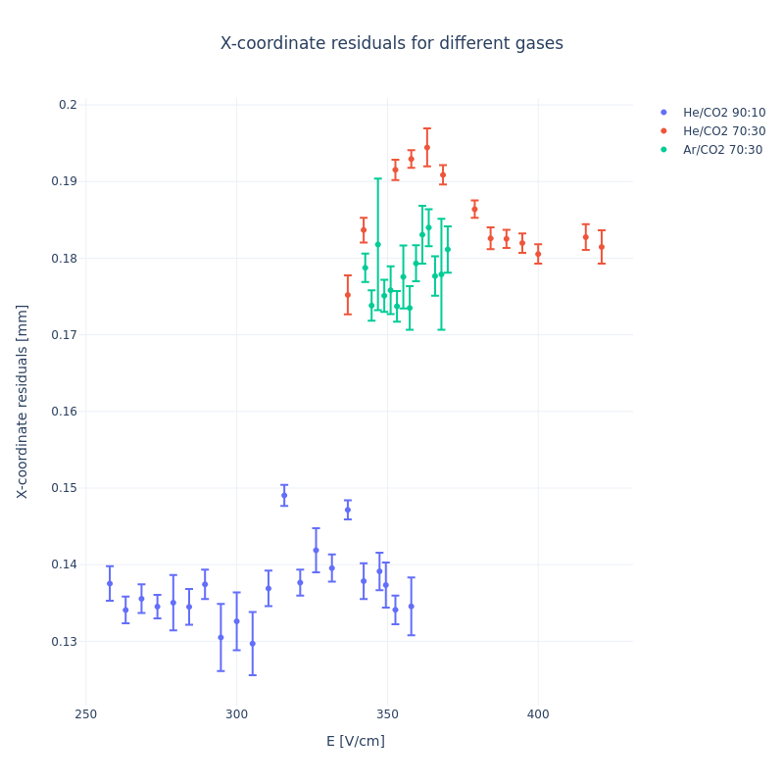
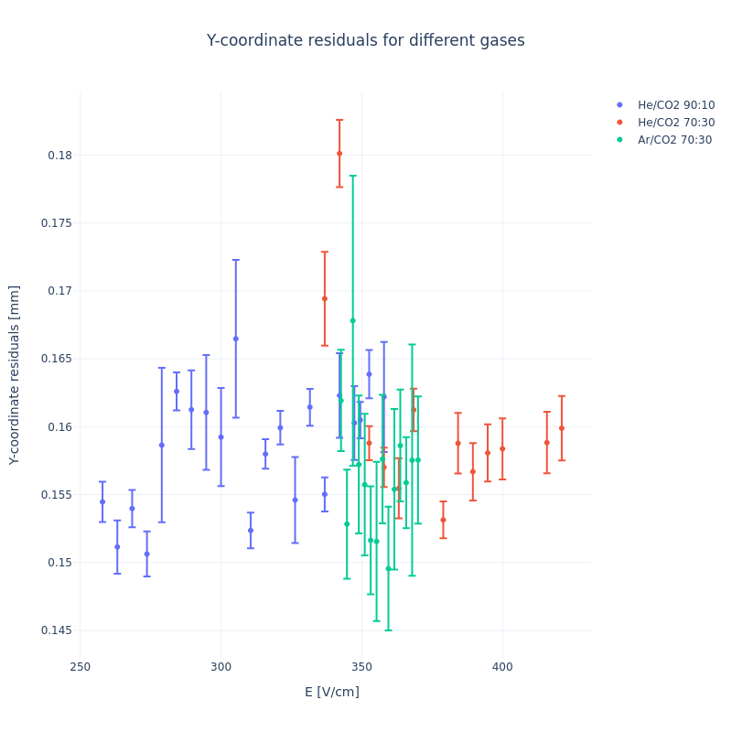
TEST BEAM at the SPS – H4 Beamline
Spatial resolution in X:
Spatial resolution in Y:
Residual Distribution for different gas mixtures
Residual Distribution for different gas mixtures
GEM-TPC σ_{x} , mm
GEM-TPC σ_{y} , mm
Field cage, V/cm
Field cage, V/cm
22

Slide 23
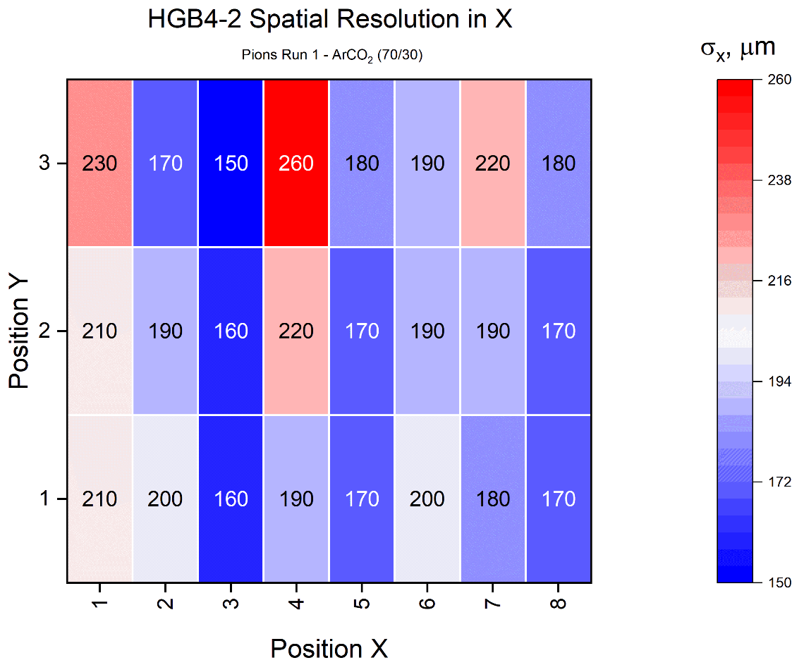
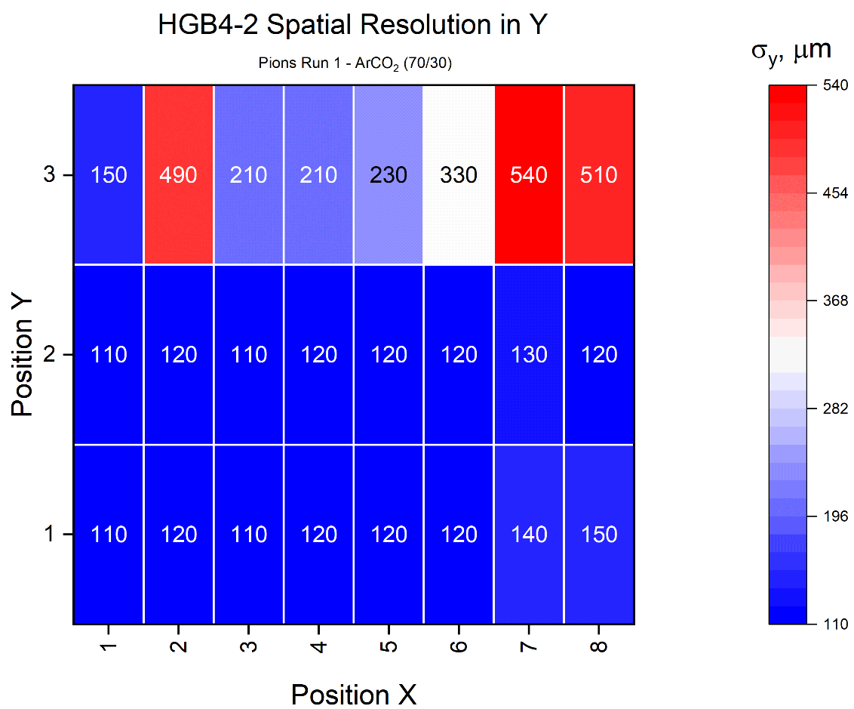

TEST BEAM at the SPS – H4 Beamline
Pions position scan for ArCO₂ (70/30) gas mixture
$ $_{HGB4-2} $=\sqrt{σ_{GEM−TPC}^{2}−σ_{Tracker}^{2}}$
Becasue of small χ² cut the $_{Tracker}^{2}$ ≅ 50 μm
23

Slide 24


TEST BEAM at the SPS – H4 Beamline
Pions position scan for HeCO₂ (90/10) gas mixture
24

Slide 25


TEST BEAM at the SPS – H4 Beamline
Pions position scan for HeCO₂ (70/30) gas mixture
25

Slide 26
SUMMARY
The synchronization of DAQs is very crucial and a paintful task, therefore work on a TLU-like unit for DRD1 is of utmost importance.
The work of the GEM-TPC (HGB4-2) with HeCO₂ (90/10) show good stability and high spatial resolution. This changing of the gas was proposed to improve the spatial resolution for MIXE experiment.
The use of Jupyter Notebooks provides a good platform for students to make important contributions to the analysis.
The support given by the GDD lab during the integration of the VMM3a/SRS DAQ and the commission was indispensable for the success on these measurements.
The RD51/DRD1 reference tracker has good operation stability and reliability, which was shown throughout the whole campaign.
26

Slide 27

Collaborators
Akcknowledgements to all the collaborators in the GDD lab and RD51 test beam coordination especially to: Eraldo, Max, Lucian, Dorothea, Hans, Yorgos, Alex, Benjamin and Miranda.
To Collaborators at the Micro Pattern Technology Workshop: Rui, Alexandra, Bertrand, Alexis, Antonio and Benilde.
To collaborators at the Detector Laboratory at GSI: Christian, Bernd, Holger, Jochen, Chan, Andrei, Christoph, Hennings, Jan and Nik.
To collaborators at HIP: Raimo, Jouni and Minna.
Francisco, Bernhard, Xiao, Michael and Karl (left to right)
27

Slide 28



Slide 29
BACKUP SLIDES
29

Slide 30

30

Slide 31

TEST BEAM LAYOUT:
TWIN GEM-TPC
TWIN GEM-TPC
31

Slide 32

Reconstruction of the scintillation grid by the GEM-TPC
PreAmp 1
PreAmp 2
THE GRID IS RECONSTRUCTED AS IN THE REFERENCE ONE
GEMEX 1
GEMEX 2
NOTE:
One of GEM-TPC grid has been rotated 180°
32

Slide 33

Drift Velocity Simulations:
ArCO₂ (70/30)
HeCO₂ (70/30)
HeCO₂ (90/10)
33

Slide 34

34

Slide 35

TEST BEAM at the SPS – H4 Beamline
The second campaign for GEM-TPC – HGB4 at SμS/πE1 - PSI
35

Slide 36

The second campaign for GEM-TPC – HGB4 at the S SμS/πE1 - PSI
Target Configuration:
Molybdenum
Tantalium and Copper
Tungten and Iron
Brass: Cu (63%), Zn (37%)
36

Slide 37
Is the P10 GAS MIXTURE a SOLUTION for the SUPER-FRS?
Until now the gas mixture used has been P10 - ArCH₄ (90/10%) → Which has a severe aging problems at high rate
Next gas mixture will be: ArCO₂ 70/30% → for Testing whole system and Characterization
Possible choice can be: ArCO₂CF₄ (45/15/40%)
Gas mixture | Drift Field, V/cm | Drift Velocity, cm/µs | D_{L}, µm/ √D(cm) | D_{T}, µm/ √D(cm) | Drift Time, µs
P10 | 320 | 4.2 | 257.2 | 603.8 | 2
ArCO₂ (70/30) | 600 | 1.5 | 150.1 | 134.0 | 6.6
ArCO₂CF₄ (45/15/40) | 600 | 2.5 | 117.3 | 118.9 | 4
12

Slide 38

Most Relevant Results at GSI
Projectiles: ¹²⁴ Xe (primary/fragments) and ¹²C
Intensity: 1 kHz/spill – 1 MHz/spill
Duration: >> 15 days
21

Slide 39

Most Relevant Results at GSI
Projectiles: ²³⁸ U ⁹²⁺
Intensity: 100 Hz/spill – 1 kHz/spill
Duration: >> 5 days
TPC41
TPC42
GEM-TPC
(HGB4-half)
22

Slide 40


ArCO₂

Slide 41


HeCO₂

Slide 42


ArCH₄

Slide 43

David Cussans, https://indico.cern.ch/event/1323113/contributions/5823585/attachments/2836907/4959134/cussans_aida_tlu_bttb12_april2024.pdf

