Slide 1



Technical challenges for the new T2K High Angle TPCs
17 October 2024
Stefano Levorato on behalf of the T2K ND280 upgrade group
The 8th International Conference on Micro-Pattern Gaseous Detectors | Oct.14th - Oct.18th 2024 USTC·Hefei, China | S. Levorato

Slide 2
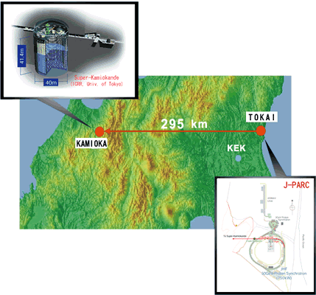
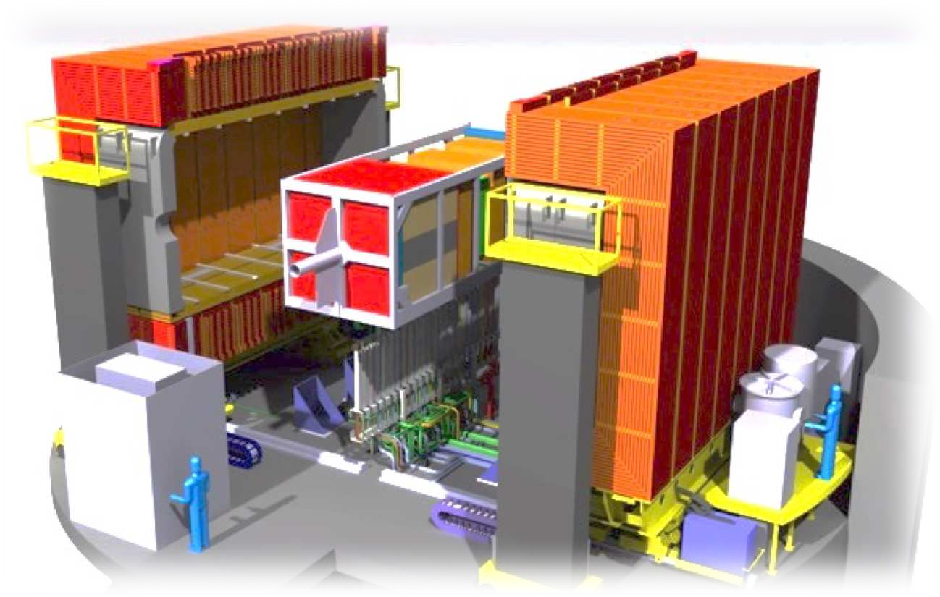
Outlook
The T2K ND280 experiment
The ND280 upgrade project
  The motivations
  The upgrade
The High Angle Time Projection Chambers (HATPC)
  A short detector description
The Encapsulated Resistive Anode Micromegas (ERAM)
  Construction
  Quality assessment
  Performance
Conclusions

Slide 3
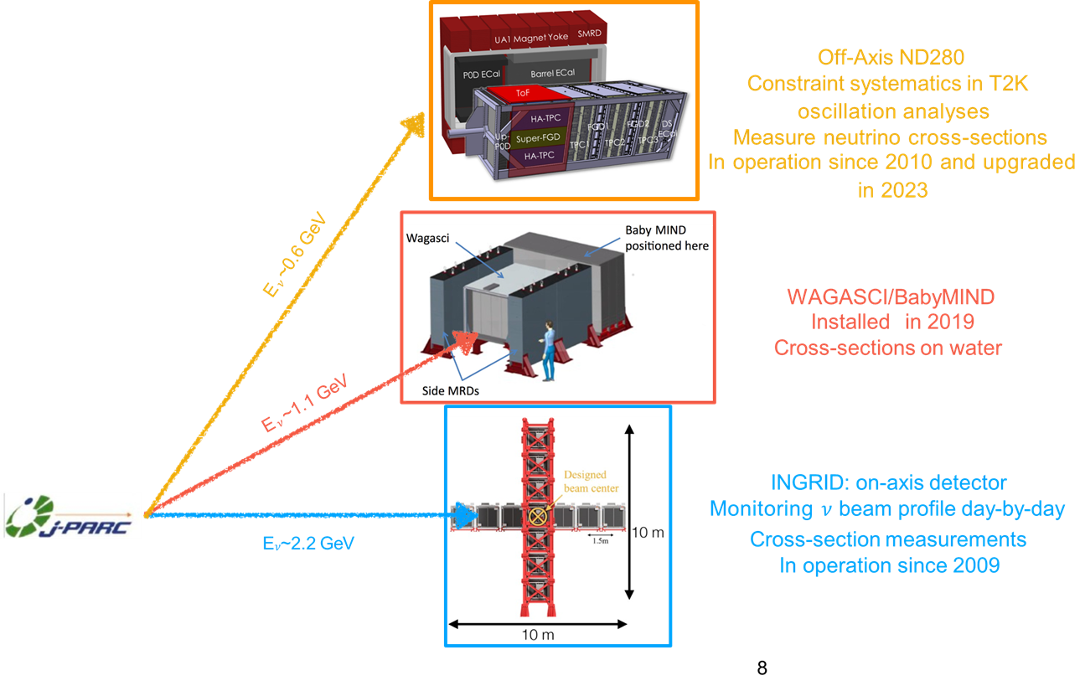
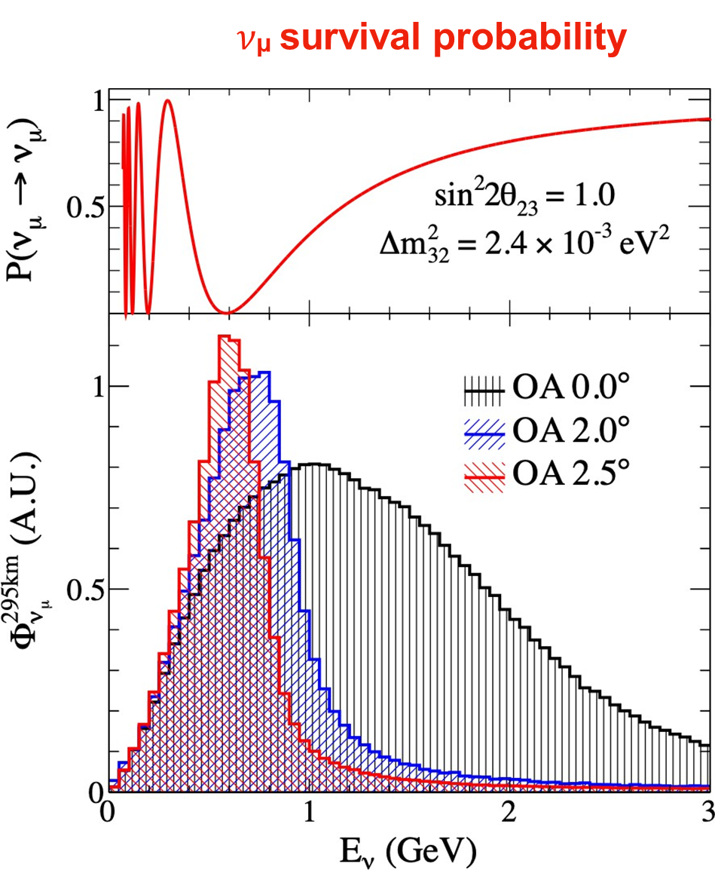
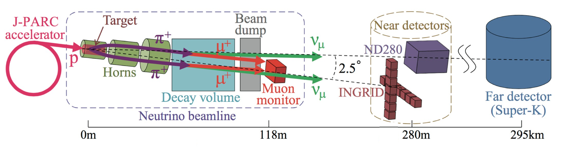
The T2K experiment and the role of ND280
High intensity, 0.6 – 2.2 GeV 𝜈μ beam produced at J-PARC (Tokai) → 𝜈 or 𝜈̅ mode by changing the horn polarity
Neutrinos detected at the Near Detector (ND280) and at the Far Detector (Super-Kamiokande)
  𝜈e and 𝜈̅e appearance → determine θ13 and δCP
  Precise measurement of 𝜈μ disappearance → θ23 and |Δm²32|
Near Detector complex at
280 meters from the target
Several detectors installed to monitor the beam reduce systematic uncertainties in oscillation analyses, and measure 𝜈 and 𝜈̅ cross-sections
ND to measure un-oscillated beam flux and ν cross sections

Slide 4
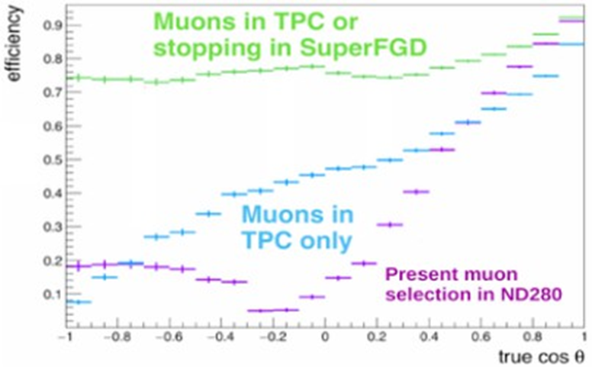
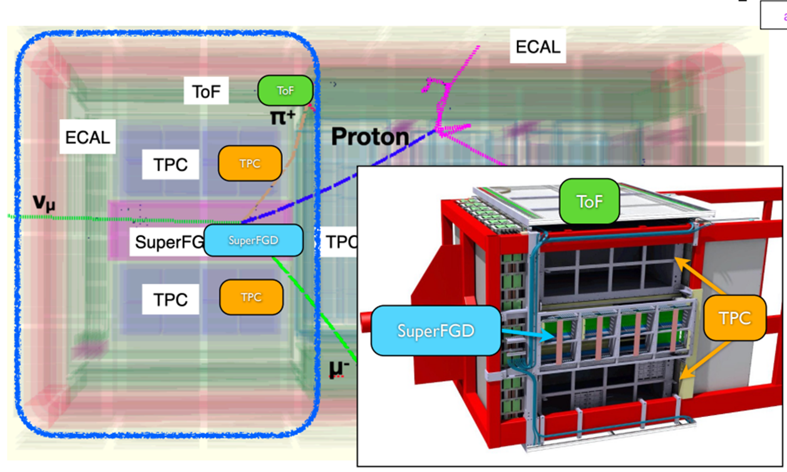
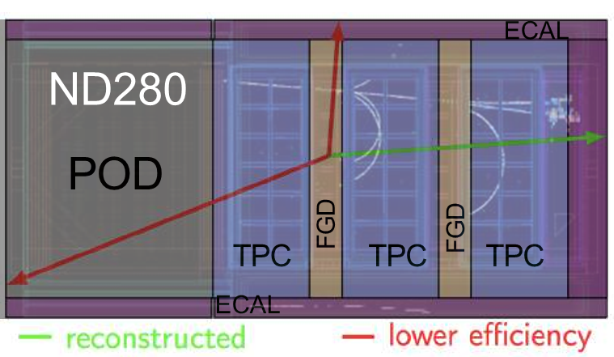
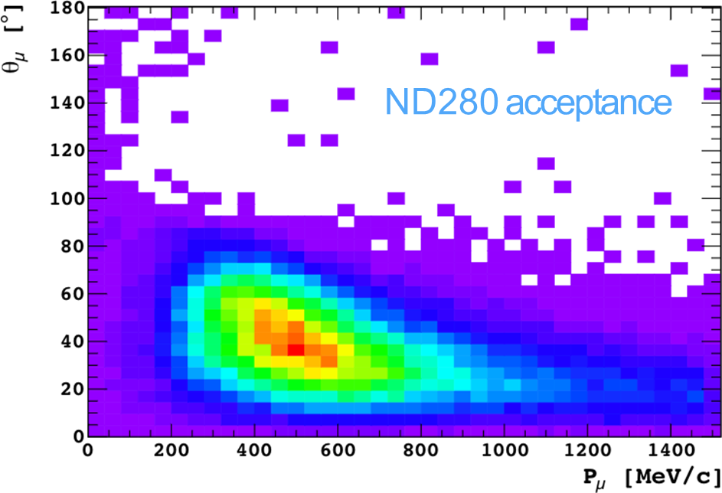
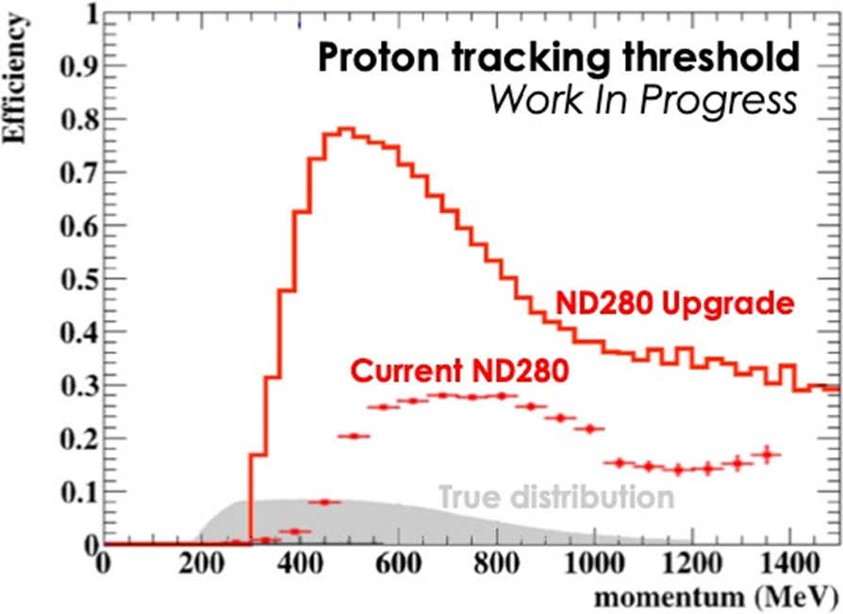
The ND280 experiment: the upgrade
Reduced angular acceptance 𝜈 events, mostly reconstruct forward going tracks entering the TPCs
Low eﬃciency to reconstruct low momenta protons
Detector installed inside
UA1/NOMAD magnet (0.2 T)
New detectors to extend acceptance for tracks at high angles

Slide 5
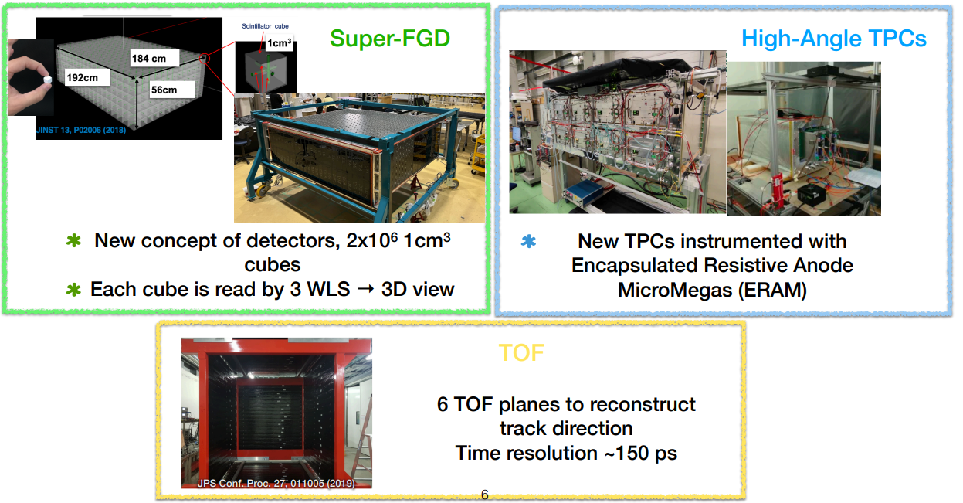
ND280: the upgrade detectors

Slide 6
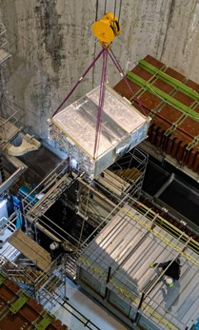
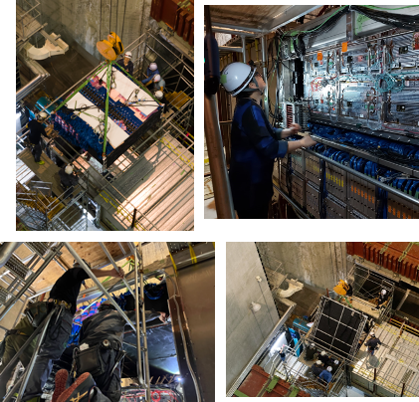
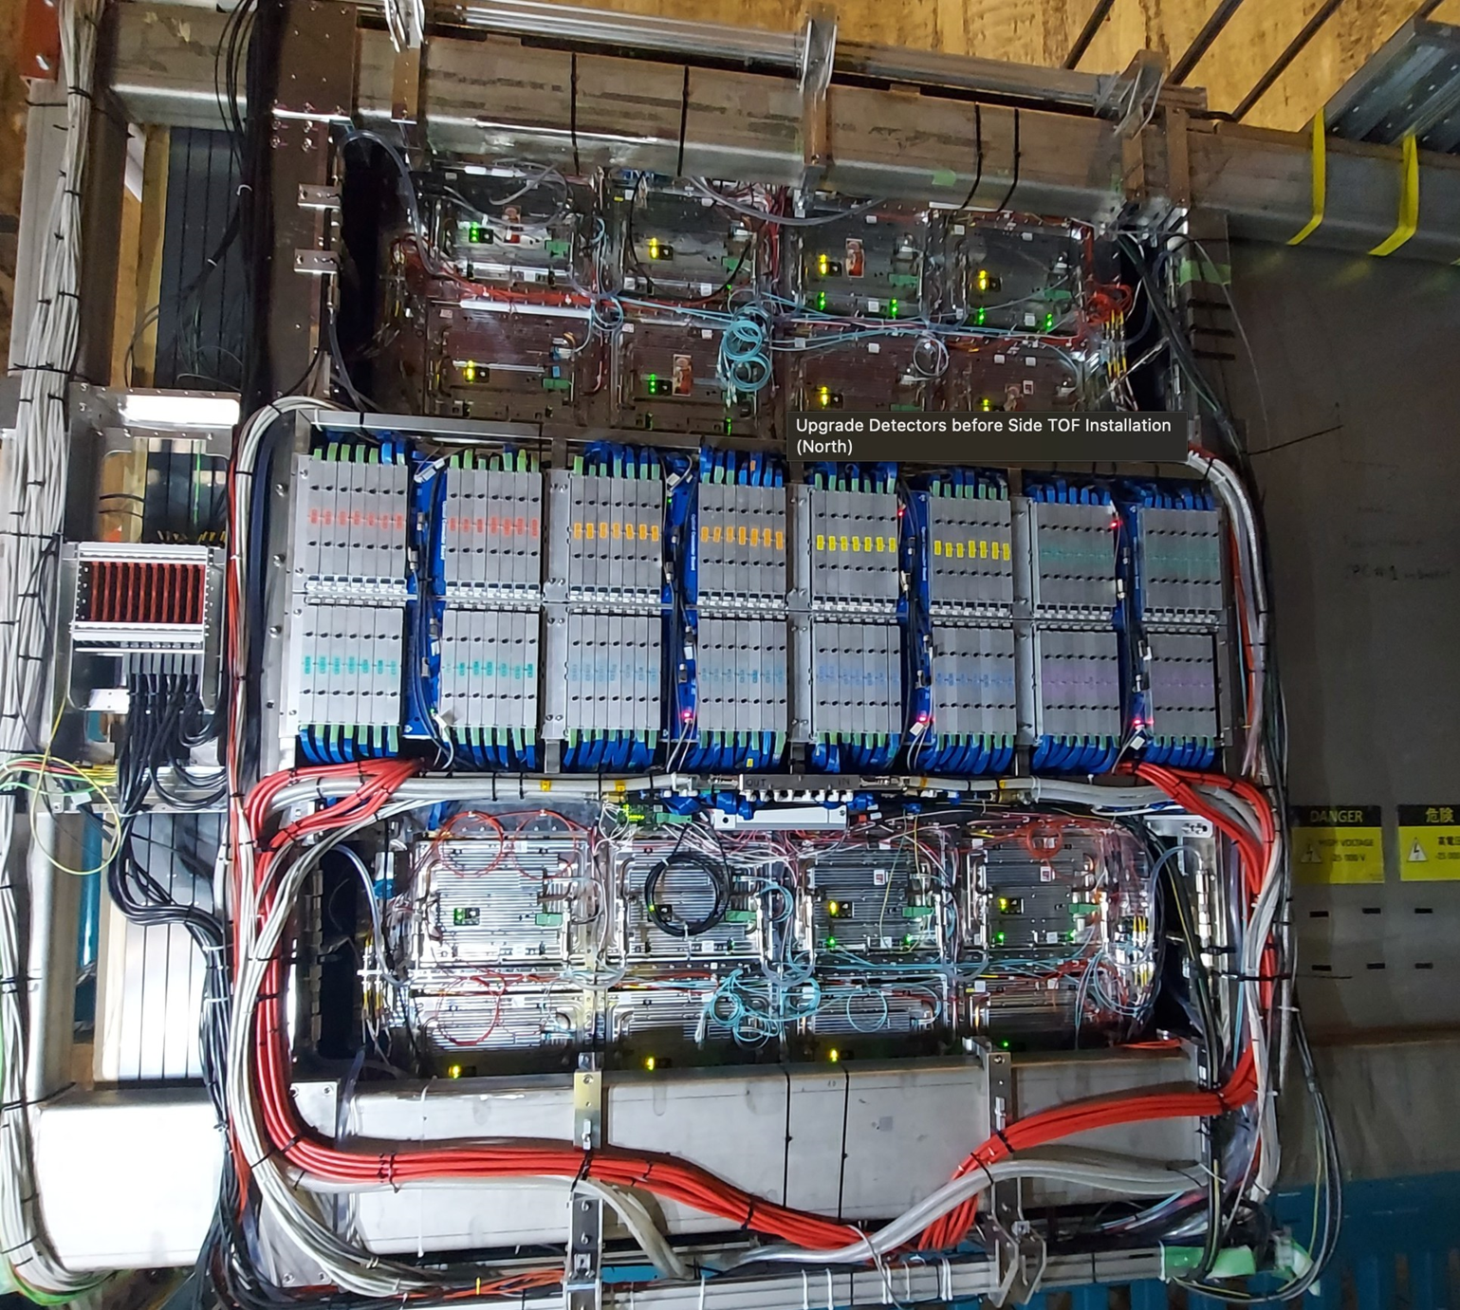
ND280: upgrade completed! Top-HATPC installed in the end of April 2024
TOF
Top HATPC
SFGD
Bottom HATPC
TOF

Slide 7
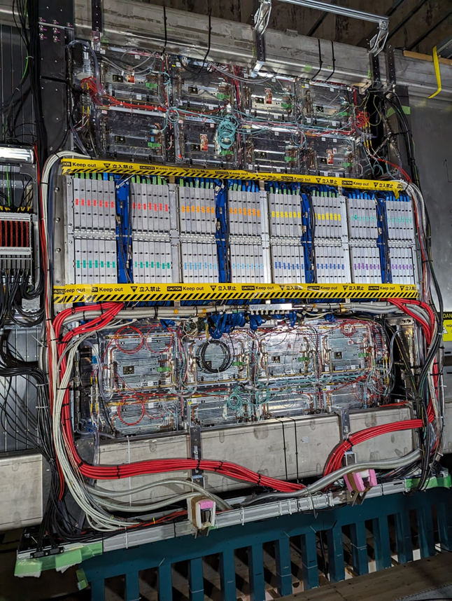
ND280: upgrade completed! Top-HATPC installed in the end of April 2024
TOF
Top HATPC
Installation of the Detectors of the ND280 upgrade
successfully completed in May 2024!
SFGD
Bottom HATPC
TOF

Slide 8
The ND280 experiment: High Angle TPC highlights
The HATPC detector
  A short introduction
Encapsulated Resistive Anode Micromegas (ERAMs)
    The realization of the 50 ERAM sensors
    The ERAM characterization
  Detector response, signal
HATPC performance

Slide 9
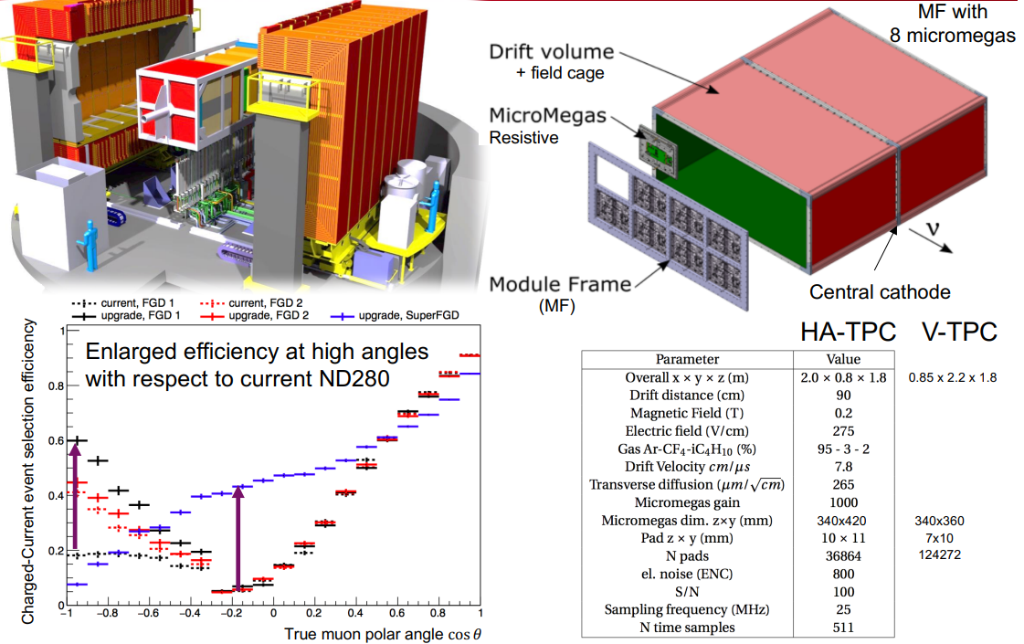
The ND280 experiment: HATPC requirements
High Angle TPC
Momentum resolution σ_{p}/p < 9% at 1GeV/c
(neutrino energy)
Energy resolution σ_{dE/dx}< 10%
(PID muons and electrons)
Space resolution O(500 μm)
(3D tracking & pattern recognition)
Low material budget walls ~ 3% X₀
(matching tracks from neutrino active target)
  Atmospheric pressure TPC
    Gas: T2K mixture (Ar-CF4-isoC4H10 = 95-3-2)
    Gas contaminants better than O(10 ppm) level
    Drift length 1m
    Central Cathode @ -27kV
    E field unif. < 10⁻³ @1cm from walls
    Low material budget, thin walls
    Active volume ~ O(3m³)
  Resistive MicroMegas sensors (ERAMs)
    Overall anode active surface ~ O(3m²)
    Sampling length ~ 80-160 cm
    pads ~ 1x1cm²
    10k+10k channels / TPC @ End Plates (Anodes)

Slide 10
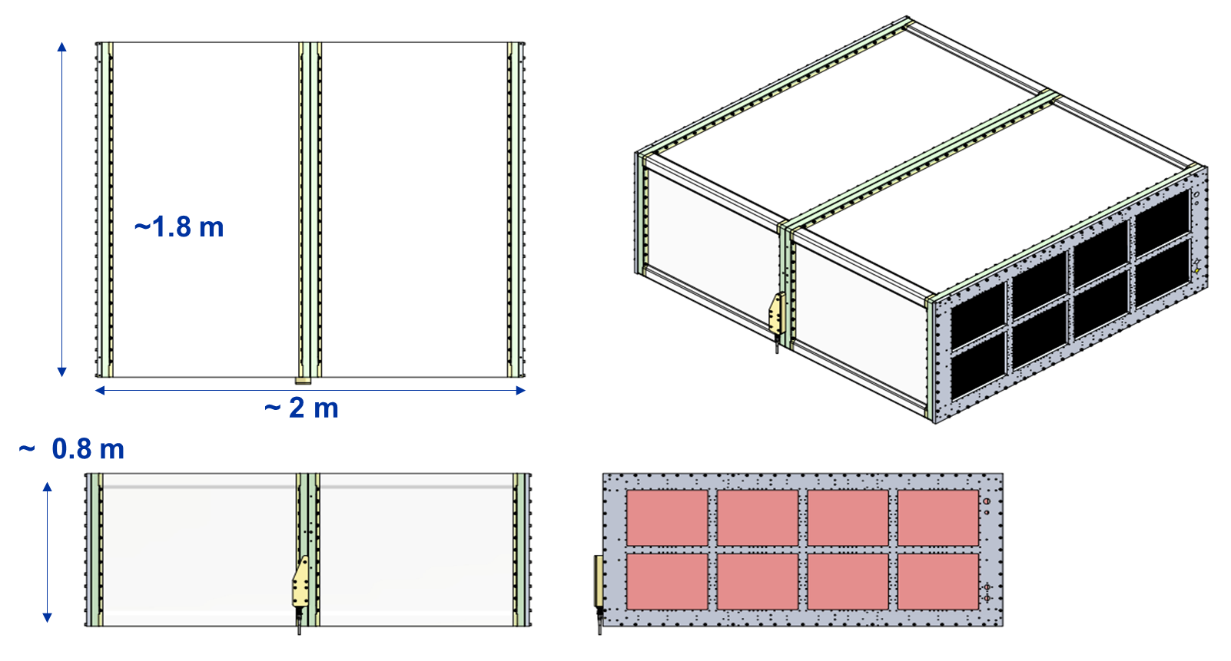
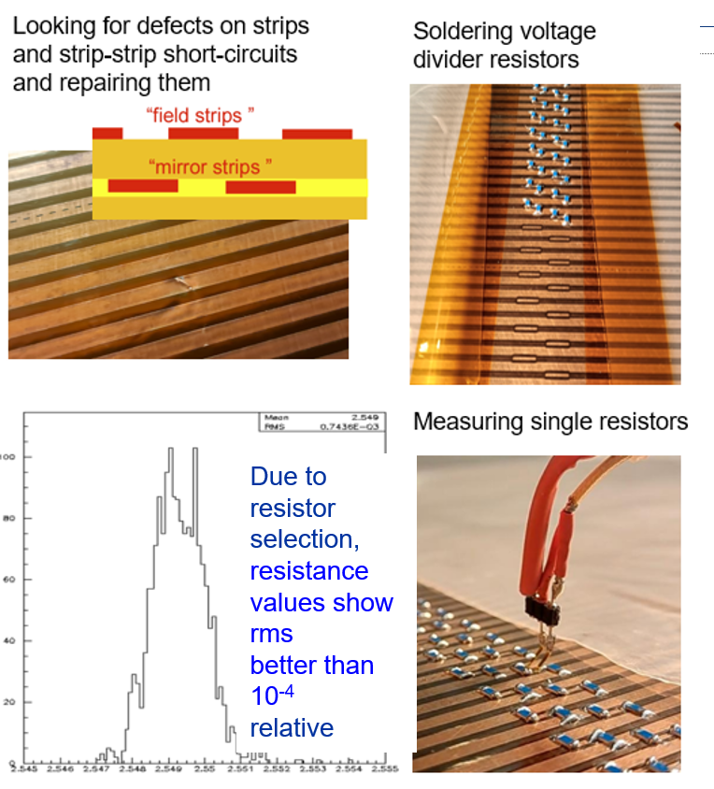
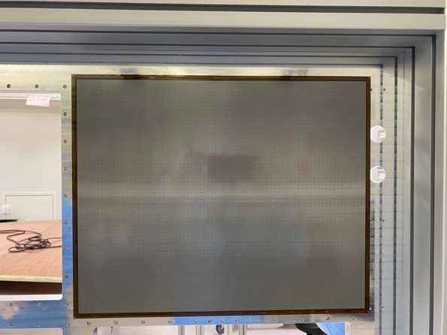
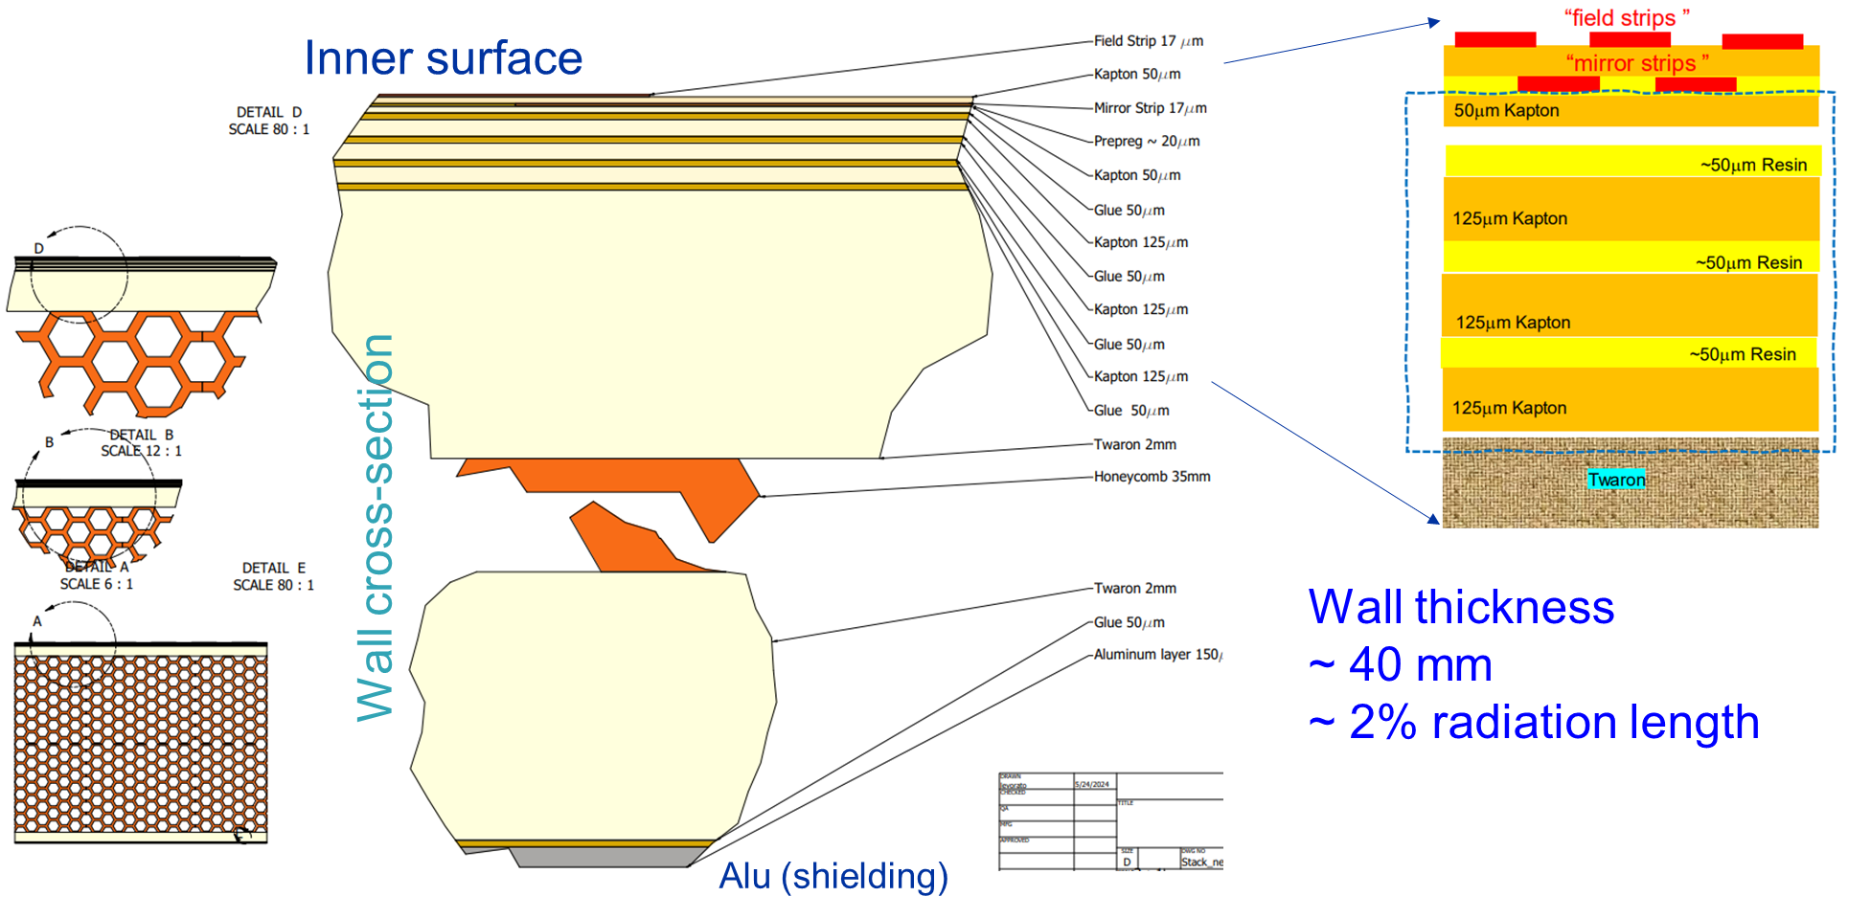
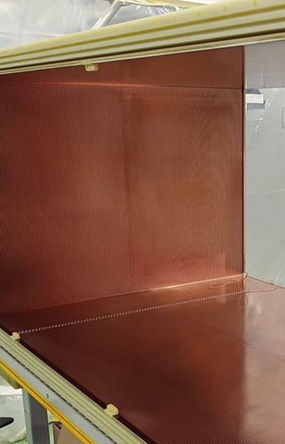
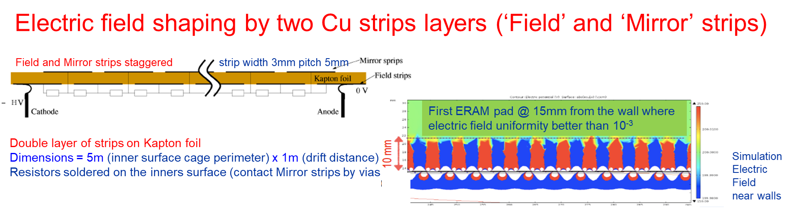
HATPC, an overview on the main elements
HATPC in two half FCs
Central cathode
Special cathode flanges w/ HV ft
Two End Plates (Al)
8 Readout Modules each
1 2 3 4
5 6 7 8
Produced at CERN EP-DT LAB
Two voltage dividers In parallel ~400 5.1MΩ resistors each: Overall R ~ 1GΩ

Slide 11
The ND280 experiment: High Angle TPC highlights
The HATPC detector
  A short introduction
Encapsulated Resistive Anode Micromegas (ERAMs)
    The realization of the 50 ERAM sensors
    The ERAM characterization
  Detector response, signal
HATPC performance

Slide 12
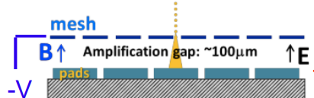
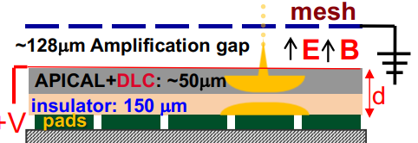
ERAM: MicroMegas with DLC resistive foil
Resistive layer enables charge spreading
→ space resolution below 500μm with larger pads
→ less FEE channels (lower cost)
→ improved resolution at small drift distance
(where transverse diffusion cannot help)
Resistive layer prevents charge build-up and quench sparks
→ enables operation at higher gain
→ no need for spark protection circuits for ASICs
→ compact FEE → max active volume
Resistive layer encapsulated and properly insulated from GND
→ Mesh at ground and Resistive layer at +HV
→ improved field homogeneity → reduced track distortions
→ better shielding from mesh and DLC → potentially better S/N

Slide 13
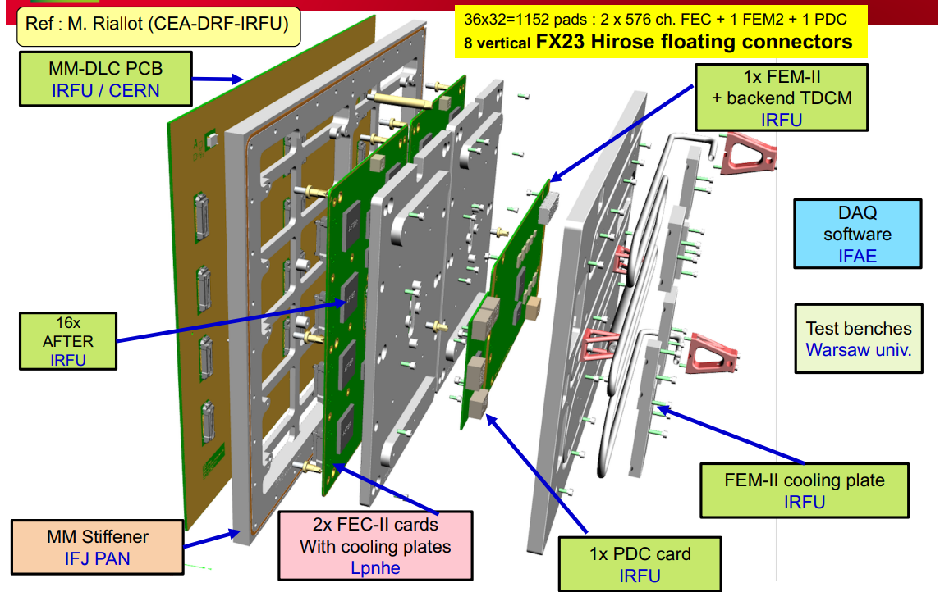
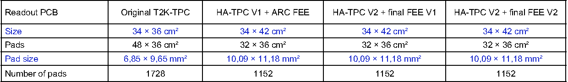

ERAM Module breakout
8 + 8 ERAMs per HATPC
← Very compact Electronics parallel to the detector

Slide 14
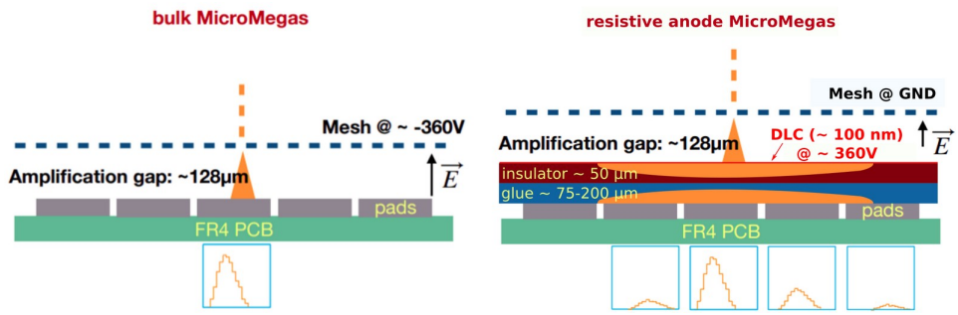



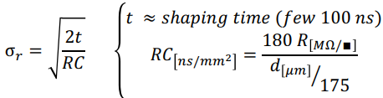
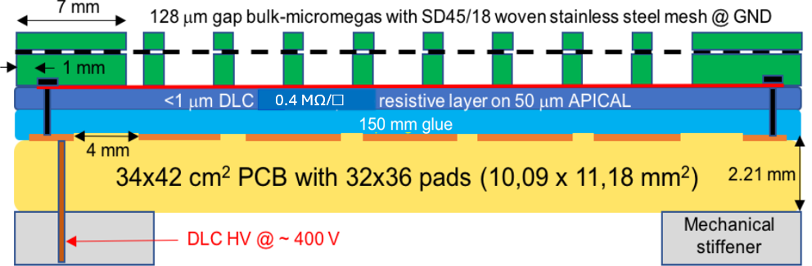
Charge spread on low resistivity foil
Charge Spreading 2D telegraph eqn. solution
time scale is driven by RC
Gaussian spread
Final ERAM layout choice for series production:
Considering pads of 11x10 mm² parameters
400 kΩ/□ DLC resistivity – low resistivity
150 μm thickness glue – C_{dlc-pad/gnd} ~ O(20pF)
→ RC ~ O(100ns/mm²)
Trade-off optimal charge spread VS spark protection
Gain not affected by resistivity
(transparency to induced signals is guaranteed)

Slide 15
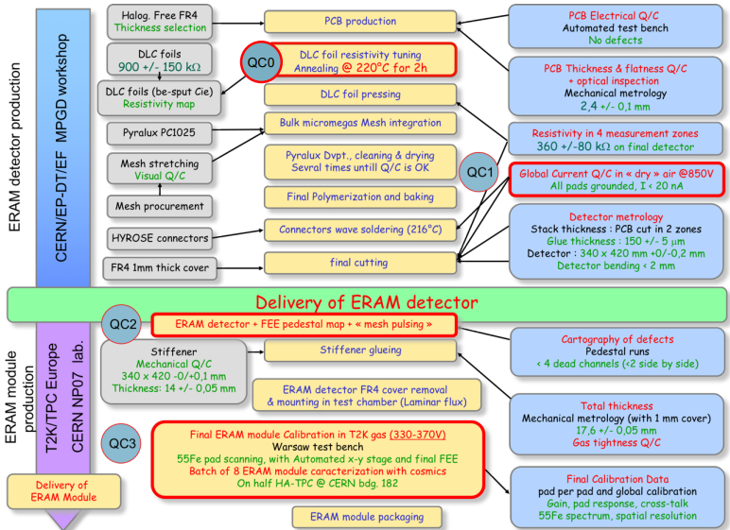
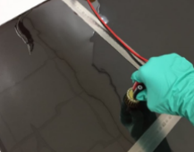
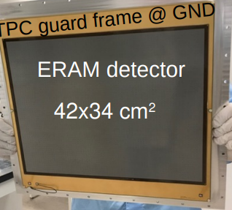
ERAM production ~ 50 detectors
Crucial steps in production
(CERN EP-DT MPGD workshop)
Selecting DLC foil resistivity
Large variations from DLC provider
Value stable after annealing
Gluing steps by Pressing
DLC to PCB
Stiffener to DLC-PCB

Slide 16
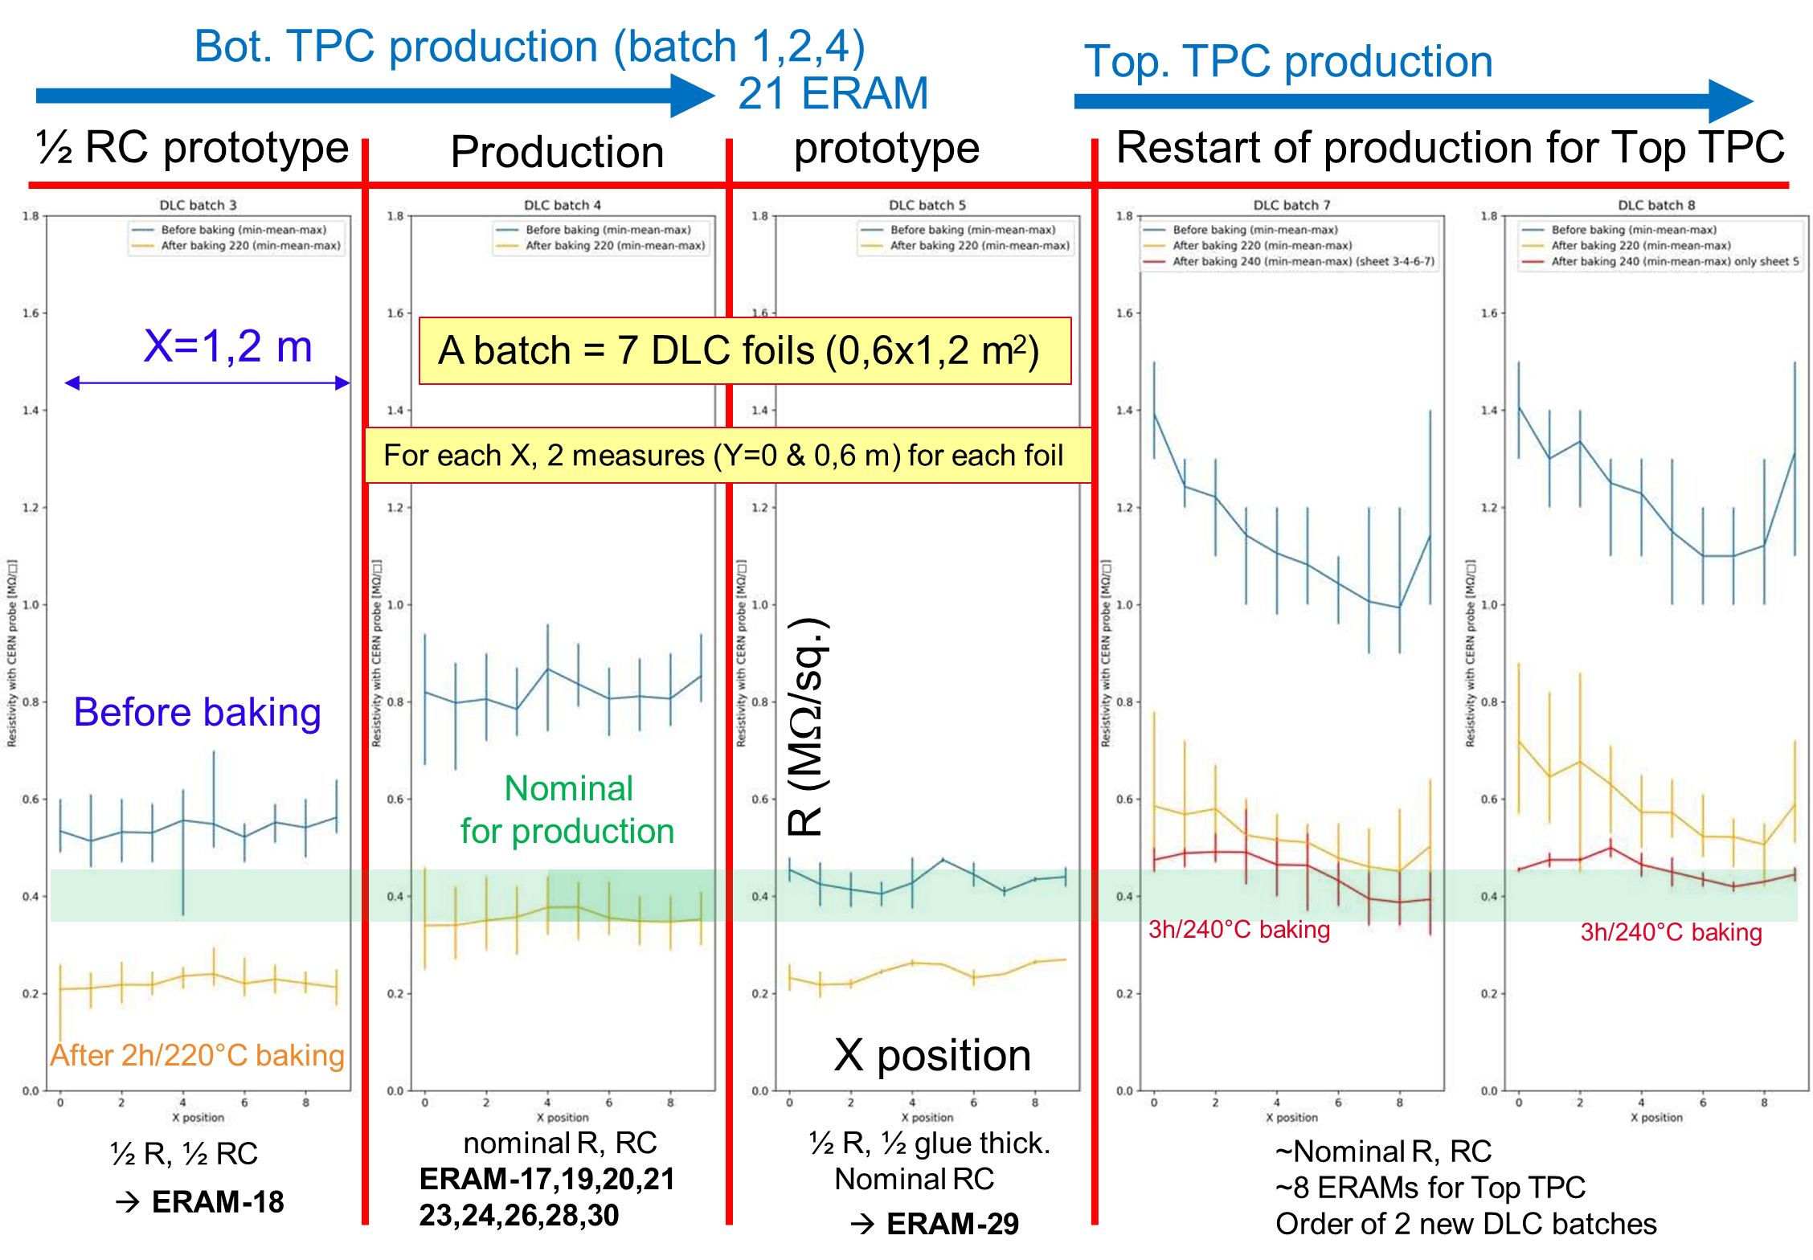
DLC layer: foil selection, QC

Slide 17
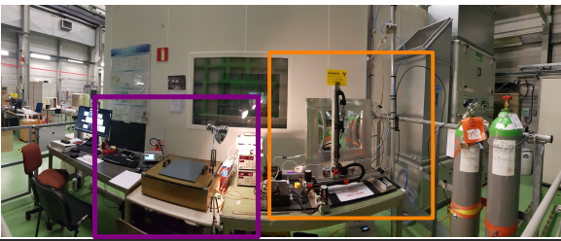
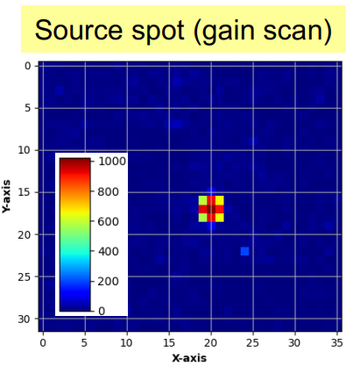
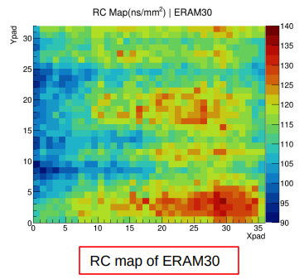
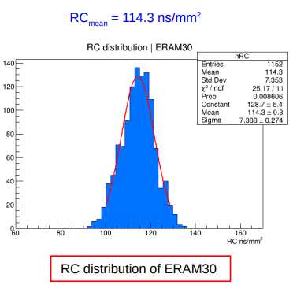
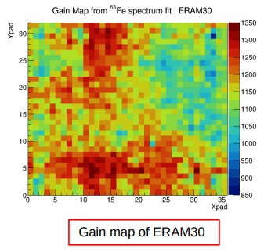
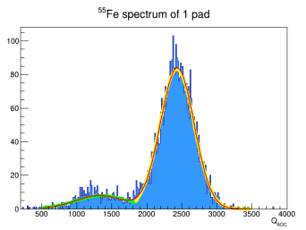
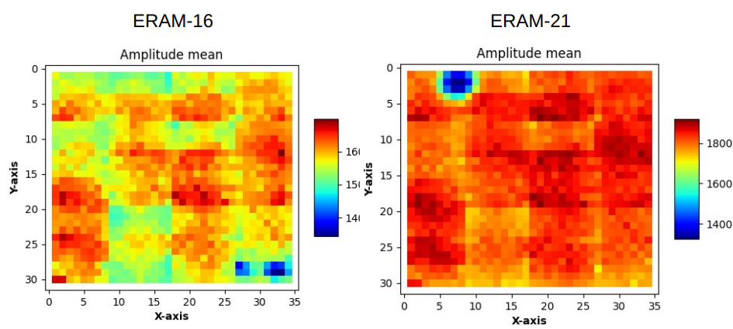
ERAM Series production experience: X-ray scan
X-rays Test Bench at CERN
fundamental to
1) Qualify, characterize and calibrate
all prototypes and series ERAMs
2) Support the development of
detailed ERAM response model
X-ray scan
Mesh pulsing
B) X-ray scan of finalized detectors with final electronic modules. Remote controlled station for scanning with mm step fine steps
Aim: QC and fine calibration in terms of gain, resolution and RC
A) Mesh Pulsing: before and after stiffener gluing
Aim: detector geom defects (i.e. pillar detach),
stiffener gluing issues, electronic noise

Slide 18
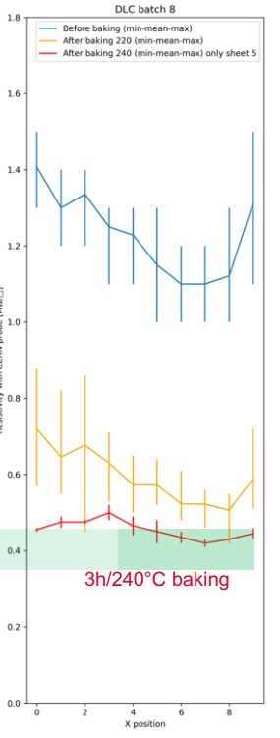
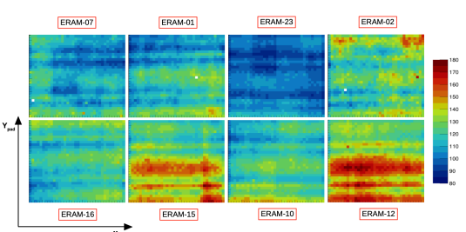
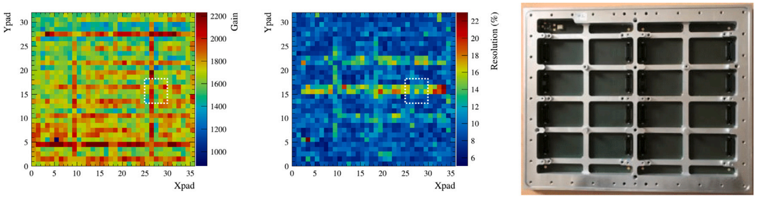
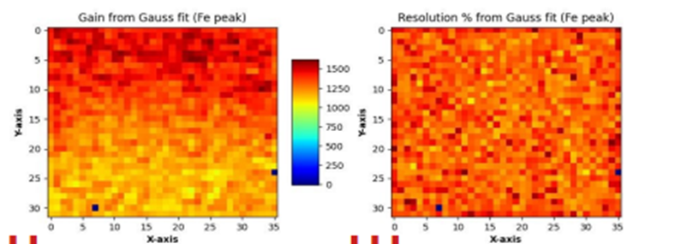
ERAM Series production experience: X-ray scan
Production steps: tough!
(needed long tuning)
Selecting DLC foil resistivity
Large variations from DLC provider
Stable values only after annealing
Gluing steps by Pressing
DLC to PCB
Stiffener to DLC-PCB
RC map of ERAMS on bottom HATPC EP1
ns/mm2
up 20% RC variation
over same ERAM
ERAM with DLC-PCB gluing issue
Gain map of ERAM OK
1μm mesh-DLC gap variation => 10% variation in gain

Slide 19
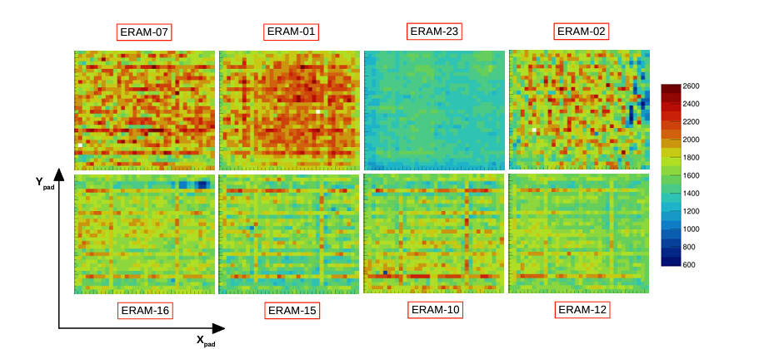
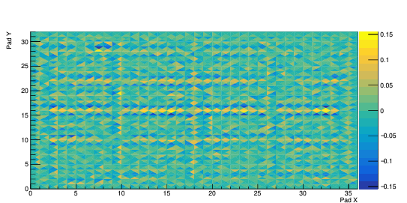
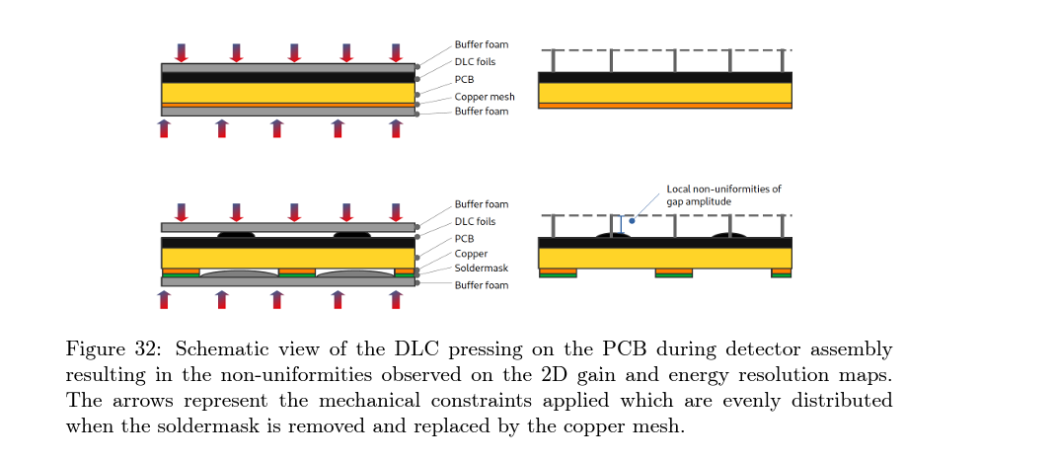
ERAM Series production experience: X-ray scan the importance of the (fast) QA
Gain maps of eight ERAMs tested together in a field cage prototype
A map of gain non-uniformity within a pad.
relative shift of the mean amplitude reconstructed in the top, bottom, left or right region of each pad under study w.r.t mean amplitude of the pad
DLC pressing on the PCB during detector assembly resulting in the non-uniformities observed on the 2D gain and energy resolution maps
→ The solder mask is removed and replaced by the copper mesh.

Slide 20
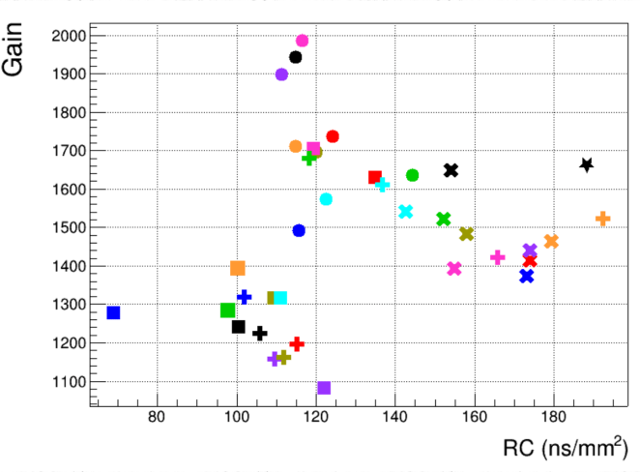
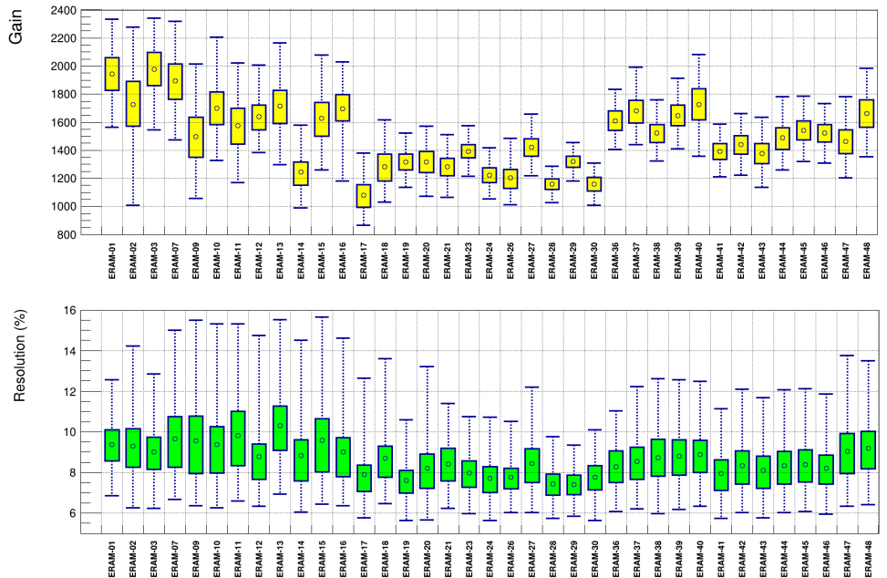
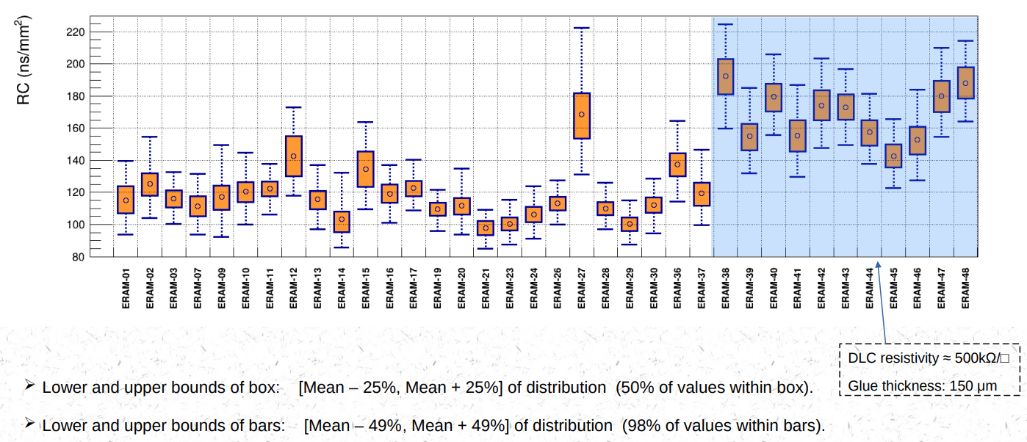
ERAM Series production: a summary table
Gain distribution @350V
Energy resolution
RC distribution

Slide 21


ERAM Assembly and Operation experience
Low resistivity DLC O(~500kΩ/□) [after annealing] features
Optimal charge spread → uniform response across pad
(combined with C ~ O(20pF/cm²)
Fast Q removal and Effective Protection against sparks
included at moderate rates ~ O(1kHz) tracks crossing pads
Leakage currents at level of few nA in normal conditions
(no beam)
Challenging installation conditions
0.8 ÷ 2 sparks/day
→ high sensitivity to dust
→ low H2O level (100ppm) before HV on
→ Confirmed by the detector operation at T2K

Slide 22



Noise: stability of the installed detector
Noise in module 0 has been stable between September 23 and June 24
All the Erams are quasi-identical but one, Eram 27, due its higher capacitance
→ the excellent uniformity of the electronics and of the mechanical definition of the glue layer driving the detector capacitance

Slide 23




ERAM detector response – Noise model
Previous conclusions supported by the noise detailed model included in the MC for Simulation of charge deposition in events

Slide 24
The ND280 experiment: High Angle TPC highlights
The HATPC detector
  A short introduction
Encapsulated Resistive Anode Micromegas (ERAMs)
    The realization of the 50 ERAM sensors
    The ERAM characterization
  Detector response, signal
HATPC performance

Slide 25


The ND280 experiment: High Angle TPC highlights
How does the signal look ? Point deposition for example
ADC signal : max 4096 counts
Time window of 511 time bins
Time bin (typ.): 40 ns (25 MHz sampling)
Peaking time (typ.) : 412 ns
Leading pad: highest and earliest signal
⇒ current induced on pads from by avalanche, ie ions signal (as electrons’ signal is too fast)
Adjacent pads: lower and later signals
⇒ current induced by potential field adjustments after electrons are collected by on DLC
(current induction by “charge spread on resistive layer”)

Slide 26



Reconstruction of charge deposition 1/2
Recovering information about deposited Q is not trivial
Within our electronics shaping time scale
in primary pads, the signal of ions is diluted by the signal of charge spreading
=> Need to combine information of all pads (primary and secondary)

Slide 27
Reconstruction of charge deposition 2/2
Charge on DLC spreads along any direction including track direction
«longitudinal correlation» across primary pads within our electronics shaping time scale
requires a dedicated signal formation model

Slide 28






ERAM response – Signal formation model
Main ingredients
In the time scale of our shaping time O(100ns)
Charge spread is properly described by
Solutions of 2D diffusion eqn.
Avalanche signal
measured
with fast electronics
on bulk micromegas
1
Ions signal (slow)
Electron signal
(too fast for our shaping times)
2
Electrical model of the sensor
4
FEE Response Function
3
Note: Of course, gas transport properties
(L, T diffusion) have to be accounted for

Slide 29
ERAM response – Signal formation model
Main ingredients
Daniele D’Ago’s talk on Monday
In the time scale of our shaping time O(100ns)
Charge spread is properly described by
Solutions of 2D diffusion eqn.
Avalanche signal
measured
with fast electronics
on bulk micromegas
1
Ions signal (slow)
Electron signal
(too fast for our shaping times)
2
Electrical model of the sensor
4
FEE Response Function
3
Note: Of course, gas transport properties
(L, T diffusion) have to be accounted for

Slide 30
The ND280 experiment: High Angle TPC highlights
The HATPC detector
  A short introduction
Encapsulated Resistive Anode Micromegas (ERAMs)
    The realization of the 50 ERAM sensors
    The ERAM characterization
  Detector response, signal
HATPC performance

Slide 31
ERAM detector response: impact on reconstruction
Use of the model for Reconstructing the charge deposition
Due to square shape of ERAM pads, the classical method (PRF+clustering) works OK
only for tracks with horizontal or vertical direction (wrt pads coordinates)
Better methods use solutions of telegraph equation in order to
compute the pattern templates for charge diffusion on DLC
calculate the overall expected signal waveform per each pad
find the best matching with the recorded waveforms
Its computationally heavy → different approximations are used for different analysis
X-rays analysis – ERAM characterization
Measurement of dE/dx – Particle Identification
Track reconstruction – momentum measurement

Slide 32

Reconstructing X-rays charge deposition
Q_{pad}(t) = Solution of 2D Teq. for diffusion of initial Q deposited charge (point-like, delta-pulse initial conditions)

Slide 33






Reconstructing X-rays charge deposition
WF templates
Current induced on a pad dQpad(t) / dt
to be convoluted with
electronics transfer function R(t)
dQ/dt ⊗ R(t) = Q(t) ⊗ dR(t)/dt
Q(t) ⊗ dR(t)/dt is more practical
WF fit against templates
Simultaneous fit of waveforms of
Leading pad + Neighboring pads
to get the best 5 parameters
Results about Gain and RC

Slide 34



Extraction of RC and Gain maps from X-rays
Use of the method for the extraction of ERAM GAIN and RC
Converted X-ray impact point position is also fitted
→accurate maps of Gain and RC
Use for detailed studies of charge diffusion and ERAM response at fine PAD position level
Indications are that the lower resistivity
the better the performance (eg space resolution)

Slide 35
Reconstructing Q along tracks
For the reconstruction of the charge along the tracks two methods
- Waveform Sum (WS)
- Crossed Pad (XP)
Compare the performance of the two methods for dE/dx extraction

Slide 36



Reconstructing Q along tracks: Waveform Sum
OK for almost H & V tracks
Q missing for inclined tracks
Simple method based on
Sum of waveforms(t) (WS)
over pads in a cluster

Slide 37

Reconstructing Q along tracks: Crossed Pad (XP)
Reconstruct tracks and consider only pads crossed (XP) by the track (primary pads)
Reconstruct original (ion induced) charge (Q) for each XP (given the track parameters there)
by Q = A x (Q/A) – where A is recorded amplitude on XP and rescaling ratio (Q/A) from Look Up tables (LUT)
LUTs build from model: original Q is distributed linearly over the segment for each XP so that solutions of diffusion equations can be used
Model
No clustering => potentially more accurate method because reconstructing full induced charge on primary pads
«dilution of ion signal» on a XP pad, due to charge spread over the pad is correctly taken into account
«longitudinal correlation» among adjacent XP pads, due to charge spread along track direction is accounted for
Fast method though based on model templates (long time is to generate LUTs …)

Slide 38


Reconstructing Q along tracks: Crossed Pad (XP)
Building the rescaling ratio Q/A ratio 4D LUTs via model

Slide 39

dE/dx preliminary results: (WS) and (XP) methods
dE/dx (4GeV electrons) – comparison of WF and XP methods on Test Beam data (DESY)

Slide 40




dE/dx preliminary results: (XP) method
dE/dx via XP method on Test Beam data (CERN PS T10)

Slide 41




PID preliminary results (XP) vs (WS)
e/μ separation @ 1.5 GeV – Test Beam data (CERN PS T10)
Short tracks (~40cm)
Long tracks (~160cm)

Slide 42
Reconstructing tracks
For the reconstruction of the tracks
Log(Q) methods
Full Waveform fit Method

Slide 43




Reconstructing tracks, trajectory fitting: an example
LogQ Method based on clustering & Log[Qprimary /Qsecondary]
logQ method to reconstruct position in each cluster
Helix fit performed on those reconstructed positions
Full Waveform fit Method – based on model & no clustering
1) Use all the pads associated to a track (Q_{max} values) to define a (v,u) local frame
2) Distribute “arbitrary” point charges along v axis separated by Δv (5mm)
the Q per each point is a free parameter
3) Diffusion model to predict the waveform generated by point charges in surrounding pads
4) Move all points along the u axis to minimize the chi-square difference between measured waveforms and templates → extract the coordinates

Slide 44



Spatial resolution: the importance of the QA
Top HAT was equipped with ERAMs with larger RC variation w.r.t. Bottom
High RC → less charge spreading “flatter curve”
Low RC → more charge spreading “steeper curve”
Non negligible RC variation among the same Endplate of the TPC
dX: distance from the center of the cluster and the real position
Need to tune the log(Q) parametrization → ERAM dependent….

Slide 45


Spatial resolution after reparameterization
Work in progress, preliminary
With the new parametrization all modules have similar performances in terms of spatial resolution
σ ≈ 0.45 mm

Slide 46




Reconstructing tracks: momentum resolution
ϕ = 5.7°
ϕ = 45°
ϕ = 84.3°
σ_{p}/p momentum resolution as a function of track drift distance: simulated 700 MeV/c muons

Slide 47


Event display, full ND280 detector!

Slide 48
Conclusions
Two new TPCs have been just installed in ND280 at JPARC
Very stable operations in commissioning and technical runs
Firs Neutrino Data taking just completed, restarting now !
Resistive MM with encapsulated anode ERAM
- First time use of an encapsulated resistive Micromegas in a High Energy running experiment
Low resistivity & optimal charge spread & no sparks effects
Series production allowed several detailed studies
The ERAM technology is complex and delicate to produce as are all the resistive MPGDs. The expertise and excellent partnership with the CERN/PCB workshop enabled a high yield (~80%) of high-quality production
New algorithms for square pads exploiting detailed response model under development
Detector performance, still preliminary but very promising!

Slide 49
Conclusions
Two new TPCs have been just installed in ND280 at JPARC
Very stable operations in commissioning and technical runs
Firs Neutrino Data taking just completed, restarting now !
Resistive MM with encapsulated anode ERAM
- First time use of an encapsulated resistive Micromegas in in a High Energy running experiment
Low resistivity & optimal charge spread & no sparks effects
Series production allowed several detailed studies
The ERAM technology is complex and delicate to produce as are all the resistive MPGDs. The expertise and excellent partnership with the CERN/PCB workshop enabled a high yield (~80%) of high-quality production
New algorithms for square pads exploiting detailed response model under development
Detector performance, still preliminary but very promising!
Thanks!

Slide 50
Spare
Just in Case

Slide 51


Slide 52
Reconstructing tracks: trajectory fitting
LogQ Method based on clustering & Log[Qprimary /Qsecondary]
logQ method to reconstruct position in each cluster
Helix fit performed on those reconstructed positions
Full Waveform fit Method – based on model & no clustering
1) Use all the pads associated to a track (Qmax values) to define a (v,u) local frame
2) Distribute “arbitrary” point charges along v axis separated by Δv (5mm)
the Q per each point is a free parameter
3) Diffusion model to predict the waveform generated by point charges in surrounding pads
4) Move all points along the u axis to minimize the chi-square difference between measured waveforms and templates
RungeKutta method to fit (u0, du/dv, q/p, t₀, dv/dt)

Slide 53



GAIN, RC

Slide 54


Detailed R measurement (dedicated probe)
A dedicated probe has been built to perform a fine measurement of the surface resistivity.
Will be soon complemented with the comparison with the data extracted from X-ray analysis
R inhomogeneities in the sputtering are clearly visible in the direction perpendicular to the drum rotation axis.

Slide 55






Slide 56
Conclusions
Two new TPCs have been just installed in ND280 at JPARC
Very stable operations in commissioning and technical runs
Firs Neutrino Data taking just completed, restarting in October 2024
Field cages
High ratio active/passive volume
Highly effective insulation & E field uniformity
Composite material technology exploited at the limit of the technology
Resistive MM with encapsulated anode
Low resistivity & optimal charge spread & no sparks effects
Series production allowed several detailed studies
The ERAM technology is complex and delicate to produce as are all the resistive MPGDs. The expertise and excellent partnership with the CERN/PCB workshop enabled a high yield (~80%) of high-quality production
New algorithms for square pads exploiting detailed response model under development

Slide 57


HATPC: features, challenges, constrains and solutions
Mechanics and Electric Field uniformity
Min dead space & max active volume in the dipole magnet
→Rectangular shape & thinnest walls & field shaping electrodes incorporated into the walls
Electric field uniformity better than 10⁻³ @1cm from walls
→ Mechanical accuracy: inner surfaces planarity & parallelism ~ O(0.2mm/m)
→ Shaping Electrode design: Field and Mirror copper strip layers on two sides of a Kapton foil
Low material budget walls
  → lightweight & lowest Z & robust (self supporting)
Electrical insulation Constrains
  HV insulation mantle R > 1TOhm and volume resistivity, HV
→geometry: several cm paths for charge from -HV strips to GND shielding (cathode flanges)
→insulating materials: very high resistivity & dielectric strength

Slide 58
HATPC: features, challenges, constrains and solutions
Building process: hand lay-up of composite materials on a Mould & polymerization in autoclave at high Pressure
  Autoclave dimensions
    → Field Cage comprising two halves (symmetrical flanges at central cathode position)
  Hand layup & large dimensions
    → several hours per process step → very long pot life for epoxy resin
  Mechanical accuracy of geometry → resin curing at low T < O(40ºC)
Materials of choice
  lamination materials: Aramid polymers for peels (Twaron) and for honeycomb (Nomex paper)
  epoxy resin limited choice: Resoltech 1054 combined with quality control against contaminants (moisture, …)
  high insulation layers: Kapton
  box skeleton material: high quality laminated G10

Slide 59
The ND280 experiment: High Angle TPC highlights
Field Cage (FC)
  Assembly and layout
  Production
  Characterization and Quality Assessment
    Mechanical
    Electrical
Encapsulated Resistive Anode Micromegas (ERAMS)
    Production of 50 sensors
    Characterization
  Detector response, signal and impact on reconstruction
Impact on HATPC performance

Slide 60


Field Cage: walls stack up layout
Inner surface
Wall cross-section
Wall thickness
~ 40 mm
~ 2% radiation length
Outer surface
Alu (shielding)

Slide 61







Field cage mechanical details

Slide 62


Field cage mechanical details: charge path to gnd
Flange thickness (5cm) too small for
degrading -30kV to GND over a flat surface
Three deep grooves
for extending the path from HV to GND
for charge moving on surface and with gas
flanges
~ 7cm thick labirinth
~14 cm path lenght
→ voltage drop / path length < 3kV/cm

Slide 63
The ND280 experiment: High Angle TPC highlights
Field Cage (FC)
  Assembly and layout
  Production
  Characterization and Quality Assessment
    Mechanical
    Electrical
Encapsulated Resistive Anode Micromegas (ERAMS)
    Production of 50 sensors
    Characterization
  Detector response, signal and impact on reconstruction
Impact on HATPC performance

Slide 64

Field Cage building, assembling and characterization
Mould building (INFN)
Production at NEXUS company (Barcelona) ~ 10 weeks
Validation, QC, electrical and mechanical assembly at CERN ~ 4 weeks
Mold features
1cm thick Alu walls
Anodyzd. Surfaces
Waviness compl.
iso1302 N8
Surfaces ┴ and ║
better than 80μm/m
Mount / unmount
geom. reproducibility
with high precision

Slide 65



Field Cage building, assembling & characterization at NEXUS
Kapton Layer
Production at NEXUS company (Barcelona) ~ 10 weeks
Validation, QC, electrical and mechanical assembly at CERN ~ 4 weeks
Strip foil (by CERN) alignment and
lamination of 3 Kapton layers
5 m perimeter x 1m height (drift length)
Mold preparation
Inner Vacuum bag
Strip Foil positioning
Thick corners w/ Kapton tape
Electrical tests on surfaces
Resin samples electrical Tests
Kapton lamination
Curing at 40C (fast)
Electrical tests on surfaces and resin samples after curing

Slide 66





Field Cage building, assembling & characterization at NEXUS
Kapton Layer and inner Twaron
Inner Twaron peel lamination
First Twaron layer lamination
Curing at 40C (fast) in autoclave
Electrical tests
- Resin sample
- Inner Twaron layer

Slide 67




Field Cage building, assembling & characterization at NEXUS
Kapton Layer + inner Twaron + G10 Skeleton
Gluing G10 structural skeleton and casting resin on flanges for ensuring gas tightness
Flanges & Bars
by ORVIM company
(TV, Italy)
Casting low viscosity resin on top flange
→sealing flange to laminated layers
Autoclave curing at 40C
G10 skeleton gluing
Curing 40C in clean room

Slide 68




Field Cage building, assembling & characterization at NEXUS
Kapton Layer + inner Twaron + G10 Skeleton + HC + Ext Twaron
Gluing Nomex Honeycomb
Curing at 40C in oven
Outer Twaron peel lamination
Flipping the box top-bottom
Resin casting on second flange
Curing at 40C in autoclave
Second Twaron peel lamination
Curing at 40C in autoclave
Post-curing at 40C in oven (lasting as long as possible)

Slide 69





Field Cage machining and final QC at Nexus
Vallmoll – Spain
Back to NEXUS company for
Mould removal
Very fine polishing of flanges
Correction of defects (eg bubbles)
Shipment to CERN
Precision machining
of cathode and anode
flanges and surfaces finishing

Slide 70
The ND280 experiment: High Angle TPC highlights
Field Cage (FC)
  Assembly and layout
  Production
  Characterization and Quality Assessment
    Mechanical
    Electrical
Encapsulated Resistive Anode Micromegas (ERAMS)
    Production of 50 sensors
    Characterization
  Detector response, signal and impact on reconstruction
Impact on HATPC performance

Slide 71

Field Cage assembling, characterization at CERN
Vertical assembly of
two Field Cages into HATPC

Slide 72






Field Cage assembling, characterization at CERN
He leak tested
  sniffer (air + 30mbar of He)
Gas leakages qualification
2) Tested against gas density changes
He Over-pressure (+20mbar)
Air Under-pressure (-20mbar)
Several T,P,RH sensors
Inside FC
Gas density corrected
for Volume variation (due to Pin - Pout)
= $\frac{Pin(t)}{Tin(t)/Tin(0)} \left(1−\frac{ΔV}{V0}\right)(Pin−Pout)$
=> Overall Leak < 10⁻³ mbar L / s

Slide 73

Field Cage assembling, characterization at CERN
Mechanical qualification
Comparison with FEM models
in fair agreement with
load tests
deformation vs pressure

Slide 74

Field Cage assembling, characterization at CERN
Mechanical qualification
Comparison with FEM models
in fair agreement with
load tests
deformation vs pressure

Slide 75

Field Cage assembling, metrology at Nexus
Tolerances and specifications at a level better than 300μm/m for planes parallelism and orthogonality and better than ISO1302-N8 for waviness are respected with few localized acceptable exceptions
Reached limits of composite material technique
Large dimensions and hand lay-up

Slide 76

Field Cage assembling, metrology at CERN
Measured internal geometry after assembly agrees with nominal CAD with pull better than 300μm with few localized, acceptable exceptions

Slide 77


Field Cage assembling, ERAM installation
Assembly the 16 ERAMs in Clean room for each TPC
ERAMs: avoid dust

Slide 78

Field Cage assembling, commissioning with cosmics

Slide 79





Field Cage assembling, commissioning: gas contamination at CERN
Water and Oxygen contamination evolution
Large amount of water uptake by Kapton: 2% in mass, with respect to dry Kapton, ~ about 70 g → purging time ~ a couple of months
Different dragging coefficient ?
Under investigation
δ water desorption from walls → 0.06 g/day water removal / desorption (long)

Slide 80


Field Cage assembling, commissioning: gas contamination at J-PARC
Gas contamination from Field Cage O₂ and H₂O
Excellent Performance of the new gas system
Typical operational values

Slide 81


Field Cage assembling, commissioning: drift velocity measurement
Perfect agreement
with expectations (Magboltz)
1.45μs
Gas contamination H₂O ~ 10 ppm H₂O @ J-PARC All TPCs
Gas contamination from Field Cage – O₂ and H₂O included
500 ppm H₂O @ CERN Bottom TPC

Slide 82

Thanks to CERN
We would like to express our gratitude for the continuous and extremely valuable support from CERN
Burkard Schmidt, Roberto Guida, Frederic Merlet and colleagues → Gas system EP-DT/ED-DT-FS
Davide Tommasini, Roland Piccin, Sebastien Clement, Cedric Urscheler → Polymer lab/TE-MSC
Rui de Olivera, Olivier Pizzirusso→ EP-DT-EF
Eraldo Oliveri, Djunes Janssen→ EP-DT-DD
Francesco Lanni, Lluis Secundino Miralles Verge Albert DE ROECK, Filippo Resnati → Neutrino Platform
Ahmed Cherif, Jean Philipphe Rigaudt → Metrology/TE-MSC-SMT
Antje BEHRENS, Jean Christophe Gayde → BE-GM-ESA
Mauro Taborelli, Colette Charvet, Marcel Himmerlich → TE-VSC-SCC
Paolo Chiggiato → TE-VSC
Patrick Muffat, Loredana ZENI Toberer, Laurence Planque, Stephanie Krattinger, Elsa Clerc→ SCE-SSC-LS

Slide 83
Thanks to CERN
We would like to express our gratitude for the continuous and extremely valuable support from CERN
Burkard Schmidt, Roberto Guida, Frederic Merlet and colleagues → Gas system EP-DT/ED-DT-FS
Davide Tommasini, Roland Piccin, Sebastien Clement, Cedric Urscheler → Polymer lab/TE-MSC
Rui de Olivera, Olivier Pizzirusso→ EP-DT-EF
Eraldo Oliveri, Djunes Janssen→ EP-DT-DD
Francesco Lanni, Lluis Secundino Miralles Verge Albert DE ROECK, Filippo Resnati → Neutrino Platform
Ahmed Cherif, Jean Philipphe Rigaudt → Metrology/TE-MSC-SMT
Antje BEHRENS, Jean Christophe Gayde → BE-GM-ESA
Mauro Taborelli, Colette Charvet, Marcel Himmerlich → TE-VSC-SCC
Paolo Chiggiato → TE-VSC
Patrick Muffat, Loredana ZENI Toberer, Laurence Planque, Stephanie Krattinger, Elsa Clerc→ SCE-SSC-LS
Thanks to INFN support at CERN and the CEA ANTENNA colleagues

Slide 84


Slide 85

Near Detector impact on Oscillation Analysis

Slide 86

ND280 limitations

Slide 87

ND280 Upgrade improvements

Slide 88

Mantle resistance

Slide 89
ERAM Production - about 50 detectors
Crucial steps in production (needed tuning)
Selecting DLC foil resistivity
Large variations from DLC provider
Value stable after annealing
Gluing steps by Pressing
DLC to PCB
Stiffener to DLC-PCB
X-rays Test Bench at CERN
was fundamental to
1) Qualify, characterize and calibrate
all prototypes and series ERAMs
2) support the development of
detailed ERAM response model

Slide 90

Field Cage assembling, characterization at CERN
Gas contamination from Field Cage – other contaminants

Slide 91


ERAM Series Production experience
Effect of gas density on (gas) GAIN
Fine grain scan
GAIN as a function
of Pad position
Effect of humidity on (gas) GAIN

Slide 93


Reconstructing tracks dE/dx
dE/dx – comparison of SWF and XP methods on Test Beam data (4GeV electrons, DESY)

Slide 94


Reconstructing tracks – pattern recognition
Time and charge definition for each hit
Waveform multipeak search in order to differentiate vertices and crossing trajectories
Merging between different ERAMs and End Plates

Slide 95


Reconstructing tracks – trajectory fitting

Slide 96

T2K gas properties

Slide 97




RC MAP DERIVED FROM X-RAY SCANS
Ref: S. Joshi (Irfu/PhD)
ERAM-07
ERAM-01
ERAM-23
ERAM-02
Seen from Electronics side
ERAM-16
ERAM-15
ERAM-10
ERAM-12
RC is quite well correlated to the measured DLC resistivity
RC is derived from the fit of the pad signal waveforms datas (leading and neighbours) with the complete modelization of the detector response
ERAM-01 R (kΩ) after DLC pressing
ERAM-01 R (kΩ) finished
~1/2 RC as expected
~ RC as expected
16/20

Slide 98
Spare
Just in Case

Slide 99






GAIN MAPS OF THE 8 ERAMs
used on the ½ mockup TPC @ CERN/T10
Ref: S. Joshi (Irfu/PhD)
ERAM-07
ERAM-01
ERAM-23 (New PCB)
ERAM-02
Seen from electronics side
ERAM-16
ERAM-15
ERAM-10
ERAM-12
All ERAMs PCB but 23, >26
~35 μm copper mesh
New PCB for ERAM>26
X-ray gain scans
Comments & to better understand
ERAM-23
PCB backside modification
« solved » the observed gain pattern (ERAM S/N < 23)
~35 μm plain copper
+ ~50 μm soldermask
16/20

Slide 100
x0,y0 extracted by baricentrum
Fit independent

Slide 101



Slide 102


Slide 103



Although a-C:H and ta-C belong to the same material family, they are not produced by the same coating process.
a-C:H is achieved by PECVD (Plasma Enhanced Chemical Vapor deposition) in a gaseous environment.
Whereas ta-C is produced by PVD-arc (Physical Vapor deposition arc) from a solid carbon target.
PVD-arc technology enables the production of a ta-C coating with a higher percentage of sp3 hybridization without hydrogen and providing a higher hardness.

Slide 104


Slide 105




Both experiments individually prefer normal ordering and δCP~-π/2, T2K prefers upper octant, SK prefer lower octant
We performed Bayesian and Frequentist analyses → frequentist analyses shown today
The CP-conserving value of the Jarlskog invariant is excluded with a significance between 1.9 and 2 σ

Slide 106
R inhomogeneities in the sputtering are clearly visible in the direction perpendicular to the drum rotation axis.

Slide 107
R inhomogeneities in the sputtering are clearly visible in the direction perpendicular to the drum rotation axis.
And this matches the resistivity direct measurement (C is very well constrained by the thickness of insulator)

Slide 108
The ND280 experiment: High Angle TPC highlights
Field Cage (FC)
  Assembly and layout
  Production
  Characterization and Quality Assessment
    Mechanical
    Electrical
Encapsulated Resistive Anode Micromegas (ERAMS)
    Production of 50 sensors
    Characterization
  Detector response, signal and impact on reconstruction
Impact on HATPC performance
An outsider: Field Cage 0 ?
Electrical Issues, what we understood…
and learnt

Slide 109

Insulation issue in full scale FC0 prototype

Slide 110


Insulation issue in full scale FC0 prototype
Strip to strip V drop disuniformity

Slide 111

Buried resistive layer: a possible explanation
All observed features could be explained by the combination of two factors:
Presence of a resistive layer buried underneath the Kapton coverlay layer protecting the mirror Mirror strip
Low resistivity of the coverlay Kapton layer

Slide 112
Buried resistive layer: phenomenology
Anode
0V
Field
strips
Center FC
Cathode
-10kV
Glue
prepreg.
Mirror
strips
Kapton 50μm
-5 kV
Kapton 25μm
-5 kV
Resin
impregnated
Twaron layer
Buried resistive
layer
After applying HV after applying HV (eg -10kV) to the cathode, two phases:
Transient state: in time scale depending on the contaminated layers resistivity (in our case very short O(10s) time scale) the buried resistive layer become ~ equipotential (setting at intermediate potential -5kV) by drawing charge from the strips
2) Steady state: Mirror strips on the Anode, first half convey current to the buried layer, while mirror strips on the Cathode side draw currents from the buried layer

Slide 113
Buried resistive layer: phenomenology
Anode
0V
Field
strips
Center FC
Cathode
-10kV
Glue
prepreg.
Mirror
strips
Kapton 50μm
Kapton 25μm
Resin
impregnated
Twaron layer
Buried resistive
layer
After applying HV after applying HV (eg -10kV) to the cathode, two phases:
Transient state: in time scale depending on the contaminated layers resistivity (in our case very short O(10s) time scale) the buried resistive layer become ~ equipotential (setting at intermediate potential -5kV) by drawing charge from the strips
2) Steady state: Mirror strips on the Anode, first half convey current to the buried layer, while mirror strips on the Cathode side draw currents from the buried layer

Slide 114
Buried resistive layer: verification
In fact we verified the following
Coverlay Kapton volume resistivity ~ 1GΩcm much lower than datasheet)
Twaron layer facing the coverlay featured surface resistivity ~ 1G/□
coverlay
Kapton 25μm
Resin
impregnated
Twaron layer
Both features could on turn be explained by the accidental use of antistatic spray (resistive) on the back of the strip foil (ie on the coverlay) after the strip foil was fixed on the Mould, in order to keep the huge foil surface (5m²) clean from dust and other possible contaminants. The spray contaminated both the Kapton coverlay (being very easily adsorbed) and the innermost layer of the Twaron (being mixed with the resin which impregnates the fiber fabric, during the Twaron lamination phase)
We could not exclude alternative sources of contamination affecting the resin and making it resistive (eg presence of water if epoxy not treated in vacuum after mixing)

Slide 115



Buried resistive layer: electrical model
Anode
0V
Field
strips
Center FC
Cathode
-10kV
Glue
prepreg.
Mirror
strips
Kapton 50μm
Buried resistive
layer
Kapton 25μm
Resin
impregnated
Twaron layer
Transmission line model
Kirchhoff law
Constraints
$[K$]=Ωm, [T]=Ω/□,[R]= Ω
I₁(x)
$$T\frac{dI3(x)}{dx}+RI1\left(x\right)−KI2\left(x\right)=0$$
R
I₁(0)+I₃(0)=I₁(L) –I₃(L)
I₂(0)=I₃(0) I₂(L)=-I₃(L)
Symmetry $\frac{dI3(x=L/2)}{dx}$=0
(middle of the cage)
V(x)
K
I₃(x)
$$\frac{dI1\left(x\right)}{dx}+I3\left(x\right)=0$$
$$\frac{dI2\left(x\right)}{dx}−I3\left(x\right)=0$$
T
I₂(x)

Slide 116

Buried resistive layer: electrical model results
Anode
0V
Field
strips
Center FC
Cathode
-10kV
Glue
prepreg.
- 1kV
Mirror
strips
- 3kV
- 4kV
- 5kV
- 6kV
- 7kV
- 9kV
Kapton 50μm
- 5kV
Kapton 25μm
- 5kV
Resin
impregnated
Twaron layer
Buried resistive
layer
Transmission line model
Kirchhoff law
Constraints
The electric field in the active volume is non uniform
Due to the spurious voltage divider formed in parallel to the regular one
I₁(x)
R
$$T\frac{dI3(x)}{dx}+RI1\left(x\right)−KI2\left(x\right)=0$$
V(x)
K
I₃(x)
$$\frac{dI1\left(x\right)}{dx}+I3\left(x\right)=0$$
$$\frac{dI2\left(x\right)}{dx}−I3\left(x\right)=0$$
T
I₂(x)

Slide 117




Buried resistive layer: electrical model results
Anode
m
m
kV
uA
kV
uA

Slide 118


Buried resistive layer: fit to the data
25μm Kapton
Breakdown observed at values much lower than datasheet

Slide 119
Buried resistive layer: electrical model results
Anode
m
m
kV
uA
Early Stage
kV
uA
Later Stage

Slide 120

Final layout, materials and procedures fixed for the series production
Key points to avoid failures
- no resin contamination !!! Note: usually glues and resins are the weakest points
- Interpose between strips and Twaron layers a “thick” layer of insulator featuring
  High resistivity ρ_{v} > 10¹⁵ Ωcm
  Dielectric strength > 150kV/mm
Final layout of the stack: minimal changes to design
new strip foil w/ thicker Kapton coverlay 50μm + 25μm glue
(produced at CERN, gluing in vacuum with press)
3 layers of Kapton: 125μm + 50μm resin each
(to be laminated on the back of strip foil on the mold)
thickness Kapton+Resin ~0.5mm → “vertical R” below 1 strip O(10TΩ) @ 10kV
Materials: Same insulating materials (Kapton + Aramid) and same resin (Resoltech)
Production procedure and enhanced countermeasures and QC
Minimize moisture trapped in wall layers: drying in oven Kapton & Twaron just before use
QC epoxy contamination -> proper control of mixing and de-gassing process (new mixing / degassing tools and QC) and … avoid antistatic spray…
QC electrical resistivity measurements after each early step in the production

Slide 121

ND280: installations at J-PARC

Slide 122

N280: commissioning at JPARC with cosmics
Detector commissioning with and without magnetic field
Alignment runs
New software deployment
New T2K gas system commissioning for both vertical and horizontal TPCs

Slide 123

N280: ν technical runs in December 2023 and
February 2024 physics run

Slide 124






The T2K run schedule: beam upgrade
ν beam @ J-PARC: dedicated upgrade of the MR facility to reach the 1.3 MW beam power
December 2023 → Beam power increased from 500 to 760 kW stable mode
800 kW reached in 2024 for the first run with the fully upgraded ND280
Expect to select 20k 𝜈μ CC0pi interactions in the super-FGD for 0.2e21 POT (1 month)
Steady improvements to reach 1.3 MW by 2027 with an increase T2K statistics ~ a factor of 3 by 2027

