Slide 1



Recent results on the low-pressure GEM-based TPC at an Accelerator Mass Spectrometer
A. Bondar, V. Parkhomchuk, A. Petrozhitskiy, T. Shakirova, A. Sokolov
Budker Institute of Nuclear Physics
Novosibirsk State University

Slide 2
Outline
Accelerator mass spectrometry
New concept of ion identification
Experimental setup
Measurements of energy spectra and track ranges from alpha particles
Measurements of energy spectra and ion ranges at AMS

Slide 3
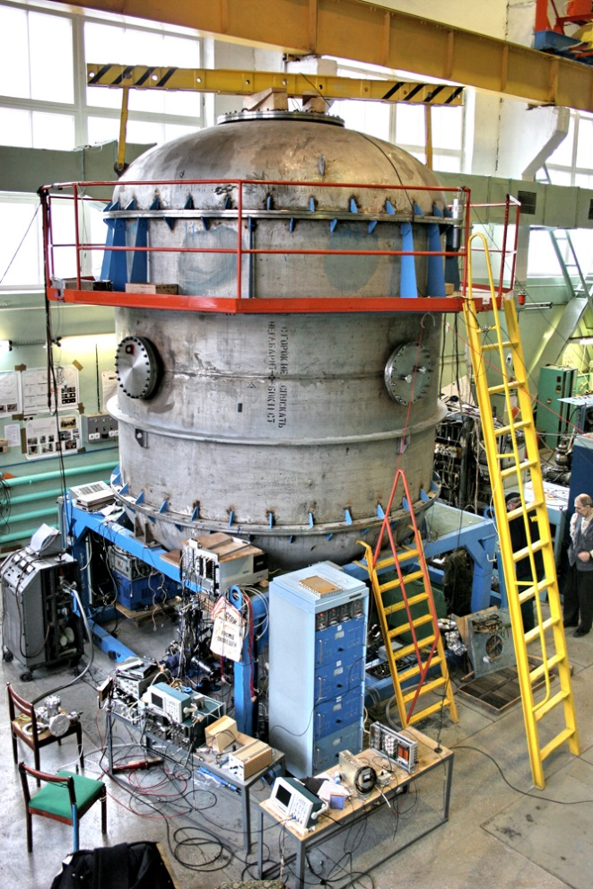
Accelerator Mass Spectrometry
Accelerator mass spectrometry (AMS) is an ultra-sensitive method of counting individual atoms.
Typical application – radiocarbon dating
Date interval – less than 50000 years to 100 years
Sample size – 1 mg
Count rate – 100 Hz
Accuracy – 0.2 %
AMS facilities operate in more than 140 physical laboratories worldwide, one of which is located in Novosibirsk at Geochronology of the Cenozoic Era Center for Collective Use.
Notes:
Accelerator Mass Spectrometry (AMS) is the standard technique for measuring rare cosmogenic radionuclides with long half-lives. It works by extracting individual atoms from a sample and counting the isotopes of interest.
A common example of AMS application is radiocarbon dating. With AMS, the radiocarbon age of a small sample (around 1 mg) that is less than 50,000 years can be determined with high accuracy.
There are about 140 AMS systems worldwide, including one developed at the Budker Institute of Nuclear Physics (BINP). This photo shows the BINP AMS, where radiocarbon dating is currently being carried out successfully.

Slide 4
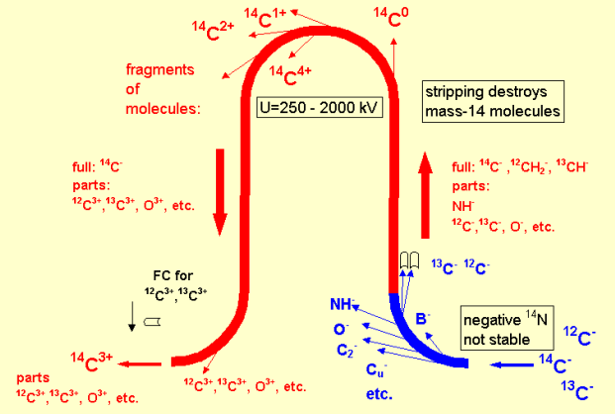
BINP AMS
1. Formation of an ion beam from atoms of the test sample
2. Ion selection at low energy
3. Ion acceleration
4. Recharging of atomic ions and destruction of molecular ions
5. Ion selection in a high voltage terminal
6. Ion acceleration
7. Ion selection at high energy
8. Identification and counting of ions
BINP AMS provides reliable separation of a pure beam of radiocarbon ions from the accompanying ion background.
Notes:
This figure shows the operating principle of the BINP AMS. Negative ions are generated from the sample in a cesium sputter source and mass-analyzed by a magnet. For ¹⁴C, using negative ions eliminates the isobaric background because ¹⁴N (nitrogen) does not form stable negative ions.
The mass-analyzed negative ions are accelerated to the positive high-voltage terminal of the tandem accelerator, where they pass through a magnesium vapor stripper. Here, molecular ions are destroyed, and atomic ions are recharged to a 3+ state. A unique feature of this accelerator is the 180° electrostatic bend, allowing only 3+ ions to pass.
These positively charged ions are further accelerated to ground potential in the second stage of the tandem accelerator. Another magnetic analyzer selects the ions of interest.
Finally, individual ions are identified and counted by a detector. A time-of-flight system is installed in the BINP AMS to ensure reliable separation of radiocarbon ions from the background.

Slide 5
Cosmogenic isotopes
Analyzed isotopes | Half life | Stable isotopes | Stable isobars (background)
¹⁰Ве | 1.39 million years | ⁹Be | ¹⁰B
¹⁴C | 5730 years | ^{12,13}С | ¹⁴N*
²⁶Al | 717 thousand years | ²⁷Al | ²⁶Mg*
³⁶Cl | 301 thousand years | ^{35,37}Cl | ³⁶Ar*, ³⁶S
⁴¹Ca | 102 thousand years | ^{40,42,43,44}Ca | ⁴¹K
¹²⁹I | 15.7 million years | ¹²⁷I | ¹²⁹Xe*
In the current BINP AMS setup the time-of-flight technique is used for the isotopes separation. But that technique has a serious problem of separating the isobars - different chemical elements having the same atomic mass. The typical example is radioactive isotopes ¹⁰Be and ¹⁰B.
* - isobars that do not form stable negative ions.
Notes:
AMS is not limited to ¹⁴C; it can also be used for other isotopes like ¹⁰Be, ²⁶Al, ³⁶Cl, and ¹²⁹I. These isotopes are very rare, with relative abundances usually less than 10⁻¹², which requires precise separation methods. AMS can measure cosmogenic isotopes at levels as low as 10⁻¹⁵ of the total element content.
In the current BINP AMS setup, the time-of-flight technique is used for isotope separation. One limitation of the BINP AMS is the isobaric background. Isobars are nuclides from different chemical elements that have the same mass number, such as ¹⁰Be and ¹⁰B.
To solve the problem of isobar separation, we have proposed a new technique for ion identification based on measuring the ion ranges and their energies in a low-pressure Time Projection Chamber with amplification of the charge signal using a gas electron multiplier.

Slide 6
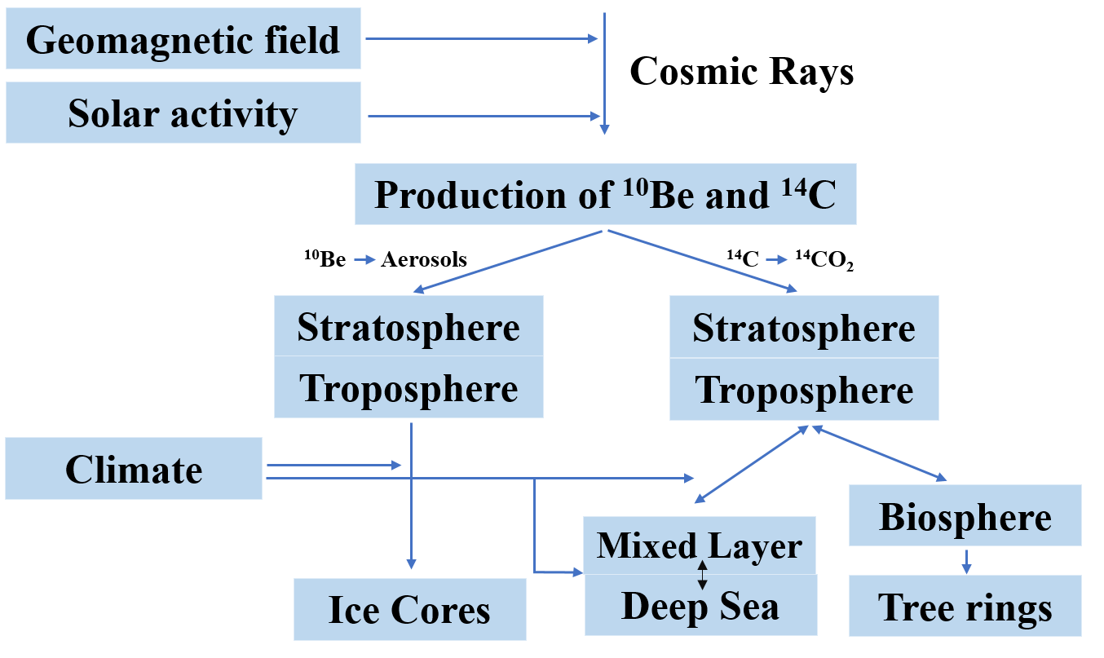
Formation and application ¹⁰Be
Time intervals of dating:
¹⁴C from 100 years to 50 thousand years
¹⁰Be from 1 thousand years to 10 million years
Application in-situ and
meteoric ¹⁰Be:
exposure dating to identified the growths and decays of the Antarctic ice sheet;
understanding ice shelf collapse history;
paleomagnetic excursions history reconstructions using ice cores;
understanding the erosion rates using depth profiles of mid latitudes outcrops;
identifying the timing of formation of the impact crater and so forth.
Notes:
10Be is the second most important radionuclide in the Earth and Environmental Sciences (besides radiocarbon).
Beryllium has a longer half-life than the radiocarbon, so the time interval of dating is ranged from 1 thousand to 10 million years. The radioactive isotope of beryllium is produced under the constant cosmic irradiation in the atmosphere as well as in situ in rocks. Atmospheric beryllium is adsorbed by aerosols and then it precipitates to the earth’s surface, where it is included in various sediment.
Beryllium has following applications: exposure dating to identified the growths and decays of the Antarctic ice sheet, understanding ice shelf collapse history, understanding the erosion rates and so on.

Slide 7
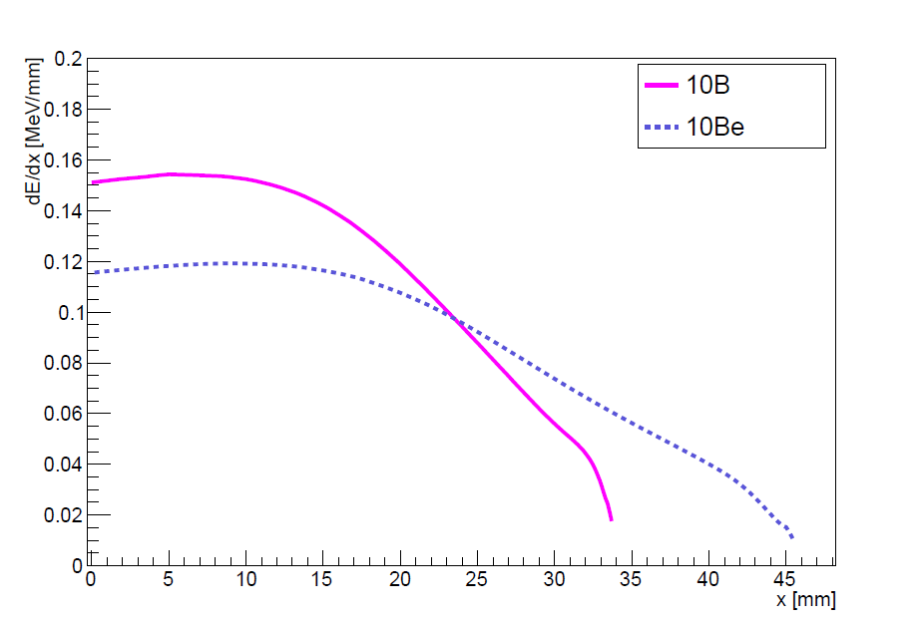

Traditional concept of ion identification at AMS
Detectors used to count the AMS ions:
silicon detectors;
time-of-flight systems;
ionization chambers.
∆Е-Е detectors
Anode 1
Anode 2
Anode 3
Frisch grid
e⁻
Ion track
$$\vec{E}$$
Window
Ions⁺
Cathode
Schematic drawing of a sample gas ionization detector with split anode. Such a detector is installed at AMS that carry out multi-isotope measurements.
Mean stopping power for ¹⁰B and ¹⁰Be projectiles against penetration depth in 50 torr isobutane.
7
Notes:
Various ion detectors are used to count AMS isotopes, including silicon detectors, time-of-flight systems, and ionization chambers.
Silicon detectors and time-of-flight systems can only provide isotope separation because ions with different masses have different energy and velocity.
To separate isobaric ions, split-anode ionization chambers are used. A typical multielement ionization chamber is shown in the figure. When ions pass through, they create electrons that drift toward the anode in a transverse electric field. The anode is divided into sections, and each section collects the electrons formed beneath it. Since ions with different atomic numbers (Z) lose energy at different rates, this energy-loss data allows for isobar separation.
The disadvantage of this type of detector is its poor signal-to-noise ratio. This is because it operates in ionization mode, which places higher demands on the electronics.

Slide 8
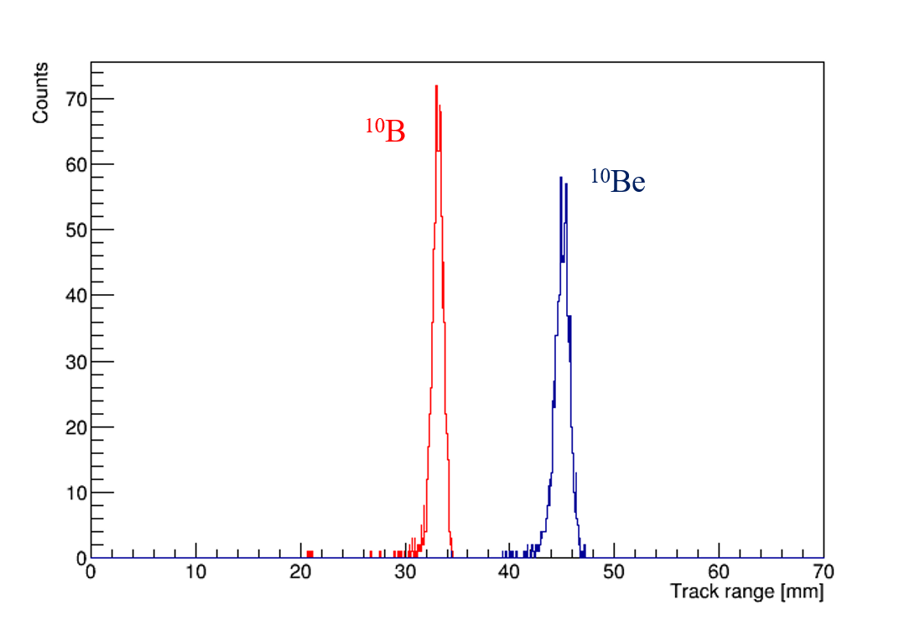
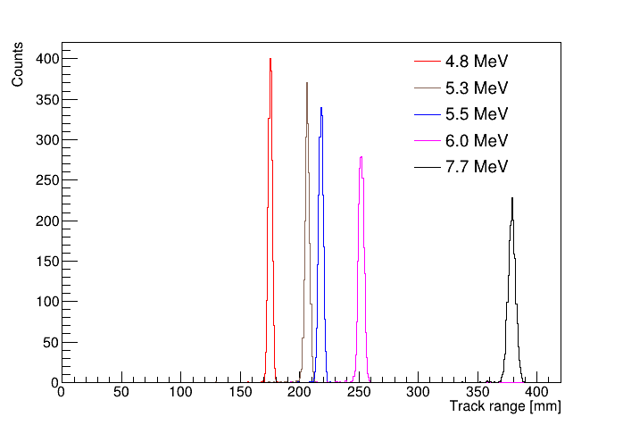
New concept of ion identification: measuring track ranges
SRIM simulation
SRIM simulation
Track ranges distribution of 4 MeV ¹⁰Be and ¹⁰B passing through 200 nm silicon nitride window into 50 torr isobutane at room temperature.
Track ranges distribution of alpha particles with different energies passing through 200 nm silicon nitride window into 50 torr isobutane at room temperature.
Notes:
The concept of identifying isobaric ions is to separate them by their track ranges. This is possible because ions with different atomic numbers have different energy losses in matter. The SRIM software package was used to determine the possibility of separating the 10Be and 10B isobars according to the track ranges.
The first picture shows track ranges distribution of 4 MeV 10Be and 10B passing through 200 nm silicon nitride window into 50 torr isobutane at room temperature. It can be seen that the ion track ranges differ by about 12 mm. Therefore, the low-pressure TPC with a spatial resolution of the order of 2–3mm will be sufficient to separate such ions.
To determine the spatial resolution of the TPC, the detector was calibrated using the alpha particles source from ²²⁶Radium. This source emits 5 alpha particles with given energies. The track ranges in isobutane from alpha particles were also simulated under the same conditions as in the experiment. The simulation result is shown in the second figure.
Alpha particles with energies of 5.3 and 5.5 MeV have the same range difference as boron and beryllium (about 12 mm). If we can distinguish such tracks using the low-pressure TPC, we will certainly be able to distinguish the tracks from 10B and 10Be ions at AMS.

Slide 9
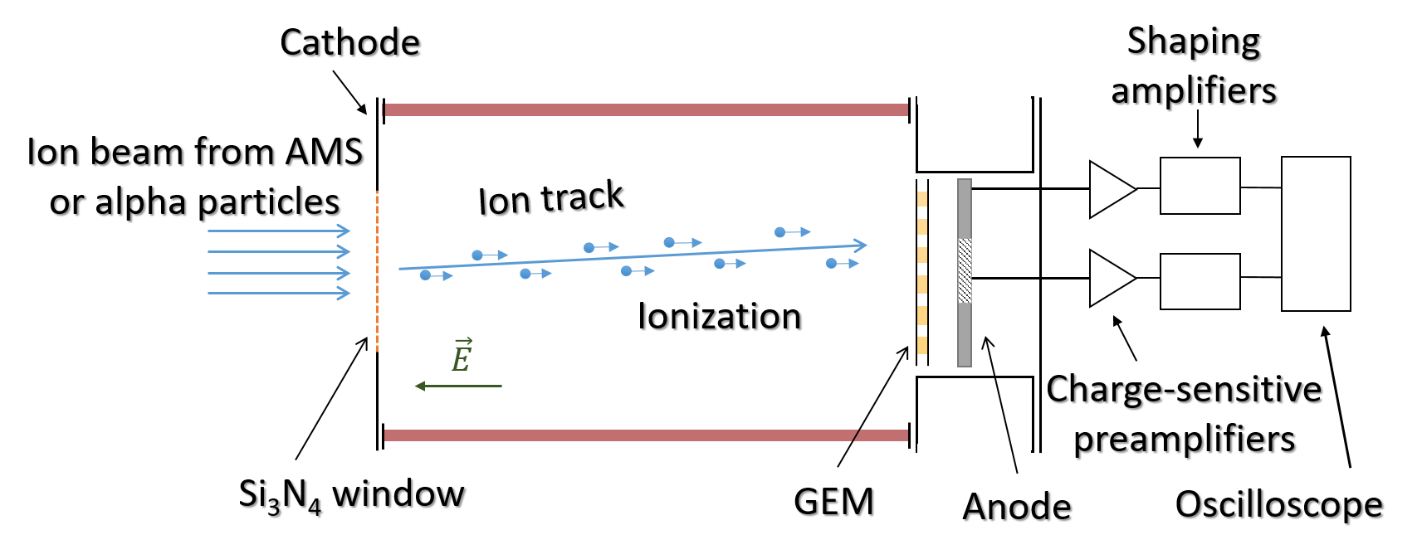
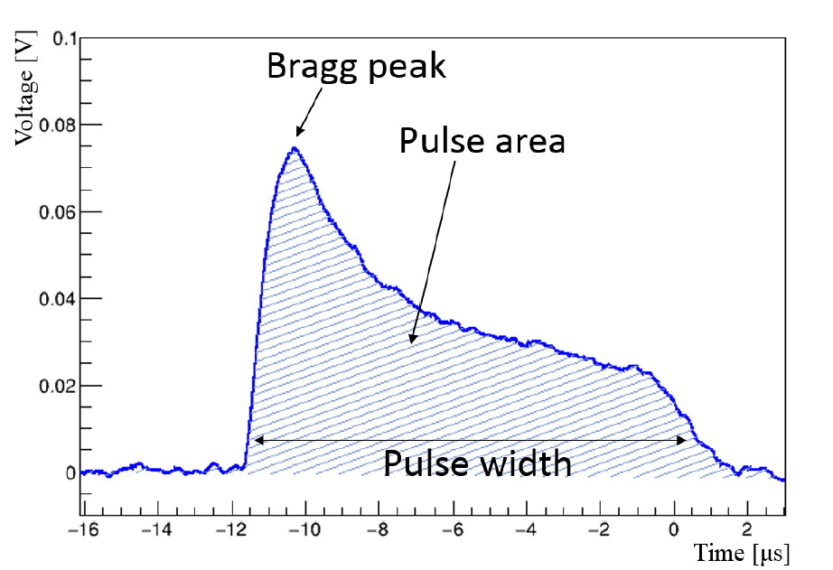

Proof of concept: low-pressure TPC
A waveform example from alpha particle in the low-pressure TPC
Schematic layout of the low-pressure TPC
Diameter ≈ 8 cm
Length ≈ 11 cm
Gas filled - Isobutane
pulse width $\sim$ track range
pulse area $\sim$ energy
Notes:
As a proof of principle, a low-pressure TPC with charge readout using Gas Electron Multiplier has been developed. A schematic representation of the detector is shown in this figure.
The chamber is 11 cm long ceramic cylinder that is divided by copper field-shaping rings. Potentials are applied to these rings, so a uniform electric field is created in the detector volume. The internal diameter of the chamber is 8 cm. The volume is filled with isobutane at room temperature and 50 Torr pressure. One flange has a silicon nitride inlet window. The Si3N4 membrane 10x10mm² area and 200 nm in thickness provides the passage for an ion beam from the AMS with energy of 4MeV or for alpha particles from the radioactive source. On the opposite flange GEM is installed on nylon rods, followed by an anode. The low-pressure TPC is placed in an external volume, which is pumped out to a vacuum.
Alpha particles or ions from the AMS create primary ionization in the detector volume passing through the gas. The resulting electrons drift towards the GEM where avalanche multiplication takes place. After that induced signal is read out at the anode and then it is amplified and digitized. The second figure shows the typical waveform from an alpha particle. When analyzing the data, the pulse width and area were determined, where the pulse width is proportional to the ion track range, and the pulse area is proportional to the deposited energy.

Slide 10
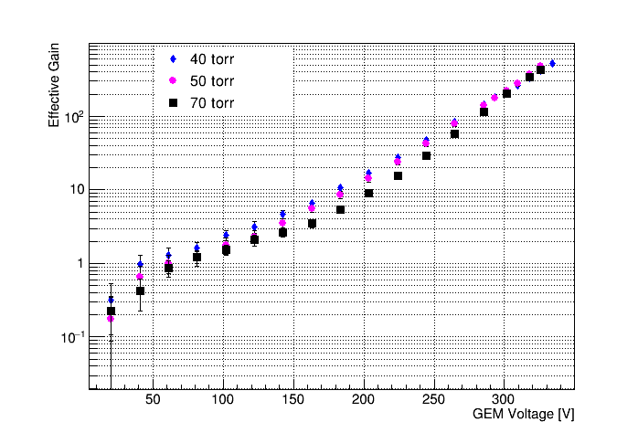
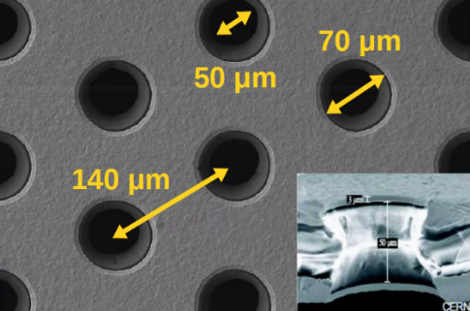
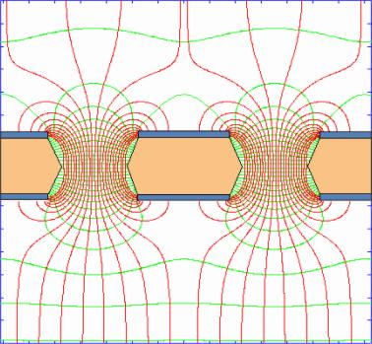
Signal amplification with GEM
Electric field inside the holes.
GEM effective gain as a function of the voltage in isobutane at pressures varying from 40 to 70 torr in the low-pressure TPC.
10
Notes:
To amplify the charge signal, we use a thin gas electron multiplier.
We studied the GEM performance at different pressures and voltages. This figure depicts GEM effective gain as a function of the voltage in isobutane at pressures varying from 40 to 70 torr in the low-pressure TPC.

Slide 11
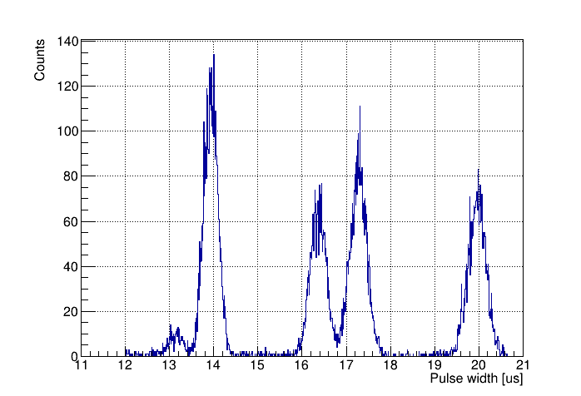
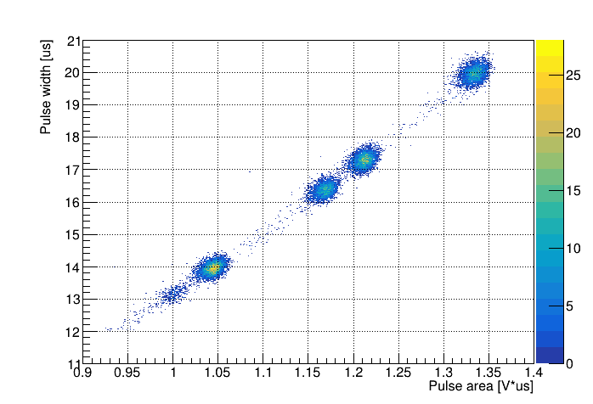
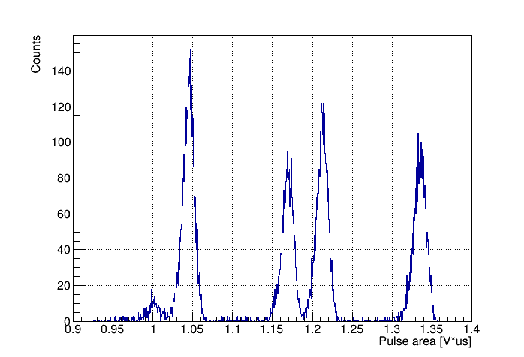
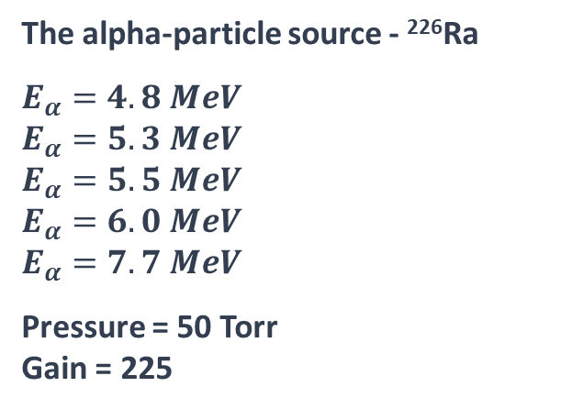
Measurements of energy spectra and track ranges from alpha particles
The alpha-particle source - ²²⁶Ra
$$E_{α}=4. 8 MeV$$
$$E_{α}=5.3 MeV$$
$$E_{α}=5.5 MeV$$
$$E_{α}=6.0 MeV$$
$$E_{α}=7.7 MeV$$
Pressure = 50 Torr
Gain = 225
Source | Sigma/Range | Separation level
²²⁶Ra | 1.13% | 5σ
Using these results and SRIM simulations it is shown that isobaric boron and beryllium ions can be effectively separated at AMS at the 5σ level.
11
Notes:
The spectrum of an alpha-particle source was measured using the low-pressure TPC with GEM. The figure shows a two-dimensional distribution of pulse width and pulse area. The projections on the pulse width and area axes are also shown. We can observe four clusters from alpha particles with energies of 4.8, 5.3, 5.5, and 6 MeV. These clusters are well-separated in both pulse width and pulse area. An alpha particle with energy of 7.7 MeV has a track range longer than the detector length.
We are particularly interested in the two clusters in the center. These alpha particles have the same track range difference as boron and beryllium ions. We can separate these peaks with a precision of 5 sigma.
Using these results and SRIM simulations, we show that isobaric boron and beryllium ions can also be effectively separated in AMS at the 5 sigma level.
In the future, we plan to make an independent trigger, which will significantly reduce the degree of dependence on diffusion and improve the time resolution.

Slide 12
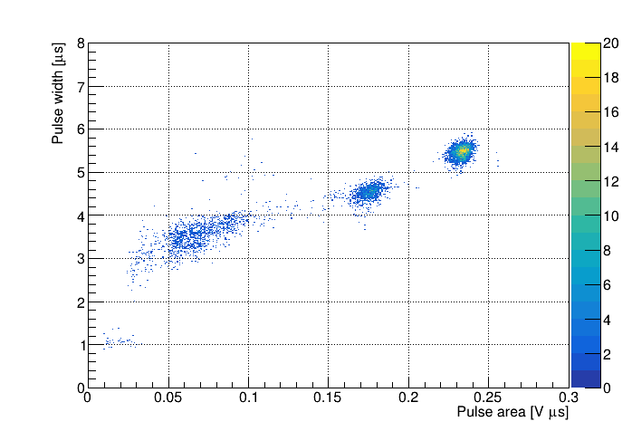
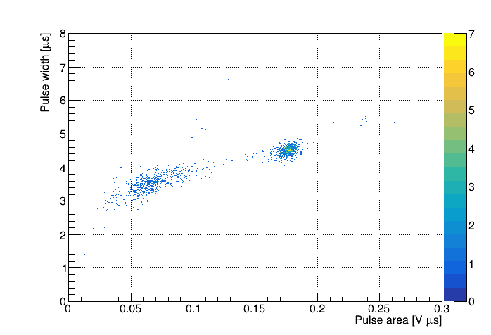
Measurements of energy spectra and ion ranges at AMS
2D plots of pulse width versus pulse area for ions from BINP AMS measured in low-pressure TPC in isobutane at 50 torr.
¹⁴C
Reference Sample
Australian National University standard.
Made from sucrose (sugar) and is one of the IAEA-certified radiocarbon standards.
Background Sample
Blank carbon samples was made from fine-grained dense graphite (dead carbon without 14C).
12
Notes:
We installed the low-pressure TPC at BINP AMS after the time-of-flight system for testing. This way, calibrating our detector does not interfere with routine AMS measurements. We performed test measurements using two sample types: a reference sample and a background sample. The 2D plots on this slide show pulse width versus pulse area for ions from BINP AMS, measured in the low-pressure TPC using isobutane at 50 torr.
The reference sample is a certified radiocarbon standard from Australian National University, made from sucrose with a known radiocarbon content. The blank carbon sample was made from fine-grained, dense graphite (dead carbon without ¹⁴C). In routine measurements, all results are background-corrected and calibrated using reference samples.
In the first figure (reference sample), we see three distinct clusters. In the second figure (background sample), only two clusters are visible. This indicates that the additional peak in the reference sample belongs to ¹⁴C ions, while the other two clusters represent background. The time-of-flight detector at BINP AMS effectively suppresses this background, as these ions have different flight times.

Slide 13
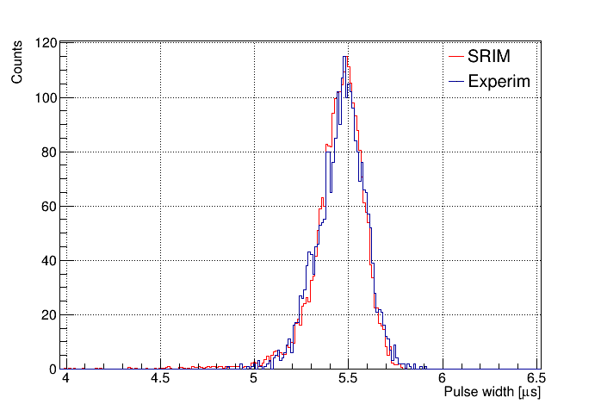
Carbon-14: experiment vs simulation
Distribution of pulse width from carbon-14 ions. Low-pressure TPC measurements are fitted with simulation using SRIM.
Experiment: υ_{dr} = 0.53 cm/µs
Drift velocity in Isobutane at 50 torr and E = 13.5 V/cm is calculated using Magboltz.
Magboltz: υ_{dr} = 0.58 cm/µs
Experiment and simulation are in good agreement.
There is currently work in progress on determination of experimental errors.
13
Notes:
This slide compares the experimental results with simulations. The pulse width distribution of ¹⁴C ions was obtained, and the measurements from the low-pressure TPC were fitted to a simulation using SRIM. The drift velocity in the experiment is 0.53 cm/µs.
The drift velocity in isobutane at 50 torr and an electric field strength of 13.5 V/cm was calculated using Magboltz, giving a simulated drift velocity of 0.58 cm/µs.
The experiment and simulation show good agreement. We are currently working on determining the experimental errors.
After the modernization of BINP AMS, we plan to conduct experiments with samples containing beryllium.

Slide 14
Results
We have developed and successfully tested low-pressure TPC with GEM readout for AMS.
A new ion identification technique based on measuring both ion track ranges and ion energies in low-pressure TPC has been developed.
Using these results and SRIM simulations, it was shown that isobaric boron and beryllium ions can be effectively separated at BINP AMS at a level of 5σ. It provides efficient dating up to 10 million years (for geochronology of Cenozoic Era).
Low-pressure TPC was installed at BINP AMS. Measurements were successfully carried out with samples containing radiocarbon.
14

Slide 15
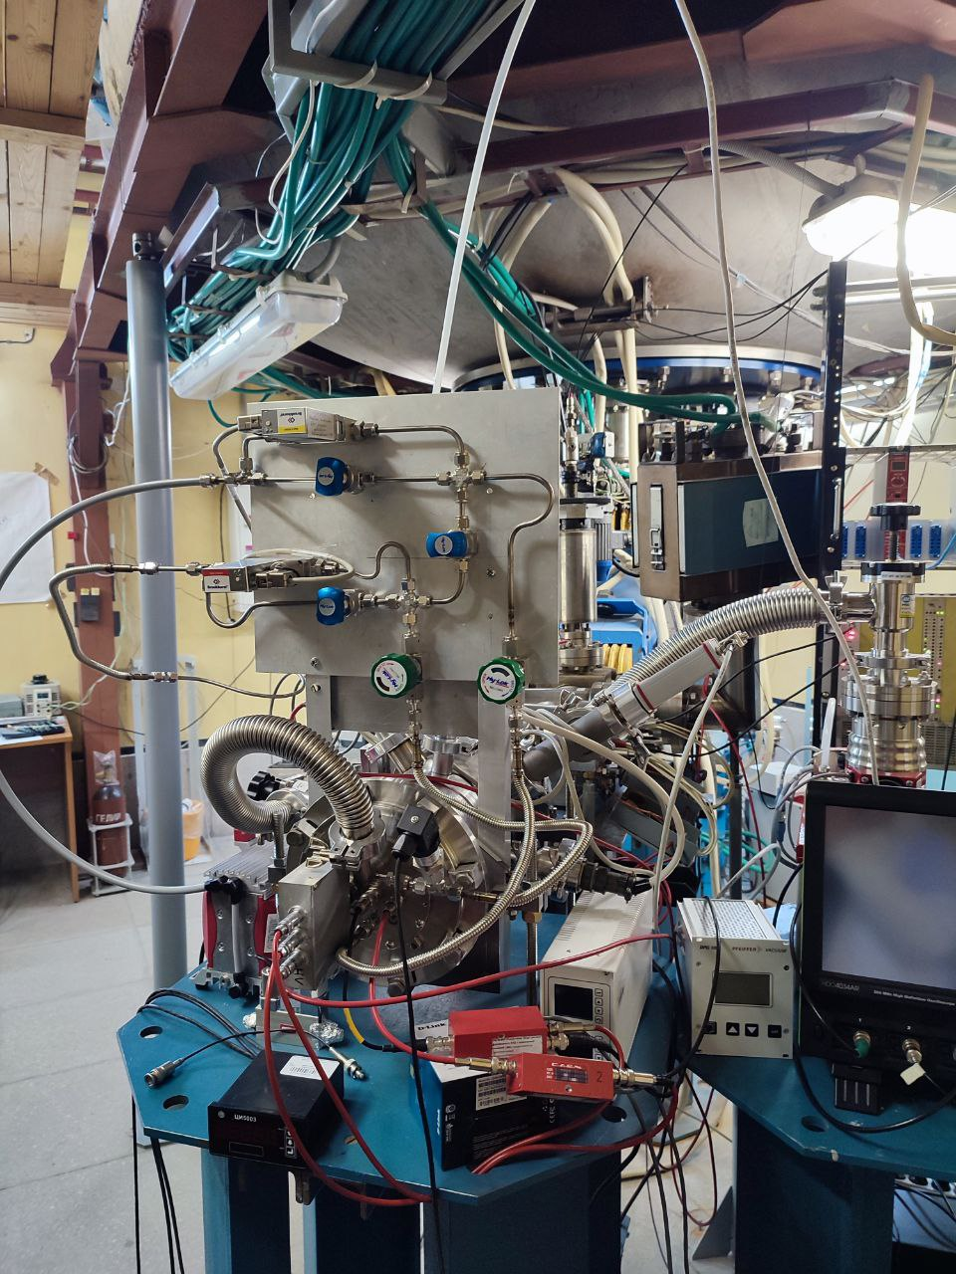
Thank you for
your attention
15

Slide 16
Backup slides
16

Slide 17

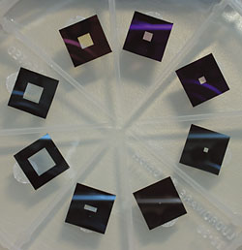
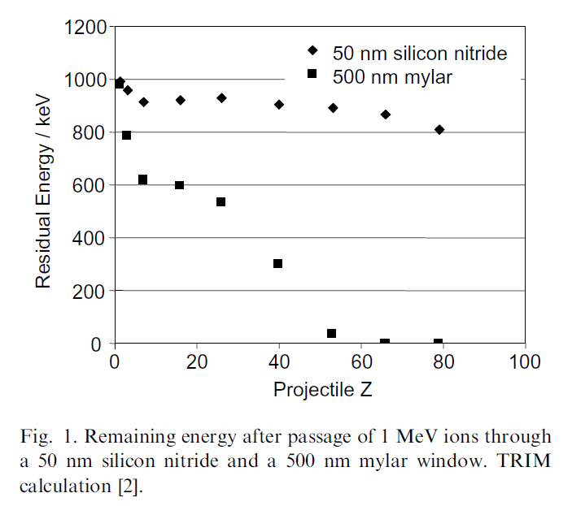
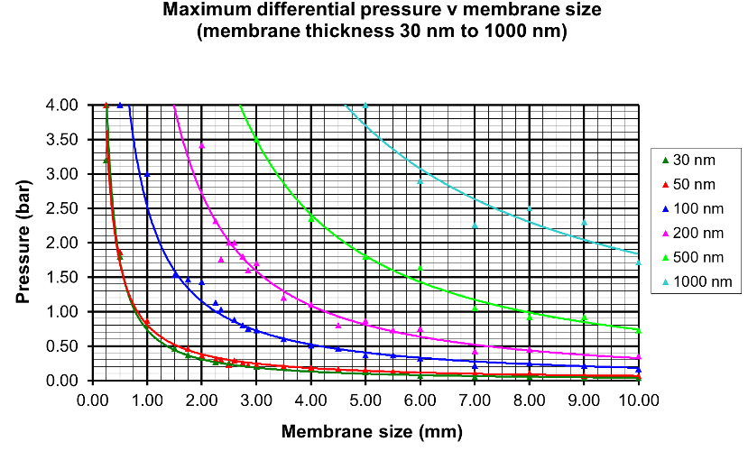
Silicon nitride membrane windows
Figure of silicon nitride membrane windows
M. Dobeli et al., Nucl. Instr. and Meth. B, 219-220 (2004) 415-419 doi:10.1016/j.nimb.2004.01.093
17

Slide 18
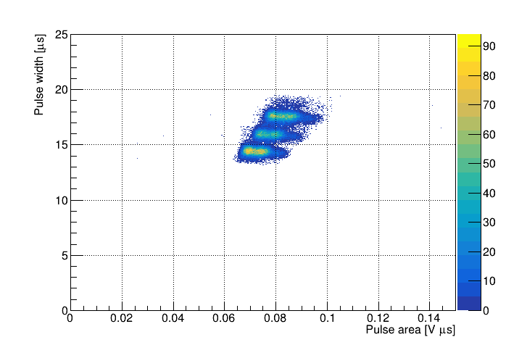
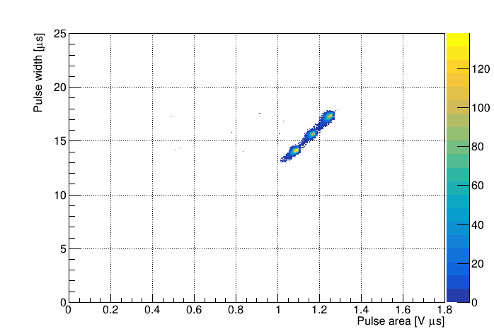
THGEM versus GEM
2D plot of pulse width versus pulse area for alpha particles from ²³³U (4.8 MeV), ²³⁹Pu (5.2 MeV) and ²³⁸Pu (5.5 MeV) source, measured in low-pressure TPC in isobutane at 50 torr and room temperature using THGEM amplification with gain of 320.
2D plot of pulse width versus pulse area for alpha particles from ²³³U (4.8 MeV), ²³⁹Pu (5.2 MeV) and ²³⁸Pu (5.5 MeV) source, measured in low-pressure TPC in isobutane at 50 torr and room temperature using GEM amplification with gain of 230.
18

