Slide 1




Exploitation of a Soft X-Ray 2D triple GEM detector
at the MASTU spherical tokamak
Agostino Celora
Andrea Muraro
Federico Caruggi
Gabriele Croci
ISTP team
Rory Scannel
Luca Garzotti
MAST-U team

Slide 2
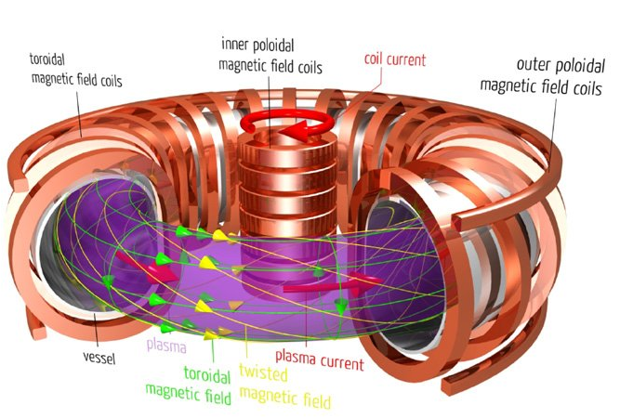
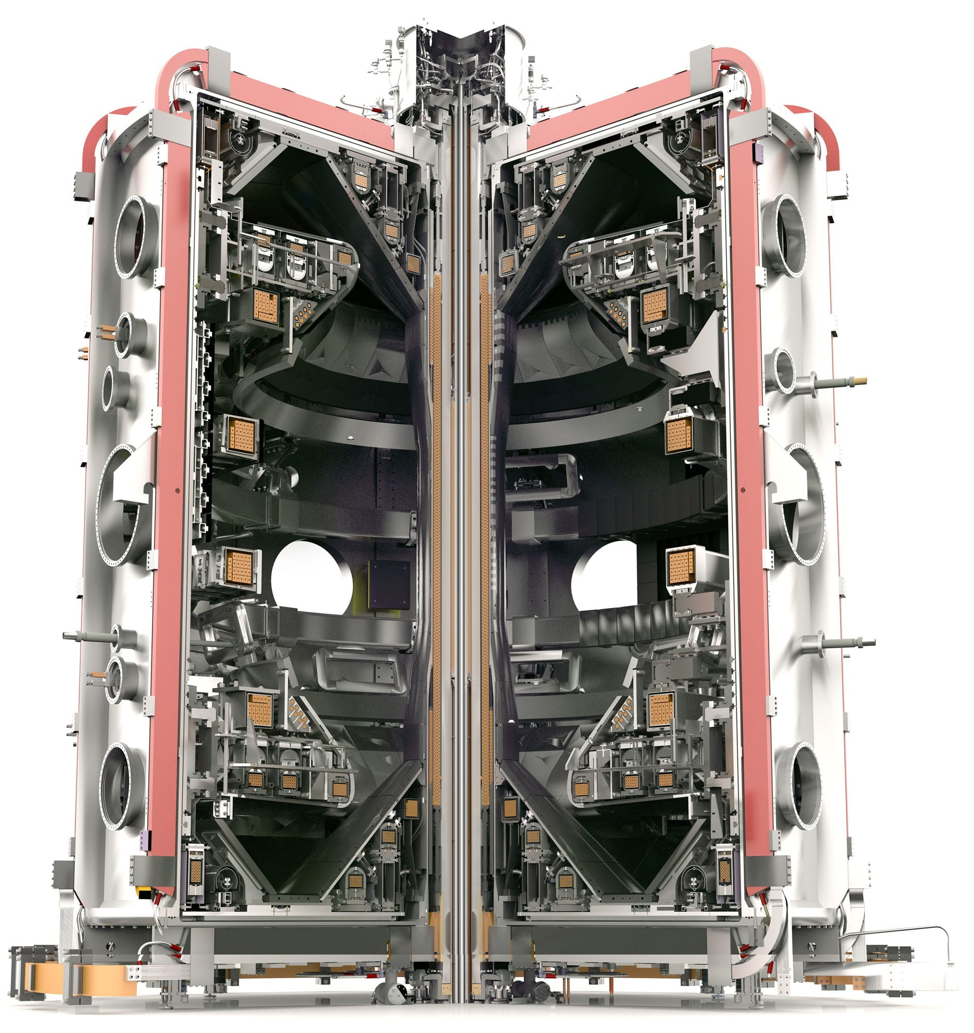
Thermonuclear fusion through magnetic confinement:
The Tokamak
A tokamak is a device used for achieving controlled thermonuclear fusion by confining plasma in a toroidal (doughnut-shaped) chamber using powerful magnetic fields.
Goal: To replicate the processes occurring in the sun, providing a nearly limitless source of energy.
Fusion Reaction: Combines deuterium and tritium nuclei to form helium and release energy.
Magnetic Confinement: Uses magnetic fields to keep the hot plasma away from the walls of the vessel.
Major and minor radii | 0.7/0.5 m
Plasma current | 1 MA
Plasma heating | 4.5 MW (Ohmic + NBI)
Pulse duration | 1-2 sec
Electron Temperature | 2.5 KeV

Slide 3
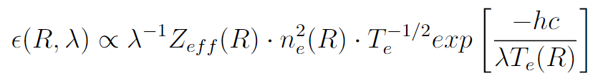
Soft X-Ray radiation from Tokamak
Soft X-Ray emission is a crucial diagnostic tool in tokamaks, providing insights into plasma behavior and characteristics. It is essential for optimizing plasma confinement and stability.
Why?
Emitted due to interactions within the plasma, mainly two types:
Bremsstrahlung:
it is one of the main energy loss channels.
line transition: the radiative decay of an excited atomic state of a bound electron into a lower energy level. the contribution of line emission is given by medium and heavy impurities.

Slide 4
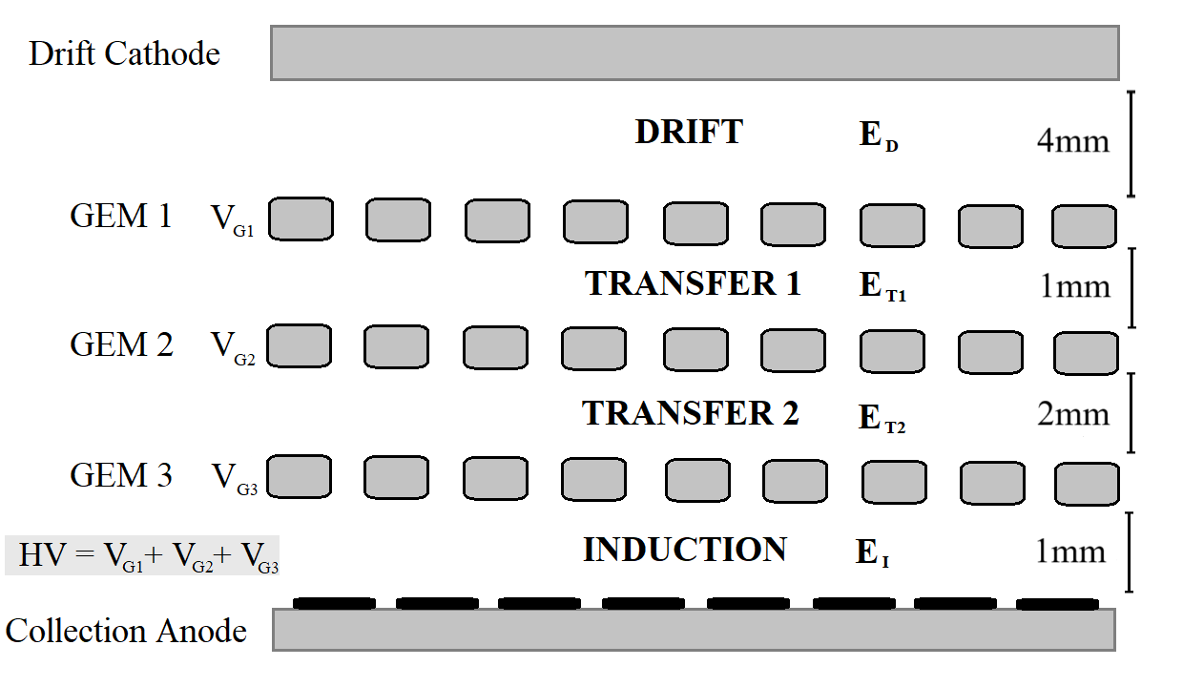
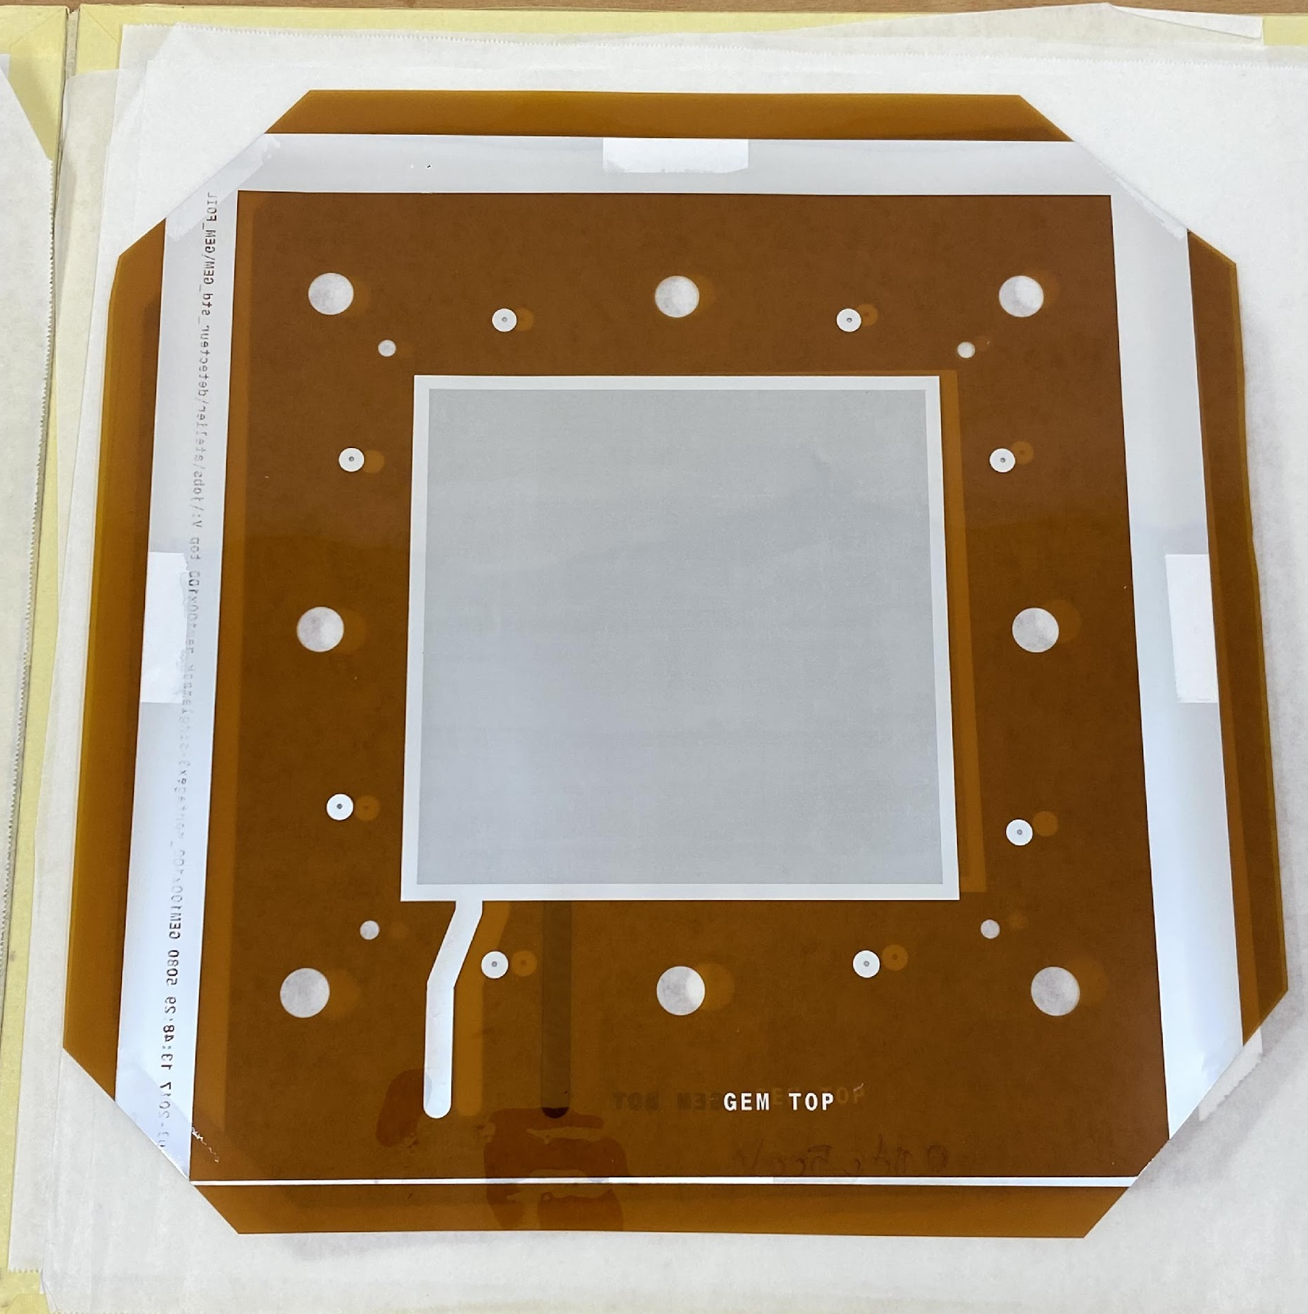
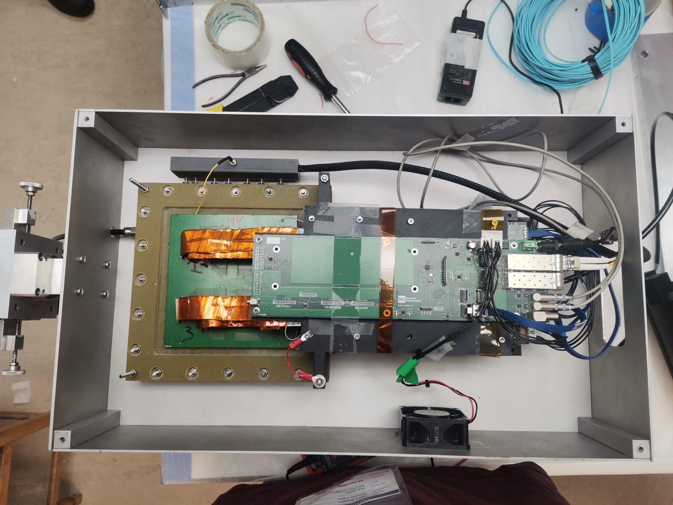
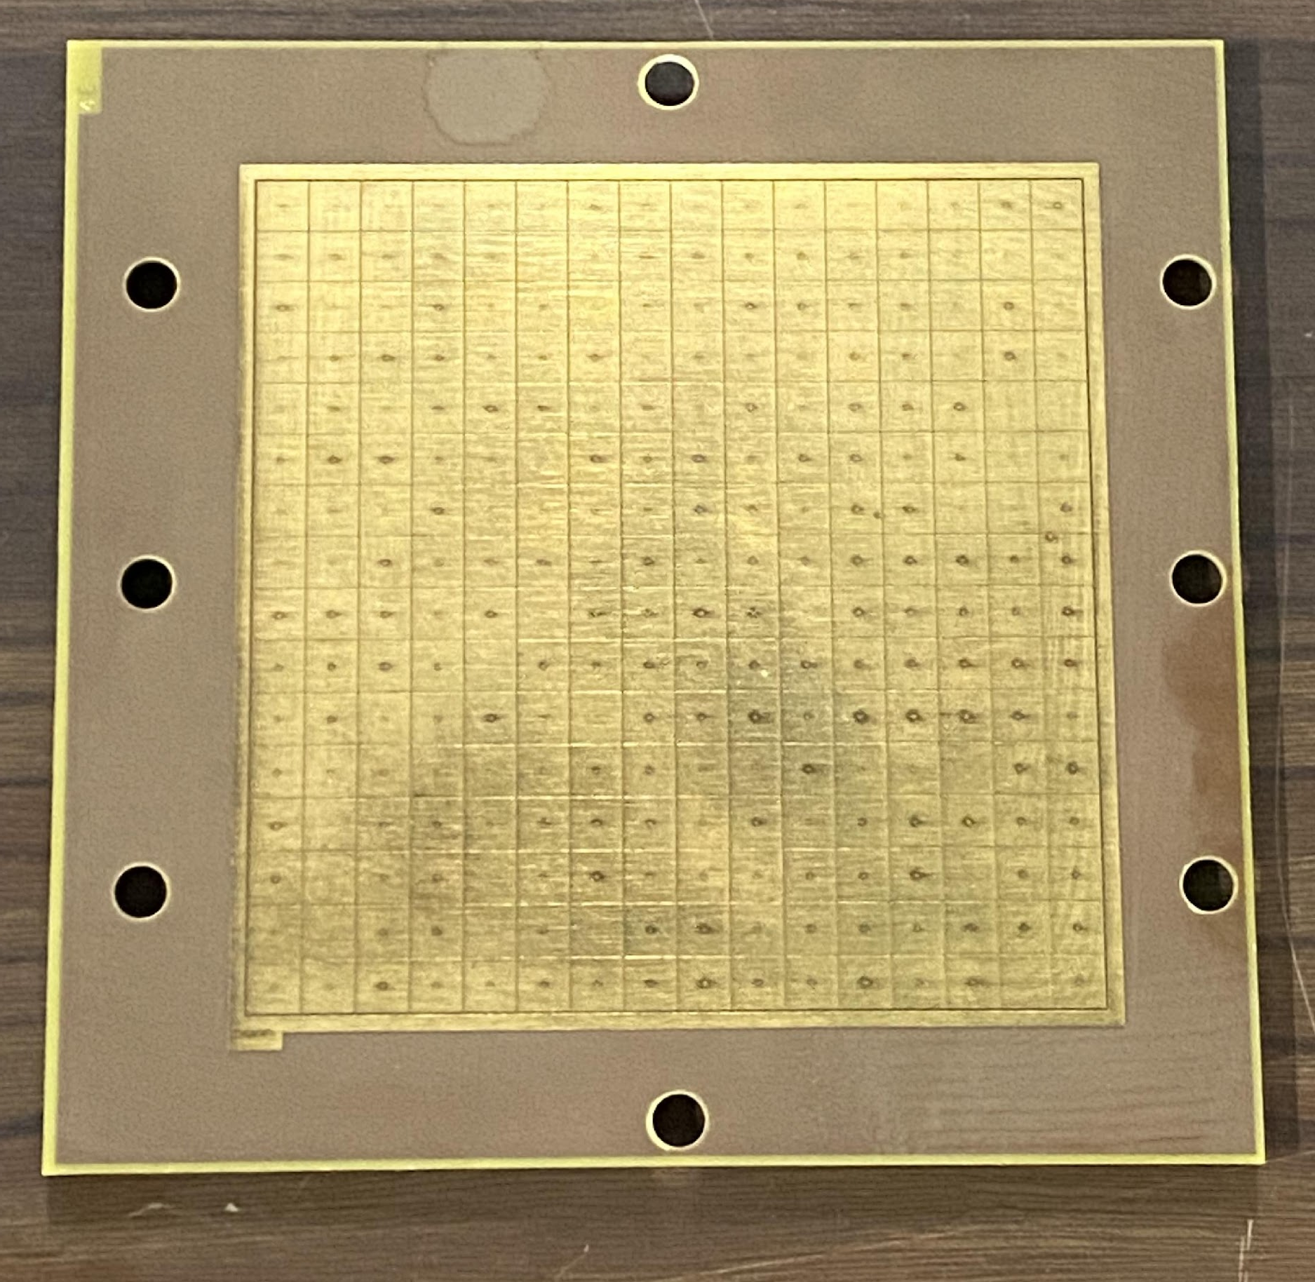
Gas Electron Multiplier detectors for SXR
Triple GEM configuration.
Ar-Co2 mixture 70%-30%.
Aluminum GEM.
1 MHz per pixel.
16 x 16 Pixel, 6mm x 6mm .

Slide 5
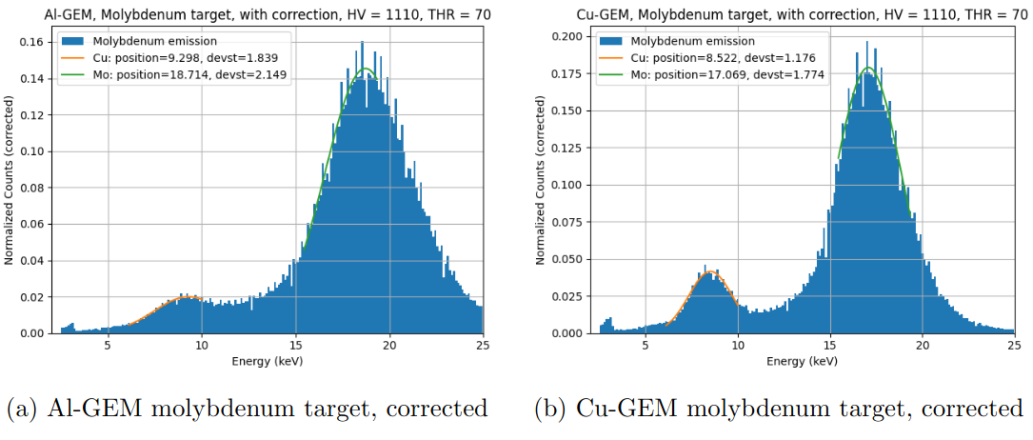
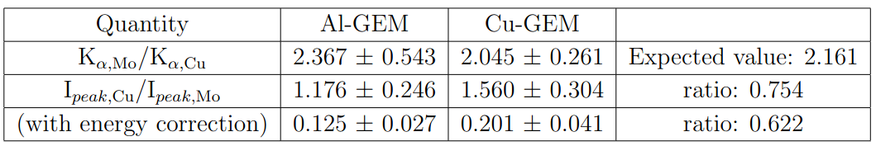
Aluminum GEM
Caruggi, Federico, et al. "Performance of a triple GEM detector equipped with Al-GEM foils for X-rays detection." Nuclear Instruments and Methods in Physics Research 1047 (2023): 167855.

Slide 6
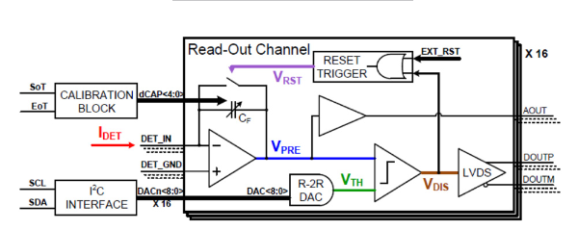
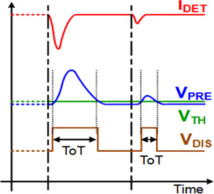
Gas Electron Multiplier detectors: Electronics
A compact Readout electronics composed by an Application Specific Integrated
Circuit (ASIC) called GEMINI and a custom made FPGA.
Each pixel is read by a single GEMINI channel, making the measure asynchronous, in photon counting mode. The energy information is retrieved by a Time over Threshold technique.
The time binning can be adapted to different event rates, the maximum event rate is 1 MHz per channel.

Slide 7
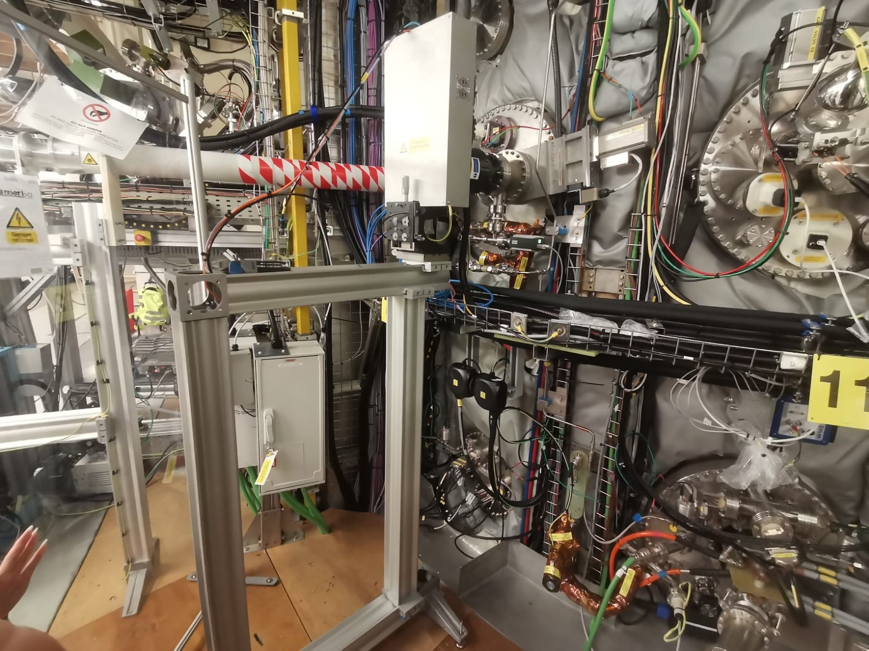
GEM diagnostic on MU03
Central Column
Outer Wall
pinhole
GEM detector
View cone

Slide 8
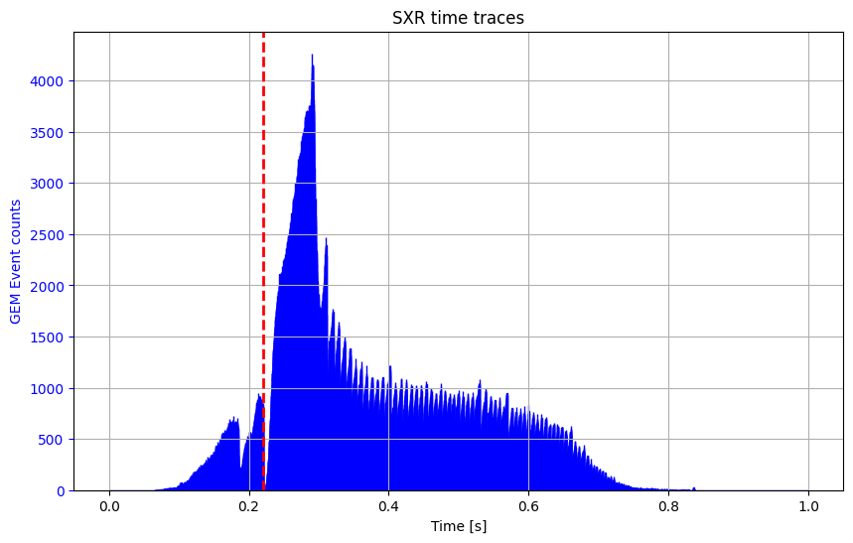
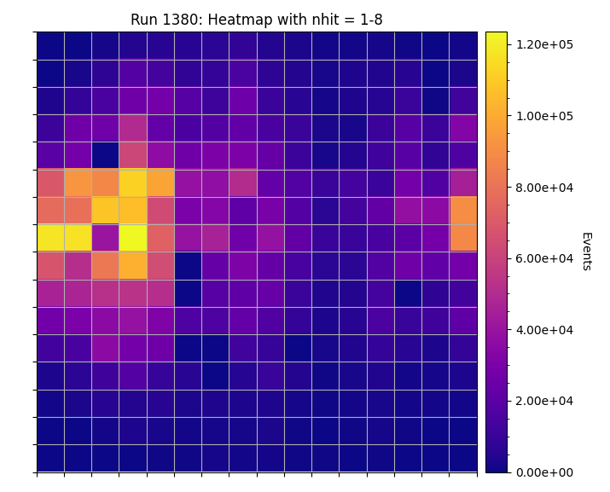
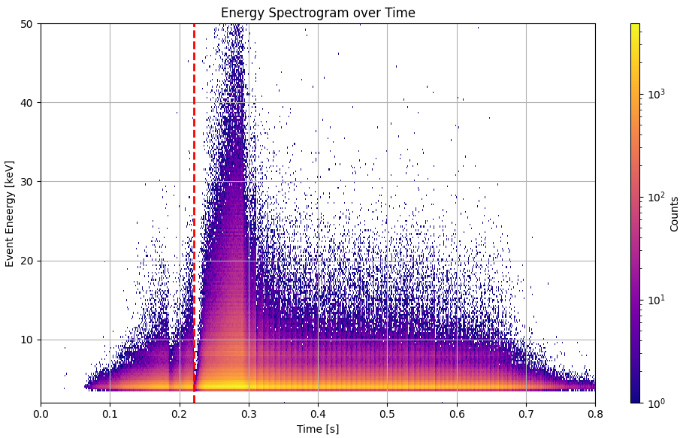
SXR timetrace and image
Heatmap image
a)
b)
c)
central solenoid projection
MASTU #49020:
SXR time trace, GEM binning at 0,1 ms.
GEM global heatmap.
Energy spectrogram, GEM binning at 0.1ms.

Slide 9
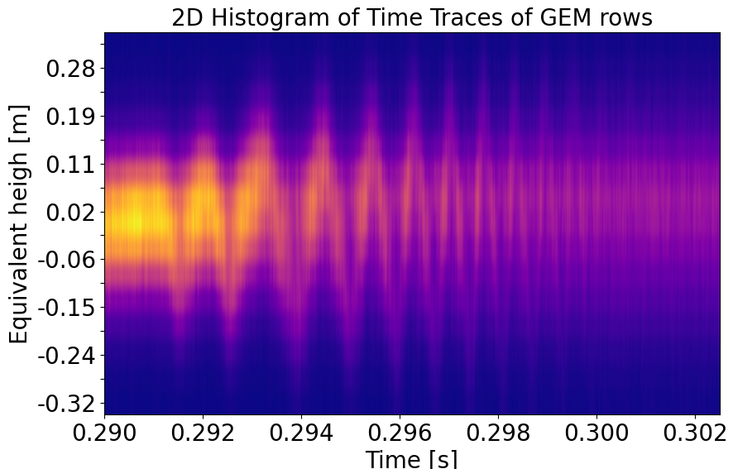
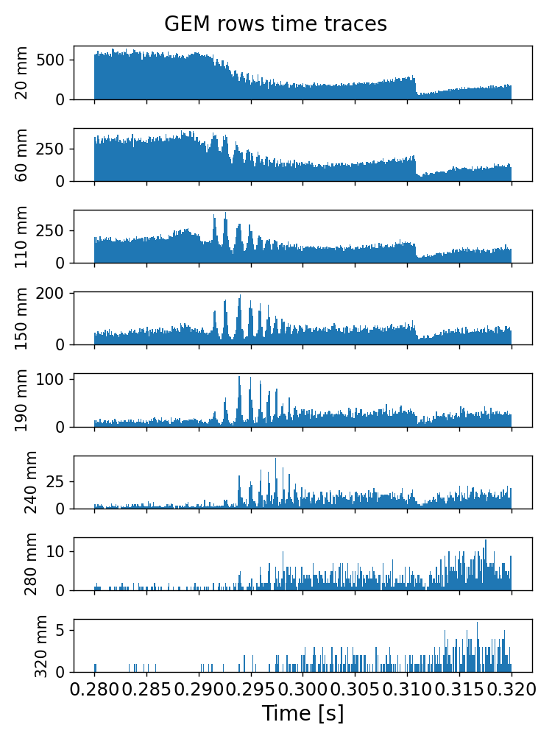
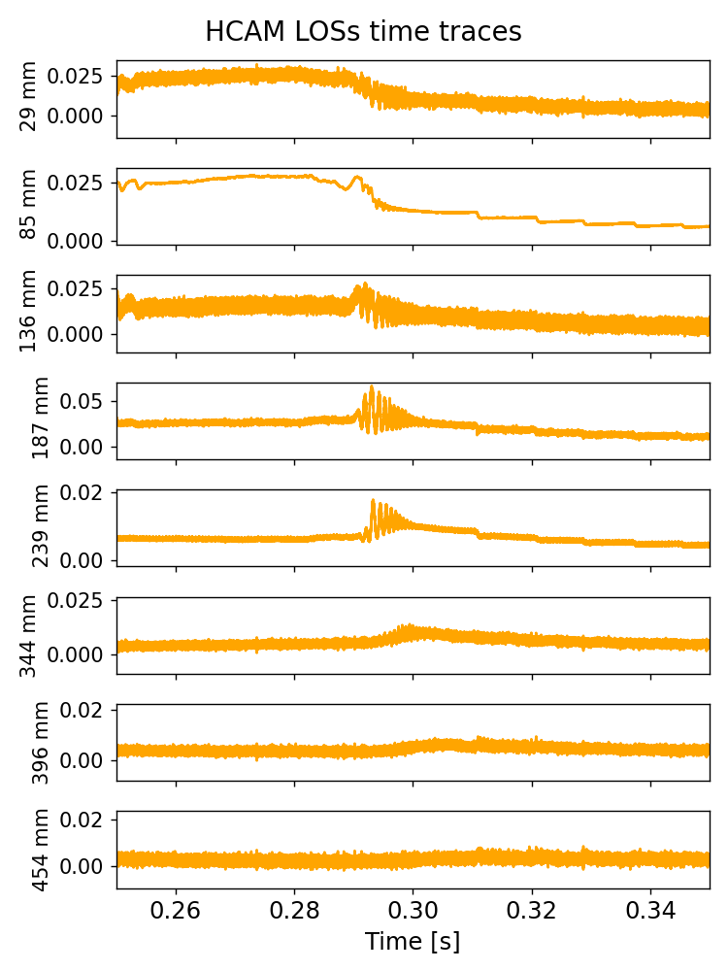
Localisation of a Snake Instability
MAST-U #49020:
time binning 0.01 ms.

Slide 10
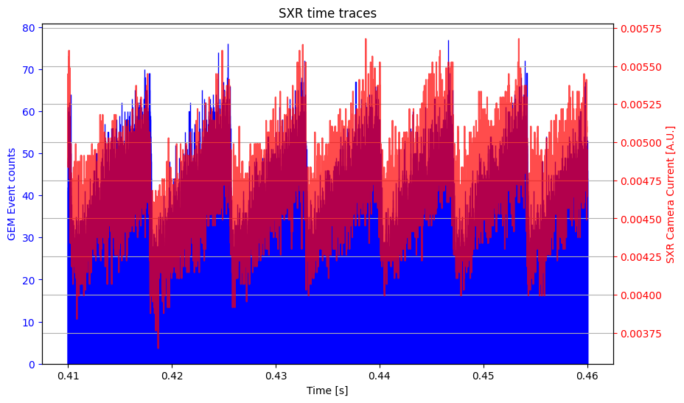
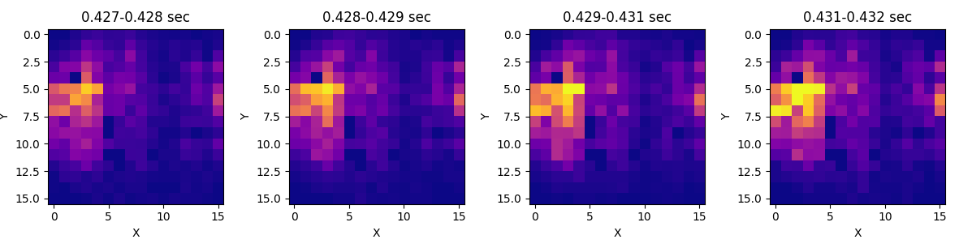
SAWTOOTH signal
SXR timetrace
Sawteeth crashes (@ 130 Hz) are clearly visible.
Clear match with standard SXR diagnostic.
The GEM time binning is 5 microSecond.
single ramp:

Slide 11
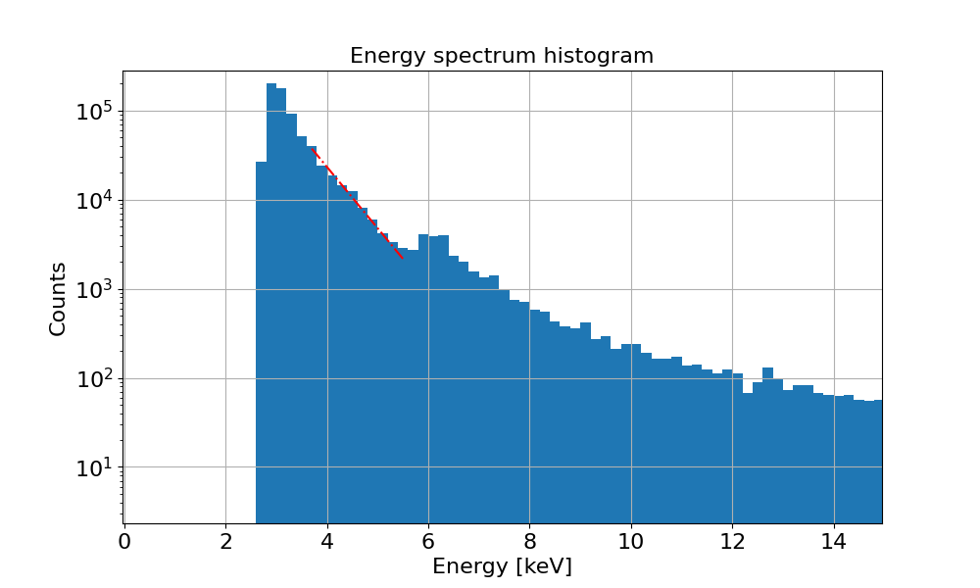
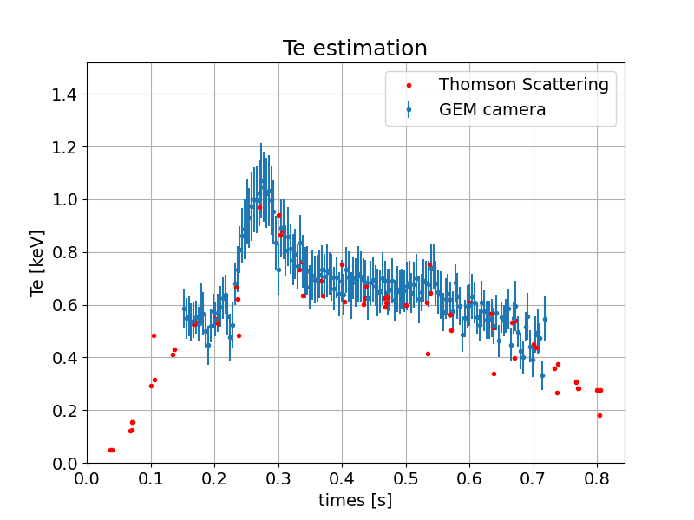
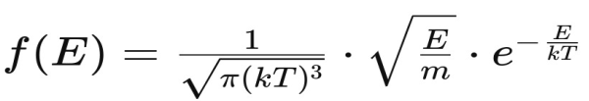
Spectroscopic capabilities: the Spectrum
Ohmic shot #49020.
GEM Energy spectrum integrate over
the full pulse and over the entire camera.
Example of exponential fit in the region
3.2 - 5.5 keV.
Good correspondence with standard diagnostic (Thomson Scattering) estimations.

Slide 12
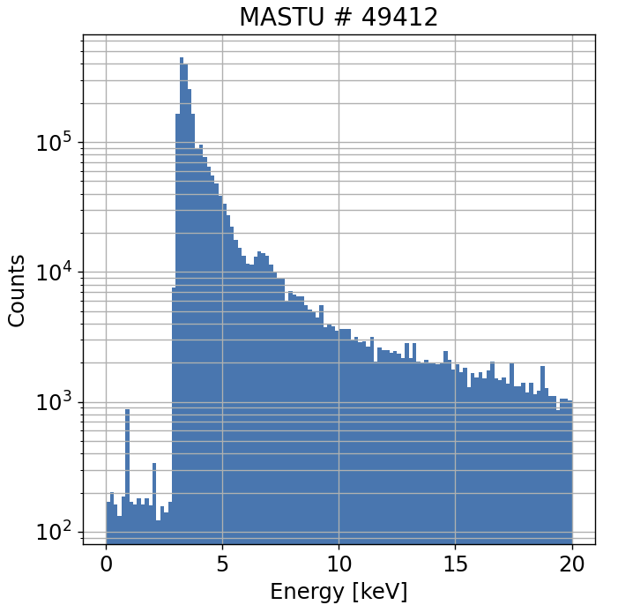
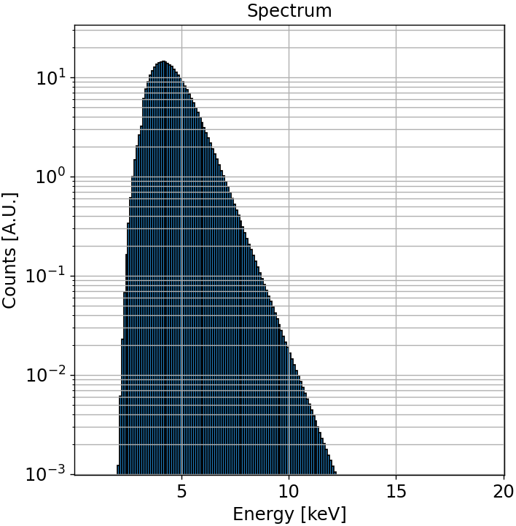
Analysis of GEM Energy Spectrum
The acquired spectrum exhibits deviations from the simulated spectrum, revealing non-idealities that must be addressed to fully utilize the detected energy range. The key issues identified are:
A secondary peak
A high-energy tail
Investigating the causes and potential mitigation strategies for these discrepancies is essential.

Slide 13
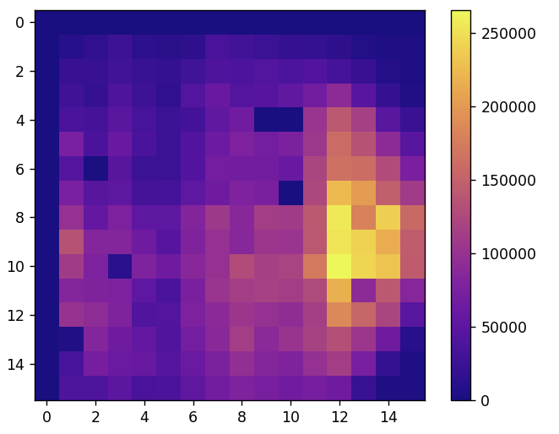
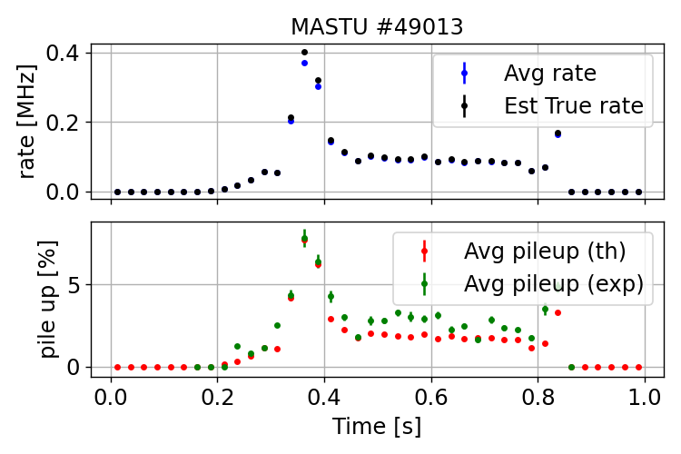
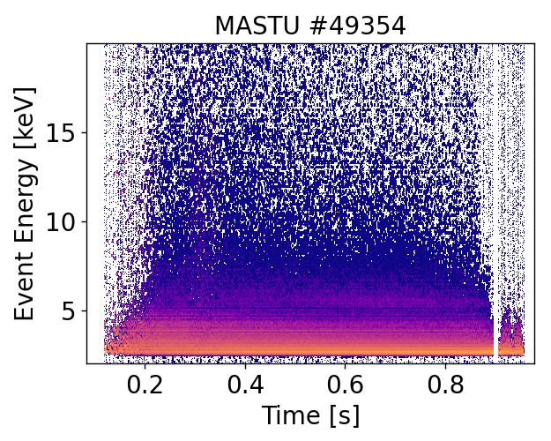
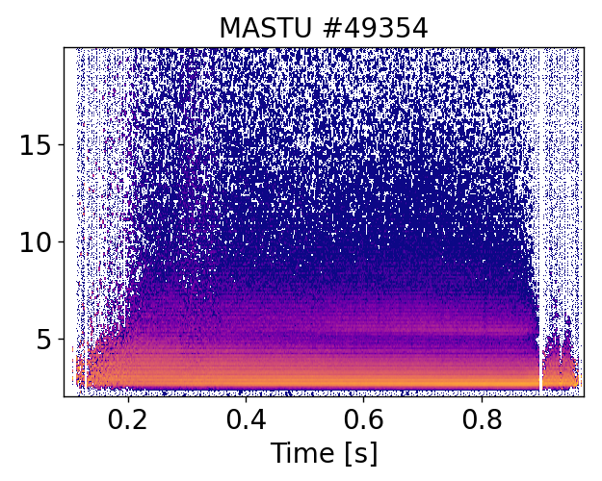
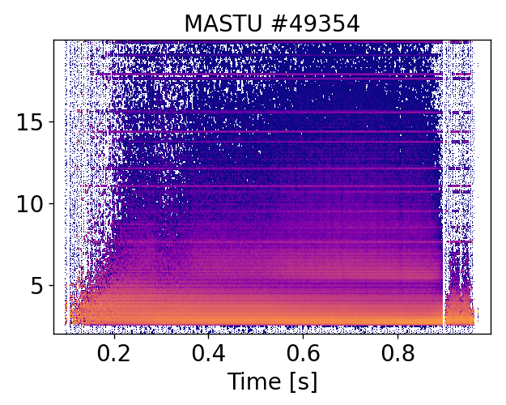
Pile-Up analysis
The presence of Pile-up is studied both qualitative and quantitative.
with a comparison with the expected pile-up for a paralyzable detector with a signal of 150 ns.

Slide 14
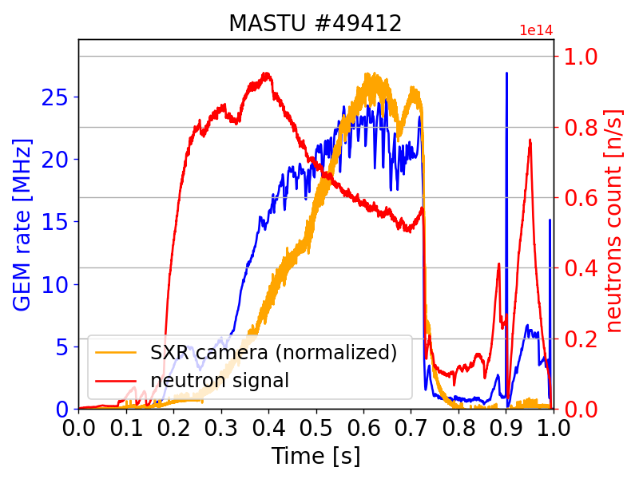
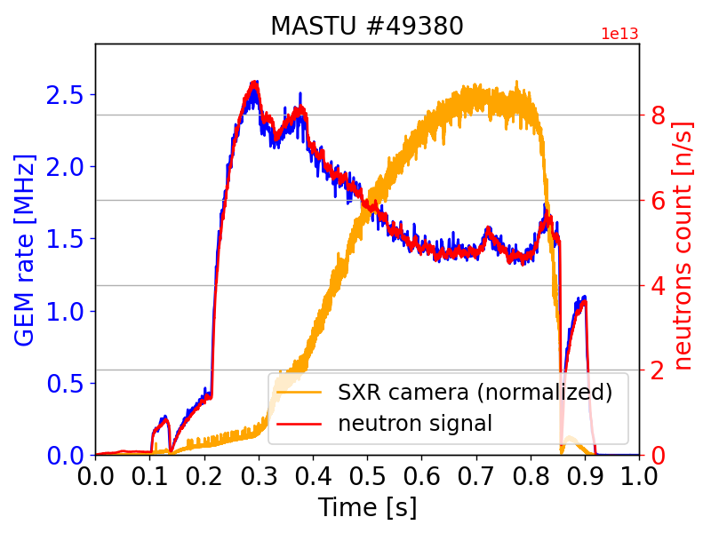
Neutron background
gate open = direct neutrons + gammas + SXR.
gate closed = direct neutrons + gammas.

Slide 15
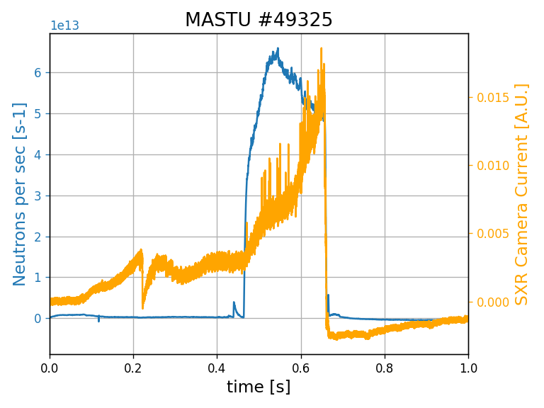
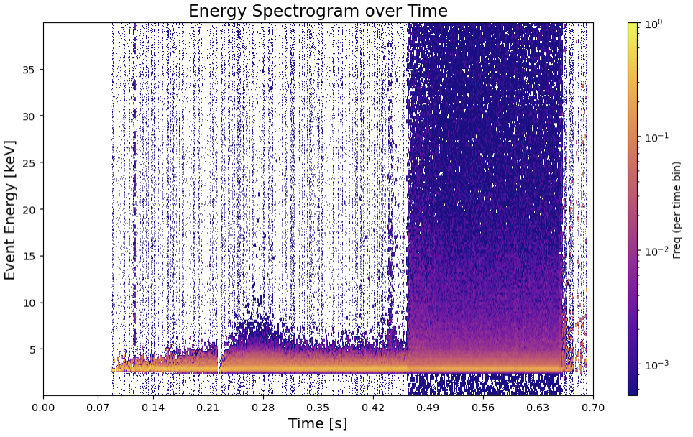
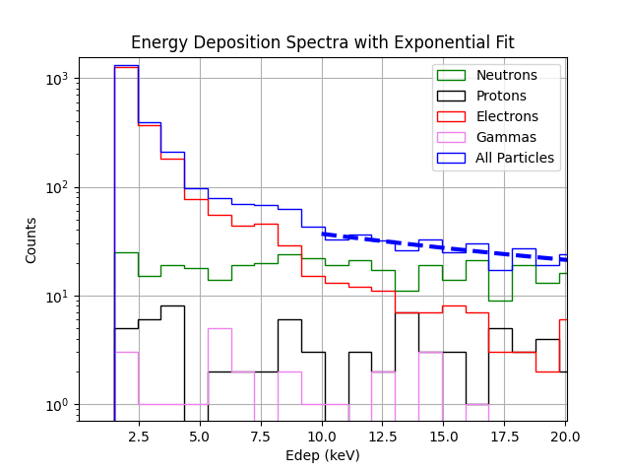
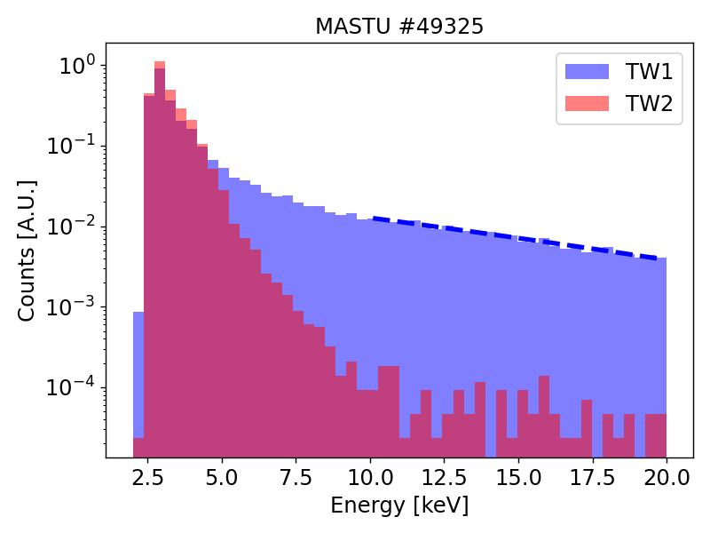
Neutron Background: differences between Ohmic & NBI shots
The shot #49325 shows an transition at 0.46s to high performance plasma state (LH transition).
It implies a sudden rise in the neutron flux.
It is possible to observe clearly the influence of neutrons on the GEM signal.

Slide 16
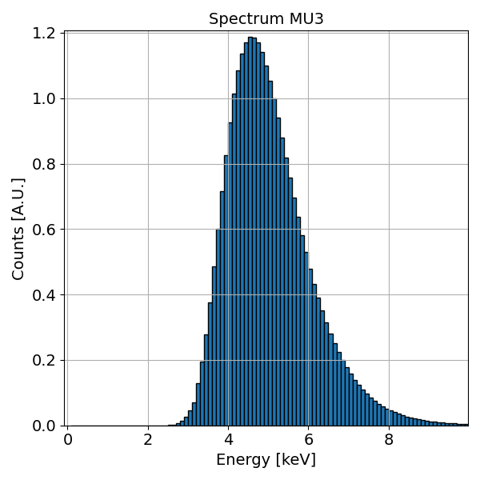
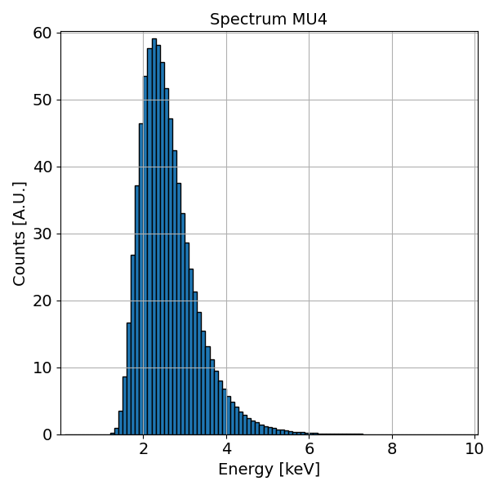
Neutron background mitigation
Design Upgrades are planned to optimize the set-up:
Detector gas mix from ArCO2 to NeCO2.
Apply an Helium buffer in front of the GEM.
Utilize smaller pads.
Utilize a smaller aperture in front of the pinhole.
Switch to a tangential point
of View.
Expected results:
Higher SNR ratio: up to 2 order of magnitude.
Reduction of pileup.
Signal starting from <2 keV.
Study Argon impurities in the tokamak.

Slide 17
Thank you

Slide 18
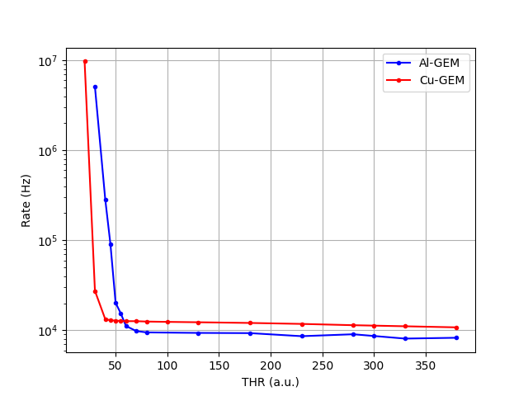
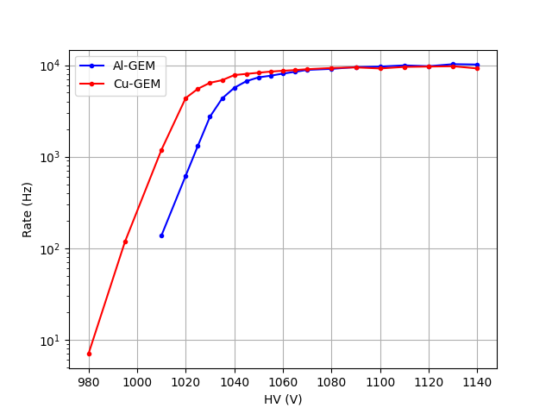
Al GEM working point: Threshold and Voltage scan
Threshold scan
Voltage scan

Slide 19
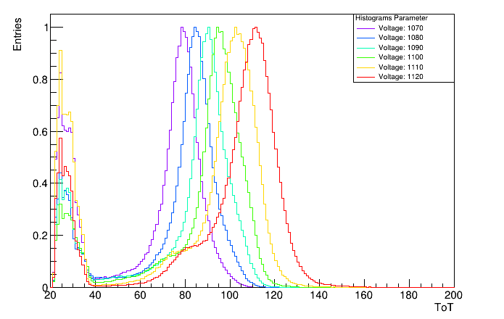
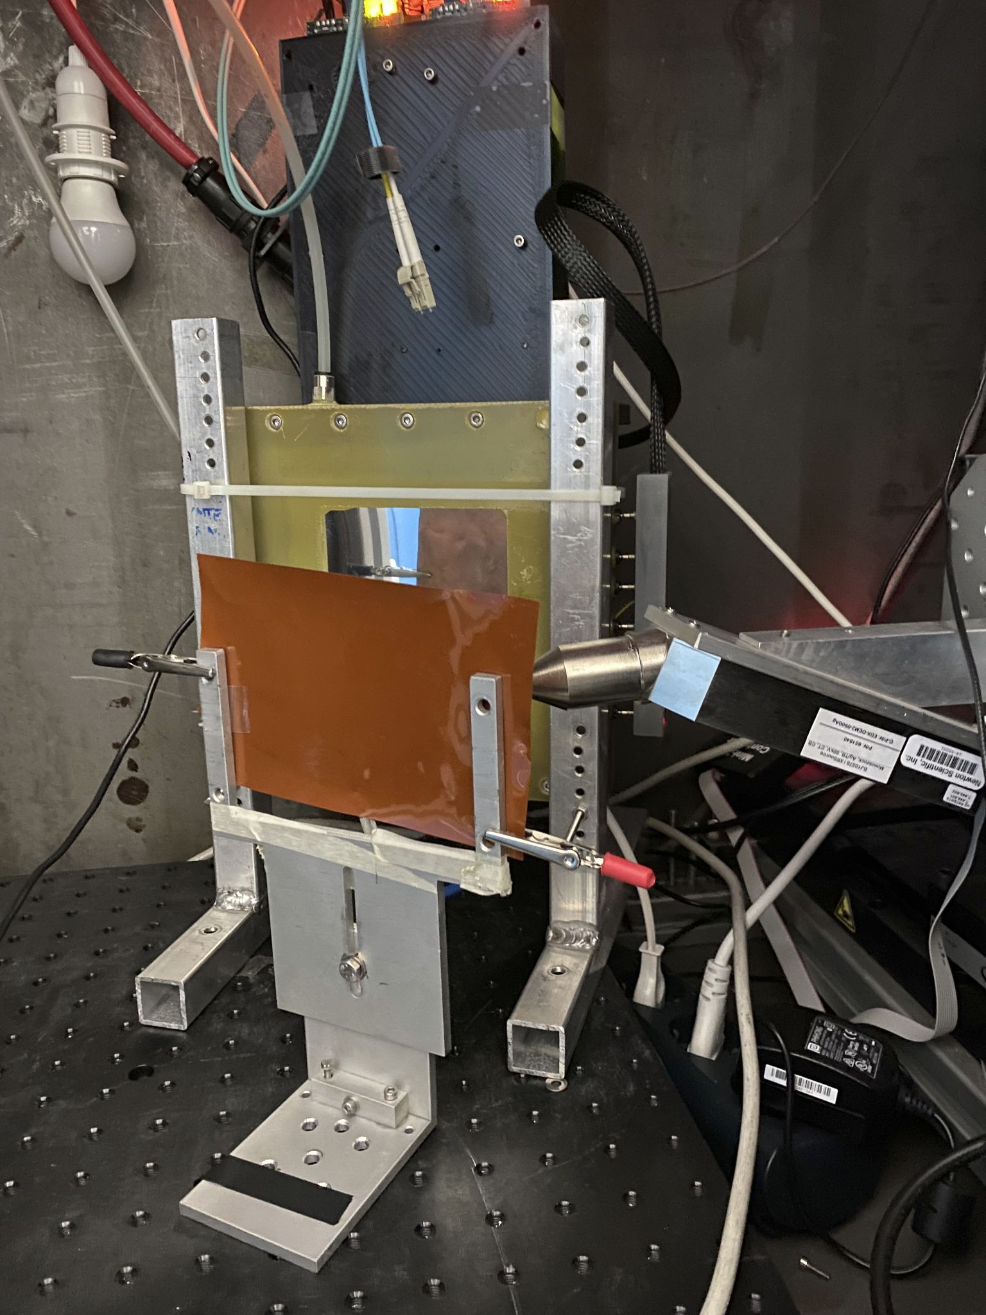

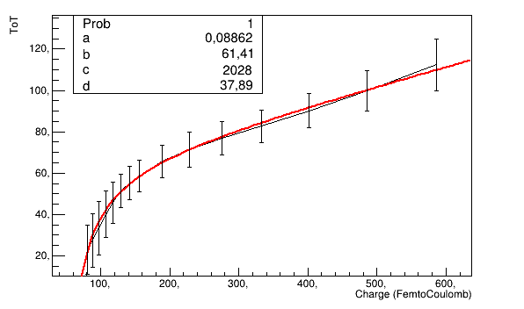

Energy Calibration
x data:
y data:

Slide 20
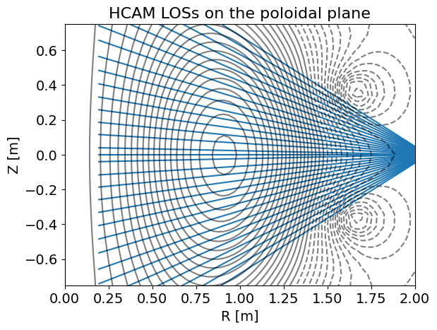
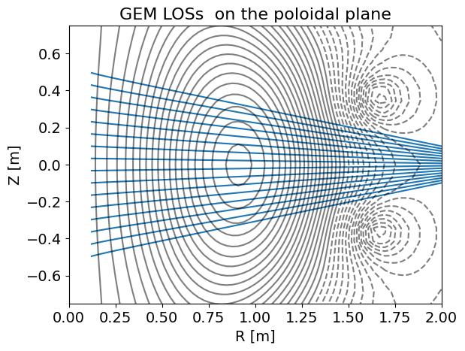
Comparison with MAST-U Horizontal Camera
The differences:
GEM camera has a smaller number of LOSs and plasma coverage compared to the horizontal camera.
The horizontal camera signal is a current signal over time, the GEM camera allows photon counting.
The horizontal camera's Beryllium foil is 12.5μm thick, resulting in an energy cut-off at 1keV. The GEM camera's Beryllium foil is 25μm thick plus air, with an energy cut-off at 3bkeV.
The diodes have a flat response, while the GEM camera drops below 10 keV.

Slide 21
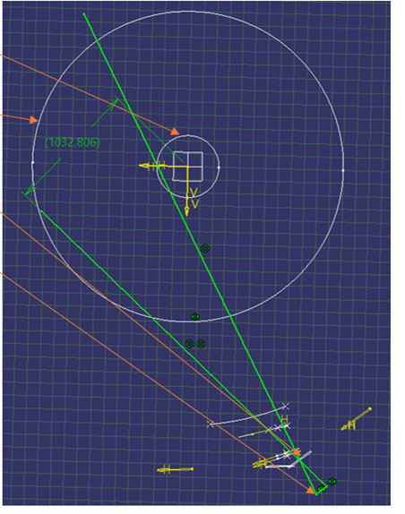
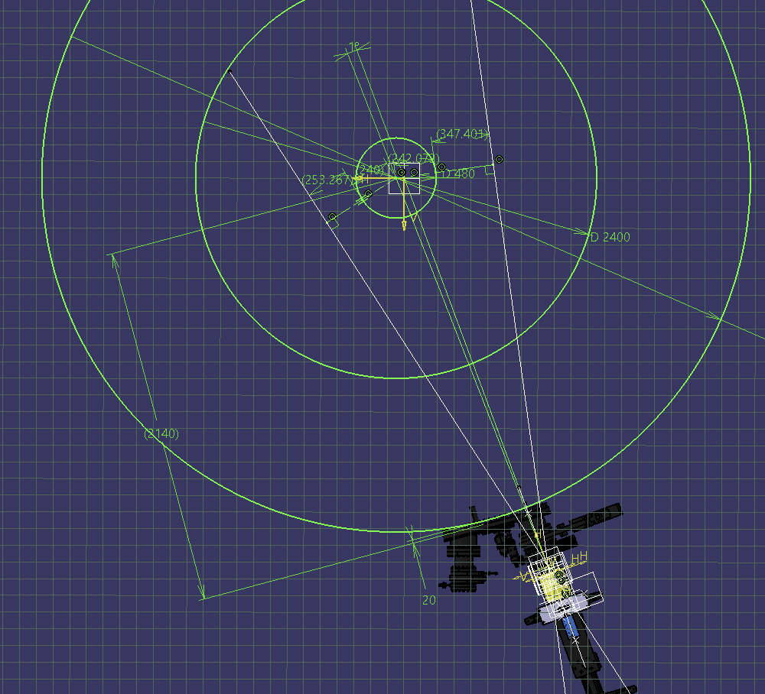
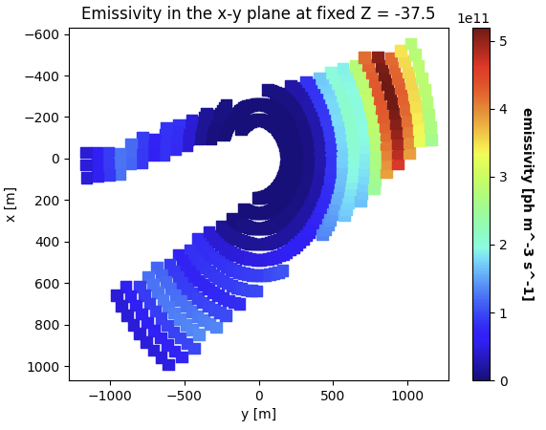
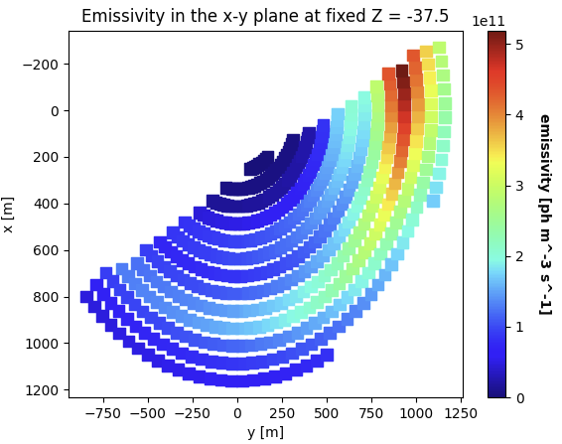
LoS Optimization: The view cone

Slide 22
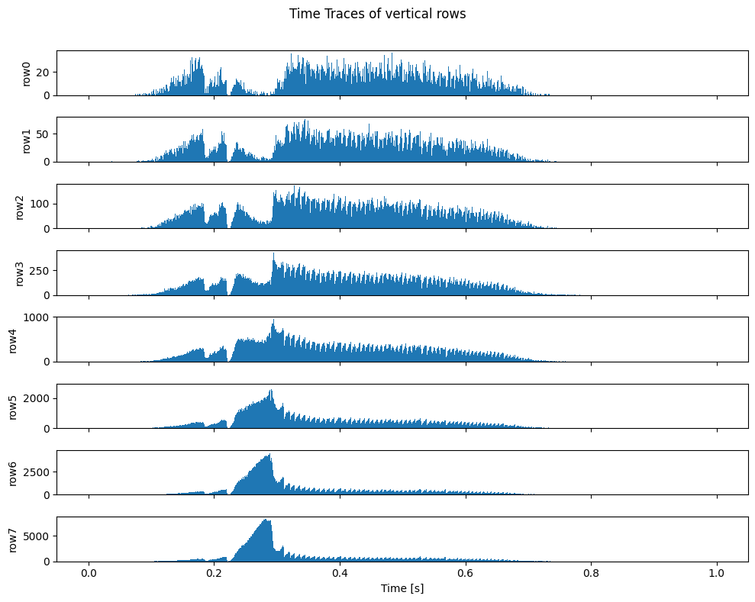

IRE Localization: the Energy spectrogram
timetrace for different LoS
Energy spectrogram for different LoS
shot #49020:

Slide 23


Neutron background
Performing an energy cut on the GEM signal, for a double beam shot, the signal trend, in orange, can follow either:
the SXR core signal from the MAST-U camera for Energies < 10 keV,
or
the neutron counting camera, in red, for Energies > 10 keV.
Neutron background estimated between 1-10%
MASTU #49412

Slide 24


SXR vx NEUTRON: post IRE peak
The peak in the GEM SXR signal is given by an effective peak of the SXR signal:
the SXR/Neutron timetrace shows a peak post IRE
the low energy side of the signal shows a peak, but the high energy signal peak is one third .
MASTU #49452

Slide 25



Neutron background: signal over neutron counts
With the gate closed the SXR/neutron trace is flat. The shot with the open valve return an estimation of the neutron background, valued between 1% and 10 %
2) MASTU #49380
Low gain & gate closed = direct neutron
High gain & gate closed = direct neutrons + gammas
High gain & gate open = direct neutrons + gammas + SXR
1) MASTU #49385
3) MASTU #49411

Slide 26



Neutron background
For some shots the gate in front of the Be windows is kept shut, to study the neutron contribution on the GEM signal.
2) MASTU #49380
Low gain & gate closed = direct neutron
High gain & gate closed = direct neutrons + gammas
High gain & gate open = direct neutrons + gammas + SXR
1) MASTU #49385
3) MASTU #49411

Slide 27
Soft X-Ray radiation from Tokamak
Soft X-Ray emission is a crucial diagnostic tool in tokamaks, providing insights into plasma behavior and characteristics. It is essential for optimizing plasma confinement and stability.
Why?
Emitted due to interactions within the plasma, of three types:
Bremsstrahlung:
it is one of the main energy loss channels.
line transition: the radiative decay of an excited atomic state of a bound electron into a lower energy level. the contribution of line emission is given by medium and heavy impurities.
radiative recombination*: free electrons of the plasma are captured by the ions, it is a secondary contribution in thermonuclear plasmas.

