Slide 1
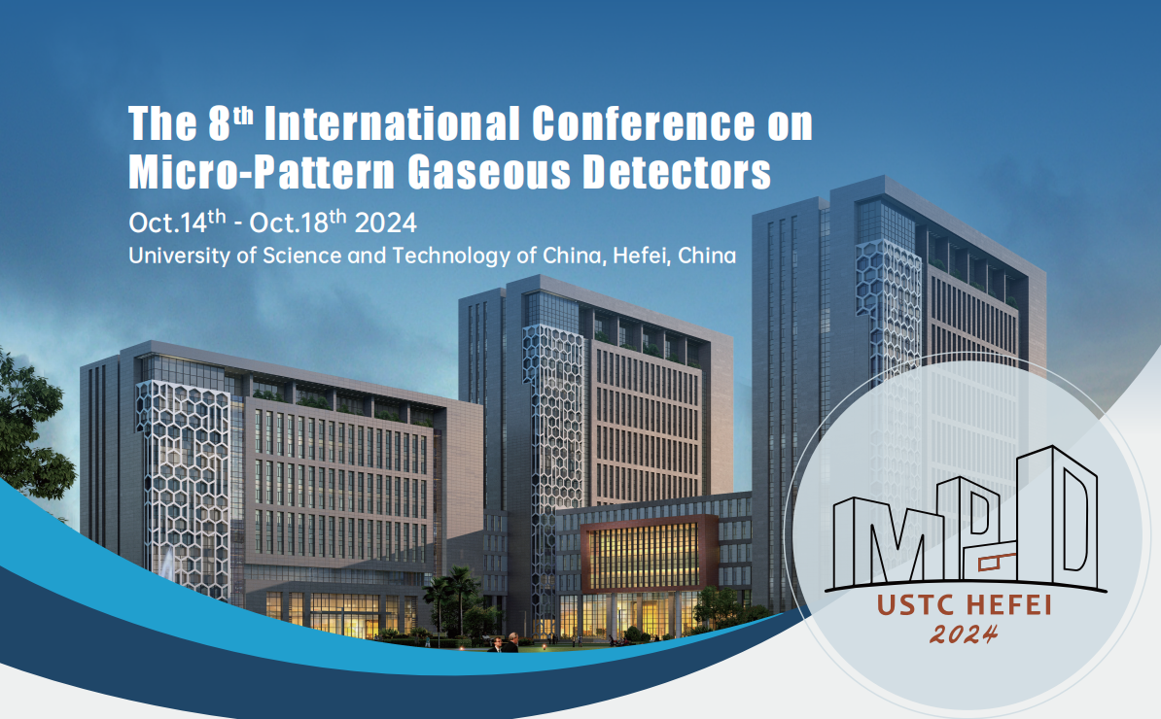


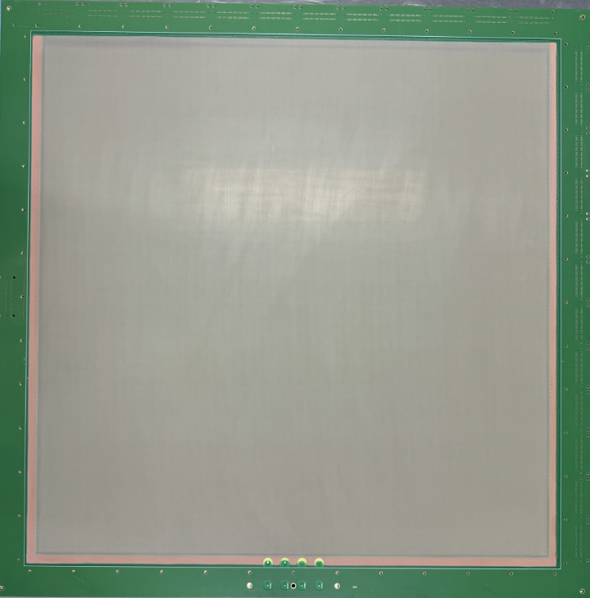
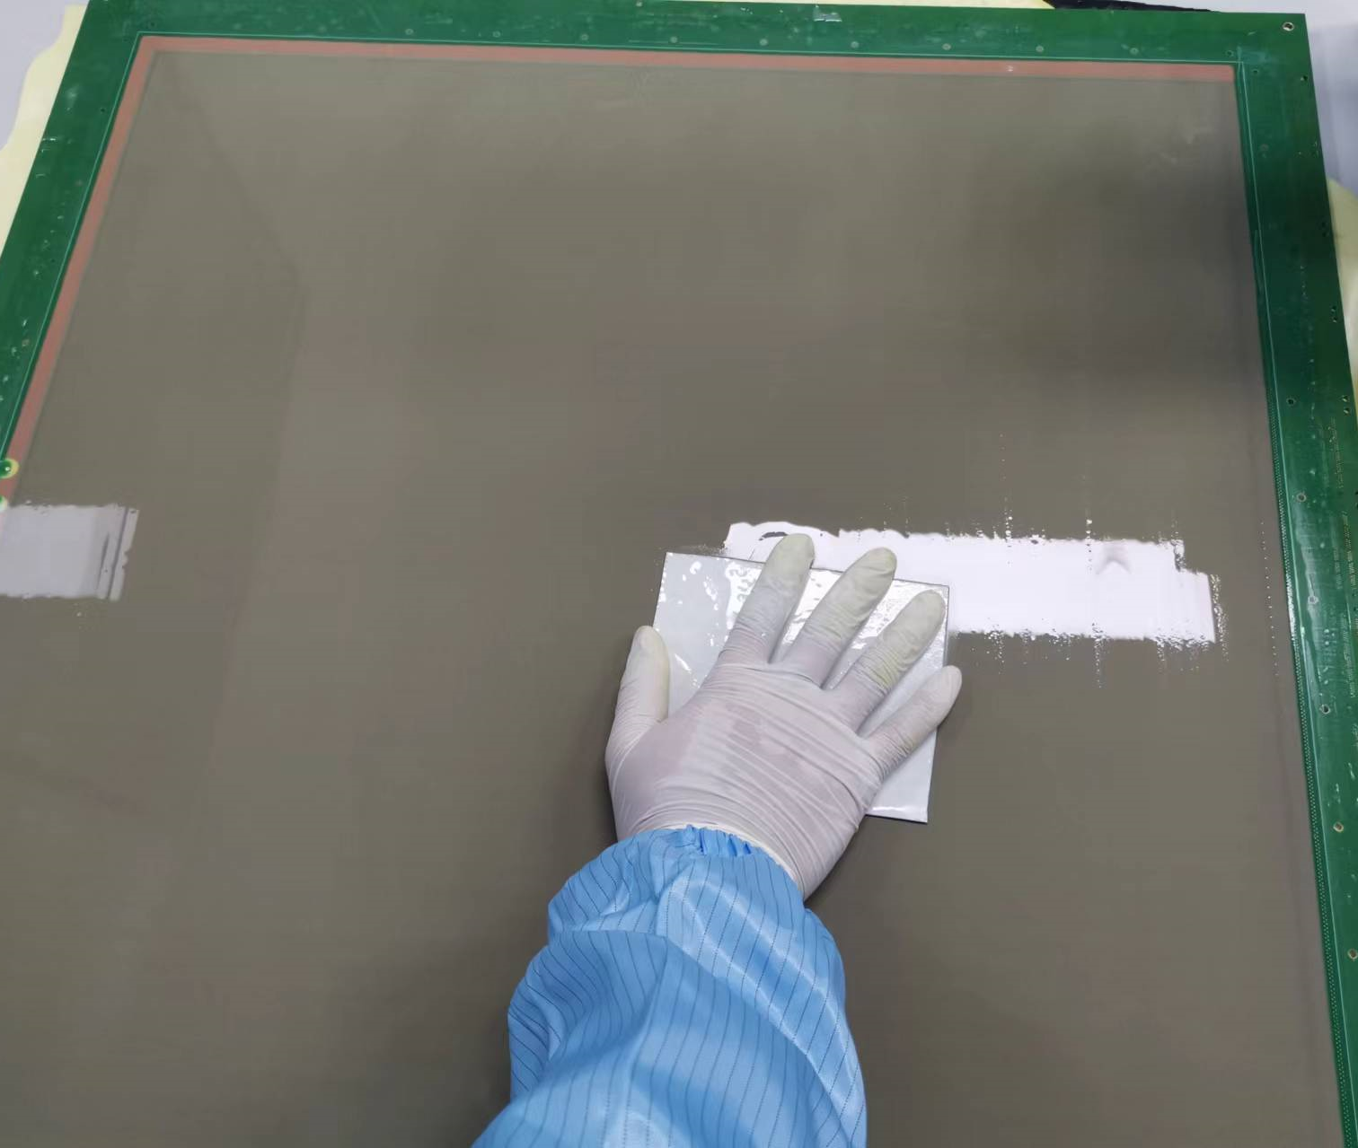
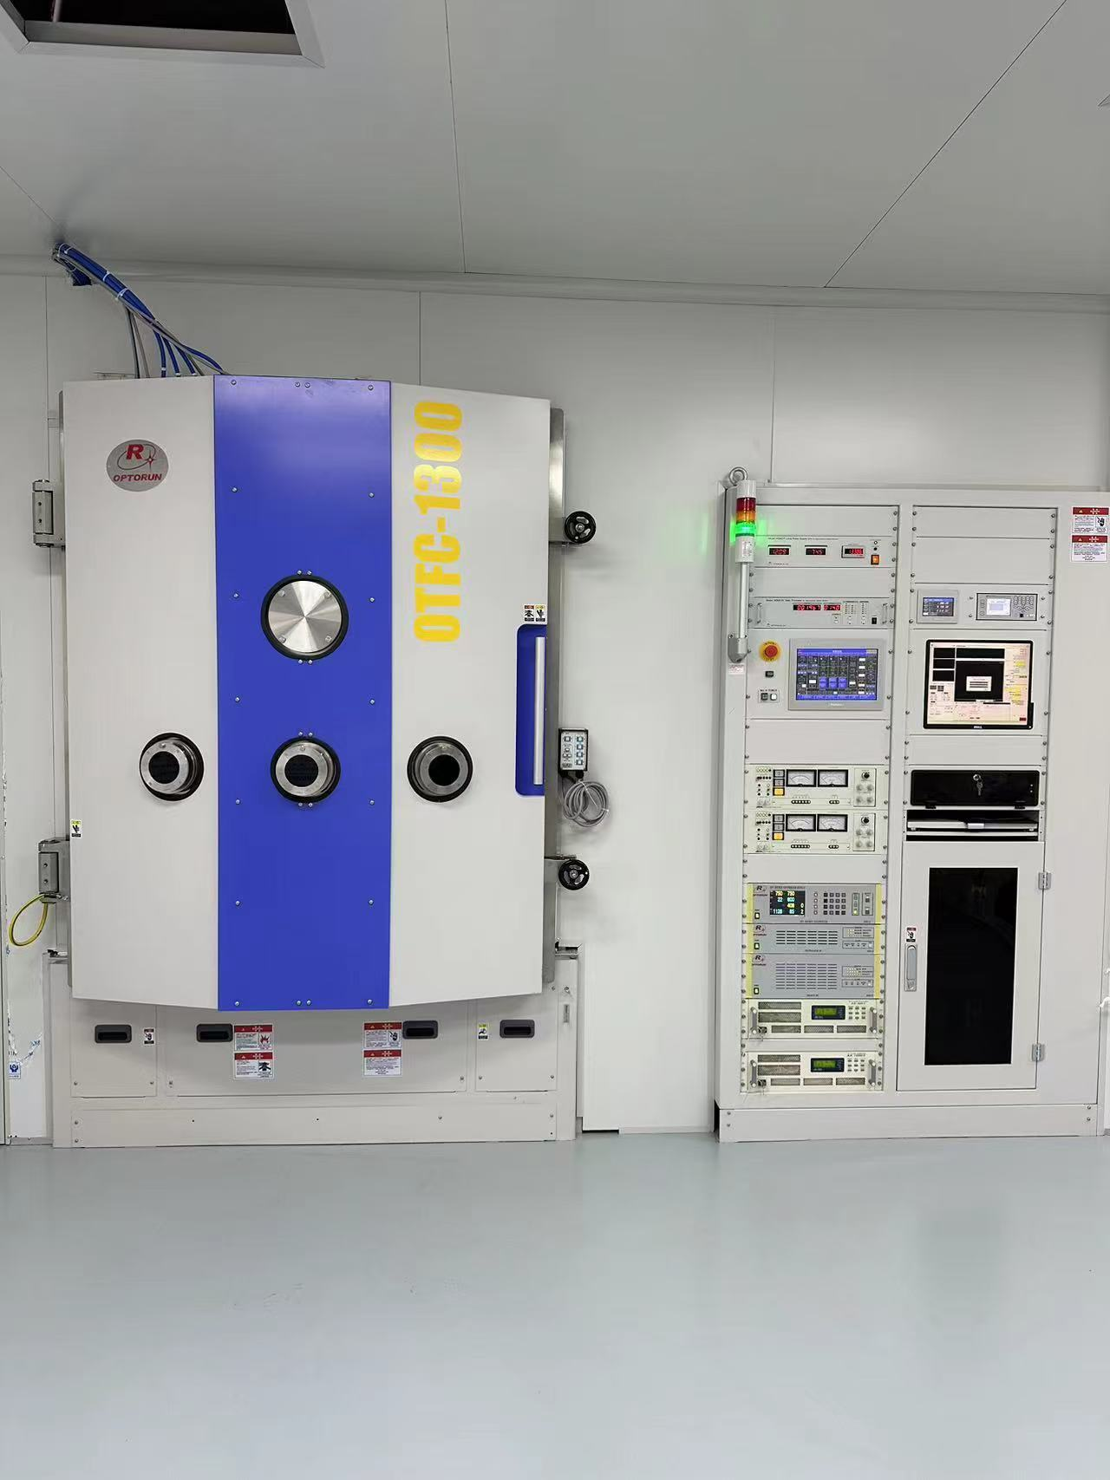
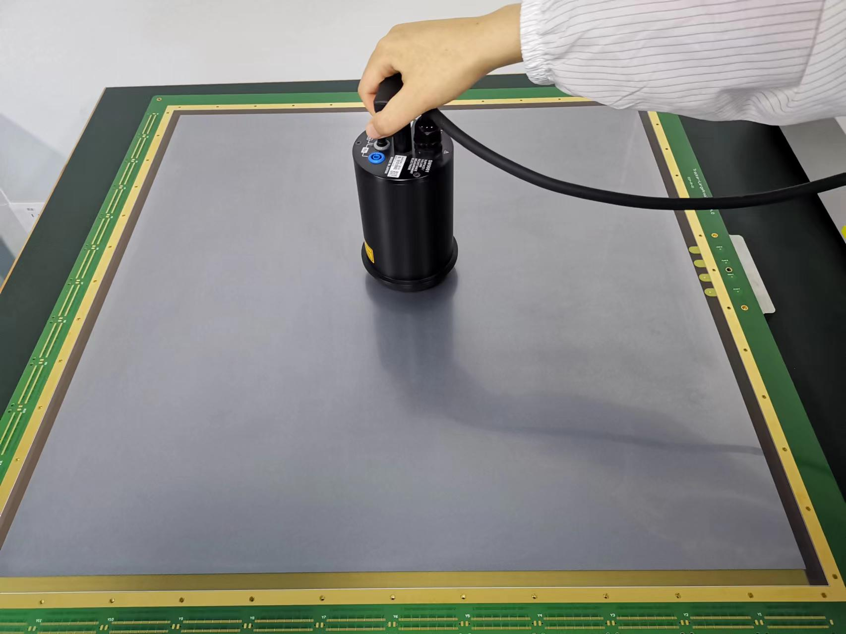
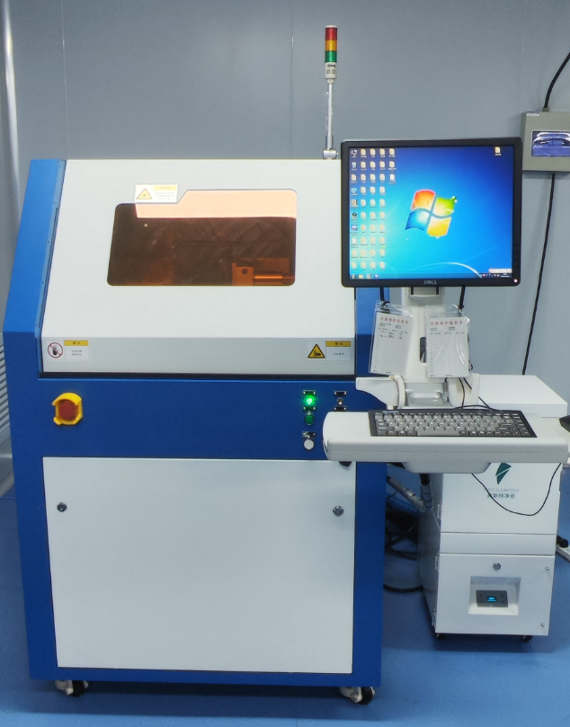
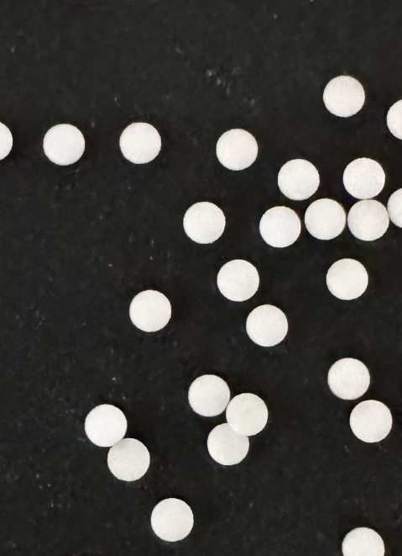
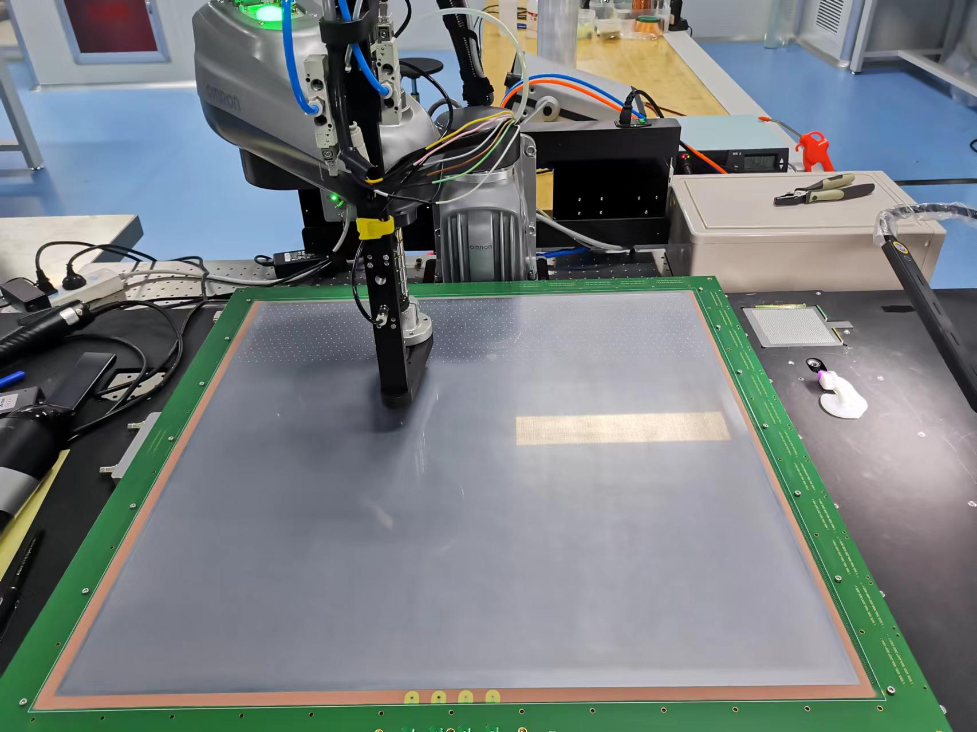
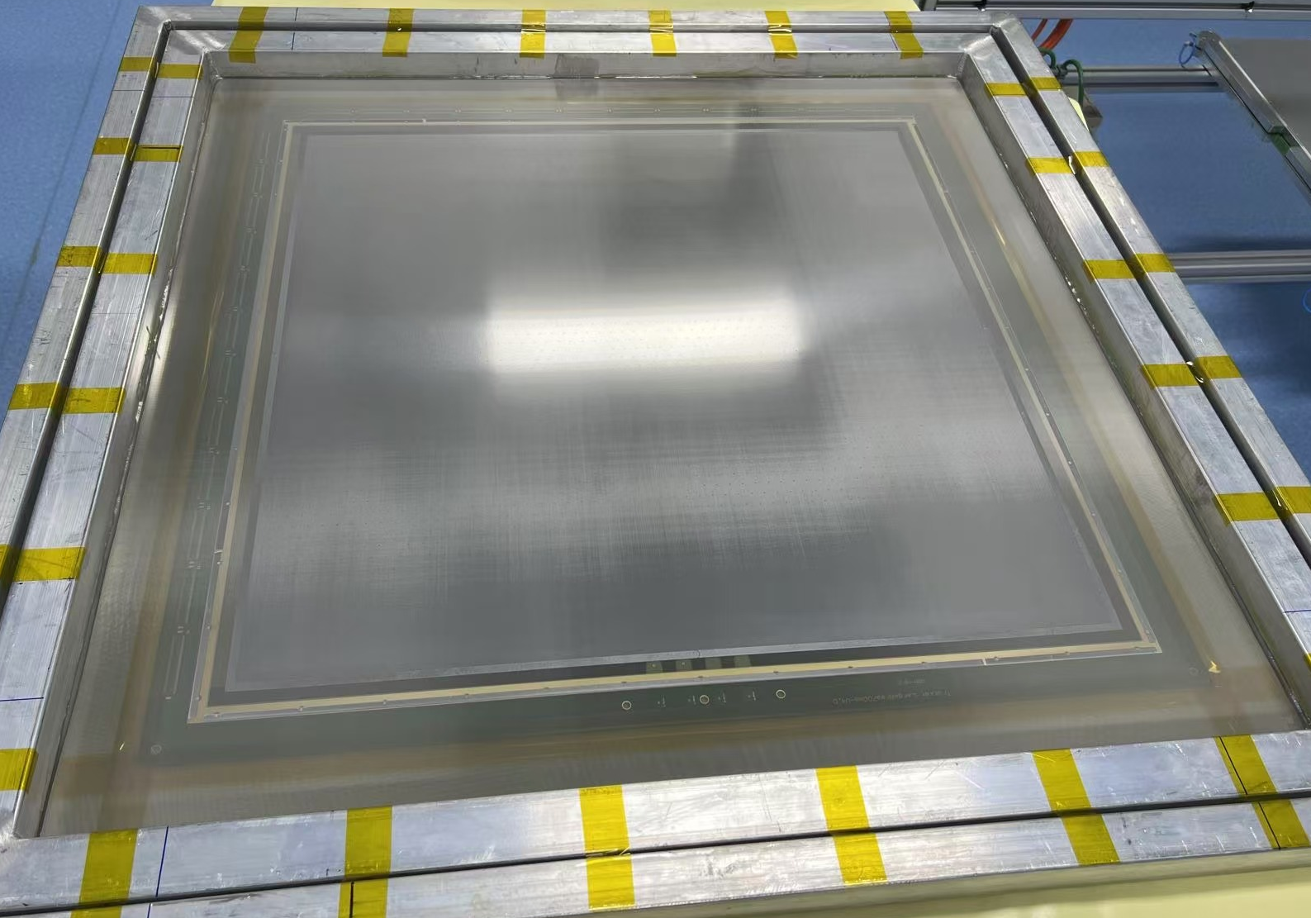
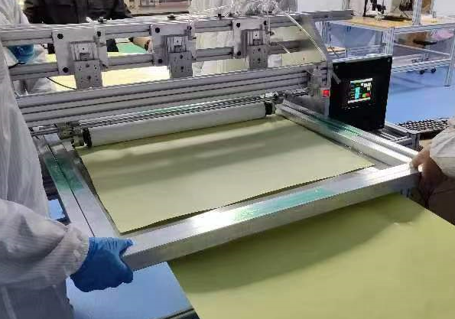
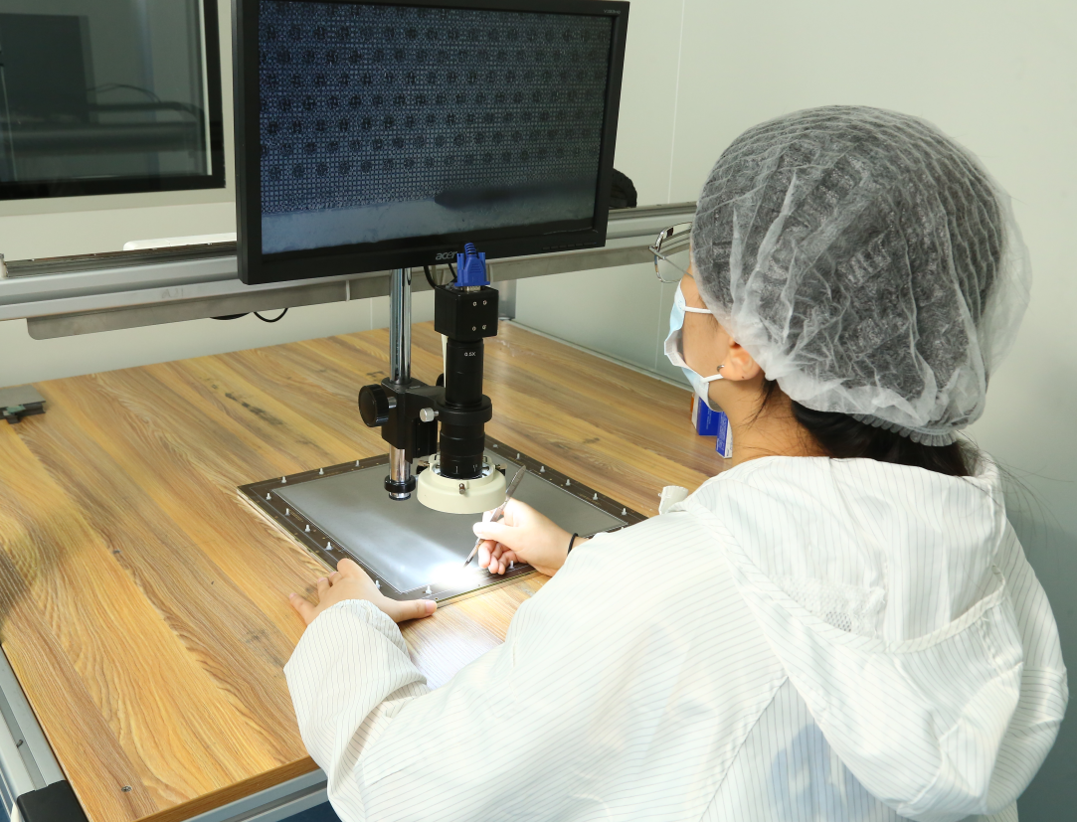
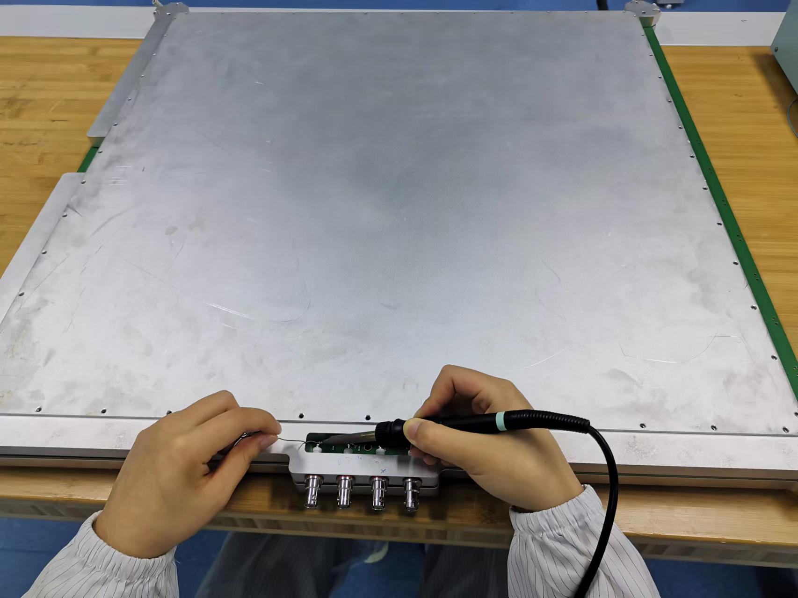
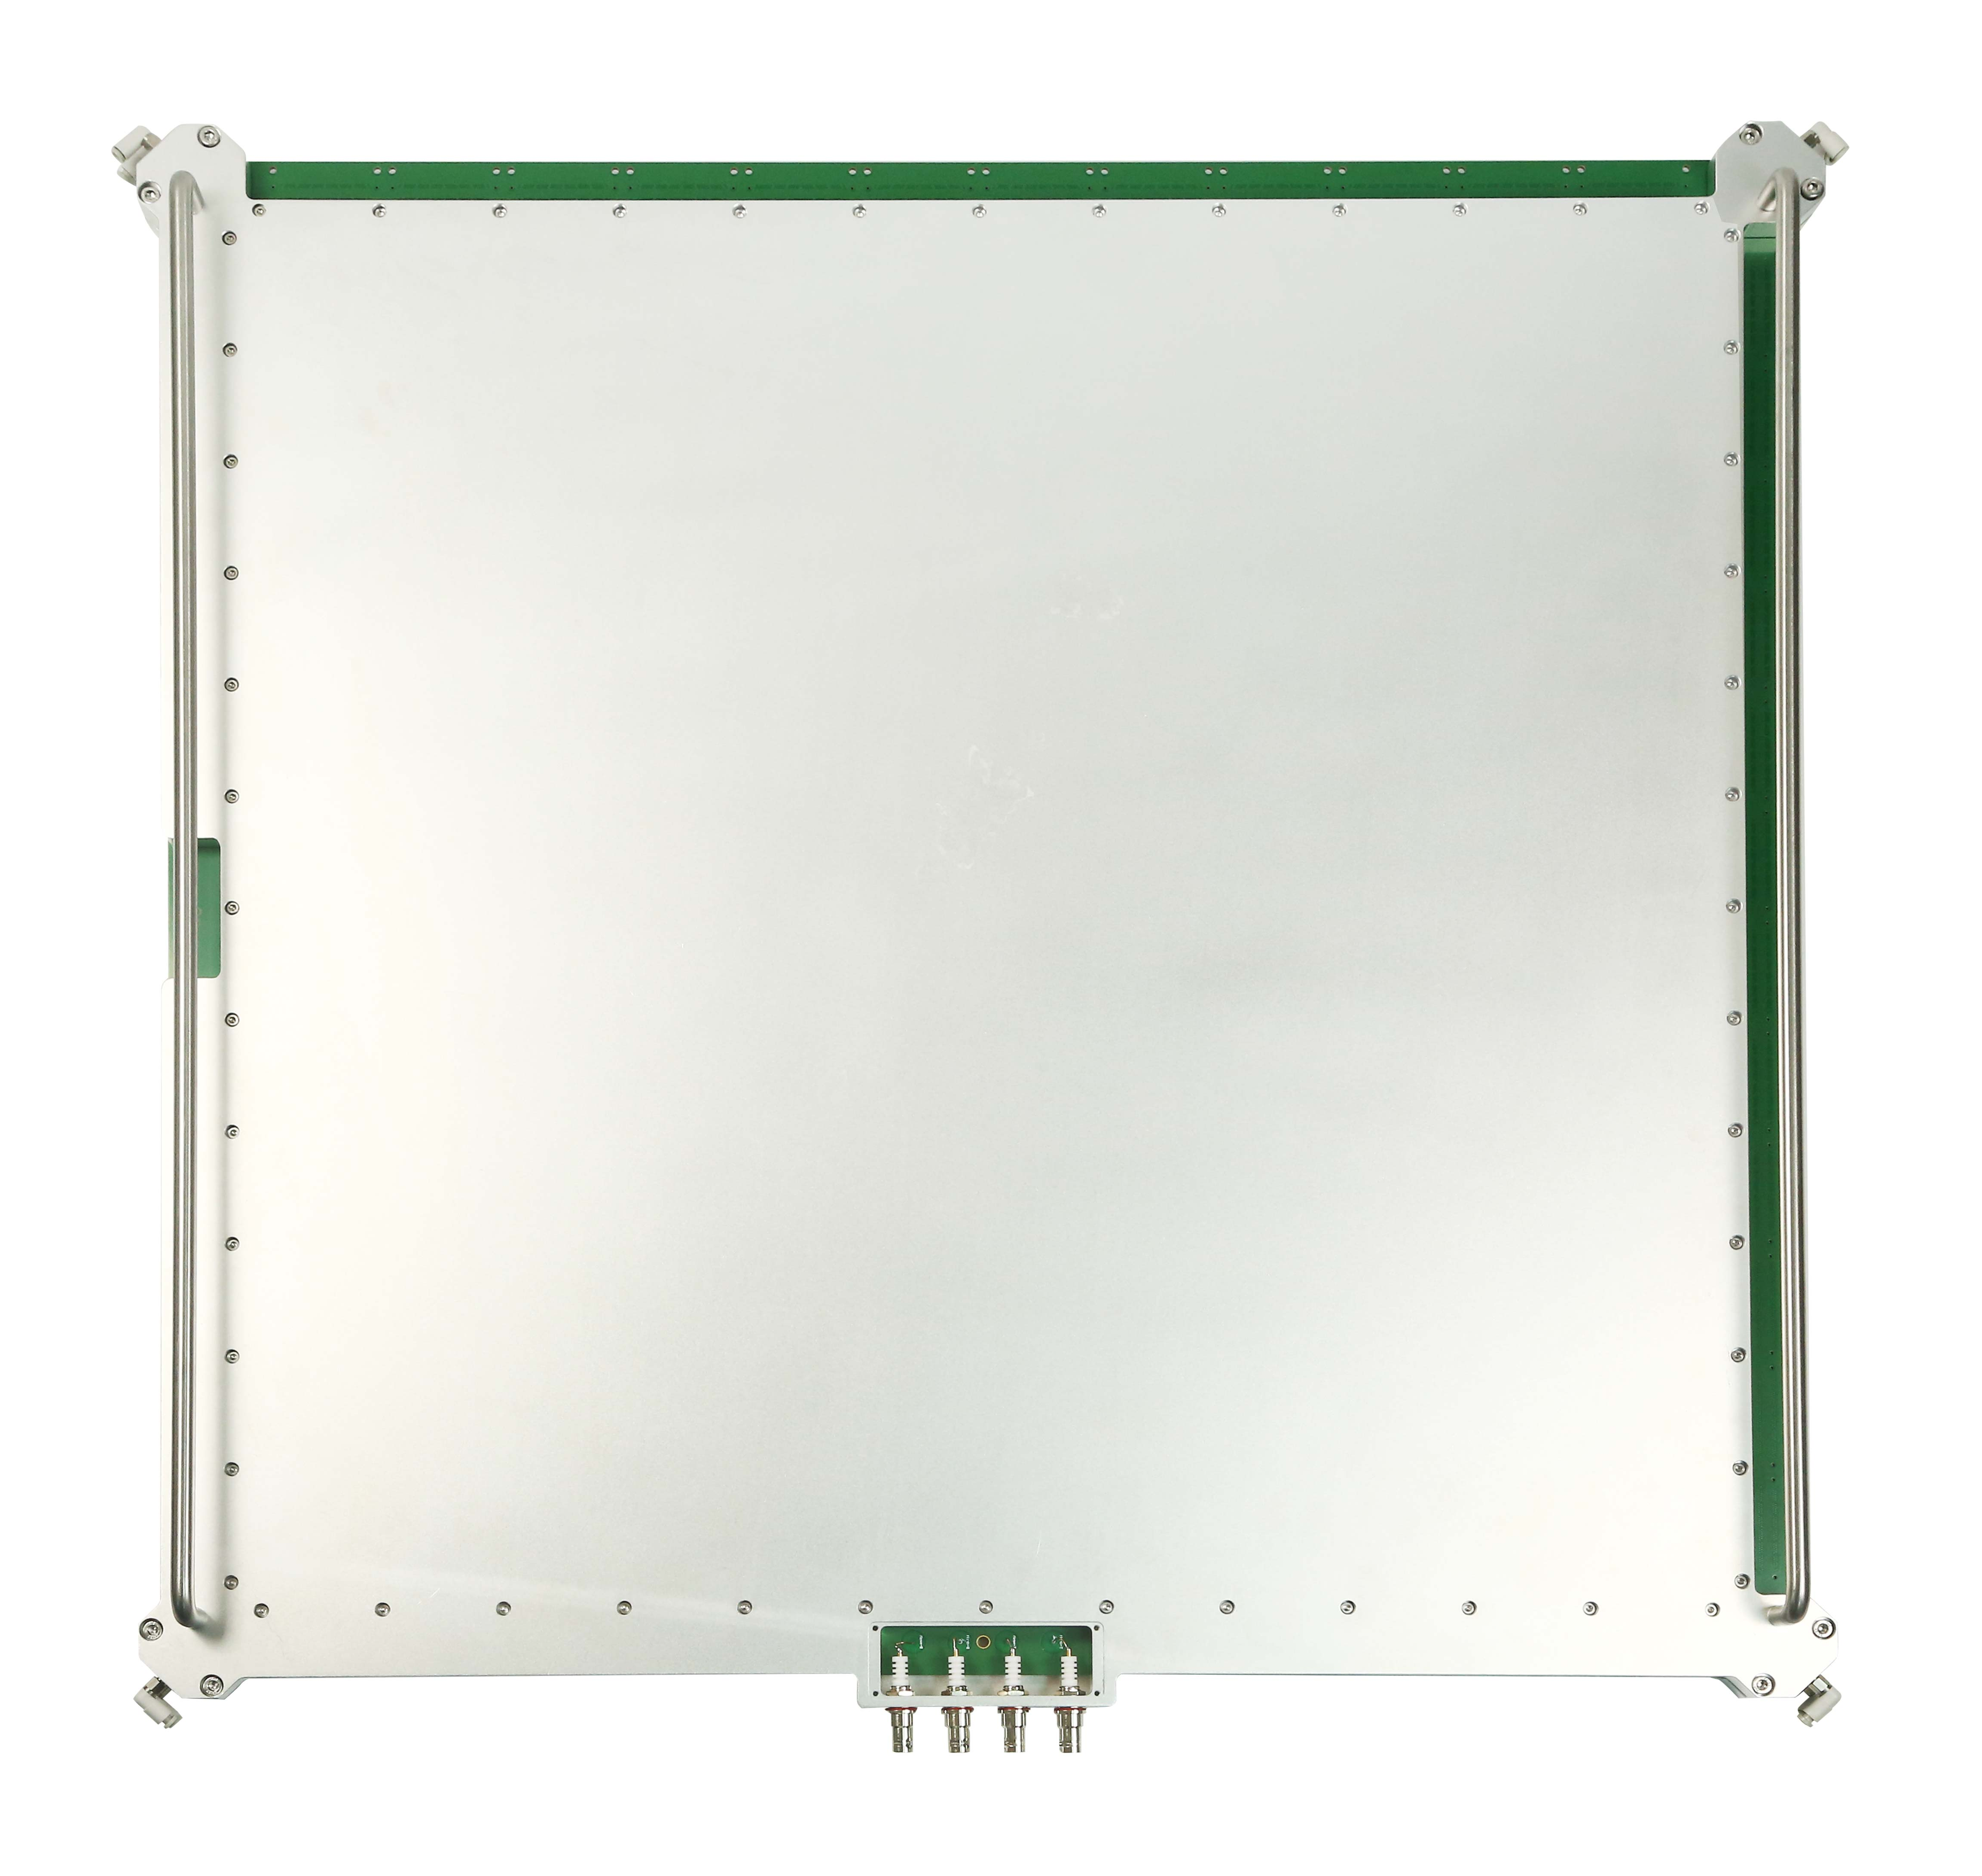
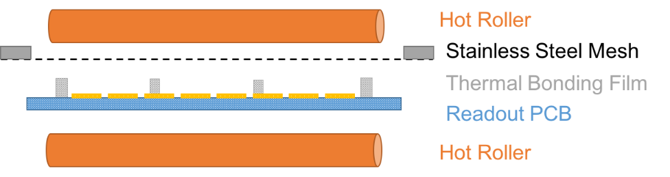
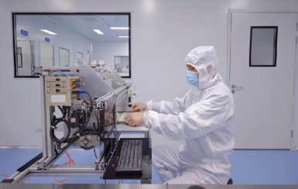
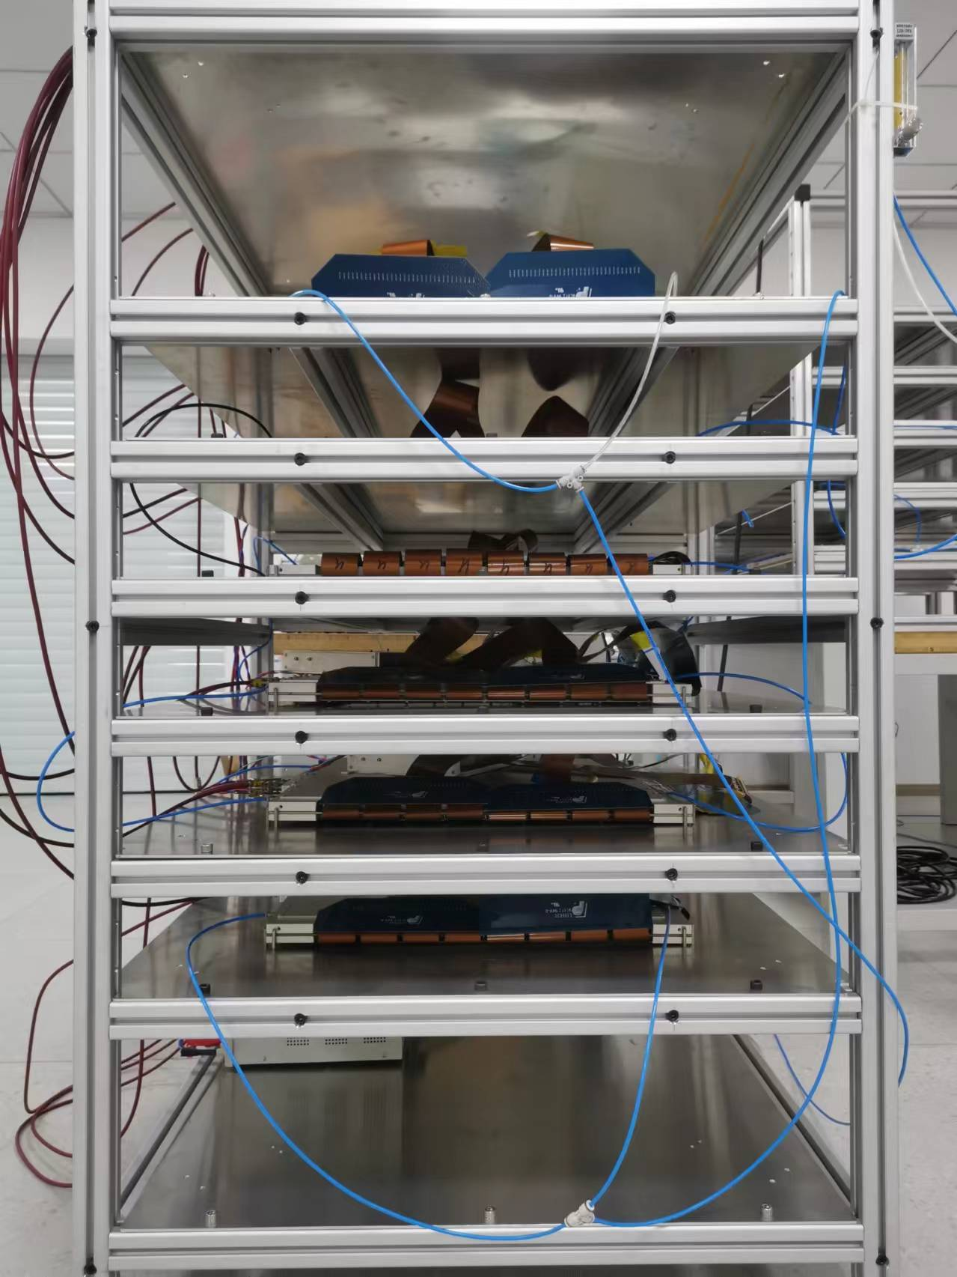
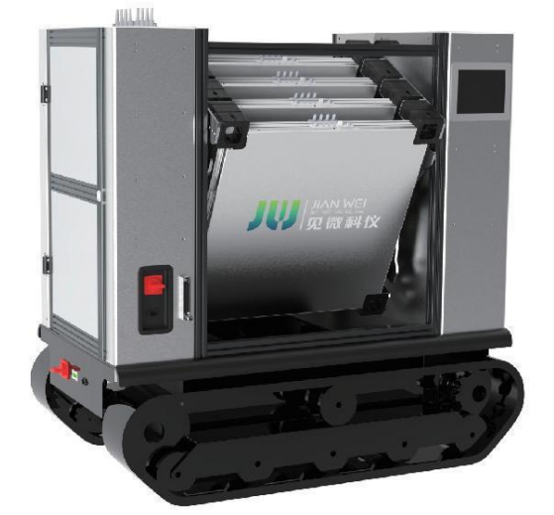
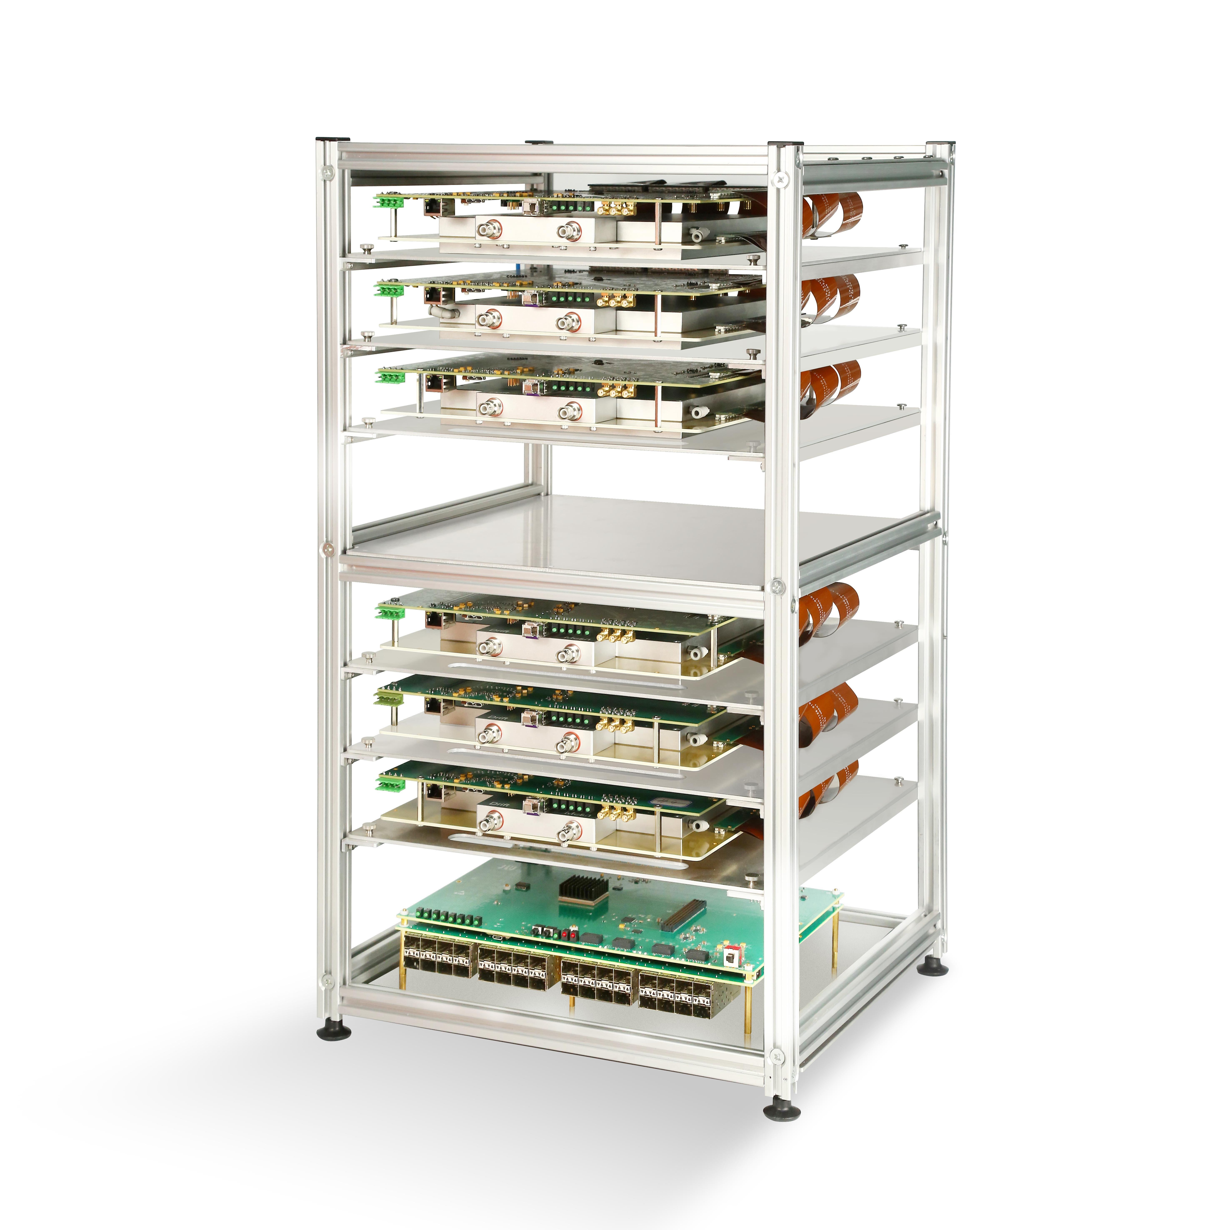
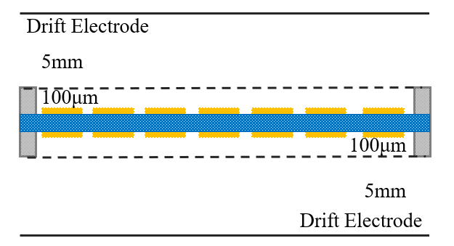
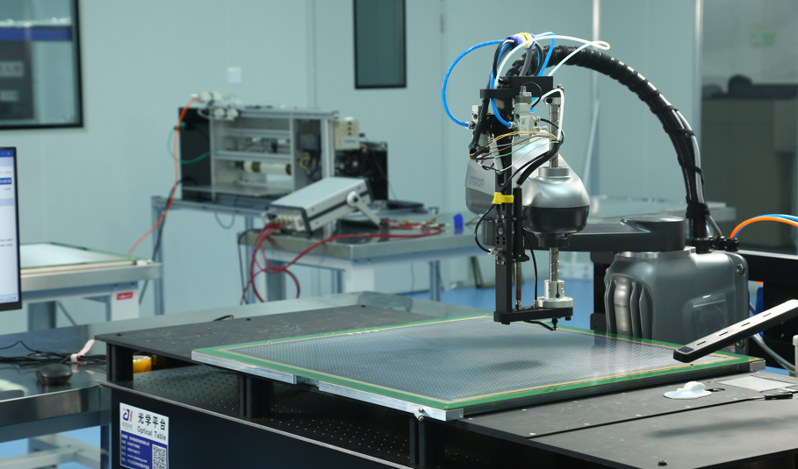
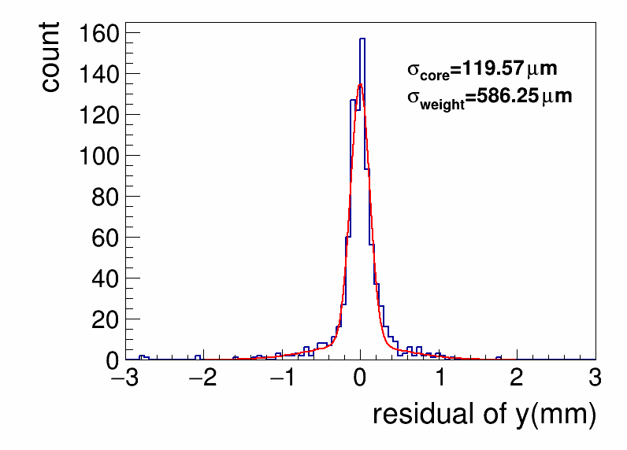
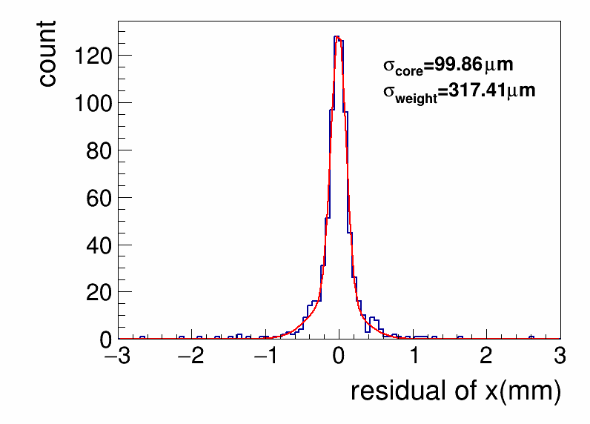
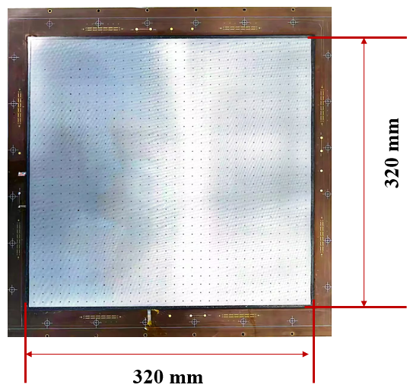
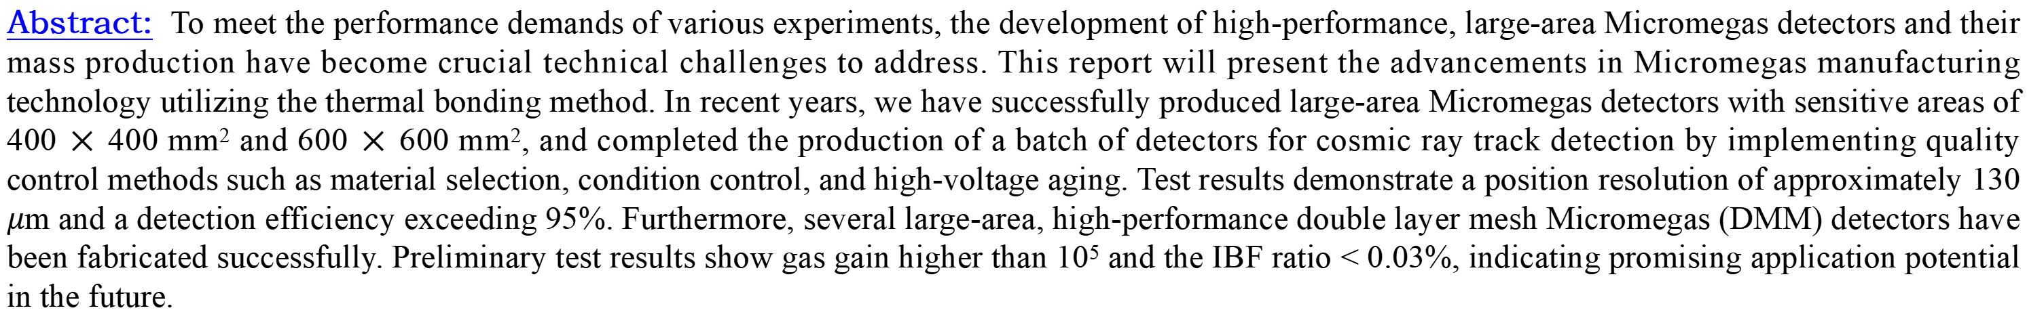
Mass production and performance of large area
Micromegas\DMM detectors
Sicheng Wen¹, Zhiyong Zhang^{2,3}, Yulin Liu^{2,3}, Qi An^{2,3}
1. Jianwei Scientific Instruments (Anhui) Technology Co., Ltd, Hefei 230000, China
2. State Key Laboratory of Particle Detection and Electronics, University of Science and Technology of China, Hefei 230026, China
3. Department of Modern Physics, University of Science and Technology of China, Hefei 230026, China
Abstract: To meet the performance demands of various experiments, the development of high-performance, large-area Micromegas detectors and their mass production have become crucial technical challenges to address. This report will present the advancements in Micromegas manufacturing technology utilizing the thermal bonding method. In recent years, we have successfully produced large-area Micromegas detectors with sensitive areas of 400 × 400 mm² and 600 × 600 mm², and completed the production of a batch of detectors for cosmic ray track detection by implementing quality control methods such as material selection, condition control, and high-voltage aging. Test results demonstrate a position resolution of approximately 130 $μ$m and a detection efficiency exceeding 95%. Furthermore, several large-area, high-performance double layer mesh Micromegas (DMM) detectors have been fabricated successfully. Preliminary test results show gas gain higher than 10⁵ and the IBF ratio < 0.03%, indicating promising application potential in the future.
Introduction
The thermal bonding method
Mass production and optimization
The Multi-layer tracker system for muography
The DMM detectors and performance
Conclusions
PCB
Pre-polishing treatment
Coasting germanium
Measure surface resistance
Prepare the spacer by laser cutting machine
Automated robotic arm to place spacers
Thermal Bonding Method（TBM）
The thermal bonding method is a highly promising and competitive technoloty for Micromegas detectors, developed by the MPGD team at the University of Science and Technology of China.
The back-to-back mesh frame mounting
Thermal bonding
Edge cutting and check up
Install the drift electrode and gas chamber
A finished Micromegas detectors
Fig. 3 The full-process of fabricatting a Micromegas detector using TBM.
The Multi-layer Tracker System for Muography
Several muography systems of different sizes and layers have been established in the laboratory and used to calibrate the detector`s performance of efficiency and position resolution^{[3]}, as shown in Fig. 4. The muon tomography and radiography were established that based on the desktop platform and all-terrain car platform respectively.At the same time, trajectory reconstruction algorithms and multi-layer alignment algorithms are being studied.
Fig. 1 the thermal bonding method of the Micromegas detector
We have developed a high-stability, high-performance, large-area manufacturing process for Micromegas detectors. This technique offers advantages such as non-etching, environmentally friendly operation, simplicity, and cost-effectiveness. As shown in the illustration on the left, the primary TBM process involves using a rolling machine to bond the stretched stainless-steel mesh onto the PCB to create the avalanche gap of the Micromegas detector. The fundamental performance characteristics of the Micromegas detectors based on the TBM process are detailed in ^{[1][2]}.
Mass Production and Improvement
Fig. 4 the three different size multi-layer Micormegas detector system for muon tomography or radiography: 150x150 mm², 400x400 mm², 600x600 mm².
Fig. 5 Spatial resolution of x/y dimensions of 400x400 mm² muon radiography system calibrated by cosmic ray muons.
Fig. 2 the “back-to-back” design and the automatic process improvement
In order to improve the stability of large area Micromegas detectors, we have adopted a "back-to-back" structure, distributing the readout strips in the X and Y directions on the upper and lower surfaces of the readout PCB, and constructing identical avalanche and drift regions on both surfaces. This "back-to-back" structure allows independent avalanche amplification in the X and Y directions on the each side of the detector, increasing the signal-noise ratio, thereby lowering voltage requirements and improving detector stability.
In terms of batch production processes, an automated robotic arm replaces manual process to place the spacers, as shows in Fig. 2, improving production efficiency while enhancing process stability, laying a solid foundation for the batch production of high-performance, large area Micromegas detectors.
DMM detector and performance
A 320×320 mm² double micro-mesh Micromegas detector was fabricated for RICH detector of the STCF project. This new detector aims to provide better time resolution, lower ion backflow, and higher gain.
Time resolution <300ps for single photon^{[4]}
The gas gain > 10⁵
IBF ratio > 0.03%^{[5]}
Fig. 6 A 320x320 mm² double-mesh Micromegas detector.
Reference
Conclusion
.
  A “back-to-back” structure designed, automated robotic arm and laser cutter are introduce to improve the batch production process.
  Several different sizes standard muongraphy platforms are built.
  Successfully fabricating a large-area double-mesh Micromegas detector with low IBF ratio of ~0.05%.
[1]Jianxin Feng, Zhiyong Zhang*, Jianbei Liu* et al., A thermal bonding method for manufacturing Micromegas detectors, NIM A, 989 (2021) 164958.
[2]Jianxin Feng, Zhiyong Zhang*, Jianbei Liu et al., A novel resistive anode using a germanium film for Micromegas detector, NIM A, 1031 (2022) 166595.
[3]Yu Wang, Zhiyong Zhang, Shubin Liu* et al., A High Spatial Resolution Muon Tomography Prototype System based on Micromegas Detector, IEEE, 69-1, 78–85, Jan. 2022.
[4]Xu Wang, Yue Meng et al., A novel fast timing detector based on the double micro-mesh gaseous structure with reflective photocathode, NIM, A 1055 (2023) 168529.
[5]BinbinQi, KunyuLiang, ZhiyongZhang* et al., Optimization of the double micro-mesh gaseous structure (DMM) for low ion-backflow applications，NIM A, 976 (2020) 164282.
Author: wensch1@mail.ustc.edu.cn 10/14/2024-10/18/2024, The 8th International Conference on Micro Pattern Gaseous Detectors

