Slide 1


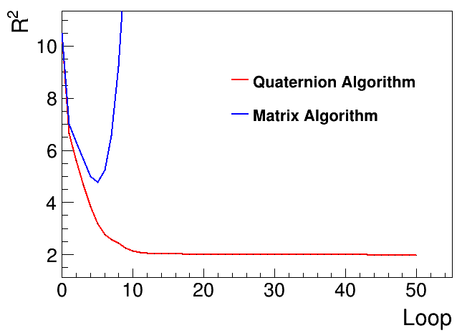

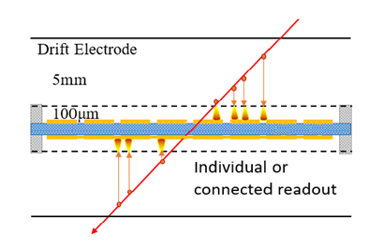
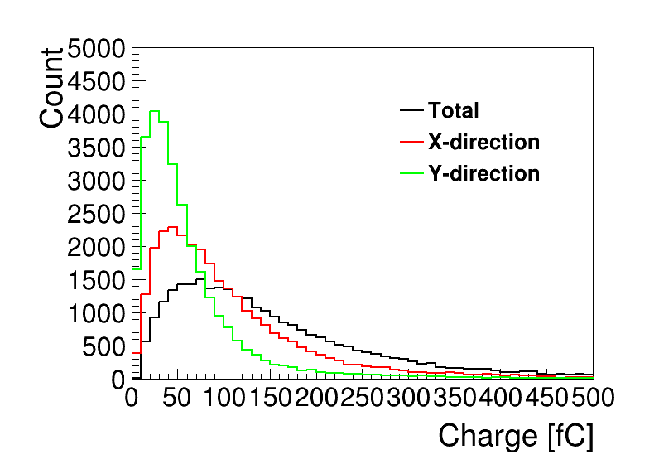
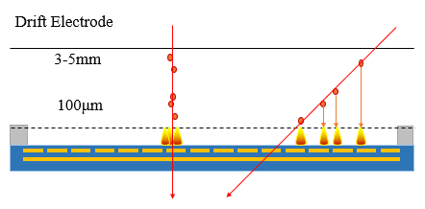

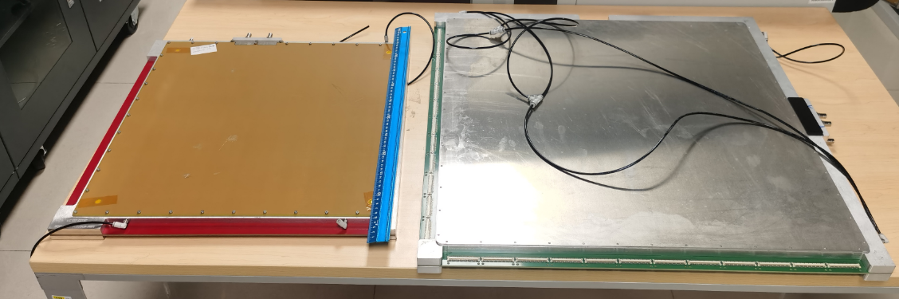
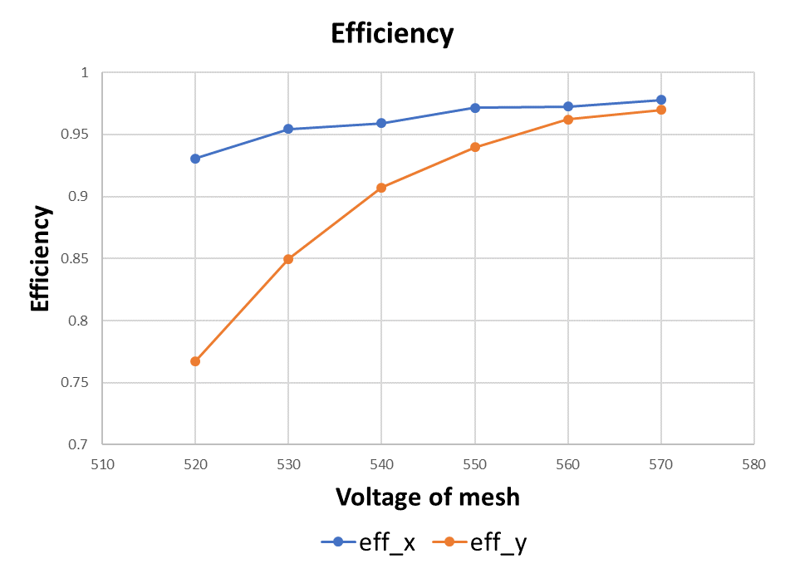
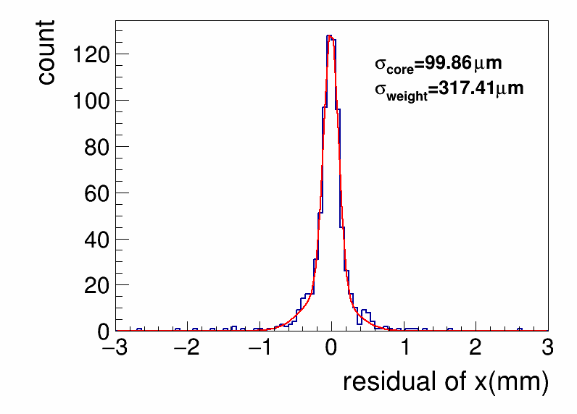
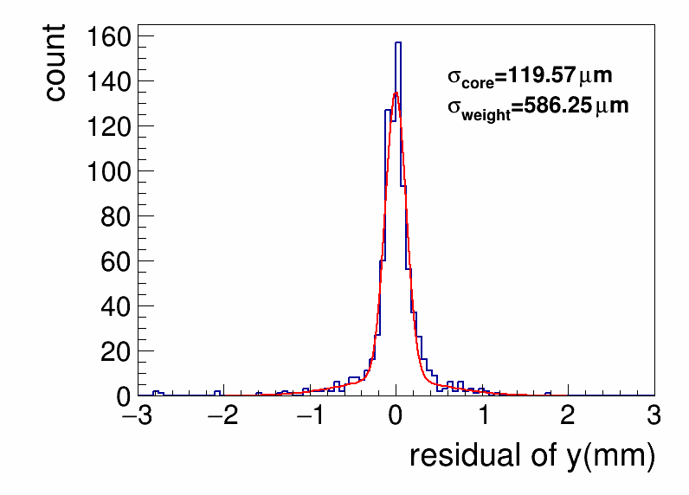
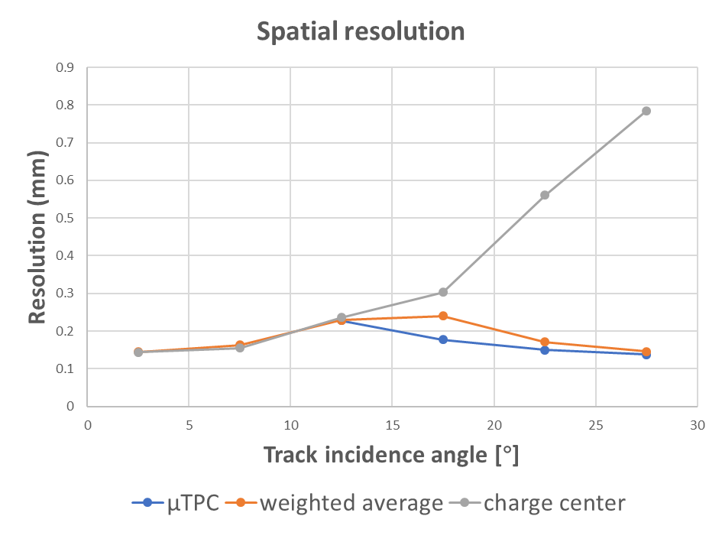
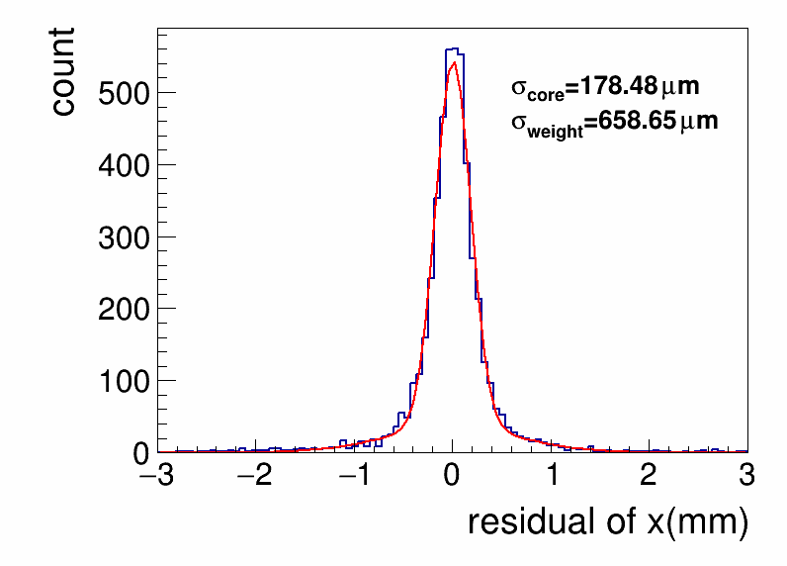
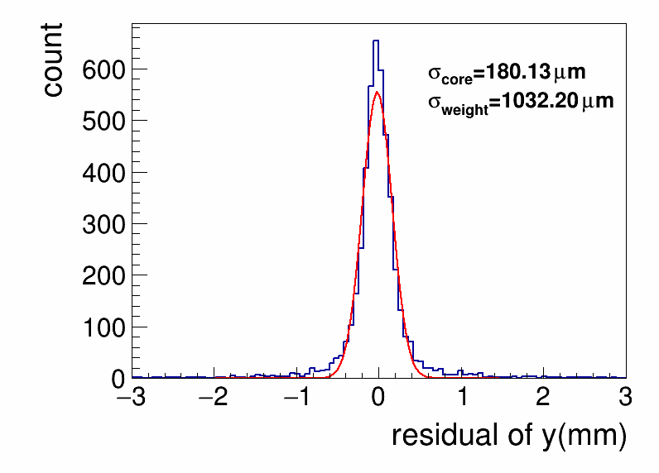
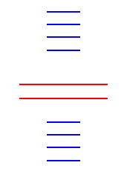
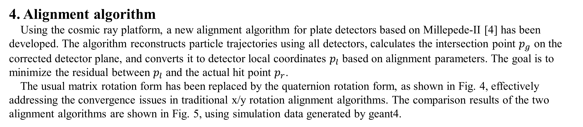
Performance study of 400 × 400 mm² and 600 × 600 mm²
Micromegas track detectors using cosmic rays
Yulin Liu^{1, 2}, Zhiyong Zhang^{1, 2}, Jianbei Liu^{1, 2}, Yu Wang^{1, 2}
State Key Laboratory of Particle Detection and Electronics, University of Science and Technology of China, Hefei 230026, China
Department of Modern Physics, University of Science and Technology of China, Hefei 230026, China
Abstract: The large area and high spatial resolution of particle detection are important aspects in the research and application of MPGD. Currently, there is no satisfactory technological solution to address these challenges, particularly in achieving long-term stable, high-resolution readout of large area detectors, and managing high irradiation background and counter rates. In this study, we utilized the thermal bonding method for manufacturing Micromegas detectors and conducted production and research on large area Micromegas detectors ranging from 400 × 400 mm² to 600 × 600 mm² in size. Several large area Micromegas detectors have been successfully developed, and a cosmic ray test system has been established. Using this system, we developed an alignment algorithm and investigated the position resolution, detection efficiency through performance testing, and μTPC reconstruction. A new alignment algorithm for plate detectors based on Millepede-II was developed using this system, effectively addressing the convergence issue of traditional algorithms in the rotation alignment of the x/y direction. The results of the cosmic ray test demonstrate that the detection efficiency of the 400 × 400 mm² thermal bonding Micromegas detector exceeds 95%, with a position resolution of approximately 130 μm. The position resolution of μTPC reconstruction is approximately 160 μm for particles with incident angles greater than 20 degrees. This paper covers the manufacturing of large area Micromegas detectors, cosmic ray testing, and data analysis methods.
Introduction
The large area and high spatial resolution of particle detection are important aspects in the research and application of micropattern gaseous detector (MPGD). For instance, in the upgrade of the ATLAS NSW [1], the large area Micromegas detector has been selected, with a single module covering an area of 2-3 m². Similarly, the CMS GEMs [2] also have opted the GEM detector, with a single module covering an area of 0.28-0.45 m².
In this study, we utilized the thermal bonding method (TBM) [3] to manufacture 400 × 400 mm² and 600 × 600 mm² Micromegas detectors and set up a cosmic ray test system to evaluate detector performance. Using this system, we have developed an alignment algorithm and investigated the position resolution, detection efficiency, and μTPC reconstruction.
4. Alignment algorithm
Using the cosmic ray platform, a new alignment algorithm for plate detectors based on Millepede-II [4] has been developed. The algorithm reconstructs particle trajectories using all detectors, calculates the intersection point $p_{g}$ on the corrected detector plane, and converts it to detector local coordinates $p_{l}$ based on alignment parameters. The goal is to minimize the residual between $p_{l}$ and the actual hit point $p_{r}$.
The usual matrix rotation form has been replaced by the quaternion rotation form, as shown in Fig. 4, effectively addressing the convergence issues in traditional x/y rotation alignment algorithms. The comparison results of the two alignment algorithms are shown in Fig. 5, using simulation data generated by geant4.
2. Design and fabrication of Micromegas
Fig. 1 (a) shows the schematic of 400 × 400 mm² detectors. The 600 × 600 mm² detectors adopt a back-to-back structure design, as shown in Fig. 1 (b).
The TBM process is selected to manufacture the avalanche gap of the Micromegas detector. With the installation of the drift electrode, gas chamber, and readout connectors, a Micromegas detector is fabricated. The photo of 400 × 400 mm² detector and 600 × 600 mm² detector is shown in Fig. 2.
Fig. 4. The alignment algorithm equations
in matrix and quaternion rotation forms.
Fig. 5. The comparison results of matrix
and quaternion algorithms.
5. Performance of Micromegas
Fig. 6 displays the amplitude distribution of hits, with the horizontal axis already converted to collected charge based on the electronics characteristics.
In Fig. 7, the scan results on detector efficiency indicate that for both x and y dimensions, an efficiency exceeding 95% is achieved when the mesh voltage is greater than 560V.
Residual distributions of 400 × 400 mm² and 600 × 600 mm² detectors are shown in Fig. 8 and 9, fitted with double Gaussian distributions. Due to platform size limitations, only 4 track detectors are used in the 600 × 600 mm² detector testing, resulting in a wider residual distribution due to errors in the reference trajectory.
The scan results on detector resolution are shown in Fig. 10, including charge center method, μTPC method and weighted average results.
Fig. 1. (a) Schematic of the 400 × 400 mm² detector structure.
(b) Schematic of the 600 × 600 mm² back-to-back detector structure.
Fig. 6. Distribution of the amplitude of hits.
Fig. 2. Photo of 400 × 400 mm² detector on the left and 600 × 600 mm² detector on the right.
3. Experimental setup for cosmic ray test
To evaluate the performance of large-area detectors, a cosmic ray test platform was established, as shown in Fig. 3. Within this system, the 2 central 400 × 400 mm² detectors are designed for testing purposes. The remaining 8 150 × 150 mm² detectors are grouped in sets of 4, with each set placed above and below the test detectors, serving as reference tracks for muons from cosmic rays.
Fig. 7. Variation of detector efficiency
with voltage of mesh.
Fig. 8. Residual distributions of x/y dimensions of 400 × 400 mm² detectors.
4 150 × 150 mm²
reference detectors
Trigger detectors
2 400 × 400 mm² test detectors
4 150 × 150 mm²
reference detectors
Fig. 10. Variation of charge center method, μTPC method and weighted average result with incident angle.
Fig. 9. Residual distributions of x/y dimensions of
600 × 600 mm² detectors. The wider residual distribution is due to errors in the reference trajectory.
Fig. 3. Schematic of cosmic ray test platform.
6. Conclusion
This paper introduces large area Micromegas detectors fabricated using the TBM method, and investigates their performance. Through cosmic ray testing of 400 × 400 mm² detectors, the efficiency is better than 95%, the position resolution by the charge center method is 100-120 μm, and the μTPC reconstruction achieves a position resolution of approximately 160 μm at angles greater than 20°. A preliminary study of 600 × 600 mm² detectors has been conducted. Additionally, a new algorithm for alignment of planar detectors is proposed in this study, effectively addressing the divergence issue during rotation alignment in the x/y dimensions.
Reference
[1] Kawamoto T , Richter R , Dallapiccola C ,et al.New Small Wheel Technical Design Report[J]. 2013.
[2] Colaleo A , Safonov A , Sharma A ,et al.CMS Technical Design Report for the Muon Endcap GEM Upgrade[J]. 2015.
[3] Feng J , Zhang Z , Liu J ,et al.A thermal bonding method for manufacturing Micromegas detectors[J].North-Holland, 2021.DOI:10.1016/J.NIMA.2020.164958.
[4] Blobel V .Software alignment for tracking detectors[J].Nuclear Instruments and Methods in Physics Research Section A: Accelerators, Spectrometers, Detectors and Associated Equipment, 2006, 566(1):5-13.DOI:10.1016/j.nima.2006.05.157.

