Slide 1
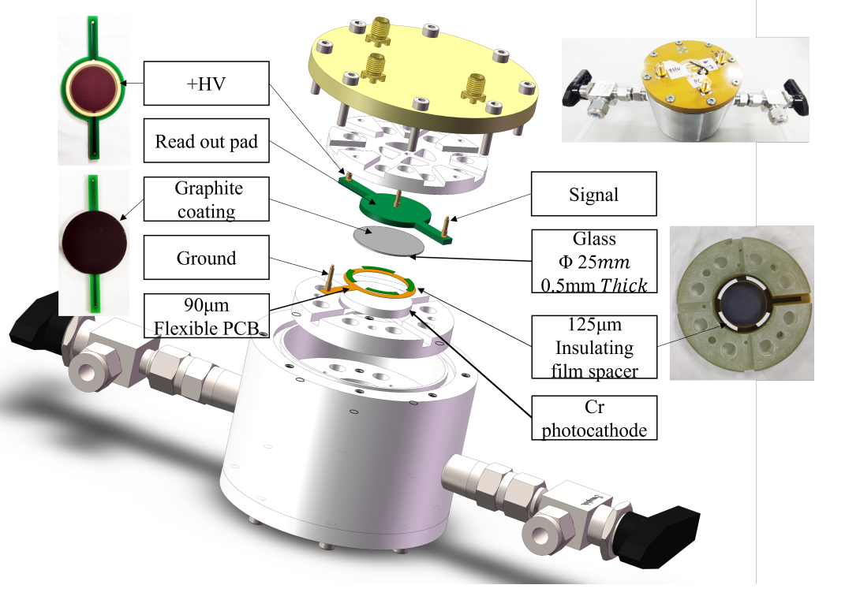
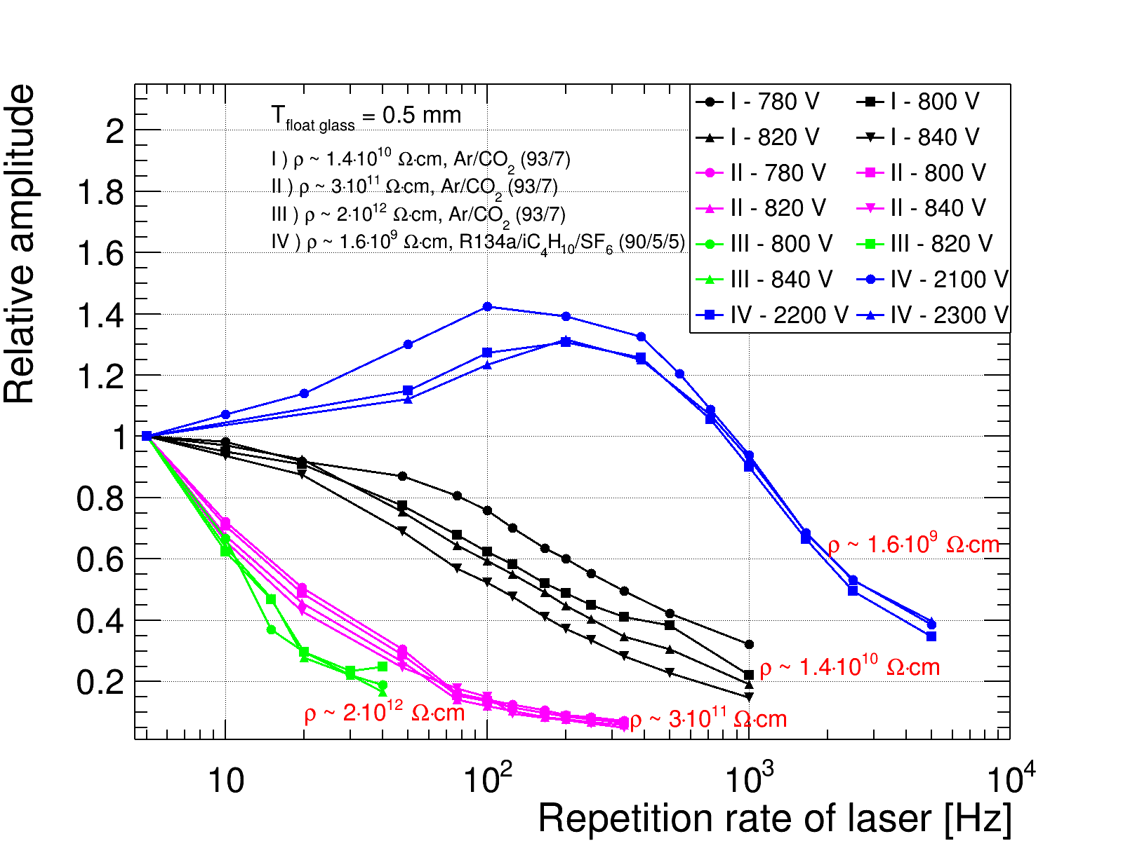
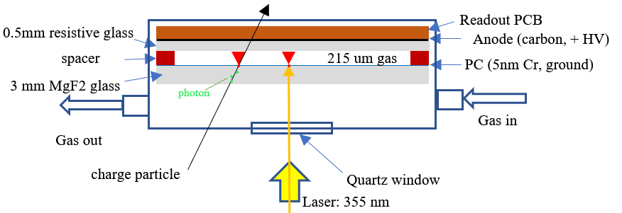
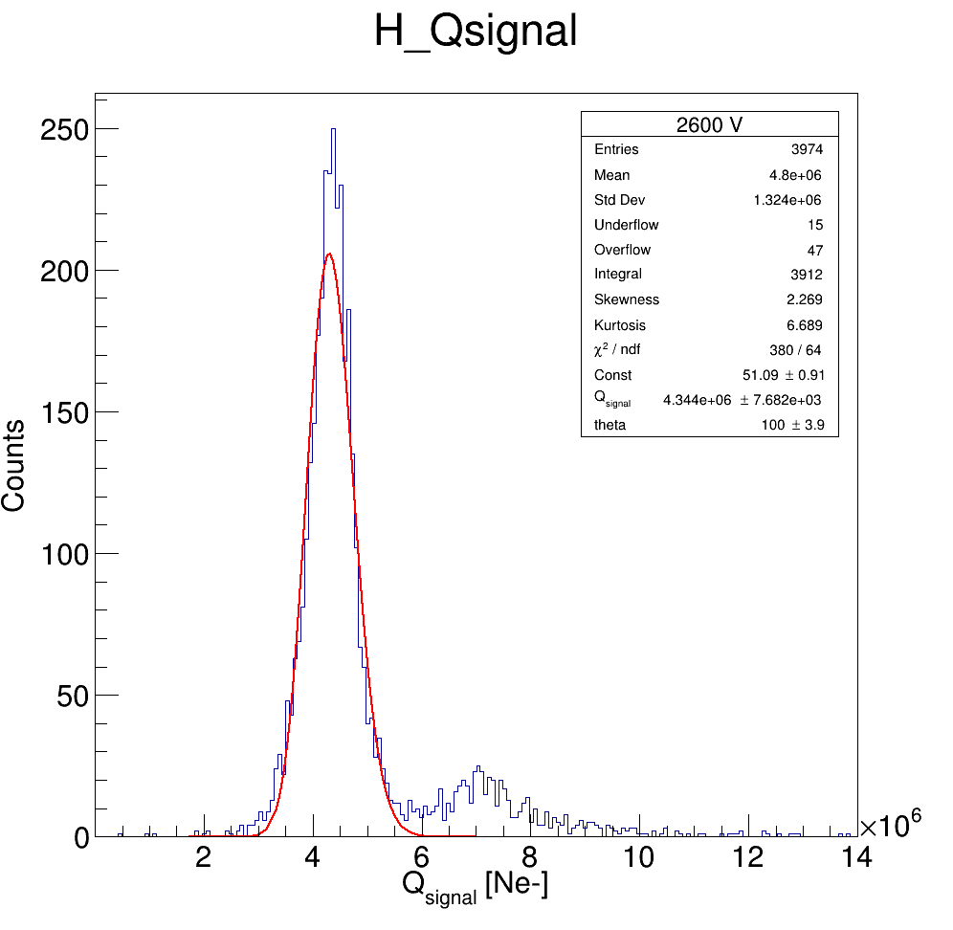
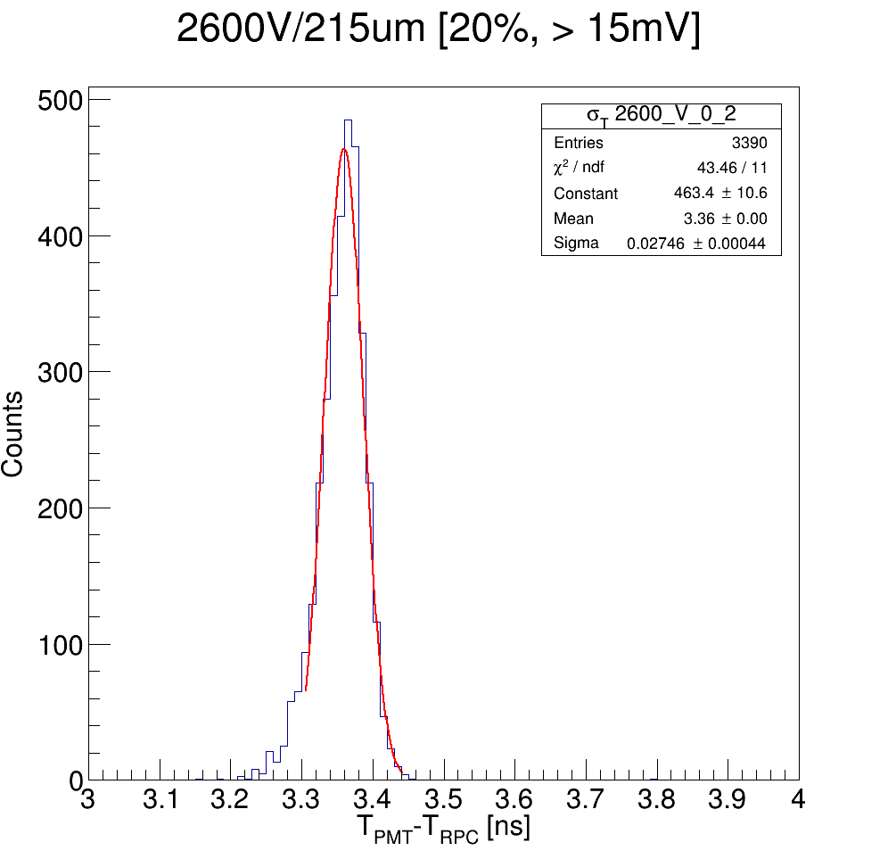
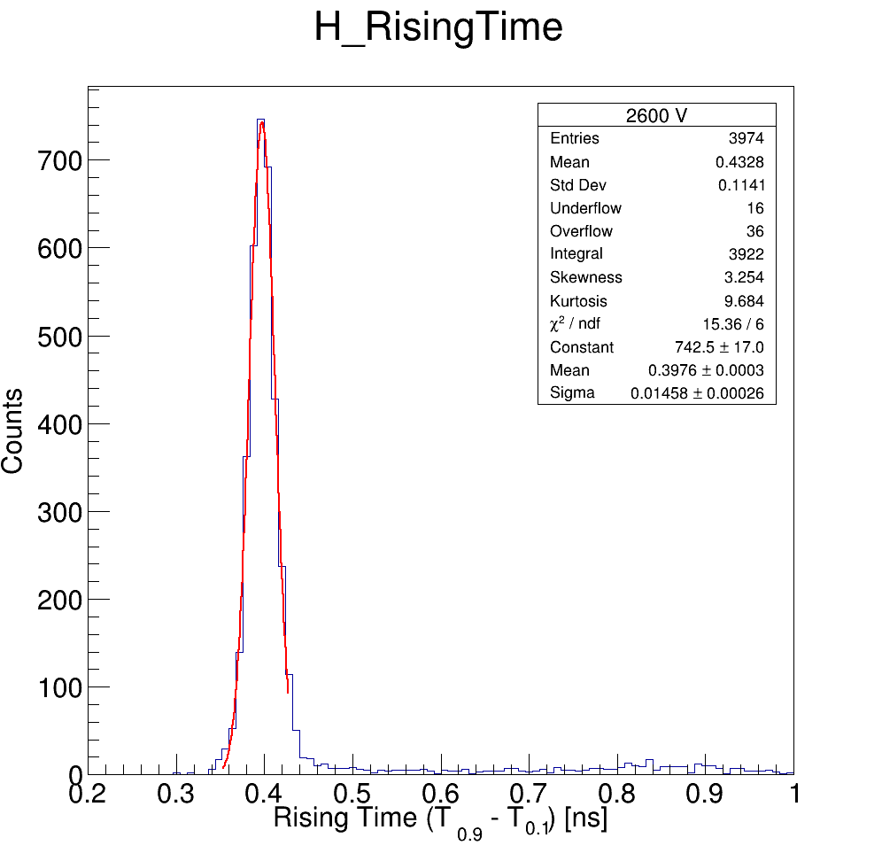
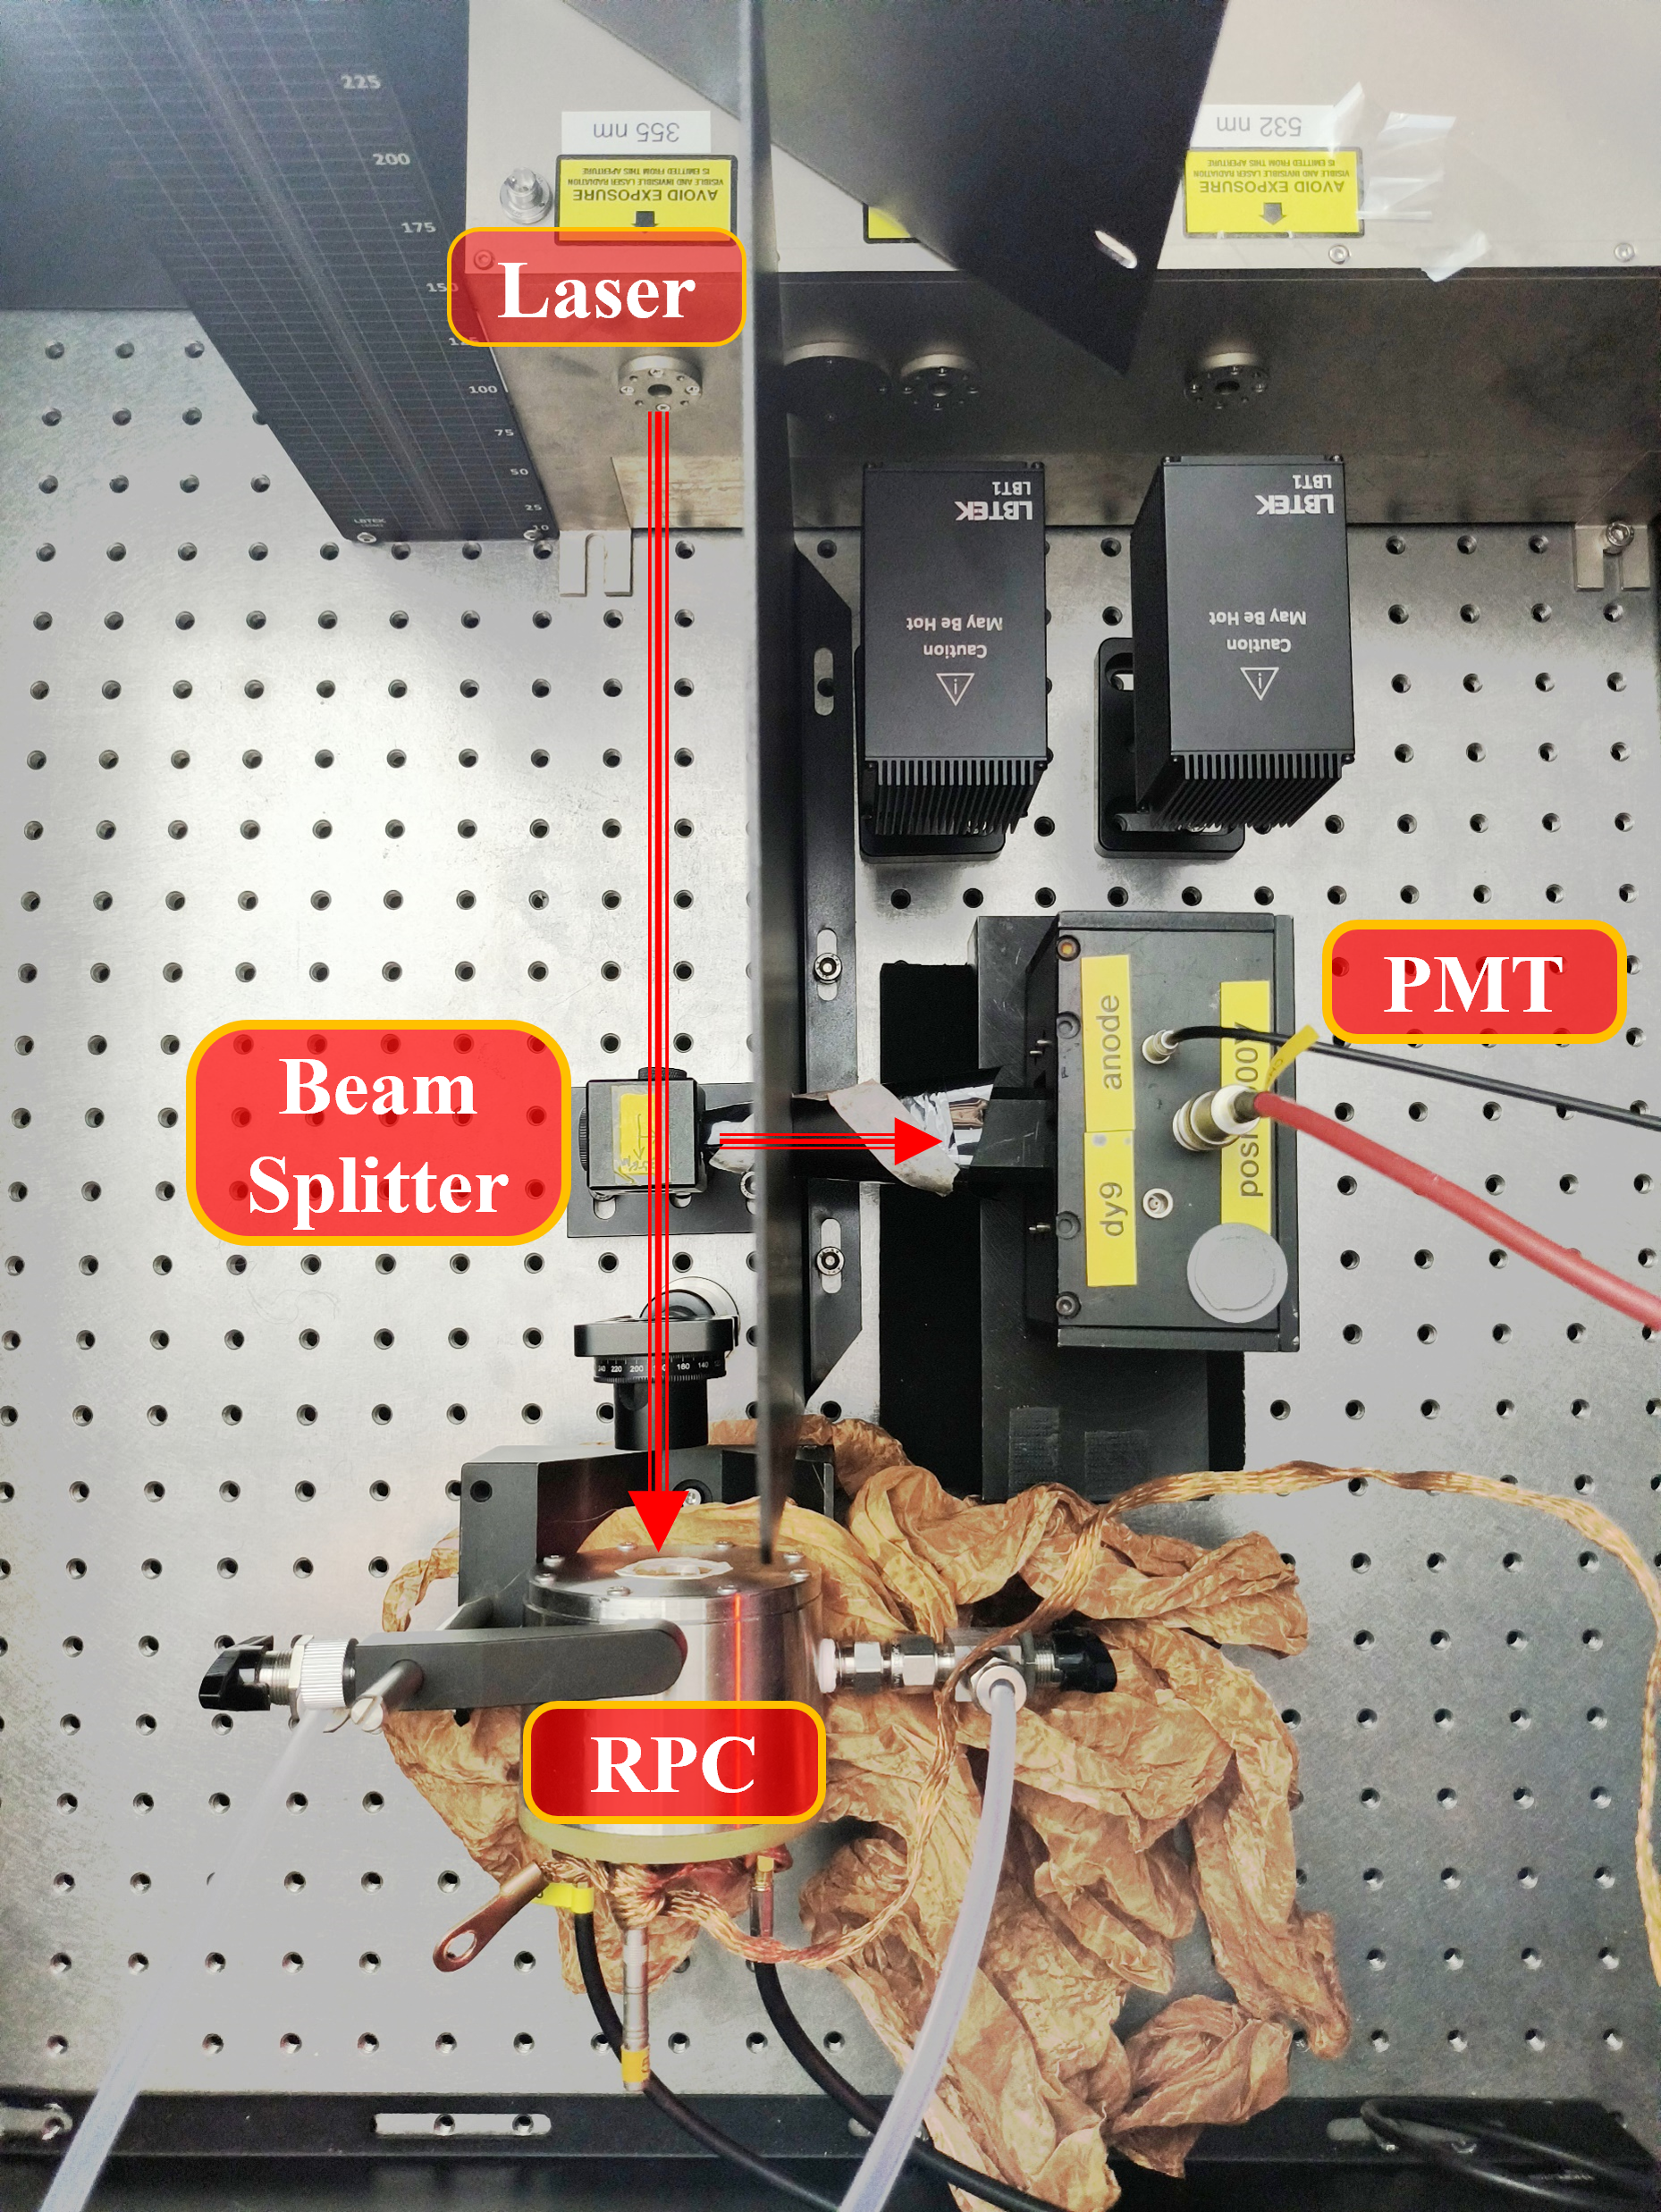
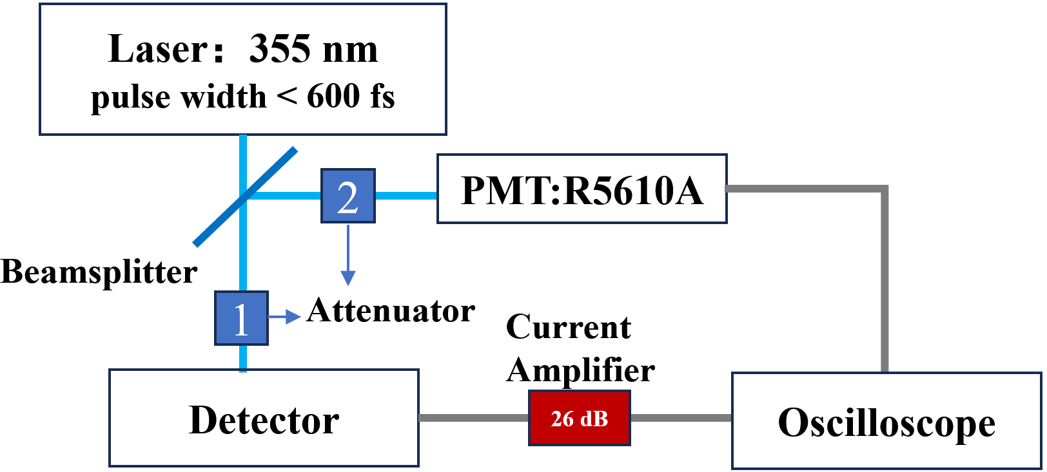
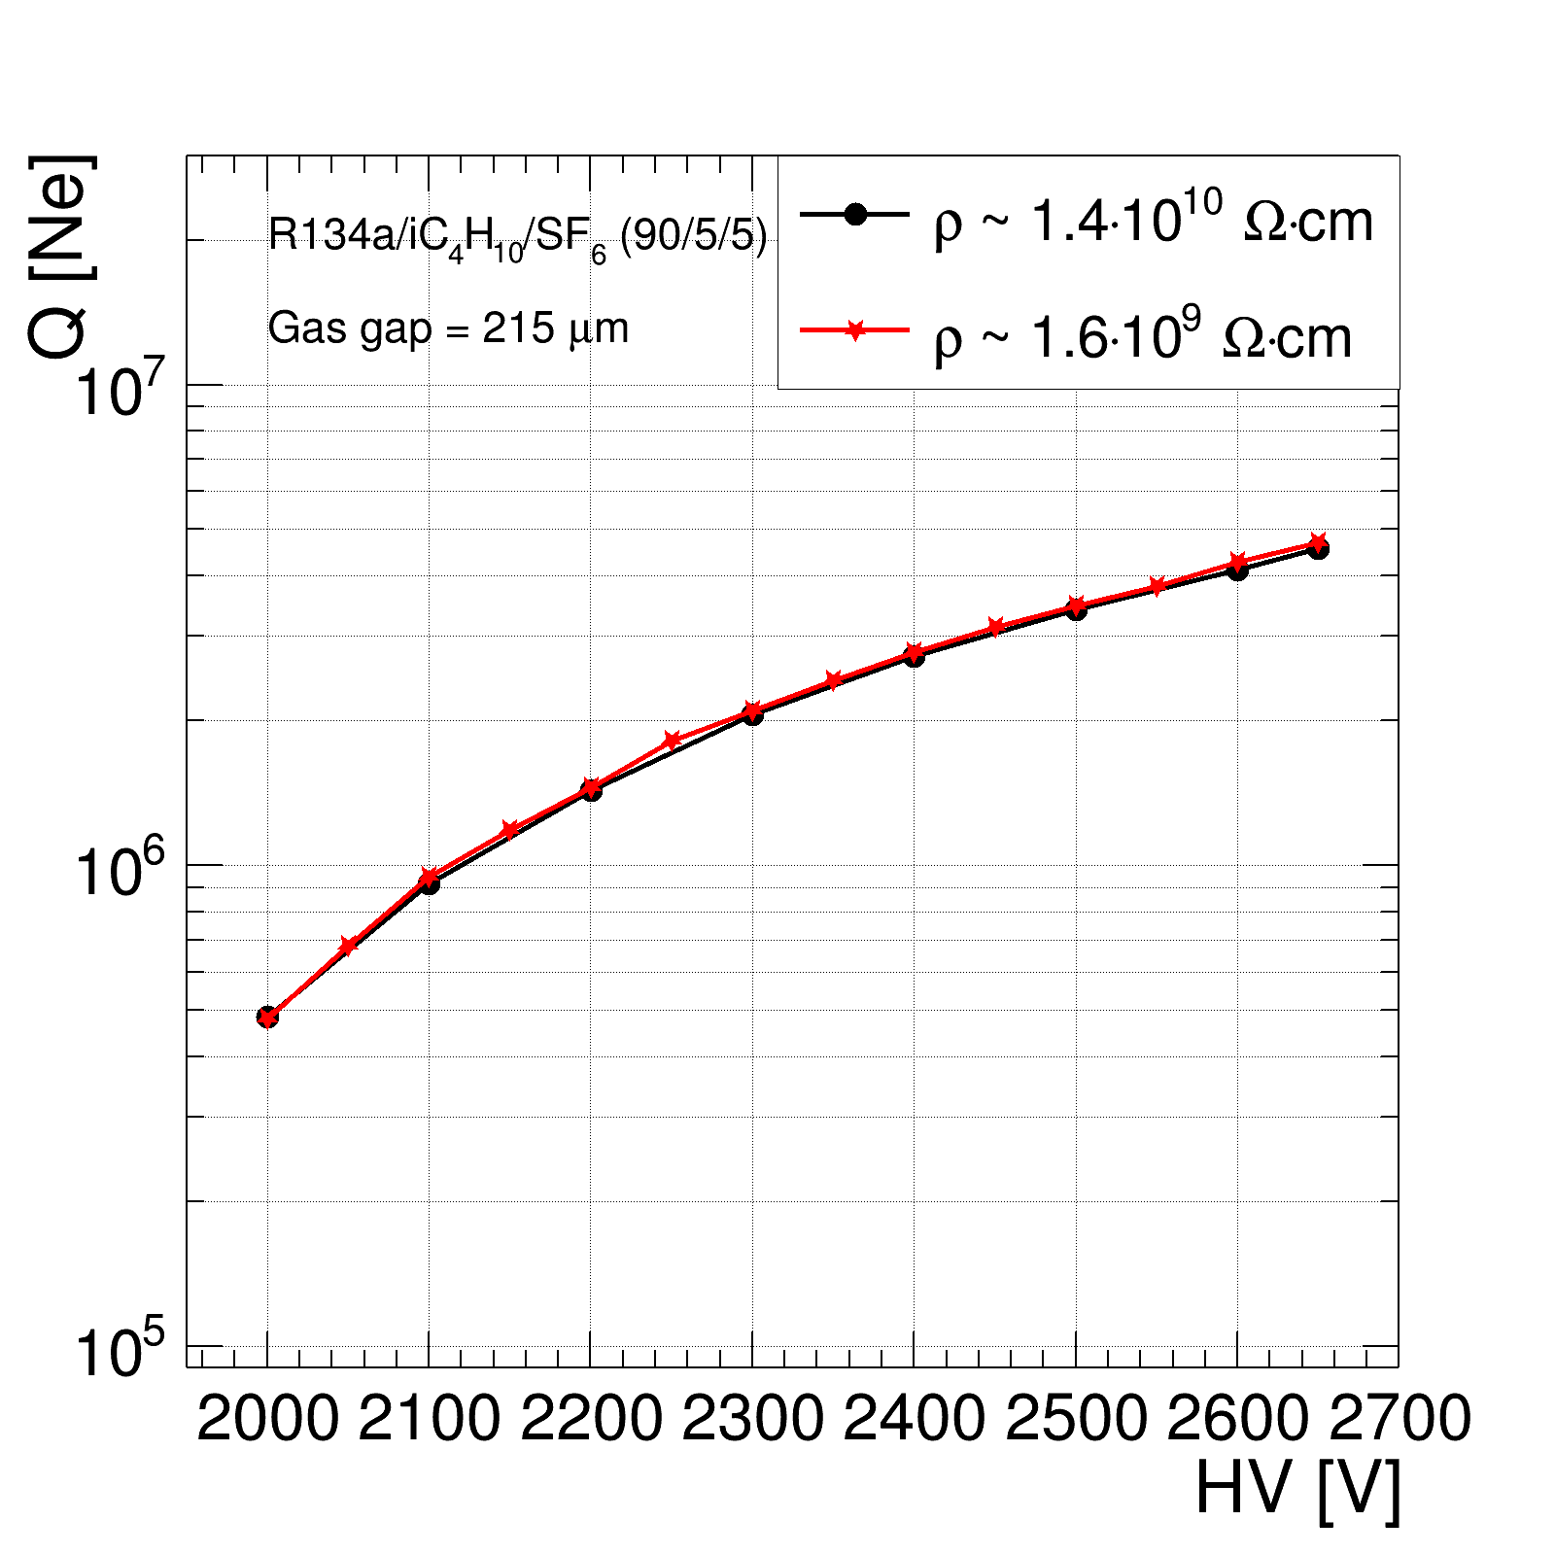
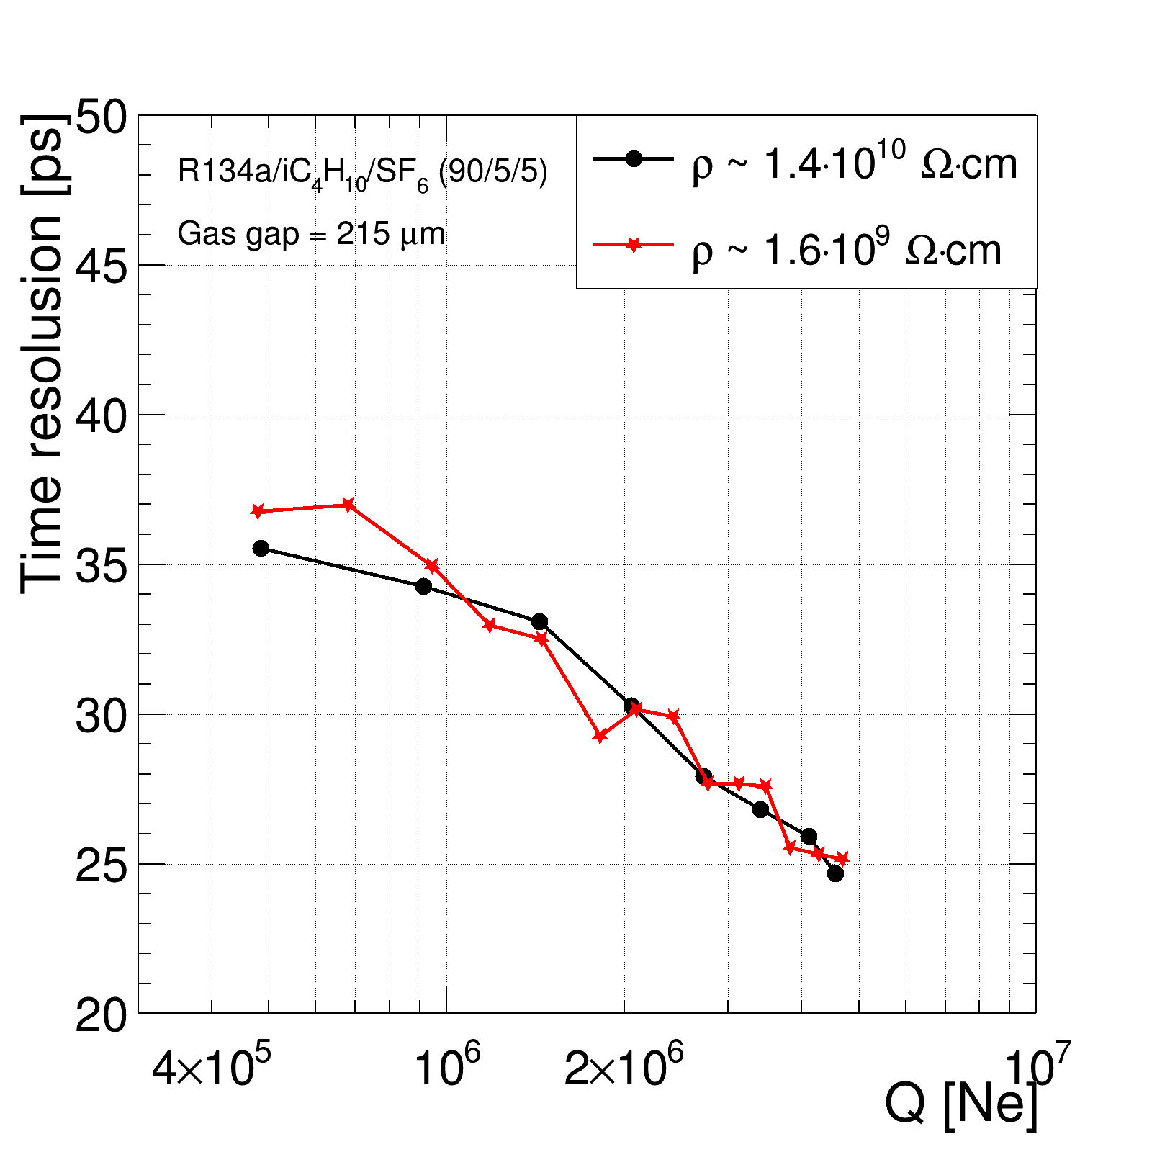
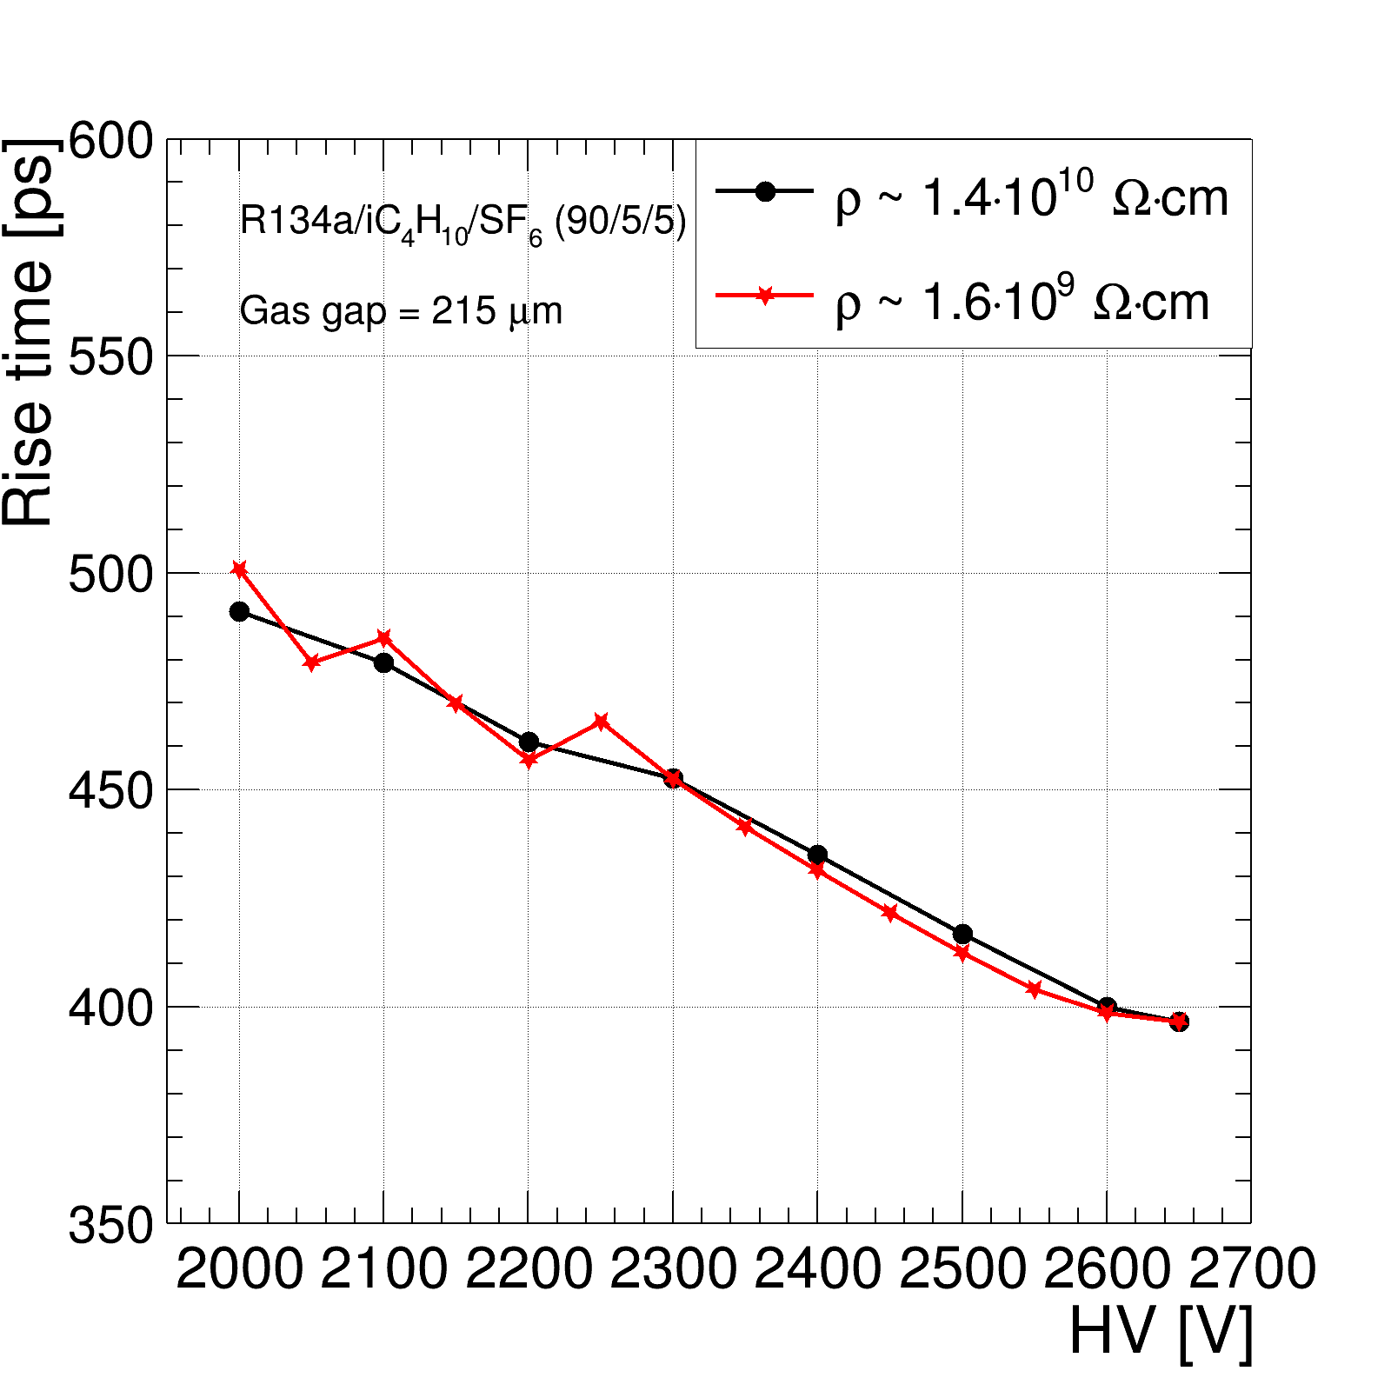
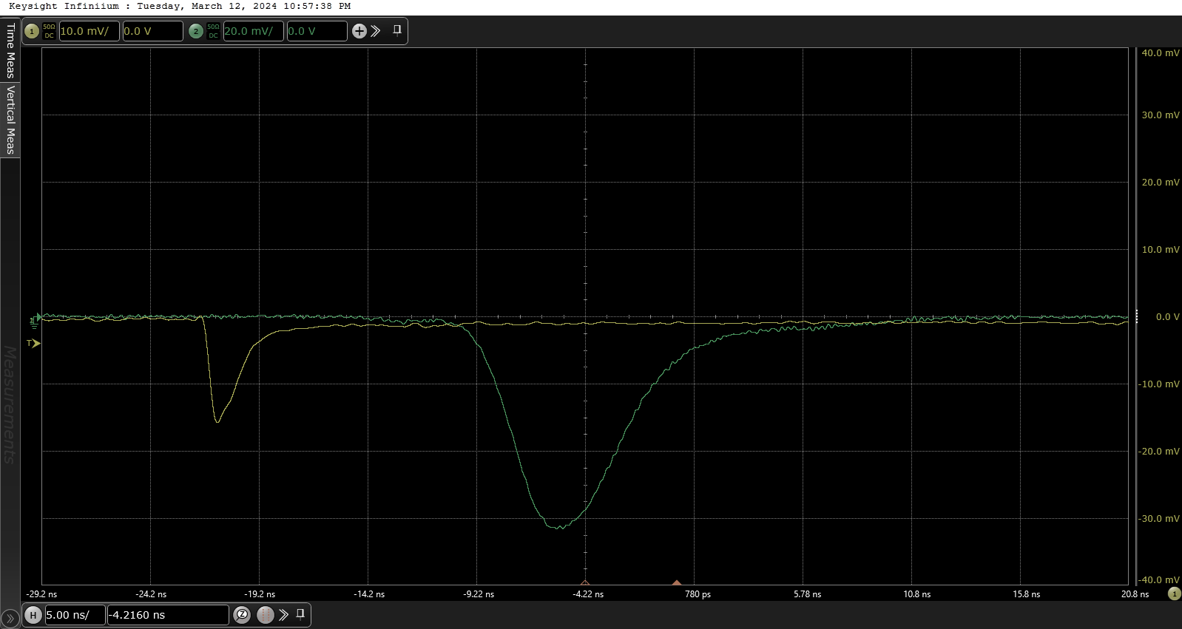

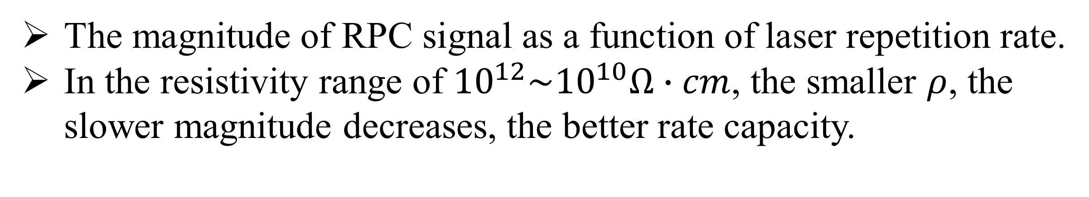




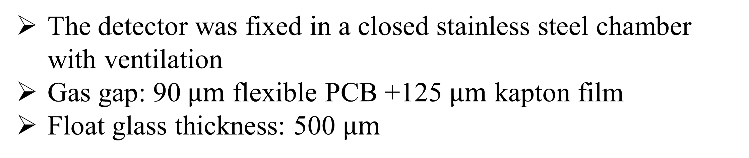






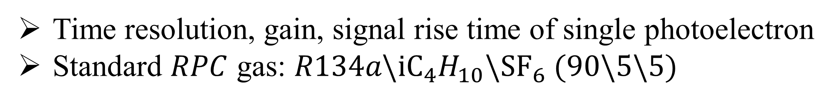
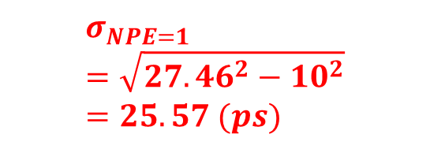
A high rate and high timing photoelectric RPC detector
Yiding Zhao, Dongdong Hu, Ming Shao, Zhen Chai, Yi Liu
State Key Laboratory of Particle Detection and Electronics, University of Science and Technology of China, Hefei 230026, China
School of Physics, Zhengzhou University 100 Science Avenue, Zhengzhou Henan, 450001, China
Introduction
Future high-energy and high-luminosity physics experiments pose new challenges to the performance of particle detectors, such as time resolution and counting rate. Photosensitive gaseous detectors have advantages over other types of photodetectors mainly in terms of size and cost. We have developed a photodetector with RPC (resistive plate chamber) structure. The detector exhibits excellent time resolution ($σ_{NPE=1}<30 ps$) and high rate ($\sim 100 kHz/cm^{2}$) by using low-resistivity float glass electrodes ($ρ \sim 1.4∙{10}^{10} Ω∙cm$) and narrow gas gap ($T_{gap}=215 μm$).
The rate capability of the resistive gas detector is constrained by the material's resistivity. Generally, a lower resistivity leads to a higher rate. However, excessively low resistivity can shield the signal induction and deteriorate the detector’s function.
In order to further improve the rate capability, we used float glass with a resistivity of $ρ \sim 1.6∙{10}^{9} Ω∙cm.$ This work focuses on:
  Can the detector work properly with the low-resistivity electrodes?
  How dose the rate capability improved?
  How does the performance of the detector change?
Photoelectric RPC structure
Low-resistivity float glass
The detector was fixed in a closed stainless steel chamber with ventilation
Gas gap: 90$μm$ flexible PCB +125 $μm$ kapton film
Float glass thickness: 500 $μm$
The magnitude of RPC signal as a function of laser repetition rate.
In the resistivity range of ${10}^{12}\sim {10}^{10}Ω∙cm$, the smaller $ρ$, the slower magnitude decreases, the better rate capacity.
For $ρ_{float glass} \sim 1.6∙10^{9}Ω∙cm$
The magnitude initially increases and subsequently decreases as the repetition rate of the laser increases.
The rate capacity is much better than that of higher $ρ$ chamber.
A schematic layout of the photoelectric RPC chamber
The mechanical structure of the photoelectric RPC chamber
Performance of RPC
Time resolution, gain, signal rise time of single photoelectron
Standard $RPC$ gas: $R134a\backslash {iC}_{4}H_{10}\backslash {SF}_{6} (90\backslash 5\backslash 5)$
Test setup
2600V
2600V
2600V
High precision test platform: $σ_{system}<10 ps$
$$ρ\sim 1.6∙10^{9}Ω∙cm$$
$$σ_{NPE=1 } \\ =\sqrt{27.46^{2}−10^{2}} \\ =25.57 (ps)$$
$$\overline{Rise time} \sim 398.6ps$$
$$\overline{Q}\sim 4.34∙10^{6}$$
The signals collected by the oscilloscope
$$\overline{Q}\sim 4.34∙10^{6}$$
RPC signal
PMT signal
$$σ_{NPE=1 }=25.57 ps$$
$$\overline{Rise time} \sim 398.6ps$$
The timing performance of detector $with 1.6∙10^{9}Ω∙cm$ resistivity float glass is as good as those with higher resistivity.
Conclusions
$\text{Develop}\text{ed} \text{a} \text{photoelectric} \text{RPC} \text{detector}$
Tested with several types of float glass $ρ_{float glass }\sim 1.6∙{10}^{9} Ω∙cm, 1.4∙{10}^{10} Ω∙cm, 3∙{10}^{11}$ $Ω∙cm$
Rate capability is improved and timing performance is good: $σ_{NPE=1}=$ 25.6 ps @(Gain~4.3$∙10^{6}$, RPC gas, 2600V).
The 8th International Conference on MPGD. Oct.14th - Oct.18th 2024 USTC· Hefei, China
Notes:
Ads

