Slide 1



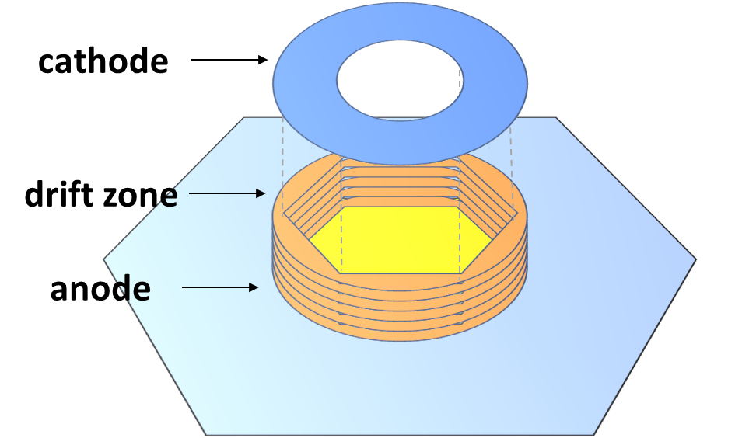
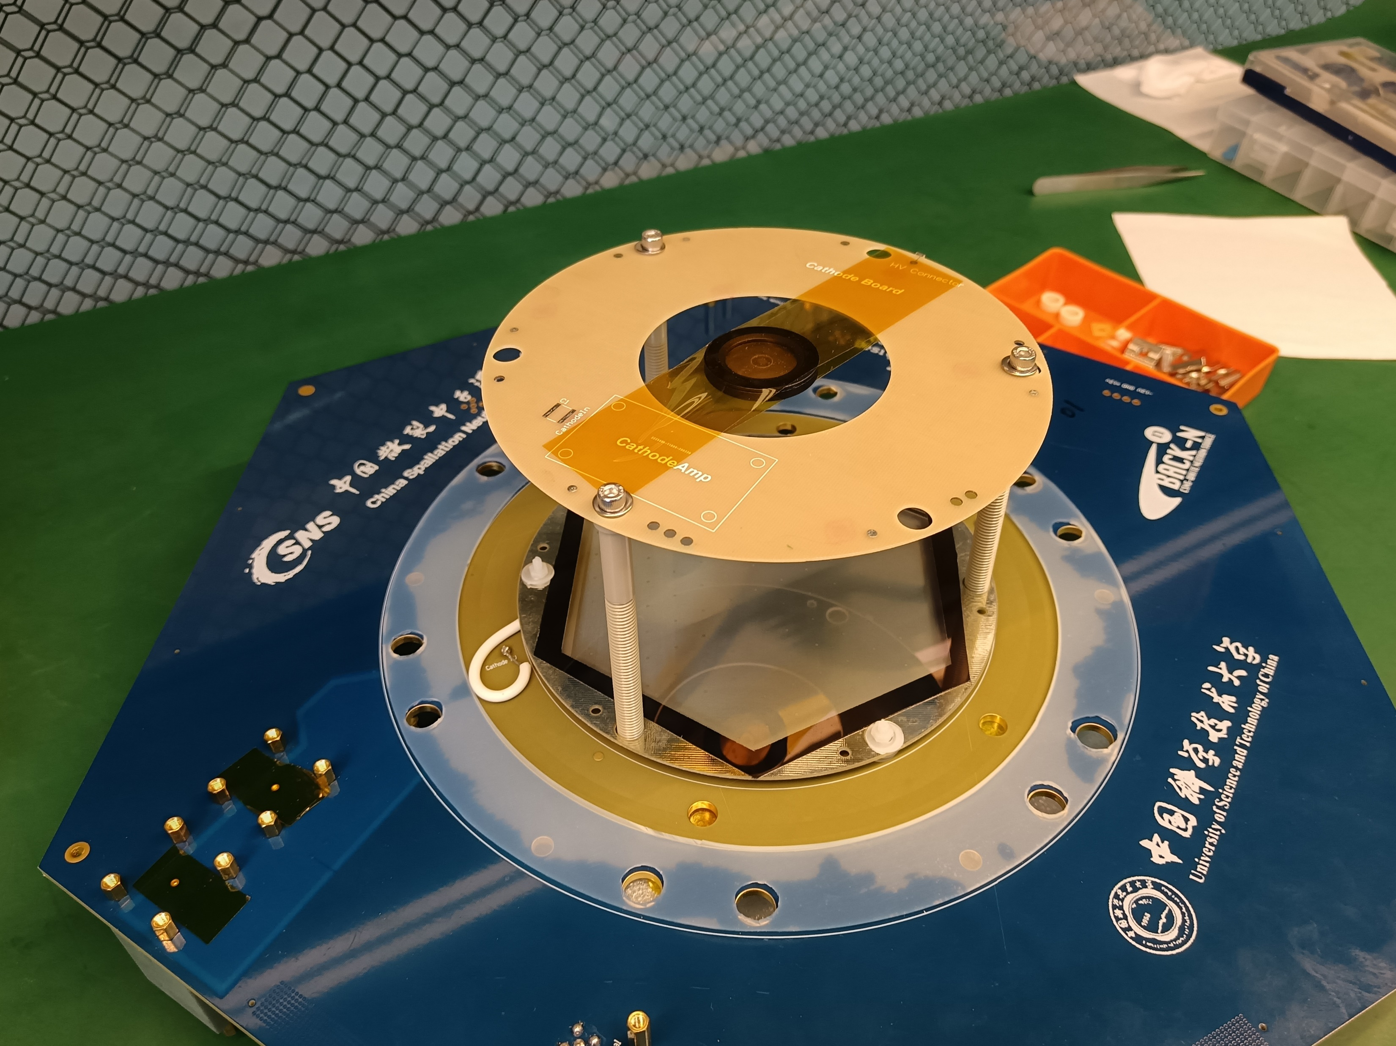
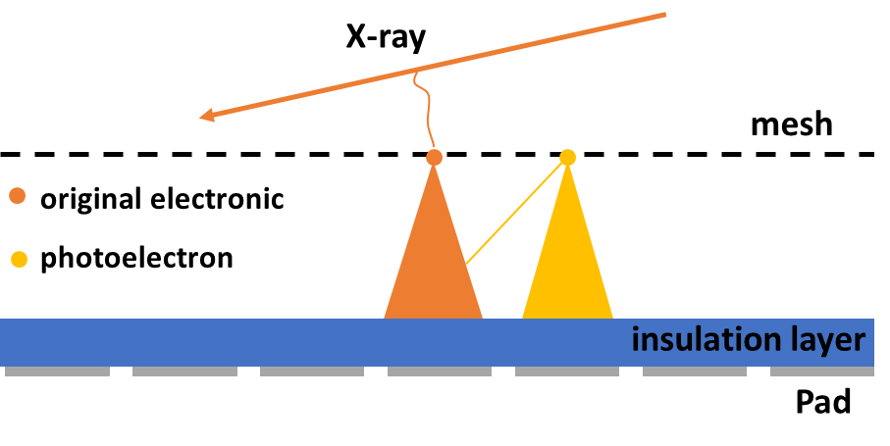
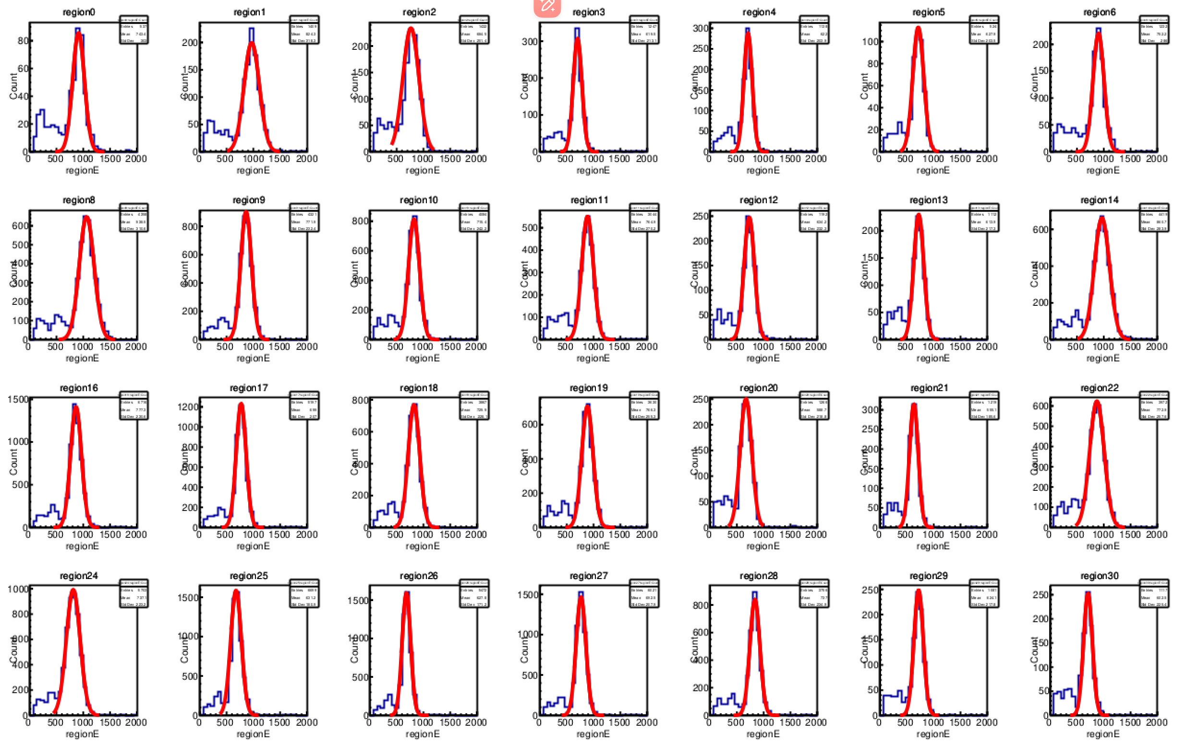
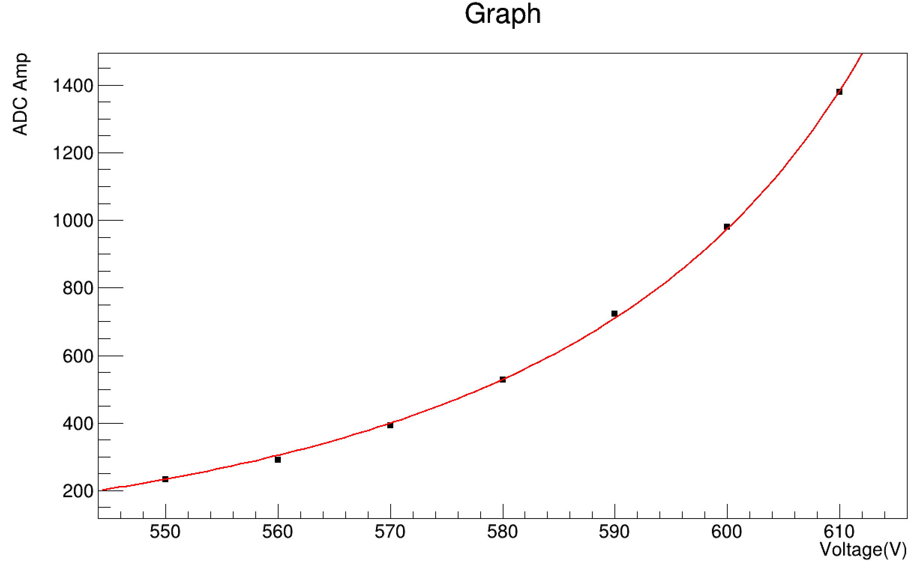
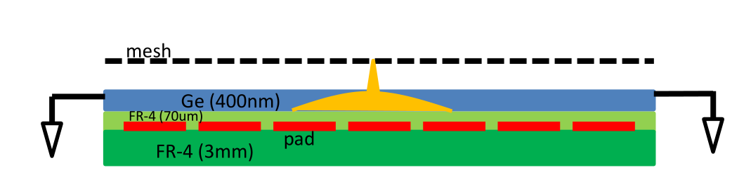
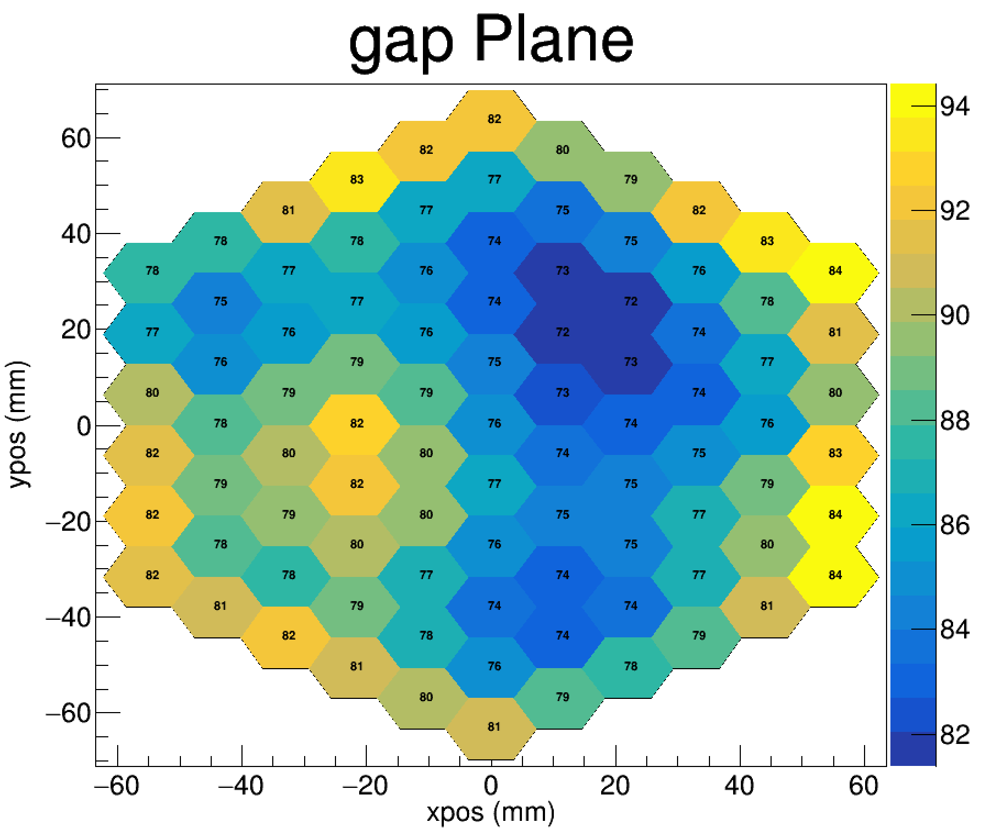
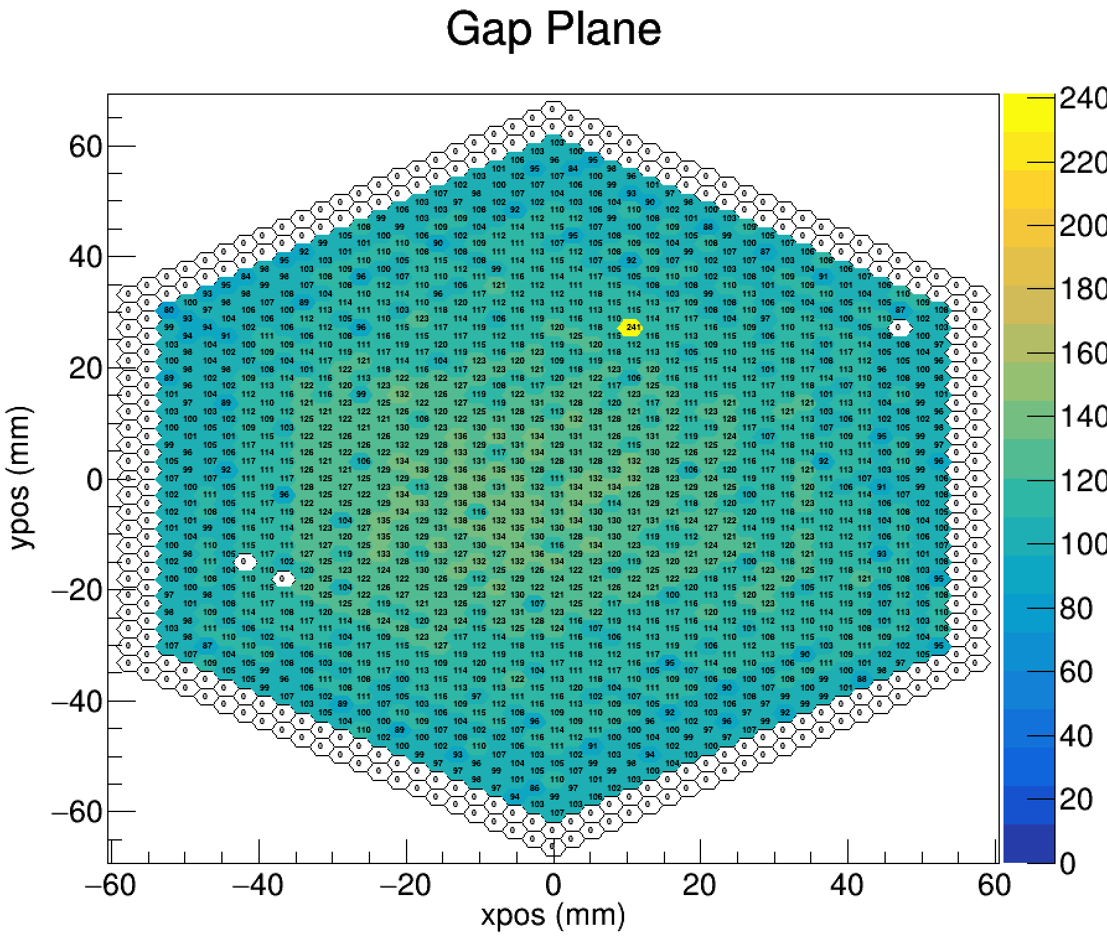

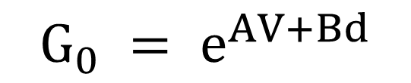

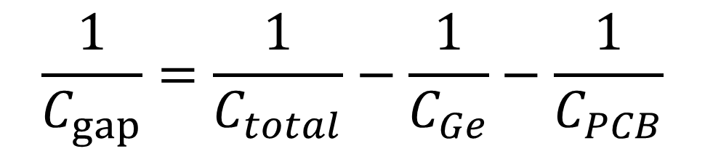
Research on the calibration method of the avalanche gap of MTPC anode plate
Tianzhi Chu^{1,2,3}, Han Yi^{1,2},Hongkun Chen^{1,2,4}, Haizheng Chen^{1,2,5} ,Yang Li^{1,2}Ruirui Fan^{1,2}, Shipeng Hu³
¹Spallation Neutron Source Science Center, Dongguan 523803, China
²Institute of High Energy Physics, Chinese Academy of Sciences (CAS), Beijing 100049, China
³College of Physics and Optoelectronic Engineering, Shenzhen University, Shenzhen 518060, China
⁴School of Physics, Sun Yat-sen University, Guangzhou 510275, China
⁵Department of Nuclear Science and Technology, School of Energy and Power Engineering, Xi’an Jiaotong University, Xi’an 710049, China
Abstract：
The particle energy corresponding to the response pad of the Multipurpose Time Projection Chamber (MTPC) is an important parameter in the measurement process of nuclear data. The accuracy of energy information on the solder pad mainly depends on the uniformity of anode plate gain. Therefore, it is necessary to calibrate the electronic avalanche gain and energy resolution of MTPC. The Micromegas detector is used as the anode plate of MTPC, and the avalanche gap between the grid and the resistance layer directly determines the gain of the anode plate. This poster describes the method of calibrating the anode plate avalanche gap using an X-ray source and mesh capacitor.
Introduction：
The Multipurpose Time Projection Chamber (MTPC) consists of a cathode, an anode plate, and drift zone, with the anode plate being a 68mm hexagonal shape, as shown in the figure on the right. We use a micromega detector as the anode, with a mesh as the wire mesh and a distance of about 100um from the resistive layer. The resistive layer is made of germanium material with a thickness of about 300nm, and the rest is covered by the PCB. When preparing Micromegas, hot pressing technology was used to paste the mesh, and the precision of the process level resulted in certain errors in the size of the gap, which in turn would affect energy measurement.
X-ray calibration method :
MTPC Structure Diagram
The ⁵⁵Fe X-ray source is placed 30cm above the anode plate with an energy of 5.9keV. Using gas with 80% Ar+20% CO₂ as the gas environment
X-rays generate electrons in a gas environment, which are amplified through avalanche regions and collected by pads
The hit position of each event is calculated by the amplitude-weighted center-of-gravity method and calculate the X-ray energy spectrum
The avalanche model was simulated using Garfield++
There is a strong photon feedback phenomenon in gases, and the influence of photon feedback can be avoided by adding fitting terms
Need to verify the accuracy of the scale through other methods
The X-ray source irradiates the anode plate(up left)and generates signal response(up right) X-ray energy spectrum (down left) and Gaussian++fitting effect ( down right)
$$G_{0} = e^{AV+Bd}$$
$$G = \frac{G_{0}}{1−γG_{0}}$$
mesh capacitor calibration method :
A capacitance is formed between the mesh and the pad, and the value of the capacitance mainly depends on the size of the gap
Provide signals on the mesh and collect coupling response on the pad. Reverse the size of the gap
MTPC Structure Diagram
$$\frac{1}{C_{gap}}=\frac{1}{C_{total}}−\frac{1}{C_{Ge}}−\frac{1}{C_{PCB}}$$
$$C_{gap}= \frac{εS_{pad}}{d_{gap}}$$
Result and Conclusion：
The left figure shows the result obtained through X-ray gain calibration. In order to ensure sufficient counting rate in each region, the anode plate was divided into 91 regular hexagons, each with a side length of 7.32mm. At the same time, considering that the pads on the outermost two circles of the anode plate are covered with glue, the counting of the center of gravity in the outermost two circles has been removed. The result obtained through fitting is approximately 80um. The right figure shows the results obtained through the mesh capacitance method, which also removes the influence of the outermost pad. The scale results show that the distribution trend of the anode plate is the same as that of the X-ray scale
Reference：
[1]Weihua Jia, You Lv, Zhiyong Zhang, et al. Gap uniformity study of a resistive Micromegas for the Multi-purpose Time Projection Chamber (MTPC) at Back-n white neutron source, Nuclear Instruments and Methods in Physics Research Section A: Accelerators, Spectrometers, Detectors and Associated Equipment, Volume 1039, 2022
[2]Yang Li, Han Yi, Yankun Sun, et al. Performance study of the Multi-purpose Time Projection Chamber (MTPC) using a four-component alpha source,Nuclear Instruments and Methods in Physics Research Section A: Accelerators, Spectrometers, Detectors and Associated Equipment,Volume 1060,2024
X-ray calibration result (left) Mesh capacitance calibration result (right)

