Slide 1
Accelerator Physics and Challenges for Future Colliders III
D. Schulte, CERN

Slide 2
Muon Collider

Slide 3
Motivation and Goal
Previous studies in US (now very strong interest again), experimental programme in UK and alternatives studies by INFN
New strong interest in high-energy, high-luminosity lepton collider
Combines precision physics and discovery reach
Application of hadron collider technology to a lepton collider
Muon collider promises sustainable approach to the energy frontier
limited power consumption, cost and land use
Technology and design advances in past years
review did not find any showstoppers
Goal is
10+ TeV collider
potential initial energy stage (e.g. 3 TeV)
higher energies to be explored later
3

Slide 4
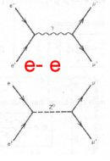
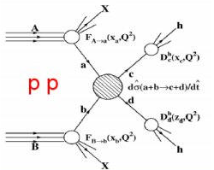
Physics Goals
Energy for discovery reach
10-14 TeV lepton collisions comparable to 100-200 TeV proton collisions
Leptons make the full energy available for particle production, protons only a fraction
Theorists defined goals:
Yields constant number of events in the s-channel
Luminosity must increase as E_{cm}² as production cross sections decrease
4

Slide 5
High-energy Colliders
accelerating cavities
Electron-positron rings are multi-pass colliders limited by synchrotron radiation: LEP, FCC-ee, CEPC
Hence proton rings are energy frontier: LHC, FCC-hh, SppC
N
N
S
S
Electron-positron linear colliders avoid synchrotron radiation, but single pass: SLC, ILC, CLIC
Typically cost proportional to energy and power proportional to luminosity,
Novel approach: muon collider (the first of its kind)
Large mass suppresses synchrotron radiation => multi-pass
Fundamental particle requires less energy than protons
But lifetime at rest only 2.2 μs
Proportional to energy

Slide 6
Muon Collider Overview
Would be easy if the muons did not decay
Lifetime is τ = γ x 2.2 μs
Short, intense proton bunch
Ionisation cooling of muon in matter
Acceleration to collision energy
Collision
Protons produce pions which decay into muons
muons are captured
6

Slide 7
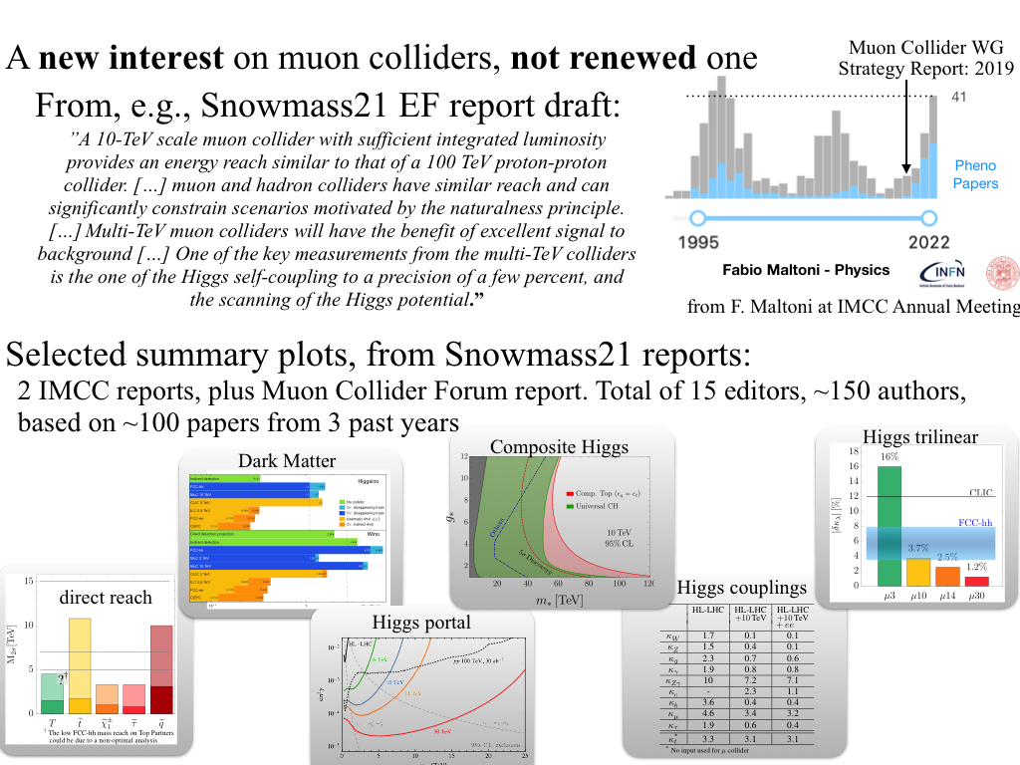
A New Interest in Muon Colliders
A. Wulzer, F. Maltoni, P. Meade et al.
O(150) authors, 15 editors, 100 papers
DELPHES card available
Strong US involvement starting with Muon Smasher’s Guide
and in Muon Collider Forum

Slide 8
Muon Collider Promises
US Snowmass Implementation Task Force: Th. Roser, R. Brinkmann, S. Cousineau, D. Denisov, S. Gessner, S. Gourlay, Ph. Lebrun, M. Narain, K. Oide, T. Raubenheimer, J. Seeman, V. Shiltsev, J. Straight, M. Turner, L. Wang et al.
 | CME [TeV] | Lumi per IP [10³⁴cm⁻²s⁻¹] | Years to physics | Cost range [B$] | Power [MW]
FCC-ee | 0.24 | 8.5 | 13-18 | 12-18 | 290
ILC | 0.25 | 2.7 | <12 | 7-12 | 140
CLIC | 0.38 | 2.3 | 13-18 | 7-12 | 110
ILC | 3 | 6.1 | 19-24 | 18-30 | 400
CLIC | 3 | 5.9 | 19-24 | 18-30 | 550
MC | 3 | 1.8 | 19-24 | 7-12 | 230
MC | 10 | 20 | >25 | 12-18 | 300
FCC-hh | 100 | 30 | >25 | 30-50 | 560
Judgement by ITF, take it cum grano salis
8

Slide 9
Goal and Accelerator R&D Roadmap
Muon collider is on European Accelerator R&D Roadmap
Reviews in Europe and US found no insurmountable obstacle
Implementing workplan
Goal: Project Evaluation Report and R&D Plan to next ESPPU/other processes
10+ TeV collider, potential 3 TeV initial stage
CERN has budget in MTP, hosting a collaboration
Design Study supported by EC, Switzerland, UK and partners contribute
Strong interest in US community to join and contribute at same level as Europe
We still need more resources
But doubled last year with EU Design Study
Might double with US joining
Preparing other requests
Exploitation of synergies
http://arxiv.org/abs/2201.07895
9

Slide 10
Muon Collider Timeline (Roadmap)
Technically limited timeline
To be reviewed considering progress, funding and decisions
Muon collider important in the long term
Even after potential FCC-hh
But also plan B as next project in Europe and maybe plan A in US and elsewhere
Fast track option if require next as project after HL-LHC:
Lower energy initial option, e.g. 3 TeV
Upgrade to 10 TeV later
  Little extra cost
Subject to funding
Evaluation+decision
Evaluation+decision
10

Slide 11
Muon Collider Community
CERN-hosted collaboration
EU Design Study helped to kick-start collaboration
(since March 2023, EU+Switzerland+UK and partners)
EU support also helps with funding in institutes
O(70) partners, 60+ already signed MoC
Increase resources of partners with other funding requests:
Submit to HORIZON-INFRA-2024-TECH
  Focus on magnet technologies
National funding agencies
Looking for new partners
In particular US
But also other regions

Slide 12
IMCC Partners
IT | INFN
 | INFN, Univ., Polit. Torino
 | INFN, Univ. Milano
 | INFN, Univ. Padova
 | INFN, Univ. Pavia
 | INFN, Univ. Bologna
 | INFN Trieste
 | INFN, Univ. Bari
 | INFN, Univ. Roma 1
 | ENEA
 | INFN Frascati
 | INFN, Univ. Ferrara
 | INFN, Univ. Roma 3
 | INFN Legnaro
 | INFN, Univ. Milano Bicocca
 | INFN Genova
 | INFN Laboratori del Sud
 | INFN Napoli
Mal | Univ. of Malta
EST | Tartu University
SE | ESS
 | University of Uppsala
PT | LIP
NL | University of Twente
FI | Tampere University
LAT | Riga Technical University
CH | PSI
 | University of Geneva
 | EPFL
BE | Univ. Louvain
AU | HEPHY
 | TU Wien
ES | I3M
 | CIEMAT
 | ICMAB
China | Sun Yat-sen University
 | IHEP
 | Peking University
KO | KEU
 | Yonsei University
IEIO | CERN
FR | CEA-IRFU
 | CNRS-LNCMI
DE | DESY
 | Technical University of Darmstadt
 | University of Rostock
 | KIT
UK | RAL
 | UK Research and Innovation
 | University of Lancaster
 | University of Southampton
 | University of Strathclyde
 | University of Sussex
 | Imperial College London
 | Royal Holloway
 | University of Huddersfield
 | University of Oxford
 | University of Warwick
 | University of Durham
US | Iowa State University
 | University of Iowa
 | Wisconsin-Madison
 | University of Pittsburgh
 | Old Dominion
 | Chicago University
 | Florida State University
 | RICE University
 | Tennessee University
 | MIT Plasma science center
 | Pittsburgh PAC
India | CHEP
US | FNAL
 | LBL
 | JLAB
 | BNL
12

Slide 13
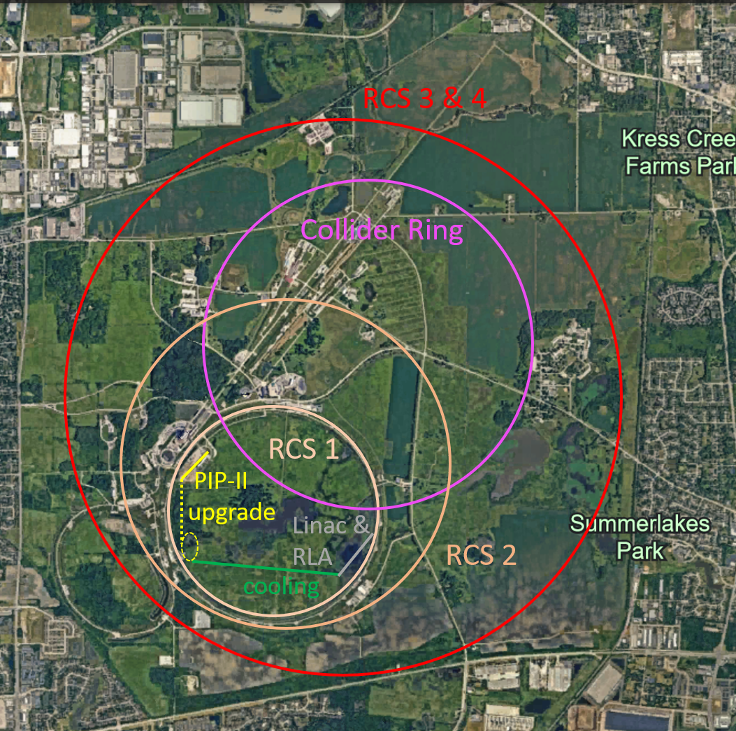
US P5: The Muon Shot
US has been instrumental in advancing the muon collider during Snowmass process
See the contributions even increase after the process
Particle Physics Project Prioritisation Panel (P5) supports US ambition to host a 10 TeV parton-parton collider
Endorses muon collider R&D: ”This is our muon shot”
Recommend joining the IMCC and consider FNAL as a host candidate
Warmly welcome the US
Informal discussion with DoE (Regina Rameika, Abid Patwa):
DoE wants to maintain IMCC as a international collaboration
Addendum to CERN-DoE-NSF agreement is being preparation
  Will allow labs to join
Universities are joining already now
IMCC prepares options for Europe and for the US in parallel
13

Slide 14
Tentative Staged Target Parameters
Parameter | Unit | 3 TeV | 10 TeV | 10 TeV | 10 TeV
L | 10³⁴ cm⁻²s⁻¹ | 1.8 | 20 | tbd | 13
N | 10¹² | 2.2 | 1.8 | 1.8 | 1.8
f_{r} | Hz | 5 | 5 | 5 | 5
P_{beam} | MW | 5.3 | 14.4 | 14.4 | 14.4
C | km | 4.5 | 10 | 15 | 15
<B> | T | 7 | 10.5 | 7 | 7
ε_{L} | MeV m | 7.5 | 7.5 | 7.5 | 7.5
σ_{E} / E | % | 0.1 | 0.1 | tbd | 0.1
σ_{z} | mm | 5 | 1.5 | tbd | 1.5
β | mm | 5 | 1.5 | tbd | 1.5
ε | μm | 25 | 25 | 25 | 25
σ_{x,y} | μm | 3.0 | 0.9 | 1.3 | 0.9
Target integrated luminosities
Need to spell out scenarios
Need to integrate potential performance limitations for technical risk, cost, power, …
Example as discussion basis
numbers will change
14

Slide 15
Muon Collider Luminosity Scaling
Fundamental limitation
Requires emittance preservation and advanced lattice design
Applies to MAP scheme
High beam power
High energy
Large energy acceptance
Dense beam
High field in collider ring
Luminosity per power increases with energy
Provided technologies can be made available
Constant current for required luminosity scaling

Slide 16
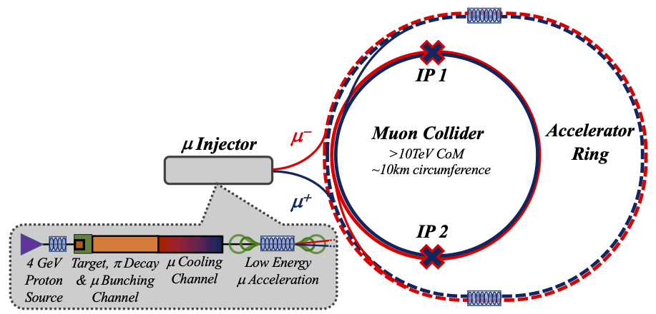
Key Challenges
0) Physics case
4) Drives the beam quality
MAP put much effort in design
optimise as much as possible
2) Beam-induced background
1) Dense neutrino flux
mitigated by mover system and site selection
3) Cost and power consumption limit energy reach
e.g. 35 km accelerator for 10 TeV, 10 km collider ring
Also impacts beam quality
16

Slide 17
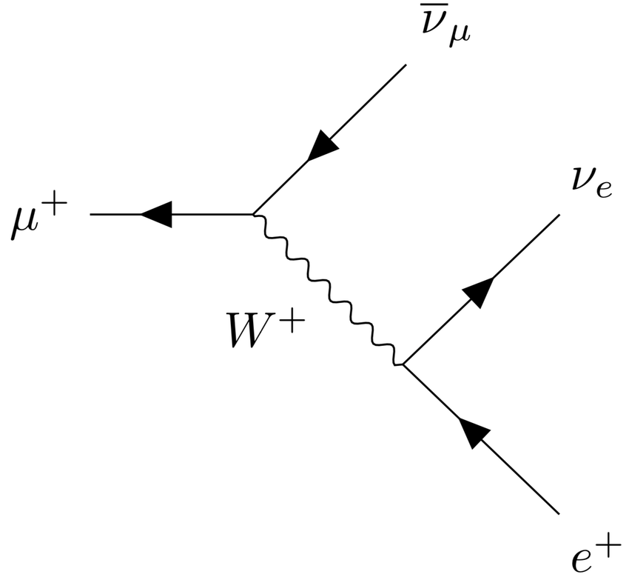
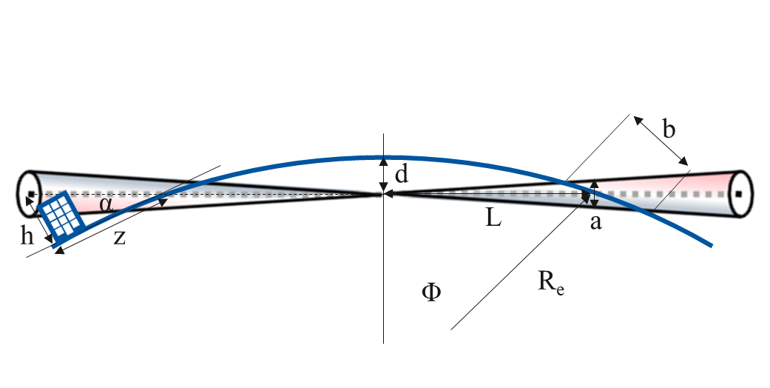
Muon Decay and Neutrino Flux
~600 m
Muon decays per bunch passage
235,000 m⁻¹ at 3 TeV
58,000 m⁻¹ at 10 TeV
t₁
But want to have negligible impact from arcs
Similar impact as LHC
At 3 TeV this is the case for 200 m depth
At 10 TeV use angle change of +/- 1 mradian to go from acceptable to negligible level
  Mockup of mover system planned
  Impact on beam to be checked
Impact of experimental insertions
3 TeV design acceptable with no further work
Maybe acquire land in direction of experiment, also for 10 TeV
t₂

Slide 18
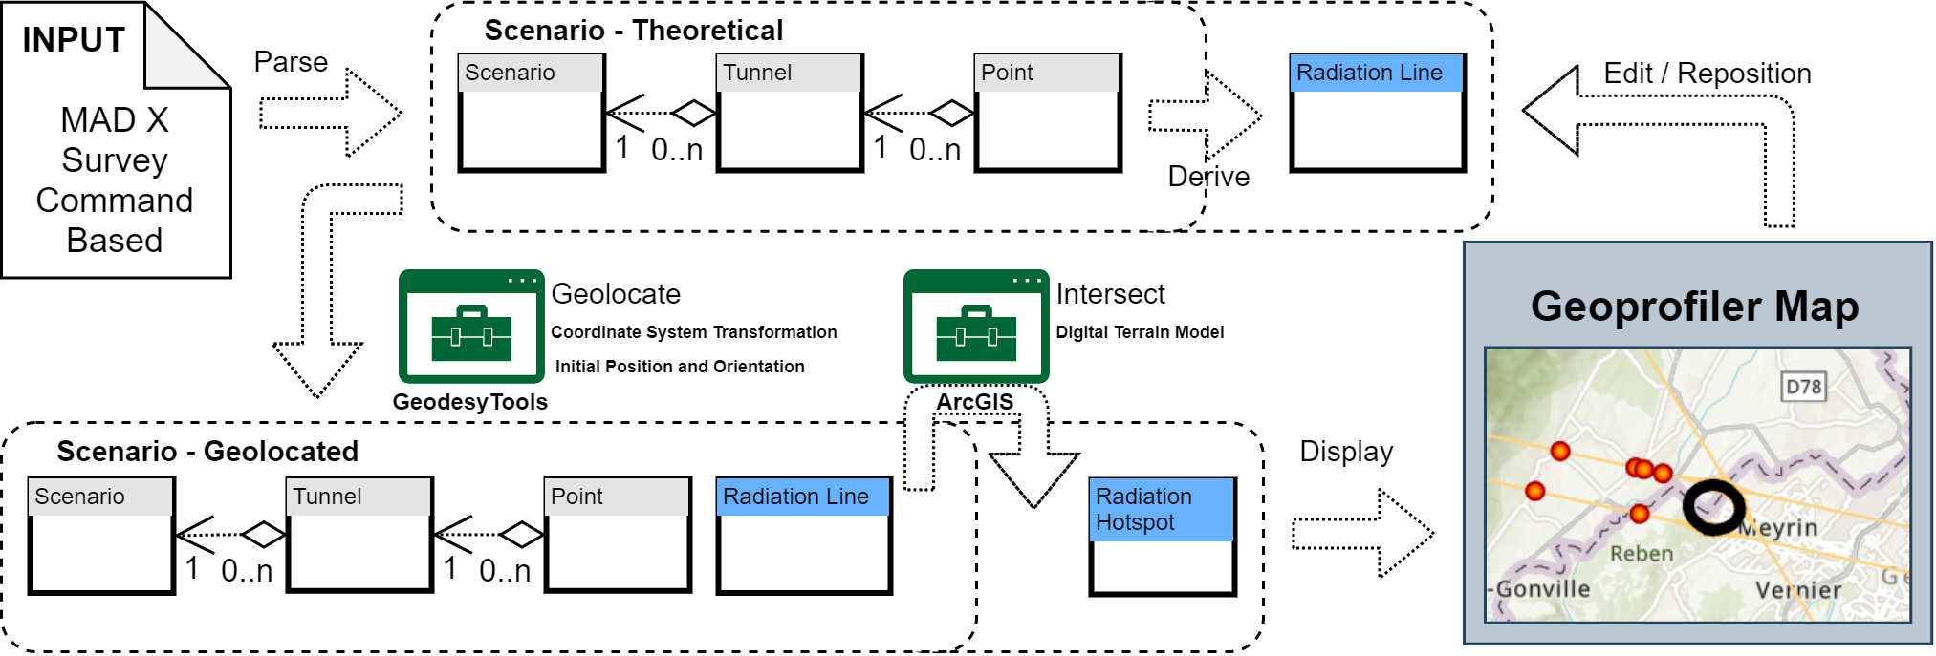
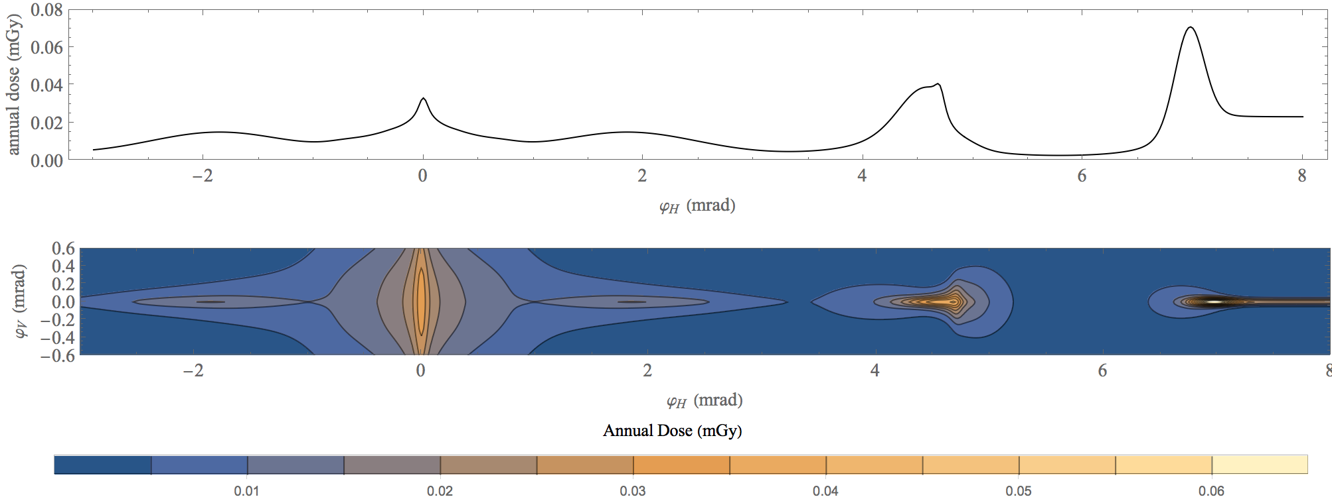
Neutrino Flux
Goal: similar to LHC: limit neutrino flux to have negligible impact, “fully optimised” (10% of MAP goal)
Verify performance of concept to be good for 14 TeV
Mover and support system
FLUKA dose studies
Conformity Verification Scheme
F. Bertinelli et al. (CERN, Riga)
G. Lerner, D. Calzolari, A. Lechner, C. Ahdida
G. Lacerda, Y. Robert, N. Guilhaudin (CERN)
C. Ahdida, P. Vojtyla, M. Widorski, H. Vincke
Flux direction map / lattice design / mover impact on beam
Mitigation:
Site choice tool
C. Carli, K. Skoufaris (CERN)
18

Slide 19
Muon Decay and Detector Background
Detector team
O(69) authors, O(150 signatories)
Muon decays produce electrons and positrons
Loss per unit length almost independent of energy
First results indicate that background does not increase much with energy
1.5 and 3 TeV studies, concept based on CLIC detector
Masks to mitigate background
Detailed FLUKA studies of masks/beamline
Tracking detector radiation level similar to HL-LHC
Studies with beam-induced background in progress
some channels are not affected by background
some improvement required for other channels
Concept for 10 TeV in progress
D. Lucchesi, F. Meloni et al.
19

Slide 20
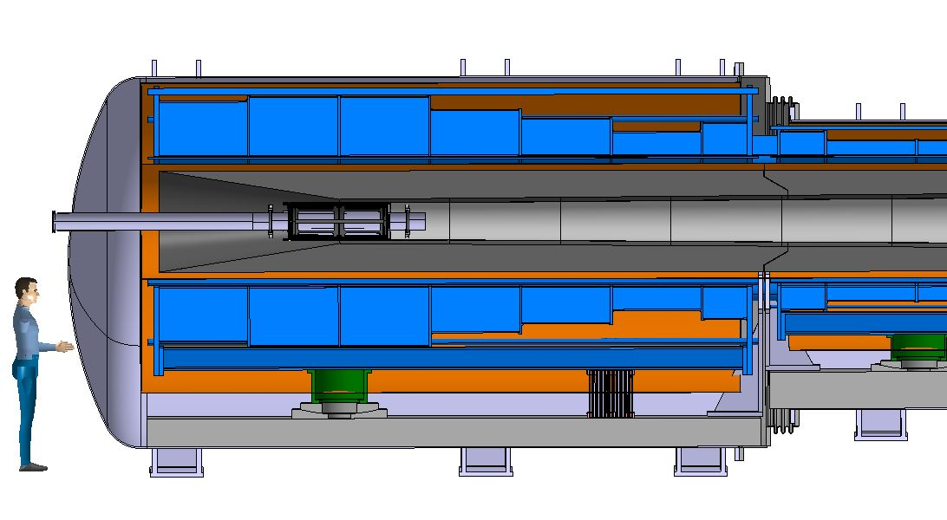
Proton Complex and Target
in target
decay
protons
pions
muons
400 kJ protons to produce 5 x 10¹³ captured muon pairs
5 GeV proton beam, 2 MW = 400 kJ x 5 Hz
Power is at hand
ESS and Uppsala will focus on merging beam into high-charge pulses
Optimisation of parameters planned
Graphite Target
20 T solenoid
to guide pions and muons
Tungsten shielding
To protect magnet

Slide 21
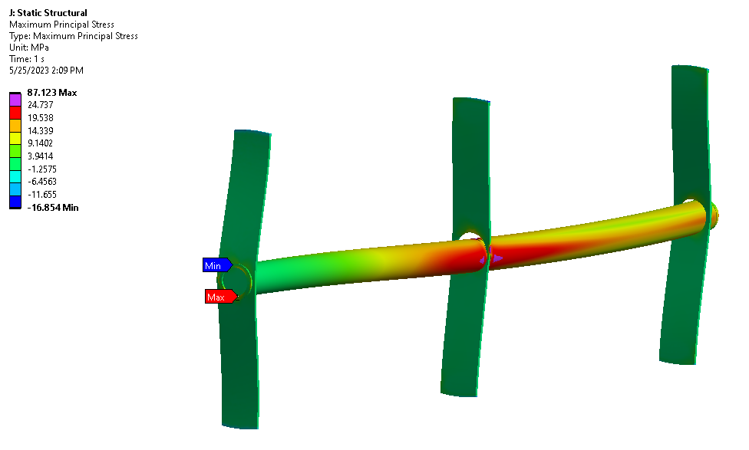
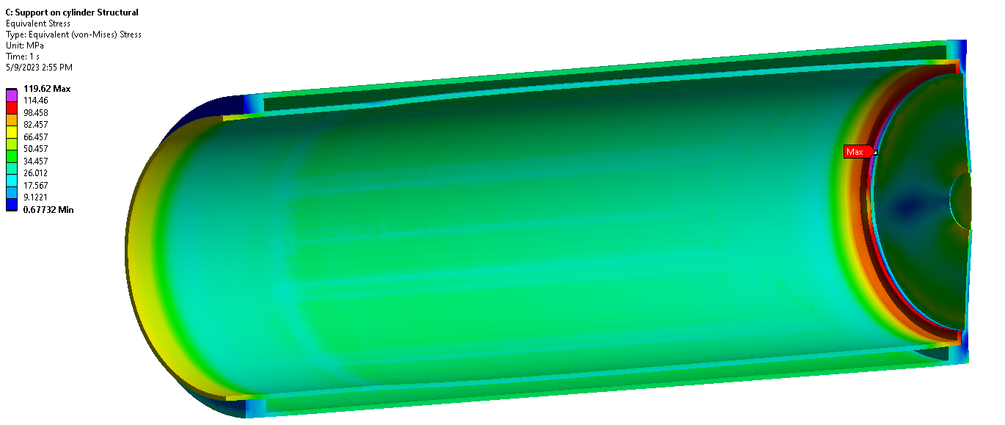
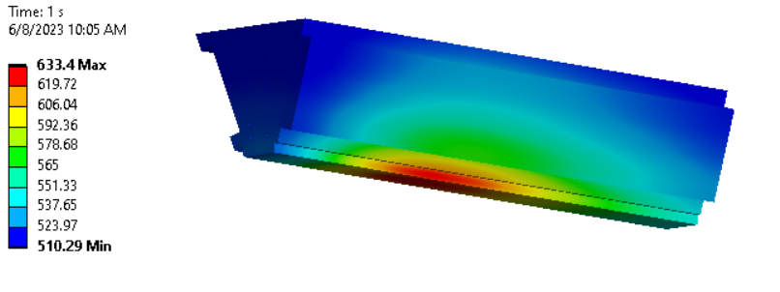
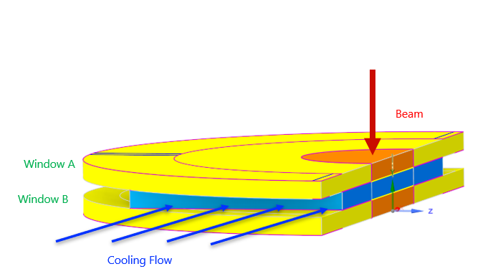
Target Design
5 x 10¹⁴ protons/pulse, 5 GeV (0.4 MJ), 5 Hz
graphite rod with 15 mm radius
or liquid lead
or fluidised tungsten
CNGS
Target
Vessel
Tunsten shielding
Window
CNGS target
3.5 x 10¹³ protons/pulse, 400 GeV (2.2 MJ), 1/6 Hz
A. Lechner, D. et al.

Slide 22
Final Cooling Principle
High field solenoids minimise beta-function and impact of multiple scattering
Energy loss = cooling
Multiple scattering = heating

Slide 23
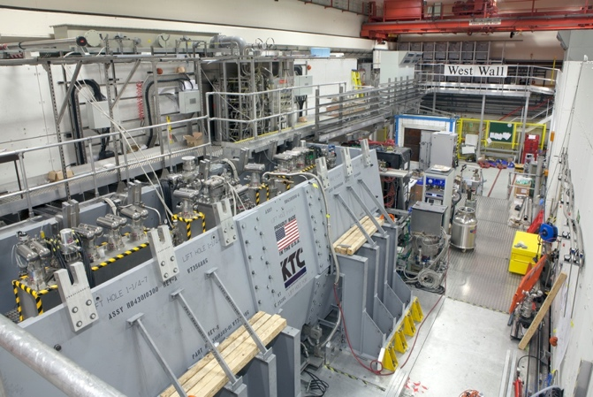
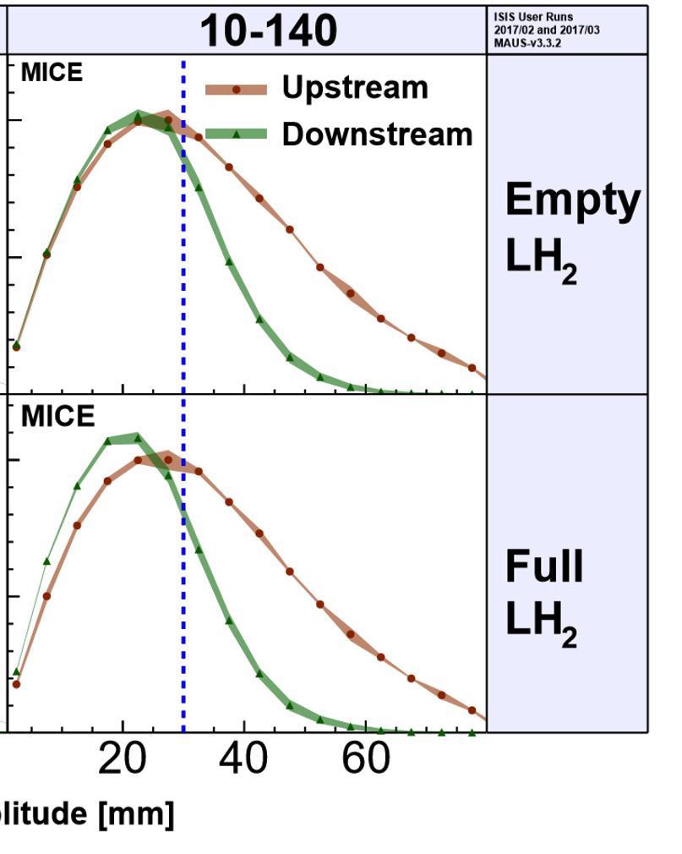
MICE: Cooling Demonstration
Principle of ionisation cooling has been demonstrated
Use of data for benchmarking is still ongoing
Nature vol. 578, p. 53-59 (2020)
More complete experiment with higher statistics, more than one stage required
Integration of magnets, RF, absorbers, vacuum is engineering challenge
More particles at smaller amplitude after absorber is put in place
23

Slide 24
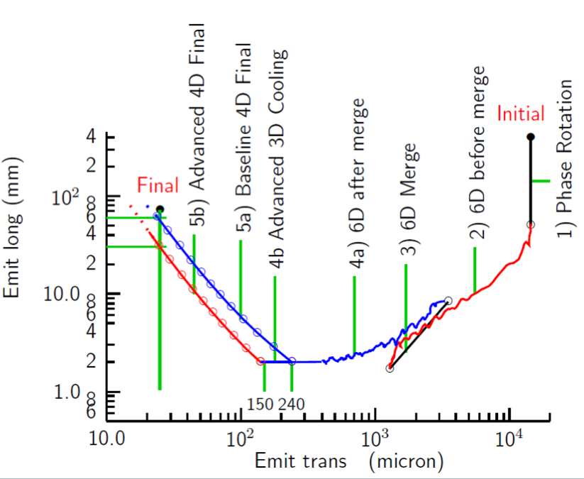
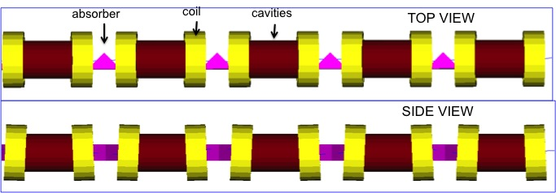
Cooling: The System Chain
Target
Y
Specification
•
•
•
For acceleration to
multi-TeV collider
Front End
For acceleration to NuMAX (325MHz injector acceptance 3mm,24mm)
Phase
Rotator
Exit Front End
(15mm,45mm)
Longitudinal Emittance (mm)
Transverse Emittance (microns)
MAP collaboration

Slide 25
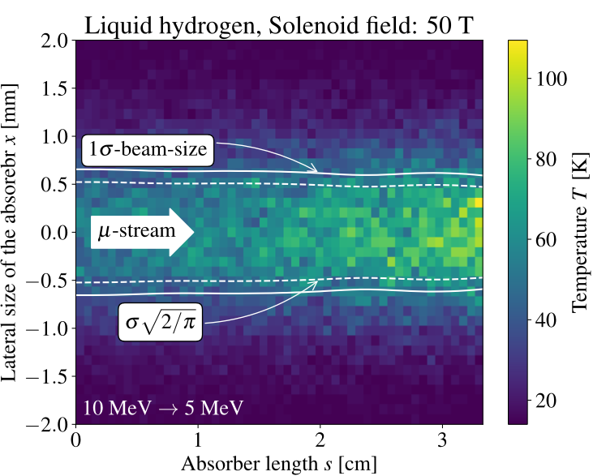
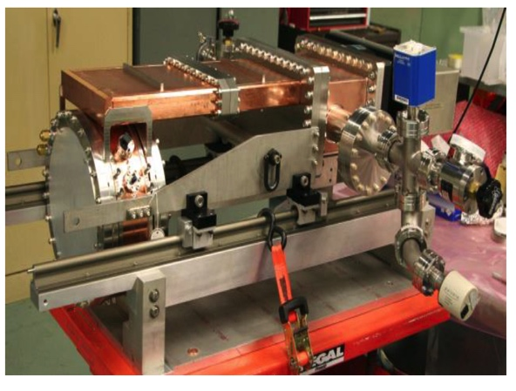
Cooling Cell Technology
Most complex example 12 T
Will develop example cooling cell with integration
tight constraints
additional technologies (absorbers, instrumentation,…)
early preparation of demonstrator facility
Windows and absorbers for high-density muon beam
Pressure rise mitigated by vacuum density
Plan window test in HiRadMat
L. Rossi et al. (INFN, Milano, STFC, CERN),
J. Ferreira Somoza et al.
RF cavities in magnetic field
MAP demonstrated higher than goal gradient
Improve design based on theoretical understanding
Preparation of new test stand, but needs funding
Test stand at CEA (700 MHz, need funding)
Test at other frequencies in the UK considered
Use of CLIC breakdown experiment considered
MuCool demonstrated >50 MV/m in 5 T
H2-filled copper
Be end caps
C. Marchand, Alexej Grudiev et al. (CEA, Milano, CERN, Tartu)
25

Slide 26
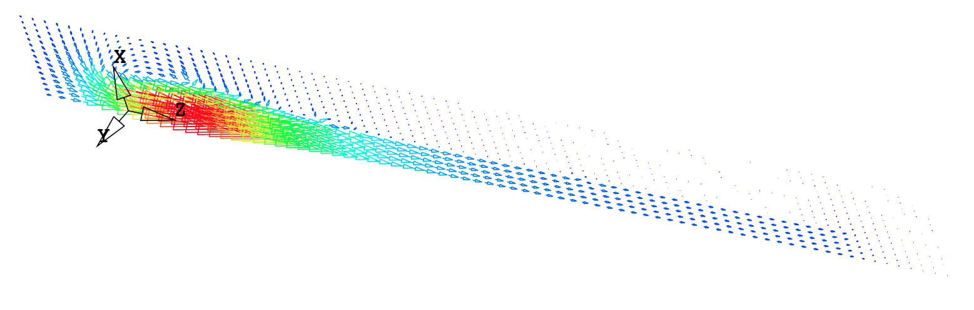
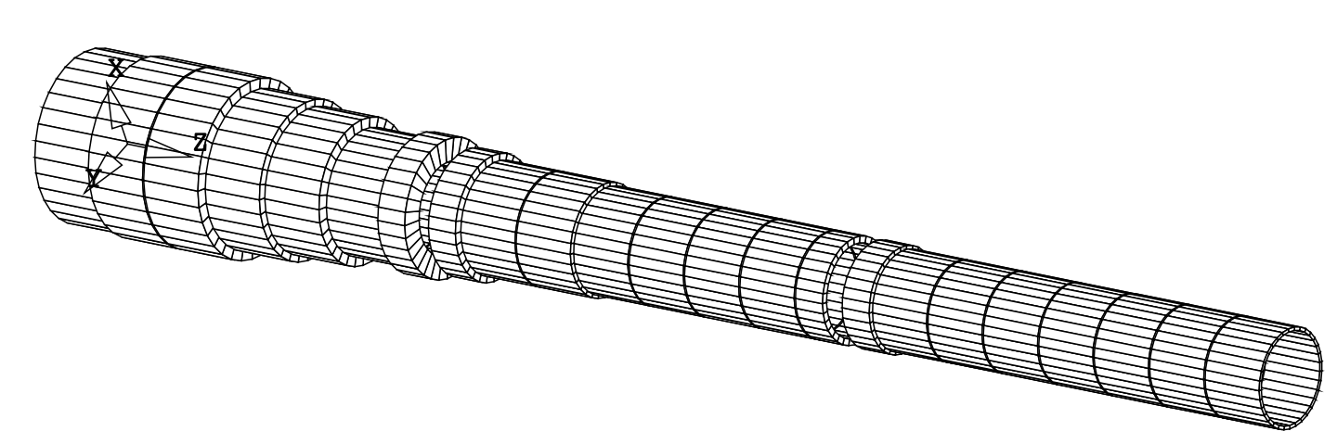
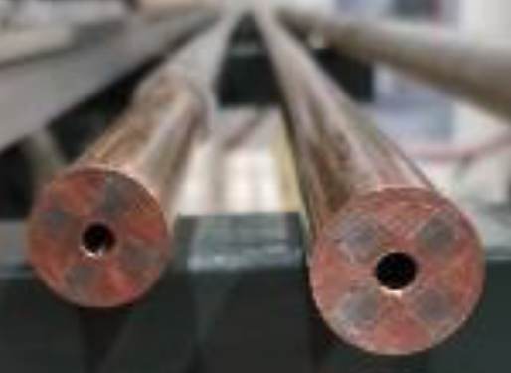
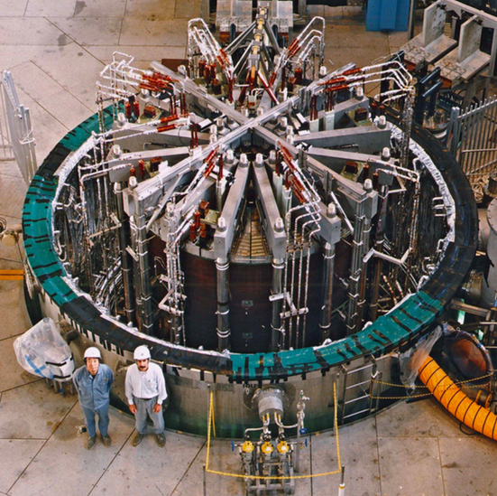

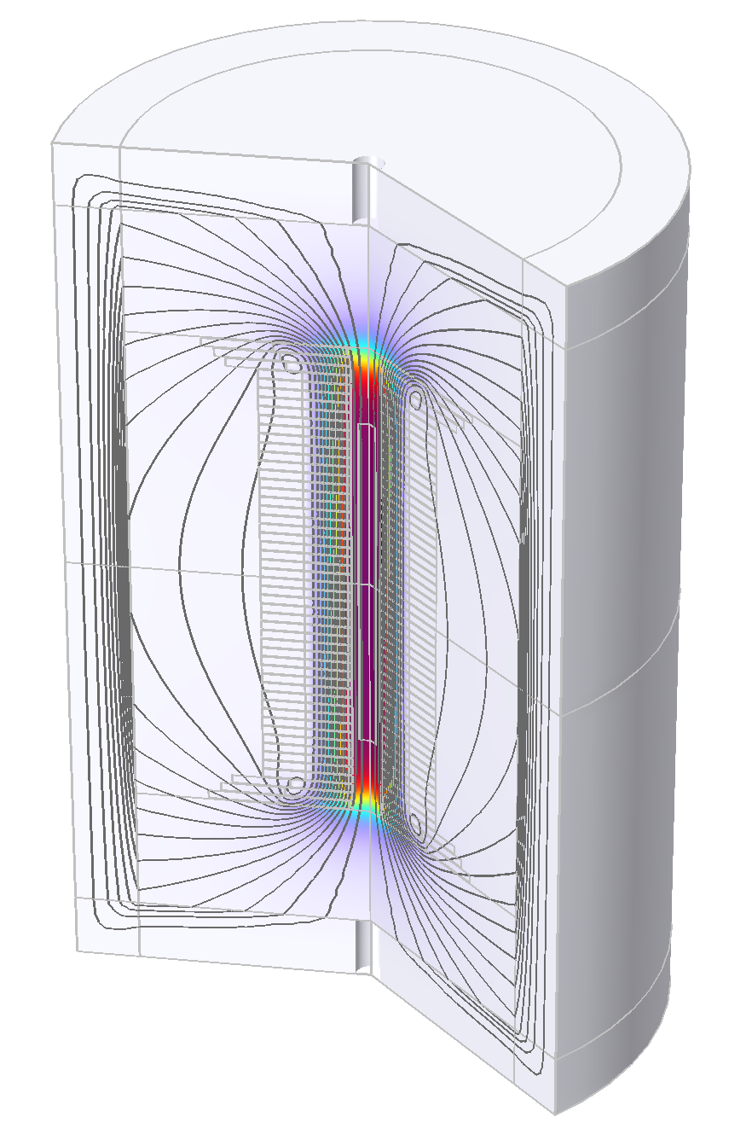
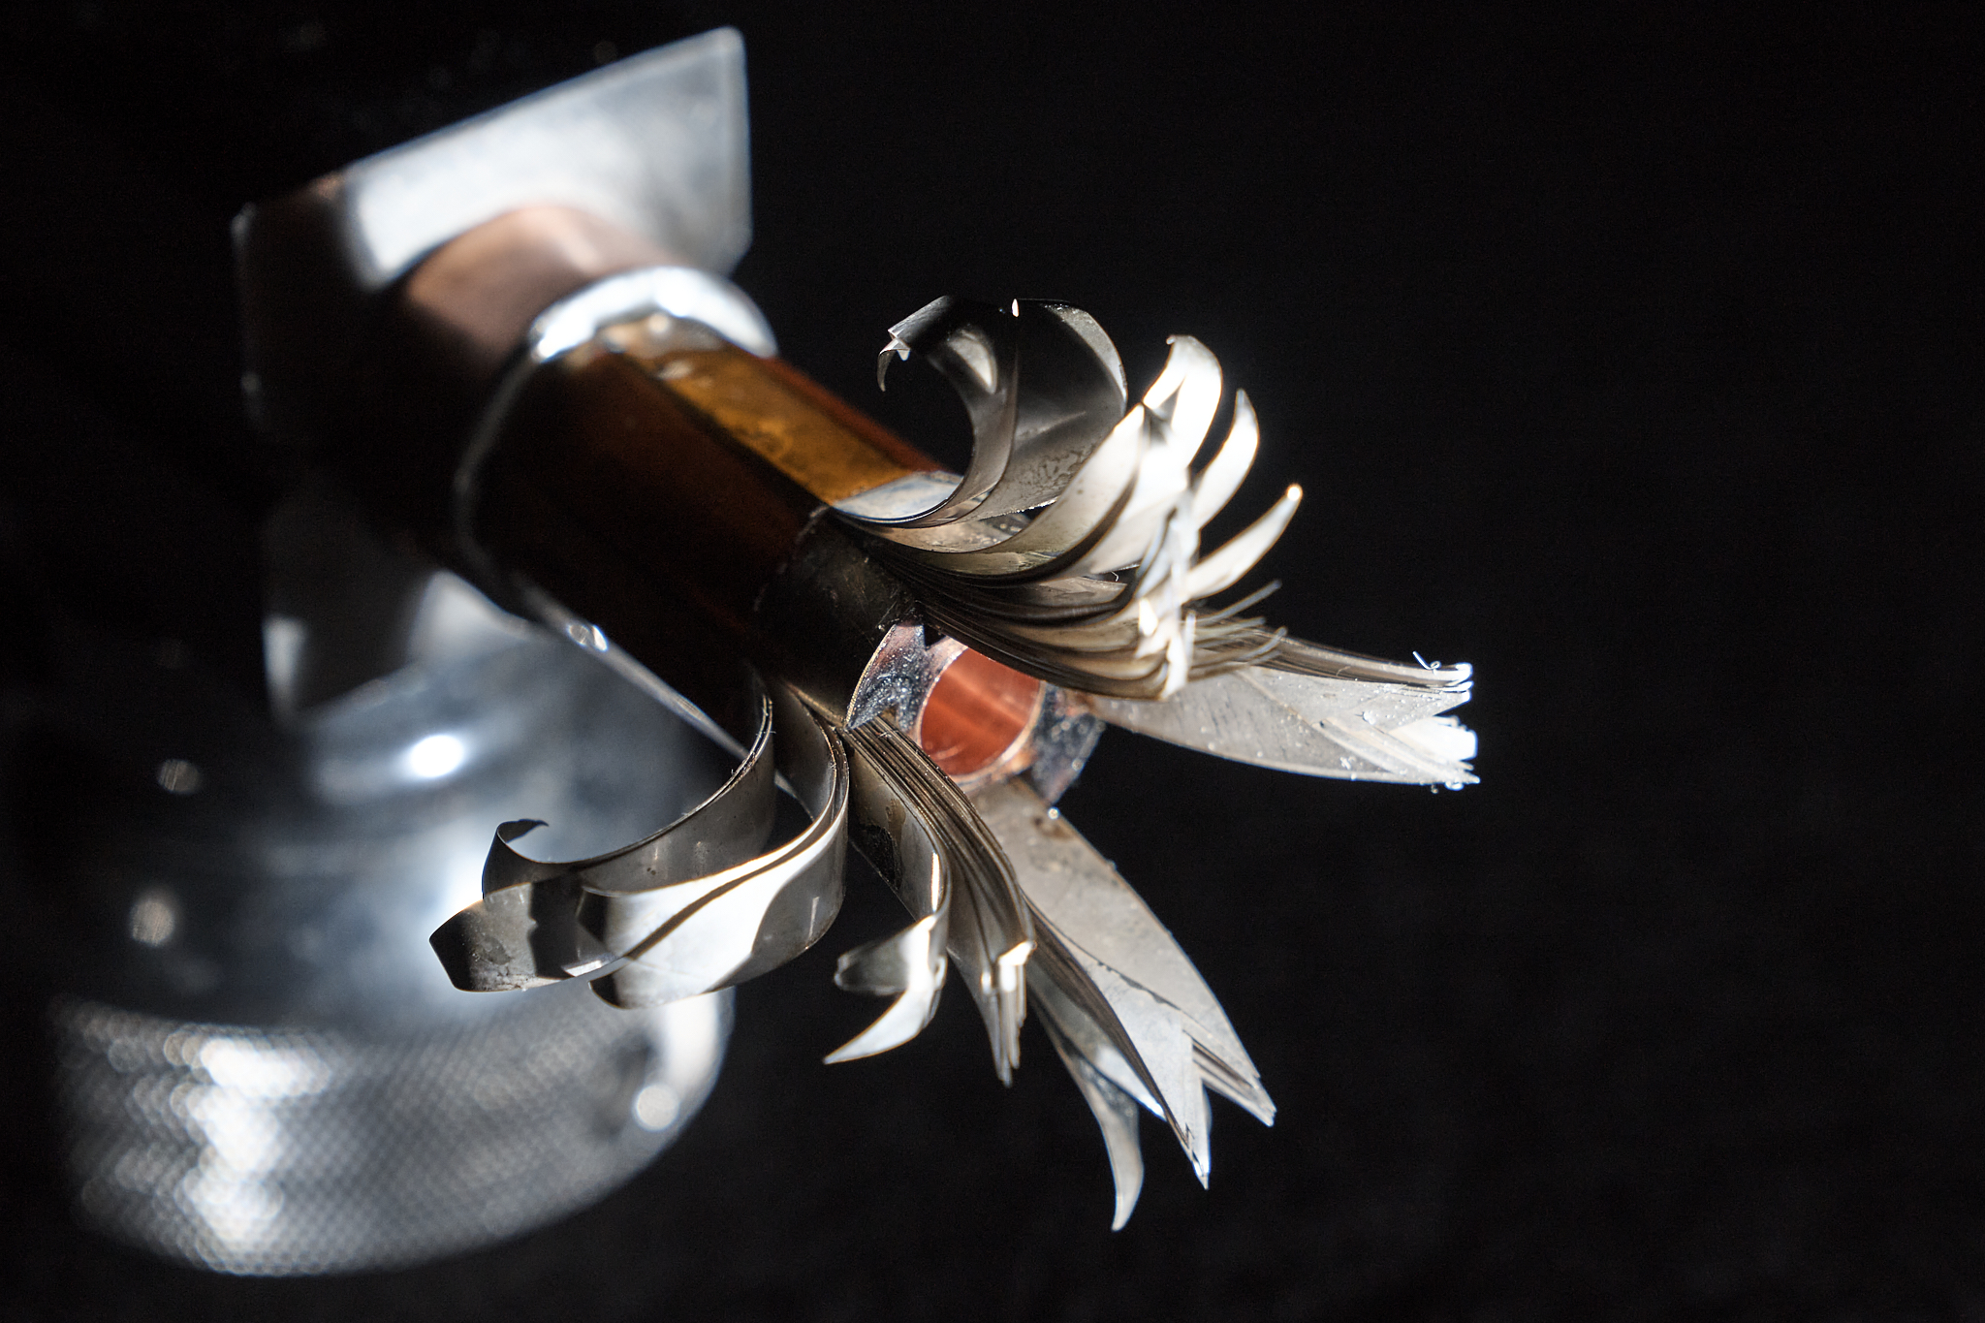
Solenoid R&D
Target solenoid, 20 T, 20 K
Started HTS solenoid development for high fields
Synergies with fusion reactors, NRI, power generators for windmills, …
15 T Nb₃Sn with 5 T resistive insert
Or 20 T HTS seems possible
Relevant for advanced fusion reactors
A Portone, P. Testoni, J. Lorenzo Gomez, F4E
Final Cooling solenoid
Goal 40 T
Estimation of limit
ITER Central Solenoid Model Coil
13 T in 1.7 m (LTS)
MIT “VIPER” conductor
NHFML
32 T solenoid with HTS
MuCol HTS conductor
Operating current: 61 kA

Slide 27
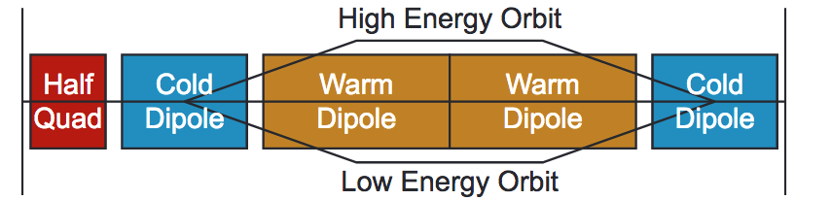
Acceleration Complex
Core is sequence of hybrid pulsed synchrotron (0.4-11 ms)
Alternative FFA
MAP study S. Berg et al.
Started work on key challenges
Integrated design of RCS
  Longitudinal dynamics
  Lattice with realistic hardware specifications
  Collective effects
Concept of key components
  Fast-ramping normal magnets
  HTS alternative
  Efficient power converters
  RF with transient beam loading
initial
final
EMMA proof of FFA principle
Nature Physics 8, 243–247 (2012)
Lattice and integration: A. Chance et al. (CEA)
Long. dynamics and RF systems: H. Damerell, U. van Rienen, A. Grudiev et al. (Rostock, Milano, CERN)
Power converter: F. Boattini et al.
Magnets: L. Bottura et al. (LNCMI, Darmstadt, Bologna, Twente)
FFA: S. Machida et al. (RAL)

Slide 28
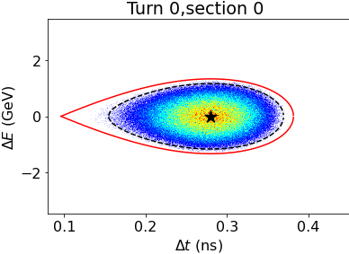
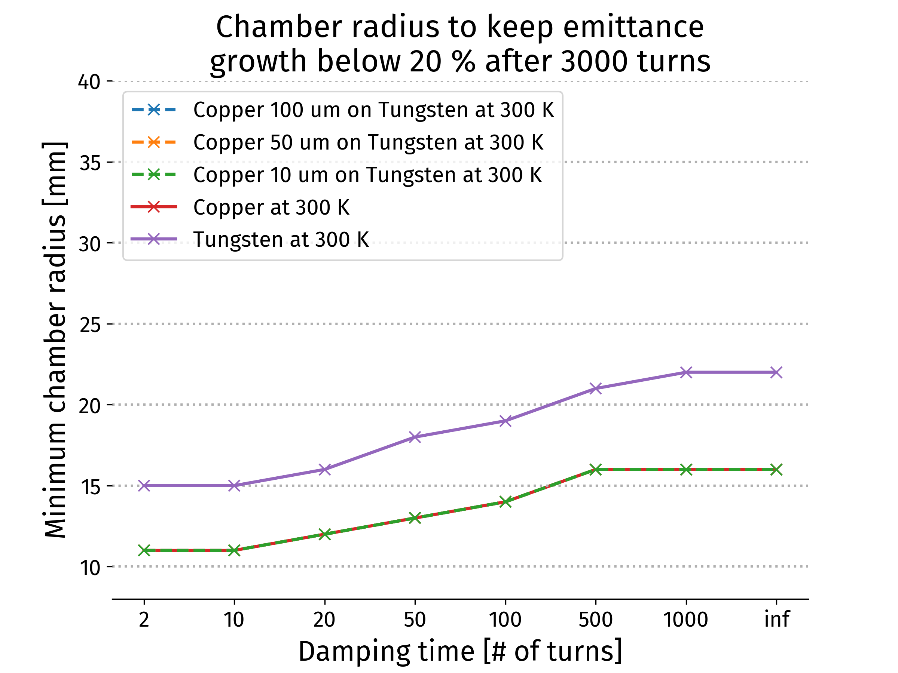
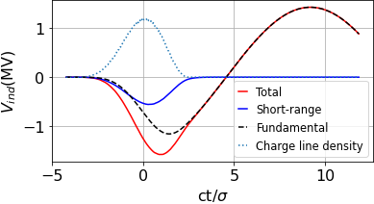
Collective Effects and RF Design
Longitudinal dynamics and RF important due to high bunch charge
> 30 RF stations needed
Orbit length changes require frequency tuning required
Single-bunch HOM power loss up to 10 kW during pulse
CW average is lower, development of high-capacity couplers needed
A. Chance, H. Damerell, F. Batsch, U. van Rienen, A. Grudiev et al. (CEA, Rostock, Milano, CERN)
E. Metral, D Amorim et al. (CERN)
Collider ring single beam instability limits
Conservative feedback
  Copper coating beneficial (few microns)
  Beam-beam studies started
Long. Distribution assumed at injection in RCS1
1.3 GHz appears possible for longitudinal effects and stability
Induced voltages in RCS1 for a single bunch

Slide 29
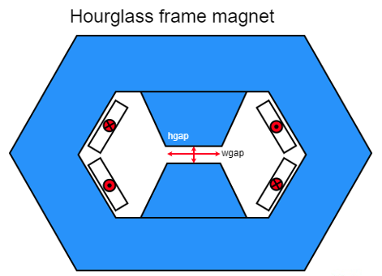
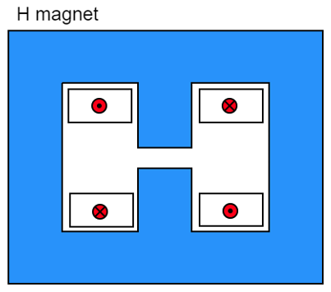
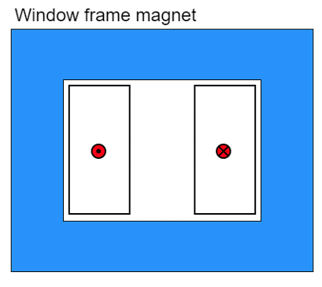
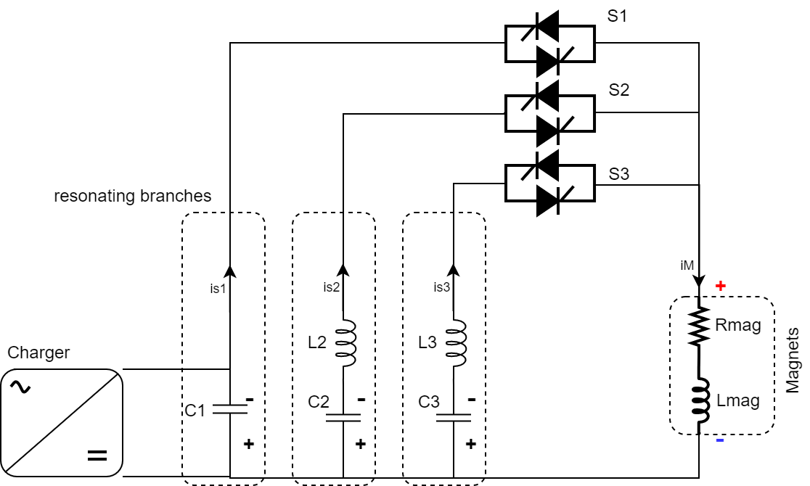
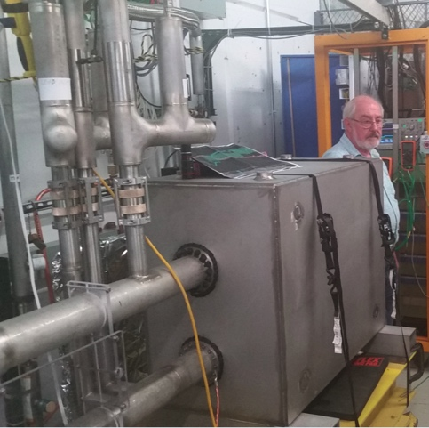
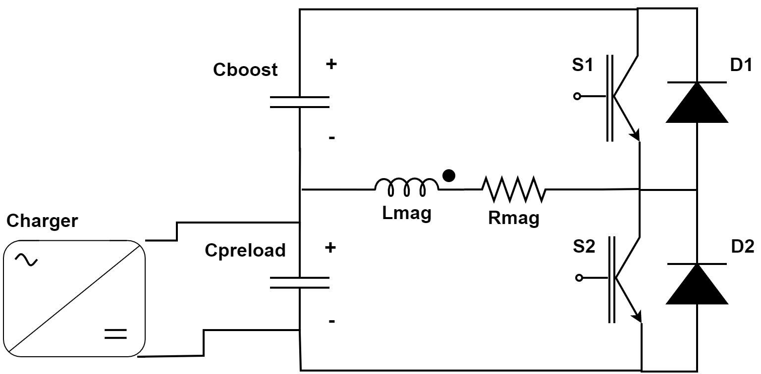
Fast-ramping Magnet System
F. Boattini et al.
Differerent power converter options investigated
Full wave resonance
5.07 kJ/m
5.65…7.14 kJ/m
5.89 kJ/m
Management of the power in the resistive dipoles (several tens of GW):
Minimum stored magnetic energy
Highly efficient energy storage and recovery
Commutated resonance (new)
Could also use HTS driven dipoles
Simple HTS racetrack dipole could match the beam requirements and aperture for static magnets
FNAL 300 T/s HTS magnet

Slide 30
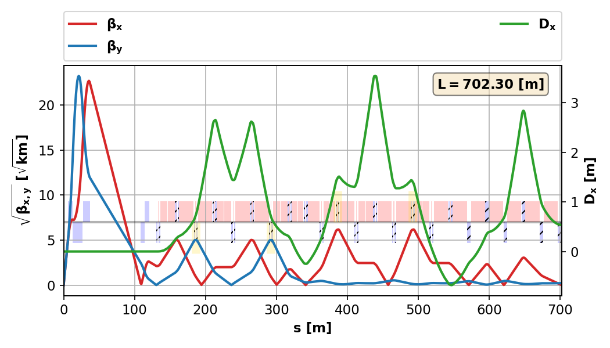
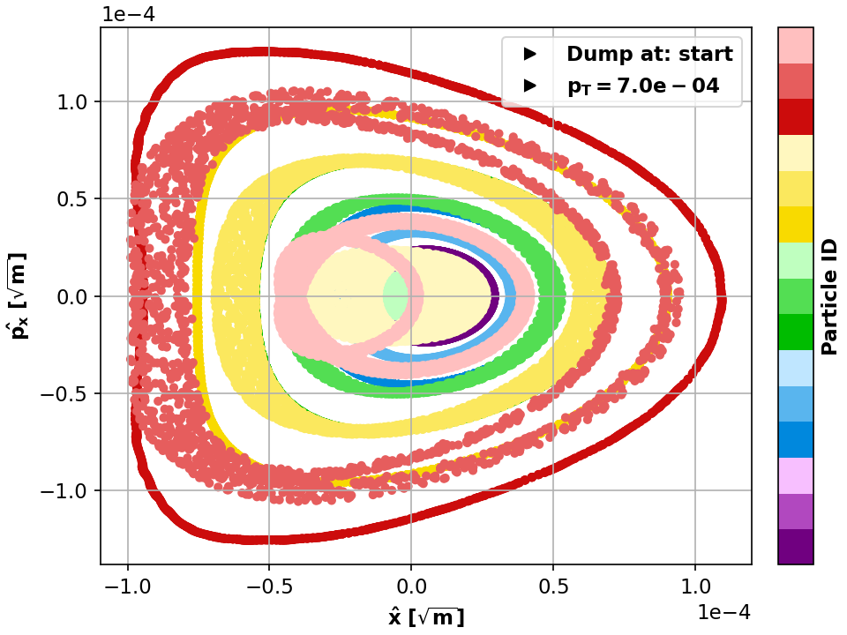
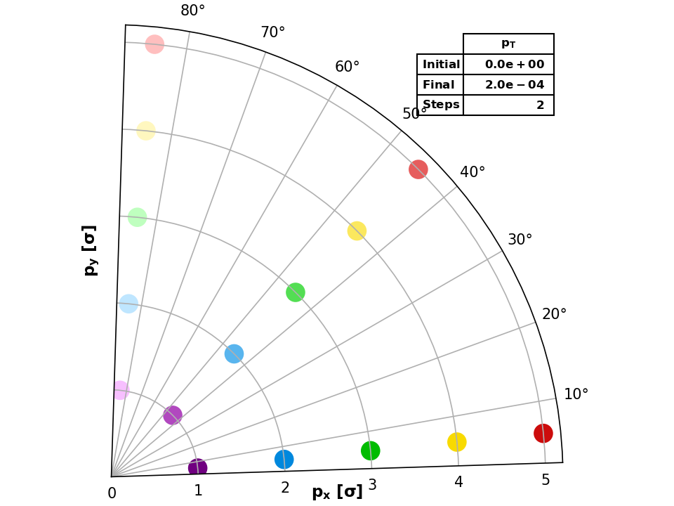
Collider Ring
Challenges:
Very small beta-function (1.5 mm)
Large energy spread (0.1%)
Maintain short bunches
K. Skoufaris, Ch. Carli, support from P. Raimondi, K. Oide, R. Tomas
MAP developed 4.5 km ring for 3 TeV with Nb₃Sn
magnet specifications in the HL-LHC range
Work progressing on 10 TeV collider ring
around 16 T HTS dipoles or lower Nb₃Sn
final focus based on HTS
Important progress: V0.6 good dynamic aperture at almost 0.1% off-energy, approaching the target
pT [%] | DAmin [σ]
0.07 | 5
0.08 | 4
0.09 | 3
0.1 | <1

Slide 31
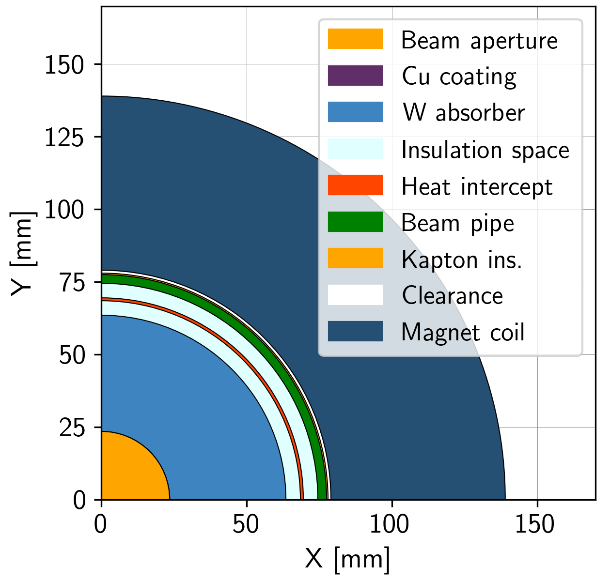
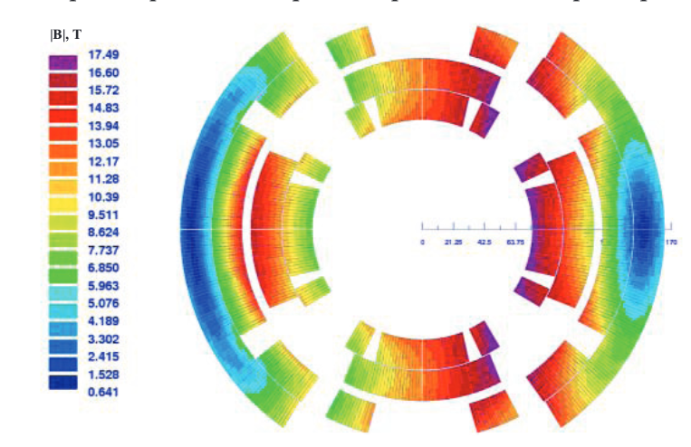
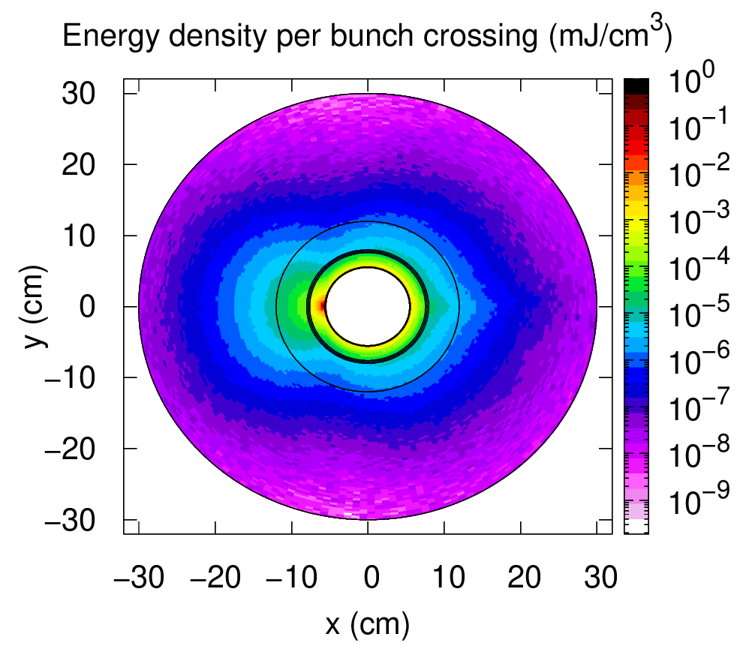
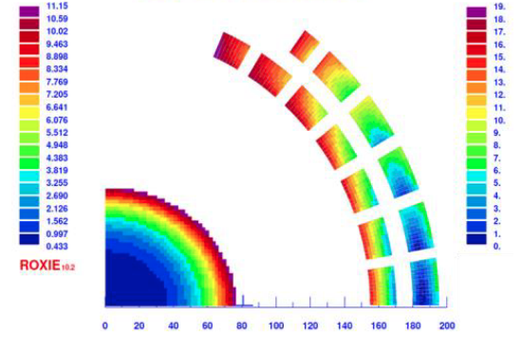
Collider Ring Technology
L. Bottura et al.
Power loss due to muon decay 500 W/m FLUKA simulation of shielding:
Require 30-40 mm tungesten
Few W/m in magnets
No problem with radiation dose
Initial estimate of magnet field limits:
11 T for Nb₃Sn, more for HTS/hybrid
Need stress management
Shielding
A. Lechner
D. Calzolari (CERN)
K. Skoufaris, Ch. Carli, D. Amorim, A. Lechner, R. Van Weelderen, P. De Sousa, L. Bottura et al.
Coil
Different cooling scenarios studied
< 25 MW power for cooling possible
Shield with CO₂ at 250 K (preferred) or water
Support of shield is important for heat transfer
Discussion on options for magnet cooling
R. Van Weelderen, P. De Sousa

Slide 32
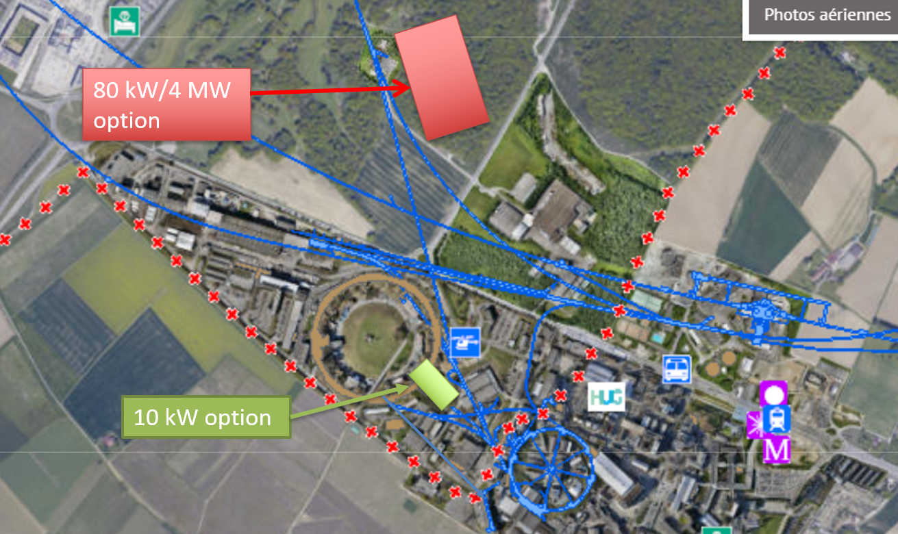
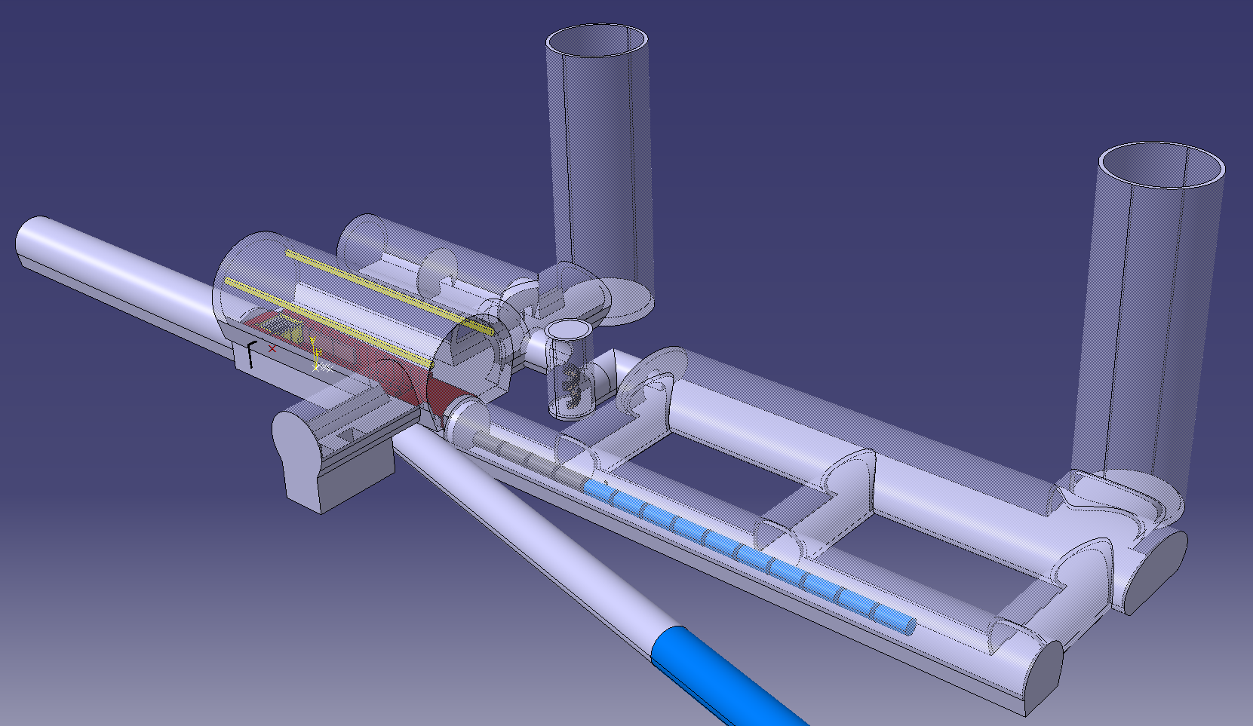
CDR Phase, R&D and Demonstrator Facility
Broad R&D programme can be distributed world-wide
Models and prototypes
  Magnets, Target, RF systems, Absorbers, …
CDR development
Integrated tests, also with beam
Cooling demonstrator is a key facility
look for an existing proton beam with significant power
Different sites are being considered
CERN, FNAL, ESS …
Discussed at ACE at FNAL
Site at CERN possible
J-PARC also interesting as option
Could be used to house physics facility
Synergies workshop to explore good options
M. Calviani, R. Losito, J. Osborn et al.

Slide 33
Test Facility Dimensions
Downstream diagnostics area, 5 m
Collimation and upstream diagnostics area, 10 m
Target
+ horn (1st phase) /
+ superconducting solenoid (2nd phase)
Cooling area, 50 m
Momentum selection chicane, 10 m
Look for an existing proton beam with significant power
Different sites are being considered
CERN, FNAL, ESS are being discussed
J-PARC also interesting as option
C. Rogers

Slide 34

Implementation Considerations
Reviewing timeline (still evolving)
Uncertainties from physics case (e.g. HL-LHC), society development, budget profile etc.
Goal:
Identifying shortest possible timeline
  Technically limited, success-oriented schedule
On the critical path
  Muon cooling technologies and integration
  Magnet technology
  Detector technologies
Technology appears to be ready before 2040
  Provided funding is being made available
  Initial stage to start physics before 2050 appears possible
  To be confirmed before next ESPPU
To be reviewed by 2026

Slide 35
Magnet Roadmap
Consensus of experts (review panel):
Anticipate technology to be mature in O(15 years):
  HTS solenoids in muon production target, 6D cooling and final cooling
    HTS tape can be applied more easily in solenoids
    Strong synergy with society, e.g. fusion reactors
  Nb₃Sn 11 T magnets for collider ring (or HTS if available): 150mm aperture, 4K
This corresponds to 3 TeV design
Could build 10 TeV with reduced luminosity performance
  Can recover some but not all luminosity later
Still under discussion:
Timescale for HTS/hybrid collider ring magnets
For second stage can use HTS or hybrid collider ring magnets
Strategy:
HTS solenoids
Nb₃Sn accelerator magnets
HTS accelerator magnets
Seems technically good for any future project

Slide 36
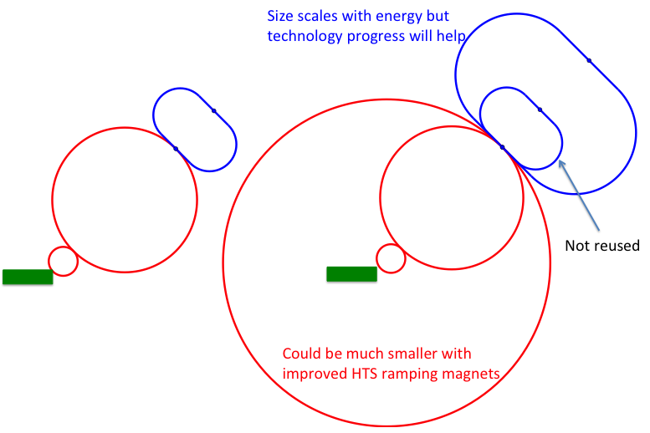
Staging Approaches
Assumptions:
In O(15 years):
  HTS technology available for solenoids
  Nb₃Sn available for collider ring
In O(25 years):
  HTS available for collider ring
Scenario 1: Energy staging
Start at lower energy (e.g. 3 TeV)
Build additional accelerator and collider ring later
Requires less budget for first stage
3 TeV design takes lower performance into account
Scenario 2: Luminosity staging
Start at with full energy, but less performant collider ring magnets
Main sources of luminosity loss are collider arcs and interaction region
  Can recover interaction region later (as in HL-LHC)
  But need full budget right away
  Some luminosity loss remains (O(1.5))
  More power for the collider ring required (lower magnet temperature)

Slide 37
Tentative Timeline (Fast-track 10 TeV)
Only a basis to start the discussion, will review this year
Need at least two years of demonstrator operation (better more)
Need RF test stand before
Decision starting in 2036
Estimated10 TeV construction/installation
Different initial estimates for detector
seem to be fast enough
Buit need to develop robust timeline

Slide 38
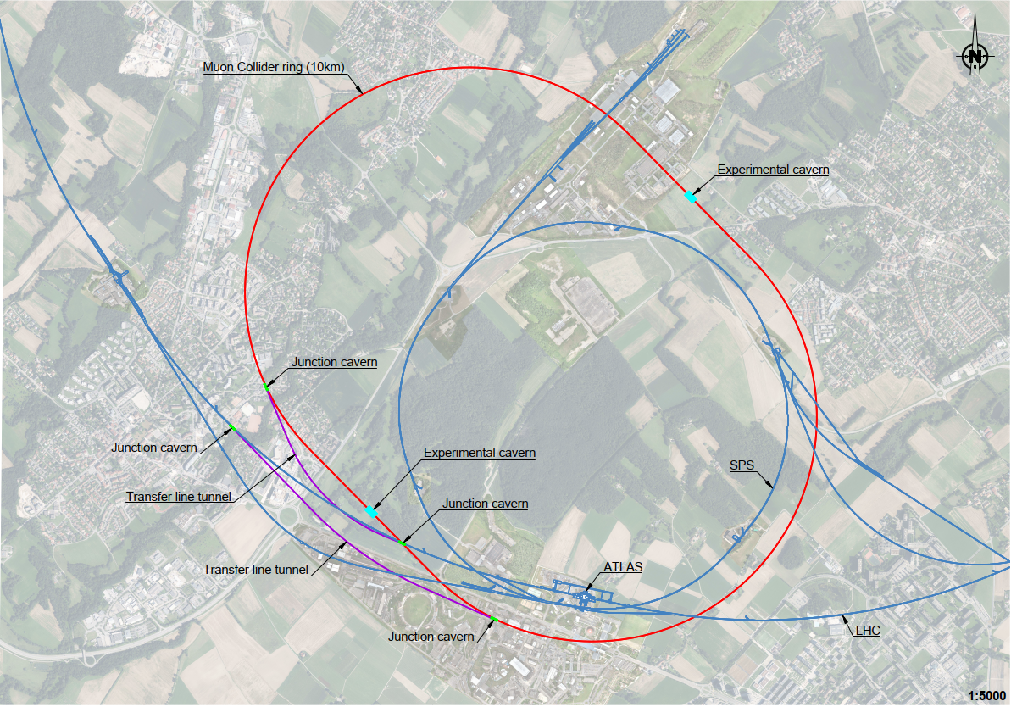
Plan for ESPPU
Study green field designs and continue to work on them
International collaboration
Parameters, lattice designs, component designs, beam dynamics, cost, …
Perform example civil engineering studies
CERN (collider and demonstrator)
FNAL, the US started doing similar studies
Provide parameters tables for the implementation at existing sites (FNAL, CERN, …)
Scaled from green field design using existing infrastructure
Do not have the resources and time to make detailed designs for CERN and FNAL for ESPPU
Reuse of SPS and LHC tunnels and implementation at CERN looks not too bad right now
38

Slide 39
Electron-proton Collider

Slide 40
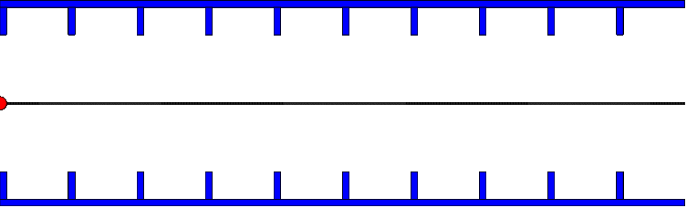
A particle that is 180° out of phase leaves energy in a cavity

Slide 41
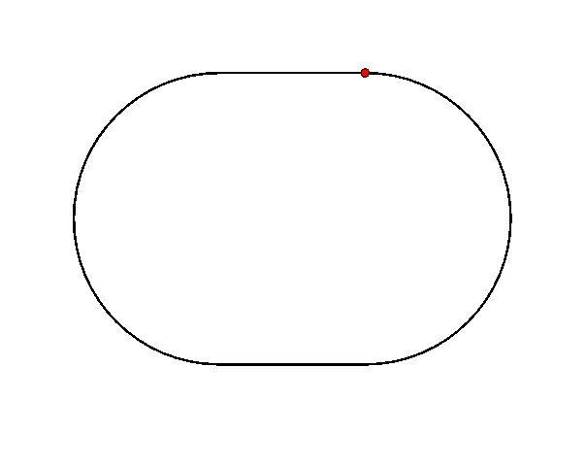
Energy Recovery Principle
Decelerate beam almost to 0 GeV
Need dedicated arc for each turn
But can share on the way up dand down
Interesting optics design in the linacs to accommodate very different energies
Rule of thumb: design for the lowest energies
Power needed to
Control the linac RF
To keep the linac cavities superconducting
To compensate the synchrotron radiation from the arcs

Slide 42
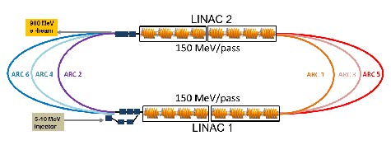
LHeC / FCC-eh
 | LHeC CDR | HL-LHeC | HE-LHeC | FCC-he
E_{p} [TeV] | 7 | 7 | 12.5 | 50
E_{e} [GeV] | 60 | 60 | 60 | 60
L [10³³cm⁻²s⁻¹] | 1 | 8 | 12 | 15
Development of accelerator technology
E.g. RF power required to control cavities
Test facility (PERLE) planned in Orsay
Interaction region
M. Klein et al

Slide 43
Energy-recovery Linear Collider
And the Cool Copper Collider (CCC)

Slide 44

ERLC
Basic idea is to extract the beam energy in a second beamline to reduce RF power consumption

Slide 45

RLHIC
Basic idea is to extract the beam energy in the same beamline to reduce RF power consumption
Requires to separate the bunches going in the different direction

Slide 46

CCC
Cool copper structure to nitrogen temperatures
Or a bit below
Increases conductivity by. Factor of a few
Less losses in the RF structures allows to fill them more slowly, reducing the cost of the RF system
Can somewhat increase the gradient before breakdown
But have to pay for cryogenics

Slide 47
Gamma-gamma Collider

Slide 48
Note: Gamma-gamma Collider Concept
Based on e⁻e⁻ collider
Collide electron beam with laser beam before the IP

Slide 49

Note: Gamma-gamma Collider Concept
Backscattered photons can have a range of energies
Depending on the photon energy
Maximum energy of backscattered photon
Maximum practical energy is 83% of the beam energy
Otherwise backscattered photons can produce electron-positron poairs with further photons of the laser
Requires laser in the eV region, O(J) per pulse

Slide 50



Note: Gamma-gamma Collider Concept
Photon-photon luminosity has a wide spectrum
Electrons can scatter more than once
Spacing laser-electron and photon-photon collision further apart helps
But reduces luminosity
Can expect about 10% of the e-e- luminosity for gamma-gamma

Slide 51
Plasma-based Collider

Slide 52

Note: Plasma Acceleration
Plasma can be generated by electron beam, proton beam or laser beam
50 GV/m demonstrated with 42 GeV energy gain
I. Blumenfeld et al, Nature 445, p. 741 (2007)
Practical solution for efficient acceleration of positrons has to be developed
Efficiency and beam quality have severe challenges
Strong plasma focusing is good for beam stability but generates synchrotron radiation
Application in other fields seem promising, e.g. free electron laser

Slide 53

HALHF Concept
e-
e+
e+ BDS
e- BDS
Use conventional acceleration for positrons
  Avoids difficulties of accelerating positrons in plasma
  Accelerate to low energy (31 GeV, 4 times less than 125 GeV)
Accelerate electron in plasma
  Profit from high gradient
  Accelerate to high energy (500 GeV, 4 times more than 125 GeV)
Results in
  Centre-of-mass energy remains at 250 GeV
  Physics is boosted in the detector

Slide 54
HALHF Concept
e-
e+
e+ BDS
e- BDS
Optimum luminosity per total beam power is reached in both beam powers are equal
Reduce electron current, also good for plasma
Increase positron current, not too bad for conventional acceleration
Luminosity proportional to N_{p}N_{e} proportional to P_{p}P_{e} proportional to P_{p}(P_{T}-P_{p}), maximum for 2Pp=P_{T}

Slide 55

Further Development
Separation of positrons and drive beam
More linacs but can enable two IPs
Energy upgrade to ttbar (380 GeV) or Higgs self coupling (550 GeV)
Upgrade both beam energies in proportion
Many things need to be studied and developed but interesting concept
However not as mature than “conventional” linear colliders, ILC and CLIC

Slide 56
ILC Energy Upgrade a la HALHF
Space for
plasma booster
Upgrade an existing 2x125 GeV ILC to 500 GeV centre-of-mass (tth, Zhh factory)
Positrons at 125 GeV, electrons at 500GeV -> 500GeV COM
Use electron linac for drive and witness beam:
run a lower gradient but higher current, upgrade RF on electron arm
Use space for undulator source between electron ML and BDS to install plasma booster
BDS already laid out for 500 GeV

Slide 57

ILC Energy Upgrade a la HALHF
Requires 3x more klystrons than in baseline configuration (baseline: 2 klystrons for 9 cryomodules) -> fits RF cell structure
Can’t inject DB @ 15 GeV - $$$ - so separate DB &CB
- but problems with this too. Watch this space….
1662ns
74ns
4.6ns
Overall: 656 mini trains in pulse -> pulse length 1090us
DB injector
BC
Colliding beam bypass
Plasma booster

Slide 58

To infinity & beyond…

Slide 59
Conclusion and Thanks
Touched only a small part of the exciting accelerator technologies
Quite some work ahead to develop the future colliders
ILC and CLIC are mature
FCC-ee feasibility is being studied
  Implementation next to CERN, cost, etc
  In the long run FCC-hh can follow
CEPC and SPPC are being considered in China (implementation in the next five-year plan?)
Muon collider is less mature but would offers a long-term lepton path
Plasma-based colliders are more speculative at this moment
LHeC would offer electron-proton collisions
Many thanks to Reende Steerenberg, Steinar Stapnes, Lucio Rossi, Mark Palmer, Ralph Assmann, Jean-Pierre Delahaye, Lucie Linssen, Steffen Doebert, Alexej Grudiev, Frank Tecker, Walter Wuensch, Stephane Poss, Jan Strube, Joerg Wenninger, M. Benedikt, Frank Zimmermann, Bernhard Holzer, Roberto Kersevan, Ph. Lebrun, …
If you can look into the seeds of time,
and say which grain will grow and which will not;
speak then to me. (Shakespeare)

Slide 60
Reserve

Slide 61



US P5: The Muon Shot
Particle Physics Project Prioritisation Panel (P5) endorses muon collider R&D: ”This is our muon shot”
Recommend joining the IMCC
Consider FNAL as a host candidate
We welcome the US community
Already participation, also in leadership
Will increase and reorganise in 2024
Ambition of US to host collider is excellent news
61

