Slide 1





Ab Initio Theory for New Physics Searches
Jason D. Holt
TRIUMF, McGill University
INVISIBLES Workshop, CERN
September 1, 2025

Slide 2
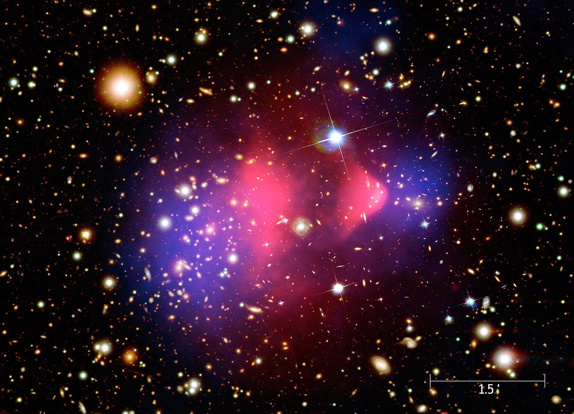
Major BSM Searches Worldwide
Worldwide search for BSM physics w/ neutrinos, dark matter, and radioactive molecules!
0νββ Decay Dark Matter Direct Detection Symmetry Violation
Billions invested worldwide – theory of the nucleus is essential
Strategic planning for discovery (motivation) + interpretation

Slide 3
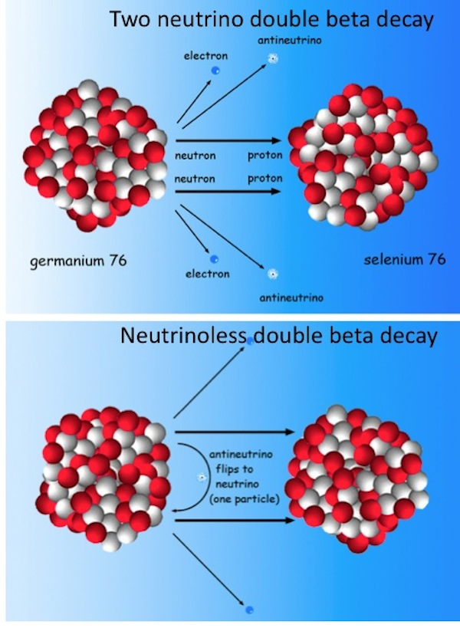
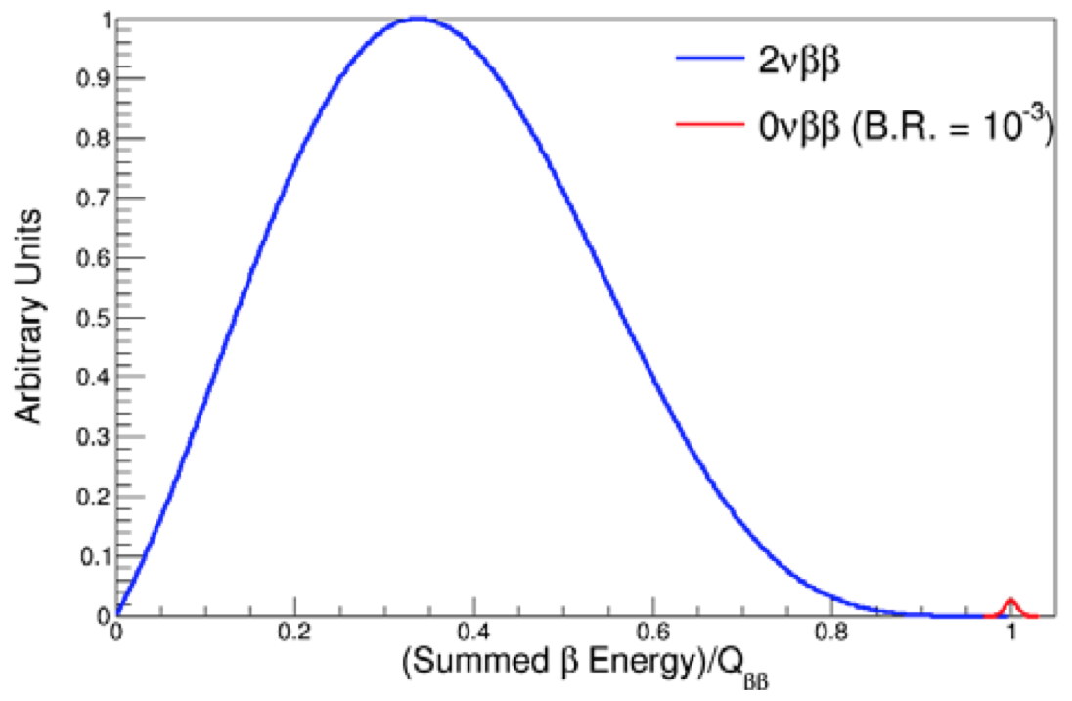
Neutrino-less (0ν) Double-Beta (ββ) Decay
Neutrino own antiparticle 0νββ decay
Tremendous impact on BSM physics
Lepton-number violation
Majorana character of neutrino
Matter/antimatter asymmetry
Absolute neutrino mass scale

Slide 4
Neutrino-less (0ν) Double-Beta (ββ) Decay
Neutrino own antiparticle 0νββ decay
Tremendous impact on BSM physics
Lepton-number violation
Majorana character of neutrino
Matter/antimatter asymmetry
Absolute neutrino mass scale NME not observable: must be calculated

Slide 5
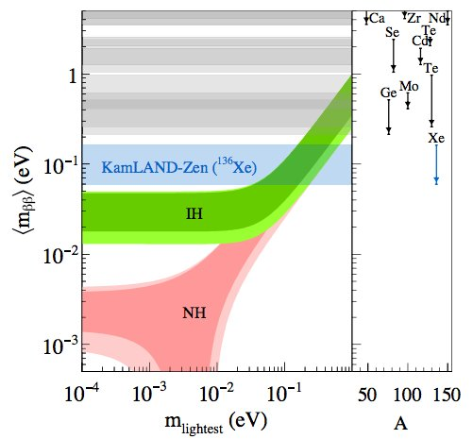
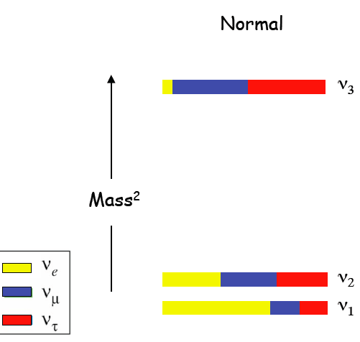
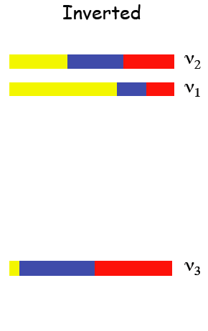
Nature of Neutrino: 0νββ Decay
Next-generation searches probe Inverted Hierarchy
Spread from Nuclear Matrix Element; bands do not represent rigorous uncertainties
KATRIN/P8
Cosmology
Essential ingredient:
Nuclear matrix element

Slide 6
Status of 0νββ-Decay Matrix Elements
All calculations to date from extrapolated phenomenological models; large spread in results
All models missing essential physics: correlations, single-particle levels, two-body currents
Impossible to assign rigorous uncertainties… but, hey, could be worse
Engel, Menendez (2016)
🤷🏻‍♀️

Slide 7
Status of 0νββ-Decay Matrix Elements
All calculations to date from extrapolated phenomenological models; large spread in results
New approach to NME calculations: ab initio theory consistent results when extrapolated
Ab Initio Methods
Engel, Menendez (2016)

Slide 8

Ab Initio Approach to Nuclear Structure
Aim of modern nuclear theory: develop unified first-principles picture of structure and reactions
(Approximately) solve nonrelativistic Schrödinger equation
Ab initio
many-body
Courtesy, S. R. Stroberg

Slide 9
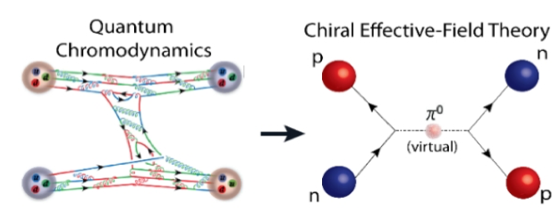
Ingredient I: Nuclear Forces
Chiral Effective Field Theory: low-energy expansion of QCD, nucleons + pions
High-energy information encoded in contact terms
Chiral Effective Field Theory
Consistent treatment of
- 2N, 3N, 4N, … forces
- Electroweak physics
Quantifiable uncertainties
Interactions
1.8/2.0, N2LO_{GO}, N3LO_{LNL}
34 non-implausible
Ab initio
many-body
Courtesy, S. R. Stroberg
Notes:
Should be drivable from QCD. As of yet, no rigorous connection.
Instead have low energy expansion of QCD where nucleons are dof and interact via pion exchange and contact.
From this we construct a perturbative expansion of nuclear forces where NN, 3N, … plus EW
Where contacts build in physics originating from high energy but that’s relevant for low energy.
- How do we do this? with each contact there are a number of underermined constants that must be constrained either by calculating or confronting with data, eg, 16 at N2LO
Finally, if done rigorously, can estimnate neglected physics when truncating at a given order.

Slide 10
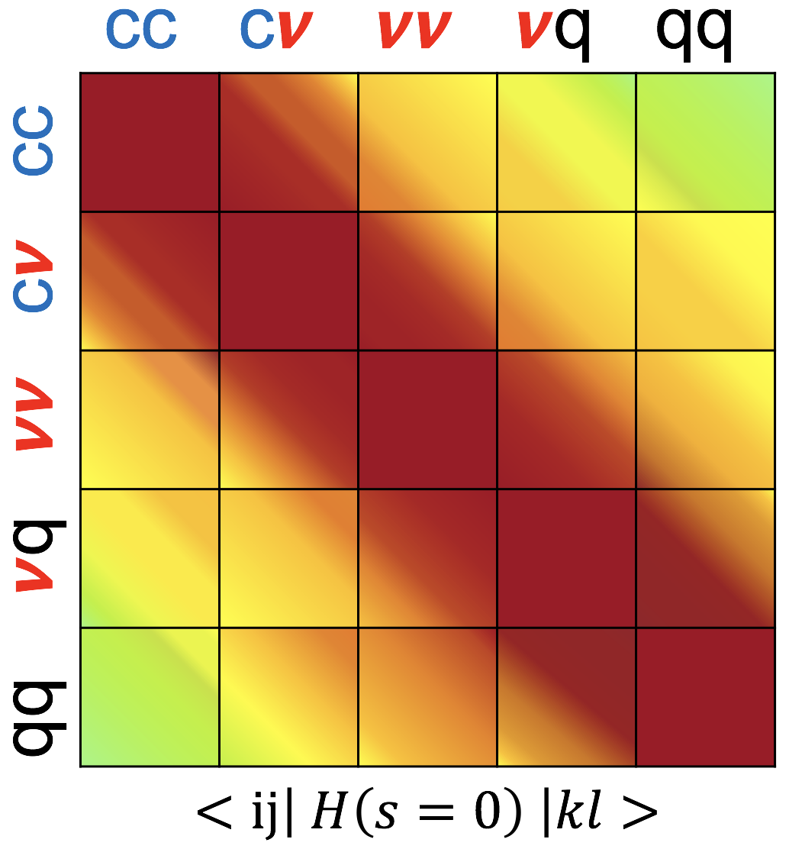
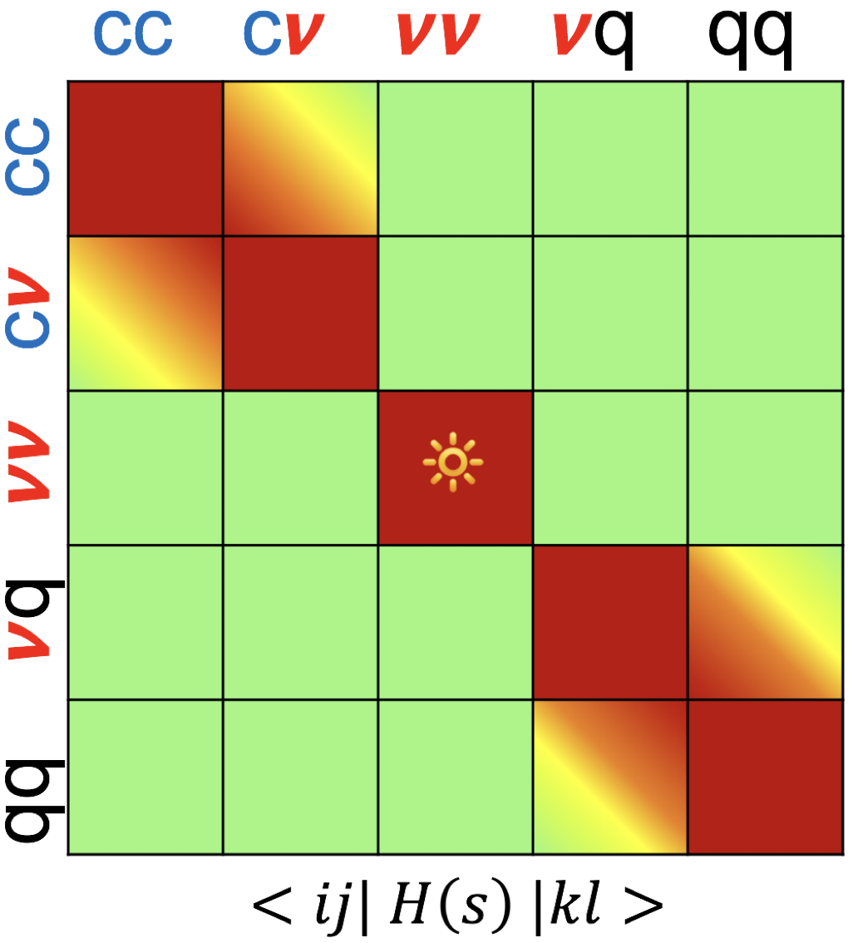



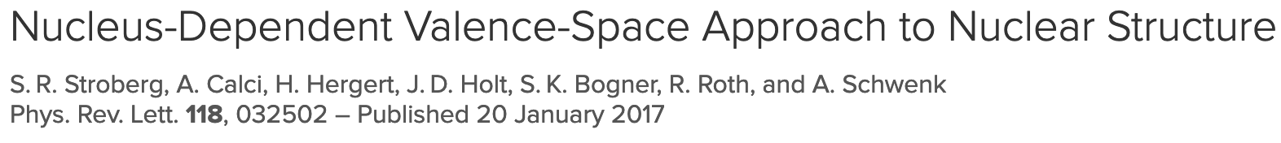
*Key Advance* Valence-Space Approach
Polynomially scaling methods tailored for doubly magic, semi-magic chains
Valence-space IMSRG: Novel approach for all open-shell nuclei
Ab initio → scope of nuclear shell model
Valence-space
Hamiltonian
Decoupled core
Courtesy, S. R. Stroberg
Ragnar Stroberg

Slide 11
Ab Initio Approach to Nuclear Structure
Aim of modern nuclear theory: develop unified first-principles picture of structure and reactions
(Approximately) solve nonrelativistic Schrödinger equation
Methods Exact up to Truncations
✅ Single-particle basis
✅ Storage limits of 3N forces
🤷🏻‍♂️ Many-body operators: e.g., CCSD(T), IMSRG(2)
Courtesy, S. R. Stroberg

Slide 12
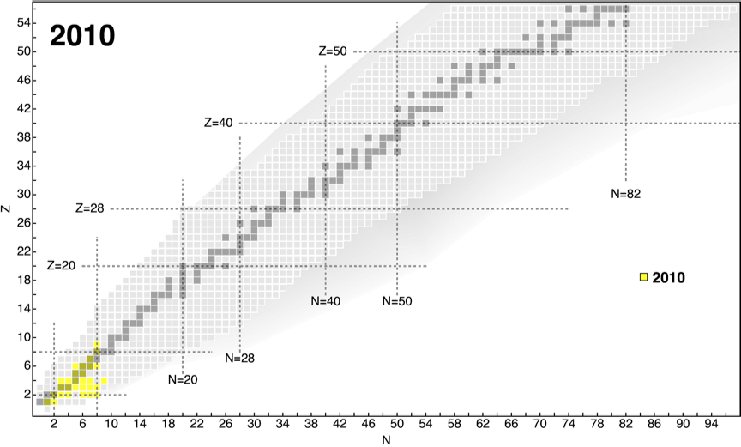
Scope of Ab Initio: 2010
2010 Quasi-exact methods for light nuclei (¹⁶O); limited capability for 3N forces
Courtesy: H. Hergert, A. Belley

Slide 13
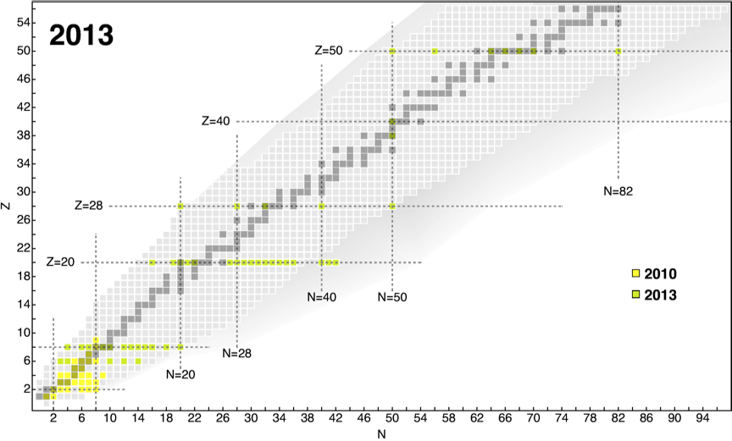
Scope of Ab Initio: 2016
2016 Polynomially scaling methods emerge (Coupled Cluster, IMSRG, etc.)
Progress to doubly magic ^{56/78}Ni and semi-magic chains
2016
2016
Courtesy: H. Hergert, A. Belley

Slide 14
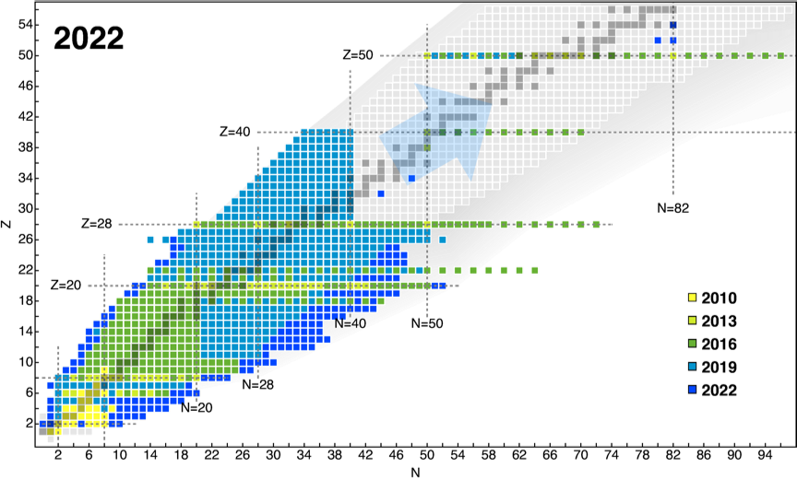
The Six-Year Revolution: Ab Initio 2022
2022 Valence-space approach: essentially all properties of all nuclei
What can we do with this advance?
Courtesy: H. Hergert, A. Belley

Slide 15
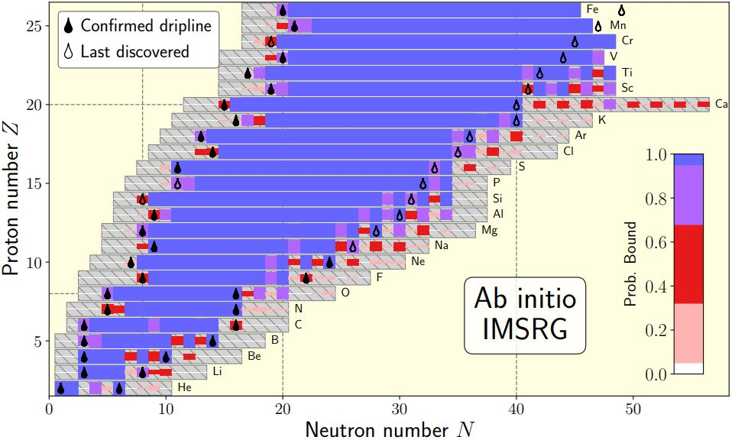
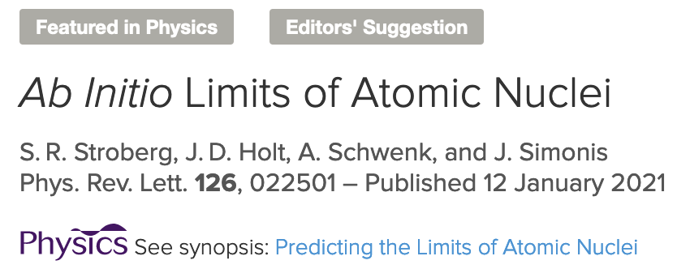

Predicting Ab Initio Limits of Atomic Nuclei
Ab initio calculations of ~700 nuclei from He to Fe
Input NN+3N fit to 2,3,4-body
Not biased towards existing data
Known drip lines predicted within uncertainties
Ab initio guide for neutron-rich driplines
5 –
0 –
-5 –
|
40
|
0
|
20
Ragnar Stroberg
Notes:
assume our calculations will
behave similarly for separation energies which have not
yet been measured
Comparing predictions to known data, we modeled the residuals of the separation energies, and through a Bayesian analysis, we obtained a PPD for the residual S^2n for

Slide 16
Ab Initio Progress: How Heavy Can We Go?
Tremendous progress in ab initio reach, largely due to valence-space IMSRG
Calculate essentially all properties all of nuclei… to N, Z ~ 50
Key Limitation
3NF matrix element storage

Slide 17
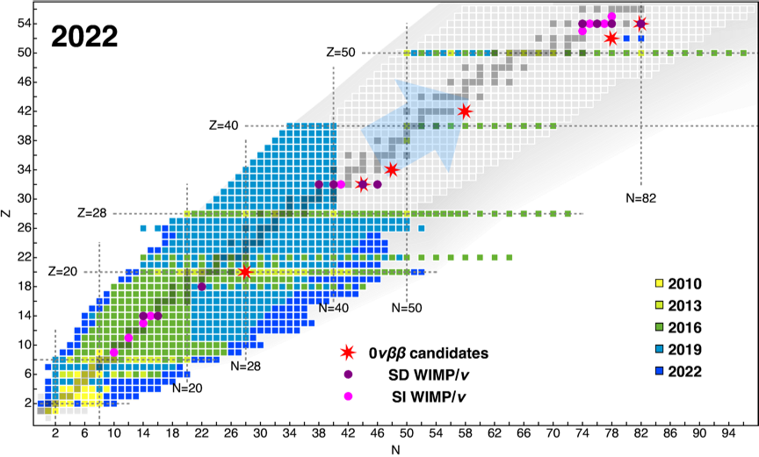
Ab Initio Progress: How Heavy Can We Go?
Tremendous progress in ab initio reach, largely due to valence-space IMSRG
Calculate essentially all properties all of nuclei… to N, Z ~ 50 (key nuclei just out of reach!)
Key Limitation
3NF matrix element storage

Slide 18
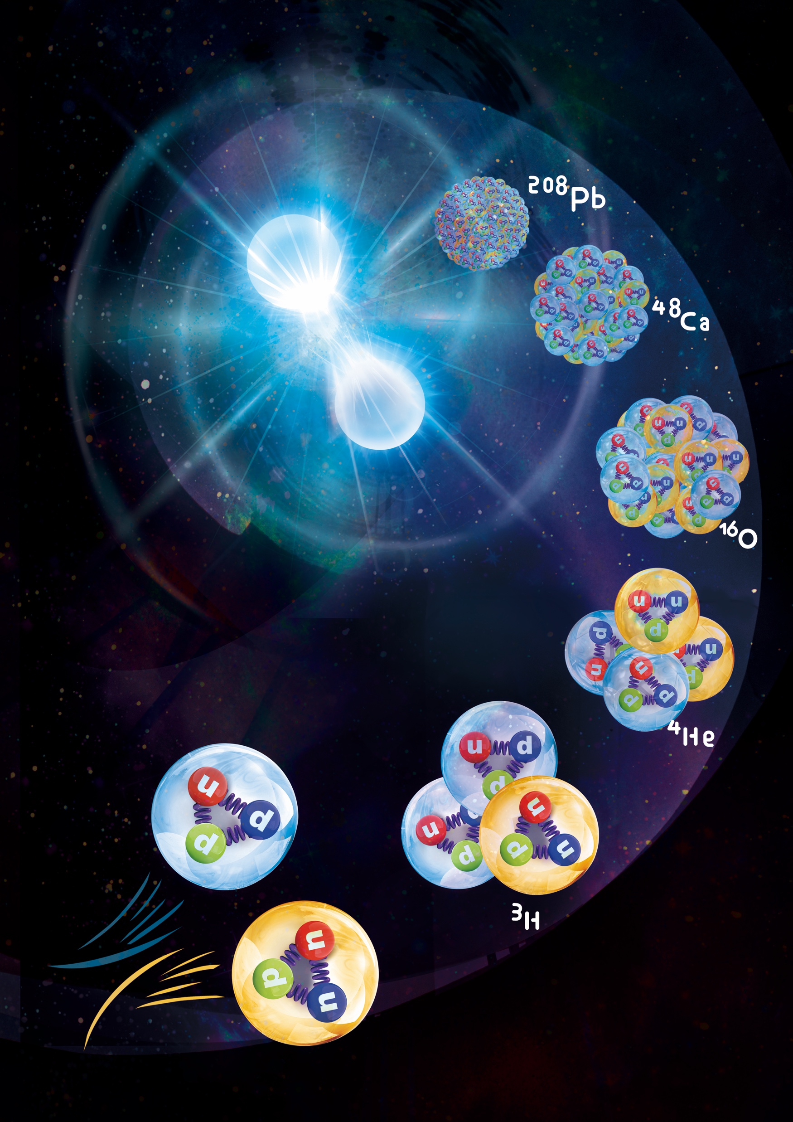


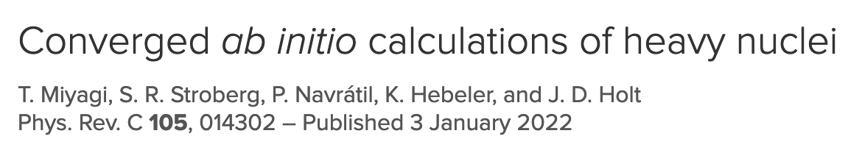
Converged Calculations of Heavy Nuclei
*KEY ADVANCE*
Takayuki Miyagi

Slide 19
Ab Initio Calculations of Heavy Nuclei
Limited by typical memory/node:
Clever storage reduces needs: TB → GB
²⁰⁸Pb now straightforward:
Solving the Schrödinger equation for 200+ nucleons!
²⁰⁸Pb

Slide 20
Ab Initio Calculations of Heavy Nuclei
Limited by typical memory/node:
Clever storage reduces needs: TB → GB
²⁰⁸Pb now straightforward:
Solving the Schrödinger equation for 200+ nucleons!
(Super)heavy accessible to ab initio!
16 years: ¹⁶O → ⁵⁶Ni
6 years: ⁵⁶Ni → ²⁰⁸Pb
²⁰⁸Pb
Hu et al., Nature Phys. 18, 1196 (2022)

Slide 21



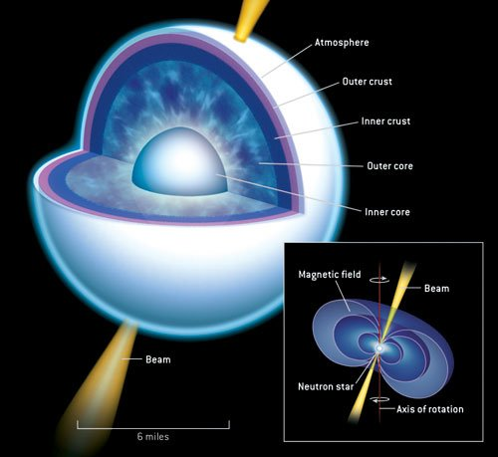
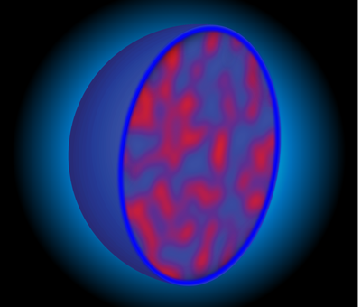
Ab Initio Neutron Skin of ²⁰⁸Pb Linked to Neutron Star Properties
*Milestone Result*
Takayuki Miyagi Baishan Hu
^{Neutron}
^{Stars}
²⁰⁸Pb
Nuclear
EOS
Ab Initio
Notes:
Ab initio statement on 208Pb, but in a new way.
Typical crude analysis: spread in a few NN+3N
New - statistically meaningful sample of NN+3N

Slide 22
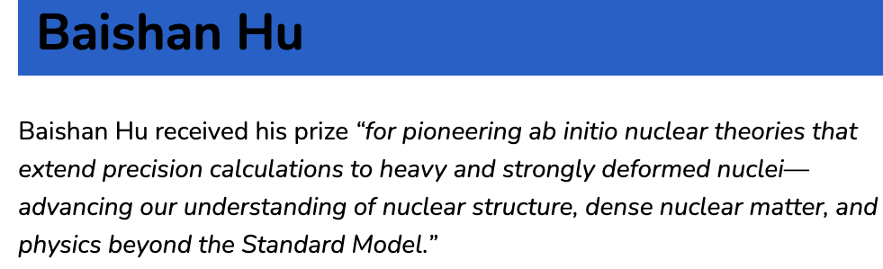
Ab Initio Neutron Skin of ²⁰⁸Pb Linked to Neutron Star Properties
*Milestone Result*
Takayuki Miyagi
^{Neutron}
^{Stars}
²⁰⁸Pb
Nuclear
EOS
Notes:
Ab initio statement on 208Pb, but in a new way.
Typical crude analysis: spread in a few NN+3N
New - statistically meaningful sample of NN+3N

Slide 23
Scope of Ab Initio: 2016
2016 Polynomially scaling methods (Coupled Cluster, IMSRG)
Progress to doubly magic ^{56/78}Ni + semi-magic chains
2016
2016
Courtesy: H. Hergert, A. Belley

Slide 24
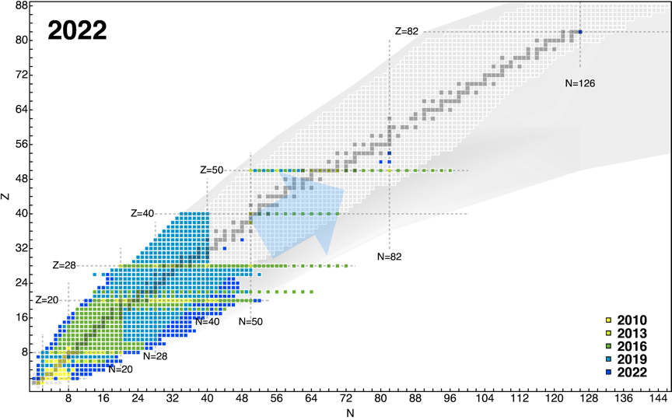
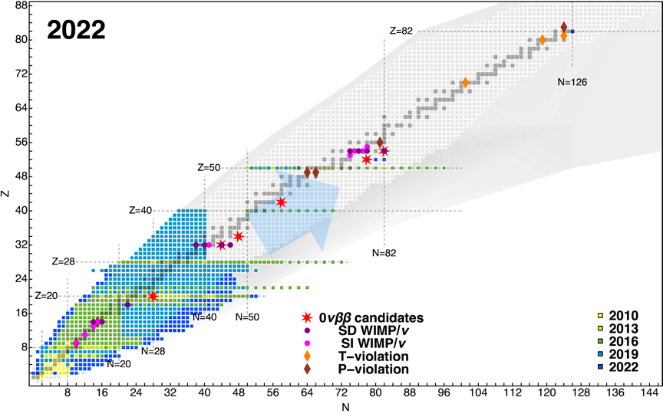
Scope of Ab Initio Theory: Today
Rapid progress in ab initio reach: global + heavy
Exciting applications to searches for BSM physics!
2024

Slide 25
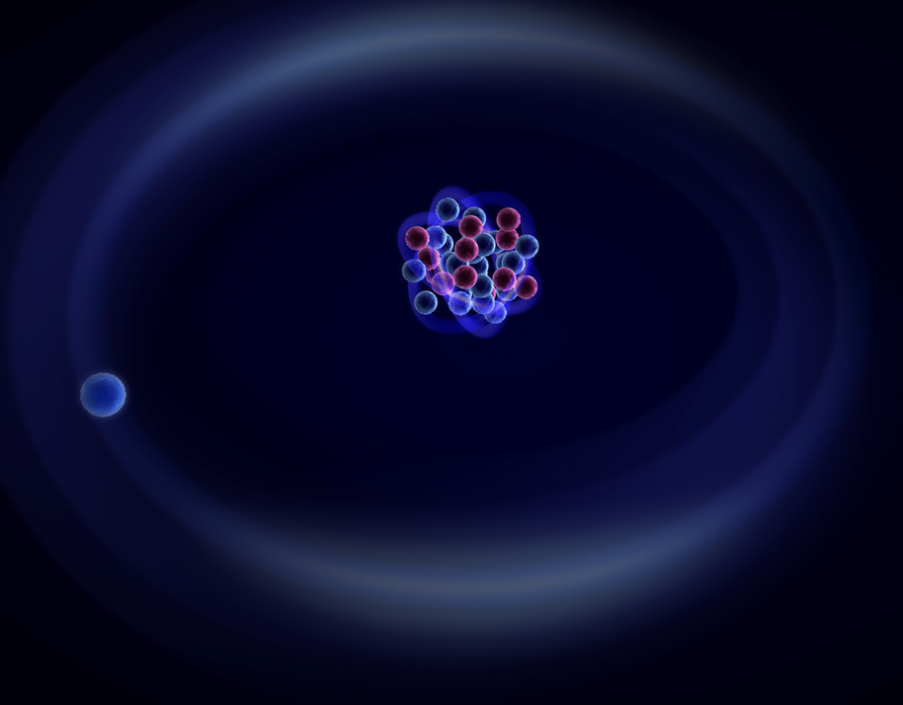
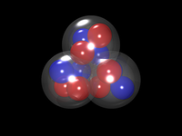
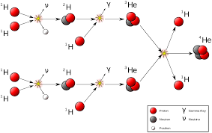
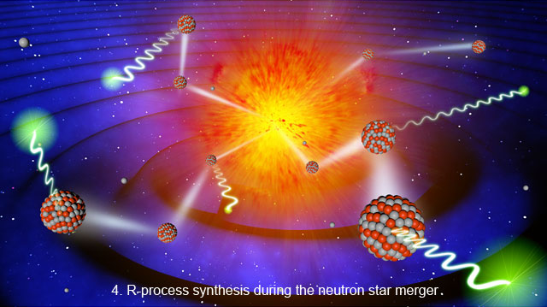
Major Questions in Nuclear Structure/Astrophysics
Limits of existence + formation/evolution of magic numbers Nuclear skins/halos/clusters
Heavy Element Nucleosynthesis Continuum and nuclear reactions Infinite matter/Neutron stars

Slide 26
Ab Initio VS-IMSRG Campaign: Masses and Charge Radii
Expansive campaign for nuclear structure, astrophysics, and BSM physics searches
Neutron skin of ²⁰⁸Pb
B. Hu et al.,
Nature Physics 18, 1196 (2022)
N=124-128: Ab initio masses for
r-process nucleosynthesis
B. Hu et al. (in preparation)
N=50-82 Sn charge radii
P.F. Gustaffson et al., Phys. Rev. Lett (under review)
In – Ag masses for structure of ¹⁰⁰Sn
M. Mougeout et al., Nature Phys. 17, 1099 (2021)
L. Nies et al., Phys. Rev. Lett. 131, 022502 (2023)
Z. Ge et al., Phys. Rev. Lett. 133, 132503 (2024)
¹³²⁻¹⁴⁰Sn masses for r-process nucleosynthesis
A. Mollaebrahimi et al., Phys. Rev. Lett. (under review)
Reduced size of excited state isomer in ^{129,131}In
A. Vernon et al., Phys. Rev. Lett. (under review)
⁷⁴⁻⁷⁶Sr masses for IMME/superallowed Fermi
Z. Hockenberry et al., Phys. Rev. C 111, 014327 (2025)
Masses of Cd isotopes for N=82 shell closure
V. Manea et al., Phys. Rev. Lett. 124, 092502 (2020)
N=28-50 Ni and Cu radii
R.P. de Groote et al., Nature Phys. 16, 620 (2020)
S. Malbrunot Phys. Rev. Lett. 128, 022502 (2022)
N=50-82 In radii for structure of ¹⁰⁰Sn
J. Karthein et al., Nature Phys. 20, 1719 (2024)
A. R. Vernon et al., Phys. Rev. C (under review)
^{55,56}Ni radii
F. Sommer et al., Phys. Rev. Lett. 129, 132501 (2020)
Masses for N=40 Island of Inversion
M. Mougeout et al., Phys. Rev. Lett. 120, 232501 (2018)
R. Silwal et al., Phys. Lett. B 833, 137288 (2022)
S.W. Porter et al., Phys Rev C 105, L041301 (2022)
C. Chambers et al., Phys. Rev. C (under review)
Isospin triplets from A=10-72
for ISB/Superallowed Fermi
M. Martin et al., PRC 104, 014324 (2021)
³²Si charge radius
K. Konig et al., Phys. Rev. Lett. 132, 162502 (2024)
²⁷⁻³²Al radii
H. Heylen et al., Phys. Rev. C
103, 014318 (2021)
³¹⁻³³Na, ³¹⁻³⁵Mg masses for N=20 Island of Inversion
E.M. Lykiardopoulou et al., Phys. Rev. Lett. 134, 052503 (2025)

Slide 27
Ab Initio VS-IMSRG Campaign: Spectra and EM Moments
Expansive campaign for nuclear structure, astrophysics, and BSM physics searches
Magnetic moments from O to Bi
T.Miyagi et al., Phys. Rev. Lett 104, 014324 (2021)
Spectroscopy of ¹²⁶⁻¹³⁶Sn and ¹²⁹Cd
T. Miyagi et al., Phys. Rev. C 105, 014302 (2022)
0⁺ states in ⁹⁰Kr
D. Walter et al., Phys. Lett. B 862, 139352 (2025)
Spectroscopy of ¹³²Sn, ¹³²In and ¹³¹Sb
K. Whitmore et al., Phys. Rev. C 102, 024327 (2020)
EM Moments of 47,49Sc
S.W. Bai et al., Phys. Lett B 829, 137064 (2022)
Reduced size of excited state isomer in ^{129,131}In
A. Vernon et al., Phys. Rev. Lett. (under review)
Magnetic moments in ⁴⁰Sc
R Powel et al., Phys. Rev. Lett. 105, 034310 (2022)
EM moments of neutron-rich Sb isotopes
S. Lecher et al., Phys. Lett. B 847, 138278 (2024)
Microsecond Isomer in ³²Mg
T.J. Gray et al., Phys. Rev. Lett. 130, 242501 (2023)
N=50-82 In EM moments
J. Karthein et al., Nature Phys. 20, 1719 (2024)
A. R. Vernon et al., Phys. Rev. C (under review)
Q moments of ³²Si
J. Heery et al., Phys. Rev. C 109, 014327 (2020)
Spectroscopy of neutron-rich Ca isotopes
S.D. Chen et al., Phys. Lett. B 843 138025 (2023)
P. J. Li et al., Phys. Lett. B 855, 138828 (2024)
T. Kowai et al., Phys. Lett. B 827, 136952 (2022)
B(E2) in ²³Mg
Physical Review C 105, 034332 (2023)
Q moments in ⁴⁹Ti
T. Gray et al., Phys. Lett. B 855, 138856 (2024)
Spectroscopy of ⁴²Sc
Physics Letters B 819, 136439 (2021)
Spectroscopy of ^{47,49}Cl
Physical Review C 104 (4), 044331 (2022)
Spectroscopy of ⁵⁰Sc and ⁵⁰Ti
Phys. Revi. C 104 (2), 024314 (2021)
Spectroscopy of ²³F
H. Crawford et al., Phys. Rev. C 103, L061303 (2022)
Spectroscopy of ^{49,50}Ar for N=32
B.D. Linh et al., Phys. Rev. C 109, 043312 (2024)
Physical Review C 102 (6), 064320 (2020)

Slide 28
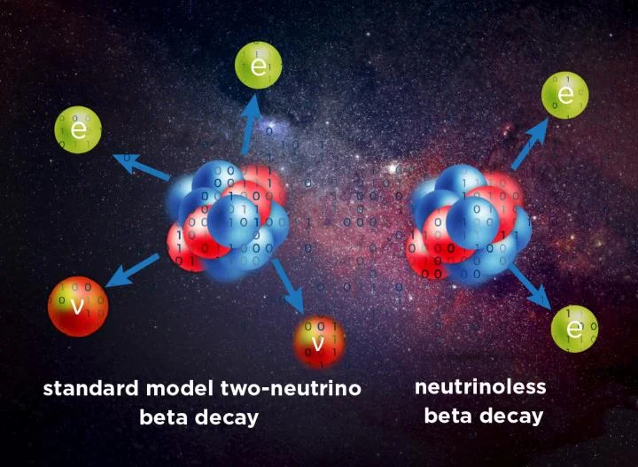
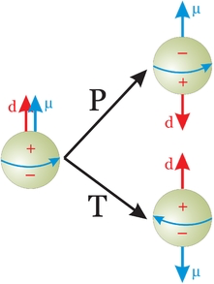
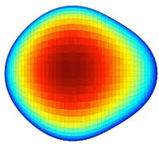

Searches for BSM Physics
Neutrinoless double-beta decay Dark matter direct detection Super-allowed Fermi transitions
Neutrino scattering Symmetry-violating moments Atomic theory

Slide 29
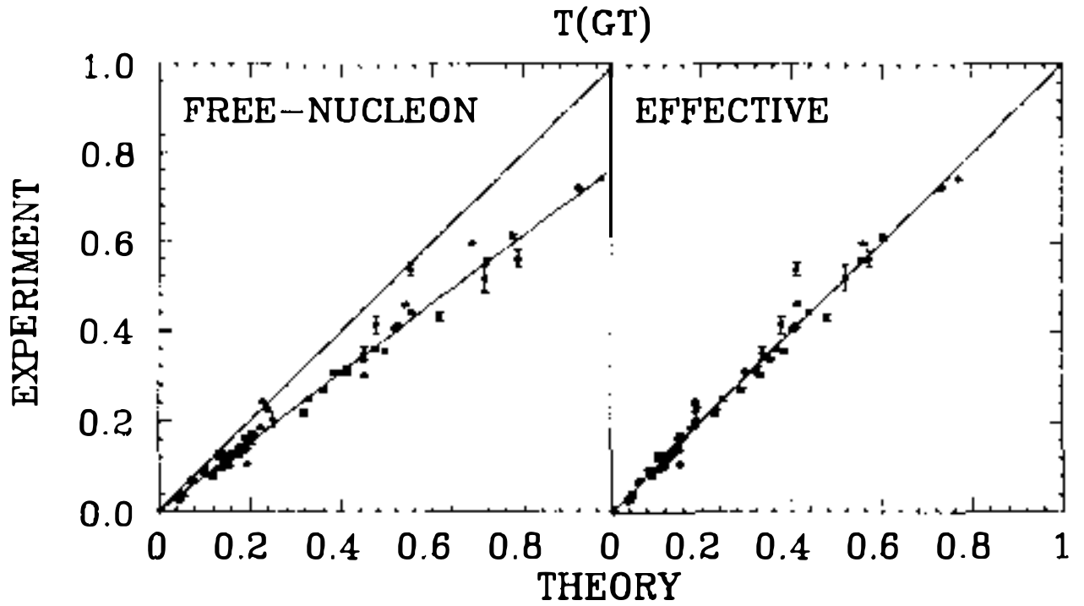
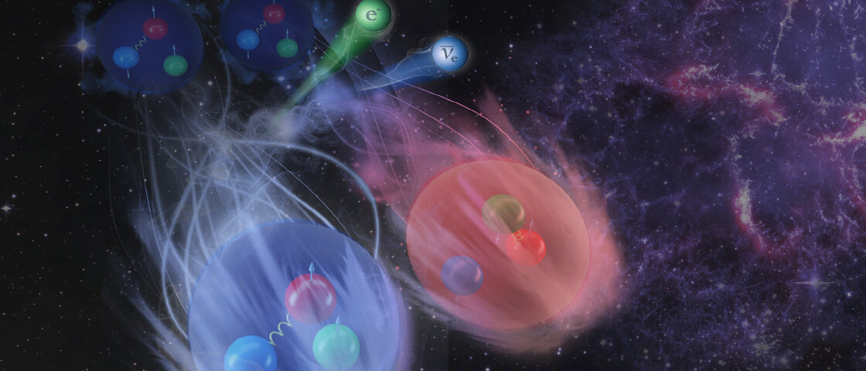
Two-Body Currents for Gamow-Teller Transitions and g_{A} Quenching
*Milestone Result*
Ab initio survey of GT matrix elements
Many-body correlations
Consistent NN+3N forces + 2BC
Broad experimental agreement with g_{A}=1.25

Slide 30

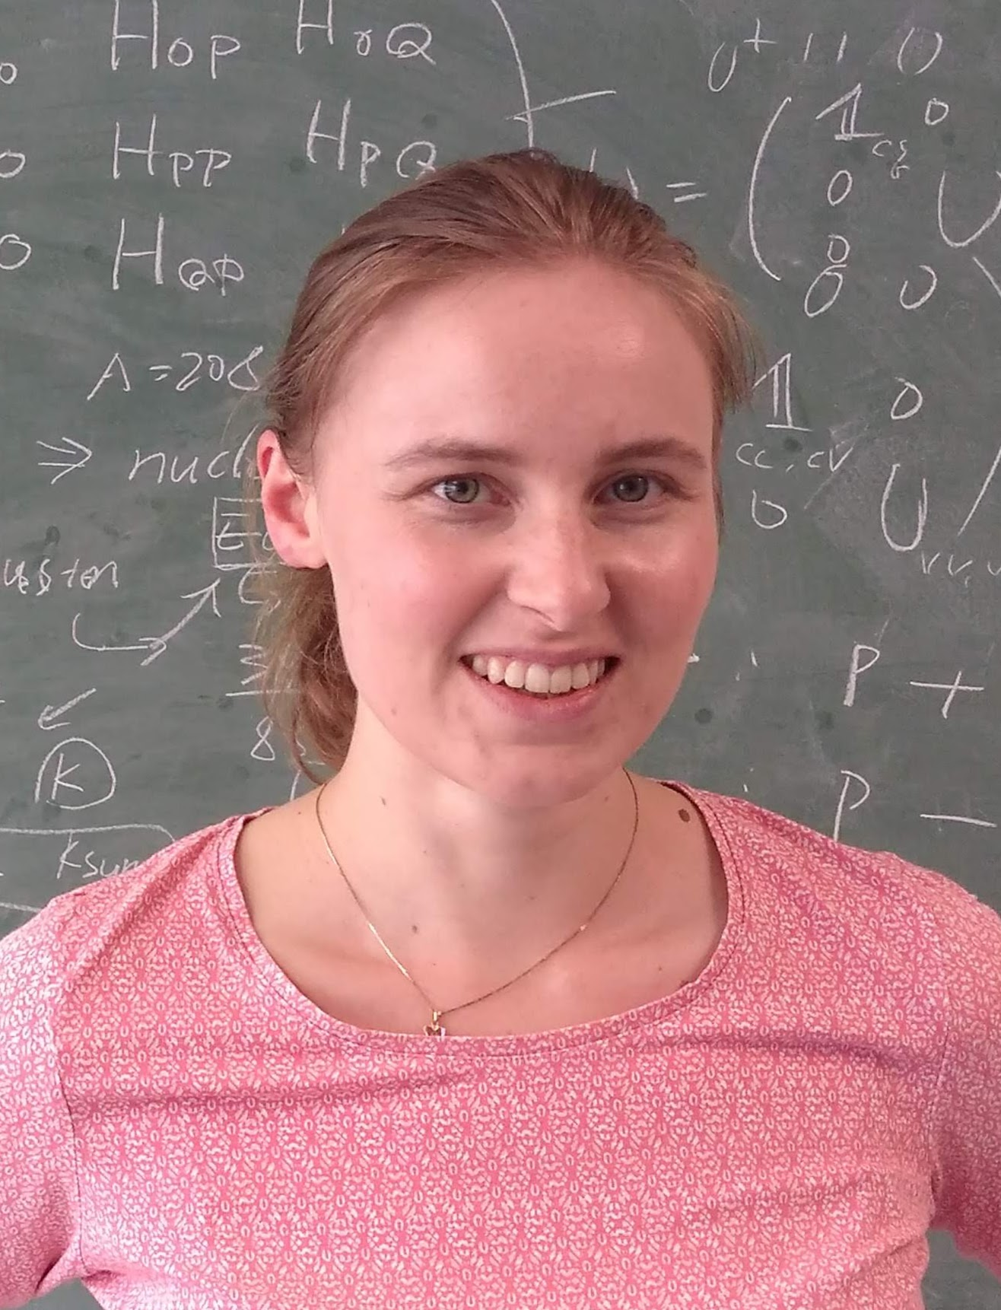




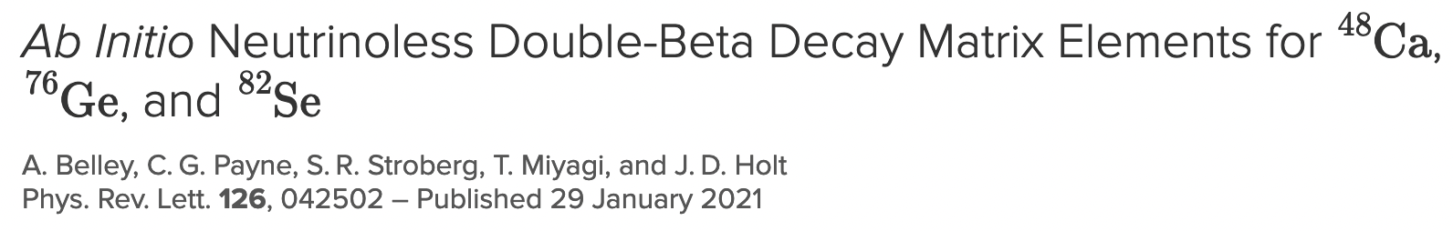
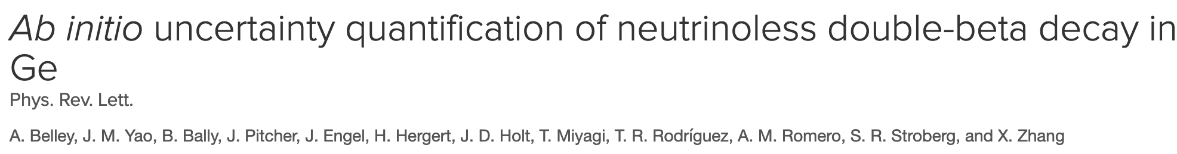
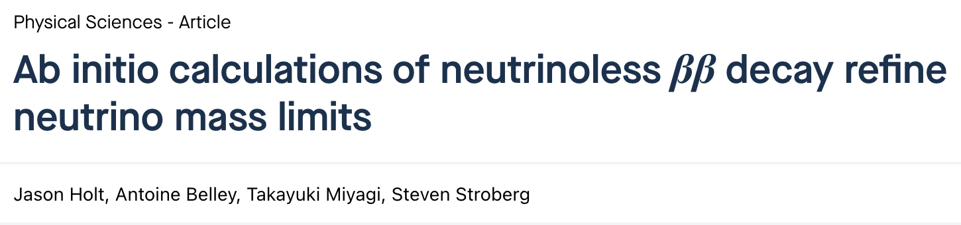

0νββ Decay for All Major Players: ⁷⁶Ge ¹⁰⁰Mo,¹³⁰Te,¹³⁶Xe
A. Belley L. Jokiniemi I. Ginnett J. Pitcher A. Todd T. Shickele

Slide 31


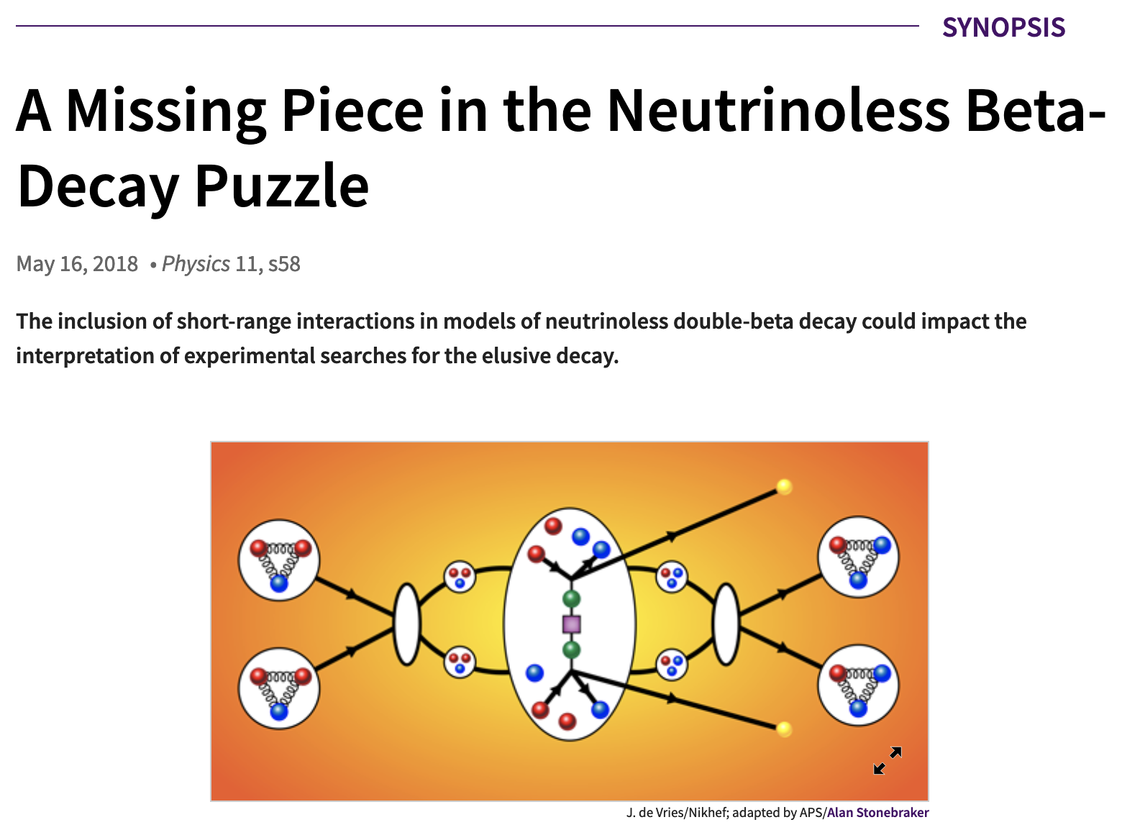
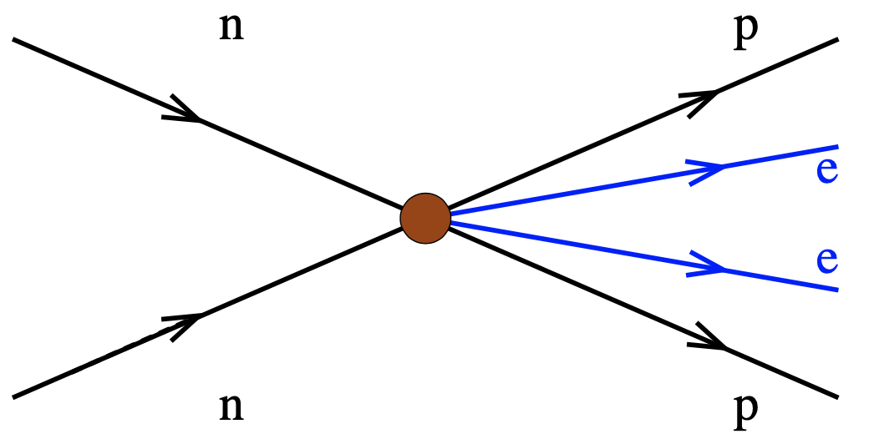
The Year(s) We Lost Hope: Leading-Order Contact
Proper renormalization requires short-range contact term at leading order
New paradigm for 0νββ decay: include long- and short-range terms
Estimated to ~30% - no consistent way to assess with phenomenology
New physics inside blob:
High-energy ν exchange
V. Cirigliano et al. PRL (2018), PRL (2022)

Slide 32
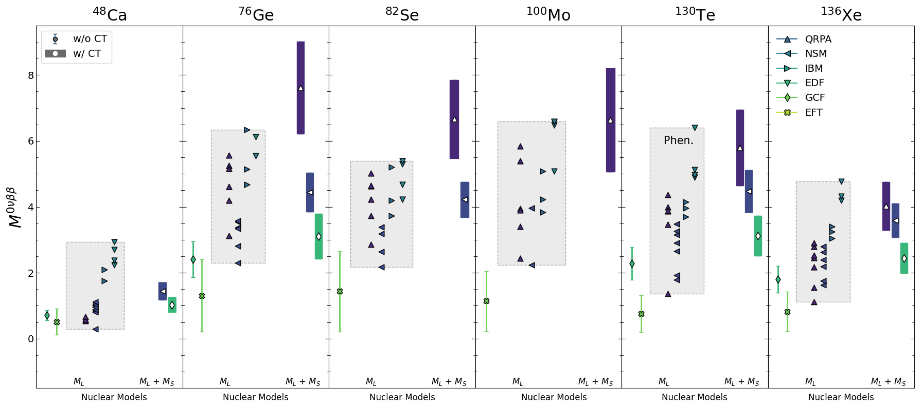
(More) Current Status of NMEs
Compiled values updated w/ phenomenology + short-range contact
New(er) results increase factors up to >10 uncertainty 😬 can we do better?

Slide 33
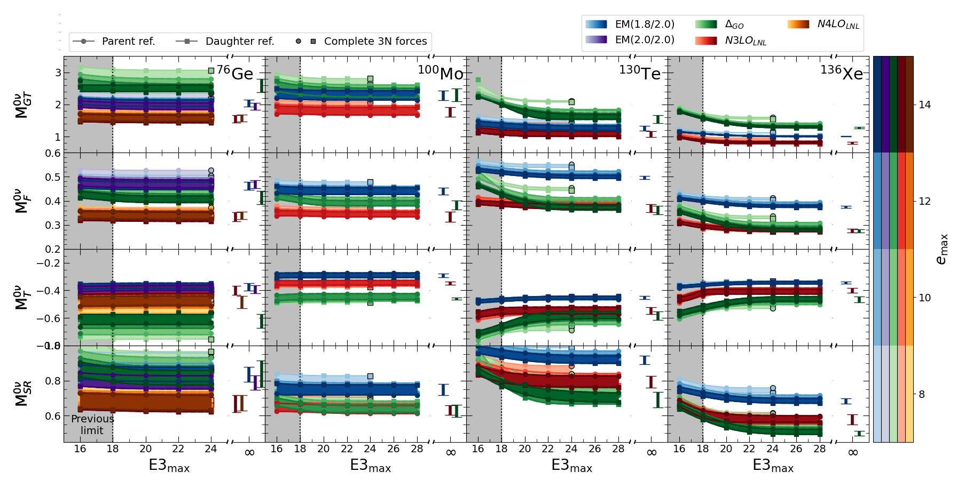
Ab Initio Strategy: Predict in Heavy Nuclei
Converged NMEs for major players in global searches: ⁷⁶Ge, ¹⁰⁰Mo, ¹³⁰Te, ¹³⁶Xe
Belley et al., arXiv:2307.15156
Nature (under review)

Slide 34
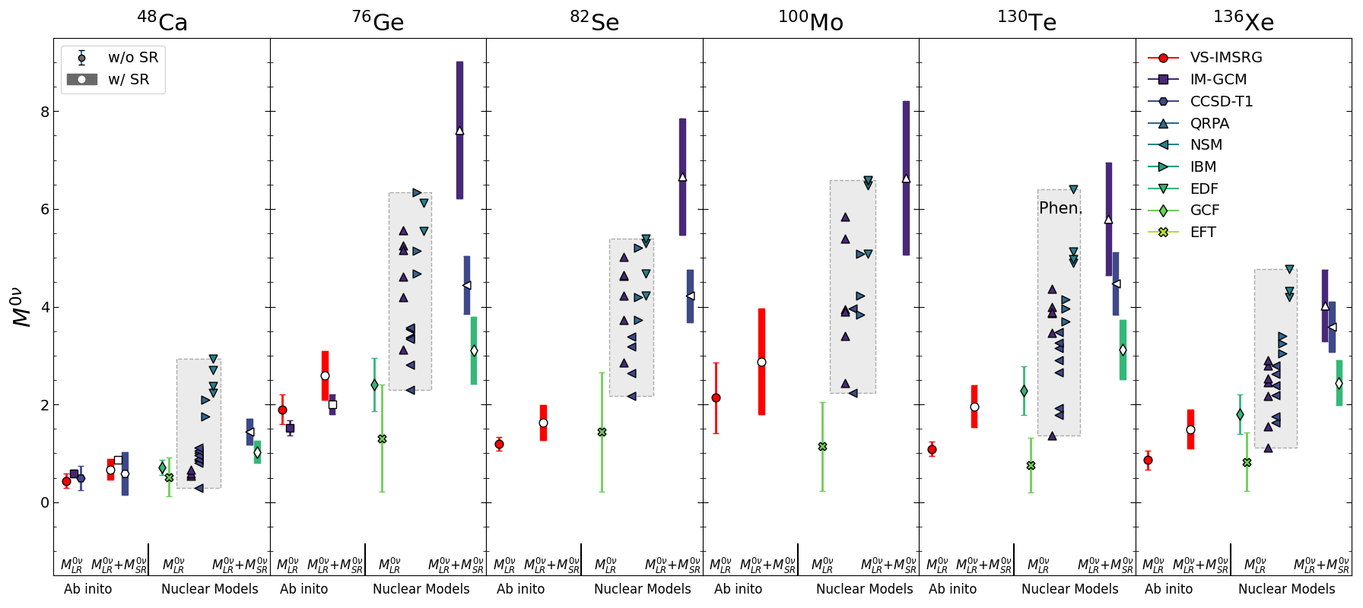
Ab Initio Strategy: Predict in Heavy Nuclei
Converged NMEs for major players in global searches: ⁷⁶Ge, ¹⁰⁰Mo, ¹³⁰Te, ¹³⁶Xe
Ab initio results: differences from models; large NMEs strongly disfavored
Belley et al.,
arXiv:2307.15156

Slide 35
Ab Initio Strategy: Predict in Heavy Nuclei
Converged NMEs for major players in global searches: ⁷⁶Ge, ¹⁰⁰Mo, ¹³⁰Te, ¹³⁶Xe
Ab initio results: differences from models; large NMEs strongly disfavored
Belley et al.,
arXiv:2307.15156

Slide 36
Why Small Matrix Elements?
Correlations in wavefunction and operator drive small NMEs
Ab initio results: differences from models; large NMEs strongly disfavored

Slide 37
Ab Initio Strategy: Explore Correlations
⁷⁶Ge: Explore correlations with other observables from 34 interactions
No obvious correlations, except DGT
Use machine learning for further insights?
Belley et al., arXiV:2210.05809
Yao, Ginnett, Belley et al., PRC (2022)

Slide 38
Machine Learning for Sensitivity Analysis
Explore dependence on chiral EFT LECs: requires many samples (as in ²⁰⁸Pb)
Use gaussian processes as an emulator
Multi-Fidelity Gaussian Process: connects few (complicated) high-fidelity data points (e.g., full IMSRG) w/ many low-fidelity data points (HF, low e_{max}, etc)
Difference function fit with Gaussian process: predict HF from LF
Deep Gaussian Process: Neural network links multiple GP
Include outputs of previous fidelity as new HF point:
Improves modeling of difference between LF and HF
Adapted for multi output:
Multi-Output Multi-Fidelity Deep Gaussian Process (MM-DGP)
Belley, Pitcher et al., in preparation

Slide 39
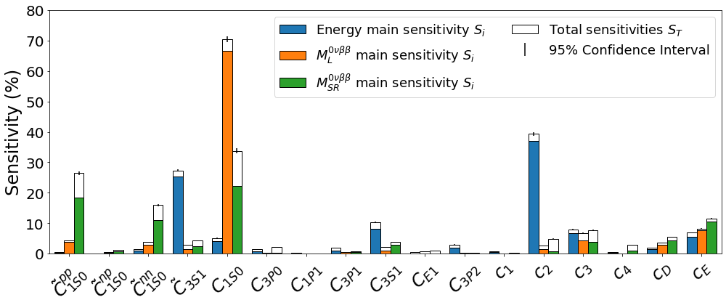
MM-DGP Emulator for IMSRG: Sensitivity Analysis
Newly developed MM-DGP data-driven emulator for VS-IMSRG
Sensitivity analysis: Connect long-range 0νββ decay to terms in nuclear forces
Highly sensitive to single constant “C1S0” – related to ¹S₀ phase shift
Belley, Pitcher et al.,
arXiv:2408.02169

Slide 40
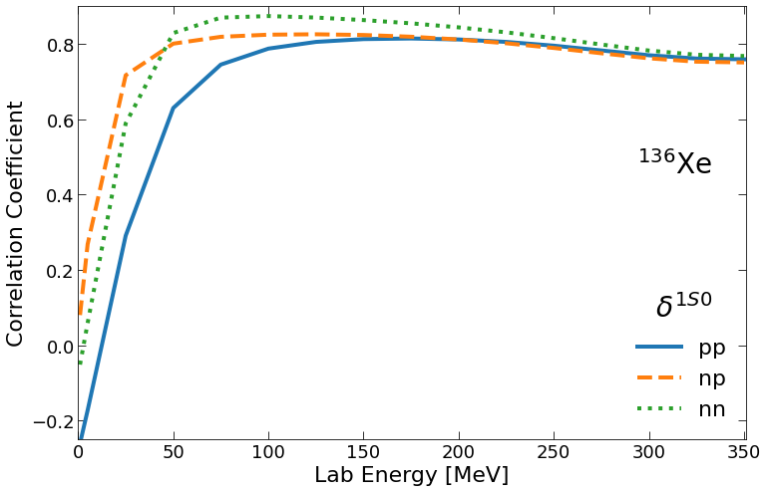
MM-DGP Emulator: Correlation w/ ¹S₀ Phase Shift
Clear correlation with ¹S₀ phase-shift
Strong correlation emerges for energies > 50MeV
Constrained by part of interaction for the two nucleons when “close” to each other
Belley, Pitcher et al.,
arXiv:2408.02169

Slide 41
Ab Initio Strategy: Explore Correlations
Explore correlations with other observables from systematic analysis (34 interactions)
Few clear correlations, except DGT in ⁷⁶Ge
Novel correlation with measured ¹S₀ phase shift!
Belley et al., arXiV:2210.05809
Belley, Pitcher et al.,
arXiv:2408.02169

Slide 42
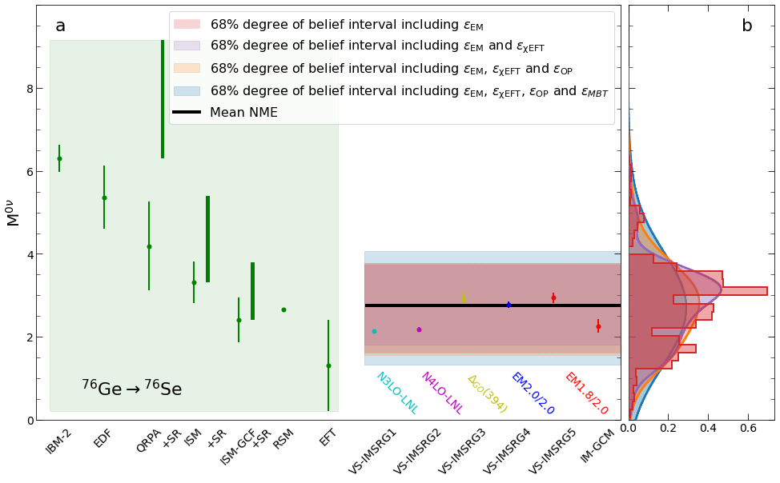
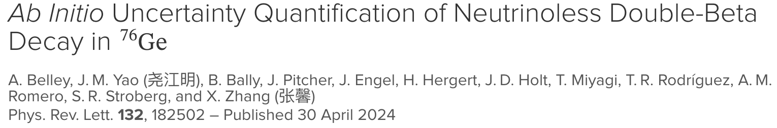
Rigorous Ab Initio Uncertainties for ⁷⁶Ge
Consider all physics contributing to theoretical error in 0νββ decay
Nuclear many-body problem treated
w/ newly developed ML emulators
Construct PPD for NME in ⁷⁶Ge
Dramatically reduced uncertainty
compared to nuclear models
Ab Initio
Nuclear Models

Slide 43
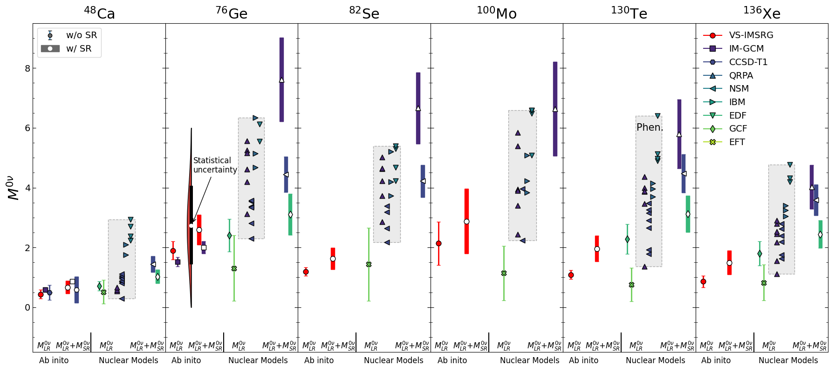
Updated Predictions in Heavy Nuclei
Converged NMEs for major players in global searches: ⁷⁶Ge, ¹⁰⁰Mo ¹³⁰Te, ¹³⁶Xe
Independent PPD agrees with previous spread

Slide 44
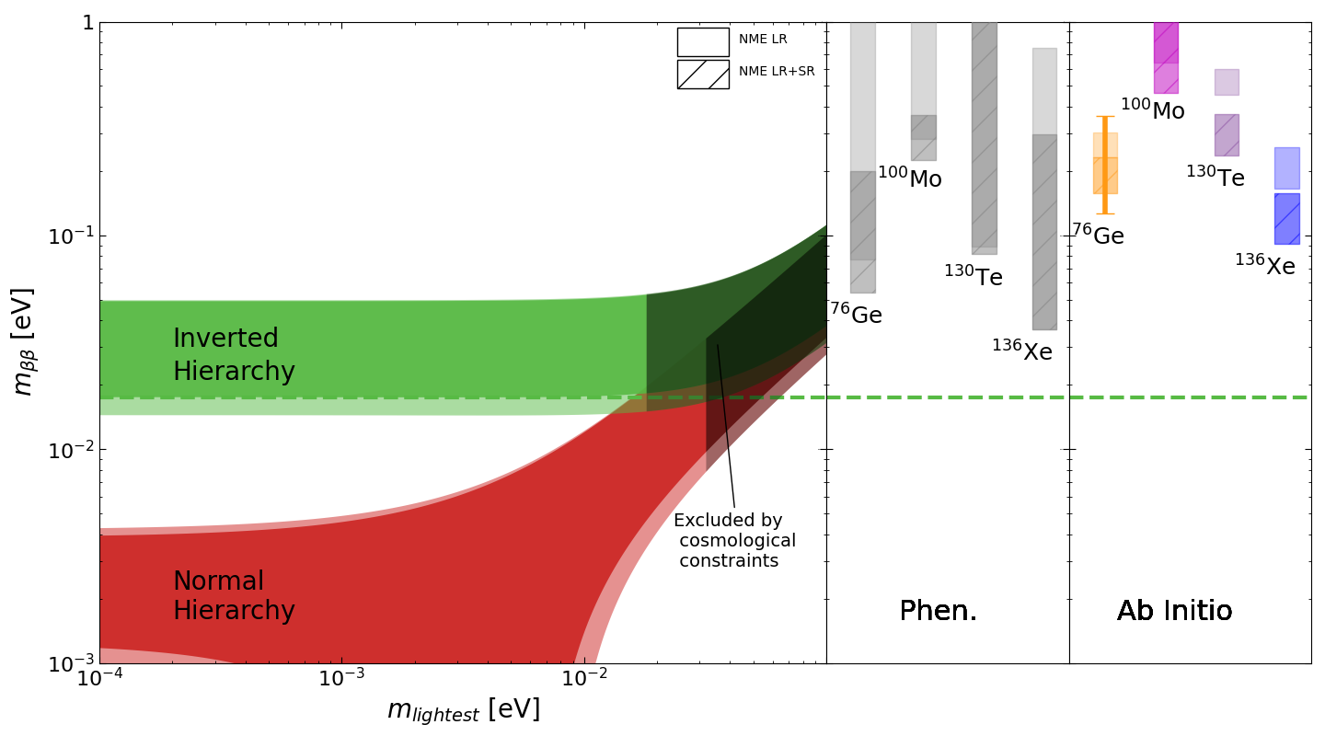
Ab Initio Strategy: Impact on Worldwide Searches
Impact for current searches: large matrix elements disfavored, lowers expected rates
Current experimental reach – improved with effects of contact term
Highly unlikely inverted Hierarchy has been probed
Belley et al, arXiv:2307.15156
Nature (under review)

Slide 45
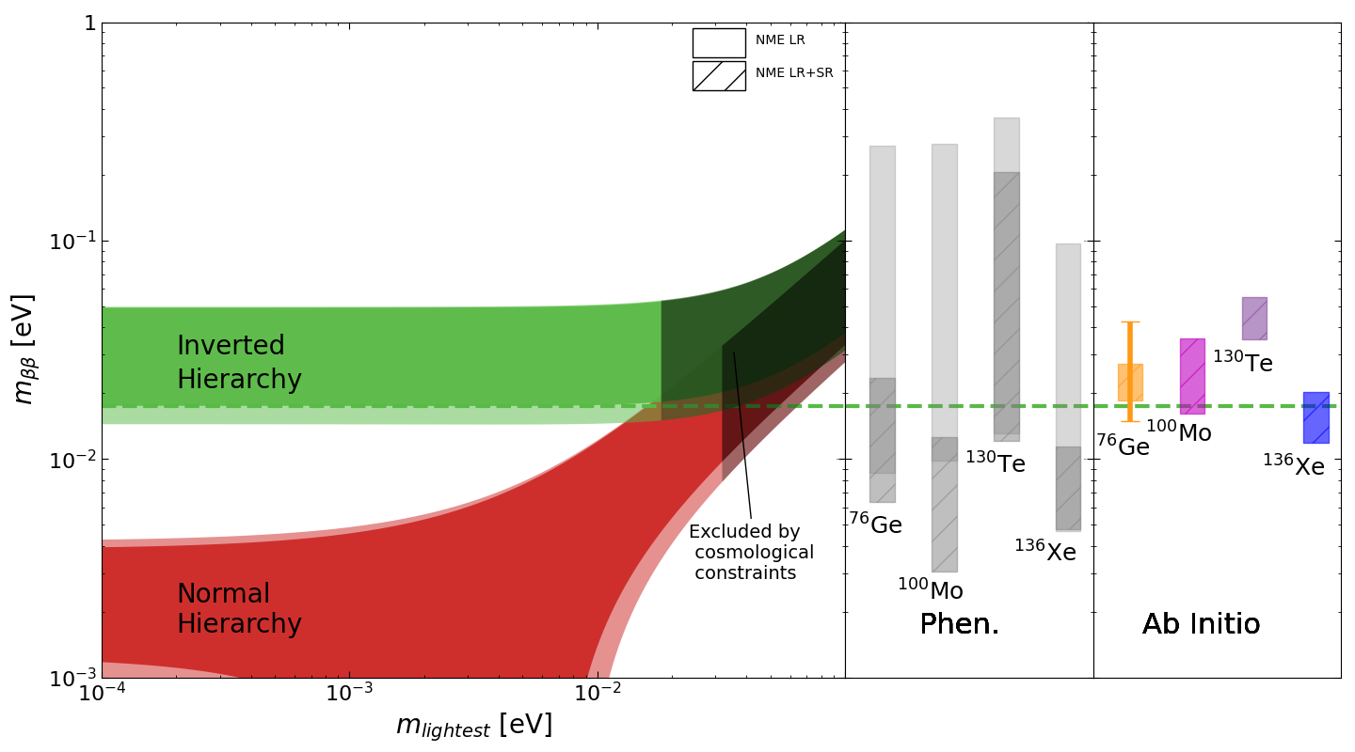

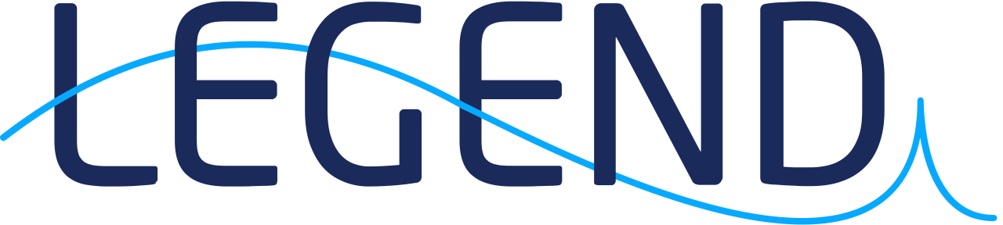


Ab Initio Strategy: Impact on Ton-Scale Searches
Impact for next-generation searches: sensitivities from LEGEND, SNO+, nEXO, CUPID
Effect of short-range term improves experimental reach… ¹⁰⁰Mo now a major player
Uncertainty reduced by over one order of magnitude!
Belley et al, arXiv:2307.15156
Nature (under review)

Slide 46
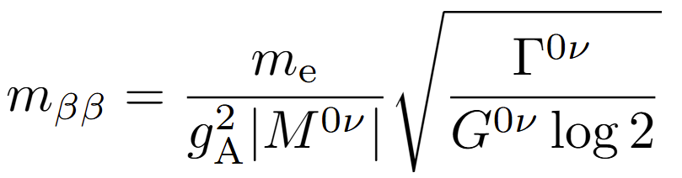

Combined Limits: Likelihood Functions
Obtain likelihood functions from experiments – convert decay rates to
Likelihoods allow combined limit via Bayes’ Theorem
Combined ab initio limits:
IH fully probed with multiple isotopes
Analysis based on S. Biller PRD (2021)
Shickele et al., in prep

Slide 47


NMEs for Heavy Sterile Neutrino Exchange
Explore other possible exchange mechanisms
Heavy sterile neutrinos: complicated operator structures
Converged heavy NMEs for all major candidates
V. Cirigliano et al.
J. High Energy Phys. (2018)
Todd, Shickele et al., in prep

Slide 48
NMEs for Heavy Sterile Neutrino Exchange
Generally smaller values (and spread) than nuclear models
Use ab initio 0νββ decay to obtain lower limits for sterile neutrino mass
Todd, Shickele et al., in prep

Slide 49
NMEs for Heavy Sterile Neutrino Exchange
Generally smaller values (and spread) than nuclear models
Use ab initio 0νββ to obtain lower limits for sterile neutrino mass
Results probe particle masses beyond the LHC: new collaborations w/ particle theory @TRIUMF
Todd, Shickele et al., in prep

Slide 50

Heavy Sterile Neutrino Exchange
New collaborations welcome!
Workshop @ TRIUMF
particle + nuclear theory
jholt@triumf.ca

Slide 51




Future of Ab Initio Theory
(Not so) Bold predictions: many new directions in the next 5 years
Nucleosynthesis
Ab initio input for r-process
2024
Nicole Vassh Maude Larivière
Baishan Hu

Slide 52

Ab Initio Theory for Origin of Heavy Elements
Most heavy elements created via rapid-neutron capture process (r-process)
Theory input is crucial where no data exists – little known “south” of ²⁰⁸Pb
r-process
Lanthanides
Actinides
Solar heavy elements
= r-process (rapid neutron capture)
+ s-process (slow neutron capture)

Slide 53
Ab Initio Impact on r-Process Simulations
Separation energies, Q-values calculated to N=12x driplines for r-process inputs
]
Significant improvement in 3rd abundance peak!

Slide 54



Future of Ab Initio Theory
(Not so) Bold predictions: many new directions in the next 5 years
Nucleosynthesis
Ab initio input for r-process
Dark Matter/v Scattering
Ab initio structure functions
2024
Sam Leutheusser Jose Padua
Mathieu Bruneault Baishan Hu

Slide 55




Nuclear Theory for BSM Searches
Dark matter direct detection and CEνNS require similar ab initio theory
Differential cross section, well-defined in SM
Weak/Axial form factors from nuclear theory

Slide 56

Ab Initio SD WIMP-Nucleus Response Overview
Ab initio structure functions for Spin-Dependent all dark-matter direct detection candidates
Result overall similar to phenomenology at low q; Largest discrepancies in ¹²⁷I

Slide 57
Ab Initio WIMP/ν-Nucleus Responses
Structure functions for dark matter direct detection and CEνNS
Typically use phenomenological form factors (Helm, etc.) same for p/n
CEνNS sensitive to neutron distribution in nuclei – neutron skin calculations improve Helm
Comparison with ab initio calculations shows refined Helm well reproduces ab initio
Hu et al. in prep.

Slide 58
Ab Initio WIMP/ν-Nucleus Responses
Structure functions for dark matter direct detection and CEνNS
Typically use phenomenological form factors (Helm, etc.) same for p/n
CEνNS sensitive to neutron distribution in nuclei – neutron skin calculations improve Helm
Provide refined “ab initio” Helm form factor for use by all in community
Hu et al. in prep.

Slide 59
Future of Ab Initio Theory
(Not so) Bold predictions: many new directions in the next 5 years
Nucleosynthesis
Ab initio input for r-process
Dark Matter/v Scattering
Ab initio structure functions
Heavy Ion Collisions
Nuclear structure/NMEs
2024

Slide 60

Nuclear Properties from Heavy-Ion Collisions
Utilize heavy ion collision data @ LHC for novel insights into nuclei and 0νββ decay!
Xe-Xe collisions provide first such determination of neutron skins, consistent with ab initio
Giacalone, Nijs in prep.

Slide 61

Nuclear Properties from Heavy-Ion Collisions
Utilize heavy ion collision data @ LHC for novel insights into nuclei and 0νββ decay!
Xe-Xe collisions provide first such determination of neutron skins, consistent with ab initio
CERN/Canada NME@LHC collaboration: refine NME from ab initio and Ge-Ge collisions!
Y, Li et al., PRL (2025)

Slide 62
Future of Ab Initio Theory
(Not so) Bold predictions: many new direction in the next 5 years
Nucleosynthesis
Ab initio input for r-process
Dark Matter/v Scattering
Ab initio structure functions
Heavy Ion Collisions
Nuclear structure/NMEs
CKM Unitarity (V_{ud})
Superallowed Fermi
2024
Leach, Holt, arXiv:1809.10793

Slide 63

Future of Ab Initio Theory
(Not so) Bold predictions: many new direction in the next 5 years
Nucleosynthesis
Ab initio input for r-process
Dark Matter/v Scattering
Ab initio structure functions
Heavy Ion Collisions
Nuclear structure/NMEs
CKM Unitarity (V_{ud})
Superallowed Fermi
Symmetry Violation
P/T-violating moments
2024
Antoine Belley Jose Munoz

Slide 64




The Magic of Molecules: CP Violation
“One of the most compelling mysteries in all of science is how matter came to dominate over antimatter in the universe.” – NSAC LRP
CP violation required beyond our current observations
Searches for CP violation ongoing for 50+ yr
neutron/atoms - ¹⁹⁹Hg EDM world leader
Effects enhanced in:
Heavy systems, Octupole deformed
Known SM CP Violation (CKM matrix)
Discovery Window
225_{Ra}
Antimatter
Matter
P-violation

Slide 65
The Magic of Molecules: CP Violation
Worldwide race to exploit power of Radioactive Molecules
Generate internal fields orders of magnitude above lab possibilities
Enhancements in molecules vs atoms >4000
Probe 1000TeV scale in our lifetimes!
Known SM CP Violation (CKM matrix)
20 years
10 years
5 years

Slide 66

The Magic of Molecules: CP Violation
Worldwide race to exploit power of Radioactive Molecules
Generate internal fields orders of magnitude above lab possibilities
Enhancements in molecules vs atoms >4000
Probe 1000TeV scale in our lifetimes
To date, no rigorous nuclear theory
(motivation, interpretation)
Known SM CP Violation (CKM matrix)
20 years
10 years
5 years
Measurement
Nuclear structure
P,T odd NN int
New physics
Experiment

Slide 67


The Magic of Molecules: Weak Structure of Nuclei
Hadronic P violation – probe the weak structure of the atomic nucleus!
W,Z exchange between nucleons generates anapole moment
Experimental tuning enhances >10¹¹
To date, no rigorous nuclear theory
Nuclear structure
P-odd NN int
New P-violating
physics
Experiment

Slide 68
The Magic of Molecules: Weak Structure of Nuclei
Hadronic P violation – probe the weak structure of the atomic nucleus!
W,Z exchange between nucleons generates anapole moment
To date, no rigorous nuclear theory ¹³³Cs underway!
¹⁵N
Nuclear structure
P-odd NN int
New P-violating
physics
Experiment

Slide 69
Future of Ab Initio Theory
(Not so) Bold predictions: many new direction in the next 5 years
Nucleosynthesis
Ab initio input for r-process
Dark Matter/v Scattering
Ab initio structure functions
Heavy Ion Collisions
Nuclear structure/NMEs
CKM Unitarity (V_{ud})
Superallowed Fermi
Symmetry Violation
Schiff/anapole moments
Atomic/molecular/QC(?)
AI/Machine Learning
New emulators
2024
Notes:
Impact: Chemistry, astrophysics, particle physics, atomic, molecular

Slide 70













Future of Ab Initio Theory
0νββ Decay
(Former)
Postdoctoral
Fellows
Ragnar Stroberg Takayuki Miyagi Lotta Jokiniemi Baishan Hu
Structure + Astrophysics
Antoine Belley Isabella Ginnette
Symmetry Violation
AI/Machine Learning
CKM Unitarity
Alex Todd Michael Liudeng
Kanting Motimele Maude Larivière
Jose Munoz Jack Pitcher
Emily Love Matt Martin
Atomic Systems
Dark Matter/ν Scattering
Just the beginning:
join our revolution!
jholt@triumf.ca
Gaurav Tenkila Hrishi Patel Vijay Chand
Sam Leutheusser Jose Padua Mathieu Bruneault

Slide 71
Valence-Space IMSRG
Explicitly construct unitary transformation from sequence of rotations
All operators truncated at two-body level IMSRG(2)
IMSRG(3) in progress
Step 1: Decouple core
Can we achieve accuracy
of large-space methods?

Slide 72
Valence-Space IMSRG
Explicitly construct unitary transformation from sequence of rotations
All operators truncated at two-body level IMSRG(2)
IMSRG(3) in progress
Tsukiyama, Bogner, Schwenk, PRC 2012
Morris, Parzuchowski, Bogner, PRC 2015
Step 1: Decouple core
Step 2: Decouple valence space
Can we achieve accuracy
of large-space methods?

Slide 73
Valence-Space IMSRG
Explicitly construct unitary transformation from sequence of rotations
Step 1: Decouple core
Step 2: Decouple valence space
Step 3: Decouple additional operators
Careful benchmarking essential

Slide 74

Ab Initio Strategy IV: Rigorous Uncertainties
Construct predictive posterior distribution for NMEs – first case ⁷⁶Ge
Consider all physics contributing to systematic error
Use 8100+ samplings of NN+3N forces - weighted by np ¹S₀ phase shift
Solve many-body problem with MM-DGP
Emulator: from process itself

Slide 75

Ab Initio Strategy IV: Rigorous Uncertainties
Construct predictive posterior distribution for NMEs – first case ⁷⁶Ge
Consider all physics contributing to systematic error
Use 8100+NN+3N forces - weighted by np ¹S₀ phase shift
Solve many-body problem with MM-DGP
Emulator: from process itself
EFT: Truncation in nuclear forces
Belley et al, arXiv:2308.15634

Slide 76
Ab Initio Strategy IV: Rigorous Uncertainties
Construct predictive posterior distribution for NMEs – first case ⁷⁶Ge
Consider all physics contributing to systematic error
Use 8100+ NN+3N forces - weighted by np ¹S₀ phase shift
Solve many-body problem with MM-DGP
Emulator: from process itself
EFT: Truncation in nuclear forces
Many-body: Truncation in many-body physics
Belley et al, arXiv:2308.15634

Slide 77

Ab Initio Strategy IV: Rigorous Uncertainties
Construct predictive posterior distribution for NMEs – first case ⁷⁶Ge
Consider all physics contributing to systematic error
Use 8100+ NN+3N forces - weighted by np ¹S₀ phase shift
Solve many-body problem with MM-DGP
Emulator: from process itself
EFT: Truncation in nuclear forces
Many-body: Truncation in many-body physics
Operator: higher order contributions to operator
Belley et al, arXiv:2308.15634

Slide 78

Ab Initio Strategy: Explore Correlations
⁷⁶Ge: Explore correlations with other observables from 34 interactions
No ab initio correlations, except DGT
Use machine learning for further insights?
⁴⁸Ca
Belley et al., arXiV:2210.05809
Yao, Ginnett, Belley et al., PRC (2022)

Slide 79

Ab Initio Strategy: Explore Correlations
⁷⁶Ge: Explore correlations with other observables from 34 interactions
No ab initio correlations, except DGT
Use machine learning for further insights?
¹³⁶Xe
Belley et al., arXiV:2210.05809
Yao, Ginnett, Belley et al., PRC (2022)

Slide 80
Ab Initio Strategy I: Benchmark in Light Nuclei
Benchmark with quasi-exact ab initio methods in light systems: A=6-22
Reasonable to good agreement in all cases
Pursue true double-beta decay candidates!
Yao, Belley et al., PRC (2020)

Slide 81

Ab Initio Neutron Skin of ²⁰⁸Pb
Combine ab initio + machine learning advances
I: History Matching: 34 “non-implausible” interactions
II: Calibration/importance sampling: ⁴⁸Ca properties
III: Validation: ²⁰⁸Pb properties from ab initio
IV: Prediction: PPD for neutron skin
R_{skin}(²⁰⁸Pb)=0.14-0.20fm – consistent with PREXII
PREX II
Nature Physics 18, 1196 (2022)
2016
Notes:
New approach to uncertainty estimation. Old way, spread in a few chiral interactions. New approach, construct statistically meaningful sample to get PPD
In order to get statistically meaningful sample, need to construct MANY
1) Emulators to perform many calculation
New approach that can be applied for any observable in any nucleus
One exciting way we could use this is in calculating nuclear structure properties to constrain

Slide 82
Neutron Skin of ²⁰⁸Pb
Combine TRIUMF/ORNL/Chalmers advances!
I: History Matching confronted with A=2,3,4 data + ¹⁶O
10⁹ calculations spanning EFT parameter space at N²LO
34 non-implausible interactions
II: Calibration use ⁴⁸Ca E/A, E(2⁺), R_{p}, dipole polarizability
Importance resampling – statistically weight interactions
III: Validation ²⁰⁸Pb E/A, R_{p} + ⁴⁸Ca/²⁰⁸Pb DP from ab initio
Clear quality description of data
IV: Prediction - posterior predictive distribution for neutron skin
R_{skin}(²⁰⁸Pb)= 0.14-0.20fm (68% credible level)
Consistent(ish) with extracted PREXII result
PREX II

Slide 83


Neutron Skin of ²⁰⁸Pb and Nuclear EOS
Slope of symmetry energy (L) related to NS pressure Correlations from ab initio ²⁰⁸Pb
Crucial for mass-radii relationship
Mirror charge radii, dipole/quadrupole polarizabilities
Correlation between R_{skin} and symmetry-energy slope (L)
Gandolfi, Carlson &
Reddy, PRC (2012)
Nature Physics 18, 1196 (2022)
L = 38-69 MeV
Potentially constrain nuclear forces:
Neutron star radii/mergers
2016

Slide 84
Large-Scale Ab Initio GT Transitions
Ab initio survey of large GT matrix elements
2BC: Coupling of weak force to two nucleons
- Light → heavy mass regions
- Many-body correlations
- Consistent NN+3N forces + 2BC
Coupled Cluster
Rios, Nature Physics
News & Views 15, 425 (2019)
VS-IMSRG
No-Core Shell Model

Slide 85

Solution to g_{A}-Quenching Problem
VS-IMSRG calculations in regions from O → Ca (sd) and Ca→Ni (pf) shells
Ab initio calculations across the chart explain data with unquenched g_{A}
Next up: explore double-beta decays…
sd-shell
pf-shell
Nature Physics 15, 428 (2019)

Slide 86
The Magic of Molecules: CP Violation
Worldwide race to exploit power of Radioactive Molecules
Generate internal fields orders of magnitude above lab possibilities
Enhancements in molecules vs atoms >4000
Probe 1000TeV scale in our lifetimes
To date, no rigorous nuclear theory
(motivation, interpretation)
Measurement
Nuclear structure
P,T odd NN int
x1000 enhancement
New physics
Experiment

