Slide 1
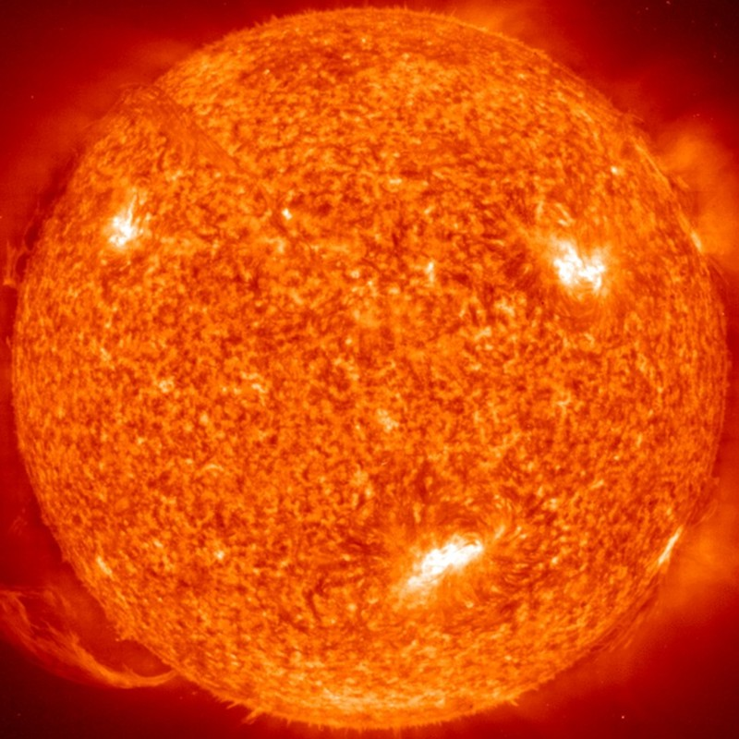
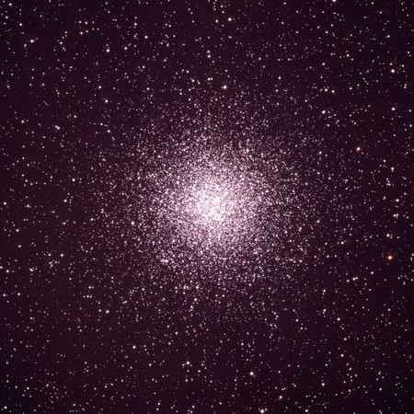
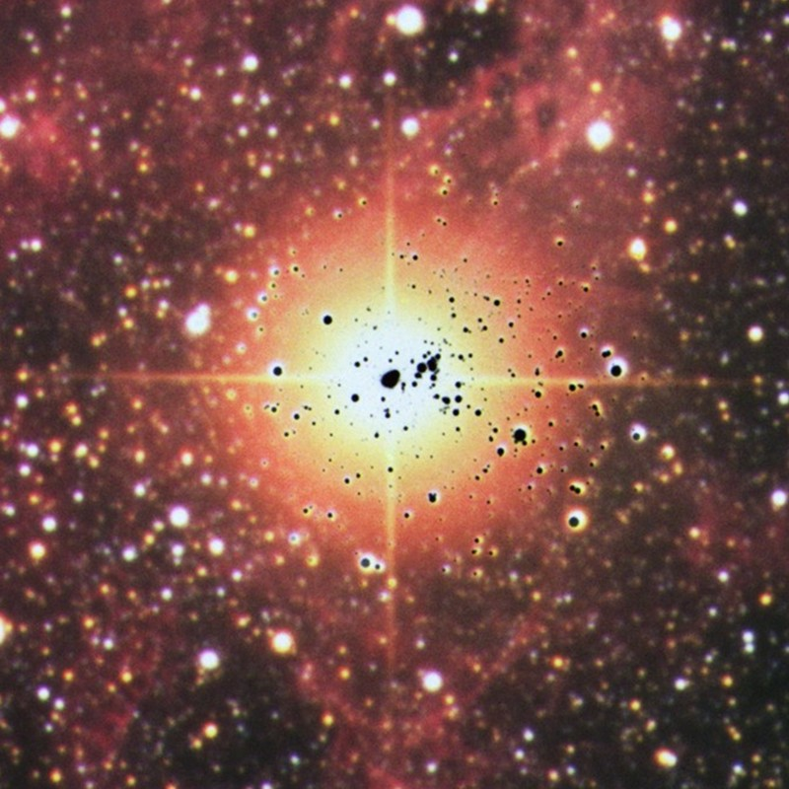
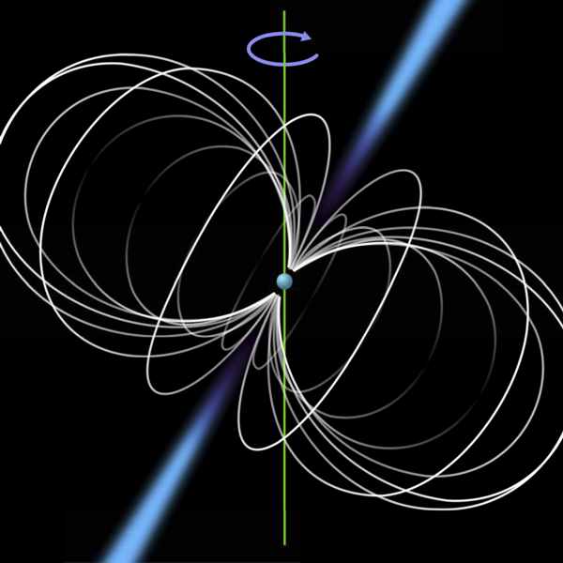
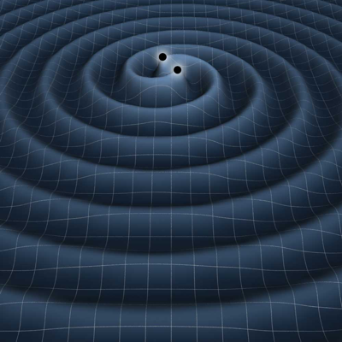
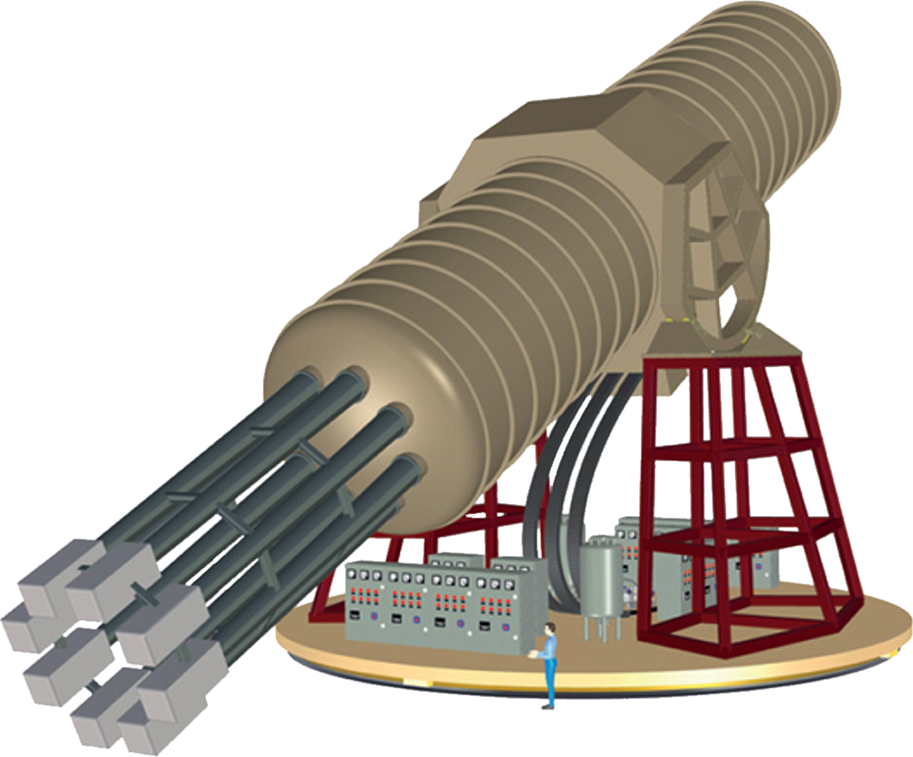




Stars as Laboratories for New Particles
Invisibles Workshop, CERN, 1 Sept 2025
Solar Axions
Globular Clusters
Supernova 1987A
Neutron Stars
Gravitational Waves
Georg G. Raffelt, Max-Planck-Institut für Physik, Garching

Slide 2
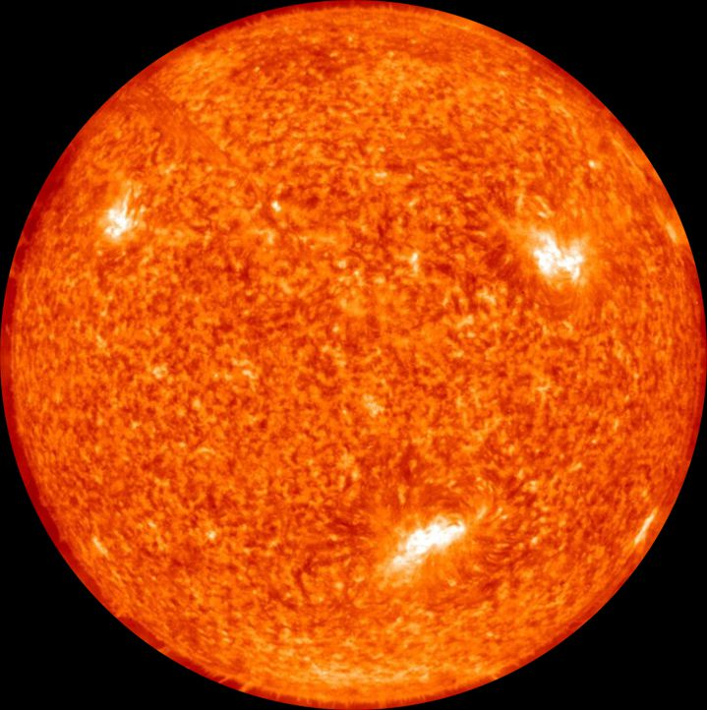

Particles and Stars
Low-mass particles are
produced in stellar interiors
• Detection opportunity
(Sun or Supernovae)
• Backreaction on stellar
properties
→ Which particles?
→ Which stars?

Slide 3
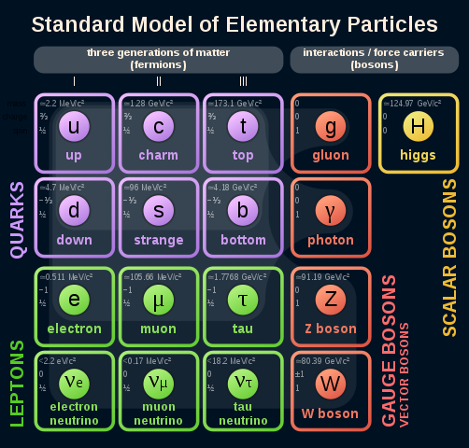
Standard Model
What else is there to know?

Slide 4
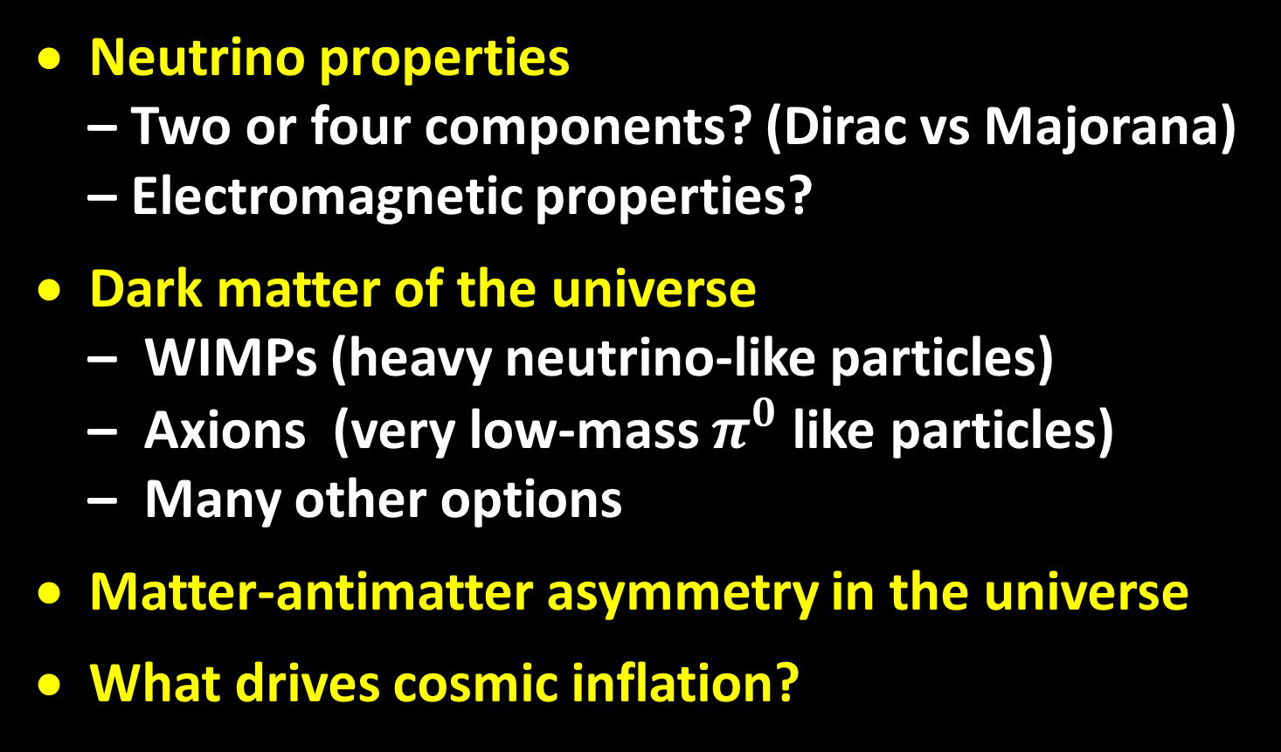
Urgent Particle-Physics Questions
• Neutrino properties
– Two or four components? (Dirac vs Majorana)
– Electromagnetic properties?
• Dark matter of the universe
– WIMPs (heavy neutrino-like particles)
– Axions (very low-mass $π^{0}$ like particles)
– Many other options
• Matter-antimatter asymmetry in the universe
• What drives cosmic inflation?

Slide 5
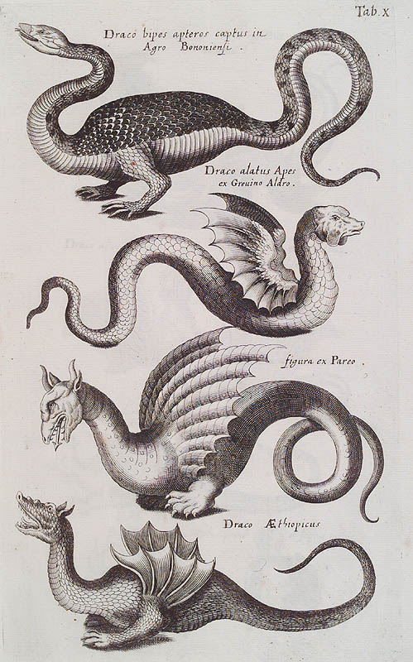
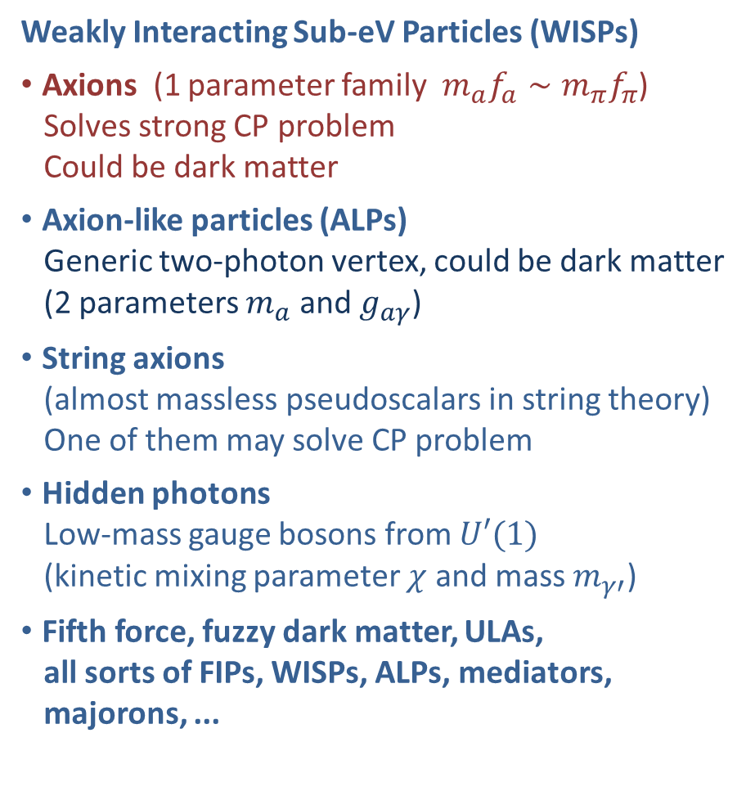
Bestiarium of Low-Mass Bosons
Weakly Interacting Sub-eV Particles (WISPs)
• Axions (1 parameter family $m_{a}f_{a}∼m_{π}f_{π}$)
Solves strong CP problem
Could be dark matter
• Axion-like particles (ALPs)
Generic two-photon vertex, could be dark matter
(2 parameters $m_{a}$ and $g_{aγ}$)
• String axions
(almost massless pseudoscalars in string theory)
One of them may solve CP problem
• Hidden photons
Low-mass gauge bosons from $U′(1)$
(kinetic mixing parameter $χ$ and mass $m_{γ′}^{ }$)
• Fifth force, fuzzy dark matter, ULAs,
all sorts of FIPs, WISPs, ALPs, mediators,
majorons, ...

Slide 6


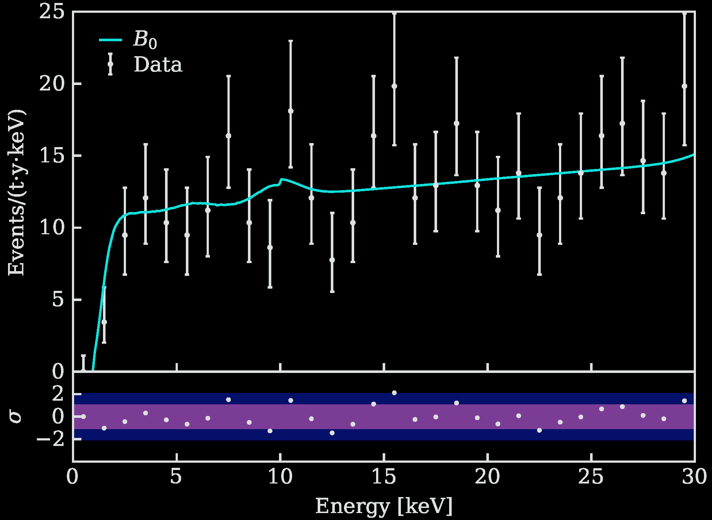
Particles from the Sun
2002 Solar Neutrinos (R.Davis, M.Koshiba)
2015 Solar Nu Oscillations (A.McDonald)
Search for solar axions
with CAST and future IAXO
No excess in XENONnT
arXiv:2207.11330
Bounds on axions,
dark photons, neutrino
dipole moments

Slide 7
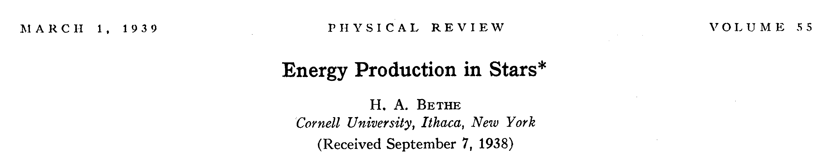
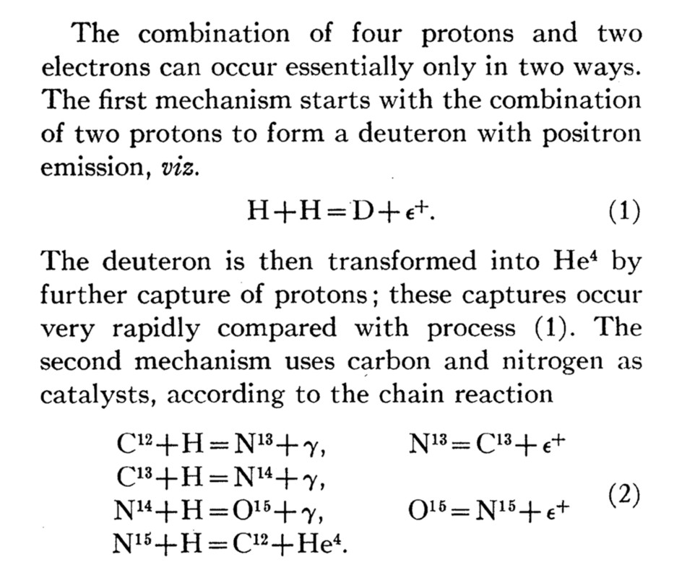
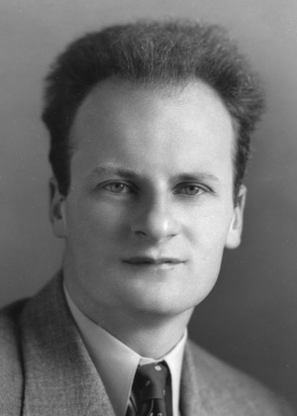
Bethe’s Classic Paper on Nuclear Reactions in Stars
Hans Bethe
1906–2005
• First mention of neutrino
emission from stars
• Neutrino losses discussed,
although overestimated

Slide 8
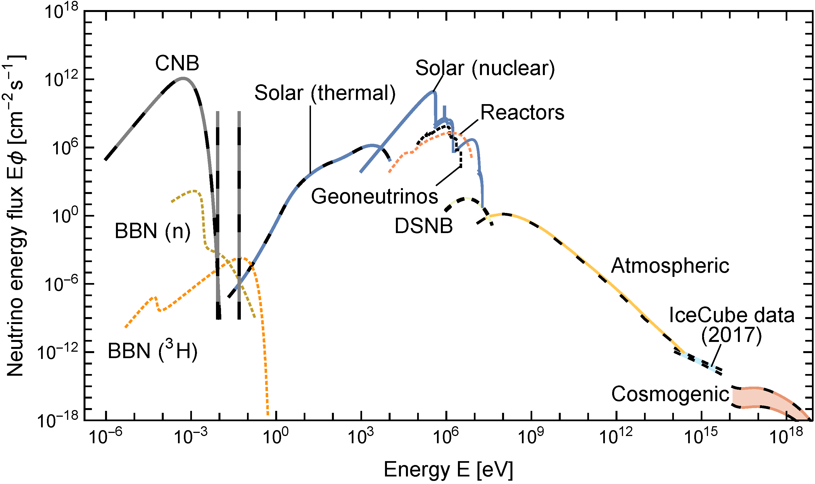
Grand Unified Neutrino Spectrum (GUNS) at Earth
Vitagliano, Tamborra & Raffelt, arXiv:1910.11878
km^{–2} y^{–1}
200 PeV
Neutrino with largest-ever energy
13 Feb 2023, KM3-230213A

Slide 9
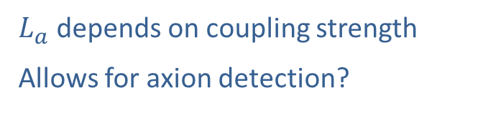
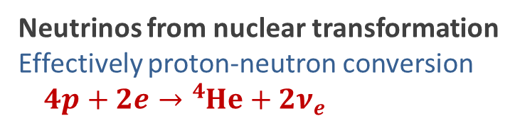
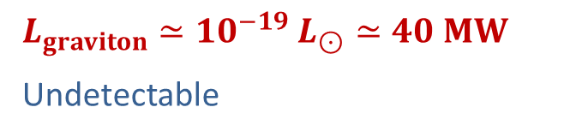
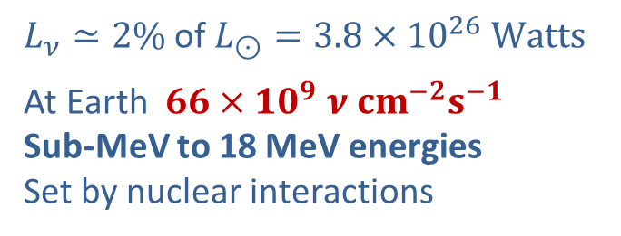
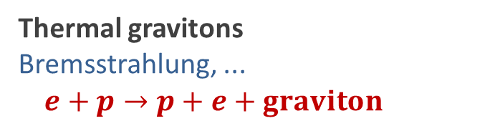
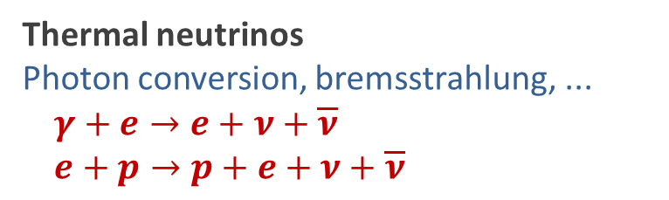
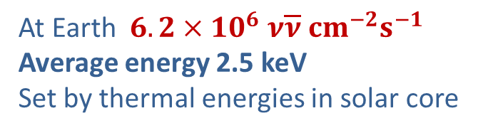
Nuclear vs. Thermal Particles from the Sun
Neutrinos from nuclear transformation
Effectively proton-neutron conversion $4p+2e→{}_{ }^{4}{He}+2ν_{e}$
$L_{ν}≃2\%$ of $L_{⊙}=3.8×{10}^{26} Watts$
At Earth $66×{10}^{9} ν cm^{−2}s^{−1}$
Sub-MeV to 18 MeV energies
Set by nuclear interactions
Thermal neutrinos
Photon conversion, bremsstrahlung, ...
$$γ+e→e+ν+\overline{ν}$$
$$e+p→p+e+ν+\overline{ν}$$
At Earth $6.2×{10}^{6} ν\overline{ν} cm^{−2}s^{−1}$
Average energy 2.5 keV
Set by thermal energies in solar core
Thermal gravitons
Bremsstrahlung, ...
$$e+p→p+e+graviton$$
$L_{graviton}≃{10}^{−19}$ $L_{⊙}≃40 MW$
Undetectable
Thermal Axions, ALPs, Dark Photons, ...
Various thermal processes
$L_{a}$ depends on coupling strength
Allows for axion detection?

Slide 10

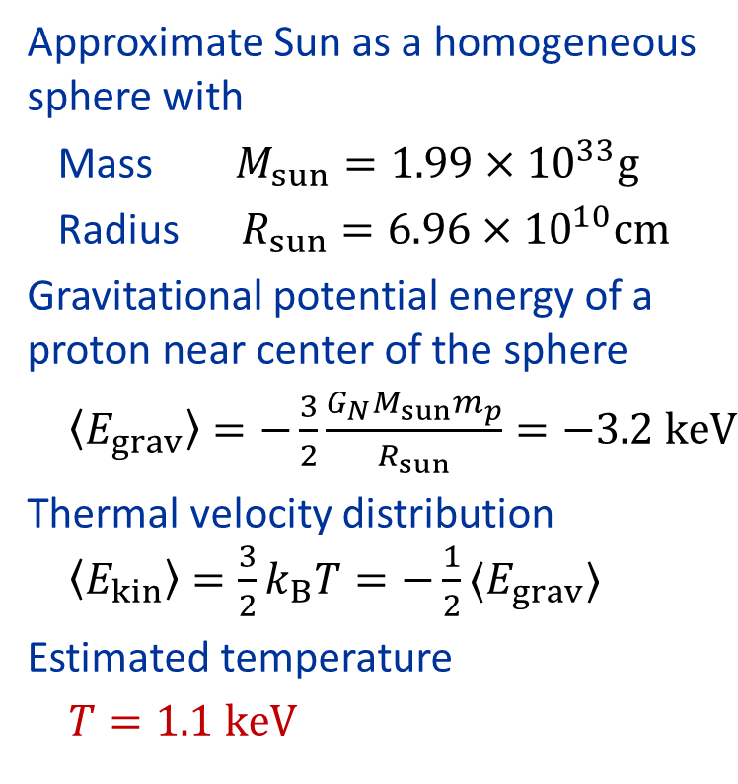

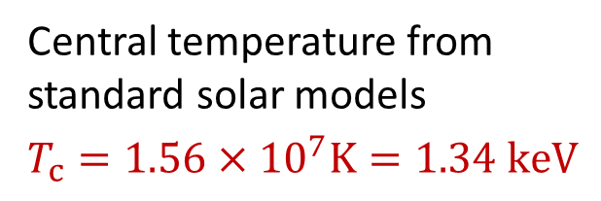
Temperature in the Sun
Virial Theorem $〈E_{kin}〉=−\frac{1}{2}〈E_{grav}〉$
Approximate Sun as a homogeneous
sphere with
Mass $M_{sun}=1.99×{10}^{33}g$
Radius $R_{sun}=6.96×{10}^{10}cm$
Gravitational potential energy of a
proton near center of the sphere
$〈E_{grav}〉=−\frac{3}{2}\frac{G_{N}M_{sun}m_{p}}{R_{sun}}=−3.2 keV$
Thermal velocity distribution
$〈E_{kin}〉=\frac{3}{2}k_{B}T=−\frac{1}{2}〈E_{grav}〉$
Estimated temperature
$T=1.1 keV$
Central temperature from
standard solar models
$$T_{c}=1.56×{10}^{7}K=1.34 keV$$

Slide 11
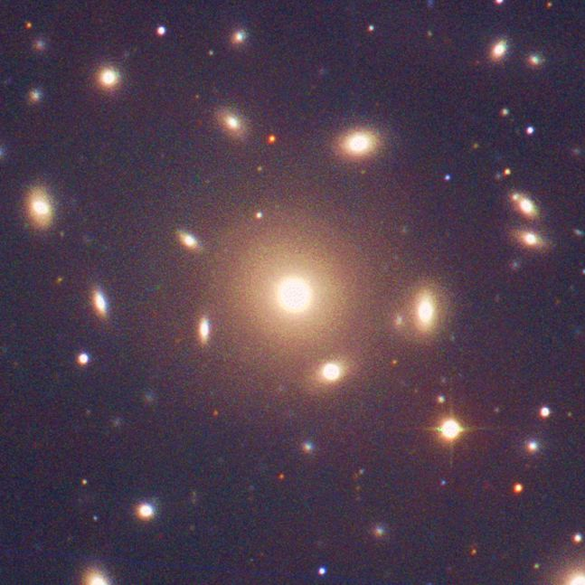
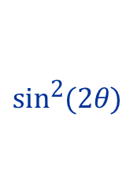
Virial Theorem – Dark Matter in Galaxy Clusters
A gravitationally bound
system of many particles
obeys the virial theorem
$$2〈E_{kin}〉=−〈E_{grav}〉$$
$$2\left\langle \frac{mv^{2}}{2}\right\rangle =\left\langle \frac{G_{N}M_{r}m}{r}\right\rangle$$
$$\left\langle v^{2}\right\rangle ≈G_{N}M_{r}\left\langle r^{−1}\right\rangle$$
Velocity dispersion
from Doppler shifts
and geometric size
Total Mass
Coma Cluster

Slide 12
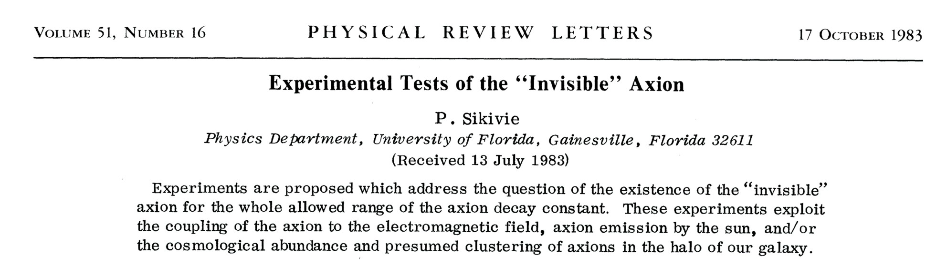
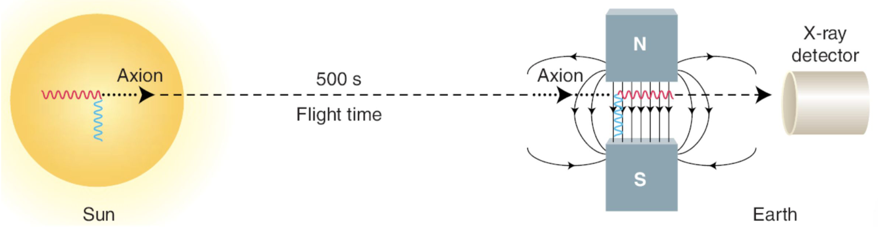
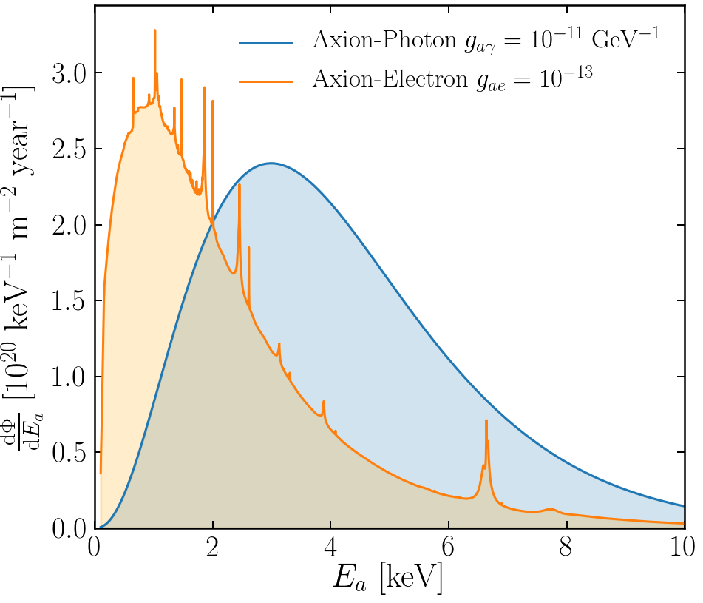
Experimental Tests of Invisible Axions
● Large coherence length overcomes
small coupling
● Axion-photon conversion in B-field similar to
neutrino flavor oscillation, PRD 37 (1988) 1237
● Can be enhanced with gas filling
van Bibber+ PRD 39 (1989) 2089
Primakoff
https://cajohare.github.io/IAXOmass/

Slide 13
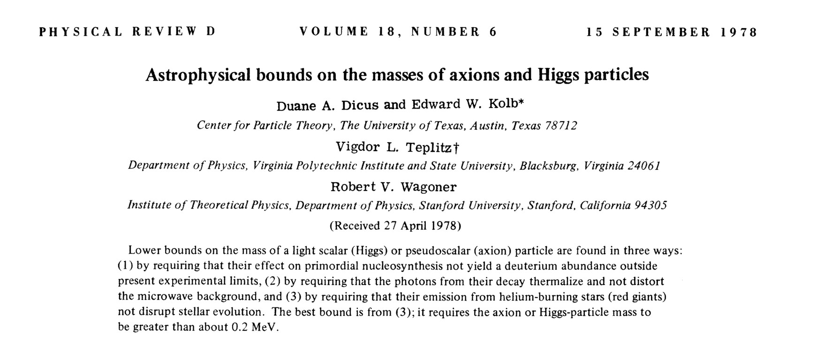
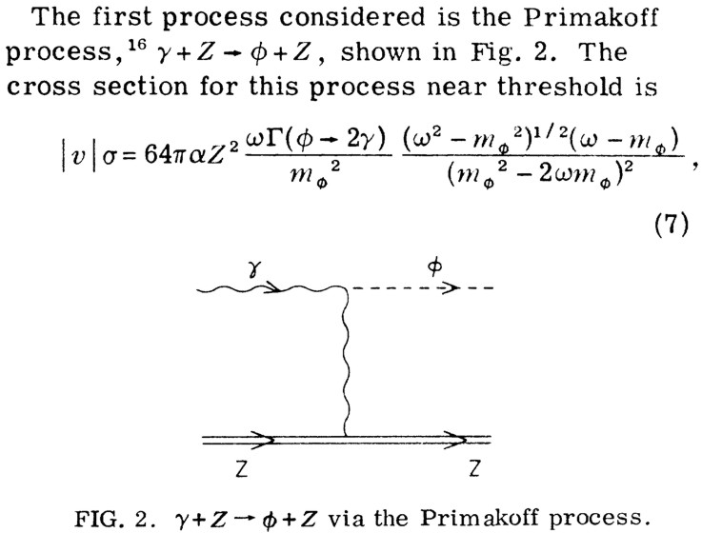

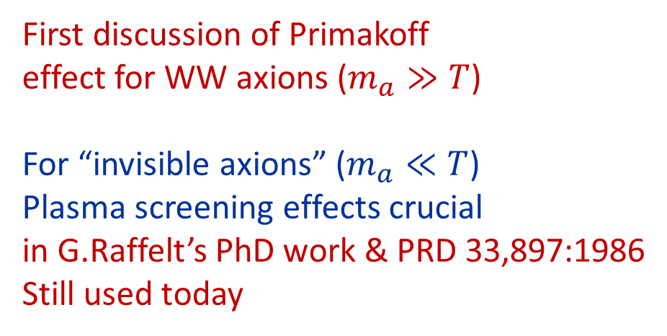
Rocky Kolb’s
PhD work
First discussion of Primakoff
effect for WW axions ($m_{a}≫T$)
For “invisible axions” ($m_{a}≪T$)
Plasma screening effects crucial
in G.Raffelt’s PhD work & PRD 33,897:1986
Still used today

Slide 14
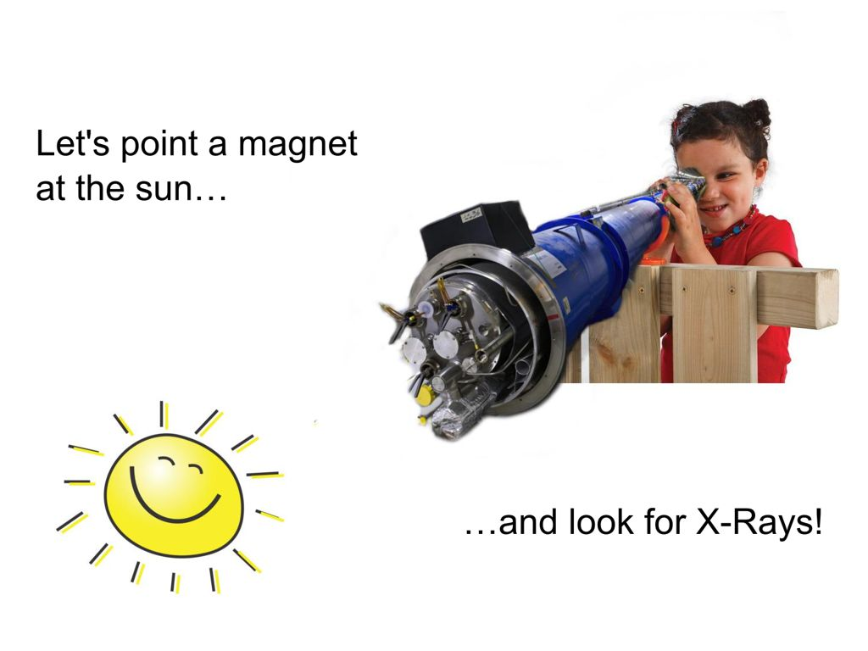
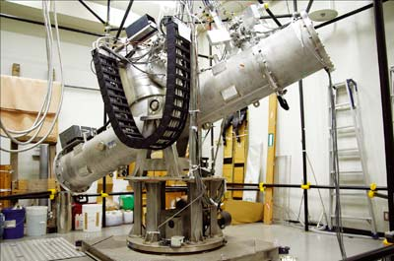
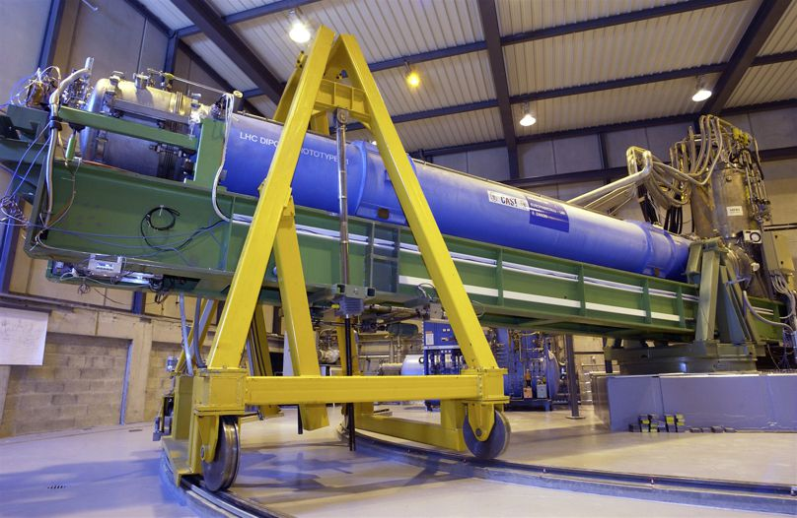
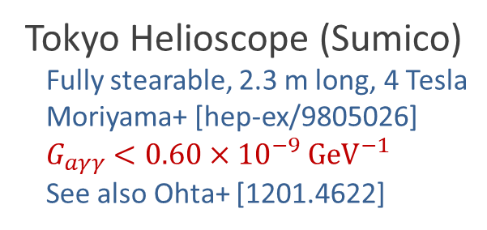
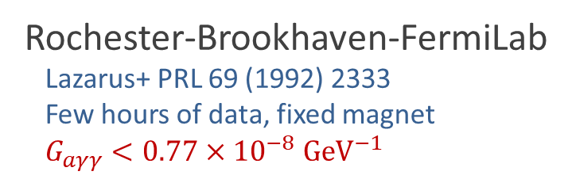
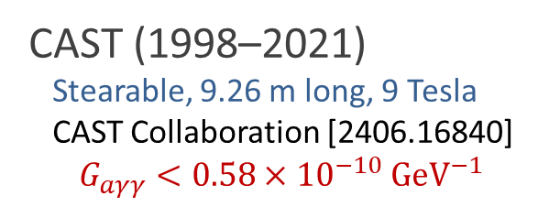
Pointing a Magnet to the Sun
Rochester-Brookhaven-FermiLab
Lazarus+ PRL 69 (1992) 2333
Few hours of data, fixed magnet
$G_{aγγ}<0.77×{10}^{−8} GeV^{−1}$
© Sebastian Baum
Tokyo Helioscope (Sumico)
Fully stearable, 2.3 m long, 4 Tesla
Moriyama+ [hep-ex/9805026]
$G_{aγγ}<0.60×{10}^{−9} GeV^{−1}$
See also Ohta+ [1201.4622]
CAST (1998–2021)
Stearable, 9.26 m long, 9 Tesla
CAST Collaboration [2406.16840]
$$G_{aγγ}<0.58×{10}^{−10} GeV^{−1}$$
CAST Movie on YouTube
https://youtu.be/XY2lFDXz8aQ

Slide 15
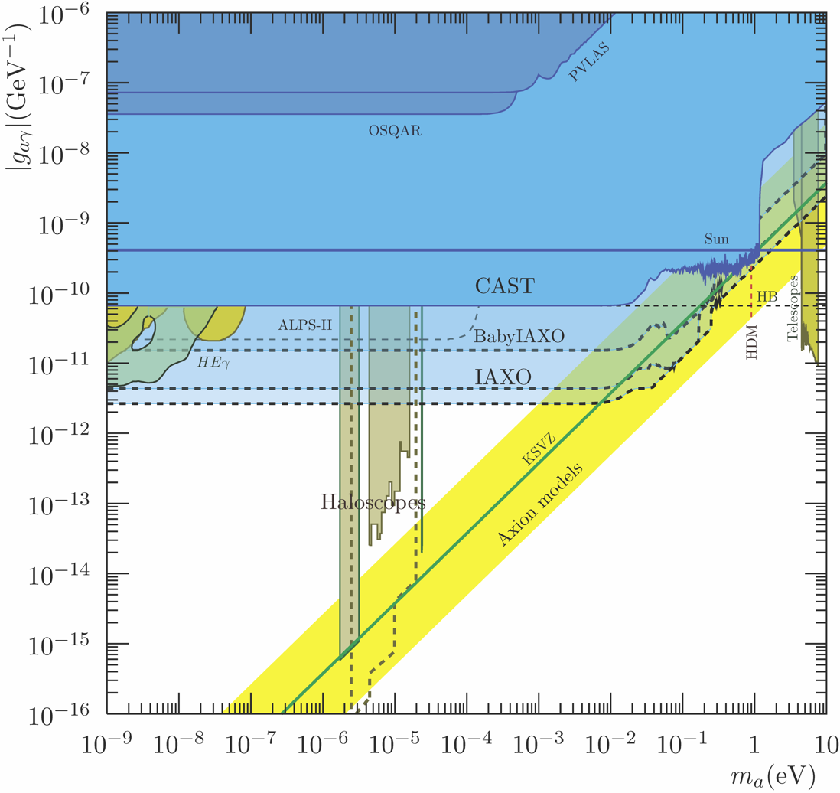

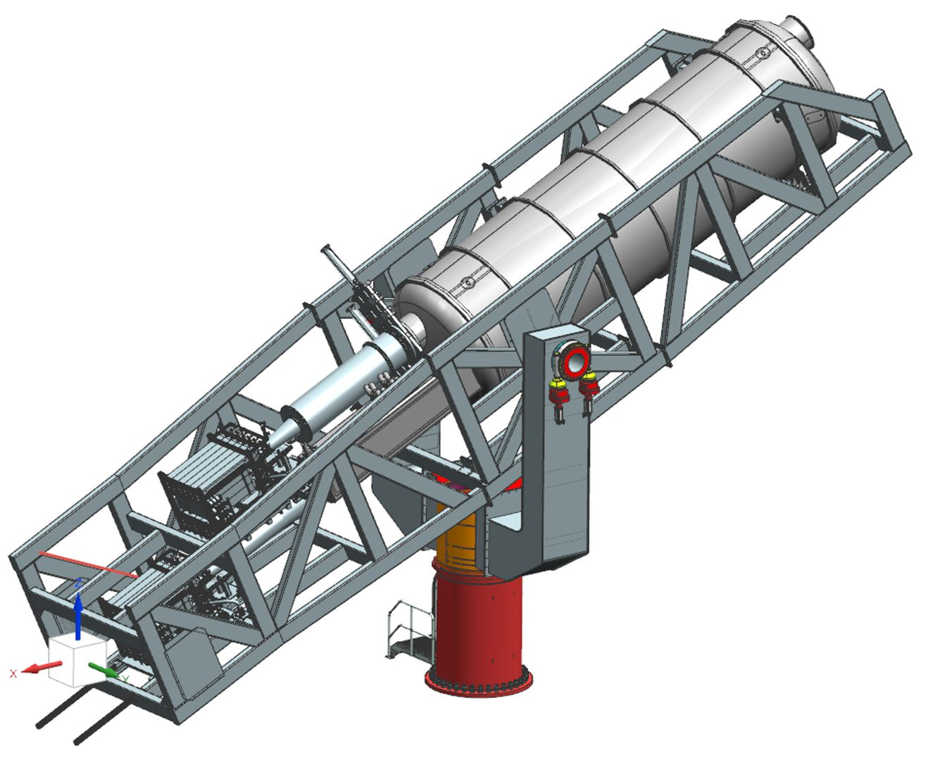
(Baby) IAXO Sensitivity Forecast
Discovery potential
for QCD axions
Physics potential of the International Axion Observatory (IAXO)
JCAP 1906 (2019) 047, arXiv:1904.09155

Slide 16
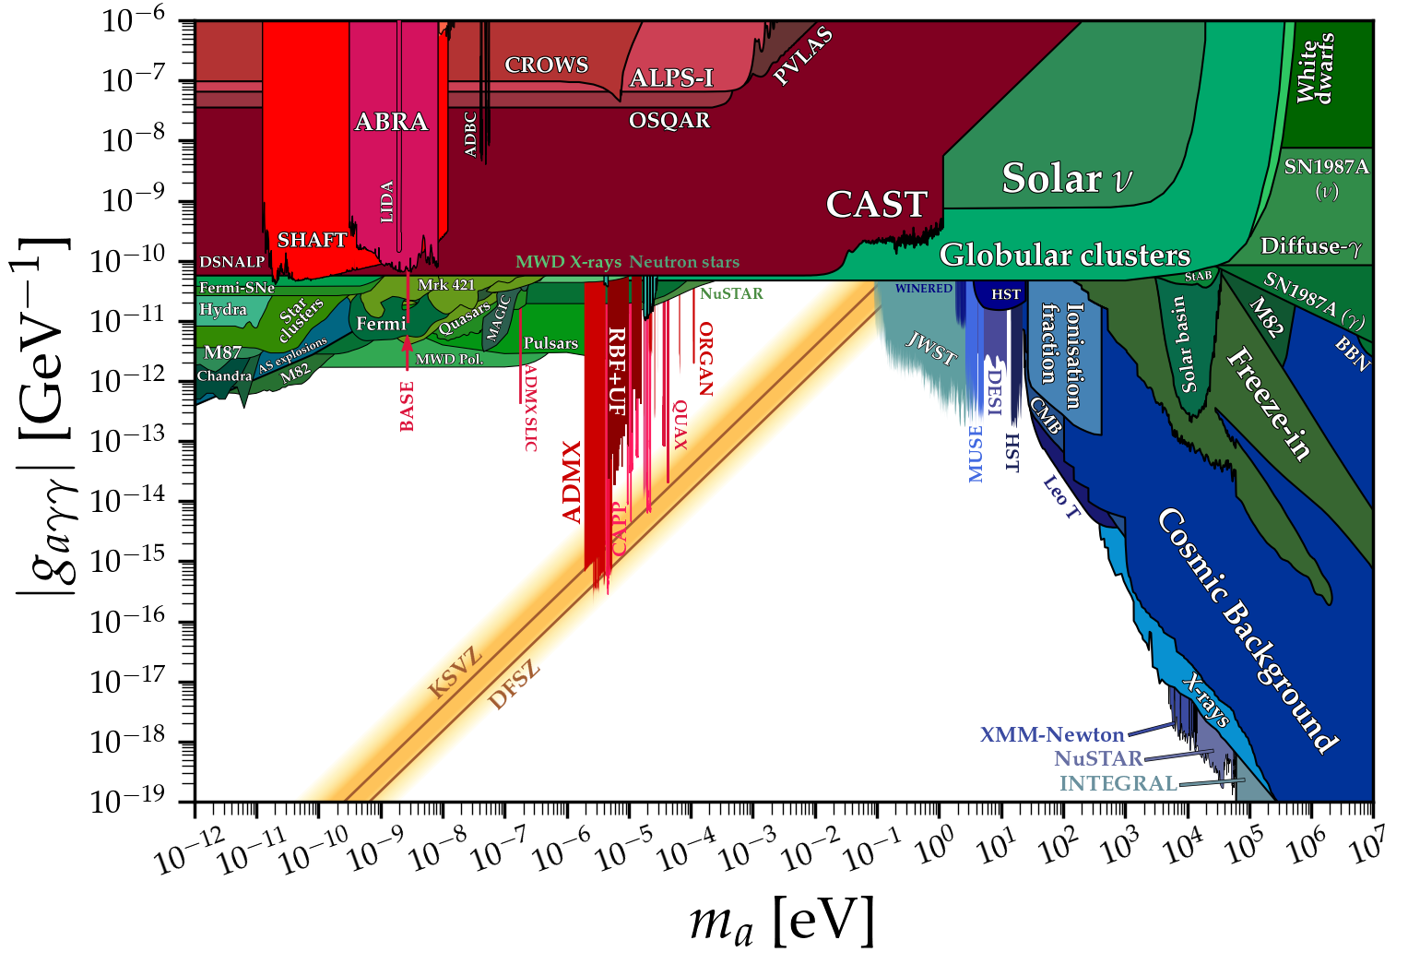
Grand Unified ALP Scape
Ciaran O'Hare @ Github

Slide 17
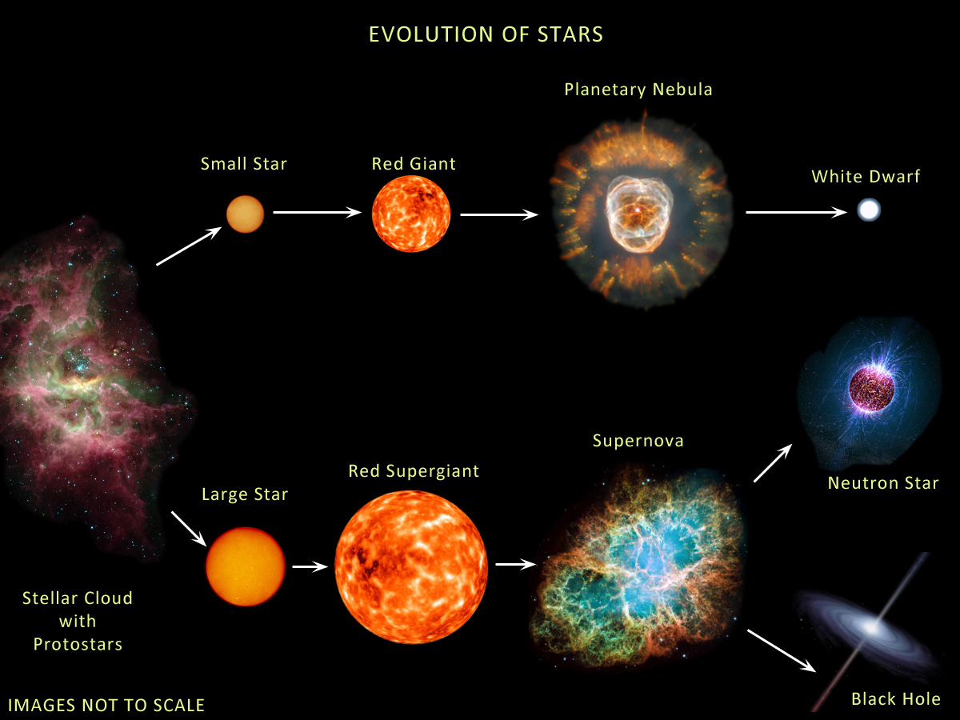





Evolution of Stars
Compact
Remnants:
$$M≲8 M_{⊙}$$
$1 M_{⊙}=2×{10}^{30}$kg
$$M∼0.6 M_{⊙}$$
R $∼$5000 km
$M$ = 1–2$M_{⊙}$
R $∼$12 km
$$M≳8 M_{⊙}$$
few-tens $M_{⊙}$
few km
BR ≈ 25% (?)
http://earthspacecircle.blogspot.com/2013/07/stellar-evolution.html

Slide 18
Evolution of Stars
Particles from the Sun:
• Direct search
• Back-reaction on Sun
• Number counts in globular clusters
• Brightness of tip of red-giant branch (TRGB)
• White dwarf luminosity function
• Period decrease of variable WDs
• WD Initial-final mass function
• EoS w/ axions
DM axion conversion in
pulsar magnetosphere
• Nus from SN 1987A & future SN
• Explosion energy
• Radiation from all past SNe
• Cooling speed
• EoS w/ axions
Superradiance
Core-collapse supernova

Slide 19
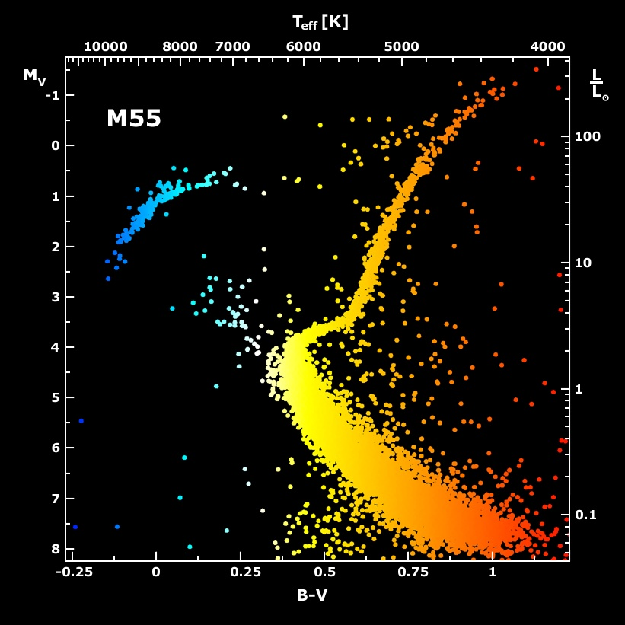
Galactic Globular Cluster M55

Slide 20
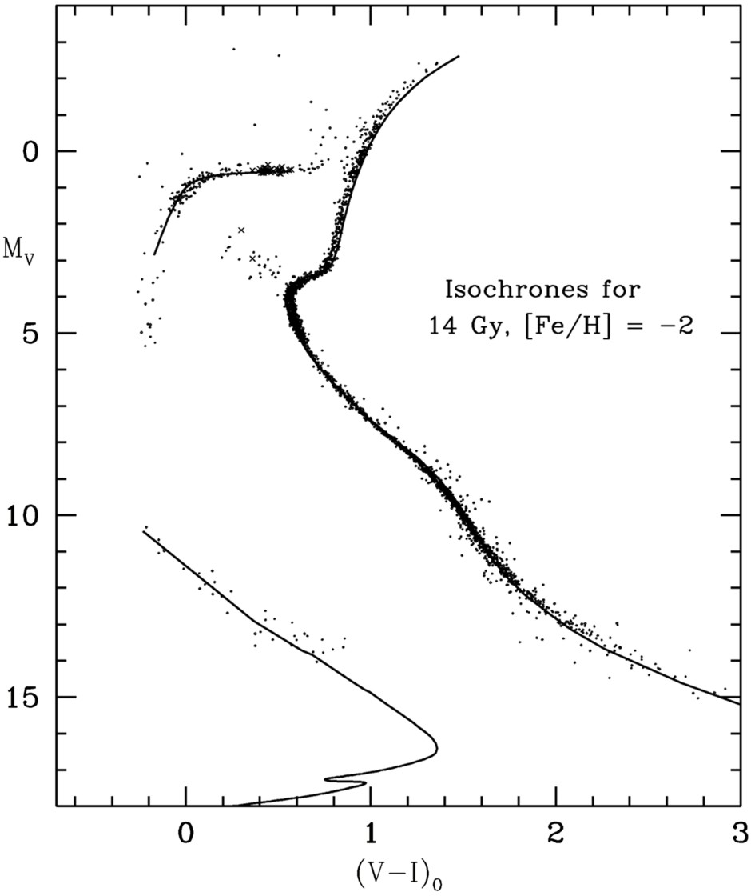
Color-Magnitude Diagram for Globular Clusters
Hot, blue
cold, red
Color-magnitude diagram synthesized from several low-metallicity globular
clusters and compared with theoretical isochrones (W.Harris, 2000)

Slide 21
Color-Magnitude Diagram for Globular Clusters
H
H
He
C O
He
Asymptotic Giant
Red Giant
H
H
He
C O
White
Dwarfs
Horizontal Branch
Main-Sequence
Hot, blue
cold, red
Color-magnitude diagram synthesized from several low-metallicity globular
clusters and compared with theoretical isochrones (W.Harris, 2000)

Slide 22
Color-Magnitude Diagram for Globular Clusters
H
Particle emission
delays He ignition, i.e.
core mass increased
H
He
C O
He
Asymptotic Giant
Red Giant
H
H
He
C O
White
Dwarfs
Horizontal Branch
Main-Sequence
Hot, blue
cold, red
Color-magnitude diagram synthesized from several low-metallicity globular
clusters and compared with theoretical isochrones (W.Harris, 2000)

Slide 23
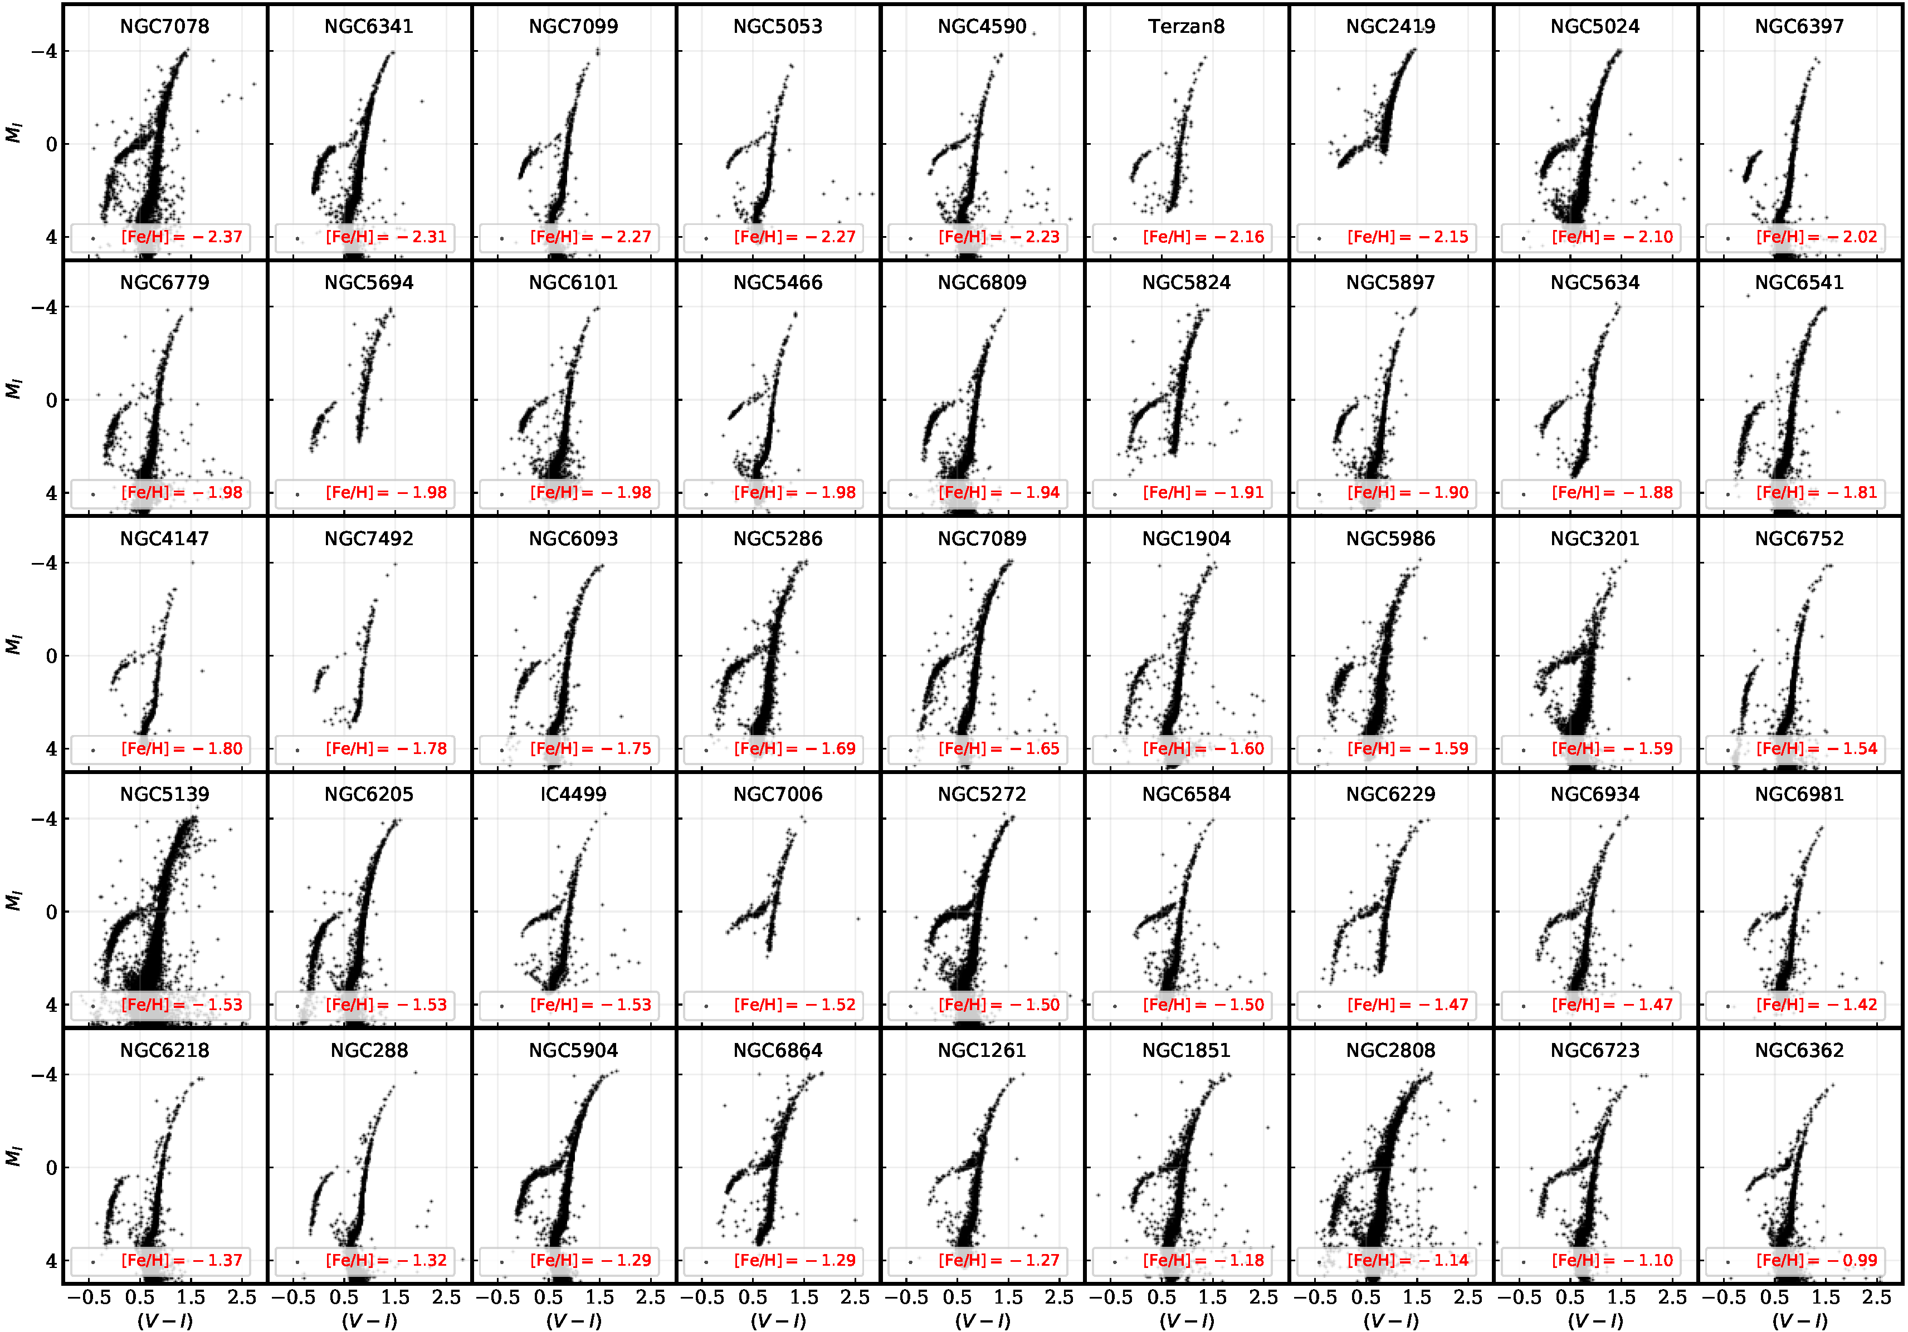
TRGB in 46 Globular Clusters [Cerny+ 2012.09701]

Slide 24

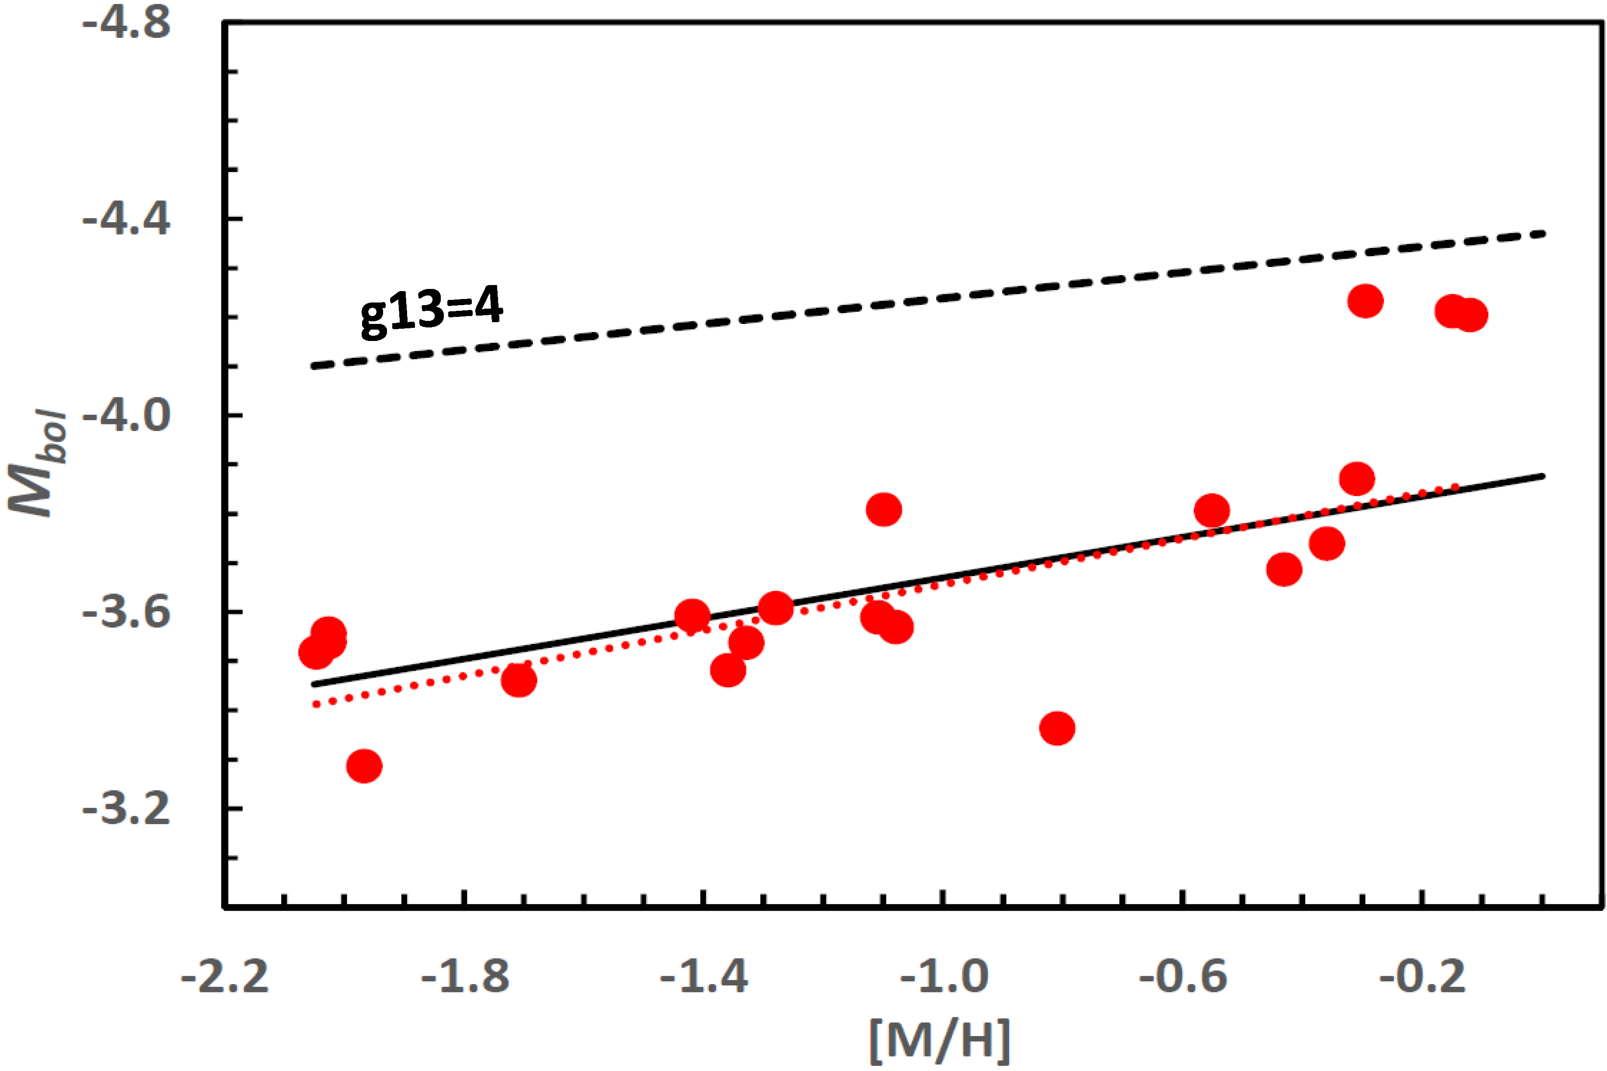
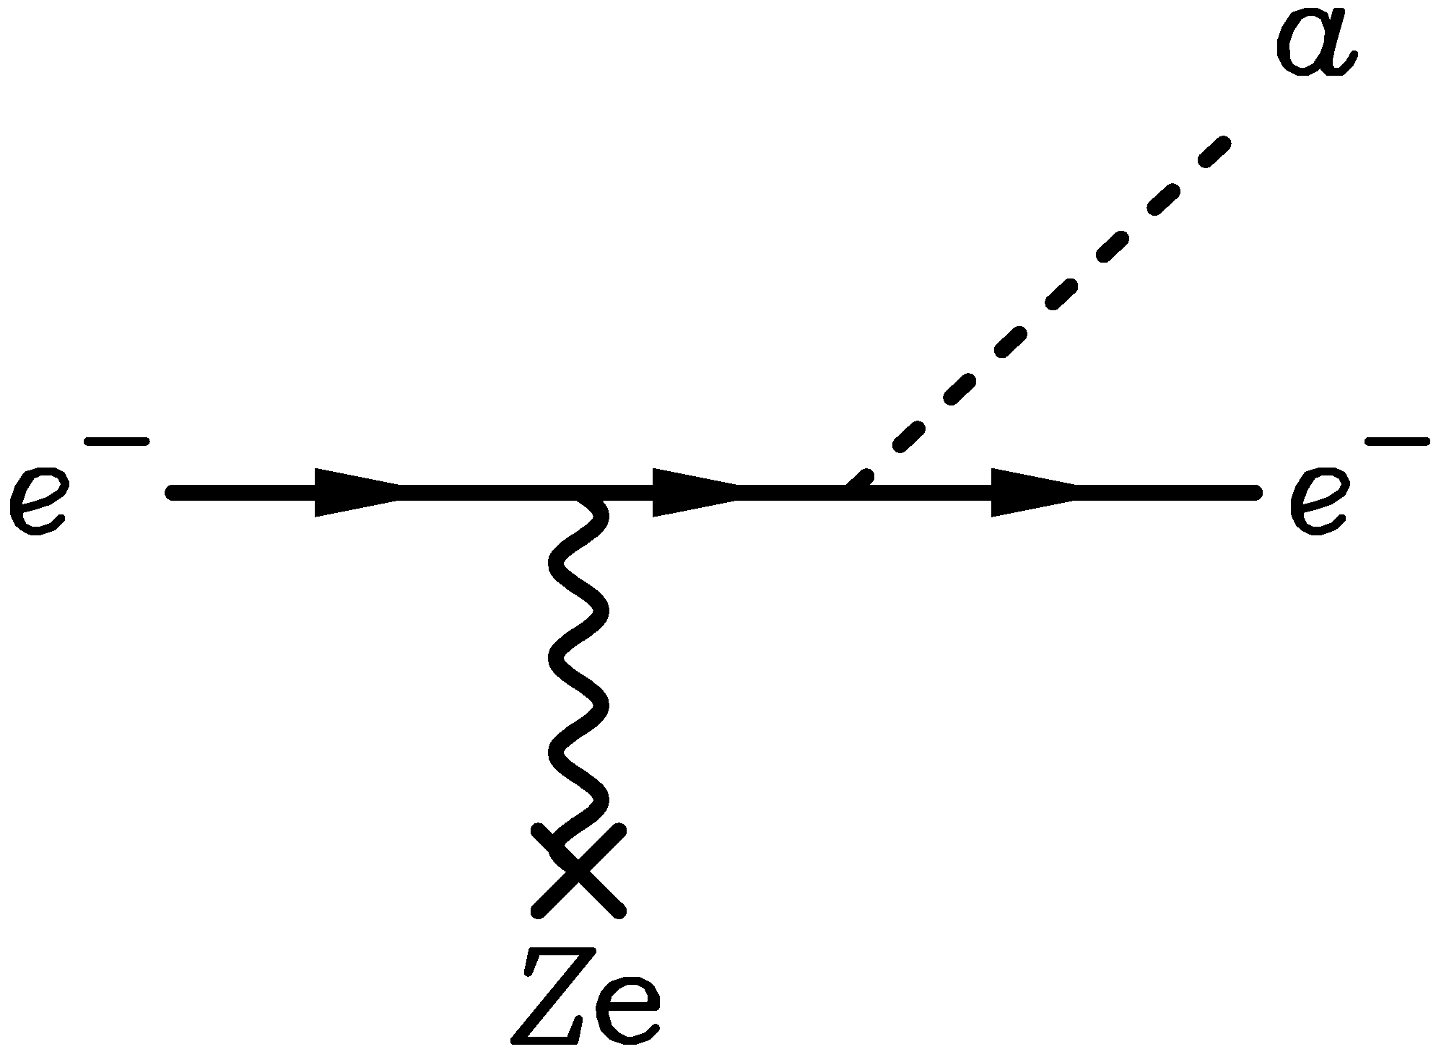
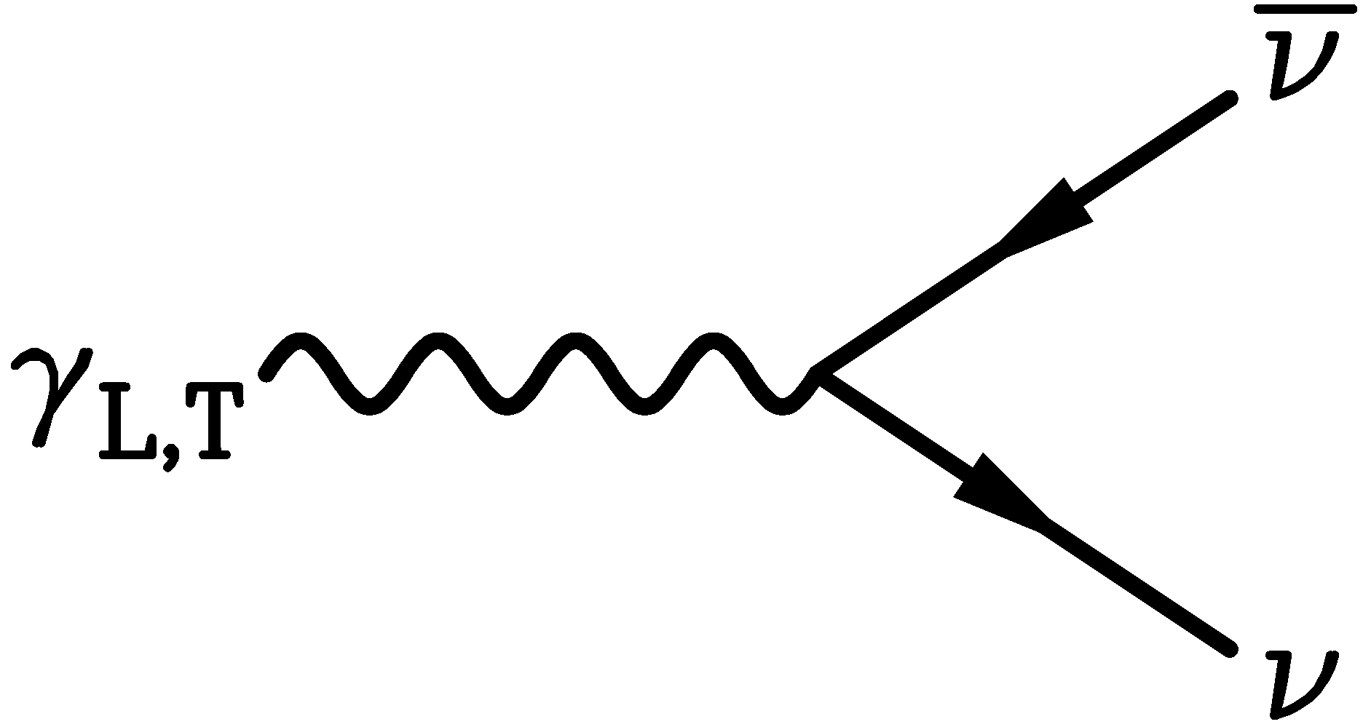
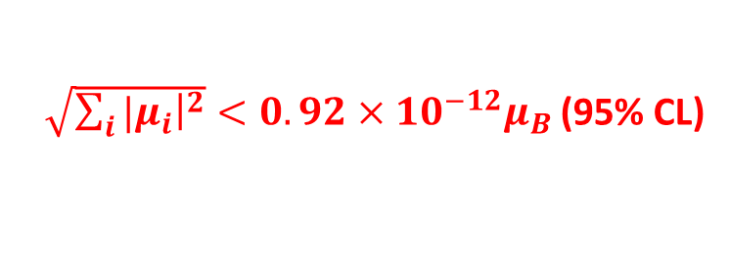
New TRGB Calibration from 21 Globular Clusters
Straniero+ arXiv:2010.03833 and https://www.ggi.infn.it/talkfiles/slides/slides6554.pdf
Emission of axions & friends
with direct electron coupling
$$g_{ae}$$
Theoretical Prediction
TRGB in 21 GCs
$g_{ae}<0.96×{10}^{−13}$ (95% CL)
Bremsstrahlung emission by
degenerate electrons
Metallicity [M/H]
Estimated bound for neutrino dipole moments
Plasmon decay
$\sqrt{\sum_{i}{{|μ}_{i}{\left.​\right|}^{2}}}<0.92×{10}^{−12}μ_{B}$ (95% CL)

Slide 25



Bounds on neutrino dipole moments
XENONnT, arXiv:2207.1133
Solar
Neutrinos
Latest Globular Cluster

Slide 26



Hubble Tension
See also Riess+
arXiv:2112.04510
Freedman ApJ 919 (2021) 16 [2106.15656]
Di Valentino+ arXiv:2103.01183

Slide 27


Tip of the Red-Giant Branch in the Galaxy NGC 4258
I-Band Brightness (HST)
Color (HST Filters)
NGC 4258 hosts a water megamaser
→ Quasi-geometric distance determination
Among the best absolute TRGB calibrations
One rung in cosmic distance ladder

Slide 28
Evolution of Stars
Compact
Remnants:
$$M≲8 M_{⊙}$$
$1 M_{⊙}=2×{10}^{30}$kg
$$M∼0.6 M_{⊙}$$
R $∼$5000 km
$M$ = 1–2$M_{⊙}$
R $∼$12 km
$$M≳8 M_{⊙}$$
few-tens $M_{⊙}$
few km
BR ≈ 25% (?)
http://earthspacecircle.blogspot.com/2013/07/stellar-evolution.html

Slide 29



Crab Nebula – Remnant of SN 1054
Crab Nebula – Remnant of SN 1054
Crab Pulsar
Chandra X-ray composite image

Slide 30
Stellar Collapse and Explosion
Progenitor Star
Iron Core − “White Dwarf”
Collapsed Core
Shells not to scale
Mass ≈ 1.5 M⊙
Nuclear density (3×10¹⁴ g cm⁻³)
Hydrogen
Helium
Carbon
Neon
Oxygen
Silicon
Iron
Bounce
Shock
$$ν \overline{ν}$$
6×10⁸ km
6000 km
60 km
Gravitational binding energy
E_{b} ≈ 3 × 10⁵³ erg ≈ 15% M_{SUN} c²
This shows up as
99% Neutrinos
1% Kinetic energy of explosion
0.01% Photons, outshine host galaxy

Slide 31

Delayed (Neutrino-Driven) Explosion
Infall
Accretion
Explosion
Shock
Wilson, Proc. Univ. Illinois Meeting on Num. Astrophys. (1982)
Bethe & Wilson, ApJ 295 (1985) 14

Slide 32


Roles of Different Forms of Radiation
Radiative transfer
Short mean free
pass (mfp)
Photon
radiation
from surface
Neutrino diffusive
transport
Neutrino emission
from “neutrino sphere”
Thermal graviton
emission (large mfp)
R_{core} ~ few 10 km
R_{star} ~ 10⁹ km
32
Invisibles Workshop, CERN, 1 Sept 2025
Georg Raffelt, MPI Physics, Garching

Slide 33

Impact of New Particles
Next Generation Large-Scale Detectors (2020+)
Progenitor Star
Energy and lepton transport
within PNS
PNS
Energy transport beyond neutrino sphere
(directly or decay products)
• Explosion
• Nucleosynthesis
Detection (direct or decay products)
• SN 1987A, next nearby SN
• Diffuse background from all past SNe

Slide 34




Supernova Bounds on Radiative Particle Decays
Low-E SNe provide
best constraints
Caputo+
arXiv:2201.09890
Adds to
Explosion
energy
Collapsed
SN core
Cosmic gamma ray background
from all past supernovae
Solar Maximum Mission
Progenitor
mantle
No excess gamma rays
@ SN 1987A neutrino burst

Slide 35

Gravitational-Wave Signatures of New Energy Transfer
• PNS convection stimulated by
novel heating at bottom of
convection layer
• Causes GW emission during
otherwise quiescent phase
shortly after core bounce
• Testing BSM forms of energy
transfer with GWs from next SN
Ehring, Abbar, Janka, Raffelt, Nakamura & Kotake, arXiv:2412.02750

Slide 36

Cooling the Shock: SN Bounds on Dark Photons
Pic Yun/Janka
• Plasma frequency in “gain layer” 100–400 keV
• Resonant conversion Plasmon → Hidden Photon
• Drains energy from “gain” layer
Caputo, Janka, Raffelt & Yun, PRL, arXiv:2502.01731

Slide 37


Supernova 1987A
Supernova 1987A
23 February 1987

Slide 38



Do Neutrinos Gravitate?
Early light curve of SN 1987A
Shapiro time delay for particles
moving in a gravitational potential
$Δt=−2\int_{A}^{B}{dt}Φ\left[r\left(t\right)\right]$
For trip from LMC to us, depending
on galactic model,
$Δt≈1$–5 months
Neutrinos and photons respond to
gravity the same to within
1–$4×{10}^{−3}$
Longo, PRL 60:173, 1988
Krauss & Tremaine, PRL 60:176, 1988
• Neutrinos arrived several hours
before photons (as expected)
• Transit time for $ν$ and $γ$ same
($160.000$ yr) within a few hours

Slide 39


GW vs Gamma-Ray Shapiro Time Delay
ApJ Lett. 848 (2017) L12
NS-NS Merger
• GW170817
• GRB 170817A
GWs & $γ$ arrive within 2 s
Equal Shapiro time delay
within $∼10^{−7}$
(Shoemaker & Murase
arXiv:1710.06427)

Slide 40

Supernova 1987A Energy-Loss Argument
SN 1987A neutrino signal
Neutrino
sphere
Volume emission
of new particles
Neutrino
diffusion
Emission of very weakly interacting
particles would “steal” energy from the
neutrino burst and shorten it.
(Early neutrino burst powered by accretion,
not sensitive to volume energy loss.)
Late-time signal most sensitive observable

Slide 41


Axion Emission from a Nuclear Medium
Axion-nucleon interaction: $ℒ_{int}=\frac{C_{N}}{2f_{a}} {\overline{Ψ}}_{N}γ_{μ}γ_{5}Ψ_{N}∂^{μ}a=\frac{C_{N}}{2f_{a}}J_{μ}^{A}∂_{a}^{μ}$
a
N
N
+ ...
Axial-vector interaction implies
dominance of spin-dependent process
V
N
N
Nucleon-Nucleon
Bremsstrahlung
• Interaction potential (one-pion exchange OPE was often used, but too simplistic)
→ Carenza+ arXiv:1906.11844
• In-medium coupling constants → Springmann+ arXiv:2410.10945
• In-medium effective nucleon properties
• Correlation effects (static and dynamical spin-spin correlations)
• Thermal $π^{−}$ contribute significantly (dominantly?) → Carenza+ arXiv:2010.02943
$$π^{−}$$
a
p
n
Axion emission is a complicated nuclear physics problem, for several issues see
Fiorillo, Gil Muyor, Janka, Raffelt & Vitagliano, work in progress

Slide 42




SN 1987A Axion Limits from Burst Duration
• Raffelt, Lect. Notes Phys. 741 (2008) 51 hep-ph/0611350
Burst duration calibrated by early numerical studies
“Generic” emission rates inspired by OPE rates
$f_{a}≳4×{10}^{8} GeV$ and $m_{a}≲16 meV$ (KSVZ, based on proton coupling)
• Chang, Essig & McDermott, JHEP 1809 (2018) 051 1803.00993
Various correction factors to emission rates, specific SN core models
$f_{a}≳1×{10}^{8} GeV$ and $m_{a}≲60 meV$ (KSVZ, based on proton coupling)
• Carenza, Fischer, Giannotti, Guo, Martínez-Pinedo & Mirizzi,
JCAP 10 (2019) 016 & Erratum 1906.11844
Beyond OPE emission rates, specific SN core models: similar to Chang et al.
$f_{a}≳4×{10}^{8} GeV$ and $m_{a}≲15 meV$ (KSVZ, based on proton coupling)
• Carenza, Fore, Giannotti, Mirizzi & Reddy 2010.02943
Including thermal pions $π^{−}+p→n+a$ (factor 3 larger emission)
$f_{a}≳5×{10}^{8} GeV$ and $m_{a}≲11 meV$ (KSVZ, based on proton coupling)
• Bar, Blum & D'Amico, Is there a supernova bound on axions? 1907.05020
Alternative picture of SN explosion (thermonuclear event)
Observed signal not PNS cooling. SN1987A neutron star (or pulsar) not yet found.
(but see “NS 1987A in SN 1987A”, Page et al. arXiv:2004.06078)

Slide 43


Where is the Neutron Star of SN 1987A?
No pulsar or neutron star has been seen until now (38 years later)
• Infra-red excess observed by ALMA: In “the blob” strong indication for NS
Expected position, remnant hidden by dust [Cigan+ arXiv:1910.02960]
• Most plausible model: Thermally cooling non-pulsar NS [Page+ arXiv:2004.06078]
https://www.bbc.com/news/science-environment-50473482
Atacama Large Millimeter/Submillimeter Array (ALMA) at ESO in Chile
1.5×10¹² km

Slide 44

SN 1987A Signal Duration Too Long?
Fiorillo+ arXiv:2308.01403
Expected Signal & BKG
Expected Signal & BKG
Expected Signal & BKG
Mysterious late events
● In a suite of Garching models (no axions), expected signal always too short
(PNS convection and reduced opacities by correlations!)
● Deserves dedicated study

Slide 45

(Near) Operational Detectors for Next SN Neutrinos
HALO (30)
SNO+ (300)
KM3NET
(3×10⁴)
LVD (300)
Baksan
(100)
Hyper-K (3×10⁴)
Super-K (4000)
KamLAND (300)
NovA
(4000 + BKG)
DUNE
(3000)
JUNO
(4000)
+ Other small
detectors
with some
SN sensitivity
In brackets events
for a “fiducial SN”
at distance 10 kpc
IceCube (10⁶)

Slide 46


Detecting Axions with Next Galactic Supernova?
Fermi-LAT
like satellites
Axion-photon
conversion in B field
of progenitor
Manzari+ arXiv:2405.19393
This figure:
Fiorillo, Gil Muyor,
Janka, Raffelt, and Vitagliano, in progress
For optimistic SN assumptions (distance, B field) QCD axion parameters reachable

Slide 47

Characteristics of Neutrino Signal
BSM Signature from the Next Galactic SN
Smoking gun signature:
Nearly any event in nearly any detector
coincident with neutrino burst
“Sneaking out directly from SN core”
• Gamma-rays (from decay or conversion)
• 100-MeV-range neutrinos
• Gravitational waves during quiescent phase
• Something unexpected

Slide 48

Astrophysical Axion Bounds
The 2024 Edition, Caputo & Raffelt, arXiv:2401.13728, 24 Jan 2024
See also Carenza, Giannotti, Isern, Mirizzi & Straniero, arXiv:2411.02492
GW231123
• Many improvements over the years, but overall picture the same
• Specific QCD axion signatures cannot come from cooling effects
• Best stellar detection opportunity probably (Baby)IAXO

Slide 49


Superradiance
Extraction of rotational energy
from spinning object by
low-frequency modes $ω<Ω$
of an external bosonic field
• Bosons with mass get
gravitationally bound
• Superradiant run-away mode
$φ=Y_{lm}\left(θ,φ\right)ψ_{lmn}\left(r\right)e^{Γt}$
• “Bosonic atom”
• Transitions → Gravitational waves
Superradiance: New Frontiers in Black Hole Physics (2020 edition)
R. Brito, V. Cardoso & P. Pani, 1501.06570v8 (8 Jan 2021)
Adapted from Jamie McDonald

Slide 50


Constraints from Black Hole Spins
Arvanitaki, Baryakhtar & Huang, 1411.2263

Slide 51

BH Spins from Binary Merger GW231123
LIGO-Virgo-KAGRA observed GWs from BH-BH merger GW231123
${137}_{−17}^{+22}M_{⊙}$ and ${103}_{−52}^{+20}M_{⊙}$ with large spins
New super-radiance bounds
on scalar boson masses
Caputo, Franciolini & Witte
arXiv:2507.21788 (29 July 2025)
Aswathi, East, Siemonsen, Sun & Jones
arXiv:2507.20979 (28 July 2025)

Slide 52


Astrophysical Axion Bounds and Opportunities
m_{Planck}
f_{a}
10¹⁸
10¹⁵
10¹²
10⁹
10⁶
GeV
peV
neV
μeV
meV
eV
m_{a}
Super
Radiance
Opportunities for detection
Astrophysical Bounds
(Energy loss of stars)
$γ$ from
next
SN
Black
Hole
IAXO Solar
Axion Telescope
Axion conversion in neutron star magnetospheres

Slide 53
Thanks
Solar Axions
Globular Clusters
Supernova 1987A
Neutron Stars
Gravitational Waves
Thanks!

Slide 54
Thanks

Slide 55
End
Bonus
Topics

Slide 56

Flavor Conversion in Core-Collapse Supernovae
Next Generation Large-Scale Detectors (2020+)
MSW region
• Adiabatic flavor
conversion
• Flavor eigenstates are
propagation eigenstates
• Flavor oscillations suppressed
(Wolfenstein 1979)
• “Slow” self-induced
flavor conversion?
(Spectral splits …)
$$ν, \overline{ν}$$
Neutrino
sphere
• Fast self-induced
flavor conversion by
$ν$-$ν$ refraction?
(Flavor equilibration?)
Shock wave

Slide 57


Large Extra Dimensions
Fundamentally, space-time can have more than
4 dimensions (e.g. 10 or 11 in string theories)
If standard model fields are confined to
4D brane in (4+n) D space-time, and only gravity
propagates in the (4+n) D bulk,
the compactification scale could be macroscopic

Slide 58


Supernova 1987A Limit on Large Extra Dimensions
Cullen & Perelstein, hep-ph/9904422, Hanhart et al., nucl-th/0007016
SN core emits large flux of
KK gravity modes by
nucleon-nucleon bremsstrahlung
$$\text{Rate}∝M_{Pl}^{−2}$$
Large multiplicity of modes
$$RT∼{10}^{11}$$
for R ∼ 1 mm, T ∼ 30 MeV
$$\text{Rate}∝\frac{{\left(RT\right)}^{n}}{M_{Pl}^{2}}∝\frac{T^{n}}{M_{Pl}^{2+n}}$$
SN 1987A energy-loss argument:
R < 1 mm, M > 9 TeV (n = 2)
R < 1 nm, M > 0.7 TeV (n = 3)
Originally the most restrictive
limit on such theories, except
for cosmological arguments.
Other restrictive limits from
neutron stars.

Slide 59

Bounds from KK Decays
Gravitationally trapped KK cloud
NS
Decays:
• Gammas constrained by observations
• All decays keep old neutron stars hot
Hannestad & Raffelt, arXiv:hep-ph/0304029v3 (April 2025)
Large correction, important for viability for recent interest
in theories with 1 extra dimension, should be reexamined

Slide 60
Dark Matter Axion-Photon Conversion in
Neutron Star Magnetospheres
Dark matter axions
$m_{a}∼μeV$, $v_{a}∼{10}^{−3}c$
Pshirkov & Popov 2007
arXiv:0711.1264
Many papers recently
Very narrow
radio line
Axion mass and plasma frequency
Degenerate near NS surface
→ Resonant conversion

Slide 61



Axion Bounds from Breakthrough Survey
2202.08274
• Green Bank Telescope Archival Data
• Breakthrough Listen Project (Search for ET Life)
• State-of-the-art ray tracing simulations
• Galactic Center Region
− Many pulsars
− Enhanced dark matter density
100 m dish

Slide 62

Dark Matter Axion Radiowaves from Pulsars
2303.11792
This work
PSR J2144−3933
Galactic Center Pulsars
Breakthrough Listen
$$m_{a}/μeV$$
CAST
SKA forecast
Galactic Center Magnetar
SKA forecast
CAPP
ADMX

Slide 63

White Dwarfs
Luminosity (compared with Sun)
Surface Temperature (Kelvin)
https://www.eso.org/public/images/eso0728c/

Slide 64


White Dwarfs
20 km
200 km
6000 km
C/O core
He
H
if present
= DA WDs
Heat
Reservoir
Photon
emission
Energy flux control
Cooling much slower for
DA type (with H layer)
$R ≃6000 km$ (Size of the Earth)
$T_{eff}≃10,000$–$30,000K$ (Sun 6000 K)
$L ≃{10}^{−4}\text{–}{10}^{−1}L_{⊙}$
$$M ≃0.5\text{–}0.8M_{⊙}$$
$ρ ≃{10}^{6}g/cm^{3}$ (very degenerate)

Slide 65




Degenerate Stars (“White Dwarfs”)
Assume temperature very small
→ No thermal pressure
→ Electron degeneracy is pressure source
Pressure ~ Momentum density × Velocity
Electron density $n_{e}={p_{F}^{3}}/{\left(3π^{3}\right)}$
Momentum $p_{F}$ (Fermi momentum)
Velocity $v∝{p_{F}}/{m_{e}}$
Pressure $P∝p_{F}^{5}∝ρ^{5/3}∝M^{5/3}R^{−5}$
Density $ρ∝MR^{−3}$
Hydrostatic equilibrium
$$\frac{dP}{dr}=−\frac{G_{N}M_{r}ρ}{r^{2}}$$
With ${dP}/{dr}∼−P/R$ we have
$$P∝G_{N}MρR^{−1}∝G_{N}M^{2}R^{−4}$$
Inverse mass radius relationship
$R∝M^{−1/3}$
$$R=10,500 km {\left(\frac{0.6 M_{⊙}}{M}\right)}^{1/3}{\left(2Y_{e}\right)}^{5/3}$$
($Y_{e}$ electrons per nucleon)
For sufficiently large stellar mass $M$,
electrons become relativistic
Velocity = speed of light
Pressure
$$P∝p_{F}^{4}∝ρ^{4/3}∝M^{4/3}R^{−4}$$
No stable configuration
Chandrasekhar mass limit
$$M_{Ch}=1.457 M_{⊙} {\left(2Y_{e}\right)}^{2}$$

Slide 66










Chandrasekhar Mass for Particle Physicists
Degeneracy pressure balances gravity
• $N$ nucleons, nucleon mass $m_{N}$
• $M_{star}=N m_{N}$
$$E_{deg}≃−E_{grav}≃\frac{{GM}_{star}^{2}}{R_{star}}≃\frac{N^{2}m_{N}^{2}}{{m_{Planck}^{2}R}_{star}}$$
• Semirelativistic particles (mass $m$): $E_{F} ≃p_{F}≃m$
• Degeneracy energy: $E_{deg}≃Nm$
• Number density: $n ≃p_{F}^{3}≃m^{3}$
$$R_{star}≃\frac{m_{Planck}}{m_{N}m}$$
$$M_{star}≃m_{N}n≃\frac{m_{Planck}^{3}}{m_{N}^{2}}=3.75×{10}^{33}g≃M_{⊙}$$
$$M_{⊙}=2×{10}^{33}g$$
• Neutron Star (NS):
Degenerate particle: Nucleon, $m=m_{N}$
$$R_{NS}≃\frac{m_{Planck}}{m_{N}^{2}}=2.8 km$$
(in reality 12–14 km)
• White Dwarf (WD):
Degenerate particle: Electron, $m=m_{e}≃m_{N}/2000$
$$R_{WD}≃\frac{m_{Planck}}{m_{e}m_{N}}=\frac{m_{N}}{m_{e}}R_{NS}=5000 km$$

Slide 67








White Dwarf Luminosity Function (WDLF)
$$1$$
$$10^{−1}$$
$$10^{−2}$$
$$10^{−3}$$
$$10^{−4}$$
$$L/L_{⊙}$$
Stars formed in the past Gyr
Oldest
WDs
$$M_{bol}=4.74−\frac{5}{2}\log_{10}{\frac{L}{L_{⊙}}}$$
Mestel’s cooling law (photons)
Dip from neutrino
cooling
Miller Bertolami, Melendez, Althaus & Isern, arXiv:1406.7712

Slide 68

Axion Bounds from WD Luminosity Function
Limits on axion-electron coupling and mass limit in DFSZ model:
$g_{ae}≲3×{10}^{−13}$ $m_{a}\cos^{2}{β}≲10 meV$
Miller Bertolami, Melendez, Althaus & Isern, arXiv:1406.7712, 1410.1677
For extensions and review see: Isern, arXiv:2002.08069

Slide 69

Pulsating Stars
https://www.eso.org/public/images/eso0728c/
https://scienceatyourdoorstep.com/2021/01/04/what-are-variable-stars/

Slide 70




Non-Radial g-Modes
• Long period waves
(100 – 1000 s)
• Gravity is the restoring force
From a talk by J. Isern
• Period decreases as
the star cools
• Characteristic rate ${10}^{−15} s/s$
• Measures cooling speed
of a single star
$$\frac{d\log{Π}}{dt}∝−\frac{d\log{T}}{dt}$$

Slide 71




Pulsating White Dwarf G117–B15A
Kepler+ ApJ 254 (1982) 676
Kepler+ ApJ 906 (2021) 7
$$D=57.5±0.1 pc$$
$$T=12,400 K$$
$$M=0.69 M_{⊙}$$
Period 215.2 s
“Most stable optical clock”, slipped by 26 s (of 215.2 s period) in 45 years
$${\dot{P}}/P=\left(5.12±0.82\right)×{10}^{−15} s/s$$

Slide 72





G117–B15A Period Decrease: Hint for Axion Cooling?
Kepler+ ApJ 906 (2021) 7
Emission of axions & friends
with direct electron coupling
$$g_{ae}$$
Bremsstrahlung emission by
degenerate electrons
Case of DFSZ Axion
$$g_{ae}= 0.28×{10}^{−13} \frac{m_{a}\cos^{2}{β}}{meV}$$
Nominal cooling signal
$$g_{ae}=\left(5.7±0.6\right)×{10}^{−13}$$
$${\dot{P}}/P=\left(5.12±0.82\right)×{10}^{−15} s/s$$

Slide 73





White-Dwarf Bounds on Axion-Electron Coupling
0
1
2
3
4
5
6
7
$$\frac{g_{ae}}{{10}^{−13}}$$
NGC 4258
TRGB,
“Cooling hints” in strong
tension with TRGB limits
Probably issue of systematics
TRGB,
21 GCs
WDLF
$$\dot{Π}$$
L 19-2
$$\dot{Π}$$
PG1351+489
$$\dot{Π}$$
R548
$$\dot{Π}$$
G117-B15A
White Dwarfs as Physics Laboratories: Lights and Shadows, arXiv:2202.02052
J. Isern, S. Torres & A. Rebassa-Mansergas
Stellar Evolution Confronts Axion Models, arXiv:2109.10368
L. Di Luzio, M. Fedele, M. Giannotti, F. Mescia & E. Nardi

