Slide 1
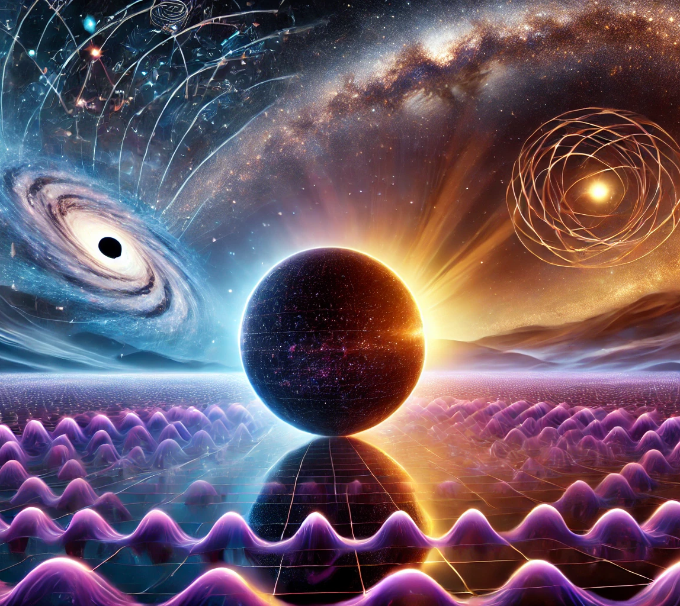

Dynamical Dark Energy: Insights from DESI and Quintessence
Invisibles25
September 2
George Alestas

Slide 2
Structure
A brief introduction to the DESI results
Evidence for dynamical dark energy
Quintessence as a possible candidate
The dangers of CPL

Slide 3
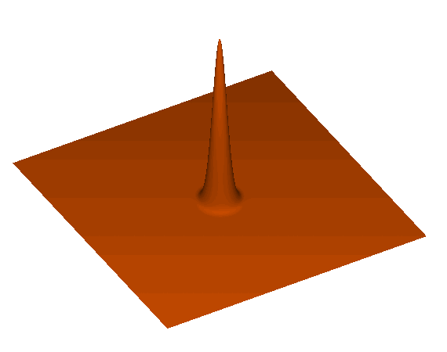
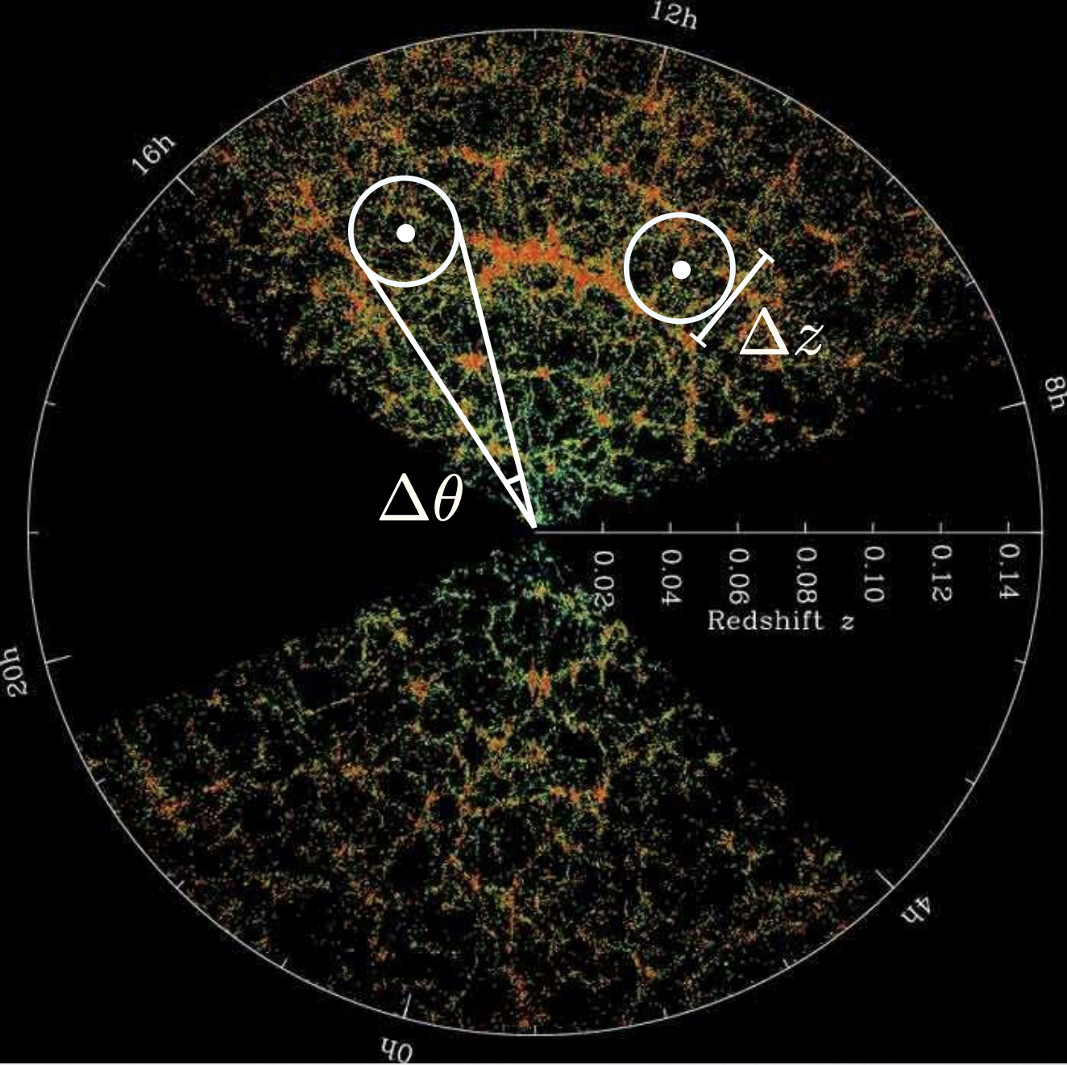
Baryon acoustic oscillations
Pre-recombination sound waves are propagating in the photon - baryon plasma
At z~1000 (recombination) baryons decouple from photons, the universe becomes transparent, the sound speed decreases and the wave stalls
There forms a spherical peak at the distance that the wave has travelled
This defines the sound horizon scale (r_{d}) (~150Mpc), which is measured precisely by the CMB
By measuring then the angular (Δθ) and redshift (Δz) separations we can infer the expansion rate of the Universe (H(z))

Slide 4
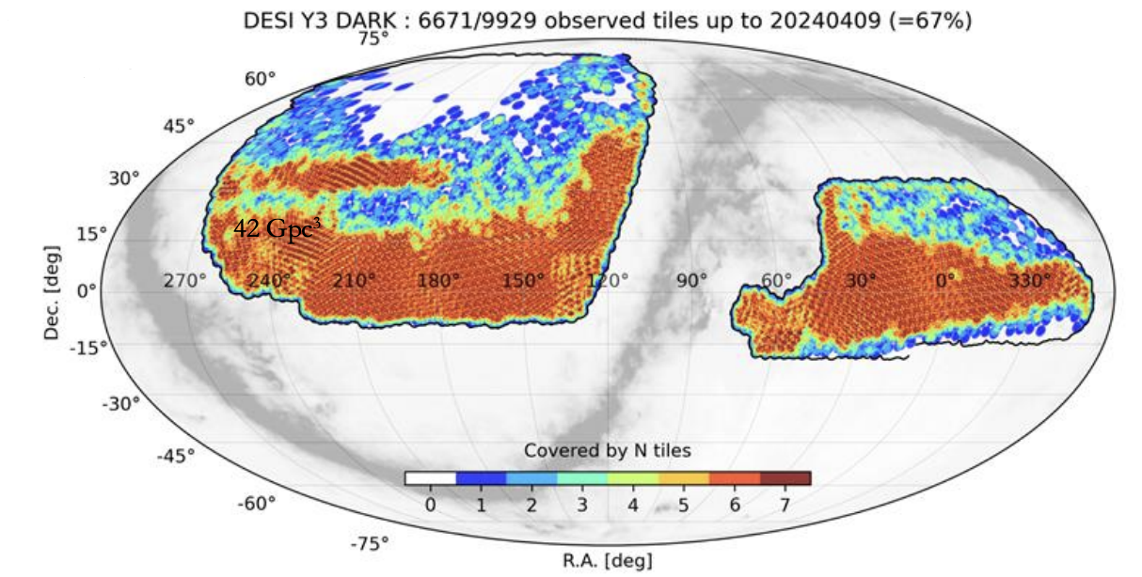
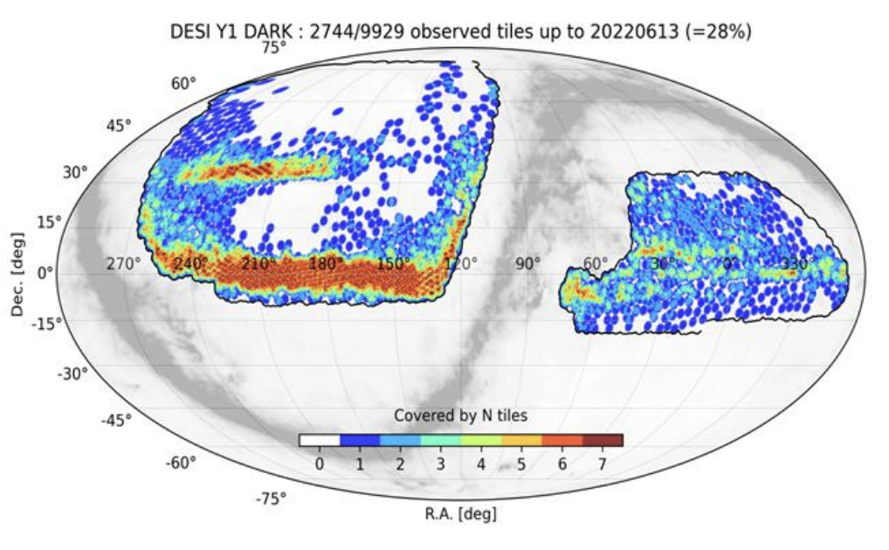
BAO precision leaps forward
DESI DR2 covers >14 million galaxies and quasars — doubling DR1’s dataset of ~6 million objects
It targets 40 million galaxies and quasars!

Slide 5
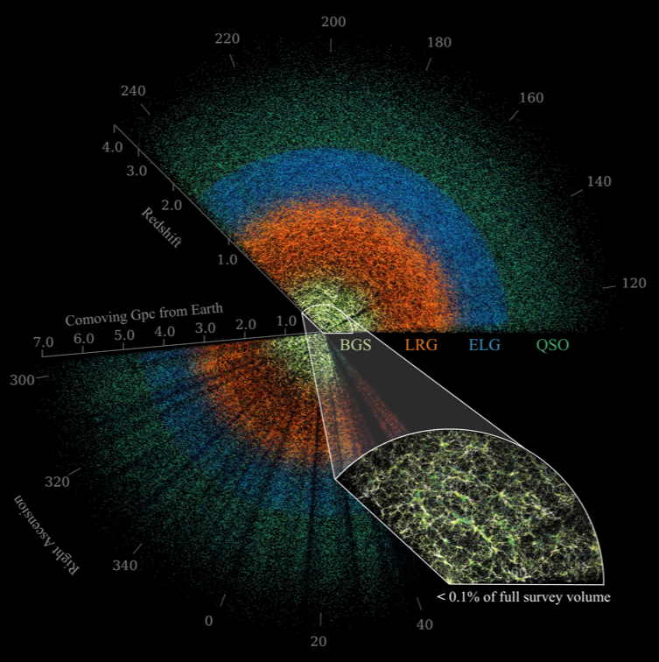
BAO precision leaps forward
Improvement in precision from ~0.5% (DR1) to ~0.28%
DESI data maps celestial objects from Earth (center) to billions of light years away.
Among the objects are nearby Bright Galaxies, Luminous Red Galaxies, Emission-Line Galaxies, and Quasars.

Slide 6

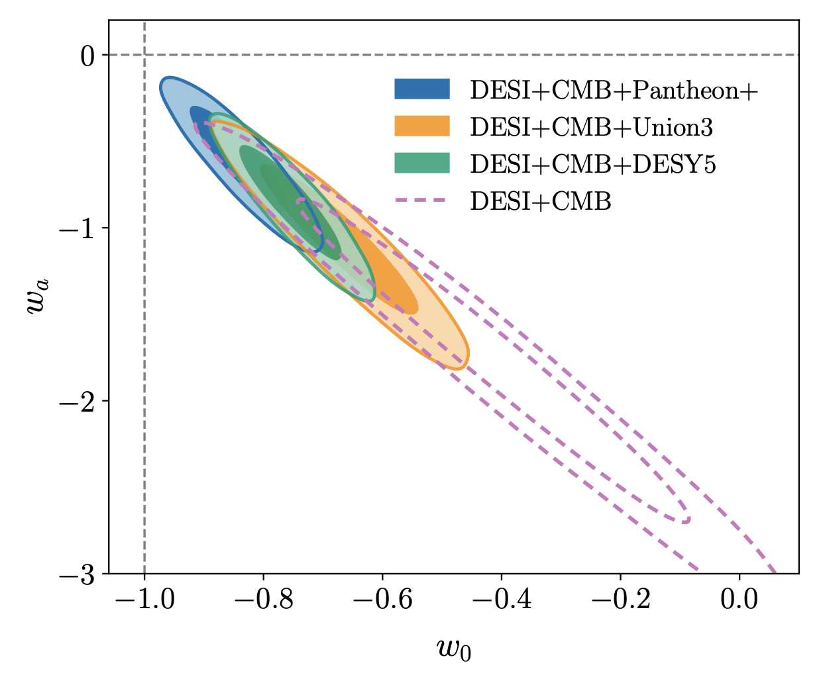
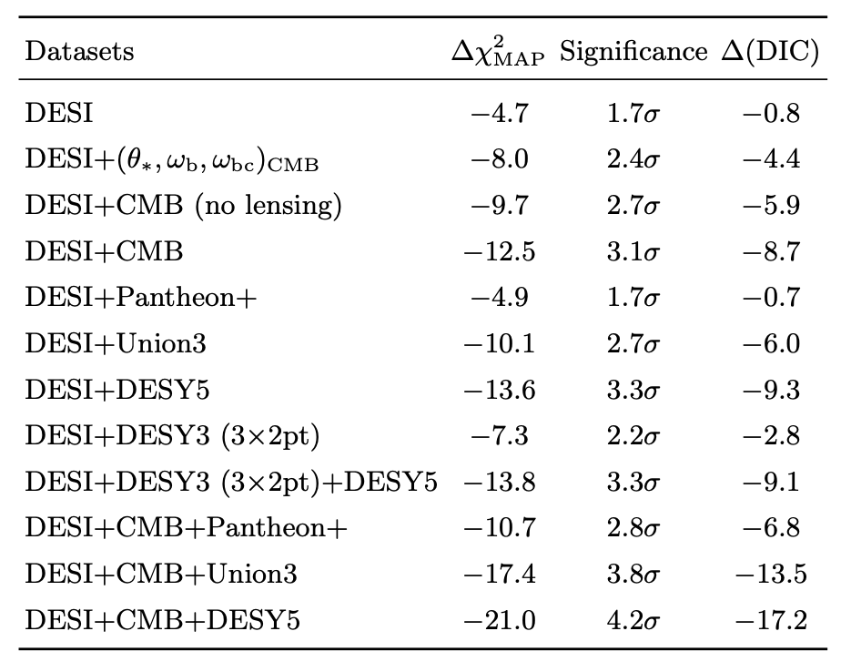
Tensions with ΛCDM – Dynamical DE
DESI DR2 BAO distances are slightly lower at z < 1 than expected under Planck-based ΛCDM
When combined with CMB data, they reveal a 3.1σ preference for dynamical dark energy over ΛCDM, based on the CPL parametrization
DESI, arXiv:2503.14738

Slide 7
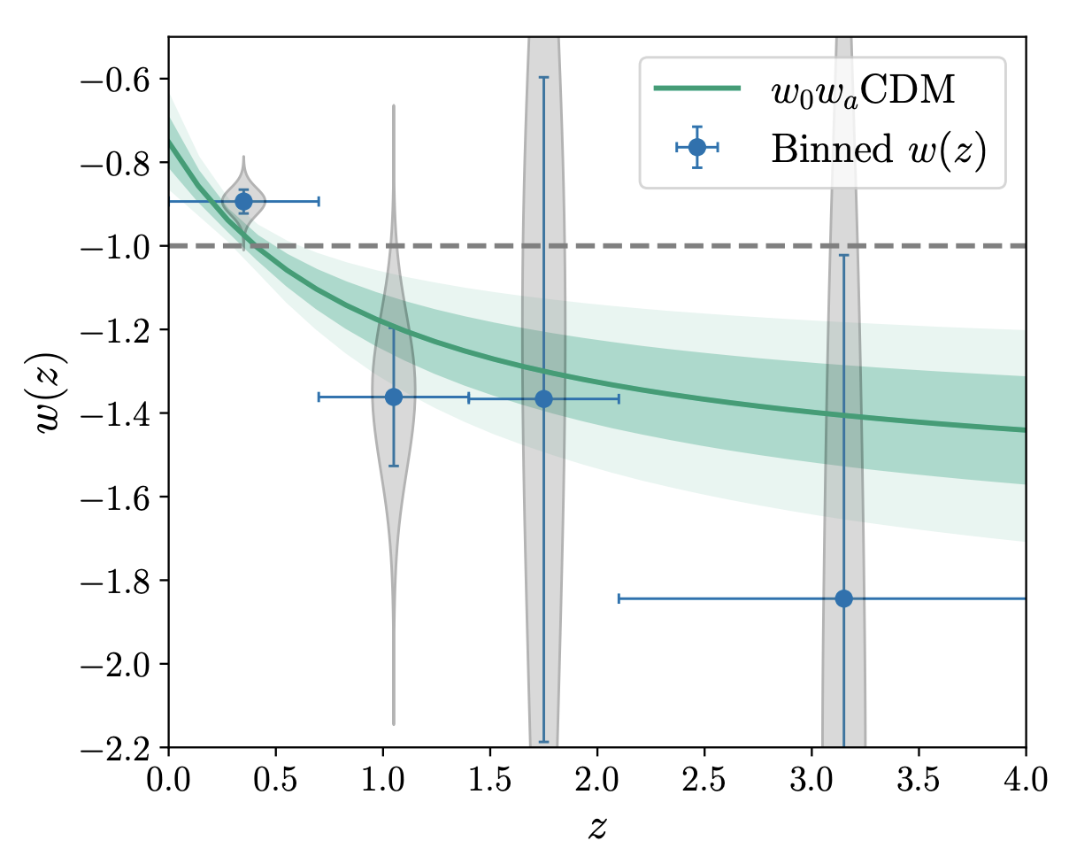
Tensions with ΛCDM – Dynamical DE
Although the statistical significances from all data depend somewhat on the choice of SNe dataset included, even the weakest of them (the DESI+CMB+Pantheon⁺ combination) is still nearly 3σ, and the significance is 3.1σ even when excluding all SNe data altogether (DESI+CMB)
In all cases, the favored w(z) shows a phase of w > −1 at low redshifts and a phantom crossing to w < −1 above redshifts z ≃ 0.4.
Comparison of the constraints on the equation of state of dark energy using the CPL parametrization and a binning reconstruction approach, using DESI+CMB+DESY5.
There seems to be an indication that a phantom crossing of the w(z) is needed in order to better fit the data.
DESI, arXiv:2503.14738

Slide 8
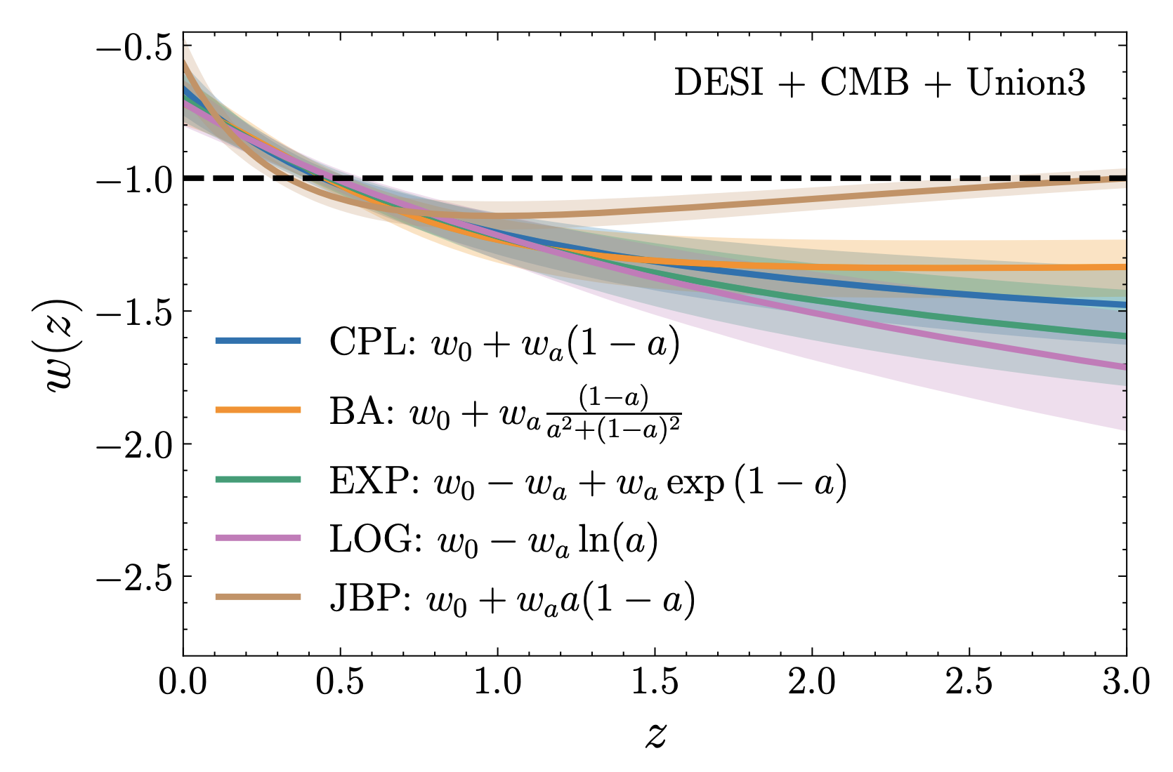
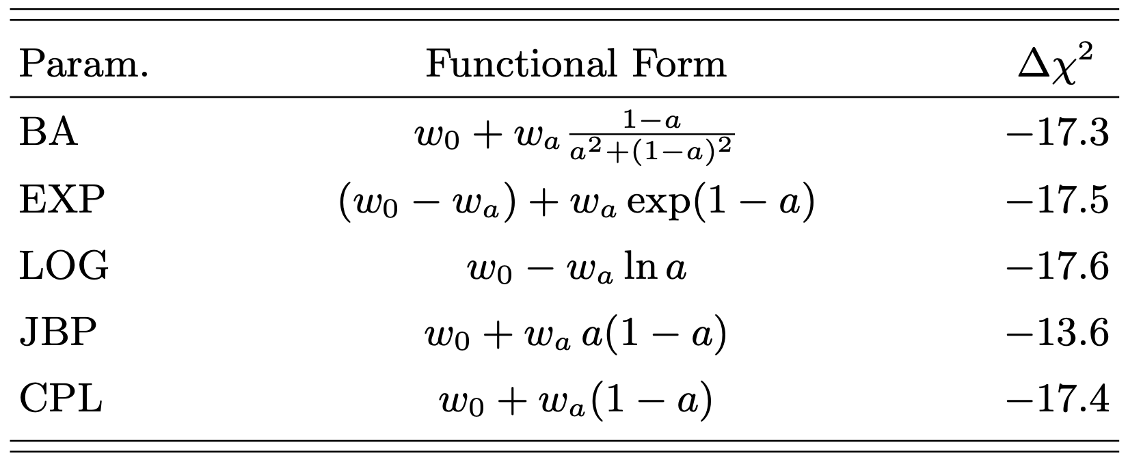
Alternative w(z) Parametrizations
Some alternative w(z) parametrizations were considered, all of them provide statistically comparable fits to the data according to their Δχ² with respect to ΛCDM.
This suggests that current data lacks the sensitivity to distinguish between these parameterizations at z > 2, regardless of the different SNe Ia datasets used.
DESI, arXiv:2503.14743
These are all effectively low-redshift parametrizations that behave almost exactly like the CPL parametrization at low redshifts

Slide 9
Could a physical model like Quintessence be a good fit?

Slide 10
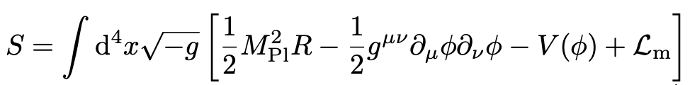
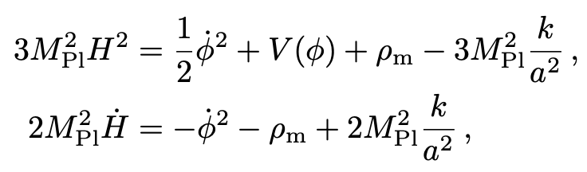
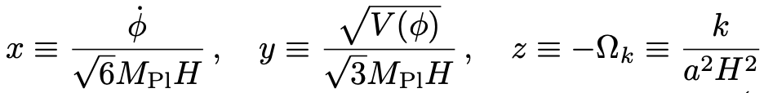
Curvature-assisted Quintessence
The action for a canonical scalar field ϕ minimally coupled to gravity and in the presence of non-relativistic matter (composed of baryonic and cold dark matter) is given by
In the context of a FLRW metric the Friedmann equations are
We define the following dimensionless variables

Slide 11

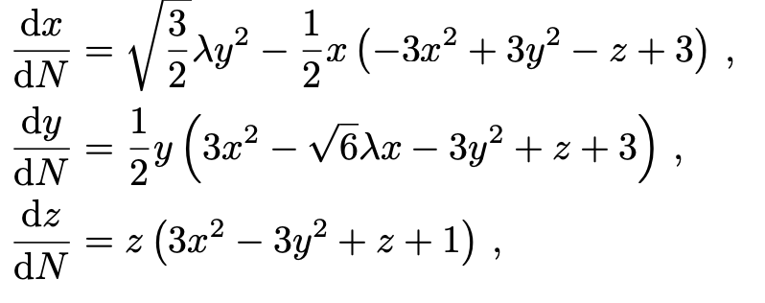
Curvature-assisted Quintessence
So, for an exponential potential the evolution of our dynamical system can be described by
Before proceeding to fit this model to the DESI data it is interesting to see whether the solution of this system produces viable cosmological histories with a long period of accelerated expansion for
λ > √2 for k = -1
If true it is could allow us to embed a realistic cosmology in the asymptotic limit of moduli
space, where string theory is under perturbative control.
String theorists say it is possible.

Slide 12
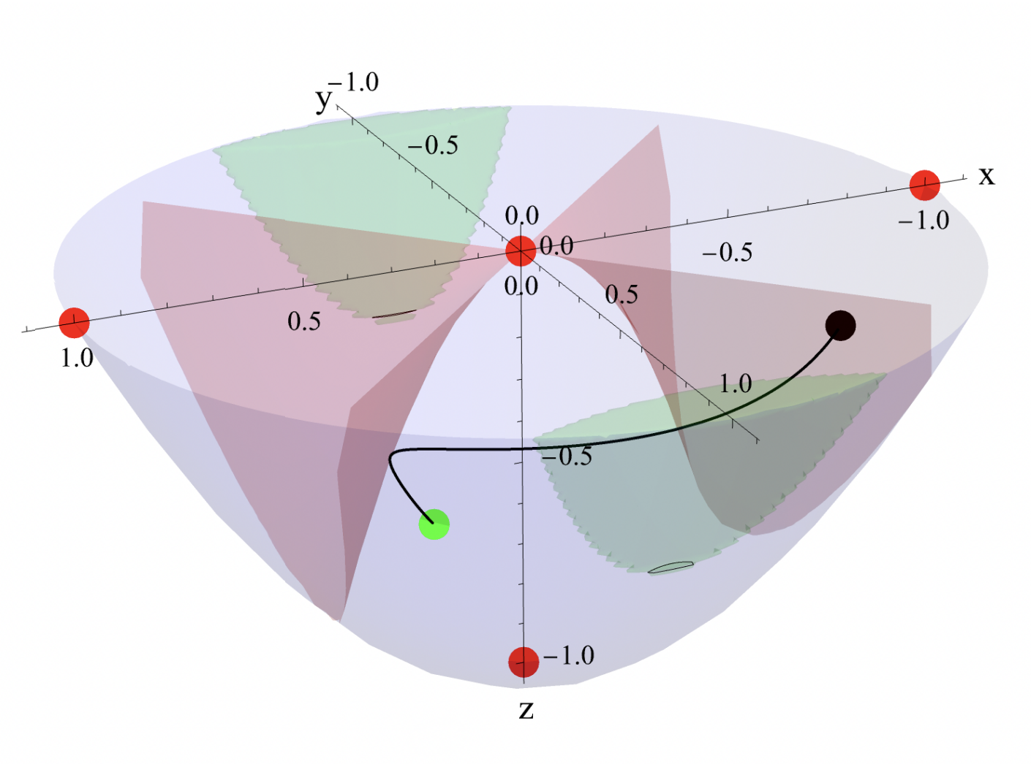
Curvature-assisted Quintessence
The phase space of the dynamical system described for a hyperbolic (or open) universe (i.e., for
k = −1). The paraboloid corresponds to the first Friedmann equation with Ω_{m} = 0. Trajectories that pass through the green areas experience accelerating expansion with w_{eff} ∈ [−1, −0.7], while the red regions correspond to w_{eff} = 0 (i.e., matter domination).
The red and green dots show the relevant fixed points of the system and correspond, respectively,
to unstable and attractor solutions. For the example of λ = 1.6 the attractor point behaves like a node,
as shown by the indicative trajectory (black curve), where the black dot shows the initial conditions.

Slide 13
Curvature-assisted Quintessence
We perform a numerical grid analysis of the phase space, to see whether we can have
cosmologically viable trajectories with large values of λ and non-zero curvature. Their viability is determined by whether they satisfy the following 2 conditions,
They should provide an extended matter domination phase before the onset of cosmic acceleration.
Yield an effective equation of state parameter, w_{eff}, that is ∼ −0.7 at the present time, compatible with the ΛCDM model.
We solve the system of differential equations for different initial conditions, i.e., for different initial values of the three phase space variables {x, y, z}, and then study the behaviour of the cosmological background solution in each case.
To do this we perform a fine grid scan of the entire phase space contained within the blue paraboloid defined as x² + y² − z ≤ 1. We compute all the trajectories for the different sets of initial conditions and keep only the ones that provide an epoch of w_{eff} ≤ −0.7, i.e., solutions which go through the green regions.

Slide 14
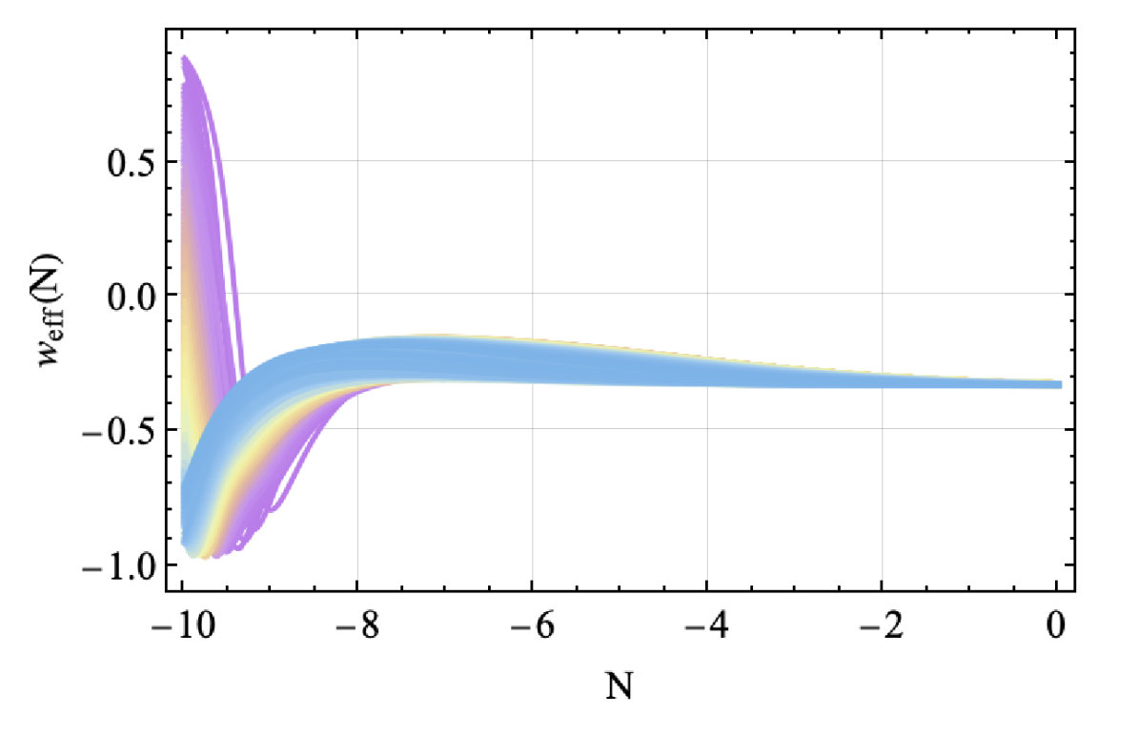
Curvature-assisted Quintessence
The evolution of w_{eff} as a function of the number of e-folds N for quintessence with λ = 1.6 and for trajectories that provide an epoch of w_{eff} ≤ −0.7, these trajectories exhibit late-time accelerated expansion consistent with cosmological observations but do not contain a matter domination epoch.
In other words, none of the solutions stay within the red regions for a sufficiently long time.

Slide 15
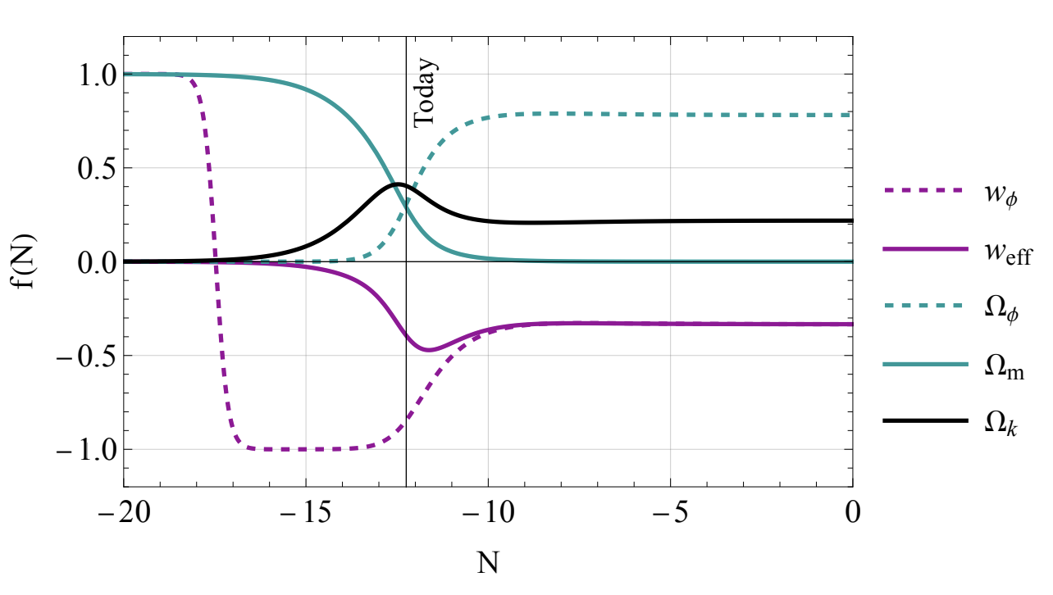
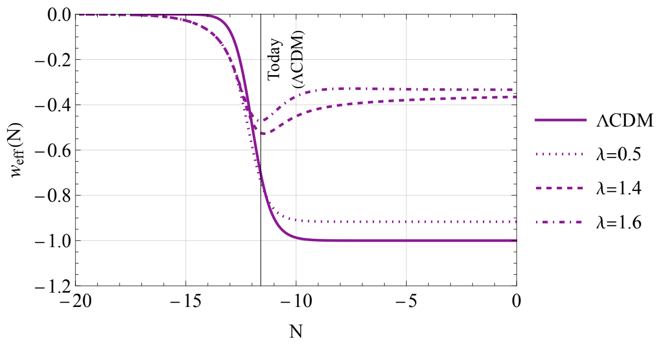
Curvature-assisted Quintessence
We present three examples of w_{eff} evolution for the curvature-assisted quintessence model, i.e., for λ = {0.5, 1.4, 1.6}, and compare them with that of a flat ΛCDM model (i.e., with Ω_{k} set to zero) that provides a good fit to the data.
By increasing λ it becomes more and more difficult for the quintessence model to provide a cosmic
history that is compatible with cosmological observations, as the current value of w_{eff} does not reach
the observationally preferred value of ∼ −0.7, as indicated by our ΛCDM example.

Slide 16
Curvature-assisted Quintessence
When we find solutions that provide extended matter domination periods, none of them provides an effective equation of state parameter w_{eff} less than ∼ −0.5 at the present time (i.e., when Ω_{m} ∼ 0.3).
This means that we do not obtain sufficient acceleration in these cases where matter domination exists.

Slide 17
Has DESI detected exponential Quintessence?
We perform a full Bayesian statistical analysis of the quintessence model of cosmic acceleration with the exponential potential and provide updated constraints on its parameters.
We study the model both when spatial flatness is imposed and when the spatial curvature density parameter Ω_{k,0} is allowed to vary and test the model in terms of goodness-of-fit criteria when compared to the standard ΛCDM model.
The main goal is to see whether this model of dynamical DE is favored over ΛCDM, and if yes, at what confidence level?

Slide 18
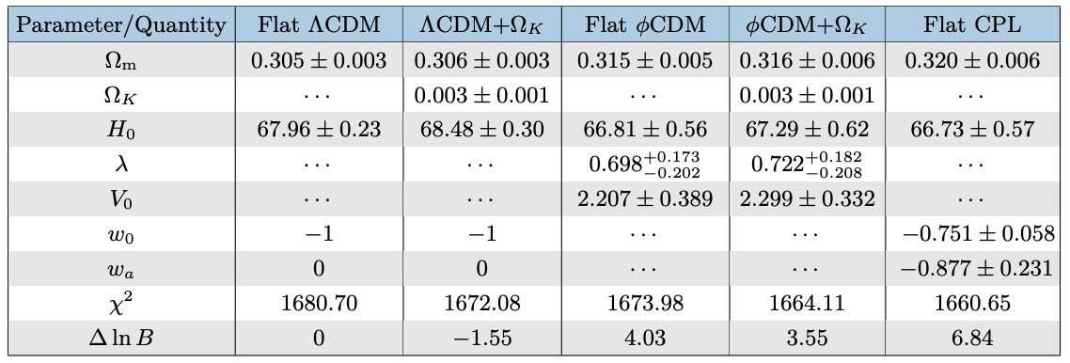
Has DESI detected exponential Quintessence?
We use the DESI DR2 BAO data in combination with the Planck cosmic microwave background (CMB) distance priors and the Dark Energy Survey Year 5 (DES Y5) type Ia supernova data.
The 1σ (i.e., 68.3% confidence level) constraints on model parameters obtained through MCMC along with their corresponding minimum χ² and ∆ ln B, where ∆ ln B_{X} = ln B_{X} − ln B_{flatΛCDM} for a given model or parametrization X.

Slide 19
Has DESI detected exponential Quintessence?
We notice that ΛCDM in the presence of free Ω_{k,0} is weakly disfavoured compared to flat ΛCDM, according to the Jeffreys’ scale, even though it offers a lower minimum χ².
Quintessence is moderately favoured over flat ΛCDM
Quintessence is strongly favoured over ΛCDM + Ω_{k,0}
∆lnB ∼ 4, ∼ 3.3σ significance (flat ϕCDM)
∆lnB ∼ 3.5, ∼ 3.2σ significance (ϕCDM+ Ω_{k,0})
∆lnB ∼ 5.6, ∼ 3.8σ significance (flat ϕCDM)
∆lnB ∼ 5.1, ∼ 3.6σ significance (ϕCDM+ Ω_{k,0})
However...
Flat CPL provides a better fit to the data → ∆lnB ∼ 6.8, corresponding to ∼ 4.1σ significance, compared to flat ΛCDM and with ∆lnB ∼ 8.4, corresponding to ∼ 4.5σ significance, compared to ΛCDM+ Ω_{k,0}

Slide 20

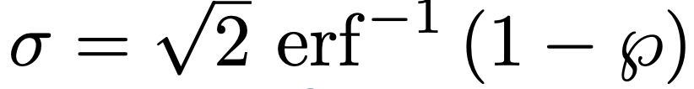
Has DESI detected exponential Quintessence?
To translate the Bayes factors into frequentist significance quantities we invert
We find the corresponding p-value in terms of the Lambert W function and then we translate it into the number of sigmas by assuming a normal distribution

Slide 21
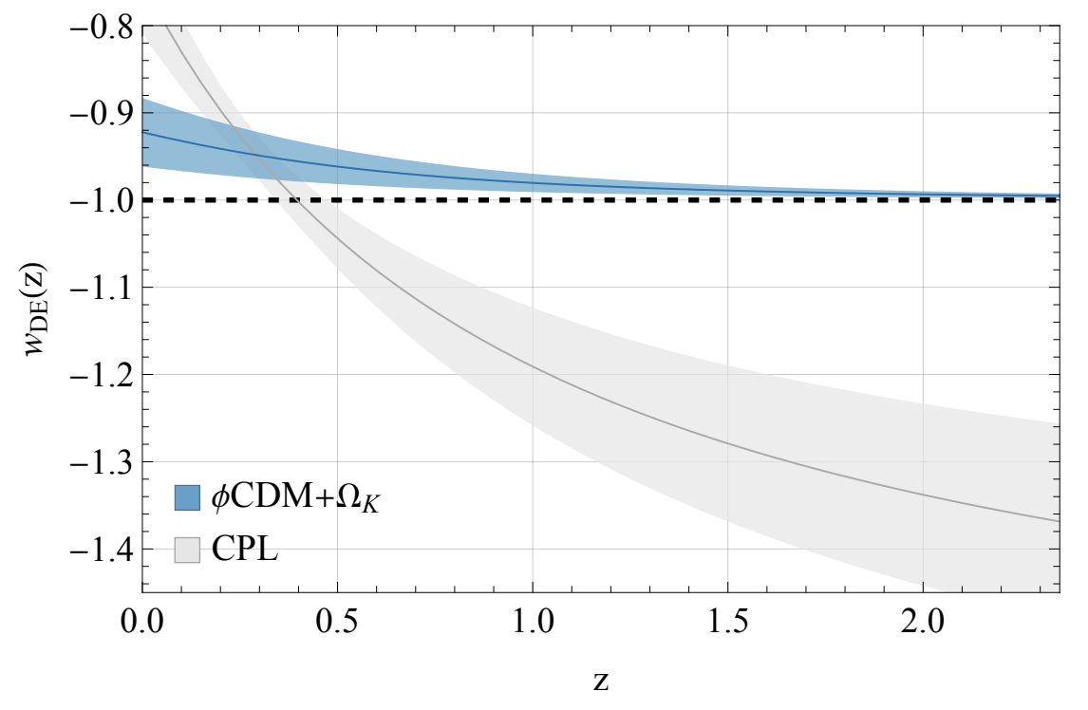
Has DESI detected exponential Quintessence?
The redshift evolution of the DE equation-of-state parameter corresponding to the Bayesian mean quintessence model when Ω_{k,0} is allowed to vary as a free parameter (blue solid curve).
The best-fit CPL parametrization with Ω_{k,0} = 0 is included for comparison (gray solid curve).
DESI data may not require phantom crossing.
Even though it is slightly less favoured statistically than CPL, quintessence is physically motivated.
CPL is a phenomenological fit, not a physical theory.

Slide 22
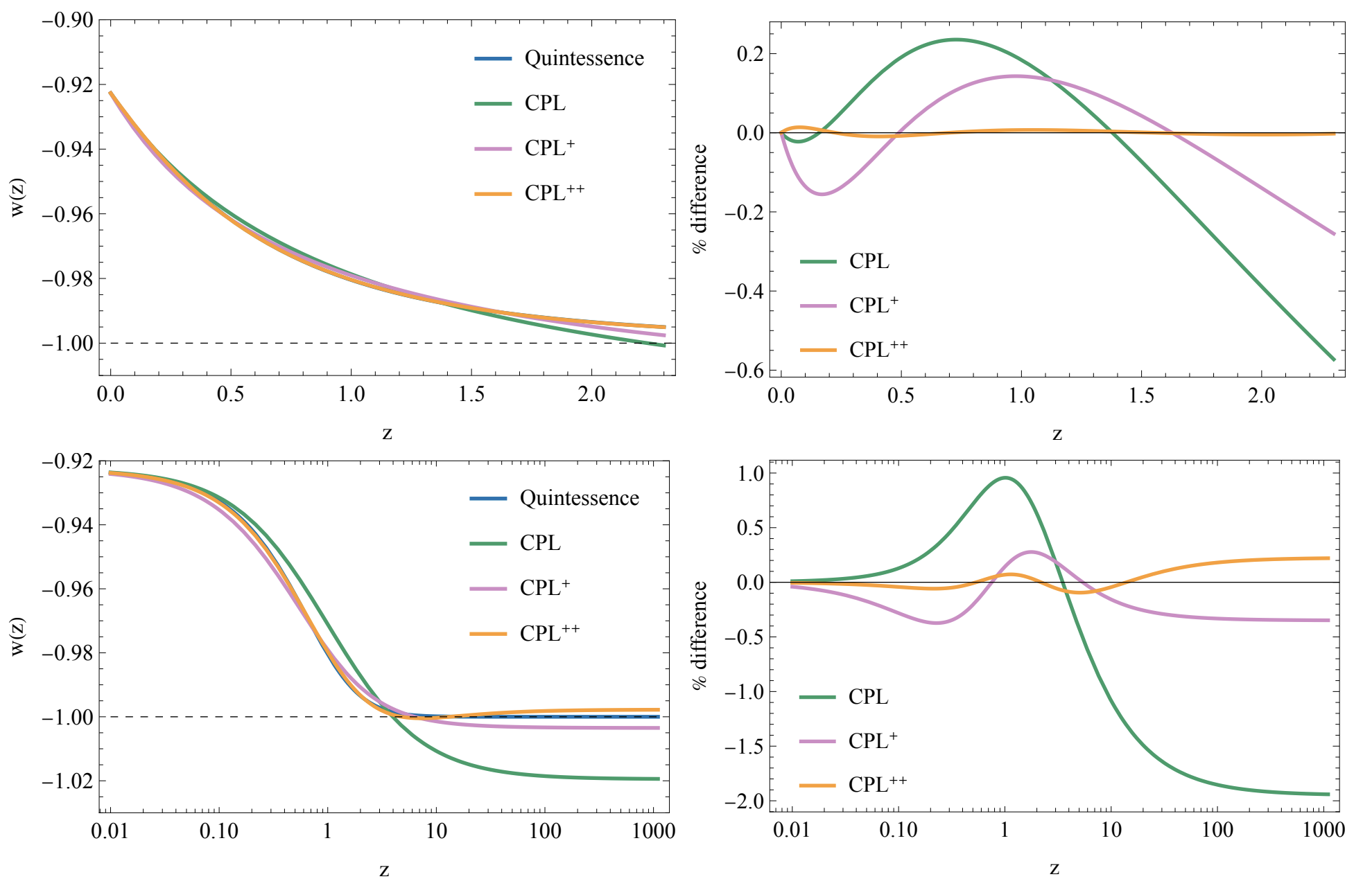
Has DESI detected exponential Quintessence?
CPL is able to provide a ≲ 2% fit to quintessence at all redshifts, all the way to the redshift of recombination
Even though the best-fit w_{CPL}(z) goes slightly below −1 at high redshifts, which is forbidden by quintessence.

Slide 23
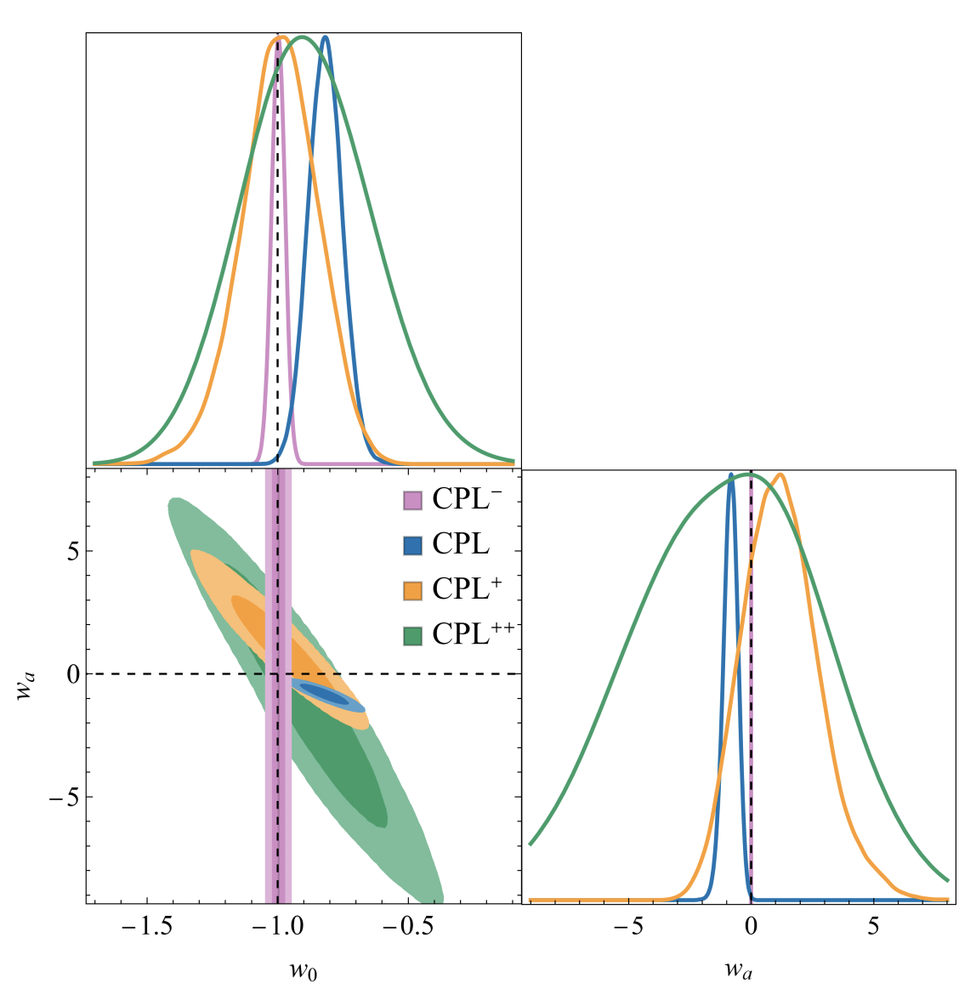

Has DESI detected exponential Quintessence?
DESI+CMB+Pantheon⁺
By projecting the data into a two-dimensional, phenomenological parameter space CPL injects a priori information into the data not necessarily consistent with the observations.
So what happens if we include more terms in the Taylor expansion?
Nesseris et.al. arXiv:2503.22529

Slide 24
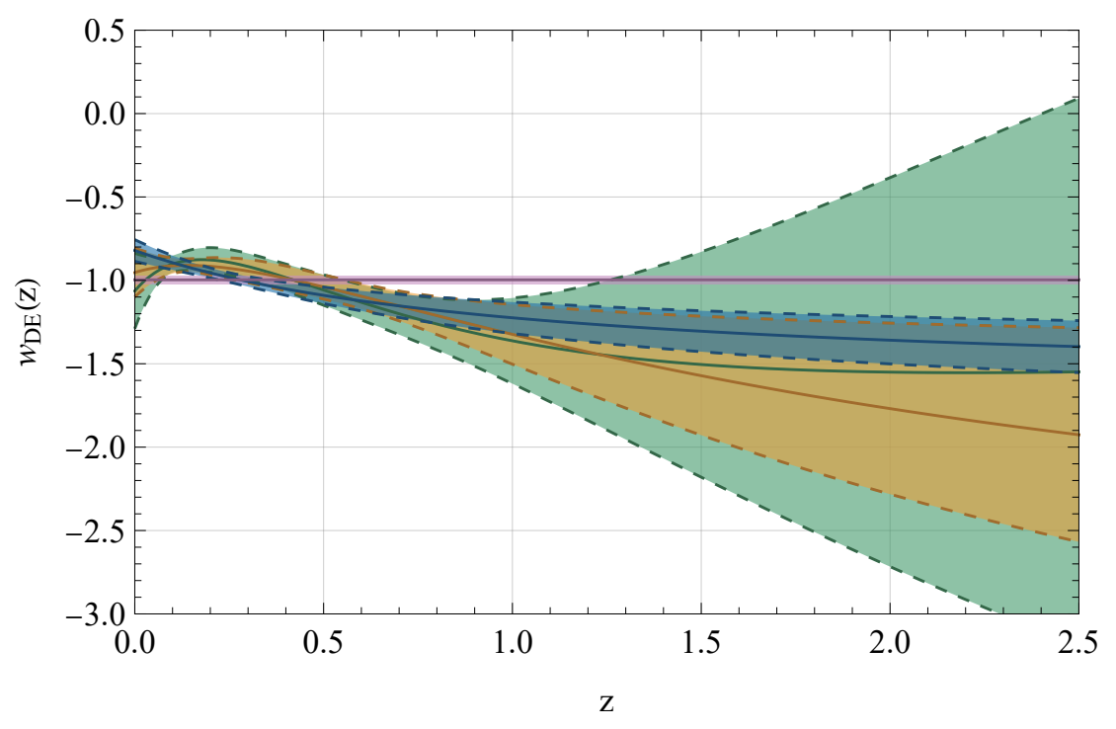
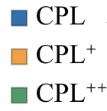
Has DESI detected exponential Quintessence?
If one allows even one additional term in the Taylor series (the CPL⁺ parametrization), then the preferred value of w_{DE} today is consistent with −1
If one marginalizes over the coefficient w_{b} instead of setting it to 0, then the evidence against
(w₀, w_{a}) = (−1, 0) falls below 2σ
If one allows two additional terms (CPL⁺⁺) and marginalizes over w_{b} and w_{c}, the evidence falls below 1σ
Nesseris et.al. arXiv:2503.22529

Slide 25
Has DESI detected exponential Quintessence?
Maybe...

Slide 26
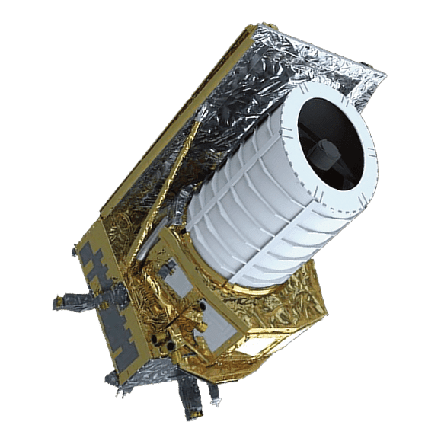
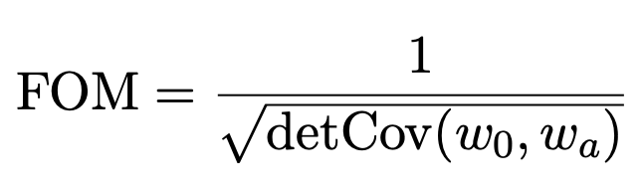
EUCLID
It is a space-based telescope that is equipped with a visible imager (VIS) and a near-infrared slitless spectrometer combined with a multiband photometer (NISP)
The survey started on 14th February 2024 and the first cosmologicaly relevant results are expected in 2026
It will measure the shapes of 1.5 billion galaxies for cosmic shear analysis and the 3-dimensional positions of 35 million galaxies for galaxy clustering analysis.
Its main goal is to determine the evolution of dark energy. Considering CPL Euclid is going to determine w₀ and w_{a} sto precisely that the figure-of-merit defined by
reaches at least 400.
It will also constrain the sum of the neutrino masses to 0.03 eV

Slide 27
Conclusions
DESI is the largest BAO survey
It points to dynamical dark energy with a possible phantom crossing
Quintessence could be a good fit to the data, without the phantom crossing
The CPL parametrization should be taken with a pinch of salt

Slide 28
Thank you!!

