Slide 1
Searching for DM with Phonons through 𝐃𝕤𝓇乇𝕕𝓲0r
Itay M. Bloch
CERN and Technion
⤜❖⤛
Based on 2411.10542, with S. Knappen A. Madden, G. Marocco

Slide 2
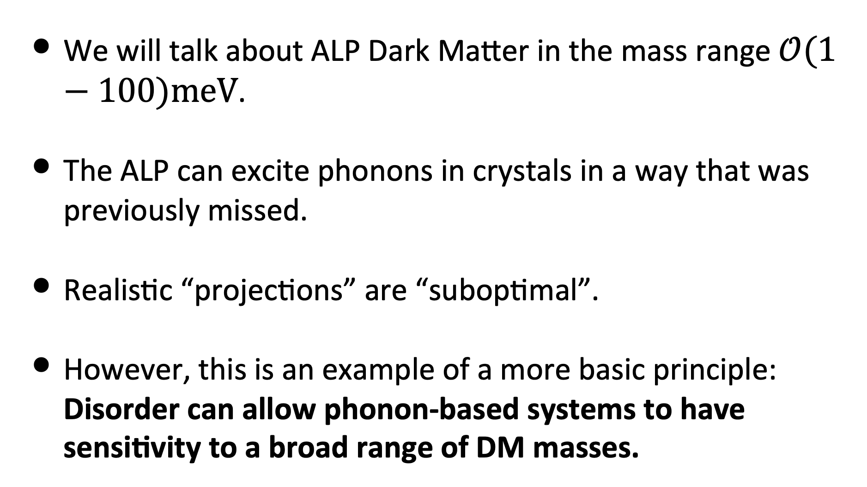
Setting Expectations
We will talk about ALP Dark Matter in the mass range $𝒪(1−100)meV$.
The ALP can excite phonons in crystals in a way that was previously missed.
Realistic “projections” are “suboptimal”.
However, this is an example of a more basic principle: Disorder can allow phonon-based systems to have sensitivity to a broad range of DM masses.
Introduction
Itay M. Bloch

Slide 3
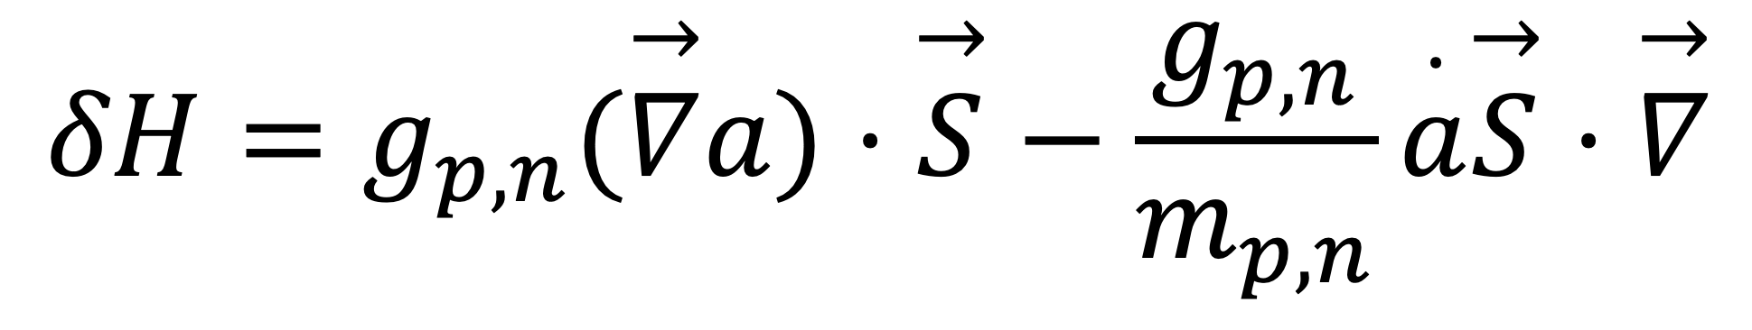
DM-Nucleon Interaction
So we start with $ℒ=g_{n}∂^{μ}a\overline{n}γ_{μ}γ_{5}n+(n→p)$.
At leading order in the non-relativistic expansion,
“Axion Wind”
“Axioelectric Effect”
$$δH=g_{p,n}(\overset{→}{∇}a)⋅\overset{→}{S}−\frac{g_{p,n}}{m_{p,n}}\overset{·}{a}\overset{→}{S}⋅\overset{→}{∇}$$
Rotates/Flips Spins &
Couples to Spatial DOFs
Rotates/Flips Spins
Introduction
Itay M. Bloch

Slide 4
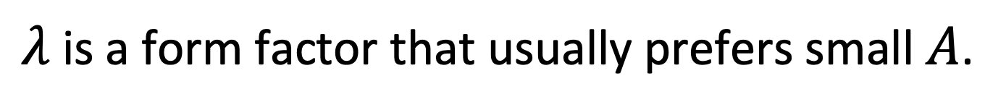
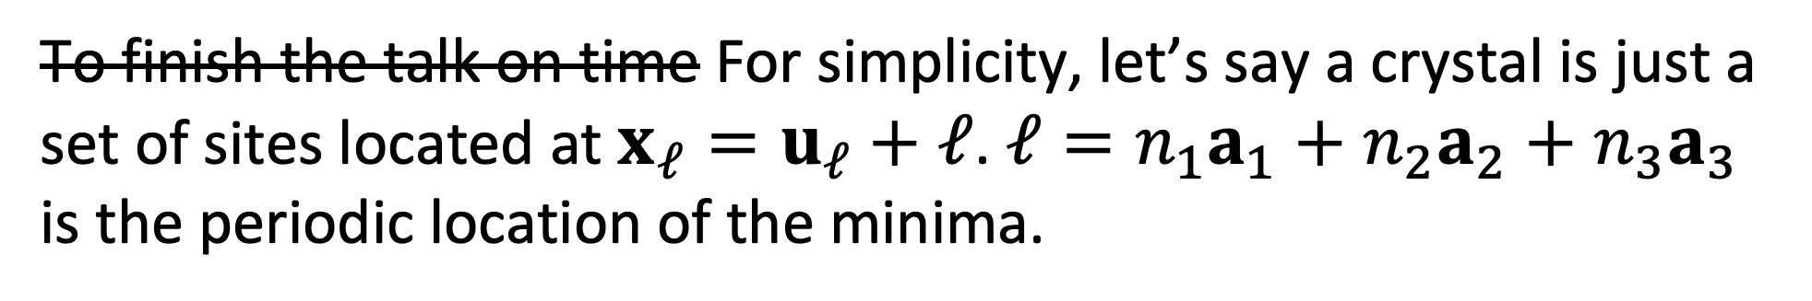
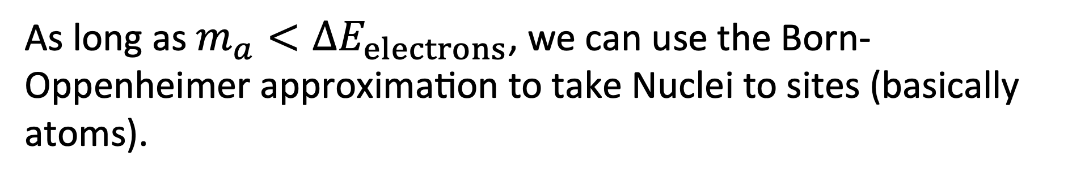
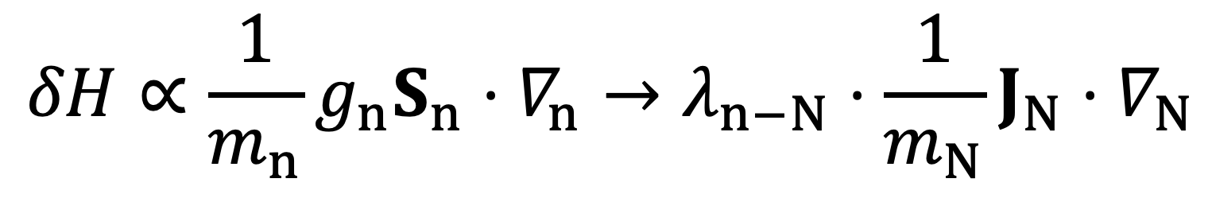
Coarse Graining DOFs
First, from a nucleon to a (no-zero spin) Nucleus:
$$δH∝\frac{1}{m_{n}}g_{n}S_{n}⋅∇_{n}→λ_{n−N}⋅\frac{1}{m_{N}}J_{N}⋅∇_{N}$$
$λ$ is a form factor that usually prefers small $A$.
As long as $m_{a}<ΔE_{electrons}$, we can use the Born-Oppenheimer approximation to take Nuclei to sites (basically atoms).
To finish the talk on time For simplicity, let’s say a crystal is just a set of sites located at $x_{ℓ}=u_{ℓ}+ℓ$. $ℓ=n_{1}a_{1}+n_{2}a_{2}+n_{3}a_{3}$ is the periodic location of the minima.
Coarse Graining DOFs
Itay M. Bloch

Slide 5
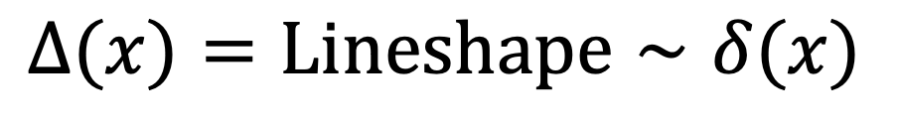
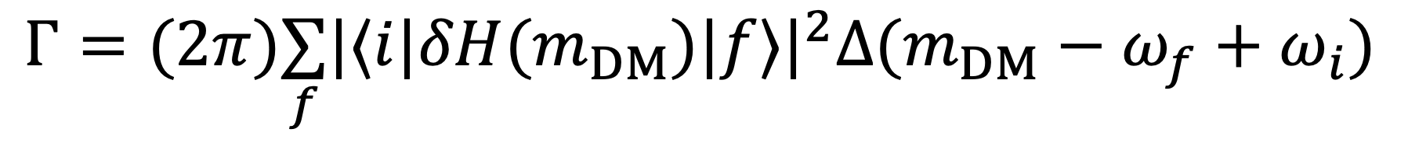
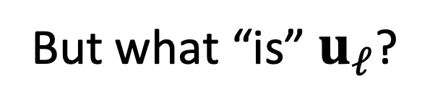

Fermi’s Golden Rule
$$Γ=(2π)\underset{f}{∑}|⟨i|δH(m_{DM})|f⟩|^{2}Δ(m_{DM}−ω_{f}+ω_{i})$$
$Δ(x)=Lineshape∼δ(x)$
If no B fields: $∇_{ℓ}=im[u_{ℓ},H_{0}]$, so
$$ℳ_{axioelectric}=...=−2im_{a}(E_{f}−E_{i})⋅a_{0}\underset{ℓ}{∑}⟨i|λu_{ℓ}⋅J_{ℓ}|f⟩$$
But what “is” $u_{ℓ}$?
Relating Phonons and DM
Itay M. Bloch

Slide 6
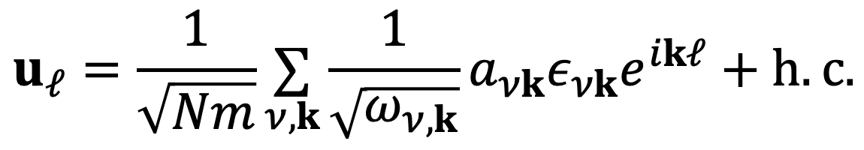
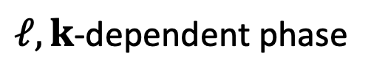
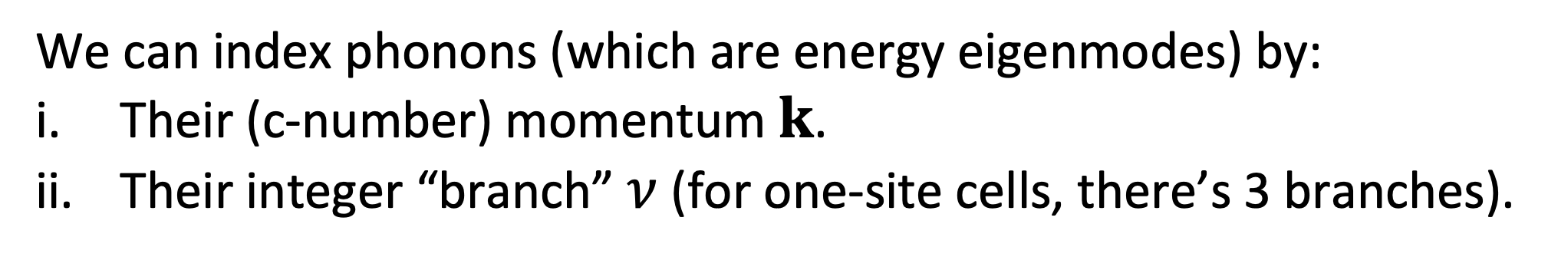
From Sites (Cells) to Phonons
We can index phonons (which are energy eigenmodes) by:
Their (c-number) momentum $k$.
Their integer “branch” $ν$ (for one-site cells, there’s 3 branches).
To a pretty good approximation, each site is sitting in a harmonic potential, and so
$ℓ,k$-dependent phase
$$u_{ℓ}=\frac{1}{\sqrt{Nm}}\underset{ν,k}{∑}\frac{1}{\sqrt{ω_{ν,k}}}a_{νk}ε_{νk}e^{ikℓ}+h.c.$$
Deviation from VEV operator
Polarization vector. Normalization is a bit non-trivial
Crystal mass
Annihilation operator
Coarse Graining DOFs
Itay M. Bloch

Slide 7
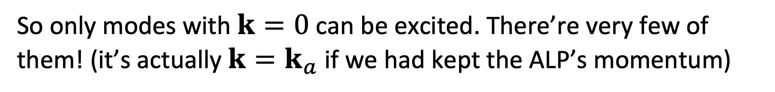
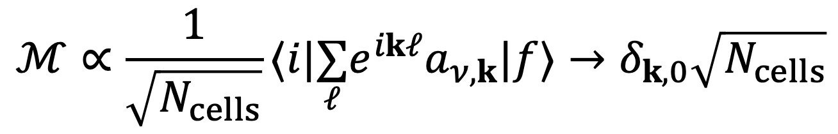
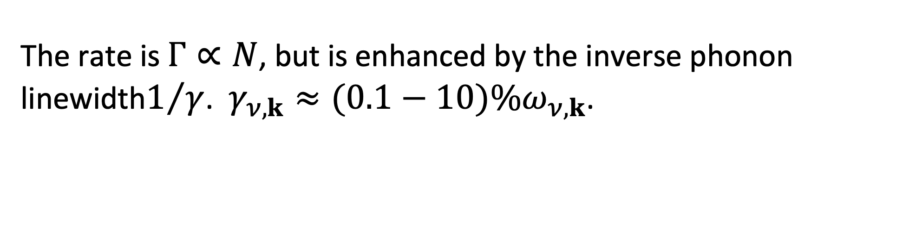
Historical Context: Coherent Phonon Production
The matrix element for a fully polarized crystal in the initial and final states is
$$ℳ∝\frac{1}{\sqrt{N_{cells}}}⟨i|\underset{ℓ}{∑}e^{ikℓ}a_{ν,k}|f⟩→δ_{k,0}\sqrt{N_{cells}}$$
So only modes with $k=0$ can be excited. There’re very few of them! (it’s actually $k=k_{a}$ if we had kept the ALP’s momentum)
The rate is $Γ∝N$, but is enhanced by the inverse phonon linewidth$1/γ$. $γ_{ν,k}≈(0.1−10)\%ω_{ν,k}$.
Relating Phonons and DM
Itay M. Bloch

Slide 8
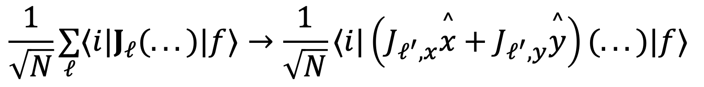
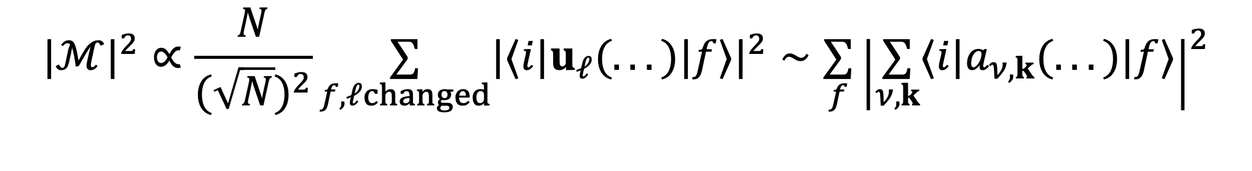
Incoherent Excitation Rate (Some of it)
New:
If we allow $|i⟩$ and $|f⟩$ to have one spin ($ℓ^{′}$) that is different,
$$\frac{1}{\sqrt{N}}\underset{ℓ}{∑}⟨i|J_{ℓ}(...)|f⟩→\frac{1}{\sqrt{N}}⟨i|\left(J_{ℓ^{′},x}\overset{^}{x}+J_{ℓ^{′},y}\overset{^}{y}\right)(...)|f⟩$$
Seemingly, we lose $N^{2}$…
But: $𝒪(N)$ sites can change their spins, and…
$$|ℳ|^{2}∝\frac{N}{(\sqrt{N})^{2}}\underset{f,ℓchanged}{∑}|⟨i|u_{ℓ}(...)|f⟩|^{2}∼\underset{f}{∑}{\left|\underset{ν,k}{∑}⟨i|a_{ν,k}(...)|f⟩\right|}^{2}$$
The number of k modes per unit energy scales with N!
Intuitively, this recovery makes sense: if we have twice as much crystal, the rate is twice as large.
Incoherent Phonons
Itay M. Bloch

Slide 9
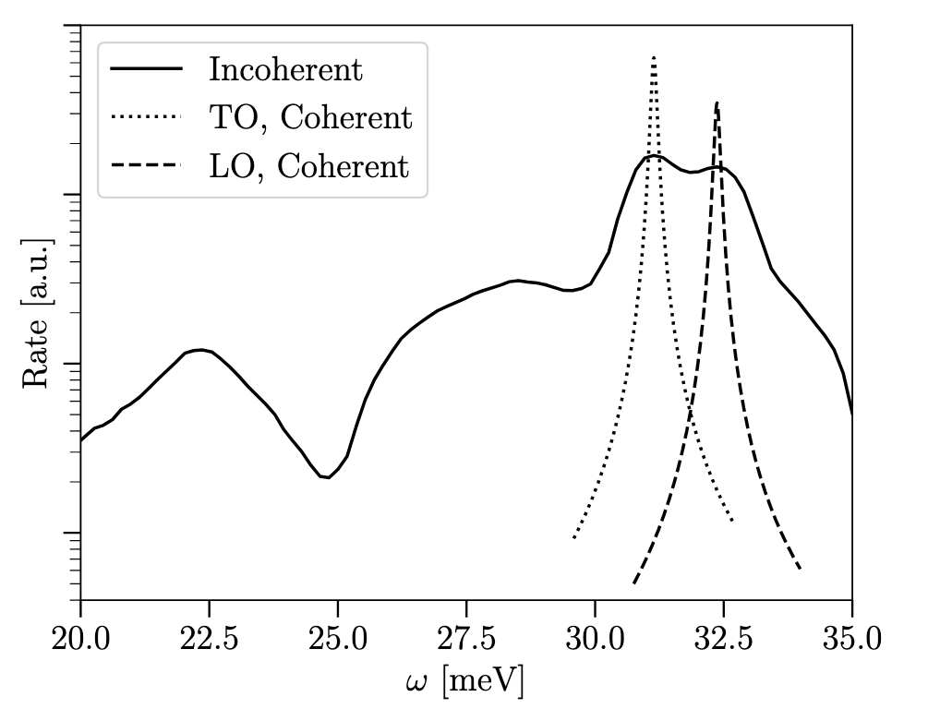
Chaos All the Way!
At this point, there’s no real reason to polarize the crystal!
The spin-changing incoherent rate is always there, but unpolarized crystals get a second spin preserving contribution of the same order, and if we compare coherent and incoherent rates:
GaAs
Experimental Bonus: Much easier if we don’t need nuclear polarization!
Theory Bonus: the coherent rate depends on several quantities that are very hard to directly compute/measure (e.g. the phonon linewidth).
Incoherent Phonons
Itay M. Bloch

Slide 10

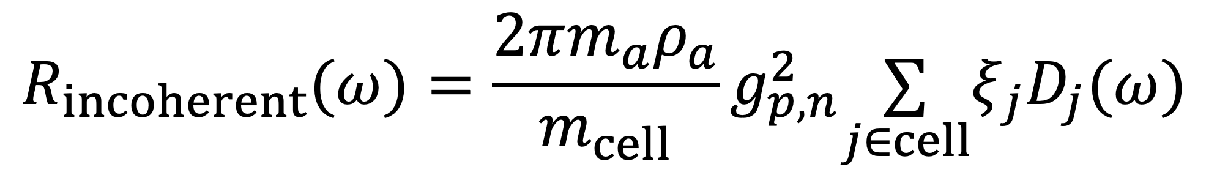
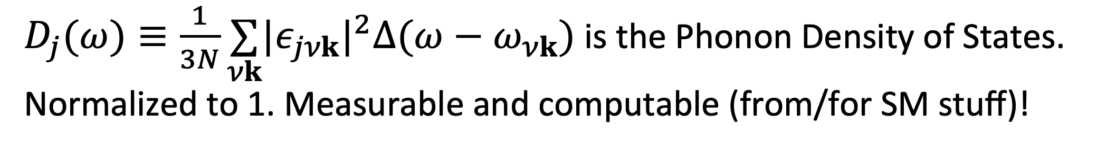
The Excitation Rate per kg year (I added cells again)
$$R_{incoherent}(ω)=\frac{2πm_{a}ρ_{a}}{m_{cell}}g_{p,n}^{2}\underset{j∈cell}{∑}ξ_{j}D_{j}(ω)$$
Total mass of a cell.
$D_{j}(ω)≡\frac{1}{3N}\underset{νk}{∑}|ε_{jνk}|^{2}Δ(ω−ω_{νk})$ is the Phonon Density of States. Normalized to 1. Measurable and computable (from/for SM stuff)!
The prefactor $ξ_{j}≡\frac{λ_{j}^{2}}{m_{j}}J_{j}(J_{j}+1)$, prefers light nuclei.
$$R_{coherent}(ω_{resonances})∼𝒪(0−1)\frac{1}{γD(ω)}R_{incoherent}∼𝒪(0−10)R_{incoherent}$$
Incoherent Phonons
Itay M. Bloch

Slide 11
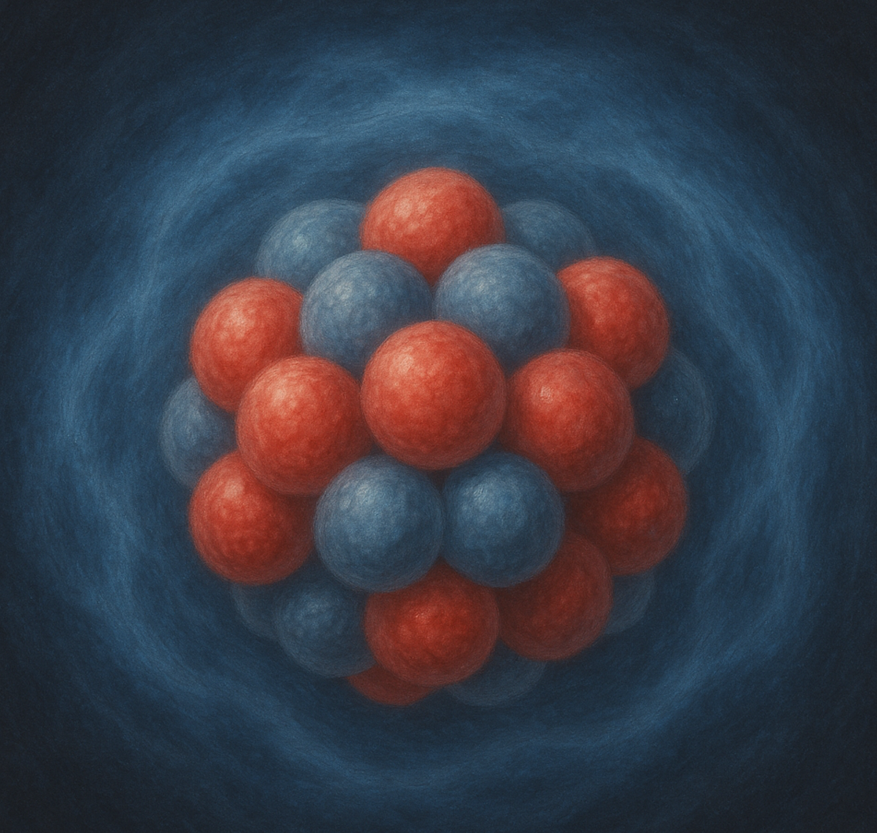
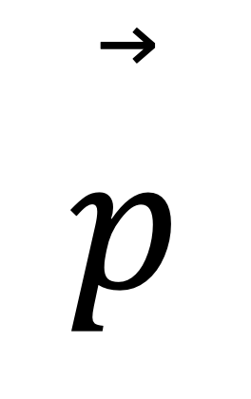
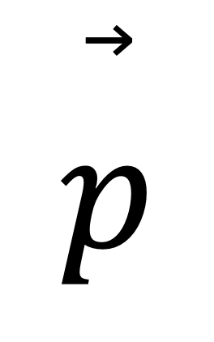
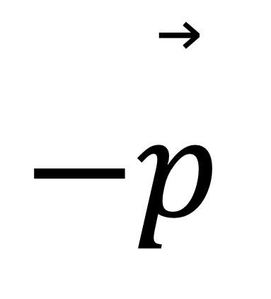
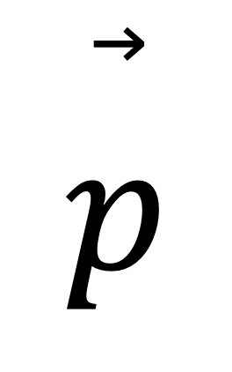
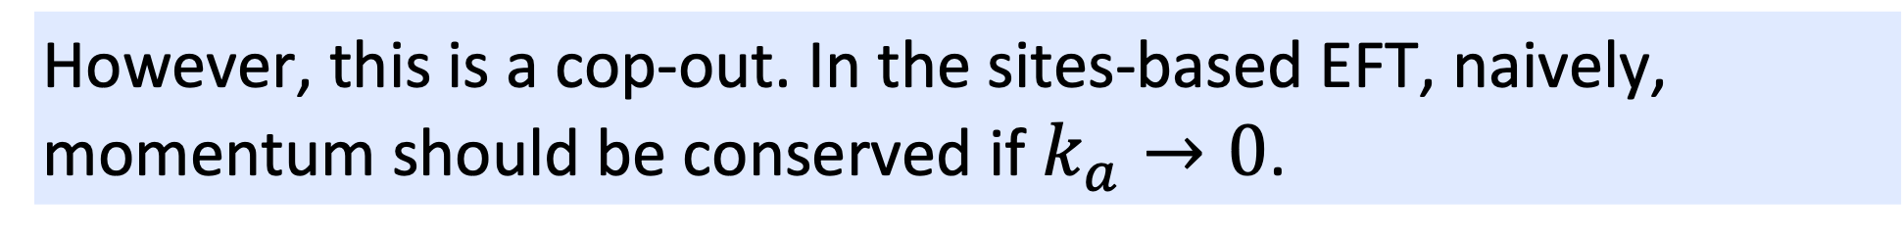
Recovering Momentum Conservation
First things first: phonon momentum is internal, and hence “perpendicular” of Center of Mass momentum.
A phonon:
By focusing on phonons, we already “integrated out” the part that “has to be” conserved.
$$\overset{⃗}{p}$$
$$−\overset{⃗}{p}$$
However, this is a cop-out. In the sites-based EFT, naively, momentum should be conserved if $k_{a}→0$.
A crystal bouncing:
$$\overset{⃗}{p}$$
$$\overset{⃗}{p}$$
However, since the potential depends on spins, in order to have no x dependence, they must be part of the Fock Space. The spin states carry momentum, but no energy. Thus momentum can be tracked again (presumably).
Incoherent Phonons
Itay M. Bloch

Slide 12
Experimental Implications and Future Directions

Slide 13
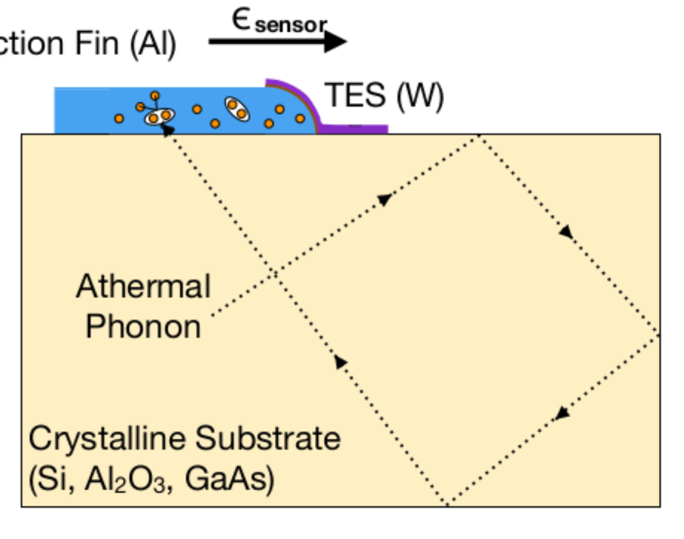
In the Real World
One collaboration pursuing low-energy phonon detection is the TESSERACT collaboration. (Apparently BREAD could also possibly do this).
Collection Fin (Al)
Right now (2503.03683):
Energy threshold is 1.5 eV.
Near threshold event rate is O(event/gram/sec).
Total mass is 0.2 grams.
Experimental Implications
Itay M. Bloch

Slide 14
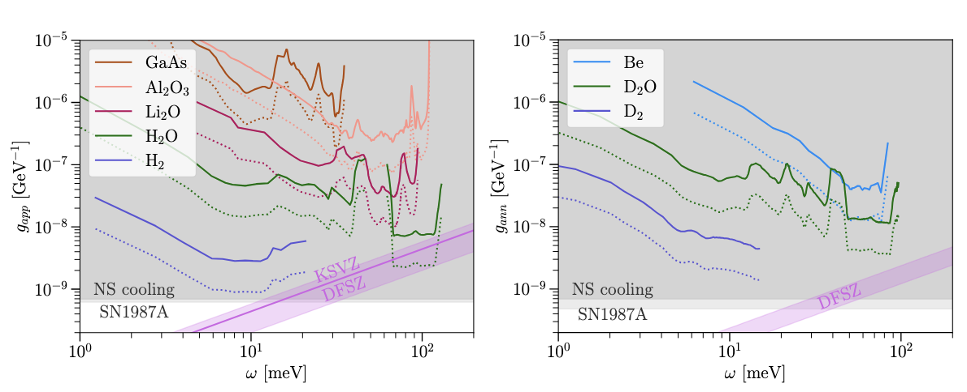
Sensitivity (AKA HIGHLY Optimistic Projections)
Solid lines=3 events per kg year
The QCD band’s (and astro bounds’) edges shouldn’t be taken too seriously.
Dotted lines=0.3 events per kg year
Experimental Implications
Itay M. Bloch

Slide 15
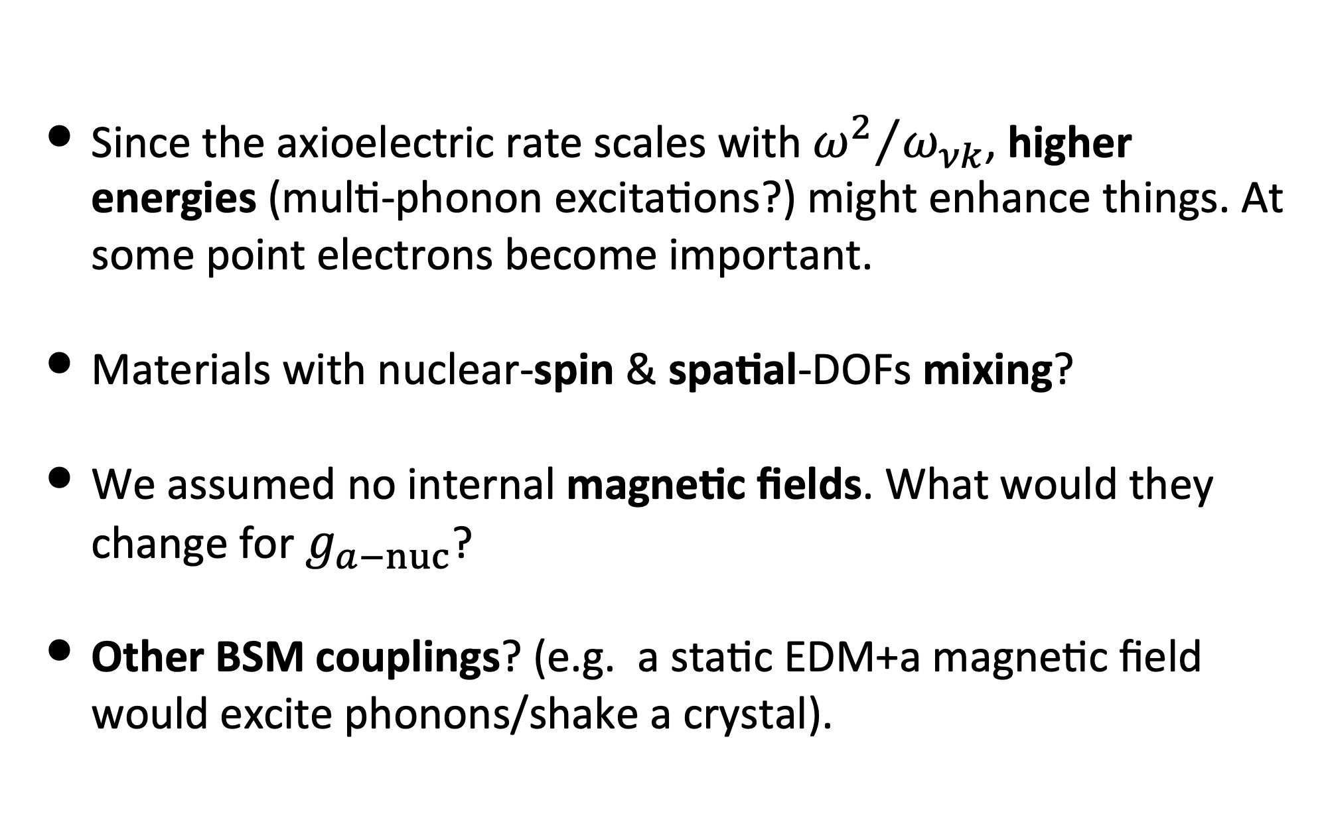
Some Future Directions
Since the axioelectric rate scales with ${ω^{2}}/{ω_{νk}}$, higher energies (multi-phonon excitations?) might enhance things. At some point electrons become important.
Materials with nuclear-spin & spatial-DOFs mixing?
We assumed no internal magnetic fields. What would they change for $g_{a−nuc}$?
Other BSM couplings? (e.g. a static EDM+a magnetic field would excite phonons/shake a crystal).
(Migdal effect? Bloch` Functions!)
(Superfluid ³He?)
Can they allow probing ALP-photon couplings?
Open to more ideas!
We haven’t looked too deeply into any of the above, except the last one, where we started looking at…
Future Directions
Itay M. Bloch

Slide 16
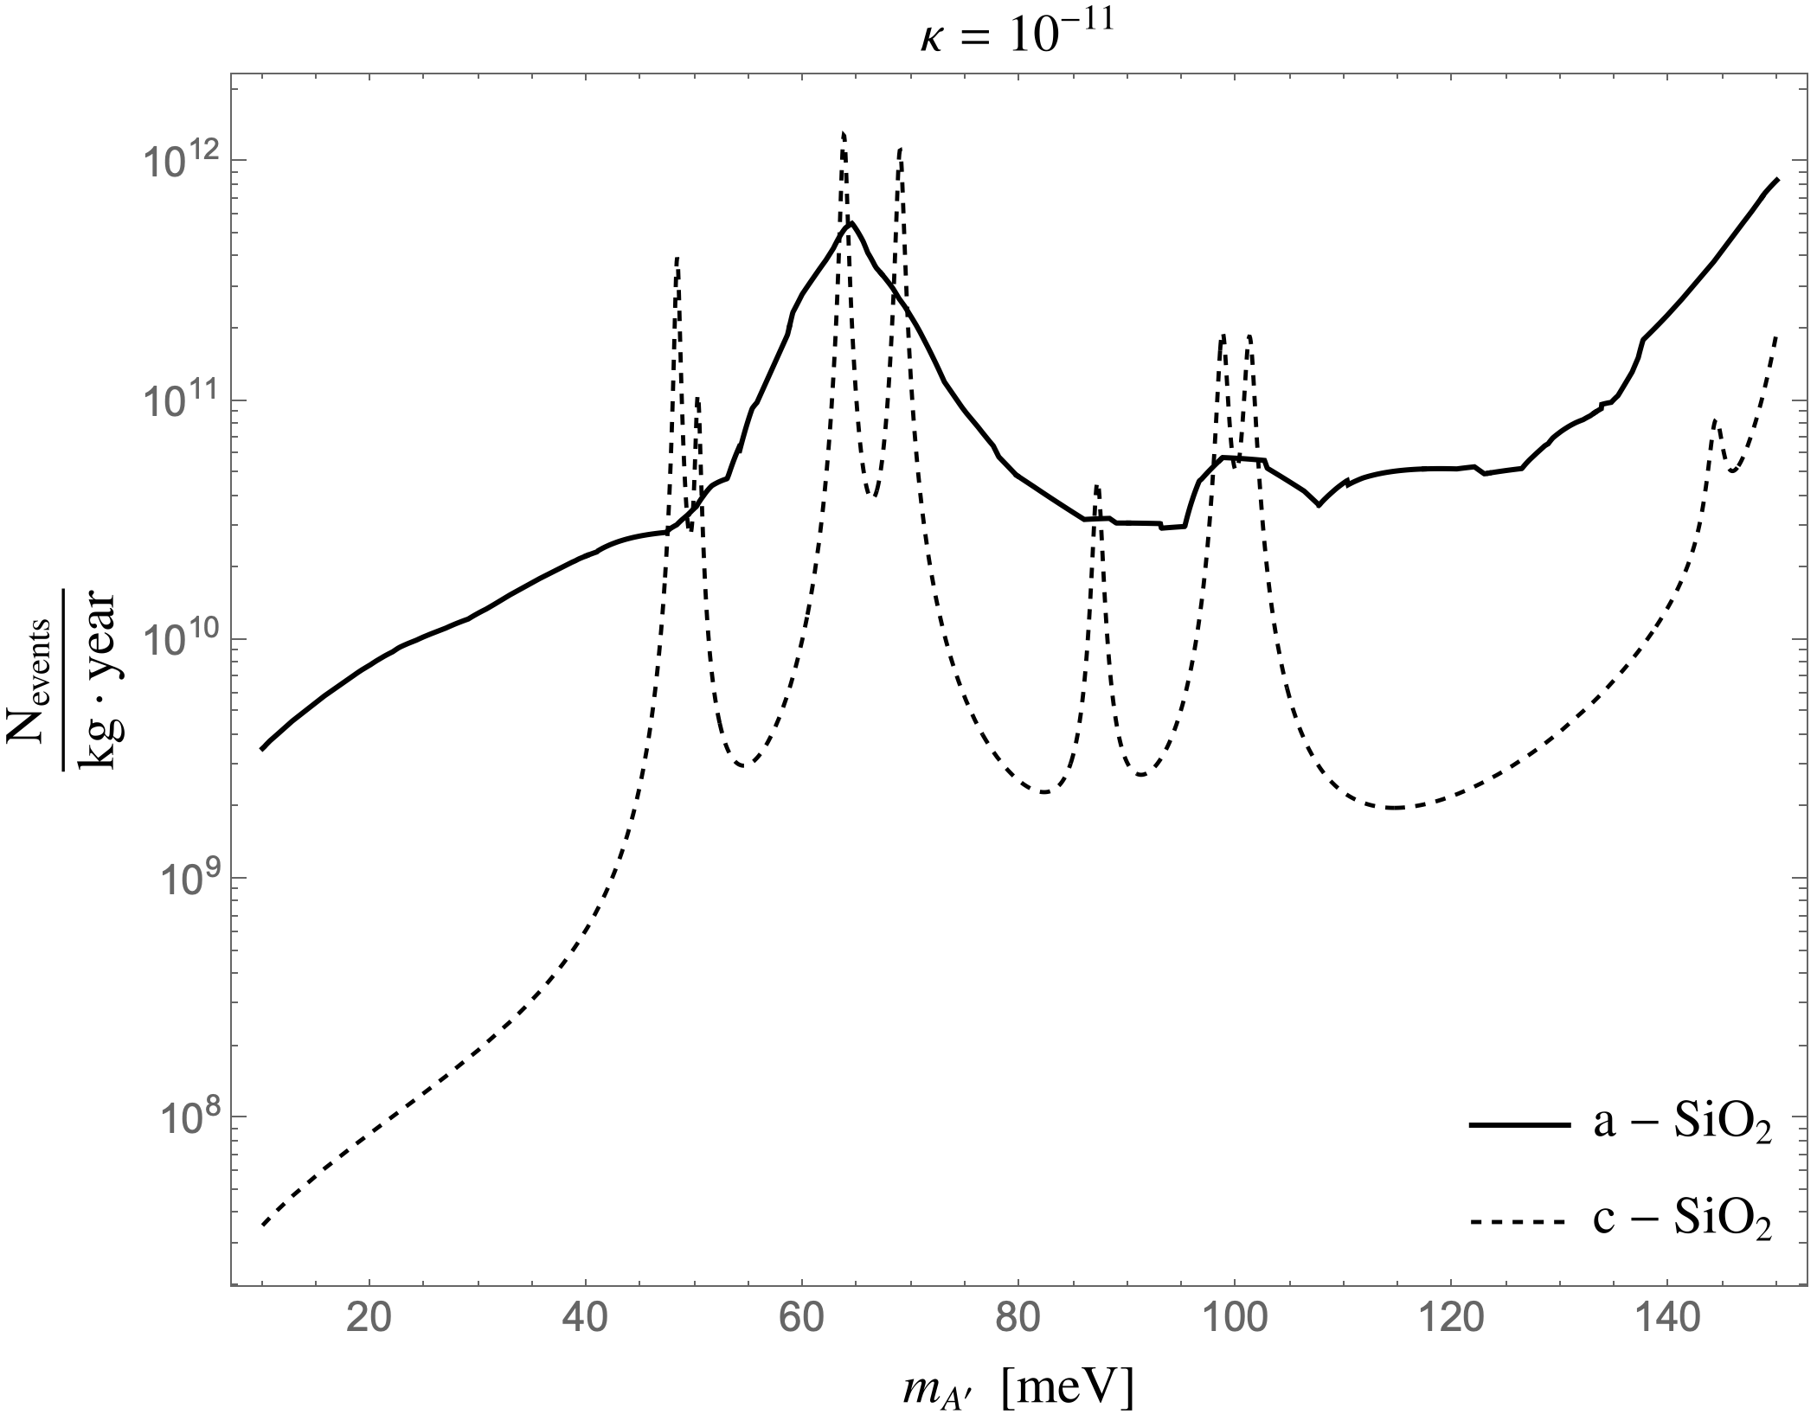
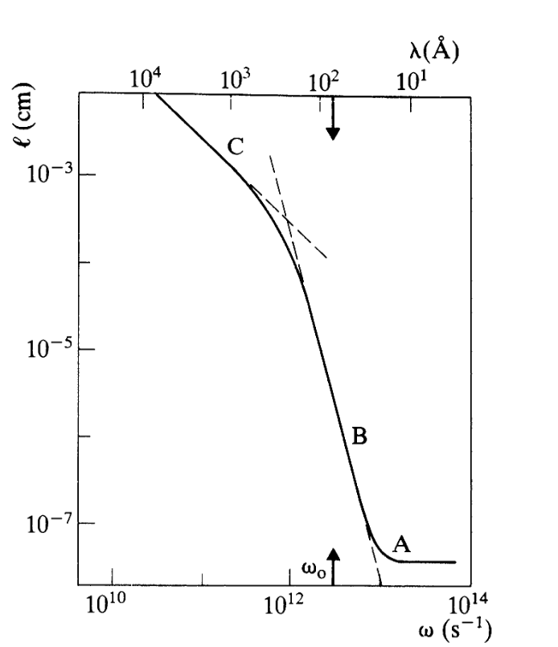
Inherently Disordered Materials
Materials with no internal order (e.g. glass) might have broadband sensitivity to a variety of DM models! In particular, for Dark Photons!
Glass was suggested for direct detection in the past, but the connection to disorder was missed and led to unexplained weirdness.
Preliminary
+
By more carefully examining it, we are uncovering new important details.
+
We’re talking to experimentalists about implementing this (at some point. maybe).
10 OOM larger rates in unexplored parts of the parameter space.
Phonon mean free path for glass
Future Directions
Itay M. Bloch

Slide 17
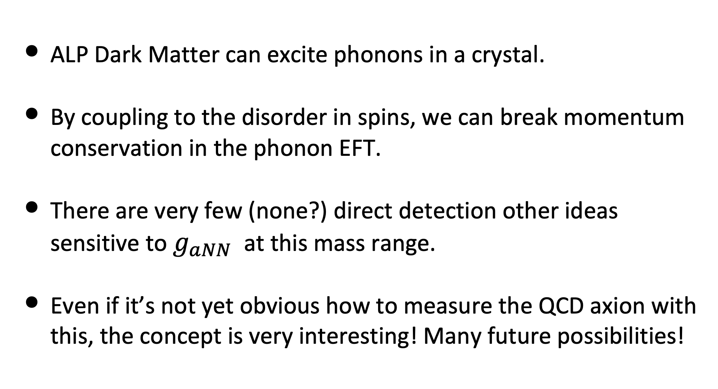
Summary
ALP Dark Matter can excite phonons in a crystal.
By coupling to the disorder in spins, we can break momentum conservation in the phonon EFT.
There are very few (none?) direct detection other ideas sensitive to $g_{aNN}$ at this mass range.
Even if it’s not yet obvious how to measure the QCD axion with this, the concept is very interesting! Many future possibilities!
Itay M. Bloch

Slide 18
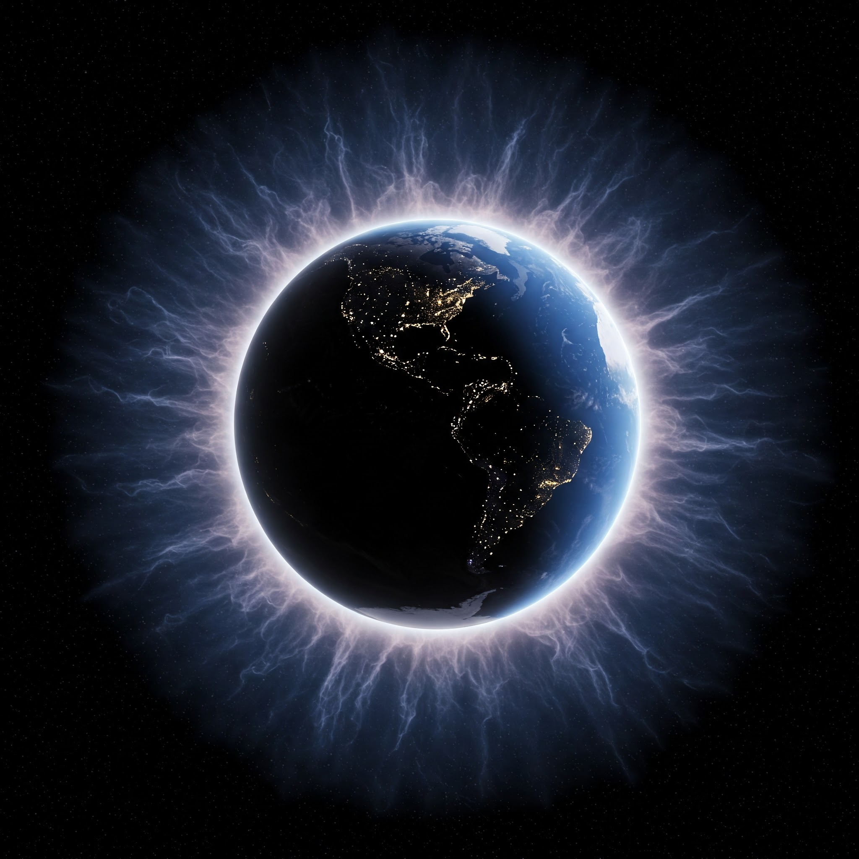
Ｔ𝓷к𝖆𝒉𝕤 ɹoɟ Ⓛ𝐢𝓢ᴛ乇几𝐢ຖg!

Slide 19
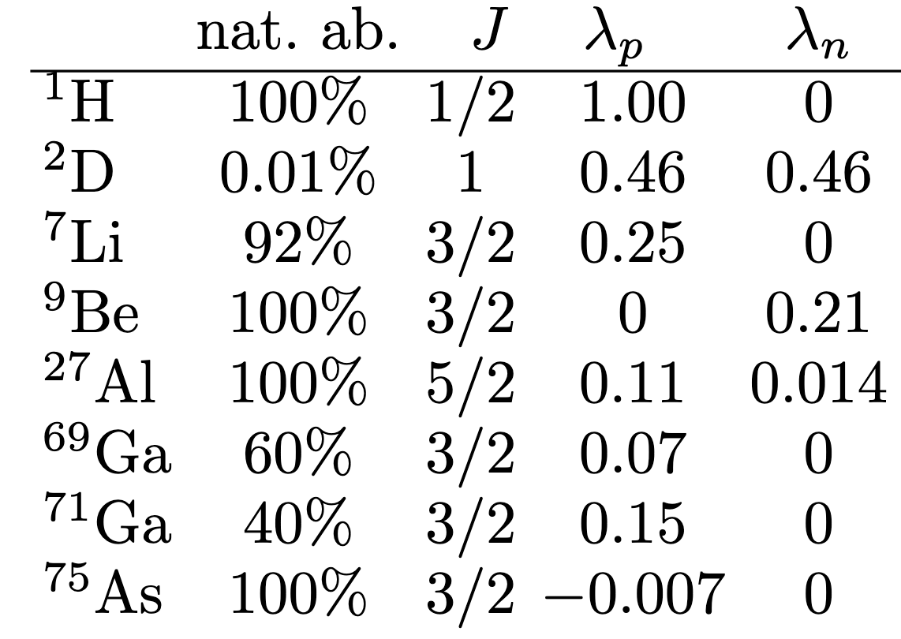
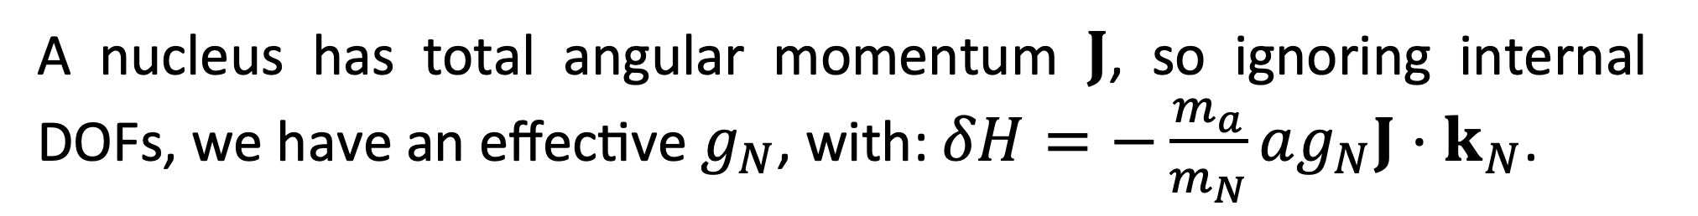
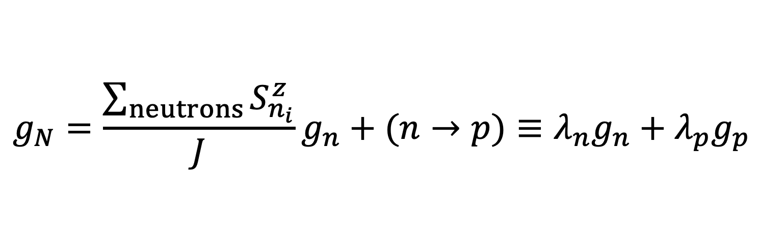
From Nucleons To Nuclei
While we cast constraints on $g_{p},g_{n}$, usually, they sit in a nucleus.
A nucleus has total angular momentum $J$, so ignoring internal DOFs, we have an effective $g_{N}$, with: $δH=−\frac{m_{a}}{m_{N}}ag_{N}J⋅k_{N}$.
$$g_{N}=\frac{\sum_{neutrons}{S_{n_{i}}^{z}}}{J}g_{n}+(n→p)≡λ_{n}g_{n}+λ_{p}g_{p}$$
Coarse Graining DOFs
Itay M. Bloch

