Slide 1




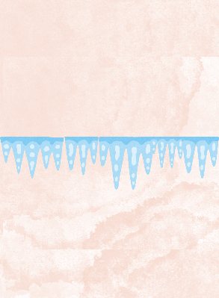
Standard Model Baryon Number Violation at Zero Temperature from Higgs Bubble Collisions
Martina Cataldi
Based on hep-ph/2508.21825
Universität Hamburg & DESY , Hamburg, Germany
Bhusal, Blasi, MC, Chatrchyan, Gorghetto, Servant
martina.cataldi@desy.de
Very first computation of Chern-Simons (CS) variations at T=0 from Higgs Bubble Collisions in a strongly First Order ElectroWeak Phase Transition (FOEWPT)
Invisibles25 Workshop
02-09-2025

Slide 2


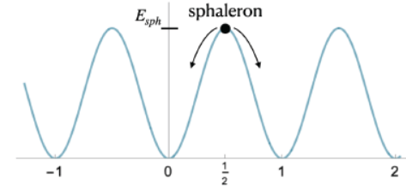
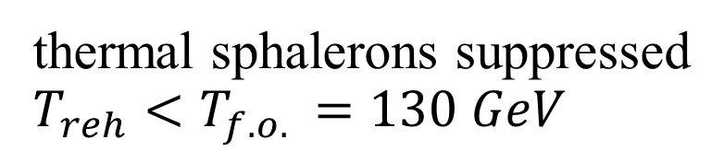
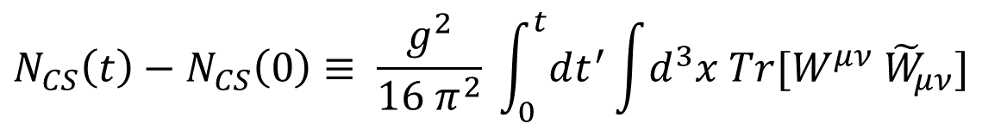


1) low temperature 2) large bubble wall velocity
Cold baryogenesis from
Higgs Bubble Collisions:
thermal sphalerons suppressed
$$T_{reh}<T_{f.o. }=130 GeV$$
$$v_{w}>v_{s }$$
(original Cold Baryogenesis by tachyonic instability in a quenched EW crossover)
Krauss, Trodden, Phys. Rev. Lett. 83 (1999) 1502
Garcia-Bellido, et al. Phys. Rev. D 60 (1999) 123504
E. J. Copeland, et al. Phys. Rev. D 64 (2001) 043506
Tranberg, Smit, JHEP 0311 (2003) 016
first idea of Cold Baryogenesis in a FOPT in
Konstandin, Servant, JCAP07(2011)024
Servant, Phys. Rev. Lett. 113, 171803 (2014)
$$N_{CS}$$
$$N_{CS}\left(t\right)−N_{CS}\left(0\right)≡ \frac{g^{2}}{16 π^{2}} \int_{0}^{t}{dt^{′}}\int{d^{3}x Tr[W^{μν} {\tilde{W}}_{μν}]}$$
Chern-Simons number of the SU(2)-gauge fields:
$$ΔB=3 ΔN_{CS}$$
It opens up a new parameter space where Standard ElectroWeak Baryogenesis via charge transport mechanism is not efficient
1
Martina Cataldi
SM Baryon Number Violation at T=0 from Higgs Bubble Collisions

Slide 3
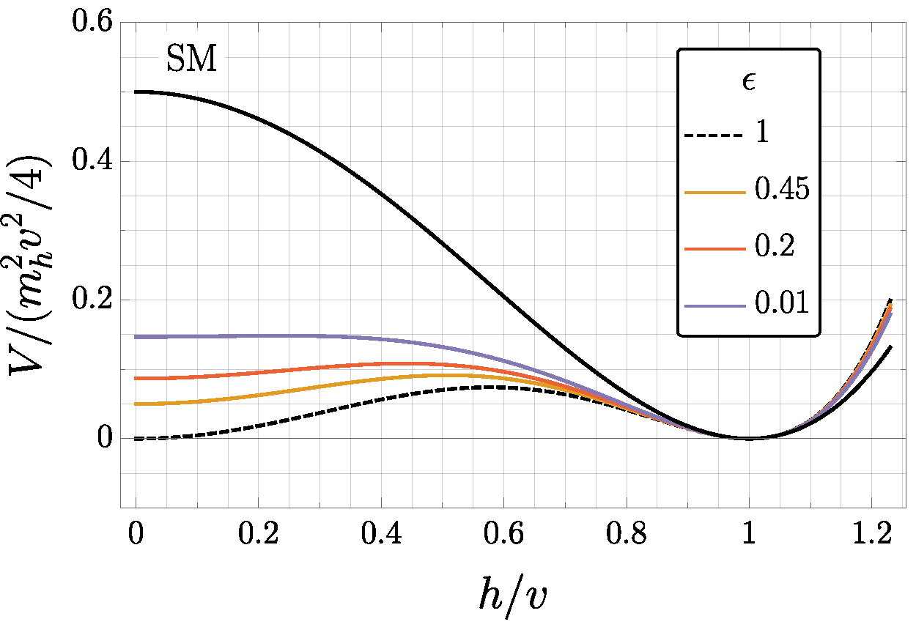



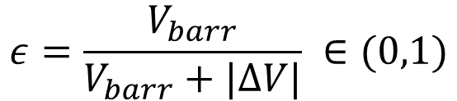

Study of dependence CS number transitions on:
1) Lorentz-boost factor of bubble walls at collision
2) Higgs potential’s shape, i.e. degeneracy parameter
$$γ_{⋆}=\frac{{ R}_{⋆}}{R_{c }}$$
$$ΔV$$
$$ε=\frac{V_{barr}}{V_{barr}+|ΔV|} ∈(0,1)$$
$$V_{barr}$$
1
2
Martina Cataldi
SM Baryon Number Violation at T=0 from Higgs Bubble Collisions

Slide 4
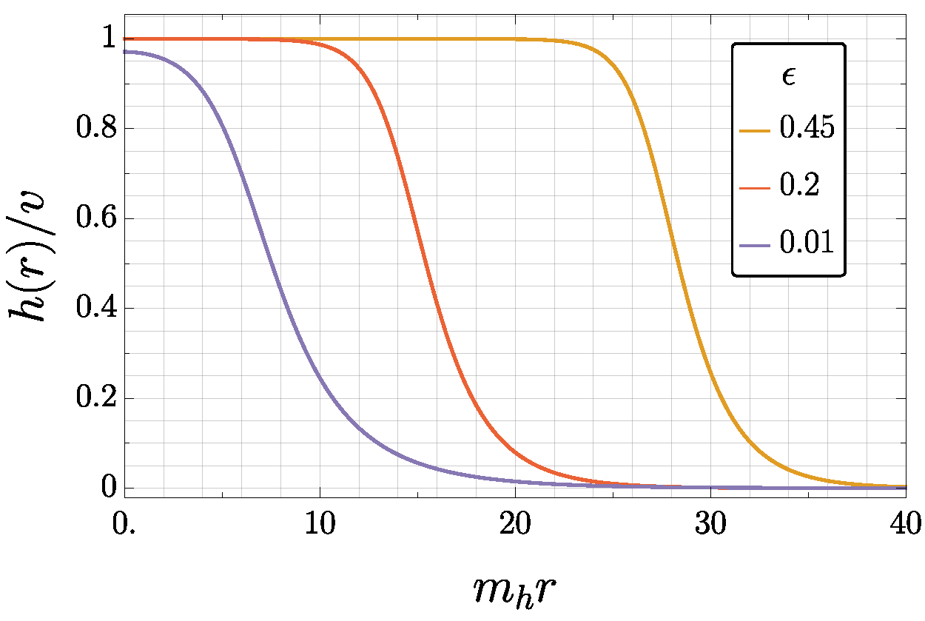
Study of dependence CS number transitions on:
1) Lorentz-boost factor of bubble walls at collision
2) Higgs potential’s shape, i.e. degeneracy parameter
$$γ_{⋆}=\frac{{ R}_{⋆}}{R_{c }}$$
$$ΔV$$
$$ε=\frac{V_{barr}}{V_{barr}+|ΔV|} ∈(0,1)$$
$$V_{barr}$$
Via large-scale (3+1)D lattice simulations of Higgs doublet and SU(2)-gauge fields
Runaway critical Higgs bubbles nucleated simultaneously with random positions and SU(2)-phase orientations
1
2
Martina Cataldi
SM Baryon Number Violation at T=0 from Higgs Bubble Collisions

Slide 5
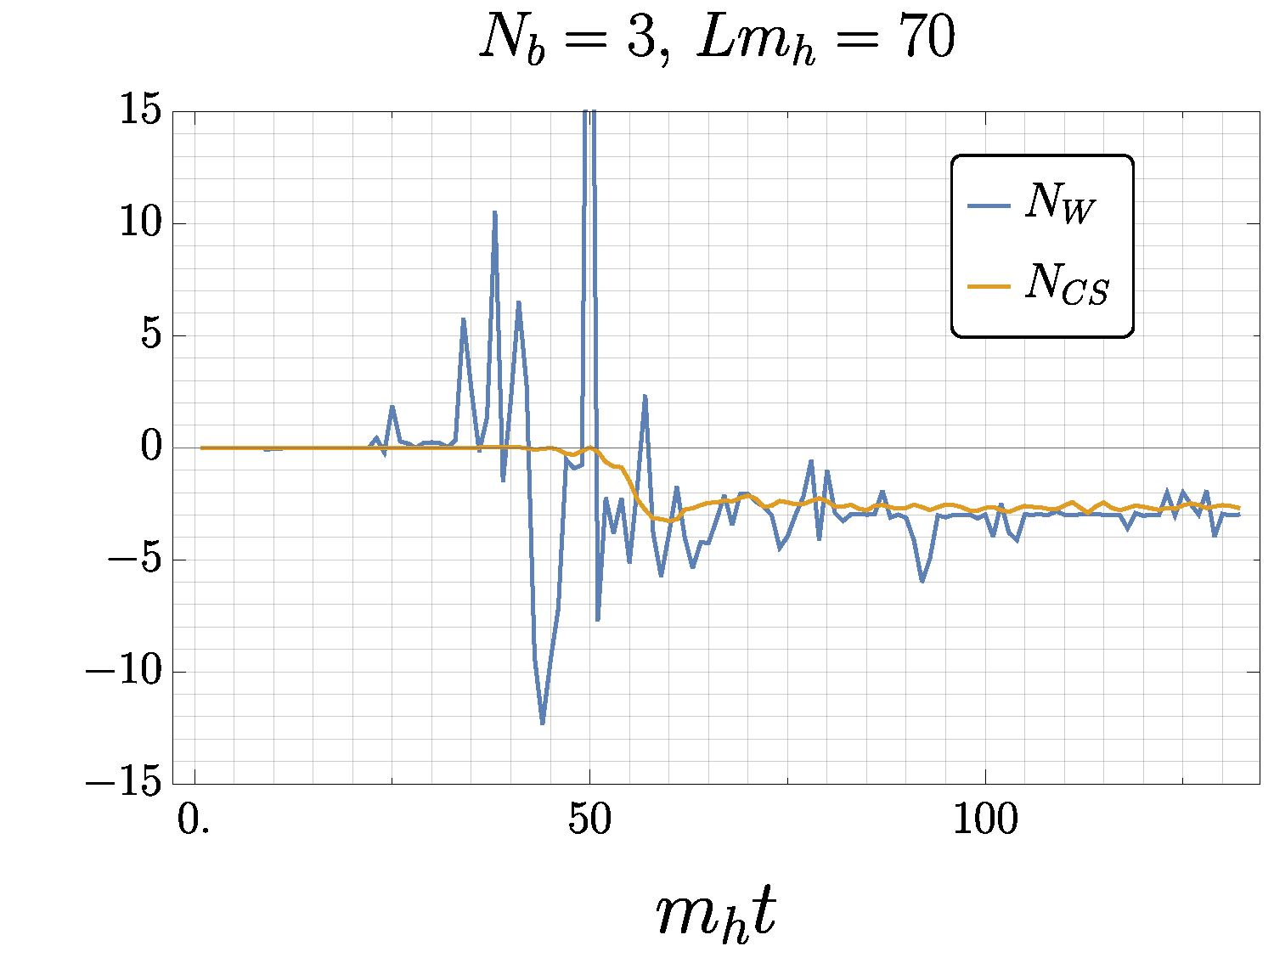



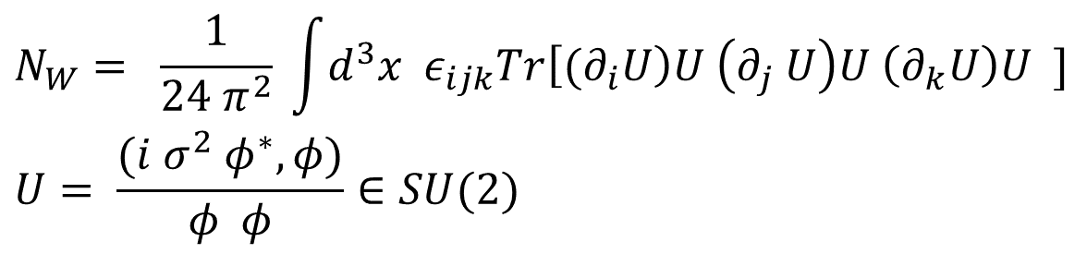
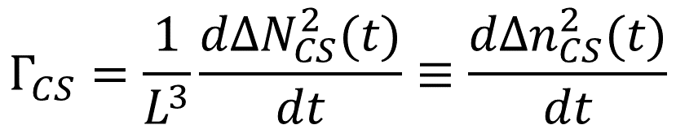
Higgs bubble collisions induce Higgs field inhomogeneities due to different SU(2) orientations
Production and decay of SU(2)-gauge textures, non-trivial Higgs configurations labeled by the winding number
$$N_{W}= \frac{1}{24 π^{2}} \int{d^{3}x ε_{ijk}Tr\left[{(∂}_{i}U\right)U \left(∂_{j} U\right)U \left(∂_{k}U\right)U ]}$$
$$U= \frac{(i σ^{2} φ^{∗}, φ)}{φ φ}∈SU(2)$$
$$N_{W}=N_{CS}≠0$$
$$Γ_{CS}=\frac{1}{L^{3}}\frac{dΔN_{CS}^{2}(t)}{dt}≡\frac{dΔn_{CS}^{2}(t)}{dt}$$
Non-zero Chern-Simons rate
with Chern-Simons variance (averaged over many realizations)
$$ΔN_{CS}^{2}(t)≡\left\langle N_{CS}{\left(t\right)}^{2}\right\rangle −{\left\langle N_{CS}\left(t\right)\right\rangle }^{2}$$
Note: CP-violation is not included in our simulations
$$⟨N_{CS}⟩ =0$$
1
3
Martina Cataldi
SM Baryon Number Violation at T=0 from Higgs Bubble Collisions

Slide 6
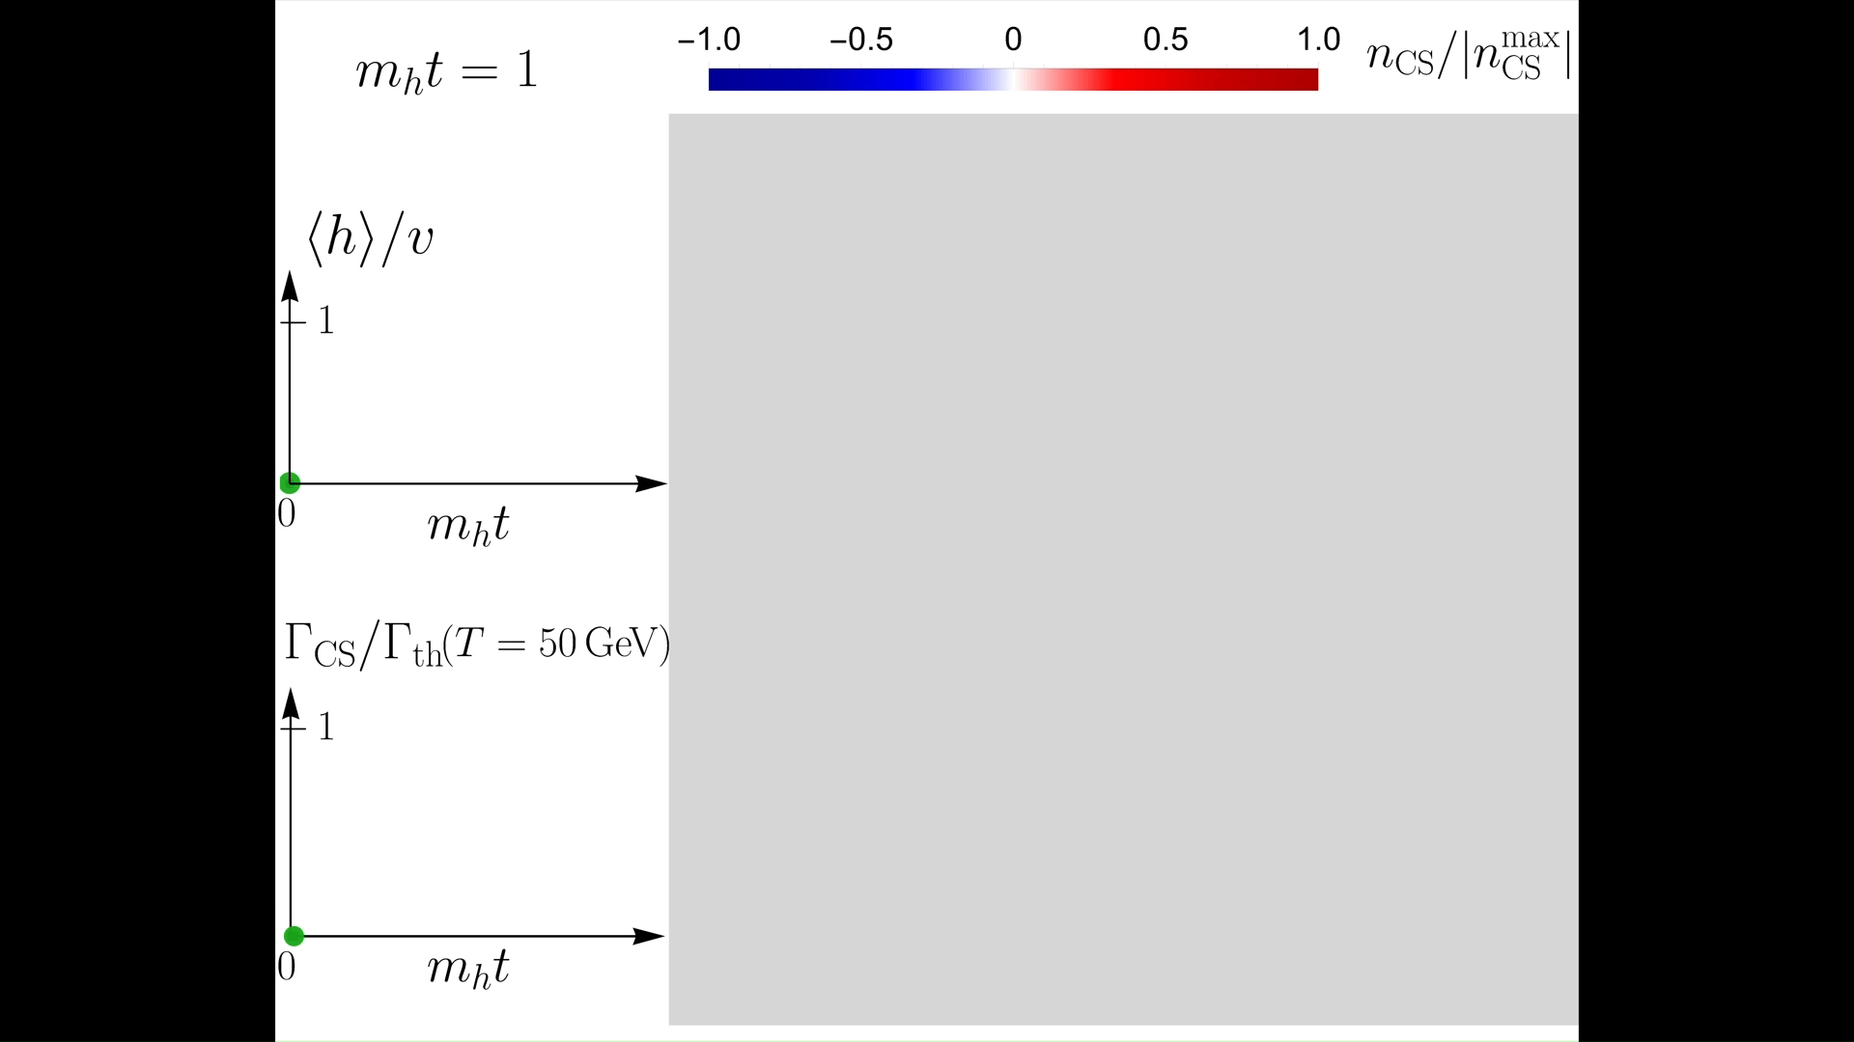
Martina Cataldi
2

Slide 7
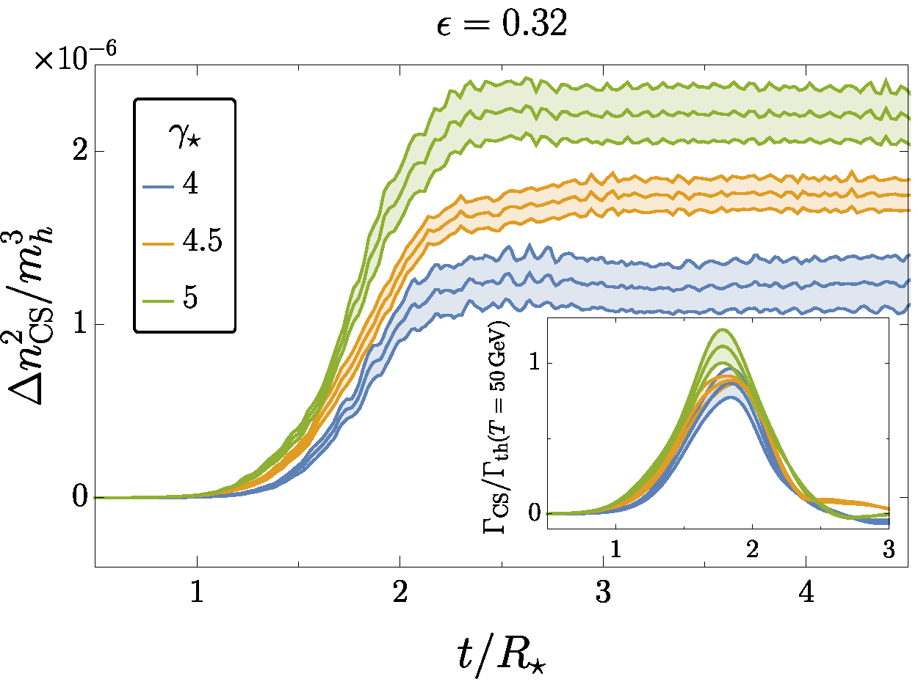
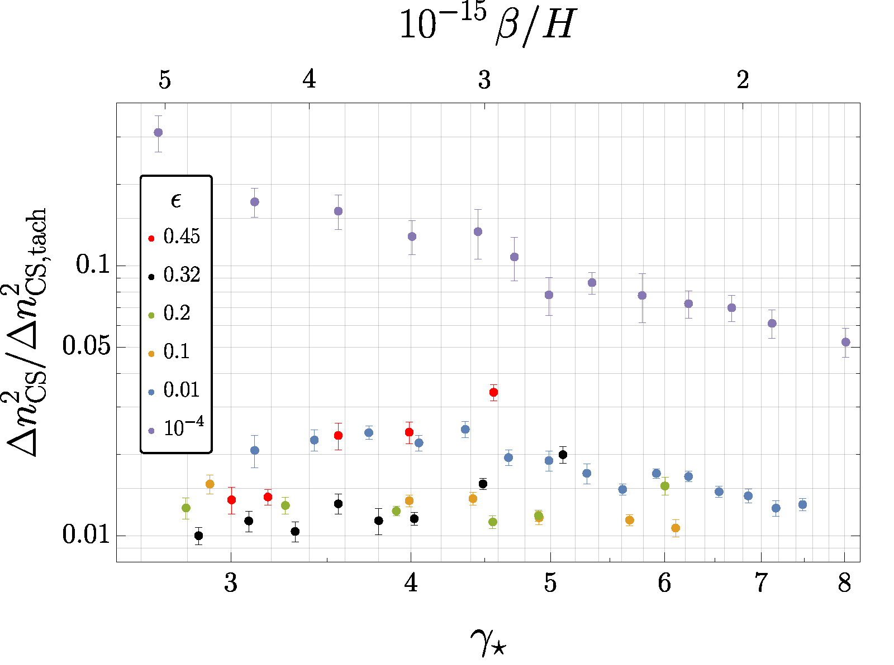



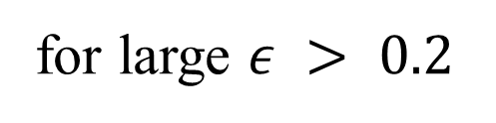
$${Δn}_{CS, tach}^{2}={10}^{−4} m_{h}^{3}$$
$$Γ_{th }\sim 25 α_{w}^{5}T^{4}$$
D’Onofrio, et al., Phys. Rev. Lett. 113, 141602 (2014)
Given the parametrization $Δn_{CS}^{2}∝γ_{⋆}^{a}$ (thus $Γ_{CS}∝γ_{⋆}^{a−1}$),
for large $ε > 0.2$
constant or increasing CS variance in the physical limit $γ_{⋆ }→ ∞$
$$a>0$$
Note: clearer hint for linear dependence, i.e. $a=1$, in the (1+1)D case with U(1)-gauge field!
Sizable baryon number production at large $ε$
Same order of magnitude as thermal sphaleron rate in the symmetric phase at electroweak temperatures
1
4
Martina Cataldi
SM Baryon Number Violation at T=0 from Higgs Bubble Collisions

Slide 8

Summary
Very first computation of SM Baryon Number Violation at Zero Temperature from Higgs Bubble Collisions in a strongly First Order ElectroWeak Phase Transition
New ElectroWeak Baryogenesis mechanism for FOEWPT with: 1) low reheat temperature
2) large bubble wall velocity
CS production strongly depends on Higgs potential’s shape, controlled by degeneracy parameter $ε$
For large $ε>0.2$, non-decreasing CS variance with bubble wall Lorentz-factor at collision $γ_{⋆}$
Sizable baryon number production, potentially leading to correct baryon asymmetry e.g with CP-violating source
Next: include numerically CP-violation.
Check out
the paper!
And more details in 2508.21825
1
5
Martina Cataldi
SM Baryon Number Violation at T=0 from Higgs Bubble Collisions

Slide 9
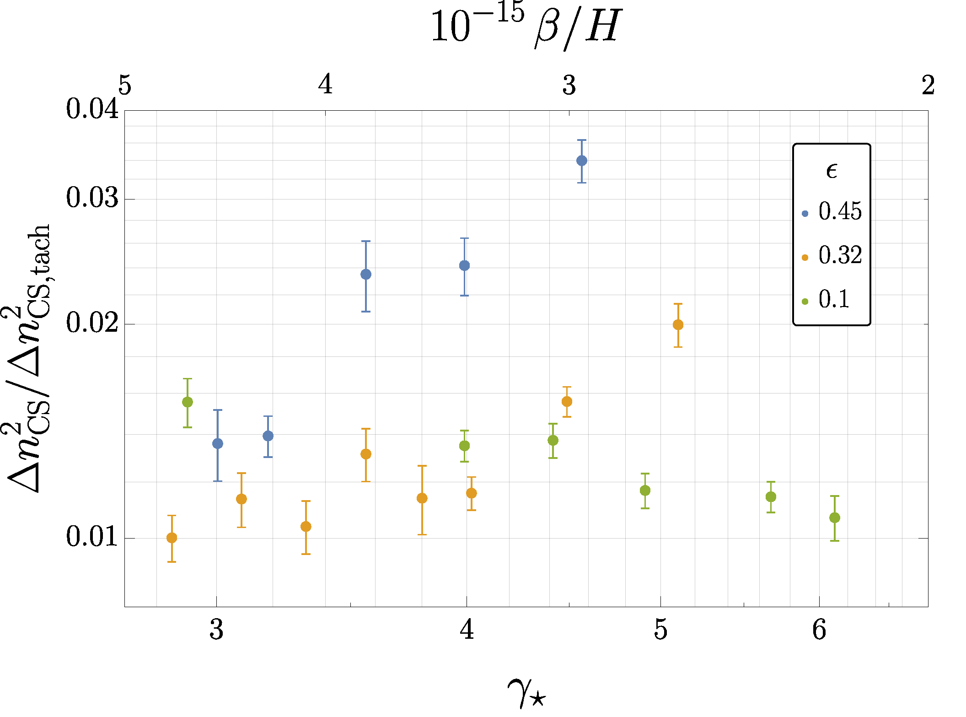






Backup – (3+1)D simulations
Extensive lattice implementation of Higgs doublet and SU(2)-gauge fields
and critical bubble profile
w/ toy potential
Sphaleron rate in the symmetric phase:
$$Γ_{th }\sim 25 α_{w}^{5}T^{4}$$
Effective sphaleron rate in a quenched EW crossover (tachyonic instability):
$$Γ_{tach }= α_{w}^{4}T_{eff}^{4}$$
with CS variance for instantaneous quench
$${Δn}_{CS, tach}^{2}={10}^{−4} m_{h}^{3}$$
B.1
Martina Cataldi
SM Baryon Number Violation at T=0 from Higgs Bubble Collisions

Slide 10



Backup -
Dependence of CS variance on $ε$ : (1+1)D case with U(1)-gauge field
SM Baryon Number Violation at T=0 from Higgs Bubble Collisions
Martina Cataldi
B.2

Slide 11

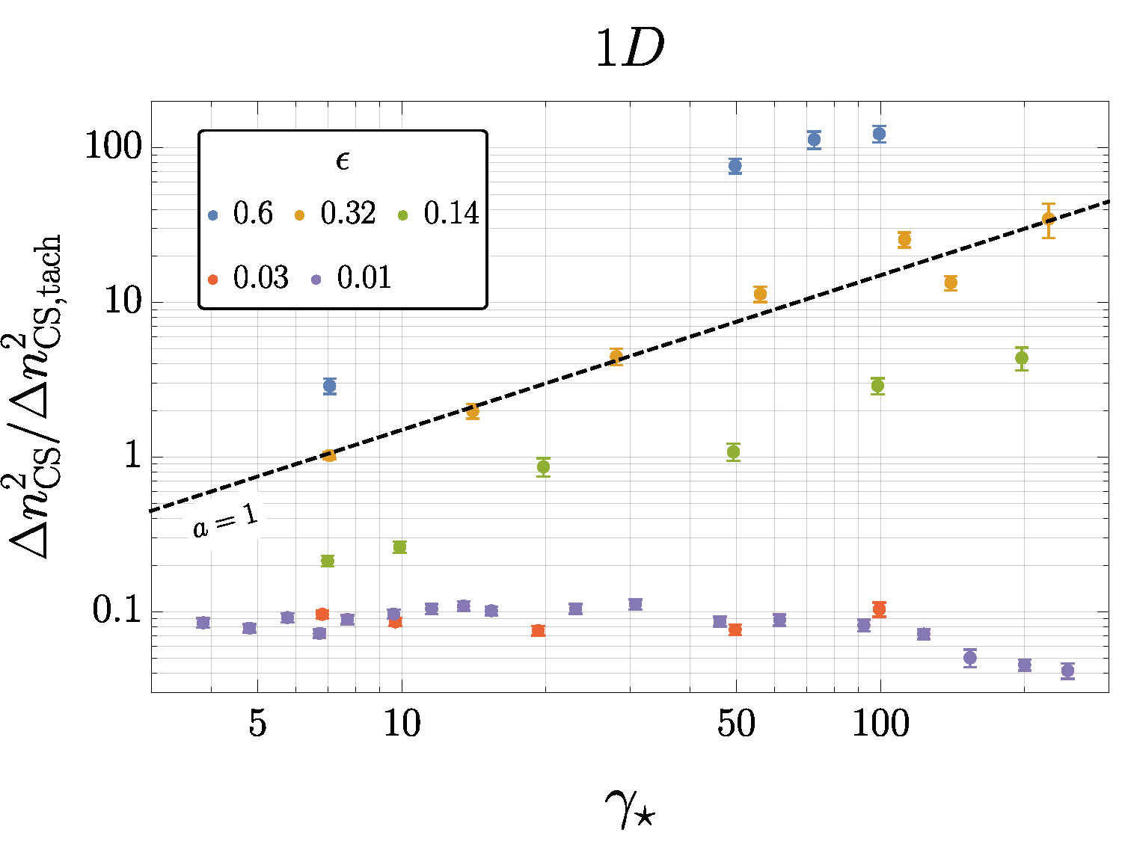
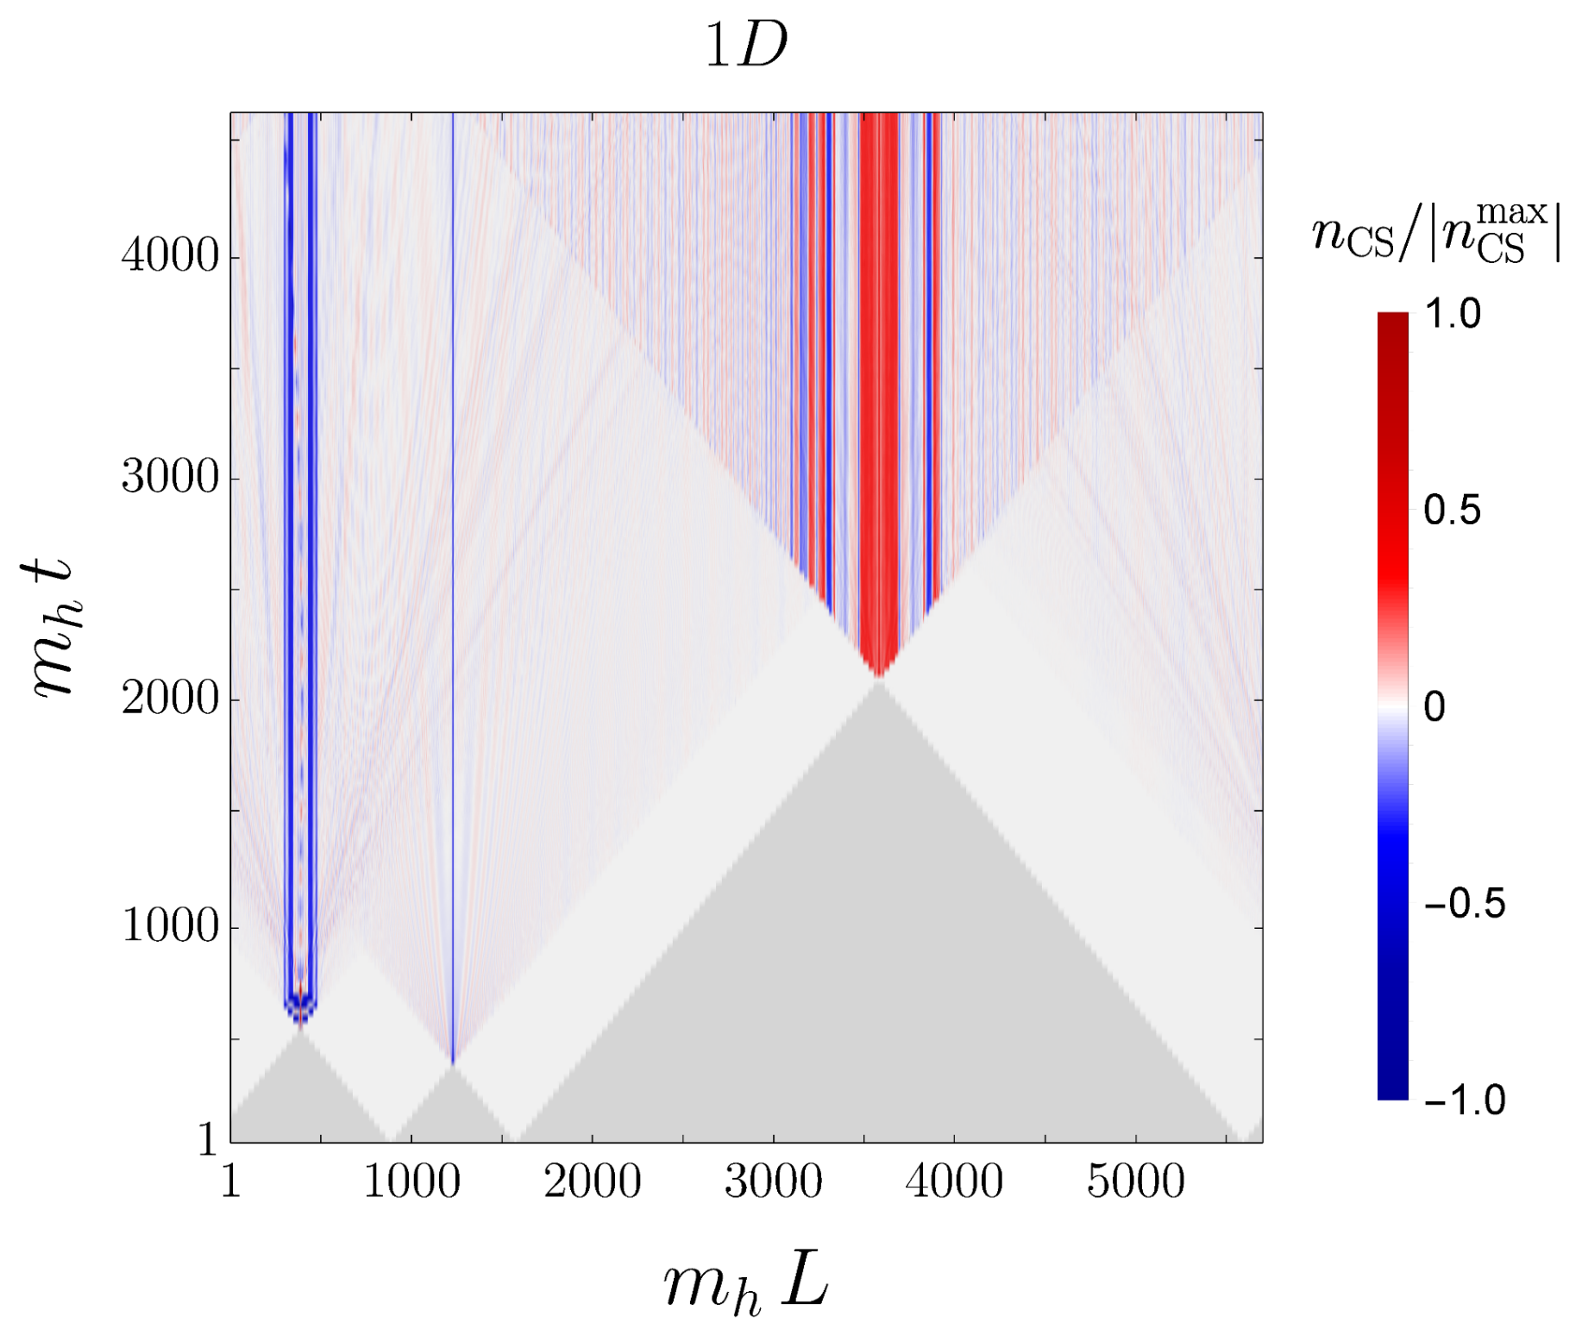




Backup -
Dependence of CS variance on $ε$ : (1+1)D case with U(1)-gauge field
Probe larger $ε$ and $γ_{⋆}$
CS production changes behavior
Martina Cataldi
SM Baryon Number Violation at T=0 from Higgs Bubble Collisions
B.3

Slide 12
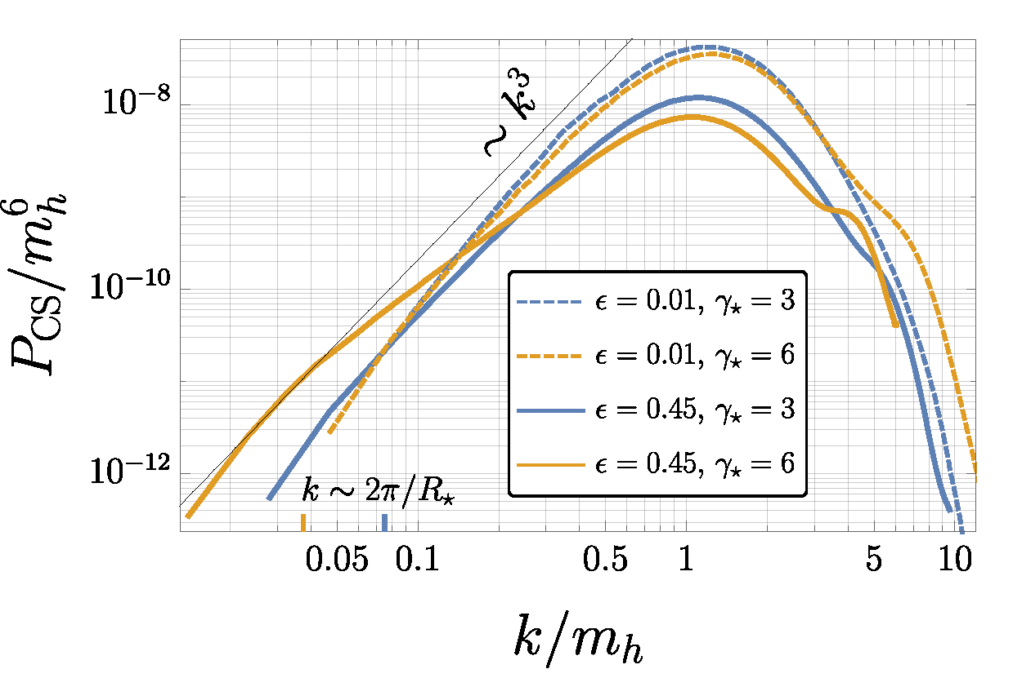
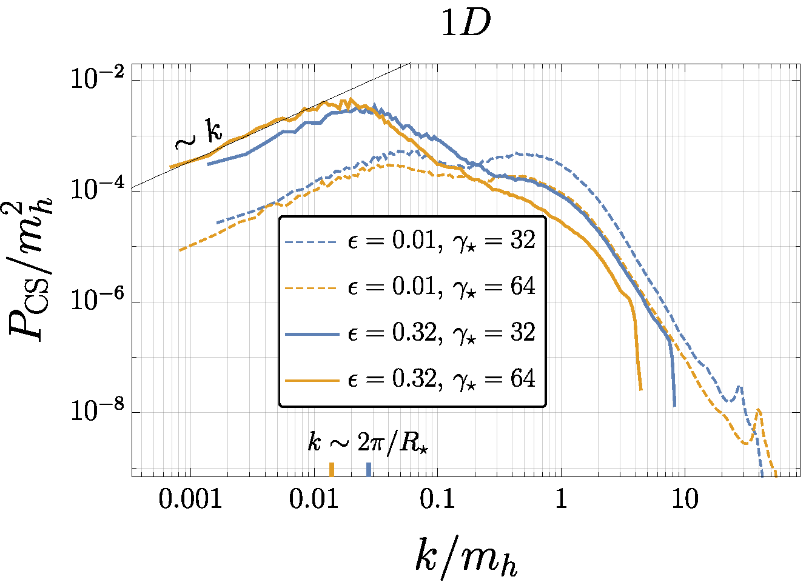
Backup – CS Spectra
3D
B.4
Martina Cataldi
SM Baryon Number Violation at T=0 from Higgs Bubble Collisions

