Slide 1
Neutrino Oscillations as
Vacuum Multi-refringence
Nico Stirling
University of Helsinki
Based on:
Markku Oksanen, Nico Stirling, & Anca Tureanu. Neutrino flavour waves through the quantum vacuum: A theory of oscillations. Physics Letters B, 865, 139461, arXiv: 2411.14348
INVISIBLES25
Neutrino Oscillations as Vacuum Multi-refringence
Nico Stirling / University of Helsinki
INVISIBLES25

Slide 2
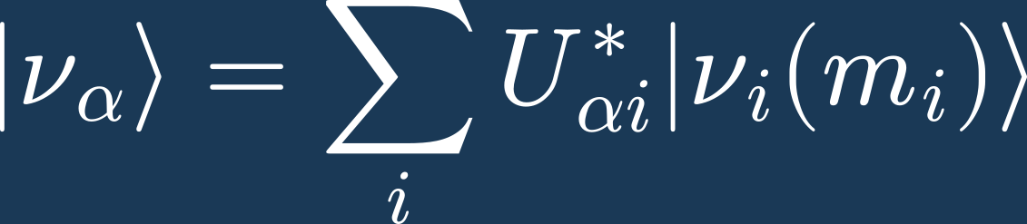



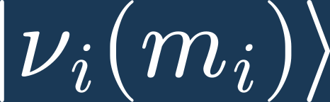
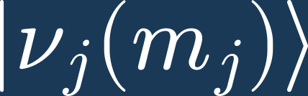
Motivation
Standard neutrino oscillation theory assumes:
, where
But, this is inconsistent with quantum theory due to superselection rules:
When it holds that ,
Then and belong to different superselection sectors
And therefore their coherent superpositions are not allowed
Neutrino Oscillations as Vacuum Multi-refringence
Nico Stirling / University of Helsinki
INVISIBLES25

Slide 3
Our Approach
Massless flavour neutrinos are the only physical particle states.
The Lagrangian mass terms are treated as interactions which induces coherent forward scattering during propagation in vacuum.
Multiple coherent forward scattering leads to a coherent wave which experiences multi-refringence.
The coherent wave gives the probability amplitude for neutrino oscillations.
The feebleness of the ''mass giving'' interaction justifies treating neutrinos as massless in weak interactions:
Neutrino Oscillations as Vacuum Multi-refringence
Nico Stirling / University of Helsinki
INVISIBLES25

Slide 4




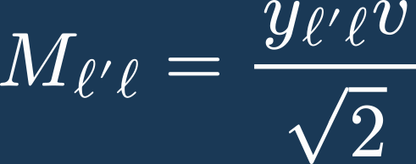
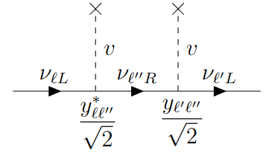

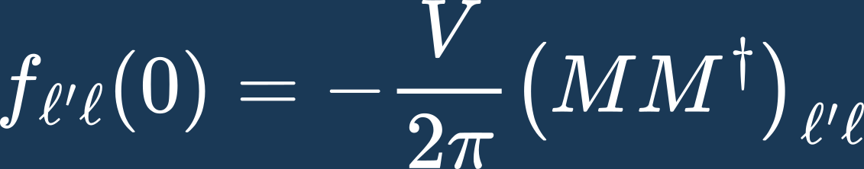

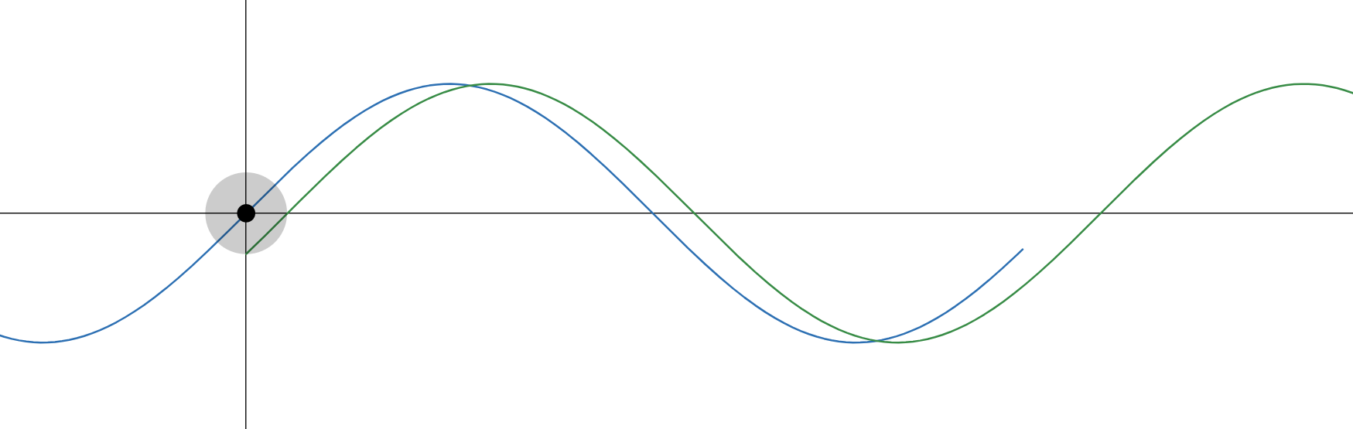

Details
1. Production
Propagation
Detection
Assuming
Dirac neutrinos
Higgs mechanism
where
Definite flavour
Definite energy
Definite momentum
Massless:
Standard Oscillation Probabilities:
2. Coherent forward scattering:
Scattering amplitude
Phase kicks at each scattering
Energy, momentum not changed
Multiple scattering:
Neutrino Oscillations as Vacuum Multi-refringence
Nico Stirling / University of Helsinki
INVISIBLES25

Slide 5
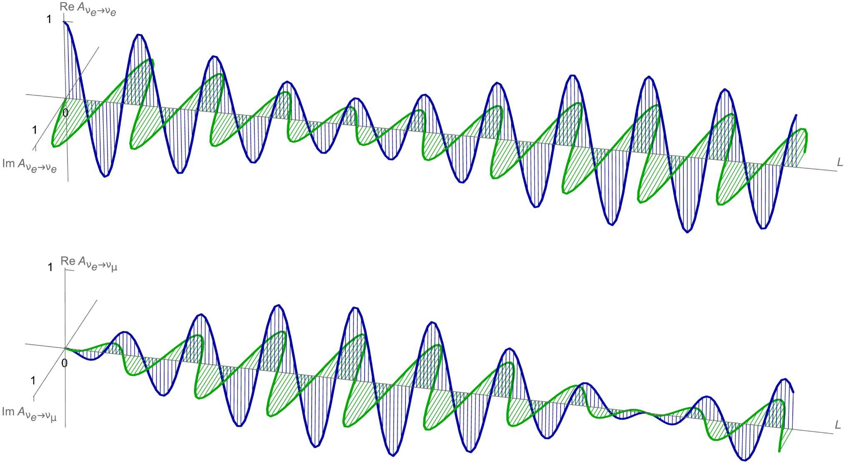
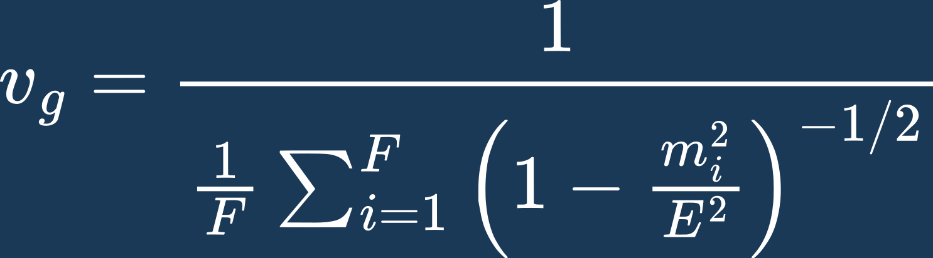
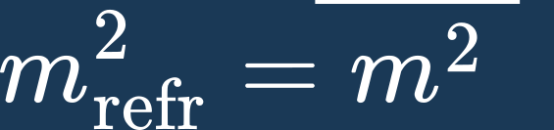
Coherent Neutrino Wave Properties
1. Multicomponent complex wave with modulated amplitude
2. Universal group velocity and effective refractive mass
,
3. Evanescence
Neutrino Oscillations as Vacuum Multi-refringence
Nico Stirling / University of Helsinki
INVISIBLES25

Slide 6
Key Results
Theoretical advantages
Describing flavour oscillation without resorting to different mass superpositions.
Coherence is manifest throughout production, propagation and detection.
Well defined speed, energy and momentum of oscillating neutrinos.
Phenomenology
Prediction of zero mass in weak decay kinematics (KATRIN, Project 8)
Prediction for neutrino time of flight based on unique group velocity.
No decoherence induced by wave packet separation due to unique group velocity of wave.
Low energy neutrino evanescence due to mass being a refractive effect.
Neutrino Oscillations as Vacuum Multi-refringence
Nico Stirling / University of Helsinki
INVISIBLES25

Slide 7
Thank you!
Poster + happy to discuss at any time
Neutrino Oscillations as Vacuum Multi-refringence
Nico Stirling / University of Helsinki
INVISIBLES25

Slide 8
References
This work:
M. Oksanen, N. Stirling, & A. Tureanu (2025). Neutrino flavour waves through the quantum vacuum: A theory of oscillations. Physics Letters B, 865, 139461. arXiv: 2411.14348
More on neutrino oscillations and multi-refringence:
2. A. Tureanu (2023). Neutrino oscillations by a manifestly coherent mechanism and massless vs. massive neutrinos.
Physics Letters B, 843, 137996. arXiv:2304.13491
3. A. Tureanu (2025). On massive neutrinos and coherence in neutrino oscillations. Nuclear Physics B, 1018, 117052.
4. S. F. Ge, C. F. Kong and A. Y. Smirnov (2024). Testing the Origins of Neutrino Mass with Supernova-Neutrino Time Delay.
Phys. Rev. Lett. 133 no.12, 121802. arXiv:2404.17352
Multiple scattering framework:
4. L. L. Foldy (1945). The Multiple Scattering of Waves. Physics Reviews, 67, 107.
5. M. Lax (1951). Multiple Scattering of Waves. Reviews of Modern Physics, 23, 287.
Superselection rules:
6. F. Strocchi, An Introduction to Non-Perturbative Foundations of Quantum Field Theory, Oxford University Press, 2013.
Neutrino Oscillations as Vacuum Multi-refringence
Nico Stirling / University of Helsinki
INVISIBLES25

