Slide 1
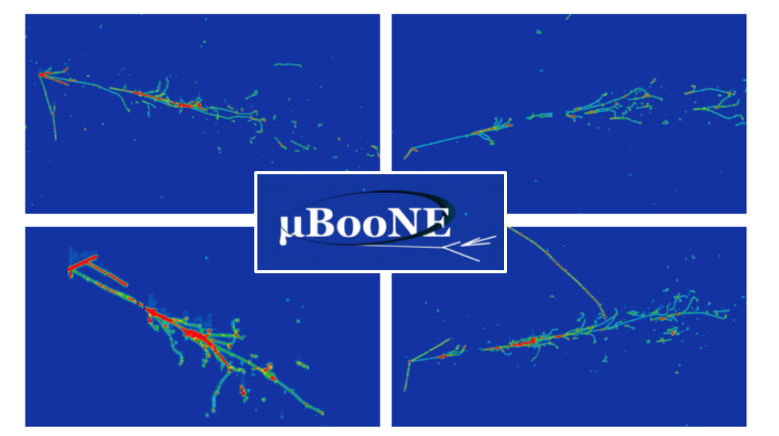
MicroBooNE’s BSM physics programme
Justin Evans
University of Manchester

Slide 2
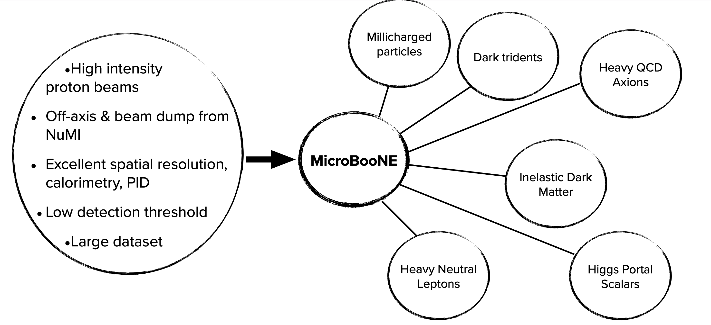
BSM physics with MicroBooNE

Slide 3
BSM physics with MicroBooNE
Results shown in this talk:
arXiv:2501.08052
Phys. Rev. Lett. 132, 241801 (2024)
Phys. Rev. Lett. 132, 041801 (2024)
J. Instrum. 19, P07032 (2024)
Phys. Rev. Lett. 130, 011801 (2023)
Phys. Rev. D 106, 092006 (2022)
Phys. Rev. Lett. 127, 151803 (2021)
Phys. Rev. D 101, 052001 (2020)
Made possible by a strong relationship with theorists, providing models and sensitivity estimates

Slide 4
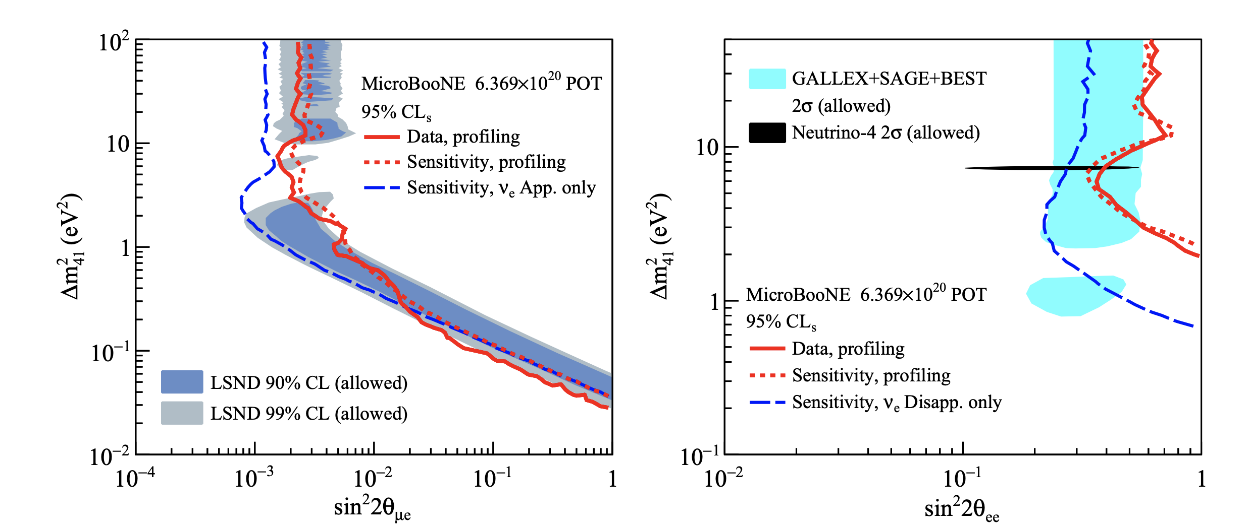
Constraints on eV sterile neutrinos
Phys. Rev. Lett. 130, 011801 (2023)

Slide 5
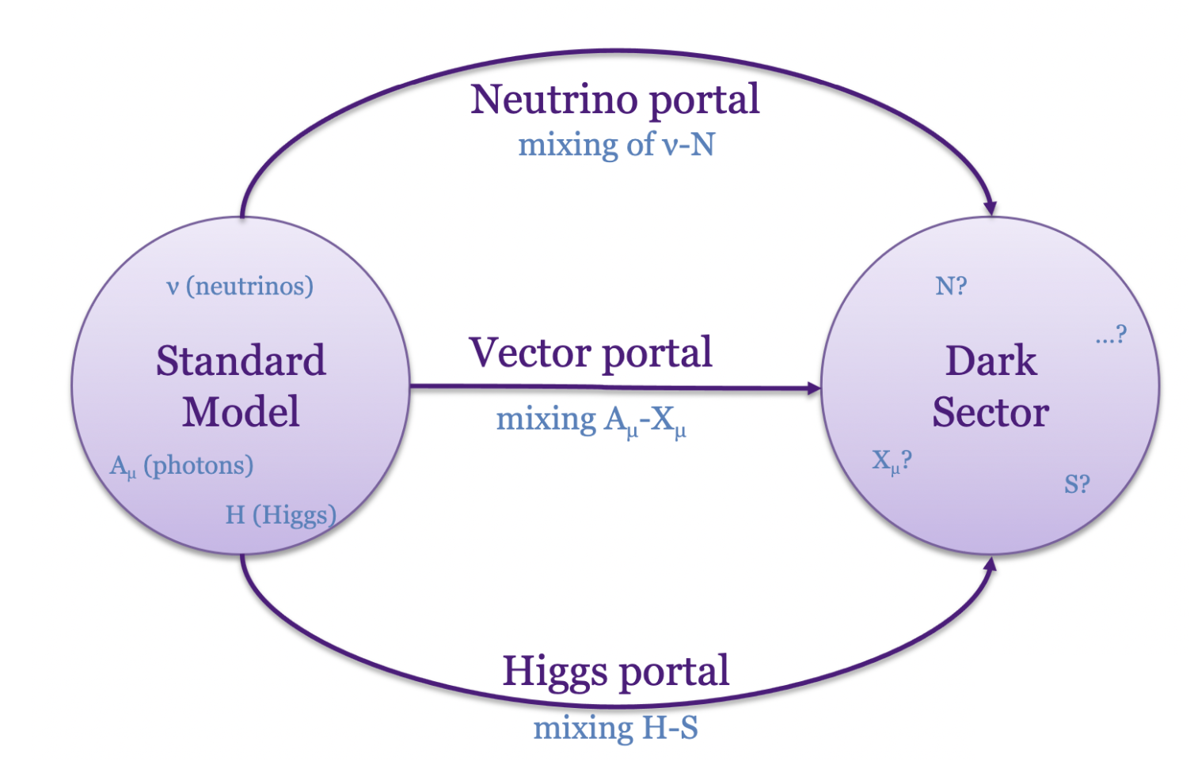
Portals to dark sectors

Slide 6
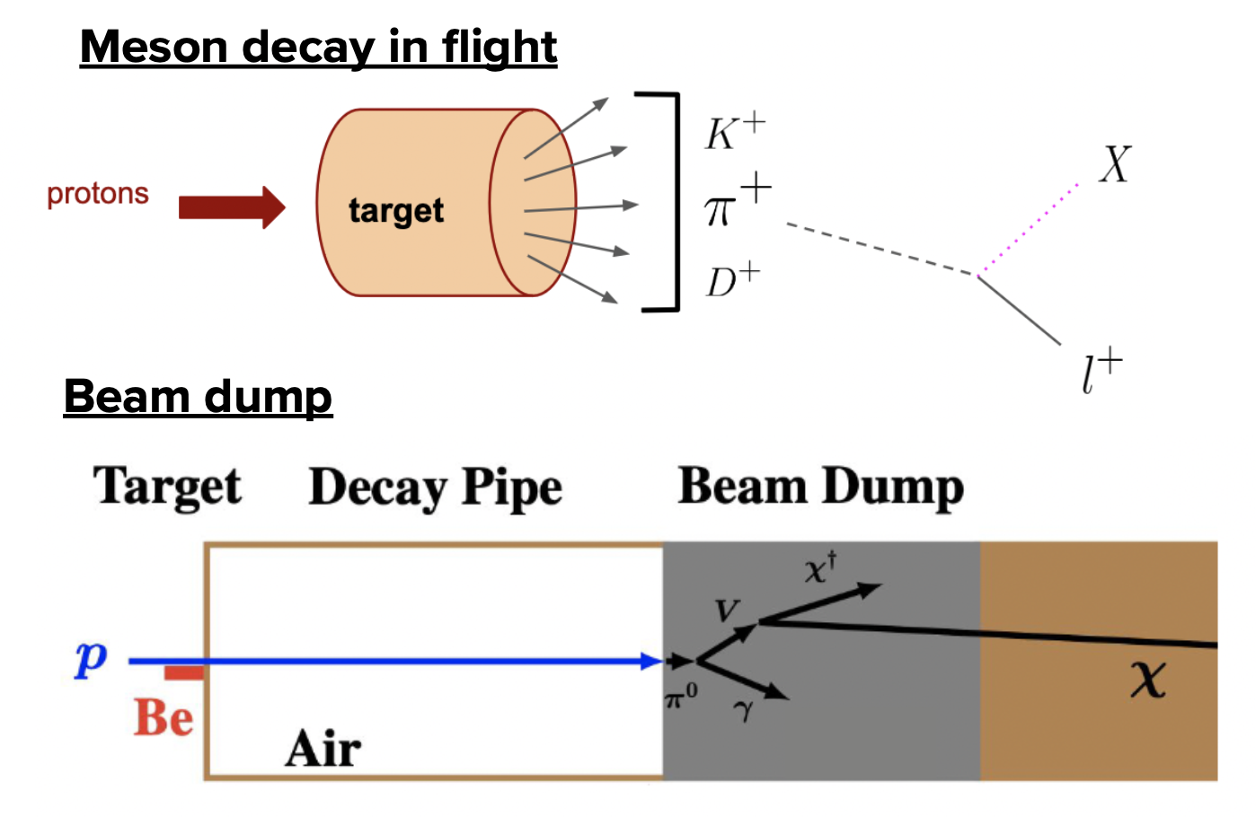
Portals to dark sectors
New particles can be produced from meson decays
  Large flux of charged & neutral mesons from high intensity proton beams

Slide 7
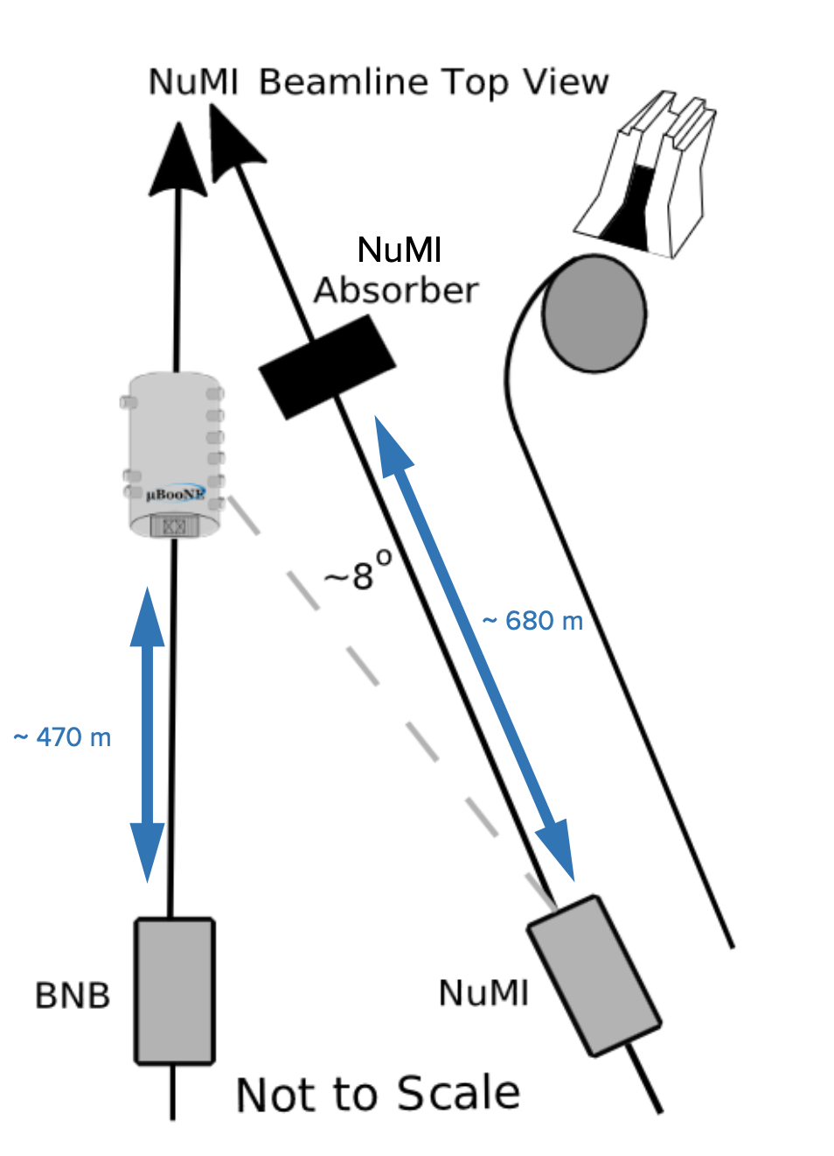
Two beamlines
Booster Neutrino Beam
8 GeV protons
0.8 GeV mean neutrino energy
On-axis
NuMI Beam
120 GeV protons
1.5 GeV mean neutrino energy
~8º off-axis

Slide 8
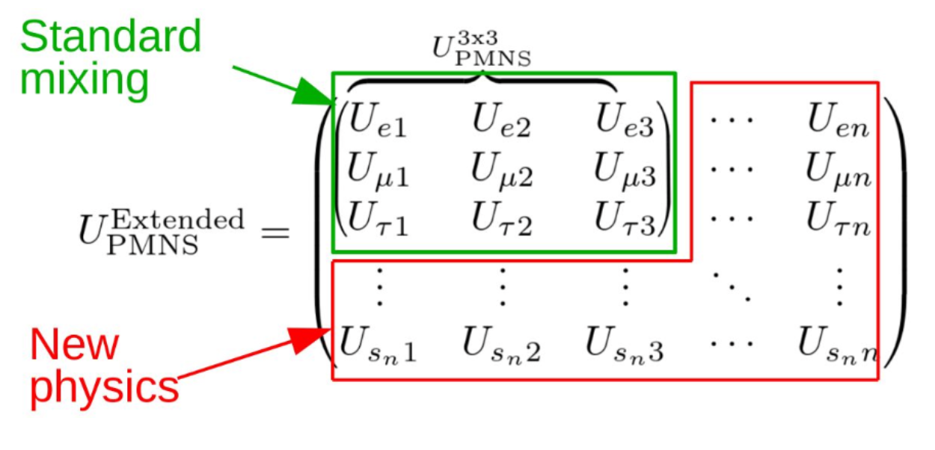
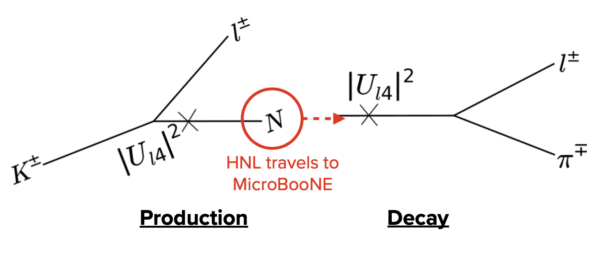
Heavy neutral leptons (HNLs)
Incorporate a new right-handed singlet that mixes with the active neutrinos
Heavy neutral leptons produced in the beam
  Decay to Standard-Model particles in the detector

Slide 9
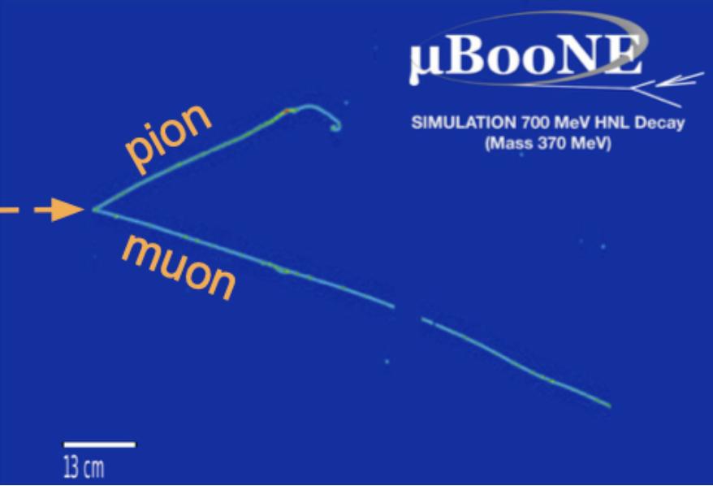
Heavy neutral leptons (HNLs)
Production and decay rates both proportional to |U_{l4}|²

Slide 10
Heavy neutral leptons (HNLs)
We assume |U_{e4}|= |U_{τ4}|=0 and set limits on |U_{μ4}|
We focus on production via K → μN

Slide 11
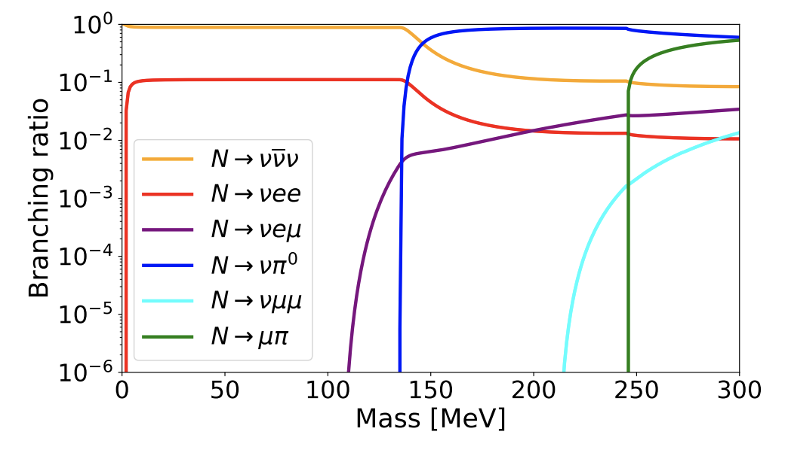
Heavy neutral leptons (HNLs)
We assume |U_{e4}|= |U_{τ4}|=0 and set limits on |U_{μ4}|
We focus on production via K → μN
Most likely decay channel depends on m_{N}

Slide 12
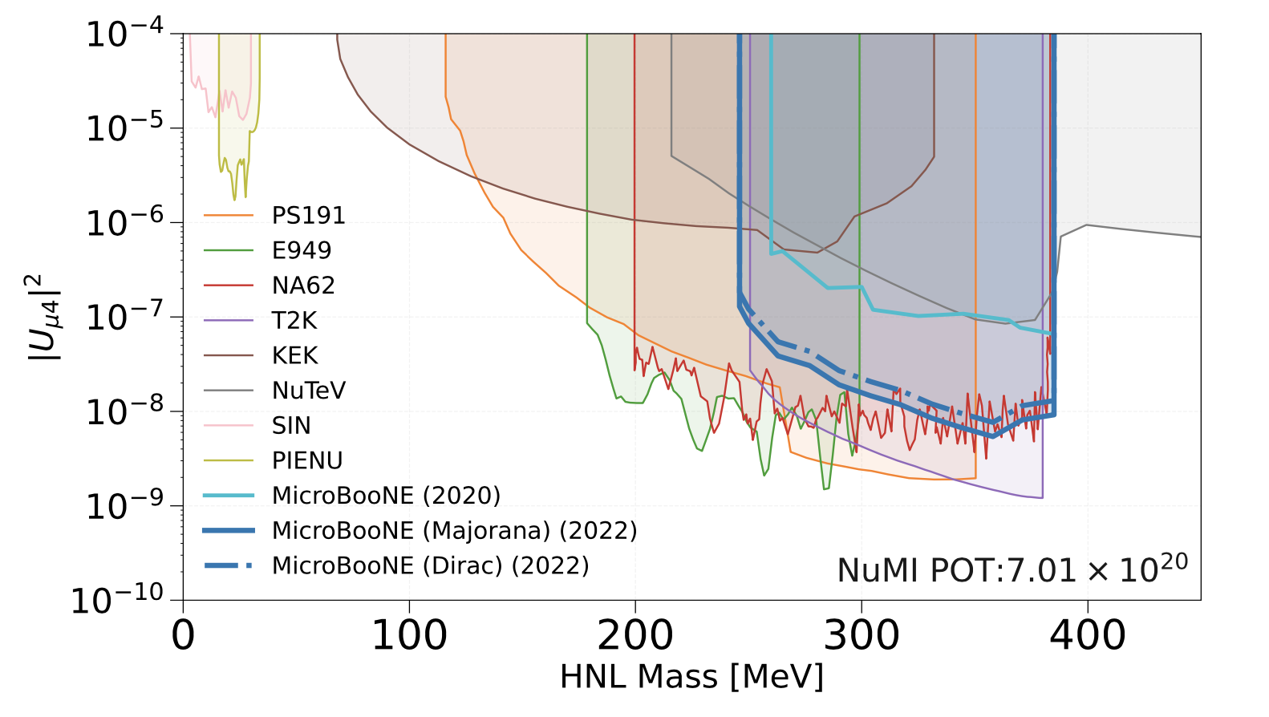
Search for N → μ±π∓
Phys. Rev. D 106, 092006 (2022)

Slide 13
Search for N → μ±π∓
Phys. Rev. D 106, 092006 (2022)
Kinematic limit for K → μN production
Kinematic limit for N → μπ decay

Slide 14
Search for N → μ±π∓
Phys. Rev. D 106, 092006 (2022)
Majorana HNL
N → μ⁺π – and N → μ – π⁺
Isotropic decays (summed over both channels)
Dirac HNL
N → μ – π⁺ only: factor of two lower rate
Non-isotropic decays (negligible effect)

Slide 15
Search for N → μ±π∓
Phys. Rev. D 106, 092006 (2022)
BNB search
Phys. Rev. D 101, 052001 (2020)
NuMI search
Phys. Rev. D 106, 092006 (2022)

Slide 16
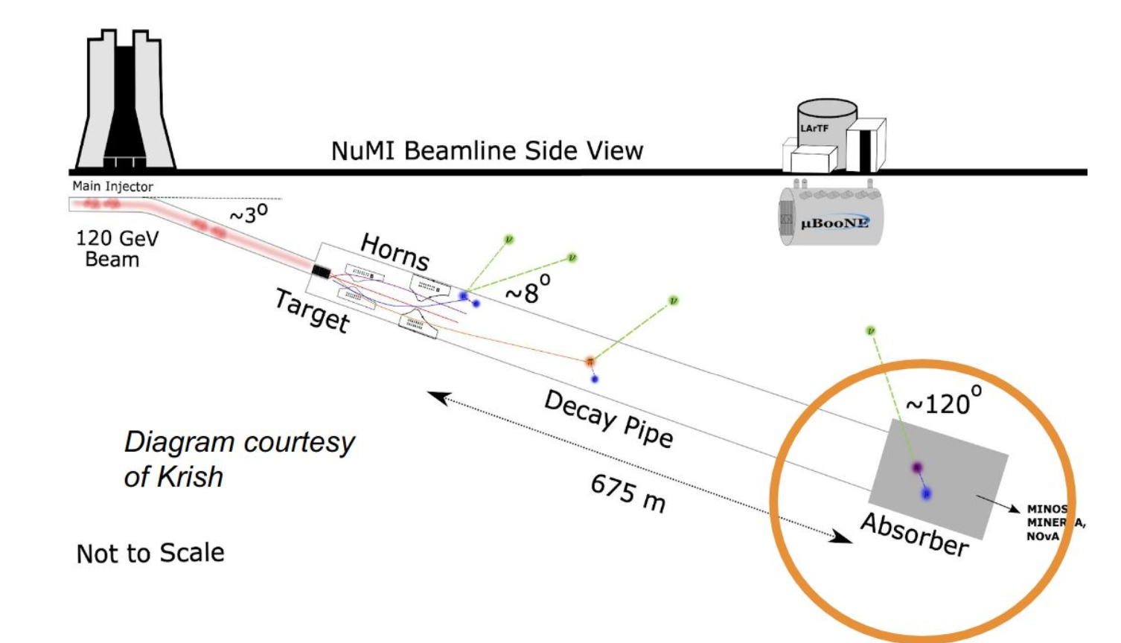
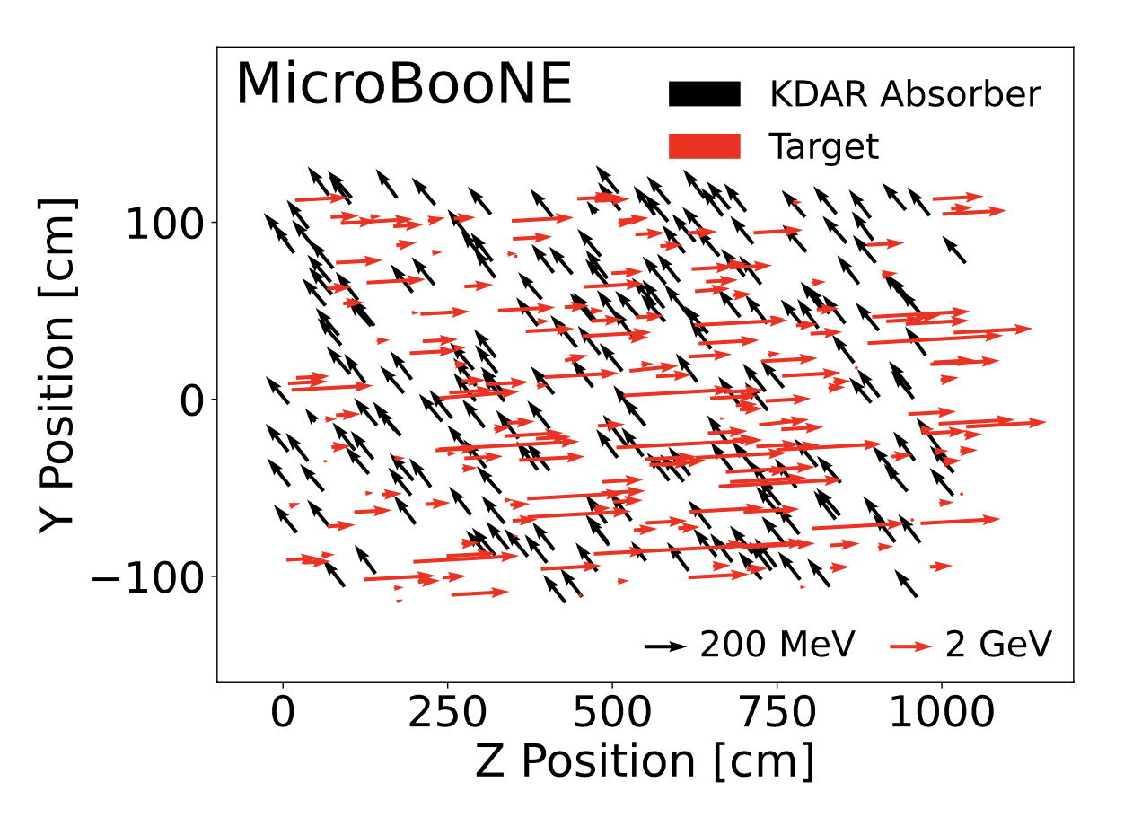
NuMI search: off-axis
Events from HNLs produced in the NuMI absorber have a specific directionality
Phys. Rev. D 106, 092006 (2022)

Slide 17
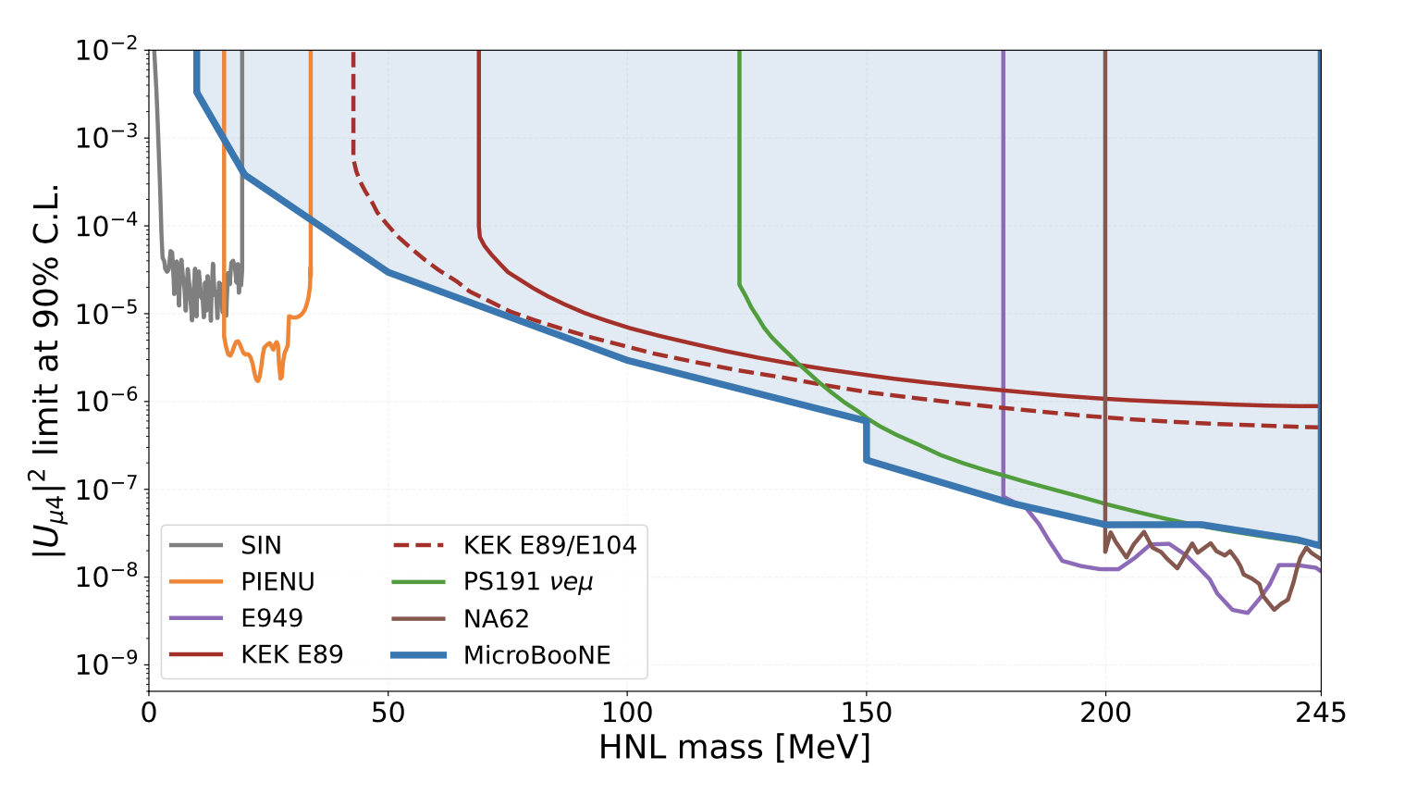
Lighter heavy neutral leptons
Phys. Rev. Lett. 132, 041801 (2024)

Slide 18
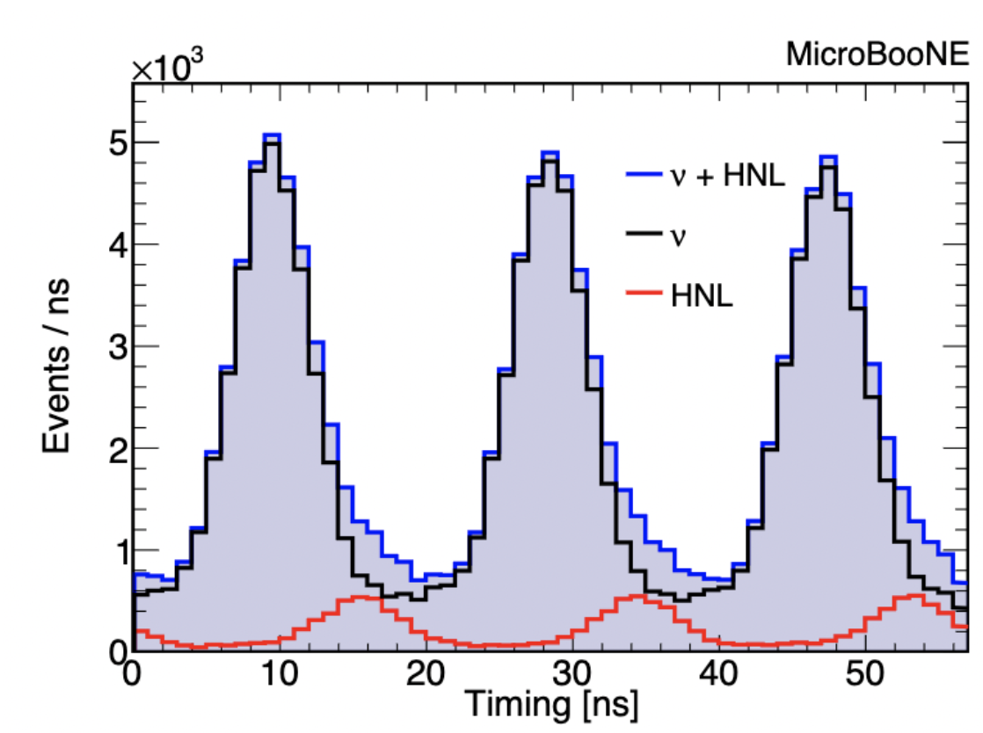
Potential upgrade with ns timing
Phys. Rev. D 108, 052010 (2023)
(70 MeV)

Slide 19
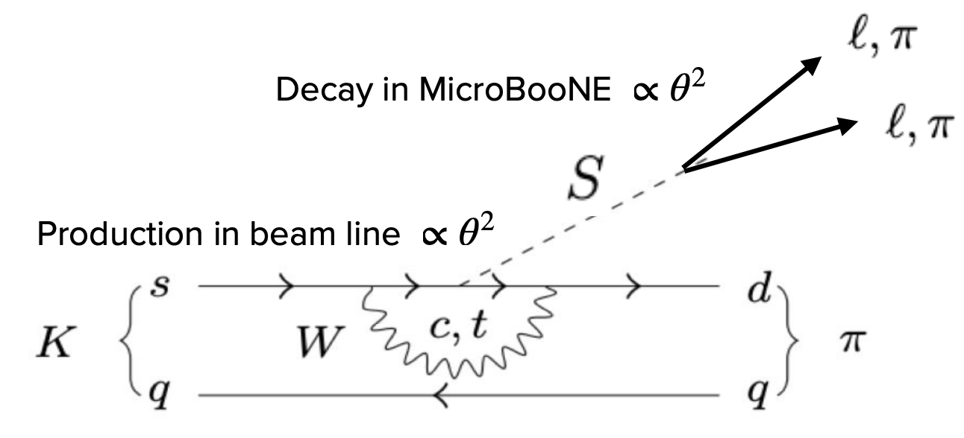
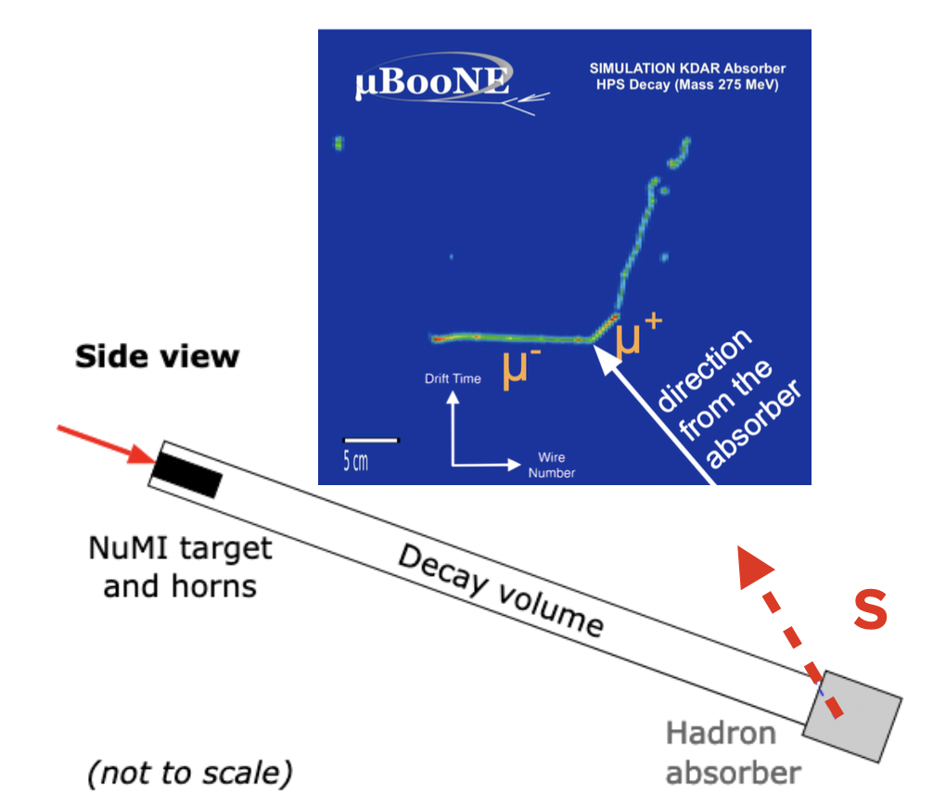
Higgs portal scalars
Neutral singlet scalar, S
Mixes with the Higgs, parameterized by an angle θ
Produced in meson decays in the beam
Decays into Standard-Model particles in the detector

Slide 20
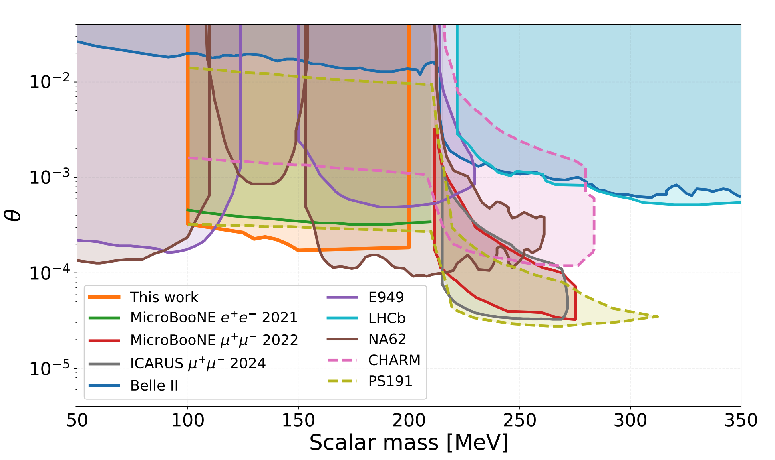
Higgs portal scalars
arXiv:2501.08052, Phys. Rev. Lett. 127, 151803 (2021), Phys. Rev. D 106, 092006 (2022)

Slide 21
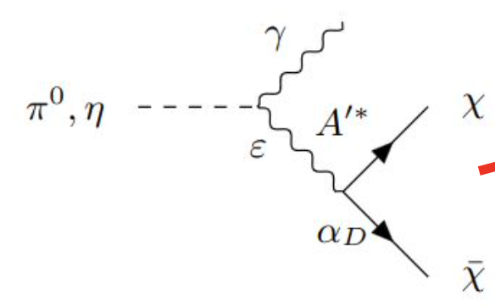
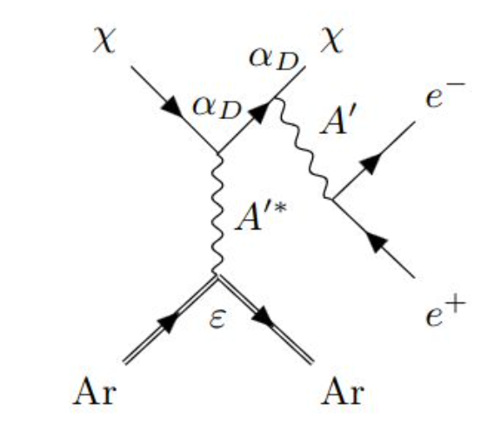
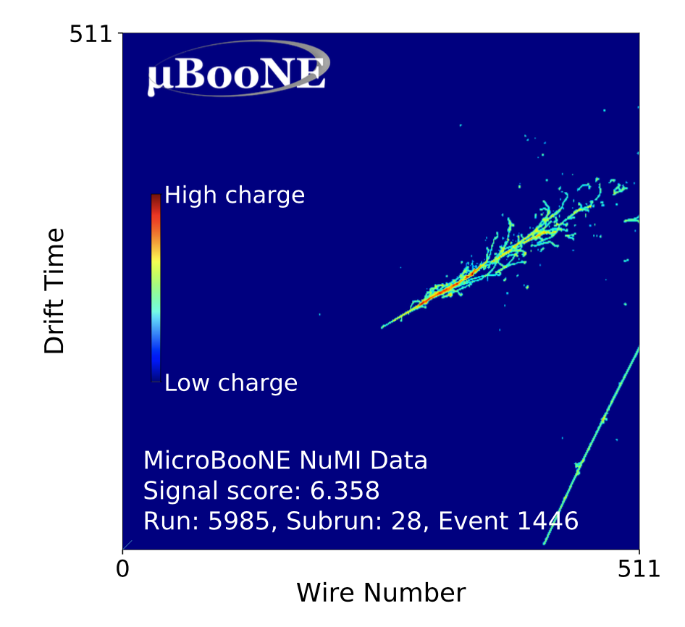
Dark tridents
Phys. Rev. Lett. 132, 241801 (2024)
Dark matter particles, χ, produced in decays of neutral mesons
χ particles interact in the detector, mediated by a dark photon
Free parameters are ε, α_{D} and M_{χ} /M_{A}
Production in the NuMI beam
Interaction in the detector
Uses pixel-based deep learning techniques

Slide 22
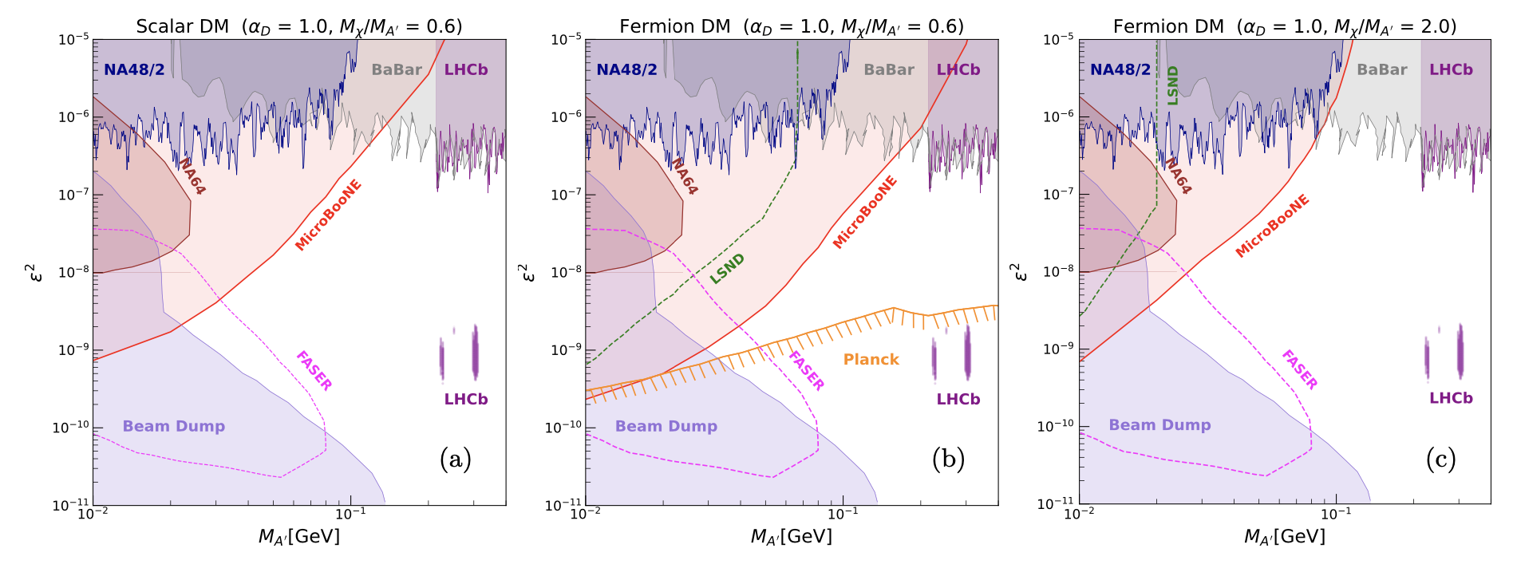
Dark tridents
Phys. Rev. Lett. 132, 241801 (2024)

Slide 23
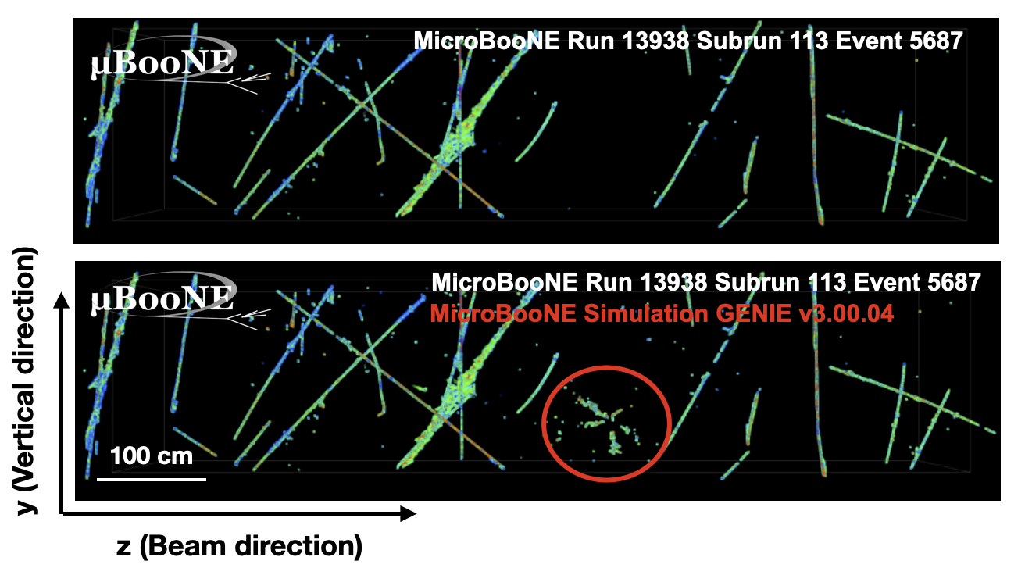
Neutron-antineutron oscillations
Neutron transforms into an antineutron
  Annihilates with a neighbouring neutron
  Produces a star-like topology of pions
We use pixel-based deep learning techniques to identify the topology
  Achieve 70% signal efficiency
  Our techniques can improve DUNE’s published efficiency for neutron-antineutron searches by a factor of 7
J. Instrum. 19, P07032 (2024)

Slide 24
Summary
Searches for BSM particles have been an integral part of MicroBooNE’s physics programme
  Heavy neutral leptons
  Higgs portal scalars
  Dark tridents
  Light sterile neutrinos
More analyses are in the pipeline
  e⁺e⁻ production, axion-like particles, millicharged particles
The full SBN programme, and DUNE, will be able to expand on these searches
We’re eager for more ideas of models we can test with our data!

