Slide 1
Science with Photons at 10s of GeV
Frank Zimmermann
many thanks to Jian-Ping Chen, M.W. Krasny, Ying Wu, J.M. Byrd and A. Variola
“Other Science Opportunities at the FCC-ee”, 28 November 2024

Slide 2
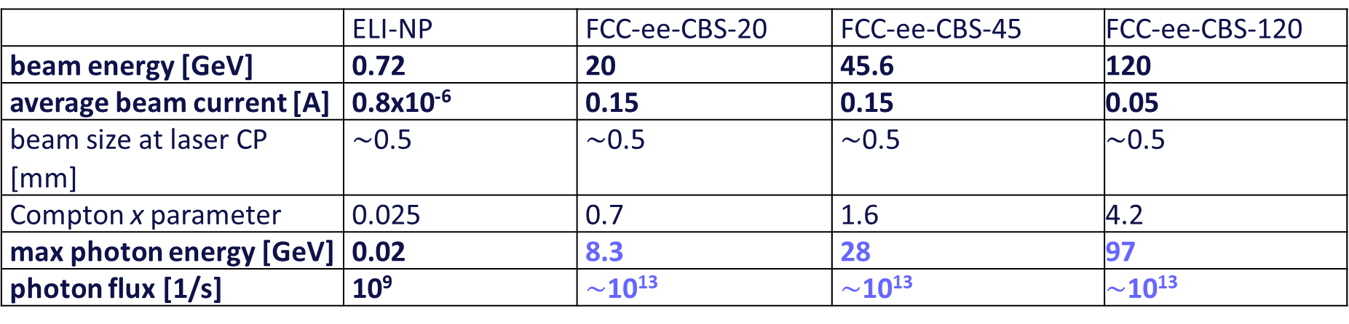
FCC-CBS: 1000-100000x more flux & higher energy than ELI-NP
Comparison of ELI-NP and FCC-ee Compton Backscattering Source (FCC-ee-CBS), assuming Yb:YAG laser (2.3 eV)
 | ELI-NP | FCC-ee-CBS-20 | FCC-ee-CBS-45 | FCC-ee-CBS-120
beam energy [GeV] | 0.72 | 20 | 45.6 | 120
average beam current [A] | 0.8x10⁻⁶ | 0.15 | 0.15 | 0.05
beam size at laser CP [mm] | $\sim$0.5 | $\sim$0.5 | $\sim$0.5 | $\sim$0.5
Compton x parameter | 0.025 | 0.7 | 1.6 | 4.2
max photon energy [GeV] | 0.02 | 8.3 | 28 | 97
photon flux [1/s] | 10⁹ | $\sim$10¹³ | $\sim$10¹³ | $\sim$10¹³
corrected by L. Serafini
The photon energies are 1000 times higher, the photon flux exceed ELI-NP’s by about a factor 10,000. To achieve this rate the laser beam recirculator system of ELI-NP would need to be modified or, possibly, be replaced by an optical cavity, suitable for cw operation.
10.5281/zenodo.7675664

Slide 3
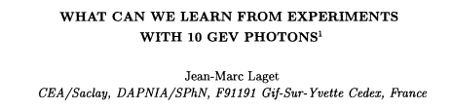
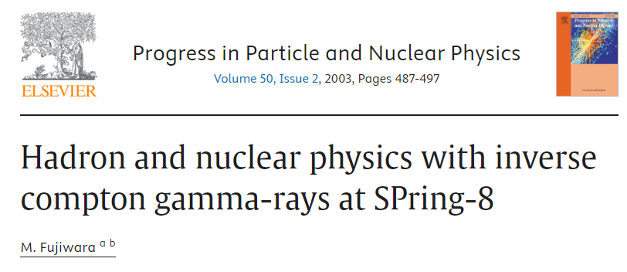
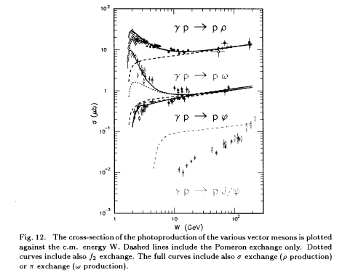
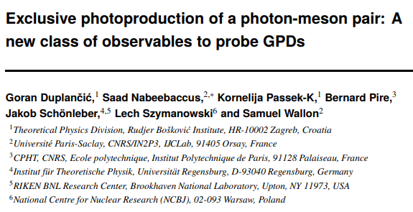
nuclear & hadron physics, QCD exploration
2003
1998
to "see" confinement mechanisms at work:
production of exotic mesons (glueballs, etc...); exchange of, free or bound, partonic systems
2024

Slide 4
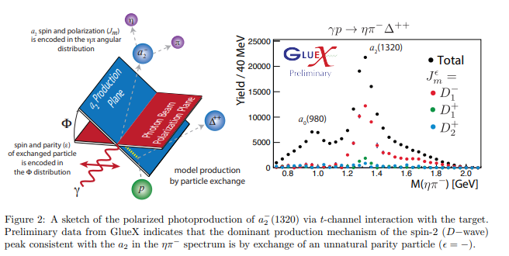
ongoing and planned studies at JLAB with 10-20 GeV photons
real photon beam in JLAB Hall D (~10 GeV) is being used for spectroscopy in search of exotic mesons (hybrid states) and near-threshold charm (J/psi) production to study the gluon field contribution (so called trace anomaly) to the proton mass (which has been a hot topic in recent years)
JLab upgrade to 22 GeV would yield real photon beam at ~ 20 GeV;
physics case highlighted in JLab22 whitepaper (https://arxiv.org/pdf/2306.09360 )
J.-P. Chen

Slide 5
physics with 40-120 GeV photons
this energy range could cover, in addition to having much wider phase space for charmonium, the beauty quarkonium and near-threshold Upsilon productions (cleaner than J/psi case and one of the main goals of EIC physics)
→ important impact on study of gluon field contributions to proton mass
circularly polarized photon beam → polarized gluon distribution, testing the convergence of the polarized sum rule (GDH sum rule) and helping constrain the high energy behavior (the Regge theory parameters)
J.-P. Chen

Slide 6
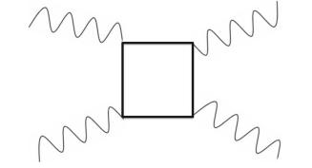
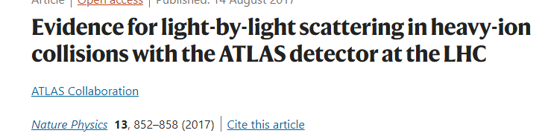
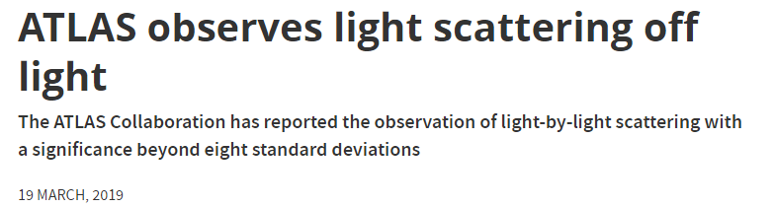
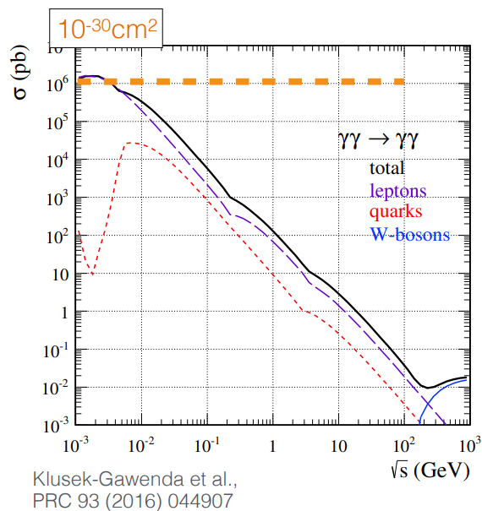
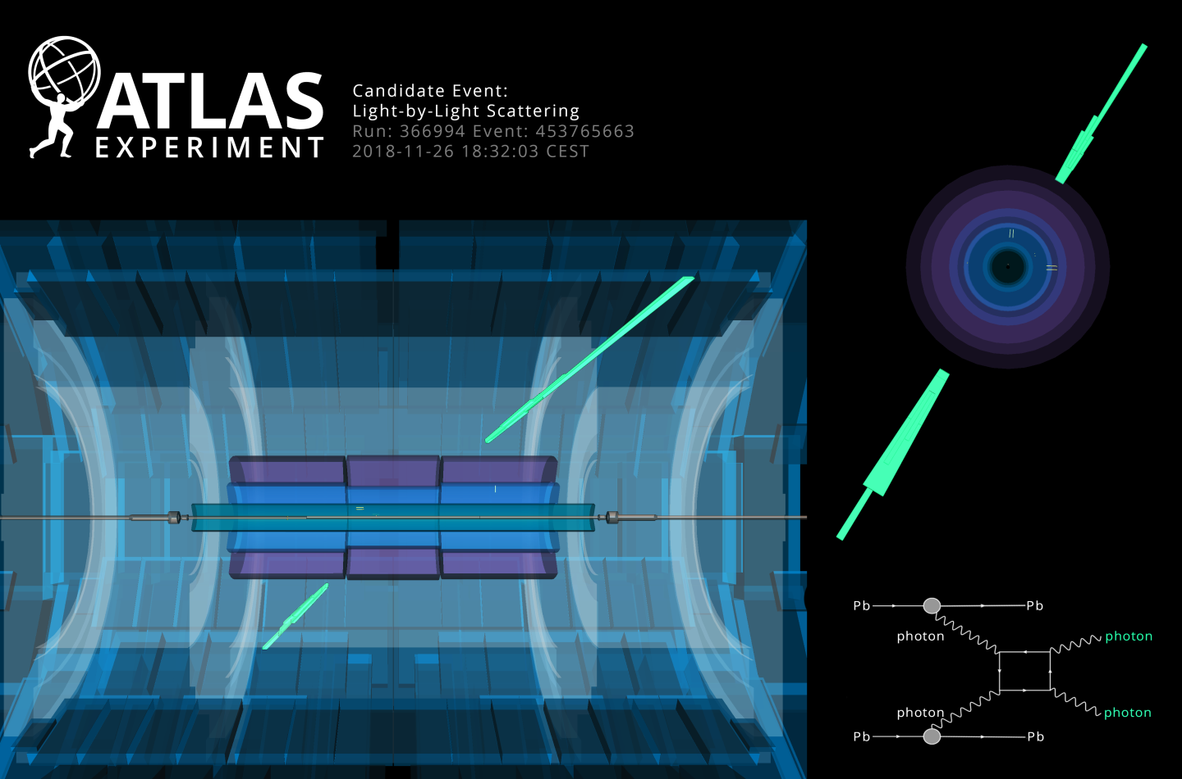
scattering light off light ?
J. Ellis et al, 2022
2017
2019
K. Schmieden
photons (counter propagating) in the energy region just below the e⁺e⁻ production threshold (~ 500 keV) to study the elastic photon-photon collisions (box diagram physics)… small cross-section → Fabry-Perot cavities to enhance flux
40-60 GeV photons off ~1 eV photons ?
Or 63 GeV photons scattering off 63 GeV photons (Higgs) ?
W. Krasny
ultra-peripheral heavy-ion collisions

Slide 7


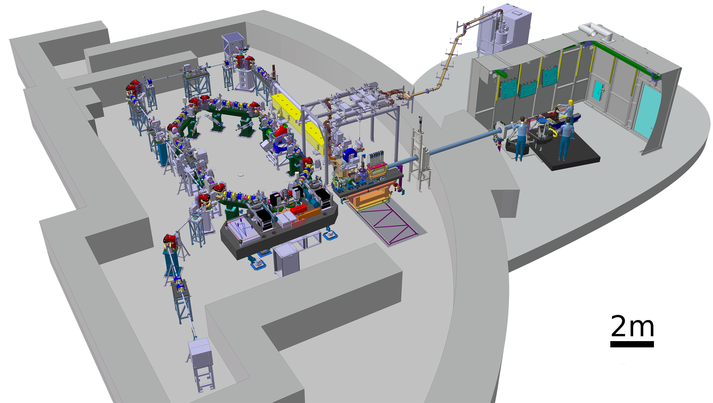
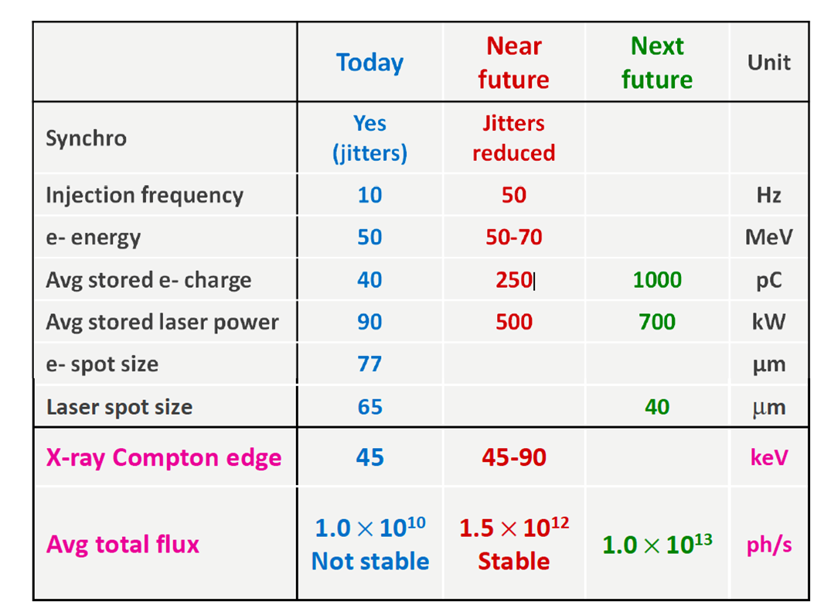
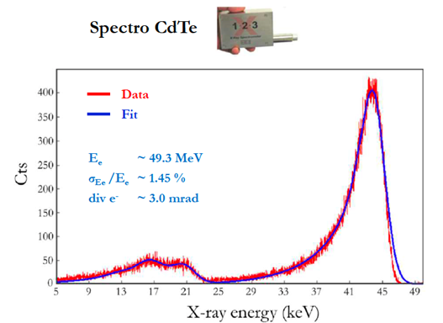
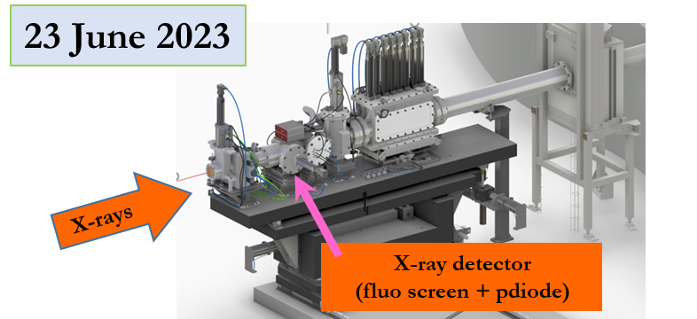
ThomX as a test bed for CBS beam dynamics
Laser /Cavity system
• average power 100W
• Stored power up to 1 MW (30 mJ/pulse)
Accelerator
• 1 nc / bunch, f_{rep} 50 Hz
• 50-70 MeV
• Ring, f_{rep} 16 MHz
• σ_{e} ~ 70 μm
• ε_{N} ~ 5-10 mm.mrad
• τ_{e} ~ 10-30 ps
Three different regimes:
Ring dominated and laser perturbation,
Laser ring regime (Thom-X design)
Nonlinear laser-interaction with harmonics
design X-ray beam
Flux ph/s
10¹³
Y. Chaikovska
Brightness ph/s/ mm² / 0.1% BW / mrad²
10¹¹
Transverse size of the source
70 μm
E_{X} on axis
40-90 keV

