Slide 1




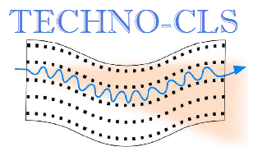
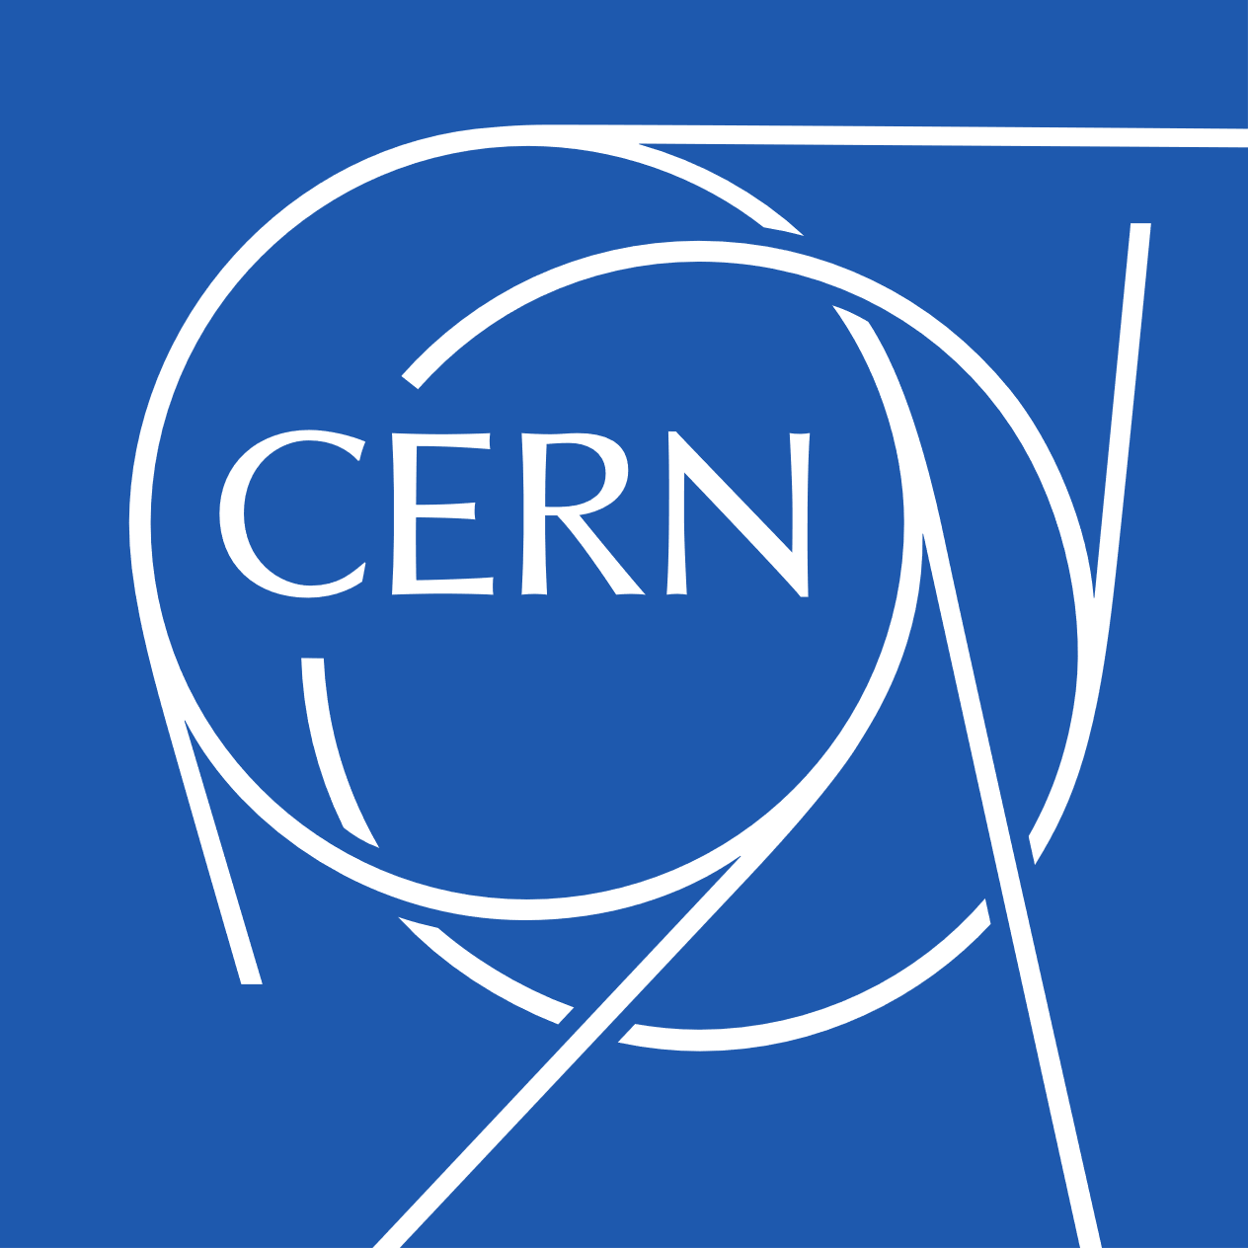

G.A. 101046458
Crystalline Undulators: A Gamma-Ray Source at the FCC-ee Linac e+ Beam
Other Science opportunities at the FCC-ee
CERN, 28 November 2024
Riccardo Negrello, PhD student
Ferrara University
INFN Ferrara
riccardo.negrello@unife.it

Slide 2
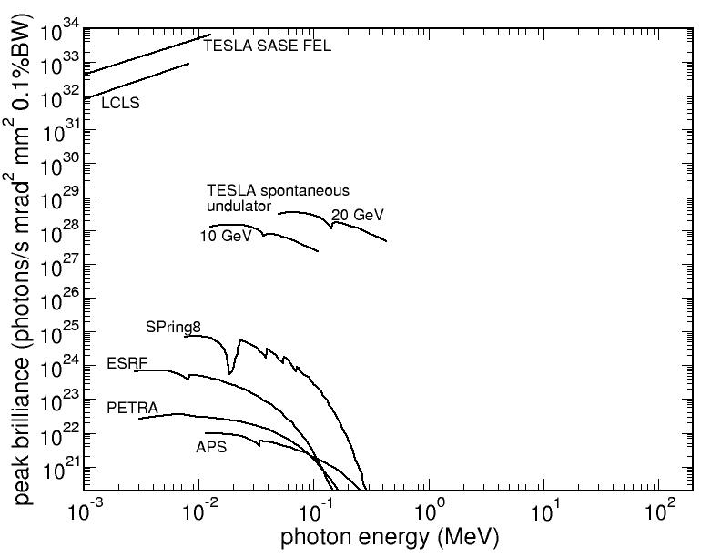
Radiation Sources: State of the Art
Which are the alternatives?
Inverse Compton Scattering &
Gamma factory
Requires an high intensity laser
Crystalline Undulator:
- Crystals are passive elements
- Better results with positrons
Cover this region
Korol, A.V., Solov’yov, A.V. Eur. Phys. J. D 74, 201 (2020).
Negrello Riccardo Other Science Opportunities at the FCC-ee

Slide 3
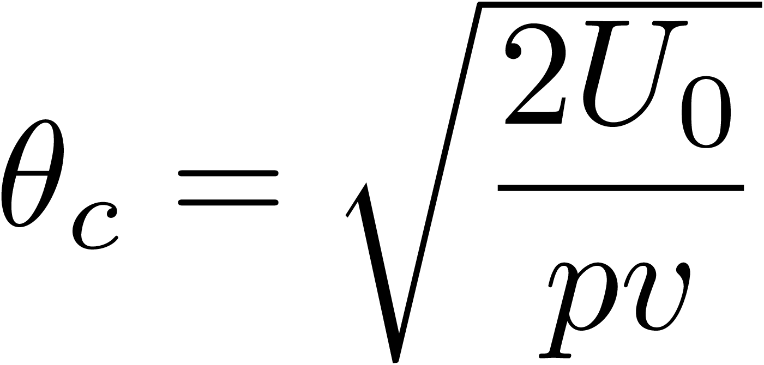
Channeling
Amorphous material
Oriented material
e+
Charged
particle
e-
Incoherent scattering
If the incidence angle < critical angle
$U_{0}≈20 eV$, $E≈20 GeV →θ_{c}≈50 μrad$
Particles feels the interaction with the atoms of the plane as a whole and start to oscillate in channeling.
Dechannelig affects electrons more than positrons.
Negrello Riccardo Other Science Opportunities at the FCC-ee

Slide 4
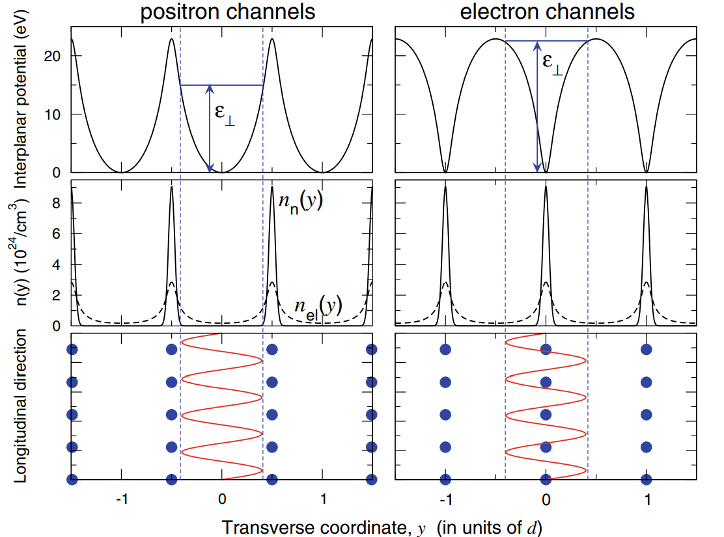
Comparison between e+ and e-
Oriented material
e+
e-
If the incidence angle < critical angle
$U_{0}≈20 eV$, $E≈20 GeV →θ_{c}≈50 μrad$
Particles feels the interaction with the atoms of the plane as a whole and start to oscillate in channeling.
Dechannelig affects electrons more than positrons.
A. V. Korol & A. V. Solov’yov, Novel Lights Sources Beyond Free Electron Lasers,Springer, 2022
Negrello Riccardo Other Science Opportunities at the FCC-ee

Slide 5
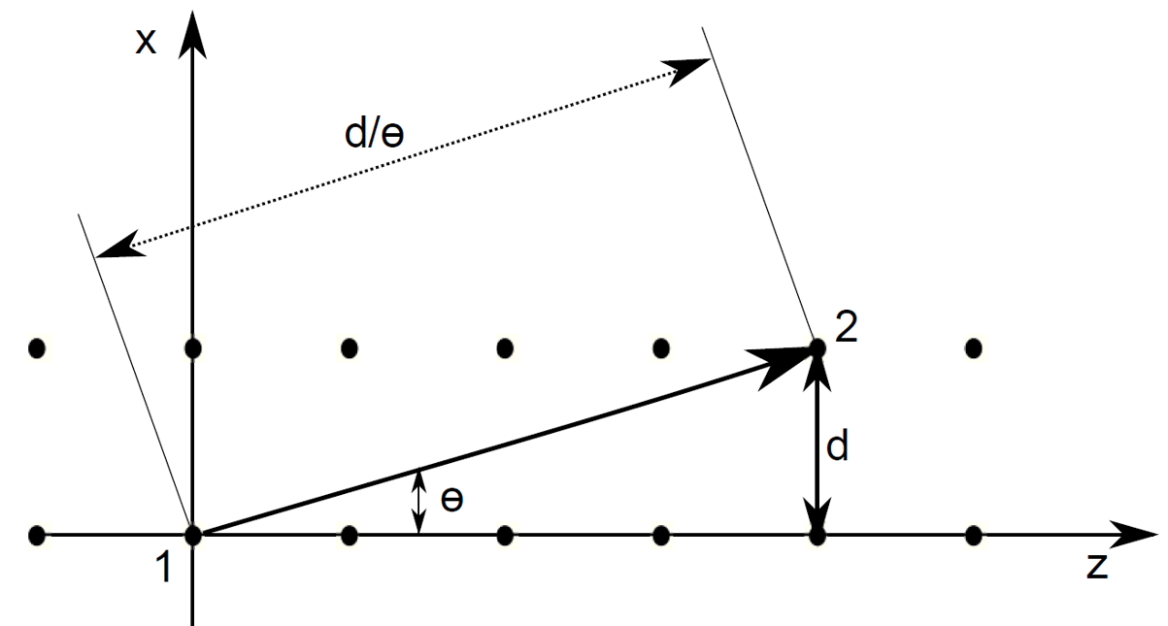

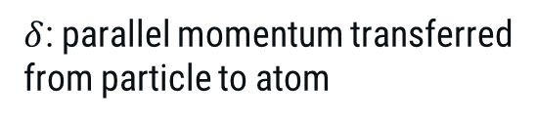


Radiation effects in crystals
Amorphous medium
Crystalline plane/axis
Coherent Bremmstrahlung
HE e+
particle
LE e+
Constructive interference condition:
$$θ_{c}= \sqrt{\frac{2U_{0}}{pv}}$$
Channeling Radiation
Dimension of reciprocal lattice vector
Bremsstrahlung
$$\frac{δ}{θ}=n\frac{2π}{d}$$
Low Energy (<GeV) → dipole radiation
(undulator)
High Energy (≫GeV) → synchrotron radiation
(wiggler)
$δ$: parallel momentum transferred from particle to atom
Negrello Riccardo Other Science Opportunities at the FCC-ee
Notes:
the bremsstrahlung radiation emitted in a crystal
increases when the momentum transferred from the
particle to the atoms matches a reciprocal lattice vector.

Slide 6
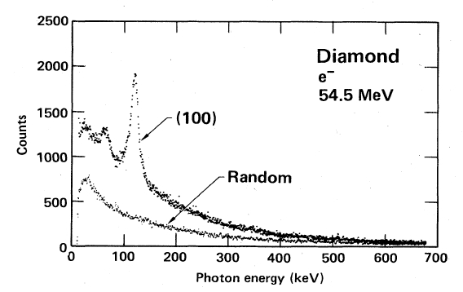
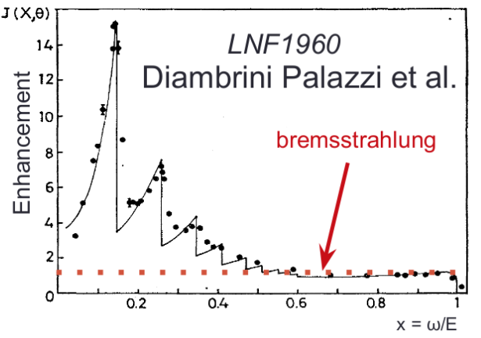
Radiation phenomena in crystals
Amorphous medium
Crystalline plane/axis
Coherent Bremmstrahlung
HE e+
particle
LE e+
Kumakhov, 1976
Bremsstrahlung
Negrello Riccardo Other Science Opportunities at the FCC-ee
Notes:
the bremsstrahlung radiation emitted in a crystal
increases when the momentum transferred from the
particle to the atoms matches a reciprocal lattice vector.

Slide 7
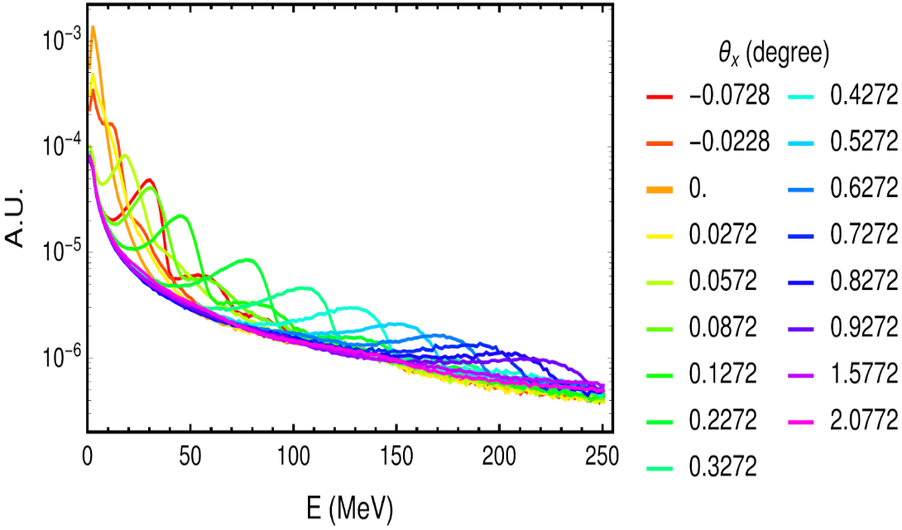
Radiation emission comparison
600 MeV e- interacting with a diamond crystal of 0.31 mm thickess along (110) planes
Channeling
Intensities even higher than Channeling Radiation can be achieved with Crystalline Undulators if some conditions are matched
CB
Bremsstrahlung
R. Negrello et al, NOVEL HIGH-INTENSITY AND GAMMA-RAYS SOURCES USING CRYSTALS, JACoW (2024)
Negrello Riccardo Other Science Opportunities at the FCC-ee
Notes:
We can achieve even higher intensity in the soft part of the spectrum using a crystalline ondulator by matching some specific conditions

Slide 8
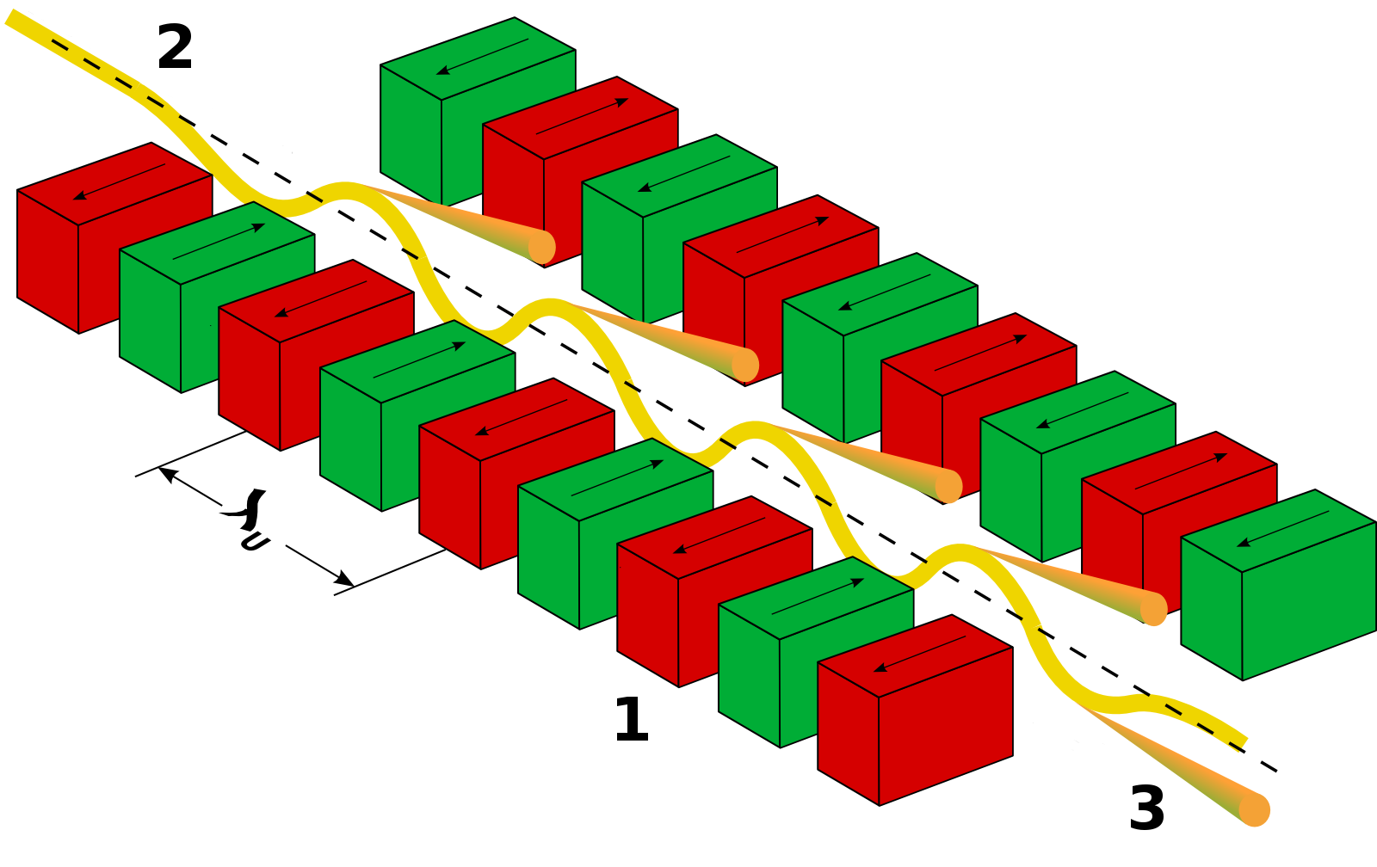
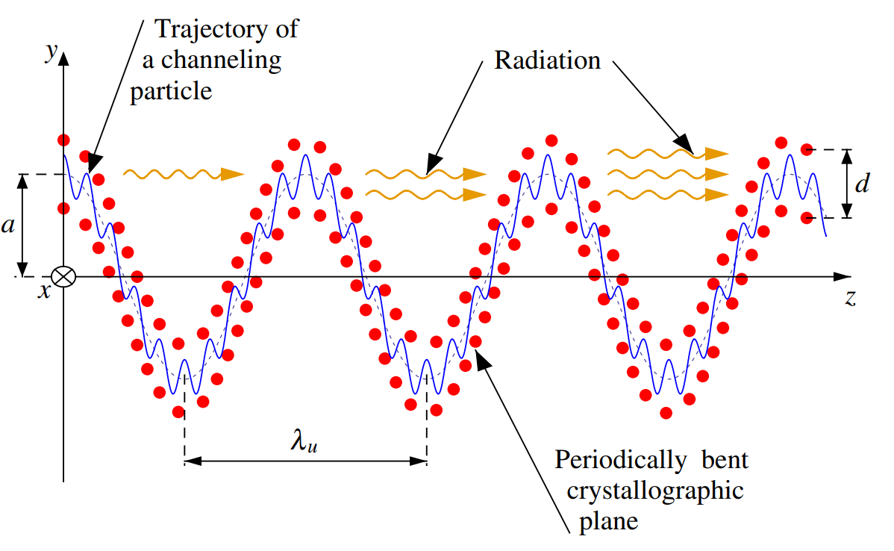
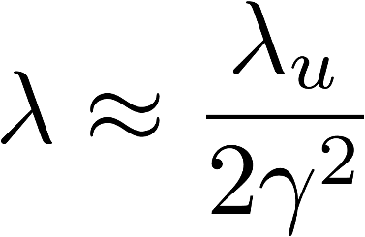
Crystalline Undulator
Magnetic undulator
Crystalline undulator
period ⁓ cm
X-ray production of ⁓10 keV
period < mm
Production of γ-rays of ⁓ MeV
A. V. Korol & A. V. Solov’yov, Novel Lights Sources Beyond Free Electron Lasers,Springer, 2022
Negrello Riccardo Other Science Opportunities at the FCC-ee

Slide 9
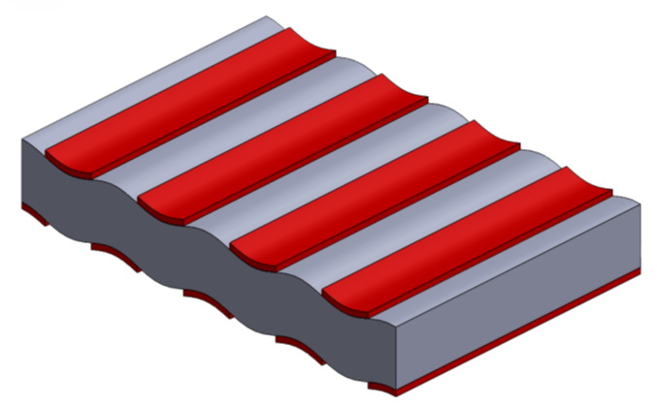
Manifacturing techniques
Principle:
Inducing a periodic deformation field in the surfaces that transfers to the bulk of the crystal
Grooving method
Camattari et al, PRAB (2019) 10.1103/PhysRevAccelBeams.22.044701
Pulsed laser melting (PLM)
Di Russo et al, App. Surf. Sci.(2023) 10.1016/j.apsusc.2022.155817
Ion Implantation
Bellucci et al, Appl. Phys. Lett (2015) 10.1063/1.4928553
Si-Ge alternate concentration
Avakian et al, NIM A, (2002) /10.1016/S0168-9002(02)01316-5
Acoustically driven
Kaleris et al, ArXiv (2024) 10.48550/arXiv.2410.11621
Low-pressure chemical vapour deposition (LPCVD):
Alternate pattern of silicon nitride on a Si wafer at high temperature (800°).
Thermal stress arises when the wafer is being cooled, due to the difference in thermal expansion coefficients between film and substrate
Thin film
(~hundreds of nm)
Substrate
(~hundreds of µm)
Guidi et al, Appl. Phys. Lett. (2007) 10.1063/1.2712510
Bagli et al, EPJC (2014) 10.1140/epjc/s10052-014-3114-x
Notes:
Alternate pattern of silicon nitride thin layer on both sides of the Si wafer at high temperature (800°).
Thermal stress arises when the wafer is being cooled, due to the difference in thermal expansion coefficients of the film and the substrate

Slide 10
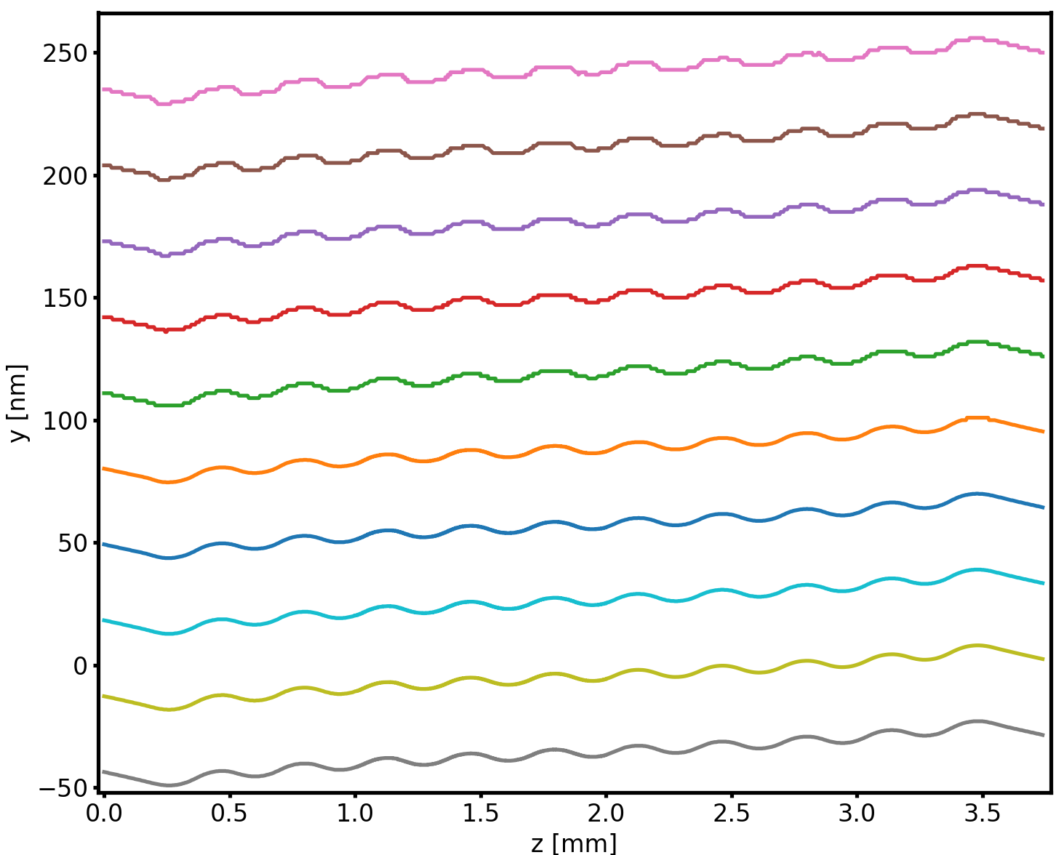
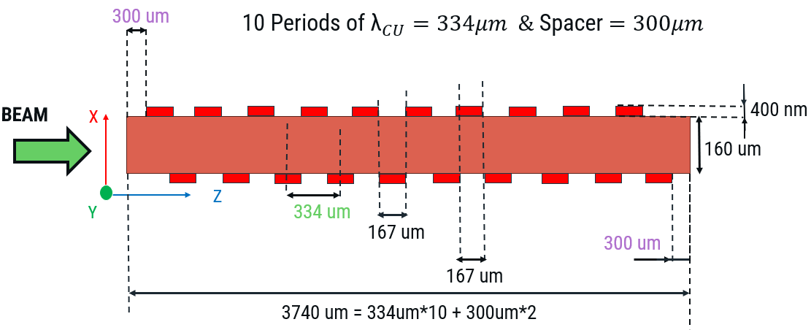
CU Modelling
CU specifically developed for 10-20GeV e+ beam!
Deformation profiles (FEM) Ansys
X
Our sample will be studied at Diamond/ESRF
Z
Negrello Riccardo Other Science Opportunities at the FCC-ee

Slide 11
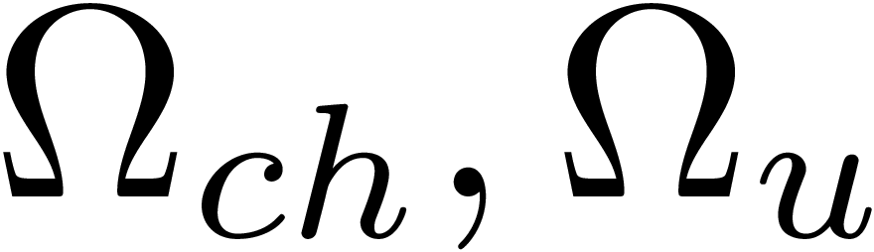
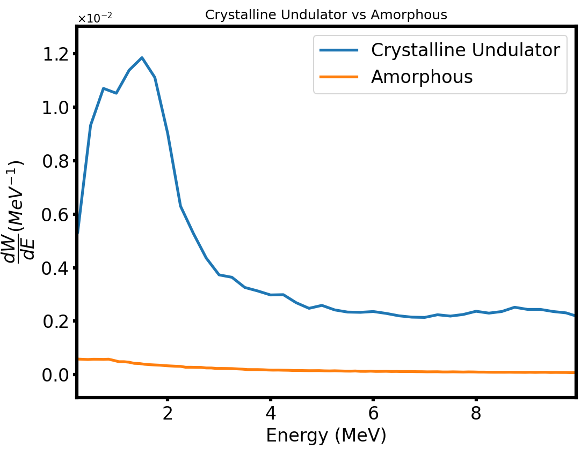
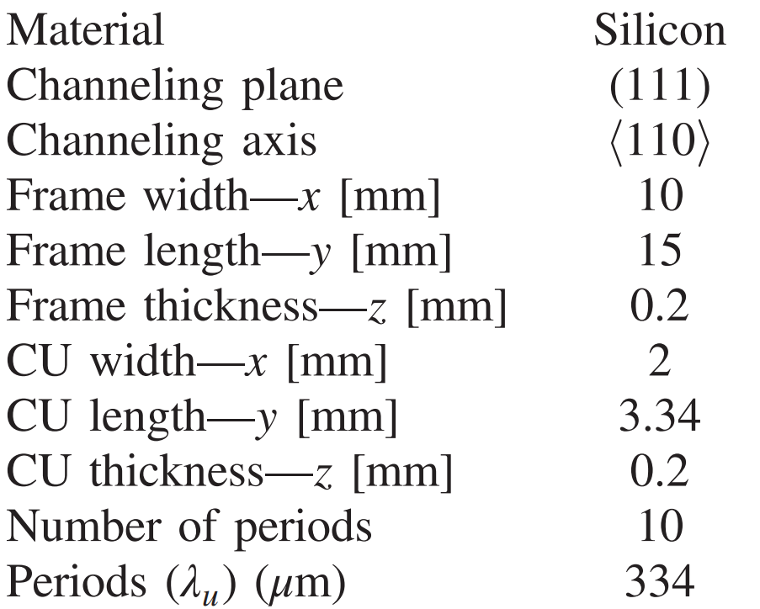
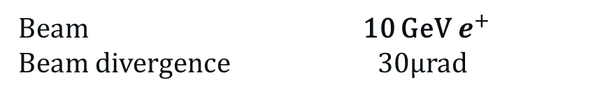
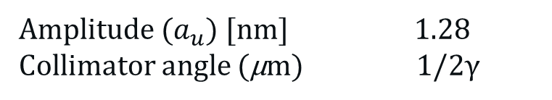
Crystalline Undulator Spectrum
A. V. Korol and A. V. Solov’yov, Novel Lights Sources Beyond Free Electron Lasers, Springer Cham, 2022
Channeling and Undulator oscillations
Large Amplitude Long Period
(LALP)
To separate the peaks and suppress :
Full Montecarlo simulation using Baier-Katkhov formula
Beam 10 GeV${ e}^{+}$
Beam divergence 30µrad
CUR peak
High monocromaticity
Amplitude ($a_{u}$) [nm] 1.28
Collimator angle (µm) 1/2γ
Camattari et al, PRAB (2019) 10.1103/PhysRevAccelBeams.22.044701
Negrello Riccardo Other Science Opportunities at the FCC-ee

Slide 12
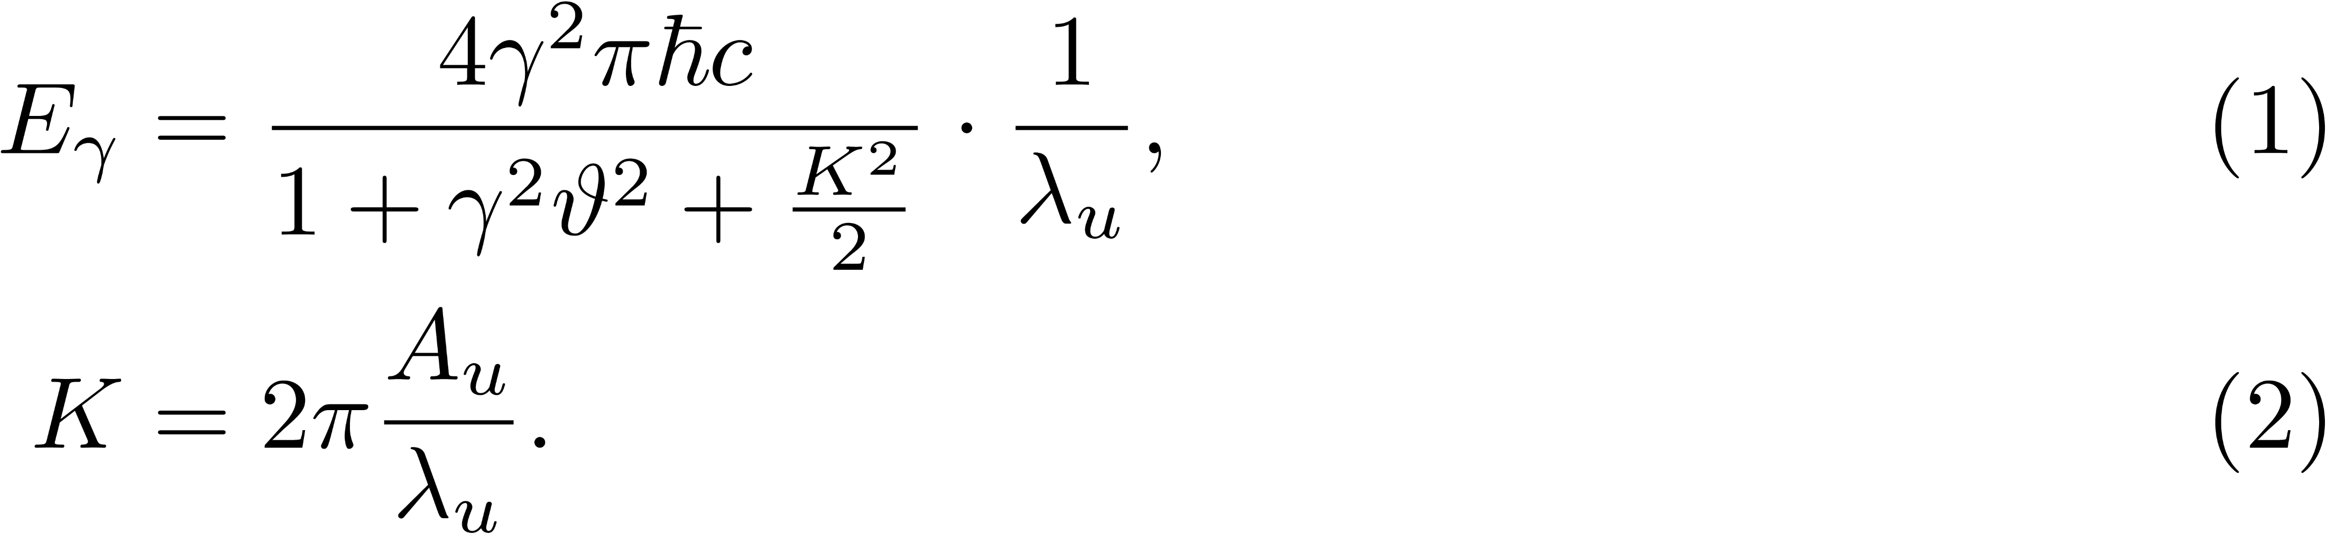
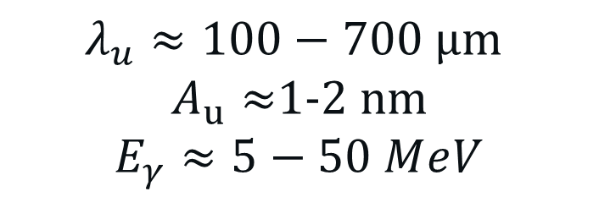
Photon energy for 20 GeV $e^{+}$
Crystalline Undulators also offers:
Possibility to optimize amplitude and period for specific applications
Control over the harmonic oscillations
More monocromatic spectrum compared to channeling radiation
$$λ_{u}≈100−700 \text{µ}\text{m}$$
$A_{u}≈$1-2 nm
$$E_{γ}≈5−50 MⅇV$$
Negrello Riccardo Other Science Opportunities at the FCC-ee
CUR peak
High monocromaticity

Slide 13
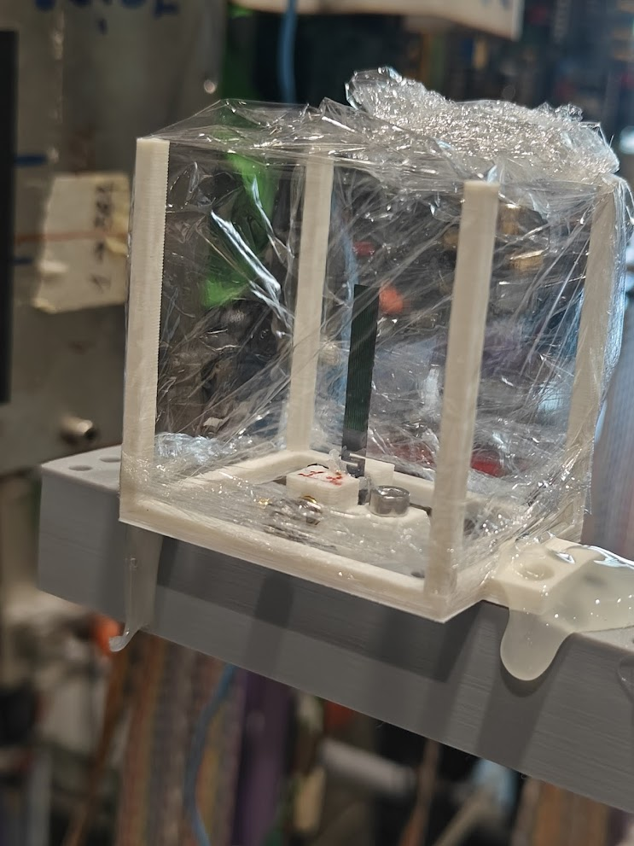
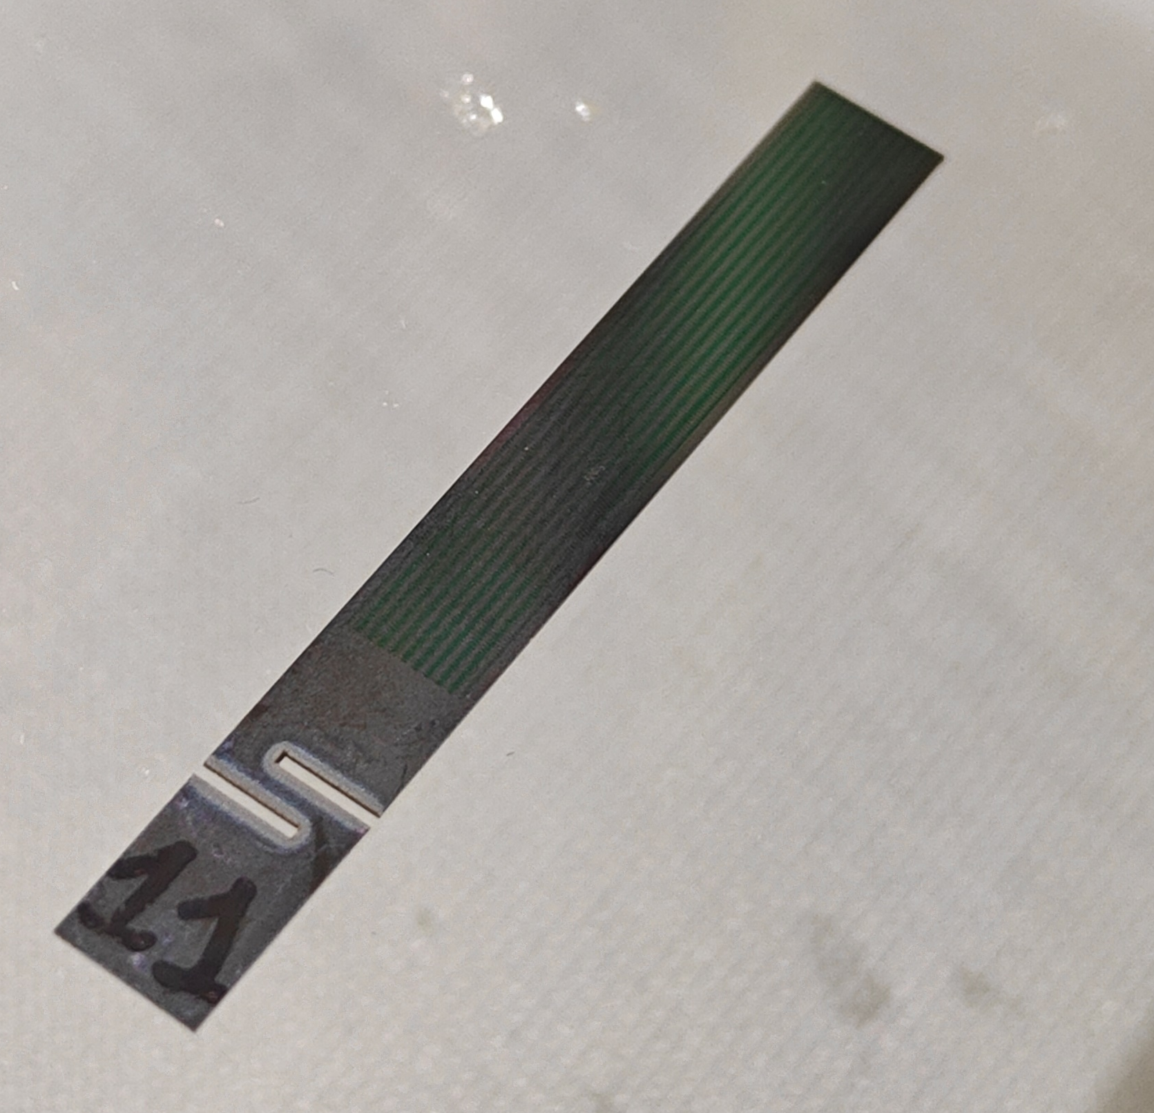
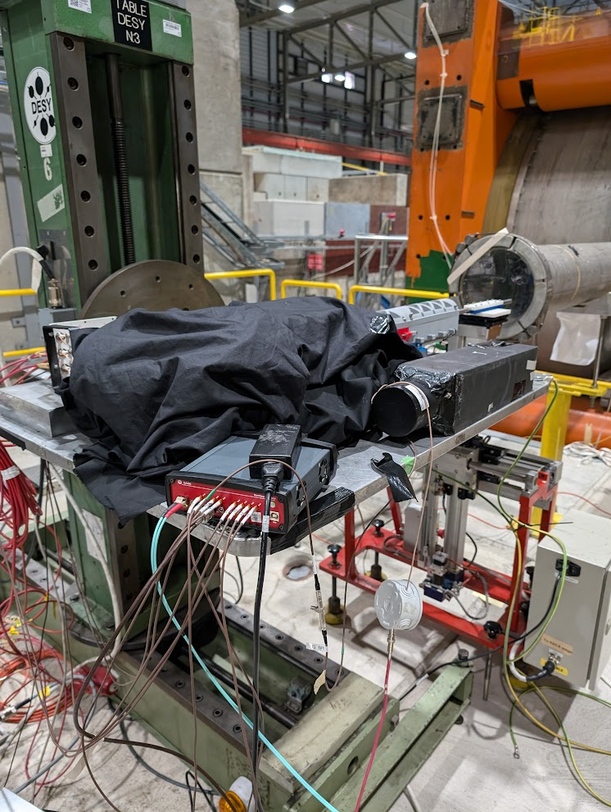
Undulator Test Beam @CERN
CERN SPS H2 Beamline,13-27 August
35 GeV e+ beam
Collimators
BGO Calorimeter
We are now analyzing the data, the results are preliminary but promising.
Non optimal condidtion, tertiary beam, purity, divergence and high radiation background
Negrello Riccardo Other Science Opportunities at the FCC-ee

Slide 14
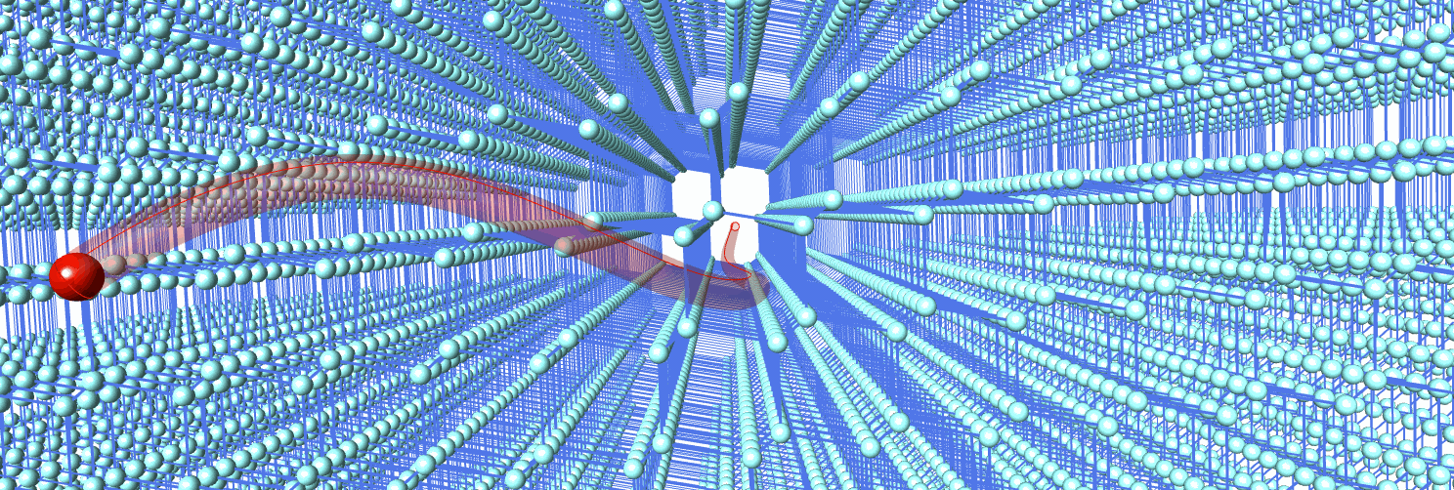
Applications
Conclusions
Medical physics
Nuclear interactions
Industry and technology
CU are tunable for specific applications.
Crystals function as passive elements.
Some prototypes have been produced and under test.
Perfectly applicable as a gamma-ray source at the FCC-ee injector LINAC
Thank you!
riccardo.negrello@unife.it
lbandiera@fe.infn.it
Negrello Riccardo Other Science Opportunities at the FCC-ee
Notes:
Currently developed for 10-20 GeV e+ and will be a perfect application for its test and exploitation as a gamma-ray source at the FCC-ee injector LINAC
where the beam will be intense and parallerel

Slide 15
Backup slides

Slide 16
Manifacturing techniques
Principle:
Inducing a periodic deformation field in the surfaces that transfers to the bulk of the crystal
Grooving method:
The deformation is obtained by a series of alternated parallel grooves on the major surfaces of the crystal.
Cons: damages in the crystal
Pulsed laser melting:
Alternate deposition of Sb on the surface of Ge though spattering technique.
A pulsed laser as a heat source, allowing to melt the substrate with spatial and temporal control.
PLM allows to produce a strained layer of Sb-Ge alloy on Ge (111).
Cell parameter variation induces the bending of the planes
Low-pressure chemical vapour deposition:
Deposition of an alternate pattern of silicon nitride thin layer on both sides of the Si wafer at high temperature (800°). Thermal stress arises when the wafer is being cooled, due to the difference in thermal expansion coefficients of the film and the substrate
Thin film
(~100nm)
Substrate
(~100um)

Slide 17
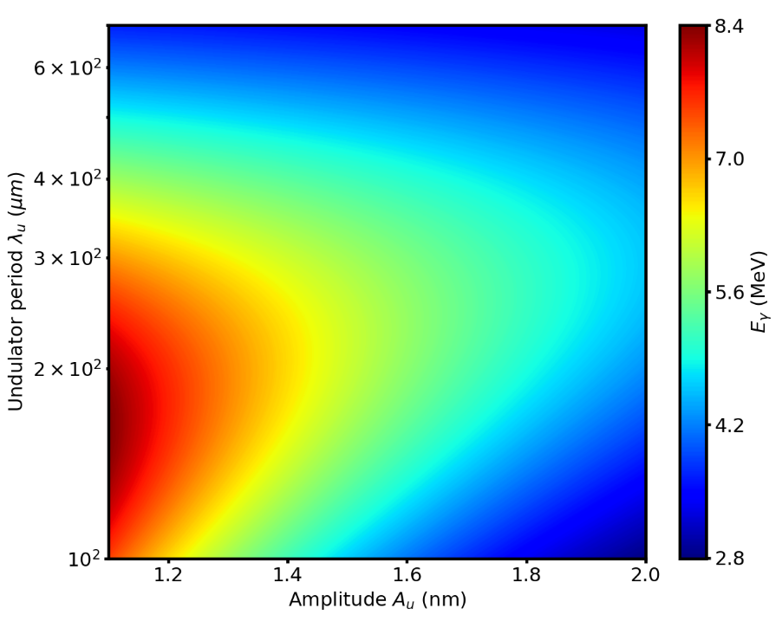
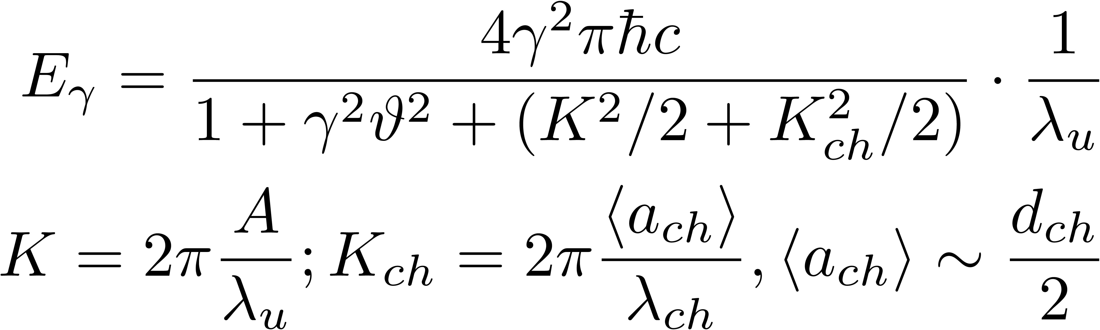
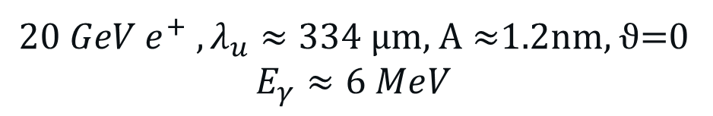

Photon energy for 20 GeV $e^{+}$
Crystalline Undulators also offers:
Possibility to optimize amplitude and period for specific applications
Control over the harmonic oscillations
More monocromatic spectrum compared to channeling radiation
$$20 GeV e^{+}$$
${20 GeV e^{+} ,λ}_{u}≈334 \text{µ}\text{m}\text{, }\text{A}≈$1.2nm, ϑ=0
$$E_{γ}≈6 MⅇV$$
CUR peak
High monocromaticity

Slide 18
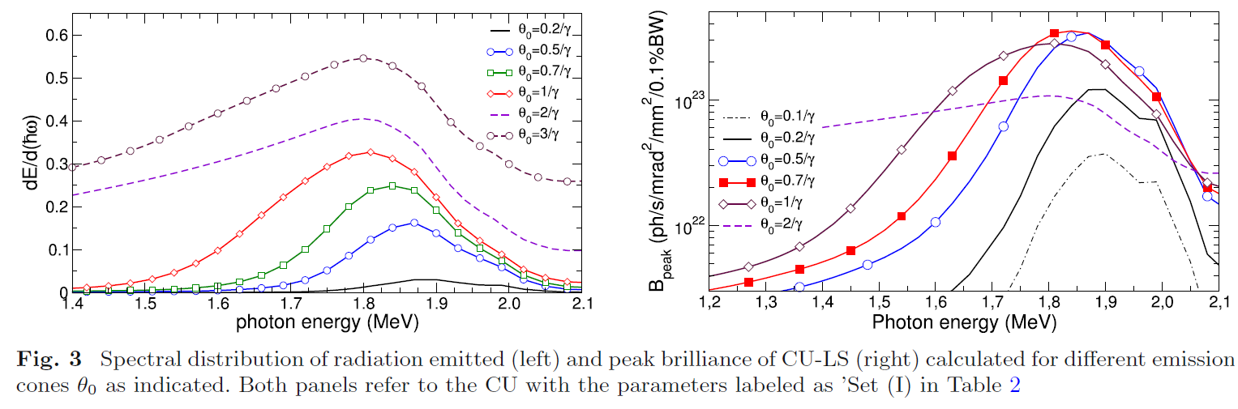
Study on the brilliance
Sushko et al, Eur. Phys. J. D (2022) 76:166
https://doi.org/10.1140/epjd/s10053-022-00502-7

Slide 19
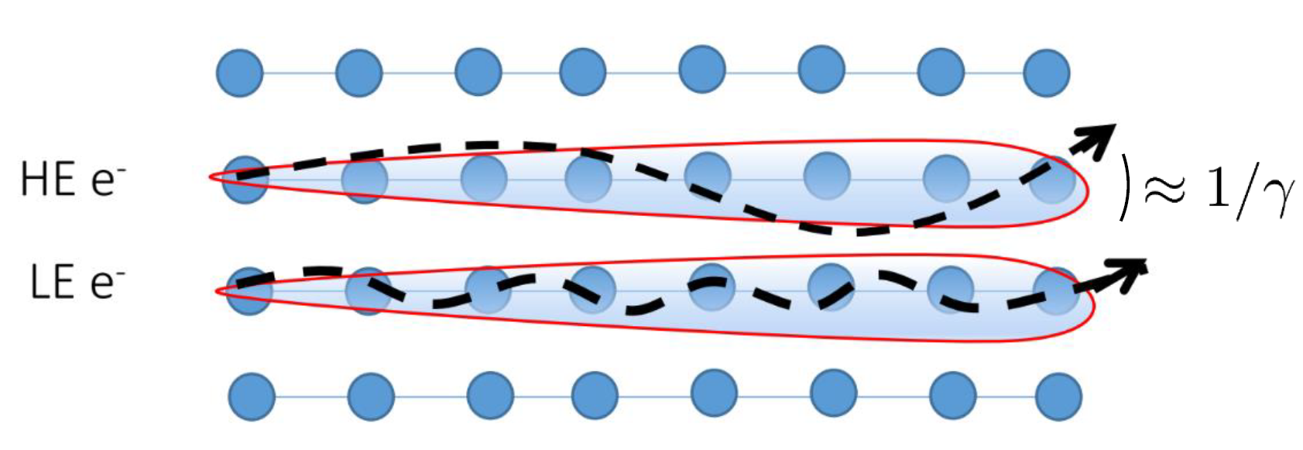
Channeling Radiation
Oriented material
Kumakhov, 1976
Channeling radiation (CR)
Low Energy (<GeV) → dipole radiation (undulator)
High Energy (≫GeV) → synchrotron radiation (wiggler)
Huge potential for a compact hard X-or γ-ray source
Crystals are passive element →no energy consumption

Slide 20
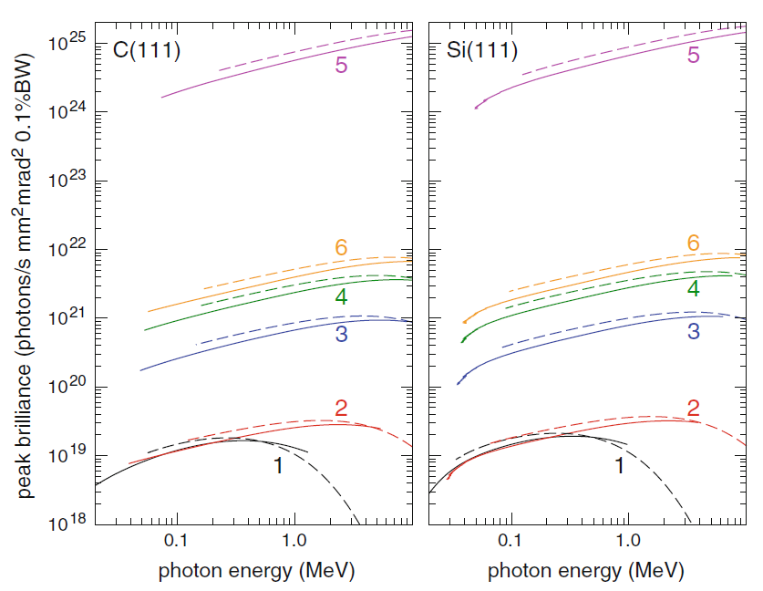
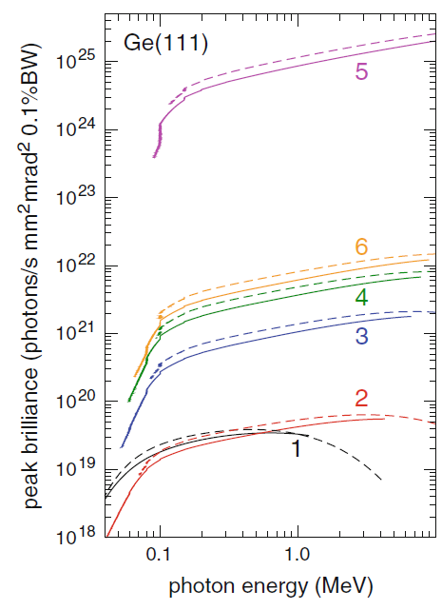
What about the Brilliance?
With Channeling Radiation: photon fluxes on the order of 10¹²/s in the primary peak, with reasonable values for the beam current (@ μA) and crystal lifetime.
Andrey V. Korol, Andrey V. Solov'yov, Walter Greiner, Channeling and Radiation in Periodically Bent Crystals
Curve 1, estimates for DAФNE beam
Negrello Riccardo Other Science Opportunities at the FCC-ee

Slide 21
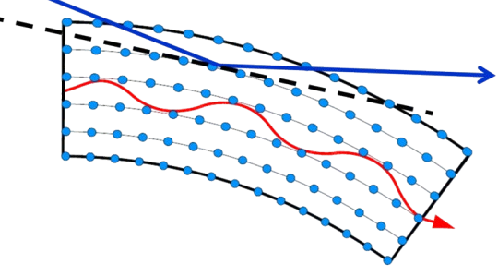
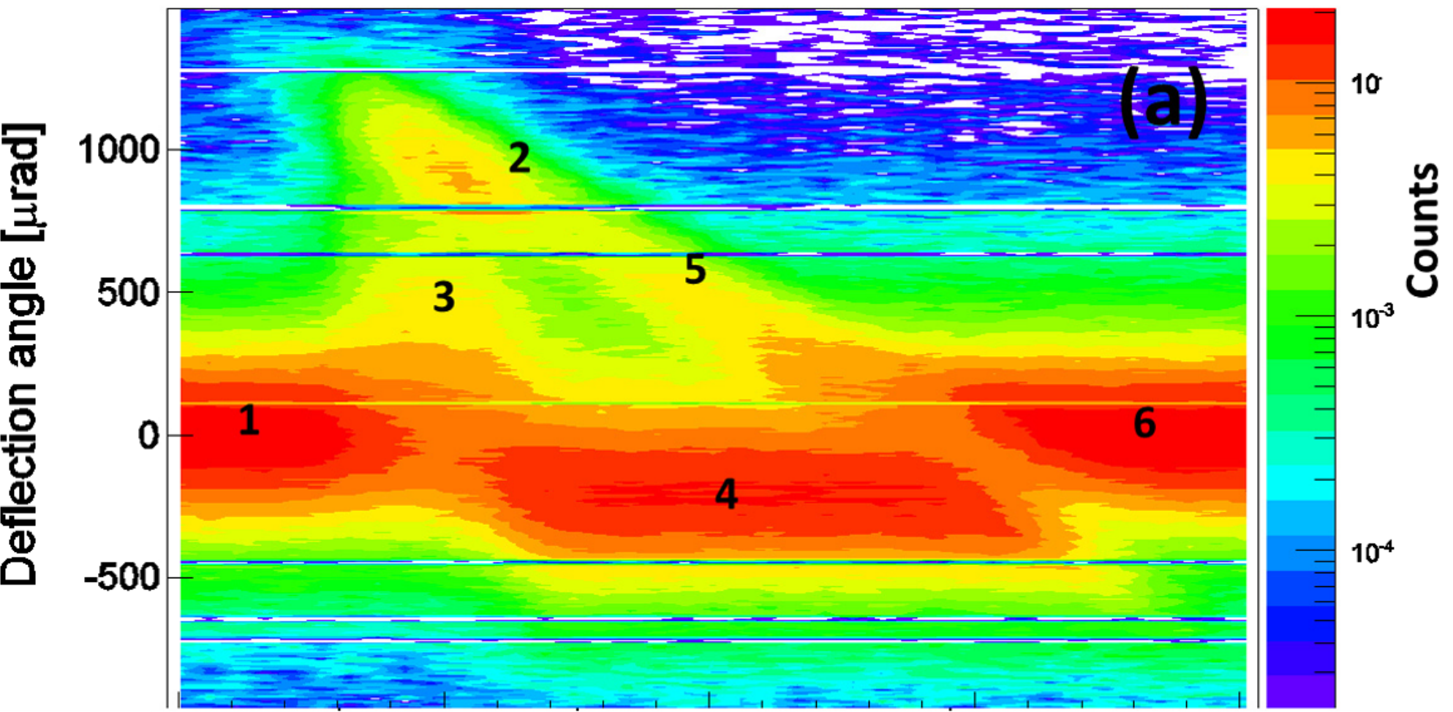
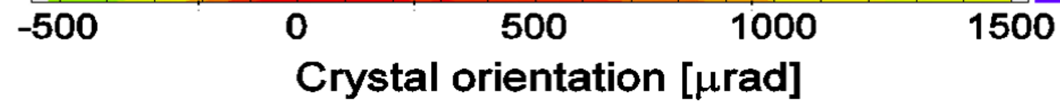
Channeling in Bent Crystals
Deflection capability
855 MeV e- on 30 µm Si crystal @MAMI
Volume Reflection
Volume Capture
E. Tsyganov, 1976
Channeling
Rechanneling
Dechanneling
Over the last decades bent crystals have been studied for hadron beam manipulation expecially by UA9 collaboration.
Bandiera et al, PRL 115, 025504 (2015) 10.1103/PhysRevLett.115.025504
Negrello Riccardo Other Science Opportunities at the FCC-ee

Slide 22
Channeling in Bent Crystals
Radiation emission
885 MeV e- on 30 µm Si crystal @MAMI
Volume Reflection
Volume Capture
E. Tsyganov, 1976
Channeling
Rechanneling
Dechanneling
Over the last decades bent crystals have been studied for hadron beam manipulation expecially by UA9 collaboration.
  Channeling Radiation
  Volume Reflection → Broader angular acceptance
Bandiera et al, PRL 115, 025504 (2015) 10.1103/PhysRevLett.115.025504
Negrello Riccardo Other Science Opportunities at the FCC-ee

