Slide 1
Laser Compton scattering in the collider
Illya Drebot

Slide 2
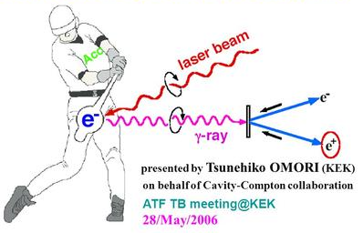
What is Compton Back Scattering?

Slide 3
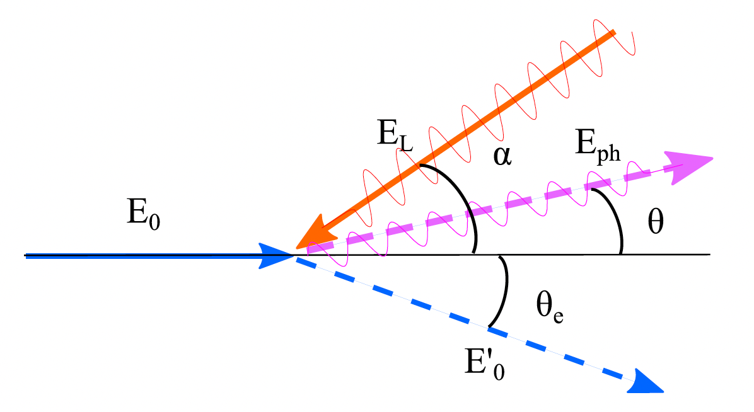
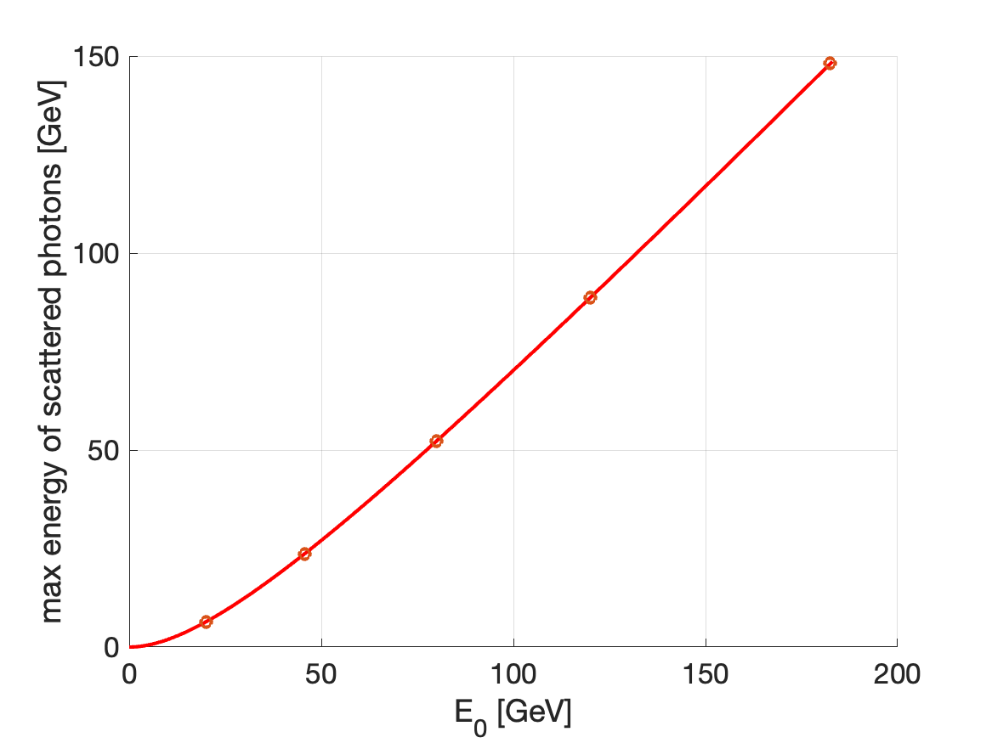


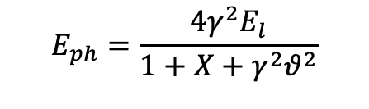
What is Compton Back Scattering?
$$E_{0}=γmc^{2}$$
$$E_{ph}=\frac{4γ^{2}E_{l}}{1+X+γ^{2}θ^{2}}$$
$$X≡\frac{4γE_{l}}{mc^{2}}$$

Slide 4
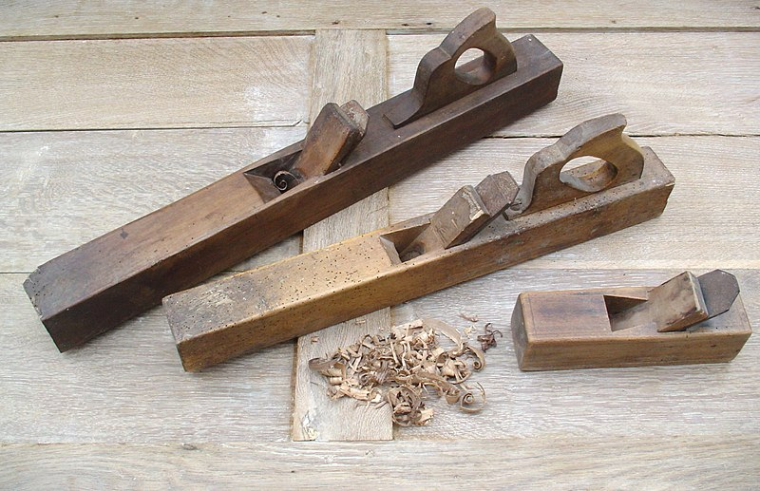
What is Compton Back Scattering?
$$E_{0}=γmc^{2}$$
$$E_{ph}=\frac{4γ^{2}E_{l}}{1+X+γ^{2}θ^{2}}$$
$$X≡\frac{4γE_{l}}{mc^{2}}$$

Slide 5
Why we CBS need it in the FCC?
Gamma source
Beam intensity control
Beam diagnostic (Polarimetry)

Slide 6
FCC POLARIMETER
Number of scattering particle 10³-10⁴ per one shot
Courtesy Robert Kieffer

Slide 7
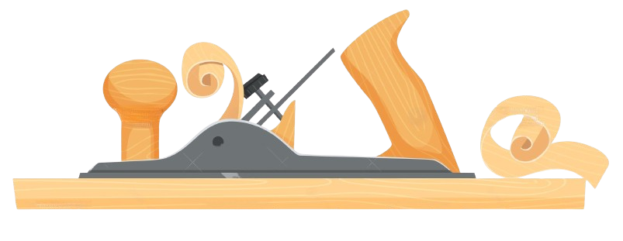
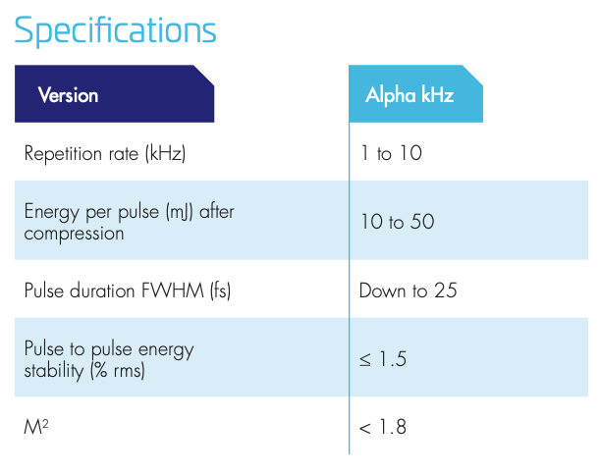
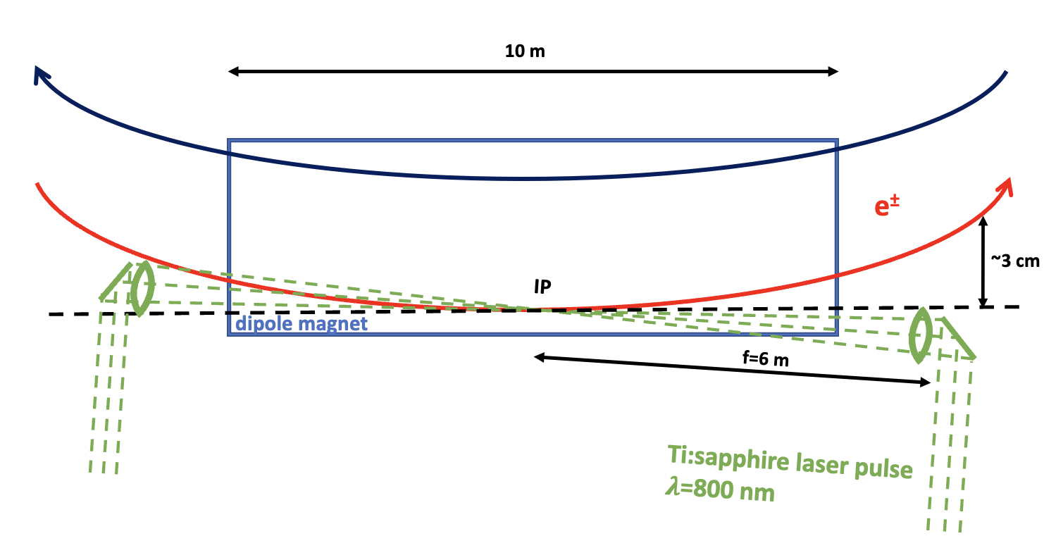
Beam intensity control
Why we need?
Asymmetry in the bunch current leads to Flip-flop instability. To avoid this bunches at IP must be bunches should be tightly controlled, with a maximum charge imbalance between collision partner bunches of less than 3−5%.
How to realise it?
Compton Back Scattering (CBS)
Laser parameters

Slide 8
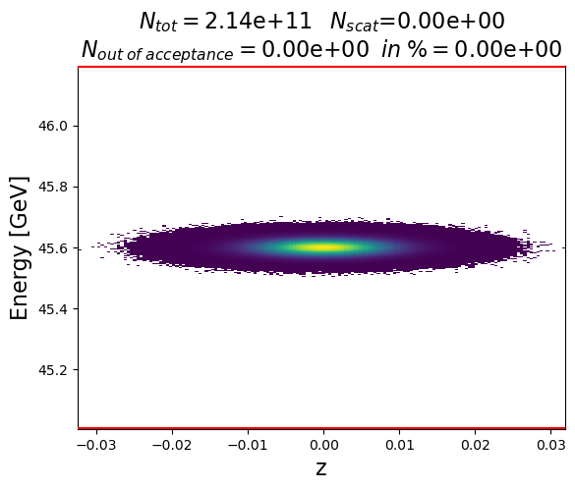
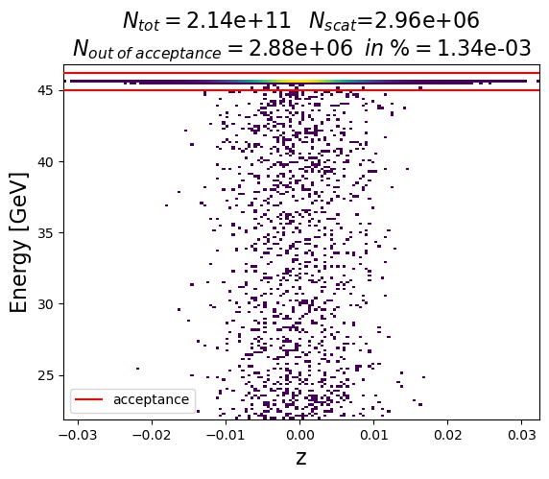
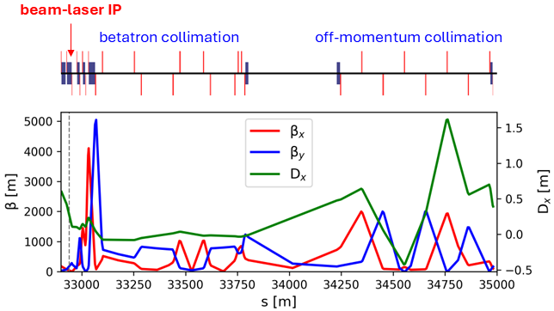
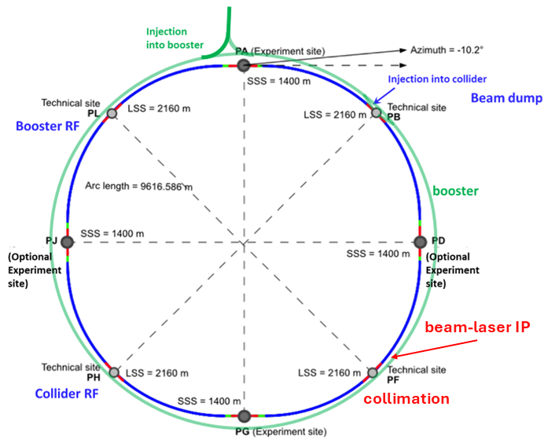
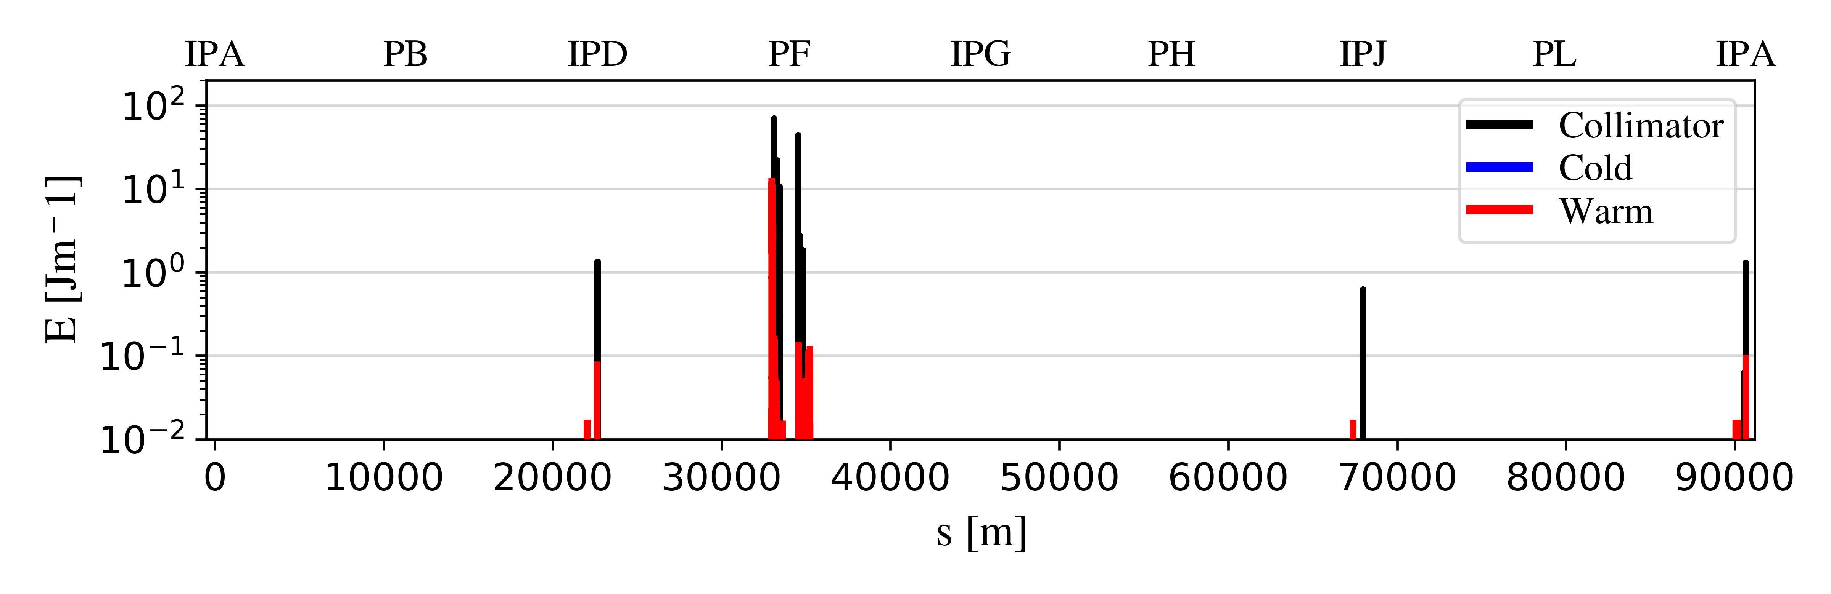
Beam intensity control
Beam ps before CBS
Beam ps after CBS
Possible location of CBS IP
IP CBS
Loss map
Courtesy Giacomo Broggi
Notes:
Loss map: the "new" loss map looks better if compared to the one in the IPAC paper. There is significantly much less leakage from the halo collimation system (located in PF) and the off-momentum collimators look much more effective in intercepting losses. Some losses reach the regions upstream of the interaction point, but most of them are intercepted by the synchrotron radiation collimators. The good news here is that, unlike in the loss map in the IPAC paper, no cold losses are observed (i.e., losses on superconducting components).
Surviving particles vs. turns: it is clear that the slope of the curve is higher (i.e., the particle removal rate is higher) if compared to the corresponding one in the IPAC paper.

Slide 9
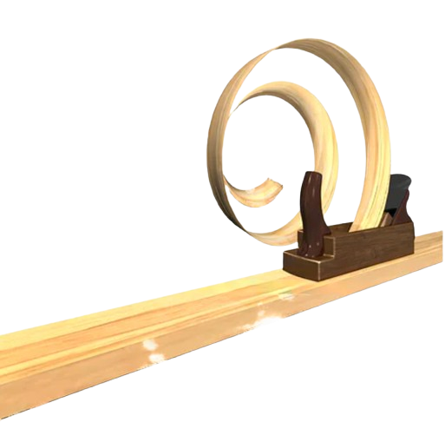
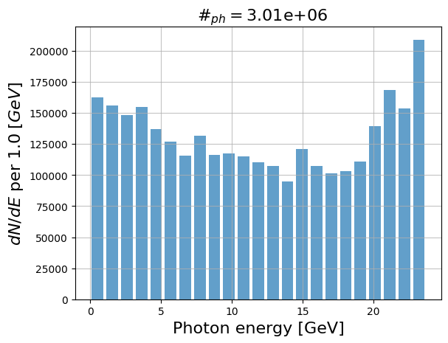
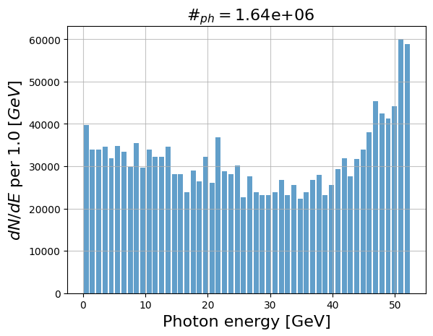
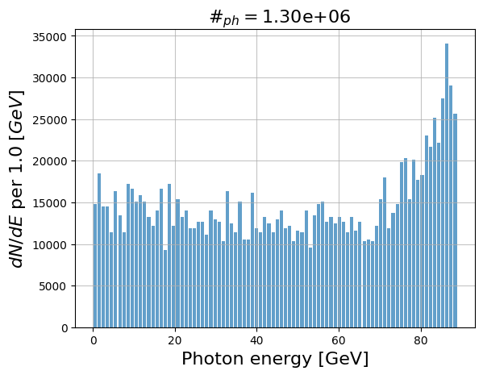
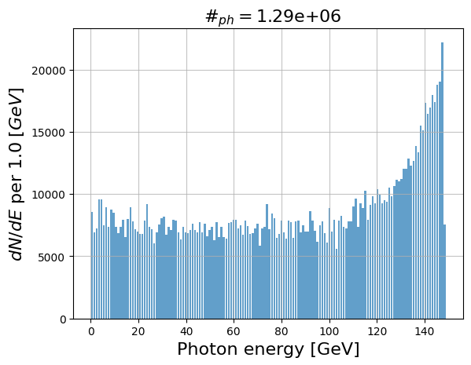
Spectrums
For 50 mJ with rep rate 3.7 kHz
Z
E= 45 GeV
E_{phmax}=24 GeV
W
E= 80 GeV
E_{phmax}=52 GeV
ZH
E= 120 GeV
E_{phmax}=89 GeV
tt
E= 180 GeV
E_{phmax}=149 GeV

Slide 10
Booster as light source

Slide 11

Booster as light source

Slide 12
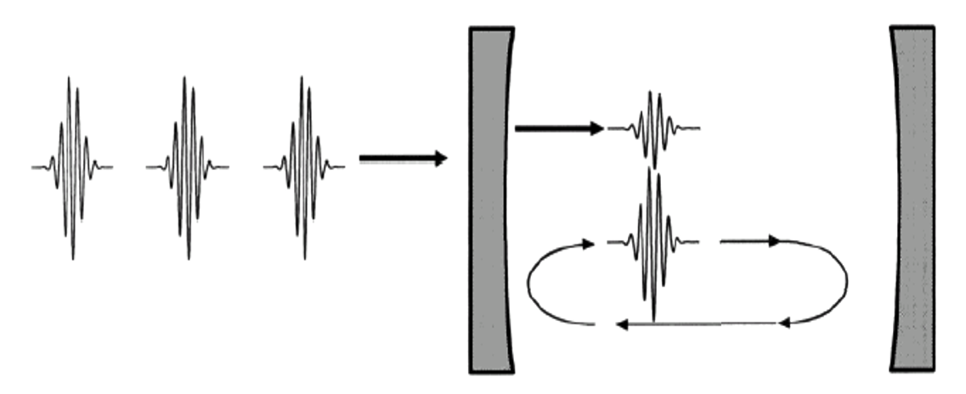


Laser & Fabry-Perot cavity
Laser input
Laser and Fabry-Perot cavity accumulate photons.
It give us possibility to collide photons with pulse energy of 15 mJ
e⁻ beam
Laser and FP cavity
Laser wavelength | 1030 nm
Laser and FP cavity Frep | 33 MHz
Pulse energy | 15 mJ
FP waist | 70 μm
Laser pulse length | 1 ps
E_{las}=1.2 eV
Notes:
We propose instal Fabry - Perot optical cavity with Ytterbium laser with wave length 1030 nm
Optical cavity accumulate laser pulses in one (similar to storage ring for electrons) and have huge rep rate 96 MHz
For us important here 96 is multiples of 2.4 so each electron pulse will collide a laser

Slide 13
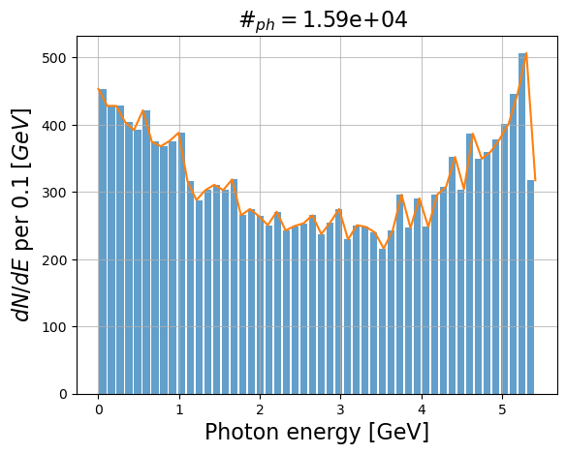
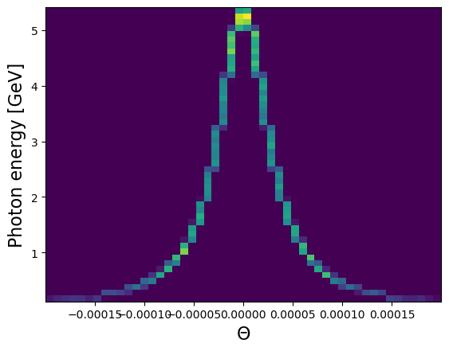
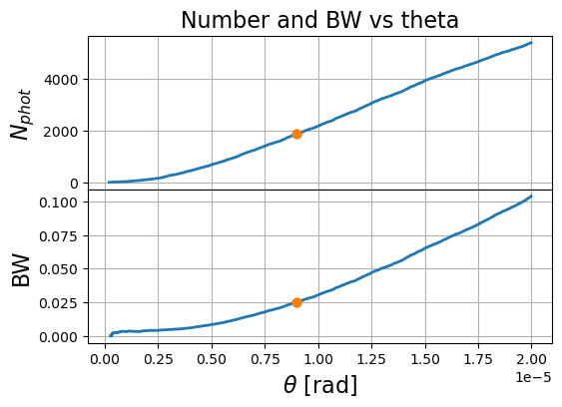
Booster as light source
(3e8*1120/90.7e3)/1e6=3.7 MHz
33MHz/3.7MHz=8.9
Total # of photons 1.59e4*3.7 MHz=5.8e10

Slide 14
Booster as light source
(3e8*1120/90.7e3)/1e6=3.7 MHz
33MHz/3.7MHz=8.9
Total # of photons 1.59e4*3.7 MHz=5.8e10

Slide 15
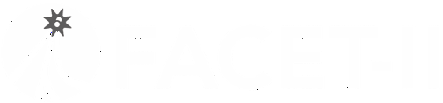
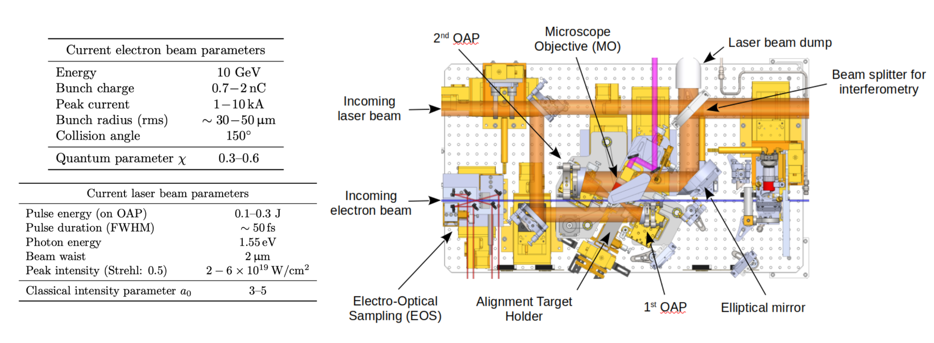
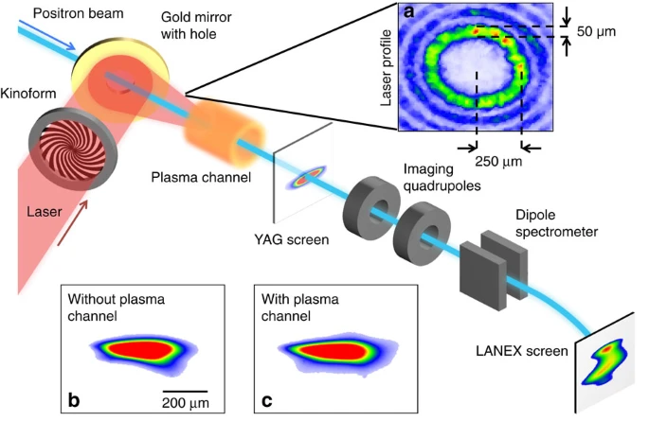
Experiment proposal at
Facility for Advanced Accelerator Experimental Tests
Leverage the E320 infrastructure at FACET-II to provide an R&D platform for:
Bunch-to-bunch laser intensity control.
Halo collimation.
Diagnostics to demonstrate collimation and control of high energy beams.
FACET-II is the only User Facility in the world that combines 10 GeV beams with high-power lasers to accommodate this type of R&D.
Courtesy Spencer Gessner

Slide 16


Thank you
Please find here spectrums and photons distribution
23 GeV
148 GeV
https://cernbox.cern.ch/s/4k86vWKIqMD23np
Free
Puppies
Photons

Slide 17
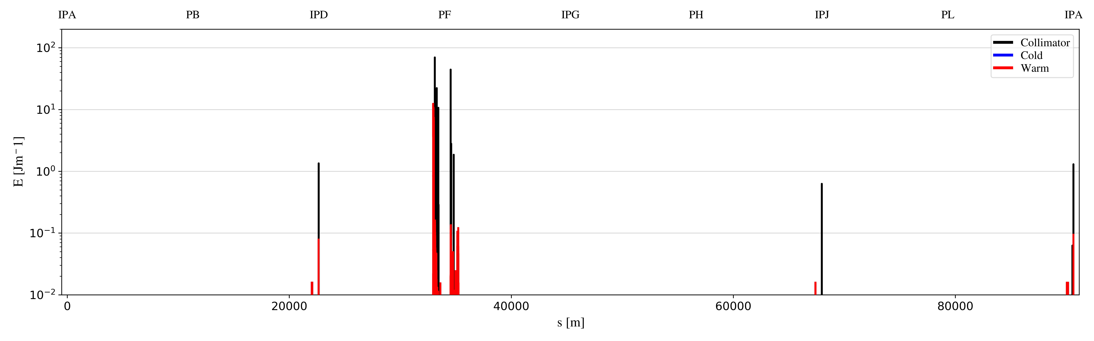
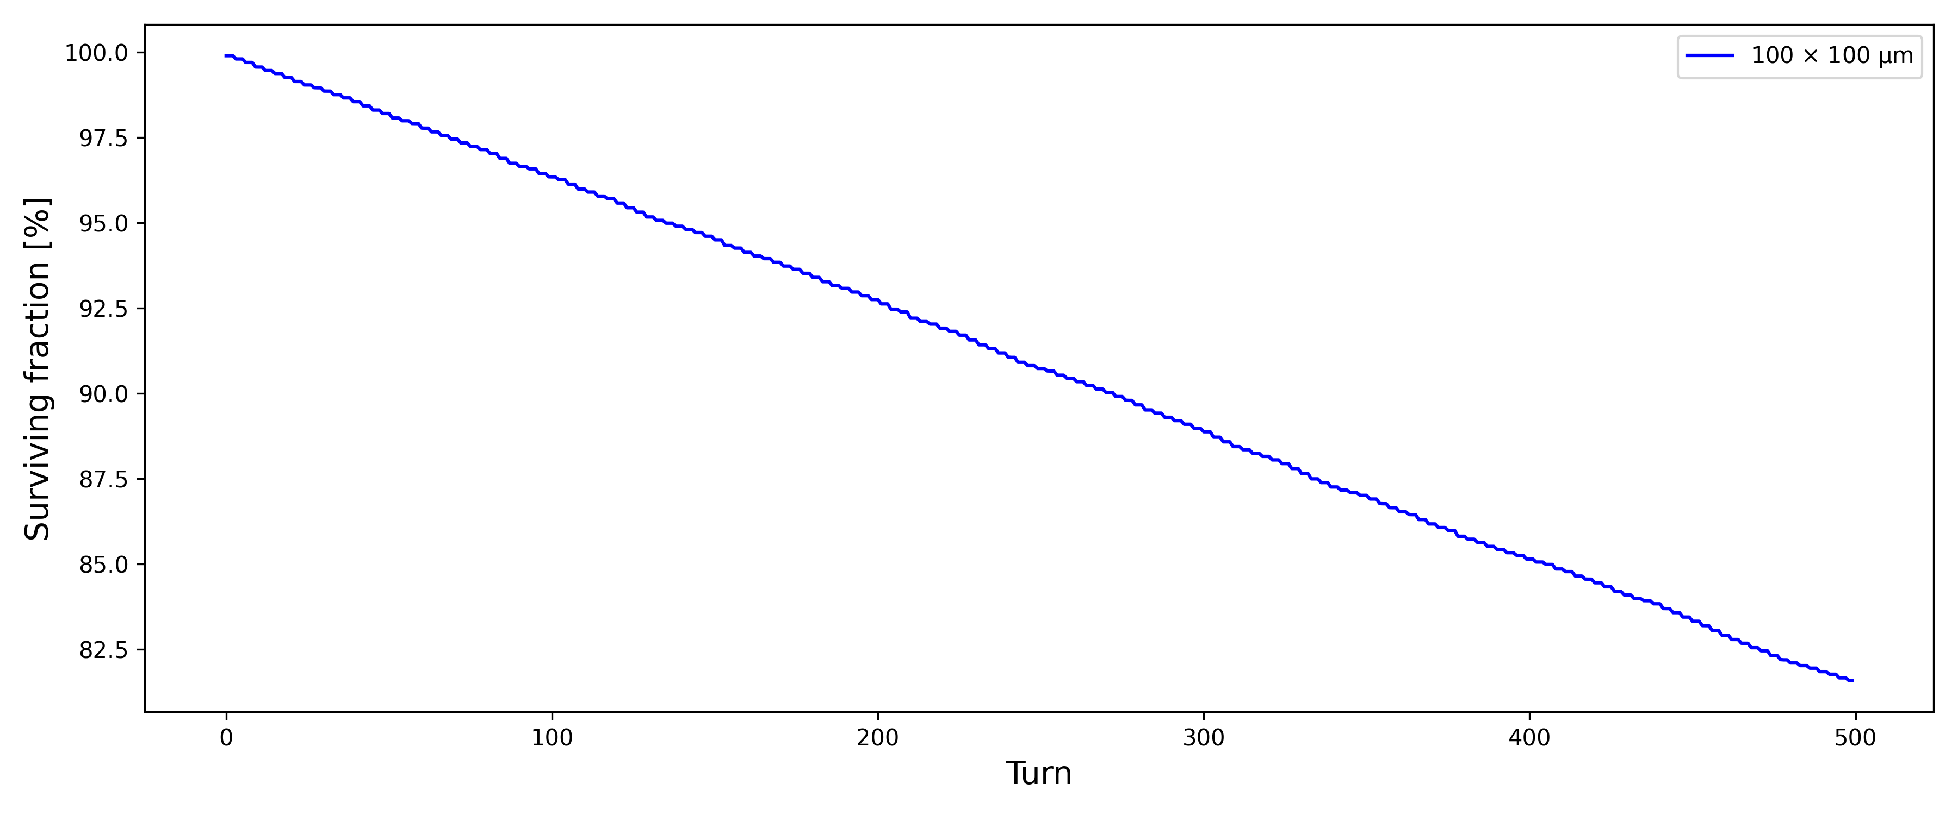
Beam intensity control
Beam ps before CBS
Beam ps after CBS
Possible location of CBS IP
Loss map
Possible location of CBS IP
Courtesy Giacomo Broggi
Notes:
Loss map: the "new" loss map looks better if compared to the one in the IPAC paper. There is significantly much less leakage from the halo collimation system (located in PF) and the off-momentum collimators look much more effective in intercepting losses. Some losses reach the regions upstream of the interaction point, but most of them are intercepted by the synchrotron radiation collimators. The good news here is that, unlike in the loss map in the IPAC paper, no cold losses are observed (i.e., losses on superconducting components).
Surviving particles vs. turns: it is clear that the slope of the curve is higher (i.e., the particle removal rate is higher) if compared to the corresponding one in the IPAC paper.

Slide 18
Beam intensity control
Why we need?
Asymmetry in the bunch current leads to Flip-flop instability. To avoid this bunches at IP must be bunches should be tightly controlled, with a maximum charge imbalance between collision partner bunches of less than 3−5%.

Slide 19
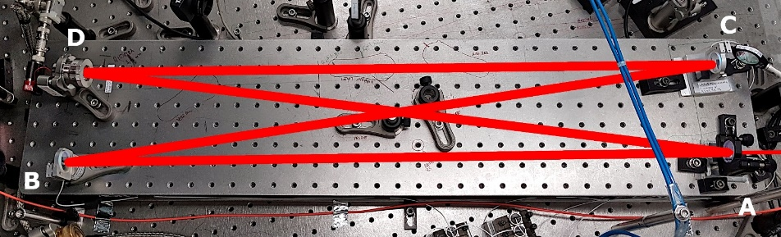
Laser & Fabry-Perot cavity
Laser input
Laser and Fabry-Perot cavity accumulate photons.
It give us possibility to collide photons with pulse energy of 3 mJ
e⁻ beam
Laser and FP cavity
Laser wavelength | 1030 nm
Laser and FP cavity Frep | 96 MHz
Pulse energy | 2.7 mJ
FP waist | 40 μm
Laser pulse length | 1 ps
E_{las}=1.2 eV
BriXSinO Fabry-Perot cavity
BriXSinO TDR: https://marix.mi.infn.it/brixsino-docs/
Notes:
We propose instal Fabry - Perot optical cavity with Ytterbium laser with wave length 1030 nm
Optical cavity accumulate laser pulses in one (similar to storage ring for electrons) and have huge rep rate 96 MHz
For us important here 96 is multiples of 2.4 so each electron pulse will collide a laser

Slide 20
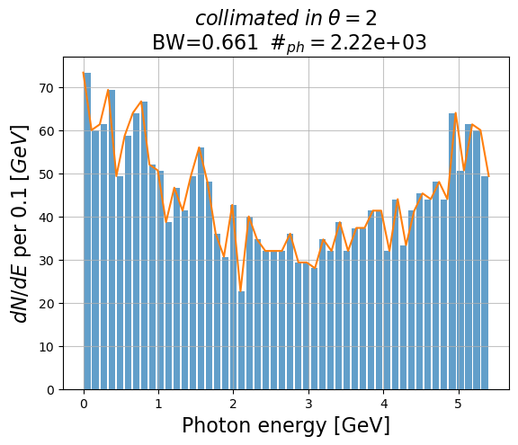
Booster as light source
(3e8*1120/90.7e3)/1e6=3.7 MHz
96MHz/3.7MHz=25.9
Total # of photons 2.22e3*3.7 MHz=8.2e9

Slide 21
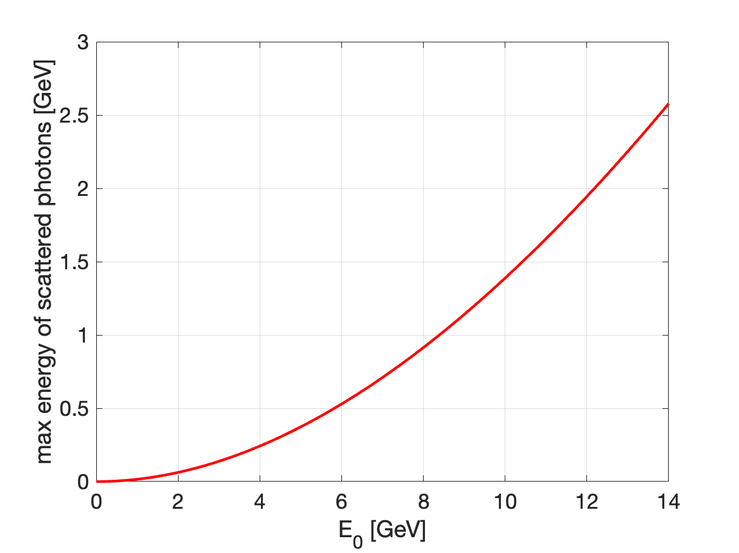
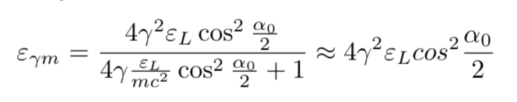
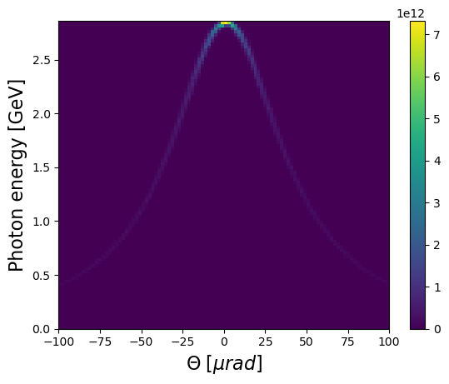
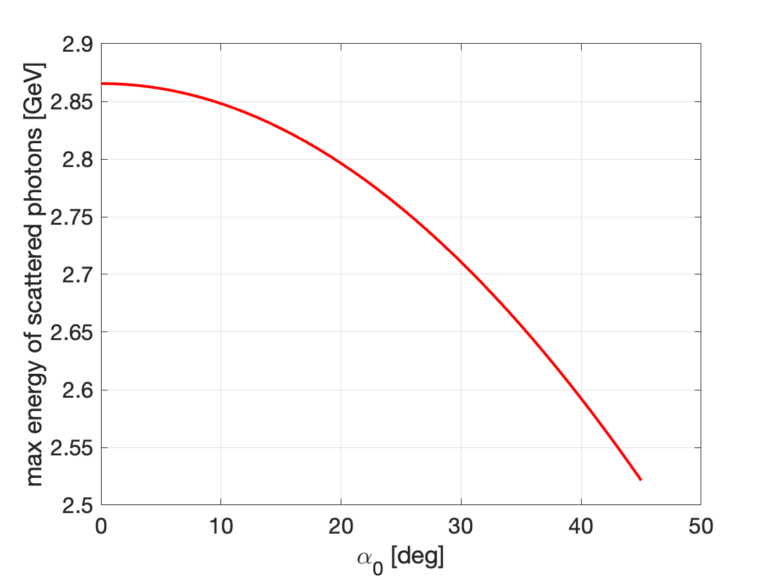
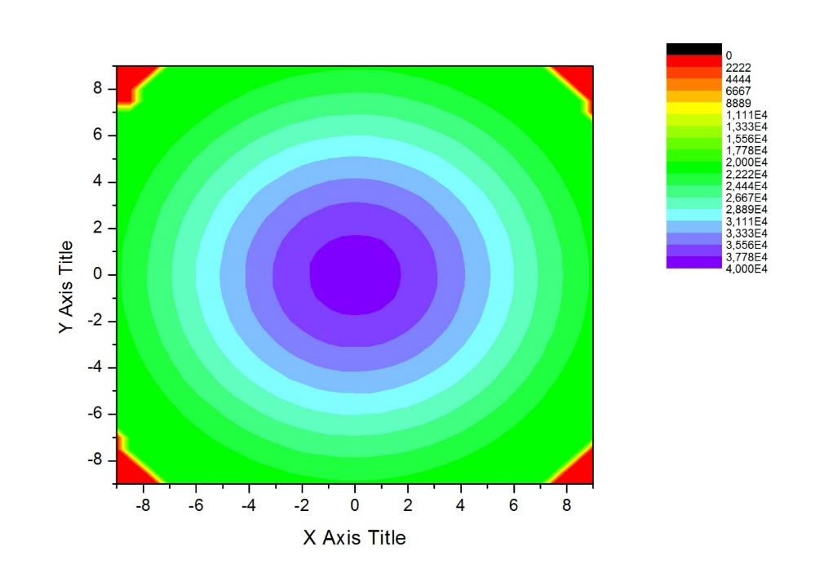
What is Compton Back Scattering?
1-βcosθ
Frequency-angle correlation
Total acceptance
Ψ_{max}=γθ_{max}= 1
θ_{max}= 1/γ
E=14 GeV-> 𝛄 = 2.7e+04
Θmax=37 µrad
n
θ
=e_{z}

Slide 22
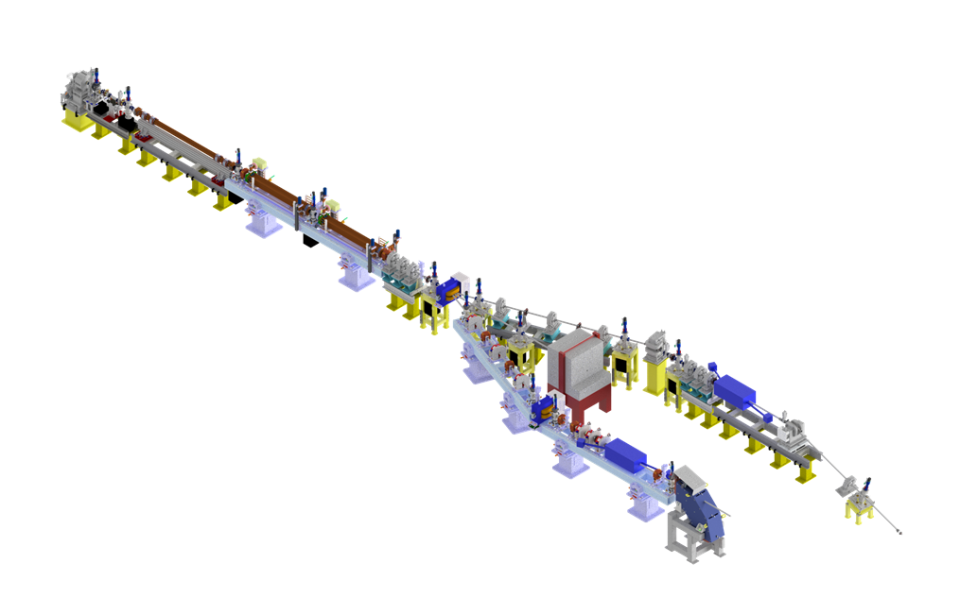
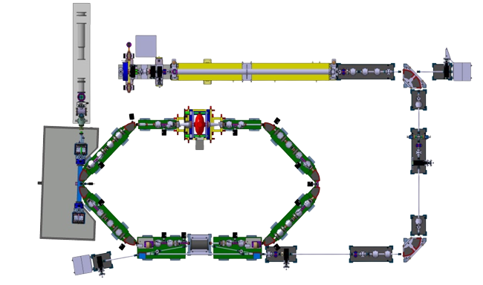
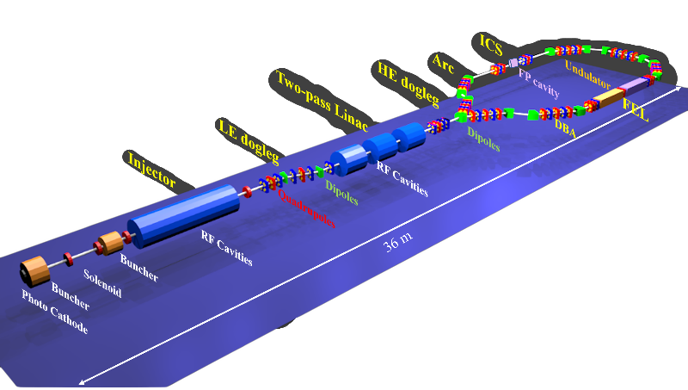
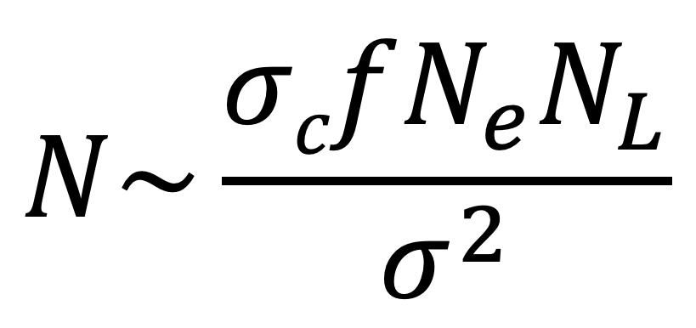

3 possible
Based on ERL
Based on storage rings
Based on linear accelerators
Projects:
STAR2
SMART*LIGHT
Projects:
BriXSinO
Cbeta
BerlinPro
Projects:
MuCLS
HIGS
ThomX
NESTOR
Rep rate ~100 MHz
Advantage:
Small emittance 2-3 mmrad
Possibility to focus beam at 5-10 μm
Hight flexibility in tuning
Disadvantage
Low repetition rate 100 Hz
Advantage:
Hight repetition rate 17.8 MHz
Disadvantage
Bigger emittance 60 mmrad
Bigger transvers size at IP ~70 μm
Notes:
Exist 3 main paradigm of making Compton sources based on linear accelerators with advantage as low emittance and beam spot size at IP but relatively small rep rate
Why this is important due to flux of scattered photons is linear function of rep rate and inverse dipendente spot sizes
And bigger emittance and spot size can compensated buy high repetition rate in the sources based on storage rings
Combine advantages we can using machine based on ERL or super conductive cavities what has low emittance and huge rep rate

Slide 23
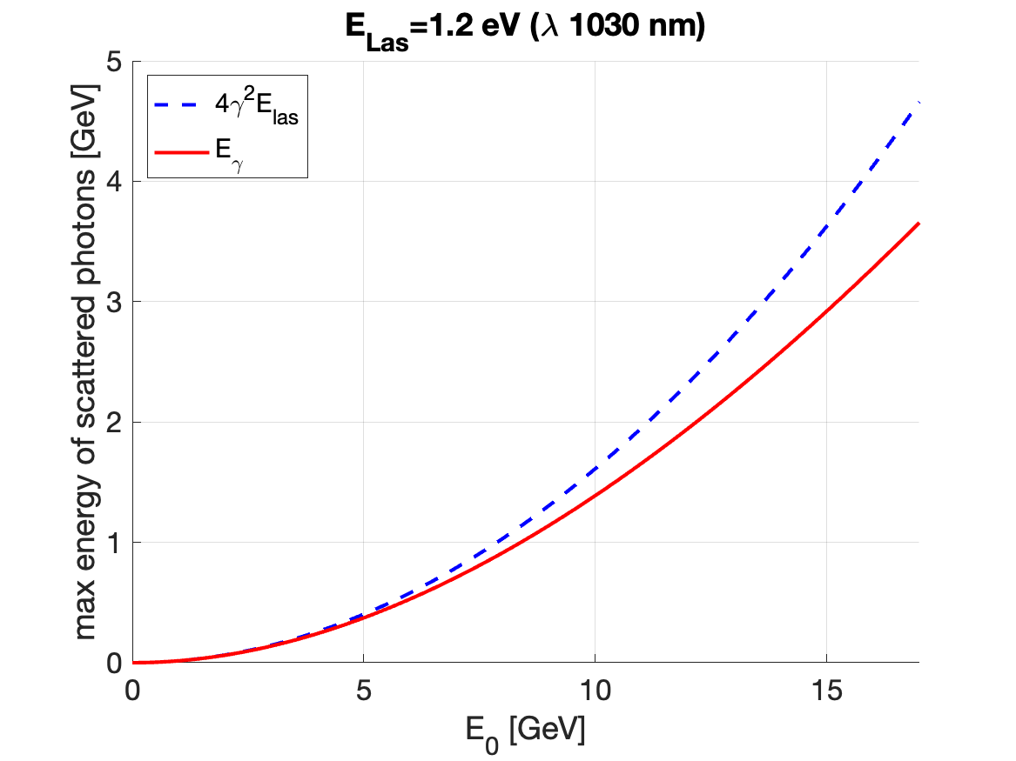
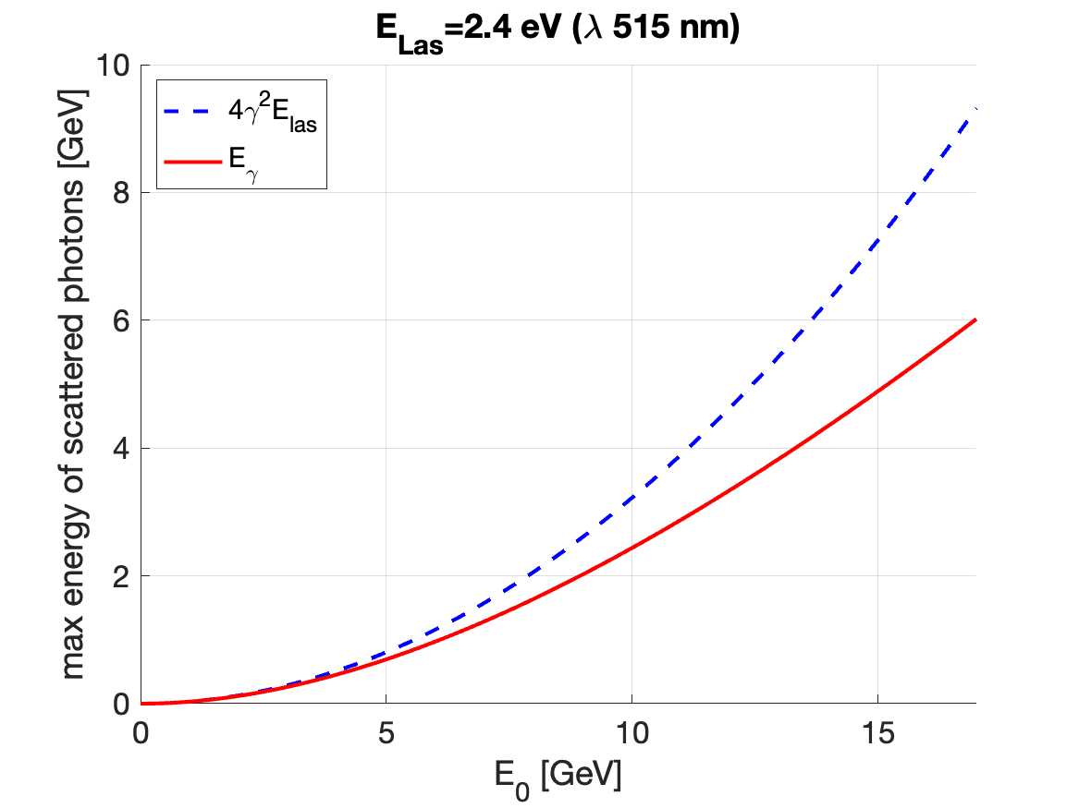


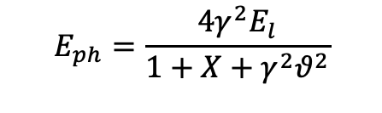
$$E_{0}=γmc^{2}$$
$$E_{ph}=\frac{4γ^{2}E_{l}}{1+X+γ^{2}θ^{2}}$$
$$X≡\frac{4γE_{l}}{mc^{2}}$$

