Slide 1
Booster capabilities including for light source applications
A. Chance, B. Dalena, Q. Bruant (CEA), A Ghribi (CNRS)
A. Mashal (IPM), M. Migliorati (UniRoma), A. Rajabi (DESY)
F. Zimmermann (CERN)
Thanks to:
B. Haerer, L. Van Riesen-Haupt, T. Charles, R. Tomas, T. Persson, F. Antoniou, O. Etisken, M. Zampetakis, S. Bettoni, M. Hofer, F. Carlier, B. Holzer, A. Franchi, A. Latina, K. Oide, T. Raubenheimer

Slide 2
Major changes since FCC week 2023
  Linac of 20 GeV as an injector + High-energy damping ring
  Same circumference as the collider.
  Better second order matching in the insertions.
  Reduced number of stored bunches in the booster (safer injection to the collider).
      Maximum number of stored bunches at Z/W/ZH/ttar operation: 1120/926/300/64.
      Requires 10/2/1/1 booster cycles to give the total number of bunches to the collider.
      Shorter accumulation time.
      Enlarges the pressure tolerance and TCBI threshold (reduced average current).
  Reduces maximum bunch charge for ZH/ttbar operation: 4 nC → 1.6 nC.
      Reduces the peak radiated power.
      Enlarges the allowed impedance budget for ZH/ttbar operation.
  Larger beam pipe aperture: 50 mm → 60 mm (Copper).
    Smaller contribution of the beam pipe to the impedance budget.
    Enlarges the TMCI/TCBI threshold: same optics possible for all modes.
  Larger misaligment errors (150 um pre-alignment in the arcs → 200 um girder-to-girder + 50 um girder pre-alignement) and orbit tuning procedures

Slide 3
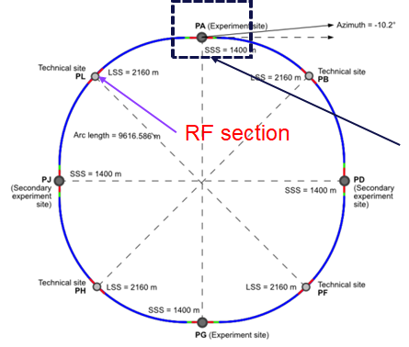
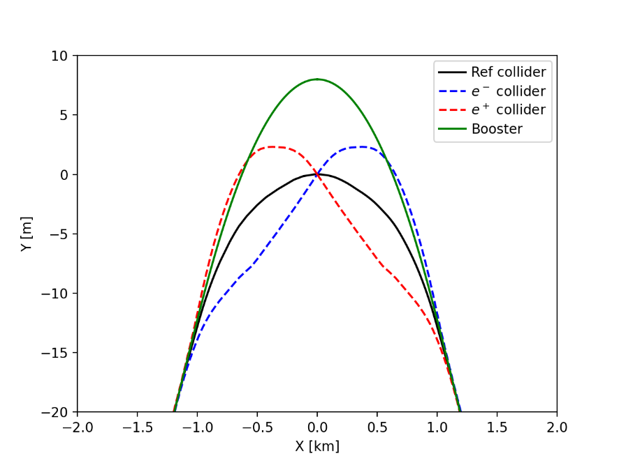
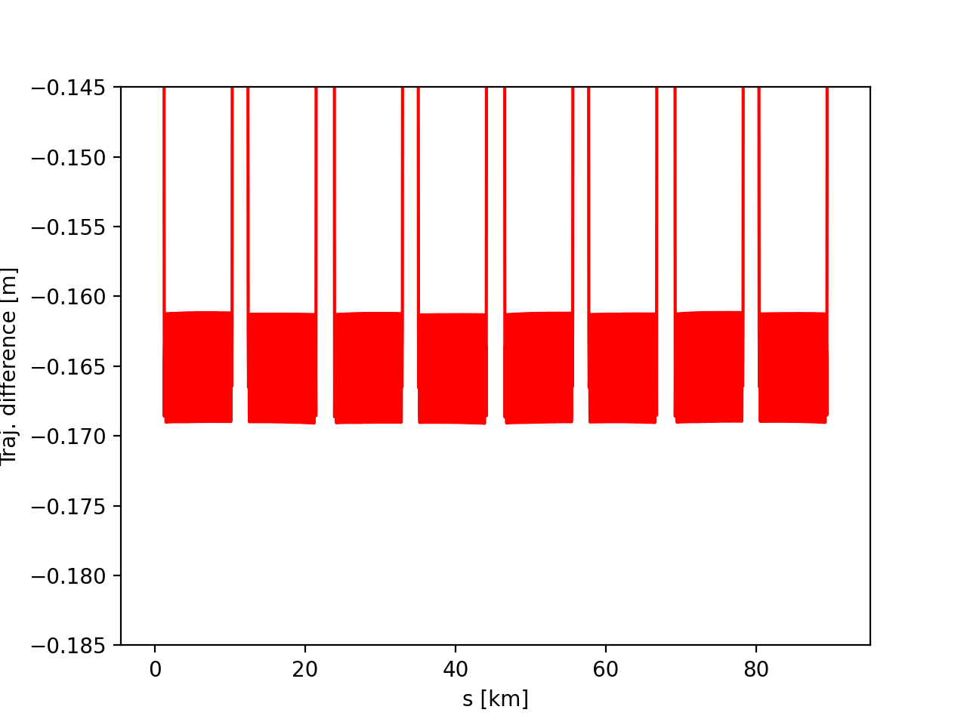
Layout status
October 2024
  800 MHz cavities are located in section L.
  The booster is in the outer side of the collider with an offset at the IP of 8 m.
  The booster follows the geometry of the collider V24.3_GHC.
  The offset in the arcs has been adjusted according to get the same circumference as the collider:
    Collider circumference: 90658.71376 m.
    Booster circumference: 90658.713761 m
    The booster has an offset of -165 +/- 4 mm in the arcs.

Slide 4
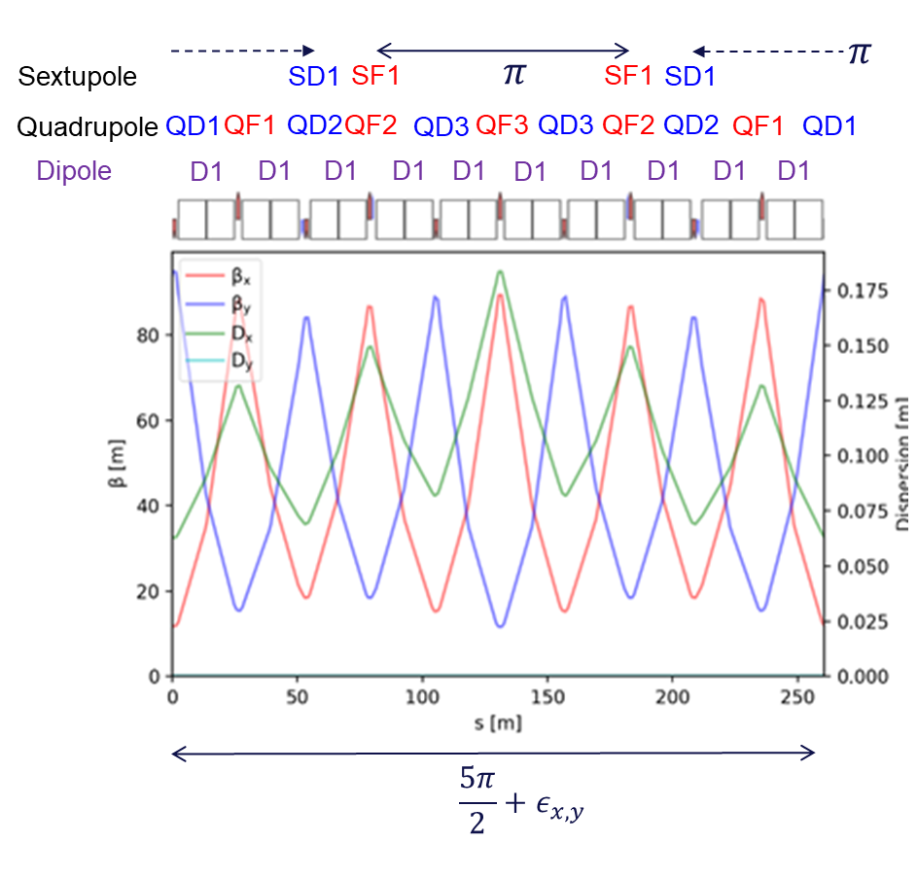
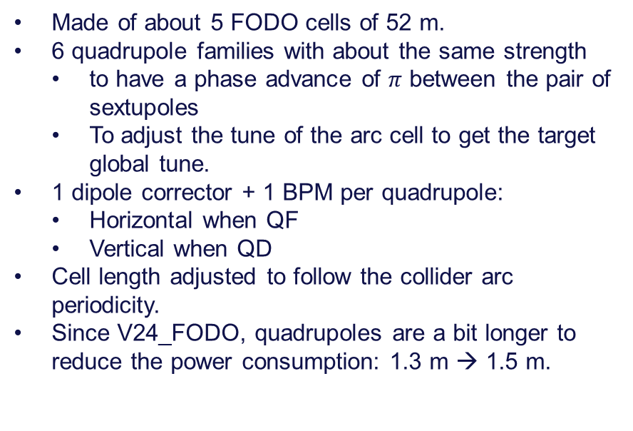
Baseline optics: V24.1_FODO
  Made of about 5 FODO cells of 52 m.
  6 quadrupole families with about the same strength
    to have a phase advance of $π$ between the pair of sextupoles
    To adjust the tune of the arc cell to get the target global tune.
  1 dipole corrector + 1 BPM per quadrupole:
    Horizontal when QF
    Vertical when QD
  Cell length adjusted to follow the collider arc periodicity.
  Since V24_FODO, quadrupoles are a bit longer to reduce the power consumption: 1.3 m → 1.5 m.

Slide 5
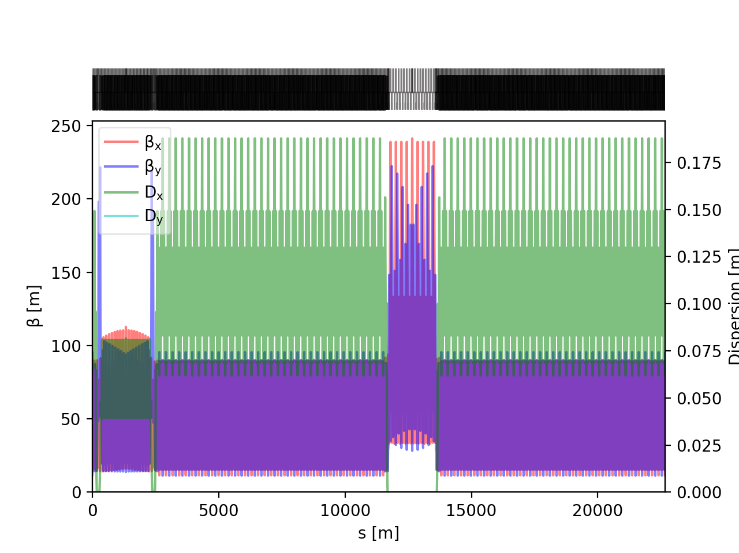
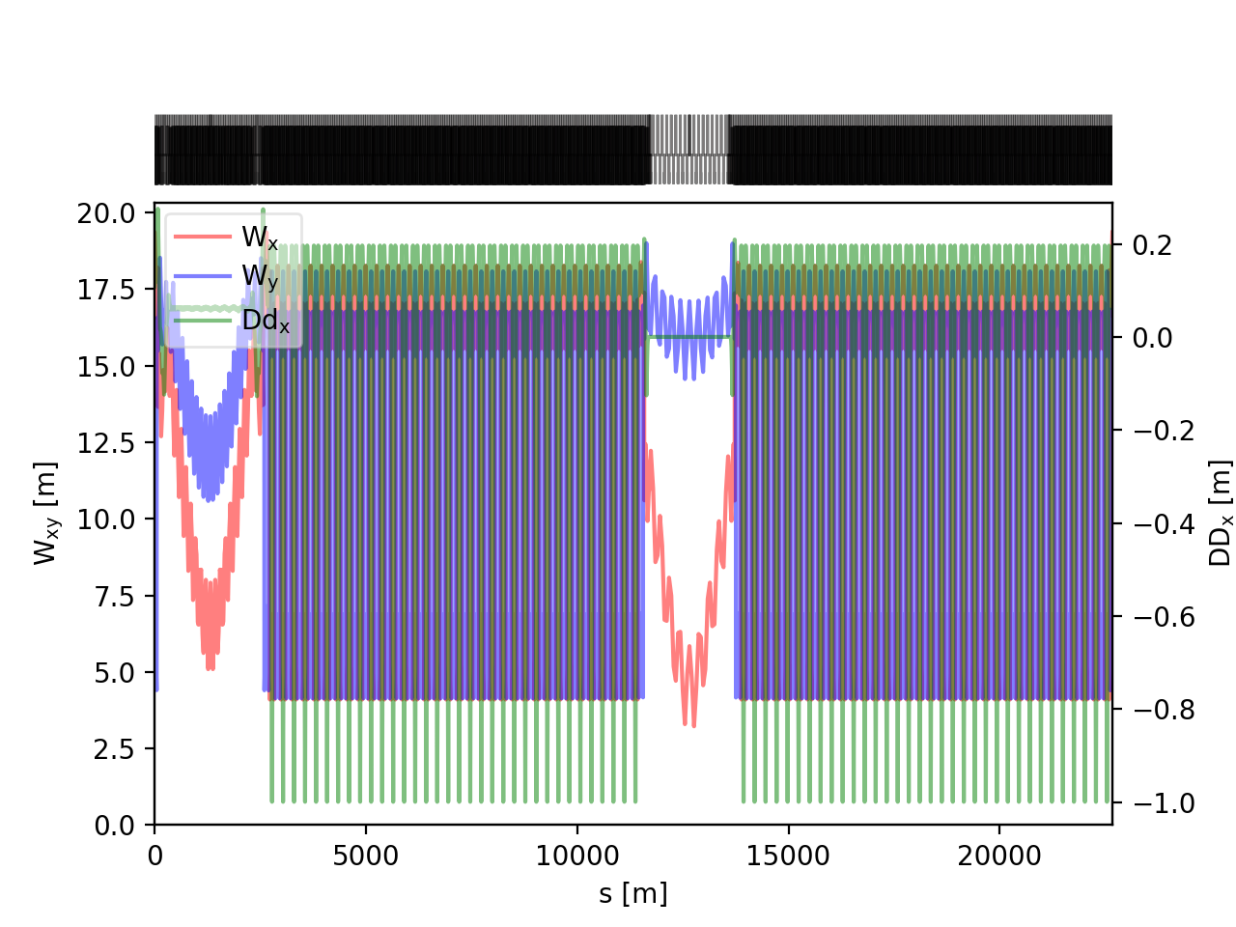
Baseline optics: V24.1_FODO
Optical functions (1/4 of ring)
  Arc cell of 260 m with 5 quasi-FODO cells of 90° of 52 m each.
  Transparency conditions for the insertions:
    Phase advance of π in both planes of between the focusing sextupoles in the dispersion suppressor to maximize the geometric aberration cancellation.
    The angles of some dipoles in the dispersion suppressors have been matched to cancel the second-order dispersion.
    Phase advance of the total insertion (including the dispersion suppressors) is equal to the phase advance of one arc cell (modulo 2 π).
    Matching of the Montague and second-order dispersion.
  Tune Q_{x}/Q_{y}: 414.225/410.29
  Momentum compaction: 7.13e-06; I5: 1.71e-11
  Cavities have been integrated to the lattice for the 4 modes.
Montague functions (1/4 of ring)
Magnet | Parameter | Unit | Value
Dipole | Min./Max. field | G | 64 – 584
 | Length | m | 11.0
Quadrupole | Min./Max. gradient | T/m | 0.5 – 23.2
 | Length | m | 1.5
Sextupole | Min./Max. gradient | T/m² | 35 – 1260
 | Length | m | 0.7 – 1.4

Slide 6
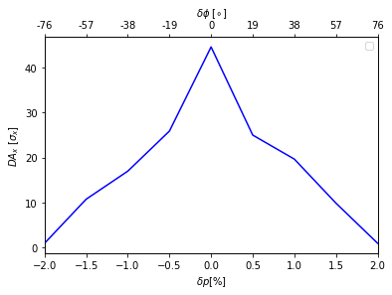
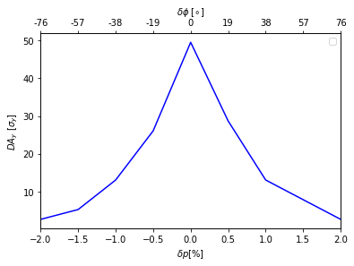
Dynamic aperture and momentum acceptance
Courtesy: B. Dalena, A. Mashal
  6D Dynamic aperture calculated at IP2.
  Thanks to the transparency conditions, dynamic aperture and momentum acceptance stay quite large.
  We should be able to accept a phase jitter at injection up to 25°.
  In parallel, some work was done to enlarge the dynamic aperture of the baseline by using more sextupole families (criteria: enlarge the xi parameter linking the path length variation to the action).

Slide 7
Layout and constraints
Courtesy: Sen Yue
Layout and geometry
  8.5 degrees (~150 mrad) angle between transfer line and beam line
  Limited space between the wall and the booster beam line
Placement
  Fast rise of the kicker requires minimizing the distance between kicker and generator (alcove)
  Presently the injection line intersects to the booster ring is ~25m from the alcove
Solution
  Dipoles in the tunnel for a total of ~ 125 mrad
  Long septum system with 25 mrad cumulated angle
  2 plane injection with small vertical angle of 90 µrad
Layout changes
  Present layout does not allow placement of septa at the intersect and kicker in front of the alcove
  2 possible solutions
    Moving the injection line intersect at least 25 m closer to the IP
    Moving the Alcove at least 25 m further
The detail information can be found in the ATDC meeting:
https://indico.cern.ch/event/1463503/

Slide 8
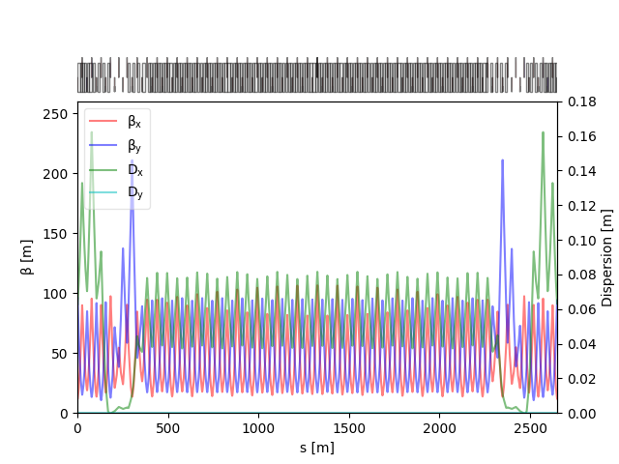
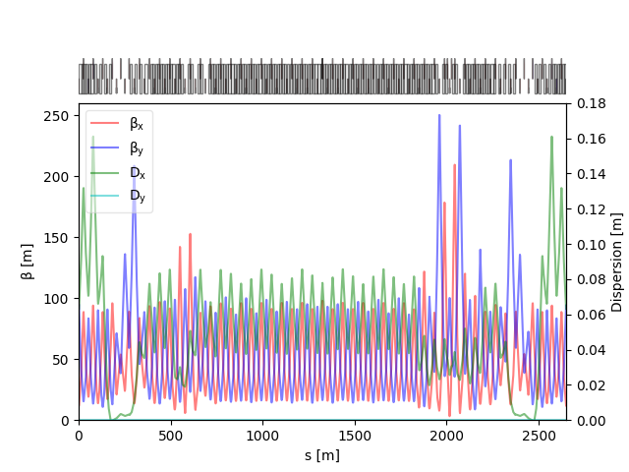
Optics design – positron
V24_FODO
NO injection optics
A vertical defocusing quad is placed between septa and kicker
  2 additional quads are added for optics optimization.
  2*11 additional independent power supplies on quadrupoles
  Minimal changes to the ring optics are expected.
A global rematching of the insertion has been performed to get the matching conditions:
  Global tune: 414.225/410.29 → 415.225/410.29
  Dispersion bump near the electron injection to match the second-order dispersion.
Dynamic aperture and momentum acceptance to be evaluated.
To be updated with V24.1_FODO.
WITH injection optics

Slide 9
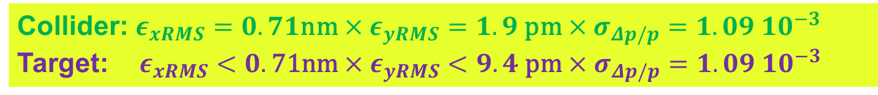
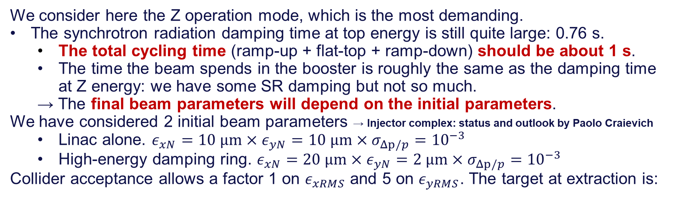
Emittance evolution
We consider here the Z operation mode, which is the most demanding.
The synchrotron radiation damping time at top energy is still quite large: 0.76 s.
  The total cycling time (ramp-up + flat-top + ramp-down) should be about 1 s.
  The time the beam spends in the booster is roughly the same as the damping time at Z energy: we have some SR damping but not so much.
  → The final beam parameters will depend on the initial parameters.
We have considered 2 initial beam parameters → Injector complex: status and outlook by Paolo Craievich
  Linac alone. $ε_{xN}=10 \text{μm}×ε_{yN}=10 \text{μm}×σ_{Δp/p}={10}^{−3}$
  High-energy damping ring. $ε_{xN}=20 \text{μm}×ε_{yN}=2 \text{μm}×σ_{Δp/p}={10}^{−3}$
Collider acceptance allows a factor 1 on $ε_{xRMS}$ and 5 on $ε_{yRMS}$. The target at extraction is:
Collider: $ε_{xRMS}=0.71\text{nm}×ε_{yRMS}=1.9 \text{pm}×σ_{Δp/p}={1.09 10}^{−3}$
Target:$ε_{xRMS}<0.\text{71}\text{nm}×ε_{yRMS}<9.4 \text{pm}×σ_{Δp/p}={1.09 10}^{−3}$

Slide 10
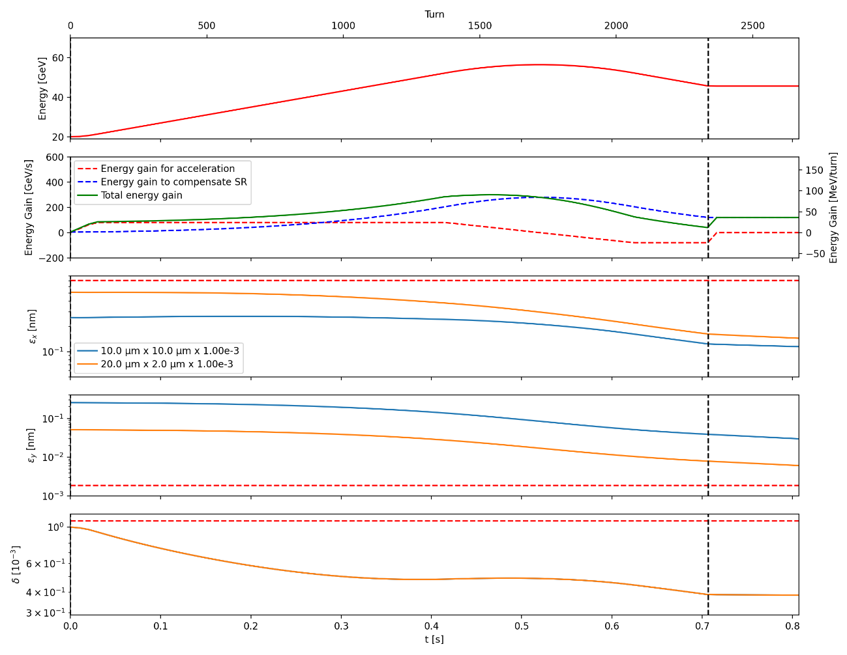
Emittance evolution
Baseline (no accumulation)
Total cycling: 0.706 (ramp-up) +0.1 (flat-top) + 0.334 (ramp-down) = 1.14 s
We use the double parabolic ramp + energy overshoot.
Adiabatic start of the ramp (5% of initial energy gain)
Steep linear energy ramp in the middle (80 GeV/s)
Adiabatic approach of the flat top energy (80% of total gain)
Linac alone: Initial beam parameters: 10 µm x 10 µm x 1e-3
  Hor. Emittance: 0.122 nm
  Vert. Emittance: 30.0 pm
  Energy spread: 0.387e-3
High-energy DR: Initial beam parameters: 20 µm x 2 µm x 1e-3
  Hor. Emittance: 0.159 nm
  Vert. Emittance: 6.12 pm
  Energy spread: 0.387e-3

Slide 11
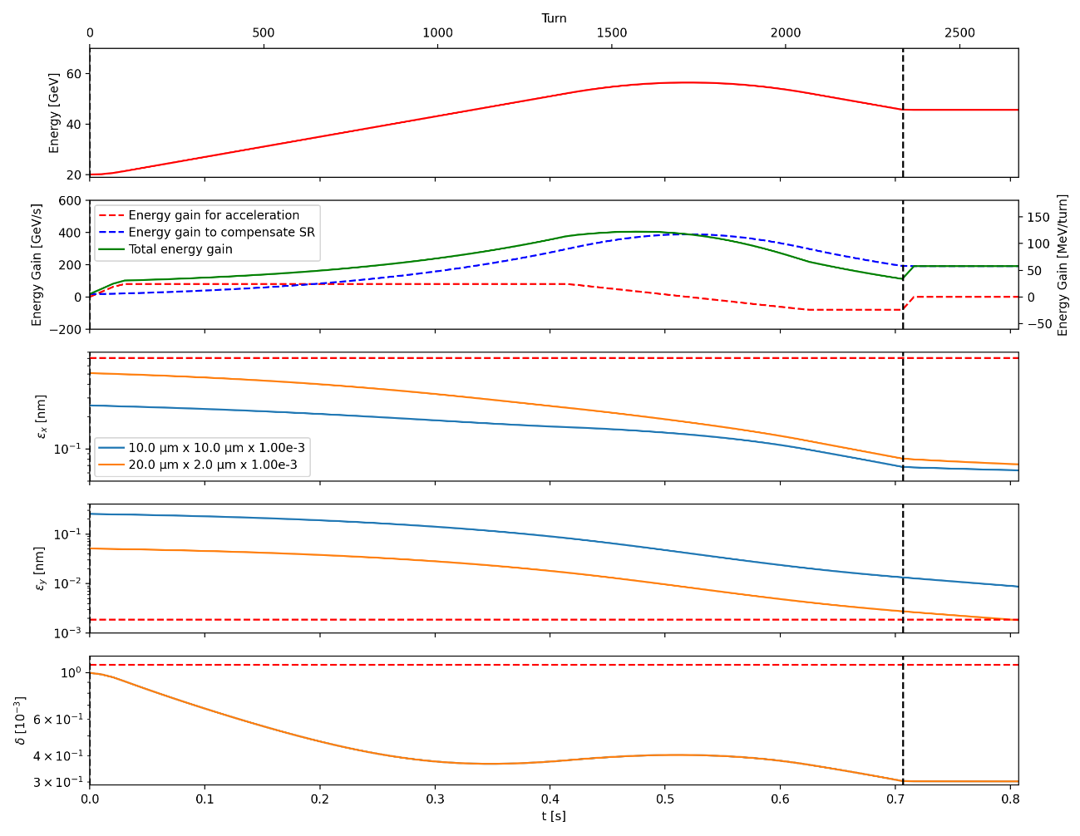
Emittance evolution
Wiggler: I₂ 0.59 mm⁻¹ → 2.43 mm⁻¹ @20 GeV
Total cycling: 0.706 (ramp-up) +0.1 (flat-top) + 0.334 (ramp-down) = 1.14 s
We use the double parabolic ramp + energy overshoot.
Adiabatic start of the ramp (5% of initial energy gain)
Steep linear energy ramp in the middle (80 GeV/s)
Adiabatic approach of the flat top energy (80% of total gain)
Wiggler 4.925 m, B_{gap}=1.45 T, L_{pole}=9.5 cm, L_{gap}=2cm, 43 poles
Linac alone: Initial beam parameters: 10 µm x 10 µm x 1e-3
  Hor. Emittance: 0.063 nm
  Vert. Emittance: 8.74 pm
  Energy spread: 0.303e-3
High-energy DR: Initial beam parameters: 20 µm x 2 µm x 1e-3
  Hor. Emittance: 0.072 nm
  Vert. Emittance: 1.836 pm
  Energy spread: 0.303e-3
NOTA: the change in I₃ is not taken into account.

Slide 12
Emittance evolution summary
  Going through higher energy than the target during the ramp speeds up the emittance damping and gives a smaller final vertical emittance.
    That requires a higher voltage (possible for Z operation since the required voltage is smaller than for the other modes) and higher consumption.
  Still a lot of room for optimization to get the target emittance:
    The down ramp can be faster (hysteresis and Eddy losses to be optimized).
    Maximum beam energy variation and Eddy currents in the dipoles to be evaluated.
    Use of an additional wiggler.
  The high-energy damping ring helps a lot thanks to an initial smaller vertical emittance.
  Ramp is under optimization to integrate RF operations considerations.
 | Case1: Linac alone | Case 2, Linac + High-energy DR
Baseline: cycle of 1.14 s | 30.0 pm | 6.12 pm
Shorter ramp-down by 170 ms | 9.27 pm | 1.99 pm
Higher max field slope 100 GeV/s | 9.1 pm | 1.96 pm
With a wiggler of 4.925 m | 8.74 pm | 1.836 pm

Slide 13
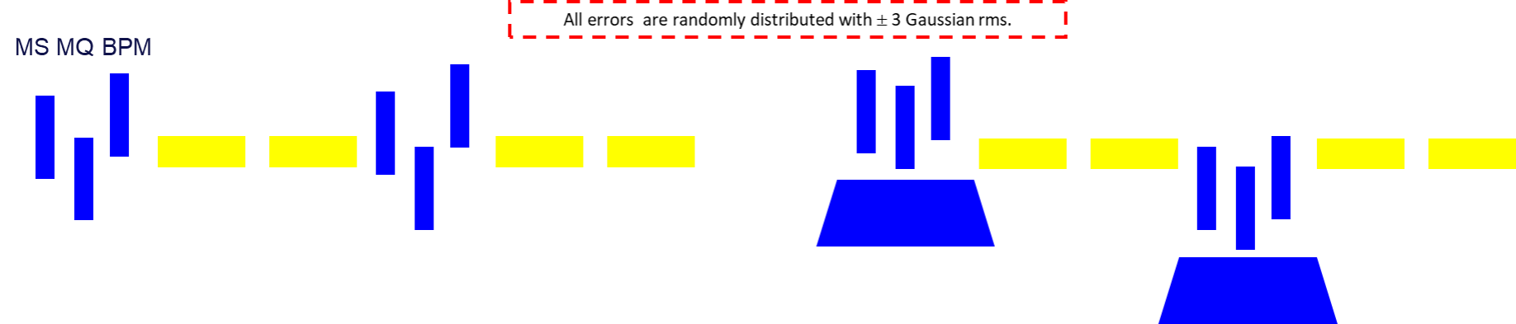
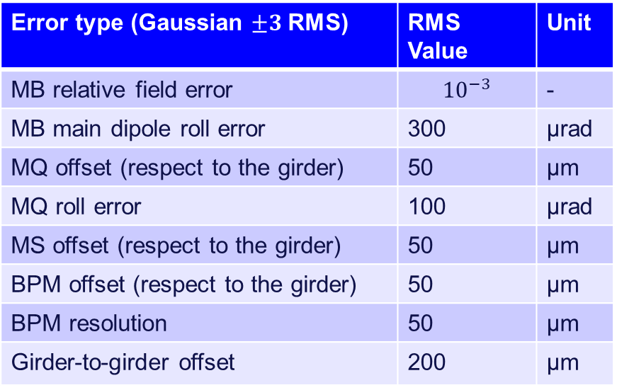
Correction strategy
Courtesy: B. Dalena, Q. Bruant
Similar to SuperKEKB commissioning
All orbit correctors are individually powered and located near one BPM at each quadrupole.
The correction strategy has two main sections:
With the sextupoles turned off (or very low strength).
  Segment-by-Segment (SbS) correction i.e. arc by arc; which is similar to the LHC commissioning.
  Two Singular Value Decompositions (SVD) on all arcs and in line, in order to get a small enough residual orbit for finding the closed orbit.
  Multiple iterations of SVD in ring.
With the sextupoles turned on (full strength).
  One iteration of SVD in ring.
  Matching of the tunes and the chromaticity to nominal values, using the quadrupoles and sextupoles in the dispersion suppression and matching regions.
  Orbit correction, tune and chromaticity.
Error type (Gaussian $±3$RMS) | RMS Value | Unit
MB relative field error | $${10}^{−3}$$ | -
MB main dipole roll error | 300 | µrad
MQ offset (respect to the girder) | 50 | µm
MQ roll error | 100 | µrad
MS offset (respect to the girder) | 50 | µm
BPM offset (respect to the girder) | 50 | µm
BPM resolution | 50 | µm
Girder-to-girder offset | 200 | µm

Slide 14
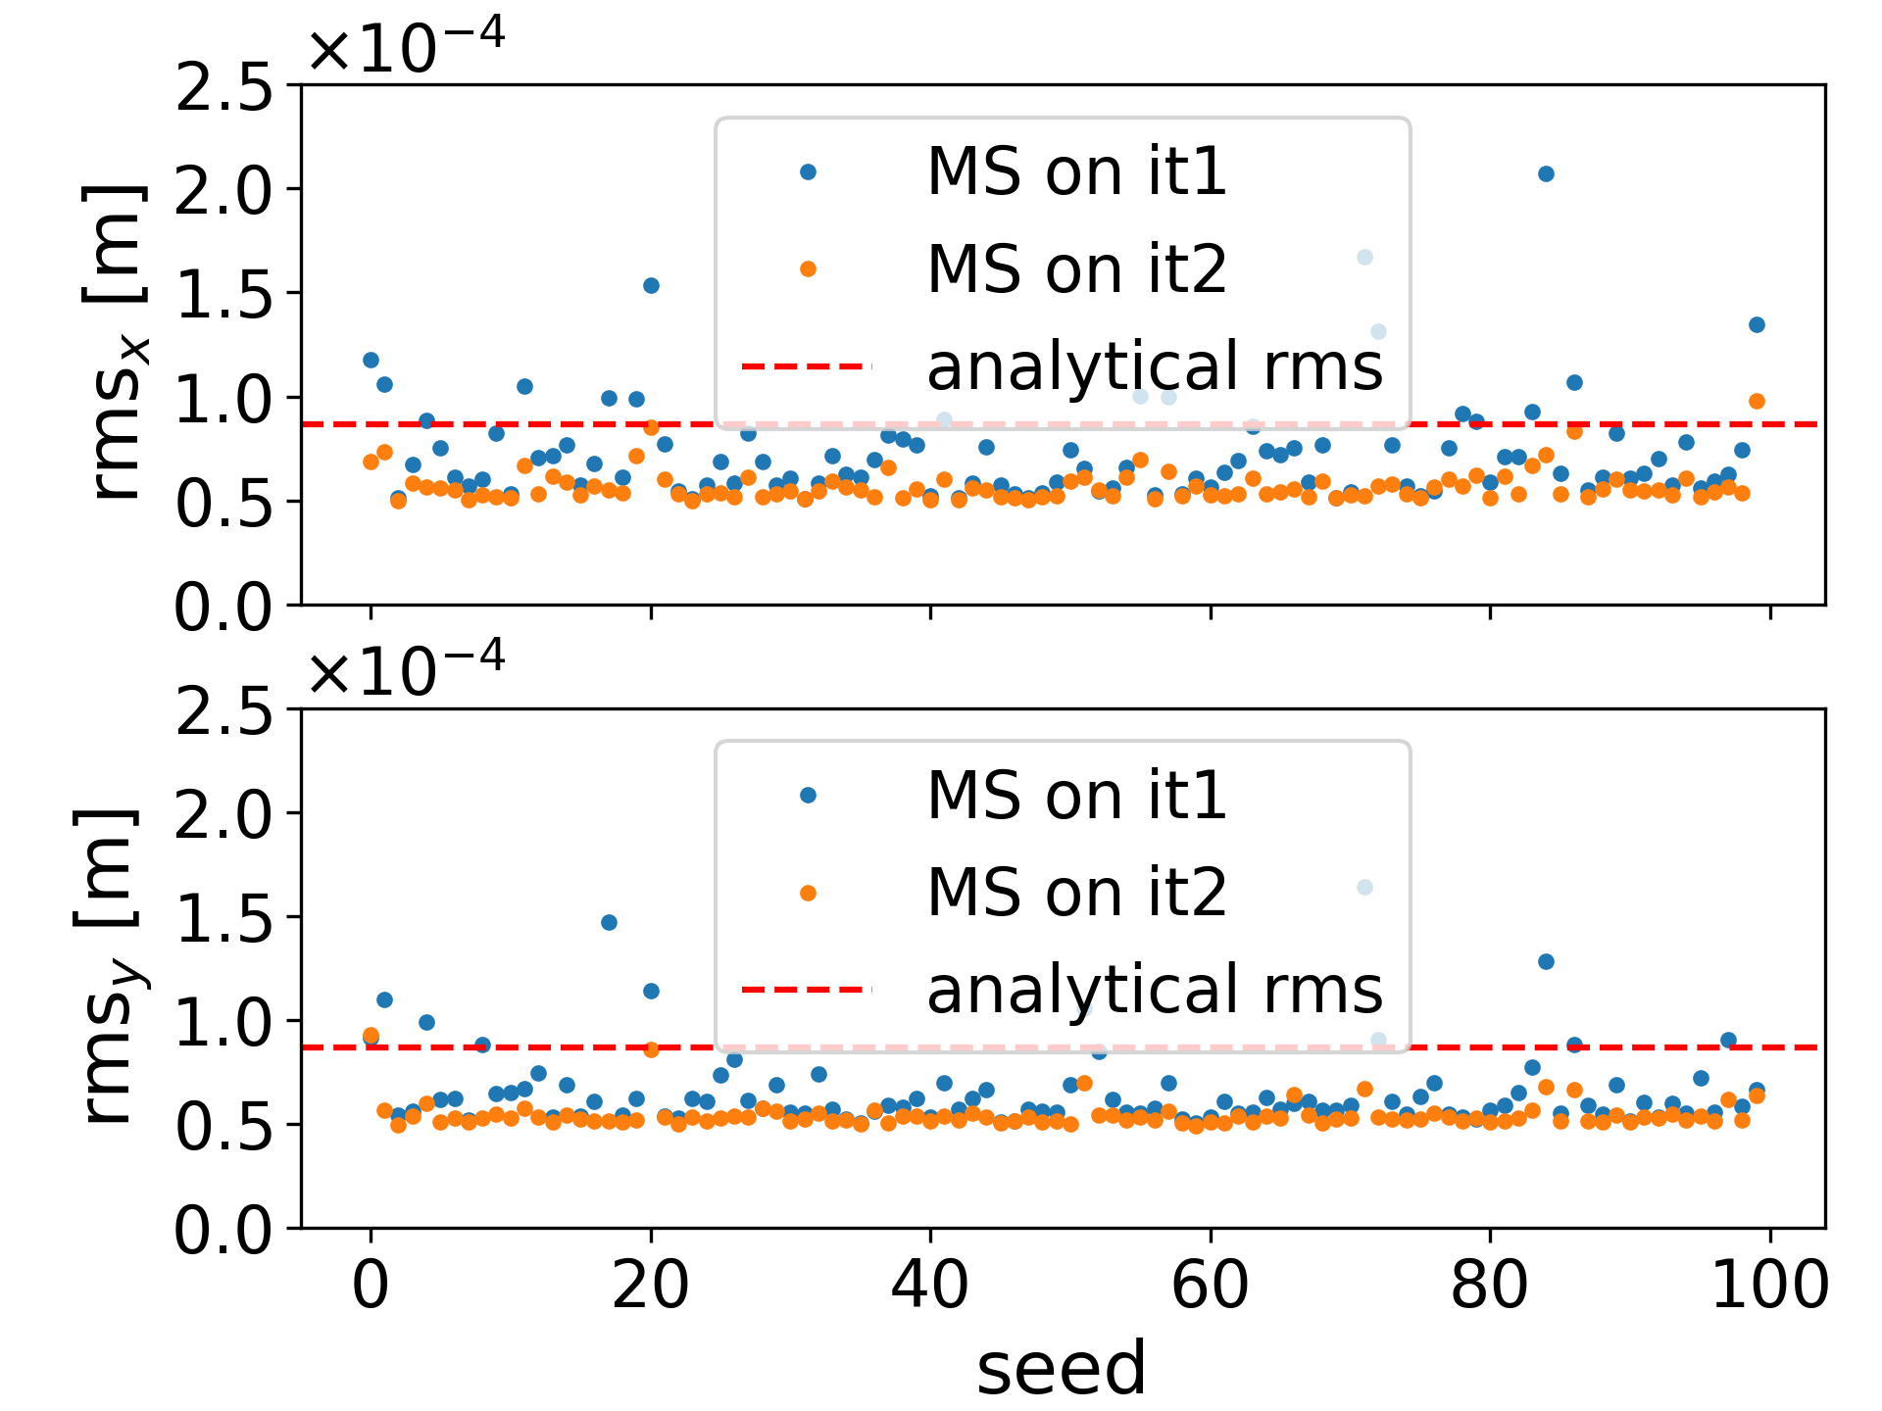
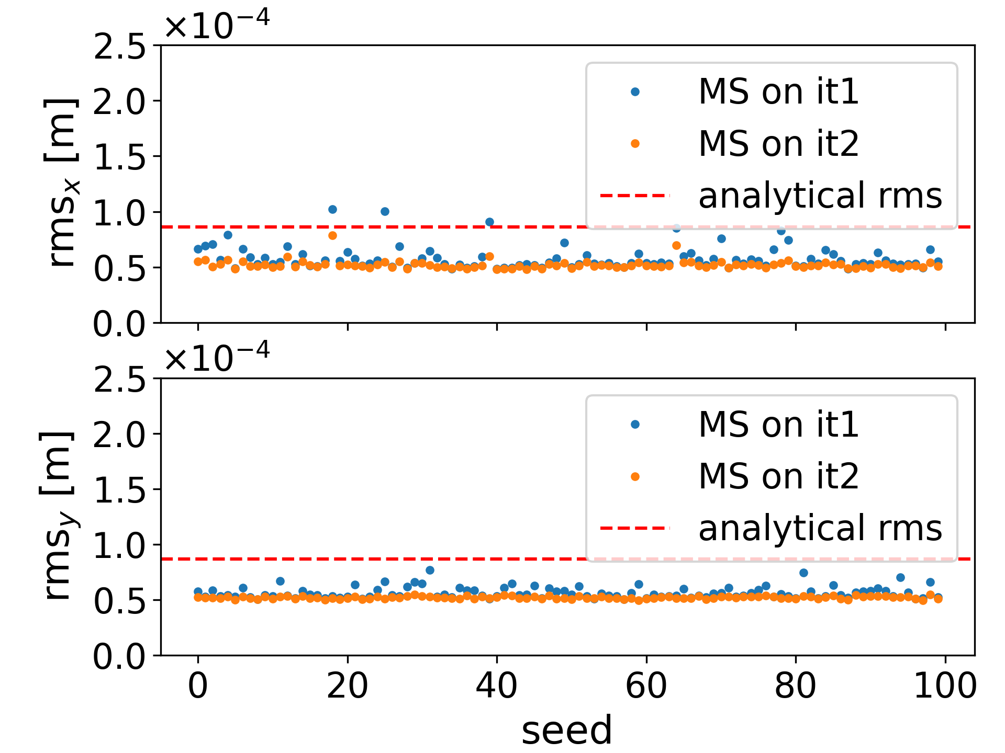
Residual orbit
Courtesy: B. Dalena, Q. Bruant
V24_FODO
V24_HFD

Slide 15
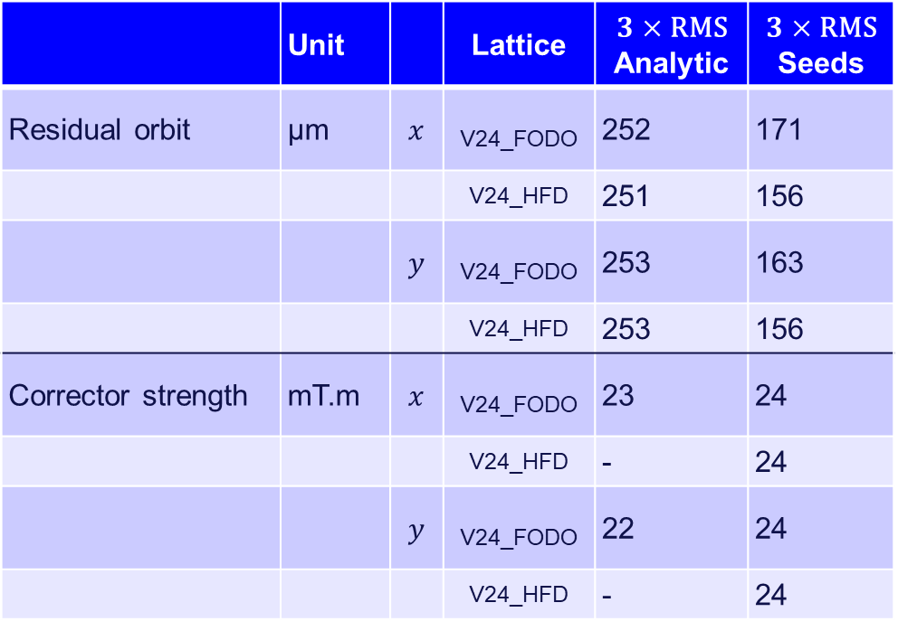
Tuning summary
 | Unit |  | Lattice | $$3×\text{RMS}$$ Analytic | $$3×\text{RMS}$$ Seeds
Residual orbit | µm | $$x$$ | V24_FODO | 252 | 171
 |  |  | V24_HFD | 251 | 156
 |  | $$y$$ | V24_FODO | 253 | 163
 |  |  | V24_HFD | 253 | 156
Corrector strength | mT.m | $$x$$ | V24_FODO | 23 | 24
 |  |  | V24_HFD | - | 24
 |  | $$y$$ | V24_FODO | 22 | 24
 |  |  | V24_HFD | - | 24
Both optics have similar final residual orbit and corrector values, even if in the case of the HFD optics, the results are less spread out.
Dedicated correction to achieve the target extraction emittance in both transverse planes under development (beta-beating, dispersion beating and coupling correction).
First results are very encouraging but need to be confirmed before communicating them.

Slide 16
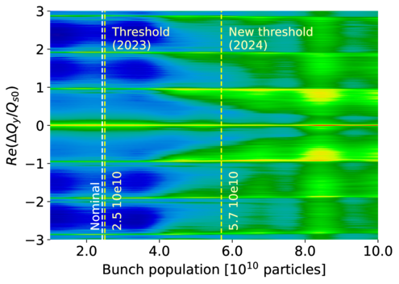
Collective effects
Bunch population scan @ injection energy
Courtesy: A. Ghribi
  Going from a radius of 25 mm to 30 mm for the vacuum chamber cures the Transverse Mode Coupling Instabilies.
  We can use the same optics for all modes.
  We need a total impedance budget to fully validate the stability at injection.
  Needs for a feedback system with a damping time of 310 turns.
Growth rate as a function of the mode number for the PA31.3 baseline (2024), Z operation, E =20 GeV, σz =4 mm, Nb = 15880, Cu beam pipe (R=30 mm).

Slide 17

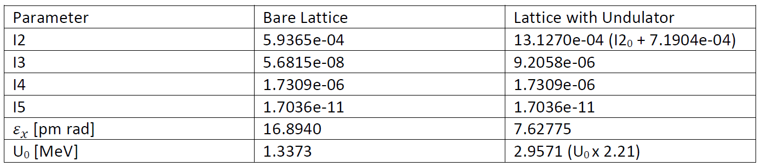
Possibility to use the booster as a light source
  The photon beam is parasitic: should not change the booster operation.
  We consider an undulator with a sinus-profile with the following parameters:
With the undulator at the middle of one straight section, we get the following synchrotron integrates (with AT):
Courtesy:
Ahmad Mashal

Slide 18
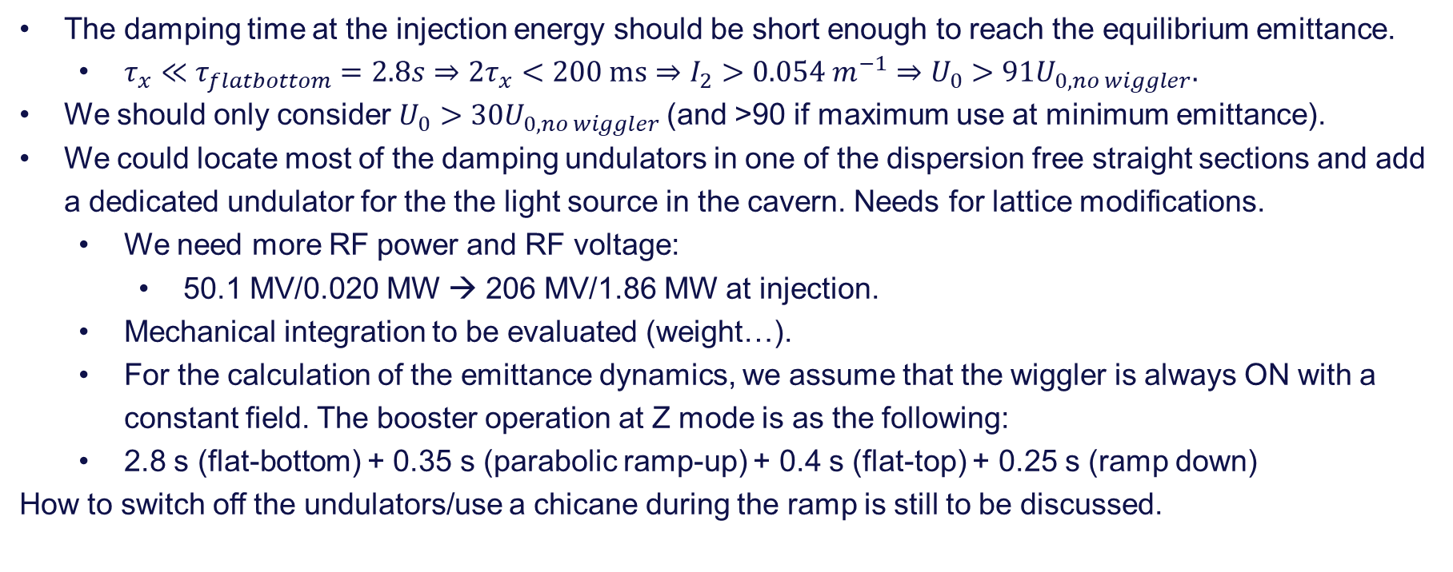
Possibility to use the booster as a light source
The damping time at the injection energy should be short enough to reach the equilibrium emittance.
  $τ_{x}≪τ_{flatbottom}=2.8s⇒{2τ}_{x}<200 \text{ms}⇒I_{2}>0.054 m^{−1}⇒U_{0}>91U_{0, no wiggler}.$
We should only consider $U_{0}>30U_{0, no wiggler}$(and >90 if maximum use at minimum emittance).
We could locate most of the damping undulators in one of the dispersion free straight sections and add a dedicated undulator for the the light source in the cavern. Needs for lattice modifications.
  We need more RF power and RF voltage:
    50.1 MV/0.020 MW → 206 MV/1.86 MW at injection.
  Mechanical integration to be evaluated (weight…).
  For the calculation of the emittance dynamics, we assume that the wiggler is always ON with a constant field. The booster operation at Z mode is as the following:
  2.8 s (flat-bottom) + 0.35 s (parabolic ramp-up) + 0.4 s (flat-top) + 0.25 s (ramp down)
How to switch off the undulators/use a chicane during the ramp is still to be discussed.

Slide 19
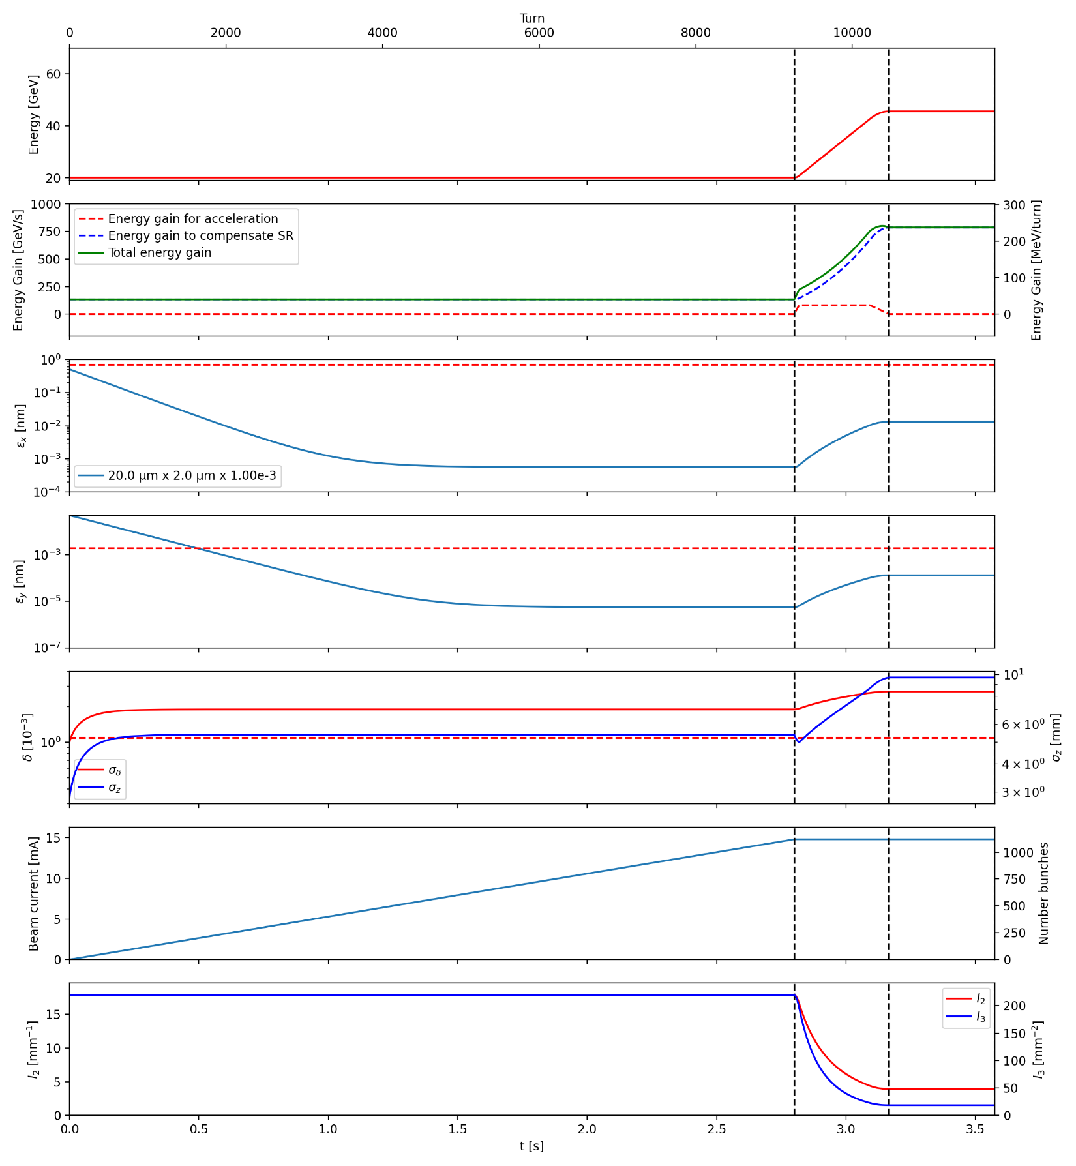
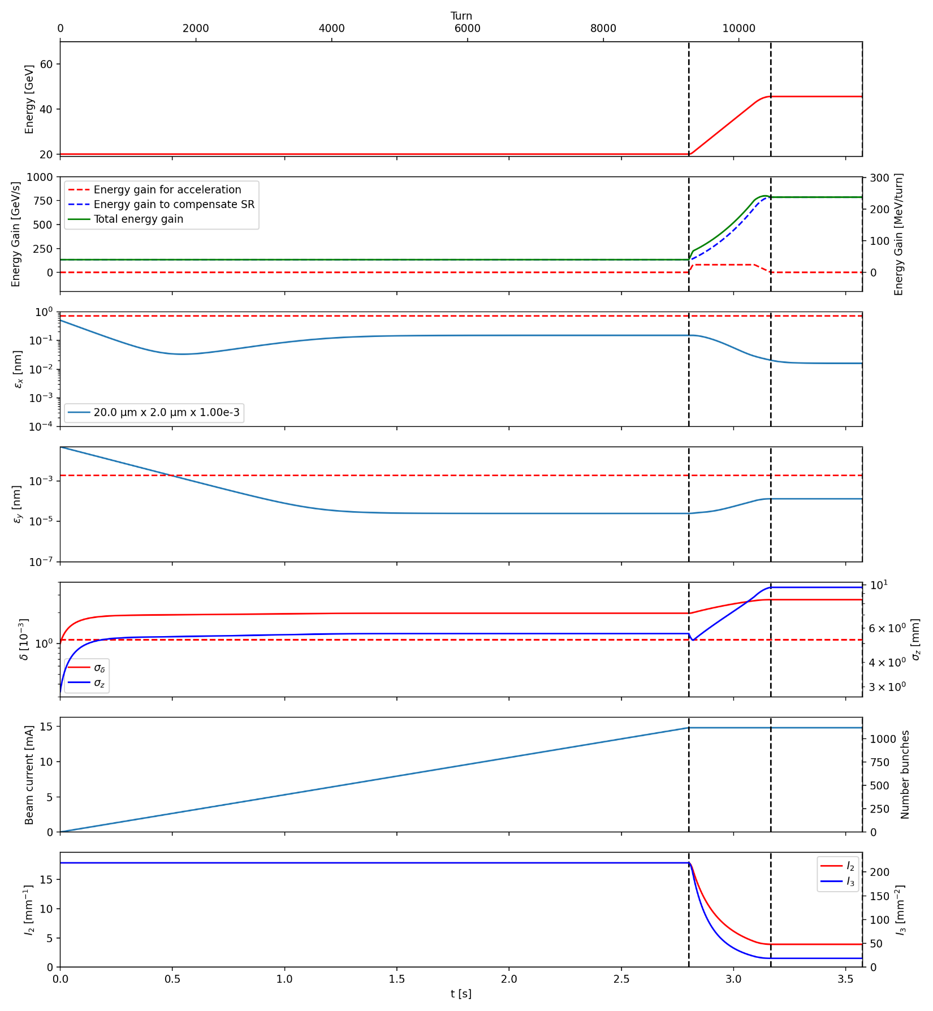
Emittance dynamics U0 x 30
No IBS
With IBS

Slide 20
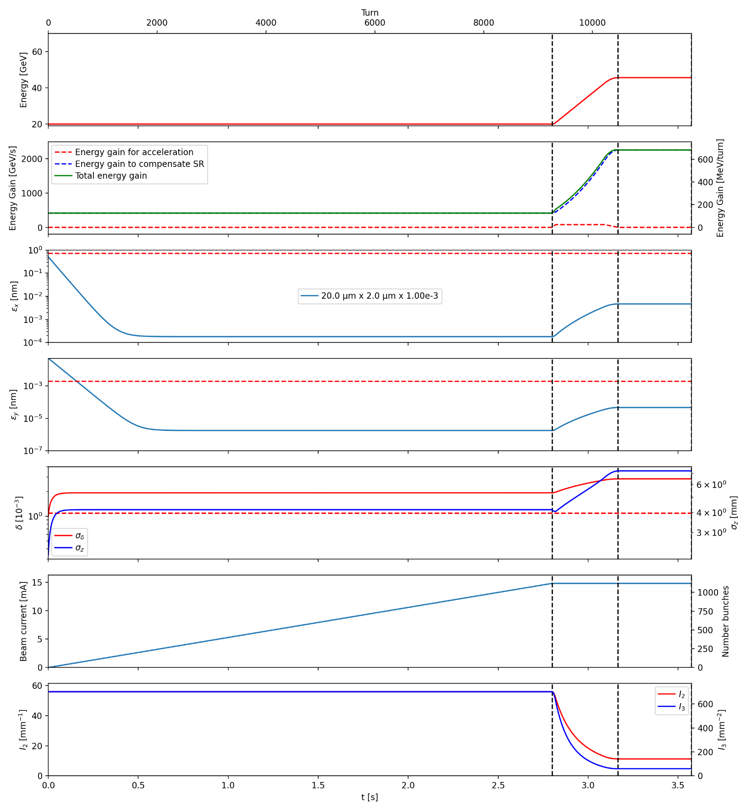
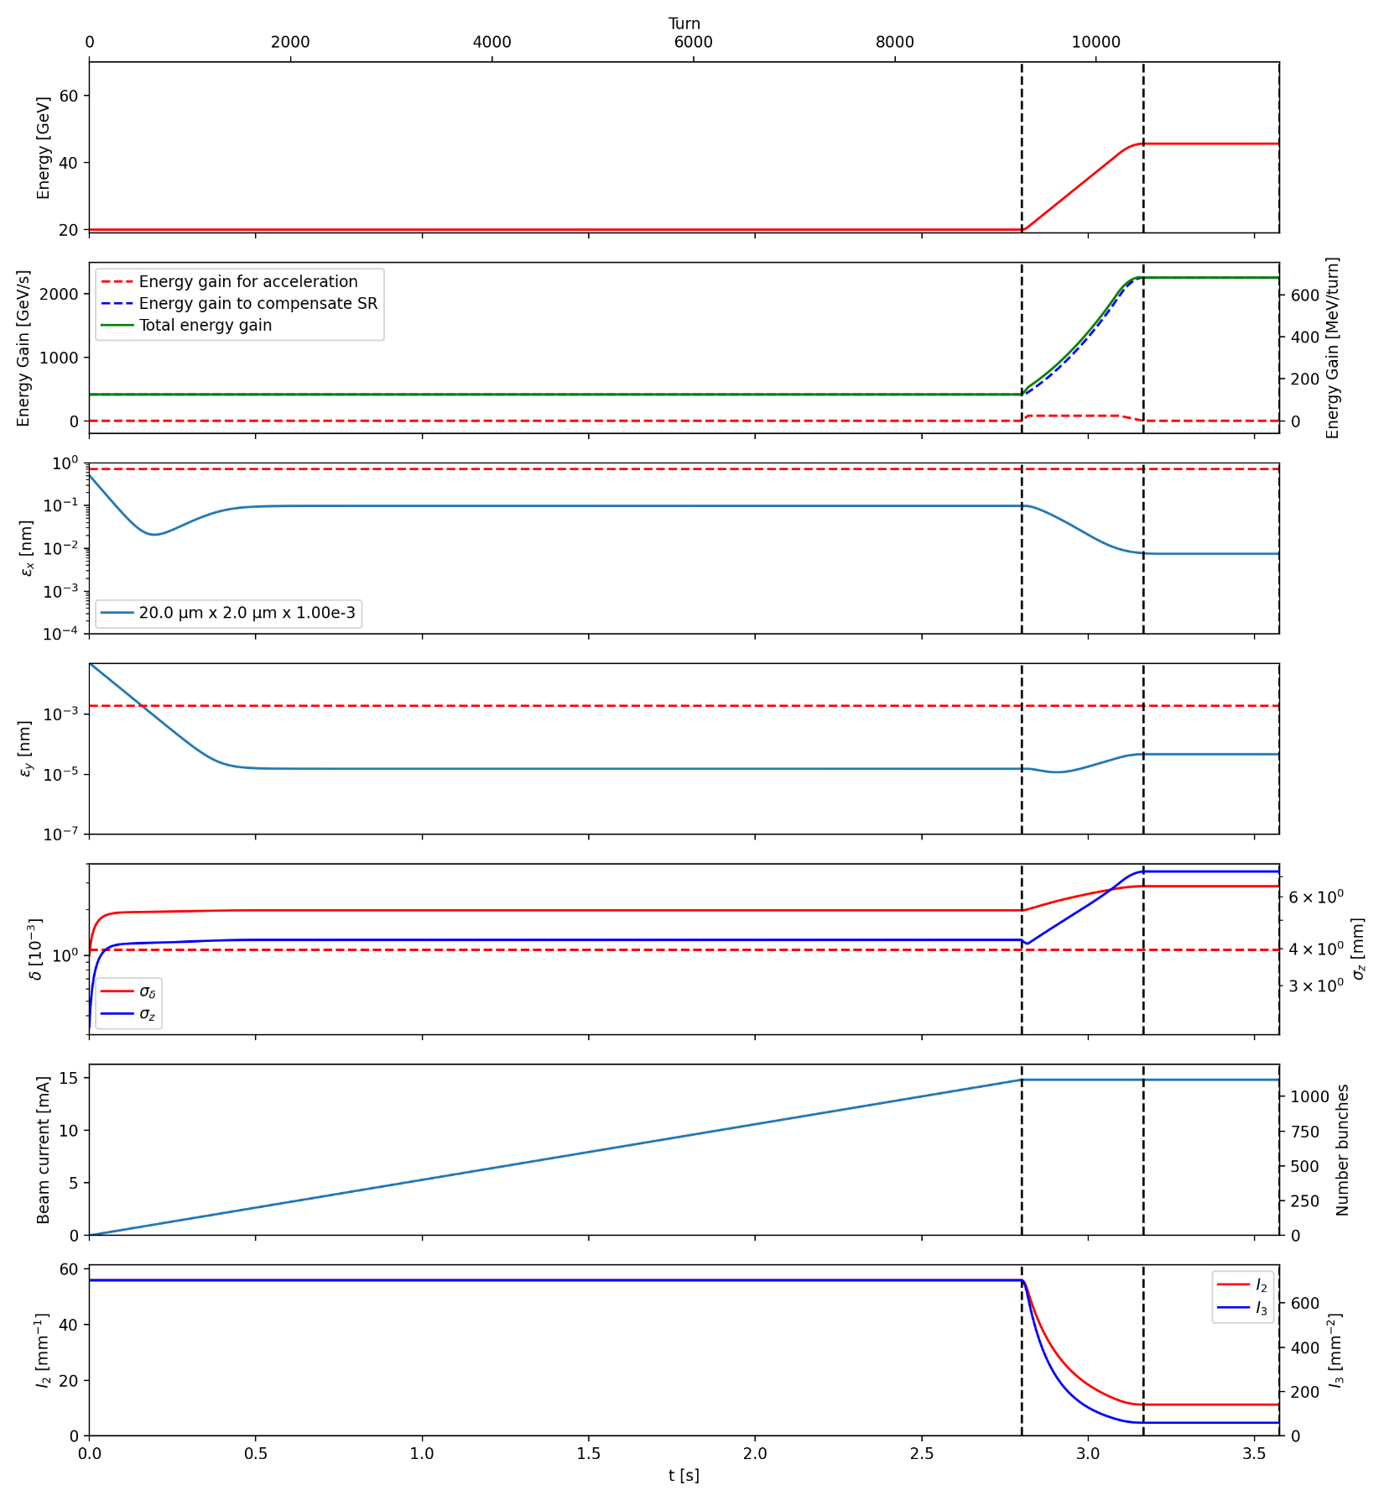
Emittance dynamics U0 x 94
No IBS
With IBS

Slide 21
Conclusions and perspectives (1)
Optics
  Better second-order matching conditions have improved the dynamic aperture and momentum acceptance.
  The injection section has been included for V24_FODO. Cavities are included in V24.1_FODO.
  Tuning strategies for the orbit correction have been improved. Emittance and coupling tunings are under polishing and first results should come very soon.
  Tapering should be also studied.
  We are below the threshold of the TMCI with the new parameter table. We have to refine the impedance budget (include RF contributions, bellows,…) and include dampers in stability correction

Slide 22
Conclusions and perspectives (2)
Booster as a light source
The impact of undulators on synchrotron integrates has been evaluated with AT.
Emitance evolution during the booster evolution has been evaluated with and without IBS.
The undulator has a non-negligible effect on the equilibrium energy spread and we should have a deeper look on the ramp optimization with undulators (voltage, RF operation due to a larger synchrotron radiation power,…).
The IBS is not negligible and significantly enlarges the horizontal emittance. More studies are necessary to:
  Confirm IBS calculations (especially at a so small emittance).
  Include machine errors to see what emittance we can reach.
  Reach the required small betatron function in the undulator to deliver a photon beam to the user.
  Study the impact of the undulators on the impedance budget and to check the beam stability.
  Space charge might at have an effect at injection energy (under investigation).
  Wakefield and transverse damper can partially mitigate IBS growth (under investigation), however, tune diffusion has to be studied.

Slide 23
Thank you for your attention

Slide 24
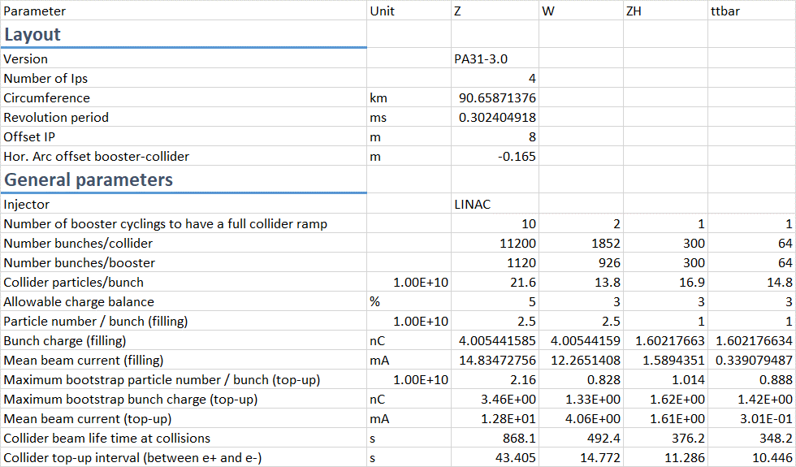
Parameter summary (1): layout + filling
https://gitlab.cern.ch/acc-models/fcc/fcc-ee-heb (access with a CERN account).
Same circumference as the collider.
Updated transverse offset between booster/collider to keep the same circumference.
Several booster cyclings in top-up to fill the collider → Less stored bunches in the booster.
Reduced max bunch charge for the filling at tt and ZH operation modes
In top-up injection the charge bunch-to-bunch can vary from 0 to 100% of the bootstrap bunch charge

Slide 25
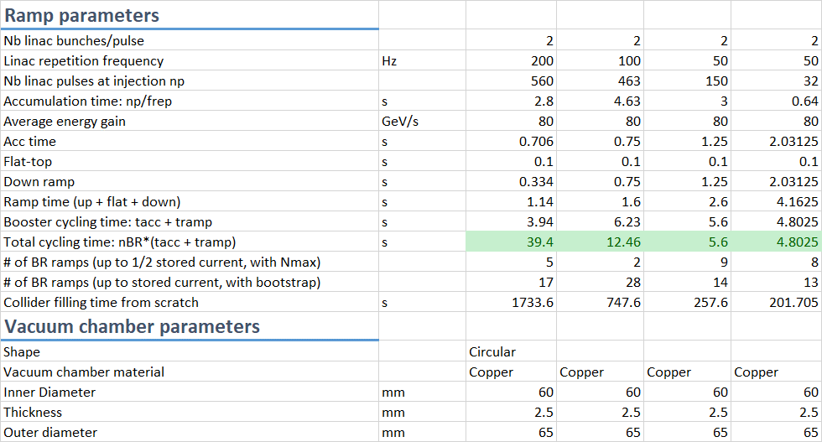
Parameter summary (2): ramp + beam-pipe
https://gitlab.cern.ch/acc-models/fcc/fcc-ee-heb (access with a CERN account).
The ramp is under evolution (especially for the Z-mode).
We keep a flat-top of 0.1 s for all modes for operation considerations.
The down ramp could be faster (less limitations for Eddy currents): under investigation.
Enlarged inner diameter of the pipe.
→ Smaller beam-pipe impedance
→ We can use the same optics for all operation modes.

Slide 26
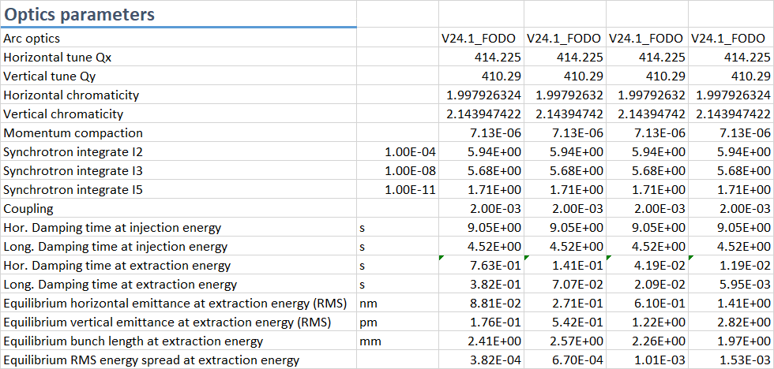
Parameter summary (3): optics
https://gitlab.cern.ch/acc-models/fcc/fcc-ee-heb (access with a CERN account).
The optics files can be found here:
https://gitlab.cern.ch/acc-models/fcc/fcc-ee-heb
Dynamic aperture, momentum acceptance, tuning similar between FODO and HFD.
This parameter needs to be reviewed: no need for a so small value to inject into the collider.
Extraction beam parameters (emittances and energy spread) are different from the collider and equilibrium (especially for Z-mode).
At Z-mode, ramp optimisation is necessary to get a vertical emittance within the requirements.

Slide 27
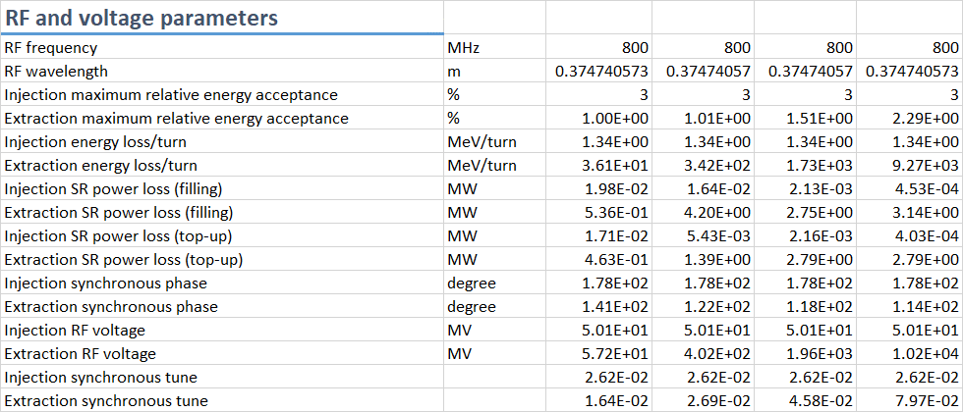
Parameter summary (4): RF
https://gitlab.cern.ch/acc-models/fcc/fcc-ee-heb (access with a CERN account).
Reduction by a factor 2 of the maximum radiated power
Cavity voltage under review (in agreement with ramp update).

Slide 28
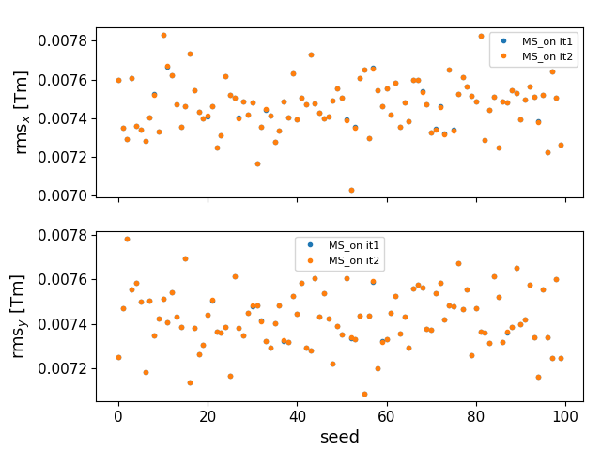
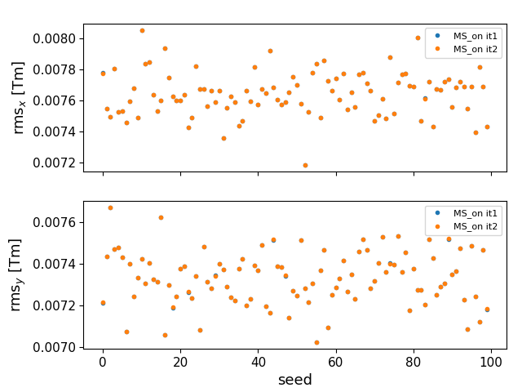
Corrector strength
Courtesy: B. Dalena, Q. Bruant
V24_FODO
V24_HFD

Slide 29
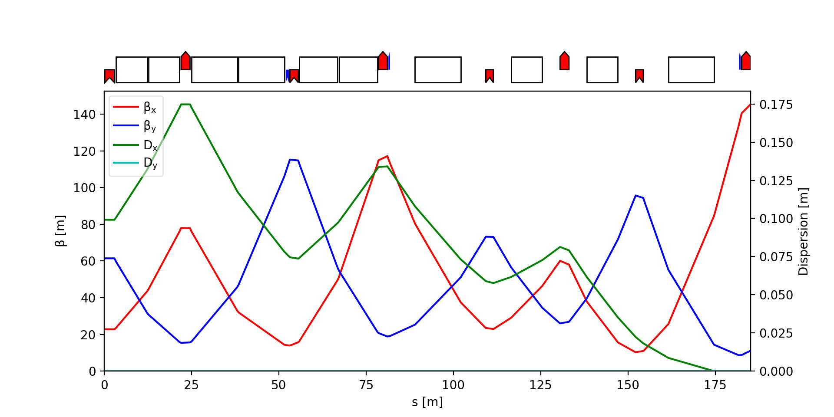
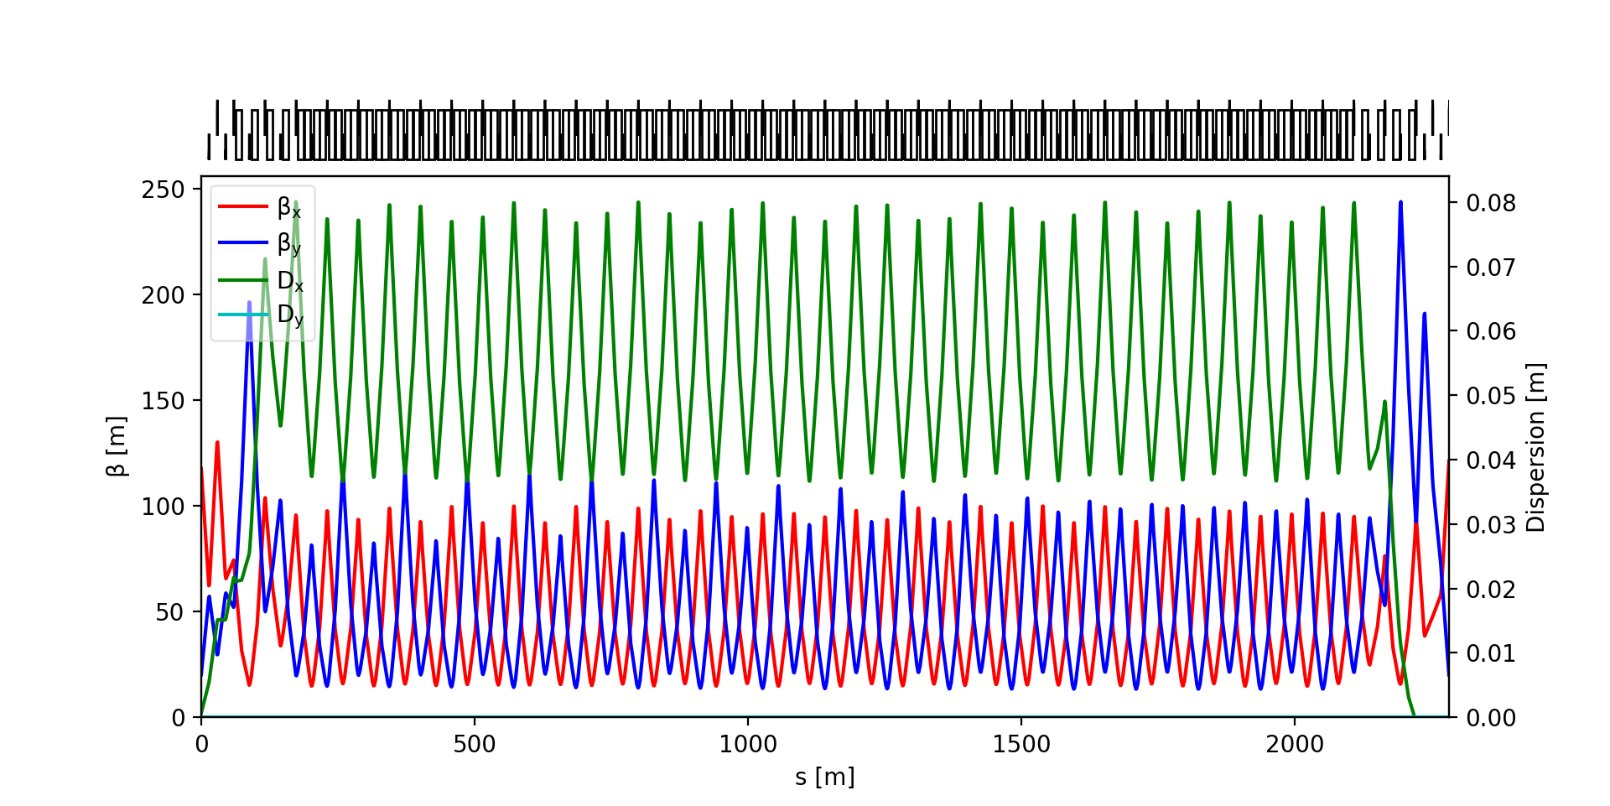


Transparency + dispersion suppressor
Dispersion suppressor
Insertion 1
$$Δμ_{x,y} ≈π$$
$$Δμ_{x,y}=2 n π+μ_{x,y cell}$$
Sextupole pair used to correct 2nd order chromaticity
Matching quadrupoles are used to match the Montague functions between the arcs

Slide 30
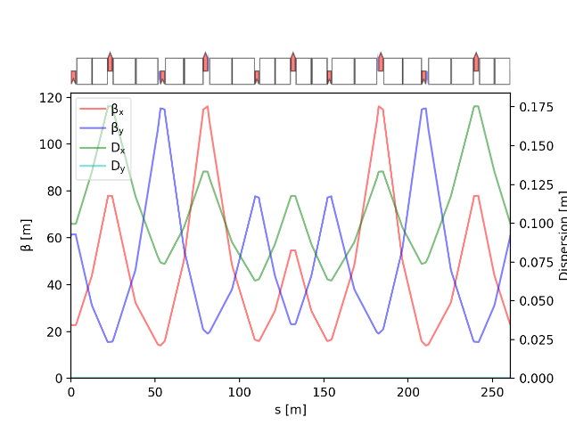



HFD
$$0.99π/0.85π$$
$$0.99π/1.01π$$
Sextupole
SD1
SF1
SF1
SD1
Quadrupole
QD1
QF1
QD2
QF2
QD3
QF3
QD3
QF2
QD2
QF1
QD1
Dipole
D1
D2
D3
D2
D1
D1
D2
D3
D2
D1
  Variation of the dipole length: 3 families BUT same field (no need of additional powering).
  6 families
    to have an optimum phase advance between the pair of sextupoles to minimize anharmonicity
    To adjust the tune of the arc cell to get the target global tune.
    The horizontal and vertical tunes are slightly different.
  1 dipole corrector + 1 BPM per quadrupole:
    Horizontal when QF
    Vertical when QD
  Cell length adjusted to follow the collider arc periodicity.
$2.5π+ε_{x}/2.3π+ε_{y}$

Slide 31
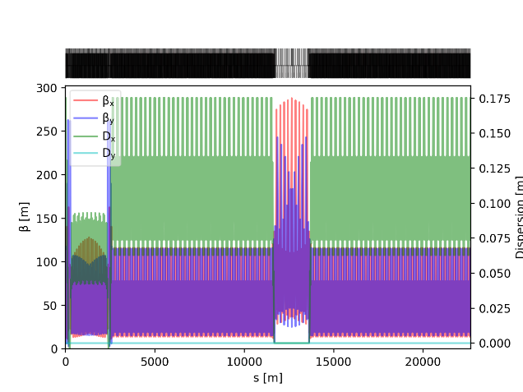
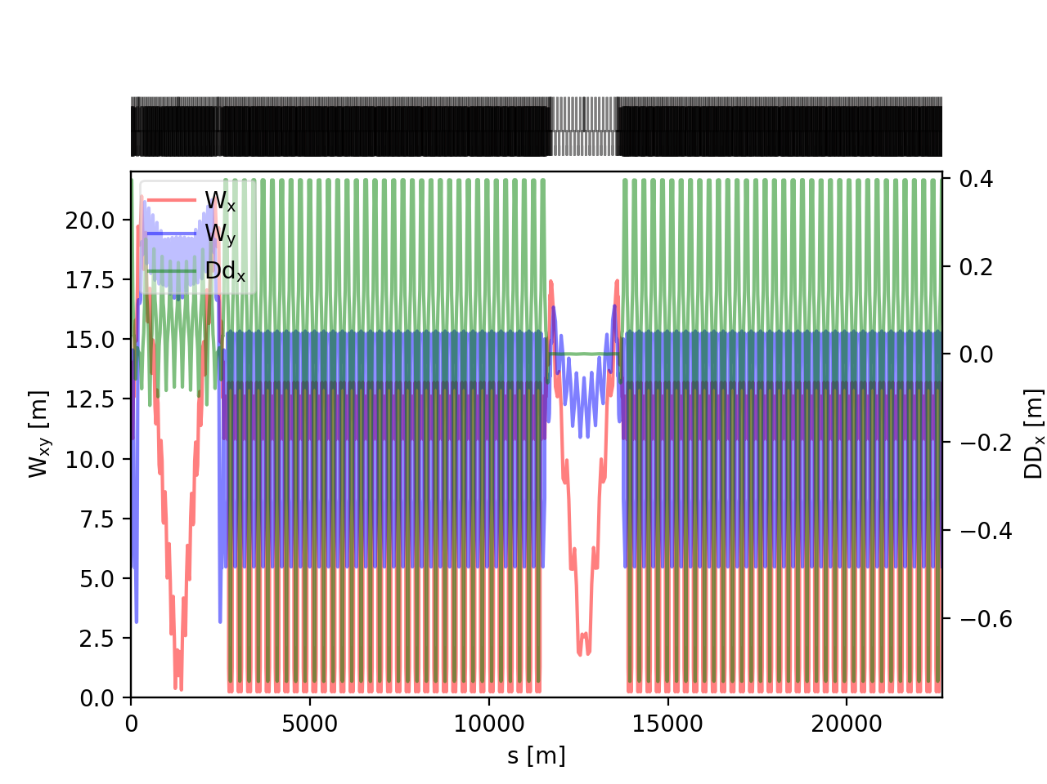
HFD
Optical functions (1/4 of ring)
  Modulation of the dipole length to get a better high-order chromaticity.
  Transparency conditions for the insertions:
    Phase advance of π in both planes of between the focusing sextupoles in the dispersion suppressor to maximize the geometric aberration cancellation.
    The angles of some dipoles in the dispersion suppressors have been matched to cancel the second-order dispersion.
    Phase advance of the total insertion (including the dispersion suppressors) is equal to the phase advance of one arc cell (modulo 2 π).
    Matching of the Montague and second-order dispersion.
  Tune Q_{x}/Q_{y}: 411.225/382.29
  Momentum compaction: 7.155e-06; I5: 1.78e-11
  Needs to refine the magnet length to balance the fields
Montague functions (1/4 of ring)
Magnet | Parameter | Unit | Value
Dipole | Min./Max. field | G | 64 – 584
 | Length | m | 11.0
Quadrupole | Min./Max. gradient | T/m | 1.42 – 14.7
 | Length | m | 2.18 – 2.76
Sextupole | Min./Max. gradient | T/m² | 128 – 1340
 | Length | m | 0.438 – 0.86

Slide 32
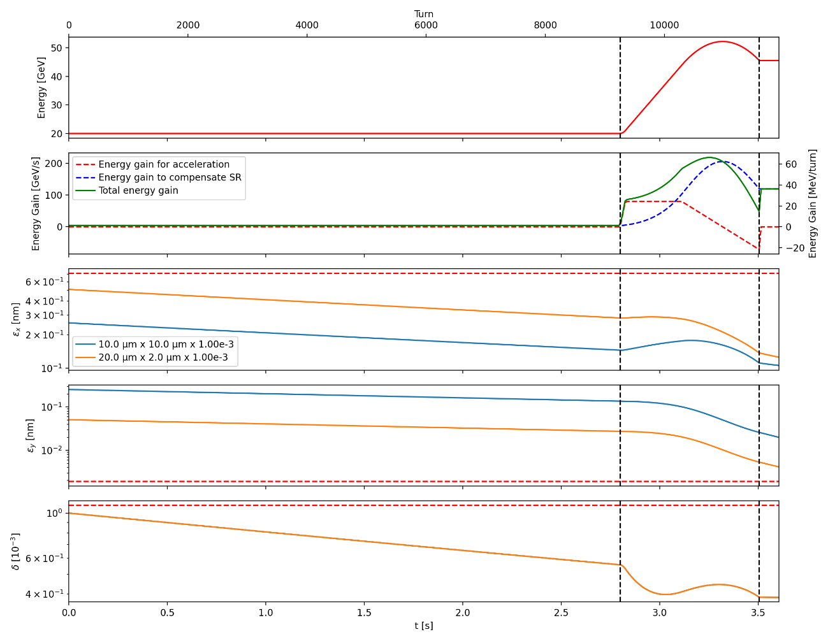
Emittance evolution
Baseline (accumulation of 2.8 s)
Total cycling: 0.706 (ramp-up) +0.1 (flat-top) + 0.334 (ramp-down) = 1.14 s
We use the double parabolic ramp + energy overshoot.
Adiabatic start of the ramp (5% of initial energy gain)
Steep linear energy ramp in the middle (80 GeV/s)
Adiabatic approach of the flat top energy (80% of total gain)
IBS seems not to be an issue (shorter accumulation time)
Linac alone: Initial beam parameters: 10 µm x 10 µm x 1e-3
  Hor. Emittance: 0.106 nm
  Vert. Emittance: 20.0 pm
  Energy spread: 0.383e-3
High-energy DR: Initial beam parameters: 20 µm x 2 µm x 1e-3
  Hor. Emittance: 0.126 nm
  Vert. Emittance: 4.13 pm
  Energy spread: 0.383e-3

Slide 33
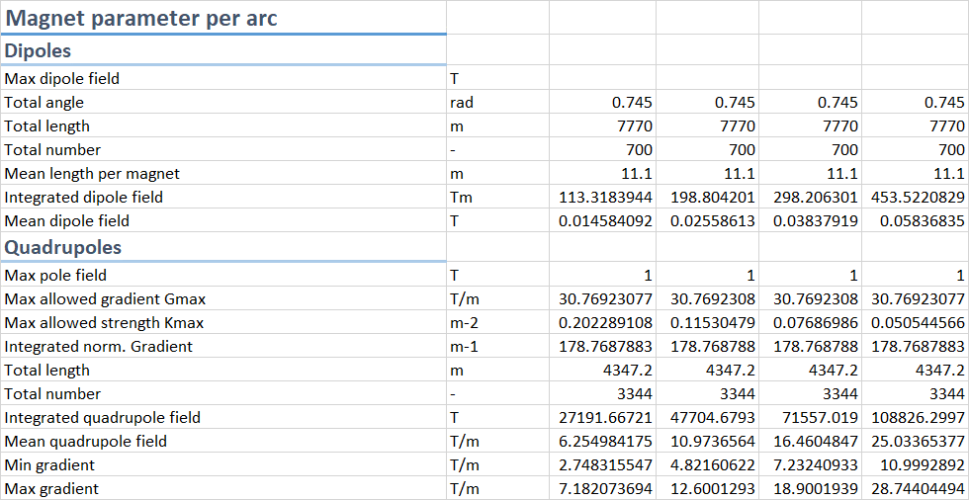
Booster parameter table (V24_FODO)
In the current tuning scheme, we have one BPM and one dipole corrector per quadrupole.
We will need also to correct the coupling.

Slide 34
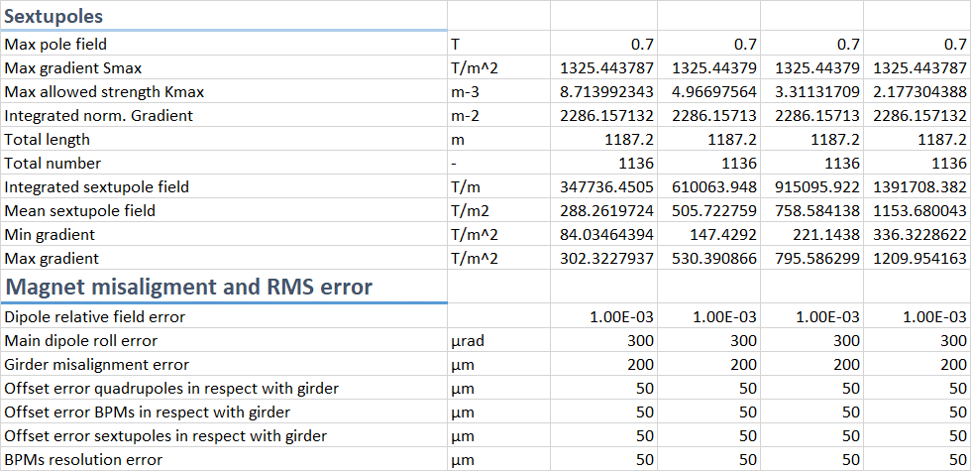
Booster parameter table (V24_FODO)
Assumptions on the dipole and quadrupole misaligment for error correction.
Assumptions of a 3-sigma truncated Gaussian distribution.
We assume also a transverse jitter of one sigma at injection.

Slide 35
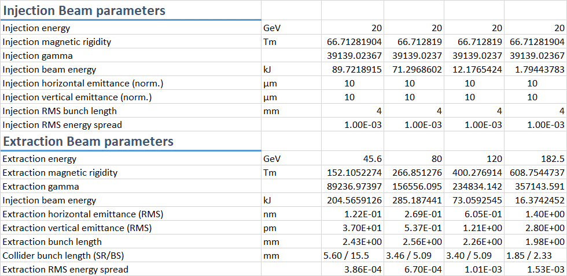
Booster parameter table (V24_FODO)
Baseline injection beam parameters.
Nota: an alernative with a high-energy damping ring is under study.
Extraction beam parameters (emittances and energy spread) are different from the collider and equilibrium (especially for Z-mode).

