Slide 1
Photons from Coherent Bremsstrahlung
Armen Apyan | A. Alikhanyan National Laboratory Yerevan, Armenia
Frank Zimmermann | CERN Geneva, Switzerland

Slide 2
Outline
Coherent Radiation Process in oriented crystal
Peculiarities of Coherent Bremsstrahlung
Summary

Slide 3

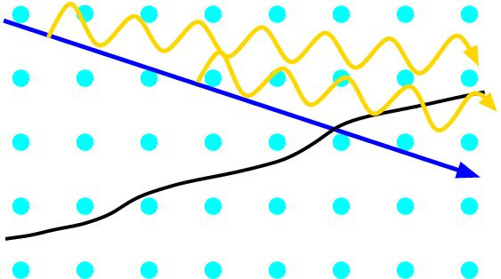

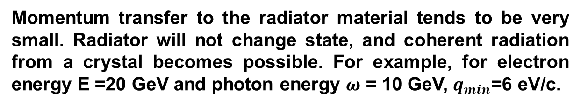
Coherent Effects in Oriented Crystals
Amorphous Material
Atoms are distributed randomly in amorphous medium. Particles traversing the amorphous material scatter on the potential fluctuation of individual atoms and radiate photons
$$θ_{0}$$
γ
Crystal Lattice
Momentum transfer to the radiator material tends to be very small. Radiator will not change state, and coherent radiation from a crystal becomes possible. For example, for electron energy E =20 GeV and photon energy $ω$ = 10 GeV, $q_{min}$=6 eV/c.
Coherent Length

Slide 4
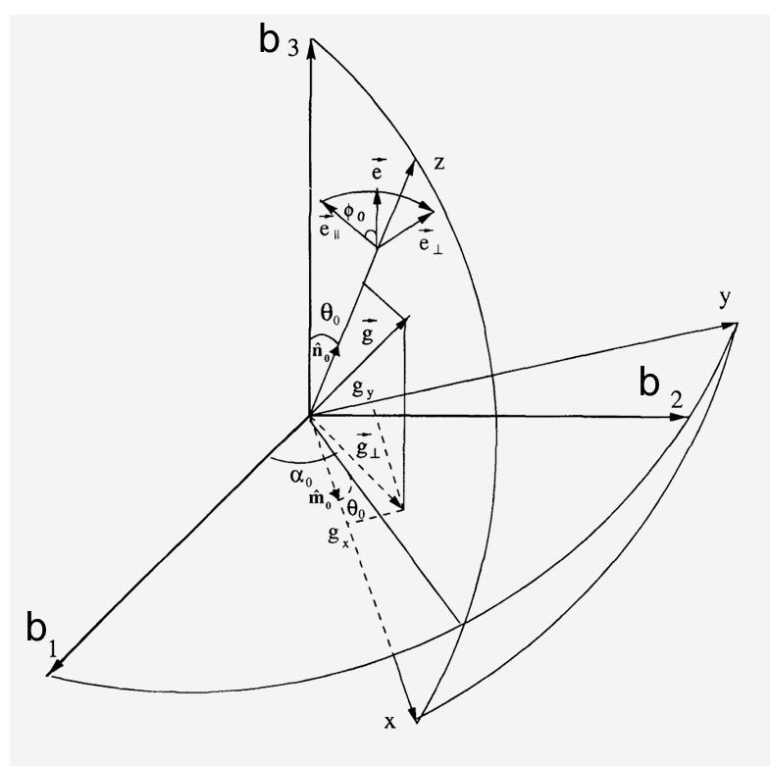
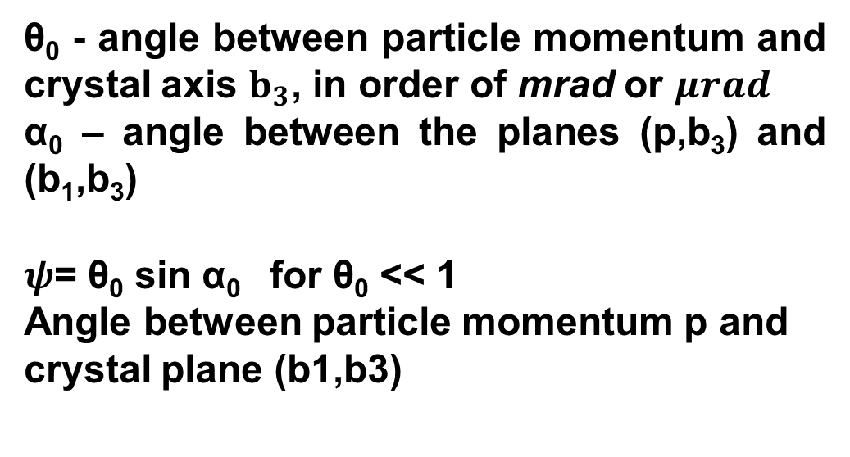
Crystal orientation with respect to the incoming particles
θ₀ - angle between particle momentum and crystal axis $b_{3}$, in order of mrad or $μrad$
α₀ – angle between the planes (p,b₃) and (b₁,b₃)
$ψ$= θ₀ sin α₀ for θ₀ << 1
Angle between particle momentum p and crystal plane (b1,b3)

Slide 5
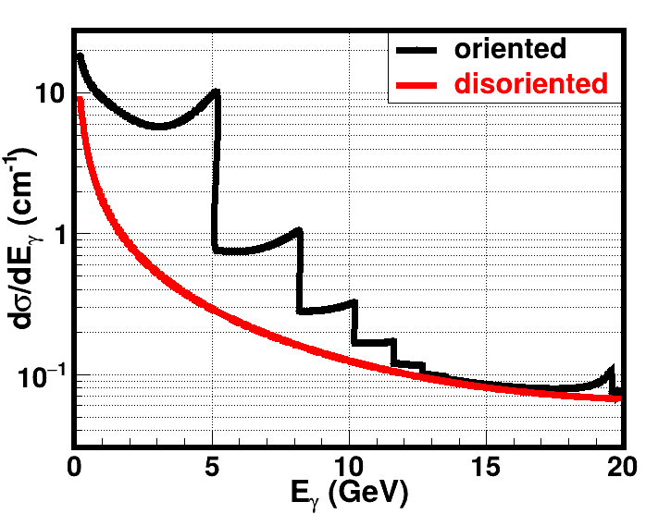
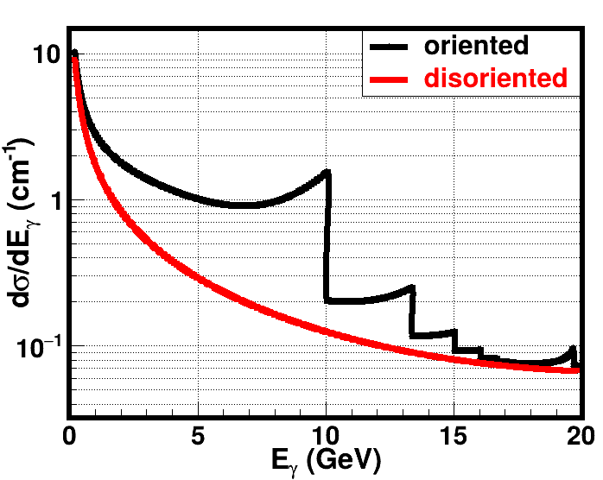
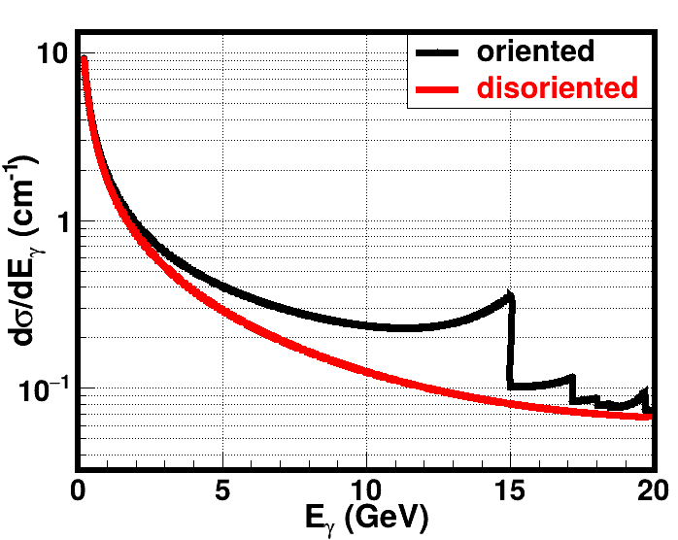



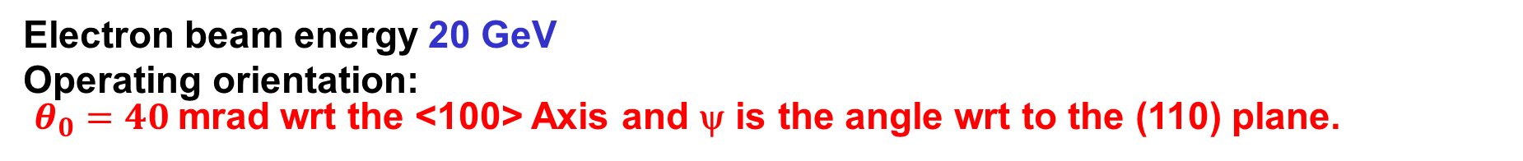
CB Cross Section in Oriented Diamond Single Crystal
Electron beam energy 20 GeV
Operating orientation:
$θ_{0}=40$mrad wrt the <100> Axis and ψ is the angle wrt to the (110) plane.
$$ψ=0. 3 mrad$$
$$ψ=0.67 mrad$$
$$ψ=2.0 mrad$$

Slide 6
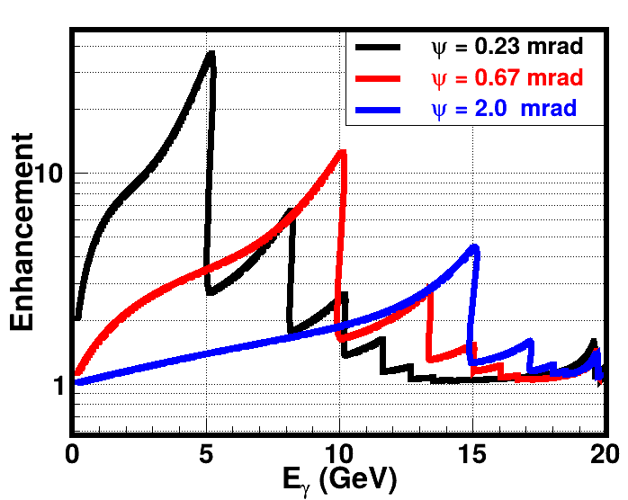
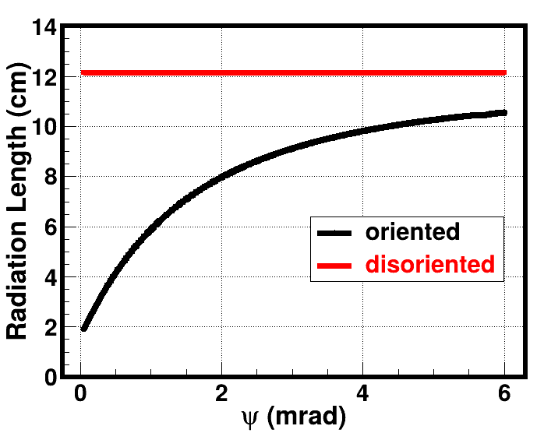
Enhancement and Radiation Length of Oriented Diamond Single Crystal
The increase in the CB radiation intensity spectrum is usually reported with respect to the incoherent bremsstrahlung spectrum. This ratio, called the enhancement
In case of oriented crystal the radiation length depends on the crystal orientation.

Slide 7
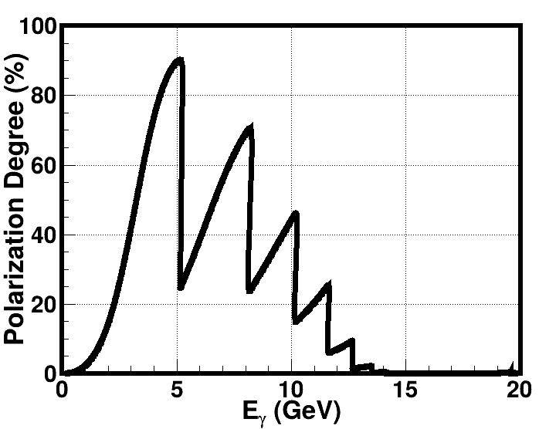
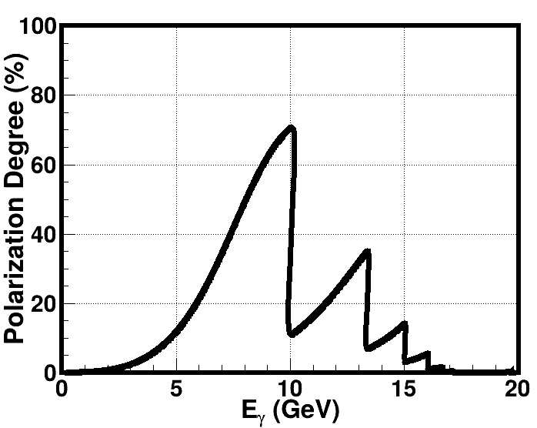
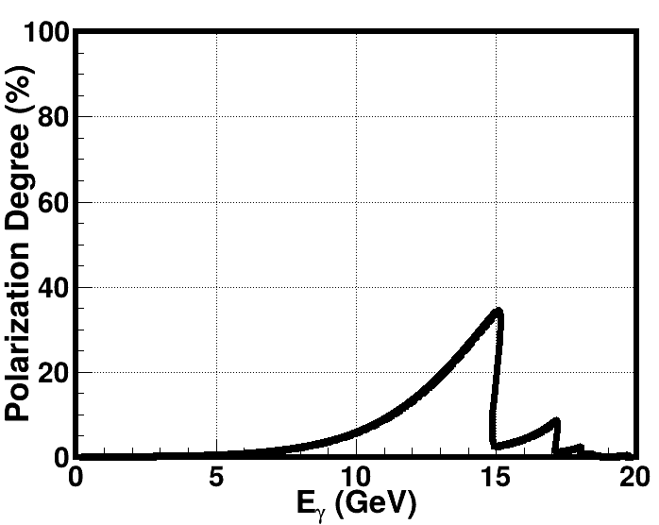
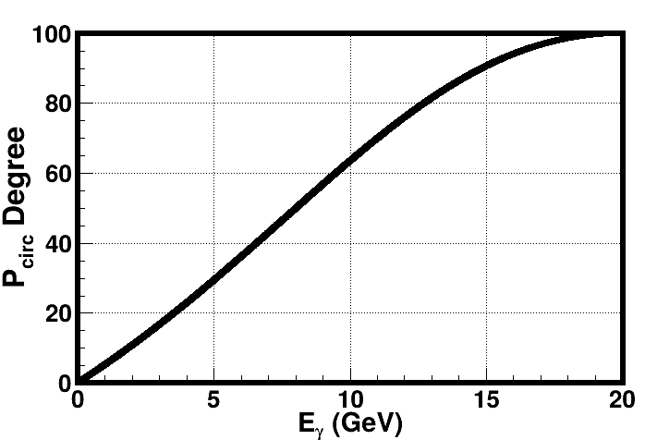
Polarization of the Photons Produced by Coherent Bremsstrahlung
Linear Polarization
CB of unpolarized electrons in aligned single crystals produces linearly polarized photons.
If the initial electron beam is longitudinally polarized, then the emitted photons are circularly polarized
Circular Polarization

Slide 8
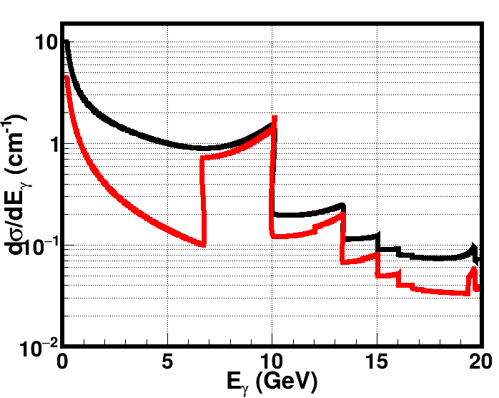
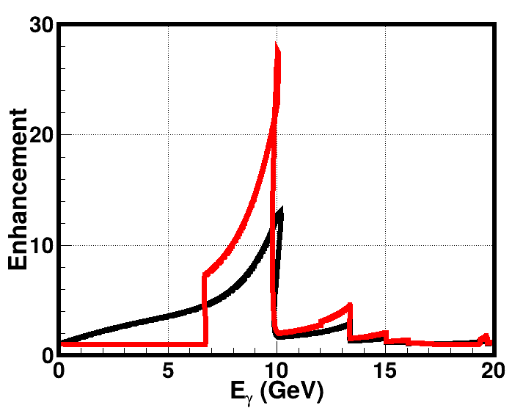
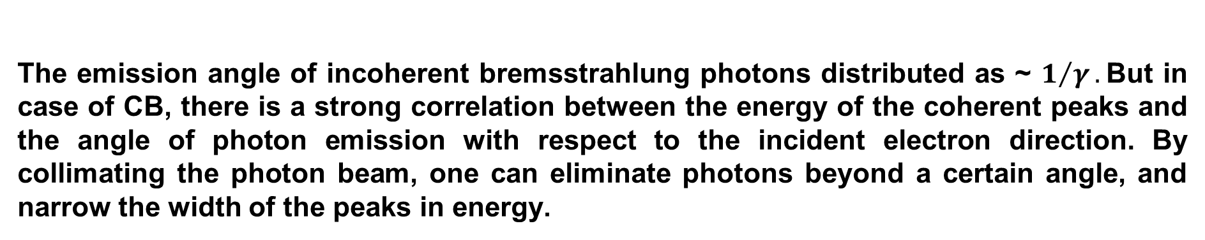

Angular Distribution of Produced Photons
Collimation angle 25 $μrad.$
The emission angle of incoherent bremsstrahlung photons distributed as ~ $1/γ.$But in case of CB, there is a strong correlation between the energy of the coherent peaks and the angle of photon emission with respect to the incident electron direction. By collimating the photon beam, one can eliminate photons beyond a certain angle, and narrow the width of the peaks in energy.

Slide 9
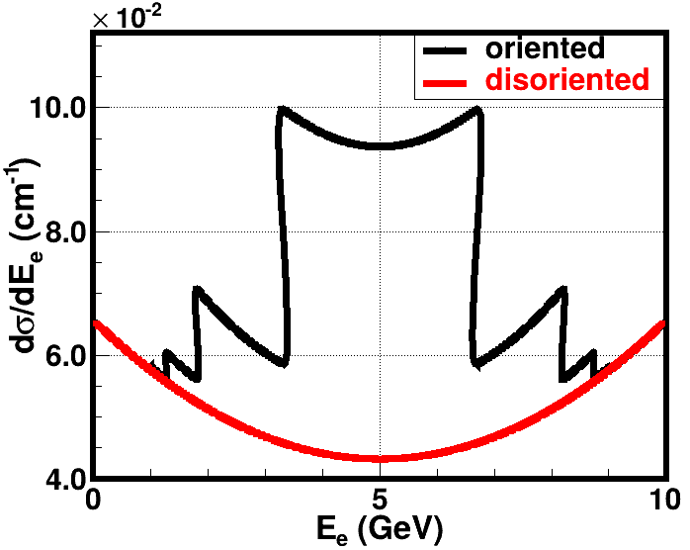
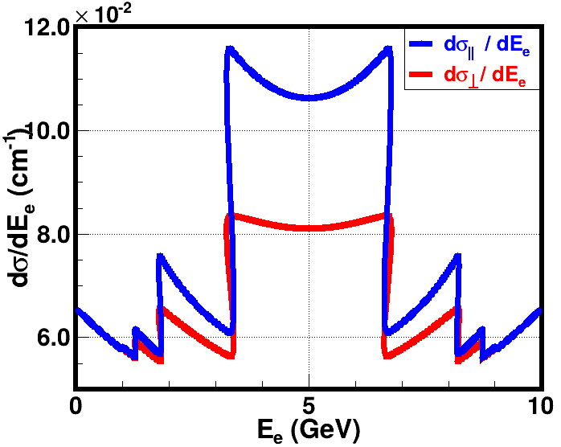
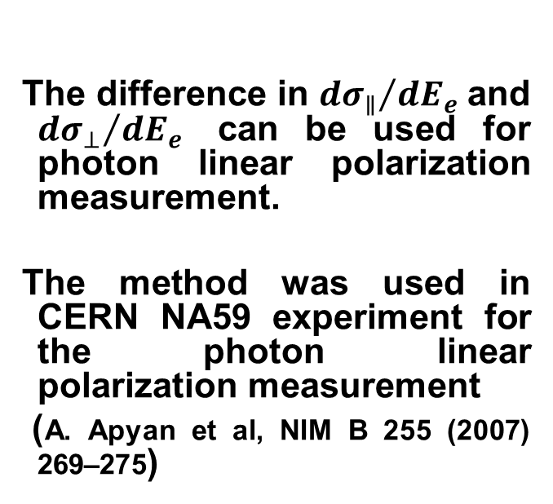
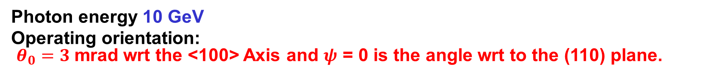
Coherent pair production in single crystals
The difference in ${dσ_{∥}}/{dE_{e}}$and ${dσ_{⊥}}/{dE_{e}}$ can be used for photon linear polarization measurement.
The method was used in CERN NA59 experiment for the photon linear polarization measurement
(A. Apyan et al, NIM B 255 (2007) 269–275)
Photon energy 10 GeV
Operating orientation:
$θ_{0}=3$mrad wrt the <100> Axis and $ψ$ = 0 is the angle wrt to the (110) plane.

Slide 10
Summary
Coherent Bremsstrahlung of electrons in single crystals is unique tool for production of high energy photons with high degree of linear polarization.
Tool for production of high energy and high intensity circularly polarized photon beam, if the primary electron beam is longitudinally polarized
Small polar angle distribution which is correlated with the energy of the emitted photon.
Tunable peak energies by crystal orientation.
The CB become more intense at higher energies
Crystal Polarimetry technique is a fast-monitoring tool of the photon beam polarization measurement.
Can be used for high intensity polarized positron production.

Slide 11
Summary
There should be a difference in the radiation (or coherent) of the electrons and positrons due to the opposite charge of the particles. But this is more seen in the low energies. For the high energy region (tens of GeV) this difference is negligible. There is no difference in radiation formulas of CB based on the first Born approximation
Monte-Carlo simulation code is ready for use based on (A. Apyan, NIM B 255 (2007) 269-275).
The MC Code was used for the prediction and the analysis of CERN NA59 experiment.

