Slide 1

255.5 keV photons can stop ANY relativistic electron
Full Inverse Compton Scattering,
Unruh photons and FICS relay in the cosmos
Can electrons emit photons of energy larger than their own?
Luca Serafini, Vittoria Petrillo and Sanae Samsam
INFN-Milano and Università degli Studi di Milano
Deep Recoil Inverse Compton Scattering revisited, how to stop (MeV’s, GeV’s, TeV’s …) electrons in a single-collision event: a portal towards quantum gravity?
From Thomson back-scattering to FICS, total transfer of energy/momentum from an electron to a photon, and how to generate 100 GeV photons at FCC-ee
Impacts in several fields: Plasma Physics (e⁻ / e⁺ trapping in plasma mirrors), Astro-Physics (cosmic γ-ray sources), QED & Quantum Gravity (Unruh radiation and overcoming the Schwinger limit)

Slide 2
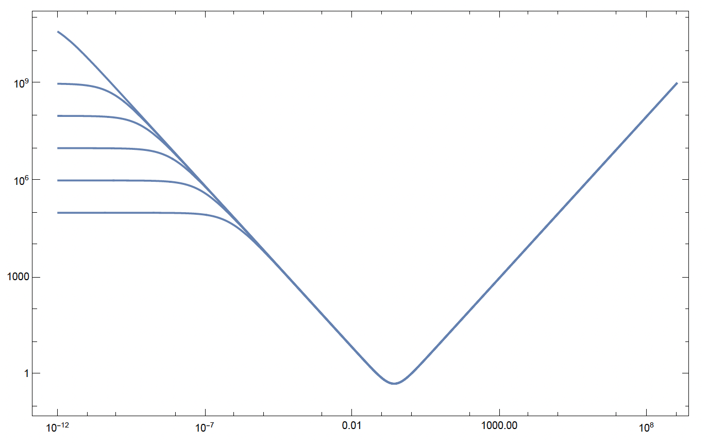
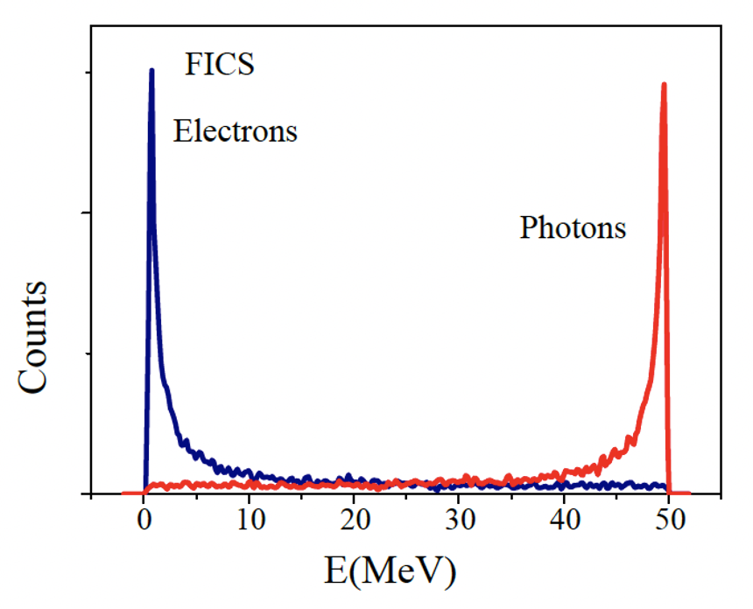
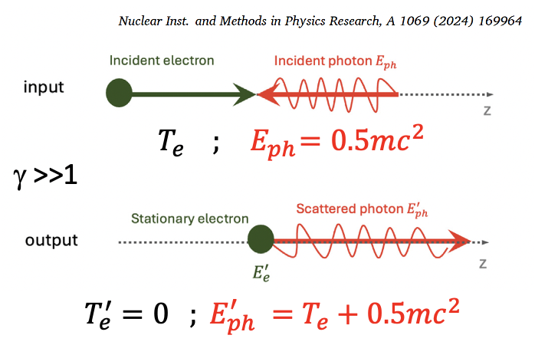
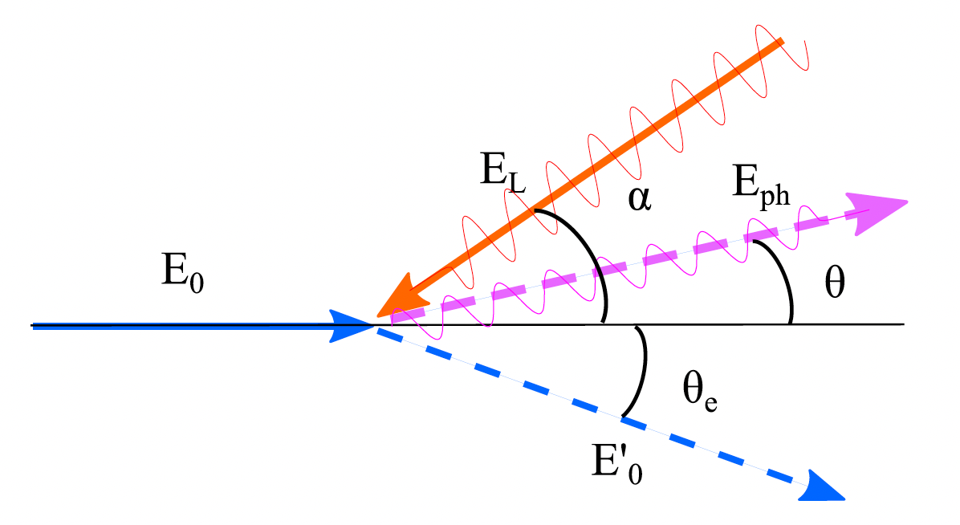




Full Inverse Compton Scattering: amazing power
of 255.5 keV photons to stop ANY colliding electron
100 PeV
0.5mc² = 255.5 keV colliding photons will
stop relativistic electrons of any energy E_{e} !
1 PeV
100 TeV
10 TeV
1 TeV
100 GeV
FCC-ee
E’_{e}
$$E_{ph}$$
$${E′}_{ph}$$
E’_{e} (MeV)
$$E_{e}$$
$${E′}_{e}$$
the most extreme acceleration
achieved in the universe ??
e⁻ at rest E’_{e}=mc²
C.M.B.R.
E_{ph} (MeV)
E_{ph}=1 meV
E_{ph}=1 eV
E_{ph} =0.5mc²
E_{ph}=1 μeV
*hadronic threshold (E_{cm} < 600 MeV) with 255.5 keV photons ≈ 360 GeV

Slide 3
Energy Budget towards γ -rays with high spectral density
25 GeV electrons would be needed to generate 2 MeV photons via synchrotron radiation (highest spectral density S 10¹² s⁻¹eV⁻¹, very small bdw 10⁻⁴)
850 MeV electrons were used to Channeling Radiate 2 MeV γ -rays (high S 10⁵-10⁶ s⁻¹eV⁻¹, broad bdw 10 %)
350 MeV e⁻s are needed to Inverse Compton Scatter 2 MeV γ -rays (good S 10⁴-10⁵ s⁻¹eV⁻¹, small bdw 10⁻³)
3.5 MeV electrons to bremsstrahlung 2 MeV γ -rays (poor S 1 s⁻¹eV⁻¹, very broad bandwidth)
2 MeV e⁻s to Symmetric Compton Scatter a photon target 2 MeV γ -ray photons (S 10⁴ s⁻¹eV⁻¹) spectral purification!

Slide 4
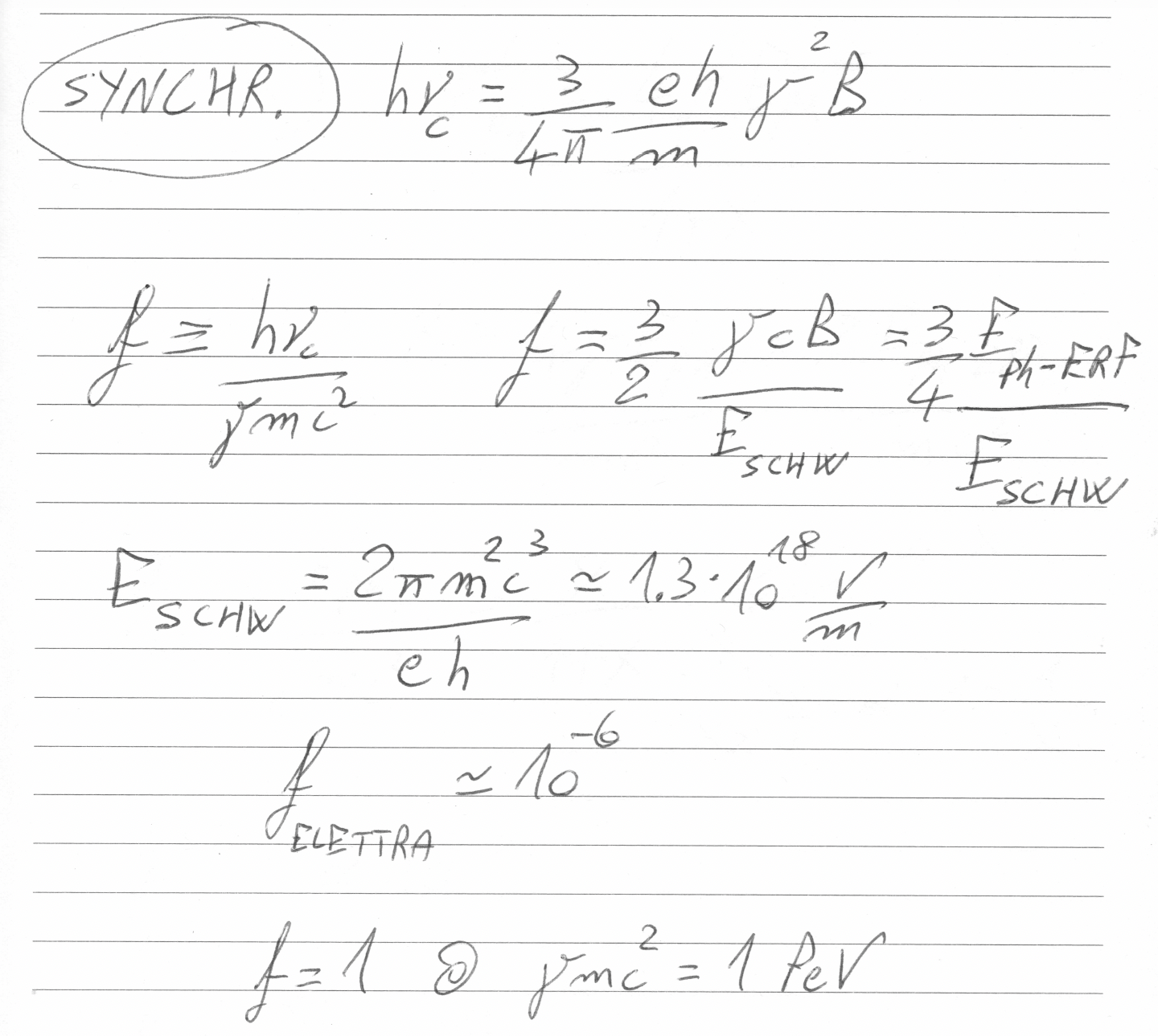

Slide 5
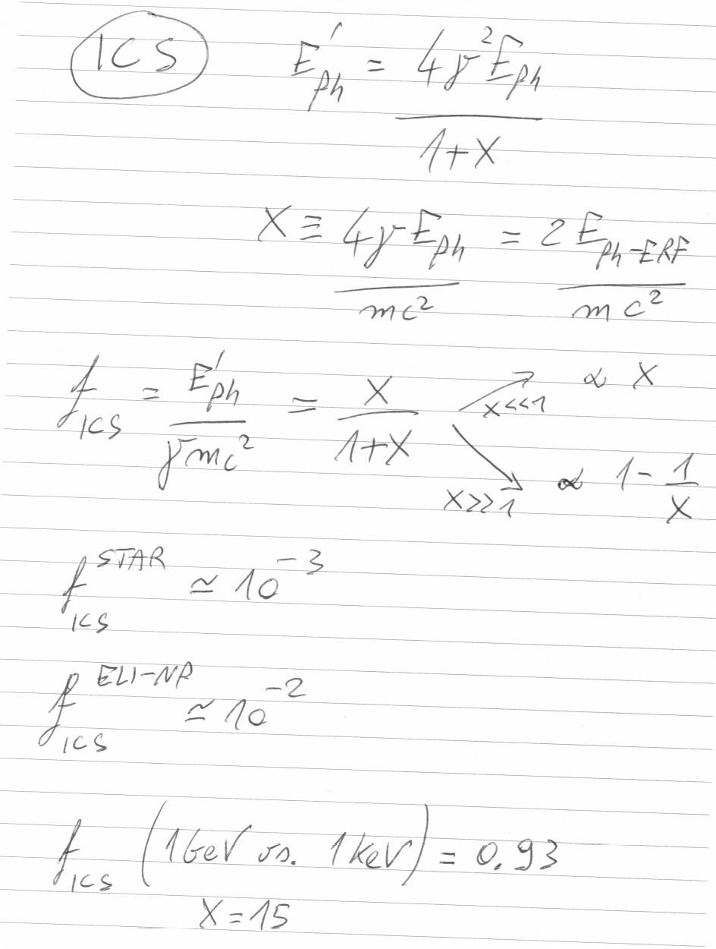

Slide 6
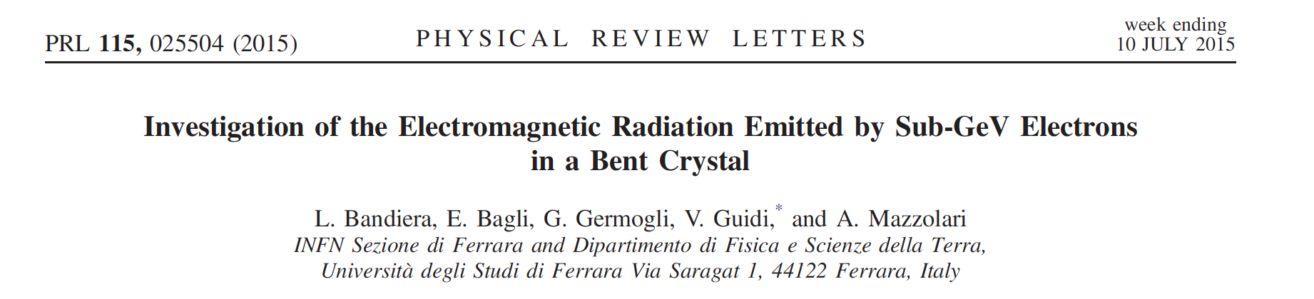
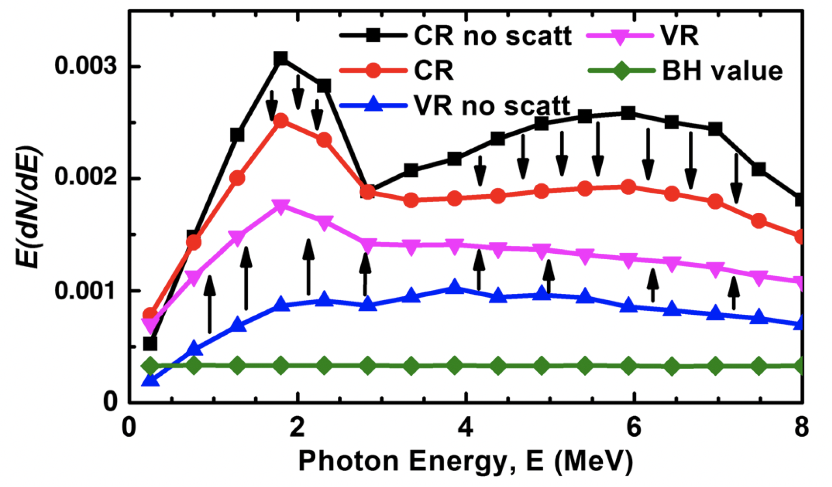
f_{CHANN} ~ 1%
Courtesy L. Bandiera

Slide 7
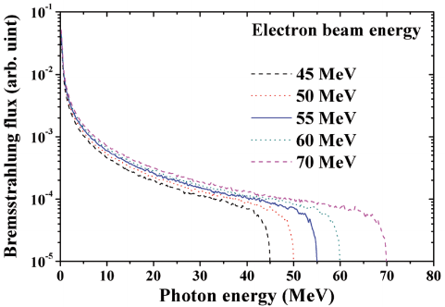
Bremsstrahlung is clearly not an option:
total electron energy loss not actually achievable
brilliance of bremsstrahlung sources is orders of magnitude smaller
f_{BREM} < 1
100% e⁻ energy loss

Slide 8
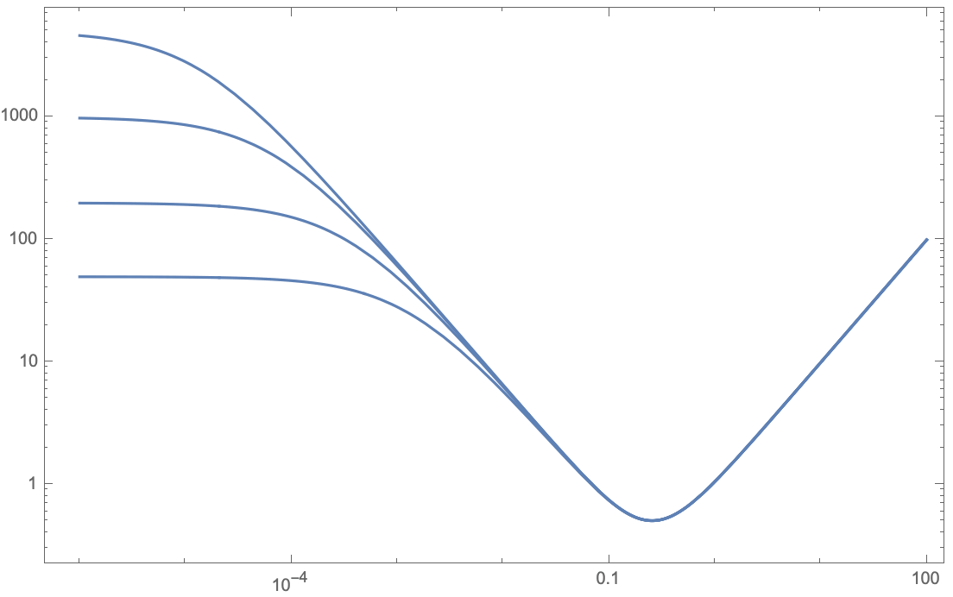




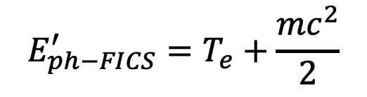
$$E_{e}$$
$${E′}_{ph}$$
in vacuum electron-photon collision
E’_{e} (MeV)
$${E′}_{e}$$
$$E_{ph}$$
5 GeV
f_{FICS} = 1 !!
FICS – Full Inverse
Compton Scattering
1 GeV
200 MeV
E_{e} = 50 MeV
$$E_{ph−FICS}^{′}=T_{e}+\frac{{mc}^{2}}{2}$$
E’_{e} =511 keV , T’_{e}=0
E_{ph} (MeV)
E_{ph} = 1 eV
E_{ph} = 1 keV
E_{ph} =0.5mc²

Slide 9
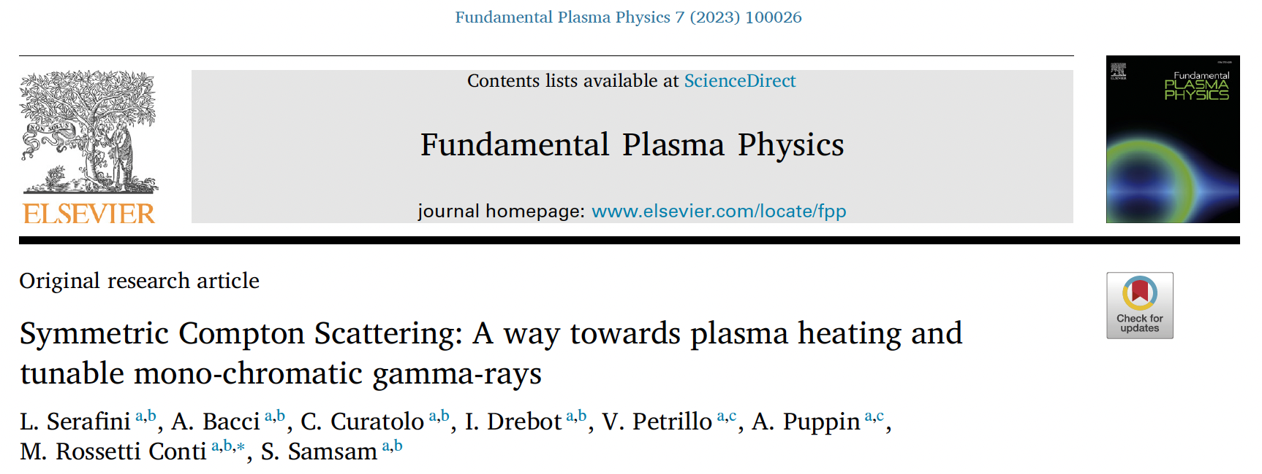
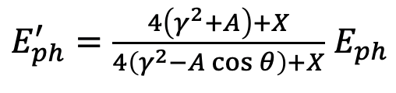





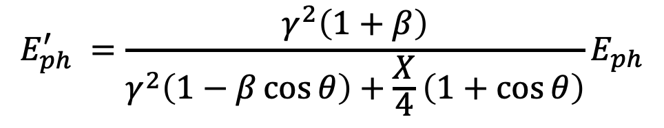
General formula valid for ANY compton scattering
$$E_{ph}^{′} =\frac{γ^{2}\left(1+β\right)}{γ^{2}\left(1−β\cos{θ}\right)+\frac{X}{4}\left(1+\cos{θ}\right)}E_{ph}$$
$$E_{ph}$$
$${E′}_{ph}$$
X ≡ 4γ² E_{ph} /E_{e}
A ≡ βγ²− X/4 = γ²(β− E_{ph} /E_{e})
$$E_{e}$$
$$if γ≫1$$
$${E′}_{ph}=\frac{4γ^{2}E_{ph}}{1+X+γ^{2}θ^{2}}$$
$${E′}_{e}$$
A=0 , i.e. Symmetric Compton Scattering cancels the γ²θ² correlation

Slide 10
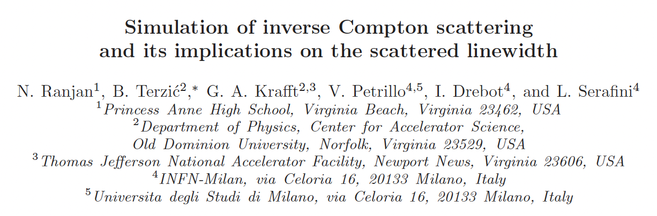
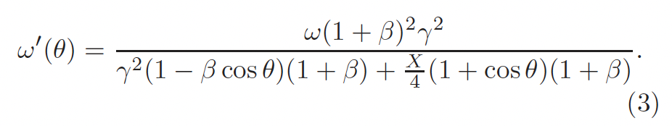
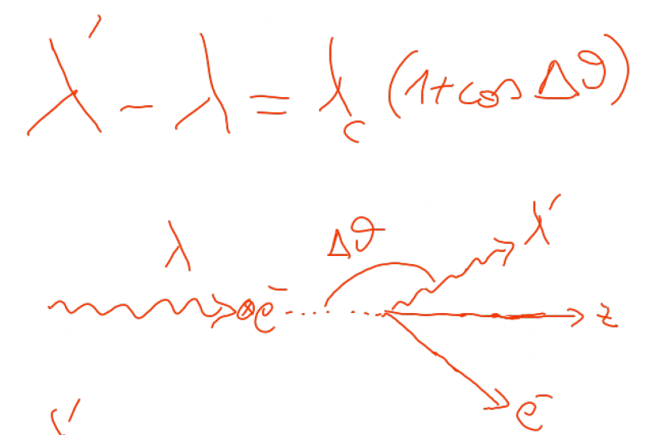

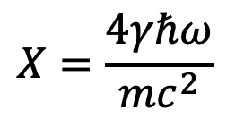



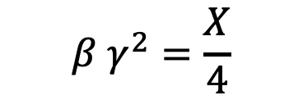
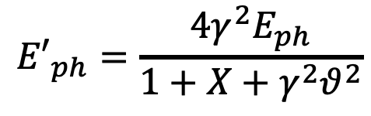
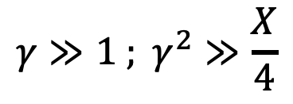

An invariant view at Compton effect - 1
(any inertial ref. frame)
Phys. Rev. AB (2018)
21, 030701
$$X=\frac{4γℏω}{mc^{2}}$$
Arthur Compton,
Nobel Prize 1927
A>0
$$γ≫1 ; γ^{2}≫\frac{X}{4}$$
A<0
A=0
photon looses energy
electron looses energy
$$β=0$$
S.C.S.
FICS !
I.C.S.
$$β γ^{2}=\frac{X}{4}$$
$${E′}_{ph}=\frac{4γ^{2}E_{ph}}{1+X+γ^{2}θ^{2}}$$
$${E′}_{ph}={βE}_{e}=βγmc^{2}$$
$$λ′≠∞$$
$${E′}_{ph}≠f\left(γ^{2}θ^{2}\right)$$
$$\lim_{X→∞}{{E′}_{ph}}=E_{e}$$
isolated e⁻ cannot absorb a photon

Slide 11
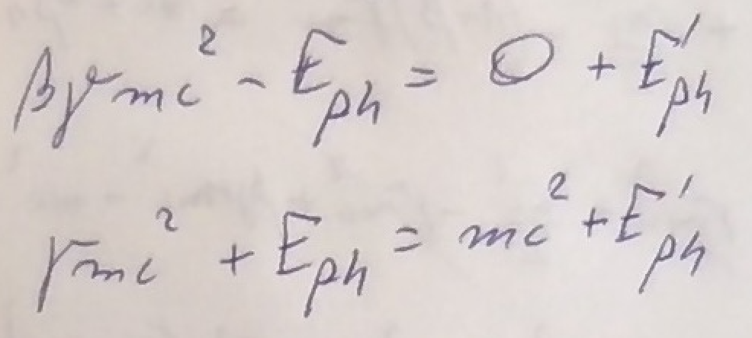
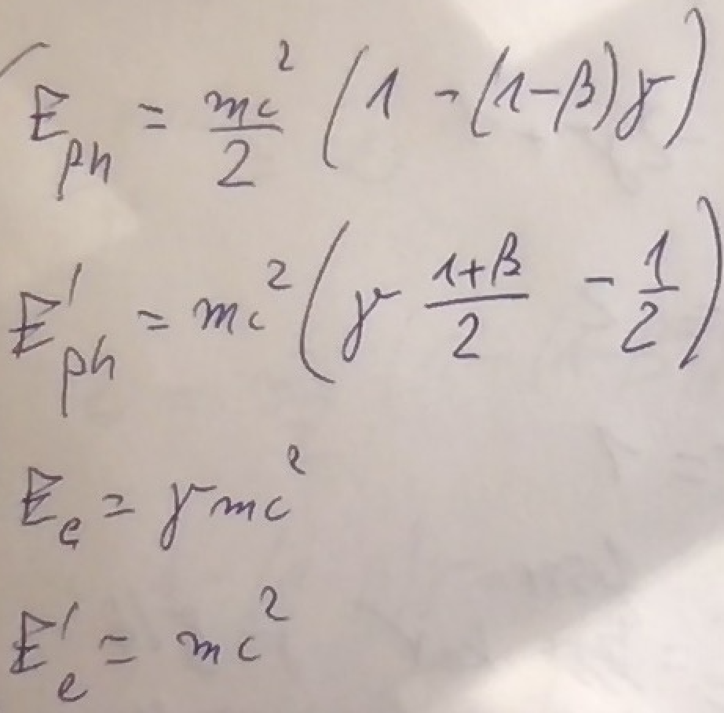






FICS equations
$$E_{e}$$
$$E_{ph}$$
$${E′}_{ph}$$
$${E′}_{e}$$
$${E′}_{e}=mc^{2}$$
$${T′}_{e}=0$$
Let’s focus on the
“turning point”
where electron starts
to be back-scattered:
FICS - Full Inverse Compton Scattering
FICS solutions
for any value of γ !

Slide 12
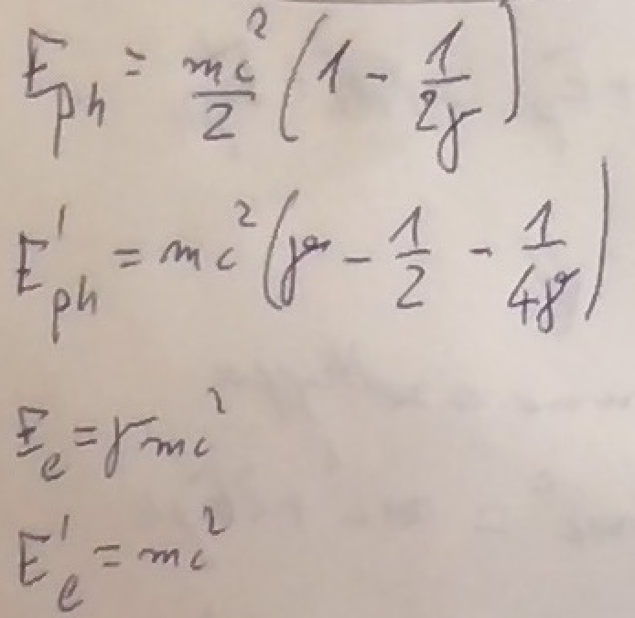
When γ >> 1 FICS solution becomes:
mc²/2 photons can stop any relativistic electron !
The fractional energy loss of FICS is 100%

Slide 13
Follin, Primakoff, etc
100 PeV
1 PeV
0.5mc² = 255.5 keV colliding photons will
stop relativistic electrons of any energy E_{e} !
100 TeV
10 TeV
1 TeV
100 GeV
FICS
E’_{e}
E’_{e} (MeV)
e⁻ at rest E’_{e}=mc²
C.M.B.R.
E_{ph} (MeV)
E_{ph}=1 meV
E_{ph}=1 eV
E_{ph} =0.5mc²
E_{ph}=1 μeV
our study

Slide 14
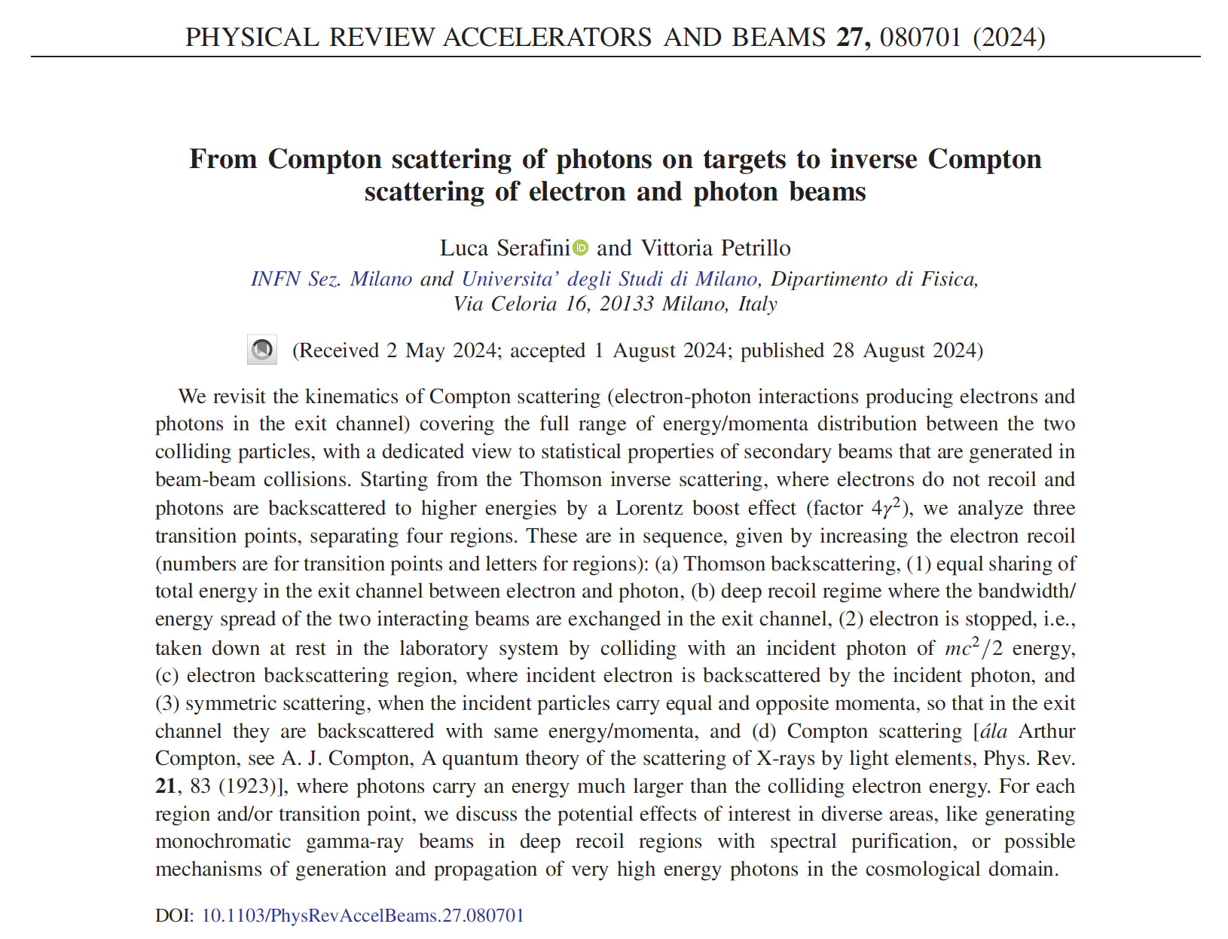
Good recap of the whole ICS history

Slide 15
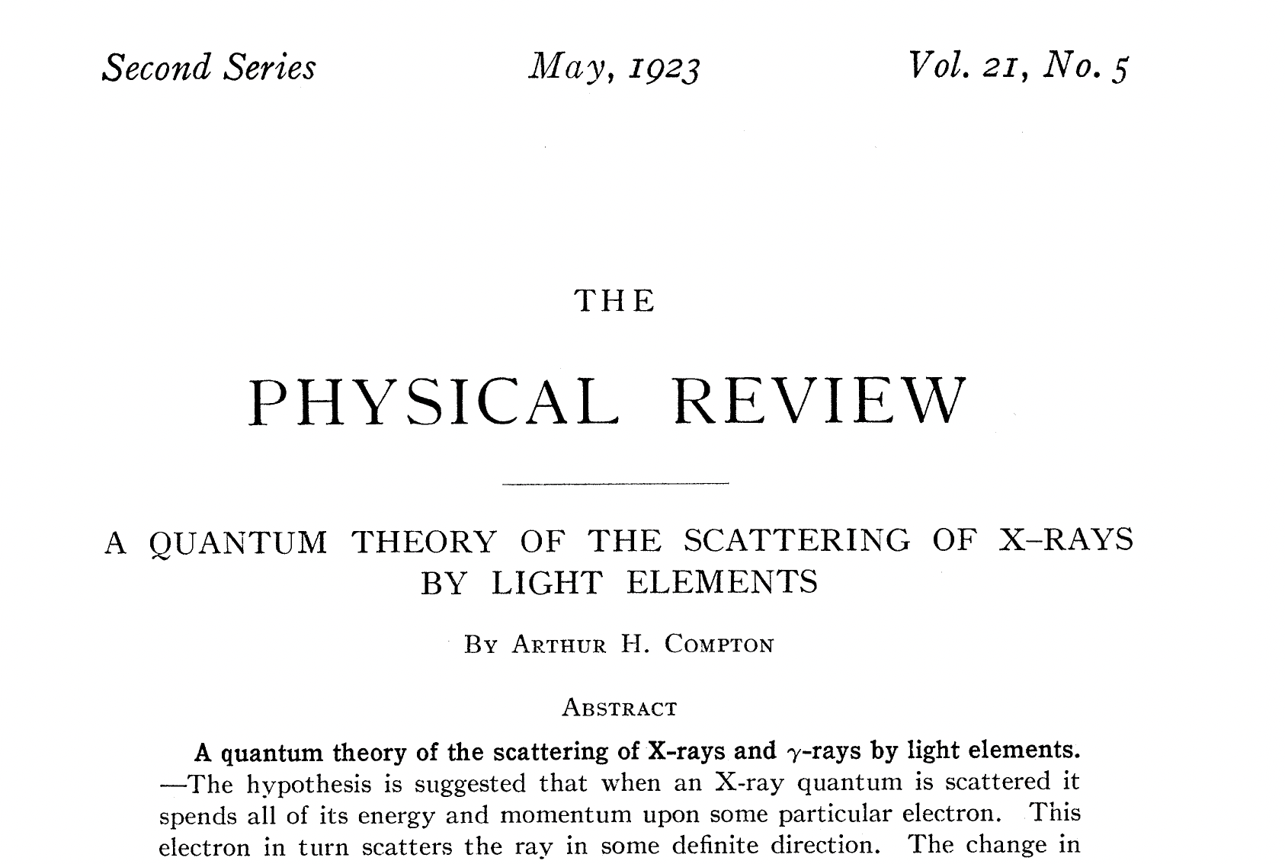
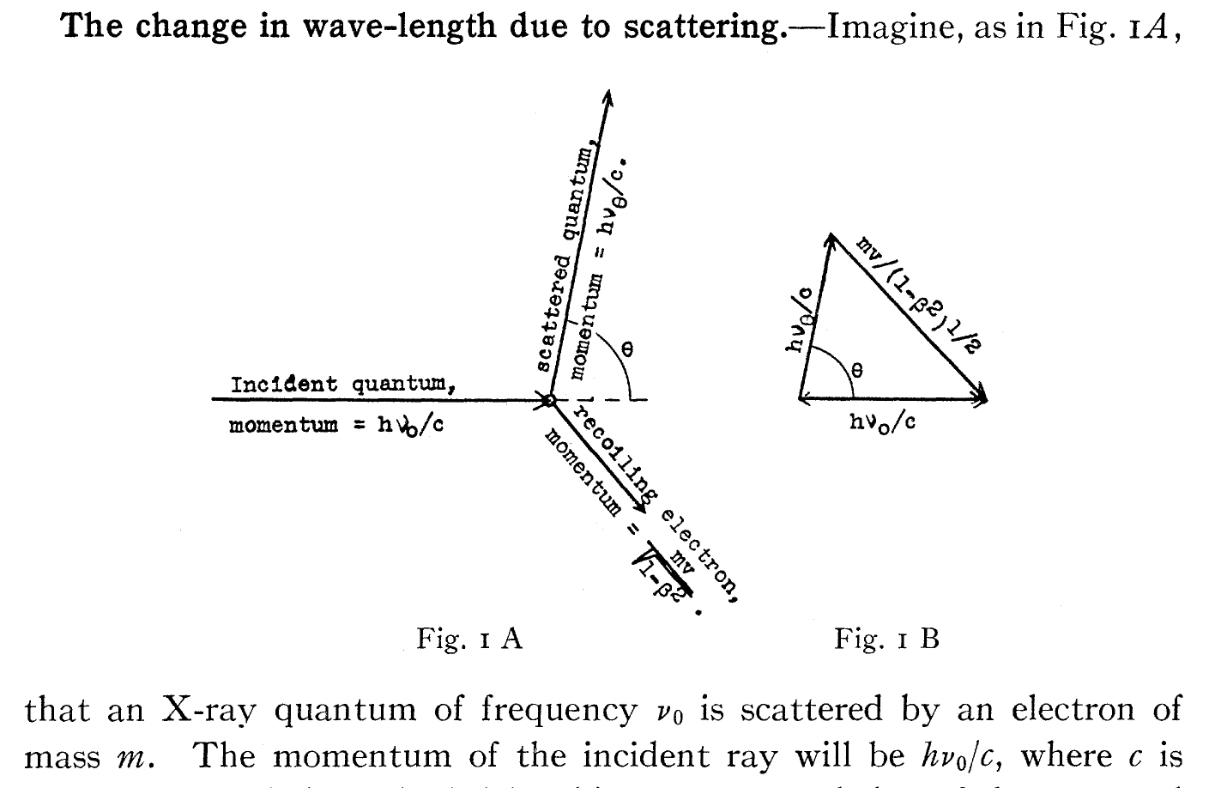
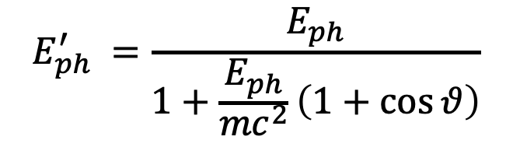
beginning of the story – the photon, quantum of energy
$$E_{ph}^{′} =\frac{E_{ph}}{1+\frac{E_{ph}}{{mc}^{2}}\left(1+\cos{θ}\right)}$$
angular correlation!

Slide 16
First physicists forced to think at Inverse Compton Scattering,
i.e. a mechanism by which electrons loose energy in favor to photons,
(opposite than direct Compton effect) were…
The developers of the Nuclear Bomb!
and, soon later,
first observers of cosmic rays in the upper atmosphere,
trying to figure out why there are many protons and very few electrons

Slide 17
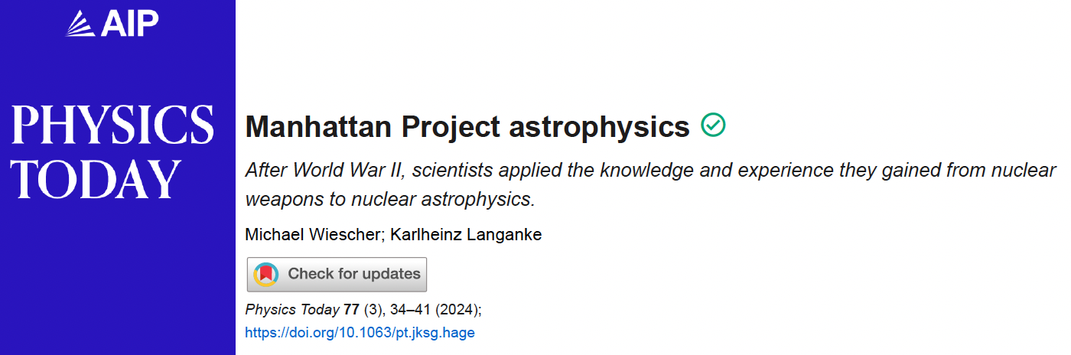
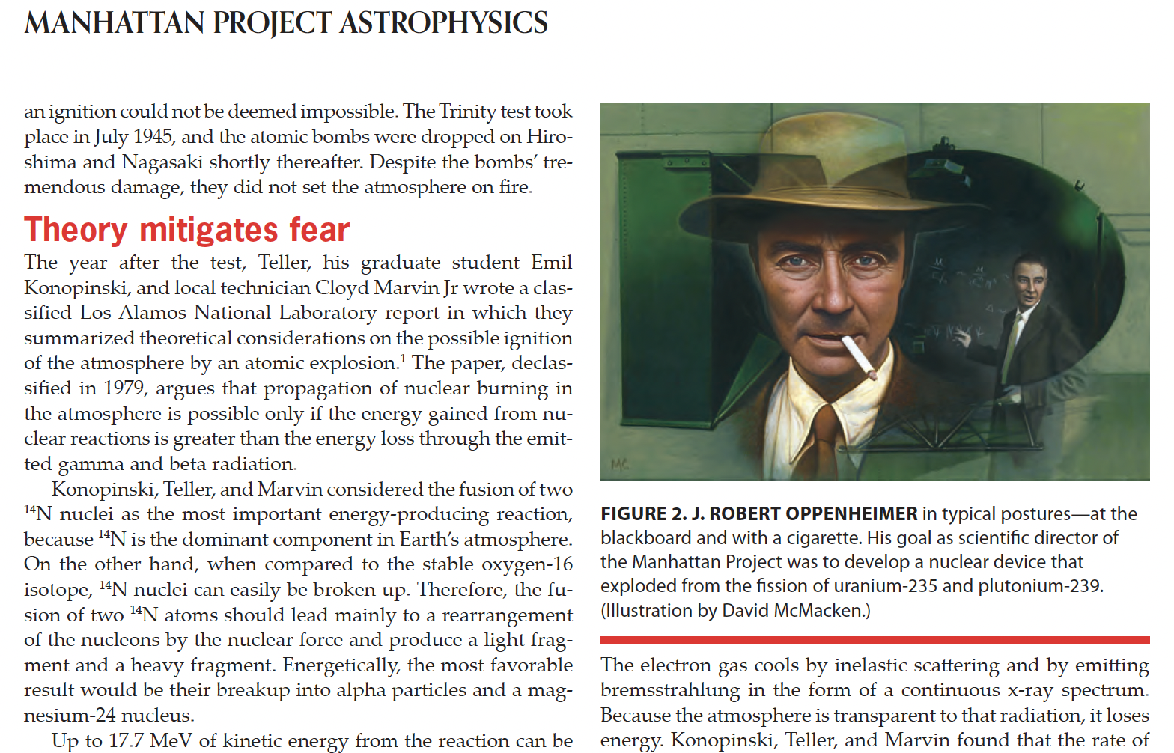
of initiating nuclear fusion
of the whole atmosphere!!!

Slide 18
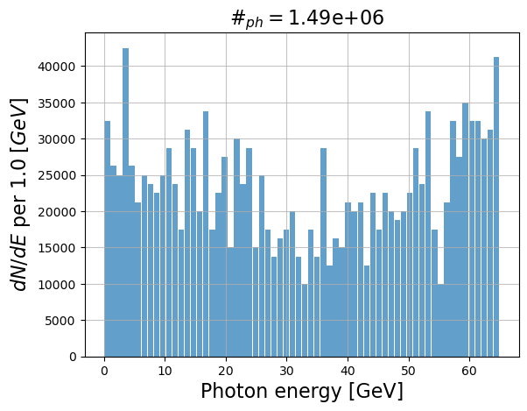
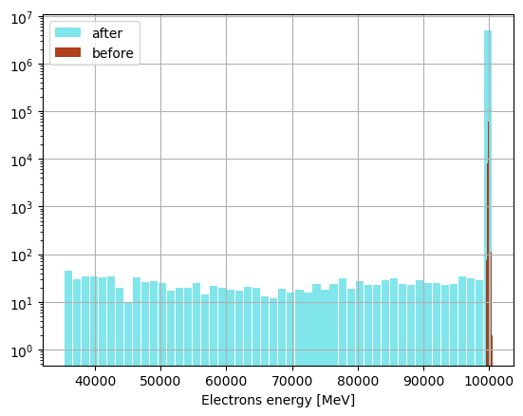
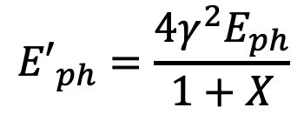
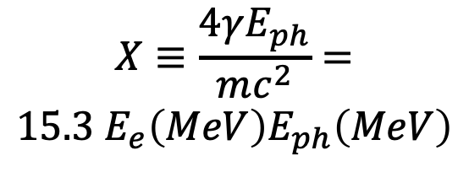
FCC-ee
primary electron beam 100 GeV
primary photon beam: optical laser
$${E′}_{ph}=\frac{4γ^{2}E_{ph}}{1+X}$$
$$X≡\frac{4γE_{ph}}{mc^{2}}=$$
$$15.3{ E}_{e}\left(MeV\right)E_{ph}\left(MeV\right)$$
X_{laser}=1.8
not negligible fraction of electrons
in the beam interact with laser
Thanks to Illya Drebot

Slide 19
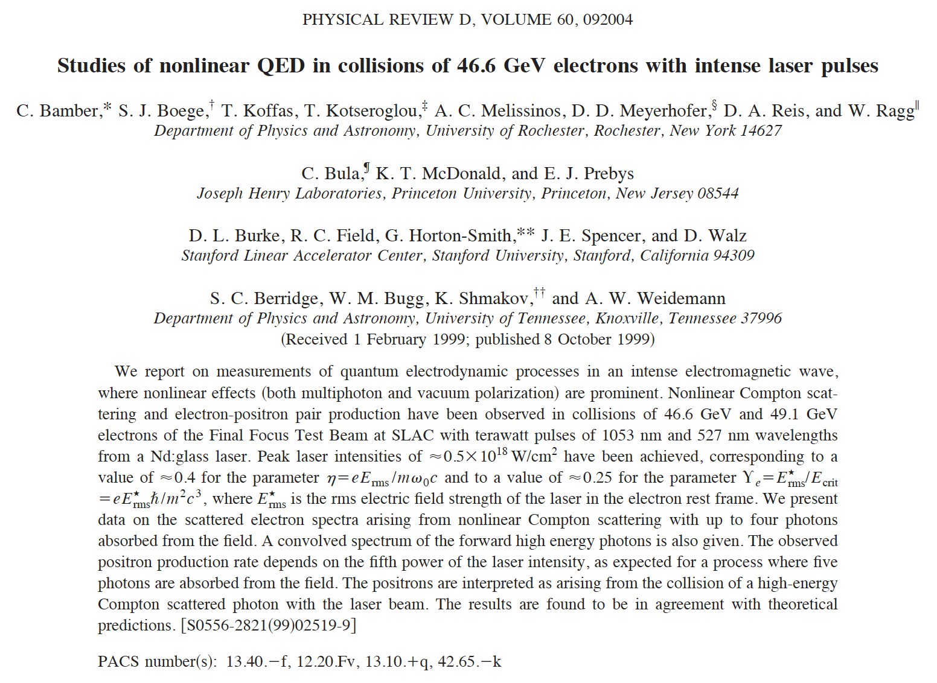
Largest value of recoil factor X achieved in
experiments so far is X=1.8 at SLAC in 1999
Colliding the XFEL photon beam (12 keV) with the
19.5 GeV electron beam would achieve X=3585 !!!

Slide 20
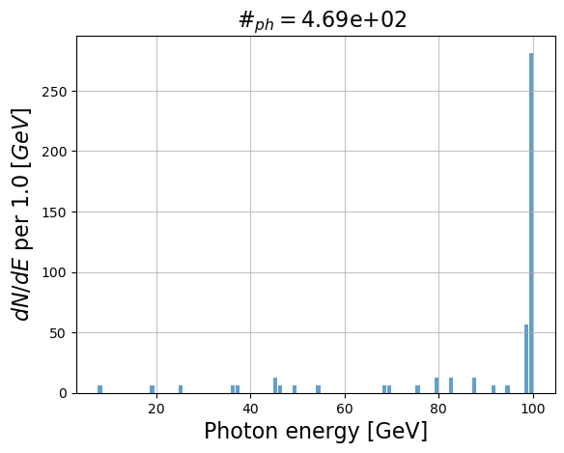
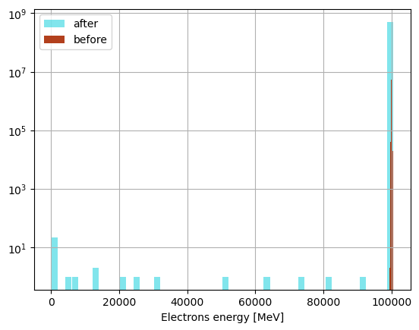
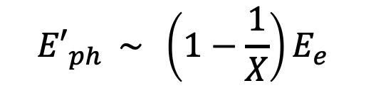
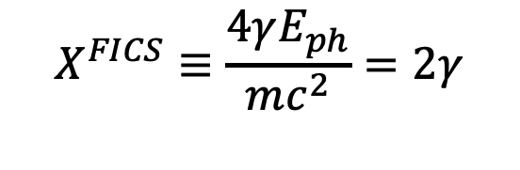
FCC-ee
primary electron beam 100 GeV
primary photon beam: 255.5 keV
Deep recoil Compton: X >> 1
$${E′}_{ph} \sim \left(1−\frac{1}{X}\right)E_{e}$$
$$X^{FICS}≡\frac{4γE_{ph}}{mc^{2}}=2γ$$
X_{FICS}=3.9*10⁵
Single particle energy extraction from the stored beam
in the form of 100 GeV photons
Thanks to Illya Drebot

Slide 21
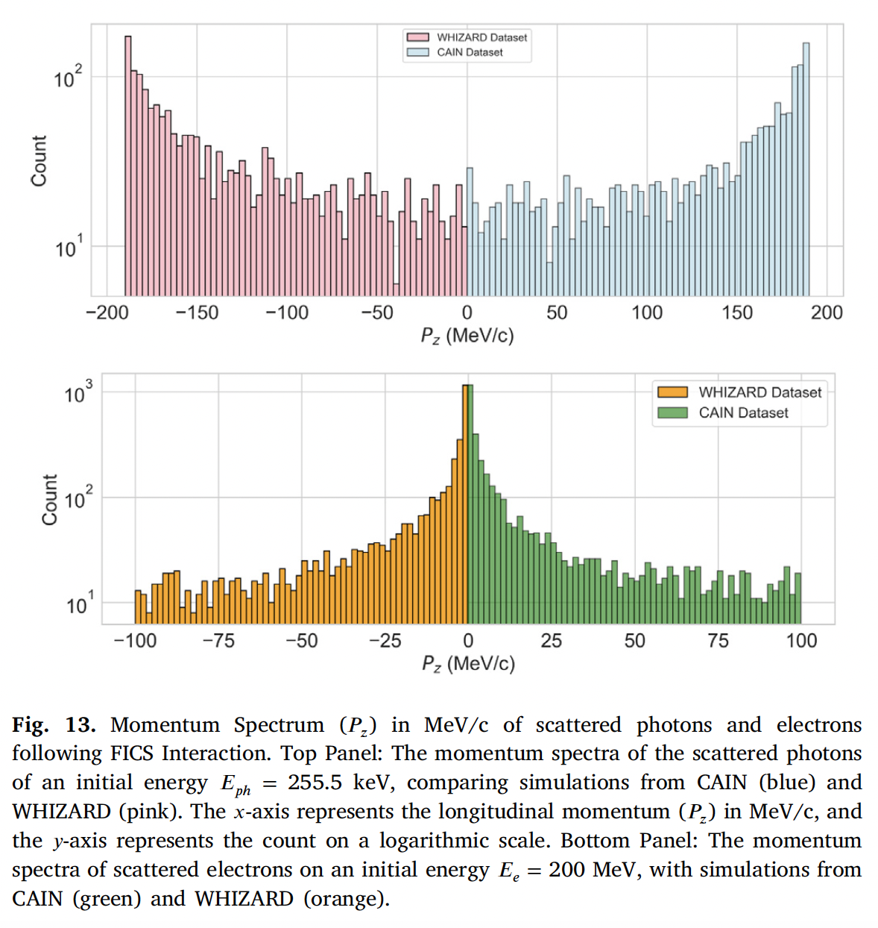
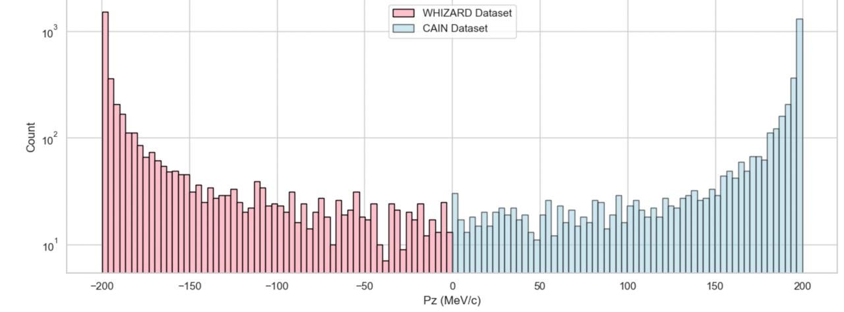
scattered photons
better statistics
with 200 MeV e⁻
scattered electrons

Slide 22
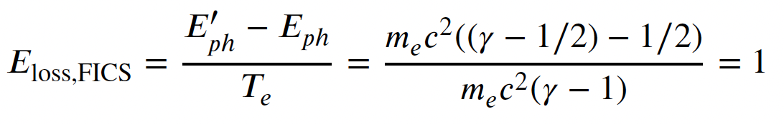
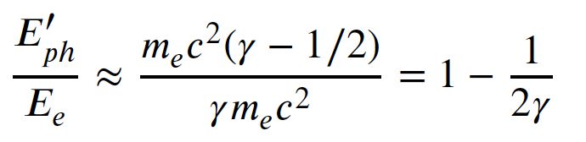
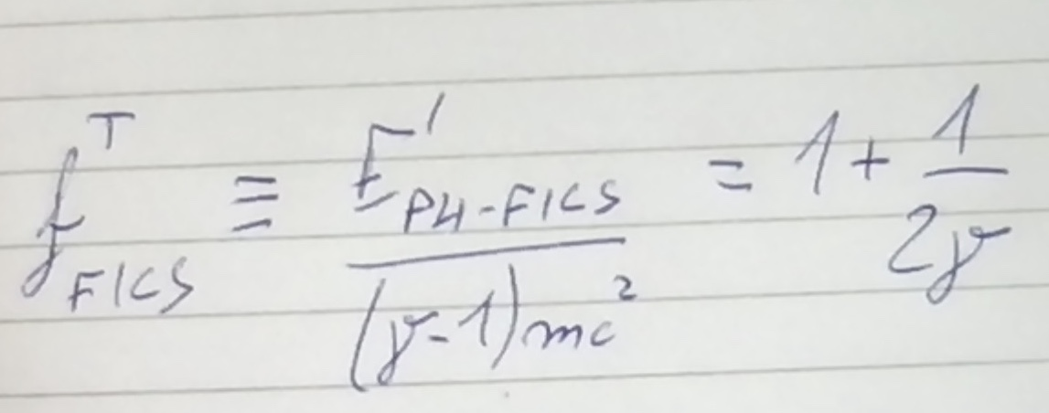
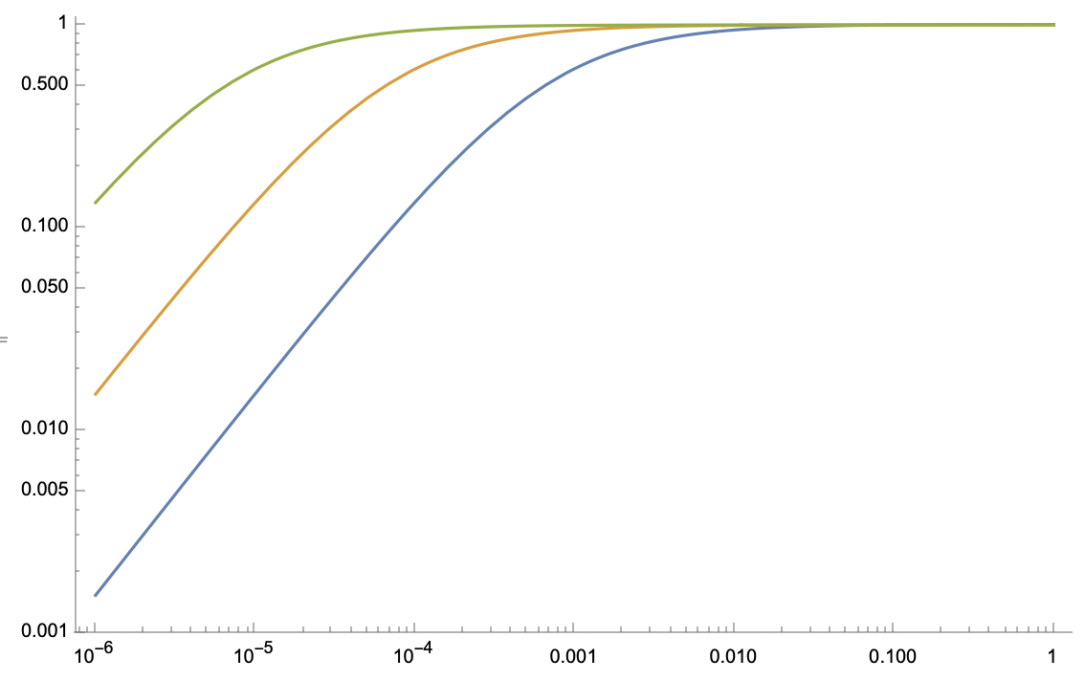
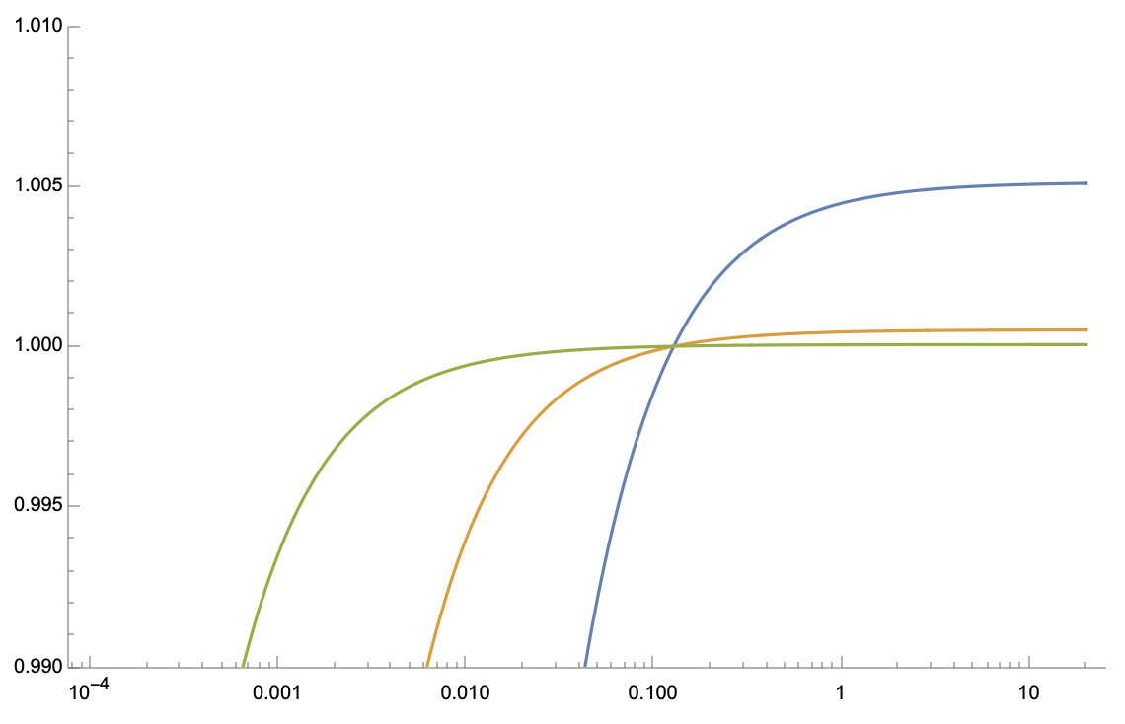
At FICS electrons emit photons with energy larger than T_{e}
T_{e}=10 GeV
f ^{T}_{FICS}
T_{e}=100 MeV
T_{e}=1 GeV
f ^{T}_{FICS}
T_{e}=10 GeV
T_{e}=1 GeV
T_{e}=100 MeV
E_{ph} (MeV)
E_{ph} (MeV)

Slide 23
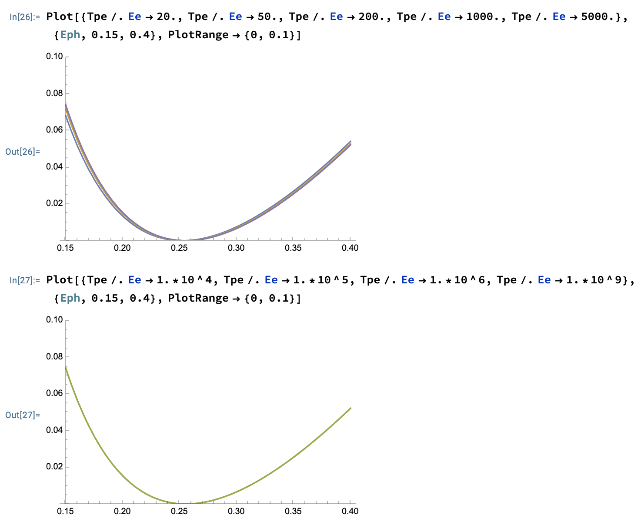
FICS has a shallow minimum:
residual electron kinetic energy T’_{e} around FICS is small
T’_{e} (MeV)
T_{e} = 20, 50, 200 (MeV),
1, 5 (GeV)
T_{e} = 10, 100 (GeV),
1 TeV , 1 PeV
T’_{e} (MeV)

Slide 24
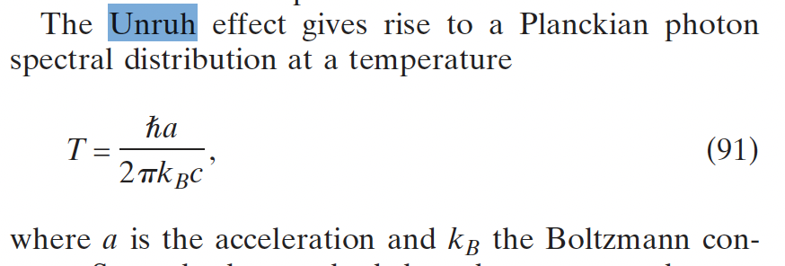
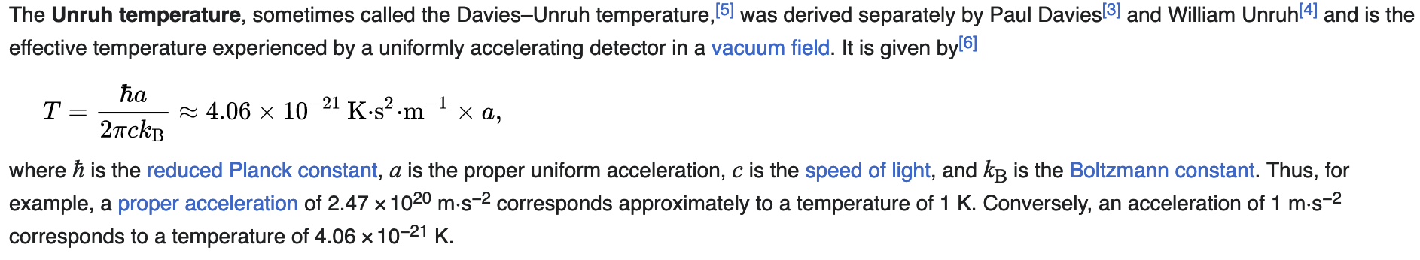
Black-hole a=10¹⁰ T=4.1.10⁻¹¹ K
Plasma acceleration (100 GV/m) a=1.8.10²² T=74 K
?? how about FICS ??

Slide 25

Probably a_{laser} = 10²³⁻²⁵

Slide 26

Unruh radiation during FICS and SCS
a_{FICS} (m/s²) = 7.3.10²⁸ * E_{e}(MeV)
T_{Unruh-FICS} (K) =3.1.10⁸ * E_{e}(MeV)
T_{Unruh-FICS} (MeV) = 0.026 * E_{e}(MeV)
going from 100 MeV up to 2 GeV electrons the Unruh photons at FICS would
cover the 2.6 – 52 MeV range (easy detection in vacuum with low background)
a_{SCS} = 2.a_{FICS}
but E_{ph} must be = E_{e} in SCS, while in FICS E_{ph} = 255.5 keV

Slide 27


a_{FICS} (m/s²) = 7.3.10²⁸ * E_{e}(MeV)
T_{Unruh-FICS} (K) =3.1.10⁸ * E_{e}(MeV)
T_{Unruh-FICS} (MeV) = 0.026 * E_{e}(MeV)

Slide 28

FICS Relay in the cosmo - a possible mechanism to
propagate very high energy electrons in the universe
FICS
Direct
Compton
FICS, etc, etc

Slide 29

Grazie per l’attenzione
Thanks for your attention

Slide 31






Total cross-section for MPP (muon pair production), Bethe-Heitler:
fraction of a μbarn at photon energies > 100 GeV onto electrons at rest
$$e^{−}+γ→e^{−}+{e^{+}}/{e^{−}}$$
$$e^{−}+γ→e^{−}+γ$$
$$e^{−}+γ→e^{−}+{μ^{+}}/{μ^{−}}$$
EXMP
Bethe-Heitler
$σ^{MPP}= αr_{μ}^{2}\left(\frac{28}{9}ln\left(\frac{2γhν}{M_{μ}}\right)−\frac{218}{27}\right)$ ${− σ}^{Borsellino}$
$$E_{CM}=2\sqrt{M_{e}γhν}$$
$$E^{′}=2γhν=\frac{E_{CM}^{2}}{2M_{e}}$$
$$E_{CM−FICS}=2M_{e}\sqrt{0.5γ}$$
E_{CM-FICS-FCCee}=320 MeV

Slide 32



Large Recoil in MPP damps the normalized emittance of the secondary generated muon beam
muon beam norm. emittance
cmp. MAP norm. emitt. 2.5.10⁴ nm.rad
after ionization cooling

Slide 33








X = 4 E_{e} E_{ph} /(mc²)²
A = βγ²− X/4
$${E′}_{ph}$$
$$E_{e}$$
$$E_{ph}^{′}=\frac{4{γ^{2}E}_{ph}}{1+X}$$
$$E_{e}^{′}=E_{e}{+E}_{ph}−\frac{4{γ^{2}E}_{ph}}{1+X}$$
$$E_{ph}$$
$${E′}_{e}$$
$$E_{tot}$$
E_{e} = 10 MeV
(MeV)
X
E’_{ph}
X=1
FICS
I.C.S.
low recoil
Thomson
X<<1
$$E_{ph−FICS}=\frac{{mc}^{2}}{2}$$
$$E_{ph−FICS}^{′}=T_{e}+\frac{{mc}^{2}}{2}$$
E’_{e}
S.C.S.
Arthur
Compton
effect
0.511 MeV
e⁻ at rest E’_{e}=mc²
deep recoil I.C.S.
E_{ph}
A >> 0
A=0
A<0
Lasers
XFEL’s
betatron-channeling
E_{ph} (MeV)

Slide 34


Slide 35
A simple yet fundamental question:
“Why do I need 150 Mega-electronVolt electrons to generate 350 kilo-electronVolt photons” ??
(STAR biased…)
(not to mention a storage ring based light source where a GeV electron beam radiates tens keV photons)
How to transfer maximum energy
from an electron to a photon…

Slide 36



Collisional radiation
(quantum nature of light essential: Inverse Compton Scattering, Deep Recoil ICS for e⁺ or μ⁺, μ⁻ secondary beam generation, Relativistic Rayleigh Scattering)
Gamma Factory @ LHC
deep recoil I.C.S.
I.C.S.
$$E_{ph}$$
$${E′}_{ph}$$
$$E_{e}$$
$${E′}_{e}$$
EXMP
low recoil
I.C.S. - STAR

Slide 37

255.5 keV 10^12 photons
### Electrons beam parameteres
n_macro=1e8; # Number of macroparticles
chargebunch = 1e-9; # Charge per electrons bunch [C] pico->10^-12 femto->10^-15
beam_energy_MeV=100e3; # initial beam energy MeV
energy_spread=0.1e-2; # initial relative energy spread (not in [%])
norm_emit_x=1e-6; # Normalised emittance x [m rad]
norm_emit_y=1e-6; # Normalised emittance н [m rad]
sigma_e_x=1e-6; # horizontal electron beam size [m]
sigma_e_y=1e-6; # vertical electron beam size [m]
bunch_length=1e-12*3e8; # initial bunch length [m]
### LASER parameteres
angle_deg=0; # in degree
pulseE=0.0361095; #laser puse energy [J]
sigLrx=10; #/2; % given in [mu m] micro meter like
sigLry=10; #/2; % given in [mu m] micro meter like laserwl=0.00549819; # laser wavelenth [nm] nano meters
sigt=1; #pulse length [ps]

Slide 38







The γ²θ² issue/disease
All radiation originated by a Lorentz Boost associated to relativistic emitting particles (electrons, heavy ions) is intrinsically poli-chromatic because of γθ correlation (energy boost of scattered photons depends on scattering angle, at θ=1/γ photon energy is 50% of max photon energy at θ =0 ) of single electron spectrum (on top of inhomogeneous effects)
True for all kinds of Undulatory and Collisional radiation (bremsstrahlung, wiggler/betatron, synchrotron, RRS, ICS), while resonant or amplified radiation (undulators, FELs), that are diffraction limited thanks to their beam quality, are not (or only partially) affected
$$E_{e}=γmc^{2}$$
$$E_{ph}$$
$${E′}_{ph}$$
$${E′}_{ph}=\frac{4γ^{2}E_{ph}}{1+X+γ^{2}θ^{2}}$$
$$E_{e}$$
$$X≡\frac{4γE_{ph}}{mc^{2}}=\frac{ 2E_{ph}^{ERF}}{mc^{2}}$$
$${E′}_{e}$$

Slide 39

Courtesy I. Drebot

Slide 40

Courtesy I. Drebot

Slide 41

Also synchrotron radiation is affected by the
γ²θ² red shift
Lorentz
boost
Courtesy L. Rivkin

Slide 42








All spontaneous undulatory X/γ Radiation Sources
(keV, MeV, GeV…) are affected by the angular correlation
Spontaneous undulatory radiation (synchrotron, wiggler, betatron, channeling, bremsstrahlung)
Resonant/amplified undulatory radiation (undulator, FEL)
$$E_{X}=f\left(γ^{2}θ^{2}\right)$$
courtesy B. Paroli, M. Potenza
courtesy L. Rivkin
$$E_{X}≠f\left(γ^{2}θ^{2}\right)$$

Slide 43

General Compton Scattering geometry
between an incident electron E_{e} and a photon E_{ph}
at a collision angle α, photon E’_{ph} scattering angle θ
and electron E’_{e} scattering angle θ_{e}
$$E_{ph}$$
$${E′}_{ph}$$
$$E_{e}$$
$${E′}_{e}$$
$$E_{e}=γmc^{2}$$
$γ=1 Direct Compton effect$
$γ≫1 Inverse Compton$
Energy/momentum transferred from photon to e-
Energy/momentum transferred from e- to photon

Slide 44


We are not considering in this study non-linear effects due to photon (laser) pulse intensity
no collective multi-photon effects
only single electron-photon interaction
(à la Klein-Nishina, linear QED)
Courtesy Marcel Ruijter
Deep Recoil ICS
FICS
X --->

Slide 45

A. Compton 1923 - Direct Compton effect
First consideration and study of Inverse Compton Scattering….
During the development of the nuclear bomb!
The Manhattan Project
Will the back-scattered photons,
by hot electrons of the plasma
created in the initial stage of the
nuclear bomb explosion, release
energy from the fire-ball decreasing
its temperature???

Slide 46

fire-ball becomes transparent
to photons, that can take energy
off the fire-ball, limiting the
maximum temperature
down to a “safe” level

Slide 47

A. Compton 1923 - Direct Compton effect
J. Follin 1947 - Inverse Compton Scattering
first published (non classified) study on ICS*
Second motivation to study ICS in the late ‘40s was understanding why
electrons are almost missing in cosmic rays bombarding the upper atmosphere
Both directions (nuclear bomb and astrophysics) were looking for
a mechanism capable to transfer maximum energy from the electrons to the photons
* but unknown and not credited in the whole literature on ICS

Slide 48


Publication referenced by everybody in ICS community
as the first published paper on ICS

Slide 49

First idea by Milburn: use electron accelerators to perform
Inverse Compton Scattering in the laboratory vs. the cosmos

Slide 50


X=0.13
Σ=596 mbarn
Deep Recoil
and its 2 benefits:
spectral purification
and
suppression of γ²θ² desease
X=13
Σ=109 mbarn
X=1286
Σ=3 mbarn

Slide 51







Inverse Compton Scattering of photons on
relativistic electrons, θ < 1/γ
$$E_{ph}^{′}=\frac{4{γ^{2}E}_{ph}}{1+γ^{2}θ^{2}+X}$$
$$X=\frac{ 4E_{ph}E_{e}}{{\left(mc^{2}\right)}^{2}}$$
Thomson limit: X << 1
Deep recoil Compton: X >> 1
$$E_{ph}^{′}=\frac{4{γ^{2}E}_{ph}}{1+γ^{2}θ^{2}}$$
$${E′}_{ph} \sim \left(1−\frac{1}{X}−\frac{γ^{2}θ^{2}}{X}\right)E_{e}$$
$E_{ph}^{′}\left(θ=\frac{1}{γ}\right)=2{γ^{2}E}_{ph}$= $\frac{E_{ph}^{′}\left(θ=0\right)}{2}$
$${E′}_{ph}\left(θ=\frac{1}{γ}\right)\sim \left(1−\frac{2}{X}\right)E_{e}$$
$$note that E_{cm}=mc^{2}\sqrt{1+X }, if X≫1⇒X\sim {\left(\frac{E_{cm}}{mc^{2}}\right)}^{2}$$

Slide 52

Previous Seminars: 1) Cooling of Photons in Symmetric Compton Scattering (S.C.S.)
20% rms spread
input e⁻ beam
10 MeV, 10⁻⁴
rms en. spread
Electron
Cooling of
photons!!
2.10⁻⁴
rms spread
no energy-
angular
correlation
10⁻¹ spread
e- beam
is heated
C. Curatolo - Whizard

Slide 53


Previous Seminars:
2) Spectral Purification
in deep recoil I.C.S.
Broad-band incident
photon beam
from channeling radiation,
bremsstrahlung,
betatron radiation, etc
spectral purification
Deep Recoil Inverse
Compton Scattering
tunability

Slide 54

Lorentz boosted radiation (synchrotron, ICS, FEL, etc)
is strongly affected by the emittance of the electron beam
Courtesy C. Barty - LLNL

Slide 55



Deep Recoil suppresses the
γ²θ² disease and the bandwidth
broadening effect due to
electron beam emittance
according to
Petrillo-Serafini criterion
low recoil ICS
$$bw ≥\frac{2ε_{n}^{2}}{σ_{x}^{2}}$$
$$S_{d}∝\frac{\left\langle I_{e}\right\rangle U_{las}}{ε_{n}^{2}E_{x}}$$

Slide 56

Ultra-low emittance positron beams from deep recoil
electron-photon collider: 5 GeV ERL vs. 5 keV FEL, X=391
up to 10¹³⁻¹⁴ e⁺/s at 50 MeV within 5% en. spread
Son of
EXMP
E_{cm}=10 MeV
E_{cm}=346 MeV
0.5 MeV/c rms
transv. momentum
0.5-1*10⁻⁷ m.rad rms norm. transv. emittance with round beam (no-cooling)
V. Petrillo, A. Puppin – Whizard

Slide 57



FICS - Full Inverse Compton Scattering - how to achieve 10³⁰ m/s² acceleration to sense Unruh radiation
V. Petrillo, ad-hoc developed Montecarlo code for linear QED

Slide 58
$$E_{e}$$
$${E′}_{ph}$$
in vacuum electron-photon collision
E’_{e} (MeV)
$${E′}_{e}$$
$$E_{ph}$$
5 GeV
FICS – Full Inverse
Compton Scattering
1 GeV
200 MeV
E_{e} = 50 MeV
$$E_{ph−FICS}^{′}=T_{e}+\frac{{mc}^{2}}{2}$$
E’_{e} =511 keV , T’_{e}=0
E_{ph} (MeV)
E_{ph} = 1 eV
E_{ph} = 1 keV
E_{ph} =0.5mc²

Slide 59


From Feenberg-Primakoff

Slide 60

From Follin

Slide 61


Slide 62


Slide 63


residual electron kinetic energy T’_{e} at FICS
with 511./2. keV photons instead of
T’_{e} (MeV)
T_{e} (MeV)

Slide 64


Slide 65






Direct Compton γ =1, β =0 , X = 4E_{ph}/mc²
$$E_{ph−min}^{′}=\frac{E_{ph}}{1+{2E_{ph}}/{mc^{2}}}$$
$$E_{ph−min}^{′}=\frac{mc^{2}}{2}$$
$$if{ E}_{ph}≫mc^{2}$$
Very energetic photons are scattered back at 255 keV
and electrons pushed to E_{ph} + 0.5mc²
$$E_{e−max}^{′}=E_{ph}+\frac{mc^{2}}{2}$$
$$E_{e−max}^{′}=mc^{2}+E_{ph}−E_{ph−min}^{′}$$
$${ , if E}_{ph}≫mc^{2}$$
So FICS is the time reversal of Compton scattering
at infinitely large recoil
kinematics is similar for any particle interacting with photons
(protons, μ, neutrinos? hν_{inc}=0.5*m_{p}c² - next step in progress…)
It’s unbelievable how much you don’t know about
the game you’ve been playing all your life”
Mikey Mantle (big baseball player of the past, after Danilo Babusci INFN-LNF)

Slide 66

Stopping Protons with photons
Relativistic protons require 938/2 MeV photons
β_{prot}
GeV
E’_{ph-prot}
_{π-threshold}
E_{ph-prot}
pion
photo-production
MeV

Slide 67

electrons do not have internal degree of freedom (apart from spin)
while protons do have - protons can act as detectors of Unruh thermal
photon bath (they can “click”) - but protons cannot be driven to strong
accelerations by intense lasers… FICS is the only way??

Slide 68

30 MeV protons vs. photon beams of
different energies (110, 120, 170 MeV)

Slide 69


Slide 70


Checked with CAIN modified for protons (I. Drebot, A. Bacci)
only interacting protons
primary proton beam
+
interacting protons

Slide 71


Slide 72
We asked Chat-GPT again (Oct. 26th 2024),
after recommending her/him/it reading our 2 papers
10.1103/PhysRevAccelBeams.27.080701
https://doi.org/10.1016/j.nima.2024.169964
Now that Full Inverse Compton Scattering (FICS) demonstrates
that total energy transfer from an electron to a photon is
theoretically possible, it shifts our understanding of photon-
electron interactions, especially at high energies.
This interaction is unique because the electron can stop completely and transfer all its kinetic energy to the photon in a controlled, head-on setup.
This level of energy transfer efficiency has significant implications, potentially enabling precise photon energy boosts and offering new applications in particle accelerators and high-energy astrophysics.

Slide 73
Grazie per l’attenzione

Slide 74





Full Inverse Compton Scattering
$$T_{e} ;{ E}_{ph}=0.5mc^{2}$$
Can electrons emit photons of energy larger than their own?
γ >>1
$$T_{e}^{′}=0 ; E_{ph}^{′} =T_{e}+0.5mc^{2}$$
Impacts in several fields:
Plasma Physics (e⁻ / e⁺ trapping in plasma mirrors), Astro-Physics (cosmic γ-ray sources), QED & Quantum Gravity (Unruh radiation and overcoming the Schwinger limit), measuring neutrino mass?

Slide 76







$$E_{ph}^{FICS}\left(T_{e}≤500 keV\right)$$
$$E_{ph}^{FICS}\left(T_{e}≤100 MeV\right)$$
$$\frac{mc^{2}}{2}$$
$$E_{ph}^{FICS}\left(T_{e}≤10 eV\right)$$

Slide 77

E_{e} = 200 MeV ; E_{ph}=255.5 keV
electron momenta distribution after FICS
electrons under-
going FICS
non interacting
electrons

Slide 78







FICS lay-out
Incident electron
Incident photon $E_{ph}$
input
z
Stationary electron
Scattered photon $E_{ph}^{′}$
output
$$E_{e}^{′}$$
z
Incident electron
Incident photon $E_{ph}$
input
z
Scattered photon $E_{ph}^{′}$
Quasi-Stationary electron
$$θ≤1/γ$$
output
z
$$E_{e}^{′}$$

Slide 79

β (T_{e}=255 keV) = 0.75

Slide 80
electrons undergoing FICS with photons back-scattered
between θ=0 and θ=1/γ have β < 0.75
back-scattered photons in FICS have energy E’_{ph} in the range
E’_{ph}(θ=0) = E_{e}(1-1/2γ) ; E’_{ph}(θ=1/γ) = E_{e}(1-1/γ)
to be compared with low recoil ICS, where
E’_{ph}(θ=0) = 4γ²E_{ph} ; E’_{ph}(θ=1/γ) = 2γ²E_{ph}

Slide 81



Slide 82


S.C.S. Spectra at different recoil factors X
back-scattering of the photon is most likely in deep recoil
if an electron/photon interaction occurs in deep recoil it must be back-scattering

Slide 83


Slide 84

Almost at the same time as Arutyunian and co-workers

Slide 85



First measured ICS – 500 MeV

Slide 86

Second measured ICS – 6 GeV

Slide 87



Many studies in the literature on electron-photon beam collisions collective/statistical properties (phase spaces, etc)

Slide 88


Relevance of recoil in electron-photon
beam-beam collisions

Slide 89


Slide 90


Slide 91













All quantities normalized to
the total energy E_{tot} = E_{e} + E_{ph}
E_{e} = 100 MeV
X(E_{ph})
$$λ^{′}−λ=λ_{C}\left(1−\cos{θ}\right)$$
$$λ_{min}^{′}−λ=2λ_{C}$$
${E′}_{ph−max} \sim 4γ2$ $E_{ph}$
I.C.S.
STAR, ELI-NP
DICS
SCS
A.H. Compton,
Phys. Rev. 21 (1923)
E’_{e} (E_{ph}) / E_{tot}
E’_{ph} (E_{ph}) / E_{tot}
E_{ph} / E_{tot}
$$E_{cm}=mc^{2}$$
FICS
$$X=1$$
$$X=4γ^{2}$$
$$E_{ph}=\frac{mc^{2}}{4γ}$$
Astro-physics?
$$E_{ph}=γmc^{2}=E_{e}$$
$$E_{cm}=2γmc^{2}$$
$$E_{cm}=\sqrt{2}mc^{2}$$
$$X=2γ$$
$$E_{ph}=\frac{mc^{2}}{2}$$
$E_{ph}^{ERF}=2γ\frac{mc^{2}}{2}$ = E_{e}
E_{ph} (MeV)

Slide 92
Grazie per l’attenzione

Slide 93

If you ask Chat-gpt :
“can an electron transfer its total kinetic energy to a photon?”
It will answer “no” - a wrong (or not updated) answer
This was done in June 2024
Courtesy S. Sanae

Slide 95

V. Petrillo, ad-hoc developed Montecarlo code for linear QED
1) low recoil 2) DICS (X=1) 3) deep recoil (X=8)

Slide 96

V. Petrillo, ad-hoc developed Montecarlo code for linear QED
electron back-scattering (X=12.000) 2) SCS (X=40.000)
3) Direct Compton (X=1.2.10⁵)

Slide 97


Slide 98

Spectral Purification of incident Channeling Radiation
Compact, sustainable, mono-chromatic gamma-ray source

Slide 99

Deep recoil cancels the γ²θ² disease/correlation, therefore strongly
decreases the dependence of the back-scattered photon beam
bandwidth on the electron beam transverse emittance

Slide 100
Broad-band incident
photon beam
from channeling radiation,
bremsstrahlung,
betatron radiation, etc
spectral purification
Deep Recoil Inverse
Compton Scattering
tunability

Slide 101



E’_{ph} - energy of scattered photon at θ
red shift at θ≠0
θ
scattered electron
E’_{e} = γmc² + E_{ph} – E’_{ph}
All I.C.S. X/γ ray Sources work at X<1 and A » 1
STAR (350 keV) X_{STAR} < 2.6.10⁻³ A_{STAR} > 10⁴
ELI-NP (20 MeV) X_{ELI-NP} < 0.026 A_{ELI-NP} > 2.4.10⁵
X = recoil parameter – twice the energy of the photon seen
by the electron in its own reference frame normalized to mc²

Slide 102

$$E_{ph}^{′} =\frac{γ^{2}\left(1+β\right)}{γ^{2}\left(1−β\cos{θ}\right)+\frac{X}{4}\left(1+\cos{θ}\right)}E_{ph}$$
$$E_{ph}$$
$${E′}_{ph}$$
X ≡ 4γ² E_{ph} /E_{e}
A ≡ βγ²− X/4 = γ²(β− E_{ph} /E_{e})
$$E_{e}$$
$${E′}_{e}$$
A=0 , i.e. Symmetric Compton Scattering cancels the γ²θ² correlation

Slide 103


Let’s consider the condition of maximum energy/momentum
transfer between electron and photon, i.e. θ = 0
$$E_{ph}$$
$${E′}_{ph}$$
$$E_{e}$$
$${E′}_{e}$$
$$E_{ph}^{′} =\frac{γ^{2}\left(1+β\right)}{γ^{2}\left(1−β\cos{θ}\right)+\frac{X}{4}\left(1+\cos{θ}\right)}E_{ph}$$
θ = 0
$$E_{ph}^{′} =\frac{2γ^{2}}{γ^{2}\left(1−β\right)+\frac{X}{2}}E_{ph}$$

Slide 104






θ = 0 corresponds to:
maximum energy of back-scattered photon $E_{ph−max}^{′}$
and
minimum energy of electron after scattering $E_{e−min}^{′}$
$$E_{ph−max}^{′}=\frac{4{γ^{2}E}_{ph}}{1+X}$$
Thomson limit: X << 1
Deep recoil Compton: X >> 1
$${E′}_{ph−max} \sim \left(1−\frac{1}{X}\right)E_{e}$$
$$E_{ph−max}^{′}=4{γ^{2}E}_{ph}$$
$${E_{TOT}=E}_{e}+E_{ph}=E_{e−min}^{′}+E_{ph−max}^{′}$$
$$E_{e−min}^{′}=E_{e}+E_{ph}−E_{ph−max}^{′}=E_{e}+E_{ph}−\frac{4{γ^{2}E}_{ph}}{1+X}$$

Slide 105
All quantities normalized to
the total energy E_{tot} = E_{e} + E_{ph}
E_{e} = 100 MeV
X(E_{ph})
$$λ^{′}−λ=λ_{C}\left(1−\cos{θ}\right)$$
$$λ_{min}^{′}−λ=2λ_{C}$$
${E′}_{ph−max} \sim 4γ2$ $E_{ph}$
I.C.S.
STAR, ELI-NP
DICS
SCS
A.H. Compton,
Phys. Rev. 21 (1923)
E’_{e} (E_{ph}) / E_{tot}
E’_{ph} (E_{ph}) / E_{tot}
E_{ph} / E_{tot}
$$E_{cm}=mc^{2}$$
FICS
$$X=1$$
$$X=4γ^{2}$$
$$E_{ph}=\frac{mc^{2}}{4γ}$$
Astro-physics?
$$E_{ph}=γmc^{2}=E_{e}$$
$$E_{cm}=2γmc^{2}$$
$$E_{cm}=\sqrt{2}mc^{2}$$
$$X=2γ$$
$$E_{ph}=\frac{mc^{2}}{2}$$
$E_{ph}^{ERF}=2γ\frac{mc^{2}}{2}$ = E_{e}
E_{ph} (MeV)

Slide 106




when recoil X is large electron swaps with photon,
maximum energy loss by the electron in favour to the photon
$$E_{ph−max}^{′}=\frac{{4E_{ph}{E_{e}}^{2}}/{{\left(mc^{2}\right)}^{2}}}{1+{{4E}_{ph}E_{e}}/{{\left(mc^{2}\right)}^{2}}}$$
$${ E}_{e−min}^{′}≈ { E}_{e}$$
X<<1
$$if γ≫1 { E}_{e−min}^{′}≈ { E}_{e} \frac{1+\left(1+X\right){E_{ph}}/{E_{e}}}{1+X}$$
X>>1
$${ E}_{e−min}^{′}≈ { E}_{ph}$$

Slide 107
100 PeV
1 PeV
0.5mc² = 255.5 keV colliding photons will
stop relativistic electrons of any energy E_{e} !
100 TeV
10 TeV
1 TeV
100 GeV
E’_{e}
E’_{e} (MeV)
e⁻ at rest E’_{e}=mc²
E_{ph} (MeV)
E_{ph} =0.5mc²
*hadronic threshold (E_{cm} < 600 MeV) with 255.5 keV photons ≈ 360 GeV

Slide 109



Total cross-section for QED ( e,γ ) reactions
$$e^{−}+γ→e^{−}+{e^{+}}/{e^{−}}$$
$$e^{−}+γ→e^{−}+γ$$
$$E_{CM}=2\sqrt{m_{e}c2γhν}$$

Slide 110



Total cross-sections for Compton and Bethe-Heitler
E_{ph} = 255.5 keV (E_{e} from 50 MeV to 5 GeV)
Σ_{tot} (mbarn)
$$e^{−}+γ→e^{−}+{e^{+}}/{e^{−}}$$
$$e^{−}+γ→e^{−}+γ$$
E_{e} (MeV)

Slide 111




FICS low relativistic
E_{e} = 5 MeV
E_{e} = 2 MeV
E_{e} = 1 MeV
E_{e} = 0.8 MeV

Slide 112




FICS very low relativistic
E_{e} = 1.1 MeV
E_{e} = 0.8 MeV
E_{e} = 0.7 MeV
E_{e} = 0.6 MeV

Slide 113
Large Recoil in ICS damps the effect of large bandwidth incident photon beams onto the bandwidth of scattered photons
equivalent to FELs Kim-Pellegrini crit. on 3D inhomogeneous effects on photon bandwidth
beam
en. spread
diffraction
collimation
angle
incident
photons
en. spread
beam
emittance
non
linearity

Slide 115










$${E′}_{ph}$$
X ≡ 4γ² E_{ph} /E_{e}
A ≡ βγ²− X/4 = γ²(β− E_{ph} /E_{e})
$$E_{e}$$
$$E_{ph}$$
$E_{ph}^{′}=\frac{4\left(γ^{2}+A\right)+X}{4\left(γ^{2}−A\cos{θ}\right)+X}$ $E_{ph}$
$${E′}_{e}$$
I.C.S. low recoil X<<1
A ~ βγ² ~ γ²-1/2
${E′}_{ph−max} \sim 4γ2$ $E_{ph}$
$${E′}_{ph−max} \sim \frac{4γ^{2}}{1+X}E_{ph} \sim \left(1−\frac{1}{X}\right)E_{e}$$
I.C.S. deep recoil X>>1
A ~ βγ²-X/4 ~ γ²-1/2 - X/4
$${E′}_{ph−max} \sim { E}_{ph}\left(1+\frac{2A}{\left(1+β\right)γ^{2}}\right)$$
S.C.S. (A = 0) or
quasi-SCS ( |A| <<1)
$${E′}_{e−min} \sim {E_{e}−E}_{ph}\frac{2A}{\left(1+β\right)γ^{2}}$$
D.C. γ =1, β =0 , A = -X/4
$E_{ph−min}^{′}=\frac{1}{1+X/2}$ $E_{ph}=\frac{1}{1−2A} E_{ph}$

Slide 116


Direct Compton γ =1, β =0 , X = 4E_{ph}/mc²
$$E_{ph−min}^{′}=\frac{E_{ph}}{1+{2E_{ph}}/{mc^{2}}}$$
$$E_{ph−min}^{′}=\frac{mc^{2}}{2}$$
$$if{ E}_{ph}≫mc^{2}$$
Very energetic photons are scattered back at 255 keV
and electrons pushed to E_{ph} + 0.5mc²
$$E_{e−max}^{′}=E_{ph}+\frac{mc^{2}}{2}$$
$$E_{e−max}^{′}=mc^{2}+E_{ph}−E_{ph−min}^{′}$$
$${ , if E}_{ph}≫mc^{2}$$
General Formula expressed in terms of energies of
primary colliding particles, valid for any γ , A , X , θ
$$E_{ph−max}^{′}=\frac{\left(1+β\right)E_{ph}E_{e}}{\left(1−β\right)E_{e}+2E_{ph}}$$

Slide 117

X = 4 E_{e} E_{ph} /(mc²)²
$$E_{ph−max}^{′}=\frac{\left(1+β\right)E_{ph}E_{e}}{\left(1−β\right)E_{e}+2E_{ph}}$$
E_{e} = 10 MeV
(MeV)
X
E’_{ph}
E’_{e}
0.511 MeV
e⁻ at rest E’_{e}=mc²
E_{ph}
E_{ph} (MeV)

Slide 118


$$E_{ph−max}^{′}=\frac{\left(1+β\right)E_{ph}E_{e}}{\left(1−β\right)E_{e}+2E_{ph}}$$
E_{e} = 50 MeV
(MeV)
E’_{ph}
X
E’_{e}
e⁻ at rest E’_{e}=mc²
E_{ph}
E_{ph} (MeV)
255 keV photon to stop electron of any E_{e} !

Slide 119


$$E_{ph−max}^{′}=\frac{\left(1+β\right)E_{ph}E_{e}}{\left(1−β\right)E_{e}+2E_{ph}}$$
$$E_{e−min}^{′}=E_{e}+E_{ph}−E_{ph−max}^{′}=E_{e}+E_{ph}−\frac{\left(1+β\right)E_{ph}E_{e}}{\left(1−β\right)E_{e}+2E_{ph}}$$
$$E_{ph−max}^{′}=\frac{{4E_{ph}{E_{e}}^{2}}/{{\left(mc^{2}\right)}^{2}}}{1+{{4E}_{ph}E_{e}}/{{\left(mc^{2}\right)}^{2}}}$$
$${ E}_{e−min}^{′}≈ { E}_{e}$$
X<<1
$$if γ≫1 { E}_{e−min}^{′}≈ { E}_{e} \frac{1+\left(1+X\right){E_{ph}}/{E_{e}}}{1+X}$$
X>>1
$${ E}_{e−min}^{′}≈ { E}_{ph}$$
$$if E_{ph}=\frac{mc^{2}}{2} −\left(1−β\right)E_{e} ⟹{ E}_{e−min}^{′}=mc^{2}$$
255 keV photon to stop electron of any E_{e} !

Slide 120



$$if E_{ph}=\frac{mc^{2}}{2} −\left(1−β\right)E_{e}{ ⟹ E}_{e−min}^{′}=mc^{2}$$
$$if γ≫1 and E_{ph}=\frac{mc^{2}}{2}\left[1−\frac{1}{γ}\right] ⟹ { E}_{e−min}^{′}=mc^{2}$$
$$E_{ph}=\frac{mc^{2}}{2}\left[1−\frac{1}{γ}\right]$$
If the incident photon energy is given by
any relativitic electron (i.e. γ >> 1) will be stopped
in a head-on collision with such a photon
255 keV photons will stop electrons of any E_{e} as far as γ >> 1

Slide 121


$E_{ph}=\frac{mc^{2}}{2}\left[1−\frac{1}{2γ}\right]$ to stop any (relativistic) electron
Incidentally, the condition is almost the same needed to make the
total energy in the lab ref. frame (LAB) equal to the total energy in
the electron rest frame (ERF)
LAB total energy E_{LAB} = γ mc² + E_{ph}
ERF total energy E_{ERF} = mc² + 2γ E_{ph}
E_{LAB} = E_{ERF}
if
$$E_{ph}=\frac{mc^{2}}{2} \frac{2γ−2}{2γ−1} \overset{→}{γ→∞} \frac{mc^{2}}{2}$$

Slide 122




Generalization to any Collision Angle α , α = π head-on
$$E_{ph}^{′} =\frac{{4γ}^{2}\left(1−β\cos{α}\right)}{{4γ}^{2}\left(1−β\cos{θ}\right)+X\left(1−\cos{α}\cos{θ}+\sin{α\sin{θ}}\right)}E_{ph}$$
$$E_{ph}^{′} =\frac{γ^{2}\left(1+β\right)}{γ^{2}\left(1−β\cos{θ}\right)+\frac{X}{4}\left(1+\cos{θ}\right)}E_{ph}$$
α=π , head-on ⇒
in agreement with Eq.3 in N. Ranjan et al., PRAB 21, 030701 (2018)

Slide 123





$$E_{ph}^{′} =\frac{{4γ}^{2}\left(1−β\cos{α}\right)}{{4γ}^{2}\left(1−β\cos{θ}\right)+X\left(1−\cos{α}\cos{θ}+\sin{α\sin{θ}}\right)}E_{ph}$$
$$if γ≫1 and β≈1−\frac{1}{2γ^{2}} and θ≪1$$
$$E_{ph}^{′} =\frac{{4γ}^{2}\left(\frac{1−\cos{α}}{2}\right)}{1+γ^{2}θ^{2}+X\left(\frac{1−\cos{α}}{2}\right)}E_{ph}$$
$$E_{ph−max}^{′} =\frac{{4γ}^{2}\left(\frac{1−\cos{α}}{2}\right)}{1+X\left(\frac{1−\cos{α}}{2}\right)}E_{ph}$$
$if θ=0 E_{ph}^{′}$= $E_{ph−max}^{′}$
in agreement with Eq.1 in I. Drebot et al., EPL 120, 14002 (2017)

Slide 124





$$E_{ph−max}^{′} =\frac{{4γ}^{2}\left(\frac{1−\cos{α}}{2}\right)}{1+X\left(\frac{1−\cos{α}}{2}\right)}E_{ph}$$
$$E_{ph−max}^{′} ={4γ}^{2}\left(\frac{1−\cos{α}}{2}\right)E_{ph}$$
X <<1 ⇒
$$E_{ph−max}^{′} =\frac{{4γ}^{2}}{1+X}E_{ph}$$
α= π , head-on ⇒
α= π/2 , X << 1 ⇒
$$E_{ph−max}^{′} ={2γ}^{2}E_{ph}$$
$$E_{ph−max}^{′} =\frac{{4γ}^{2}}{X}E_{ph}=E_{e} ∀α ‼$$
X >>1 ⇒

Slide 125
Colliding a gaussian distributed (20% rms spread) broad-band
radiation beam, representing the first peak
of channeling spectrum at 2 MeV,
with a low energy (variable) electron beam (2,3,5,10 MeV)
Mono-chromatization, Tunability

Slide 126
SCS
Colliding the full spectrum
ICS
DC
Spectral purification
Compton Scattering across SCS

