Slide 1
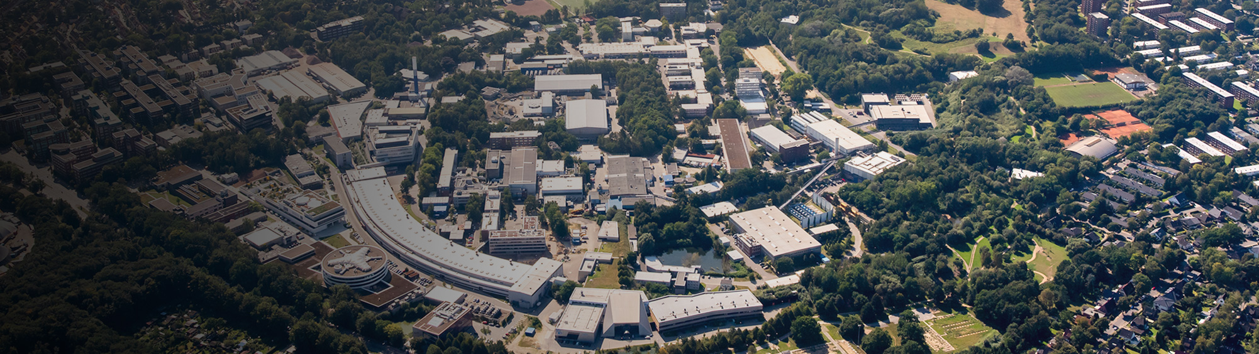
Ultimate limit on beam brightness
Ilya Agapov, Sergey Antipov, C. Cortés Garcia
Other Science Opportunities at the FCC-ee, CERN Geneva November 28, 2024

Slide 2
Why would one want a light source at high energy?
Many contemporary light sources (will) operate at 3-6 GeV
Parameters of operating and planed 4th generation light sources
Machine | Energy | Circumference | Hor. emittance
P4 | 6 GeV | 2.3 km | 20 pm
ESRF-EBS | 6 GeV | 844 m | 110 pm
APS-U | 6 GeV | 1.1 km | 65 pm
HEPS | 6 GeV | 1.36 km | 35 pm
SLS-II | 2.7 GeV | 288 m | 131 pm
Diamond-II | 3.5 GeV | 562 m | 162 pm
SOLEIL-II | 2.75 GeV | 354 km | 83 pm
MAX-IV | 3 GeV | 528 m | 200 pm
FCC-ee Booster* 20 GeV (inj.) 90.7 km 15 pm
* S. Casalbuoni, F. Zimmermann, FCC Week’21
| Other Science Opportunities at the FCC-ee | Sergey Antipov, 28.11.2024
Notes:
2

Slide 3
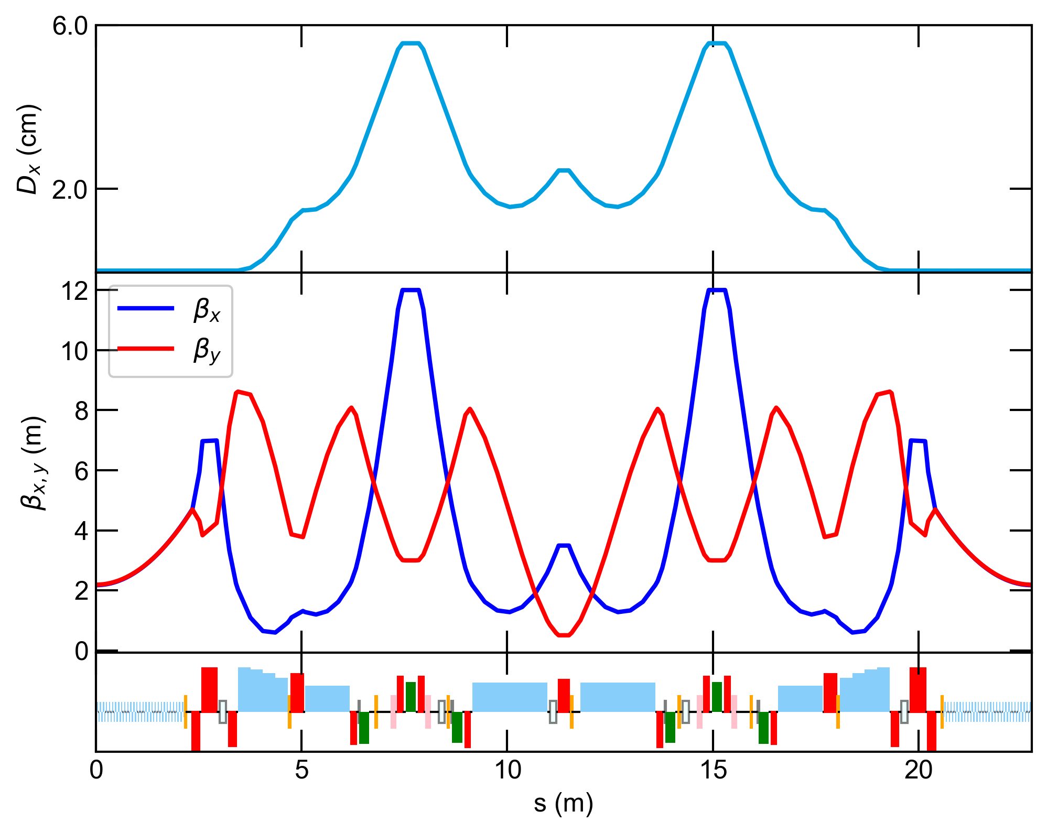
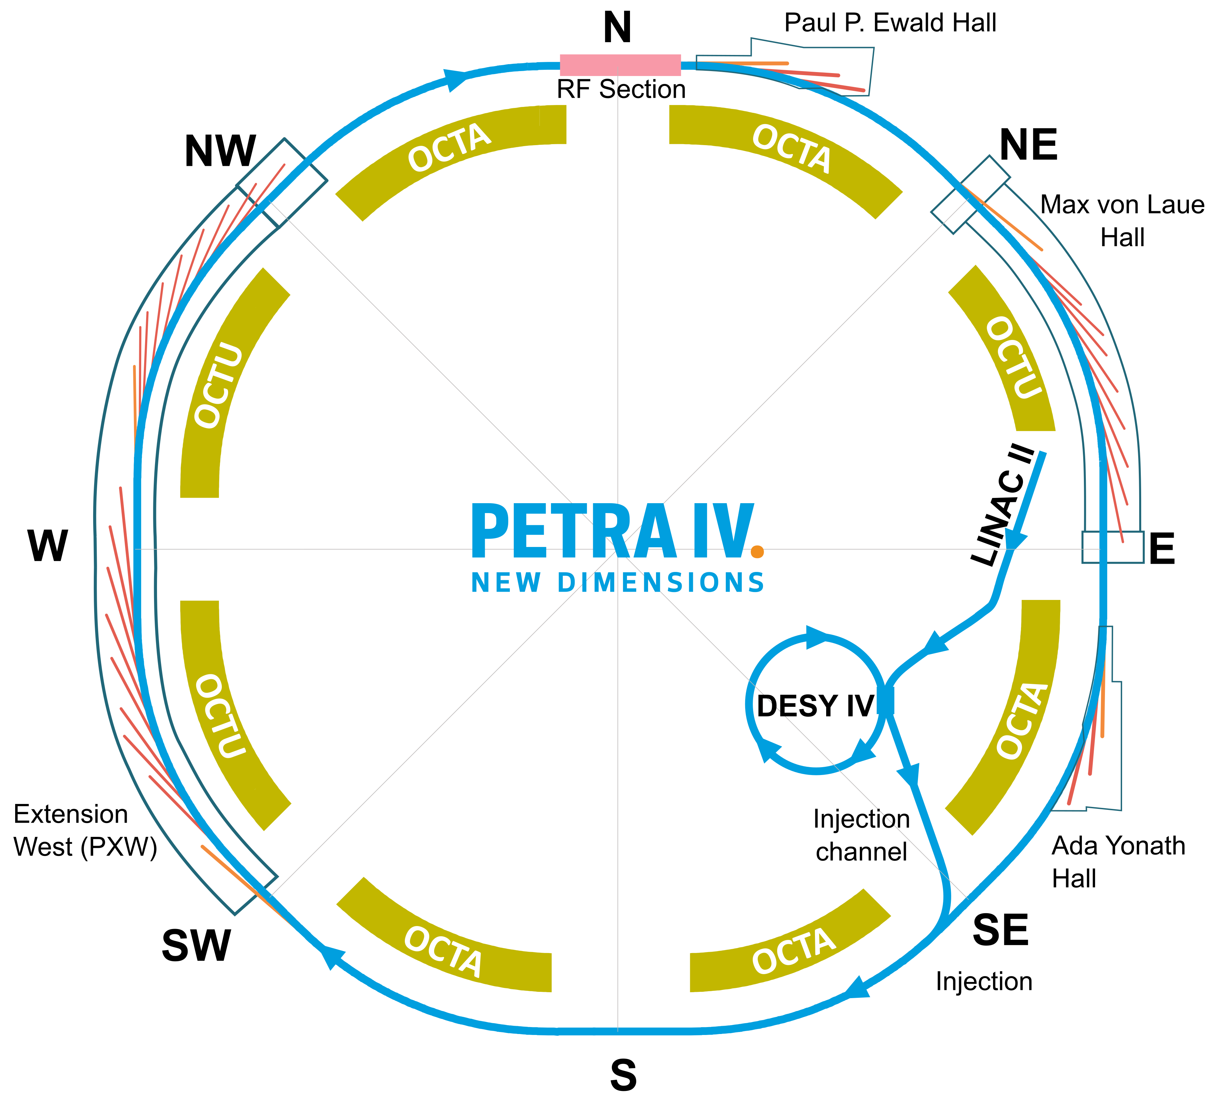
PETRA IV: Germany’s future flagship light source
6 GeV, 2.3 km, 20 pm
Highly optimized achromatic
cell to approach diffraction
limit at 10 keV
arXiv:2408.07995
| Other Science Opportunities at the FCC-ee | Sergey Antipov, 28.11.2024
Notes:
3

Slide 4

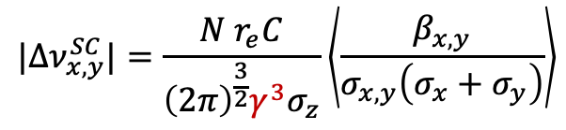
Space charge tune shift
6 GeV, 2.3 km, 20 pm
$$|Δν_{x,y}^{SC}|=\frac{N r_{e}C}{{\left(2π\right)}^{\frac{3}{2}}γ^{3}σ_{z}}\left\langle \frac{β_{x,y}}{σ_{x,y}\left(σ_{x}+σ_{y}\right)}\right\rangle$$
$$1/{10}^{12}$$
| Other Science Opportunities at the FCC-ee | Sergey Antipov, 28.11.2024
Notes:
4

Slide 5
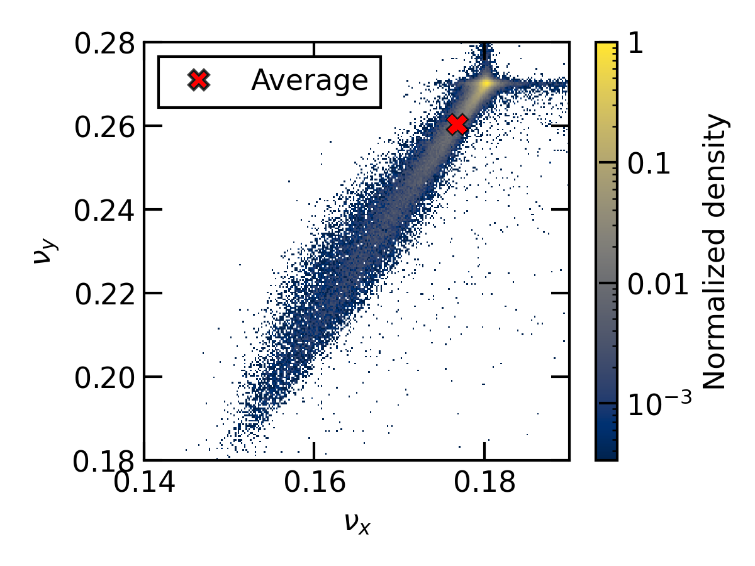
Space charge tune shift
6 GeV, 2.3 km, 20 pm
$$|Δν_{x,y}^{SC}|=\frac{N r_{e}C}{{\left(2π\right)}^{\frac{3}{2}}γ^{3}σ_{z}}\left\langle \frac{β_{x,y}}{σ_{x,y}\left(σ_{x}+σ_{y}\right)}\right\rangle$$
$$1/{10}^{12}$$
Tune footprint with SC. Simulation in XSuite.
10 nC bunch, 128 turns, long. wakes included,
single-harmonic RF system
arXiv:2409.08637
| Other Science Opportunities at the FCC-ee | Sergey Antipov, 28.11.2024
Notes:
5

Slide 6
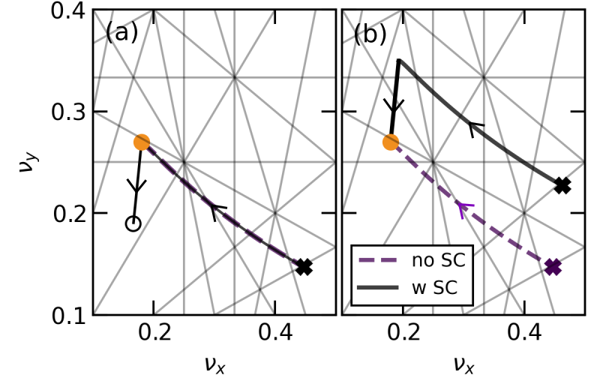
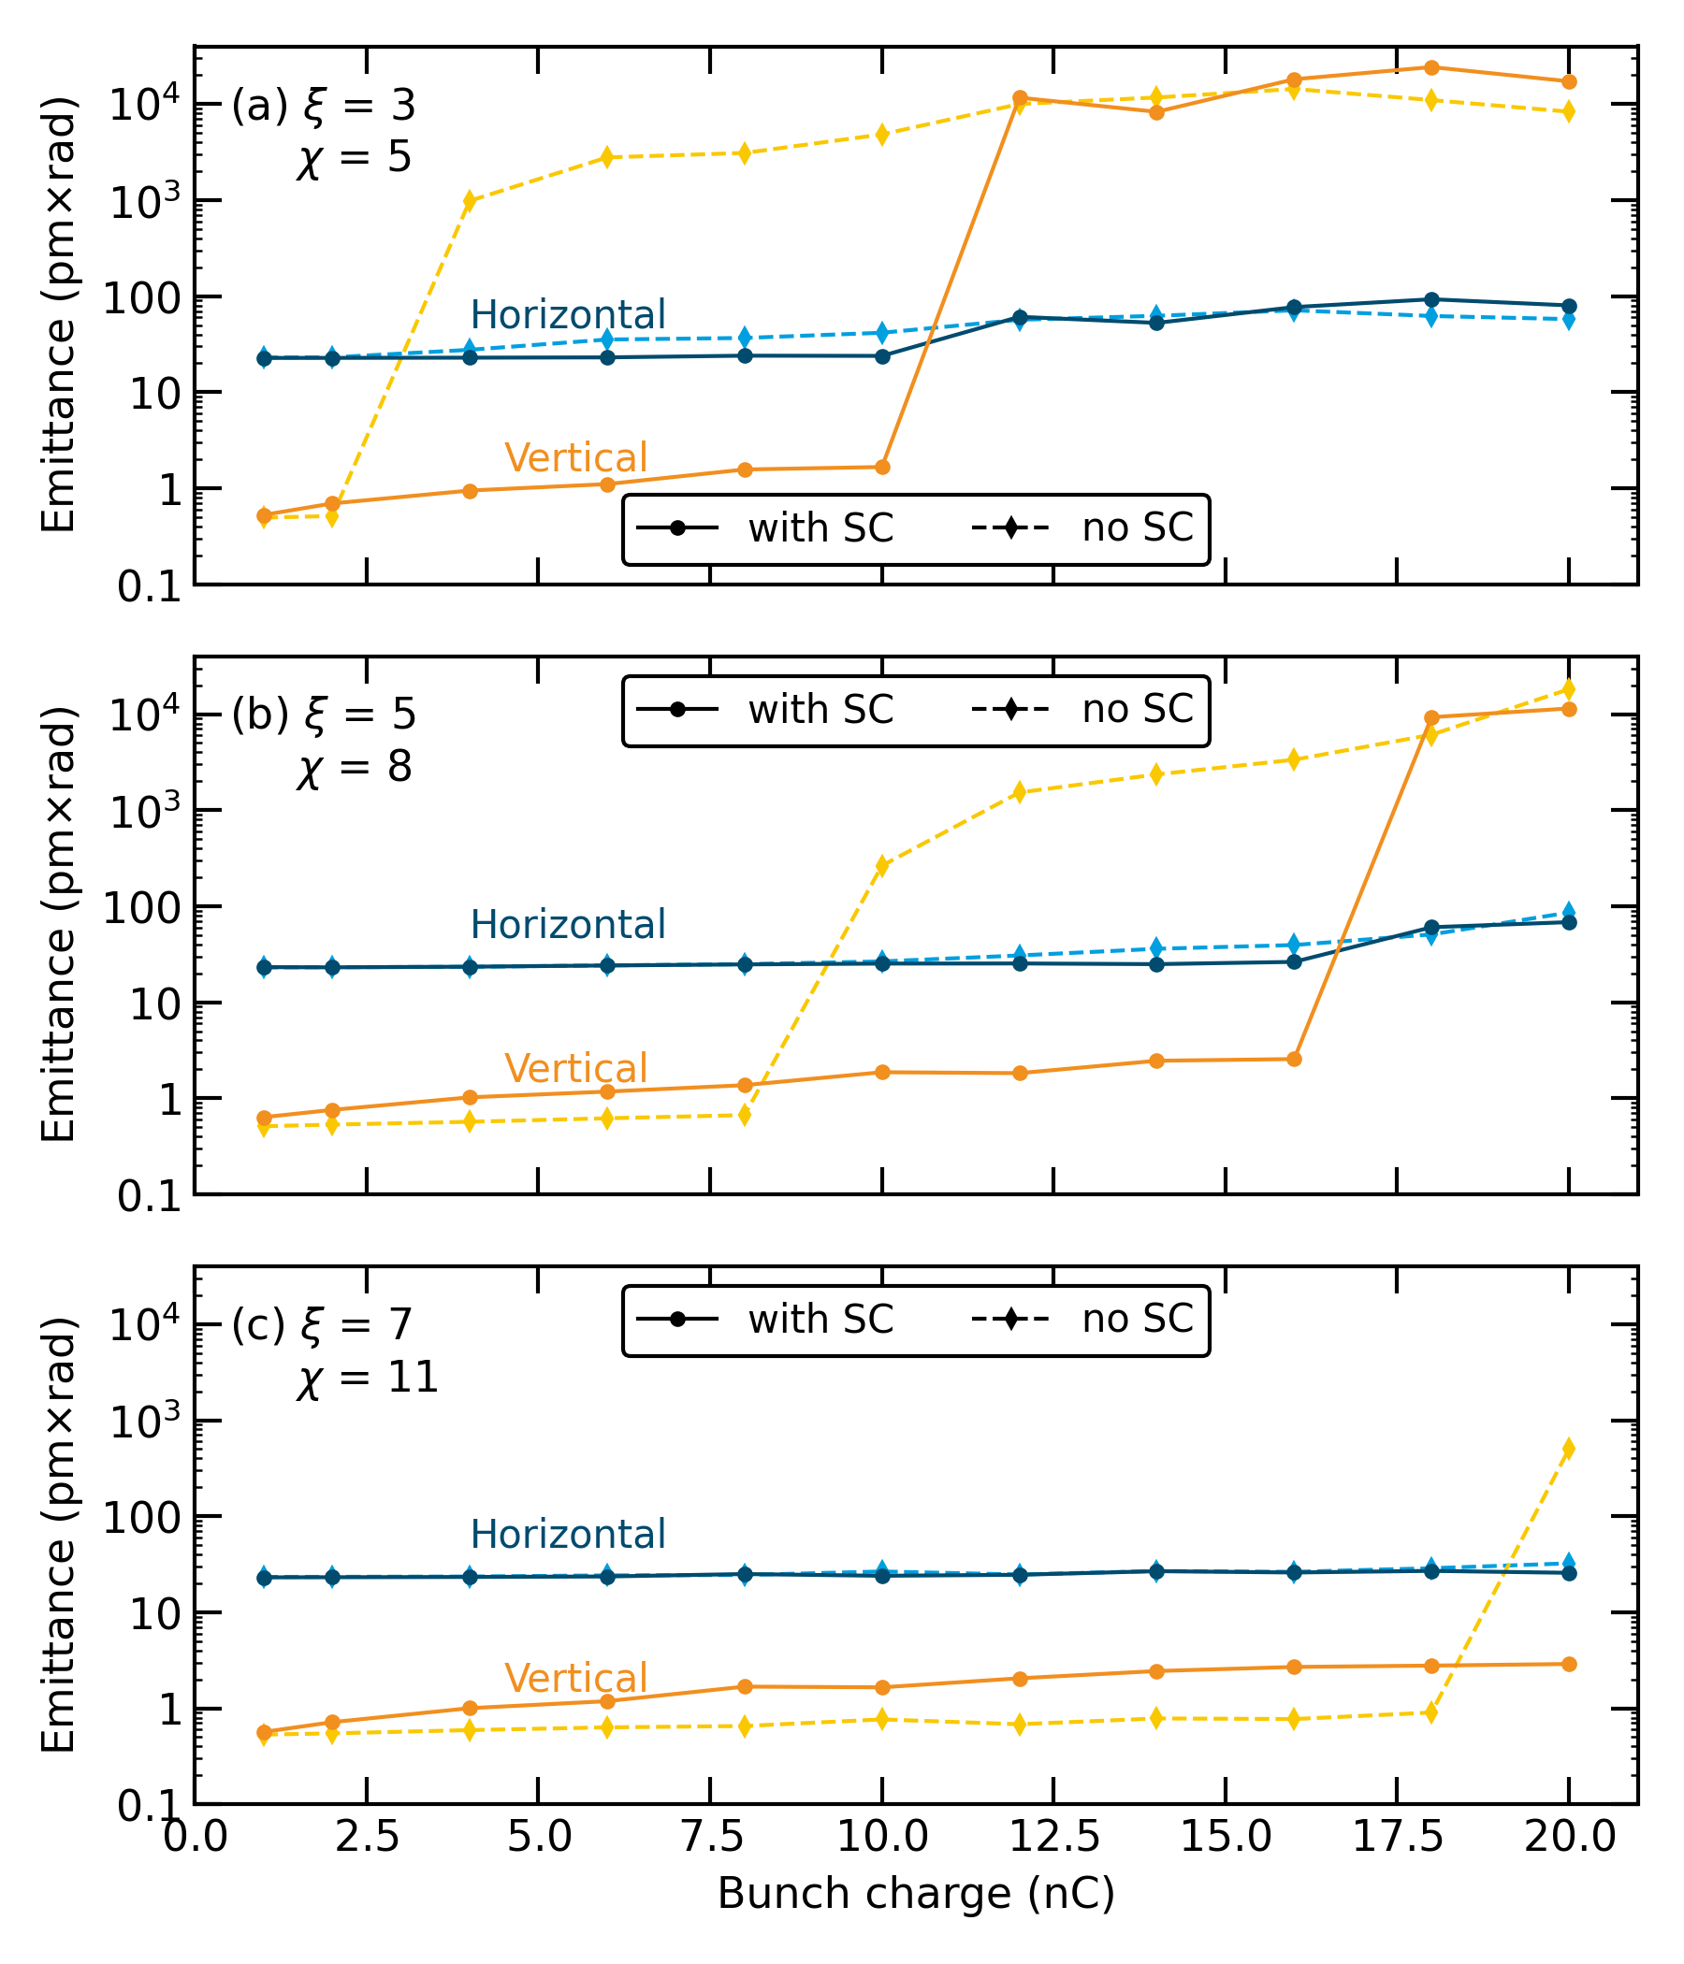
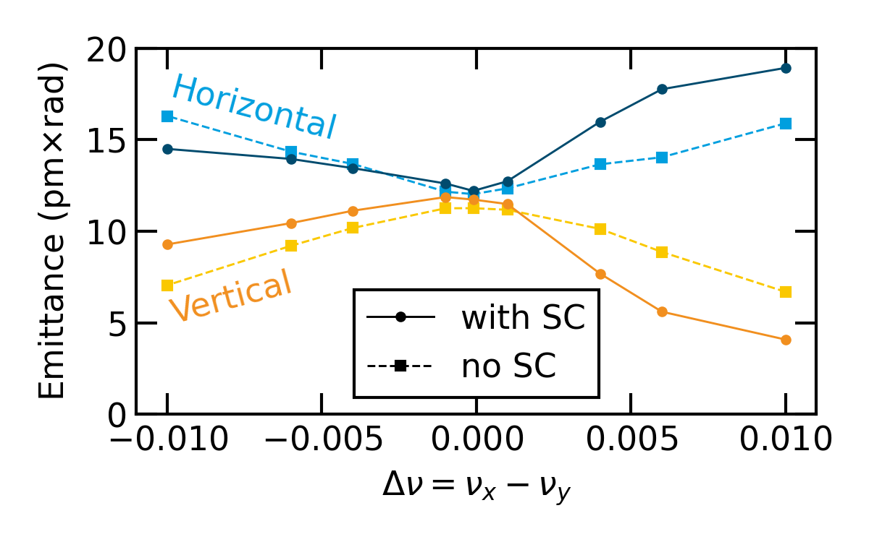
Space charge effects
Both coherent and incoherent
Dynamics of off-axis top-up injection
Emittance ratios at high coupling
Single-bunch intensity limit
arXiv:2409.08637
| Other Science Opportunities at the FCC-ee | Sergey Antipov, 28.11.2024
Notes:
6

Slide 7
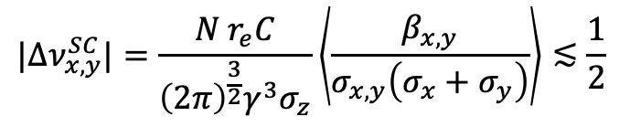
SC will ultimately lead to crossing of the integer resonance the problem
This shall limit the bunch intensity even if there is no beam coupling impedance
$$|Δν_{x,y}^{SC}|=\frac{N r_{e}C}{{\left(2π\right)}^{\frac{3}{2}}γ^{3}σ_{z}}\left\langle \frac{β_{x,y}}{σ_{x,y}\left(σ_{x}+σ_{y}\right)}\right\rangle ≲\frac{1}{2}$$
Key Assumptions:
Linear SC model
Integer resonance cannot be crossed
The largest tune shift is in the vertical plane
Dispersion contribution to beam size is small, on average
Coupling is sufficiently small
| Other Science Opportunities at the FCC-ee | Sergey Antipov, 28.11.2024
Notes:
7

Slide 8

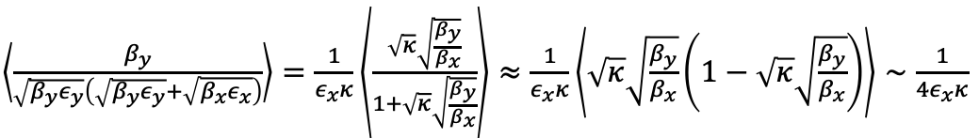
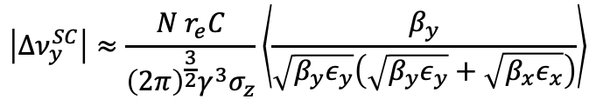
Approximate SC limit
Crossing of the integer resonance
Key Assumptions:
Linear SC model
Integer resonance cannot be crossed
Dispersion contribution to beam size is small, on average
Coupling is sufficiently small
$$|Δν_{x,y}^{SC}|=\frac{N r_{e}C}{{\left(2π\right)}^{\frac{3}{2}}γ^{3}σ_{z}}\left\langle \frac{β_{x,y}}{σ_{x,y}\left(σ_{x}+σ_{y}\right)}\right\rangle ≲\frac{1}{2}$$
$$\left|Δν_{y}^{SC}\right|≈\frac{N r_{e}C}{{\left(2π\right)}^{\frac{3}{2}}γ^{3}σ_{z}}\left\langle \frac{β_{y}}{\sqrt{β_{y}ε_{y}}\left(\sqrt{β_{y}ε_{y}}+\sqrt{β_{x}ε_{x}}\right)}\right\rangle$$
$\left\langle \frac{β_{y}}{\sqrt{β_{y}ε_{y}}\left(\sqrt{β_{y}ε_{y}}+\sqrt{β_{x}ε_{x}}\right)}\right\rangle =$ $\frac{1}{ε_{x}κ}\left\langle \frac{\sqrt{κ}\sqrt{\frac{β_{y}}{β_{x}}}}{1+\sqrt{κ}\sqrt{\frac{β_{y}}{β_{x}}}}\right\rangle ≈\frac{1}{ε_{x}κ}\left\langle \sqrt{κ}\sqrt{\frac{β_{y}}{β_{x}}}\left(1−\sqrt{κ}\sqrt{\frac{β_{y}}{β_{x}}}\right)\right\rangle ∼\frac{1}{{4ε}_{x}κ}$
*
$$κ=ε_{y}/ε_{x}$$
to be checked later
| Other Science Opportunities at the FCC-ee | Sergey Antipov, 28.11.2024
Notes:
8

Slide 9
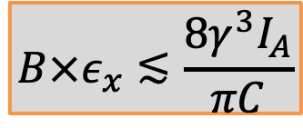
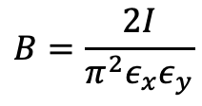
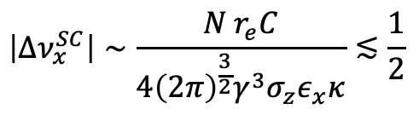
Approximate SC limit
Crossing of the integer resonance
$$|Δν_{x,y}^{SC}|=\frac{N r_{e}C}{{\left(2π\right)}^{\frac{3}{2}}γ^{3}σ_{z}}\left\langle \frac{β_{x,y}}{σ_{x,y}\left(σ_{x}+σ_{y}\right)}\right\rangle ≲\frac{1}{2}$$
$$\left|Δν_{x }^{SC}\right|∼\frac{N r_{e}C}{{4\left(2π\right)}^{\frac{3}{2}}γ^{3}σ_{z}ε_{x}κ}≲\frac{1}{2}$$
$$\left|Δν_{y}^{SC}\right|≈\frac{N r_{e}C}{{\left(2π\right)}^{\frac{3}{2}}γ^{3}σ_{z}}\left\langle \frac{β_{y}}{\sqrt{β_{y}ε_{y}}\left(\sqrt{β_{y}ε_{y}}+\sqrt{β_{x}ε_{x}}\right)}\right\rangle$$
$$B=\frac{2I}{π^{2}ε_{x}ε_{y}}$$
$\left\langle \frac{β_{y}}{\sqrt{β_{y}ε_{y}}\left(\sqrt{β_{y}ε_{y}}+\sqrt{β_{x}ε_{x}}\right)}\right\rangle =$ $\frac{1}{ε_{x}κ}\left\langle \frac{\sqrt{κ}\sqrt{\frac{β_{y}}{β_{x}}}}{1+\sqrt{κ}\sqrt{\frac{β_{y}}{β_{x}}}}\right\rangle ≈\frac{1}{ε_{x}κ}\left\langle \sqrt{κ}\sqrt{\frac{β_{y}}{β_{x}}}\left(1−\sqrt{κ}\sqrt{\frac{β_{y}}{β_{x}}}\right)\right\rangle ∼\frac{1}{{4ε}_{x}κ}$
$$κ=ε_{y}/ε_{x}$$
$$B×ε_{x}≲\frac{8γ^{3}I_{A}}{πC}$$
| Other Science Opportunities at the FCC-ee | Sergey Antipov, 28.11.2024
Notes:
9

Slide 10
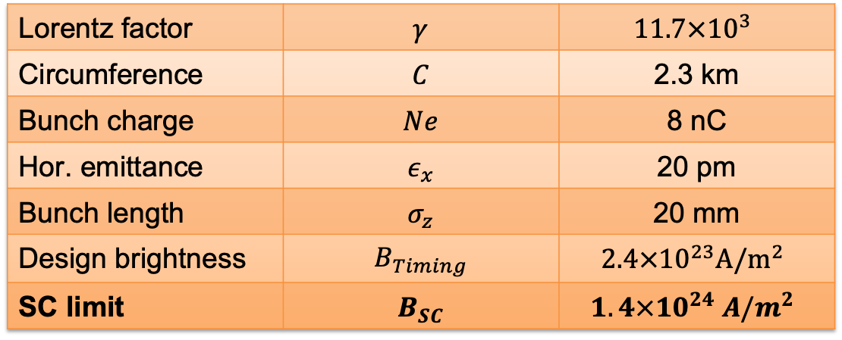
Approximate SC limit
Crossing of the integer resonance
$$|Δν_{x,y}^{SC}|=\frac{N r_{e}C}{{\left(2π\right)}^{\frac{3}{2}}γ^{3}σ_{z}}\left\langle \frac{β_{x,y}}{σ_{x,y}\left(σ_{x}+σ_{y}\right)}\right\rangle ≲\frac{1}{2}$$
Example: PETRA IV, high charge Timing mode
$$\left|Δν_{x }^{SC}\right|∼\frac{N r_{e}C}{{4\left(2π\right)}^{\frac{3}{2}}γ^{3}σ_{z}ε_{x}κ}≲\frac{1}{2}$$
Lorentz factor | $$γ$$ | $$11.7×10^{3}$$
Circumference | $$C$$ | 2.3 km
Bunch charge | $$Ne$$ | 8 nC
Hor. emittance | $$ε_{x}$$ | 20 pm
Bunch length | $$σ_{z}$$ | 20 mm
Design brightness | $$B_{Timing}$$ | $$2.4×{10}^{23}A/m^{2}$$
SC limit | $$B_{SC}$$ | $$1.4×{10}^{24} A/m^{2}$$
$$\left|Δν_{y}^{SC}\right|≈\frac{N r_{e}C}{{\left(2π\right)}^{\frac{3}{2}}γ^{3}σ_{z}}\left\langle \frac{β_{y}}{\sqrt{β_{y}ε_{y}}\left(\sqrt{β_{y}ε_{y}}+\sqrt{β_{x}ε_{x}}\right)}\right\rangle$$
$$B=\frac{2I}{π^{2}ε_{x}ε_{y}}$$
$\left\langle \frac{β_{y}}{\sqrt{β_{y}ε_{y}}\left(\sqrt{β_{y}ε_{y}}+\sqrt{β_{x}ε_{x}}\right)}\right\rangle =$ $\frac{1}{ε_{x}κ}\left\langle \frac{\sqrt{κ}\sqrt{\frac{β_{y}}{β_{x}}}}{1+\sqrt{κ}\sqrt{\frac{β_{y}}{β_{x}}}}\right\rangle ≈\frac{1}{ε_{x}κ}\left\langle \sqrt{κ}\sqrt{\frac{β_{y}}{β_{x}}}\left(1−\sqrt{κ}\sqrt{\frac{β_{y}}{β_{x}}}\right)\right\rangle ∼\frac{1}{{4ε}_{x}κ}$
$$κ=ε_{y}/ε_{x}$$
$$B×ε_{x}≲\frac{8γ^{3}I_{A}}{πC}$$
| Other Science Opportunities at the FCC-ee | Sergey Antipov, 28.11.2024
Notes:
10

Slide 11
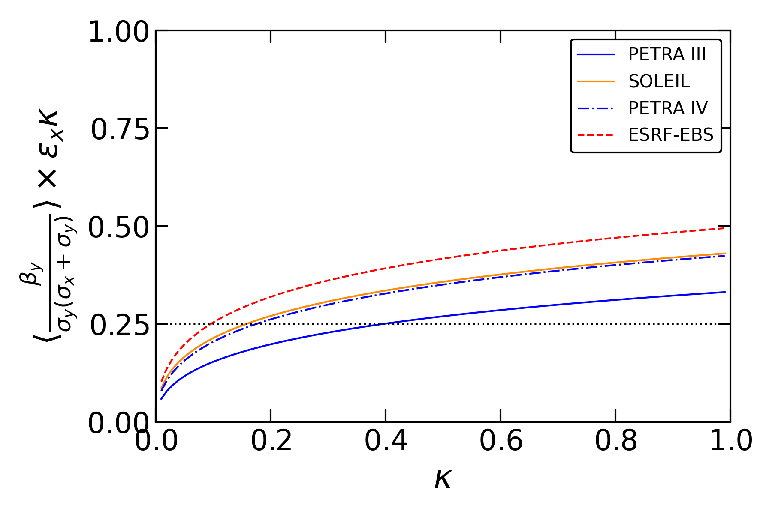
Approximation holds in a wide parameter range
Within a factor 2 for any conceivable coupling ratio, any machine
H7BA
DBA
H6BA
1/8 DBA + 7/8 FODO
| Other Science Opportunities at the FCC-ee | Sergey Antipov, 28.11.2024
Notes:
11

Slide 12
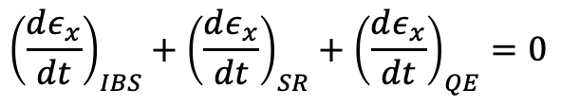
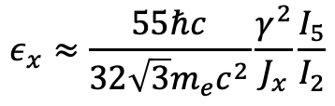
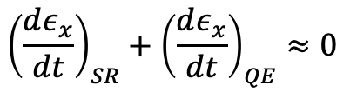
Horizontal emittance at high energy
Governed by a balance of synchrotron radiation and quantum excitation
$${\left(\frac{dε_{x}}{dt}\right)}_{IBS}+{\left(\frac{dε_{x}}{dt}\right)}_{SR}+{\left(\frac{dε_{x}}{dt}\right)}_{QE}=0$$
IBS is a small correction
$${\left(\frac{dε_{x}}{dt}\right)}_{SR}+{\left(\frac{dε_{x}}{dt}\right)}_{QE}≈0$$
$$ε_{x}≈\frac{55ℏc}{32\sqrt{3}m_{e}c^{2}}\frac{γ^{2}}{J_{x}}\frac{I_{5}}{I_{2}}$$
| Other Science Opportunities at the FCC-ee | Sergey Antipov, 28.11.2024
Notes:
12

Slide 13
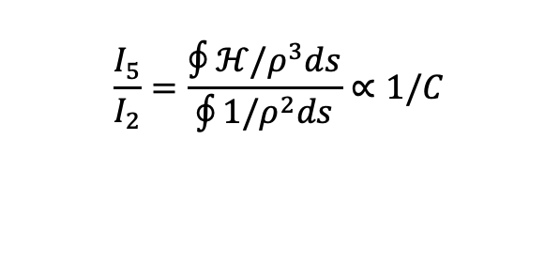
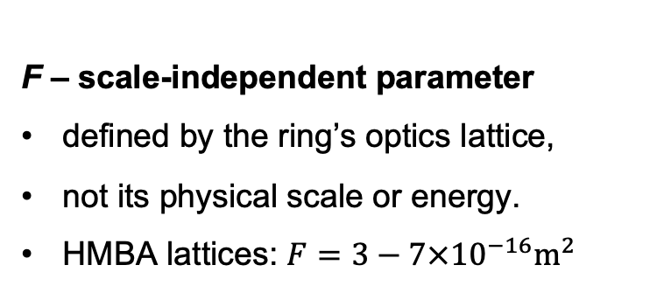

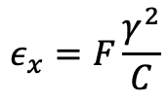
Horizontal emittance at high energy
Governed by a balance of synchrotron radiation and quantum excitation
$${\left(\frac{dε_{x}}{dt}\right)}_{IBS}+{\left(\frac{dε_{x}}{dt}\right)}_{SR}+{\left(\frac{dε_{x}}{dt}\right)}_{QE}=0$$
IBS is a small correction
$$J_{x}∈[1;2]$$
$$\frac{I_{5}}{I_{2}}=\frac{∮ℋ/ρ^{3}ds}{\oint{1/ρ^{2}ds}}∝1/C$$
$${\left(\frac{dε_{x}}{dt}\right)}_{SR}+{\left(\frac{dε_{x}}{dt}\right)}_{QE}≈0$$
$$ε_{x}≈\frac{55ℏc}{32\sqrt{3}m_{e}c^{2}}\frac{γ^{2}}{J_{x}}\frac{I_{5}}{I_{2}}$$
$$ε_{x}=F\frac{γ^{2}}{C}$$
F – scale-independent parameter
defined by the ring’s optics lattice,
not its physical scale or energy.
HMBA lattices: $F=3−7×{10}^{−16}m^{2}$
| Other Science Opportunities at the FCC-ee | Sergey Antipov, 28.11.2024
Notes:
13

Slide 14

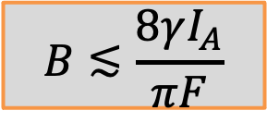
Horizontal emittance at high energy
Governed by a balance of synchrotron radiation and quantum excitation
$${\left(\frac{dε_{x}}{dt}\right)}_{IBS}+{\left(\frac{dε_{x}}{dt}\right)}_{SR}+{\left(\frac{dε_{x}}{dt}\right)}_{QE}=0$$
IBS is a small correction
$$J_{x}∈[1;2]$$
$$\frac{I_{5}}{I_{2}}=\frac{∮ℋ/ρ^{3}ds}{\oint{1/ρ^{2}ds}}∝1/C$$
$${\left(\frac{dε_{x}}{dt}\right)}_{SR}+{\left(\frac{dε_{x}}{dt}\right)}_{QE}≈0$$
$$ε_{x}≈\frac{55ℏc}{32\sqrt{3}m_{e}c^{2}}\frac{γ^{2}}{J_{x}}\frac{I_{5}}{I_{2}}$$
$$ε_{x}=F\frac{γ^{2}}{C}$$
F – scale-independent parameter
defined by the ring’s optics lattice,
not its physical scale or energy.
HMBA lattices: $F=3−7×{10}^{−16}m^{2}$
$$B×ε_{x}≲\frac{8γ^{3}I_{A}}{πC}$$
$$B≲\frac{8γI_{A}}{πF}$$
A 20 GeV-range machine should have a higher brightness limit compared to most 4th generation light sources
| Other Science Opportunities at the FCC-ee | Sergey Antipov, 28.11.2024
Notes:
14

Slide 15
Space charge imposes a limit on achievable beam brightness
The way to push further is to aim at higher energies
Space charge can no longer be ignored in state-of-the art light sources
Emittance reaches the point where it becomes strong enough
Generates incoherent tune shift and spread affecting beam dynamics
There is a limit on achievable beam brightness
Due to crossing of the integer resonance
Consequently, the photon brilliance is limited
The SC limit increases with energy as the interaction weakens
Potentially, higher photon brilliance at higher beam energies
| Other Science Opportunities at the FCC-ee | Sergey Antipov, 28.11.2024

Slide 16
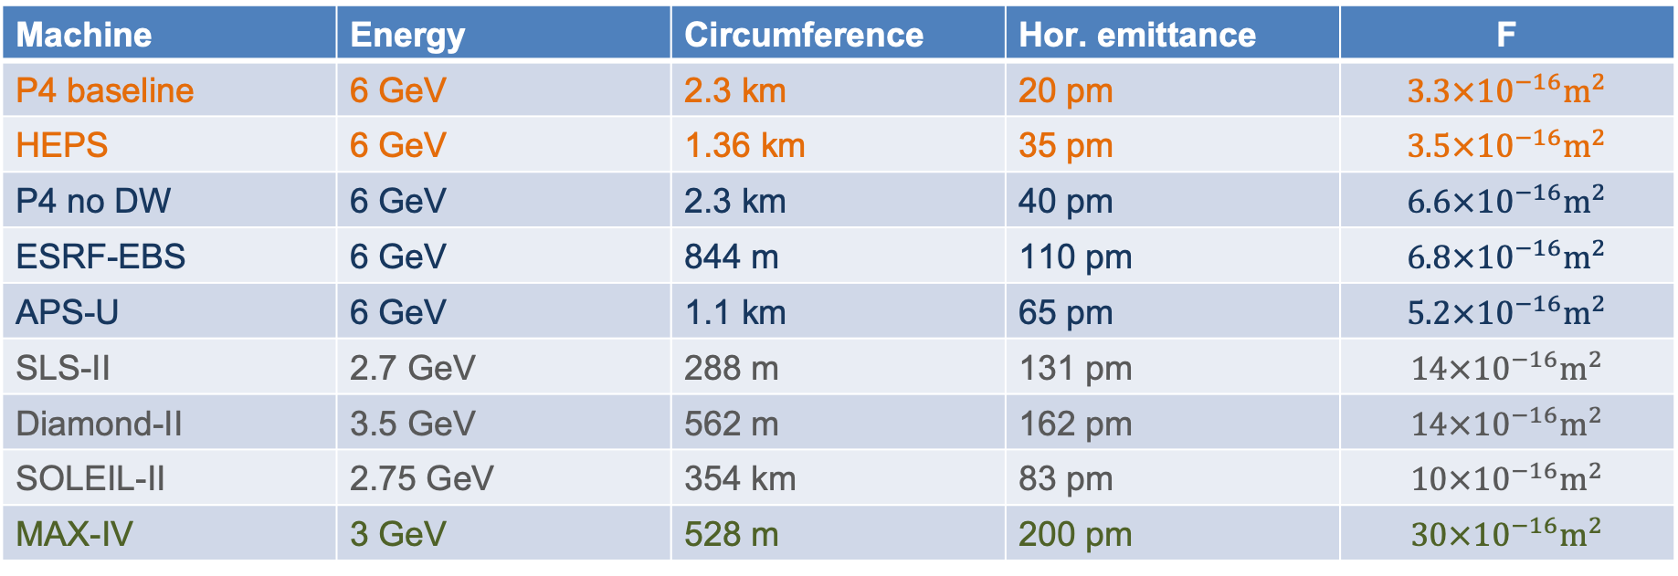
Extras: emittance scaling factor for different machines
Many state-of-the art HMBA machines have similar performance despite different scales
Machine | Energy | Circumference | Hor. emittance | F
P4 baseline | 6 GeV | 2.3 km | 20 pm | $$3.3×{10}^{−16}m^{2}$$
HEPS | 6 GeV | 1.36 km | 35 pm | $$3.5×{10}^{−16}m^{2}$$
P4 no DW | 6 GeV | 2.3 km | 40 pm | $$6.6×{10}^{−16}m^{2}$$
ESRF-EBS | 6 GeV | 844 m | 110 pm | $$6.8×{10}^{−16}m^{2}$$
APS-U | 6 GeV | 1.1 km | 65 pm | $$5.2×{10}^{−16}m^{2}$$
SLS-II | 2.7 GeV | 288 m | 131 pm | $$14×{10}^{−16}m^{2}$$
Diamond-II | 3.5 GeV | 562 m | 162 pm | $$14×{10}^{−16}m^{2}$$
SOLEIL-II | 2.75 GeV | 354 km | 83 pm | $$10×{10}^{−16}m^{2}$$
MAX-IV | 3 GeV | 528 m | 200 pm | $$30×{10}^{−16}m^{2}$$
FCC-ee Booster* 20 GeV (inj.) 90.7 km 15 pm $∼10×{10}^{−16}m^{2}$
| Other Science Opportunities at the FCC-ee | Sergey Antipov, 28.11.2024
Notes:
16

Slide 17
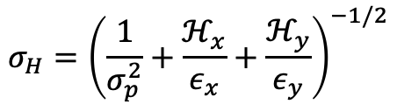


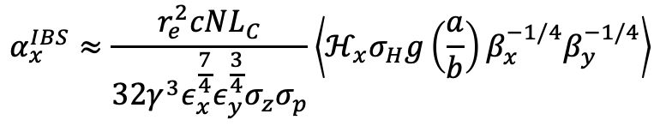
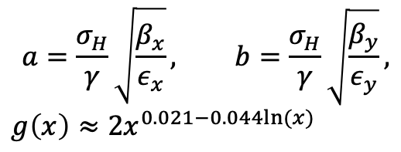
Extras: Intra-beam scattering
A small correction at high energy
Bjorken-Mtingwa model:
SR damping rate:
$$α_{x}^{SR}=γ^{3}\frac{r_{e}cI_{2}}{3C}$$
Equilibrium emittance:
$$ε_{x}=\frac{ε_{x,0}}{1−α_{x}^{IBS}/α_{x}^{SR}}$$
$$σ_{H}={\left(\frac{1}{σ_{p}^{2}}+\frac{ℋ_{x}}{ε_{x}}+\frac{ℋ_{y}}{ε_{y}}\right)}^{−1/2}$$
$$a=\frac{σ_{H}}{γ}\sqrt{\frac{β_{x}}{ε_{x}}}, b=\frac{σ_{H}}{γ}\sqrt{\frac{β_{y}}{ε_{y}}},$$
$$g\left(x\right)≈2x^{0.021−0.044ln⁡(x)}$$
$$α_{x}^{IBS}≈\frac{r_{e}^{2}cNL_{C}}{32γ^{3}ε_{x}^{\frac{7}{4}}ε_{y}^{\frac{3}{4}}σ_{z}σ_{p}}\left\langle ℋ_{x}σ_{H}g\left(\frac{a}{b}\right)β_{x}^{−1/4}β_{y}^{−1/4}\right\rangle$$
$$σ_{z}σ_{p}∝U_{0}^{1/4}∝γ$$
See K. Bane, SLAC-AP-141
and R. Bartolini, IPAC’22
| Other Science Opportunities at the FCC-ee | Sergey Antipov, 28.11.2024
Notes:
17

