Slide 1






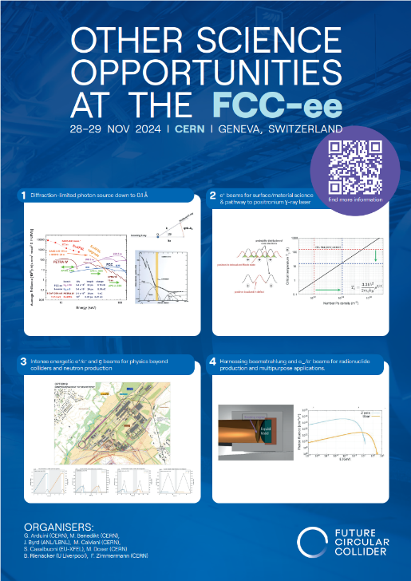

Low-energy dense positron beams
Other Science Opportunities at the FCC-ee
Benjamin Rienäcker | Research Associate | University of Liverpool / QUASAR Group

Slide 2
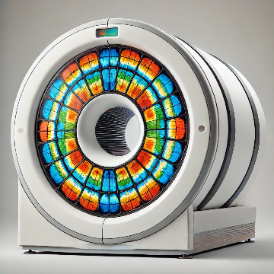
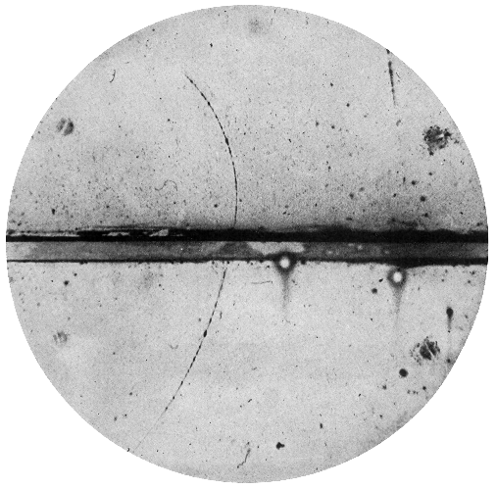
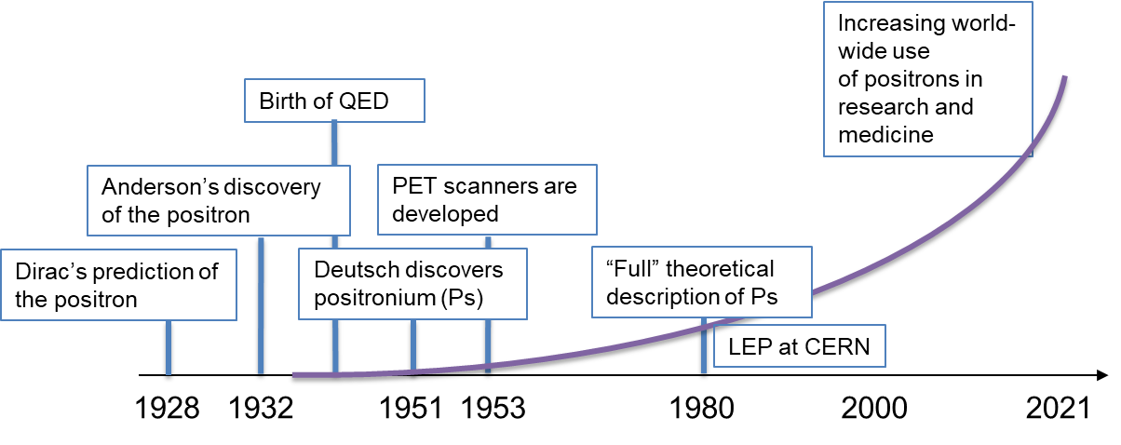
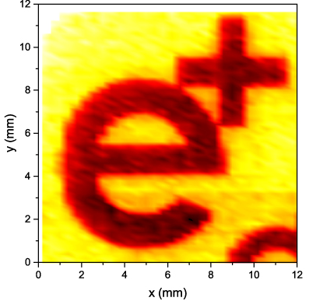
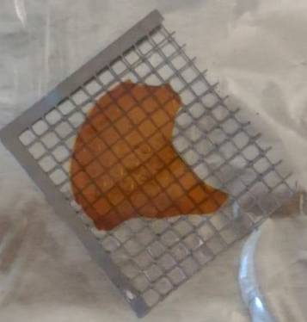
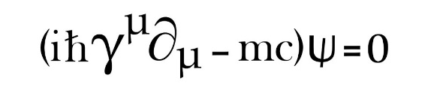
A century worth of positrons ...
2024

Slide 3
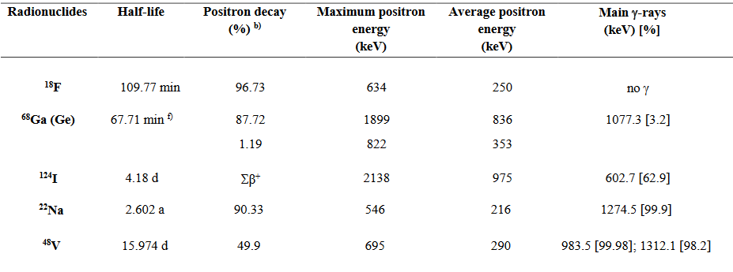
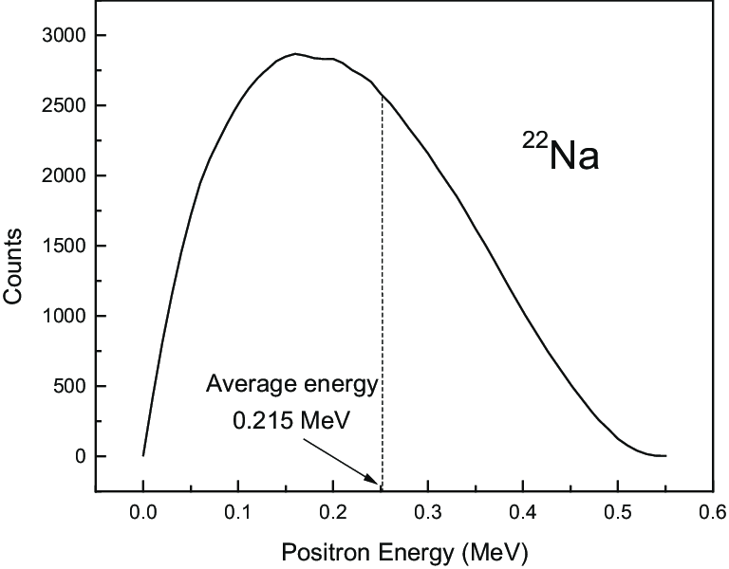


1/3 – Radionuclide sources
Positron Emission
Tomography (PET)
Tool in research
²²Na (halflife 2.6 years):
Most common laboratory positron source.
Single supplier world-wide for intense sources (50mCi)
4-pi source with
Moderated beam:
${2∙10}^{9}$ e⁺/s at @ 0-546keV
${3∙10}^{6}$ e⁺/s at @ 6eV

Slide 4
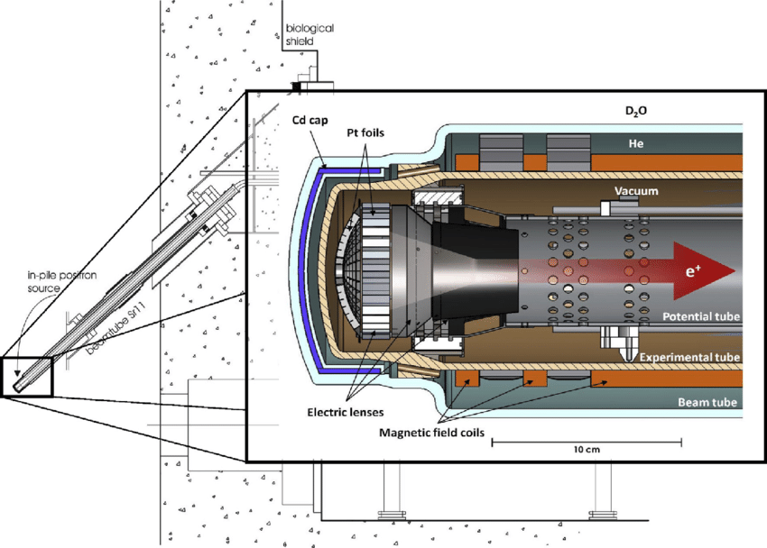
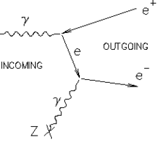



2/3 – Reactor sources
Example: Neutron induced positron source Munich (NEPOMUC), Germany
Research reactor
FRM-II, Garching
Other reactor-based positron sources:
ILL (Institut Laue-Langevin) in France
KUR (Kyoto University Research Reactor) in Japan
POSH (Delft University of Technology) in the Netherlands
PULSTAR (NC State University) in the USA
$${}_{}^{113}{\text{Cd}} +\text{n}→ {}_{}^{114}{\text{Cd}}+γ(\text{9 }\text{MeV})$$
${3∙10}^{9}$ e⁺/s at @ E_{L} = 1keV
${5∙10}^{7}$ e⁺/s at @ E_{L} = 20eV
Pt

Slide 5
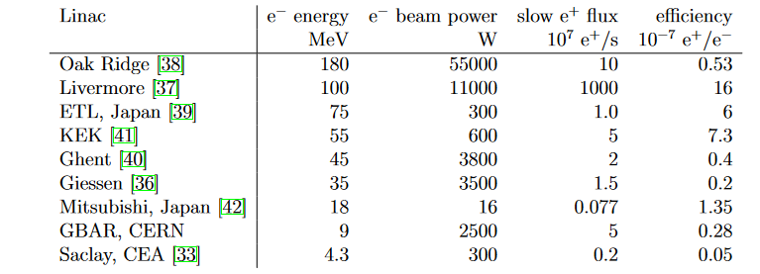
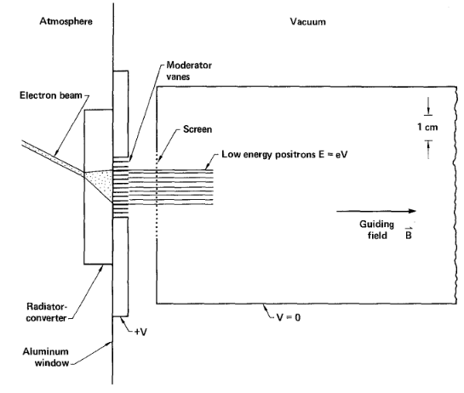

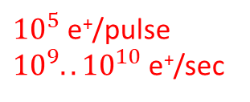

3/3 – Accelerator sources
$$⋮$$
10-100kHz repetition rate
moderated
Tungsten wired: $ε= {<10}^{−3}$
${10}^{5}$ e⁺/pulse
${10}^{9}..{10}^{10}$e⁺/sec
at @ E_{L} = 0.05-20keV
Appl. Phys. A 43, 247-255 (1987)

Slide 6
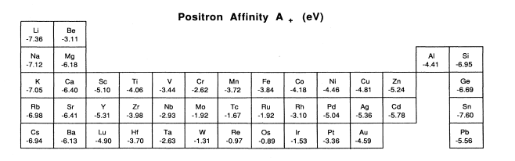
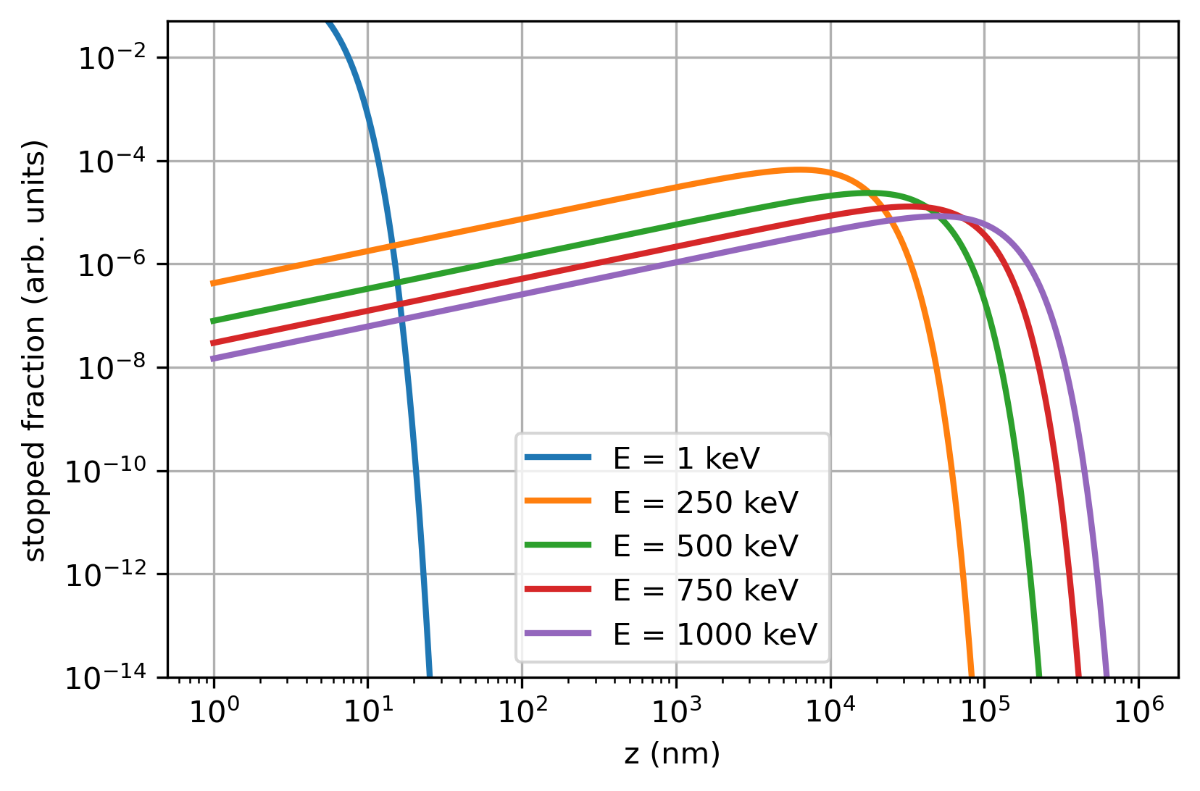
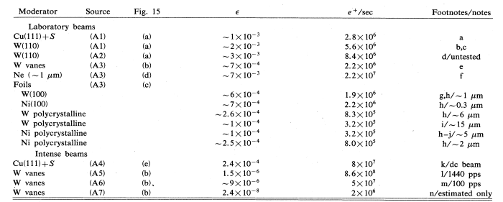
Positron moderators
Positron implantation profile on W
(Makhov profile)
1mm
+ some newer materials like 4H/6H-SiC ...
Schultz and Lynn, 1988

Slide 7
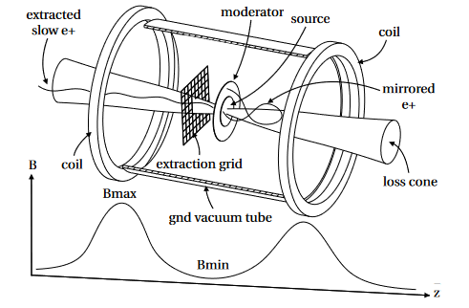


Combination positron sources
Proton Synchrotron (8-12 MeV)
$${}_{}^{48}{\text{Ti}} +\text{p}→ {}_{}^{48}{\text{V}}+n$$
W moderator + magnetic bottle
${4∙10}^{3}$ e⁺/s at @ E_{L} = 100eV
L. Gerchow et al., Instruments 2018, 2, 10
DOI: 10.3390/instruments2030010

Slide 8





Low energy positrons in experiments
e⁺ with
MeV energy
e⁺ with
eV energy
Isotope sources ($β^{+}$- decay)
Moderator
Continuous slow e⁺ beam
Pair production with:
Nuclear reactor-based sources
Accelerator-based sources
$$ε≈{{10}^{−3}..10}^{−2}$$
Decelerator?
Applications of slow positrons
Bulk defect studies
Surface and dislocation probing
Electronic structures
Trapping, cooling, remoderation, bunching
e⁺ beam
$$ε≈{ 10}^{−1}…{ 10}^{−?}$$
$$ε≈{ 10}^{−1}$$
Conversion into positronium (Ps)
Experiments with slow Ps
Precision tests of QED
Fundamental symm. (CPT, WEP)
BEC with Ps
Porosimetry
$$ε≈{ 10}^{−1}$$

Slide 9
Physics with slow positrons
Low energy positron/positronium physics at one glance:
Bose-Einstein condensates (BEC) with positronium
Fundamental symmetry tests (annihilation channels)
Precision QED studies (Ps spectroscopy)
Material studies (defect studies)

Slide 10
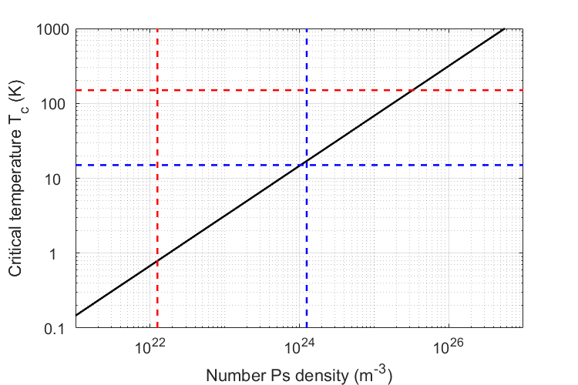
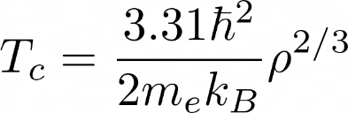
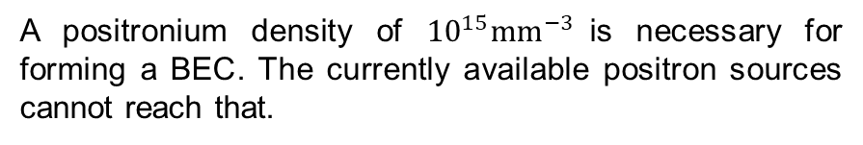
1/3 Towards Bose-Einstein condensates
Efforts towards the first Bose-Einstein condensation of Ps
Nanoporous silicon targets are able to produce Ps at temperatures of 150K and below.
PRL 104 (2010) 243401
Laser cooling precooled positronium atoms could reduce the temperature by 200K, i.e. down to <10K
PRL 132 (2024) 083402
A positronium density of ${10}^{15}{\text{mm}}^{−3}$is necessary for forming a BEC. The currently available positron sources cannot reach that.
When a Ps-BEC annihilates, a coherent burst of gamma rays is emitted.
A proposed way to build a 511 keV gamma ray laser!

Slide 11
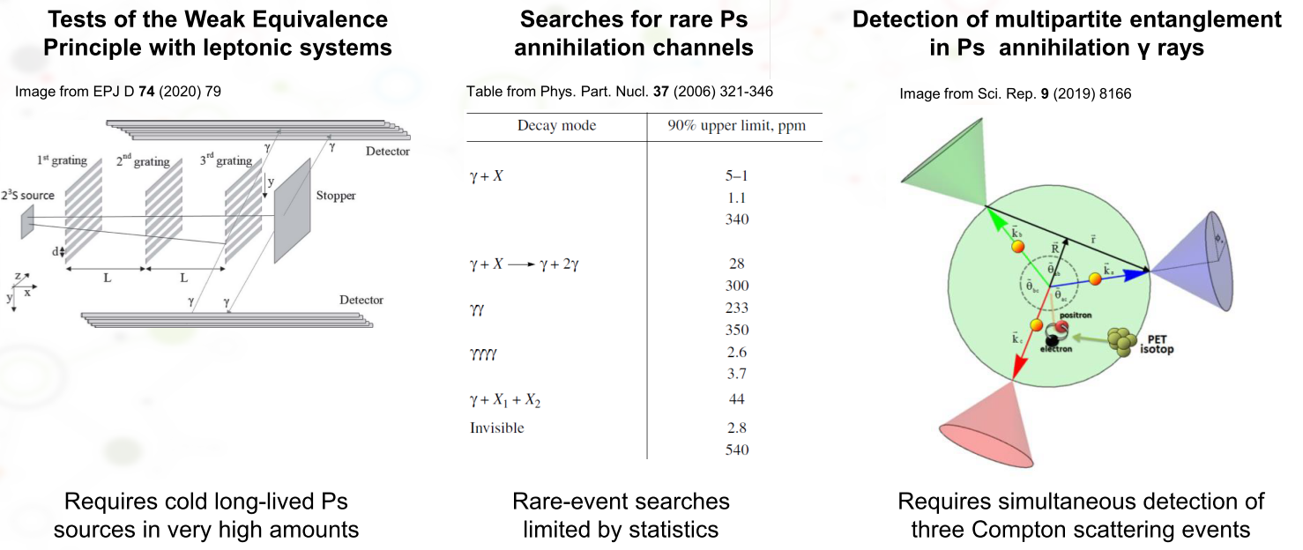
2/3 Fundamental symmetries
Tests of fundamental symmetries and BSM searches

Slide 12
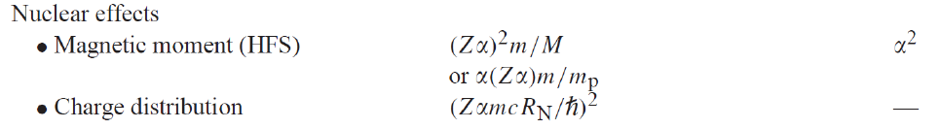
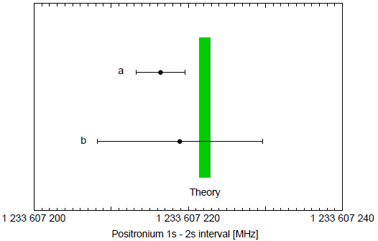
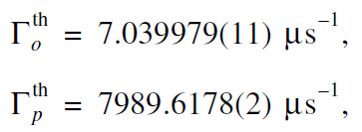

3/3 Precision QED tests
New precision QED measurements with colder Ps sources
Ps is an ideal system to test bound state
QED due to the absence of nuclear effects
Searches for BSM physics in:
energy intervals
decay rates
decay modes
1³S-2³S transition frequency
Decay times
Phys. Rep. 422 (2020) 1-63
?
Fifth fundamental force
Axion-like particles
Symmetry violations
Phys. Part. Nucl. 37 (2006) 321-346
Limited by second order Doppler effect, requires colder Ps sources

Slide 13

Take home message
Material Science: non-destructive nanoprobes
=> possibly beam time for global partners in industry and academia?
Positrons
Next generation Ps sources with
high intensity,
low energy and
higher density
Better measurement efficiency (results/time)
Higher data quality (less systematics)
A new intense low-energy e+ beam at
Unlocking exciting new possibilities (e.g. Ps-BEC, precision QED, BSM )
THANK YOU

