Slide 1
BEAMSTRAHLUNG RADIATION PROPERTIES
Other Science Opportunities at the FCC-ee
29/11/2024
Alessandro Frasca, Giuseppe Lerner, Anton Lechner, Marco Calviani, Antonio Perillo Marcone,
Rui Franqueira Ximenes, Silvio Candido, Andrea Ciarma

Slide 2
What is beamstrahlung radiation?
29/11/2024 | Other Science Opportunities at the FCC-ee
Alessandro Frasca | Beamstrahlung radiation properties
BEAMSTRAHLUNG RADIATION
at the IP of particle colliders
particle trajectories bent by the EM of the opposing bunch
γ
γ
emission of synchrotron radiation→beamstrahlung radiation
e⁺ BUNCH
e⁻
same is true for the other beam
IP
e⁻ beam
e⁺ beam

Slide 3
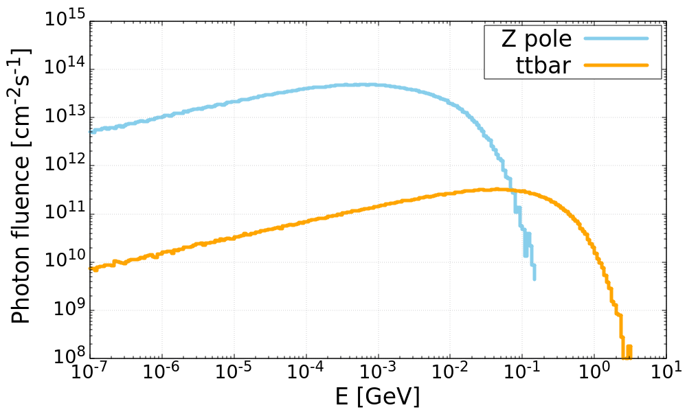
Why beamstrahlung at FCC-ee?
29/11/2024 | Other Science Opportunities at the FCC-ee
Alessandro Frasca | Beamstrahlung radiation properties
5
6
r_{e}²γN_{e}
ασ_{z}(σ_{x}+σ_{y})
ϒ _{avg}=
at FCC-ee ϒ<<1:
<E_{γ}> ~ E x 0.462ϒ
α²σ_{z}
r_{e}γ
1
[1+ϒ^{2/3}]^{1/2}
<n_{γ}> ~ 2.54 ϒ
A. Ciarma et al., “Machine Induced Backgrounds in the FCC-ee MDI Region and Beamstrahlung Radiation”, JACoW eeFACT2022 (2023)
Photon distributions from GuineaPig++,
courtesy of A. Ciarma
v22 | Z pole | ttbar
beam energy [GeV] | 45.6 | 182.5
# bunches/beam | 10000 | 36
bunch population [10¹¹] | 2.43 | 2.64
horizontal rms IP spot size [um] | 8 | 21
vertical rms IP spot size [nm] | 34 | 66
 | Z pole | ttbar
total power per beam [kW] | 370 | 77
mean photon energy [MeV] | 1.7 | 62.3
extremely intense beamstrahlung radiation!

Slide 4
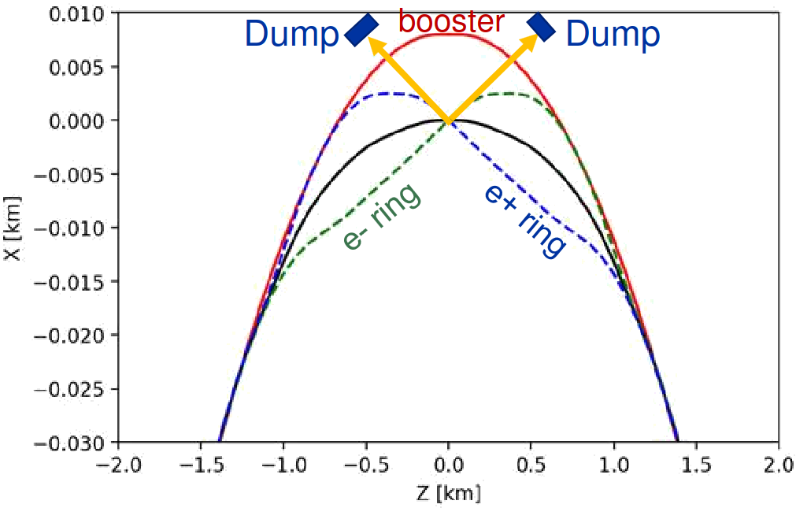
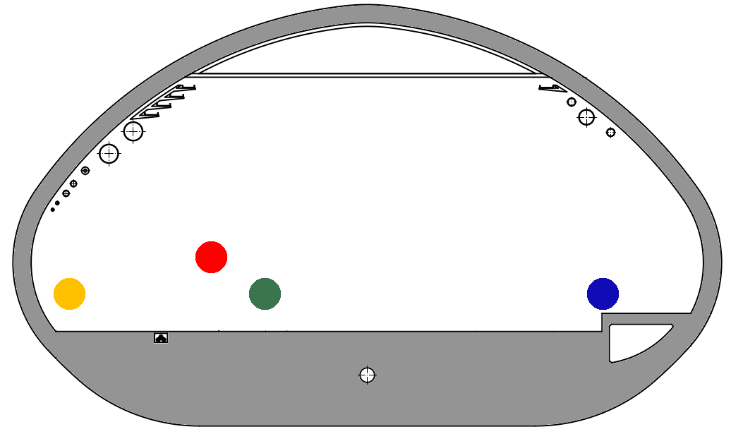
Beamstrahlung dumps
29/11/2024 | Other Science Opportunities at the FCC-ee
Alessandro Frasca | Beamstrahlung radiation properties
Two dedicated external dumps per IP
core to dispose of this power
  must withstand high power densities and temperatures
shielding to contain the radiation showers
located 500 m downstream
  largest separation from booster and collider rings
  far from the IP
  larger photon beam spot size
500 m long extraction line to integrate
3.9 m
5.4 m
9.3 m

Slide 5
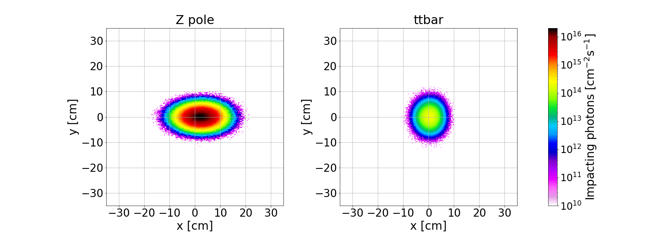
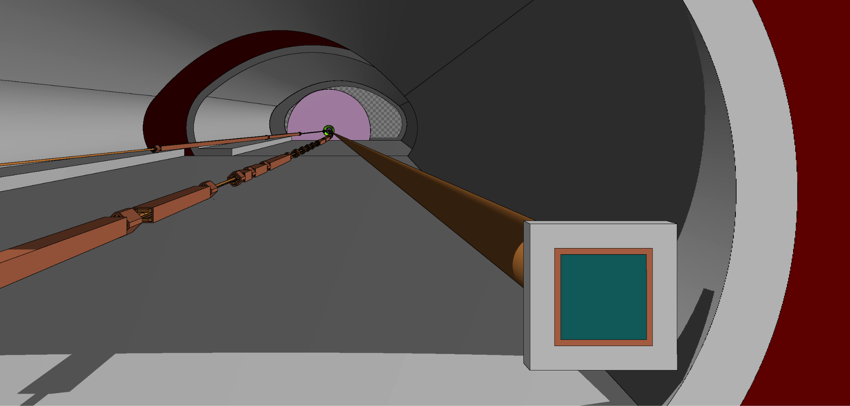
FLUKA model for beamstrahlung dump studies
29/11/2024 | Other Science Opportunities at the FCC-ee
Alessandro Frasca | Beamstrahlung radiation properties
guide the thermomechanical design of the dump
full tunnel geometry with beamlines and soil around
dump with 70 cm ⌀ to contain 8σ_{x} at Z pole
tested two dummy dump models
  3-m long graphite
  20-cm long liquid lead
μ_{x} = 2.270 cm σ_{x} = 4.589 cm
μ_{y} = 0.004 cm σ_{y} = 2.458 cm
Z pole
FLUKA geometry
IP
☆
μ_{x} = 0.473 cm σ_{x} = 2.229 cm
μ_{y} = 0.000 cm σ_{y} = 2.515 cm
DUMP
ttbar

Slide 6
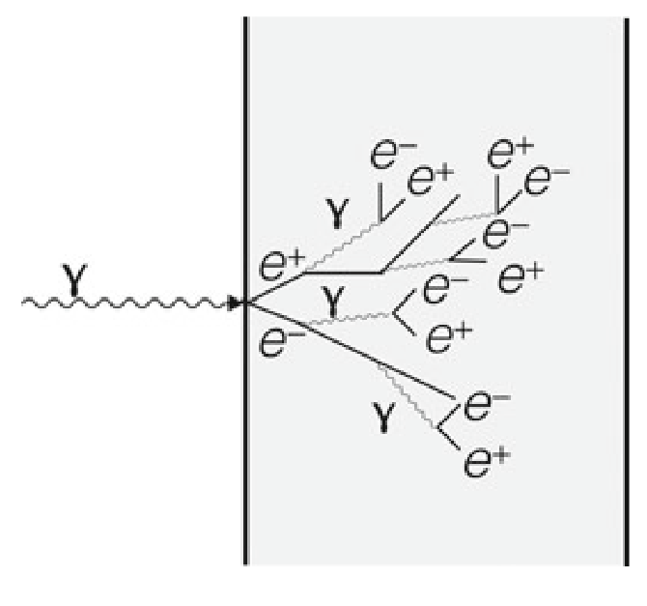
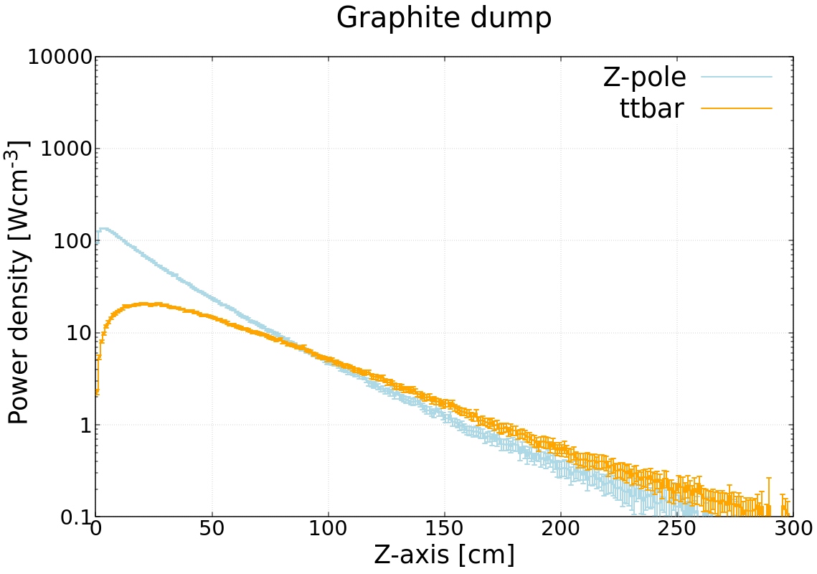
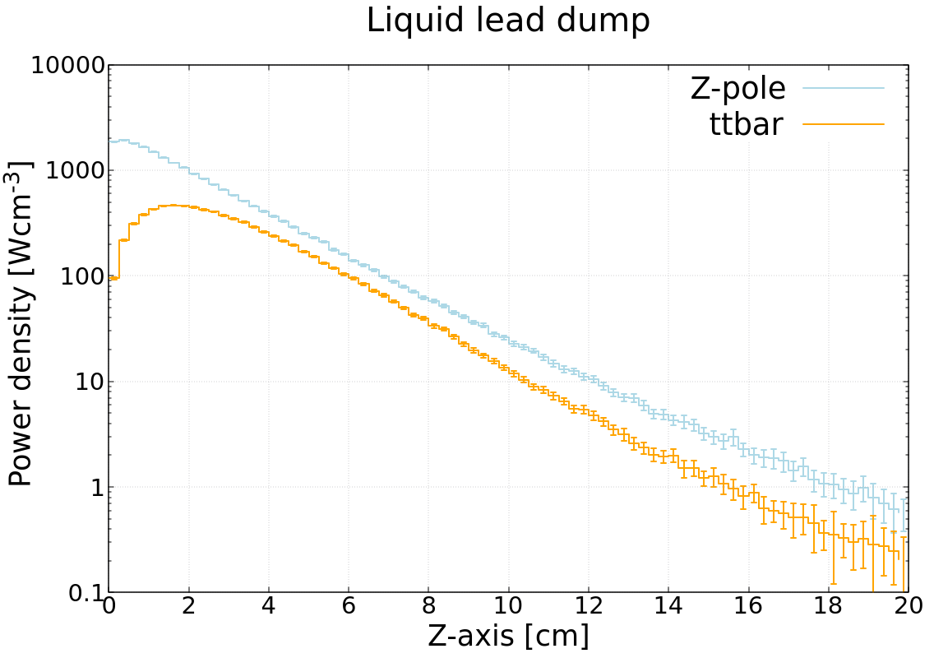
Peak power deposition inside the dump
29/11/2024 | Other Science Opportunities at the FCC-ee
Alessandro Frasca | Beamstrahlung radiation properties
Photons interacting in the dump
generate EM showers
induce photonuclear reactions
DUMP
Power absorbed in dummy models
98% at Z pole
99% at ttbar
BS
1920 W/cm³
466 W/cm³
136 W/cm³
20.6 W/cm³

Slide 7
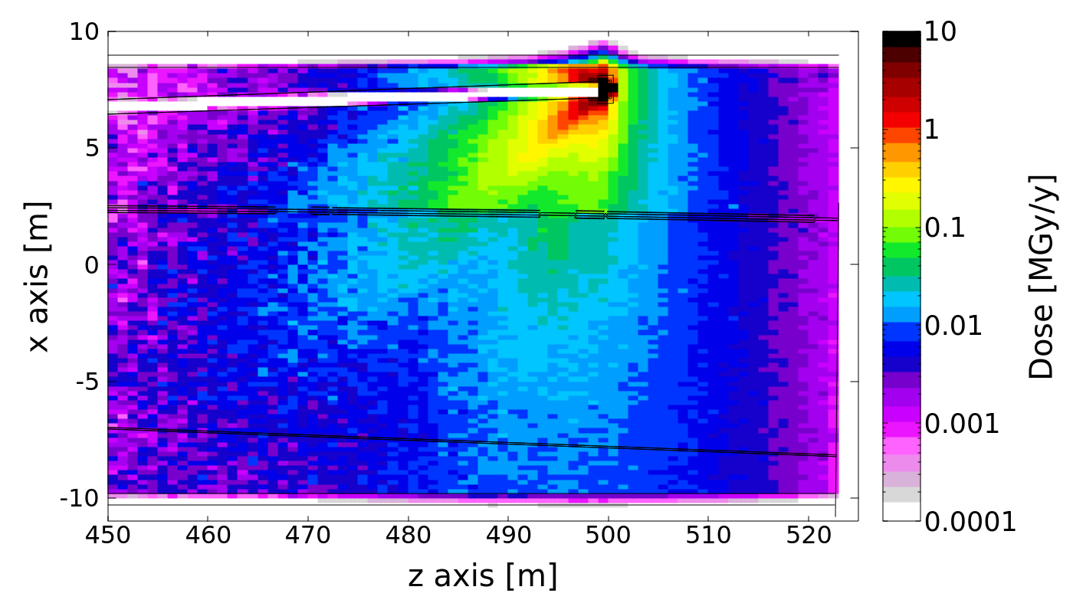
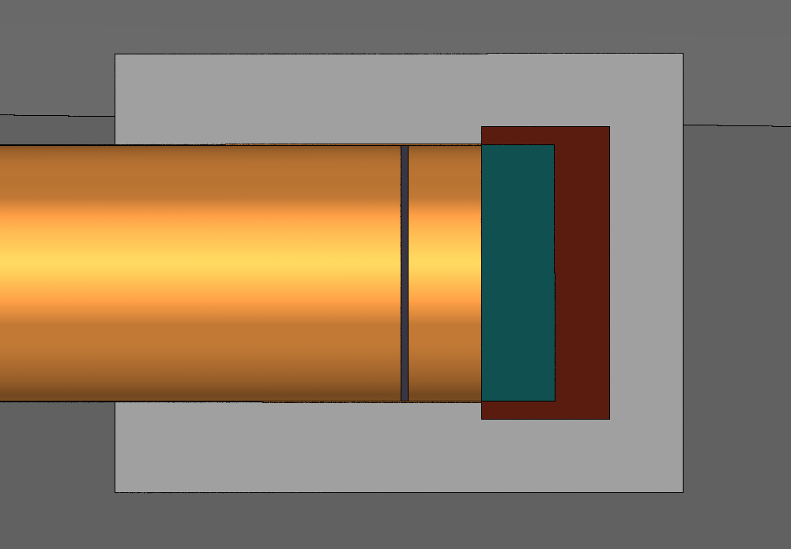
Radiation environment
29/11/2024 | Other Science Opportunities at the FCC-ee
Alessandro Frasca | Beamstrahlung radiation properties
Radiation environment dominated by EM showers with the additional contribution of MeV-scale neutrons from photonuclear reactions
proper shielding and experiment positioning to isolate neutron field
dumps must be shielded
  limit radiation-induced effects to other equipment
  limit activation in the surroundings to protect personnel
Annual dose at Z pole
conceptual two-layer shielding
  5-cm thick iron
  20-cm thick concrete
BS photons
LEAD
20 cm
RP requirements need a much thicker shielding ~1m of concrete
A. Frasca et al., “Energy deposition and radiation level studies for the FCC-ee experimental insertions”, IPAC’24

Slide 8
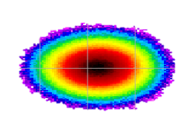
Implementation of a liquid Pb system
29/11/2024 | Other Science Opportunities at the FCC-ee
Alessandro Frasca | Beamstrahlung radiation properties
Pure Pb ‘slide flow’ system under design
thermomechanical studies showed graphite limitations
better heat dissipation
required dimensions with reasonable mass flow rate
design accompanied by FLUKA studies
In between windows protected area from high temperature and UHV
Shielding
potential experiment placement
Liquid Pb
0.7 m
Ar (cover gas)
Photon beam
Ar
Vacuum
0.7 m
>0.2 m
5 m
2 windows (graphitic material)
Lead System
Courtesy of R. Franqueira XImenes

Slide 9
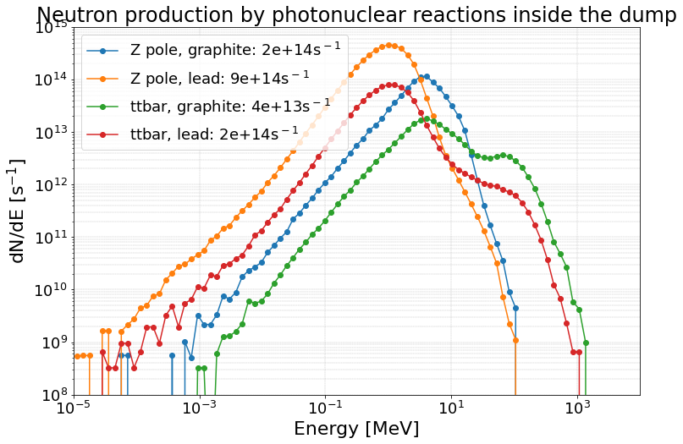
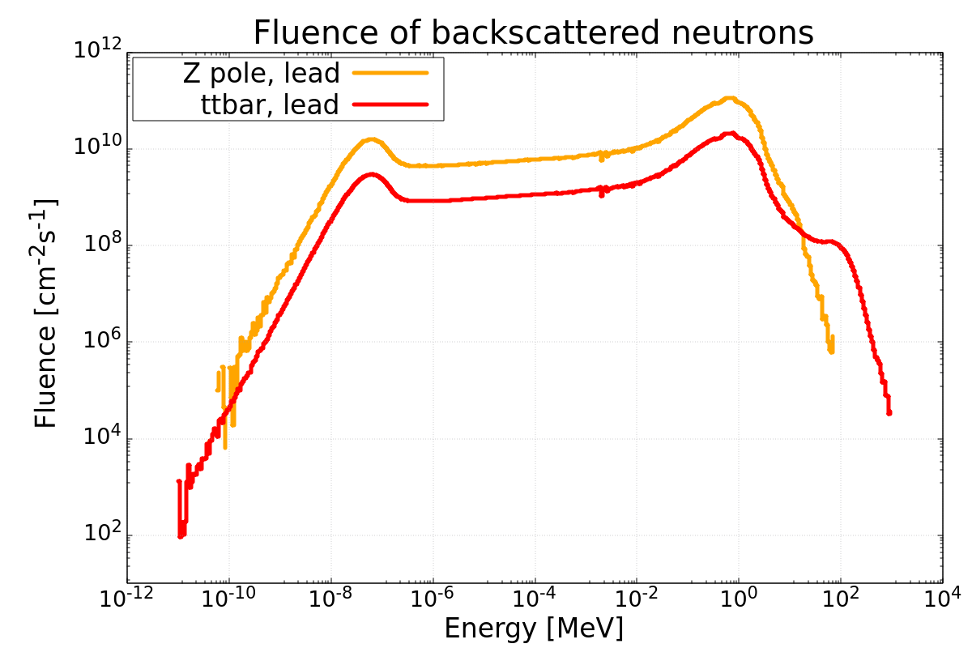
Neutron production
29/11/2024 | Other Science Opportunities at the FCC-ee
Alessandro Frasca | Beamstrahlung radiation properties
Neutron production from photonuclear reactions in the dump
different production spectra from different materials and operation modes
These are not the neutrons available
for experiments
Neutrons found at the window level, but other radiation backgrounds present

Slide 10
Summary
29/11/2024 | Other Science Opportunities at the FCC-ee
Alessandro Frasca | Beamstrahlung radiation properties
Intense photon beams ‘for free’ from beamstrahlung
370 kW (Z pole) to 77 kW (ttbar) to be safely dumped
spectra up to ~100 MeV (Z pole) and ~2 GeV (ttbar)
  photon energies allowing radionuclide production through photonuclear reactions
peak of 10¹⁶ cm⁻²s⁻¹ photon flux on the dump at Z pole
  possible complementary physics experiments with respect to CBS
Neutron production inside the dump
photonuclear reactions producing significant neutron fields in every scenario
  possible contribution to radionuclide production
  exploitable neutron source
To be considered
assessment of neutron flux in realistic experiment position
integration constraints
background from EM showers

Slide 11
Thank you for your attention.
29/11/2024 | Other Science Opportunities at the FCC-ee
Alessandro Frasca | Beamstrahlung radiation properties

