Slide 1





Preliminary Electromagnetic and Mechanical Design of a Cosθ Dipole for the Muon Collider Project
F. Mariani^{1,2}, L. Alfonso³, A. Bersani³, L. Bottura⁴, B.Caiffi³, S. Mariotto^{2,5},
D. Novelli^{1,3}, S. Farinon³, A. Pampaloni³, T. Salmi⁶, S. Sorti^{2,5}
¹ Università La Sapienza Roma
² INFN LASA Milano
³ INFN Sezione di Genova
⁴ CERN
⁵ Università degli Studi di Milano
⁶ Tampere University
Notes:
Hello everyone, my name is Francesco Mariani , I am Ph.D student at La Sapienza university of Rome and I am associated with INFN of Milan.
Today, I’m here to talk about the «preliminary EM & Mec Design of a cos-theta Dipole for the Muon Collider Project».

Slide 2
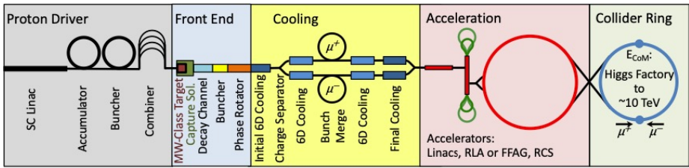
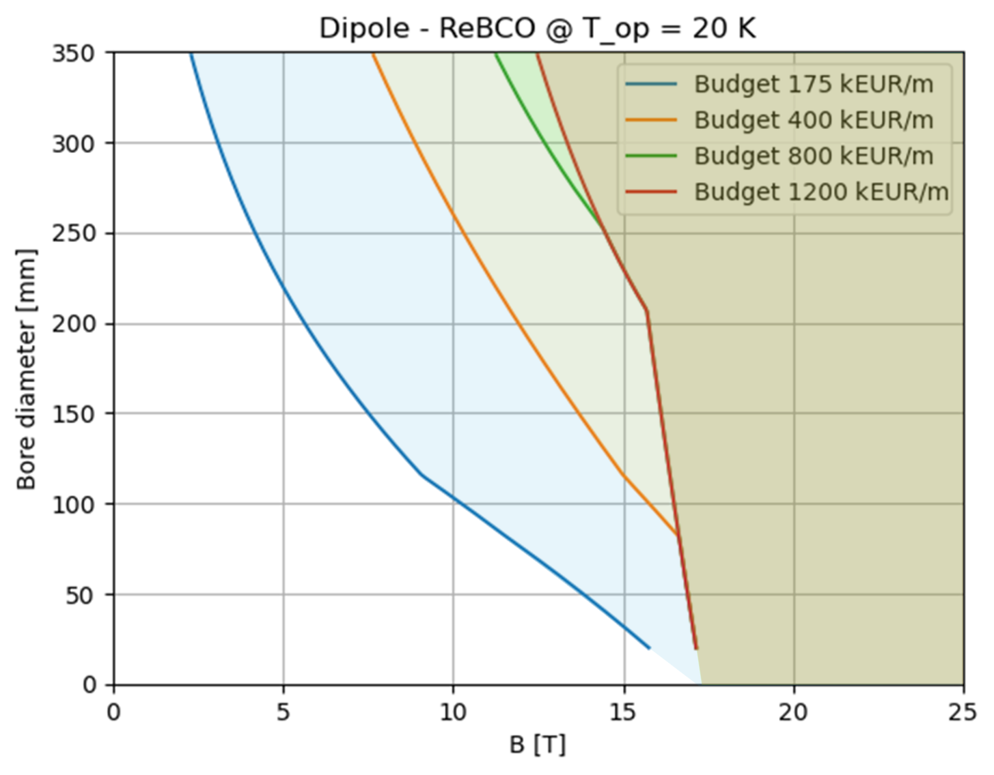


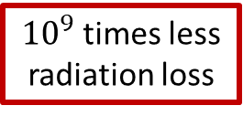
The Muon Collider
IMCC (International Muon Collider Collaboration) aims at studying the feasibility of a 10 km, 10 TeV center of mass energy Muon Collider.
Why a Muon Collider?
Collider ring dipole magnets:
Highest field possible to have a compact ring.
Large aperture dipoles for shielding against beam induced heat.
$$m_{μ}≈200{ m}_{e}$$
$μ$ = elementary particle
ARC [16T,140 mm]
${10}^{9}$ times less
radiation loss
all COM energy available
for the collision
(See D. Novelli ID 3LPo2H-05 )
Notes:
Here I'll go quickly because a general overview has already been presented. The IMCC (International Muon Collider Collaboration) is engaged in studying the feasibility of a 10-kilometer-long muon collider machine, reaching the center-of-mass energy of 10 TeV.
Muons have 2 important qualities: they are particles 200 times heavier than electrons, so their synchrotron radiation losses are much less. Also, since they are elementary particles, the center of mass energy is entirely involved in the collision.
As can be seen in the upper right, the machine consists of many stages useful to accelerate these particles as soon as possible to make them collide before they decay.
Collider ring should accommodate dipole magnets generating the highest field possible (to have a compact ring) and with large aperture for the insertion of a tungsten shielding needful to prevent the magnet to be damaged by electromagnetic shower induced by muon decay.
A quick analytical calculation (whose details are described by poster of Daniel Novelli) was performed to evaluate the best magnet configuration in terms of cost and performances.
By this process, a 16 T dipole magnet with a bore aperture of 140 mm was considered a good solution.

Slide 3
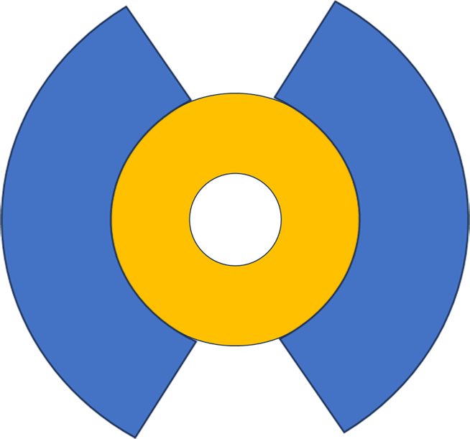
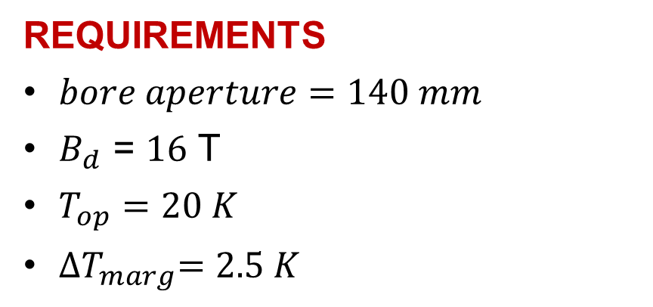

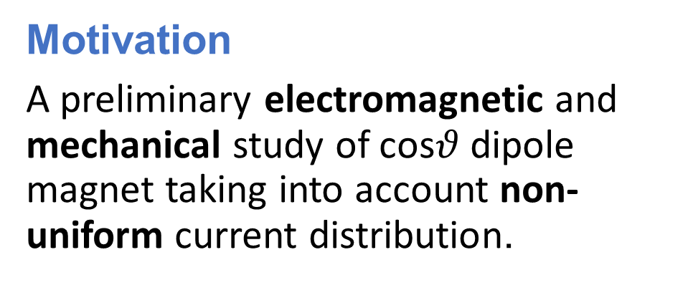

Motivation & Magnet Requirements
Motivation
A preliminary electromagnetic and mechanical study of cos$θ$dipole magnet taking into account non-uniform current distribution.
coils
}
1 2 3 4
$$140mm$$
tape
$$23.5 mm$$
REQUIREMENTS
$bore aperture=140 mm$
$B_{d}\text{ = }16 \text{T}$
$T_{op}=20 K$
${∆T}_{marg}=2.5 K$
4 layers
}
tungsten shielding
HTS techonology is needed!
Cable: Double tape
Tape: REBCO (12 mm) Fujikura FESC tape
Notes:
My work consisted of integrating these requirements in a cos theta geometry presenting 4 layers and operating at 20 K. Since this temperature makes HTS technology needful for this magnet I modelled the coils with cables made by 2 Fujikura REBCO tapes.

Slide 4
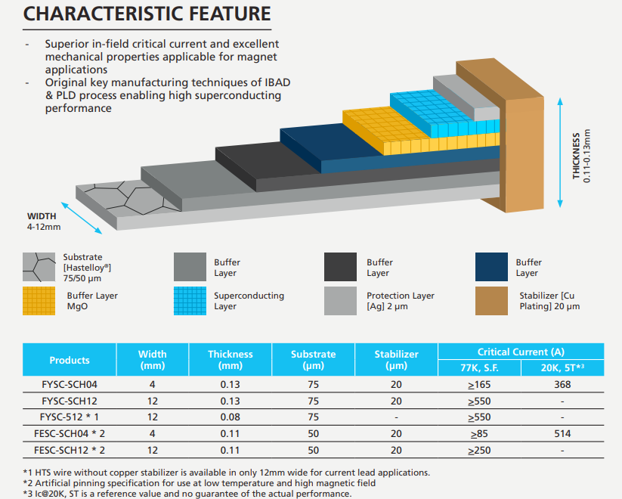

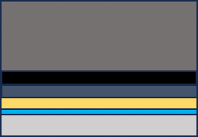
Tape & Cable
double tape & metal-insulated cable, co-wounded with:
50 𝜇𝑚 thick SS tape (layers 1-2)
- 25 𝜇𝑚 thick SS tape (layers 3-4)
Cable
in layers 1-2
Cable
in layers 3-4
Notes:
The tape is 12 mm wide and 110 um thick.
Within its copper coating, it includes several materials: Hastelloy for mechanical stability (gray), buffer layers for sc deposition (represented by different colors), the SC layer of thickness 2.5 um (in light blue), and then a protective silver layer (light gray) (that prevents the copper from reacting with the superconductor).

Slide 5

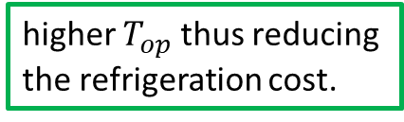
HTS vs LTS technology
Advantages
Disadvantages
(See T.Salmi ID 1LPo1I-04 )
Magnet can reach higher
field without quenching.
Higher $B_{c2}$
Higher $I_{c}$
Higher $T_{c}$
Challenging quench protection
More expensive than LTS
Wide width of REBCO tapes (12mm) + No twisted/transposed tapes
More compact magnets.
higher $T_{op}$ thus reducing the refrigeration cost.
Current distribution inside tapes must be taken into account!
Higher magnetization w.r.t. LTS cables, leading to higher losses and threatening the field quality.
Notes:
HTS techonology presents advantages but also some disadvantages.
Obviously the higher high critical field value allows to reach higher field without quenching, the high current density allows to build more compact magnets thus reducing the cost of the whole machine, and last but not least the higher Tc allows to operate at higher temperature thus reducing the refrigeration cost.
However, due to their properties, the quench protection is more challenging and cables are in general more expensive than LTS.
As last point, the wide width of HTS tapes and the non trasposed configuration inside the cable generate higher magnetization leading to higher isteretic losses and threatening the field quality.
So, to perform the design of the HTS dipole magnet, I had to take into account the real current distribution producing this magnetization.

Slide 6
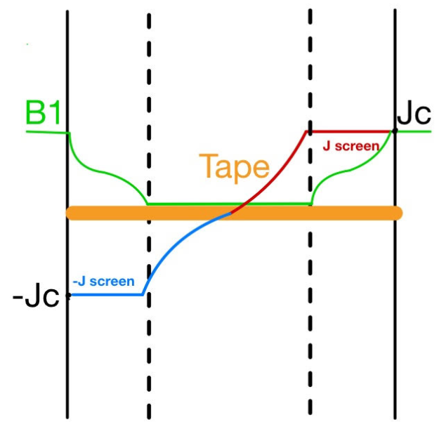

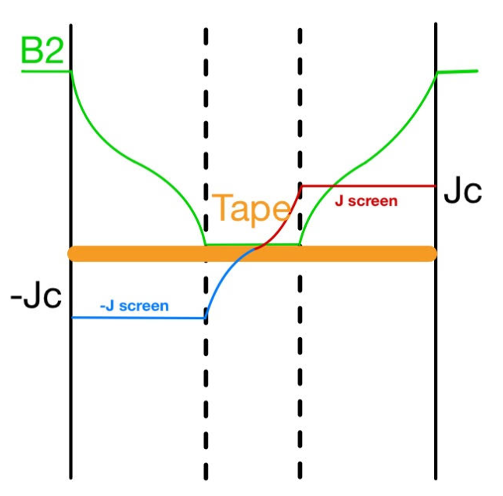

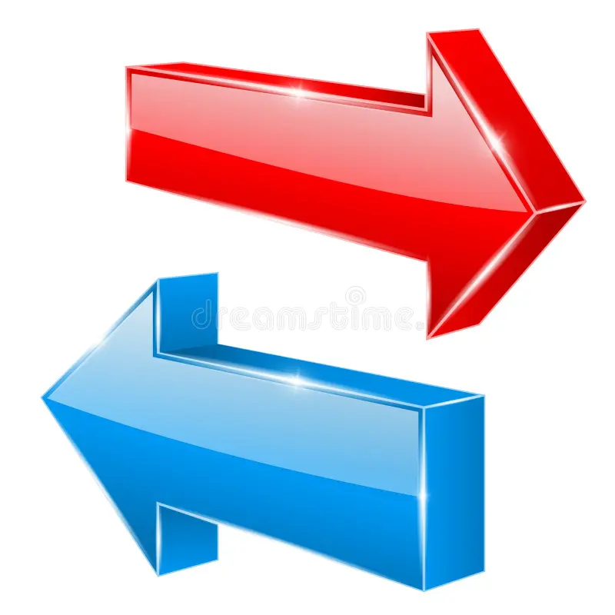

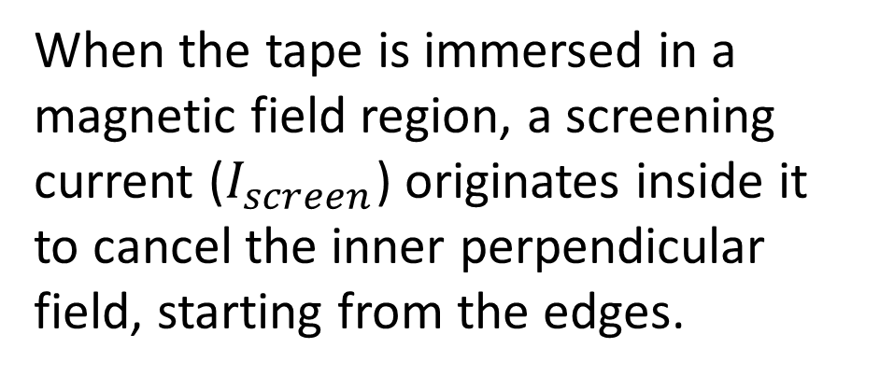
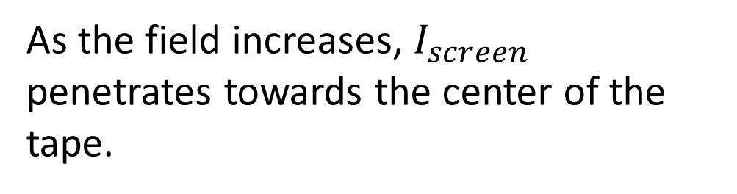
J distribution according to
Brandt Model (1)
When the tape is immersed in a magnetic field region, a screening current ($I_{screen}$) originates inside it to cancel the inner perpendicular field, starting from the edges.
As the field increases, $I_{screen}$ penetrates towards the center of the tape.
Notes:
For this scope, I wrote a code based on the so called Brandt model developed in 1993 and describing how the current distributes inside the tape. This model can be briefly described by the following steps:
When the tape is immersed in a magnetic field region, a screening current ($I_{screen}$) originates inside it to cancel the inner perpendicular field, starting from the edges.
As the field increases, $I_{screen}$ penetrates towards the center of the tape thus reducing the zero-field region.

Slide 7
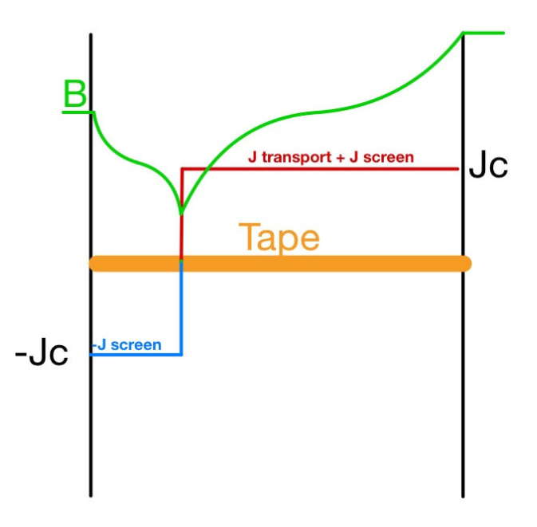
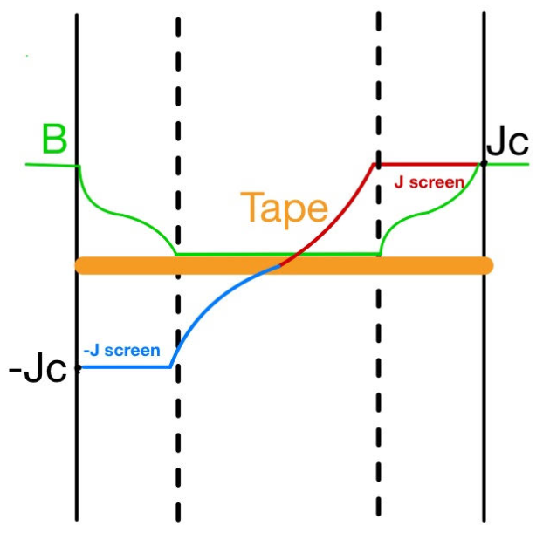
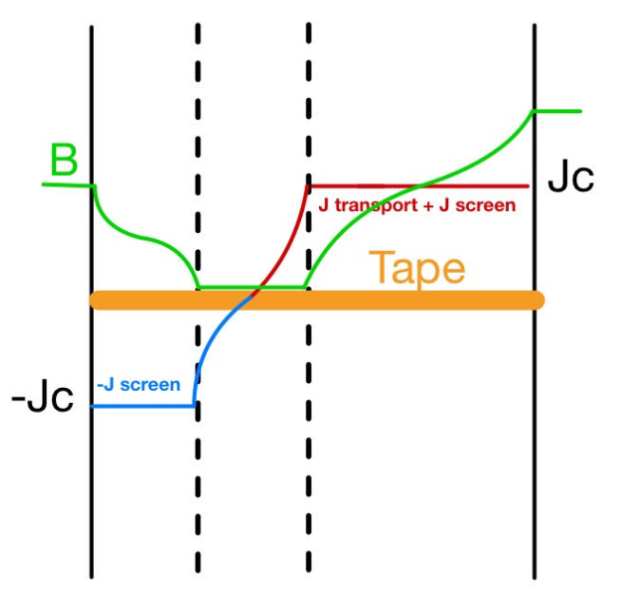
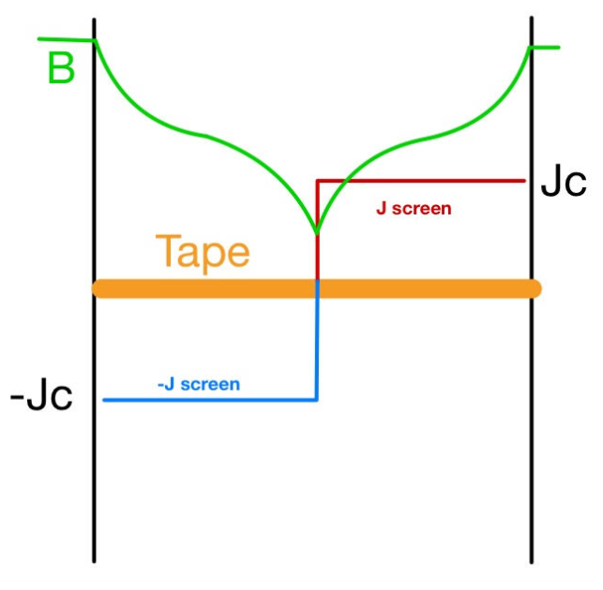

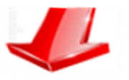

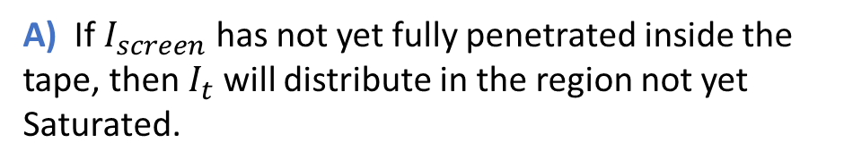




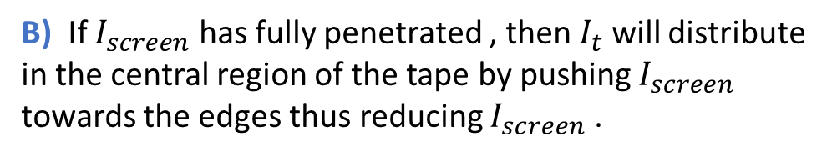
J distribution according to
Brandt Model (2)
If a transport current $I_{t}$ flows along the tape, we need to distinguish between 2 scenarios:
A) If $I_{screen}$ has not yet fully penetrated inside the
tape, then $I_{t}$ will distribute in the region not yet
Saturated.
B) If $I_{screen}$ has fully penetrated , then $I_{t}$ will distribute in the central region of the tape by pushing $I_{screen}$ towards the edges thus reducing $I_{screen}$ .
$$I_{t}=0$$
$$I_{t}≠0$$
$$I_{t}=0$$
$$I_{t}≠0$$
Notes:
If a transport current $I_{t}$ flows along the tape, we need to distinguish between 2 scenarios:
If $I_{screen}$ has not yet fully penetrated inside the tape, then $I_{t}$ will distribute in the region not yet saturated;
Whereas if $I_{screen}$ has fully penetrated , then $I_{t}$ will distribute in the central region of the tape by pushing $I_{screen}$ towards the edges and so reducing its intensity.
Paying attention to the figures on the right, we can see that if the tape is completely complete saturation, the zero-field region vanishes.

Slide 8
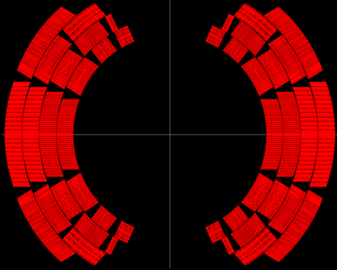
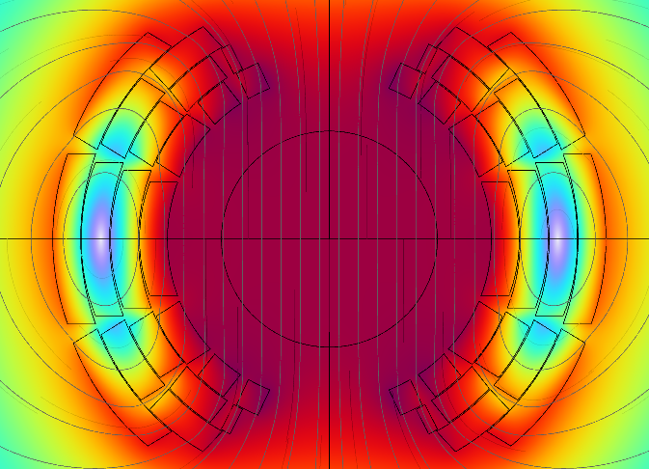

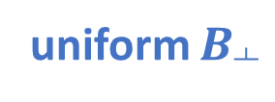
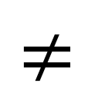
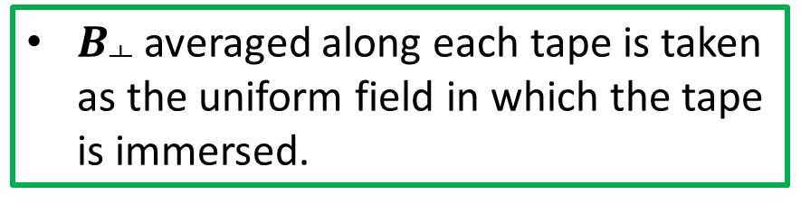
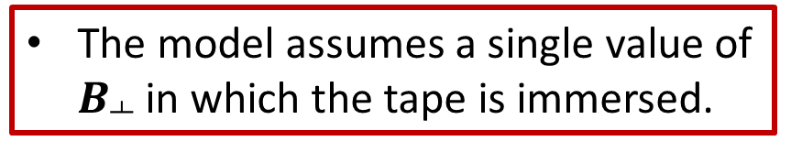
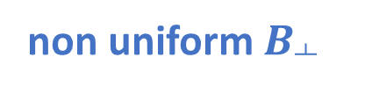
Limitations of the model
and Mitigations adopted
The model considers only a single tape, whereas the dipole magnet is made of thousands of tapes.
The model assumes a single value of $B_{┴}$ in which the tape is immersed.
uniform $B_{┴}$
non uniform $B_{┴}$
10736 tapes
1 tape
$$≠$$
$$≠$$
tape
Iterative solution was performed to consider how each tape is affected by the current distribution of the others.
$B_{┴}$ averaged along each tape is taken as the uniform field in which the tape is immersed.
Notes:
However, the model just described assumes particular conditions that are not fulfilled in the case of a cos-theta magnet.
- First of all, it is accurate only for a single tape study, whereas the dipole magnet is made by thousands of tapes. So, iterative solution was performed to consider how each tape is affected by the current distribution of the others.
In addition, the model assumes a single value of $B_{┴}$ in which the tape is immersed, but the field produced by the magnet is non-uniform inside the coils. So, to apply the model, the mean value of $B_{┴}$ inside each tape was taken as the uniform field in which the tape is immersed.

Slide 9
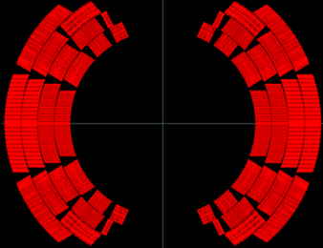
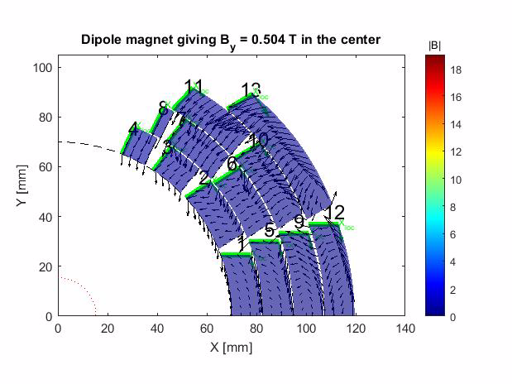
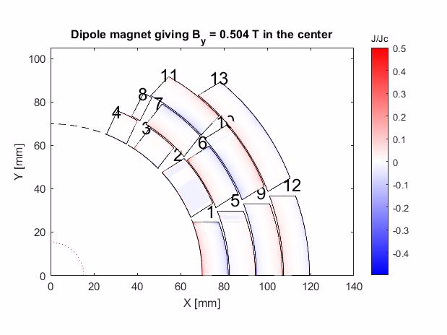




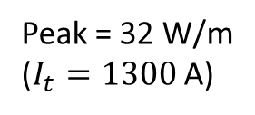

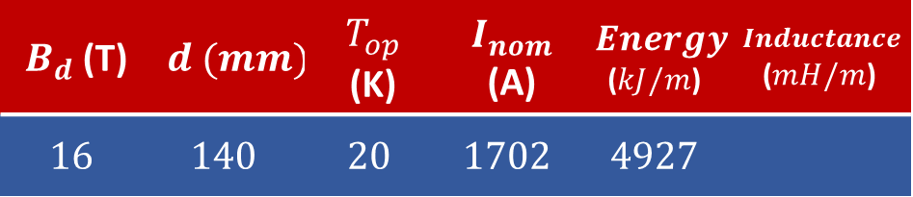
ELECTROMAGNETIC STUDY
Field & Current distribution
$B_{d}$ (T) | $$d (mm)$$ | $T_{op}$ (K) | $I_{nom}$ (A) | $$Energy$$ ($kJ/m$) | $$Inductance$$ ($mH/m$)
$$16$$ | $$140$$ | $$20$$ | $$1702$$ | $$4927$$
Field quality ($I_{nom}$)
$I=1702$ A | $$b_{3}$$ | $$b_{5}$$
J unif | 0.05 | 1.2
J non-unif | $$5$$ | $$2$$
$$3402$$
Peak = 32 W/m
($I_{t}=1300$ A)
P(W/m)
Color Legend:
${(I}_{screen}$)
($I_{t}+I_{screen}$)
ramp time $t_{r}=20 min$
Notes:
These are the main results of my code.
Let’s see how the field (on the right) and the current density change during the energization : as the transport current increases, the screening current penetrates more and more inside the blocks, increasing the intensity of magnetization. The peak of losses takes place when the magnetization is more intensive.
To see how the field quality is affected by the presence of the screening current, I compared the field quality in case of uniform J and non uniform J. As we expected the field quality gets worse if screening current is taken into account.

Slide 10
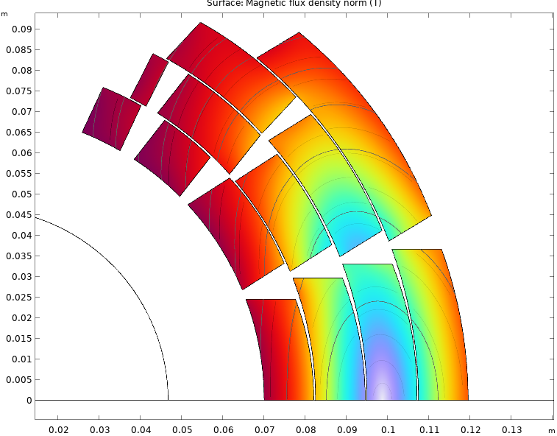
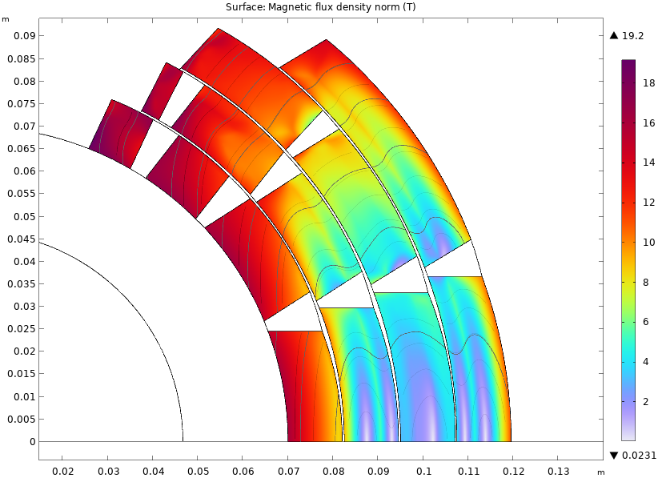
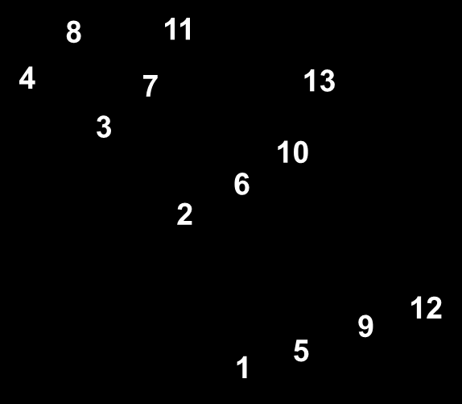
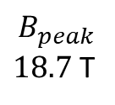

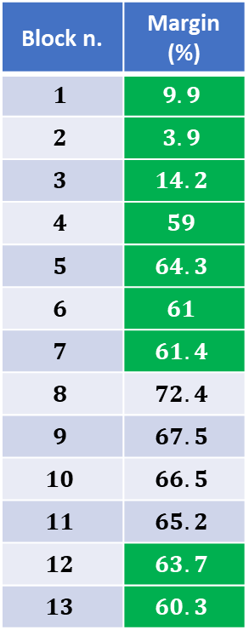
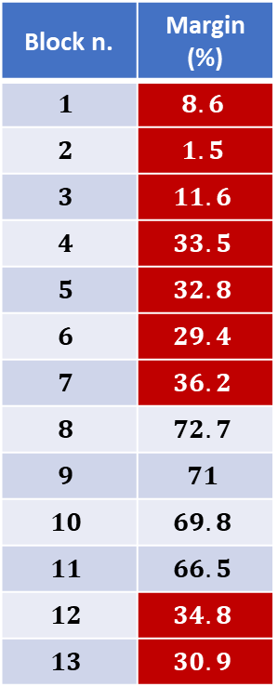
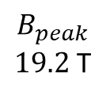
Electromagnetic Study
Margin
$B$(T)
Block n. | Margin (%)
$$1$$ | $$8.6$$
$$2$$ | $$1.5$$
$$3$$ | $$11.6$$
$$4$$ | $$33.5$$
$$5$$ | $$32.8$$
$$6$$ | $$29.4$$
$$7$$ | $$36.2$$
$$8$$ | $$72.7$$
$$9$$ | $$71$$
$$10$$ | $$69.8$$
$$11$$ | $$66.5$$
$$12$$ | $$34.8$$
$$13$$ | $$30.9$$
Screening current
(non uniform J)
Block n. | Margin (%)
$$1$$ | $$9.9$$
$$2$$ | $$3.9$$
$$3$$ | $$14.2$$
$$4$$ | $$59$$
$$5$$ | $$64.3$$
$$6$$ | $$61$$
$$7$$ | $$61.4$$
$$8$$ | $$72.4$$
$$9$$ | $$67.5$$
$$10$$ | $$66.5$$
$$11$$ | $$65.2$$
$$12$$ | $$63.7$$
$$13$$ | $$60.3$$
No screening current
(uniform J)
$$B_{peak}$$
$18.7$ T
$$B_{peak}$$
$19.2$ T
Notes:
The two tables show the margin of each coil block in case of uniform current density (so without screening current) and in case of non-uniform current density.
Since the screening current attenuates the perpendicular field, the margin from quench of each block increases.
Only four blocks keep their margin unchanged. Indeed, in these blocks, the perpendicular field looks weak also without screening current.

Slide 11
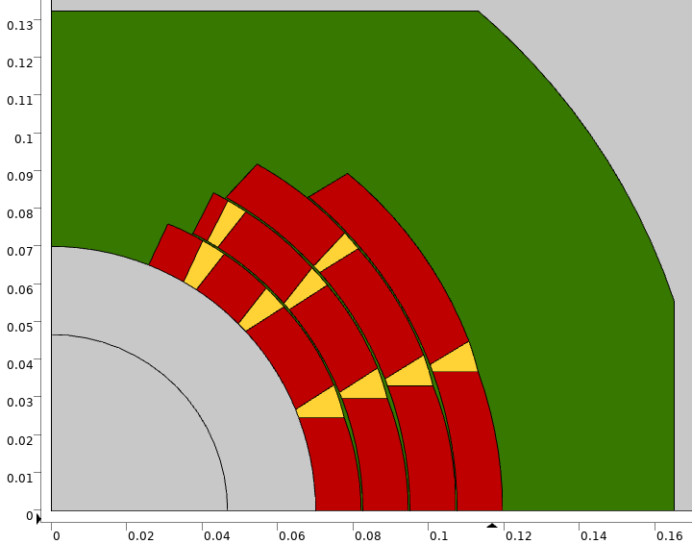
Mechanical Study
Assumptions
2 different mechanical studies:
  1) Bounded layers
  2) Frictionless layers (with separation)
Infinitely rigid collar
Frictionless contact between collar and layers
Young modulus of layers E=174 GPa
Wedges material → copper
Notes:
Let’s see how the screening current influences the mechanical study. For this study:
I suppose to have an infinitely rigid collar around the magnet and a frictionless contact between collar and layers;
for layers is assumed a young modulus of 174 Gpa, whereas for the wedges the young modulus of copper.
In the analysis of stress I compared two different scenarios:
The former assumes the layers to be bounded between each other;
The latter assumes that layers are separated and in frictionless contact.

Slide 12
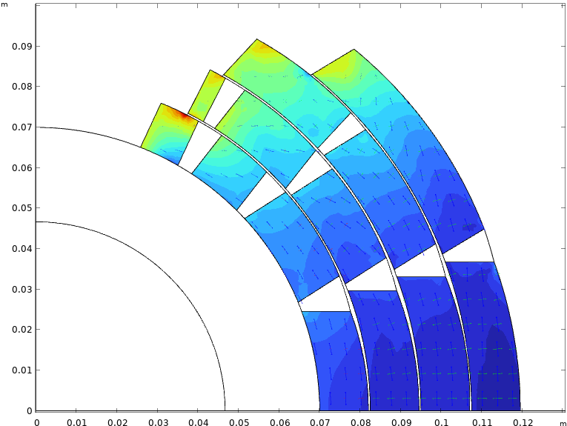
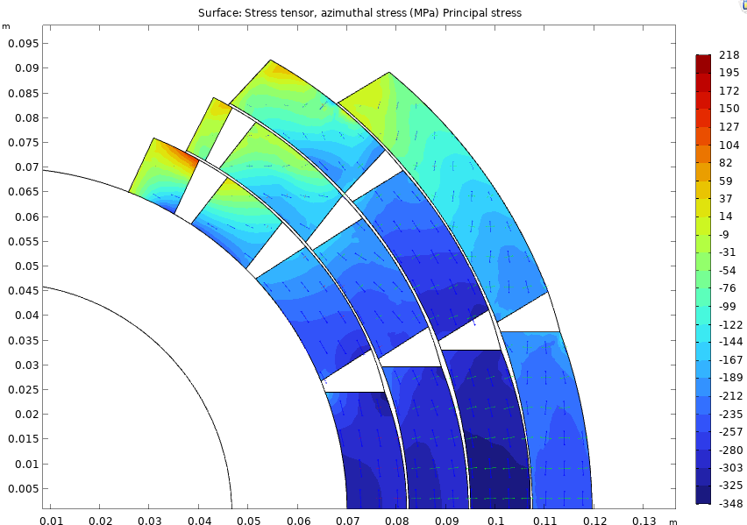




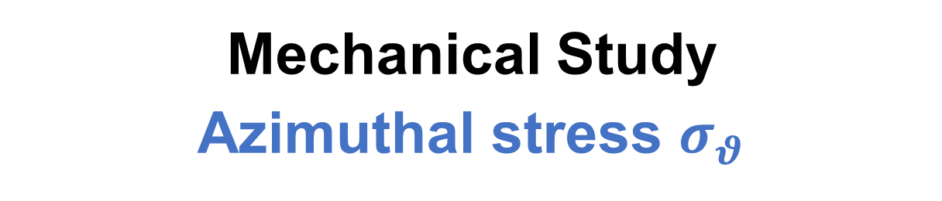
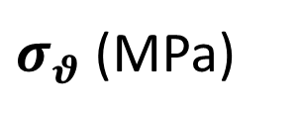
Mechanical Study
Azimuthal stress $σ_{θ}$
Bounded layers
Frictionless layers
$σ_{θ max}$= 218 MPa
$σ_{θ max}$= 133 MPa
$σ_{θ min}$= -321 MPa
$σ_{θ min}$= -348 MPa
$σ_{θ}$ (MPa)
Notes:
The two images show the azimuthal stress produced by the Lorentz Forces obtained with non uniform current in case of bounded and separated layers in frictionless contact.
There is a compressive stress on the midplane and a tensile stress near to the pole of the magnet.
The tensile stress at the top of the magnet should be canceled to prevent tapes from delamination, whereas the compressive stress on the midplane should be reduced of almost 100 Mpa for both cases.
As can be seen, separation between layers allows to keep the tensile stress lower, but compressive stress slightly increases.
An other difference is that the maximum compressive stress in case of bounded layers takes place in layer 4, whereas in case of separated layers it takes place in layer 3.
So, a more in-depth study will allow us to assess which is the better of the two options.
Anyway, the take home message is that that for both cases we are dealing with stresses that should not be too difficult to manage by an appropriate mechanical structure.

Slide 13
Conclusion & Perspectives
A cos$θ$ dipole magnet entirely designed with HTS technology needs to account for non-uniform J distribution.
The non-uniform J distribution calculation based on Brandt model allowed to evaluate the losses taking place during the ramping time and how field quality is affected by magnetization.
For the moment, the margin requirement of 2.5 K is not fulfilled in the first layer. However:
  High margin in outer layers.
  Iron contribution.
The tensile stress at the top of the magnet must be cancelled, whereas the compressive stress on the midplane needs to be compensated/reduced by appropriate structures (stress management could be a valid solution).
Further improvement of code for current distribution evaluation will be performed to obtain more accurate results. Mechanical study will be further developed to find appropriate solutions to assure mechanical stability.
Notes:
So in conclusion:
First of all, I explained why A cos$θ$ dipole magnet entirely designed with HTS technology needs to take into account non-uniform J distribution: it comes from the wide width and no transposition between tapes.
We saw that the non-uniform J distribution calculation based on Brandt model allowed to evaluate the losses taking place during the ramping time and how field quality is affected by magnetization.
For the moment, the margin requirement of 2.5 K is not fulfilled in the first layer. However:
The high margin of outer layers thanks to screening current could suggest a possible grading in the next design optimization, to increase the margin inside;
When Iron will be added around the magnet, its contribution to the field will allow to reduce the nominal current;
Moving to the mechanics, the tensile stress at the top of the layers must be cancelled, whereas the midplane stress needs to be compensated/reduced by appropriate structures (stress management could be a valid solution).
Further improvement of code for current distribution evaluation will be performed to obtain more accurate results. Mechanical study will be further developed to find appropriate solutions to assure mechanical stability.

Slide 14
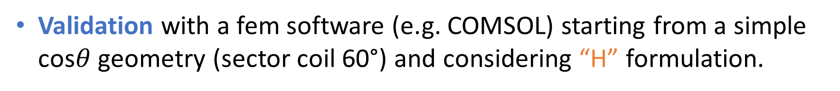
Next Steps
Computational time optimization of the analytical code and improvement of the Brandt Model:
  J distribution inside a tape immersed in non-uniform B.
  Not only first magnetization study.
Validation with a fem software (e.g. COMSOL) starting from a simple cos$θ$ geometry (sector coil 60°) and considering “H” formulation.
Further validation with more complex geometries using “T-A” or “J-A” formulations (coil homogenization to reduce computational time).

Slide 15
Preliminary Electromagnetic and Mechanical Design of a Cos-Theta Dipole for the Muon Collider Project / Francesco Mariani / Università La Sapienza and INFN LASA

Slide 16
Backup Slides

Slide 17
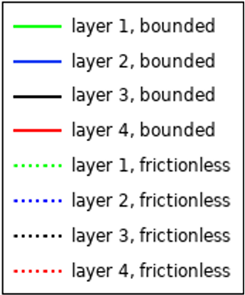


Mechanical Study
Stress on Midplane & Deformation
Difference on midplane stress between bounded and frictionless layers:
Maximum compressive stress in layer 4 in case of bounded layers$.$
Maximum compressive stress in layer 3 in case of frictionless layers$.$
MIDPLANE STRESS (Mpa)
Notes:
To investigate further the difference between the two models, let’s focusing on the midplane stress.
The plot shows that the maximum compressive stress in case of bounded layers takes place in layer 4, whereas in case of separated layers it takes place in layer 3
Anyway, the take home message is that that for both cases we are dealing with stresses that should not be too difficult to manage by an appropriate mechanical structure

Slide 18









Field Quality
Limit of the model
Non Uniform J
$$I =50 \text{A}$$
$b_{3}$
Ideal model
$$B_{┴}=0$$
My model
My model
Ideal model
$${\overline{B}}_{┴}=0$$
$${\overline{B}}_{┴}=0$$
$$B_{┴}=0$$
Inside tape
Inside tape
$50$A
Preliminary Electromagnetic and Mechanical Design of a Cos-Theta Dipole for the Muon Collider Project / Francesco Mariani / Università La Sapienza and INFN LASA
Notes:
From a theoretical point of view, at low current intensity, the sextupole error should be high and reduce as the current increases since the field shielding effect is less and less intense. However, the code I have made is such that the shielding current cancels the mean perpendicular field and not the perpendicular field at each point inside the tape (as it really should). So, if we look at the field lines produced through my code (in blue) they appear quite vertical within the bore even at low current. In contrast, if we had an exact model that is, one that at low current is able to cancel the field along the entire tape, then the field lines coming out of the layer would have zero derivative, which would greatly affect the non-verticality of the field lines.

Slide 19




tape quantity and cost
Total tape quantity = $10.736$ $Km/m$ → Total cost of tape = $6441.6 €/m$
Block n. | Cable length (per meter)
$$1$$ | $$182$$
$$2$$ | $$182$$
$$3$$ | $$106$$
$$4$$ | $$76$$
$$5$$ | $$220$$
$$6$$ | $$190$$
$$7$$ | $$170$$
$$8$$ | $$32$$
$$9$$ | $$270$$
Block n. | Cable length (per meter)
$$10$$ | $$270$$
$$11$$ | $$240$$
$$12$$ | $$300$$
$$13$$ | $$446$$
Layer n. | Cable length (per meter)
$$1$$ | $$546$$
$$2$$ | $$612$$
$$3$$ | $$780$$
$$4$$ | $$746$$

Slide 20

Field quality uniform nominal current

Slide 21


Field quality at non uniform current
b3 ($I_{nom})$ = -5
Preliminary Electromagnetic and Mechanical Design of a Cos-Theta Dipole for the Muon Collider Project / Francesco Mariani / Università La Sapienza and INFN LASA

Slide 22

Field quality non uniform nominal current

Slide 23


Margin
J uniform
J non uniform

Slide 24

Deformation

Slide 25


Radial stress
J uniform
J non uniform

Slide 26

Radial stress
Bounded layers
Unbounded layers

Slide 27



Field & Forces
(J uniform)
$$Stored Energy$$ | $$Self Inductance$$
$$4927 kJ/m$$ | $$3402 mH/m$$
Field
Lorentz Forces
Preliminary Electromagnetic and Mechanical Design of a Cos-Theta Dipole for the Muon Collider Project / Francesco Mariani / Università La Sapienza e INFN LASA

Slide 28

Stress on Midplane
Preliminary Electromagnetic and Mechanical Design of a Cos-Theta Dipole for the Muon Collider Project / Francesco Mariani / Università La Sapienza e INFN LASA

Slide 29


heat intercept
Preliminary Electromagnetic and Mechanical Design of a Cos-Theta Dipole for the Muon Collider Project / Francesco Mariani / Università La Sapienza e INFN LASA

