Slide 1

Magnetic and mechanical design of the large aperture HTS superconducting dipoles for the accelerator ring of the Muon Collider
F. Levi¹, L. Alfonso¹, L. Balconi^{2,3}, A. Bersani¹, L. Bottura⁴, B. Caiffi¹, S. Fabbri⁴, S. Farinon¹, A. Gagno^{1,5},
T. Maiello^{1,5}, F. Mariani^{2,6}, S. Mariotto^{2,3}, D. Novelli^{1,5}, A. Pampaloni¹, C. Santini², S. Sorti^{2,3}, M. Statera²
¹ INFN – Genova, ² INFN – Milano, ³ University of Milan, ⁴ CERN, ⁵ Università degli Studi di Genova, ⁶ Sapienza Università di Roma
3LOr2B-06
Notes:
Hello everyone! My name is Filippo Levi and I’m a researcher at INFN Genova, Italy.

Slide 2
Magnetic and mechanical design of the large aperture HTS superconducting dipoles for the accelerator ring of the Muon Collider
Outline:
Overview on the Muon Collider outline
Requirements on the accelerator dipole
Cable assumption
Magnetic design and analysis
Mechanical analysis
Future developments
F. Levi¹, L. Alfonso¹, L. Balconi^{2,3}, A. Bersani¹, L. Bottura⁴, B. Caiffi¹, S. Fabbri⁴, S. Farinon¹, A. Gagno^{1,5},
T. Maiello^{1,5}, F. Mariani^{2,6}, S. Mariotto^{2,3}, D. Novelli^{1,5}, A. Pampaloni¹, C. Santini², S. Sorti^{2,3}, M. Statera²
¹ INFN – Genova, ² INFN – Milano, ³ University of Milan, ⁴ CERN, ⁵ Università degli Studi di Genova, ⁶ Sapienza Università di Roma
3LOr2B-06
Notes:
What I’m going to show you is the magnetic design of the 10 T HTS dipole for the acceleration stage of the Muon Collider. I will start with a quick overview on the Muon Collider in general, then I will present the requirements in terms of geometry and field quality set for this dipole, the assumption made on the conductor that could be used. After that I will go through the results of the fem analysis concerning field quality, charging operations and magnetization and then I will show you the early results on the mechanical effect of the Lorentz forces with also the proposal for a mitigation strategy. Finally I will point out the next steps for this project.

Slide 3
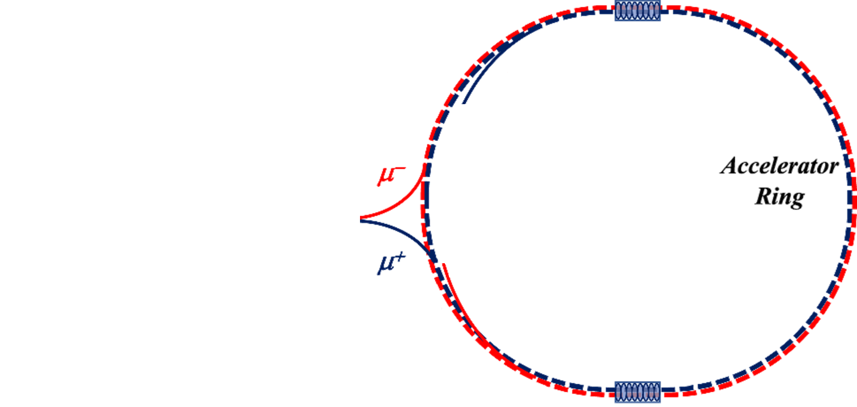
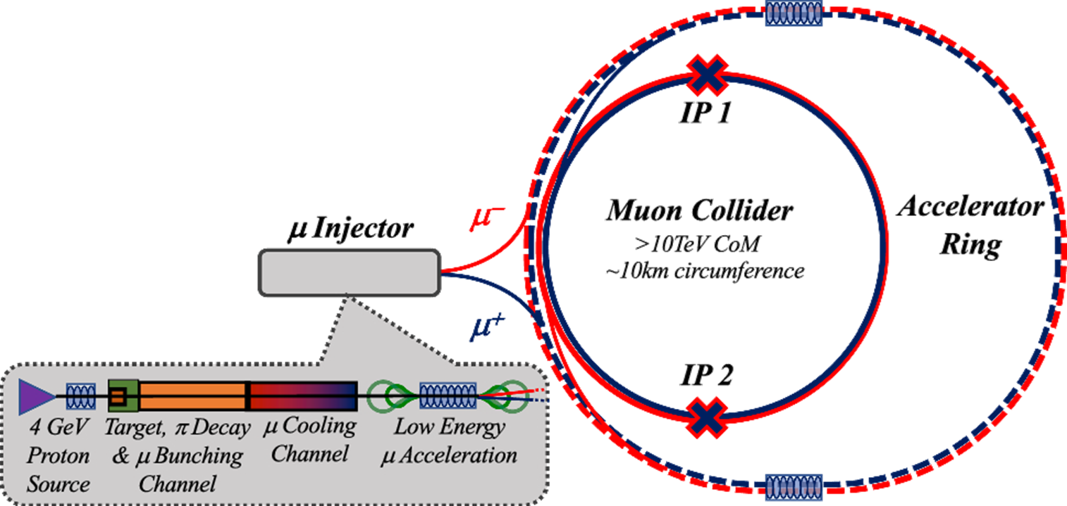
Overview of the Task
Magnets:
Fast ramped NC Dipoles
Steady large aperture SC Dipoles
Main stages of a muon collider complex
Purpose:
Study suitable geometries and materials for fields in the range of 8 to 10 T.
Basic 2D electromagnetic and mechanical design.
Task 7.3.2
More details on the development of the magnets for the Muon Collider:
Oral:
  1LOr2E-01 Luca Bottura
Notes:
First of all a quick overview of the Muon Collider outline: It is based on 5 stages, the first three are dedicated to the production and colling of the muons, then the beams are injected into the acceleration ring, where lies our dipole of interest and then to the collider ring. The acceleration ring relies on a combination of NC, fast ramped dipoles and the SC ones fed in steady state conditions. The purpose of this specific task is to find a suitable 2D magnetic design for this 10 T dipole and to evaluate the effect of the Lorentz forces on the conductors. For a broader overview of the status of the studies on all the magnets of the Muon Collider please look for Luca Bottura’s contribution, whose talk already took place yesterday.

Slide 4
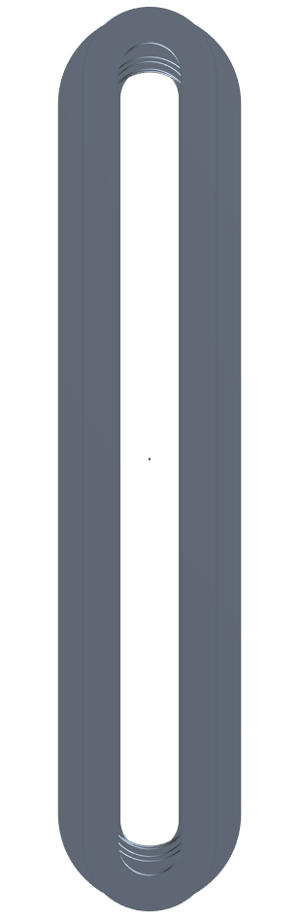
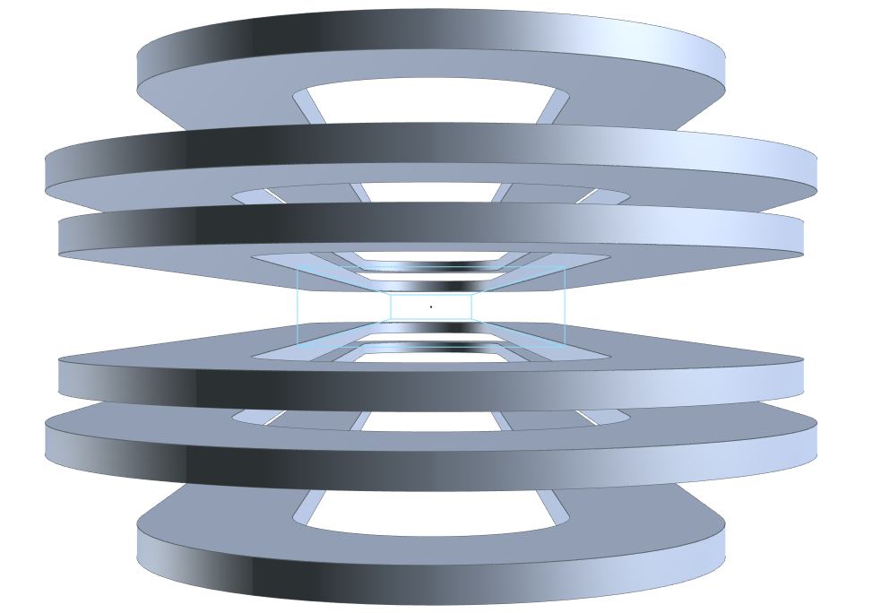

Requirements for the SC dipoles
Main characteristics:
Open midplane dipole to avoid deposition of the radiation from muon decay.
10 T of central field.
Rectangular aperture of 100 mm x 30 mm.
Magnetic length of about 1.3 m.
Proposed solution:
Magnet design based on metal insulated
HTS racetracks.
$$\sim 1.3 m$$
Aperture
30 mm
100 mm
Notes:
Considering the short lifetime of muons and all the radiation that comes from their decay, it is required that the dipole in the acceleration ring feature an open midplane to avoid the deposition of heat on the conductors. Moreover, in order to allow the passage of the muons in a wider range of curvature radii, this SC dipole is characterized by a large 100 X 30 mm aperture. These requirements have led to a design based on metal insulated HTS racetracks. The magnetic length required for this dipole is about 1.3 m.

Slide 5
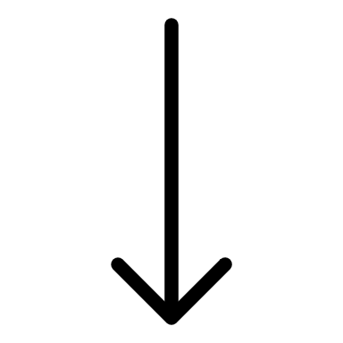
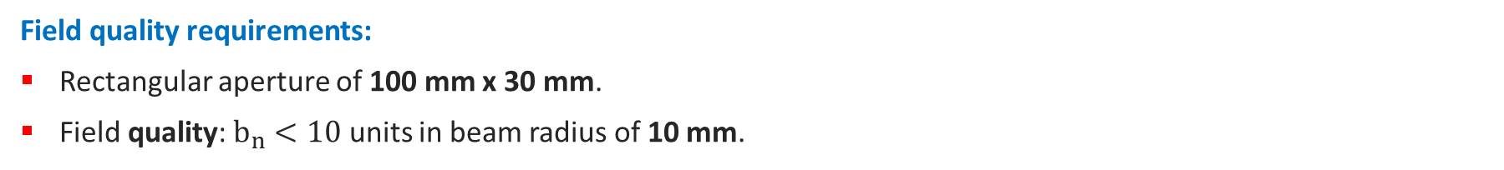
Requirements for the SC dipoles
Field quality requirements:
Rectangular aperture of 100 mm x 30 mm.
Field quality: $b_{n}<10$ units in beam radius of 10 mm.
Aperture
15 mm
Good Field Region
Harmonic coils
25 mm
10 mm
50 mm
10 mm
0 mm
5 mm
15 mm
25 mm
Notes:
The good field region correspond to 50 X 20 mm window inside the aperture. The optimization of the field quality has been performed with ROXIE by placing 4 harmonic coils to cover even a wider portion of the aperture in order to have a more conservative analysis. The requirements foreseen harmonic components over this region of less than 10 units.

Slide 6
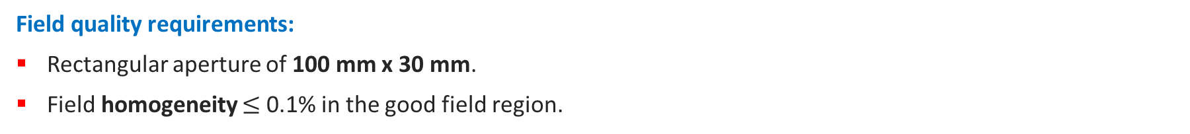
Requirements for the SC dipoles
Field quality requirements:
Rectangular aperture of 100 mm x 30 mm.
Field homogeneity $≤$ 0.1% in the good field region.
Aperture
15 mm
Good Field Region
25 mm
Field Paths
50 mm
10 mm
Notes:
Which could be translated into a field homogeneity of 0.1%, computed over the 4 paths represented in the sketch.

Slide 7
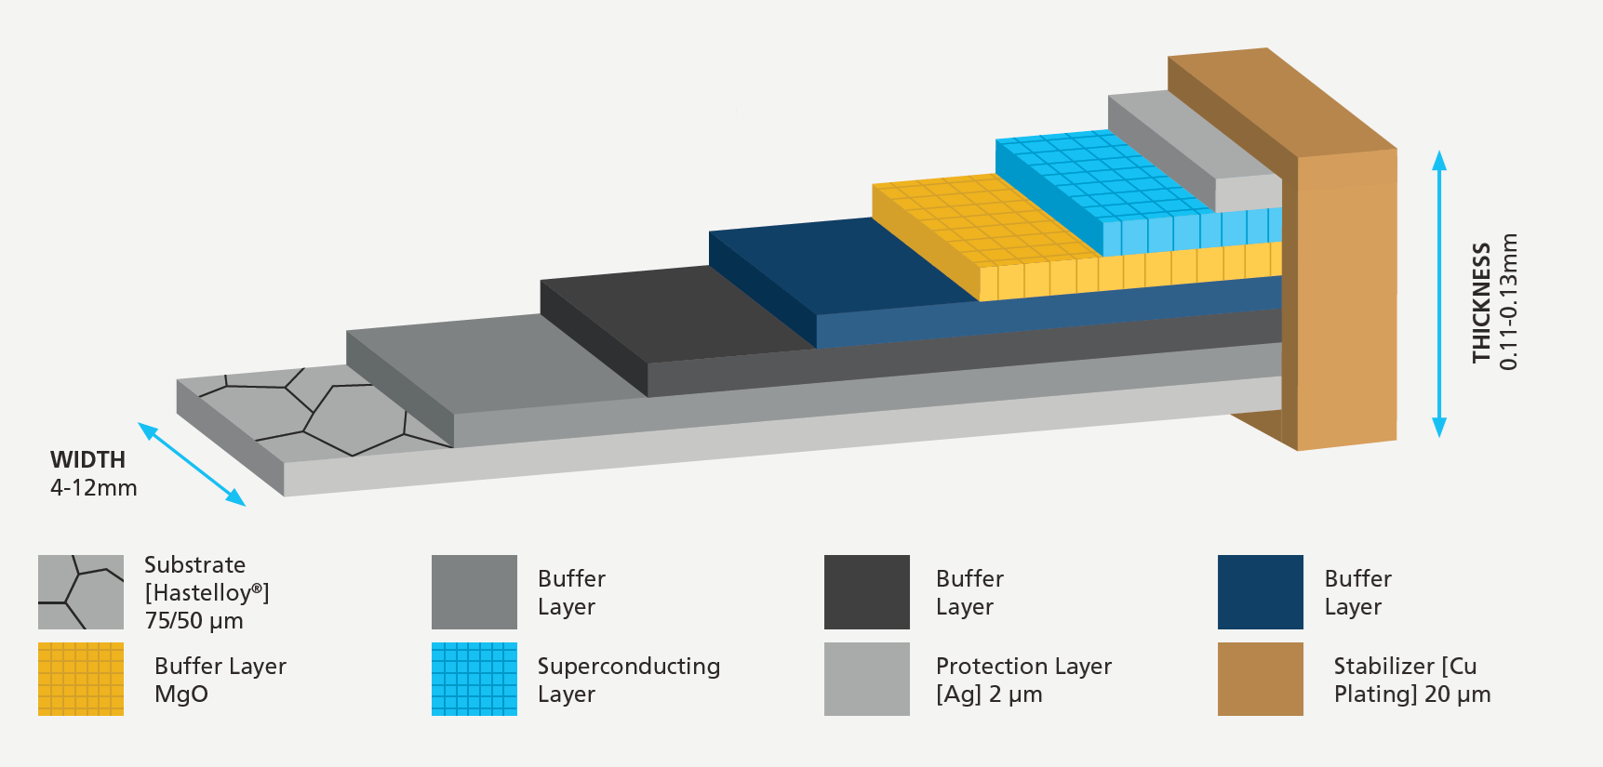
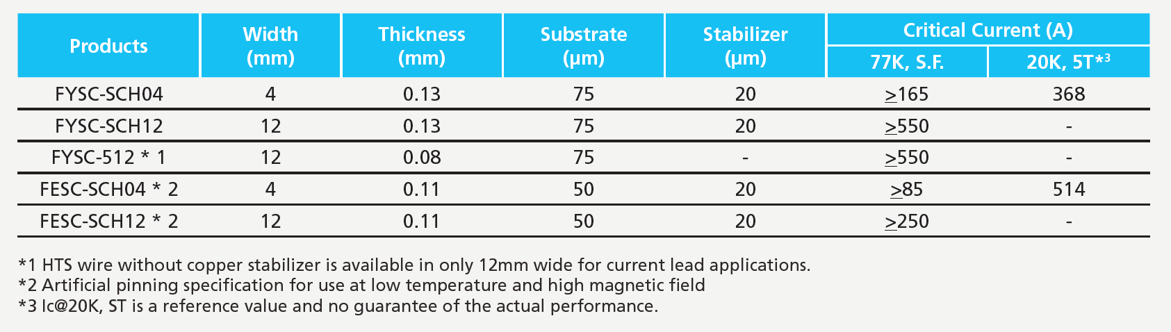









Cable Assumptions
Same assumption as for the collider studies:
Posters:
  3LPo2H-05 Daniel Novelli
  4LPo1I-01 Luca Alfonso
Orals:
  4LOr2B-01 Samuele Mariotto
  1LOr2E-06 Francesco Mariani
The conductor consists of two tapes and one $50 μm$ SS strip.
The SC is based on a commercial YBCO tape from Fujikura.
$$20 μm$$
Cu
SC
$$2.5 μm$$
Ag
$$2 μm$$
Substrates
$$110 μm$$
SS strip
$$50 μm$$
$$12 mm$$
$$A_{tot}=3.24 mm^{2}$$
$$A_{SC}=0.0598 mm^{2}$$
$$A_{Cu}=0.9656 mm^{2}$$
Notes:
For the conductor we have assumed to use two YBCO tape from the Fujikura catalogue, arranged as in figure with SC layer facing each other in the middle, coupled with a 50 micron SS strip. This assumption is a shared one, between us, of the accelerator stage, and our colleagues that are working on the magnets of the collider stage. This configuration for the conductor took inspiration from the work done for the ESMA dipole. A very similar magnet, design by INFN Milan and built in Genova at ASG Superconductor. By this way we will probably take advantage of the experience gained during the construction of this cutting-edge magnet.

Slide 8
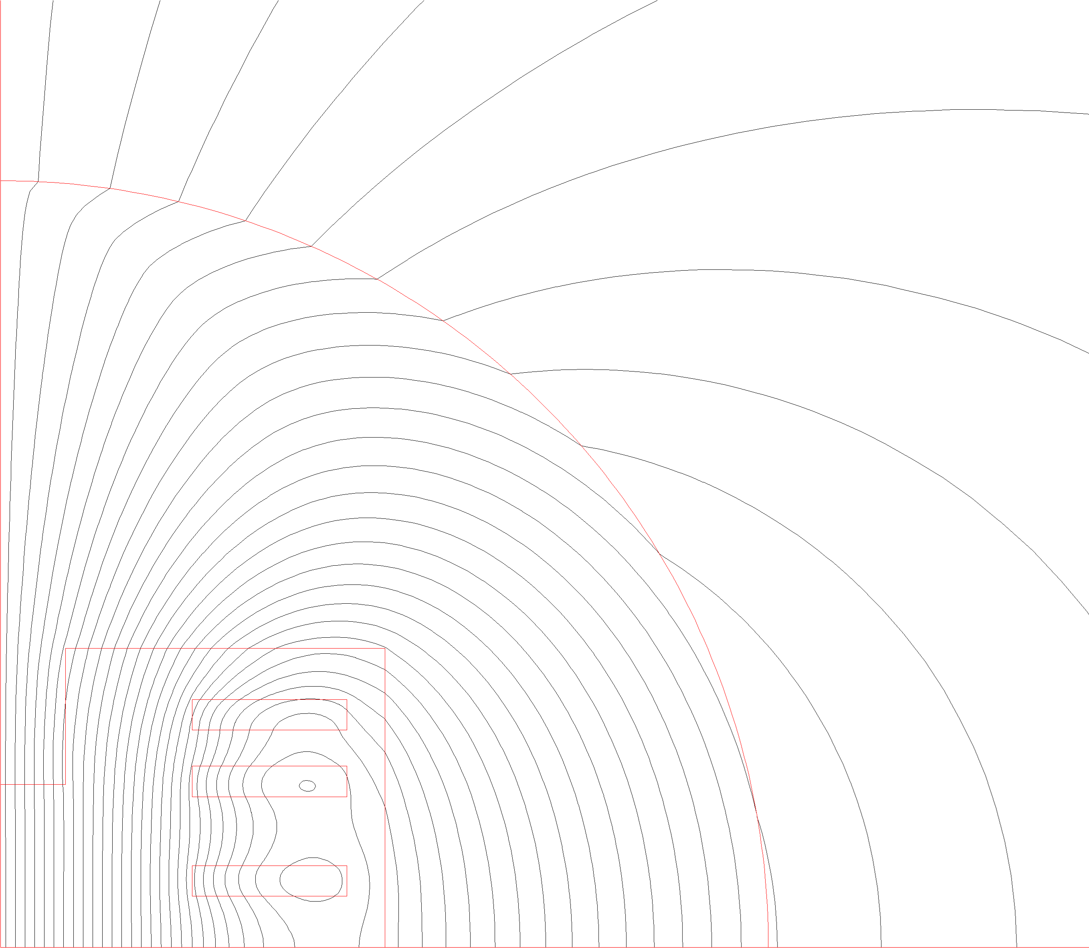
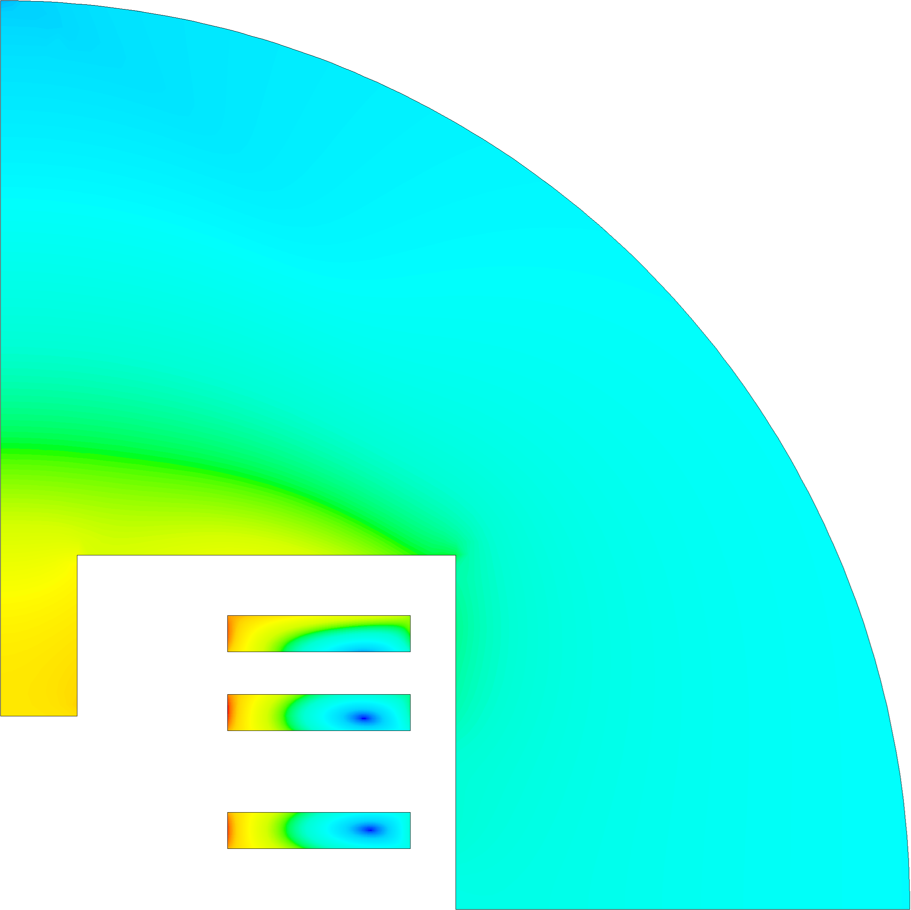

Magnetic Design
Three identical racetracks.
Alignment of racetracks for easier mechanical design.
I [A] | J_{eng} [A/mm²] | B₀ [T] | B_{p} [T] | margin on load line | Energy [MJ] | Inductance [H]
2 314 | 714 | 10 | 12.51 | 25.7% | 2.24 | 1.3
T_{op} [K] | T margin [K] | N conductors per racetrack | N tapes per racetrack | Mag Length [m] | Mec Length [m] | Yoke radius [mm]
20 | 2.5 | 205 | 410 | ~1.3 | ~1.6 | 300
$$B [T]$$
0.17
1.50
2.83
4.16
5.50
6.83
8.16
9.49
10.82
12.51
Notes:
The optimized magnetic design features 3 identical racetrack, made of 205 turns. For a simpler mechanical design and assembly operation, the racetrack are perfectly aligned. This design generates 10 T in the center at 2.3 kA of current, with 12.5 T of peak field. The operating temperature is 20 K and the temperature margin is at least 2.5 K. Also this choice is shared with collider studies. The shape of the iron yoke has been optimized to improve the field quality, considering to have at least 30 mm between yoke and conductors to host the mechanical structure of the racetracks.

Slide 9
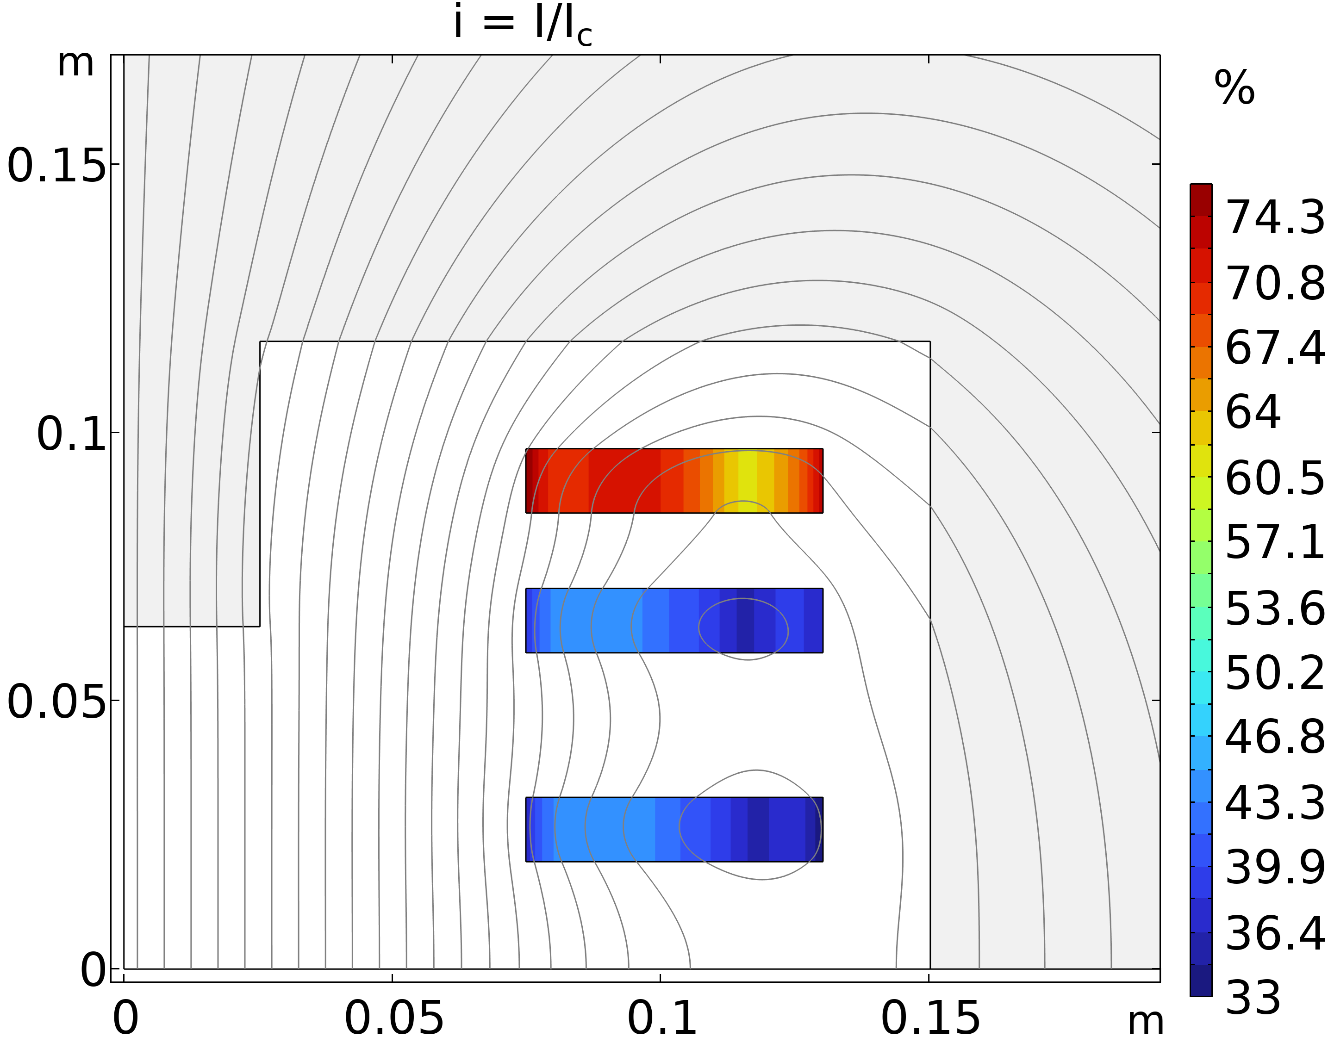

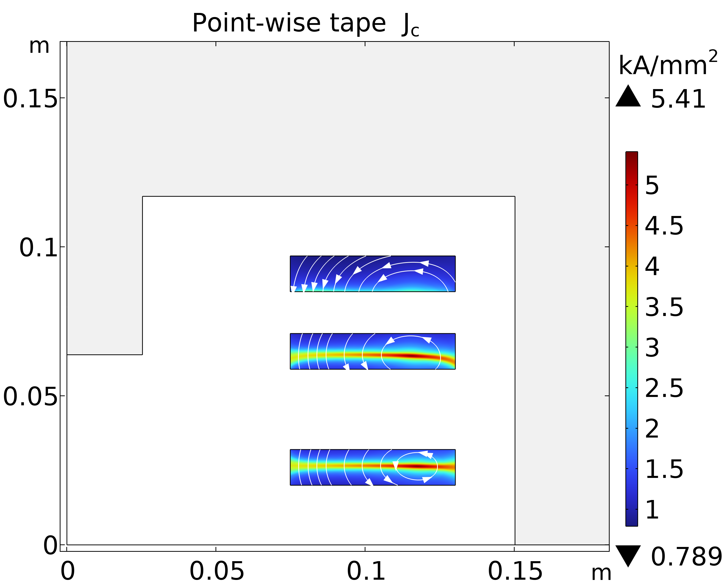
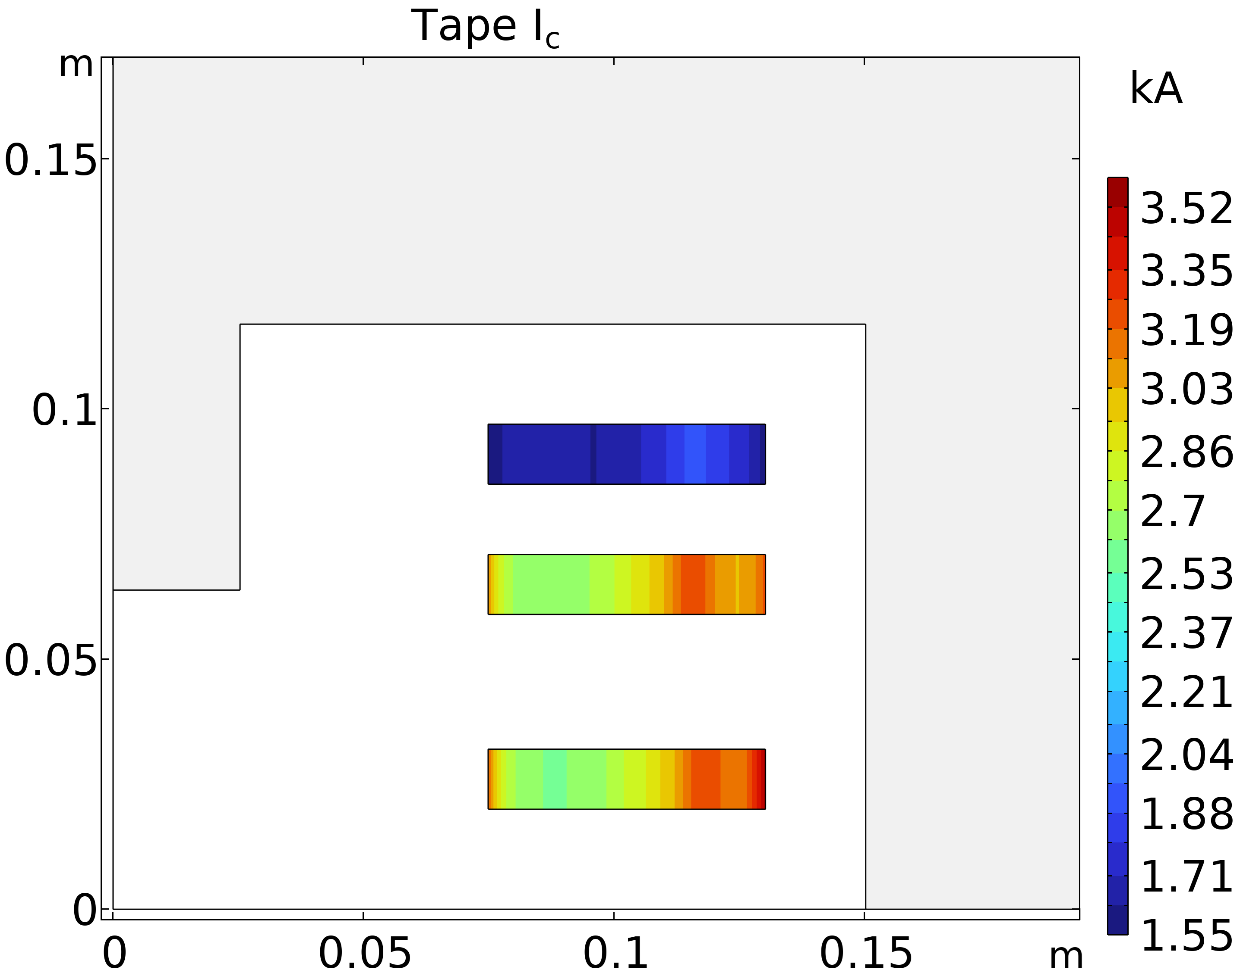
Magnet Stability
For more info about ESMA:
Orals:
  3LOr1B-01 Lucio Rossi
  5LOr1A-06 Stefano Sorti
  1LOr2B-04 Lorenzo Balconi
A 2D COMSOL study has been performed to evaluate the performance of each tape.
To better estimate the margin the calculation takes into account the dependence of J_{c} on the angle between field lines and tape.
The data of the critical surface is the one supplied by FFJ for the design of the ESMA dipole.
Notes:
The margin on the loadline of 25.7% has been computed taking into account the angle dependence between the orientation of the tapes and the field lines. To make this calculation we made use of the computational tools from the design operations of the ESMA dipole, which features a comparable YBCO tape from Faraday. If you are interested in ESMA you can look for Lucio Rossi, Balconi and Sorti contributions.

Slide 10
Field Quality
All harmonics greatly less then 10 units.
The harmonics higher than the 7th order less than 0.003 units.
The field homogeneity evaluated at x = 25 mm is about 0.03%.
0.003 T
Aperture
15 mm
Good Field Region
Field Paths
25 mm
50 mm
10 mm
Notes:
The results of the field quality analysis are solid, with all the requirements fulfilled with great margin. For example, the highest harmonic components is less than half of the limit imposed: which is a 4.5 units of b2 at 25 mm from the center.

Slide 11
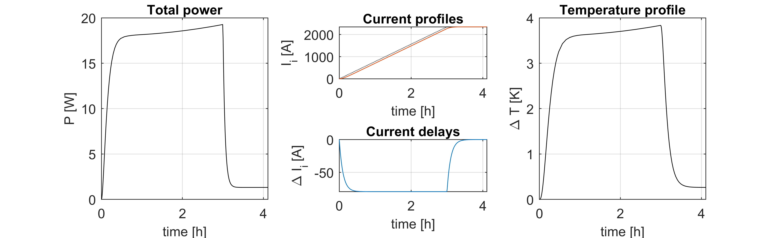
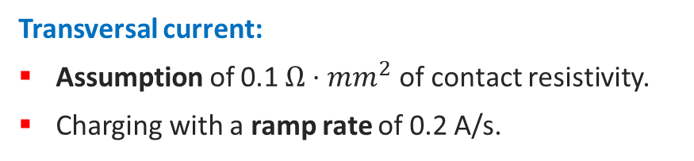
Charging and Dissipations
Transversal current:
Assumption of 0.1 $Ω⋅mm^{2}$ of contact resistivity.
Charging with a ramp rate of 0.2 A/s.
Magnetization:
Neglecting the transport current (non-conservative assumption).
Critical state model approximation.
Results:
Charging time: 3.4 h
Joule dissipation: ~ 15 W
Results:
Magnetization dissipation: ~ 10 W
~ 25 W
Of total dissipation
Notes:
By assuming 0.1 ohm times mm squared of contact resistivity and a ramp rate of 0.2 A X s, it has been possible to estimate a charging time of about 3 and half hours, with a joule dissipation of 15 W. This analysis benefits from the studies carried out on the ESMA dipole. While a rough estimation of the losses due to the magnetization of the tapes, through a critical state model without the transport current, foreseen about 10 W, for a total dissipation during charging of about 25 W.

Slide 12
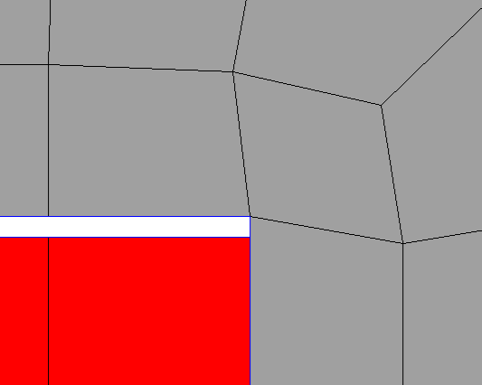
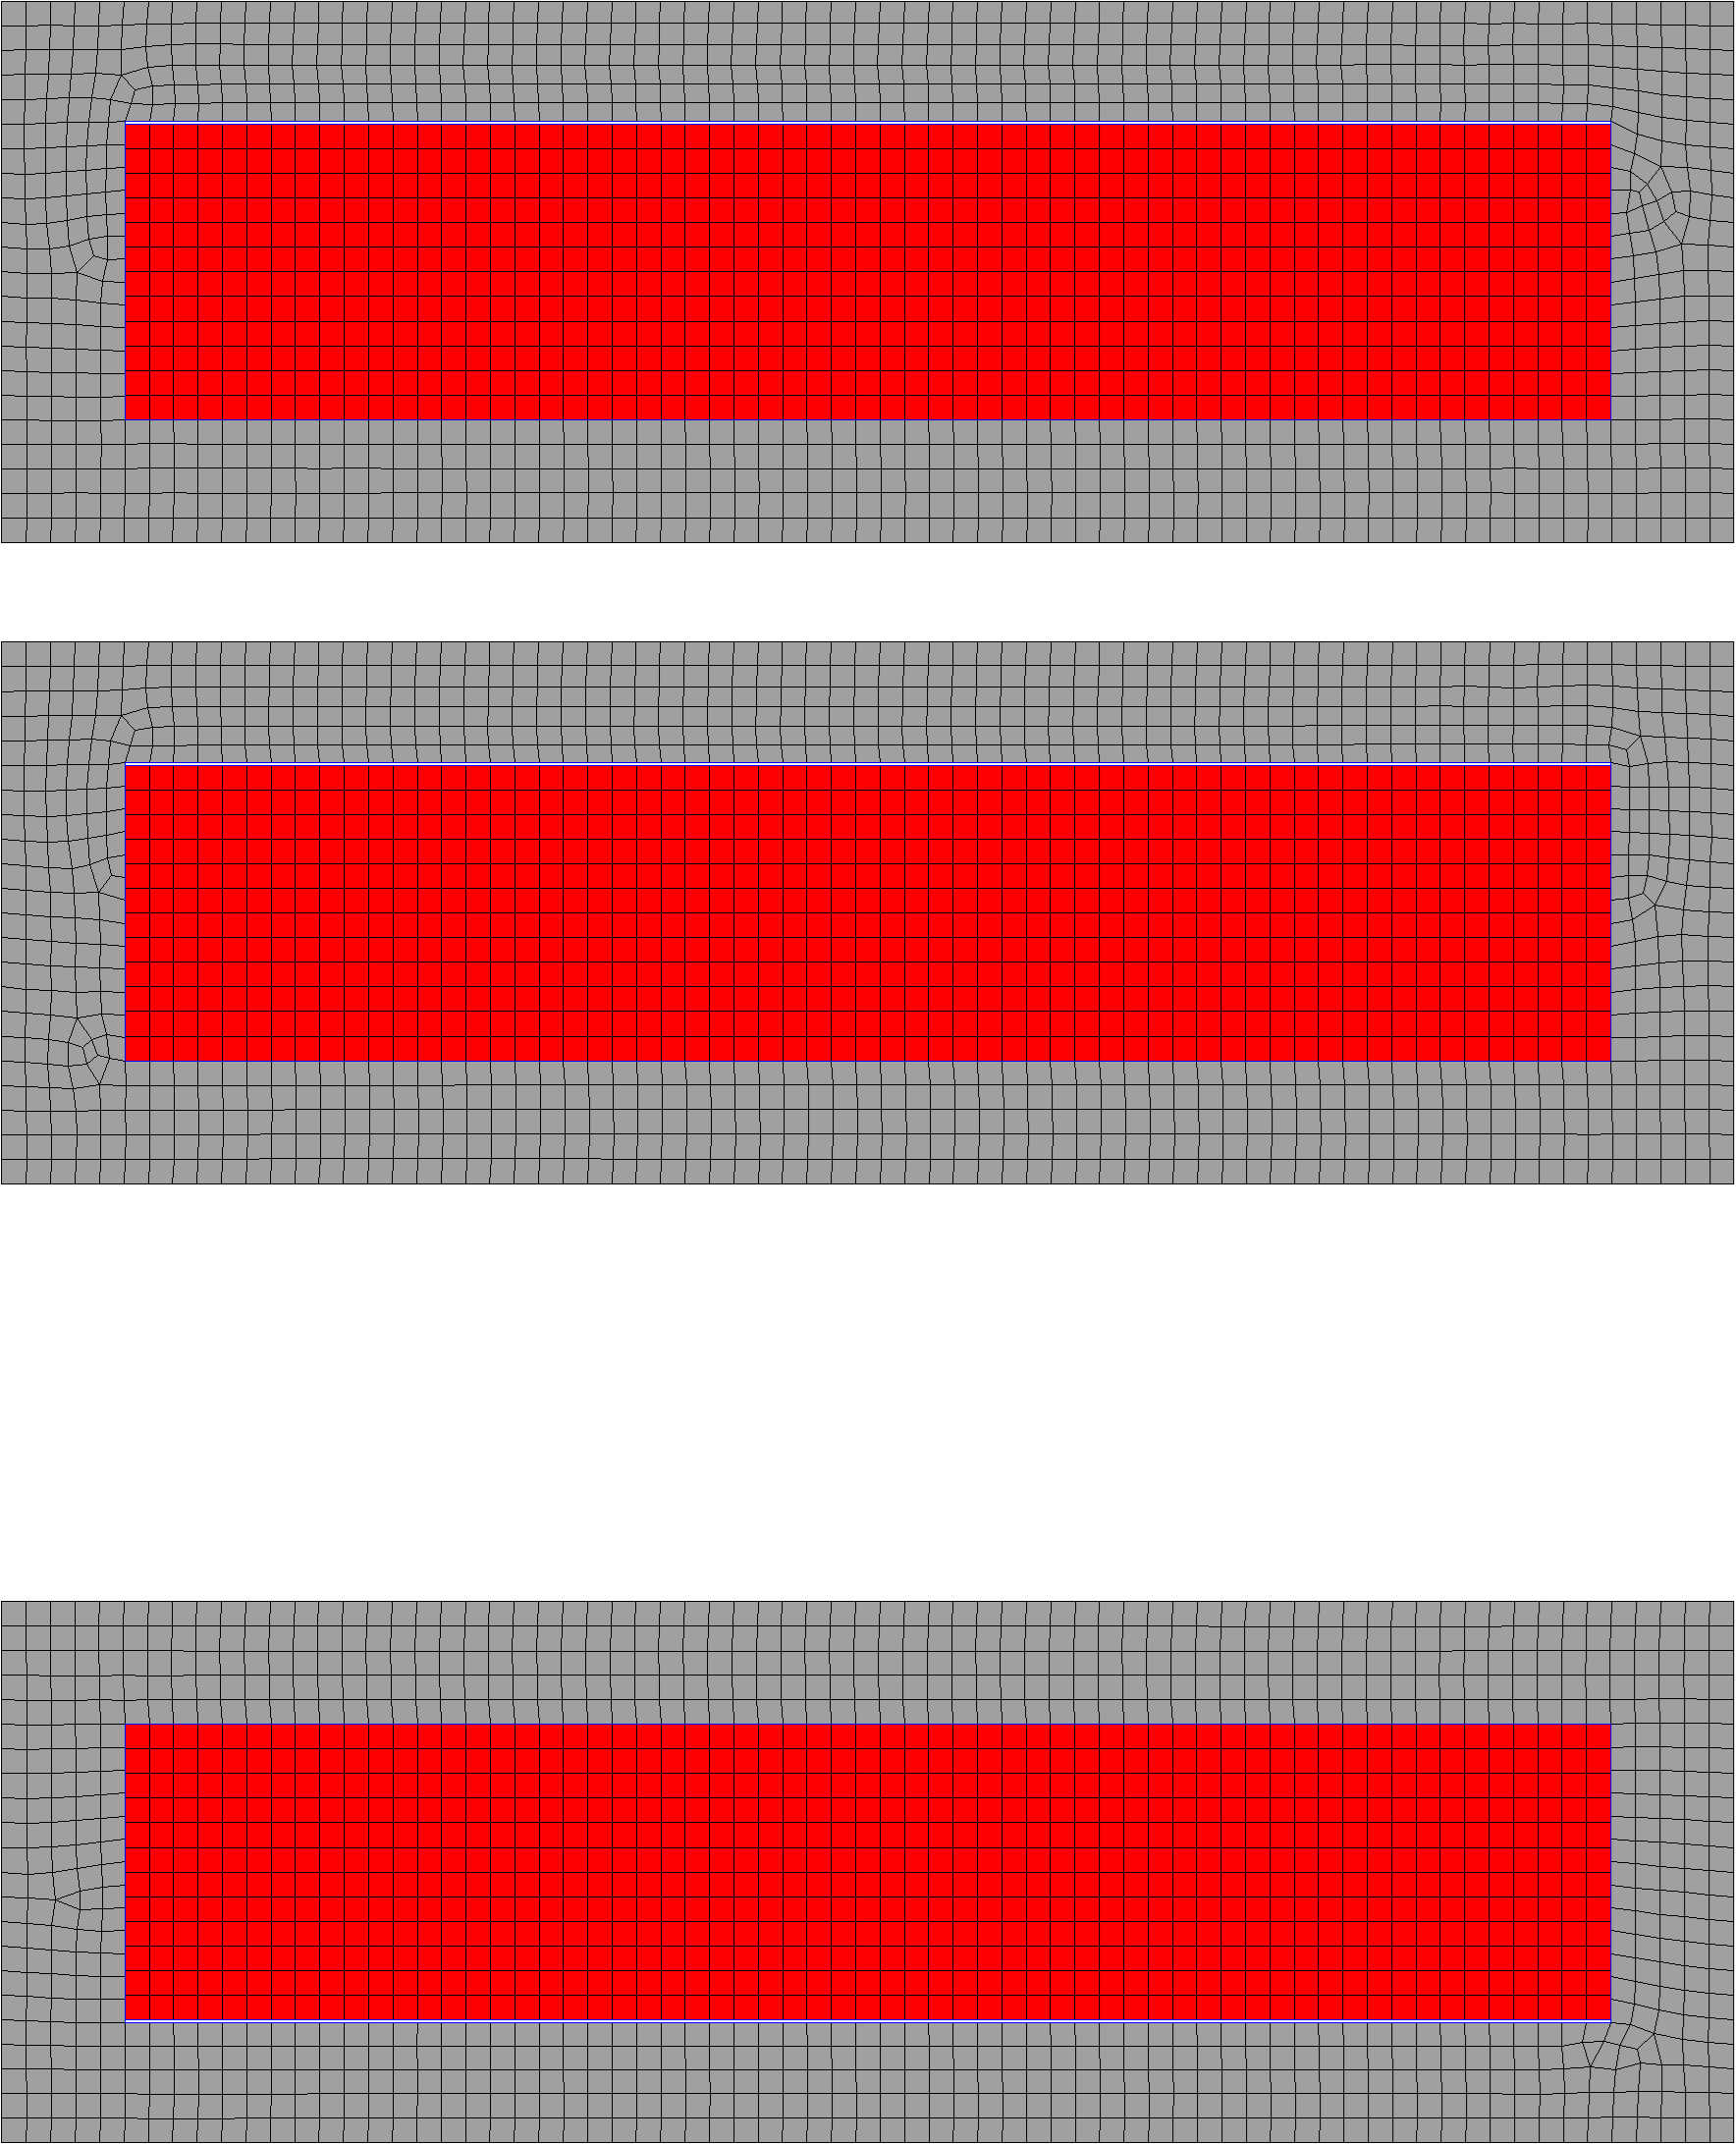

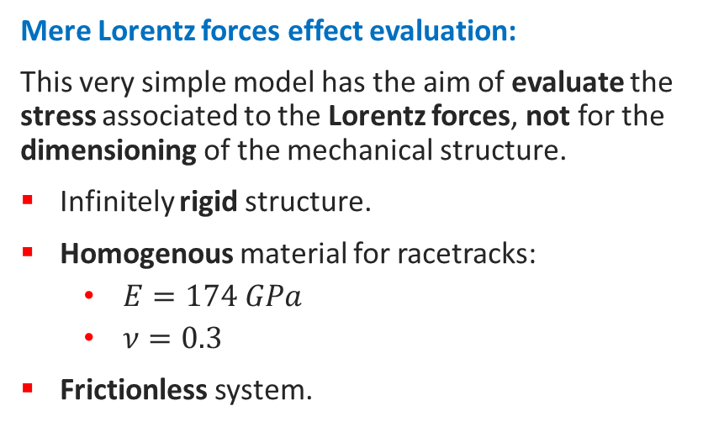
Mechanical Performance
Mere Lorentz forces effect evaluation:
This very simple model has the aim of evaluate the stress associated to the Lorentz forces, not for the dimensioning of the mechanical structure.
Infinitely rigid structure.
Homogenous material for racetracks:
  $E=174 GPa$
  $ν=0.3$
Frictionless system.
0.1 mm
¹
The model includes a case over-thickness of 0.1 mm to simulate it more realistically, avoiding excessively constrained deformations.
¹ Value taken from “Electro-mechanical properties of REBCO coated conductors from various industrial manufacturers at 77 K, self-field and 4.2 K, 19 T”
https://iopscience.iop.org/article/10.1088/0953-2048/28/4/045011
Notes:
To evaluate the effect of the Lorentz forces it has been set a mechanical model that includes infinitely rigid, frictionless, structures around the racetracks. Each SS case feature a 0.1 mm clearance on the upper side to simulate a more realistic mechanical structure by avoiding an excess of constrains on the racetrack.

Slide 13
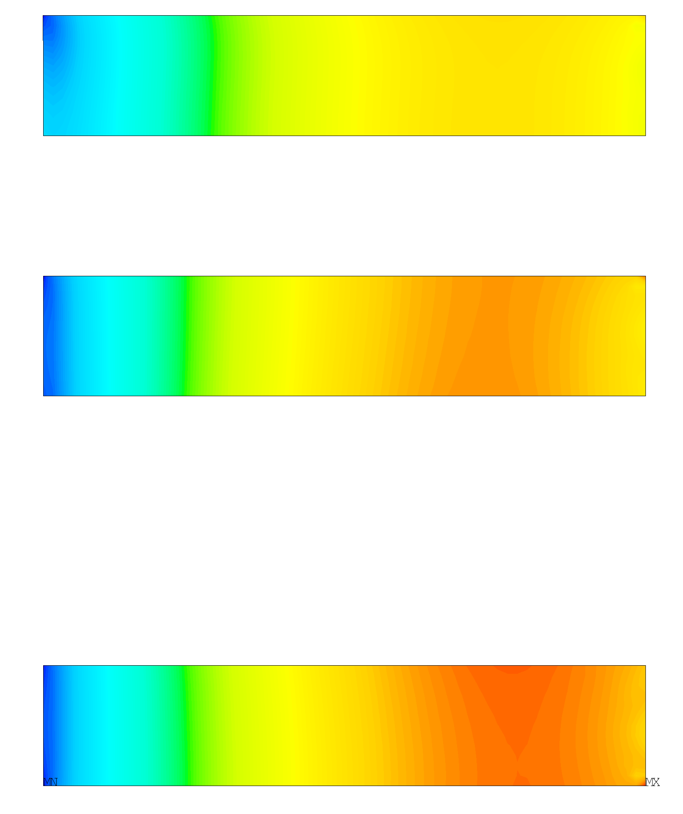
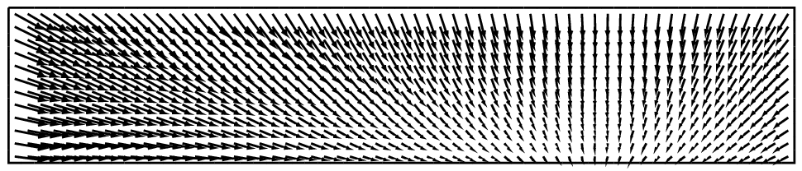
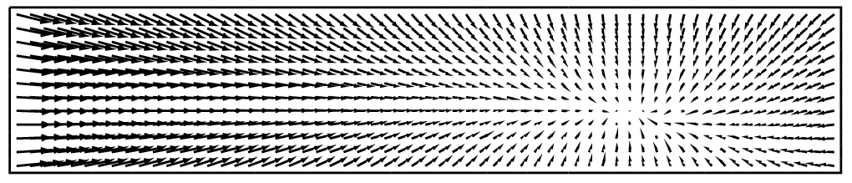
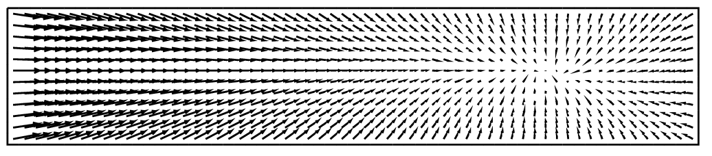

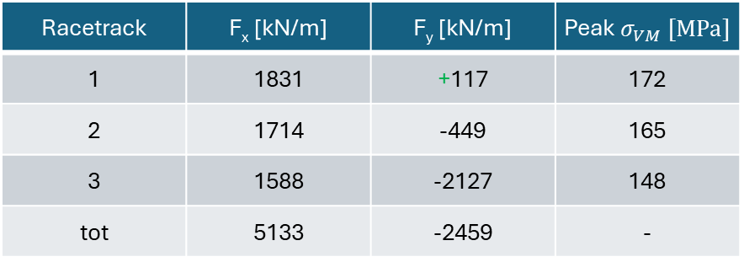
Mechanical Performance
Mere Lorentz forces effect evaluation:
This very simple model has the aim of evaluate the stress associated to the Lorentz forces, not for the dimensioning of the mechanical structure.
Infinitely rigid structure.
Homogenous material for racetracks:
  $E=174 GPa$
  $ν=0.3$
Frictionless system.
Racetrack | F_{x} [kN/m] | F_{y} [kN/m] | Peak $σ_{VM} [MPa]$
1 | 1831 | +117 | 172
2 | 1714 | -449 | 165
3 | 1588 | -2127 | 148
tot | 5133 | -2459 | -
$$σ_{VM} [MPa]$$
0
19
38
57
75
94
113
132
151
172
Notes:
The simulation foreseen a peak of VM stress of 170 MPa, localized in the lower right corner of the cross-section. Notice that the optimization of the cross-section had a secondary target, consisting in obtaining a net up-oriented y force in the first block. By this way, it will be much easier to design a mechanical structure that do not lies in the midplane, where there is the deposition of the radiation.

Slide 14
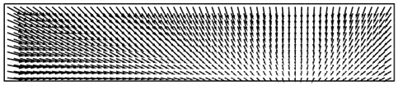
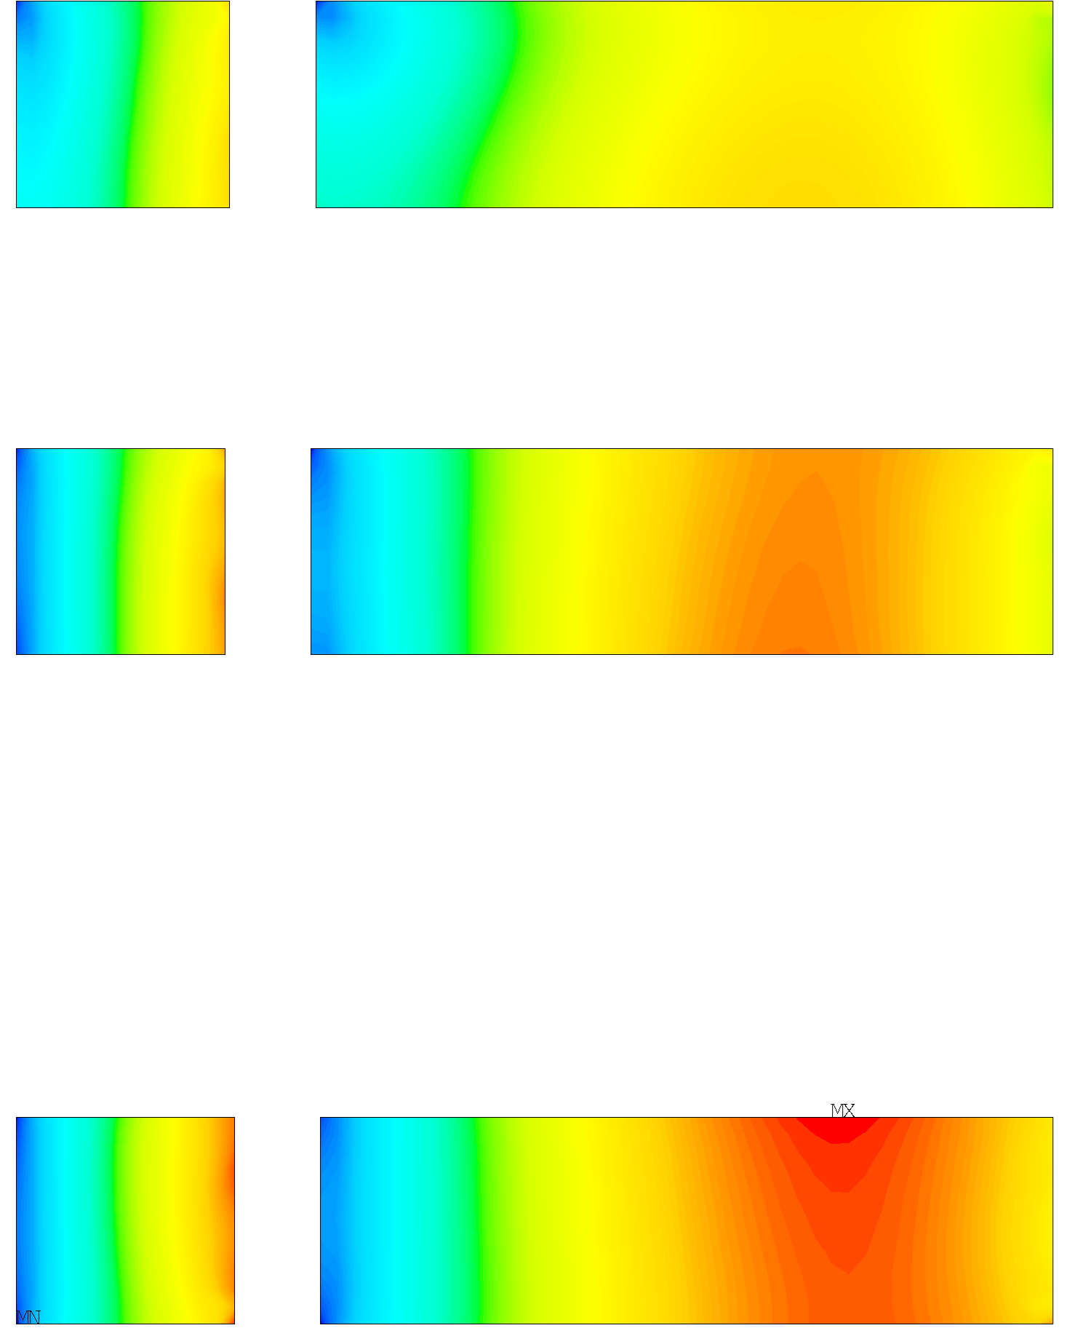
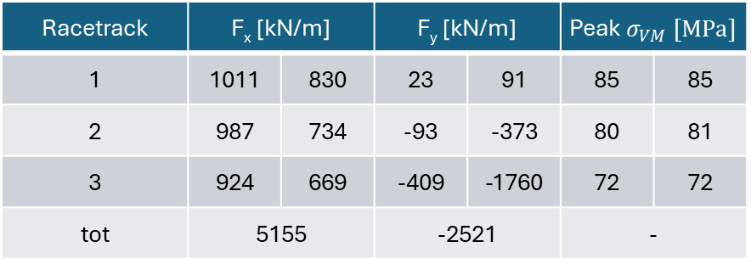
Stress management Strategy
N cond
N cond
5 mm
Strategy for lowering the stress due to Lorentz forces:
To intercept the horizontal Lorentz forces we split the racetracks in two at an optimized position that balance the stress distribution.
The septum is part of the infinitely rigid structure.
The septum thickness has been set to a reasonable value of 5 mm.
46
159
45
160
Racetrack | F_{x} [kN/m] |  | F_{y} [kN/m] |  | Peak $σ_{VM} [MPa]$
1 | 1011 | 830 | 23 | 91 | 85 | 85
2 | 987 | 734 | -93 | -373 | 80 | 81
3 | 924 | 669 | -409 | -1760 | 72 | 72
tot | 5155 |  | -2521 |  | -
47
158
$$σ_{VM} [MPa]$$
0
9
19
28
37
47
56
65
74
85
Notes:
Considering that most of the stress is due to the x components of the Lorentz forces, it has been introduced a 5 mm mechanical septum for each of the racetracks to intercept them. The position of the septum has been optimized for each block to obtain the less stress possible, resulting in a number of conductors before and after the stress management structure slightly different in each case. The results, as expected, is an halving of the VM stress, which is now 85 MPa.

Slide 15
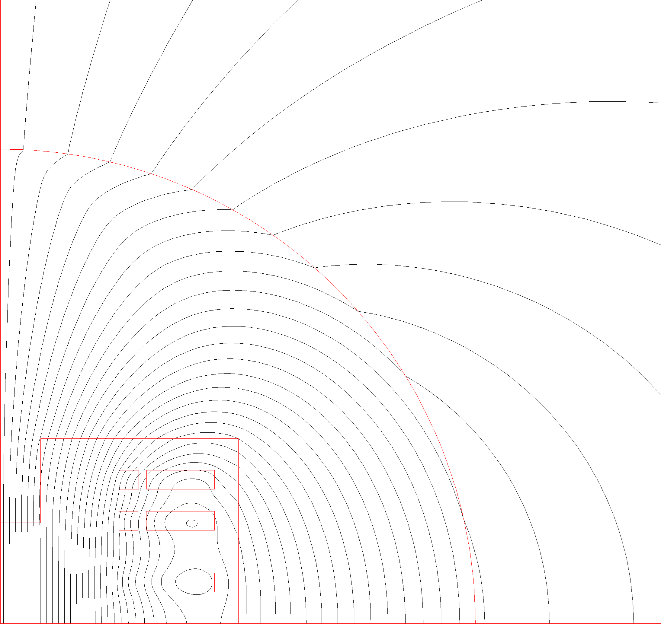

Stress Managed Magnetic Design
The new field homogeneity at x = 25 mm is about 0.04%.
The presence of the septum has no meaningful influence on the charging time and on the magnetization effect.
I [A] | J_{eng} [A/mm²] | B₀ [T] | B_{p} [T] | margin on load line | Energy [MJ] | Inductance [H]
2 356 | 727 | 10 | 12.34 | 22.8% | 2.34 | 1.3
+2% | +2% | - | -1.4% | -2.9% | +5% | -
$$B [T]$$
0.23
1.55
2.88
4.20
5.53
6.85
8.18
9.50
10.83
12.34
Notes:
To include the septum, the conductors on its left are in the same position of the baseline configuration, the one on the right are shifted of 5 mm. No other changes has been implemented in the design. The presence of the stress management structure has no meaningful influence on the magnetic performance, with a slightly increase in the current and energy stored, and a lowering of the margin by 2.9%, while the field quality is still well within the criteria.

Slide 16
Conclusions and Future Developments
Conclusions:
A solid 2D magnetic design is ready and it fulfils all the requirements:
  Good field quality and homogeneity over large aperture
  Large margin at high temperature (20 K, with 2.5 K T_{margin})
A strategy to mitigate the effect of the Lorentz Forces has been studied, through stress management concept.
A preliminar evaluation of dissipations and charging time is ready.
Next steps to be studied:
A detailed and optimized 2D and 3D mechanical design.
A 3D electromagnetic design.
An evaluation of the effect of persistent currents on the field quality.
Thermal analysis concerning both a more refined magnetization model and the effects of quench.
Notes:
The conclusions are that a solid 2D magnetic design is ready. Even if the preliminary mechanical analysis has showed no meaningful source of concern, a mitigation strategy to intercept the Lorentz forces has been optimized in case the infinitely rigid structure assumption is too much non-conservative. The next steps for the project include a true mechanical design, the 3D magnetic design with the evaluation of the integrated field quality, possibly taking into account also the effect of the persist currents and finally a thermal model that better integrate the effect of magnetization and a quench simulation.

Slide 17
Thanks for your attention
F. Levi¹, L. Alfonso¹, L. Balconi^{2,3}, A. Bersani¹, L. Bottura⁴, B. Caiffi¹, S. Fabbri⁴, S. Farinon¹, A. Gagno^{1,5},
T. Maiello^{1,5}, F. Mariani^{2,6}, S. Mariotto^{2,3}, D. Novelli^{1,5}, A. Pampaloni¹, C. Santini², S. Sorti^{2,3}, M. Statera²
¹ INFN – Genova, ² INFN – Milano, ³ University of Milan, ⁴ CERN, ⁵ Università degli Studi di Genova, ⁶ Sapienza Università di Roma

Slide 18
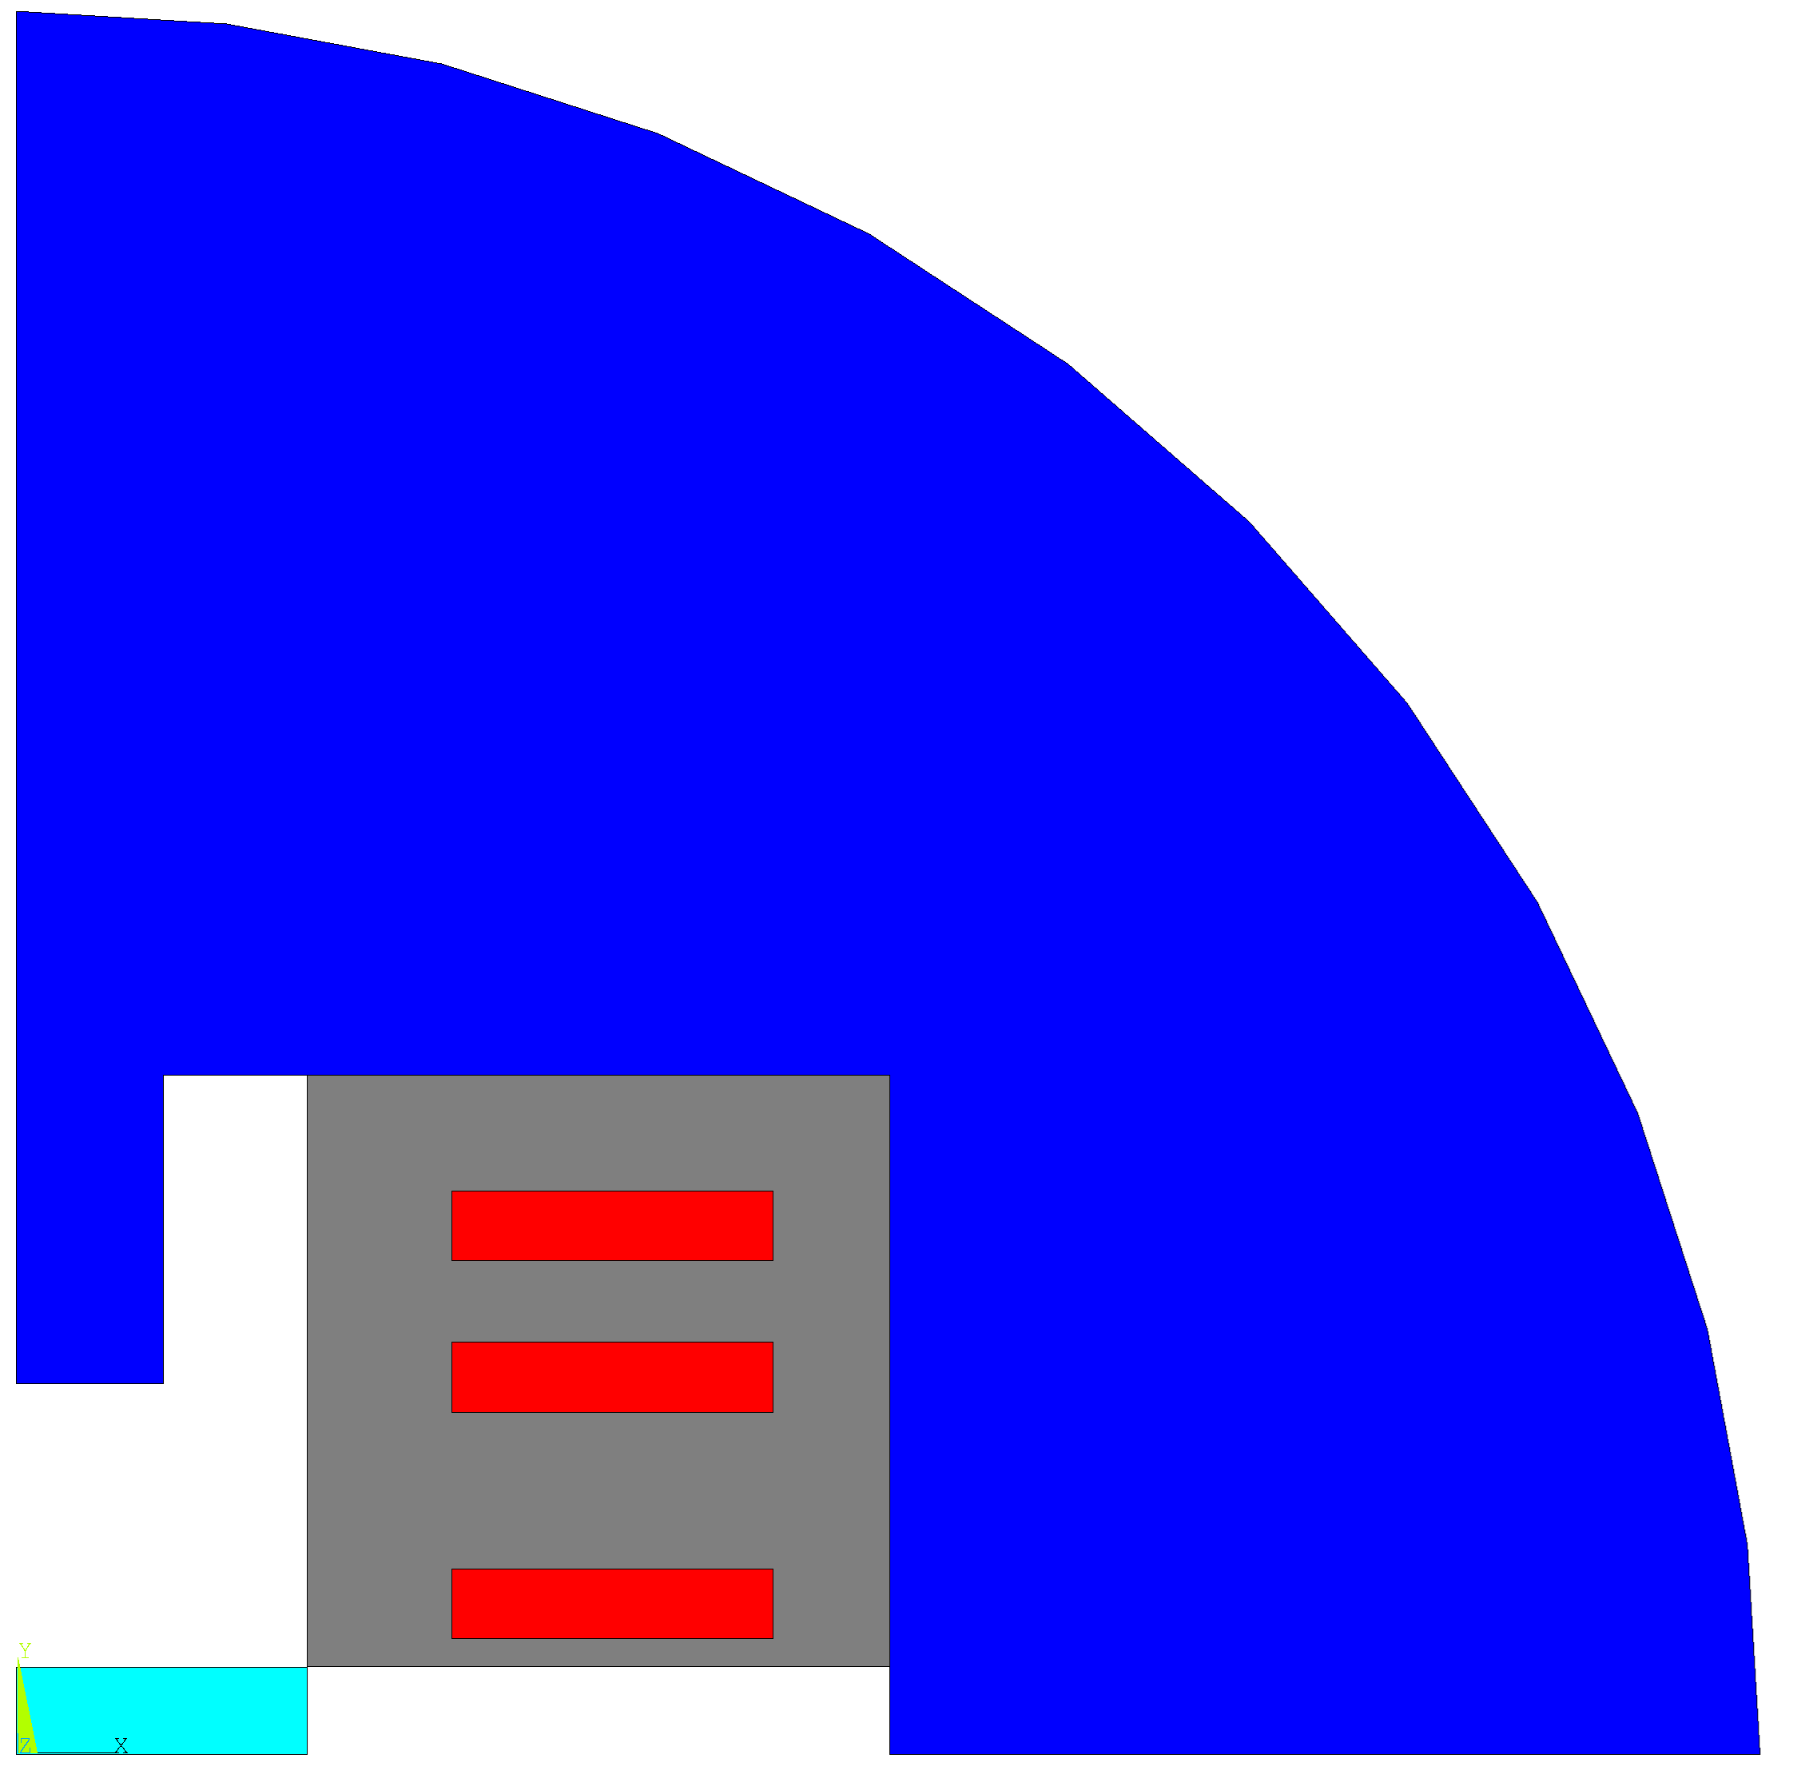
Costs
Costs hypothesis:
2500 €/kg of YBCO superconductor.
8 €/kg of iron.
10 €/kg of SS for mechanical structure.
Conductor | 160 k€/m
Iron yoke | 14 k€/m
Mechanical structure | 3 k€/m
Assembly | 20 k€/m
Total cost | 197 k€/m
Aperture

Slide 19
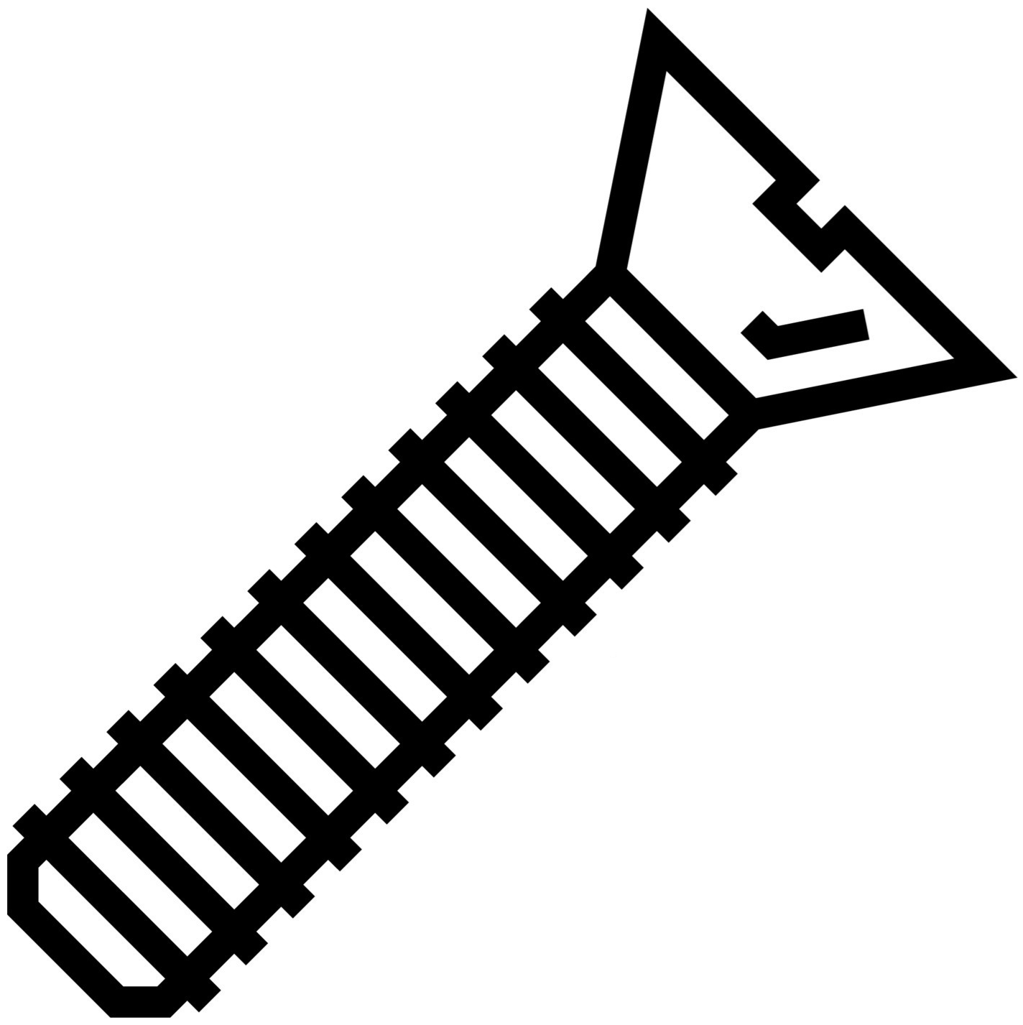
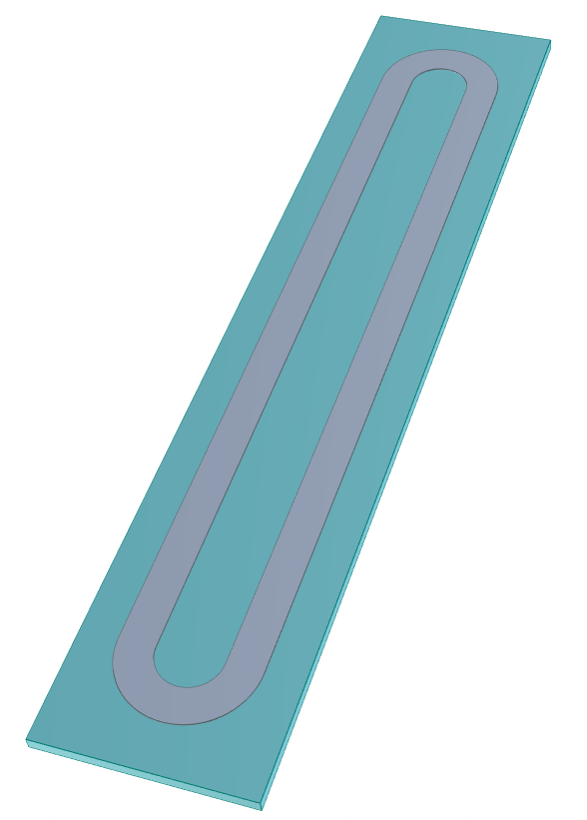
case
Very preliminary mechanical concept:
SS both inside and outside of the racetrack.
Threads to convey the preload from outside.

Slide 20
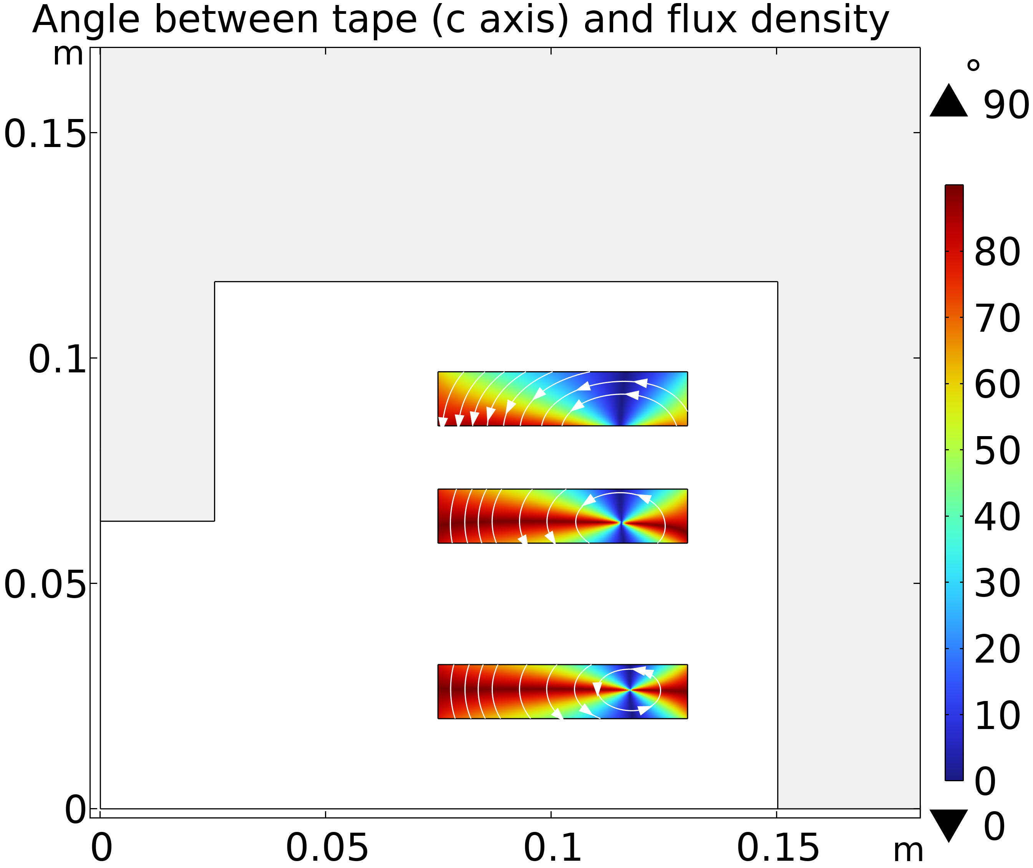
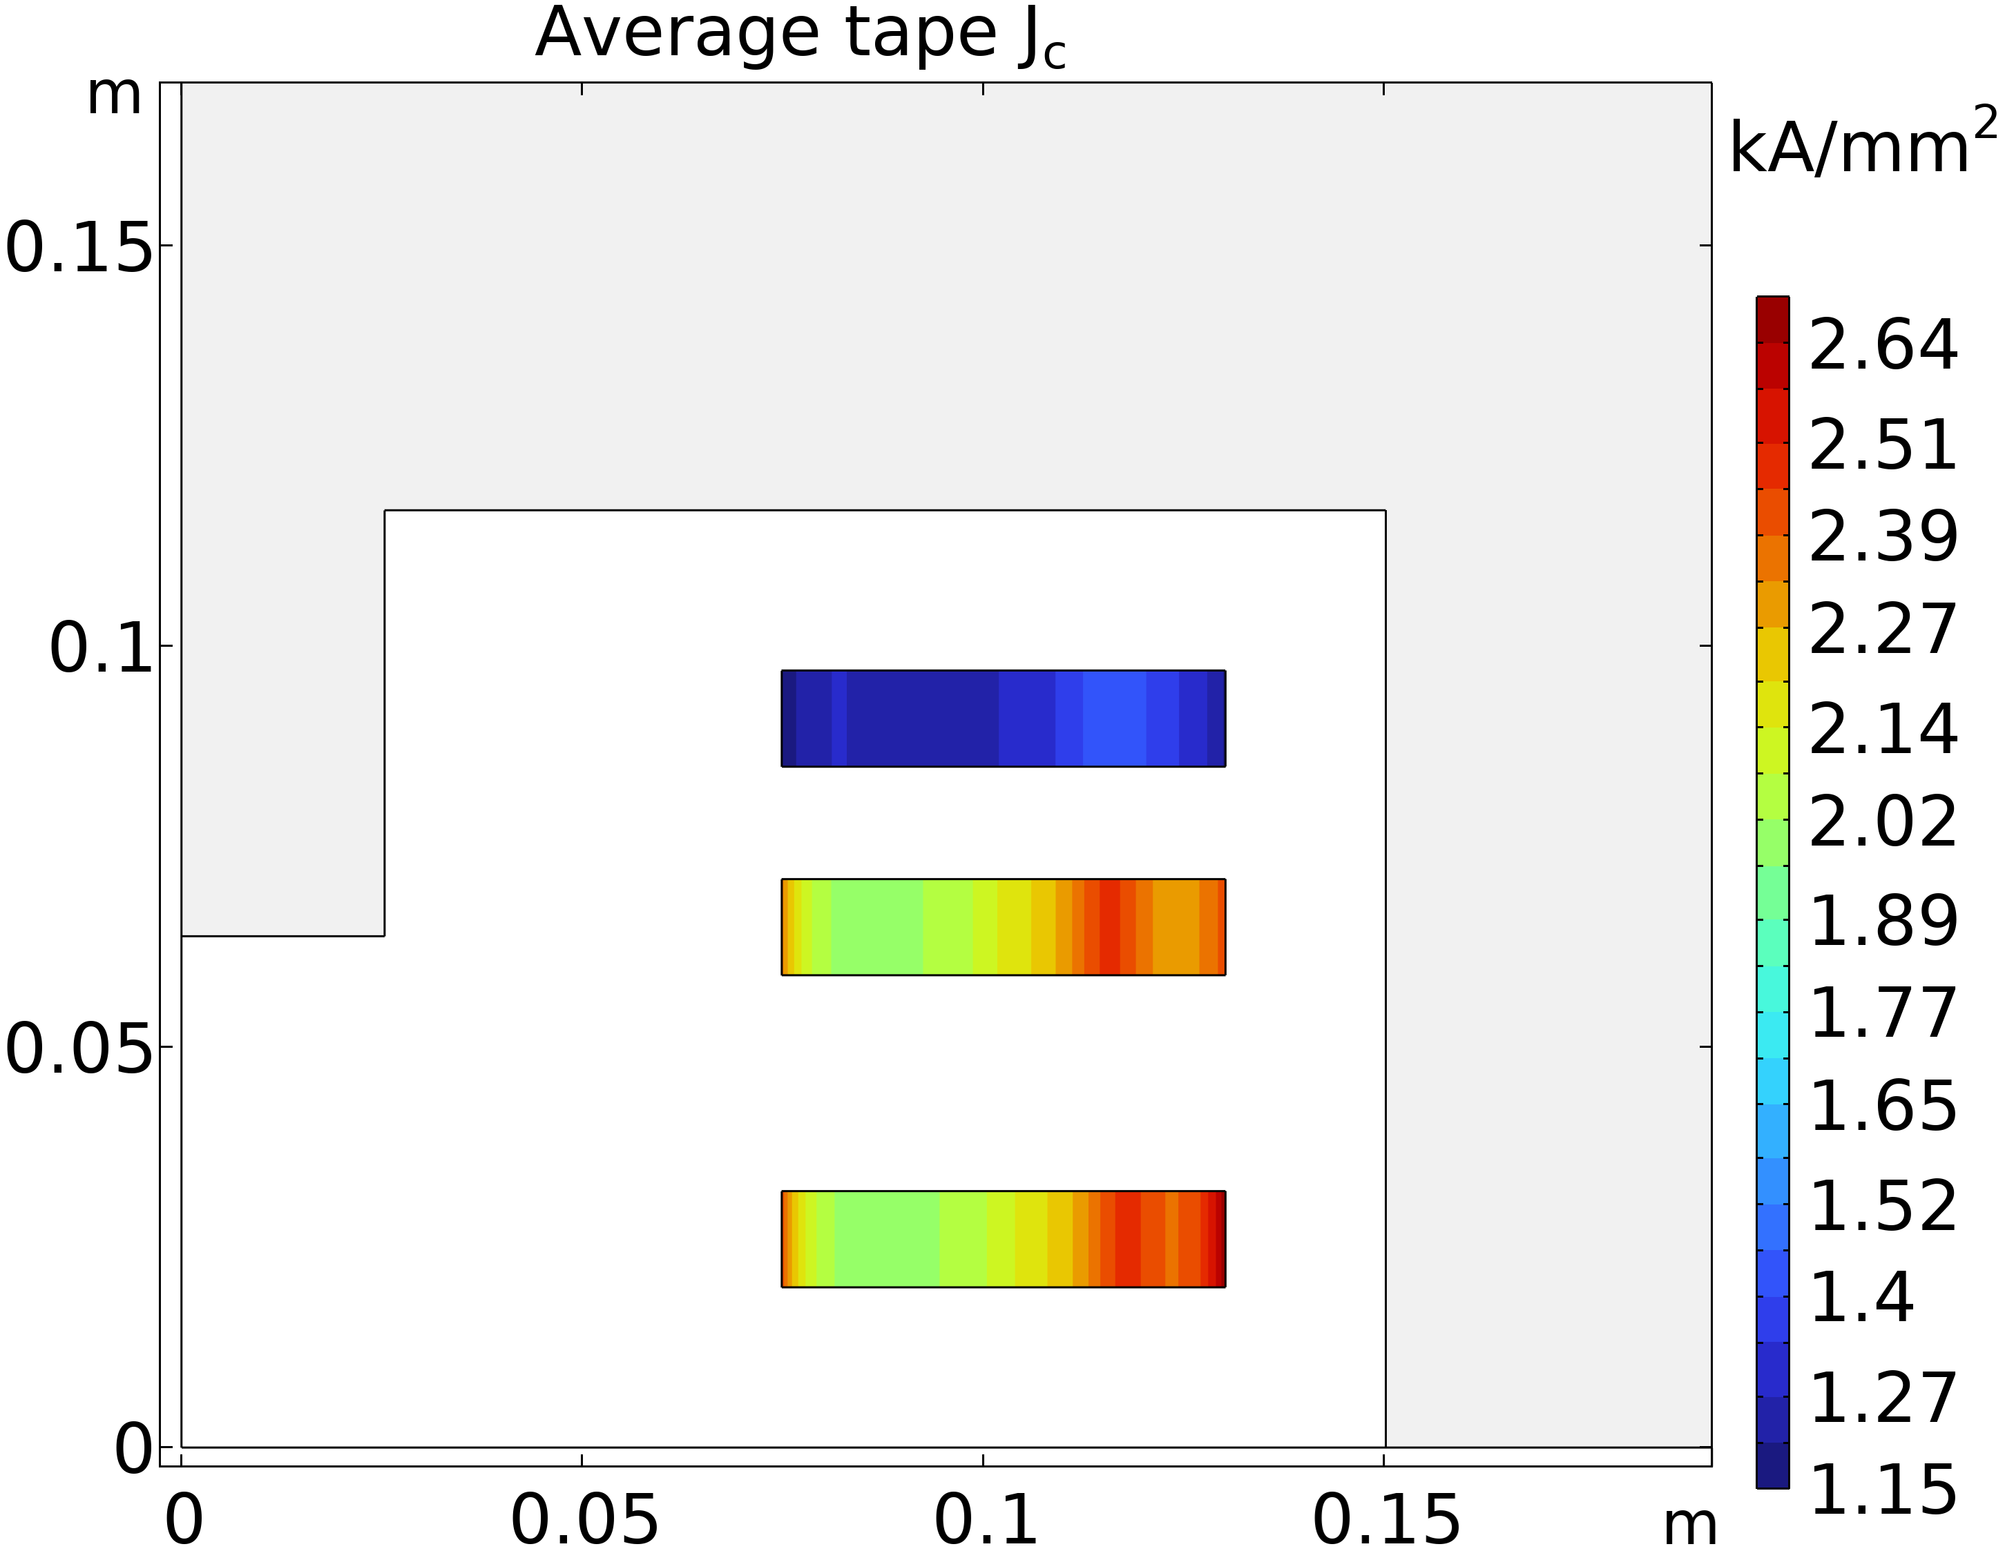
More details on basic configuration

Slide 21
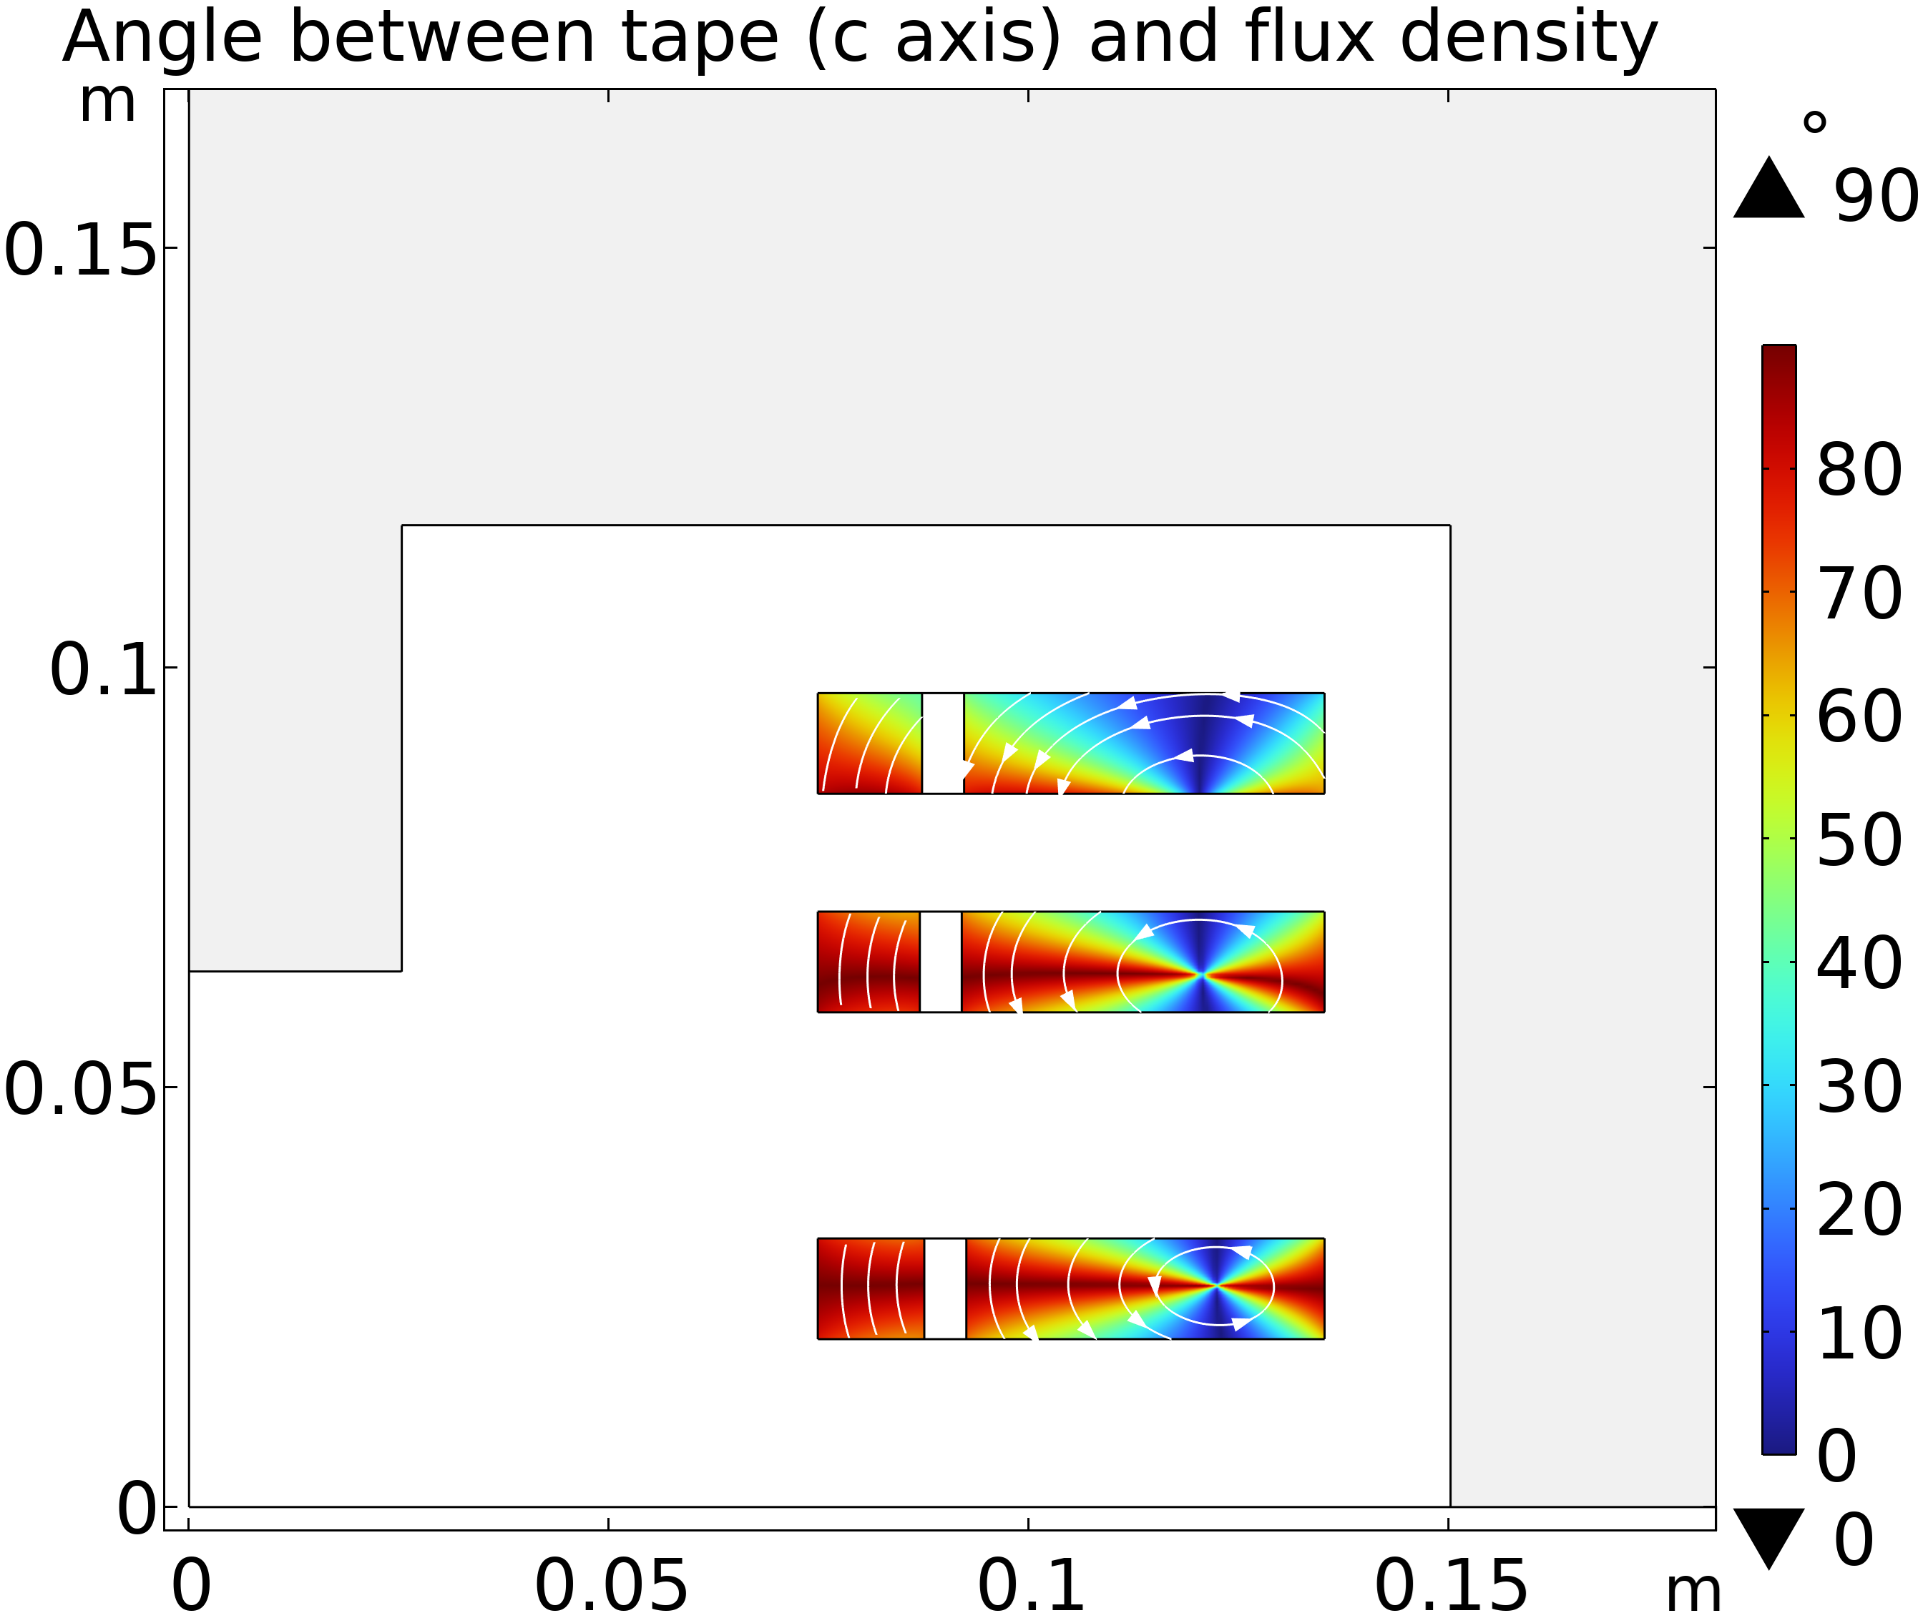
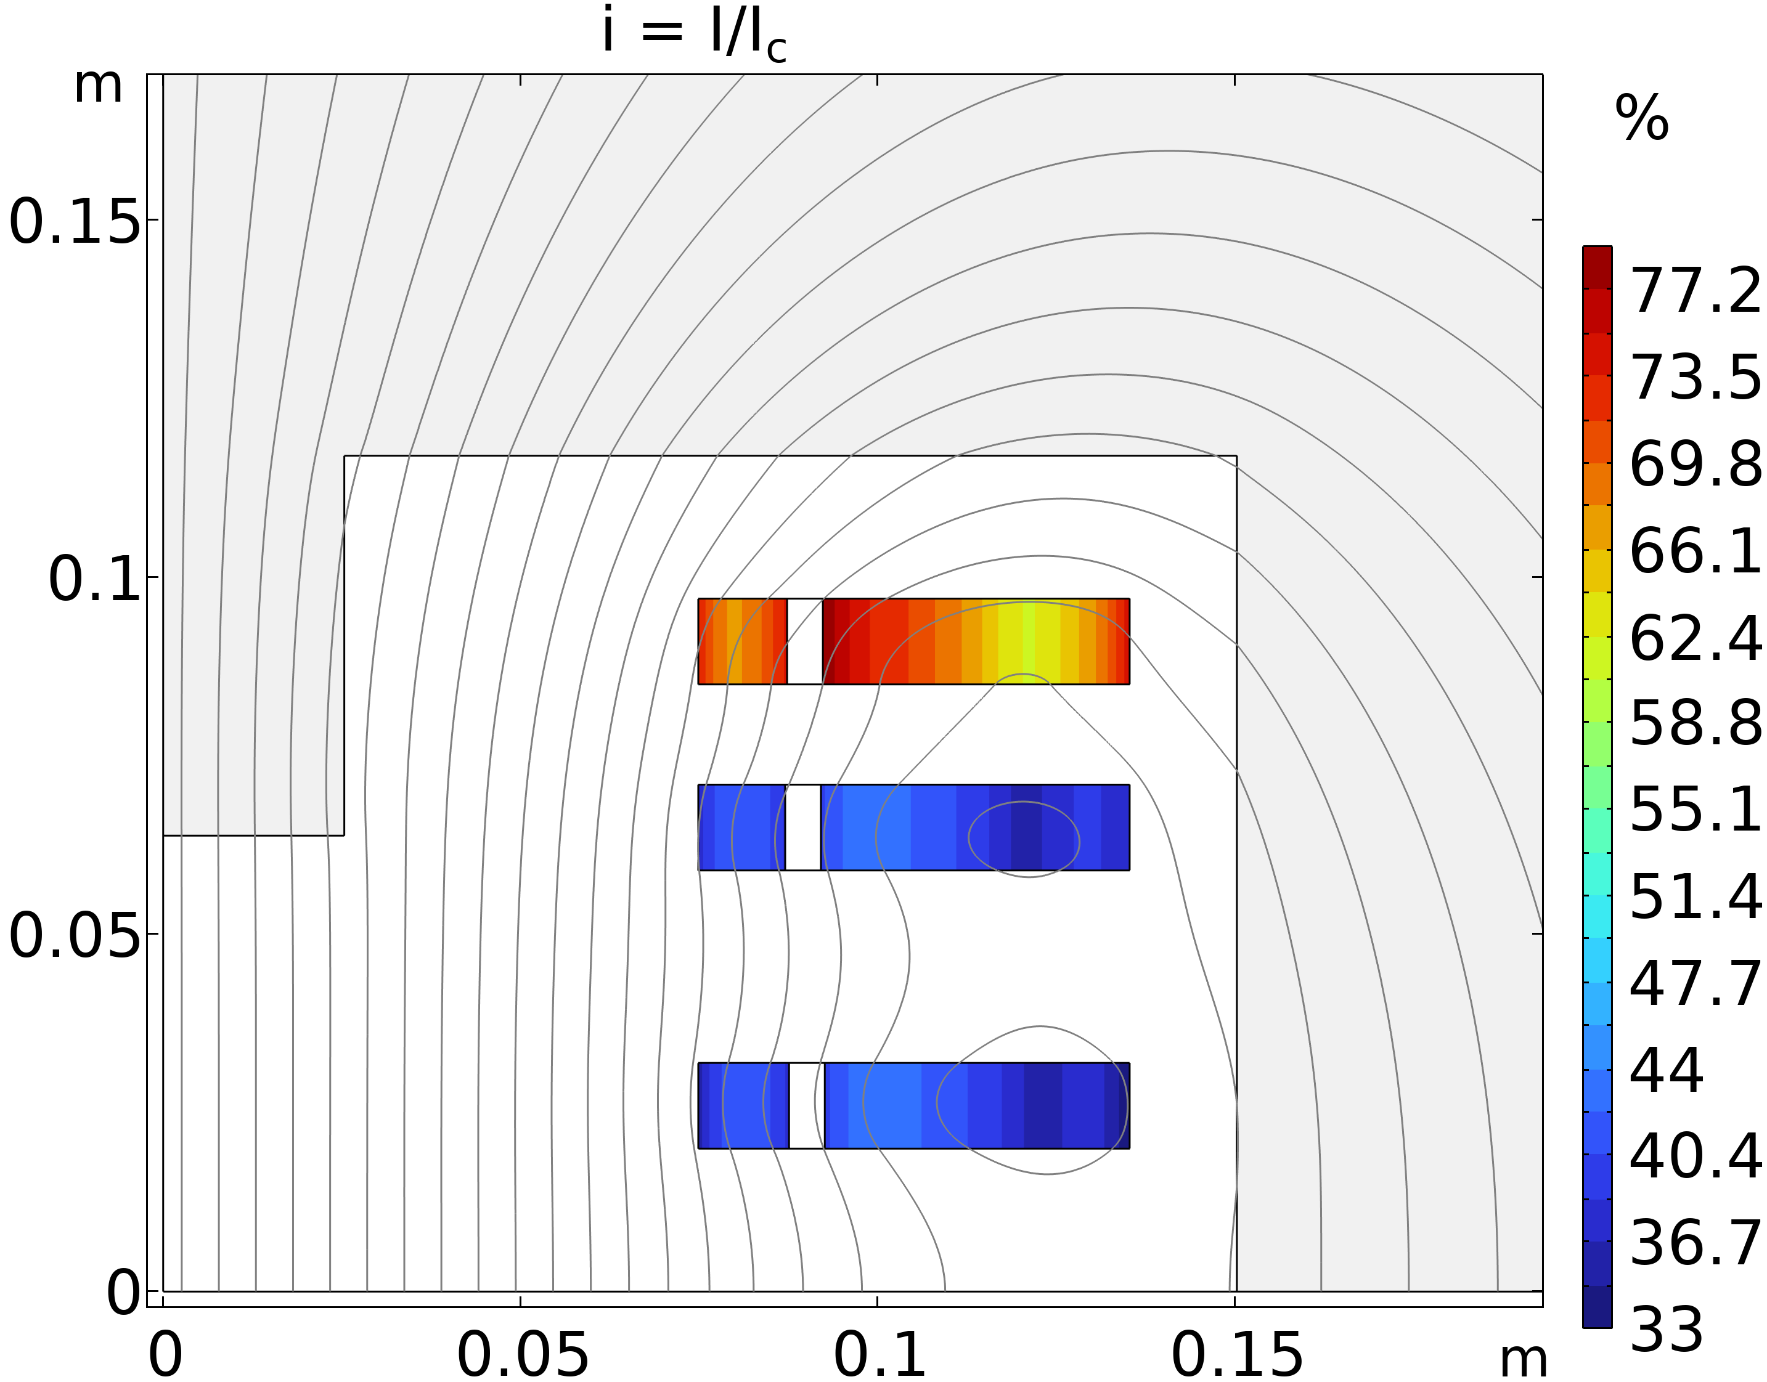
More details on septum configuration

Slide 22
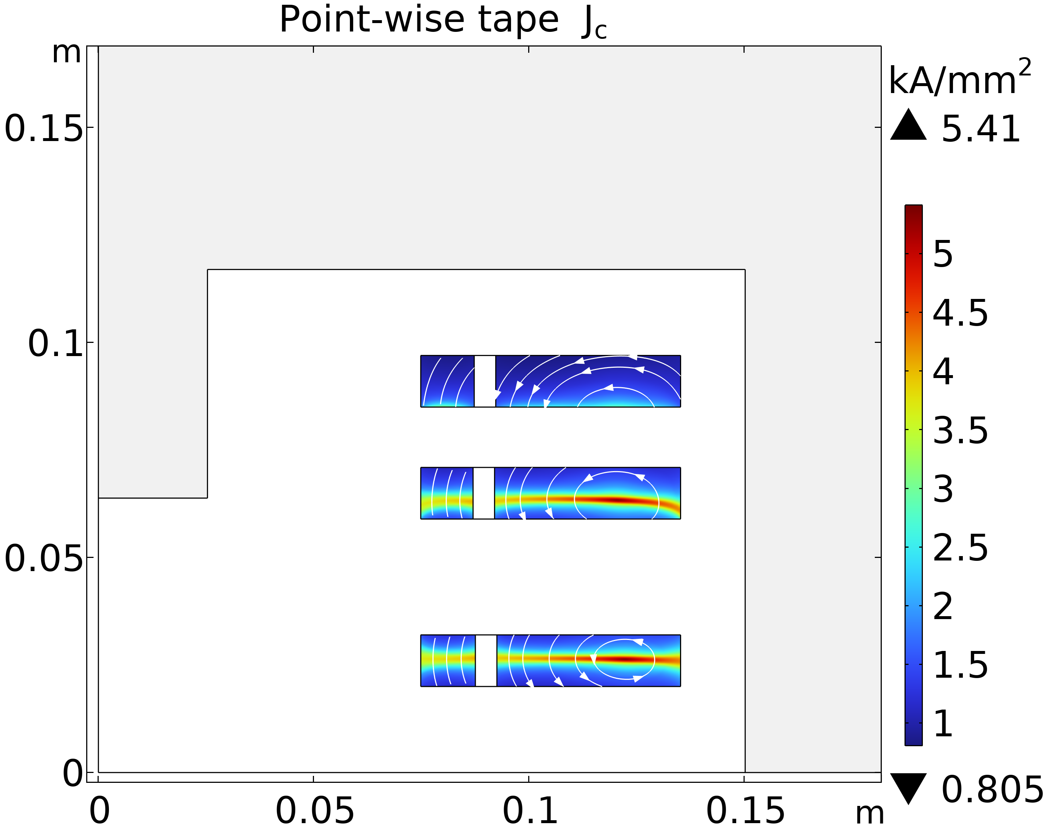
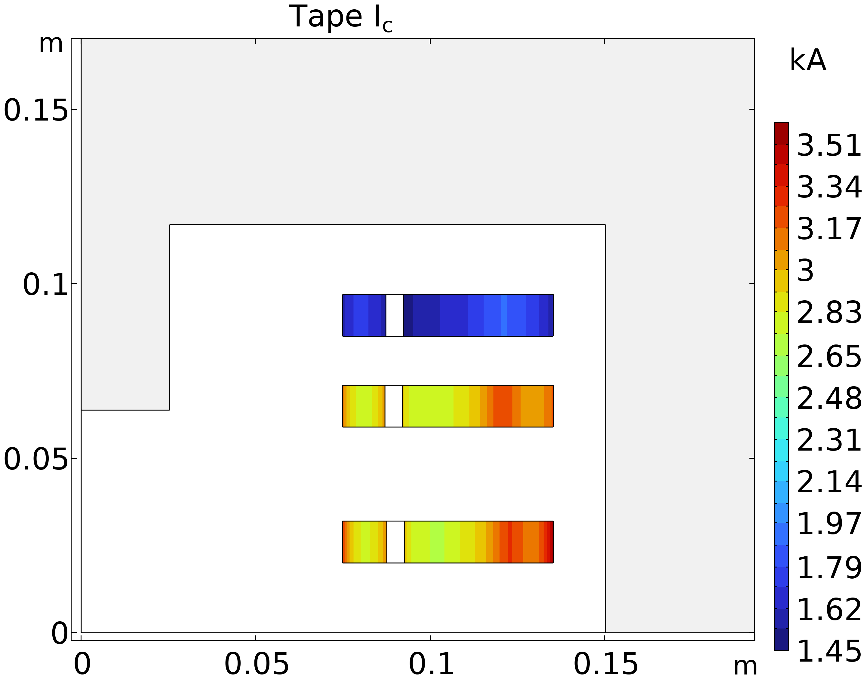
More details on septum configuration

Slide 23
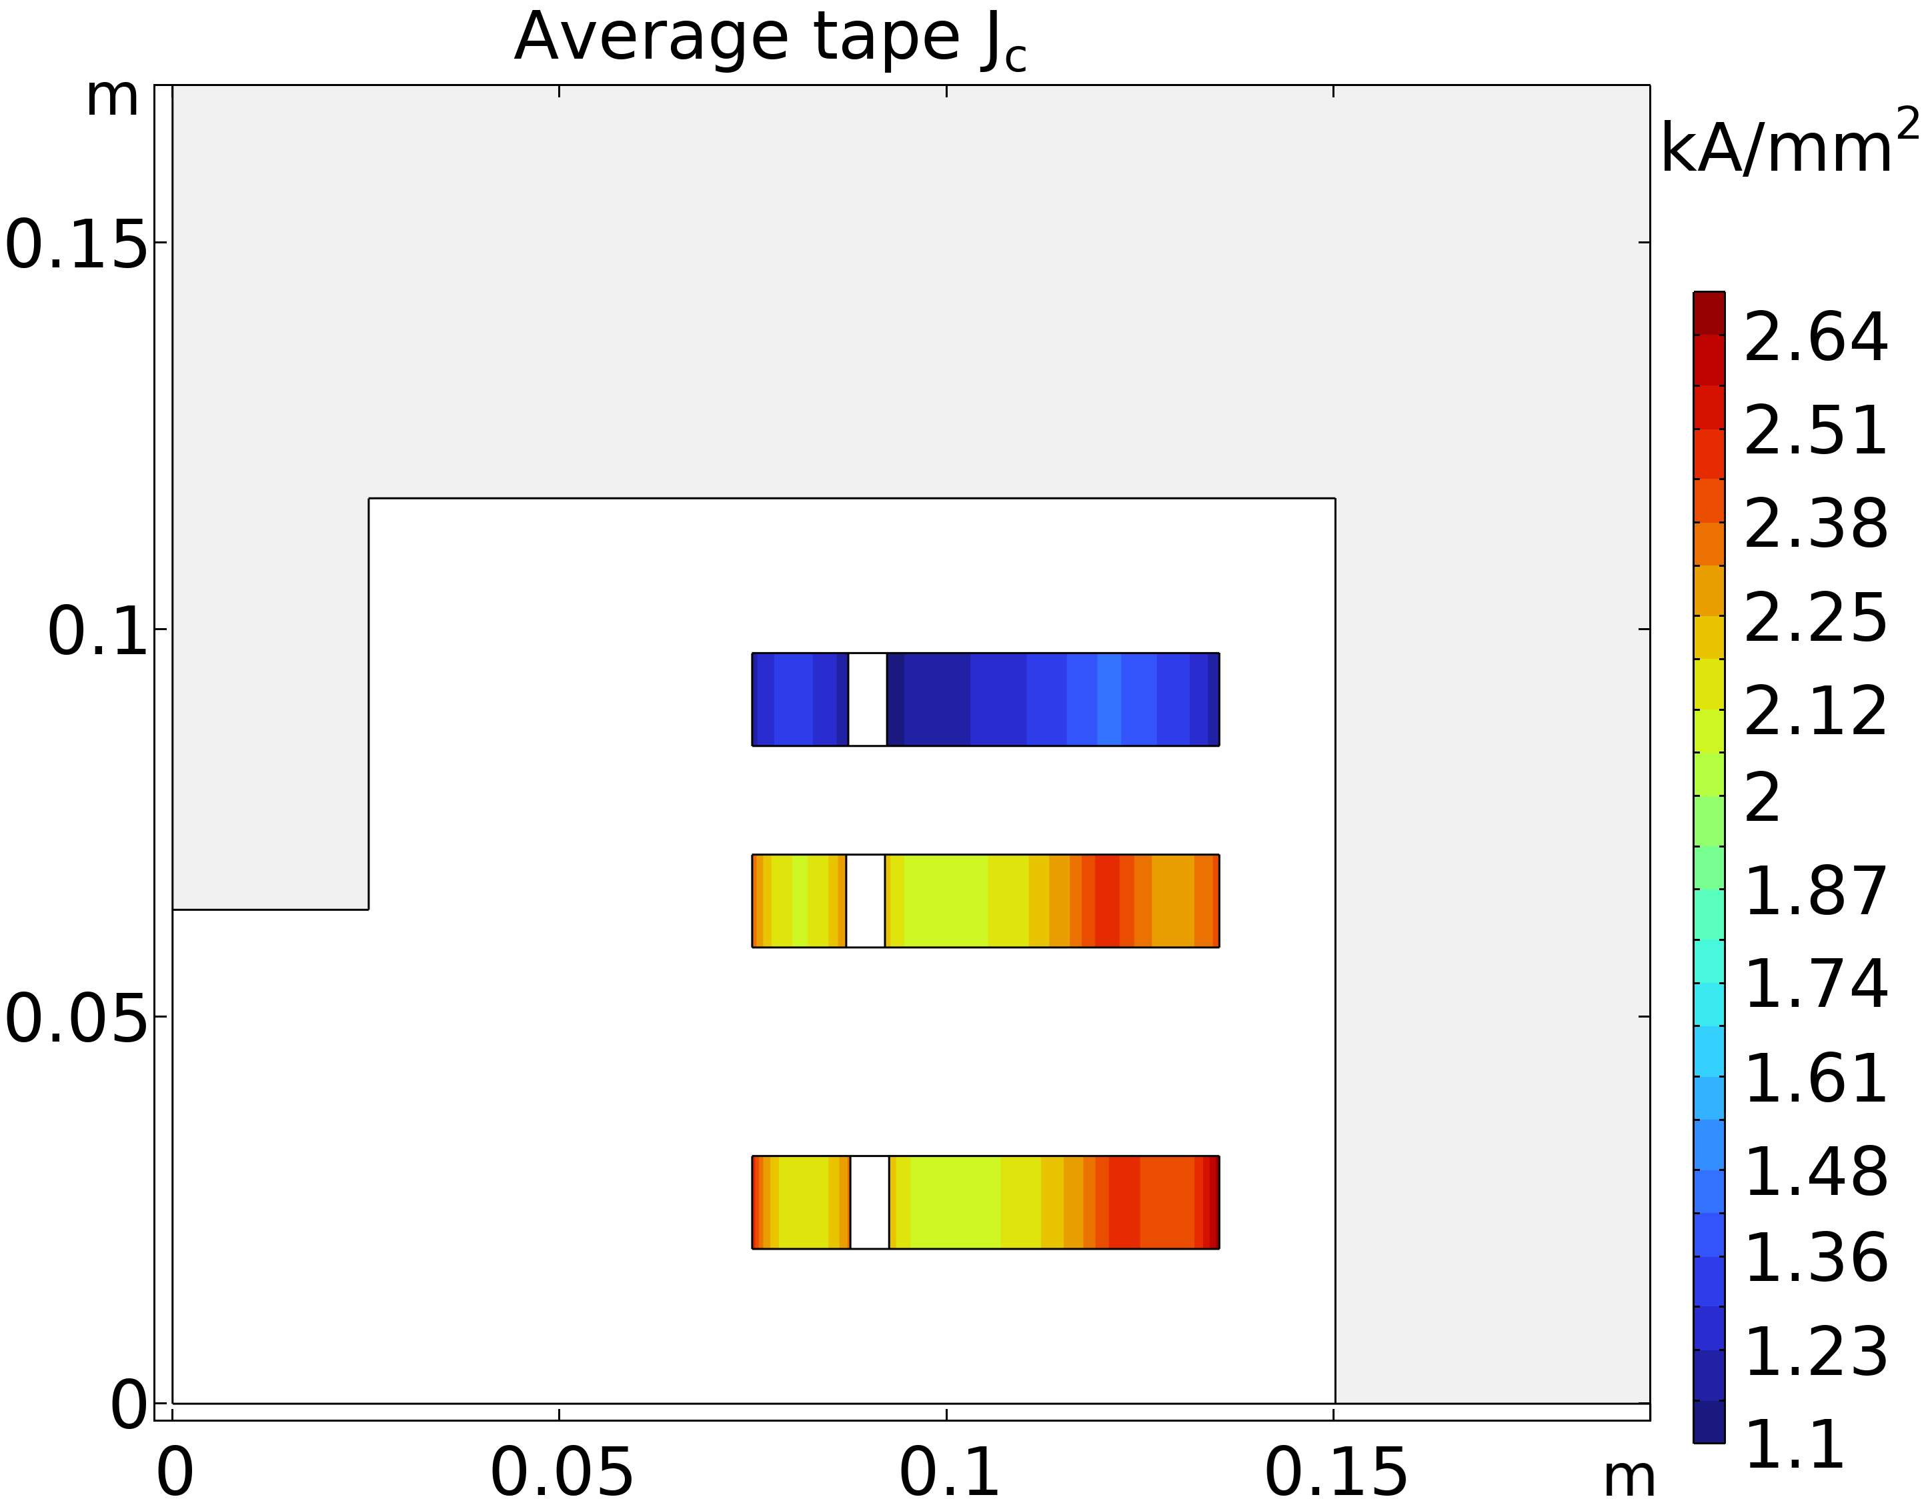
More details on septum configuration
0.0035 T

