Slide 1

Thermo-mechanical analysis of
ReBCO tapes and stacks
S. Hoell, Ó. Sacristán
11/7/2024

Slide 2
Outline
Campaign status
Thermal analysis
  Examined tapes and stacks
  Measurement configuration
  Results
Upcoming measurements

Slide 3
Campaign status
Thermal Analysis
Mechanical Testing

Slide 4
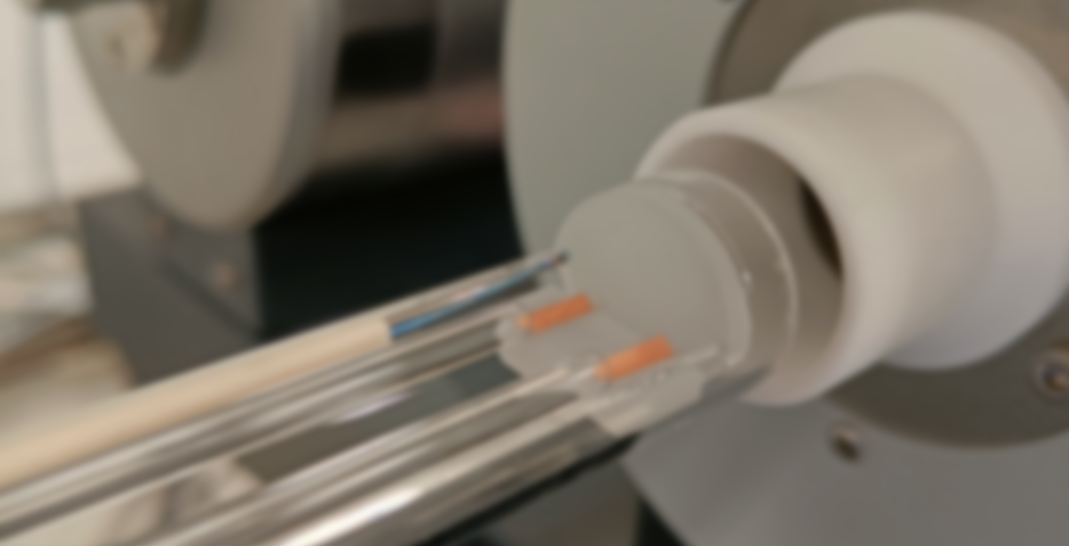
Thermal analysis

Slide 5
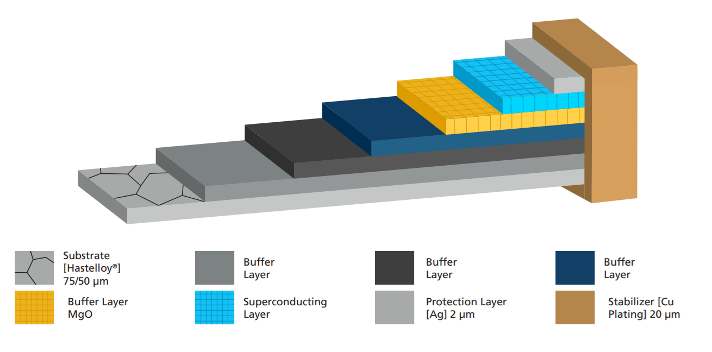
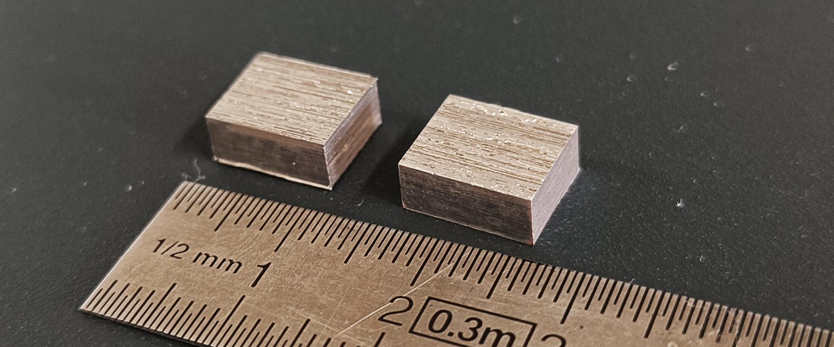
Examined material
Tapes
  SS304 tape (50 µm thickness)
  → proof of method
  FESC-SCH04 from Fujikura
  TPL4421 from THEVA
Stacks
  Stack of tapes of TPL4421 (bonded by tin)
    in-plane
    through-plane

Slide 6
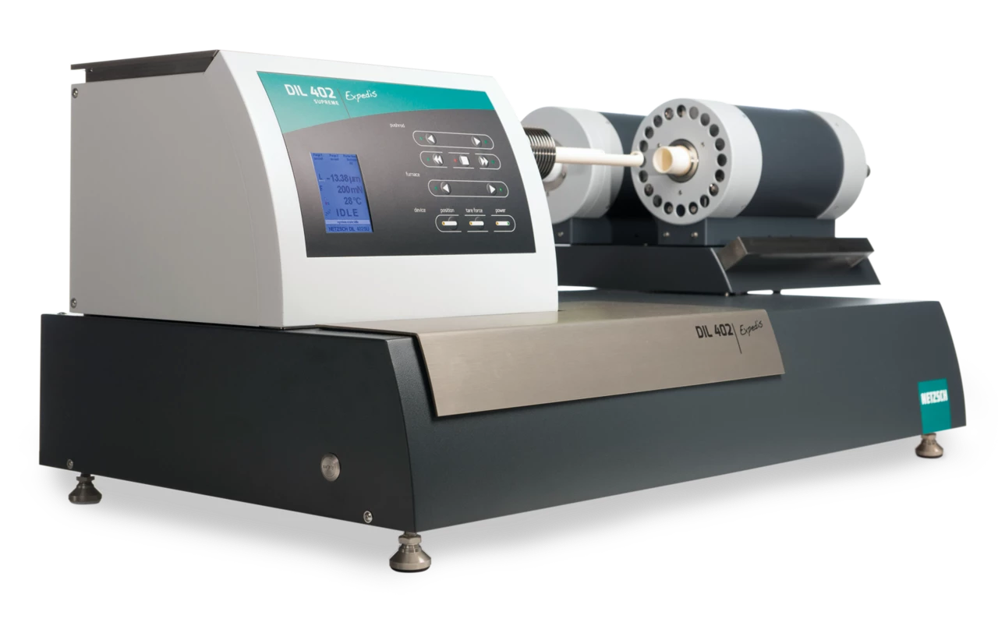
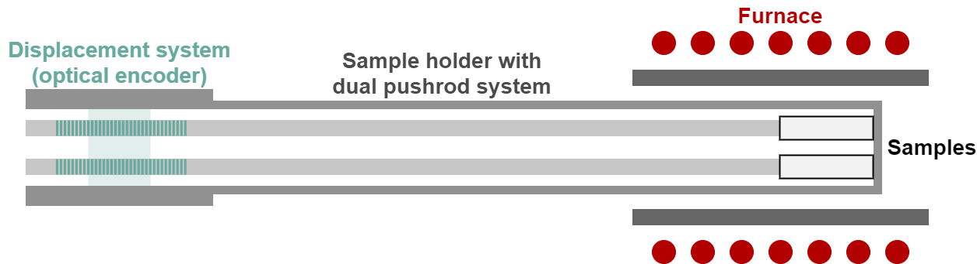
Measurement configuration
Push-rod dilatometer with dual push-rod system
  NETZSCH 402 Expedis SU
  Accuracy in the 2-5 % range
Configuration
  Copper furnace + fused silica sample holder
  (-175 to 500 °C)
  Helium atmosphere (50 ml/min)
  Contact force of 0.2 N
Actual measurement
Isothermal at -175 °C
Heating with 2 K/min
Isothermal at 110 °C
Cooling with 5 K/min
Isothermal at 10 °C

Slide 7
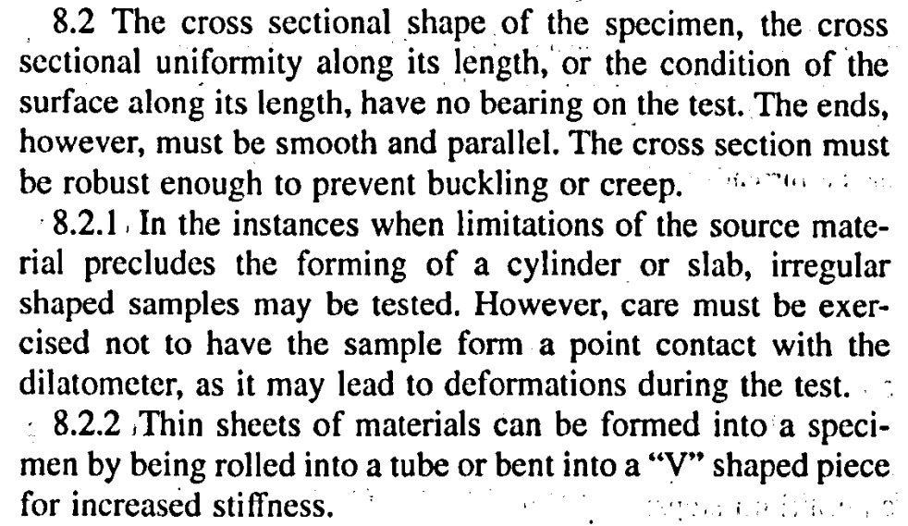
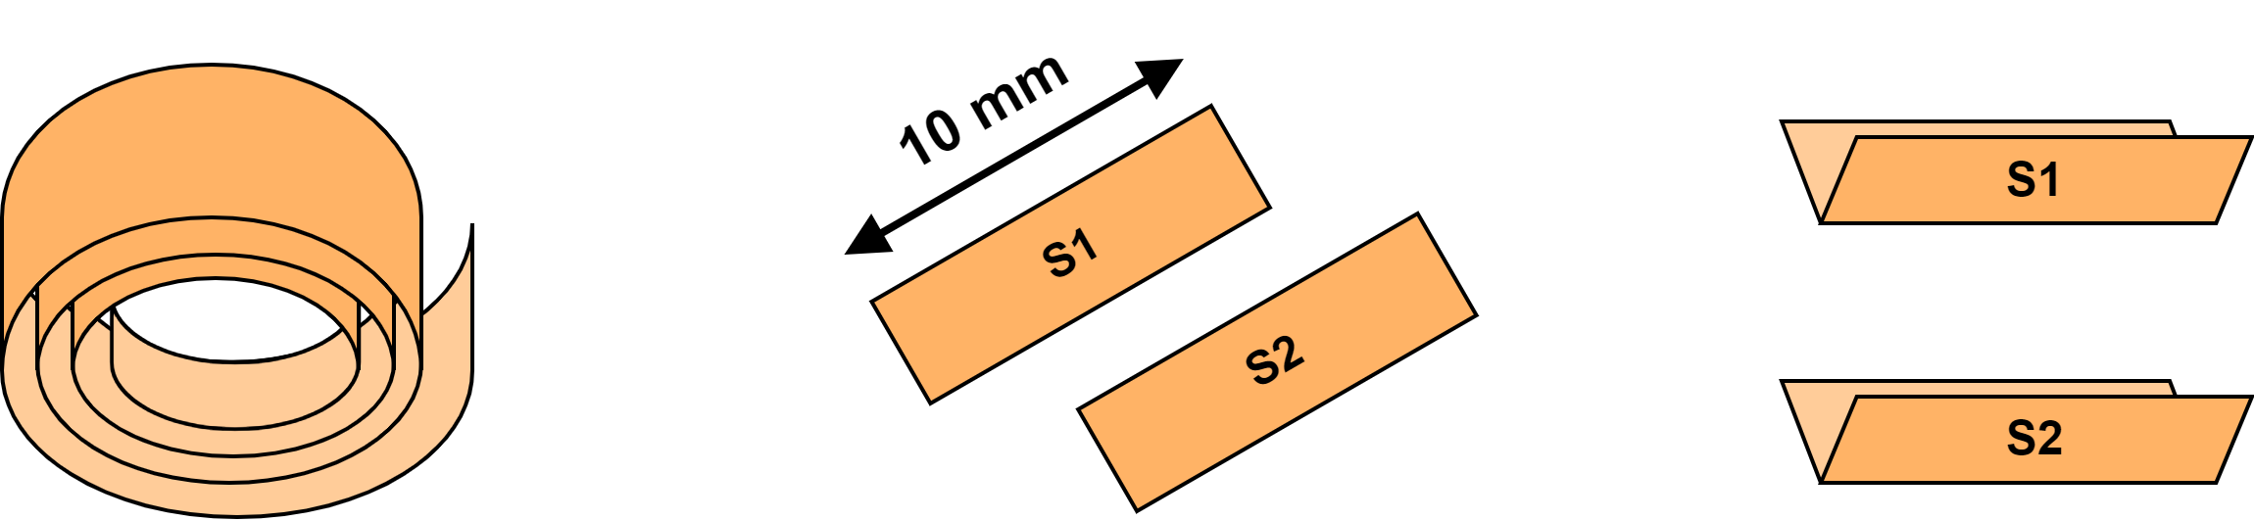
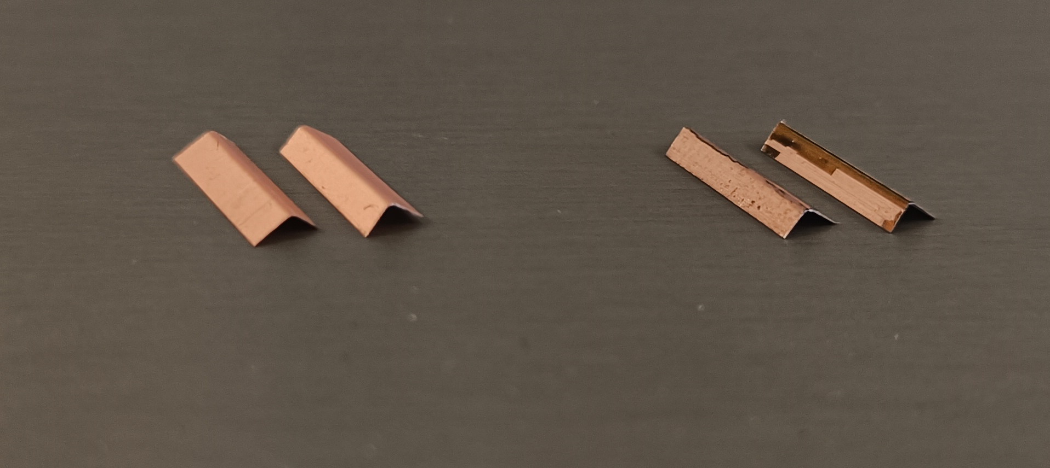
Sample preparation
The tape itself is not rigid enough to prevent buckling of the samples
  Standard (ASTM E228) proposes to introduce a plastic bend along the
  measurement axis to significantly increase the stiffness
Procedure
  Extracting 10 mm long samples with a scissor
  Bending samples along their axis (= perpendicular to the edges of the two extremities)
  During this procedure, the samples were fixated using Kapton tape
FESC-SCH04
TPL4421

Slide 8
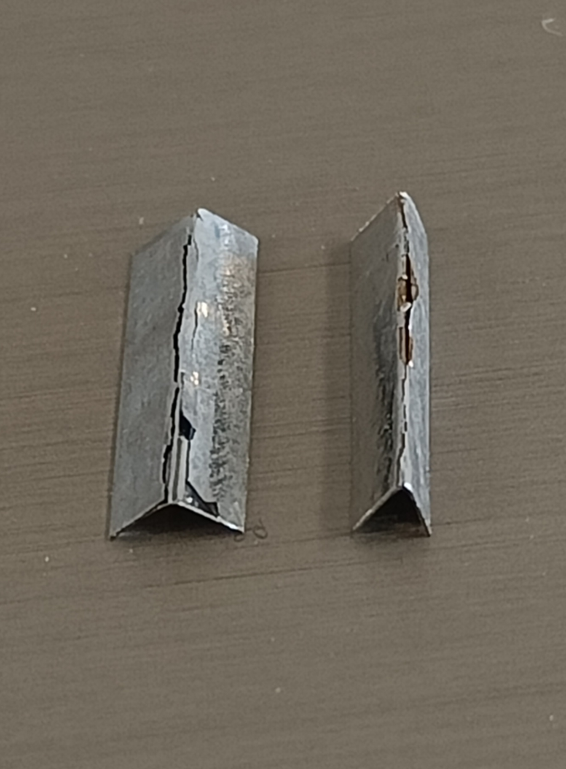
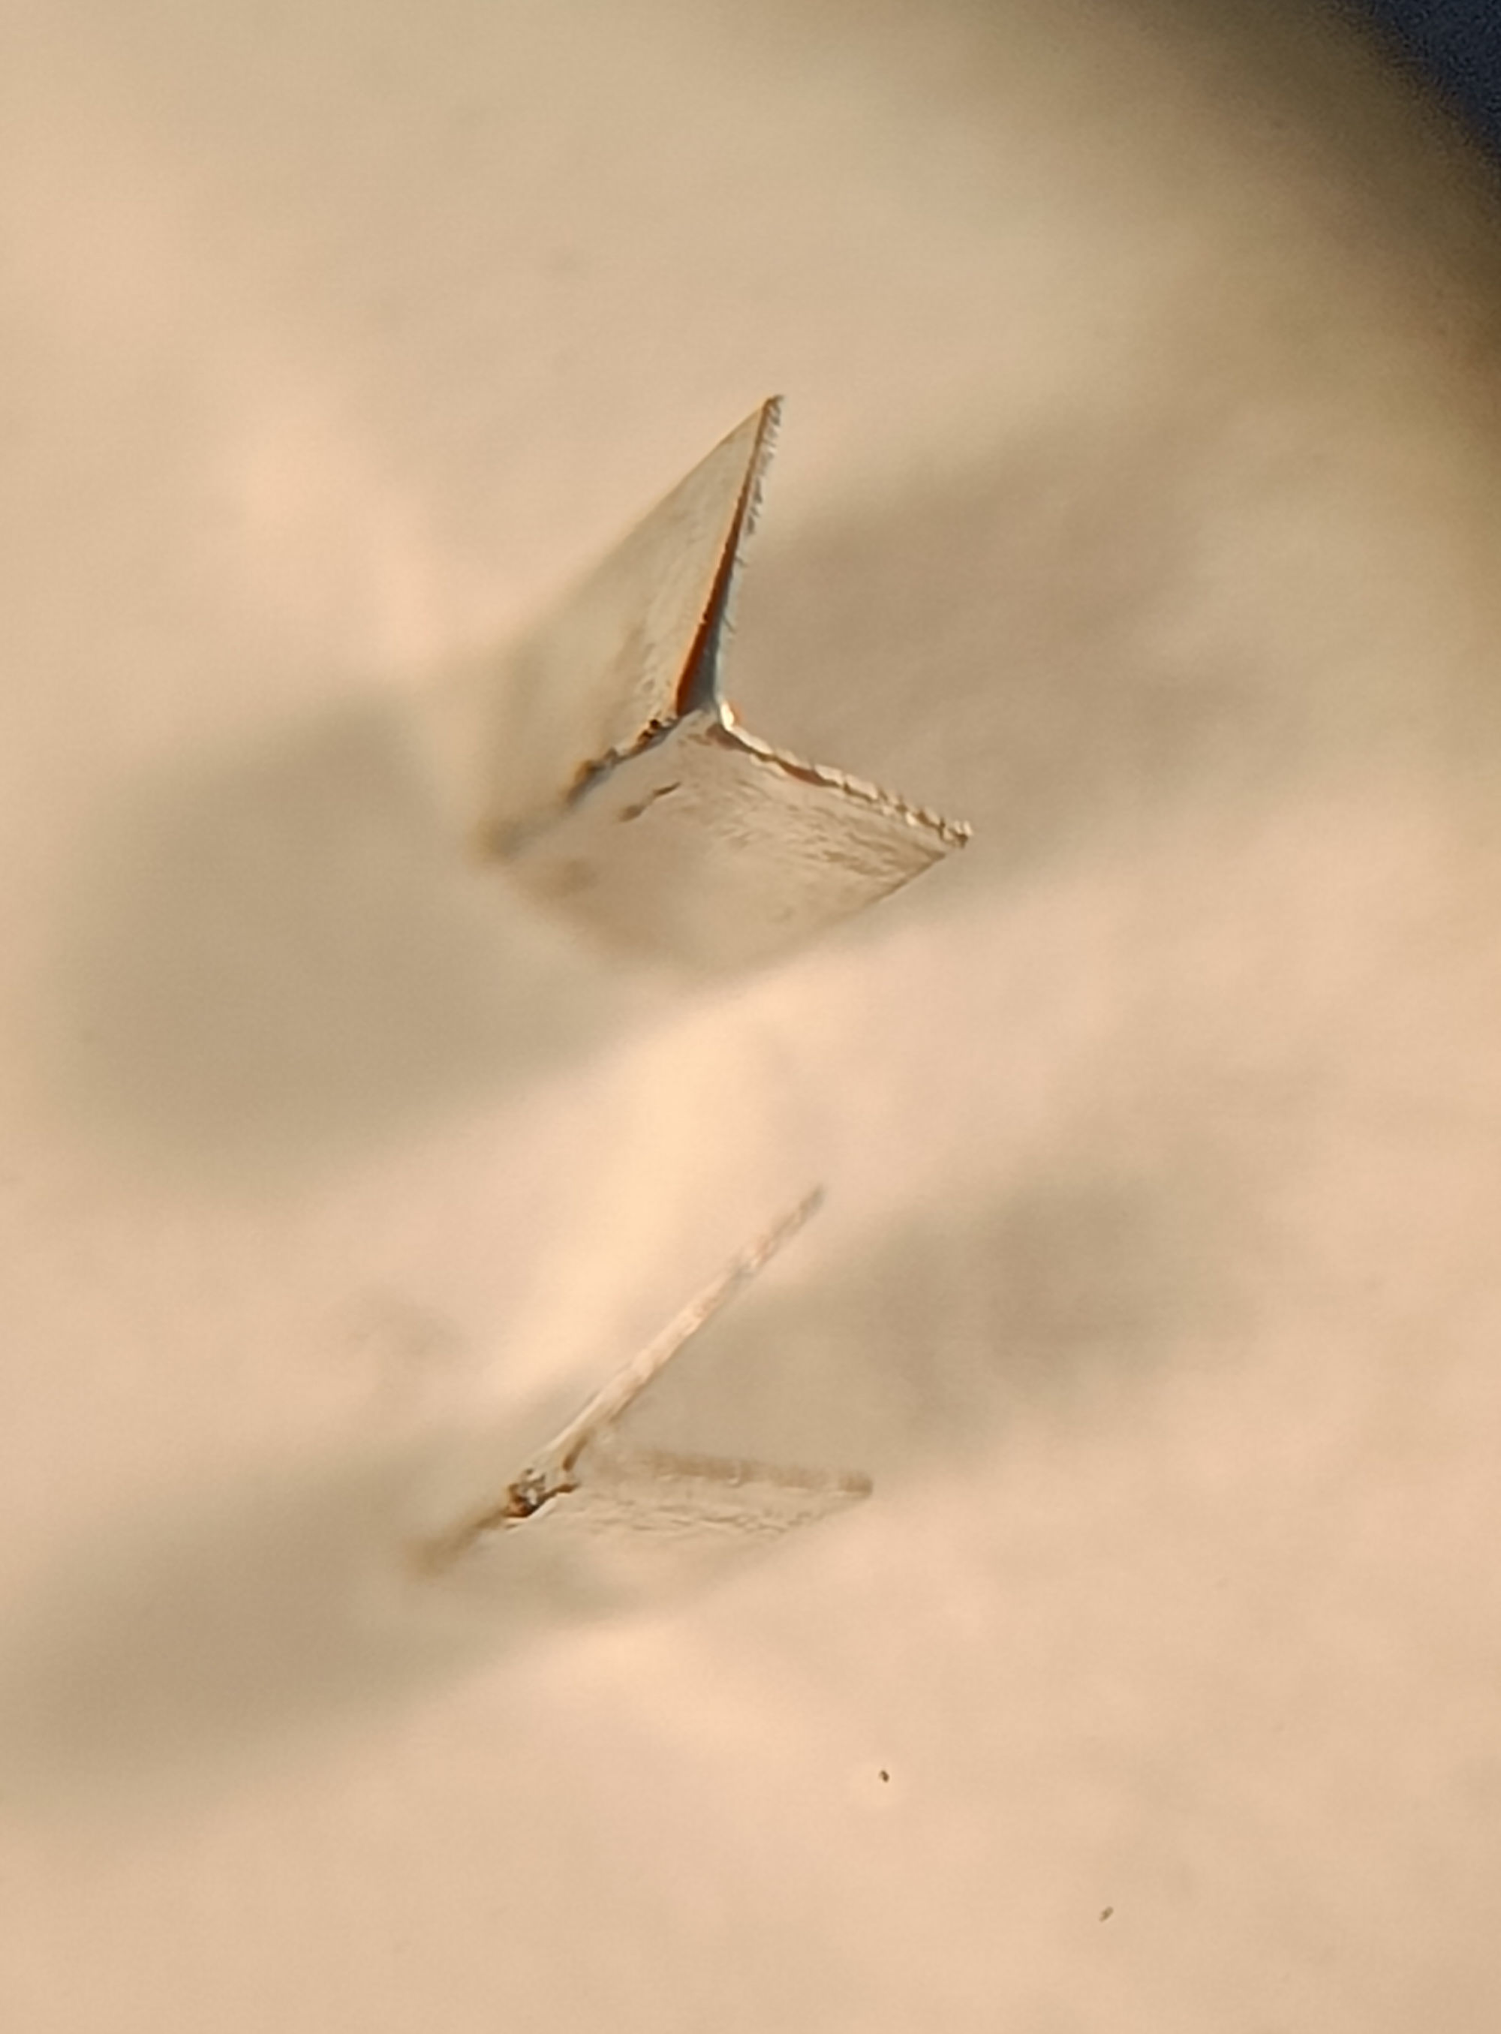
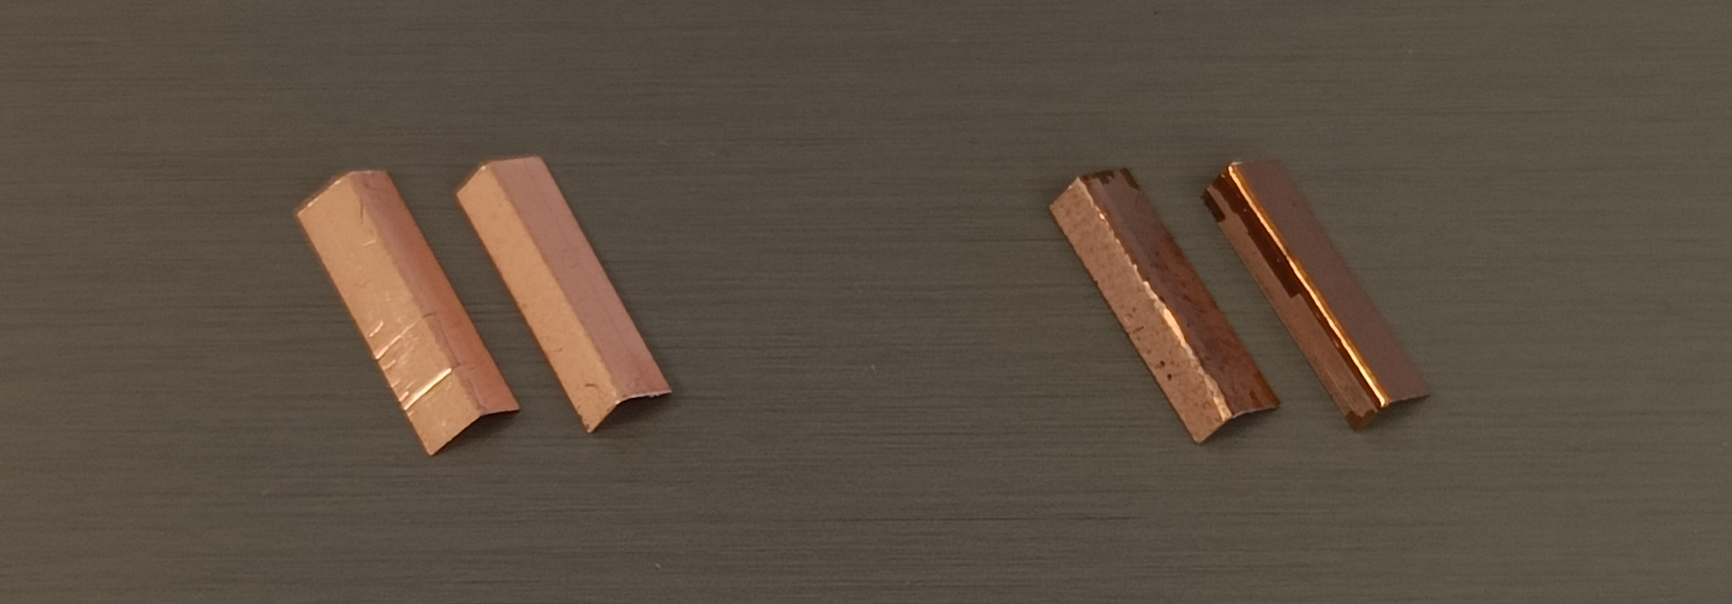
Sample preparation – delamination
Delamination occurred on the samples extracted from a soldered stack
Bending did not cause any clearly visible delamination for the other tapes
  Only small cracks visible for one of the TPL4421 samples (extracted from pristine tape)

Slide 9
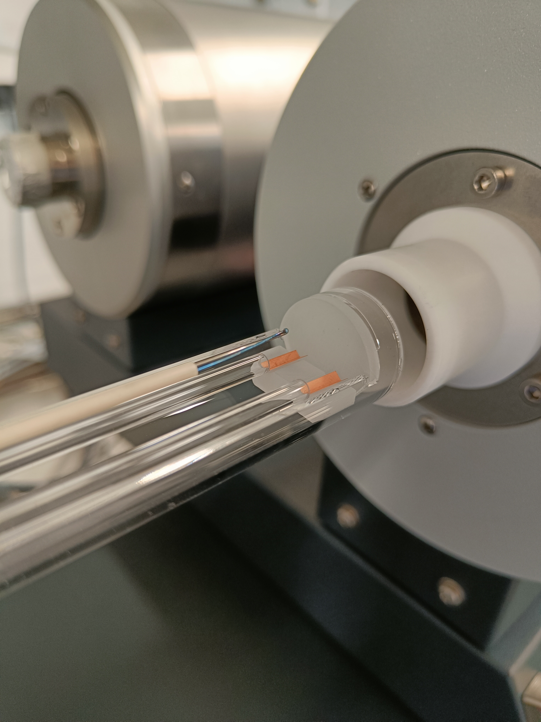
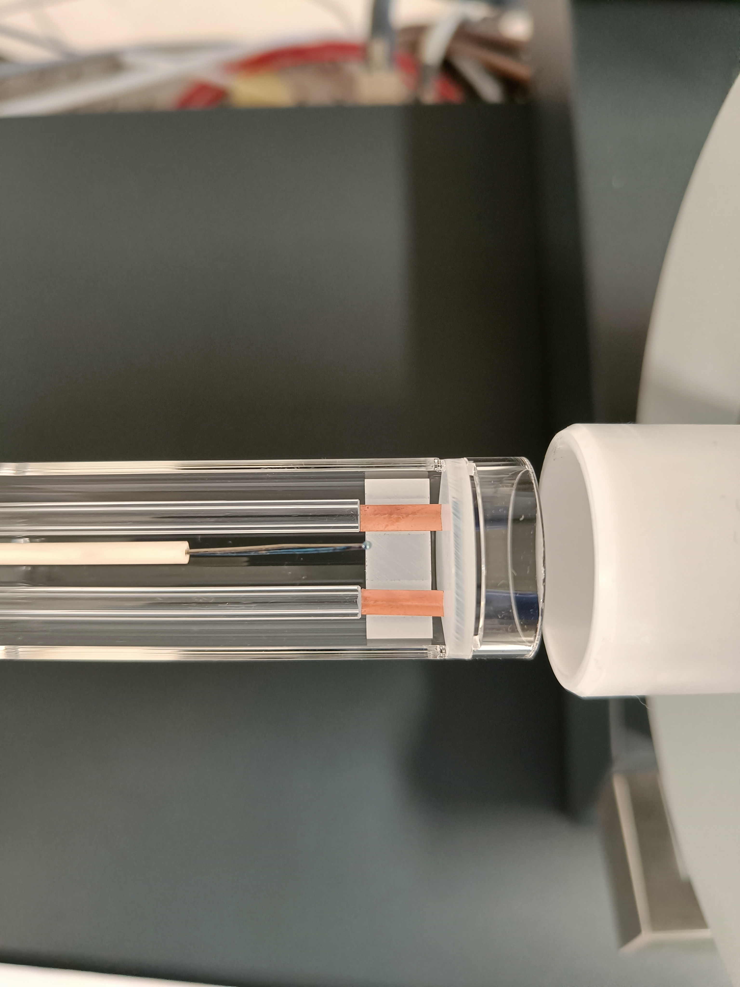
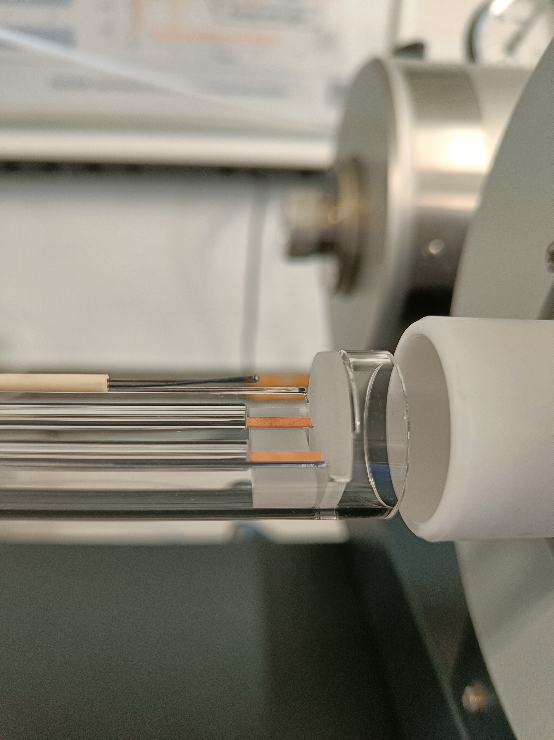
Measurement setup
Thermocouple
Sample S1
Furnace
Sample S2
Sample support
Sample holder

Slide 10
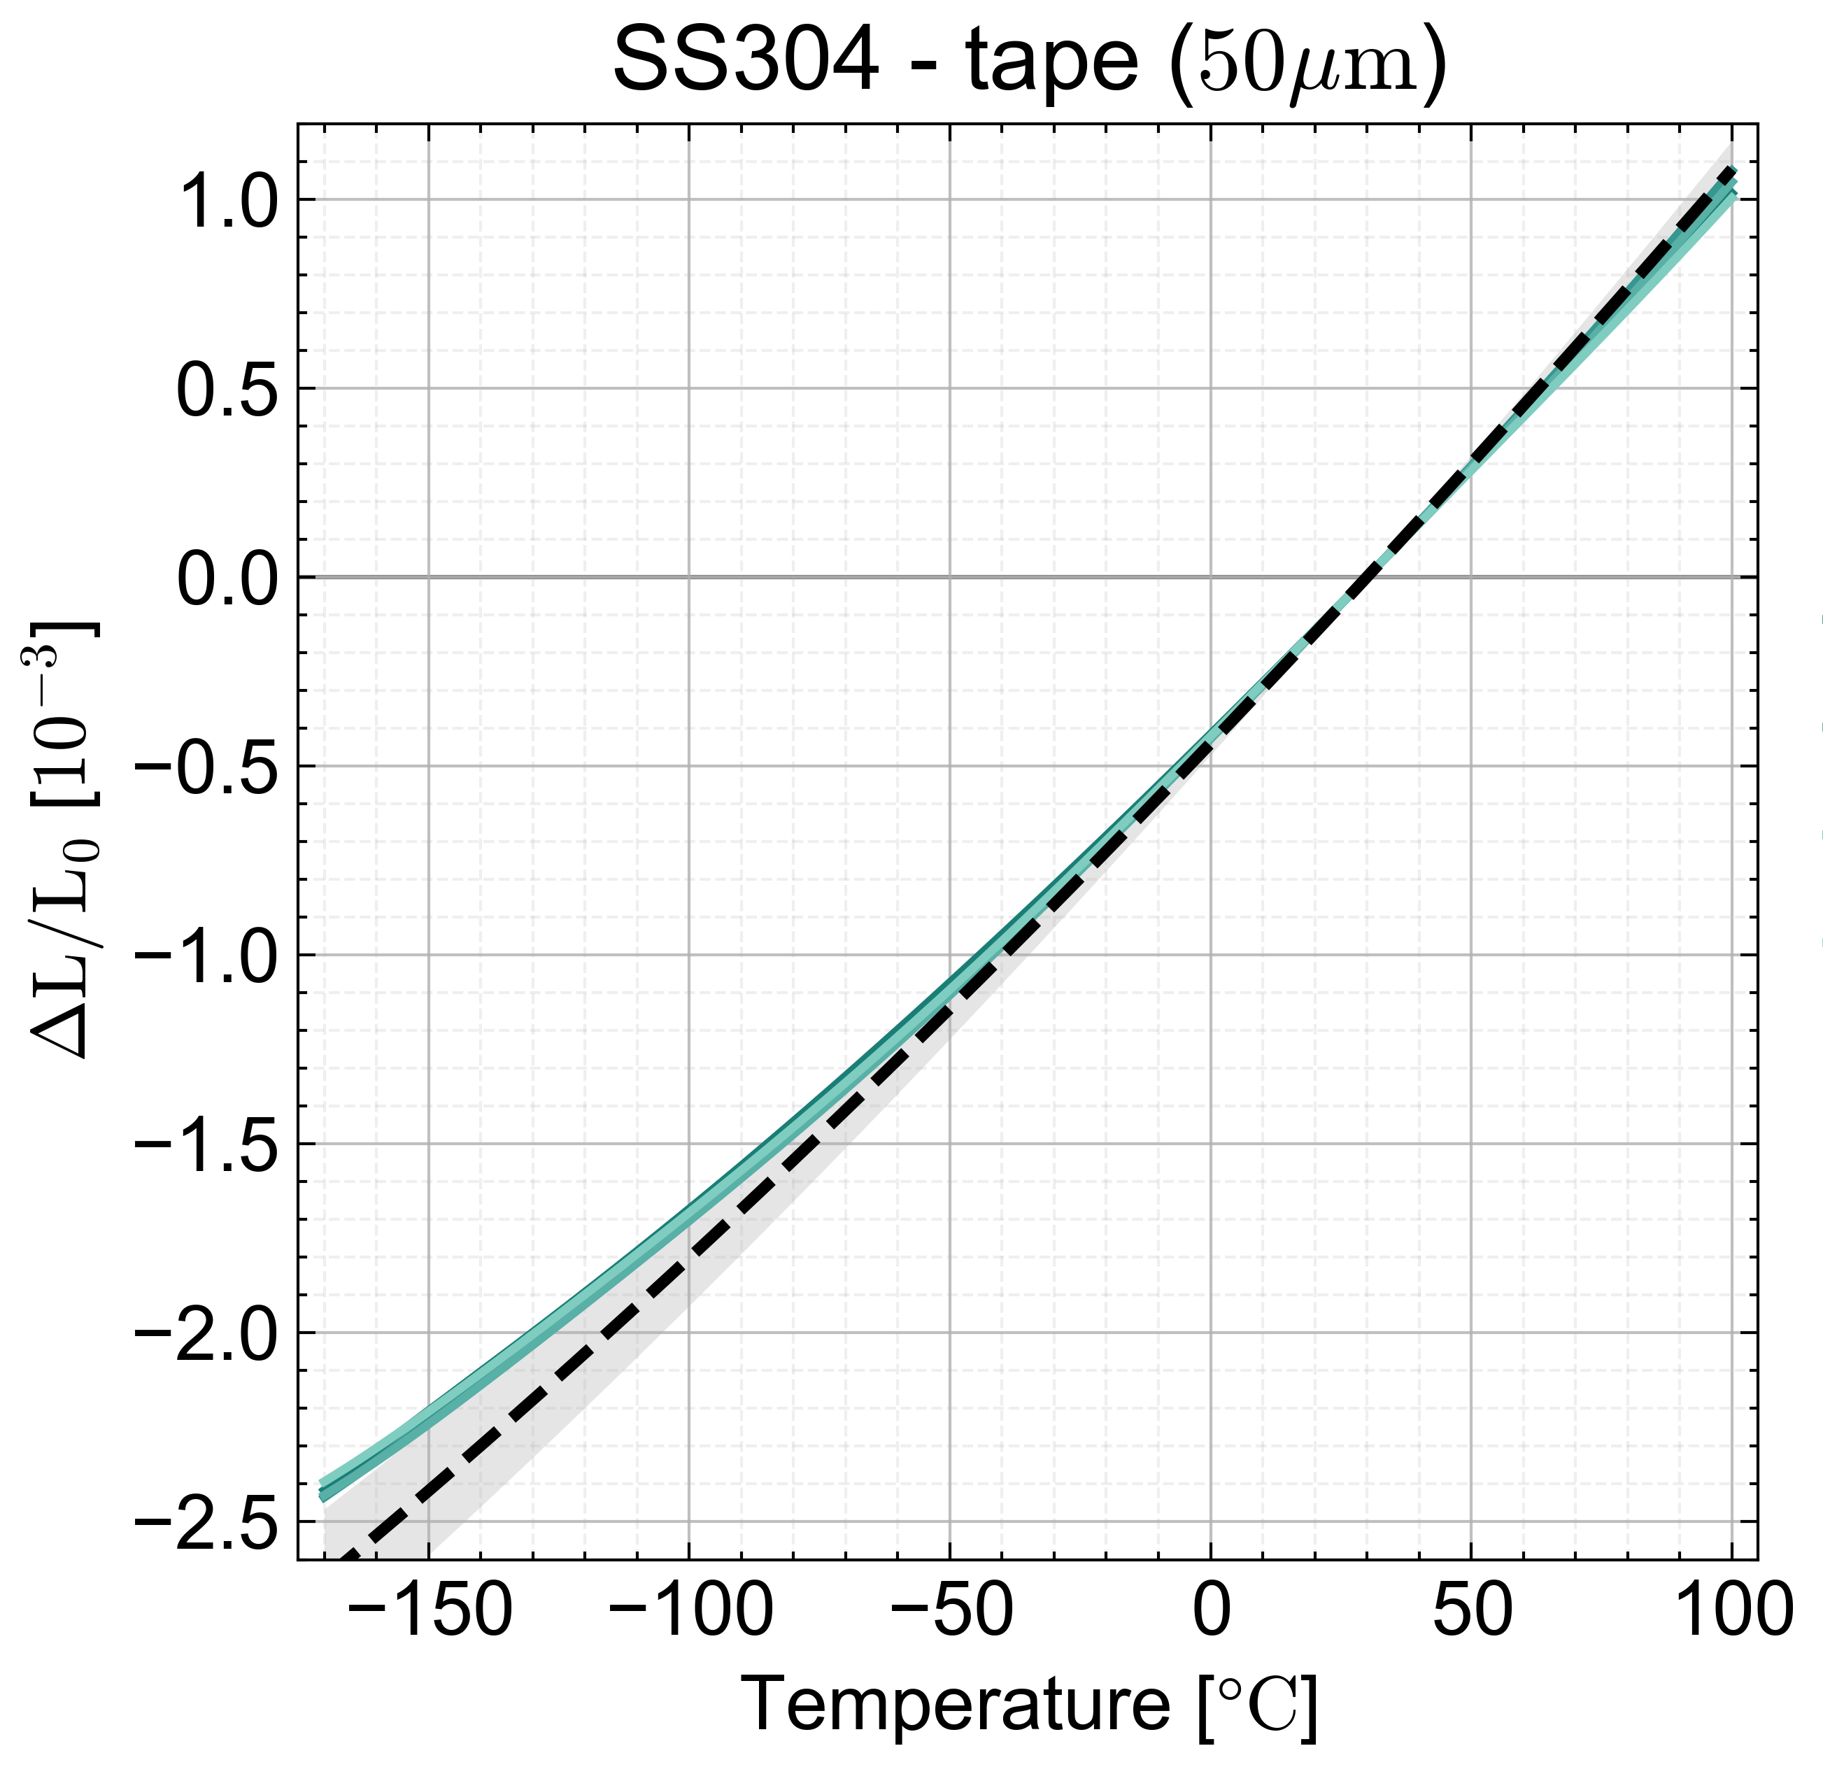
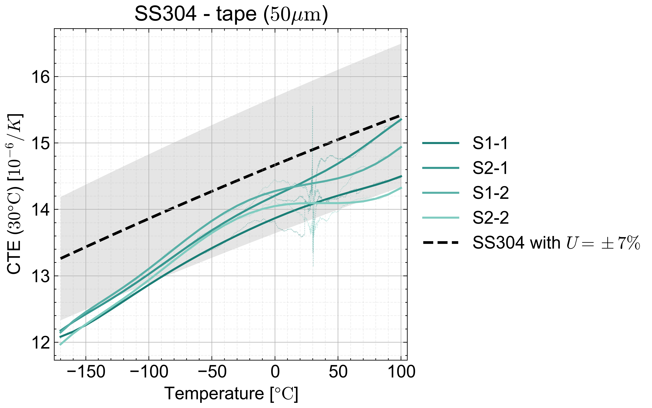
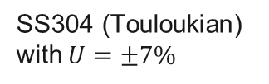

Proof of method – SS304 tape (50 µm)
Uncertainty of the method can be assumed to be better than $±10\%$
SS304 (Touloukian) with $U=±7\%$

Slide 11
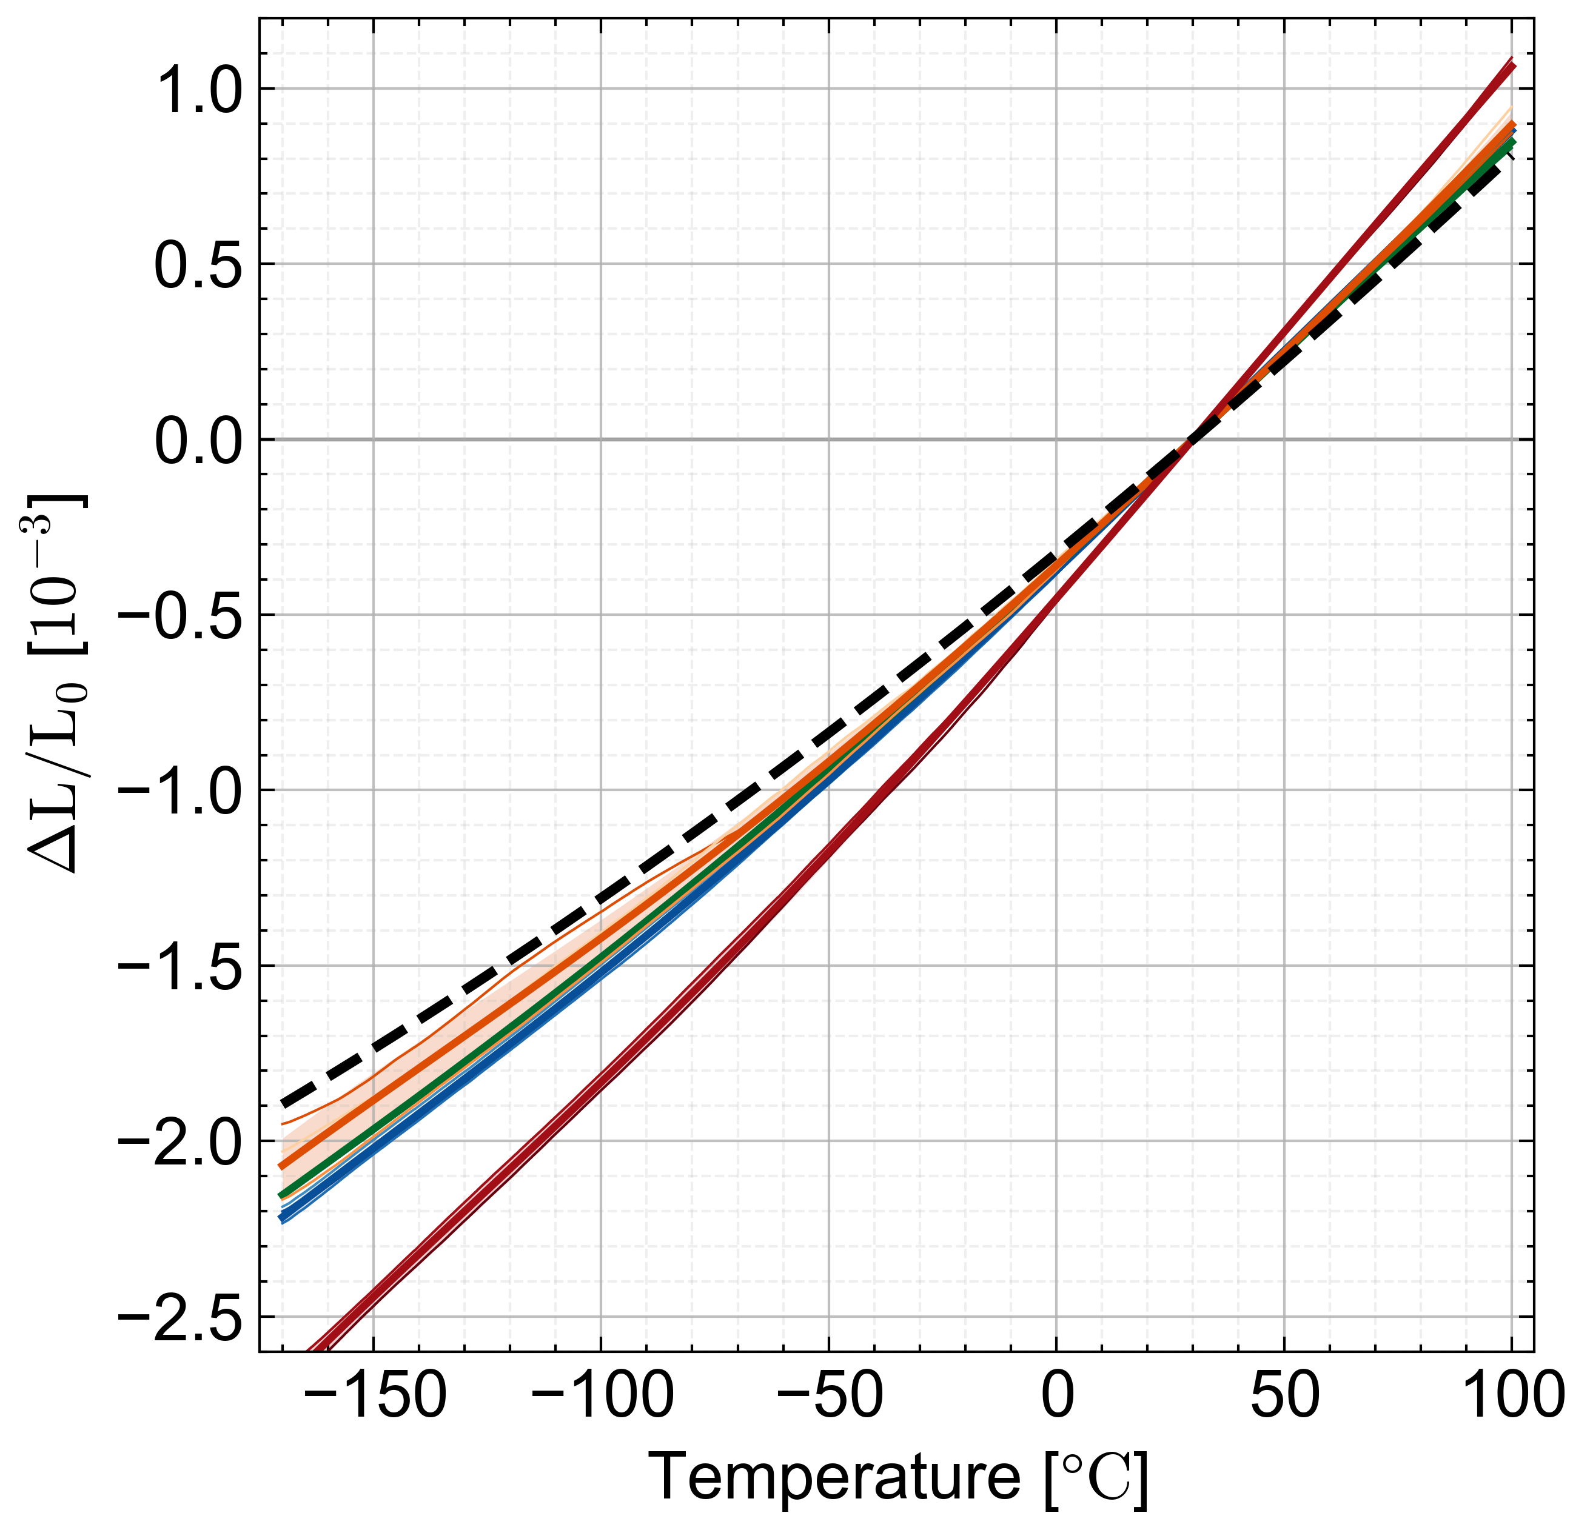
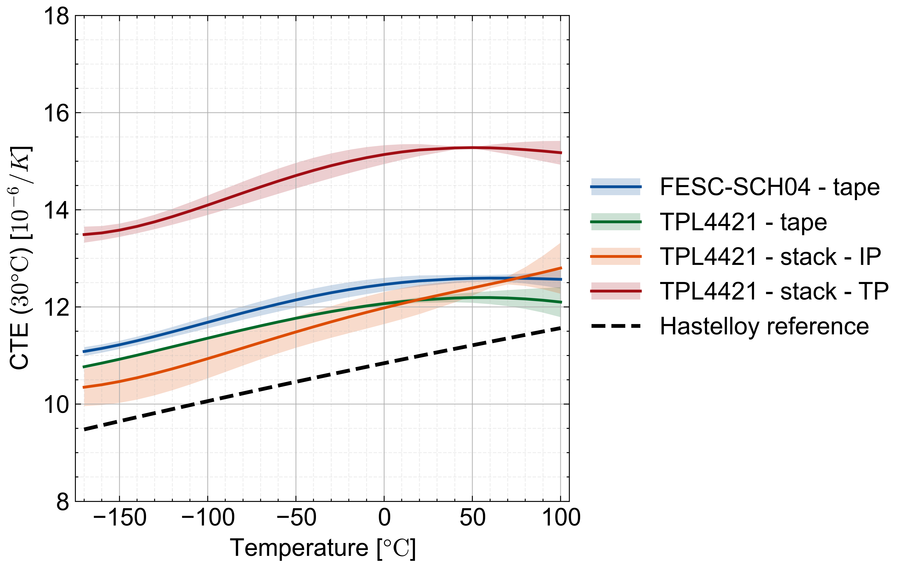
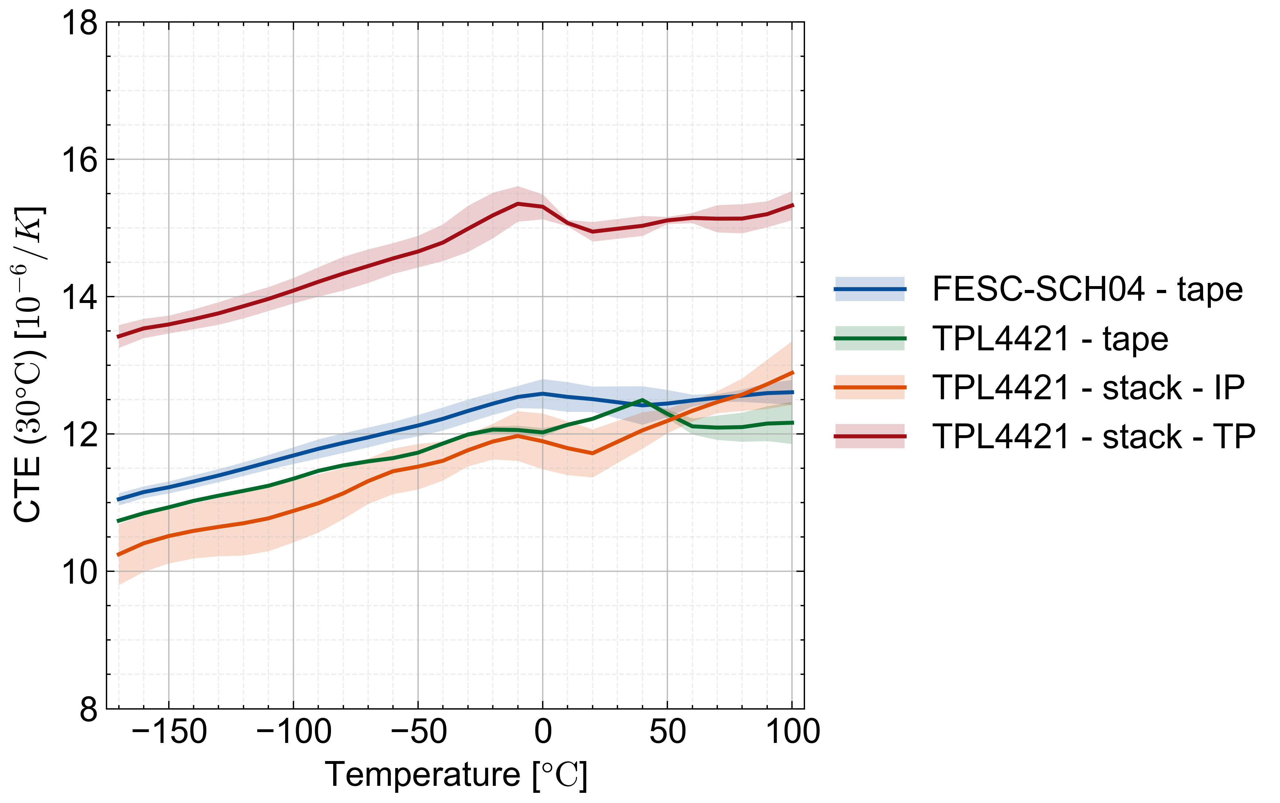
Results
  Stack in-plane behaves very similar to the tape samples
  Through-plane shows a higher expansion rate
Orthotropic behavior
  Tape + stack in-plane (IP)
  CTE at RT = 11 to 13 ppm/K
  → dominated by Hastelloy
  Stack through-plane (TP)
  CTE at RT = 13.5 to 15.5 ppm/K
Stack TP
Tape + stack IP
Ratio of tape-to-tin coherent with CTE in through-plane direction?

Slide 12
Upcoming thermal analysis tests
Tapes
(2 samples per tape)
  Hastelloy (substrate)
  Fujikura FESC-SCH04 etched
  Faraday
  SST
PUSHROD DILATOMETRY
-175 to 110 °C
CTE
CRYOGENIC DILATOMETRY
-271 to 30 °C
CTE
Stacks
(2 samples per stack)
  THEVA TPL4421 stack (1 stack)
  Fujikura FESC-SCH04 (3 stacks)
  Faraday (3 stacks)
  SST (3 stacks)
LASER FLASH ANALYSIS
-125 to 110 °C
(through-plane to be seen)
a / λ

Slide 13
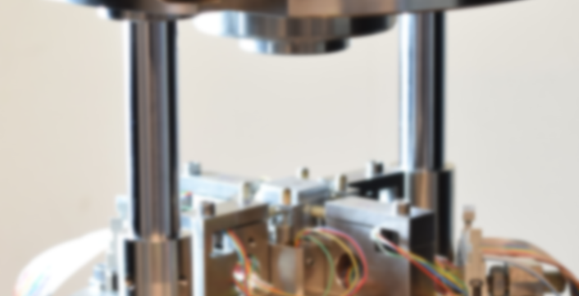
Upcoming mechanical tests

Slide 14
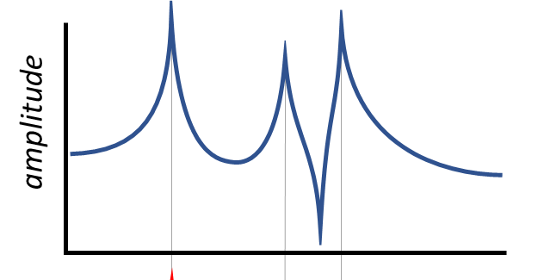
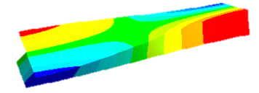


Impulse Excitation Testing
ASTM E1876
Simple Modal Analysis
To determine the resonant frequencies
A non-destructive and accurate way to determine materials elastic properties (E, G, µ)
Elastic Properties
Mass
Mechanical resonant frequencies
First Flexural Mode
First Torsional Mode
Geometry
known properties
FEA Analysis
To back calculate the elastic properties

Slide 15

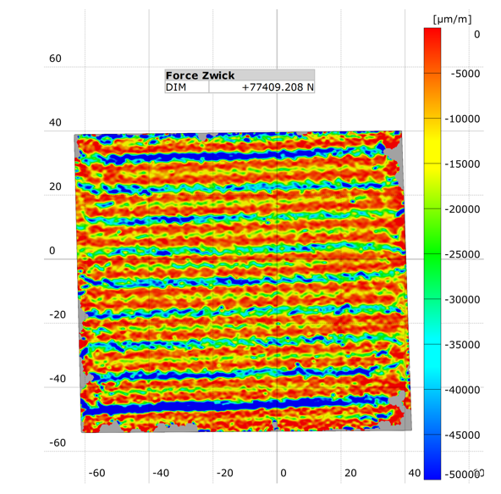
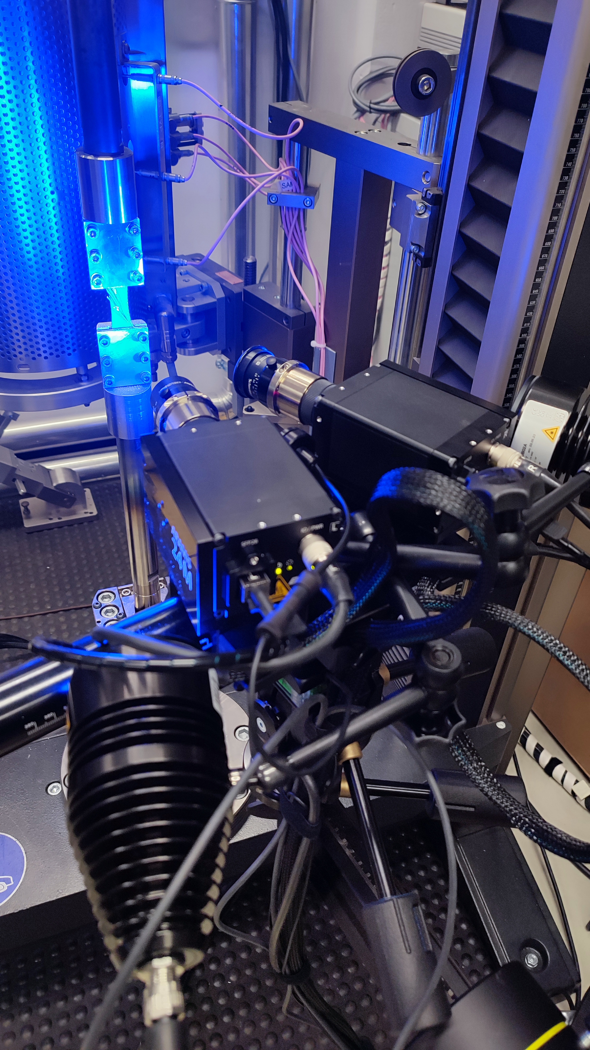
Compression Testing
Determination of:
  Young’s modulus and Poisson’s ratio
  Permanent deformation under different load levels
Mature dedicated test set-up in a universal testing machine combination with a Digital Image Correlation system
Non-contact, full field measurement
High spatial resolution <0.1 mm
Ɛ₂ Distribution

