Slide 1



Quantum Graph Neural Networks for HEP
Master Thesis presentation
Thibault Desrousseaux
Supervisor: Prof. Dr. G. Dissertori
Co-supervisor: Vasileios Belis

Slide 2
Introduction
Two projects:
  Computation of Feynman diagrams
  Jet classification
Goals:
  Explore potential applications of Quantum Graph Neural Networks (QGNN) for HEP
  Study QGNN properties, when combined with other methods (data reuploading, equivariance…)

Slide 3
Computation of Feynman diagrams

Slide 4
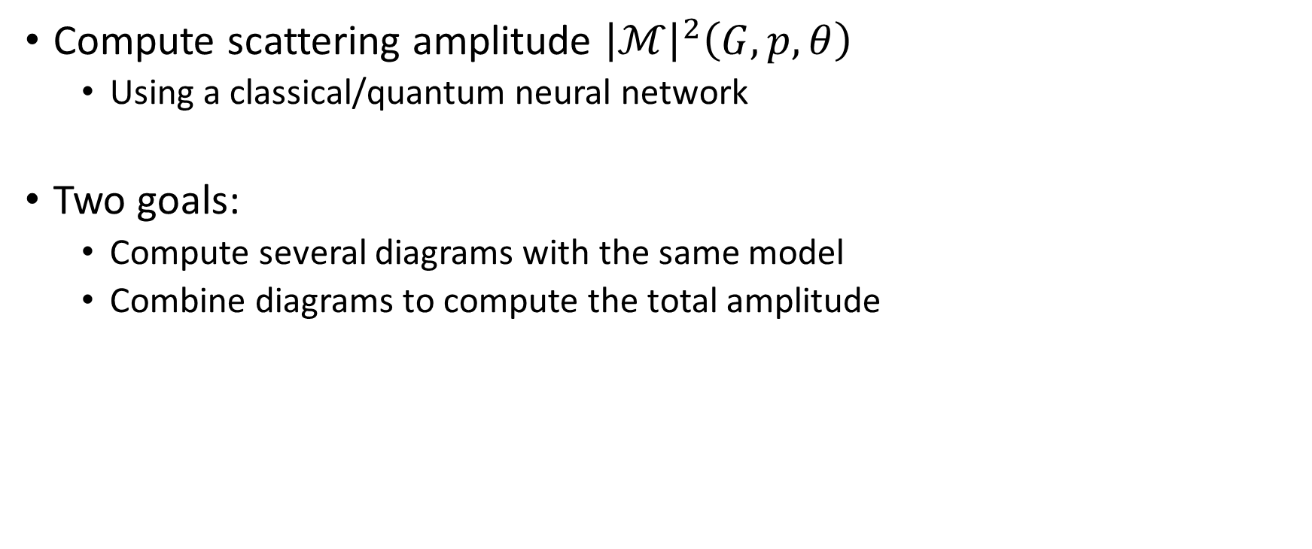

Aim of the project
Compute scattering amplitude ${\left|ℳ\right|}^{2}\left(G,p,θ\right)$
  Using a classical/quantum neural network
Two goals:
  Compute several diagrams with the same model
  Combine diagrams to compute the total amplitude
S-channel
T-channel
Loop channel
Input: a diagram, $p,θ$

Slide 5
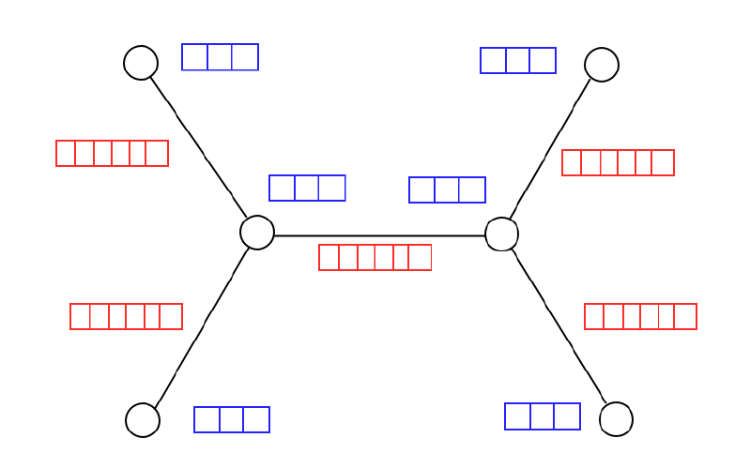
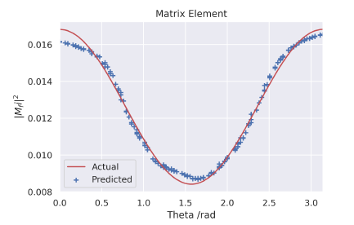
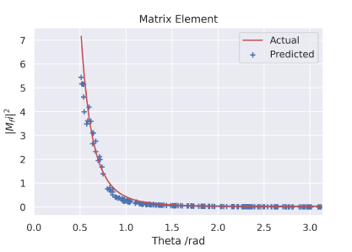
Previous Work
Graph encoding
Classical approach: Mitchell & al.
  Consider Feynman diagrams as graphs:
    Edges: particles
    Nodes: flow of time
  Use classical graph ML methods (GAT+FNN) to compute the scattering amplitude
  Limit:
    They don’t try to compute different amplitudes with the same model
    They don’t combine amplitudes when they want add diagrams
S-channel
T-channel

Slide 6
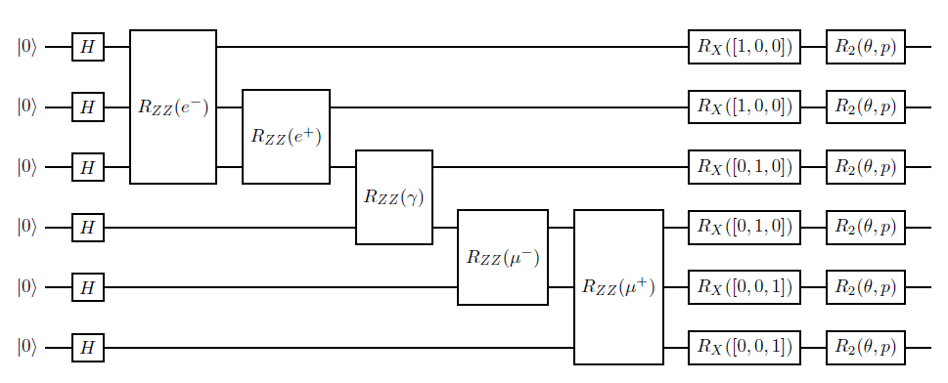
Previous Work
Feature map
Quantum approach: L. Ballerio
  Encode the graph structure in a quantum circuit (feature map)
  Trainable ansatz and observable
  Idea: amplitudes add with interferences, like quantum systems

Slide 7
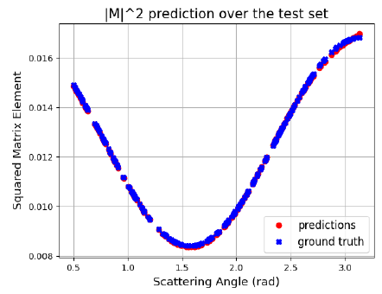
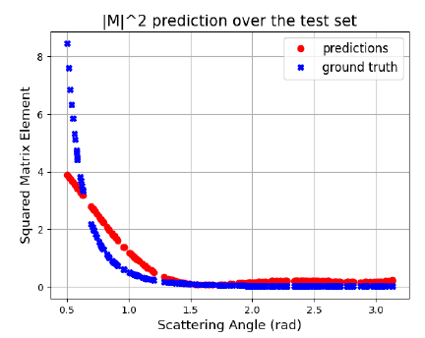
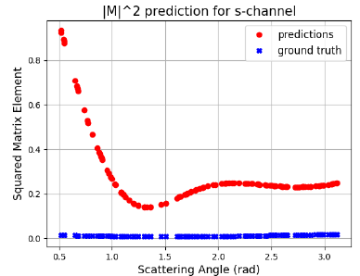
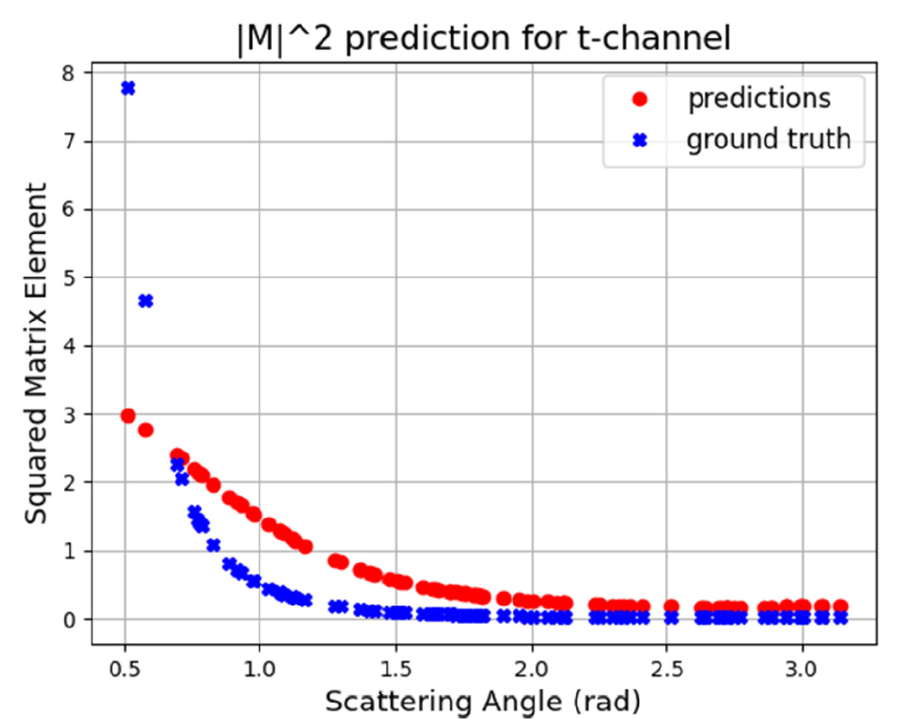
Previous Work
S-channel
T-channel
Separate training
As for the classical model, combined training do not work
Combined training

Slide 8
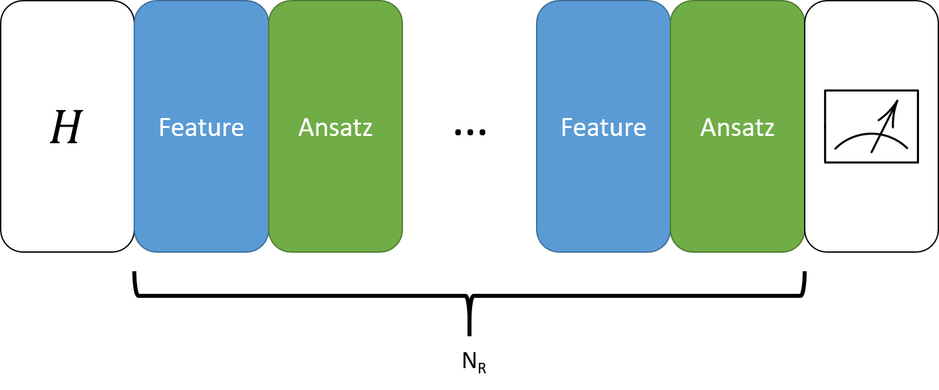
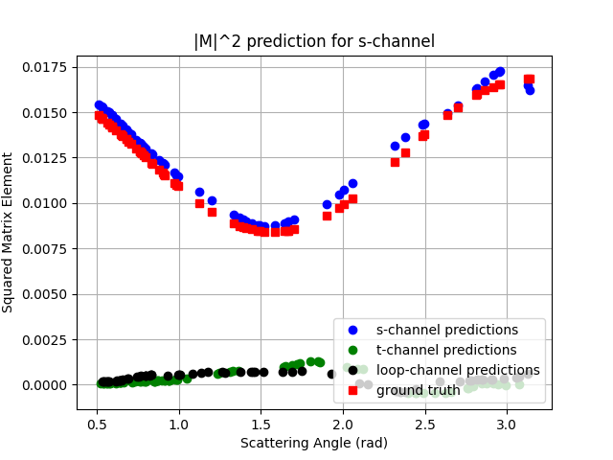
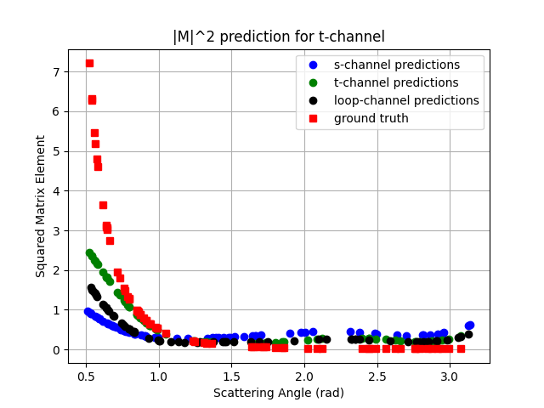
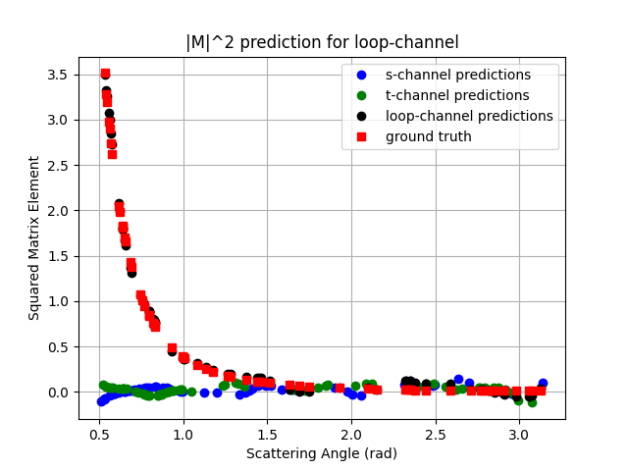
Algorithm and results
New ideas:
  Use data reuploading:
    Equivalent in simple cases to adding frequencies to the Fourier decomposition of the target function
  Use of one trainable observable per channel
Data reuploading

Slide 9
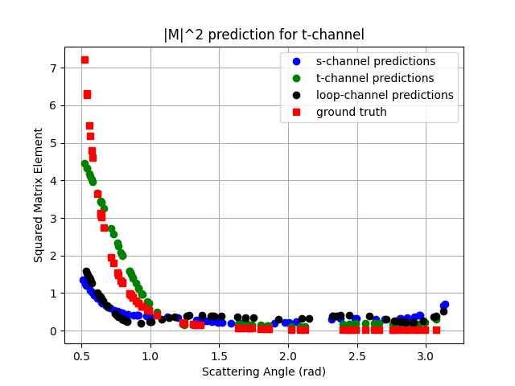
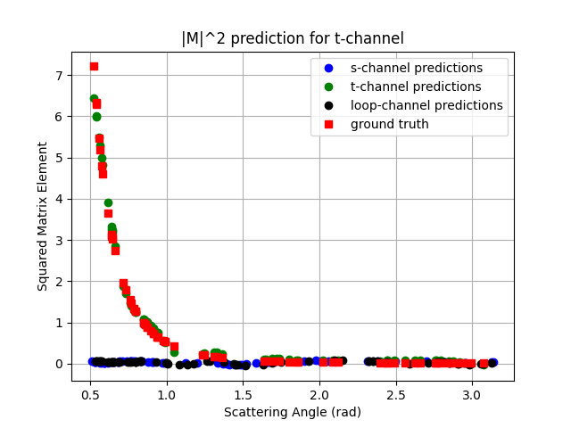
Studies around the algorithm
How does the model improve with the number of reuploads?
3 reuploads
5 reuploads
7 reuploads

Slide 10
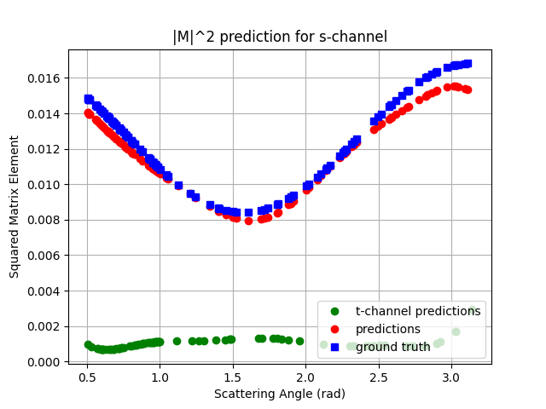
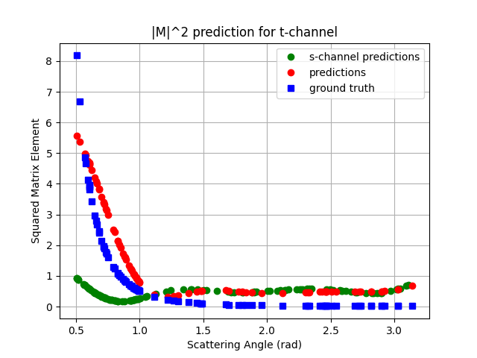
Studies around the algorithm
Which information in the encoding is really important?
  Keep only the topology of the graph
  Training works

Slide 11
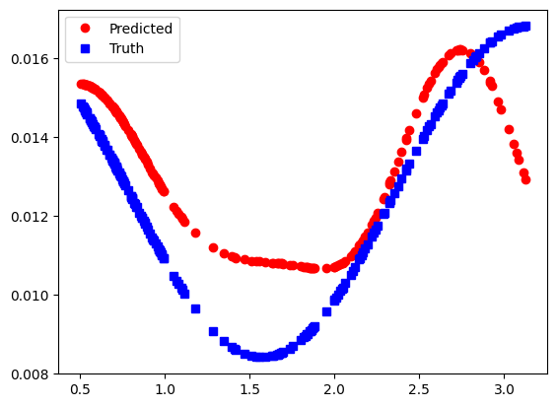
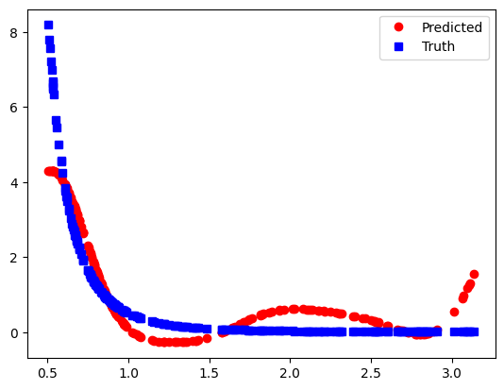
Studies around the algorithm
Is this encoding just a fancy switch?
  Change the encoding into an angle encoding
  The model do not train correctly
S-channel
T-channel

Slide 12


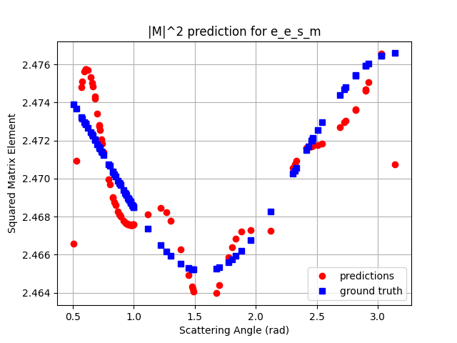
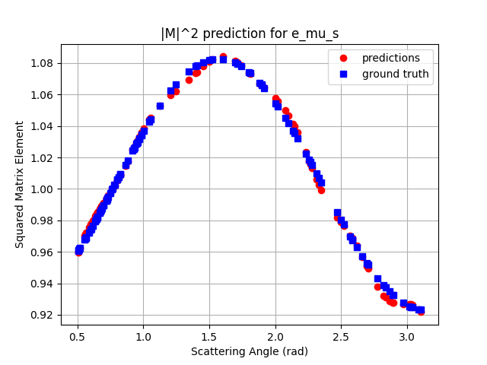
Studies around the algorithm
Can the encoding work if the topology is the same?
  Use and :
  The model trains

Slide 13
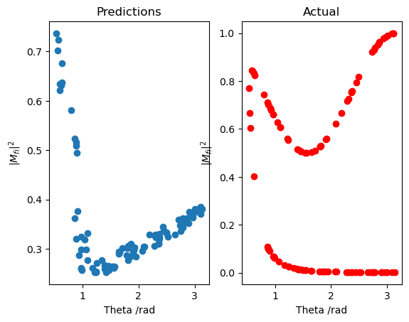
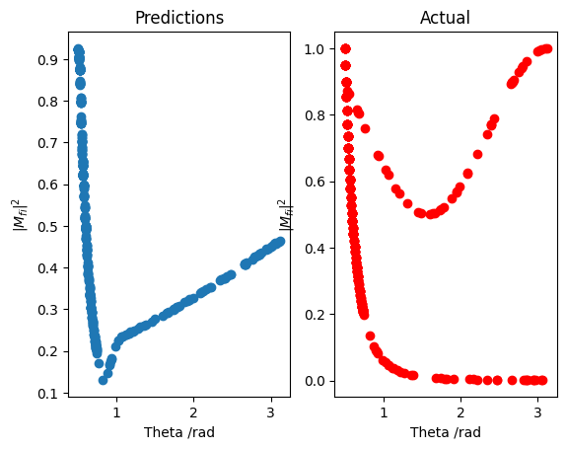
Studies around the algorithm
Is it possible to reproduce the results with the classical NN?
With one observable
With two observables

Slide 14




Computing the total amplitude?
Original hope: the algorithm would produce a state corresponding to the complexe amplitude: or
Squared amplitude:
Total amplitude (using LCU):
However:
  Complexe amplitudes actually depend on the spins
  There is a extra degree of freedom (relative phase)

Slide 15
Conclusion
New QGNN able to perform both classification and regression at the same time
Graph encoding combined with data reuploading is a promising method
Showed that computing the total amplitude won’t work
Could we apply this algorithm to other problems?

Slide 16
Jet Classification with a hybrid equivariant neural network

Slide 17
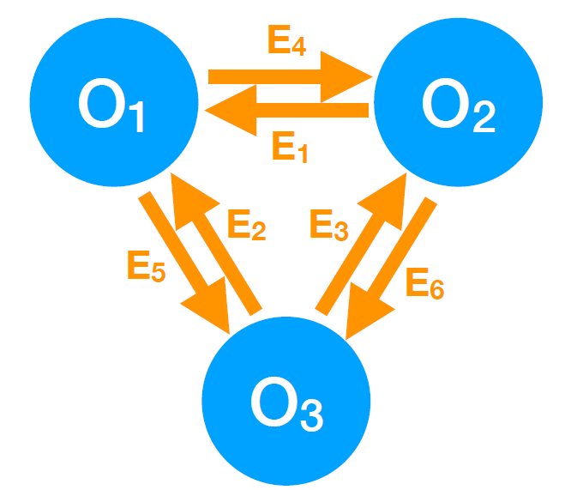
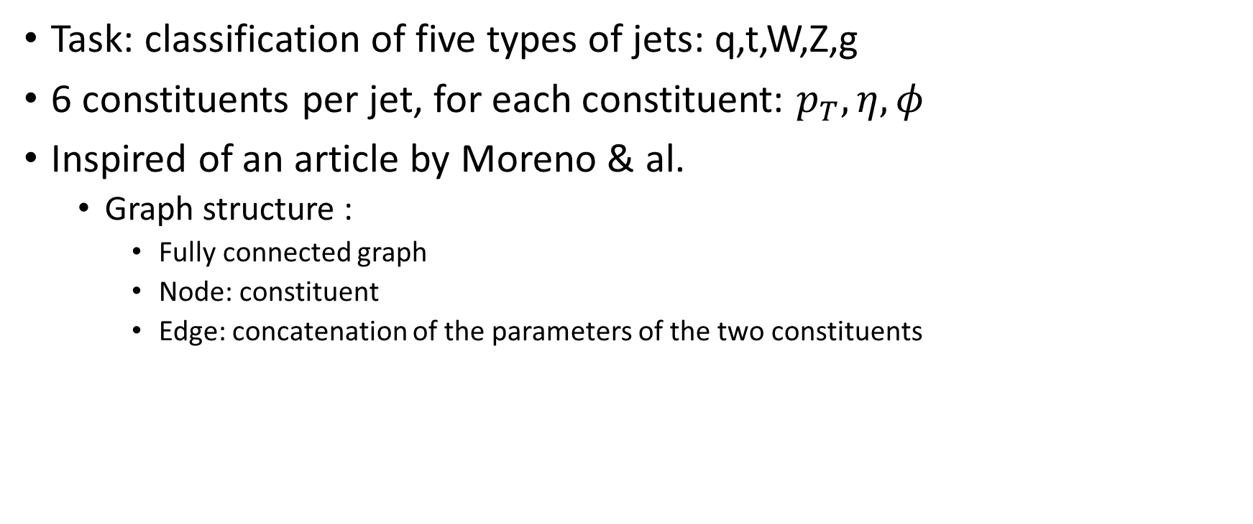
Overview
Task: classification of five types of jets: q,t,W,Z,g
6 constituents per jet, for each constituent: $p_{T},η,φ$
Inspired of an article by Moreno & al.
  Graph structure :
    Fully connected graph
    Node: constituent
    Edge: concatenation of the parameters of the two constituents

Slide 18
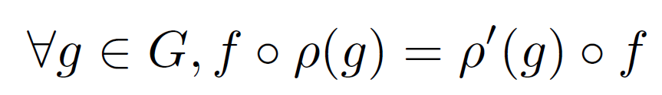
Equivariance
For a group G, a function f is G-equivariant with respect to its representations ρ and ρ’ if:
Less restrictive than invariance
Recipe for the permutation group for qubits:
  1-qubit gate: apply it on all qubits
  2-qubit gate: apply it on all pairs of qubits

Slide 19
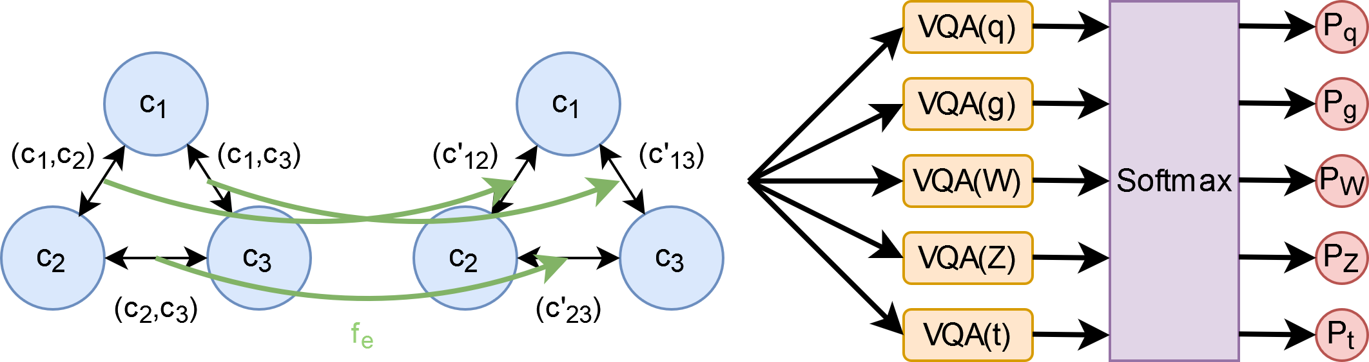
The Hybrid Algorithm
FNN applied to the edges
  Transform the edge information for the quantum circuit
  One hidden layer
  The same FNN for all the edges
The resulting graph is encoded in 5 different quantum classifiers
  With data reuploading, and invariant observables
The whole algorithm is permutation-equivariant

Slide 20
The Classical layers
Dimension:
  Input: 6
  Hidden layer: 12
  Latent representation: 6

Slide 21
The Quantum Classifier
Feature map
Ansatz

Slide 22
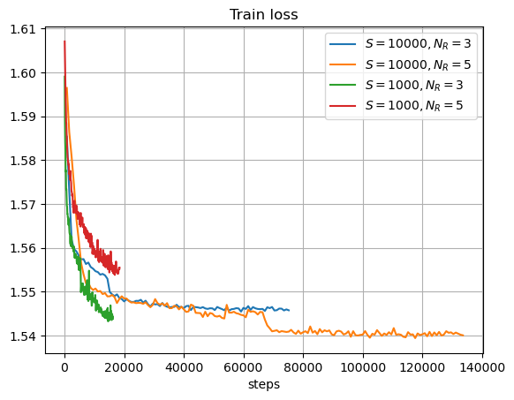
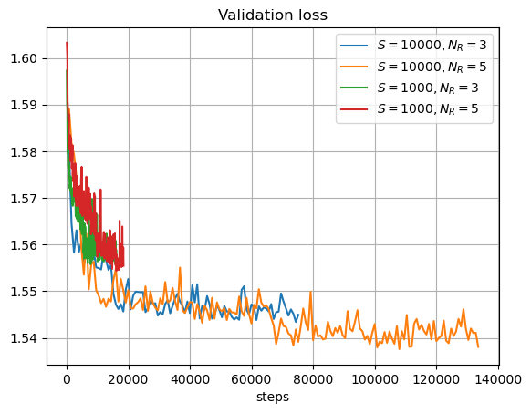
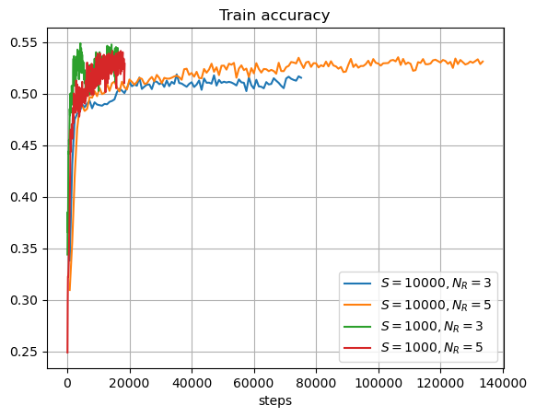
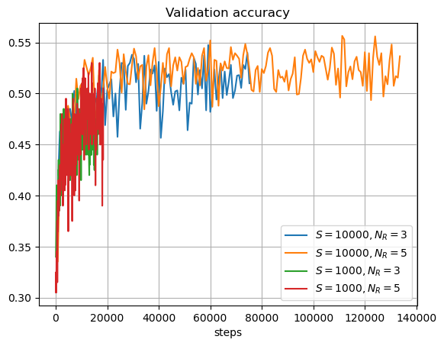
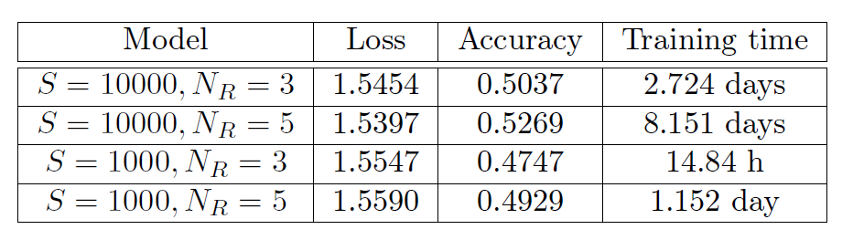
Results
Size of the dataset:
  S=1000/10000
Number of reuploads:
  N_{R}=3/5
Equivalent MLP: 47% accuracy

Slide 23
Conclusion
Two projects that illustrate the potential of reuploading for QGNN
  In the case of Feynman diagrams: much better resultsthan the other existing methods
  Jet classification: need some more work to compare its performances to other methods

Slide 24
Backup

