Slide 1
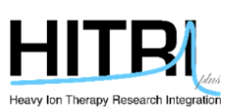



Radiosurgery for Skullbase Μeningioma
Dr Christos BOSKOS
Radiosurgeon / Radiation-Oncologist

Slide 2
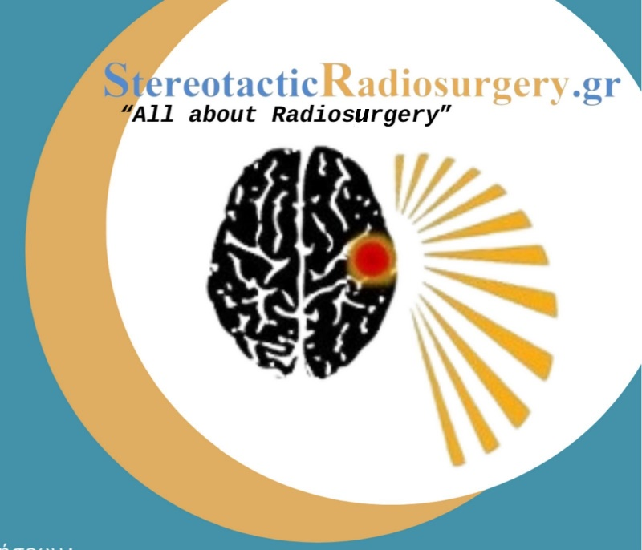
I have no conflict of interest to disclose

Slide 3
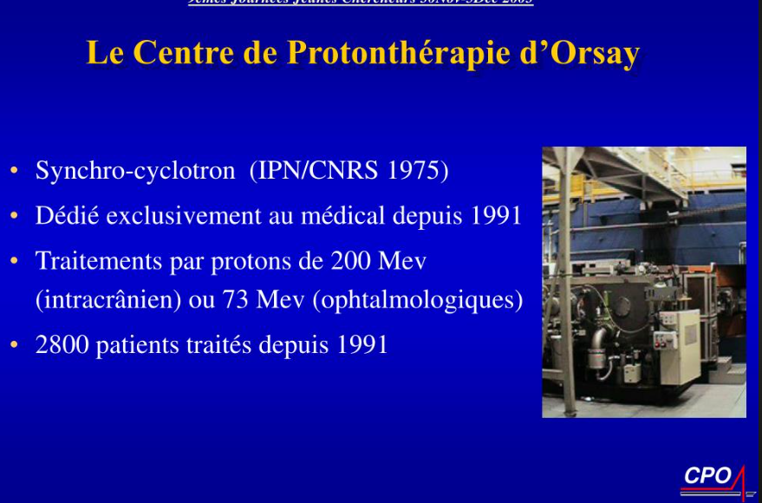
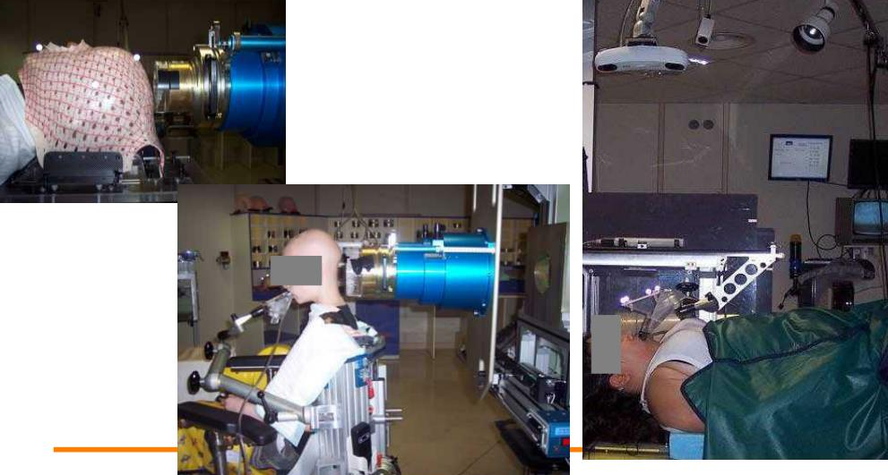
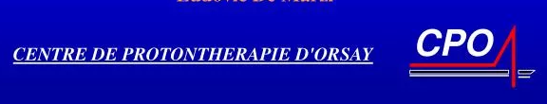
My experience in Charged Particles: Protontherapy
Centre Protontherapie Orsay (Paris) 2003 (resident)
Centre Protontherapie Orsay (Paris) 2006-2008

Slide 4
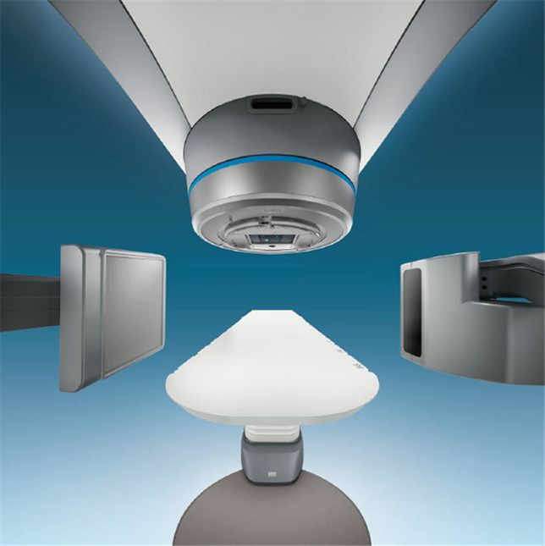
My experience in Stereotactic Radiosurgery
Saint Savvas Hospital (Athens) Elekta 2001-2005 (resident)
Hopital Pitie-Salpetriere (Paris) Varian BrainLab 2006-2009
UCLA (Los Angeles) Novalis BrainLab 2007
Iatropolis Radiosurgery Center (Athens) CyberKnife Accuray 2019
Metropolitan Clinic (Athens) EDGE Varian 2021
Saint Lukas Clinic (Thessaloniki) EDGE Varian 2024

Slide 5
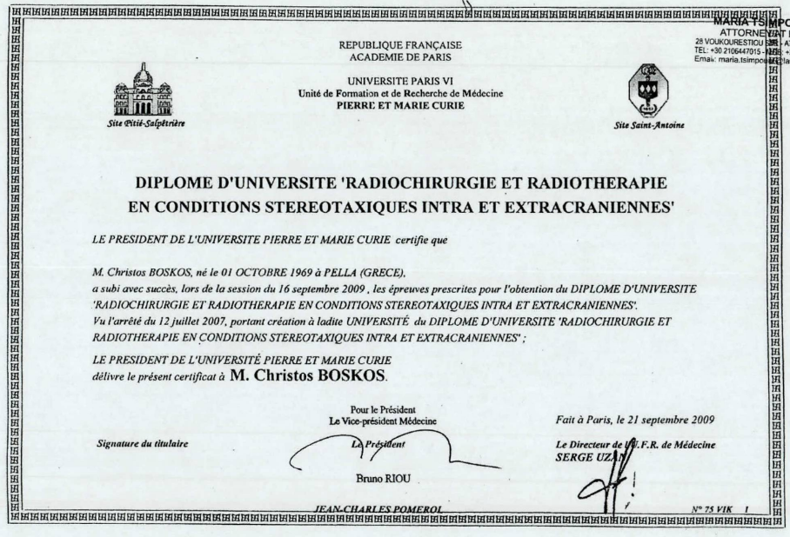
Diplome Universite in
Stereotactic Radiosurgery and Protontherapy
Universite Pierre and Marie Curie (Paris VI)
2010

Slide 6

Research in Protontherapy: Skullbase Meningioma
“Combined proton and photon conformal radiotherapy for intracranial atypical and malignant meningioma”,
Christos Boskos ¹, Loic Feuvret, Georges Noel, Jean-Louis Habrand, Pascal Pommier, Claire Alapetite, Hamid Mammar, Regis Ferrand, Gilbert Boisserie, Jean-Jacques Mazeron
Boskos et al., Int J Radiat Oncol Biol Phys. 2009 Oct 1

Slide 7

“Focal” is better…
Radiosurgery
Protontherapy
But “Focal + radiobiology advantage” is…
far better
Carbon ions

Slide 8
Challenges for Skullbase Meningiomas
Meningioma most common benign CNS tumor
Increasing incidence as population grow older
Imaging quality progression (easier define residual and relapse)
Factors affecting management decision (age, volume, location, Simpson grade)
Skullbase is a high risk area for surgical complications

Slide 9
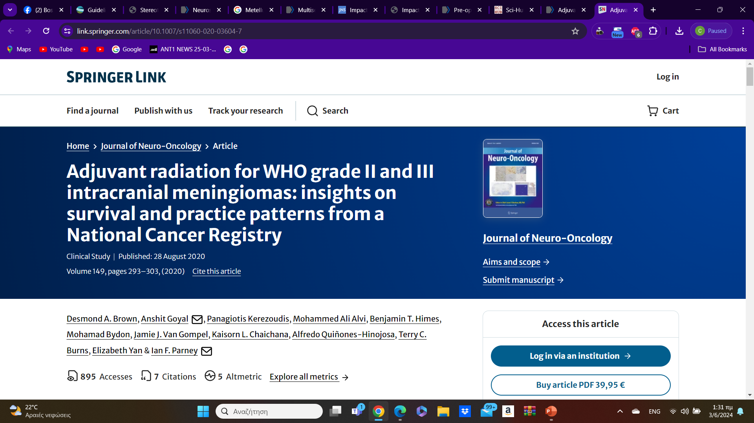
Skull base meningiomas
Female 74% and white race 79%
Benign
Atypical meningiomas are not considered either benign or malignant. They can become malignant
Grade II and III almost 7% National Database (SEER)
Alfredo Quinones Hinojosa J Neurooncology 2020

Slide 10
Pou P., Biau J., Verrelle P., Lemaire J.J., El Ouadih Y., Chassin V., Magnier F., Dedieu V., Lapeyre M., Dupic G., et al. Long-Term Outcomes After Linac Radiosurgery for Benign Meningiomas. Clin. Oncol. 2020
skull base meningiomas had better LC when compared to those located at the convexity of the brain has been reported previously

Slide 11
skull base meningiomas
Lower probability of high-grade histology when compared to those located at the rest of the brain
Maclean J., Fersht N., Short S. Controversies in Radiotherapy for Meningioma. Clin. Oncol. 2014
Slower growth of skull base meningiomas
Hashimoto N., Rabo C.S., Okita Y., Kinoshita M., Kagawa N., Fujimoto Y., Morii E., Kishima H., Maruno M., Kato A., et al. Slower growth of skull base meningiomas compared with non–skull base meningiomas based on volumetric and biological studies: Clinical article. J. Neurosurg. 2012
Lower MIB1 proliferation index in skull base meningiomas
McGovern S.L., Aldape K.D., Munsell M.F., Mahajan A., DeMonte F., Woo S.Y. A comparison of World Health Organization tumor grades at recurrence in patients with non–skull base and skull base meningiomas: Clinical article. J. Neurosurg. 2010

Slide 12
skull base meningiomas originate
originate from a variety of different structures including, but are not limited to:
  clinoid processes,
  tuberculum sellae,
  dorsum sellae,
  sphenoid wing,
  petrous/petroclival area,
  falcotentorial region,
  cerebellopontine angle,
  foramen magnum.

Slide 13
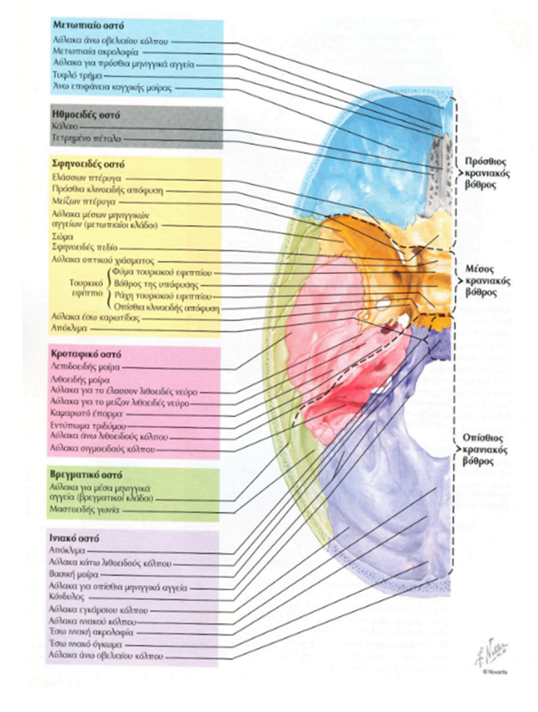
Skull base locations
Frontal fossa
Median fossa
Posterior fossa
Cavernous sinus (CS)
CerebroPontal Angle (CPA)
Petro Clival (PC)

Slide 14
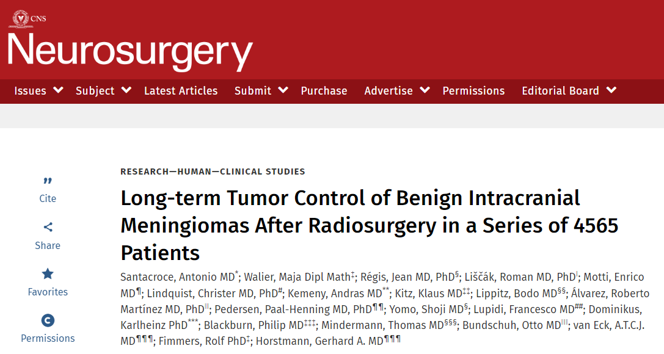
3754 skullbase meningiomas for SRS
Cerebellum Pontine Angle 432
Petro Clival 468
Cavernous sinus 1272
Santacrose et al. Long-term Tumor Control of Benign Intracranial Meningiomas After Radiosurgery in a Series of 4565 Patients 2011

Slide 15
Skullbase meningiomas irradiation
Main therapy (single treatment)
Post-operative (residual)
Post-operative (relapse)
VMAT
Radiosurgery
Particles Radiotherapy

Slide 16
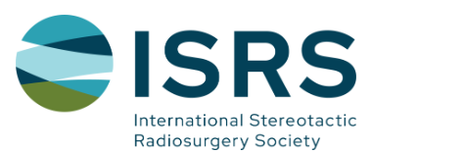
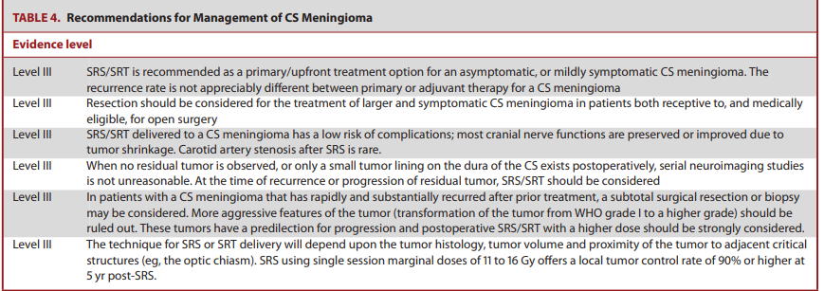
ISRS guidelines for Cavernus Sinus meningioma SRS
ISRS guidelines

Slide 17
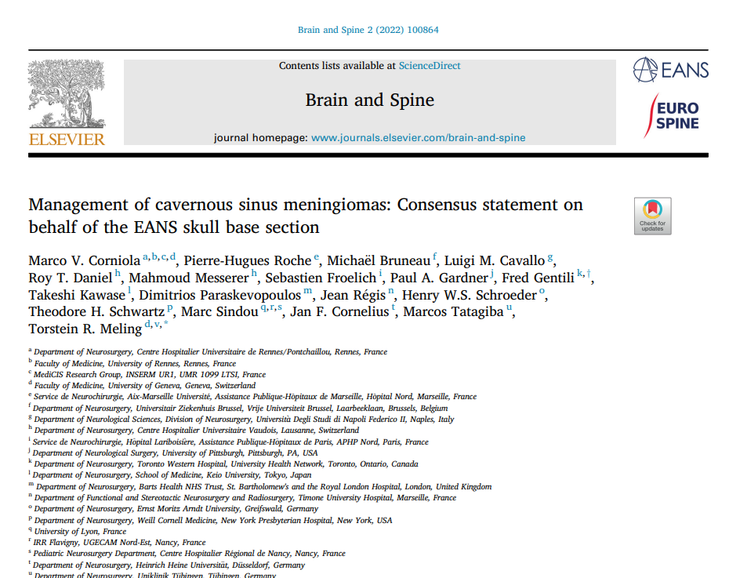
Management of cavernous sinus meningiomas: Consensus statement on behalf of the EANS skull base section (2022)
Stereotactic RadiosurgerySRS (single-dose or fractionated) should be considered in the following cases, insofar as the distance to the ON is superior to 3 mm (Level C):
- Asymptomatic, > 40 years old patients with a purely intracavernous
CSMs <2.5 cm showing growth on serial imaging after initial conservative treatment;
- Asymptomatic patients with partly extracavernous CSMs showing
growth on serial imaging after initial conservative treatment;
- Symptomatic patients with CSMs <2.5 cm, provided that the symptoms are not related to ON compression
- Symptomatic patients with partly extracavernous CSMs in whom
surgery is contraindicated.
fractionated SRS or RT should be considered in cases that warrant treatment (see above) if the distance to the ON is less than 3 mm and the ipsilateral visual function is good (Level C).
EANS guidelines
https://www.ncbi.nlm.nih.gov/pmc/articles/PMC9560706/pdf/main.pdf

Slide 18
Conclusions
SRS should be advocated as first line treatment in small/asymptomatic lesions/in elderly patients.
Offer excellent tumour control with low rates of oculomotor/visual complications.
Endoscopic Endonasal Approach (EEA), a safe strategy of bony skull base decompression and limited tumour removal in the exophytic component of the tumour, outside the cavernous sinus. Combined with SRS can be for symptoms relief and tumour control

Slide 19
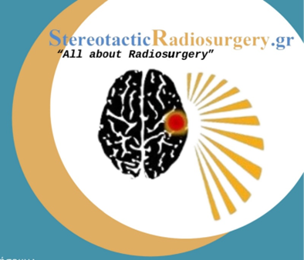
Radiosurgery for Skullbase meningioma

Slide 20

Radiosurgery - Definition
High dose in 1 fraction
High accuracy <1mm
High gradient of dose (rapid fall off dose) → normal tissue preservation

Slide 21

SRS Radiobiology
RADIOSURGERY:
  creates more double-strand breaks in DNA,
  results in less DNA damage repair,
  has anti-vascular effects,
  Has in situ vaccine effects and abscopal effect
    (immuno-stimulation and immuno-upregulation)

Slide 22
Factors for SRS treatment desicion
Size
Location
Rate of growth (aggressiveness)
Age
Performance Status
Patients goals for treatment (choice)
Alfredo Quinones Hinojosa
J Neurooncology 2020

Slide 23
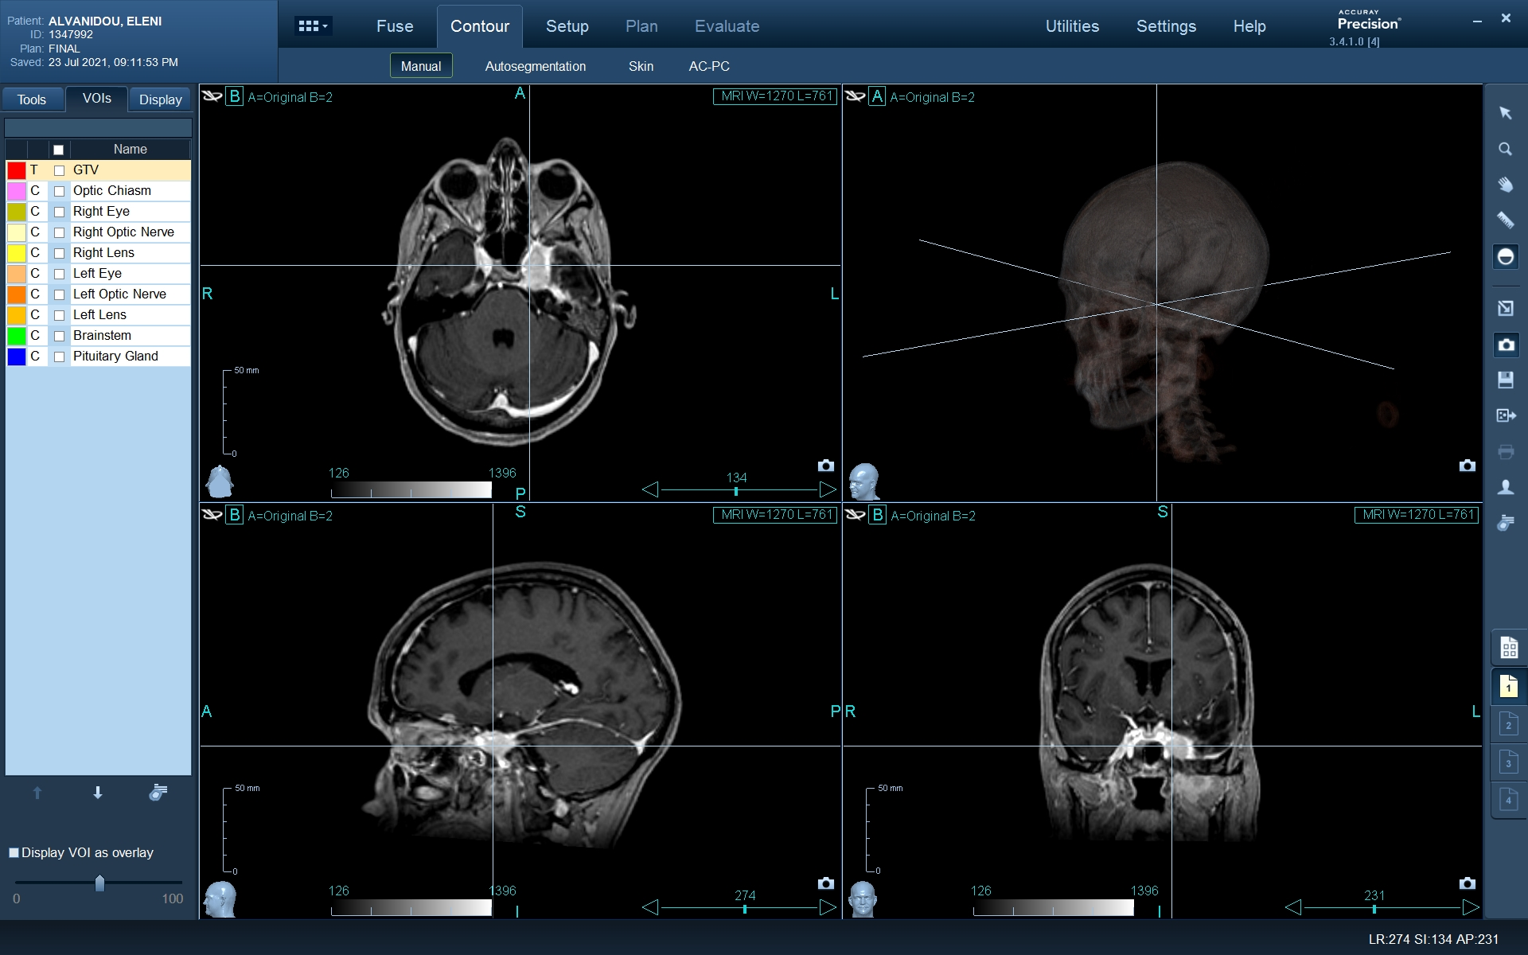

Slide 24
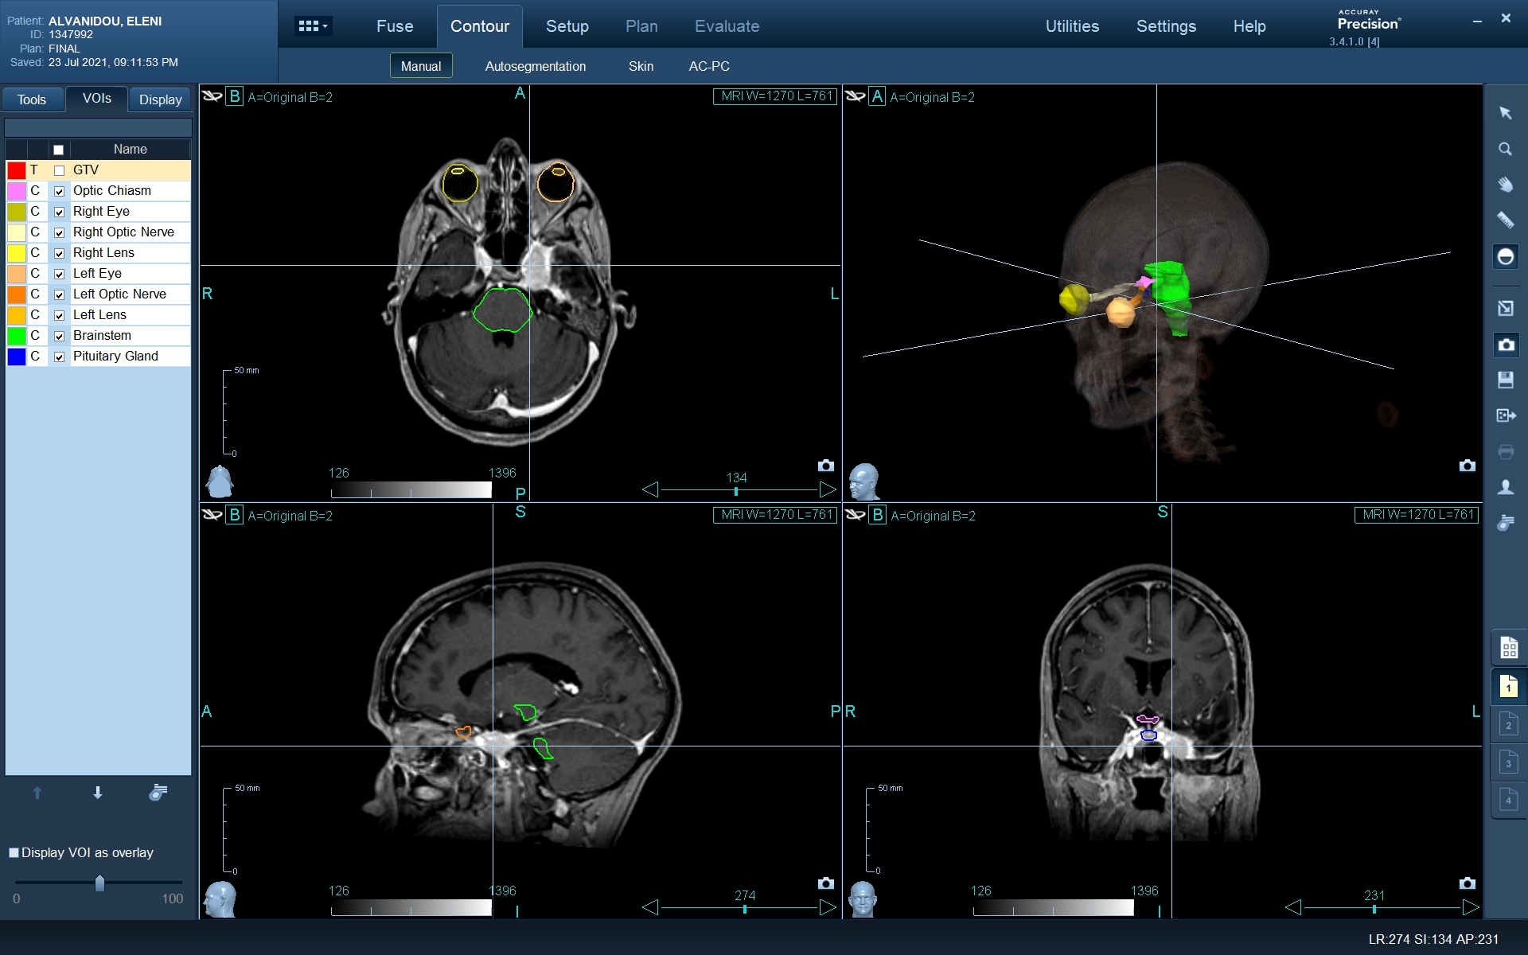

Slide 25


Slide 26
Prescription Dose
Single fraction: 12-13Gy
Dose (crute) (Local Control)
Dose conformality (Toxicity)
Dose fall off (Toxicity)
Dose and Local Control
11Gy possible working
12Gy – 13Gy standard working
14Gy+ working but…

Slide 27
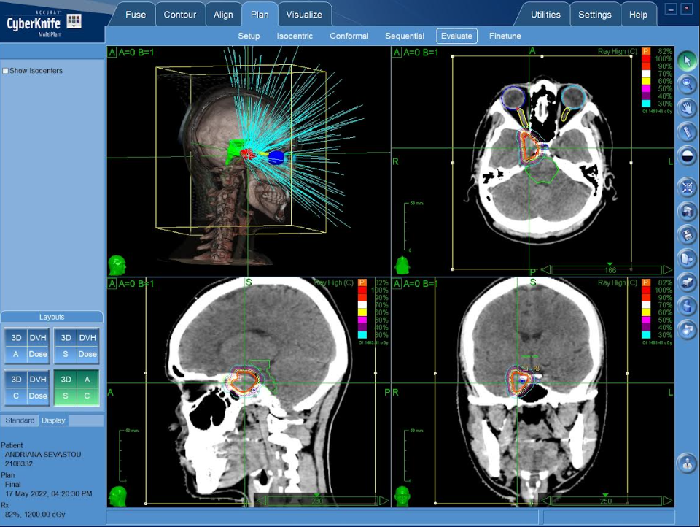
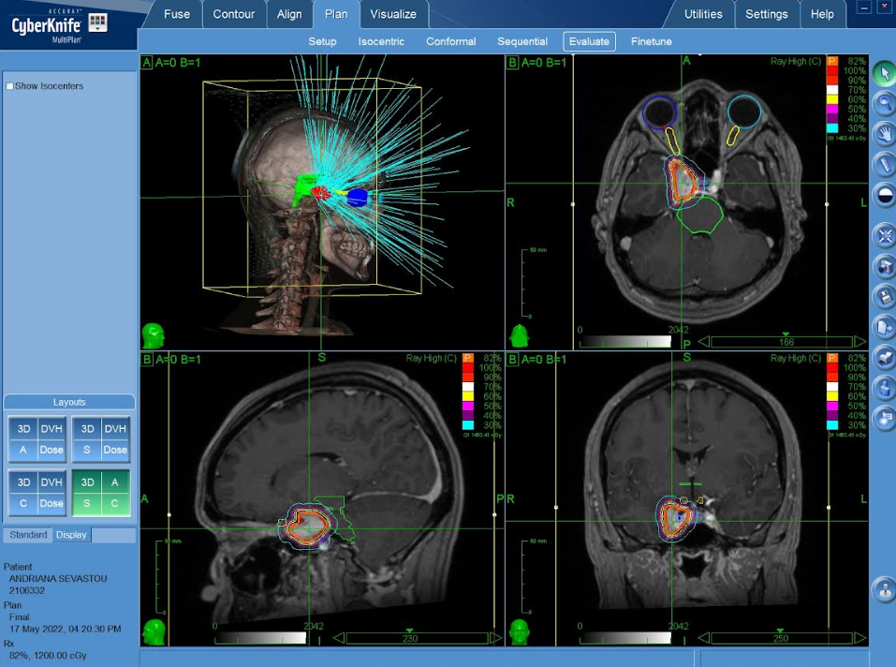

Slide 28

Radiosurgery outcomes

Slide 29
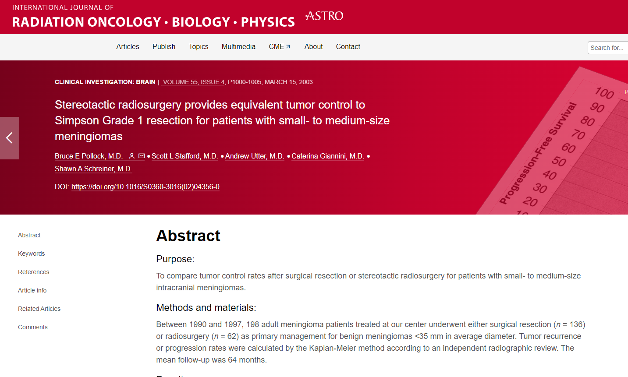
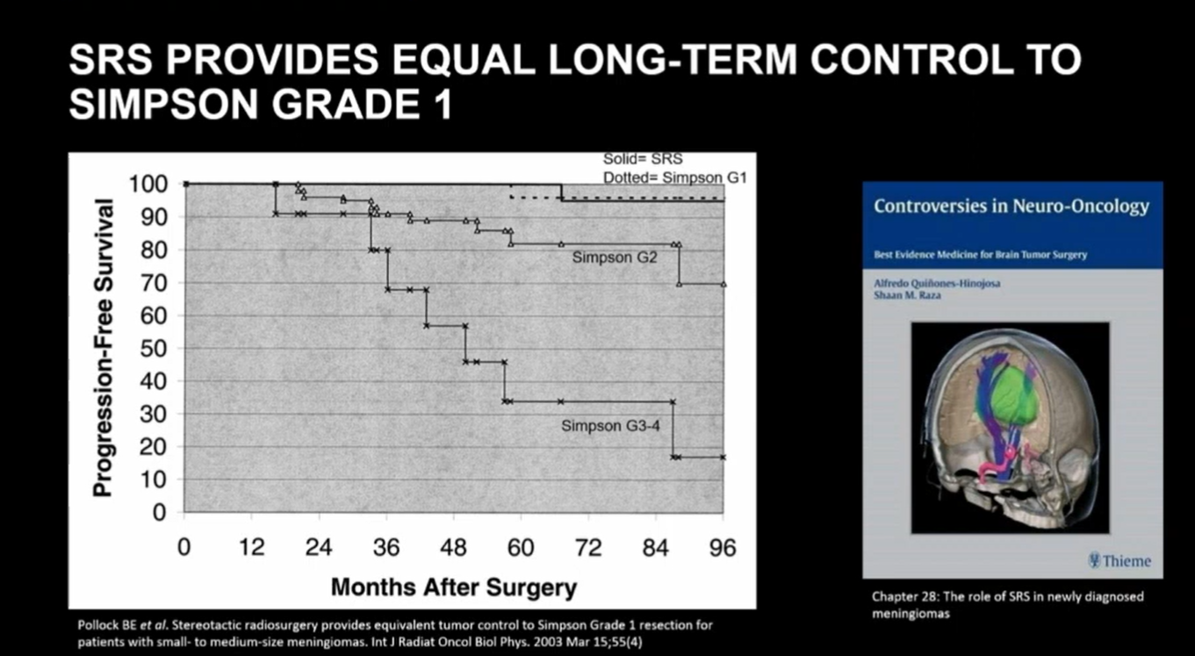
SRS equal long-term control to Simpsons Grade 1
No statistically significant difference was detected in the 3- and 7-year actuarial progression-free survival (PFS) rate between patients with Simpson Grade 1 resections (100% and 96%) and patients who underwent radiosurgery (100% and 95%, p = 0.94).
198 patients , surgical resection (n = 136) or radiosurgery (n = 62)
as primary management for benign meningioma
Pollock IJROBP 2003
https://pubmed.ncbi.nlm.nih.gov/12605979/

Slide 30
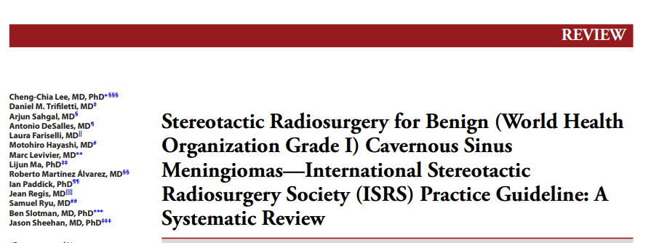
ISRS Guidelines for Cavernous Sinus Meningiomas
5- yr Local Control rate of 99%
10-yr Local Control rate of 93%
5-yr PFS 86% to 99%
10-yr PFS 69% to 97%
15-yr PFS rates 92%
20-yr PFS rates ranging from 87%
ISRS guidelines Cavernous Sinus Meningioma

Slide 31
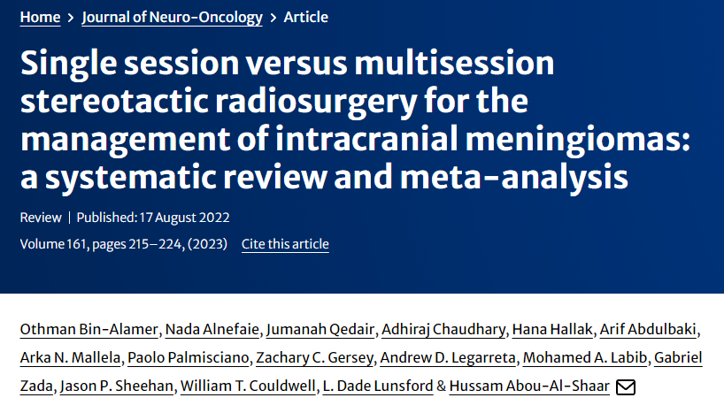
Skull base meningioma Local Control
 | 3years | 5years | 10 years | 20years
Cavernus Sinus | 94 | 91 | 85 | 72
Petroclival | 97 | 95 | 94 | 86
C P Angle | 95 | 90 | 86 | 81
Clinoid | 95 | 93 | 88 | 82
Sphenoid Wing | 96 | 96 | 90 | 90
Olfactory Groove | 93 | 88 | 83 | 78
Tentorial | 96 | 94 | 87 | 84
Othman Bin-Alamer et al, Neuro-Oncology, 2023

Slide 32
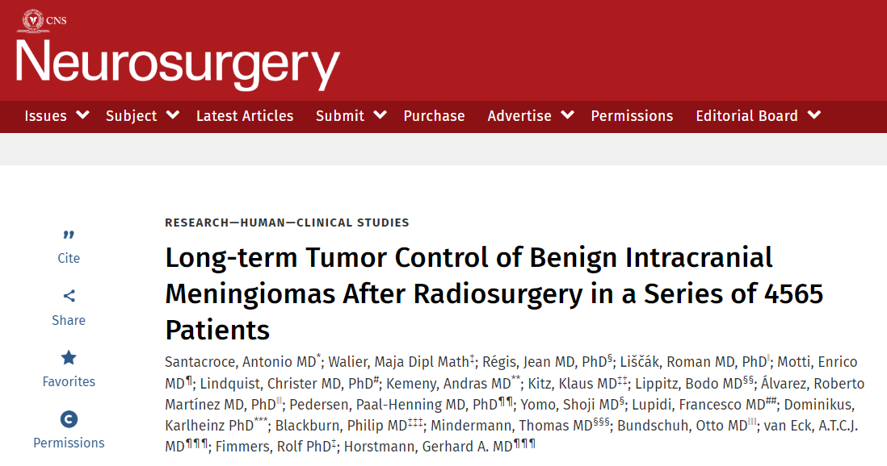
Clinical follow up SRS treated Skullbase Meningioma
Neurological improvement
  CS 44.2%
  PC 34%
  CPA 38.5%
Complete symptoms response
  CS 23.2%
  PC 15%
  CPA11.5%
CS:Cavernous sinus
CPA:CerebroPontal Angle
PC:Petro Clival
Santacrose et al. Long-term Tumor Control of Benign Intracranial Meningiomas After Radiosurgery in a Series of 4565 Patients 2011

Slide 33
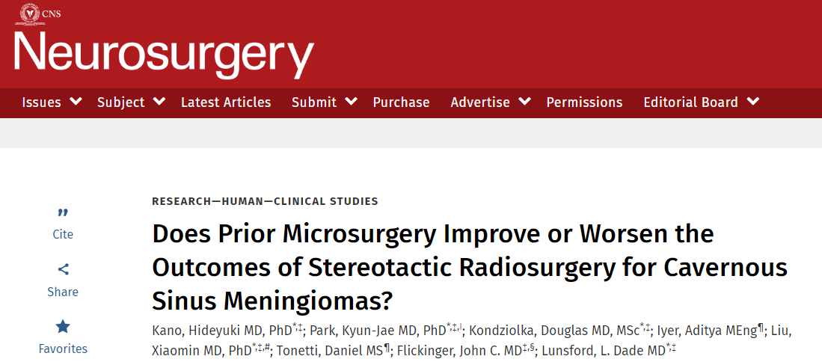
Kano H, Park KJ, Kondziolka D, et al. Neurosurgery. 2013
Cranial nerve outcomes in patients who underwent SRS for CS meningiomas
with or without prior microsurgery
Improvement rates specific to Cranial Nerve Deficits after SRS :
              20% at 1 yr,
              34% at 2 yr,
              36% at 3 yr, and
              39% at 5 yr.

Slide 34

Fractionated SRS

Slide 35
Fractionated SRS for Skullbase Meningioma
Large Tumor Volume
Proximity to Optic Pathway
Local Control ?
Toxicity ?
Lesion>30mm
Lesion >15cc
Lesion<2-3mm optic nerve distance
https://www.redjournal.org/article/S0360-3016(22)03236-9/fulltext

Slide 36
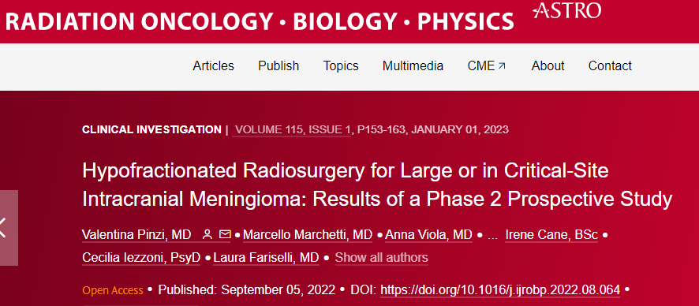
Multi session SRS for meningiomas
Phase II Prospective study
Dose: 25Gy in 5 fractions
N=178
5-year tumor control: 97%
Overal Toxicity:12,7%
https://www.redjournal.org/article/S0360-3016(22)03236-9/fulltext
Fariseli et al, 2023

Slide 37
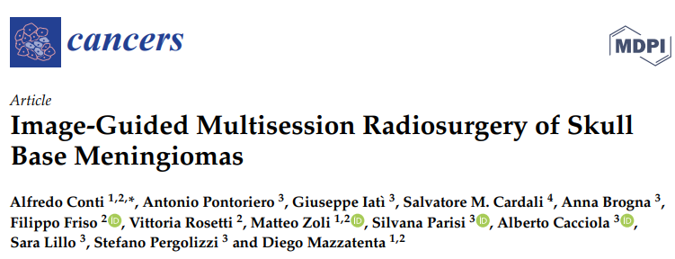
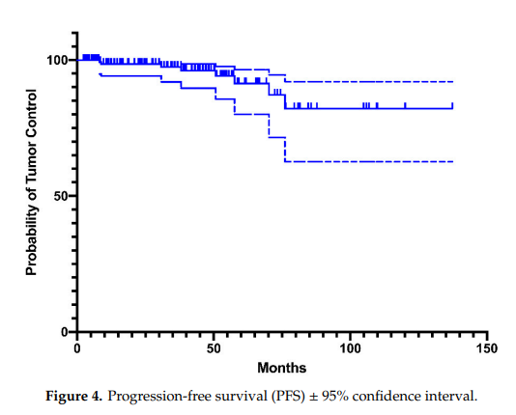
Image Guided Multisession Radiosurgery of Skullbase meningiomas
Retrospective Analysis
Dose: 25Gy in 5 fractions
N=156
5-year tumor control: 90%
Progression-free survival at 2-, 5-, and 10- years was 95%, 90%, and 80.8%, respectively.
There were no new visual or motor deficits, nor cranial nerves impairments, excluding trigeminal neuralgia, which was reported by 5.7% of patients.
Conti et al,Cancers 2022
https://www.ncbi.nlm.nih.gov/pmc/articles/PMC7761100/pdf/cancers-12-03569.pdf

Slide 38
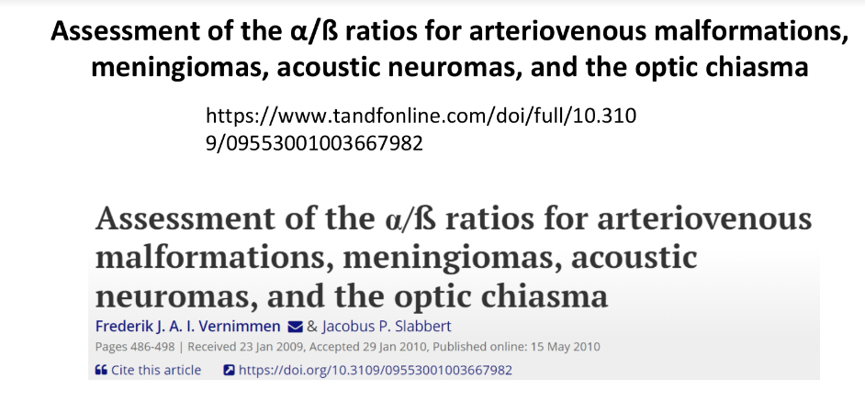
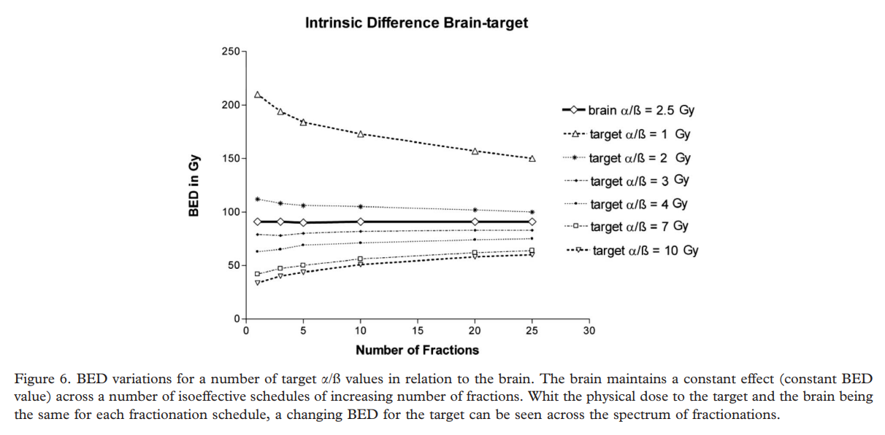
Assessment of the α/ß ratios for meningiomas
Radiobiological advantage in fractionation?
Brain normal tissue alpha/beta 2.5
meningiomas alpha/beta 3.3 – 3.7
Probably not so much as we think
Frederik J. A , South Africa, May 2010
https://www.tandfonline.com/doi/full/10.3109/09553001003667982

Slide 39
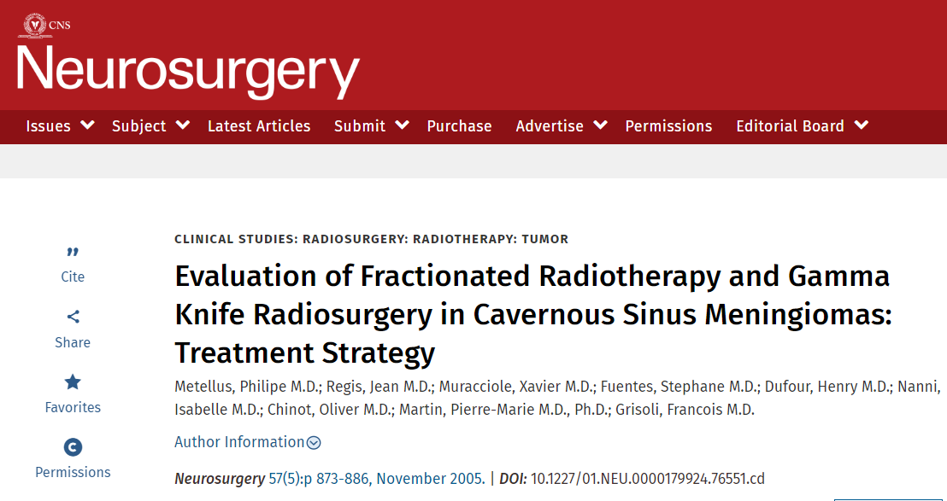
SRS vs. SRT CS Meningioma: tumor shrinkage ???
However, radiologically 29% of patients who underwent SRT, and 53% of patients who underwent SRS, showed tumor shrinkage (P < .04)
The result implied that SRS offered a higher rate of tumor shrinkage, but no significance in clinical improvement.
Metellus P, Regis J, Muracciole X, et al. Evaluation of fractionated radiotherapy and gamma knife radiosurgery in cavernous sinus meningiomas: treatment strategy. Neurosurgery. 2005

Slide 40
High Grade skullbase meningiomas

Slide 41
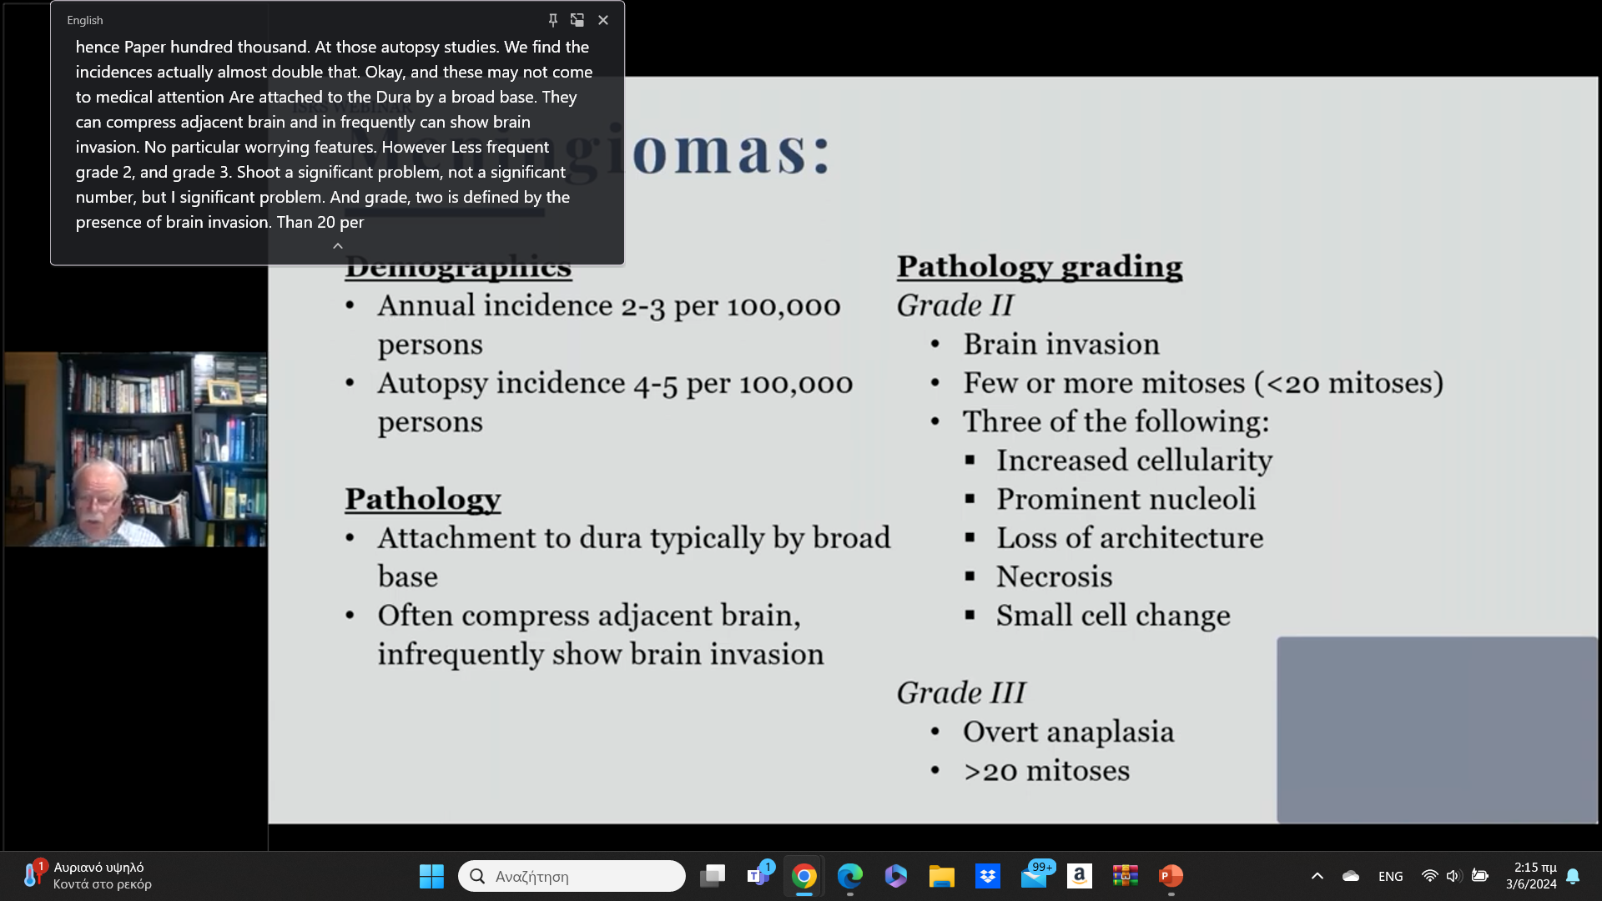
Grade II and Grade III meningioma criteria

Slide 42
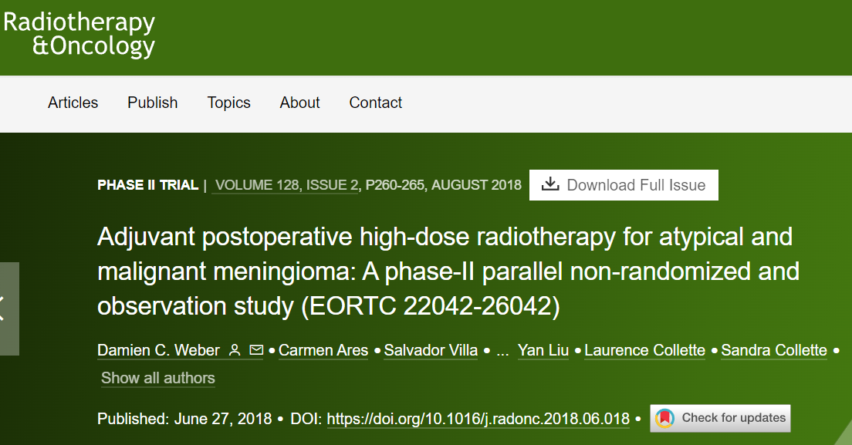
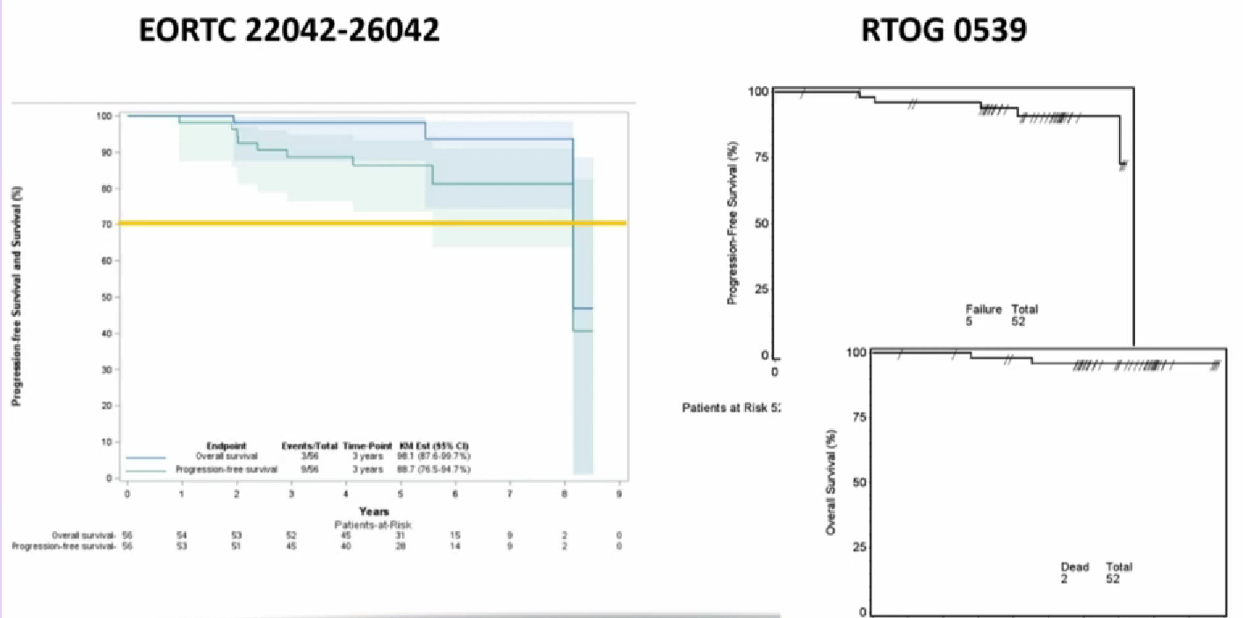
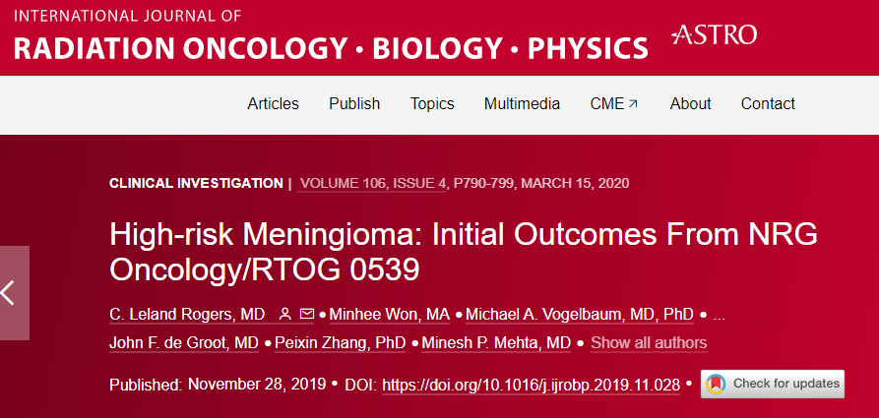
Grade II: immediate or waiting RT after GTR ?
EORTC 22042-26042
RTOG 0539
Excellent results in Favor of post-operative RT

Slide 43
EORTC 22042-26042 and RTOG 0539
Using modern RT technics (like IMRT)
we can deliver higher dose in the target, protecting the normal brain
very low rate of high grade late toxicity
paradox
SRS :
higher conformity in the target
increased dose gradient outside the target (rapid fall off the dose)

Slide 44
Adjuvant SRS improves Post-surgical long term outcomes (regardless of the extent of resection)
7486 patients,
6788 with atypical meningiomas
698 with malignant meningiomas
Overall 5-year survival was 76.9% and 43.3% among patients with WHO grades II and III meningiomas, respectively.
Adjuvant RT correlated with improved survival in a multivariable model in patients with grade II tumors (p = 0.029)
https://pubmed.ncbi.nlm.nih.gov/32860156/
Alfredo Quinones Hinojosa J Neurooncology 2020

Slide 45
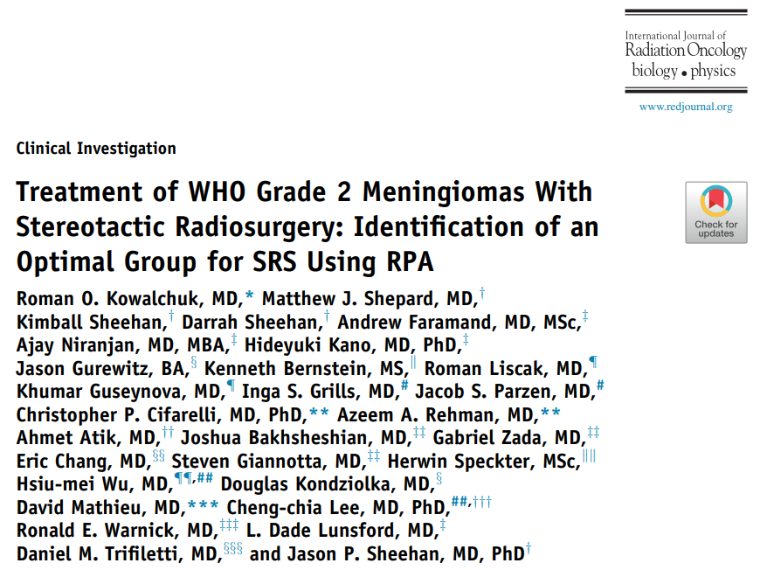
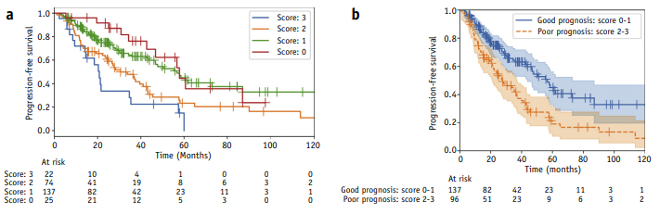
Selection of pts Grade II meningioma for SRS (adjuvant or definitive)
Stratifications of the cohort
SRS is a good choice for patients age<50, up to 1 previous resection, no previous RT (+ Volume<11.5cc)
Kowalchk et al. USA Red Journal Jan 2021

Slide 46
Factors affecting SRS outcomes

Slide 47

factors associated with improved SRS local control
Statistically significant (P < .05) factors associated with improved SRS local control outcomes were:
higher marginal dose,
small- to medium-sized tumors,
WHO grade I,
upfront SRS (irradiated tumor without surgical resection),
early SRS (cranial deficits < 1 yr),
female sex,
younger age,
less conformal plans
ISRS guidelines

Slide 48
Multivariate analysis of factors associated with improved local control after SRS
(stable and reduced volume)
Center experience (CS)
Female (CS,CP)
meningiomatosis vs sporadic (CS, PC)
Prescription dose (PC)
Maximum dose (CP)
Cavernous sinus
CerebroPontal Angle
Petro clival
Santacrose et al. Long-term Tumor Control of Benign Intracranial Meningiomas After Radiosurgery in a Series of 4565 Patients 2011

Slide 49
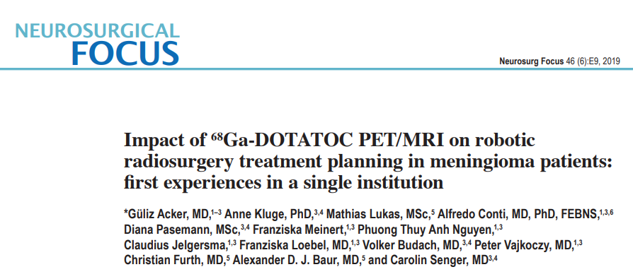
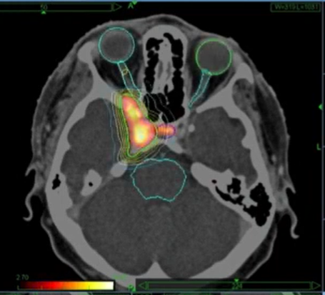
IMAGING: impact of ⁶⁸Ga-DOTATOC PET to SRS on target volume delineation of meningiomas
Easier to define target
planning volumes showed significantly smaller per physician
preference for PET/MRI by radiosurgeons (particularly in proximity to critical structures)
Acker, Neurosurgical Focus (JNS) 2019

Slide 50
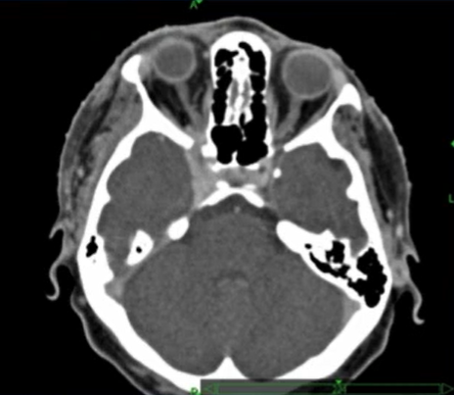
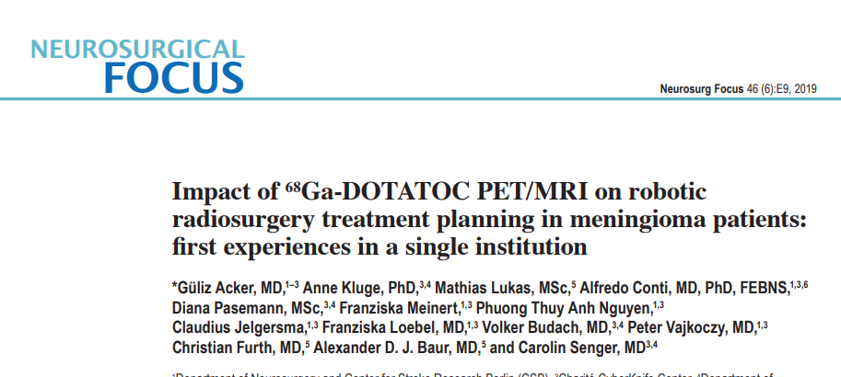
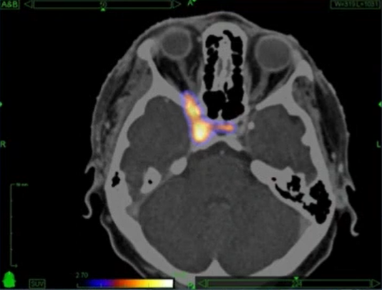
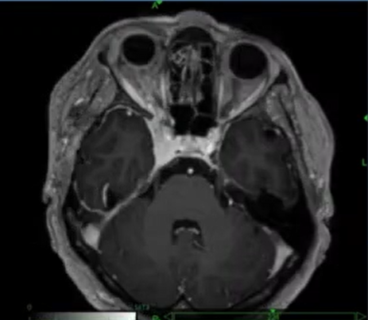
Acker, Neurosurgical Focus (JNS) 2019

Slide 51
Skullbase meningioma Radiosurgery
Complications

Slide 52
Complications SRS for Skullbase Meningiomas
Neuropathy
Optic pathway toxicity
Facial Nerve toxicity
Radiation Necrosis Brain
Oedema
Pituitary gland hormone deficit
Headache

Slide 53
neurological deterioration
Incidence of neurological deterioration, or development of new neurological deficits in those series with long-term follow-up, has been relatively low.
Approximately 80% to 100% of patients preserve neurological functions
ISRS guidelines

Slide 54
complications
Neurological deterioration
  CS 10.8%
  PC 15%
  CPA 14.2%
Permanent morbidity rates
  CS 5.9%
  PC 8.4%
  CPA 8.3%
Santacrose et al. Long-term Tumor Control of Benign Intracranial Meningiomas After Radiosurgery in a Series of 4565 Patients 2011

Slide 55
Post-SRS Edema
Skullbase meningiomas lower risk of post-SRS edema
Edema is related with Dose and Volume
Edema is NOT DIRECTLY RELATED with Dose and Volume
Multivariate mechanism with unclear relationship

Slide 56
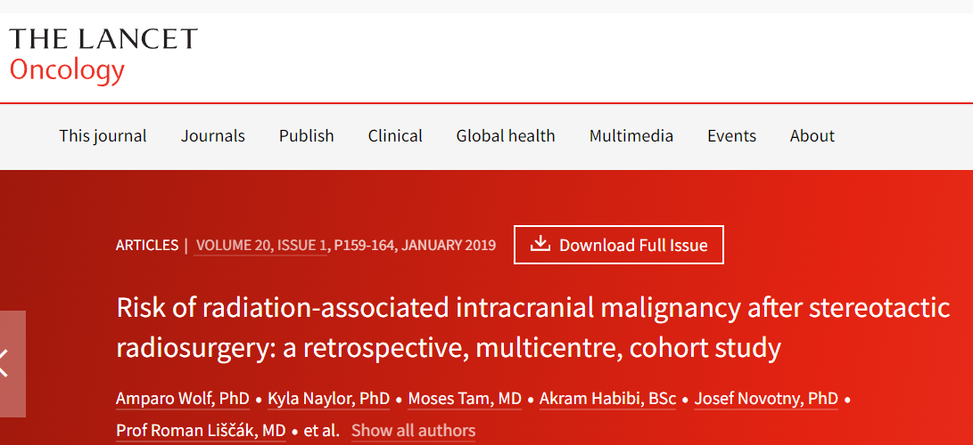
Risk of radiation-associated intracranial malignancy after stereotactic radiosurgery: a retrospective, multicentre, cohort study
6·87 per 100 000 patient-years for malignant transformation
2·26 per 100 000 patient-years for radiosurgery-associated intracranial malignancy
estimated risk for intracranial secondary malignancy or malignant transformation of a benign tumour in patients treated with stereotactic radiosurgery remains low at long-term follow-up
similar to the risk of the general population to have a primary CNS tumour
Douglas Kondjiolka et al,
Lancet 2018
https://sci-hub.se/10.1016/s1470-2045(18)30659-4

Slide 57
“Stereotactic Radiosurgery”

Slide 58
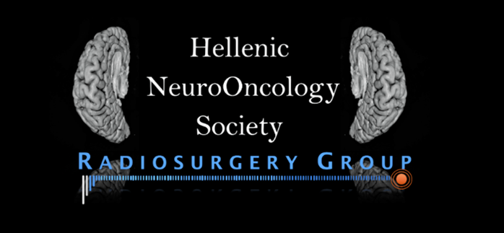
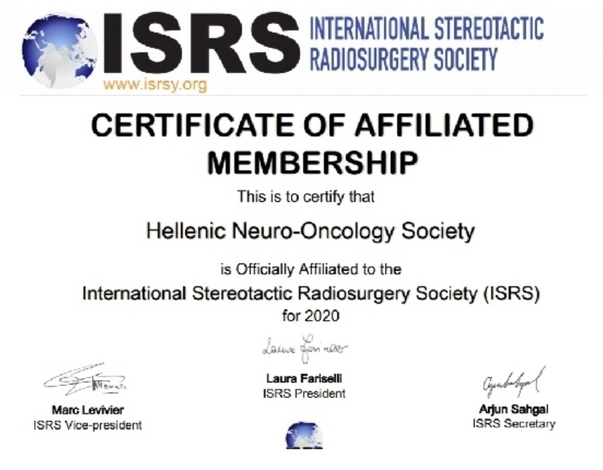
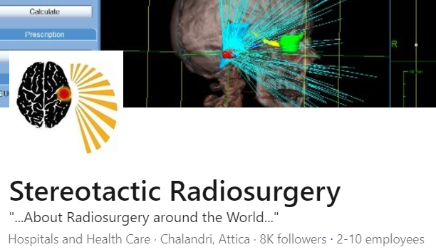

“Stereotactic Radiosurgery”
Dedicated in SRS
International SRS Training and Practice 2006
International SRS Certification 2010
Establish “SRS Group” of Hellenic Neuro-Oncology Society 2017
Establish Greek Radiosurgery Guidelines 2019
Affiliated ISRS members of 2020
Linkedin “Stereotactic Radiosurgery” (8500 members) 2021
Represented in Radiosurgery Board 2021
  Greek Ministry of Health
  Greek Public Insurance (EOPYY)

Slide 59
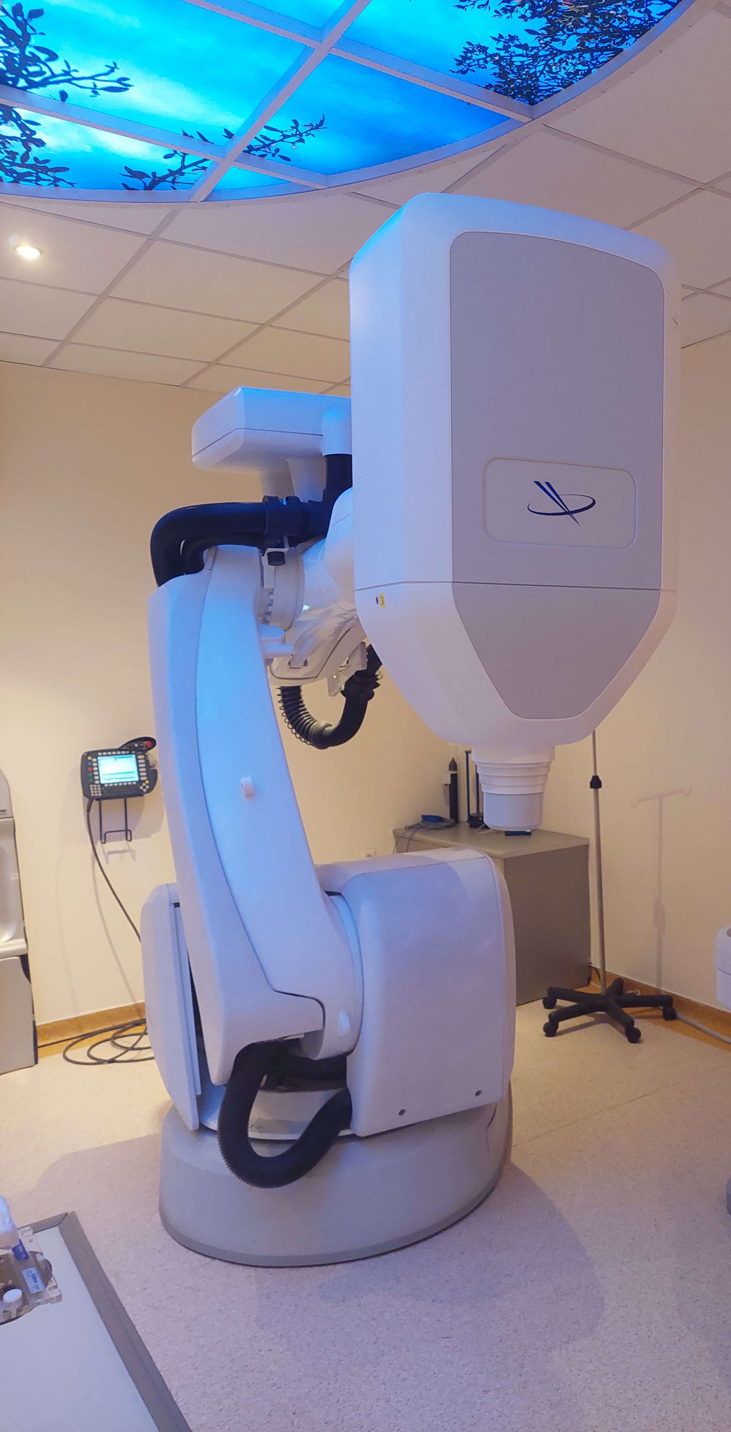
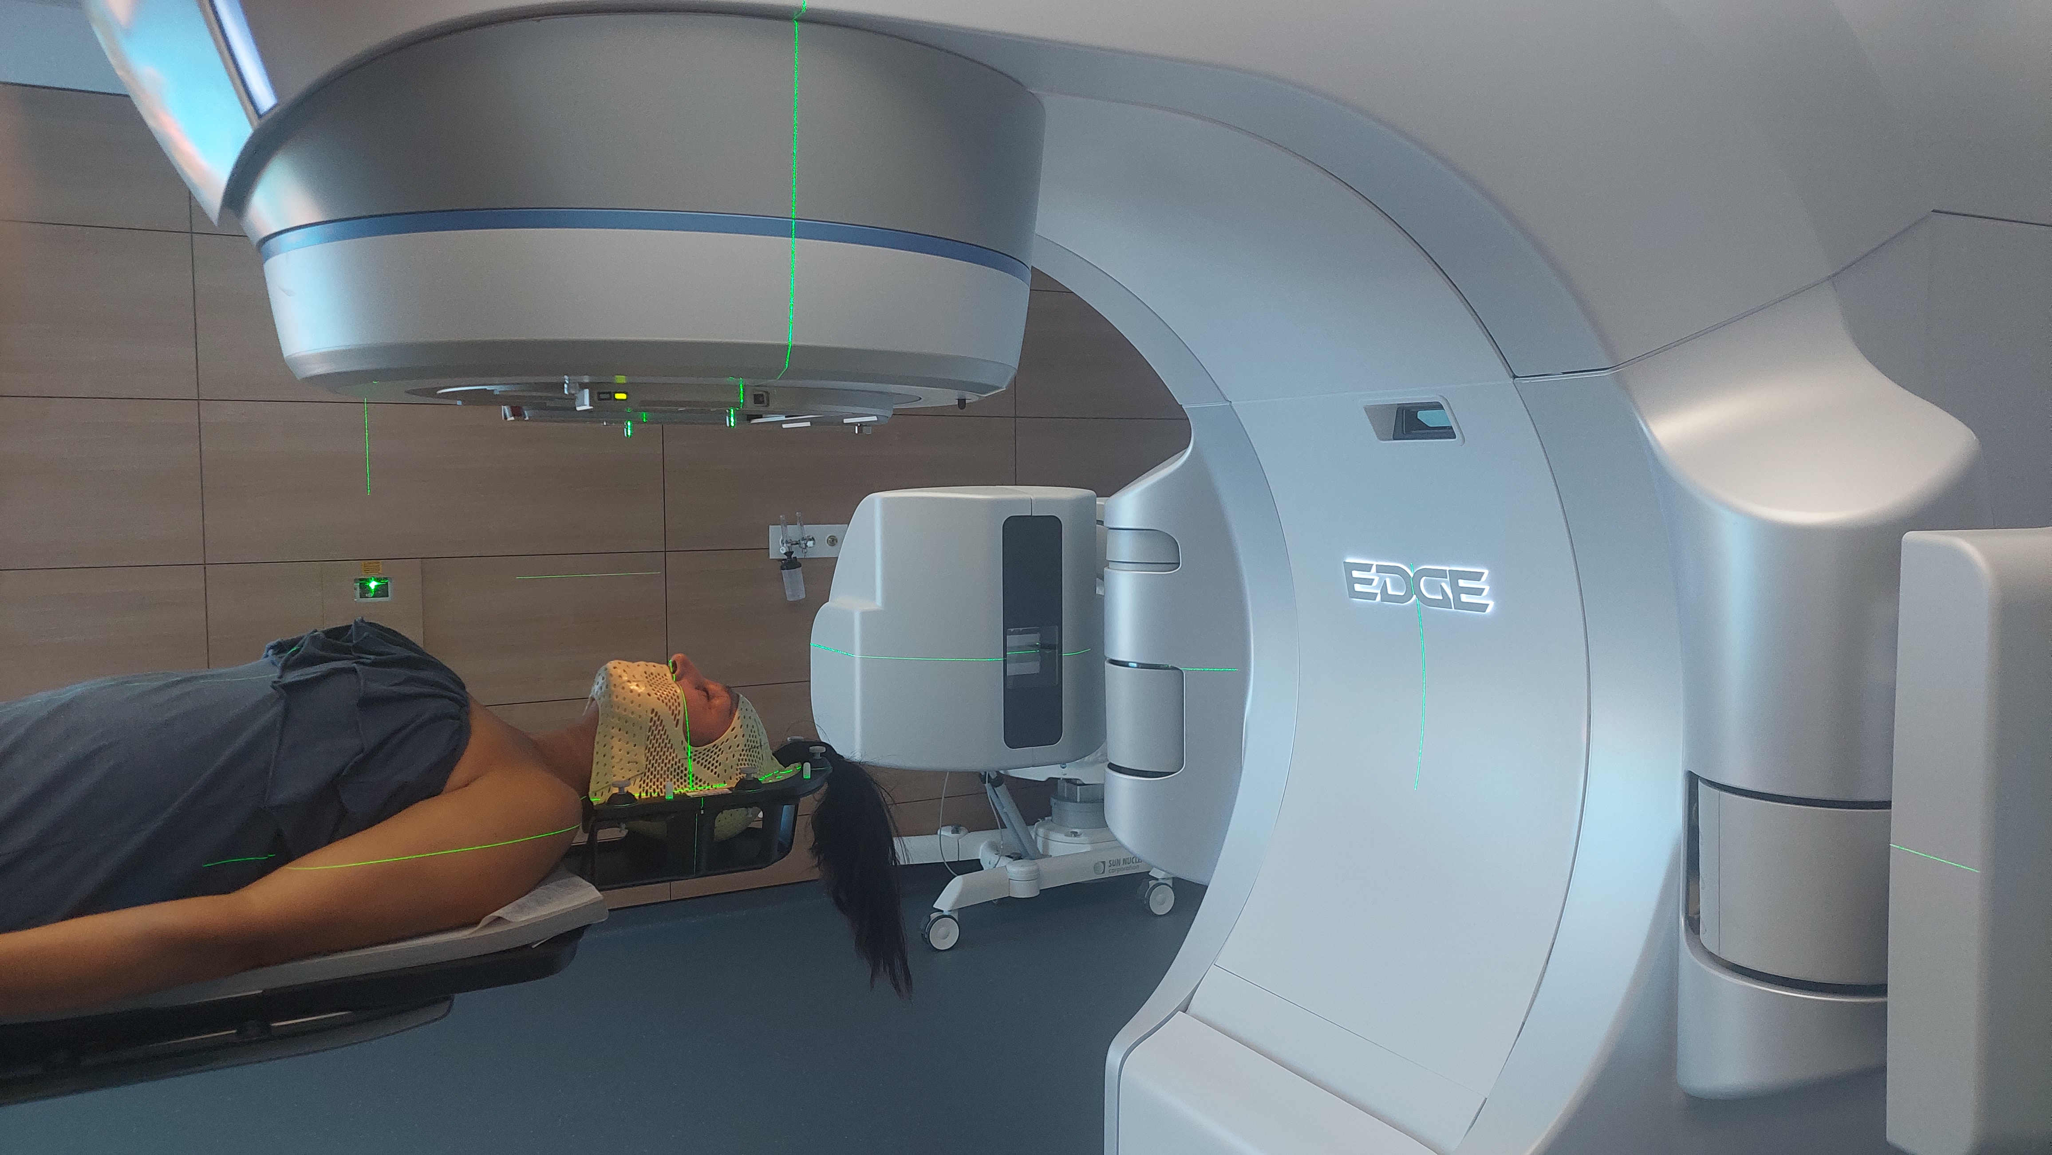

Operating systems
Radiosurgery (isocentric) THESSALONIKI
Robotic Radiosurgery (non isocentric) ATHENS

Slide 60
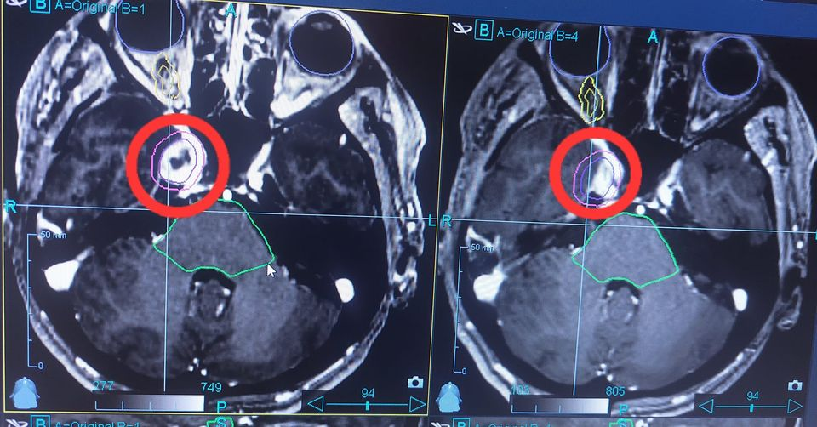
Cavernous Sinus Meningioma treated with SRS
Case 1
Response after 3 years
Tumor Necrosis and Shrinkage

Slide 61
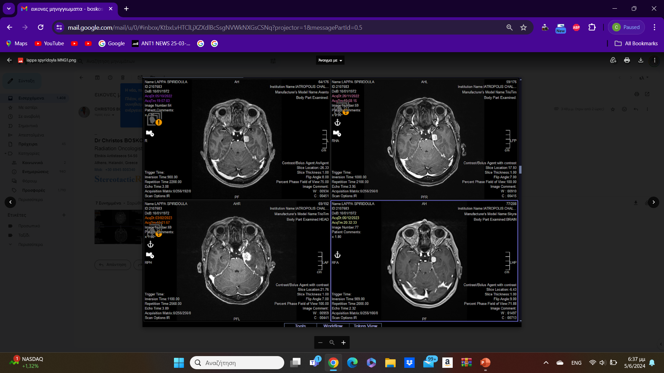
Female 52 yrs
Meningioma
Initial enlargement and Delay Response after SRS
6months: enlargement
12 months Shrinkage
Case 2
Meningioma treated with SRS

Slide 62
Sep 2022 SRS
Nov 2022, 2 Months
Apr 2023, 6 Months
Sep 2023, 12 Months

Slide 63


Female, 44 yrs mild deficit ocular motor
Case 3
Jan 2021: SRS

Slide 64

Feb 2023: Response
Jan 2021: SRS

Slide 65


Relapse - Feb 2023 (2nd SRS)

Slide 66

Local Control Aug 2024
Relapse - Feb 2023

Slide 67
Conclusions
Radiosurgery is a safe and efficient therapy for skullbase meningioma
high rate of tumor response and neurological improvement
Low rates of complications
Molecular and Genetic profile of the tumor is a challenge for better outcomes
Modern imaging is a precious tool
Selection of the proper Dose is crucial

Slide 68


