Slide 1
Hadron Therapy at GSI - where we come from, where we go
Dr. Konrad Lehmann

Slide 2
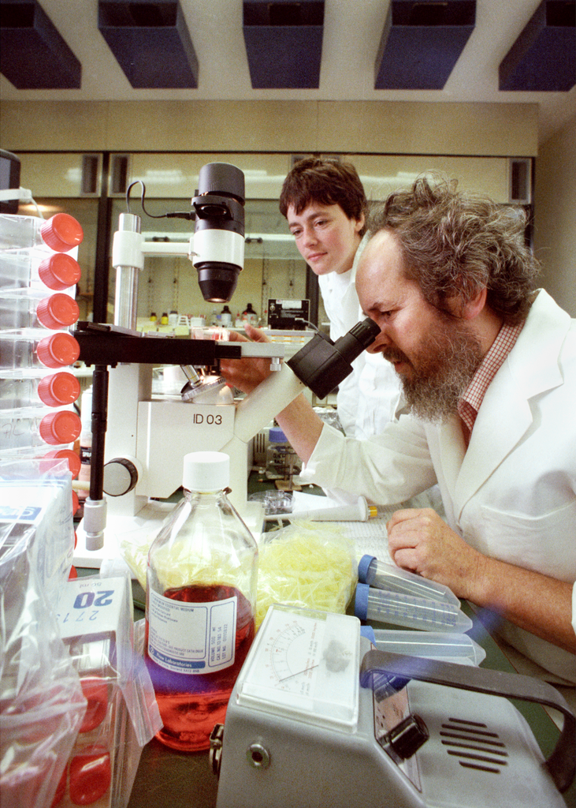
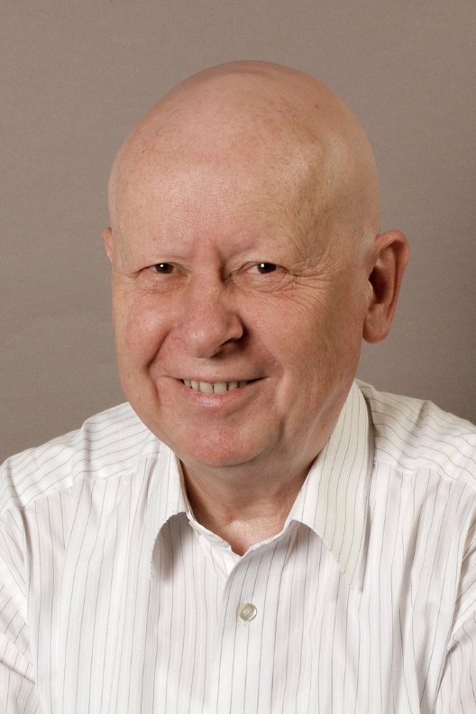
How it all started
Gerhard Kraft
29.10.1941 – 18.3.2023

Slide 3
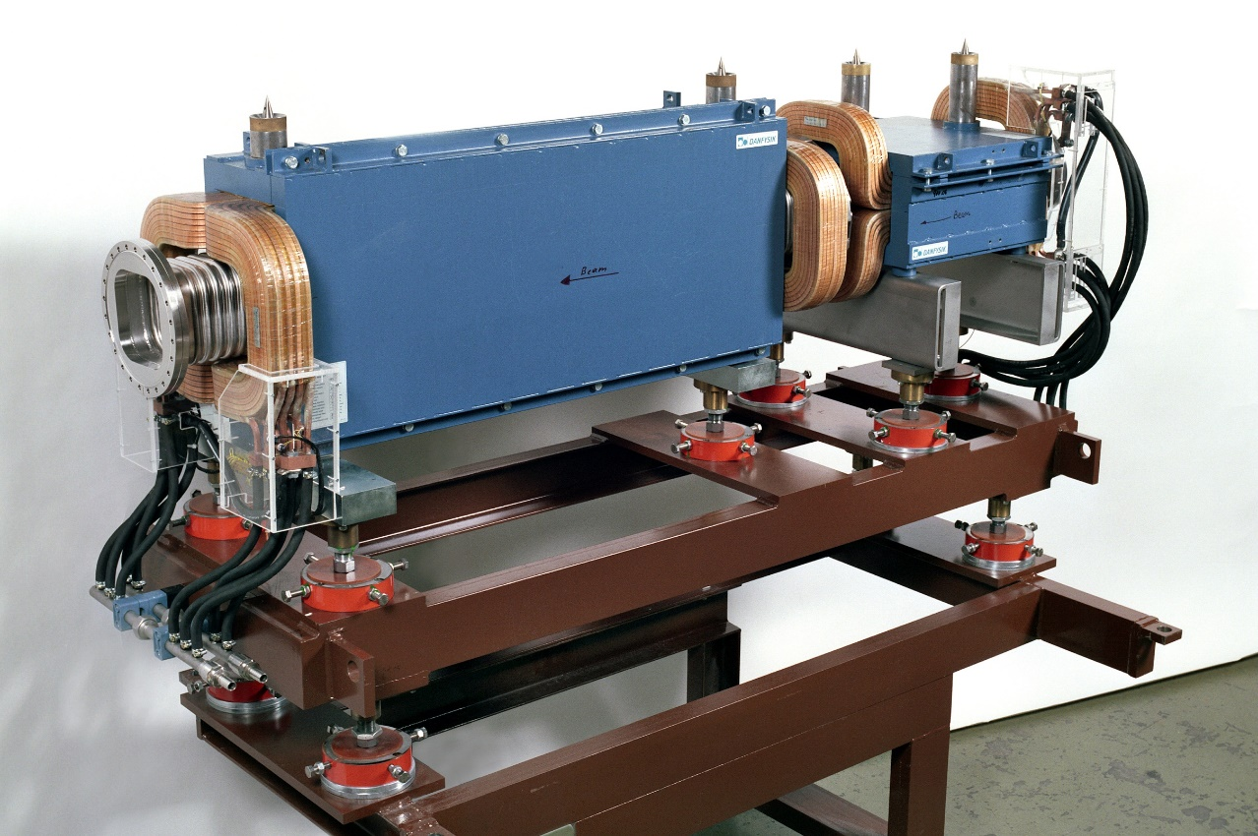
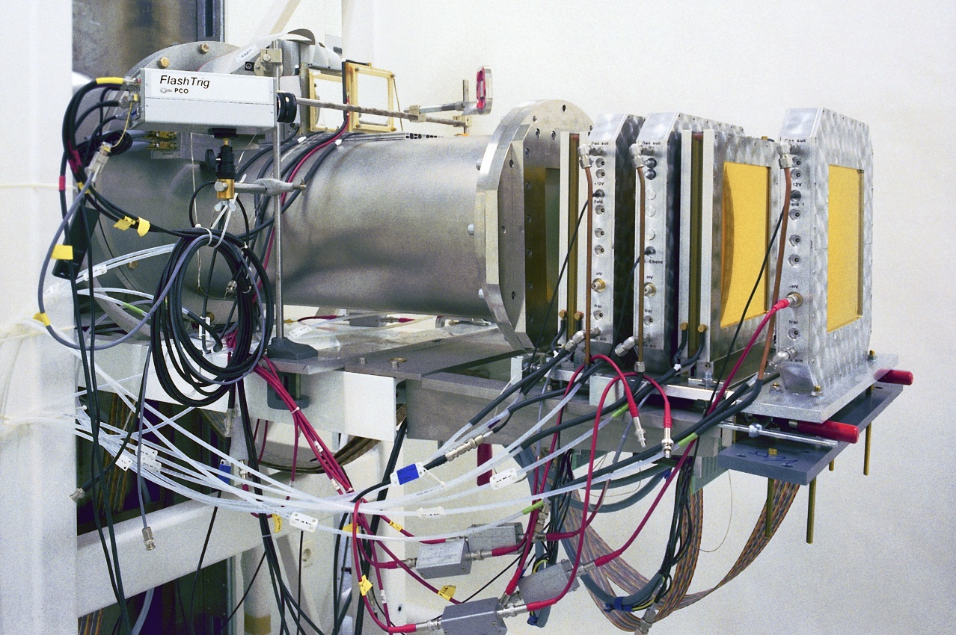
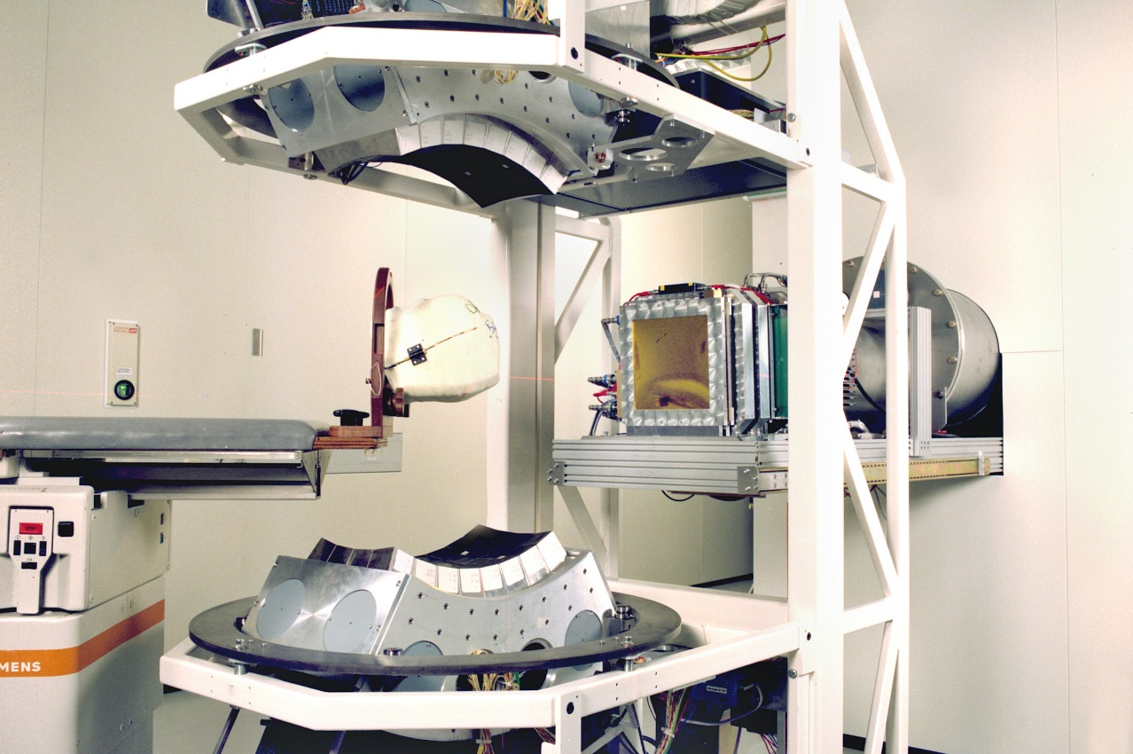

Slide 4
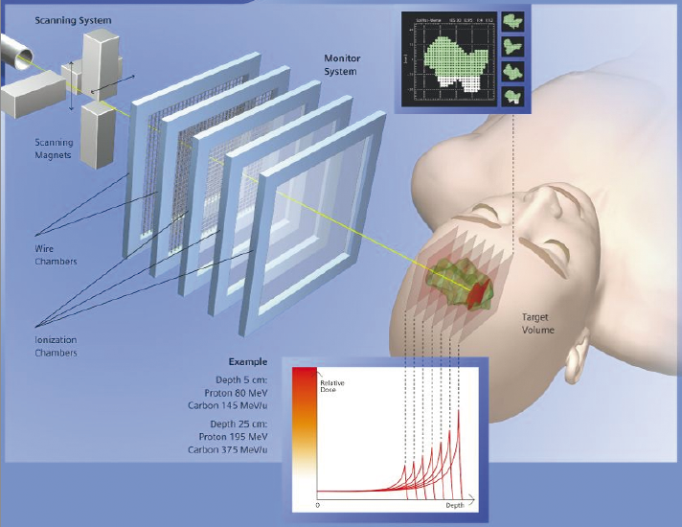
The Result
Tumor scanning in 3D
Monitoring of both beam and target
RBE modeling

Slide 5
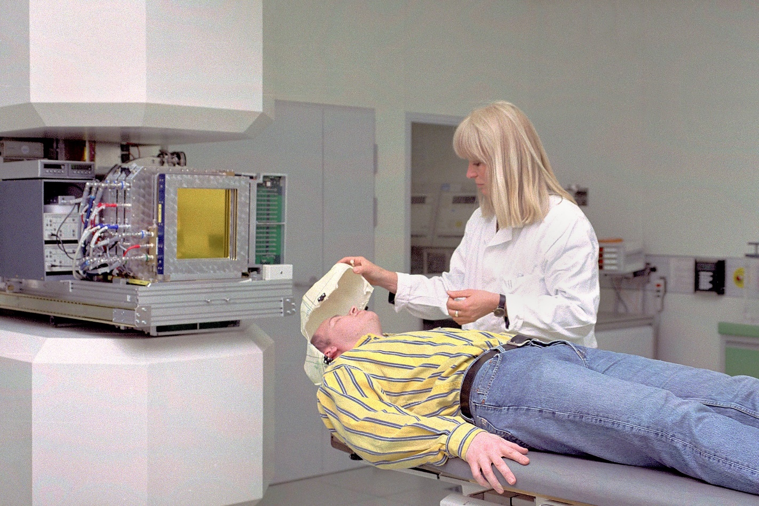
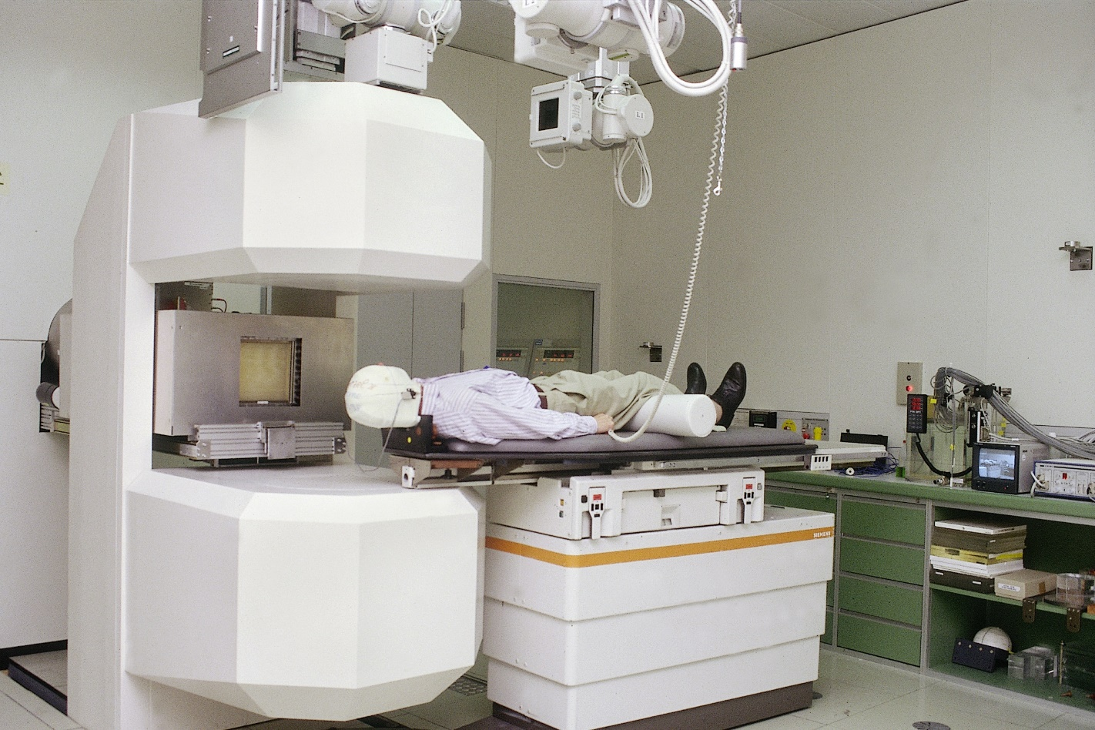

Slide 6
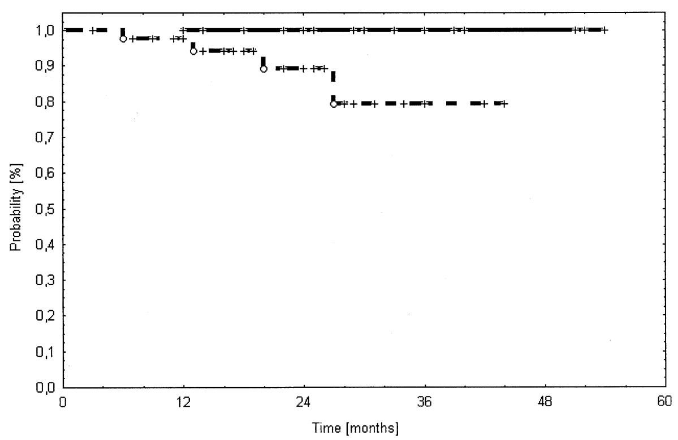
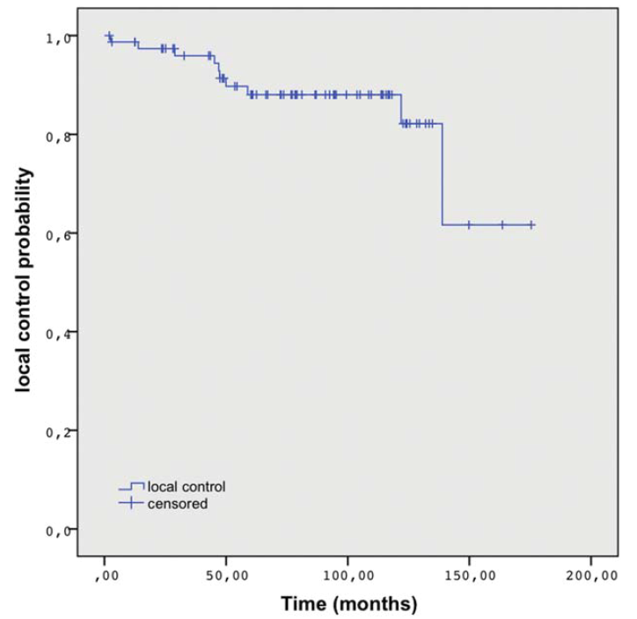
Pilot project for hadron therapy 1997-2008
Treatment of 434 patients with head-and-neck tumors
chondrosarcoma
chordoma
Tumor control (152 patients)
Schulz-Ertner et al. (2004)
Uhl et al. (2014) Cancer 120: 1579

Slide 7
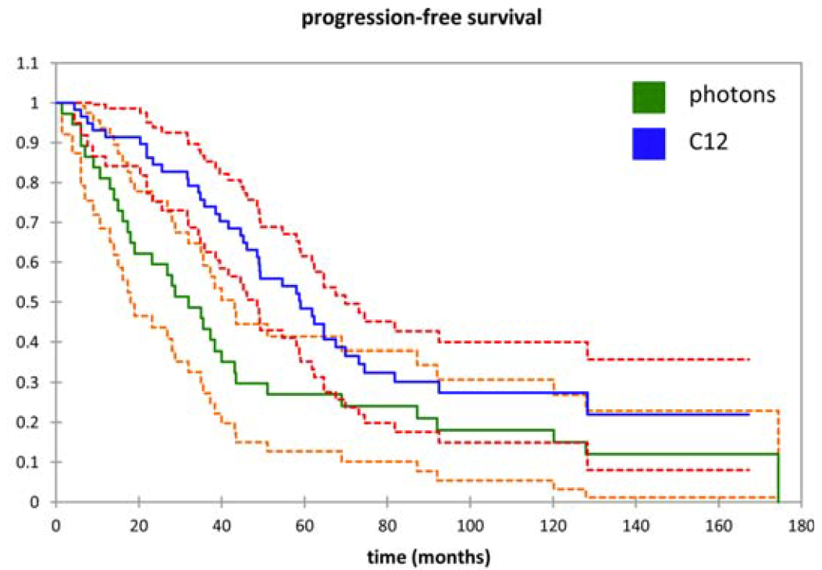
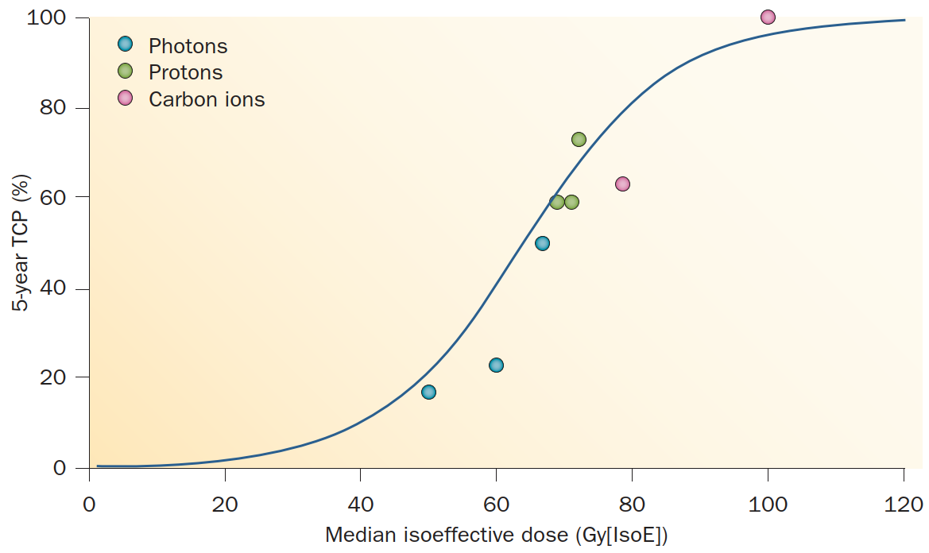
Better than x-ray
Adenoid-cystic carcinoma
Jensen et al. 2015, Cancer
Loeffler & Durante (2013) Nat. Rev. Clin. Oncol. 10: 411

Slide 8
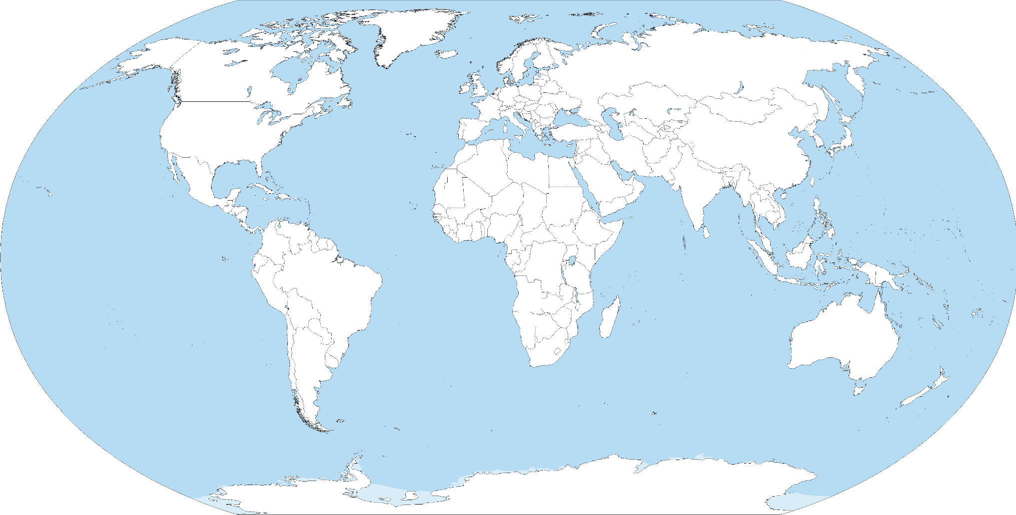
We metastasize
Darmstadt
Marburg
Caen
Wien
Gunma
Yamagata
Heidelberg
Pavia
Seoul
Chiba
Jacksonville
Wuwei
Busan
Yokohama
Shanghai
Osaka
Hyogo
Taipei
Tosu

Slide 9
But science never ends
FLASH / Ultra-High Dose Rate
BARB
Mixed beam

Slide 10
FLASH / Ultra-High Dose Rate treatment
FLASH effect first discovered in X-ray therapy.
Sparing of healthy tissue with equal tumor control.
Easily done with protons in a cyclotron, but more difficult with heavy ions.
First carbon UHDR by collaboration of GSI / HIT in cell cultures in 2021, and first tumor treatment in experimental animals at GSI in 2021.

Slide 11
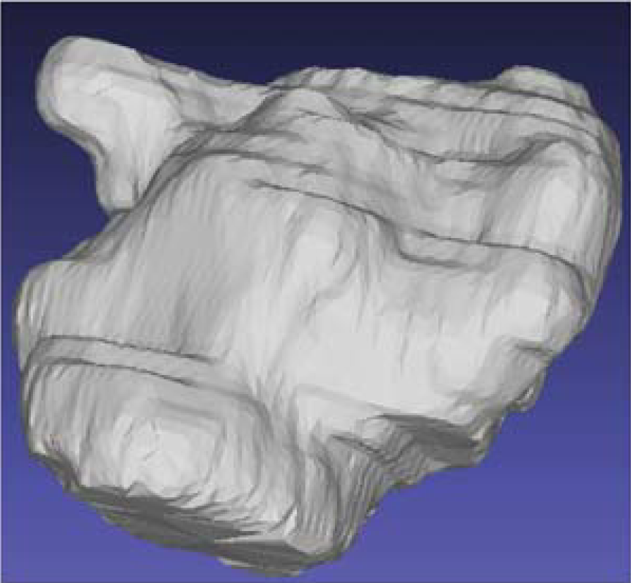
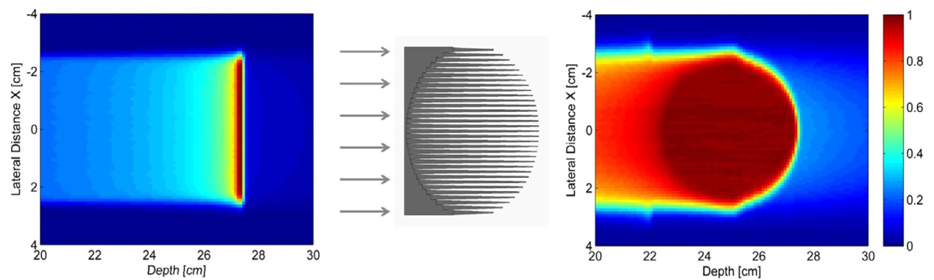
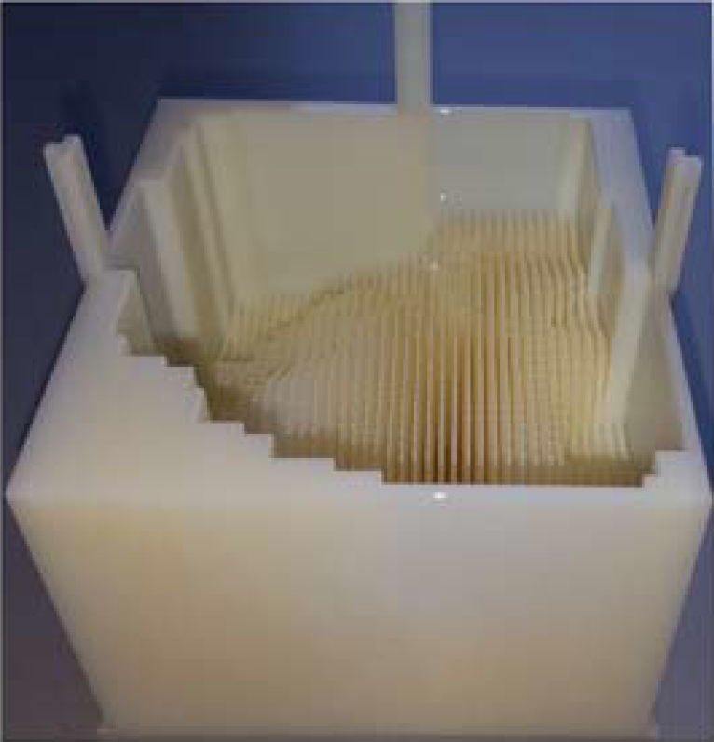
Range modulator
Problem: UHDR too fast for scanning.
development of the range modulator
Simeonov et al. (2022) Biomed. Phys. Eng. Express 8: 035006
Weber et al. (2021) Med. Phys. 48: 1974

Slide 12
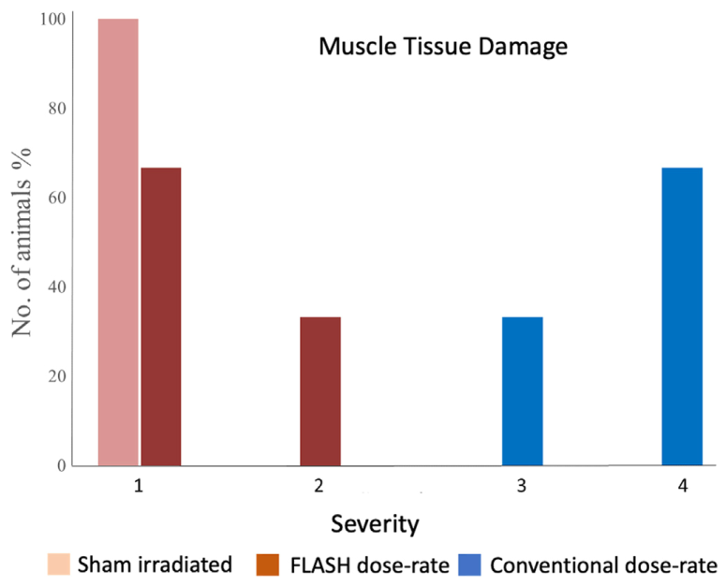
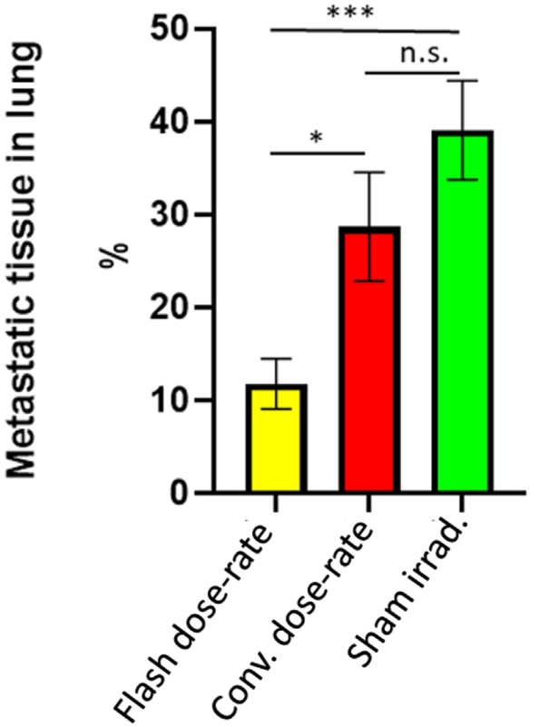
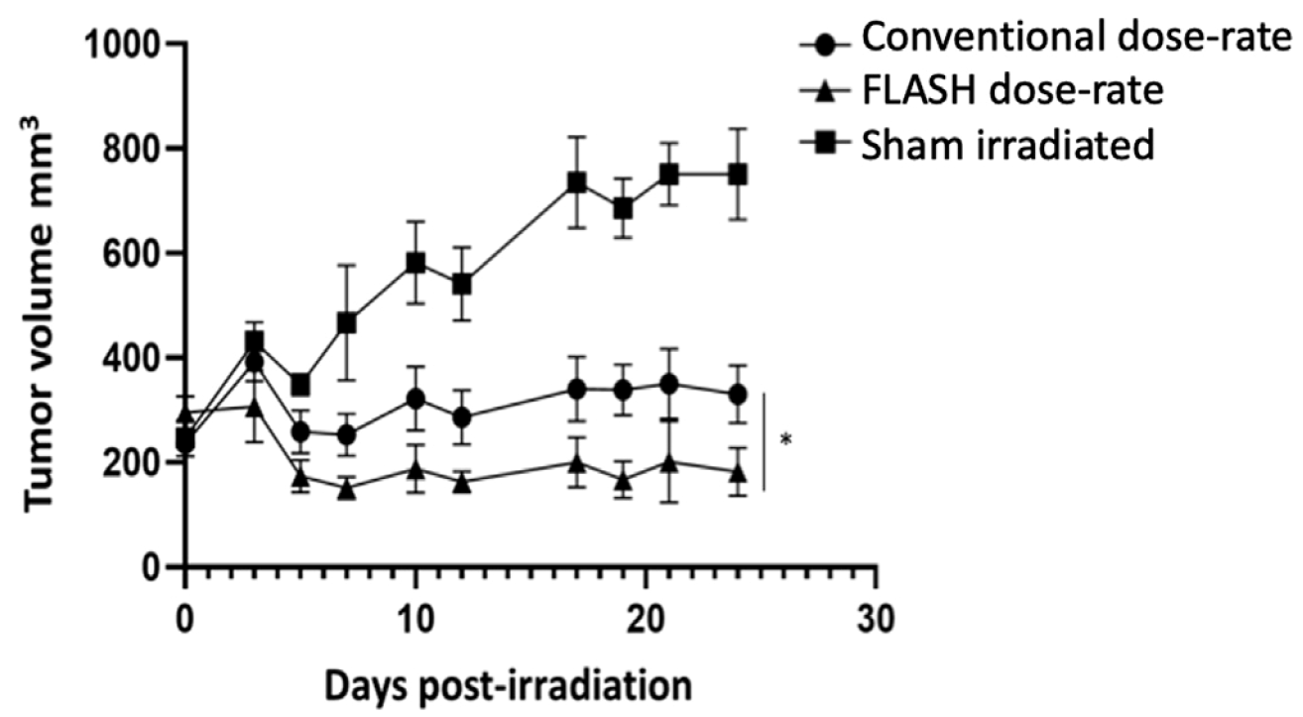
Carbon FLASH in mice
sham
conv.
FLASH
Tinganelli et al (2022) Radiother. Oncol. 175: 185-190

Slide 13
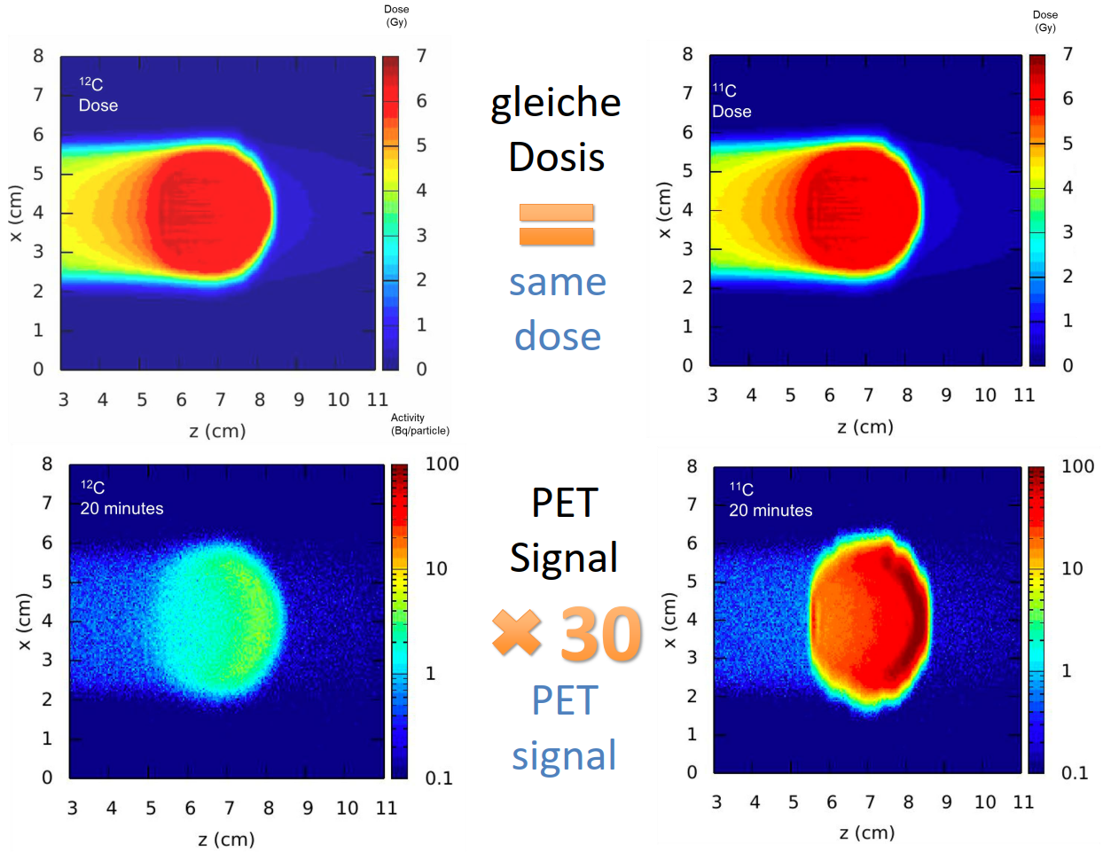
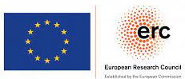


BARB
12C
11C
Problem: Do we hit the tumor?
PET too weak for an online image.
Solution: radioactive beam
Boscolo et al (2021) Front. Oncol. 11

Slide 14
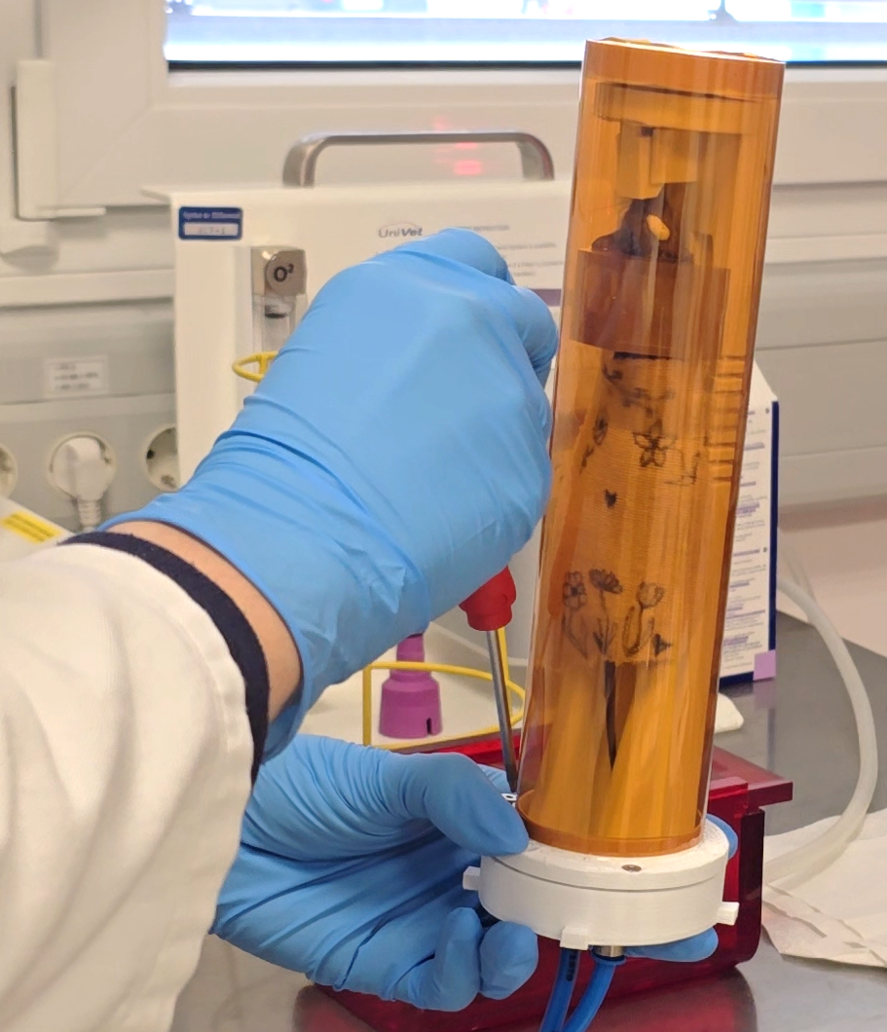
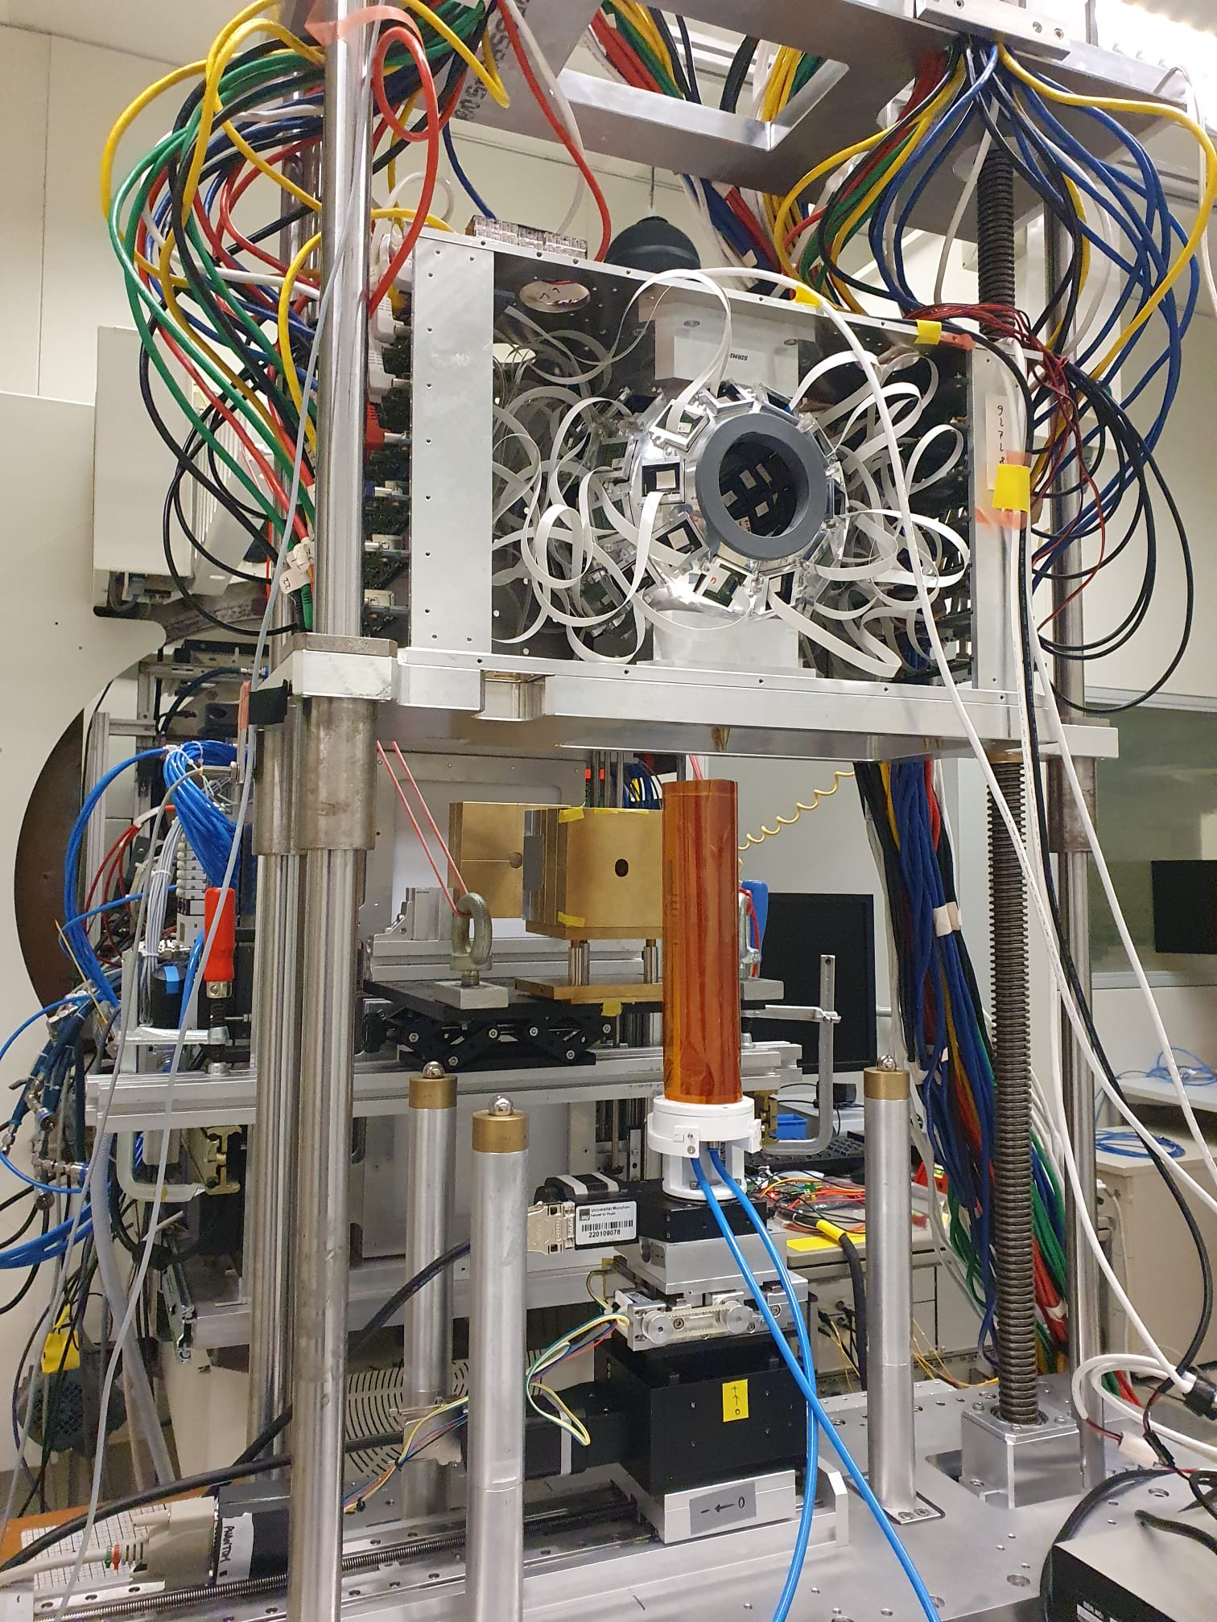
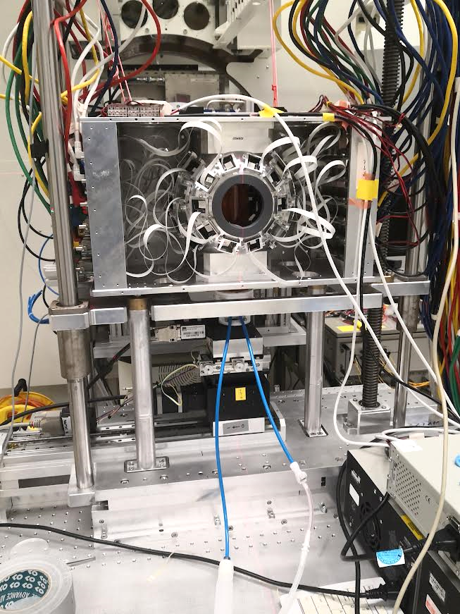
First BARB study in animals
tumor-bearing mice
SIRMIO PET scanner by Katia Parodi
range determination
washout

Slide 15
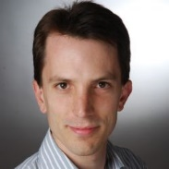
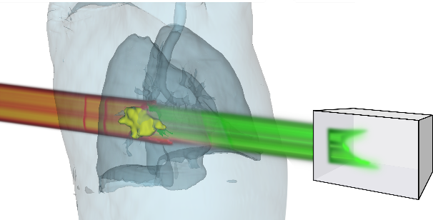
Mixed He C ion beams for range monitoring
Funded by the European Union (ERC CoG PROMISE, 101124273). Views and opinions expressed are however those of the author(s) only and do not necessarily reflect those of the European Union or the European Research Council Executive Agency. Neither the European Union nor the granting authority can be held responsible for them.
Range uncertainty is a major challenge, especially for moving targets
Mixed carbon and helium ions for concurrent therapy and monitoring:
  ~90% carbon for therapy, stops in patient
  ~10% helium for imaging, with 3x higher range, exits patient for online range inference
Several theoretical papers published:
  [Graeff et al 2018, Volz et al 2020, Hardt et al 2024]
  Minimal additional dose
  Helium should be detectable
  Correlation of He and C range
This is the first experimental proof of
concurrent mixed ion beam production
¹²C
⁴He
Treatment
Imaging

Slide 16
Further projects
moving targets
improved treatment planning models
immune system involvement
torpor-like state
microbiome

Slide 17
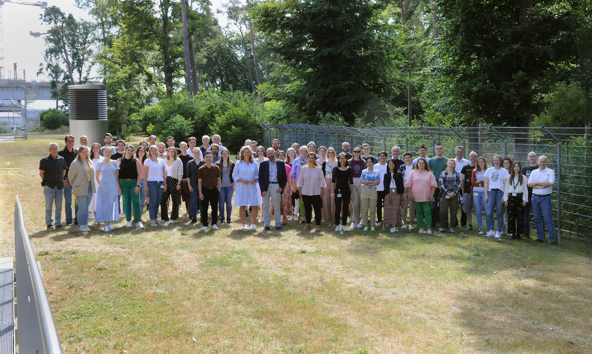
Biophysics Department today
86 members
26 staff
52% women
44% foreign citizens
18 nationalities
Median age 34 years
www.gsi.de/biophysik

Slide 18
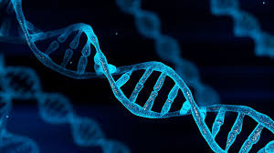
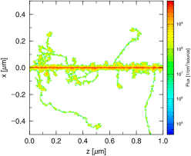
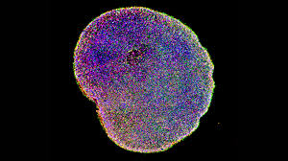
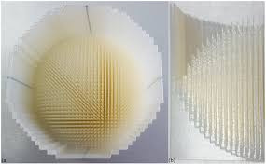
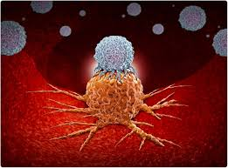
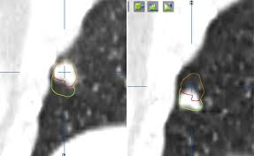
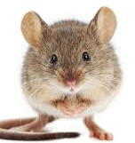
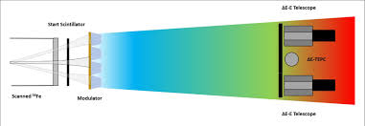
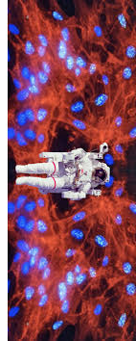
The Biophysics Department
DNA repair:
Burkhard Jakob
Biophysical modelling:
Thomas Friedrich
Organoids:
Insa Schröder
Particle therapy physics:
Uli Weber
Immunology:
Claudia Fournier
Medical physics:
Christian Graeff
Clinical radiobiology:
Walter Tinganelli
Space radiation physics:
Christoph Schuy
Space radiation biology:
Charlot Vandevoorde

Slide 19
Biophysics at GSI – science with existing facilities
Space radiation protection
Particle therapy
1997 2024
ESA reference facility for ground-based space radiation protection studies
Current ESA-supported programs ongoing: IBER/IRES/ROSSINI/GCRsim
ESA/FAIR Summer School in Darmstadt
EU programs: RADNEXT-HEARTS
Target station: Cave A (SIS18)
First European center to treat patients with high energy ¹²C-ions (434 patients treated on site)
Now extensive research program in particle therapy covering from nuclear physics to molecular biology
Work supported by BMBF, EU, NIH
Target station: Cave M (SIS18)

Slide 20
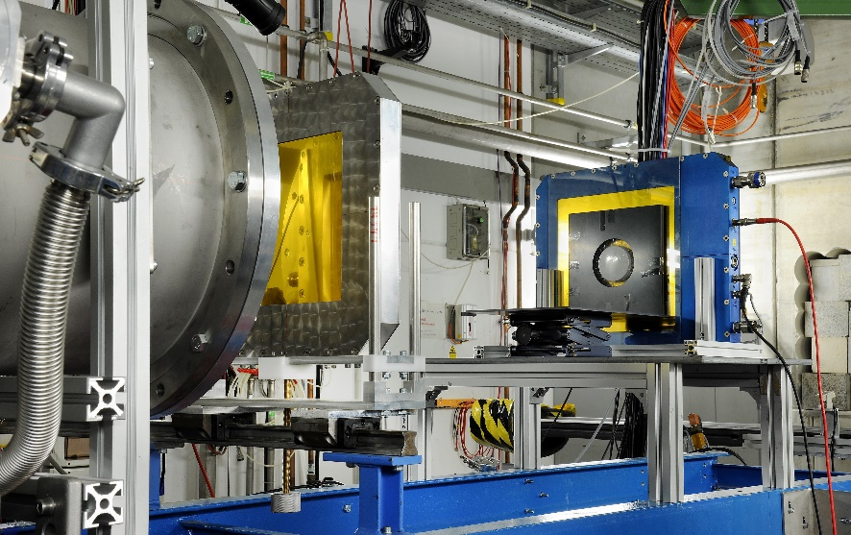
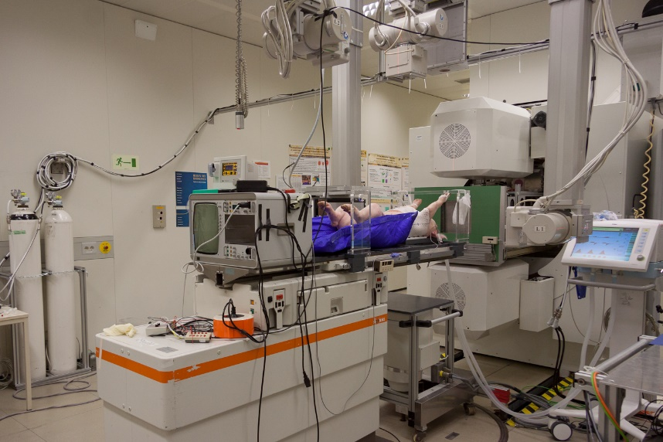

Biophysics at present facilities
Cave A
Cave M

Slide 21
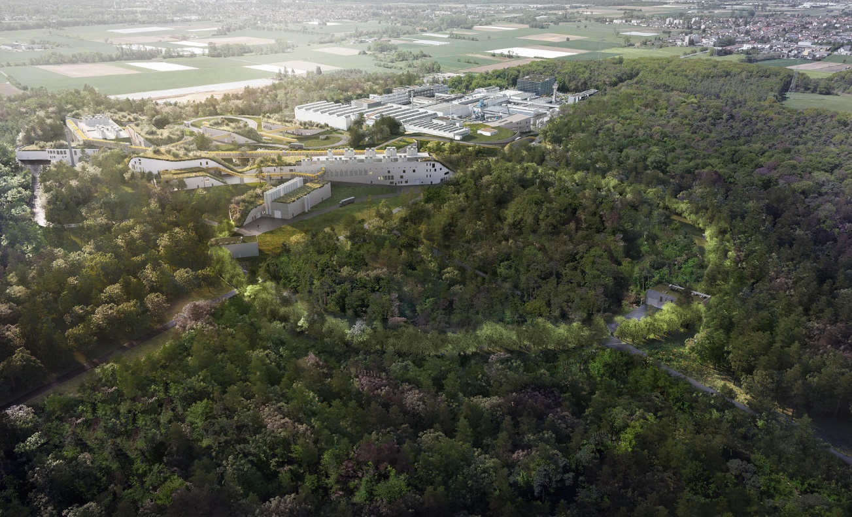
A FAIR future

Slide 22
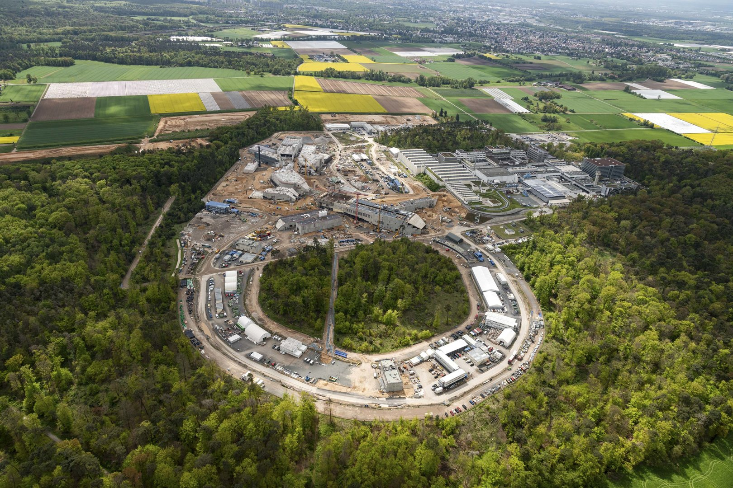
A FAIR future

Slide 23
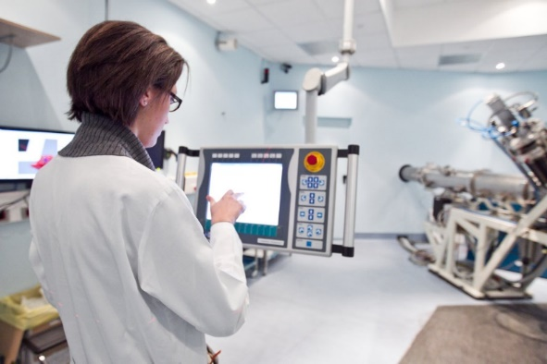
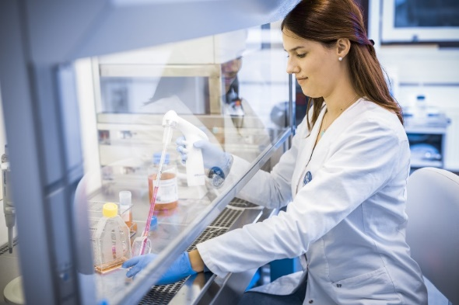


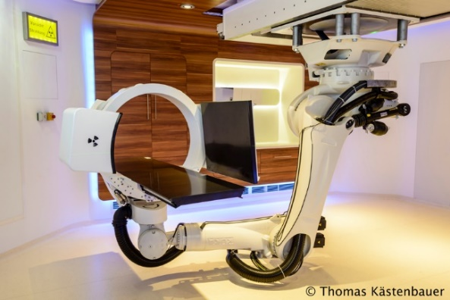
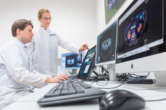

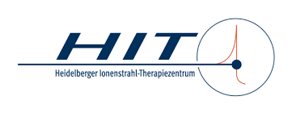
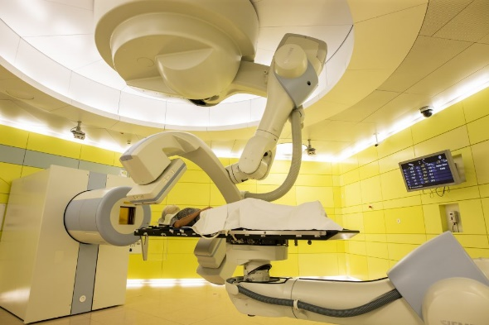

A few words on HITRI+ TNA
Consortium of all carbon centres in Europe:
  GSI
  HIT
  MIT
  MEDAUSTRON
  CNAO
Clinical & research TNA
Application via website: https://www.hitriplus.eu/

Slide 24
Thank you!

