Slide 1

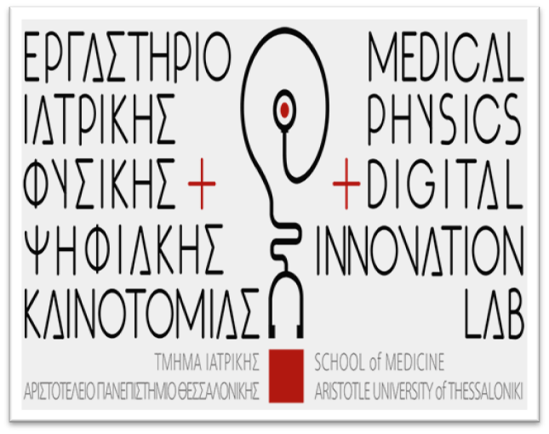
Radiation treatment plan for pediatric cancer: a clinical view
Georgios Giakoumettis
Medical Physicist, Medical Physics & Digital Innovation Laboratory, School Of Medicine, Aristotle University Of Thessaloniki, AHEPA University Hospital, Greece

Slide 2
Outline
Most common pediatric cancers
Pediatric cancers statistics
Radiotherapy in Pediatric Cancer
Photon & Proton Therapy Common techniques
History
Artificial Intelligence assisted Systematic Review
Comparison Proton Beam vs Photon Beam Therapy
References

Slide 3
Most common pediatric cancers
400.000 children and adolescents of 0-19 yo develop each year cancer. Most common types are:
  Leukaemias,
  Neuroblastomas,
  Wilms’ tumours,
  Brain cancers,
  Rhabdomyosarcomas,
  Lymphomas,
  Retinoblastomas,
  Osteosarcomas,
  Ewing's sarcomas

Slide 4
Pediatric Cancer Statistics
Leukaemia accounts for approximately 35% of all childhood cancers. Although it is more common in children under the age of 10, approximately 1 in 1000 children are diagnosed with leukaemia by the age of 1.
Neuroblastoma accounts for 5%-7% of all childhood malignancies and usually occurs by the age of 5.
Wilms’ tumor accounts for 6-7% of childhood cancer cases. It occurs in about 8 in 10⁶ children < 14 yo.
Brain cancers account for 15% of paediatric cancers (gliomas and medulloblastomas). The average age of glioma development is about 6 years old. Most medulloblastomas occur before the age of 10.
Notes:
-Leukaemia is a cancer of the bone marrow, the spongy centre of the bones that makes blood cells
-Neuroblastoma is a disease in which malignant (cancer) cells form in nerve tissue of the adrenal gland, neck, chest or spinal cord.
-Wilms’ tumor is a type of kidney cancer also known as nephroblastoma
-Rhabdomyosarcoma is a fast-growing, highly-malignant soft-tissue sarcoma which develops in the muscle, mostly in the neck, head, bladder and testes
-Lymphomas are malignant cell infiltrations of the lymphatic system located in the neck, armpit, and groin
-Retinoblastoma is a type of eye cancer that occurs in the retina of one, or both eyes.
-Osteosarcoma and Ewing's sarcoma are the most common malignancies of bone tissues in children.

Slide 5
Pediatric Cancer Statistics
Rhabdomyosarcoma accounts for 5-8% of childhood cancers. It usually affects children between the ages of 2-6 and 15-19.
Lymphomas are broadly classified as Hodgkin's and non-Hodgkin's. Hodgkin's generally occurs in individuals between 15-40 years of age.
Retinoblastoma is the most common eye tumour in children and accounts for 3-4% of all childhood cancers. It usually occurs < 5yo
Osteosarcoma is usually present in bones around the knee whereas Ewing's sarcoma may affect bones of the pelvis, thigh, upper arm, or ribs. Bone cancers are most common in ages 10-20 and they account for about 6% of all childhood cancers.
Notes:
-Leukaemia is a cancer of the bone marrow, the spongy centre of the bones that makes blood cells
-Neuroblastoma is a disease in which malignant (cancer) cells form in nerve tissue of the adrenal gland, neck, chest or spinal cord.
-Wilms’ tumor is a type of kidney cancer also known as nephroblastoma
-Rhabdomyosarcoma is a fast-growing, highly-malignant soft-tissue sarcoma which develops in the muscle, mostly in the neck, head, bladder and testes
-Lymphomas are malignant cell infiltrations of the lymphatic system located in the neck, armpit, and groin
-Retinoblastoma is a type of eye cancer that occurs in the retina of one, or both eyes.
-Osteosarcoma and Ewing's sarcoma are the most common malignancies of bone tissues in children.

Slide 6
Radiotherapy in Pediatric Cancer
Pediatric Cancer | Radiation Therapy
Leukaemia | Not the primary form of treatment – RT mostly used to treat metastases
Neuroblastoma | RT in the guidelines as adjuvant to chemotherapy, and/or surgery
Wilms’ tumor | EBRT as part of treatment for more advanced Wilms tumors (stages III, IV, V) and earlier stage tumors with anaplastic histology
Brain cancers | Almost all brain cancers receive RT, either as monotherapy, or as part of a scheme, pre- or post-operative.
Rhabdomyosarcoma | RT to the site of the primary tumor is indicated for the HR and VHR groups, and the majority of Standard Risk Subgroup C patients (SIOP Europe)
Lymphomas | Are usually radiosensitive. RT part of therapy in Hodgking and non-Hodgkin lymphomas
Retinoblastoma | Is a radiosensitive tumor. EBRT/IMRT or Proton Beam therapy has the advantage over surgery of possibly saving vision.
Osteosarcoma | Is not usually radiosensitive. EBRT as adjuvant to surgical excision, if the tumor cannot be completely removed.

Slide 7
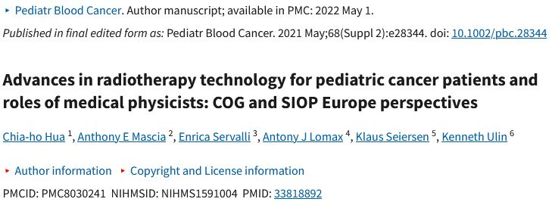

Slide 8
Photon therapy - pediatric patients
The standard treatments for various pediatric cancers:
  3D Conformal Radiation Therapy (3D-CRT),
  Intensity-modulated radiation therapy (IMRT),
  Volumetric-modulated arc therapy (VMAT),
  Helical Tomotherapy (HT),
  Stereotactic body radiation therapy (SBRT) for bone tumors, metastatic and recurrent lesions is under investigation,
  Some centers are now using high dose-rate (HDR) brachytherapy to treat pediatric sarcomas.

Slide 9
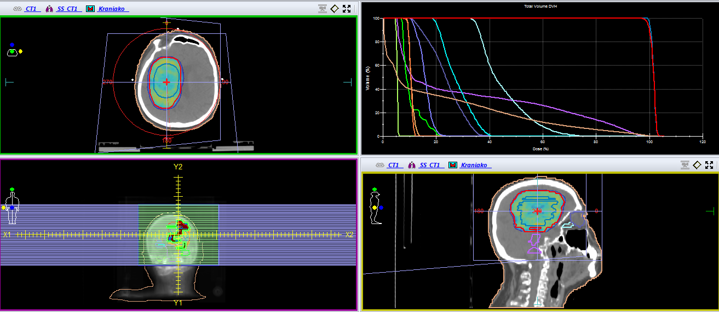
Brain Irradiation
VMAT technique delivers the radiation dose continuously as the treatment machine rotates

Slide 10
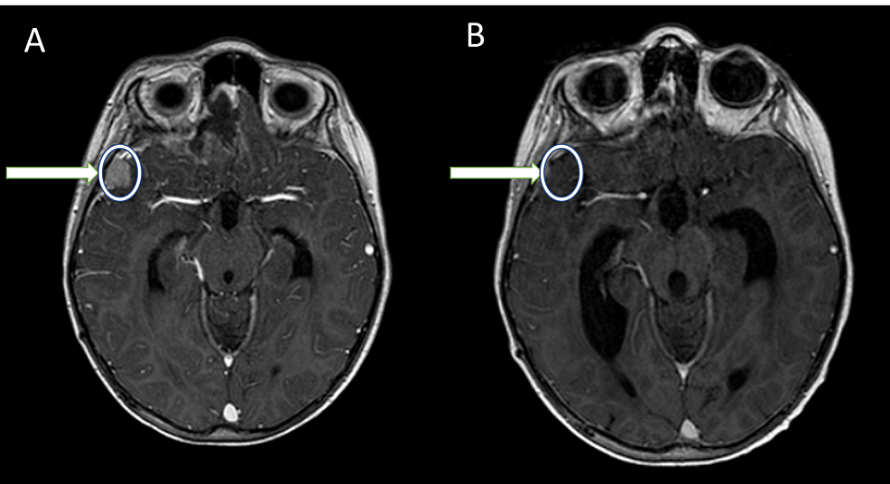
Re-irradiation of Pediatric Medulloblastoma
A: Recurrence of medulloblastoma, B: Three months after VMAT re-irradiation.

Slide 11
Craniospinal Irradiation
{Source: St. Clair, et al (2004)}

Slide 12
Proton therapy - pediatric patients
Pencil-Beam Scanning (PBS)
  Conformity
  Flexibility
Intensity-Modulated Proton Therapy (IMPT)
  More Complex
  Highly Modulated
  Highly Conformal

Slide 13
History of Proton Beam Radiation Treatment
1899: The First Use of Radiation Therapy to Cure Cancer.
1929: Cyclotron invented by Ernest O. Lawrence as a way to accelerate nuclear particles to very high speeds
1946: Robert R. Wilson proposed the use of proton beams for treating cancer.
1948: Berkeley Radiation Laboratory conducts extensive studies on protons and confirms predictions made by Wilson.
1954: First patient treated with protons at Berkeley Radiation Laboratory.
1957: Treatment successfully duplicated on patients in Uppsala, Sweden.
1961: Harvard treats first patient in its cyclotron
1972: UC Davis cyclotron team develops the first method for making pure iodine-123, employed in thyroid imaging and to detect tumors.

Slide 14
History of Proton Beam Radiation Treatment
1974: Los Alamos National Laboratory cyclotron treats first patient with pi-meson beam.
1975: Use of ionized particle beams to treat eye cancers pioneered by team of scientists using the Harvard cyclotron.
1978: UCSF and Lawrence Berkeley Laboratory team begins clinical trials of choroidal melanoma treatment with ionized helium beam.
1988: Proton therapy approved by FDA as radiation-treatment option for certain tumors.
1990: Loma Linda University opens first hospital-based proton-beam clinic. The 250 MeV machine is designed and built by Fermilab, where Wilson was the founding director, with $19.6 million in federal funding.
2001: Northeast Proton Therapy Center at Massachusetts General Hospital treats first patient.

Slide 15
AI-assisted Systematic Review - Methods
Pubmed and Cochrane Library
Search terms: “proton beam therapy” AND “pediatric cancer”
Inclusion Criteria
  Language: English
  Type of publication: Original studies and meta-analyses
  Population: adults < 18 years old
  Last 10 years
Exclusion Criteria
  Type of publication: case reports, reviews, letter to the editor
  Population: Adult
Mourad Ouzzani, Hossam Hammady, Zbys Fedorowicz, and Ahmed Elmagarmid. Rayyan — a web and mobile app for systematic reviews. Systematic Reviews (2016) 5:210, DOI: 10.1186/s13643-016-0384-4.

Slide 16
AI-assisted Systematic Review - Results
Literature search results: 584 articles
Duplicates deleted: 2
Included articles = 37
Excluded articles = 545
  Wrong study design = 452
  Case Reports = 25
  Wrong population = 35
  Animal study = 12
  Wrong publication type = 21
Mourad Ouzzani, Hossam Hammady, Zbys Fedorowicz, and Ahmed Elmagarmid. Rayyan — a web and mobile app for systematic reviews. Systematic Reviews (2016) 5:210, DOI: 10.1186/s13643-016-0384-4.

Slide 17
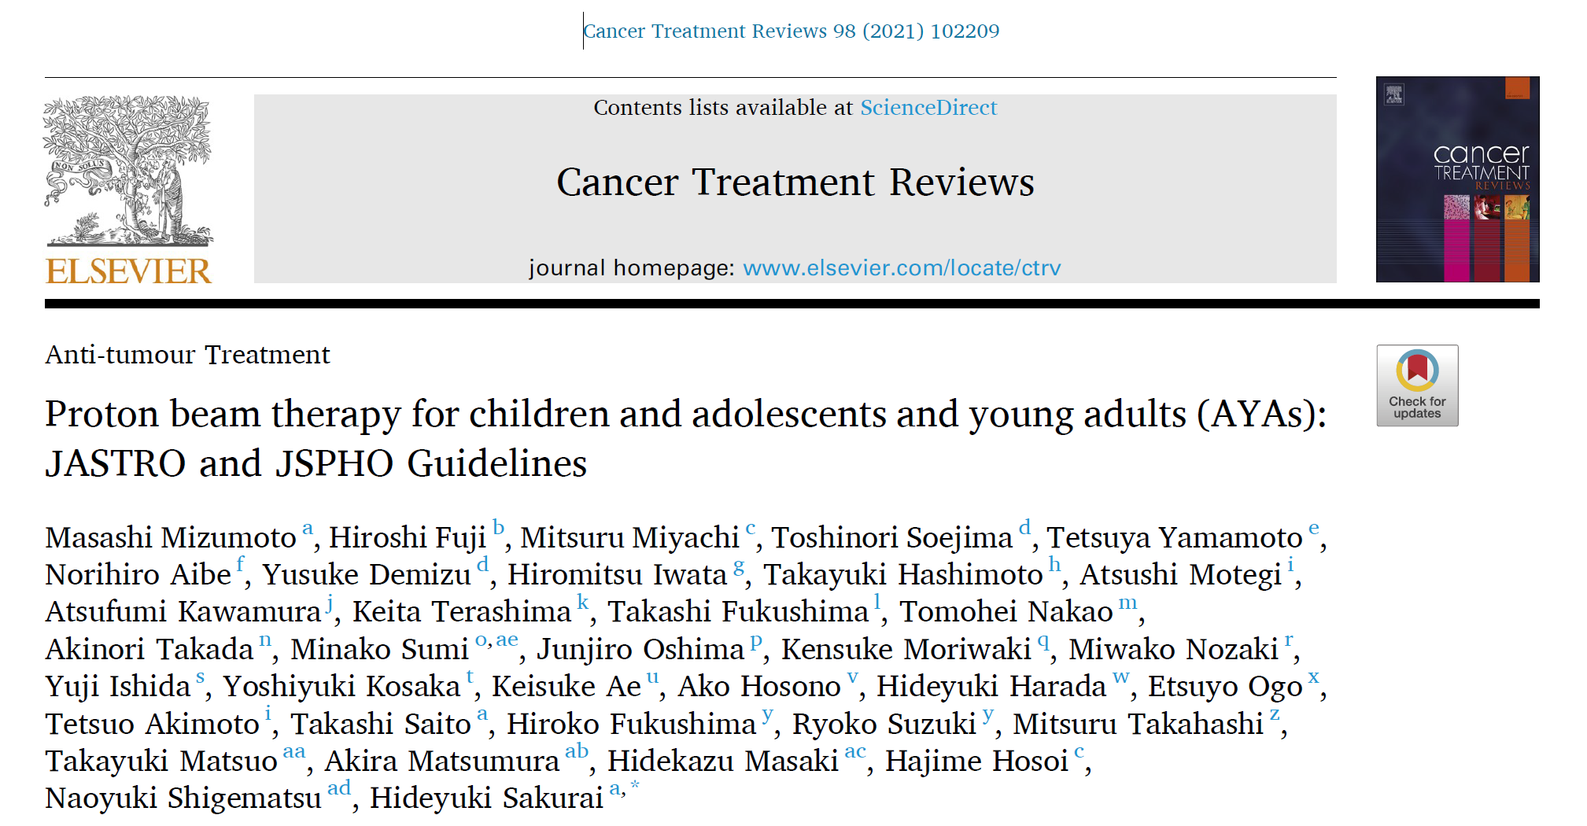
Guidelines ???

Slide 18
Recommendation and Evidence level
Clinical | Strength of Recommendation
Medulloblastoma | B (Moderate)
Ependymoma | C (Low)
Unresectable/Postoperative Persistent Craniopharyngioma | C (Low)
Whole Ventricle Irradiation and Craniospinal Irradiation for Intracranial Germ Cell Tumor | D (Very Low)
Rhabdomyosarcoma | C (Low)
Postoperative radiotherapy for a Primary Lesion of Neuroblastoma | D (Very Low)
Unresectable/Incompletely Resectable Pediatric Osteosarcoma | C (Low)
Ewing’s Sarcoma Family of Tumors (ESFT) | D (Very Low)
Unresectable/Incompletely Resectable Spinal Chordoma and Chondrosarcoma | C (Low)

Slide 19
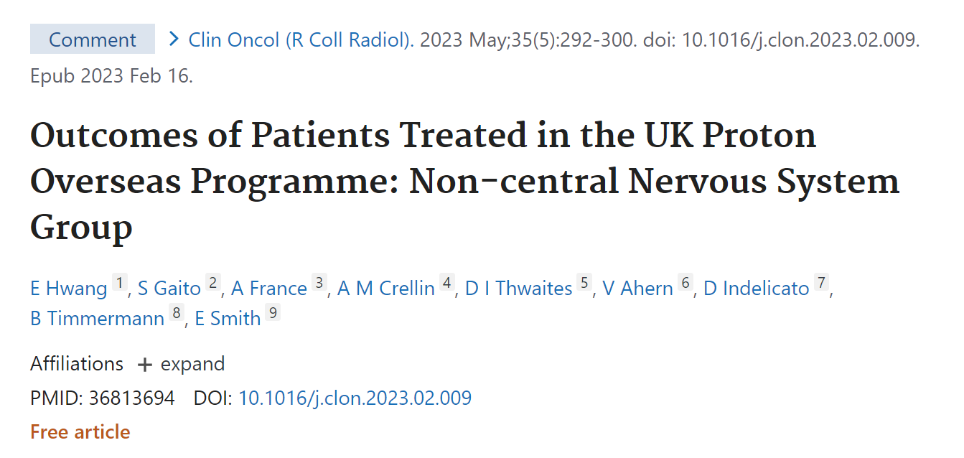

Slide 20
86.1% survival rate and 90.3% local control for non-CNS tumors in children.
  Grade 3 toxicity rate 12.6%
  Cataracts most common complication.
Effective disease control,
Acceptable toxicity rates,
  Especially for rhabdomyosarcoma and Ewing sarcoma

Slide 21
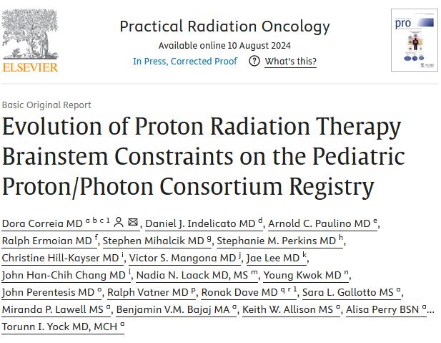
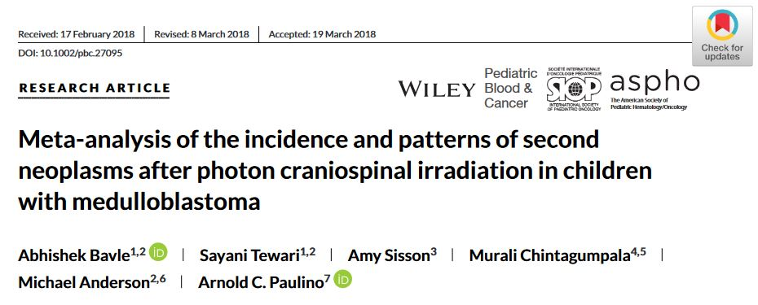
Notes:
the pediatric proton community has adopted more conservative brainstem constraints. Children with ependymoma, particularly those needing higher doses (e.g., 59.4 Gy RBE) to treat areas near the brainstem, are less likely to meet these stricter constraints. Furthermore, data from institutions using more conservative constraints and lower doses for fully resected tumors show that disease control can still be maintained while reducing brainstem toxicity risks
It highlights that the use of photon CSI increases the risk of developing secondary neoplasms, particularly due to radiation exposure, which impacts long-term survivorship in these children. The study emphasizes the need for careful monitoring and possibly adopting more advanced radiation techniques like proton therapy to reduce this risk.

Slide 22
Proton Beam vs Photon Beam THx
Aspect | Proton Beam Therapy | Photon Beam Therapy
Radiation Type | Protons (charged particles) | Photons (X-rays, electromagnetic waves)
Energy Deposition | Energy peaks at Bragg peak, sparing tissue beyond the tumor | Energy is deposited along the entire path (before, in, and after the tumor)
Precision | Highly precise, minimal damage to healthy tissue | Less precise, affects more surrounding tissue
Side Effects | Fewer side effects, especially long-term | More side effects, potential for secondary cancers
Clinical Use | Pediatric cancers, tumors near critical structures | Common cancers, broader applications
Cost and Availability | More expensive, limited availability | More affordable, widely available

Slide 23
REFERENCES
1. Athiyaman H, Mayilvaganan A, Chougule A, Joan M, Kumar HS: Estimation of radiation-induced second cancer risk associated with the institutional field matching craniospinal irradiation technique: A comparative treatment planning study. Rep Pract Oncol Radiother. 2019, 24:409-420. 10.1016/j.rpor.2019.06.004
2. Chen J, Chen C, Atwood TF, et al.: Volumetric modulated arc therapy planning method for supine craniospinal irradiation. Journal of Radiation Oncology. 2012, 1:291-297. 10.1007/s13566-012-0028-9
3. Correia D, Indelicato DJ, Paulino AC, et al.: Evolution of Proton Radiation Therapy Brainstem Constraints on the Pediatric Proton/Photon Consortium Registry. Pract Radiat Oncol. 2024. 10.1016/j.prro.2024.05.013
4. Hua CH, Mascia AE, Seravalli E, Lomax AJ, Seiersen K, Ulin K: Advances in radiotherapy technology for pediatric cancer patients and roles of medical physicists: COG and SIOP Europe perspectives. Pediatr Blood Cancer. 2021, 68 Suppl 2:e28344. 10.1002/pbc.28344
5. Hwang E, Gaito S, France A, et al.: Outcomes of Patients Treated in the UK Proton Overseas Programme: Non-central Nervous System Group. Clin Oncol (R Coll Radiol). 2023, 35:292-300. 10.1016/j.clon.2023.02.009
6. Mizumoto M, Fuji H, Miyachi M, et al.: Proton beam therapy for children and adolescents and young adults (AYAs): JASTRO and JSPHO Guidelines. Cancer Treat Rev. 2021, 98:102209. 10.1016/j.ctrv.2021.102209
7. Seravalli E, Bosman M, Lassen Y, et al.: Acta Oncologica Dosimetric comparison of five different techniques for craniospinal irradiation across 15 European centers: analysis on behalf of the SIOP-E-BTG (radiotherapy working group) Dosimetric comparison of five different techniques for craniospinal irradiation across 15 European centers: analysis on behalf of the SIOP-E-BTG (radiotherapy working group) Ã. Acta Oncologica. 2018, 57. 10.1080/0284186X.2018.1465588
8. Pollul G, Bostel T, Grossmann S, et al.: Pediatric craniospinal irradiation with a short partial-arc VMAT technique for medulloblastoma tumors in dosimetric comparison. Radiat Oncol. 2020, 15:256. 10.1186/s13014-020-01690-5
9. Baliga S, Yock TI: Proton beam therapy in pediatric oncology. Curr Opin Pediatr. 2019, 31:28-34. 10.1097/MOP.0000000000000724
10. Giakoumettis G, Mantzavinou A, Moschos G, Giakoumettis D, Capizzello A: Re-irradiation of Pediatric Medulloblastoma: A Case Report and Systematic Review. Cureus. 2022, 14:e31585. 10.7759/cureus.31585

Slide 24
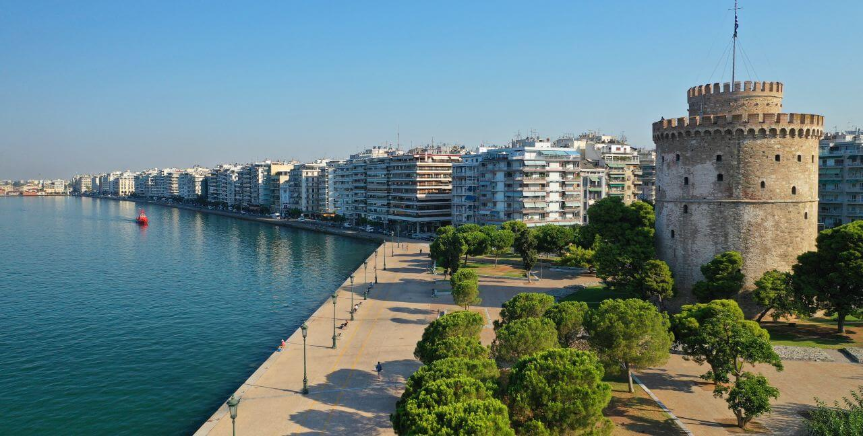
THANK YOU

