Slide 1
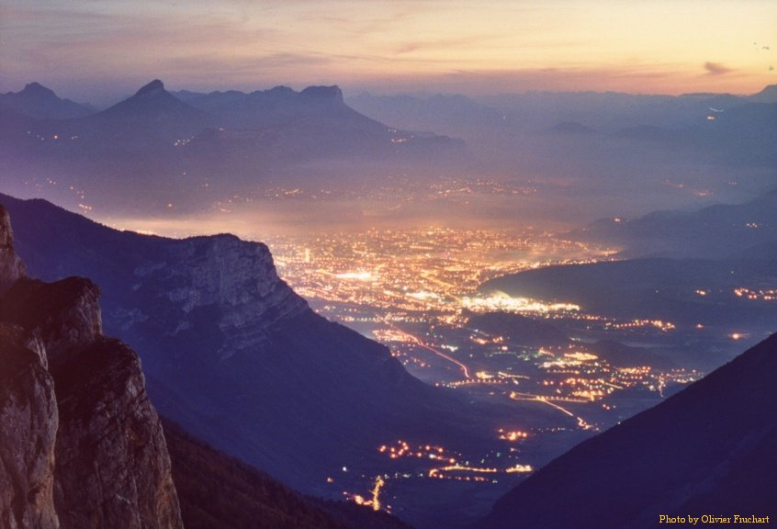


Neutrino Physics – Accomplishments and Future Challenges
Joint ECFA-EPS Session
EPS HEPP
Grenoble
July 23 2011
Dave Wark
Imperial/RAL
(but speaking
only for me!)

Slide 2
What will I talk about?
This is not the plenary neutrino talk – that is by Nishikawa-san on Tuesday.
This talk is about the decisions we need to make.
This is an ECFA session, so I will only talk about experiments with an accelerator in them – no solar neutrinos, no double-beta decay, not even very much reactor neutrinos – sorry.....
And I won’t talk all that much about accomplishments.
We have more than enough Future Challenges for a 20 minute talk....

Slide 3
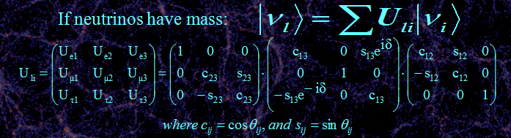
Three neutrino mixing.
Remember degeneracies
And covariances!
~0.03
∼π/4

Slide 4
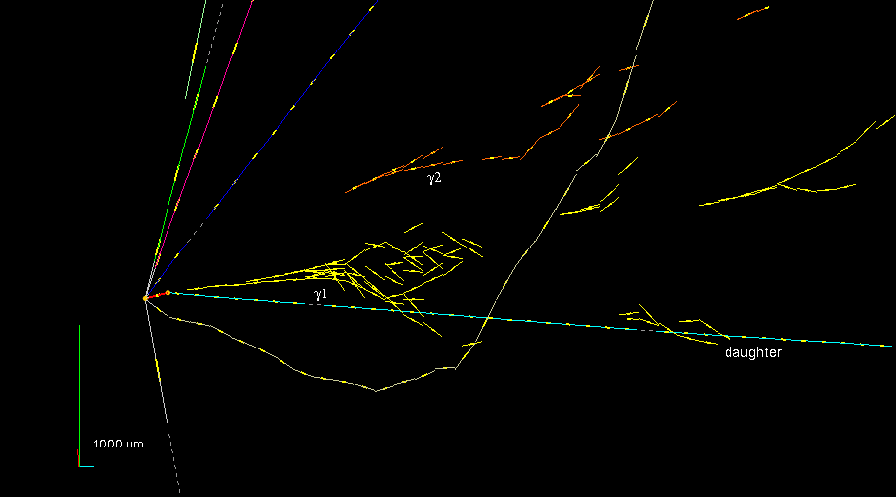
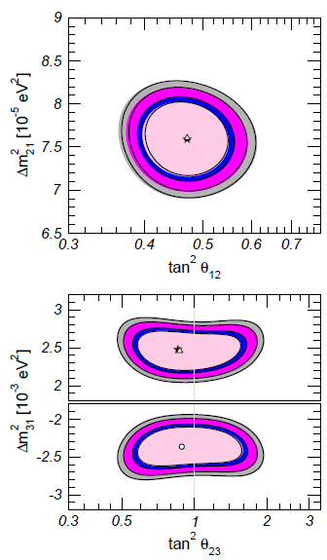

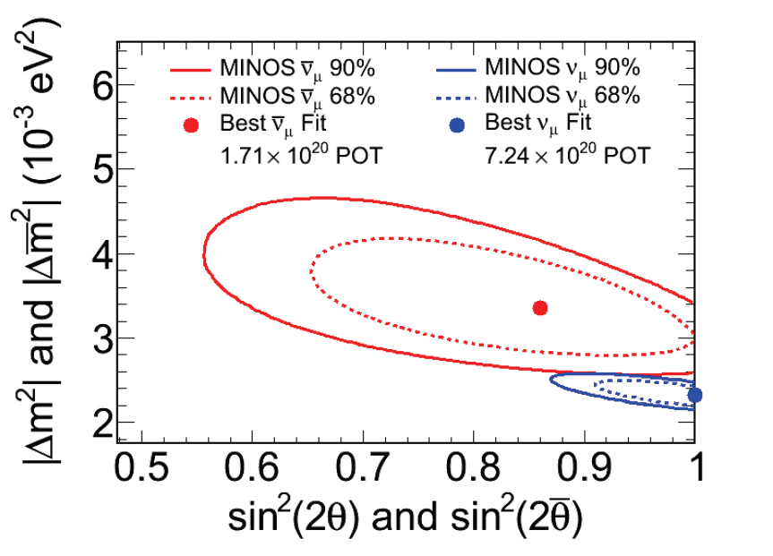
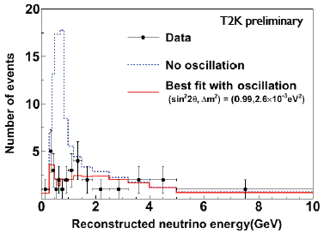
How well do we know θ_{ij}?
Dusini
OPERA τ appearance event....
.... has no friends yet. Expect 1.65±0.16
_
MINOS ν vs ν in
mild tension –
new result soon.
Gonzalez-Garcia, Maltoni, Salvado
Holin
1st T2K
ν_{μ}
disappearance
Giganti

Slide 5
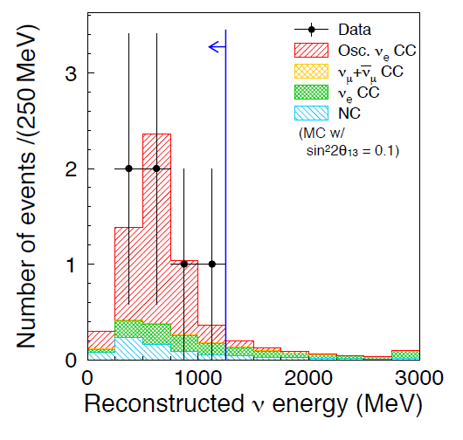
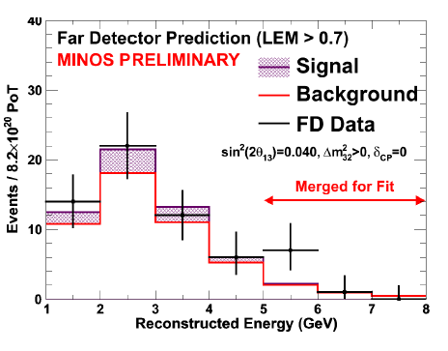

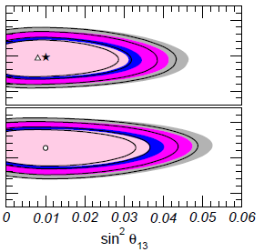

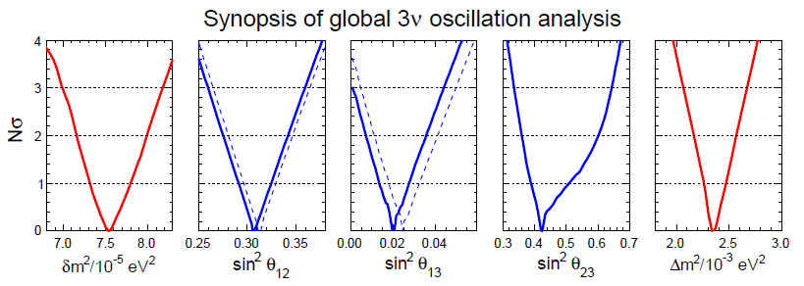
What about
θ₁₃?
T2K (2.5σ)
MINOS (1.7σ)
ν_{e} appearance, θ₁₃ > 0?
For this talk, assume
θ₁₃ > 0, and T2K and
NOvA will prove it!

Slide 6
What then for ν oscillations?
Prove θ₁₃ > 0.
Measure all parameters with greater precision (because you need it for the rest of the list, but is there any particular necessary accuracy indicated by theory?).
Make the most sensitive possible test of the deviation of θ₂₃ from 45º.
Determine the mass hierarchy by observing matter effects → higher energy, longer baseline.
Measure the angle δ!
Are there any surprises?

Slide 7
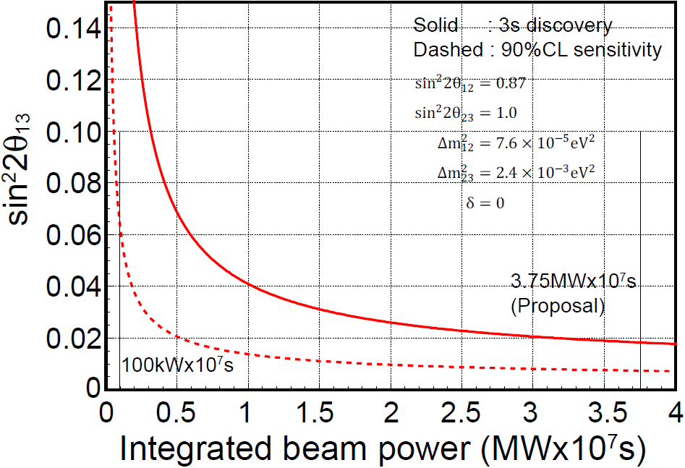
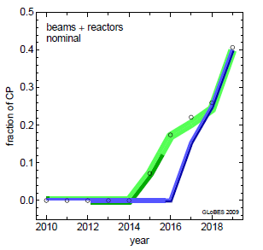

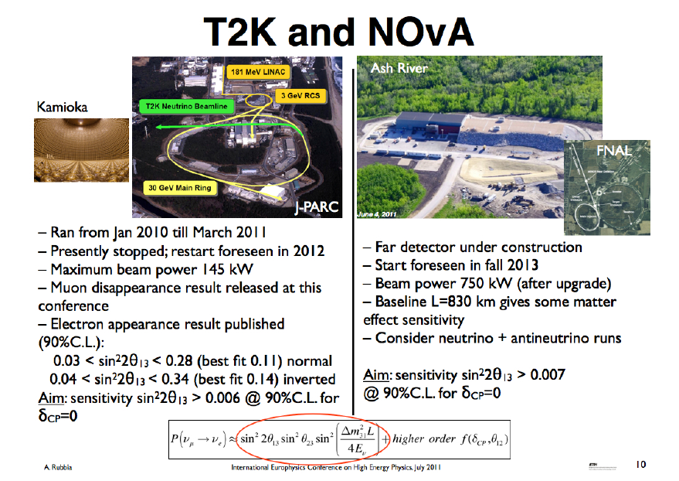
Even some 90% CP violation sensitivity...
T2K central value
sin²2θ₁₃ = 0.1, NH
Fogli global best fit[1]
T2K 90% Lower
→500 kW (2yr)
→ >1 MW (>5yr)

Slide 8
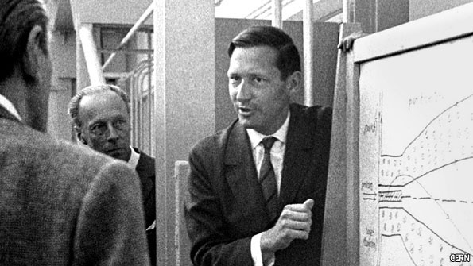
OK, then what?
Simon van der Meer, 1925 - 2011
Three “conventional” beam proposals:
  An upgrade of T2K based on reaching 1.6 MW beam power and a new far detector.
  LBNE – a plan to build a new neutrino beam at Fermilab aimed at Homestake, where either a large water Cerenkov detector or a LAr tracking calorimeter would be built.
  LAGUNA-LBNO – three different options for new long baseline in Europe.

Slide 9
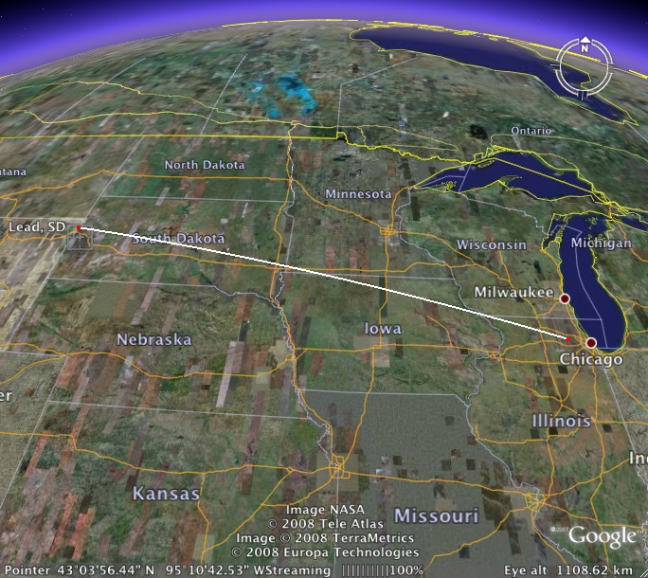
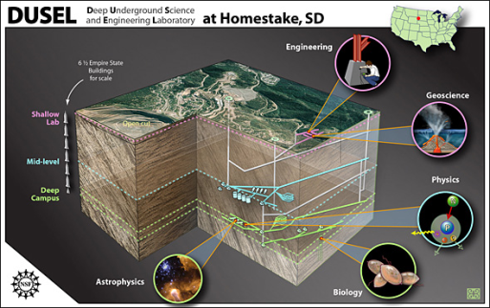
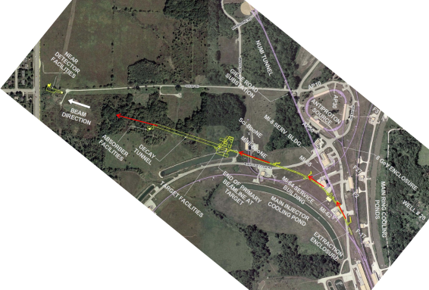
US: Long Baseline Neutrino Experiment
CD 0: January 2010
1300 km
Collaboration:
288 members from 54 institutions (India, Italy, Japan, UK, US)
Continue to grow!

Slide 10
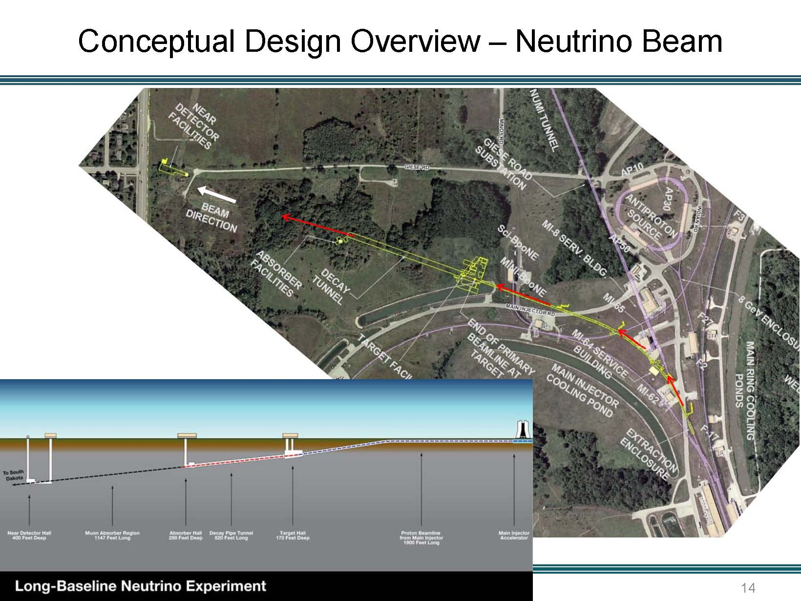

Slide 11
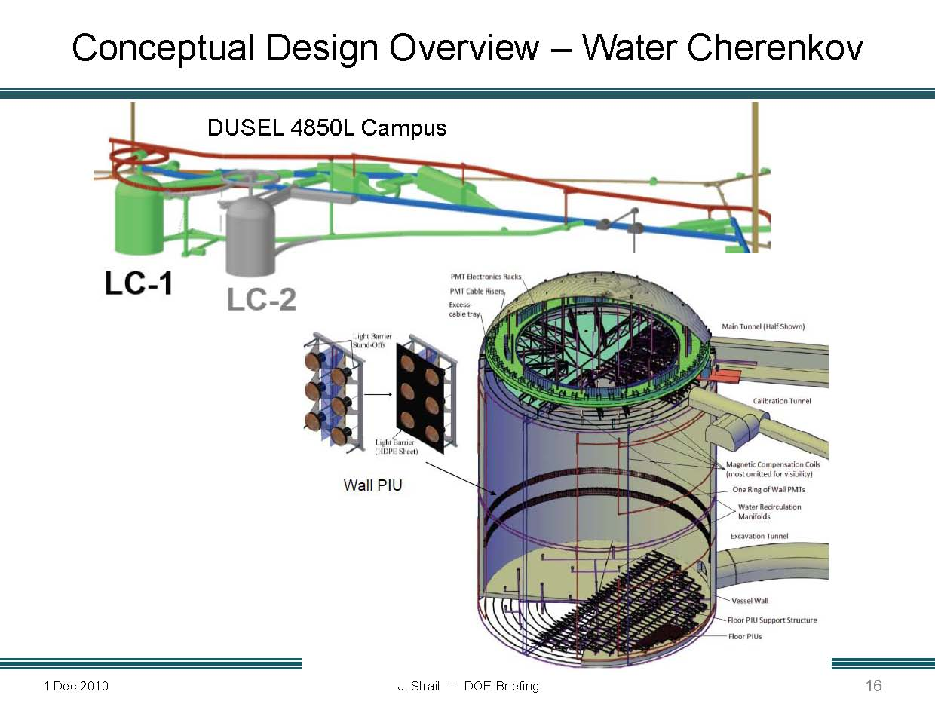
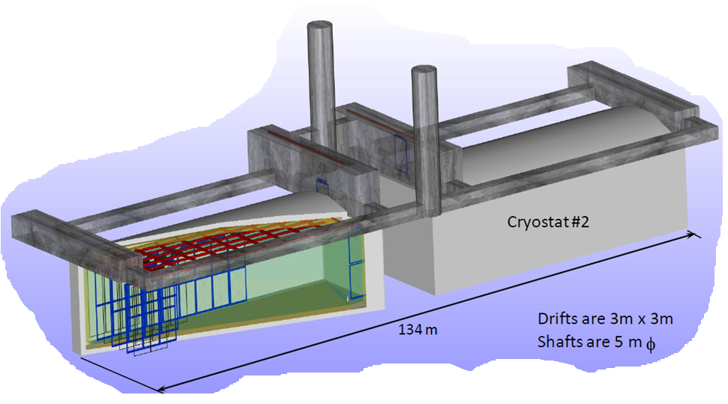
Alternative is
34 kT of LAr
LAr Slight cheaper but riskier – Marx Committee

Slide 12
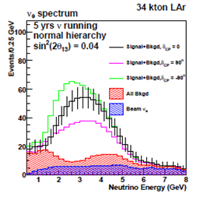
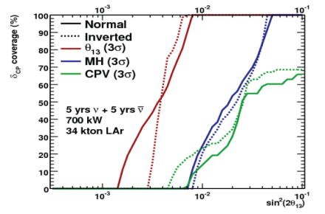

Slide 13
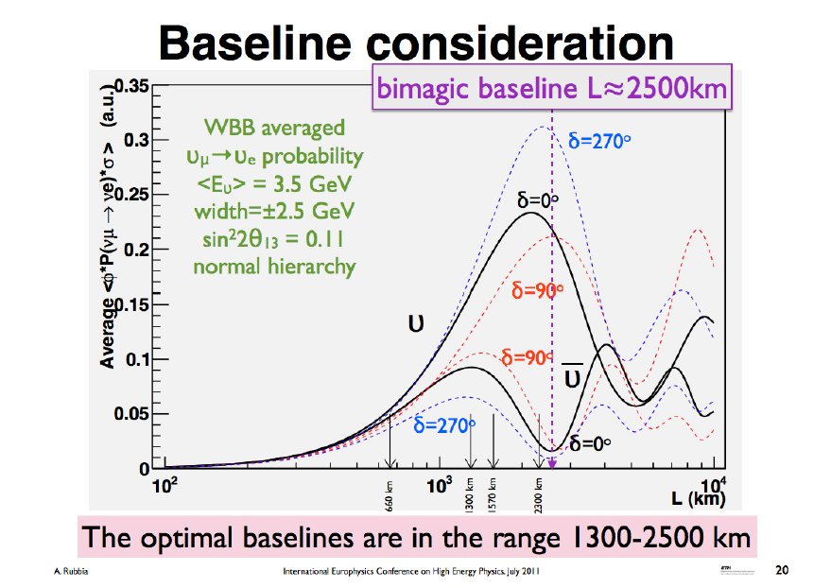

Slide 14

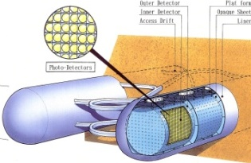
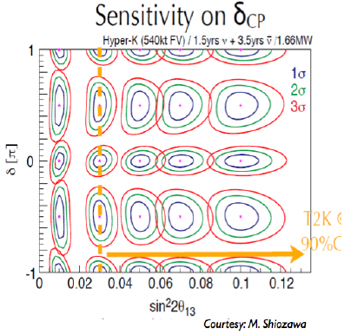
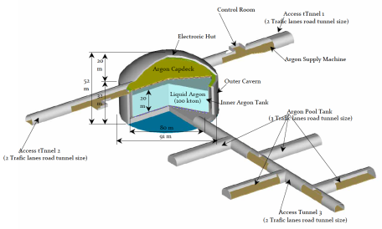

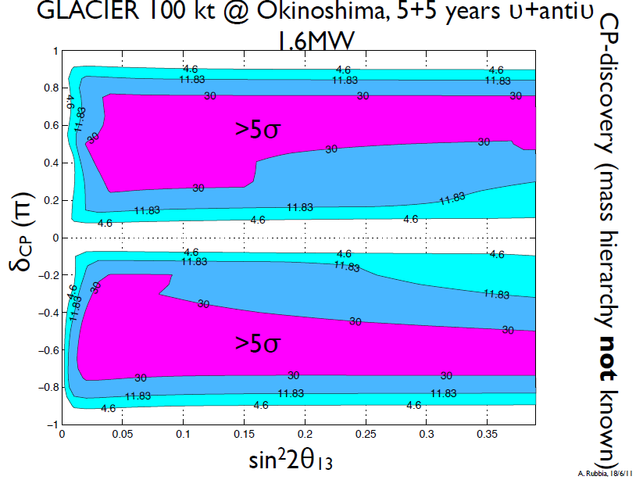
Scenarios in Japan
Kamioka L=295km OA=2.5deg
Okinoshima L=658km OA=0.78deg
Almost On-Axis
J-PARC
→1.7MW
P32 proposal (Lar TPC R&D)
Recommended by J-PARC PAC
(Jan 2010), arXiv:0804.2111

Slide 15
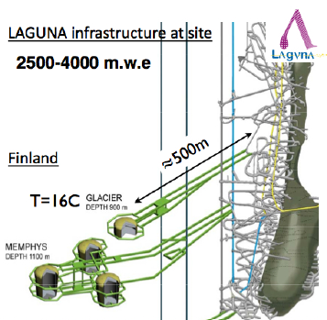
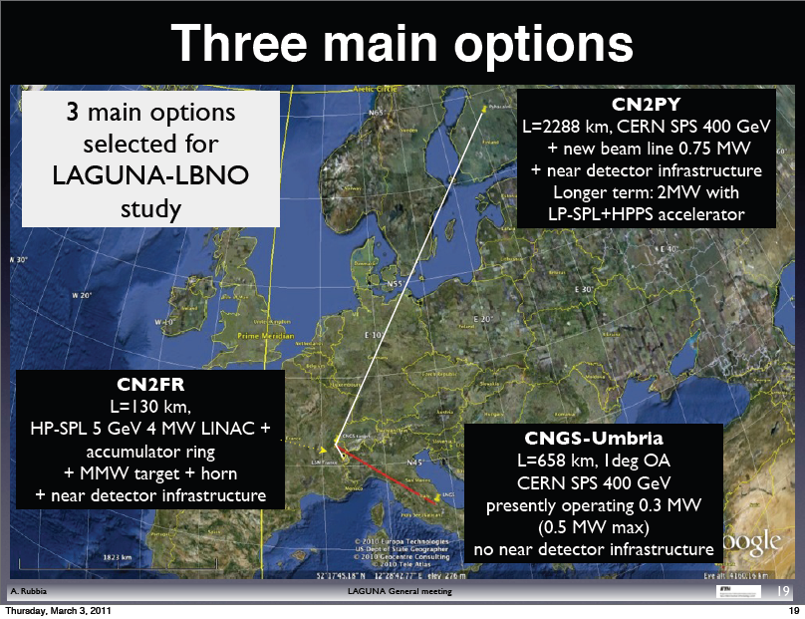
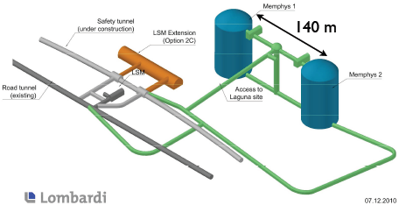
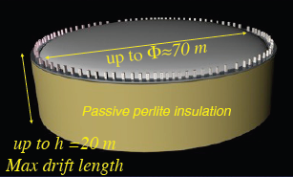
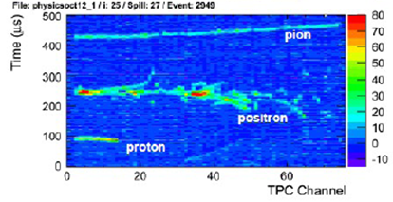
Joint Japanese/European approach
Possible synergy with a β beam

Slide 16

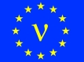
CERN Beta Beams, Synoptic
RCS
SPL
Linac4
Dotted lines: alternative layouts
Linac
ISOL target
Molten Salt Loop
Collection
PR
6He
18Ne
ν-Beam
8B/8Li
Baseline
6He/18Ne
ECR
RFQ
Linac 100 MeV
PS
DR
SPS
PS and SPS existing
RCS
Decay Ring: Bρ ~ 500 Tm, B = ~6 T, C = ~6900 m, L_{ss}= ~2500 m, γ = 100, all ions
16
Notes:
What is changing is mainly the production

Slide 17
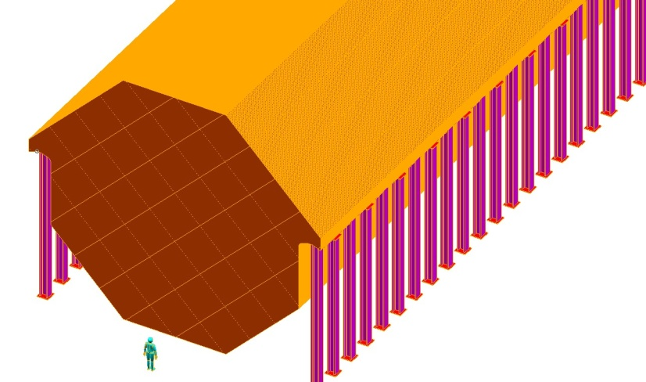
Neutrino Factory Baseline
Two Magnetised Iron Neutrino Detectors (MIND):
  100 kton at 2500-5000 km
  50 kton at 7000-8000 km
Baseline constantly under
review in light of new
physics results

Slide 18
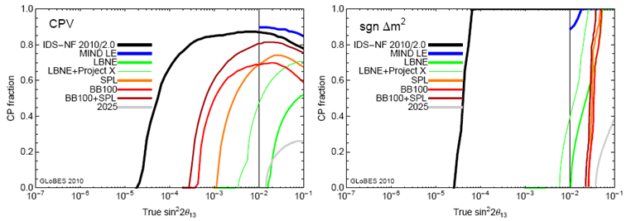
All thinking has to be refined for large θ₁₃.
For large θ₁₃ we will quickly
be systematics dominated!

Slide 19

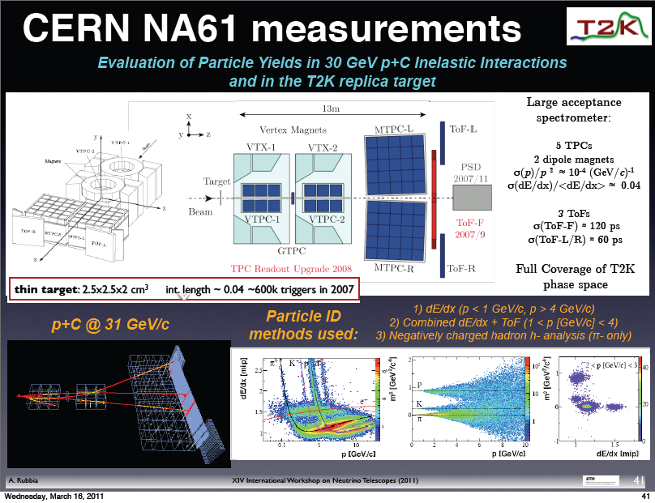
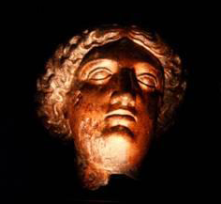
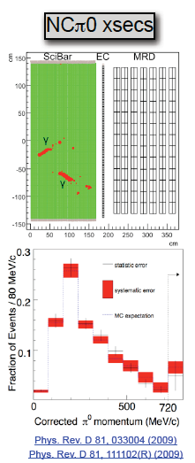
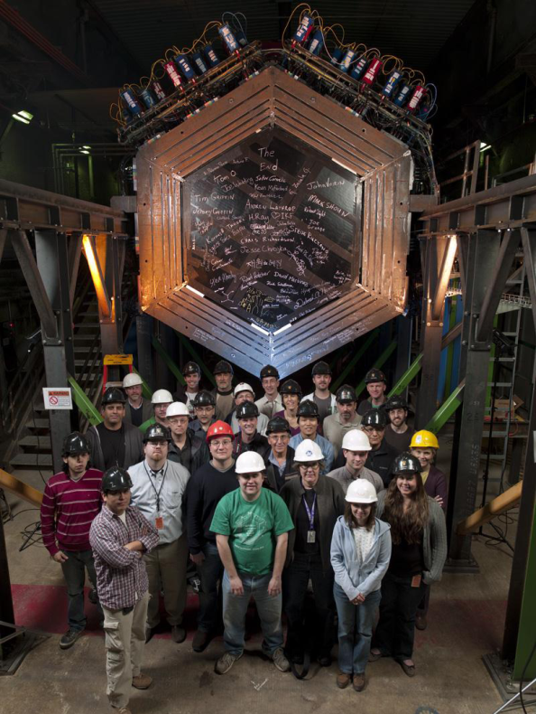
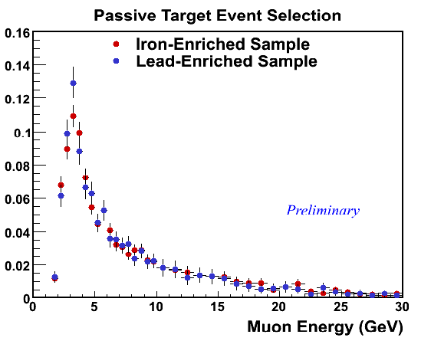
In the systematics dominated era
support measurements are even more important

Slide 20
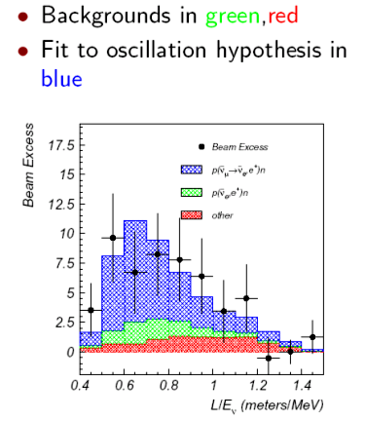
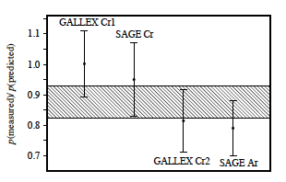
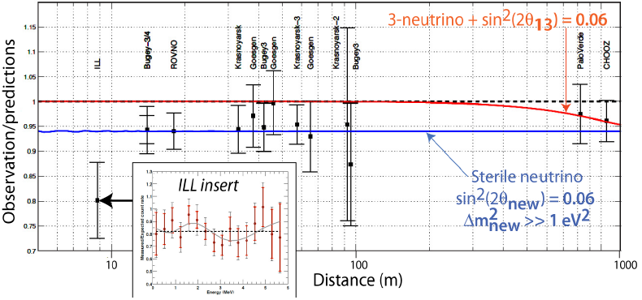
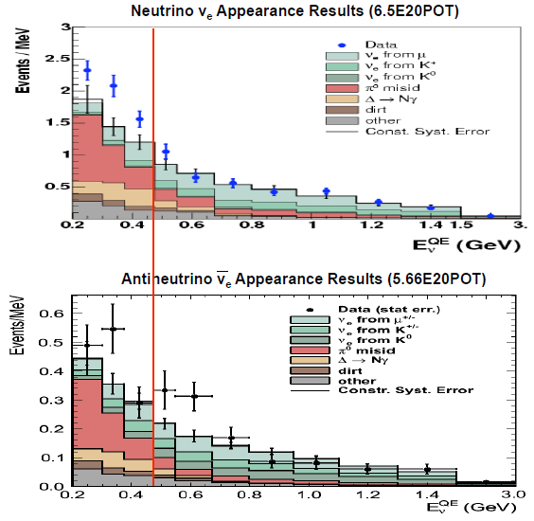
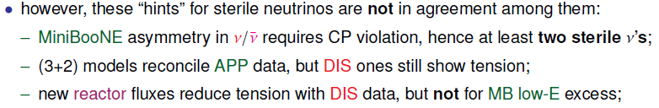
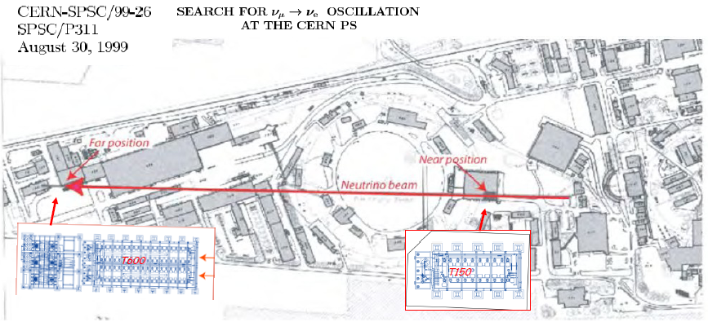
LSND Starts it all...
Short baselines
(L/E ~ 1)
and sterile ν.
MiniBooNE says....
No!
Maltoni
Yes!?

Slide 21
Conclusions (I)
Neutrino oscillations are the first confirmed physics beyond the SM, and their continued study is essential to extend our knowledge of fundamental interactions.
Current indications are that sin²2θ₁₃ ≥ ~0.01, which would make further long baseline experiments the most attractive option for first searches for CP violation in the neutrino sector.
Do not assume we know everything that is going on – redundancy is essential!
Continued operation of “existing” experiments (T2K, MINOS, NOvA, Double Chooz) is the highest priority.
There are three proposed next-generation projects. We can probably justify two, but not three, so we need to some international coordination.
The mine at Pyhäsalmi is potentially an extremely valuable resource for European neutrino physics due to its distance from CERN, but we should move fast if we are going to retain the option of using it in the future. Can we build a 5 kT LAr prototype?
Dave Wark
Imperial College/RAL

Slide 22
Conclusions (II)
There will be many other opportunities for smaller-scale involvement in cross-section, hadron production, and other critical technological development projects such as the MICE experiment.
Oscillations depend on L/E, not E or L, so other possibilities should be considered – DAEdALUS?
Beyond those facilities we will almost certainly wish to have an even more capable facility, either a Beta Beam or a Neutrino Factory – more work is needed to optimize the sensitivity if θ₁₃ is large.
A PS neutrino beam project to look for sterile neutrinos has been suggested for CERN. Here are my very personal views:
  We don’t need another 2-3 sigma effect. Any proposed experiment should have clear 5 sigma sensitivity over the entire indicated range.
  It could be an interesting part of a broad suite of European neutrino experiments, but I wouldn’t want to see it be CERN’s only neutrino experiment.
Neutrino oscillations offers a very wide range of experiments, which must happen, no matter what we do at the energy frontier!
Dave Wark
Imperial College/RAL

