Slide 1
Planning and Go/No-Go criteria for the installation of the new AD e-cooler
#24 AD E-Cooler Meeting: Planning and Go/No-Go
30 September 2024

Slide 2
Outline
LHC/Injectors long term schedule and AD e-cooler planning
Go/No-Go brief overview per system
Summary of outstanding questions

Slide 3
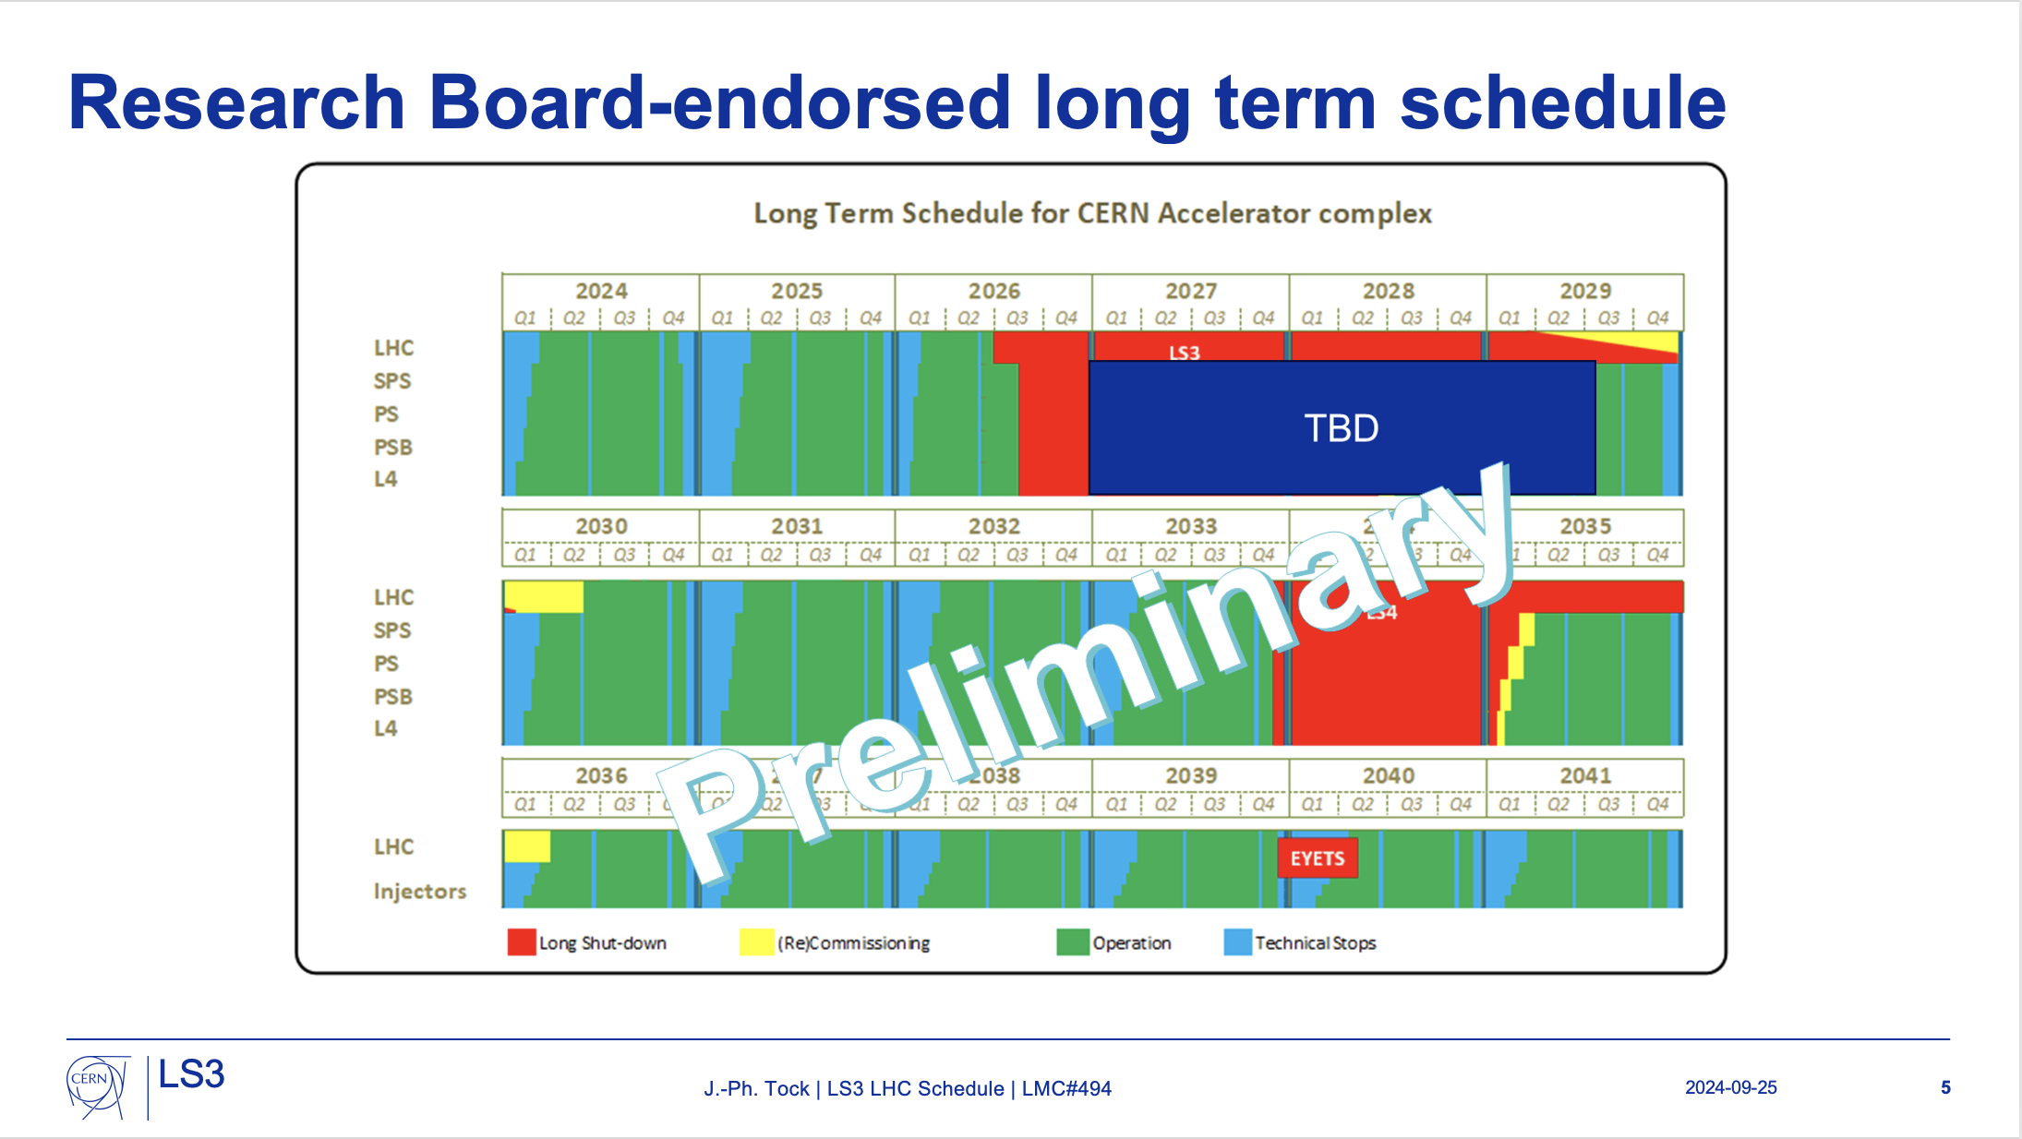
Outcome of LS3 readiness review
15 y

Slide 4
Overall planning
15 y
Current delay
EN-HE
with offset-load lifting beams
Presentation by William
Shielding opening
ISR tunnel
Interplay with other AD activities to be checked

Slide 5
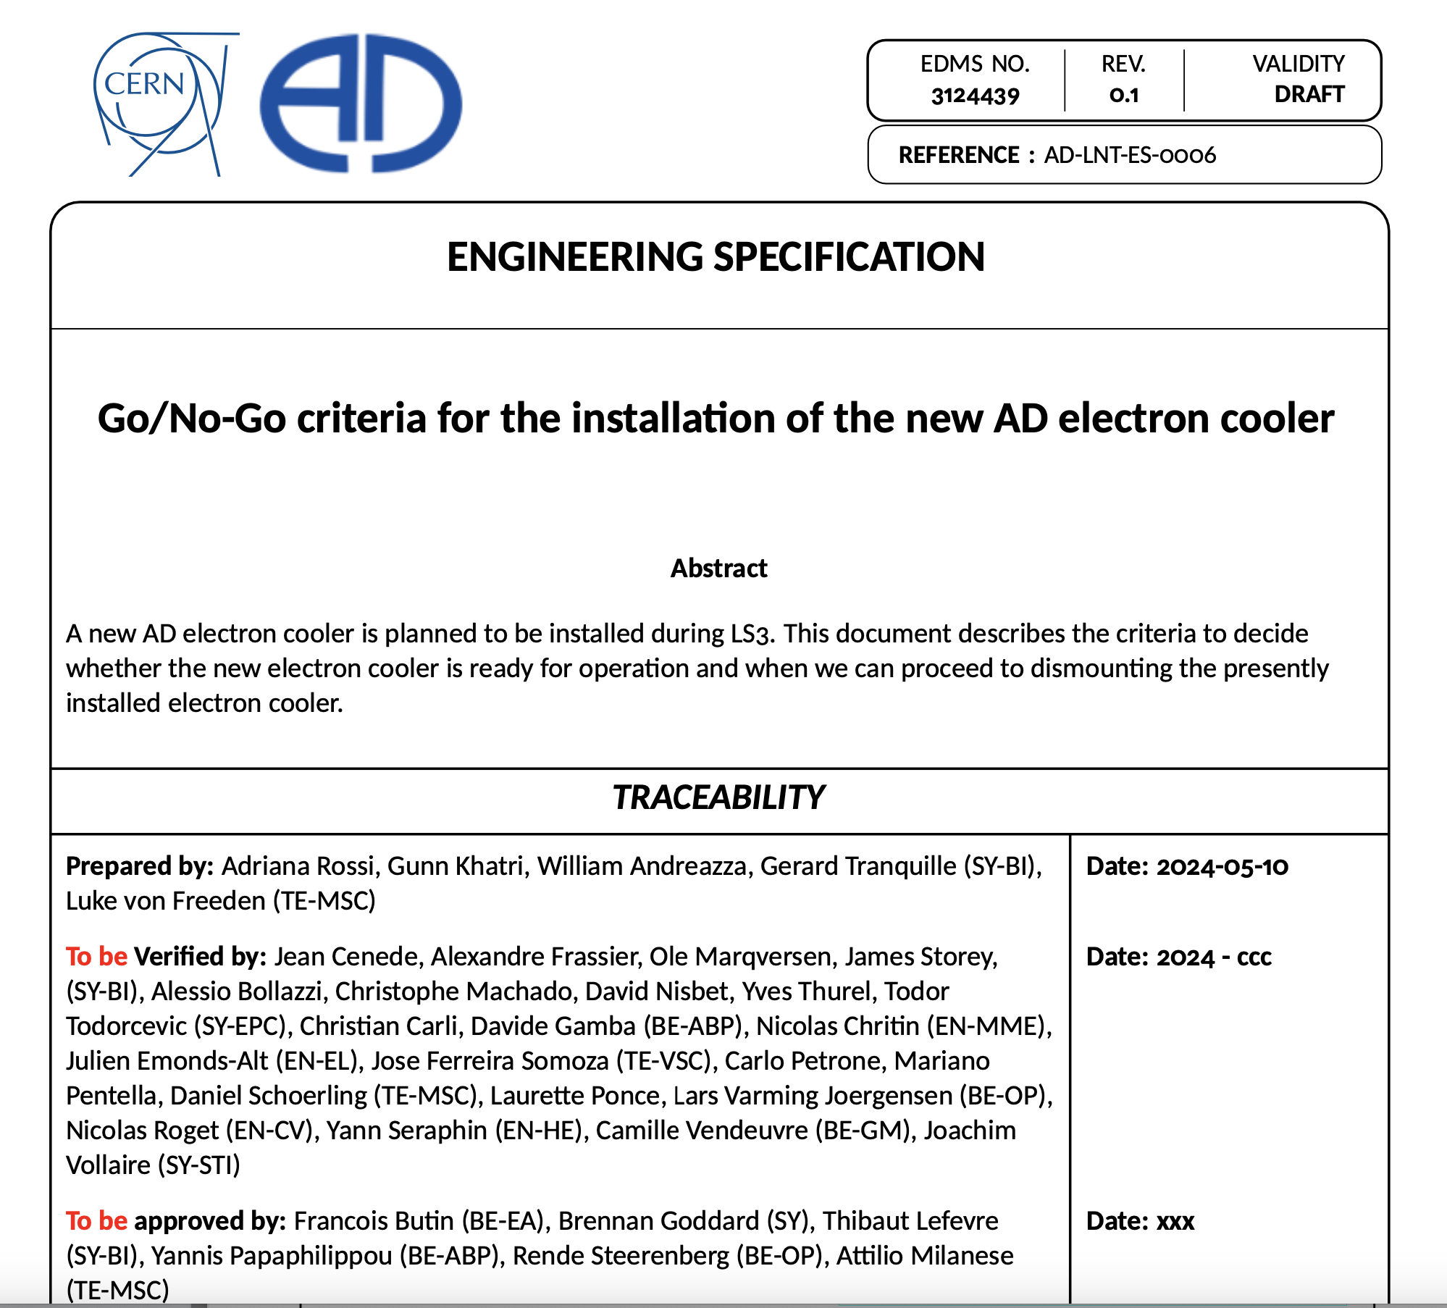
Go/No-Go document
The limited timescales available between the delivery of its sub-components and final installation will not allow testing the fully assembled electron cooler
Testing only single components and characterize full magnetic system
Go/No-Go document details measurements to be performed and the target result values for the new electron cooler to be operational
Go/No-Go ➔ De-install only when all the critical components are delivered from the supplier at CERN and tested to their specifications

Slide 6
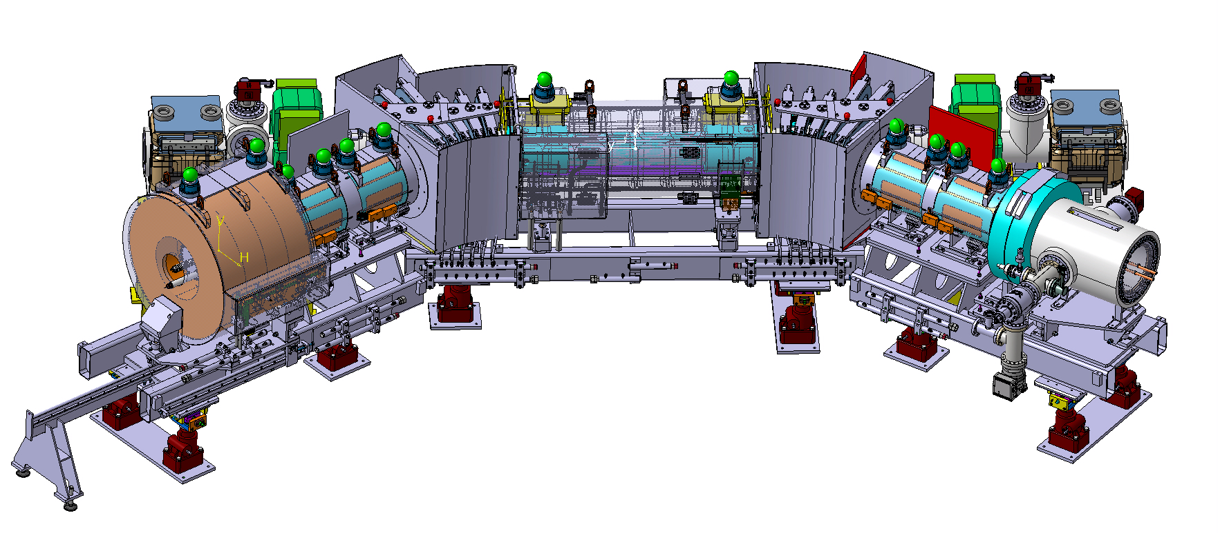
Overall mechanical design and integration, SY-BI & EN-MME
Mechanical integration (drawings)
  At the level of the AD ring almost completed (H/V correctors missing)
  At the level of sub-component
    Girders completed
    Magnets (but H/V correctors) completed
    Vacuum chamber completed (including BPM and cables)
    Collector vacuum chamber integrated
    Gun in design
Acceptance tests done at reception
Pre-assembly ➔ see William’s presentation
Need of further specifications?

Slide 7
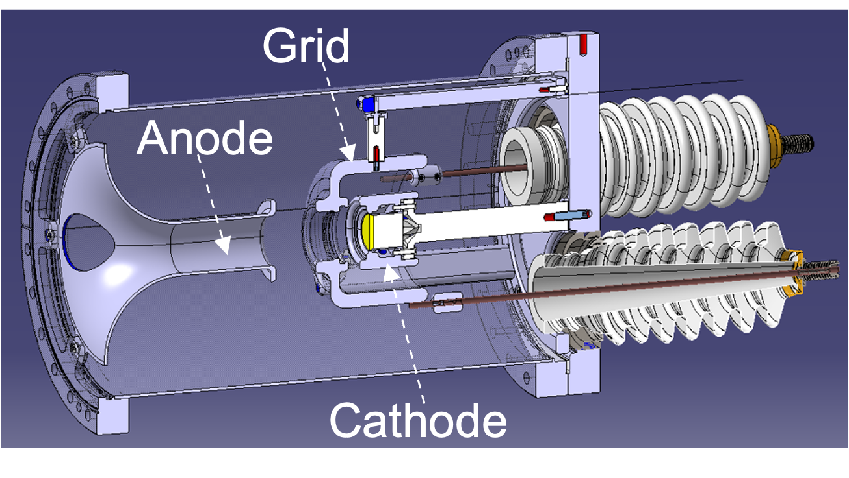
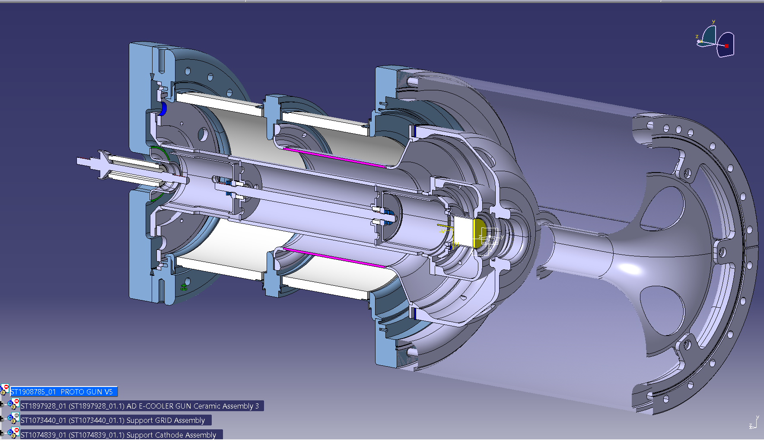
Acceptance criteria for the electron gun, SY-BI
Mechanical measurements at reception within tolerances
➔ “standard tolerances enough” (Gerard)
Vacuum after bakeout
HV leakage current
Cathode temperature
Extracted current and perveance
Beam profile (when BTV mounted on test stand)
This is requiring a new design
G Khatri Specifications of the electron gun & collector for the new AD e-cooler EDMS document AD-LNT-SPC- 0002 (CERN, 2024)

Slide 8
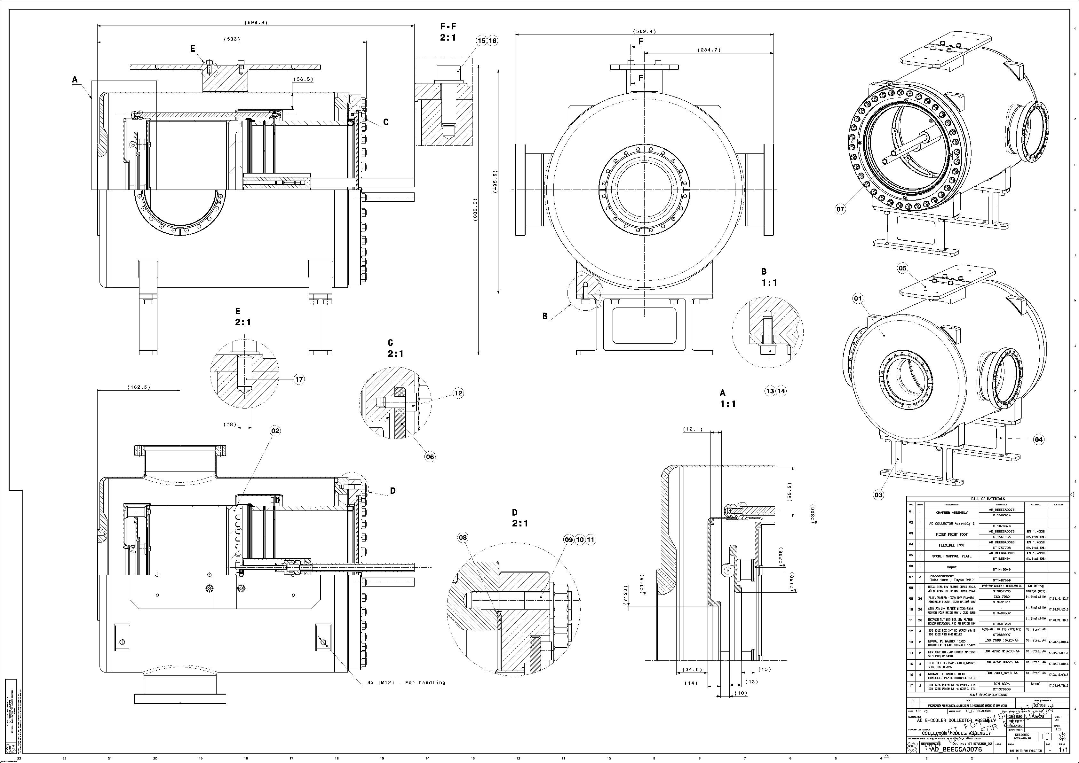
Acceptance criteria for the collector, SY-BI
Mechanical measurements at reception within tolerances
Vacuum after bakeout
HV leakage current (including decelerating and repeller electrodes)
Resistance to high flux (temperature of the ”pot”)
Efficiency (leakage) with electrodes
G Khatri Specifications of the electron gun & collector for the new AD e-cooler EDMS document AD-LNT-SPC- 0002 (CERN, 2024)

Slide 9
Magnetic system, TE-MSC
C. Petrone. L von Freeden: The New AD Electron Cooler Magnet System Measurement Campaign EDMS document AD-LNT-ES-000???????
Acceptance tests of single magnets ➔ Go/No-Go
Full magnetic system measured (on aligned girders but without vacuum chambers) to
  Characterize circuits and tune to specified magnetic field quality
  Define nominal settings for steerers
Tuning with electron beam commissioning after installation
Final tuning with pbars and cooling performance
L von Freeden: The New AD Electron Cooler Magnet System EDMS document AD-LNT-ES-0002 (CERN, 2024)

Slide 10
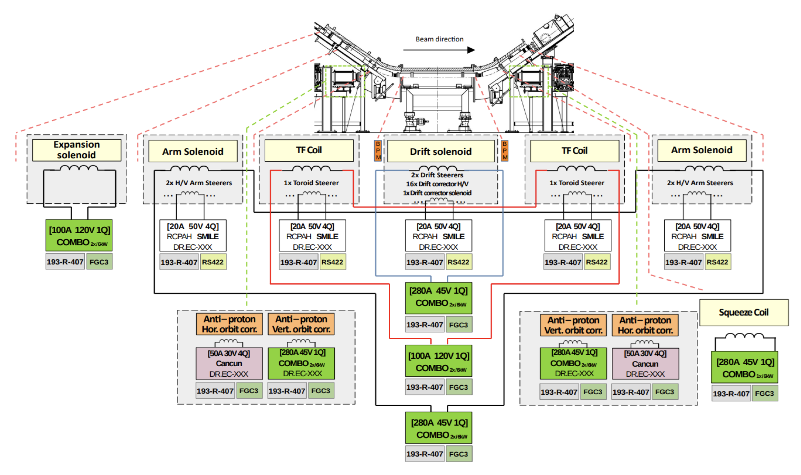
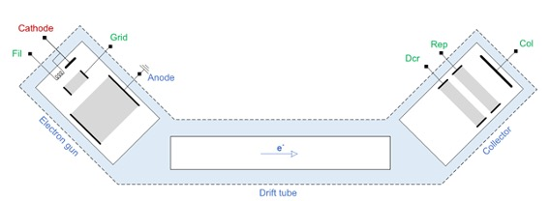
Powering system, SY-EPC
``
Off-the-shelf components
Acceptance tests ???
DC powering required for magnets measurements
HV powering: need to measure in situ ???
C Machado Functional Specification for the AD E-Cooler HV Powering
EDMS document AD-LNT-ES- 0004
Yves Thurel, Alessio Bollazzi Functional Specification for the Power Converters for the AD Electron Cooler
EDMS document AD-LNT-SPC-0004

Slide 11
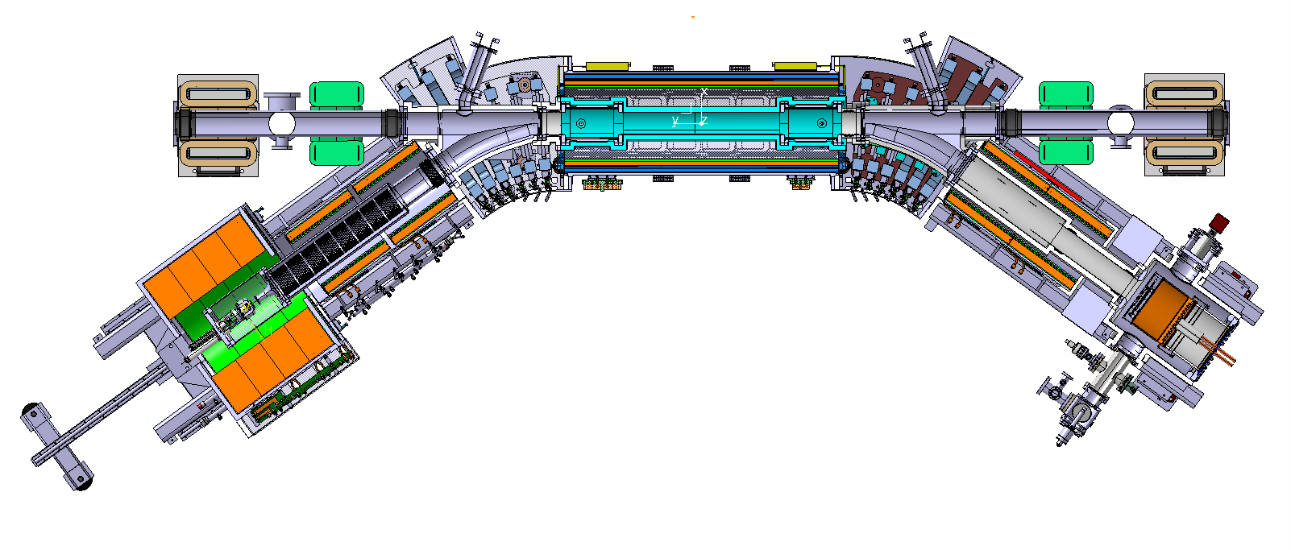
Vacuum system, TE-VSC
``
Mechanical acceptance
All vacuum components have to undergo to acceptance tests defined in:
P Chiggiato, J Somoza, G Bregliozzi
CRITERIA FOR VACUUM ACCEPTANCE TESTS
EDMS document ACC-V-ES-0001 (CERN, 2020)

Slide 12
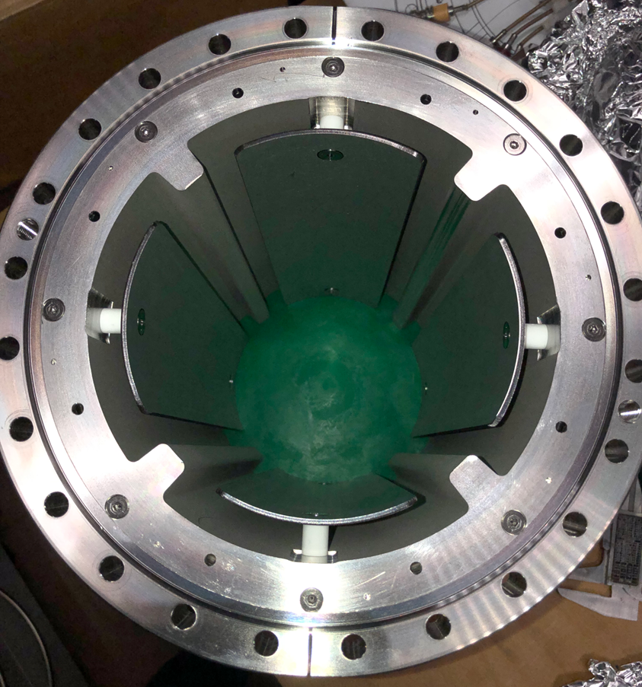
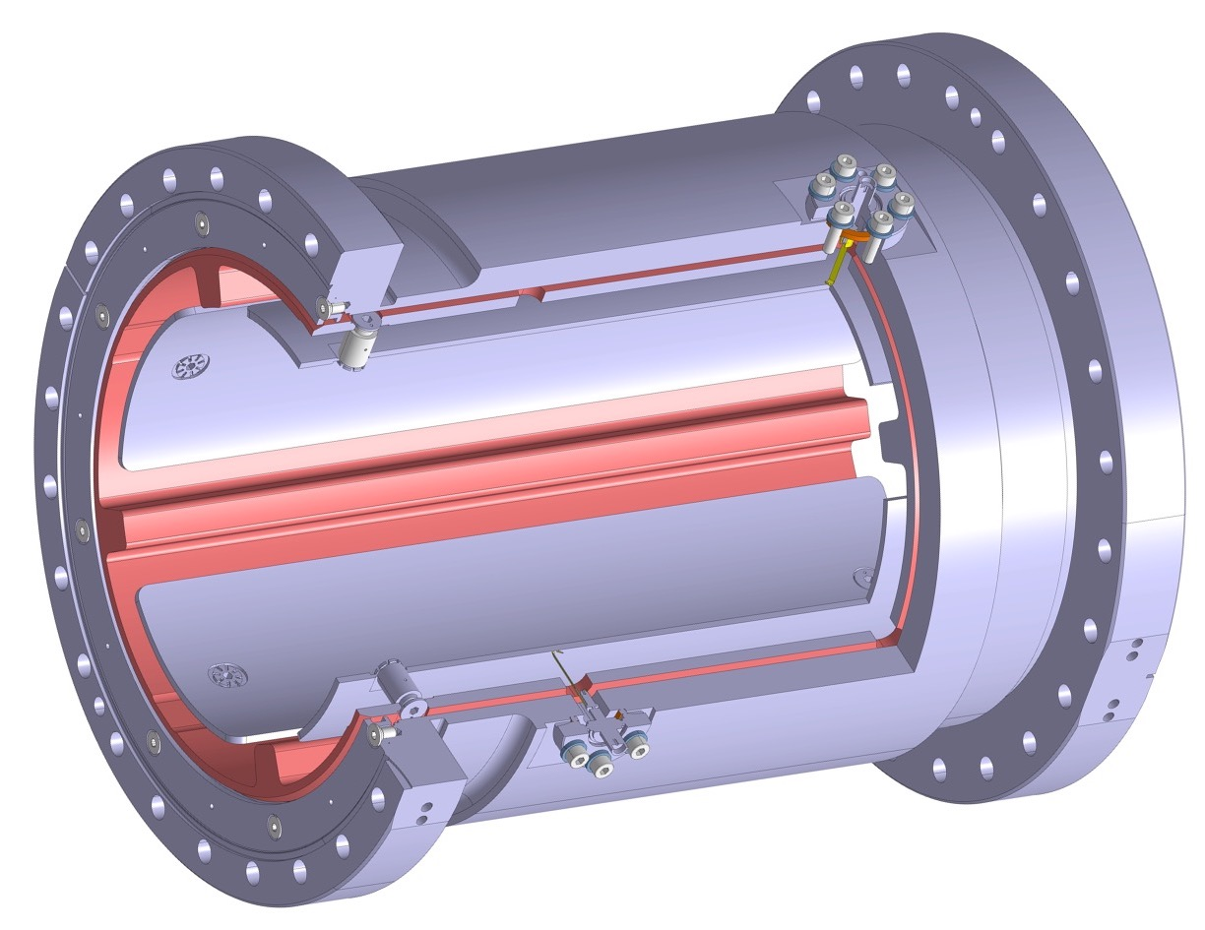
BPM, SY-BI
``
Mechanical acceptance
Vacuum after NEG coating and bake-out
Cables magnetic properties
BPM electric response yet to be defined in document

Slide 13
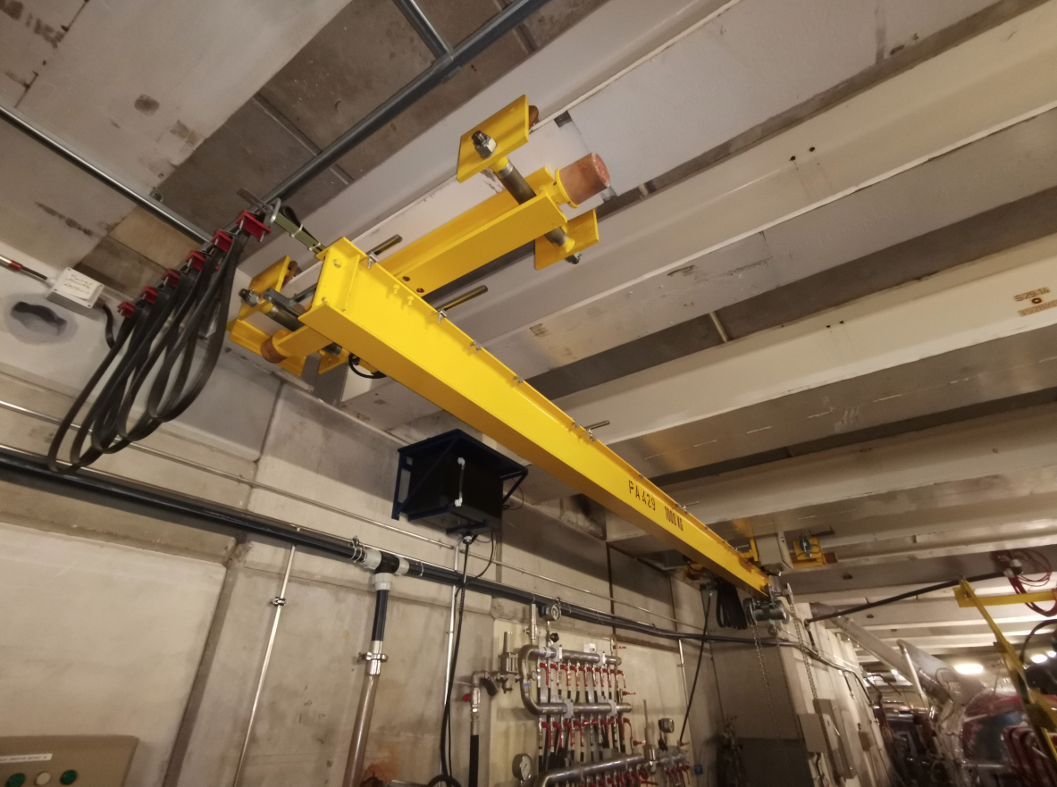
Handling, EN-HE
``
A new handling system (crane + offset-load lifting beams) has been studied to allow the lifting of – in particular – the expansion solenoid, and shall be ready prior starting the de-installation
Timeline and acceptance criteria?

Slide 14
Integration and Installation Sequence Review
An Integration and Installation Sequence Review will be organized around Easter 2026
Scope
  To communicate to everyone any non-conformity during production and allow enough time to react and compensate
  To make sure that all tooling necessary for installation is ready in time
  Improve coordination between different teams and avoid time/space clashes
  Give guidelines

Slide 15
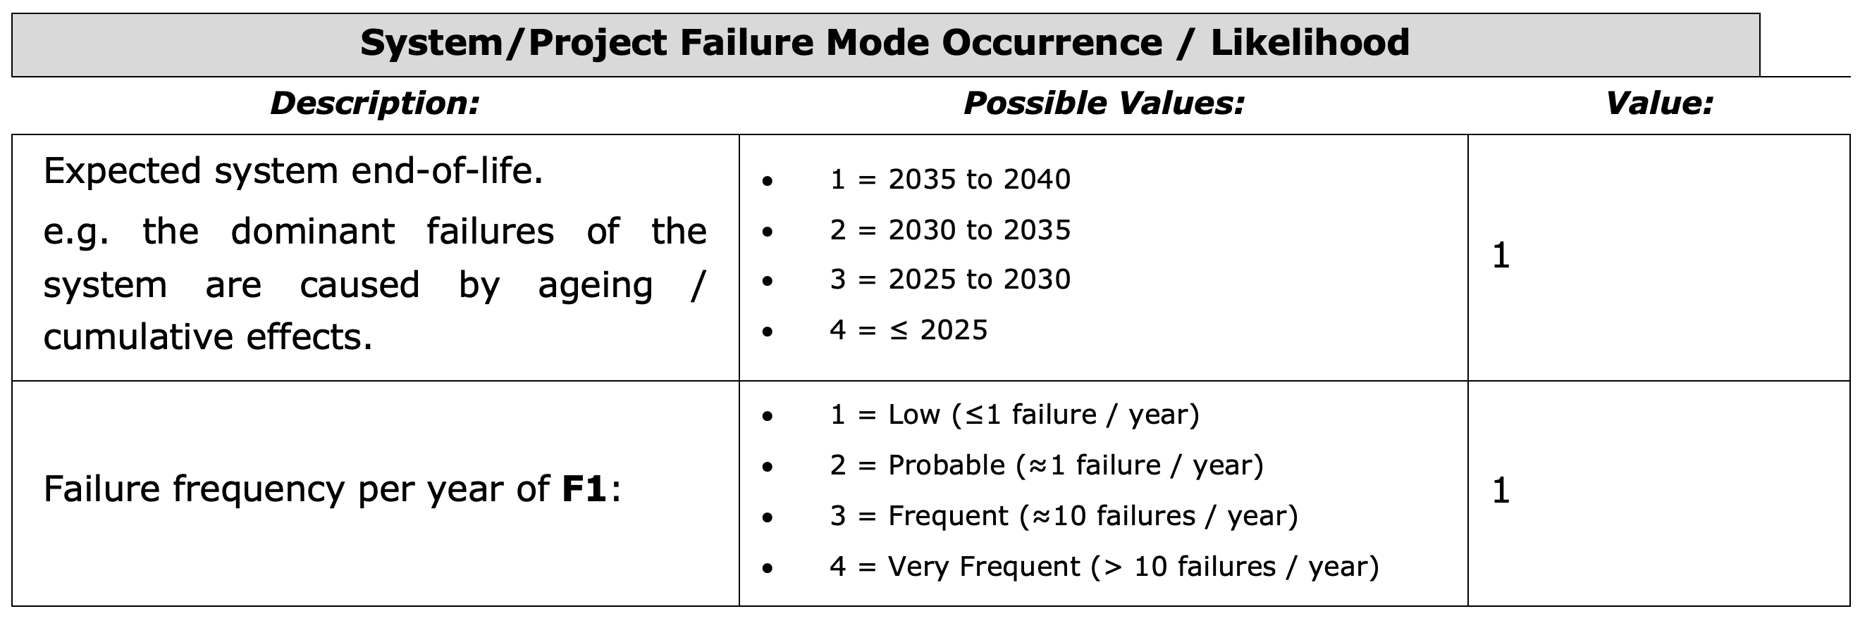
Example of risk “light” analysis

Slide 16
Summary of outstanding questions
Schedule with LS3 delayed compensates for magnet procurement
  Still Go/No-Go necessary to be able to dismount and leave enough time
For the Go/No-Go need of DOCUMENT defining test results
  Mechanical integration almost completed – Go/No-Go values in doc?
  Gun in design,
  Collector tests after construction – technical specs document
  Magnets in procurements – Go/No-Go document
  Power converters in procurements – Go/No-Go document
  BPM being tested – Go/No-Go value in doc
  Handling??
Risk analysis

Slide 17
AD e-cooler cartoon
Controls & Intelocks

Slide 18
Magnets planning as of 1st Aug ’24
H/V orbit correctors design not yet completed
Supports mounted and aligned
DC power converters

Slide 19
Magnets planning as of 30th Sep ’24
H/V orbit correctors design not yet completed
Supports mounted and aligned
DC power converters

