Slide 1
Indication of Electron Neutrino Appearance in the T2K experiment and its long-term implications
July 14, 2011
CERN Colloquium
CERN Auditorium
Takashi Kobayashi
Institute of Particle and Nuclear Studies,
High Energy Accelerator Research Organization (KEK)
&
J-PARC Center
For T2K collaboration

Slide 2
Contents
Introduction
Introduction of T2K experiment
  Overview
  Milestones
  J-PARC accelerators & experimental setup
Beam operation & data taking
Analysis
Results
J-PARC&T2K status and recovery plan
Implication of T2K results to future projects
Summary

Slide 3
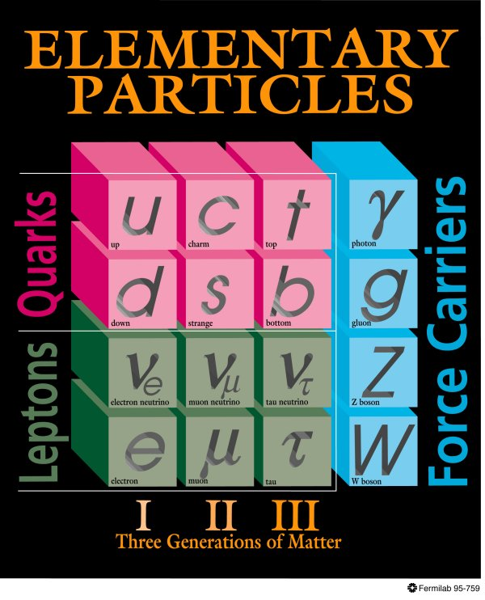
Neutrinos in the present standard model
3 types (flavors)
Has no electric charge
  Only interact weakly
Mass has been assumed to be 0 in the standard model
3

Slide 4
Brief history of neutrino
Another struggle
Time of struggle & inspiration
Discovery race
1st golden age
2nd golden age
Making ~80yrs of history short in 1min,…
“Mysteries” of neutrino has been fascinating particle physicists for all the time
But still many mysteries remain which are suspected to hold a key to another breakthrough
Thus probably continue to fascinate particle physicists another many years

Slide 5
Neutrino physics situation
Especially since 1998, neutrino physics has made great progress
  Discovery of oscillation (ν_{μ} disappearance) in atm ν by SK (98)
    Confirmation in acc ν beam by K2K(2004)/MINOS(2006)
  ν_{e} disappearance (→ν_{μ}/ν_{τ}) established by solar neutrino measurements by SNO/SK (2002)
    Confirmation in reactor ν by KamLAND (2004)
  OPERA observed first ν_{τ} appearance candidate (2010)
Surprises (=Mysteries) are
  Neutrino has really finite (but small) mass: First evidence of violation of Standard Model
  Neutrino has finite (but big) flavor mixing (unlike quarks)
    Lepton flavor is violated
Unraveling full nature of neutrino could provide breakthrough to approach our goals of particle physics

Slide 6
Toward one of big goals of particle physics: Origin of Matter-dominated Universe
Sakharov’s 3 conditions
Baryon number violation
  Proton decay
CP violation
  Quark CPV seems not sufficient
  Lepton CPV may contribute
Non-equilibrium
Neutrino might play essential role

Slide 7
Neutrino oscillation
Quantum mechanical effect
Flavor of neutrino changes to other flavor during flight
Only occur when neutrino has finite mass
The way of changing depend on mass, (energy/flight distance) of neutrino
Strong tool to explore neutrino mass and mixing
ντ
νμ
Mu neutrino
Tau neutrino

Slide 8
3 flavor mixing of neutrinos
Flavor eigenstates
Mass eigenstates
m₁
ν_{e}
ν_{μ}
m₂
ν_{τ}
m₃
Pontecorvo-Maki-Nakagawa-Sakata Matrix (CKM matrix in lepton sector)
Atm/Acc
Acc/Reactor
Sol/Reactor
6 independent parameters govern oscillation
θ₁₂, θ₂₃, θ₁₃, δ
Δm₁₂², Δm₂₃², Δm₁₃²
Δm_{ij}=m_{i}²-m_{j}²
8

Slide 9
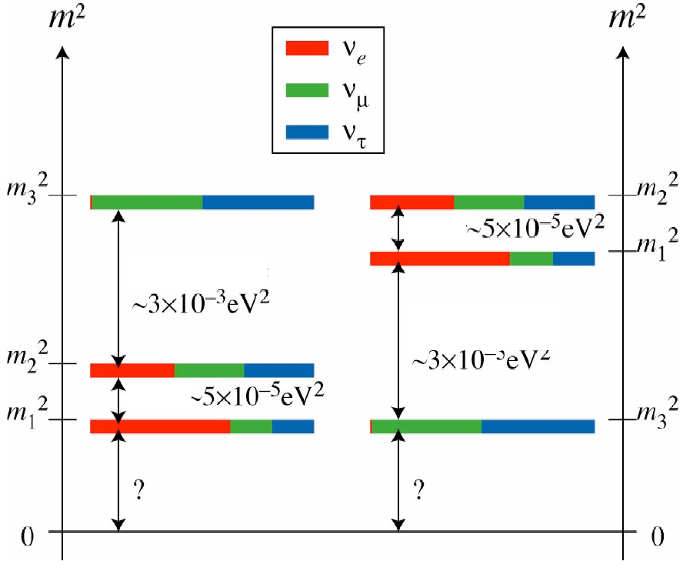
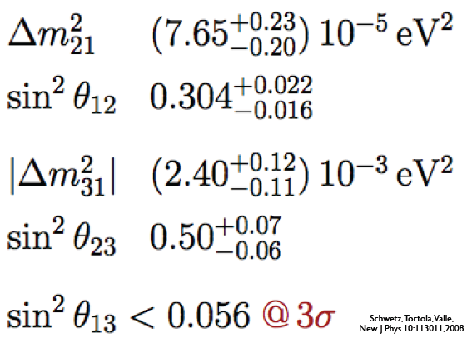
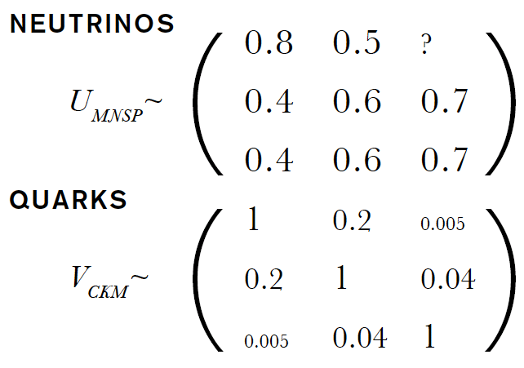
Present knowledge
ν_{e}??
Sol/Reactor
ν₃
Atm/Acc
ν₂
OR
ν₁
δ unkown
Which??
Big diff from KM matrix

Slide 10
Today’s Questions in neutrino physics
Last unknown mixing θ₁₃. 3flavor mixing picture valid?
  ➔Long baseline Accelerator neutrino experiments
  ➔Reactor neutrino experiments
CP symmetry violated?
  Could be a hint to solve origin of matter in universe
  ⎝ Long baseline Accelerator neutrino experiments
Mass hierarchy
  ⎝ Long baseline Accelerator neutrino experiments
Absolute mass?
  ⎝Tritium beta decay spectrum
  ⎝neutrino-less double beta decay
Neutrino is Dirac? Or Majorana?
  ⎝ neutrino-less double beta decay
T2K
10

Slide 11
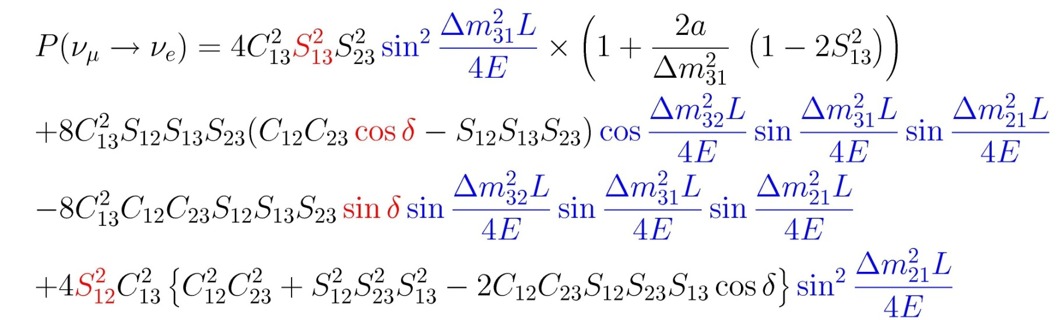
Why θ₁₃? ν_{μ}→ν_{e} appearance and CPV
CPV
Sol term
CPV effect
Unknown!
(sinθ₁₂~0.5, sinθ₂₃~0.7, sinθ₁₃<0.2)
The size of θ₁₃ decides future direction!
11

Slide 12
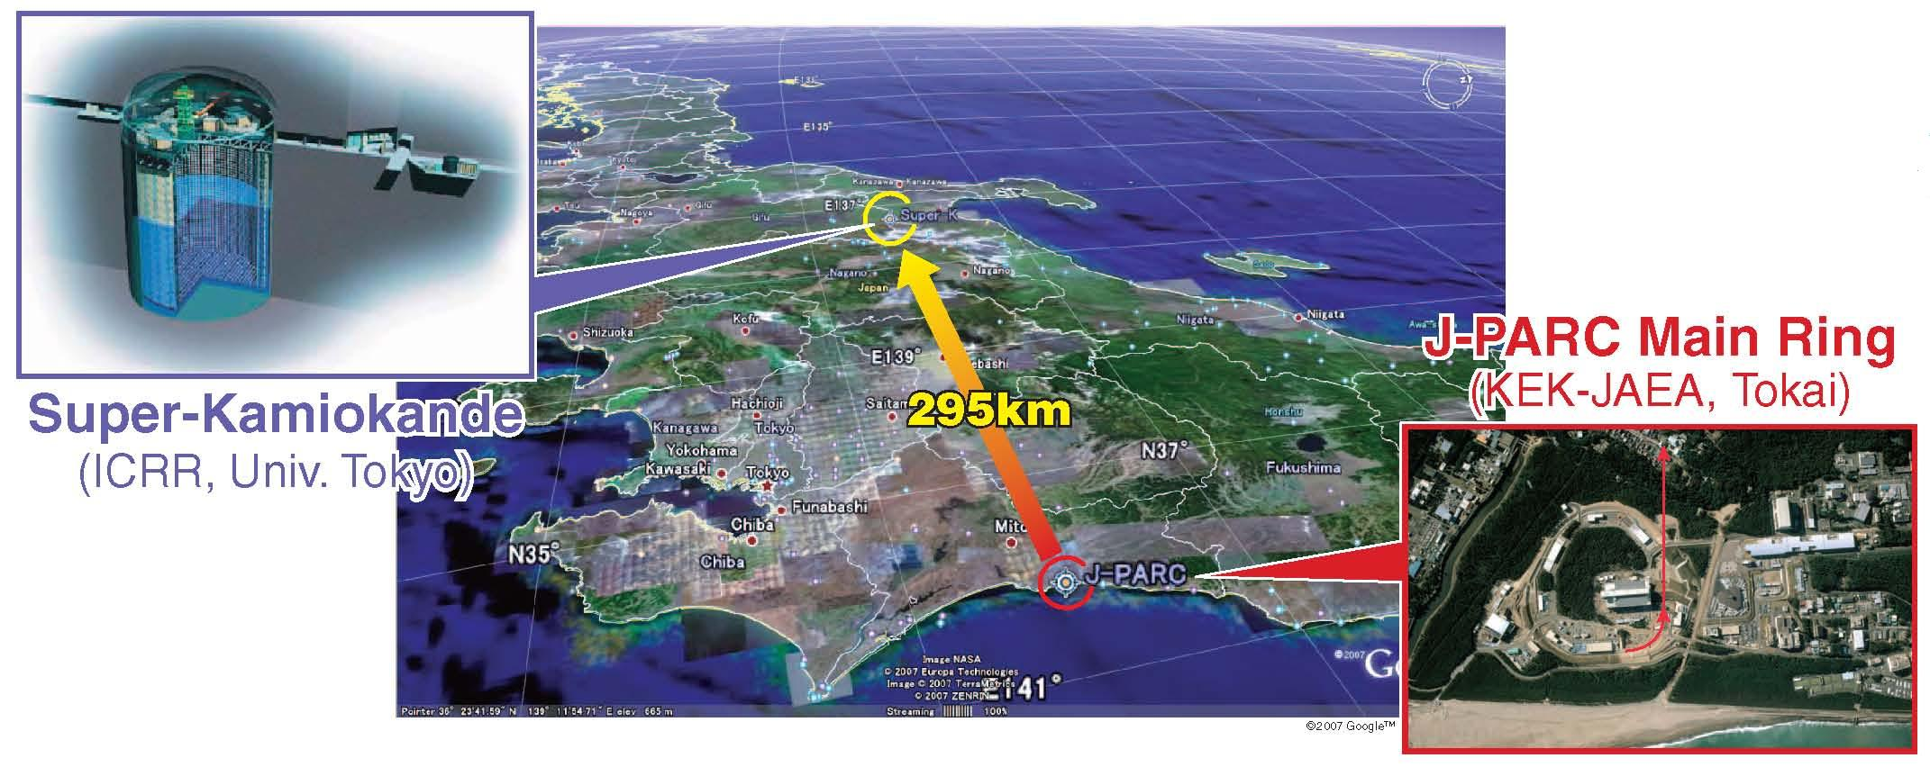
Tokai-to-Kamioka (T2K) experiment
The 1st experiment w/ J-PARC ν facility
High intensity ν_{μ} beam from J-PARC MR to Super-Kamiokande @ 295km
Discovery of νe appearance → Determine θ₁₃
  Last unknown mixing angle ➔ Prove 3 flavor mixing
  Open possibility to explore CPV in lepton sector
Precise meas. of ν_{μ} disappearance → θ₂₃, Δm₂₃²
  Really maximum mixing? Any symmetry? Anything unexpected?

Slide 13
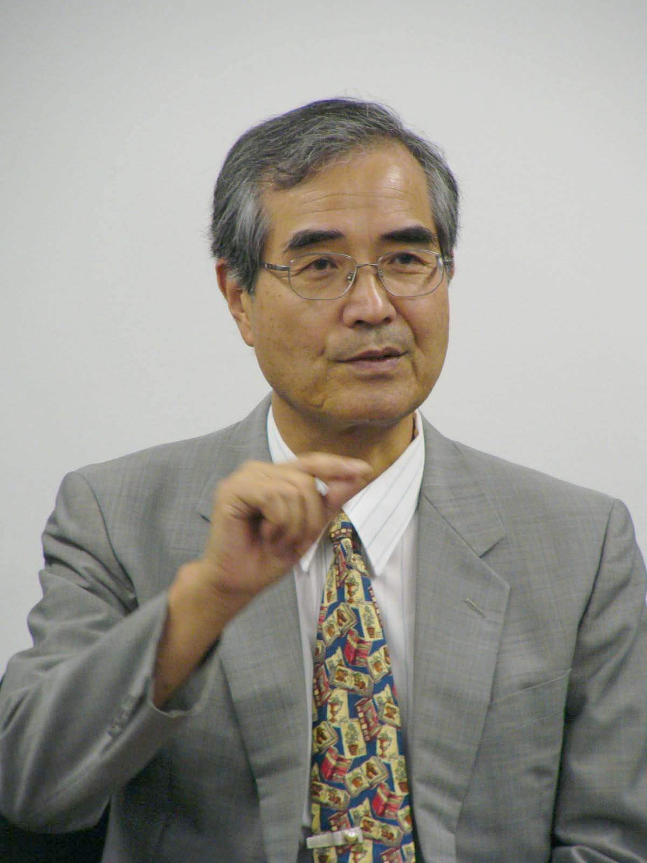

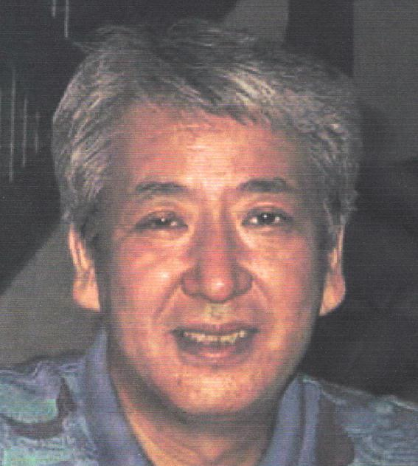
Milestones
Y.Totsuka (1942~2008)
1999: Nishikawa&Totsuka proposed to measure ν_{e} appearance as a next critical step toward CP measurement
2000: Letter of Intent
April 2004:
  Officially approved by Japanese Government and 5yr Construction started
  T2K international collaboration officially formed
  Spokesperson: K.Nishikawa
March 2009: Construction completed as scheduled
April 23, 2009: First neutrino beam production and commissioning started
January 2010: Data accumulation for oscillation search started!
Feb. 24, 2010: First T2K Event in Super-Kamiokande!
K.Nishikawa

Slide 14












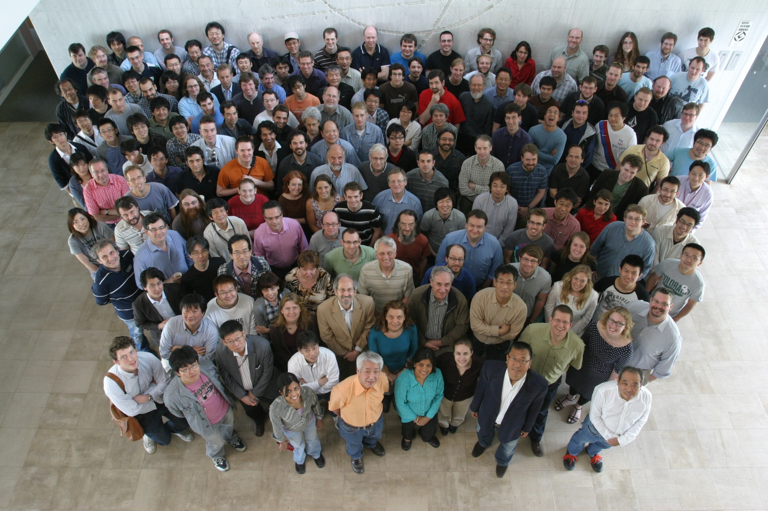
The T2K Collaboration
~500 members, 59 Institutes, 12 countries
Canada
TRIUMF
U. Alberta
U. B. Columbia
U. Regina
U. Toronto
U. Victoria
York U.
France
CEA Saclay
IPN Lyon
LLR E. Poly.
LPNHE Paris
Germany
U. Aachen
Italy
INFN, U. Roma
INFN, U. Napoli
INFN, U. Padova
INFN, U. Bari
Japan
ICRR Kamioka
ICRR RCCN
KEK
Kobe U.
Kyoto U.
Miyagi U. Edu.
Osaka City U.
U. Tokyo
Poland
A. Soltan, Warsaw
H.Niewodniczanski, Cracow
T. U. Warsaw
U. Silesia, Katowice
U. Warsaw
U. Wroklaw
Russia
INR
S. Korea
Chonnam N.U.
Dongshin U.
Seoul N.U.
Spain
IFIC, Valencia
IFAE(Bacelona)
Switzerland
U. Bern
U. Geneva
ETH Zurich
United Kingdom
Imperial C. London
Queen Mary U. L.
Lancaster U.
Liverpool U.
Oxford U.
Sheffield U.
Warwick U.
STFC/RAL
STFC/Daresbury
USA
Boston U.
B.N.L.
Colorado S. U.
Duke U.
Louisiana S. U.
Stony Brook U.
U. C. Irvine
U. Colorado
U. Pittsburgh
U. Rochester
U. Washington

Slide 15
Participants for T2K
S.Korea
8 (1.7%)
Canada
68 (14.3%)
USA
77 (16.1%)
Europe
240 (50.3%)
Japan
84 (17.6%)
Europe
France
United Kingdom
Germany
ALL
Italy
Poland
Switzerland
Russia
Spain

Slide 16
Experimental setup

Slide 17
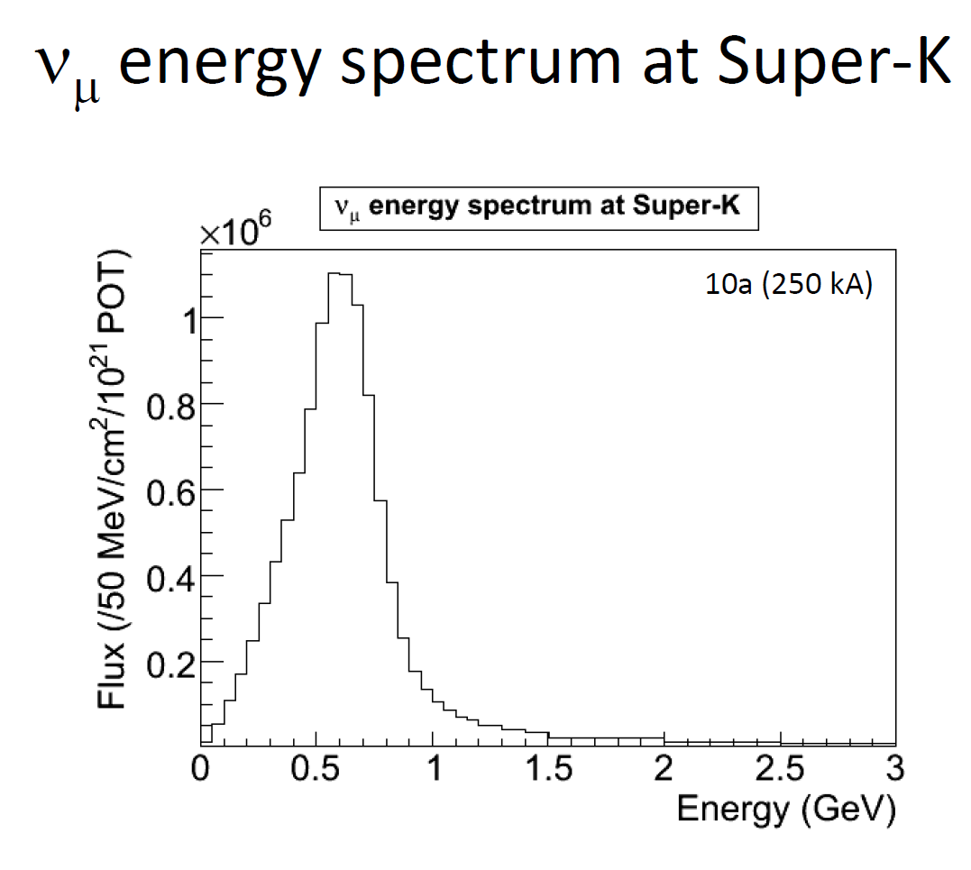
Overview
Super-Kamiokande
p
π
μ-mon
ν
off-axis
on-axis
2.5º
Near detectors
0m
120m
280m
295 km
30GeV proton beam from MR to produce neutrino beam
Beam is 2.5 deg off-axis from far detector direction
Muon monitors @ ~120m
Near detector @280m
  On-axis detector “INGRID”
  Off-axis (toward SK direction)
Far detector Super-Kamiokande @ 295km
MC
ν_{μ} flux (arb. unit)

Slide 18
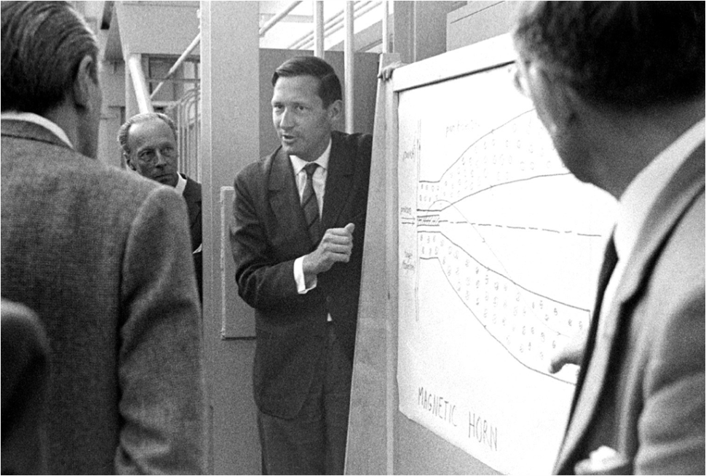
How to make ν_{μ} beam
(Conventional horn focused beam)
Decay Pipe
Proton
Beam
Target
Focusing
Devices
μ
π
ν_{μ}
Simon van der Meer
(1925~2011)
Focusing device: Electromagnetic Horn
Beam Dump
Aluminum
Current
π⁺
B
p beam
半径 ｒ
π⁺
B
磁場強さ B
Pure ν_{μ} beam (≳99%)
ν_{e} (≲1%) from π→μ→e chain and K decay(K_{e3})
ν_{μ}/ν_{μ} can be switched by flipping polarity of Horns

Slide 19
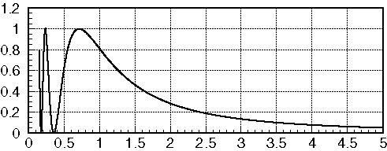
Off-axis (OA) beam
High intensity narrow band beam
(ref.: BNL-E889 Proposal)
Far Det.
振動確率＠
Δm²=3x10⁻³eV²
Target
Horns
Decay Pipe
θ
Decay Kinematics
OA0°
ν_{μ} flux
OA2°
E_{ν}(GeV)
OA2.5°
1
OA3°
1/γ_{π}~θ
E_{π}(GeV)
Increase statistics @ osc. max.
Decrease background from HE tail

Slide 20
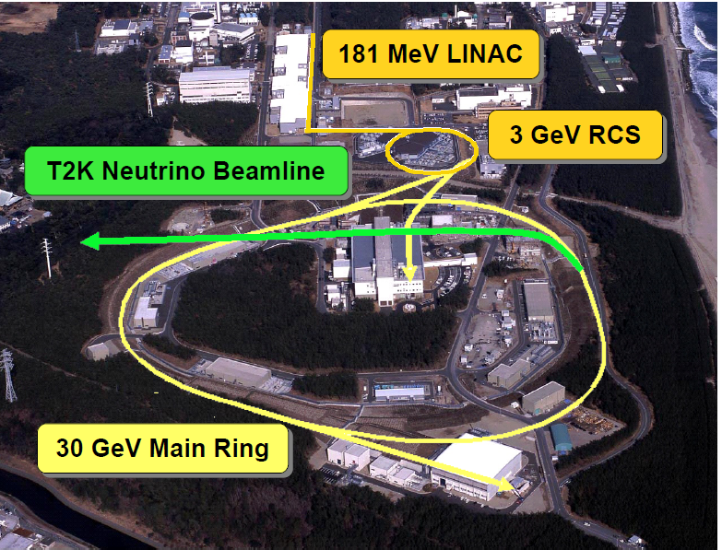
J-PARC
Japan Proton Accelerator Research Complex
Located in Tokai-village, 60km N.E. of KEK
Completed in 2009
Design goal
  RCS: 1MW
  MR: 750kW
JAEA
60km
Joint project of KEK & Japan Atomic Energy Agency (JAEA)

Slide 21
LINAC
Stable operation at 15~20mA/500usec pulse width achieved
Longer continuous operation w/o Ion source maintenance are being tried. >1000hr @16mA achieved
Upgrade 400MeV is delayed to 2013

Slide 22
3GeV-RCS
Design int. 1MW
200kW stable beam provided for MLF
300kWequiv beam provided for MR
420kW high power test succeeded (99.5% transmission), ready for providing to MR

Slide 23
MR
Circumference 1567.5 m
Repetition rate ～0.3 Hz@Start Up
Injection energy 3 GeV
Extraction energy 30 GeV
Superperiodicity 3
h 9
No. of bunches 8 (6 in day 1)
Transition γ 31.7(imaginary)
Typical tune 22.4, 20.8
Transverse emittance
At injection ~54 πmm-mrad
At extraction ~10 πmm-mrad
Beam power 0.75MW
Slow extraction
Experimental Facility
Stable operation at 145kW realized (Mar,2011)
  Np=1.1x10¹³/bunch, Nbunch=8 ➔ 0.9x10¹⁴ PPP, 3.04sec cycle
Currently limited by beam loss at injection due to dirty pulse shape of injection kicker magnets
  ➔ Will be replaced during present shutdown and be fixed
Toward design intensity and higher
  For higher PPP: Space charge (RF HH)
  For higher rep rate: PS, RF
  Collimator upgrade

Slide 24
J-PARC Neutrino Beam
Conventional horn focused beam
First application of off-axis beam
  Adjustable off-axis angle 2~2.5deg.
  2.5 deg at Day1
First MW-capable beamline
  Design intensity is 750kW with safety factor
  Parts which can never be upgraded later are designed for Multi-MW (3~4MW)
    Shielding and cooling capacity of target station, decay volume, beam dump
First application of superconducting combined function magnet
Key issues
  Beam loss
  Remote/quick maintenance of activated components
  Radio active waste
Primary line
280m
Near detector
To Super-Kamiokande

Slide 25
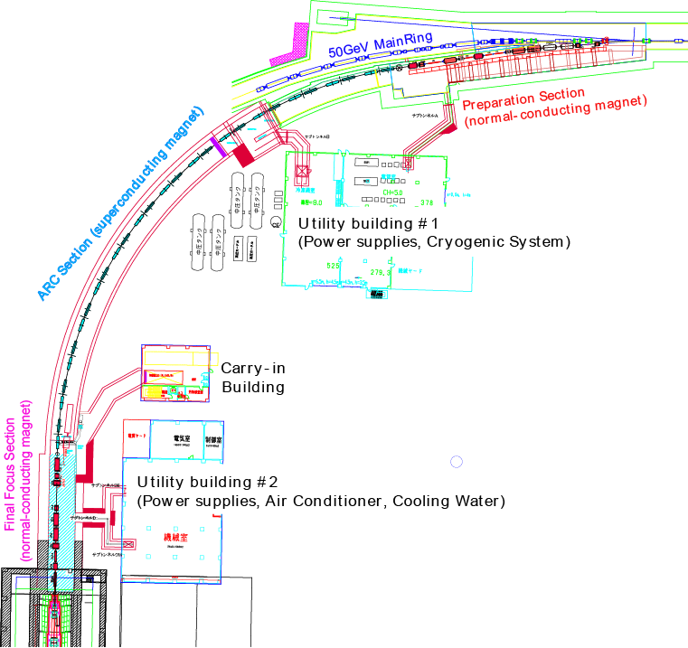
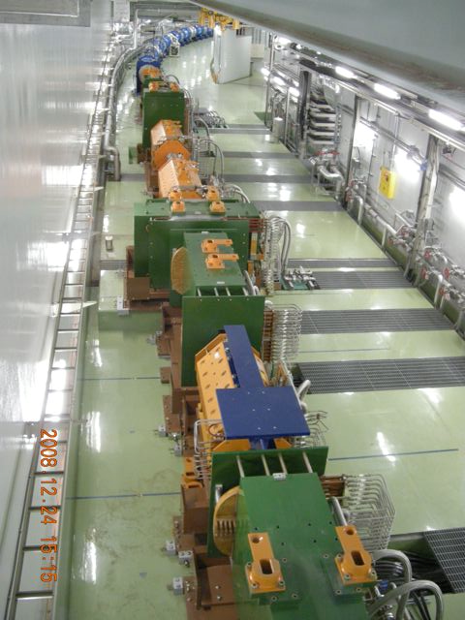
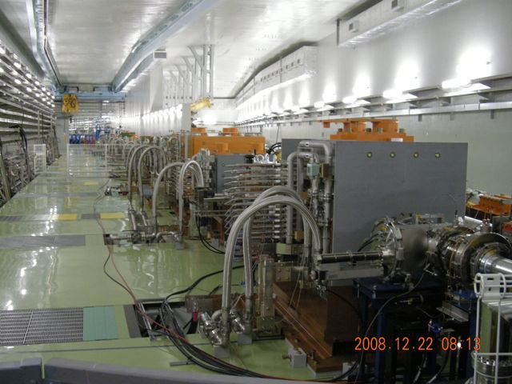
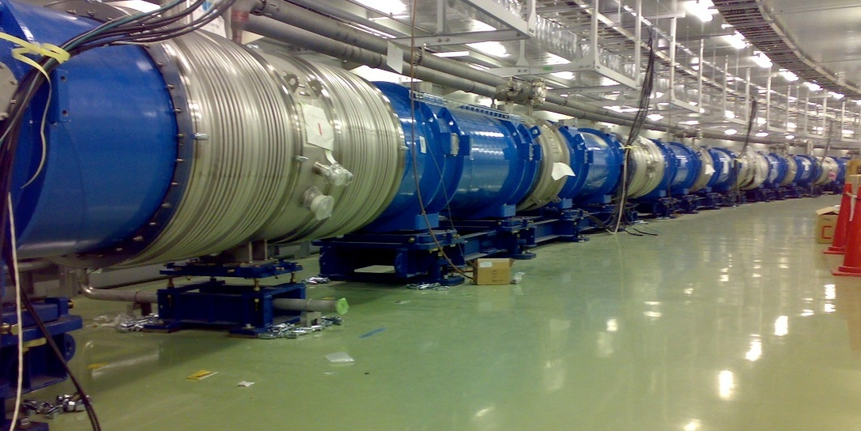
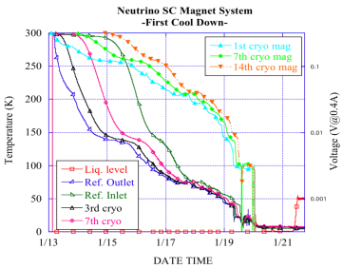
Primary beamline
Preparation section
  11 normal conducting magnets
  750W beam loss shield
Final focusing (FF) section
  10 normal conducting magnets
  250W loss shield
Arc section
  28 superconducting combined function magnets
  D2.6T,Q18.6T/m, L=3.3m
  1W/m loss allowed
3 corrector mags (from US)
MSS from Saclay
CERN cooperation
25

Slide 26
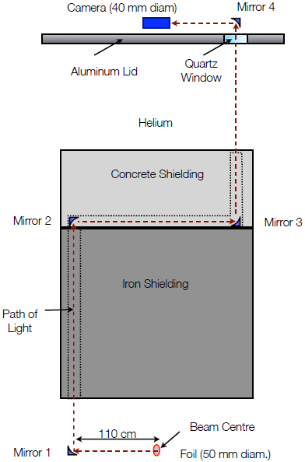
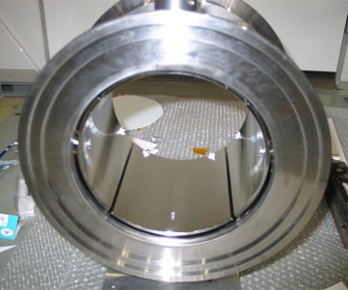
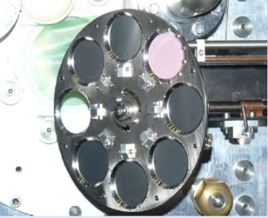
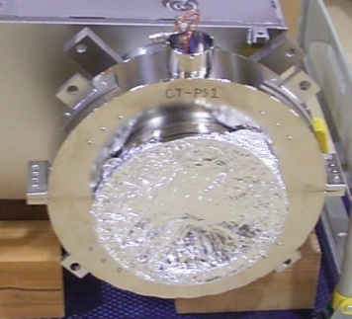
Beam Monitors
Position:
  21 x Electrostatic monitors
Profile
  19 x Segmented Secondary Emission monitors
Intensity
  5x Current Transformers
Loss
  50 x proportional counters
Targetting
  Optical Transition Radiation detector (Canada)
Elec.: from US/Korea/Jp
Beam timing: GPS (US)
OTR
(Canada)
ESM
CT
SSEM
5μm^{t} Ti foil strips
3
4
7
6

Slide 27
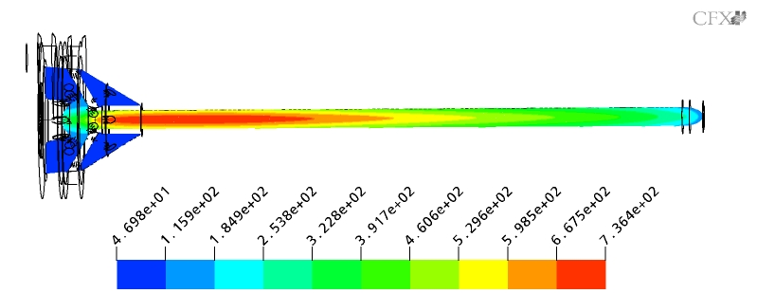
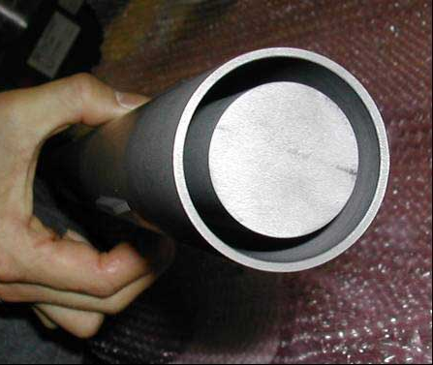
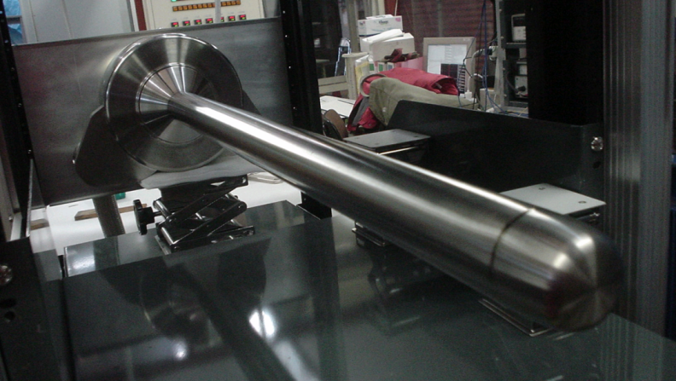
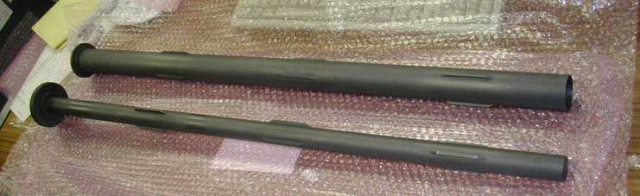
Target
Isotropic Graphite (IG-430) 1.8g/cm3
26mm(D)x900mm(L)
  1.9 int len. (70% int.),
Heat load: 58kJ/spill (~20kW)
Thermal shock stress (ΔT~200K) ~ 7MPa (< tensile strength 37MPa)
Forced flow Helium gas cooling in Ti-alloy(Ti-6 A1-4V) container
  Higher temp = less rad. damage
  O2 < 100ppm to avoid Oxidization (burn!) → to keep S.F.>2 for 5 yrs
Remote maintenance
Design done by KEK/RAL
30GeV-750kW
736℃
ΔT~200K ~7MPa(Tensile 27MPa)

Slide 28
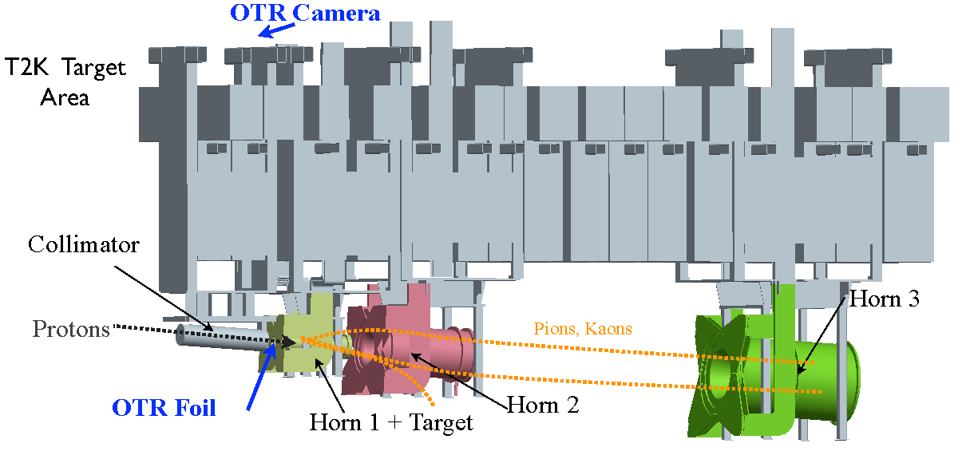
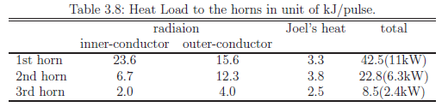
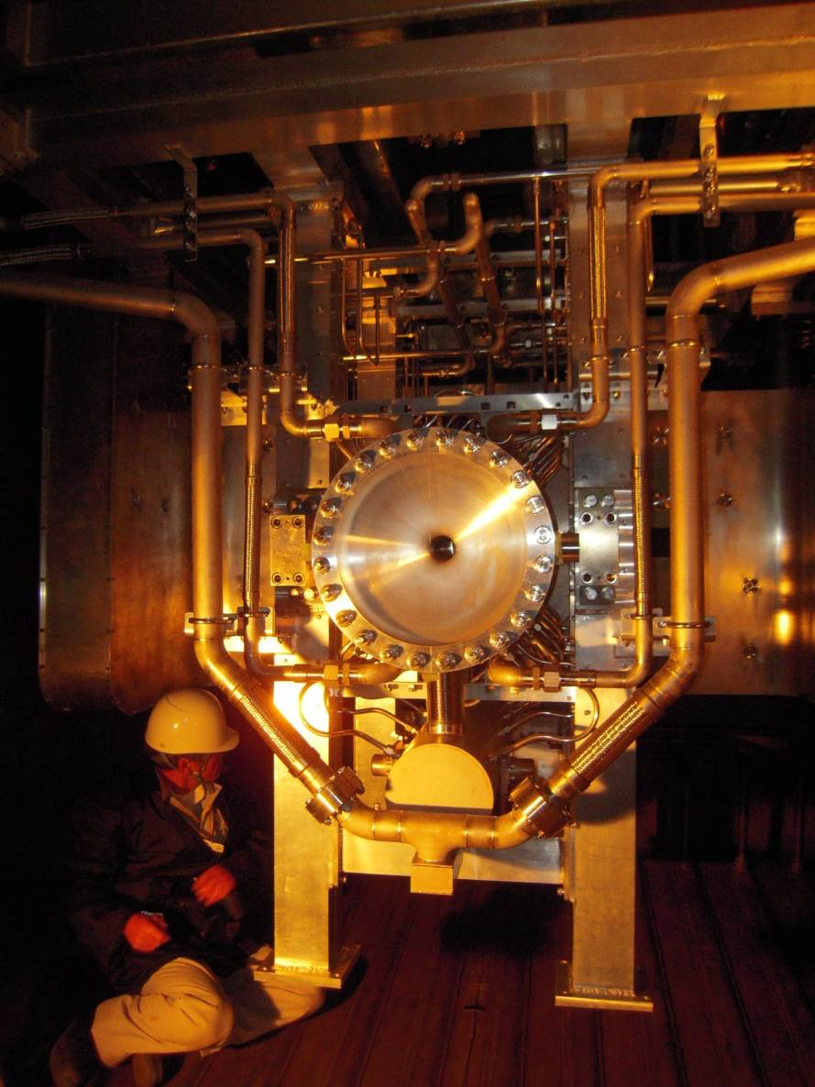
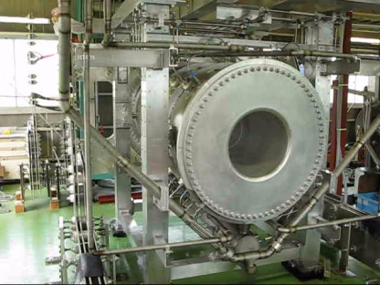
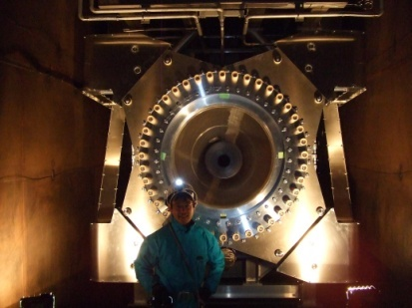
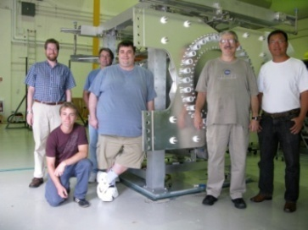
Electromagnetic horns
3 horn system
320kA design (now 250kW)
  0.7ms for 1st horn
  2ms for 2nd/3rd (series)
Max field: 2.1T
Al alloy (A6061-T6)
Heat load ~11kW@1st horn (beam+Joule)
Water cooled.
Design max thermal stress: 25MPa (Lorentz+Thermal) (cf. tensile stren. 282MPa)
Fully remote maintenance
1st horn
2nd horn (US)
3rd horn
28

Slide 29
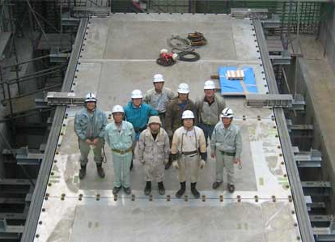
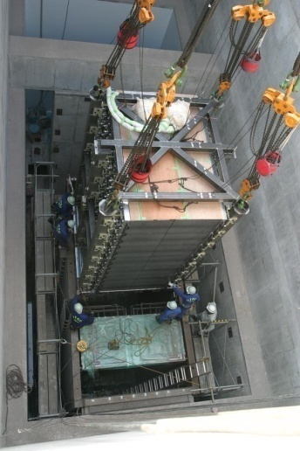
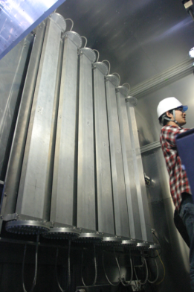
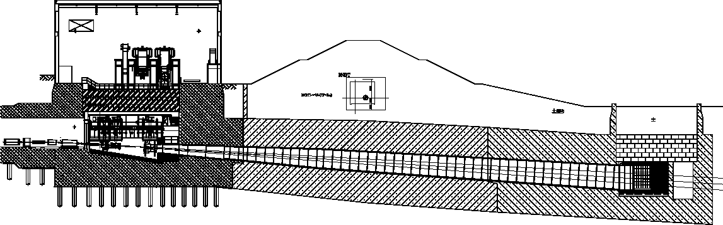
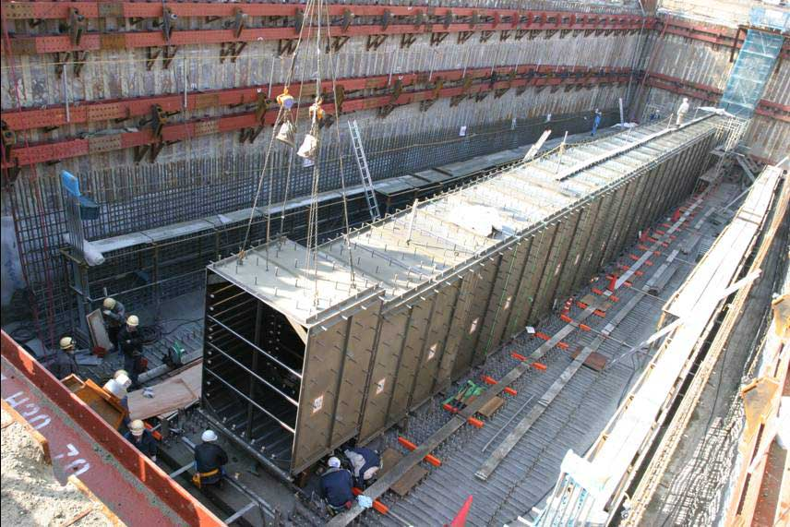
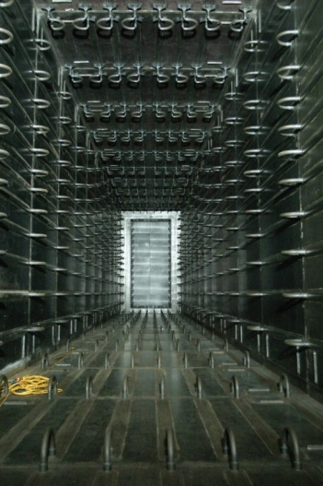
Secondary beamline
TS He vessel
Muon monitors
Beam dump
Heat load (@750kW)
  TS ~300kW
  DV ~150kW
  BD ~240kW
Whole volume filled w/ He gas (~1000m³)
  Reduce NOx & ³H
  Reduce pion abs.
All inner surfaces water cooled
  Concrete upto ~100deg
  Periodically waste with dilution (obey law)
Beam dump
  Graphite blocks
  Water-pipe casted Al block attached to both side
  Upto 3MW beam
Muon monitor
  5GeV thresh.
  Ionization chamber & Si
  7x7 grid each
  Monitor dir/int spill-by-spill
  Emulsion
3
NBT
6
m
Thick concrete shield
Target station
Decay volume 94m
Beam dump
Decay volume
Decay volume & beam dump
29

Slide 30
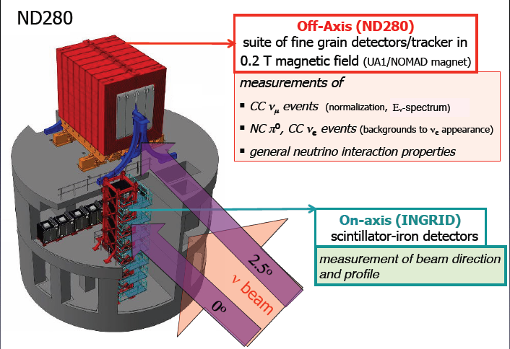
Near detectors

Slide 31
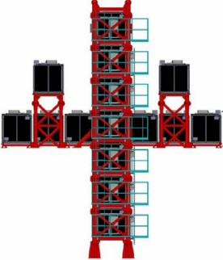
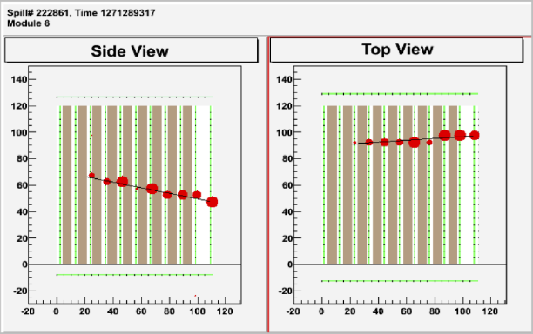
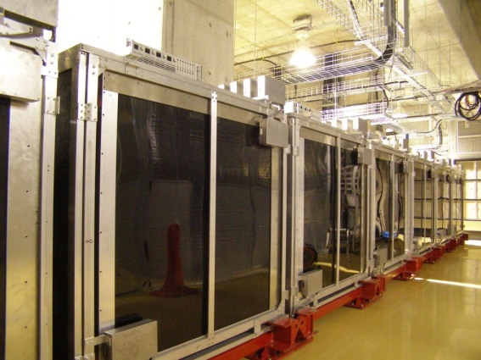
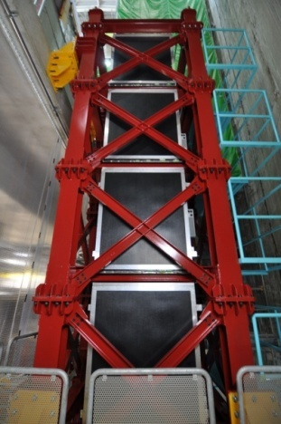
INGRID detector
Placed on beam axis at 280m from target
Iron plates + Scintillator bar tracker
Measure neutrino interaction rate & beam profile
  Monitor beam intensity & direction

Slide 32
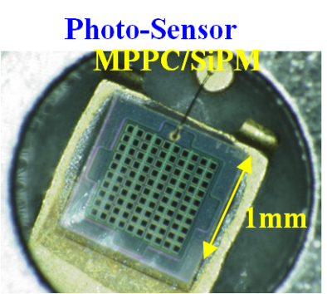
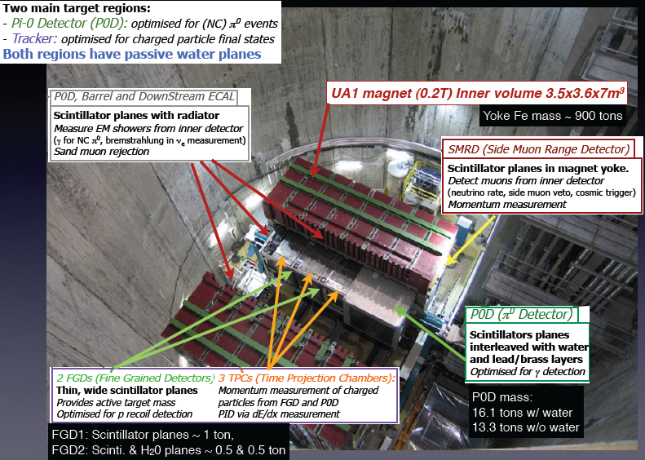
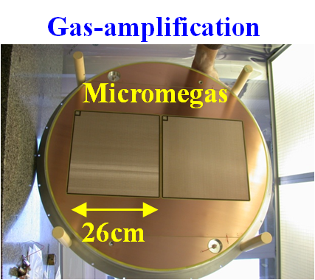
Off-Axis Detector

Slide 33
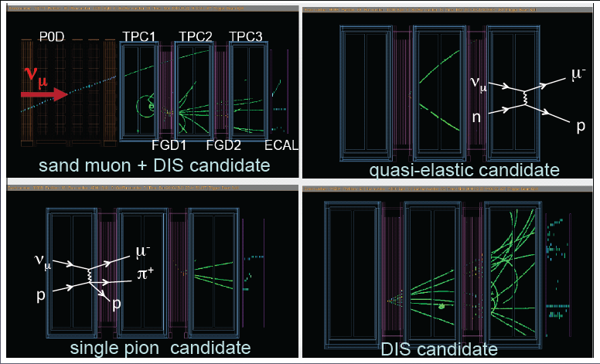
ND280 off-axis event gallery

Slide 34
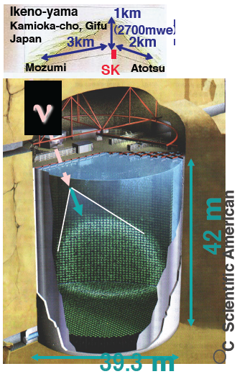
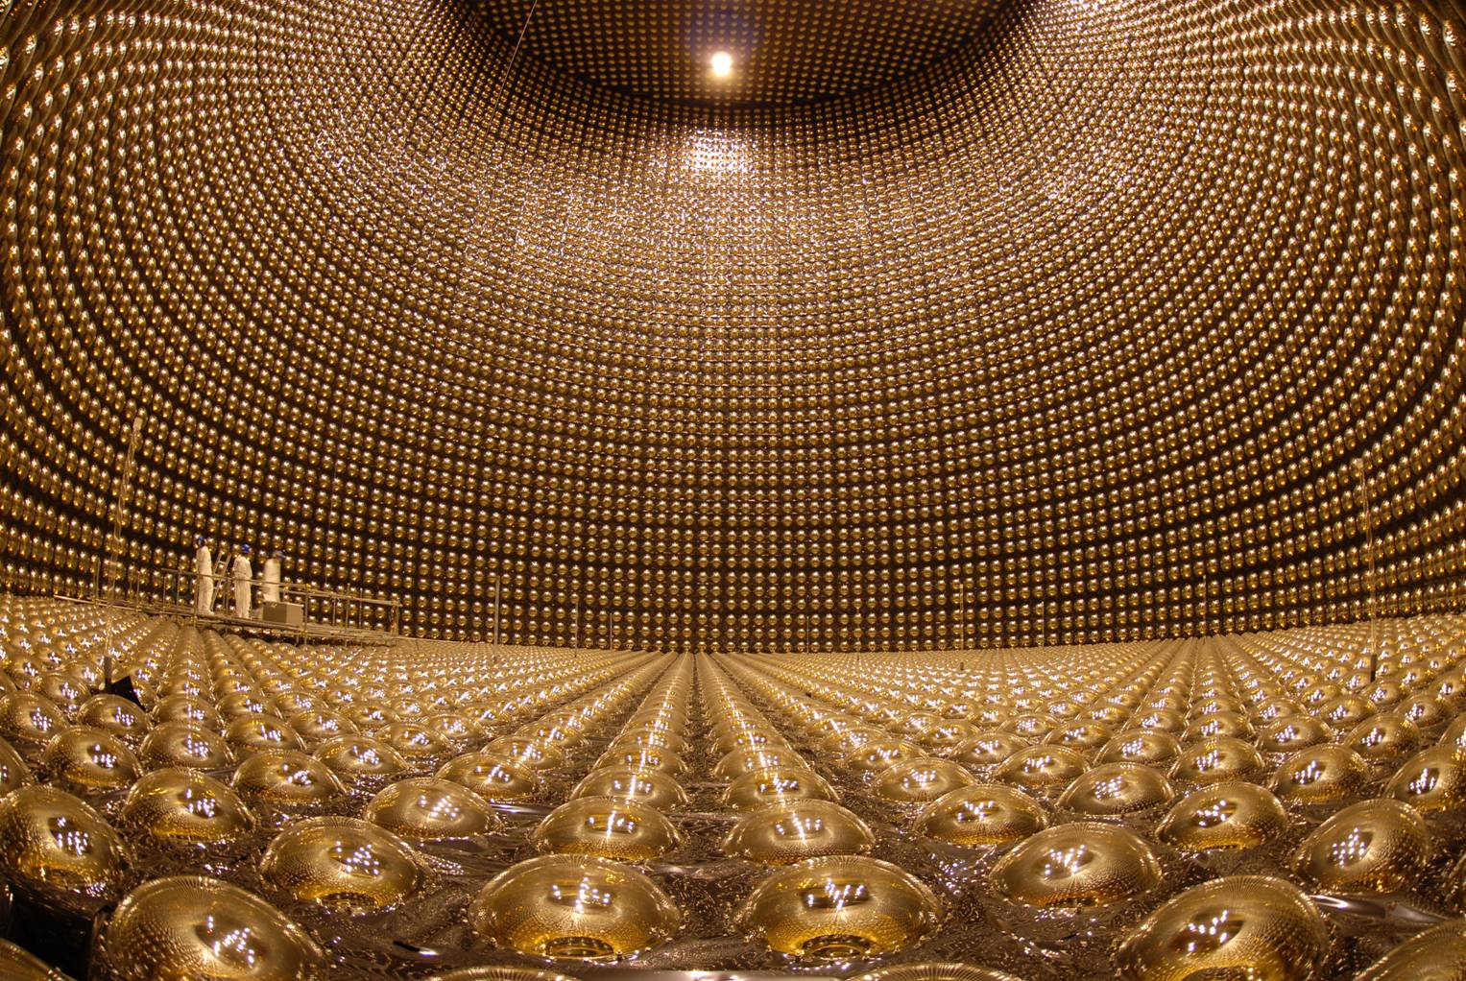
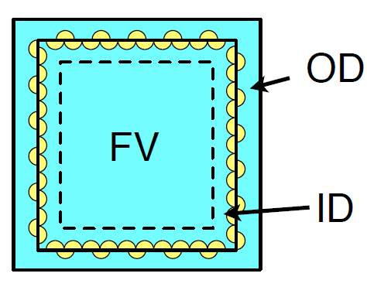

Far Detector: Super-Kamiokande
Water Cherenkov detector operational since 1996
Total volume: 50kton (Fiducial volume: 22.5kton)
11129 20" PMTs in inner detector (ID)
1885 8" PMTs in outer detector (OD)
New dead time less readout electronics since 2008 summer.
T2K event trigger by accelerator timing sent online
39m
©ICRR, Univ. of Tokyo

Slide 35



Slide 36



First beam!
First shot after turning on SC magnets at 19:09, Apr.23, 2009
Muon monitor signal
Ion chamber
Behind 5GeV equiv material (dump)
Silicon detector
Scintillator (for commissioning)
First observation of muons produced in neutrino beamline

Slide 37

Delivered proton
Started physics data taking Jan, 2010
Stable beam operation at 145kW achieved
By Mar.11, 2011, 1.43x10²⁰ (~70 [kW・1e7s]) delivered
All data taken was analyzed

Slide 38
ν_{μ}→ν_{e} appearance search

Slide 39
Signature
Signal: ν_{e}CCqe (ν_{e}+n→e+p)
  Dominant reaction < 1GeV
  Single EM shower
    No decay electron (from μ or π)
  With same E_{ν} dist as orig. ν_{μ}
Background
  Beam intrinsic ν_{e} (~1%)
    Different (broad) energy distribution
  NC π⁰ production
    π⁰➔2γ with 1 hidden EM shower
ν_{μ}
ν_{e}
e
e
p (invisible)
π⁰
ν_{x}
π⁰
γ
γ
ν_{x}

Slide 40




Analysis overview
Expected # of events at SK
Compare w/ observation
BG
SK MC pred normalized by ND meas
Int xsec
Det. eff.
ND meas extrapolated by far/near extrapolation ratio
Predict expected # of events(sig&BG)
Measure # of CC int at ND
Predict nu flux & Near→far extrapolation
Cancellation of flux normalization, interaction cross section is expected!
CERN NA61 play critical role!

Slide 41

Beam prediction

Slide 42


Beam prediction w/ CERN/NA61 results
NA61 Results of pion production from 2007 thin (~2cm) target data
Intrinsic ν_{e} ~1% of
flux below 1 GeV
Error from beam uncertainty
N.Abgrall et al., arXiv:1102.0983[hep-ex]
Accepted for publication in Phys. Rev.C(2011)
Cancellation in ratio prediction thanks to near&far correlation
Kaon uncertainty is dominant (7.6% out of 8.5%) ➔ will be improved by NA61 Kaon results

Slide 43

Off-axis near detector measurement
To give normalization factor
Measure # of ν_{μ} CC inclusive events
  Select events w/ vertex in FGD attached to a muon track in TPC
  90% ν_{μ}CC (50% ν_{μ}CCqe)
Used data Run1 (2.88x10¹⁹ POT)
Run1

Slide 44


Event selection (1) timing
Event timing @ SK
Near detector (INGRID)
Event timing distribution
121 FC events detected!
Clear bunch timing structure of J-PARC!!
121 Fully Contained(FC) events detected (FC: hits in ID only, no OD hits)
Non-J-PARC neutrino contamination in 12us time window: 0.023 events

Slide 45


Event selection (2)
4.Visible energy > 100 MeV
➔
Suppress NC background and electrons from μ decay
2.Single ring
➔Enhance CCqe
41 events remained
7 events remained
3. PID is e-like
➔Enhance ν_{e} CC
5.No decay-e
(delayed e)
➔
Suppress invisible π or μ
8 events remained
6 events remained

Slide 46


Event Selection (3)
6. Invariant mass of already found 1 e-like ring + additional forced-reconstructed e-like ring M_{inv} < 105MeV/c²
➔ Reject remaining π⁰ background
6 events remained
7. Reconstructed neutrino energy < 1250 MeV
- Reject higher energy intrinsic beam
background from kaon decays
6 final candidate events remained!
Signal Efficiency = 66%
Background Rejection:
77% for beam ν_{e}
99% for NC
Expected BG
1.5evts
Selection criteria & cut values are fixed before analysis. Unbiased

Slide 47


Systematic error
Further improvements are planned. Eg. Inclusion of NA61 Kaon results, etc
Smaller error for larger S/N

Slide 48
Number of events summary
 | Total | Beam νe | NC | ν_{μ}→ν_{e} (sol term)
Expected BG | 1.5±0.3 | 0.8 | 0.6 | 0.1
Observed | 6
Probability to observe six or more events if θ₁₃=0: 0.007
(2.5 σ significance)

Slide 49

A candidate

Slide 50

Vertex distribution

Slide 51





θ₁₃ measurements
Chooz experiment
90% CL limit.
(Δm₂₃²>0)
(Δm₂₃²<0)
90%CL range
Central value

Slide 52
J-PARC&T2K status & prospects

Slide 53

Earthquake on Mar. 11th
Happened at 14:46 on Mar. 11th
  Magnitude 9.0 in Richter scale
  Seismic intensity 6+ at Tokai
  No Tsunami reached to J-PARC
  All of electric power was stopped
  Maintenance day=Acc. not operated
No one injured T2K, KEK, J-PARC

Slide 54







Ground level damages
RCS (elec yard)
LINAC
Neutrino (TS)
Severe subsidence here and there (1~2m depth)
Near by piping/cabling were damaged
LINAC
Neutrino (Dump)
Neutrino (Dump)

Slide 55



Being rapidly repaired
RCS
RCS
Neutrino (dump)
Neutrino (dump)

Slide 56




Equipments
Generally no fatal damages
LINAC floor, MR tunnel side pit, Near detector bottom floor once submerged under water
  Fixed in a few weeks
  No serious damages on components
Tunnel moved or bent ~ several cm
  Major alignment of many components need to be done
LINAC

Slide 57
J-PARC Plan
We will resume J-PARC operation in Dec. 2011
We plan to have >2 “cycle”(~month) beam for users within JFY2011 (by the end of Mar,2012)
LINAC energy recovery from 181MeV to 400MeV originally scheduled in 2012 was delayed to start July 2013
  User’s needs to take longer beam after long shutdown by the earthquake
  Delay of preparation caused by earthquake

Slide 58

T2K Expected sensitivities
O(1[MWx10⁷s]~2e21pot) is major milestone (turning point)
Need to reach ASAP
T2K central value
~400kWx1e7s
8e20pot
Fogli global best fit[1]
1~2MWx10⁷s
T2K 90% Lower
[1] G.L.Fogli, et.al, arXiv:1106.6028v1 [hep-ph]

Slide 59
Future milestones
Highest priority is to firmly establish non-zero θ₁₃ and its precise determination as quickly as possible
We have 70 [kWx10⁷s] = 1.43e20 pot
We aim to have
By Summer 2013: ~0.5 [MWx10⁷s] ~ 1e21pot
  Conclude non-zero θ₁₃
  >5sigma for present T2K central value
Within a few yrs : ~ 1 [MWx10⁷s] ~ 2e21pot
  > 3sigma for sin²2θ₁₃ > 0.04
Approved goal : 3.8 [MWx10⁷s] ~ 8e21pot
  > 3sigma for sin²2θ₁₃ >~ 0.02
T2K official part is up to here
Notes:
To go 5sigma at lower bound of 90%CL, 540 kW x 1E7sec = 150kW x 3.6E7sec = 200kW x 2.7E7sec = 1.8E7sec necessary

Slide 60
Implication on Future
If sin²2θ₁₃> ~0.01
  Conventional Multi-MW super beam long baseline experiment will be really promising to explore CPV in lepton sector
  We need to put even more effort to formulate the future project in this direction as soon as possible
IF not
  Need “ideal” beam such as Neutrino Factory or beta beam to probe CPV
Therefore, confirming the indication of large θ₁₃ by T2K is a very important and urgent issue

Slide 61



How to measure CPV & sign(Δm₂₃)
665km
2300km
CPV
Matter
νe appearance energy spectrum shape
  Peak position and height for 1st, 2nd maximum and minimum
  Measure both sinδ & cosδ terms ➔ can discriminate 0deg vs 180deg
Difference between νe and νe behavior
  Sensitive to any mechanism to make asymmetry (No assumption)
  Basically measure sinδ term
Distance:
  Larger L Matter effect large ➔ Sensitive to sign(Δm₂₃) too
  Smaller L (lower E): Purer CPV measurement
61

Slide 62
Essential requirements for CPV discovery
Order of magnitude higher statistics from present generation experiments
➔
High intensity beam (Multi-MW)
  Increase statistics
High sensitivity huge detector
  Increase statistics
  Increase signal efficiency
  Reduce background
  Reduce systematic errors
  Should also capable for proton decay detection

Slide 63


“Available” technologies for huge detector
Good at low E (<1GeV) narrow band beam
Good at Wideband beam
Liq Ar TPC
Aim O(100kton)
Electronic “bubble chamber”
  Can track every charged particle
  Down to very low energy
Neutrino energy reconstruction by eg. total energy
  No need to assume process type
  Capable upto high energy
Good PID w/ dE/dx, pi0 rejection
Realized O(1kton)
Water Cherenkov
Aim O(1000kton)
Energy reconstruction assuming Ccqe
  Effective < 1GeV
Good PID (μ/e) at low energy
Cherenkov threshold
Realized 50kton

Slide 64
Possible experimental configuration
Multi-MW beam + Longer distance O(1000km)+ Wide band beam + LiqAr
  Energy spectrum measurement
  Cover both 1st and 2nd peaks
  Possible to determine “everything” in 1 shot
    CPV
    Hierarchy
    θ₂₃ octant
Multi-MW beam + Shorter distance (a few 100km) + Low energy narrow band beam + Water Cherenkov
  Nue/nuebar asymtery of 1st peak
  Possible to determine
    CPV
  Need external input to discriminate mass hierarchy (such as atm nu)
To realize, international cooperation is essential
  Europe (LAGUNA) and Japan are pursuing these options coherently

Slide 65




Scenarios in Japan
Kamioka L=295km OA=2.5deg
Okinoshima L=658km OA=0.78deg
Almost On-Axis
J-PARC
→1.7MW
→??MW
KEK’s primary option
P32 proposal (Lar TPC R&D)
Recommended by J-PARC PAC
(Jan 2010), arXiv:0804.2111

Slide 66


Physics potential
CPV
Hierarchy
Beam ν_{e}
Background
Very good chance both to detect CPV & determine sign(Δm₂₃)

Slide 67







R&D toward realizing 100kt LArTPC
J-PARC T32 exp
(ETHZ/KEK/Iwate/Waseda)
Double phase readout test @ ETHZ (CERN RE18)
250L LAr TPC
180k trig (80k Kaon)
Site visit

Slide 68
Summary
T2K reports new results on ν_{μ} → ν_{e} oscillations based on 1.43 x 10²⁰ p.o.t. (2% exposure of T2K’s goal)
  Expected number of events is 1.5 ± 0.3 (sin²2θ₁₃ = 0)
  6 candidate events are observed
  Under θ₁₃=0 hypothesis, the probability to observe 6 or more candidate events is 0.007 (equivalent to 2.5σ significance)
  0.03 (0.04) < sin²2θ₁₃ < 0.28 (0.34) at 90% C.L. for normal (inverted) hierarchy (assuming Δm²₂₃=2.4 x 10⁻³ eV², sin²2θ₂₃=1, δCP=0)
  To appear in PRL (arXiv:1106.2822v1)
We will resume J-PARC operation in Dec,2011 and restart T2K data taking as soon as possible
ν_{μ} disappearance result with full data set will be reported at EPS conf. next week

Slide 69
Summary (2)
Impact of T2K result on future project was briefly discussed
  With large sin²2θ₁₃ (>0.01), detection of CPV with conventional beam method (w/ Multi-MW & huge high sensitivity detector) becomes promising!!
KEK is pursuing and making R&D on huge Liq Ar detector at further distance in close cooperation with European initiative, LAGUNA

Slide 70
Acknowledgements
T2K is a CERN recognized experiment (RE13)
We thank CERN on
  Donation of UA1/NOMAD magnet
  Infrastructure for detector preparation
  CERN test beam for detectors
  Micromegas production and test by CERN TS/DEM group
  Various technical, administrative support on detector preparation, especially for UA1/NOMAD magnet related issues
  CERN-KEK cooperation on super conducting magnet for neutrino beam line
  Fruitful exchange of information on beam line (K2K & T2K)
  Warm word and donation for the earthquake
We also thank NA61 Collaboration
  Successful collaboration

