Slide 1
A Wide Dynamic Range Beam Monitor for Ion Therapy Machines
Simon Waid, Richard Thalmeier, Andreas Gsponer, Philipp Gaggl, Jürgen Burin, Sebastian Onder, Matthias Knopf, Thomas Bergauer
Trento Workshop 2025
1

Slide 2
Outline
Motivation
Advantages of Silicon Carbide
Results
Summary/Conclusion
2

Slide 3
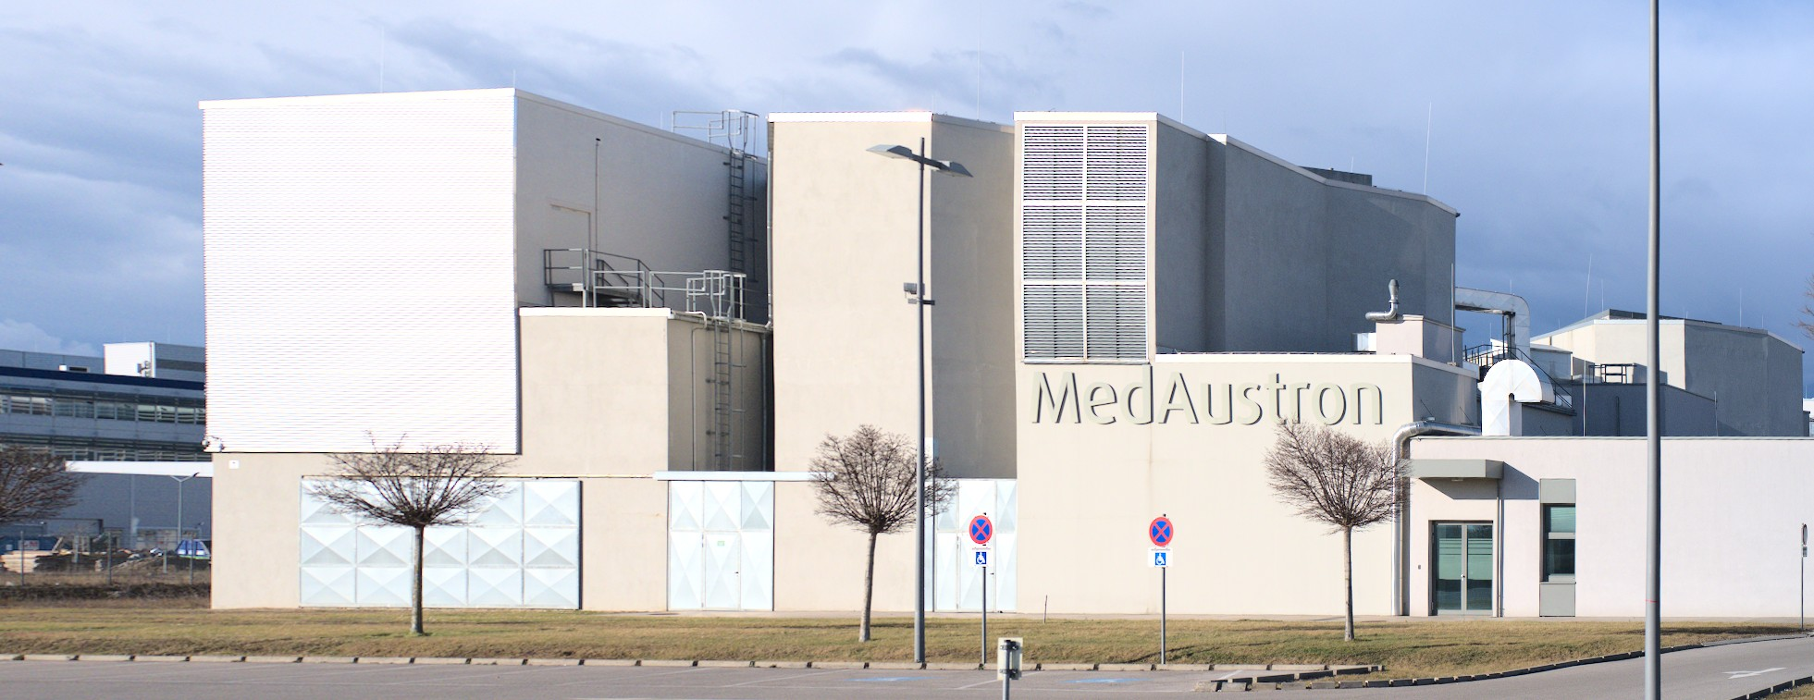
Motivation
We use the Medaustron accelerator in Wiener Neustadt for sensor tests in a “low-flux” mode.
The accelerator was designed for cancer treatment (similar to CNAO).
Current beam detectors are blind to particle fluxes we use for sensors.
Need for beam monitors capable of working in “low-flux” mode while ideally covering clinical intensities too.
3

Slide 4
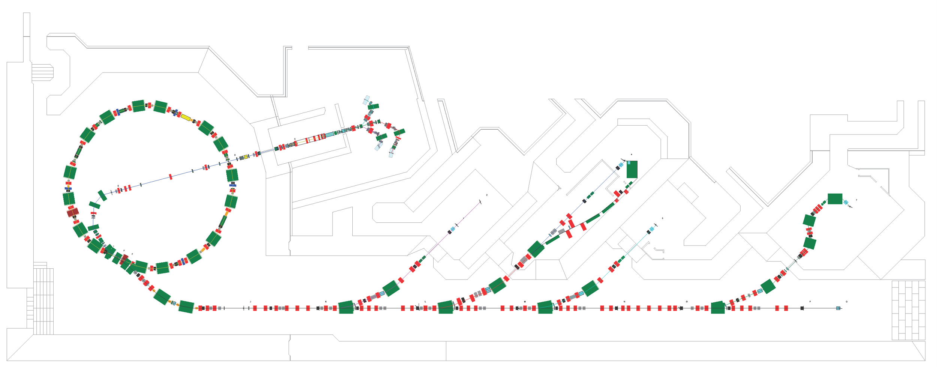
Requirements
Add beam monitors for single particle detection:
6.4 x 6.4 cm² active area.
0.5 mm lateral resolution
At least 25 frames per second
4

Slide 5
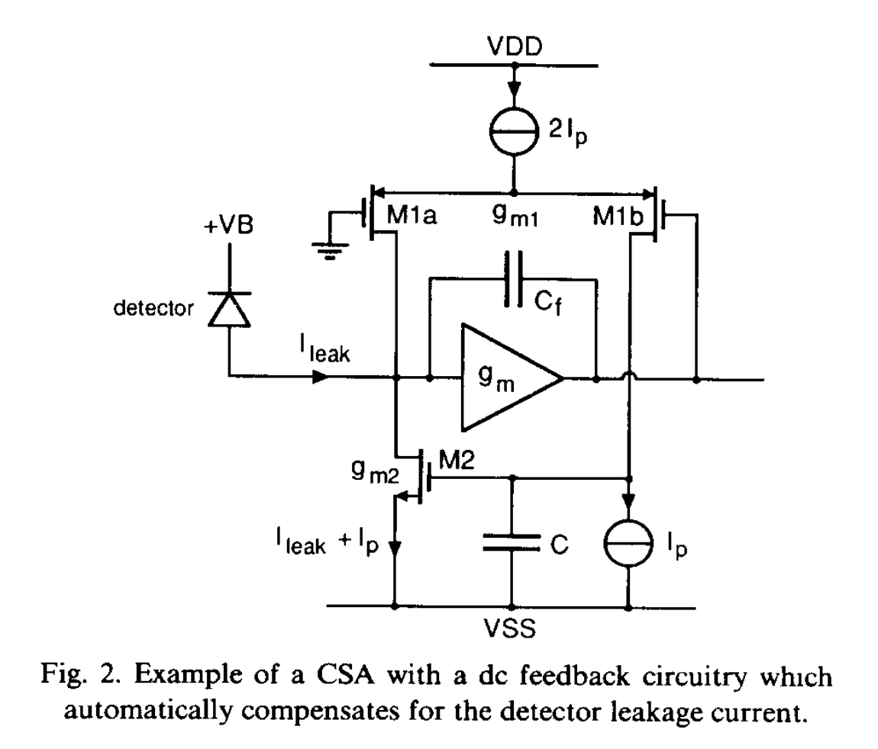
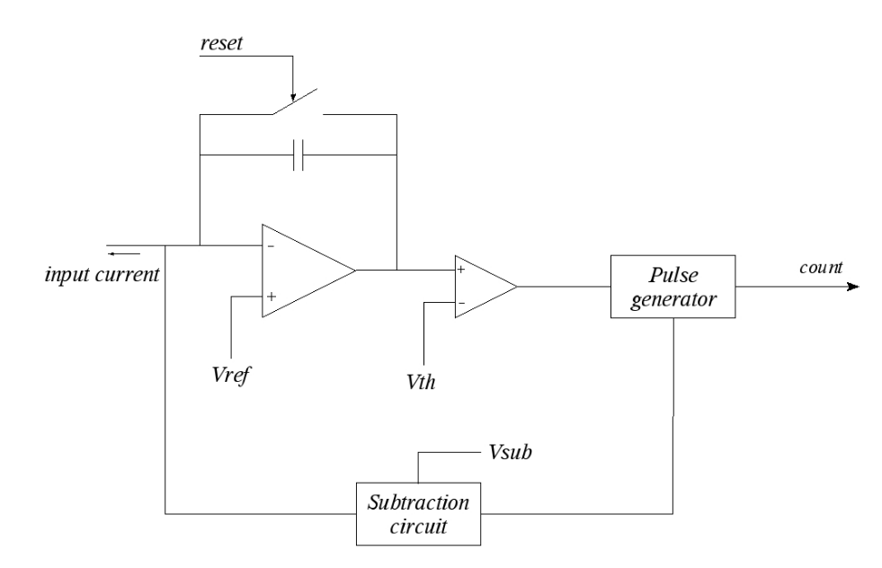
Implementation
Typical circuit for single particle detection. Current pulses are detected, dark current is suppressed.
Circuit used for ionization chambers at clinical rates: DC current is measured using a current-to-frequency converter.
Integrator
F. Krummenacher, “Pixel detectors with local intelligence: an IC designer point of view,” NIM A vol. 305, no. 3, pp. 527–532, Aug. 1991, doi: 10.1016/0168-9002(91)90152-G.
G. Mazza et al., “A 64-channel wide dynamic range charge measurement ASIC for strip and pixel ionization detectors,” in IEEE Symposium Conference Record Nuclear Science 2004., Oct. 2004, pp. 964-968 Vol. 2. doi: 10.1109/NSSMIC.2004.1462367.
5

Slide 6
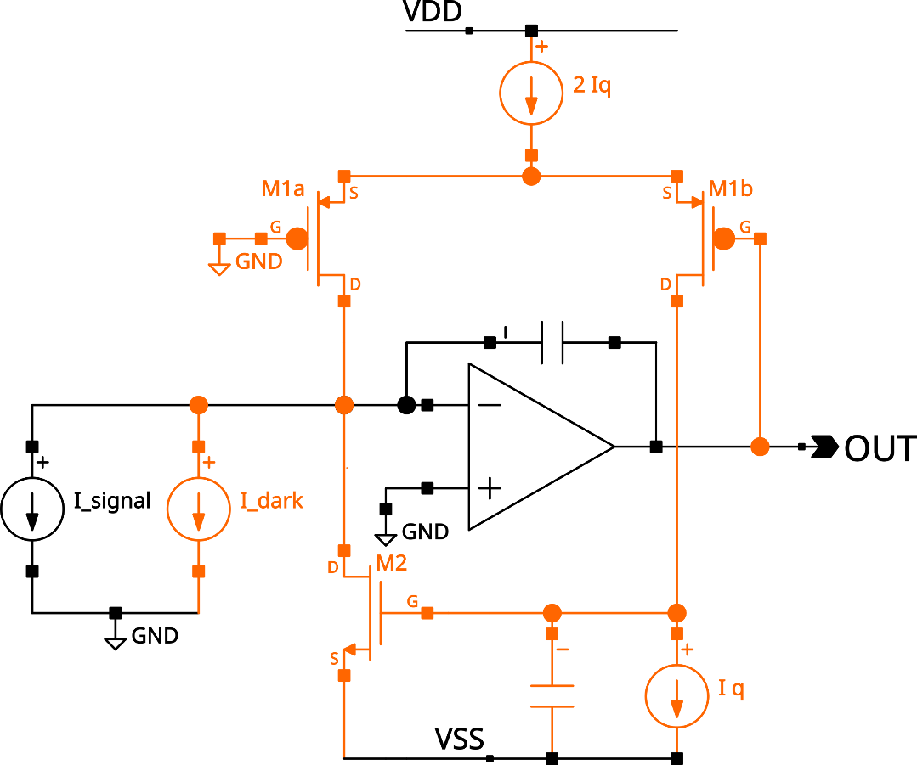
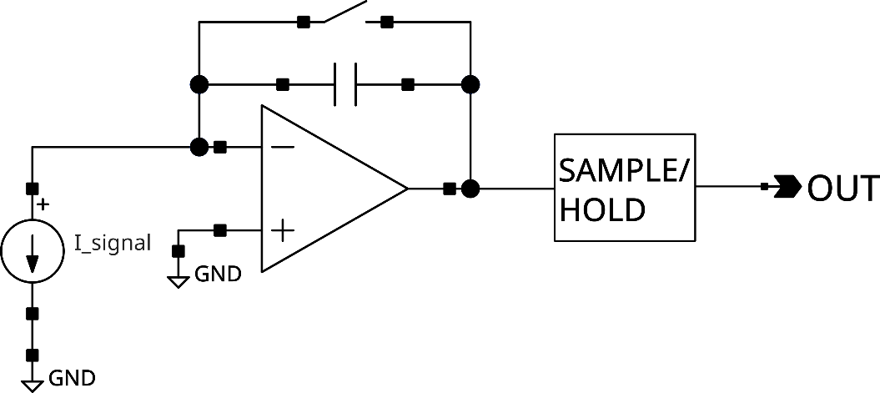
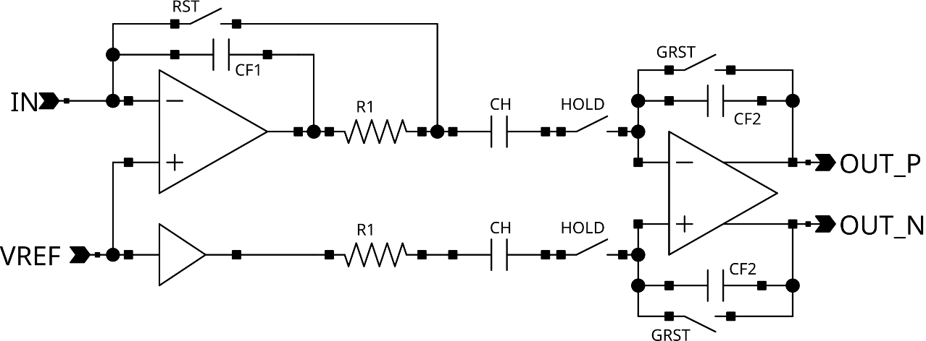
Implementation
Orange parts are for dark current compensation. Can we get rid of the dark current of our sensors?
Without dark current, we can use the same circuit for single particle detection and current measurements.
Commercially available circuit. AD8488 contains 128 channels plus multiplexer.
6

Slide 7
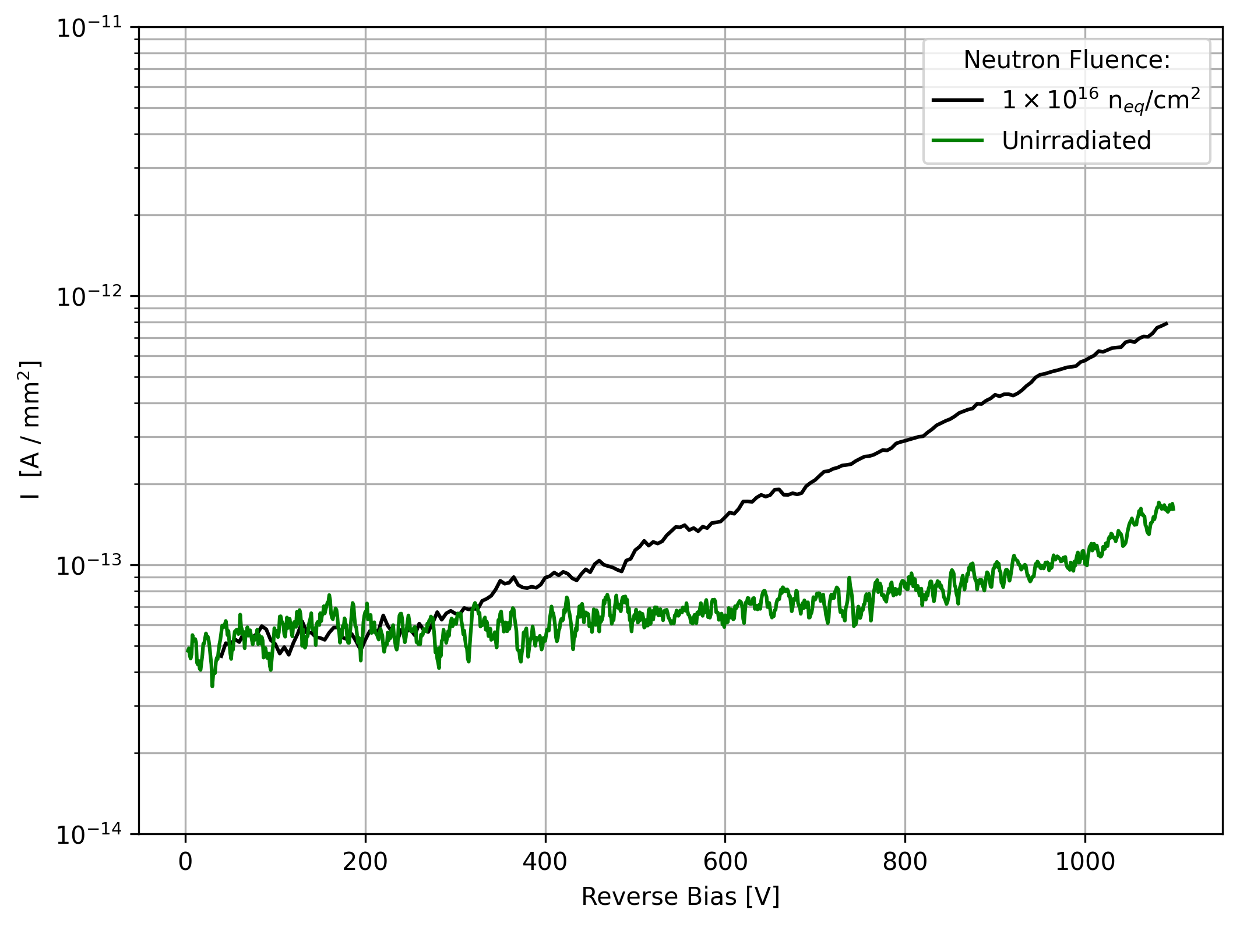
How to eliminate the dark current? Use SiC!
Current measured using a 3x3 mm², 50 um thick SiC detector obtained from CNM
For 1 MeV equivalent Neutron fluences up to 10¹⁶ SiC has a darkcurrent is below 1pA/mm²
7

Slide 8
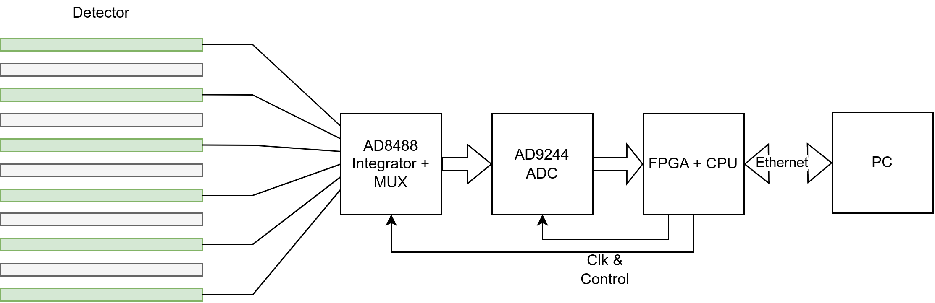
No Need for an ASIC: AD8488 as Frontend
Input referred noise: 993 electrons/sample (at 38pF input capacitance)
128 input channels integrator with integrate/hold and MUX elements
Up to 37 kHz sampling rate (> 12µs integration, 15µs readout)
Selectable amplification. Full range current from +/- 3.6 nA To +/- 1.8 µA
8

Slide 9
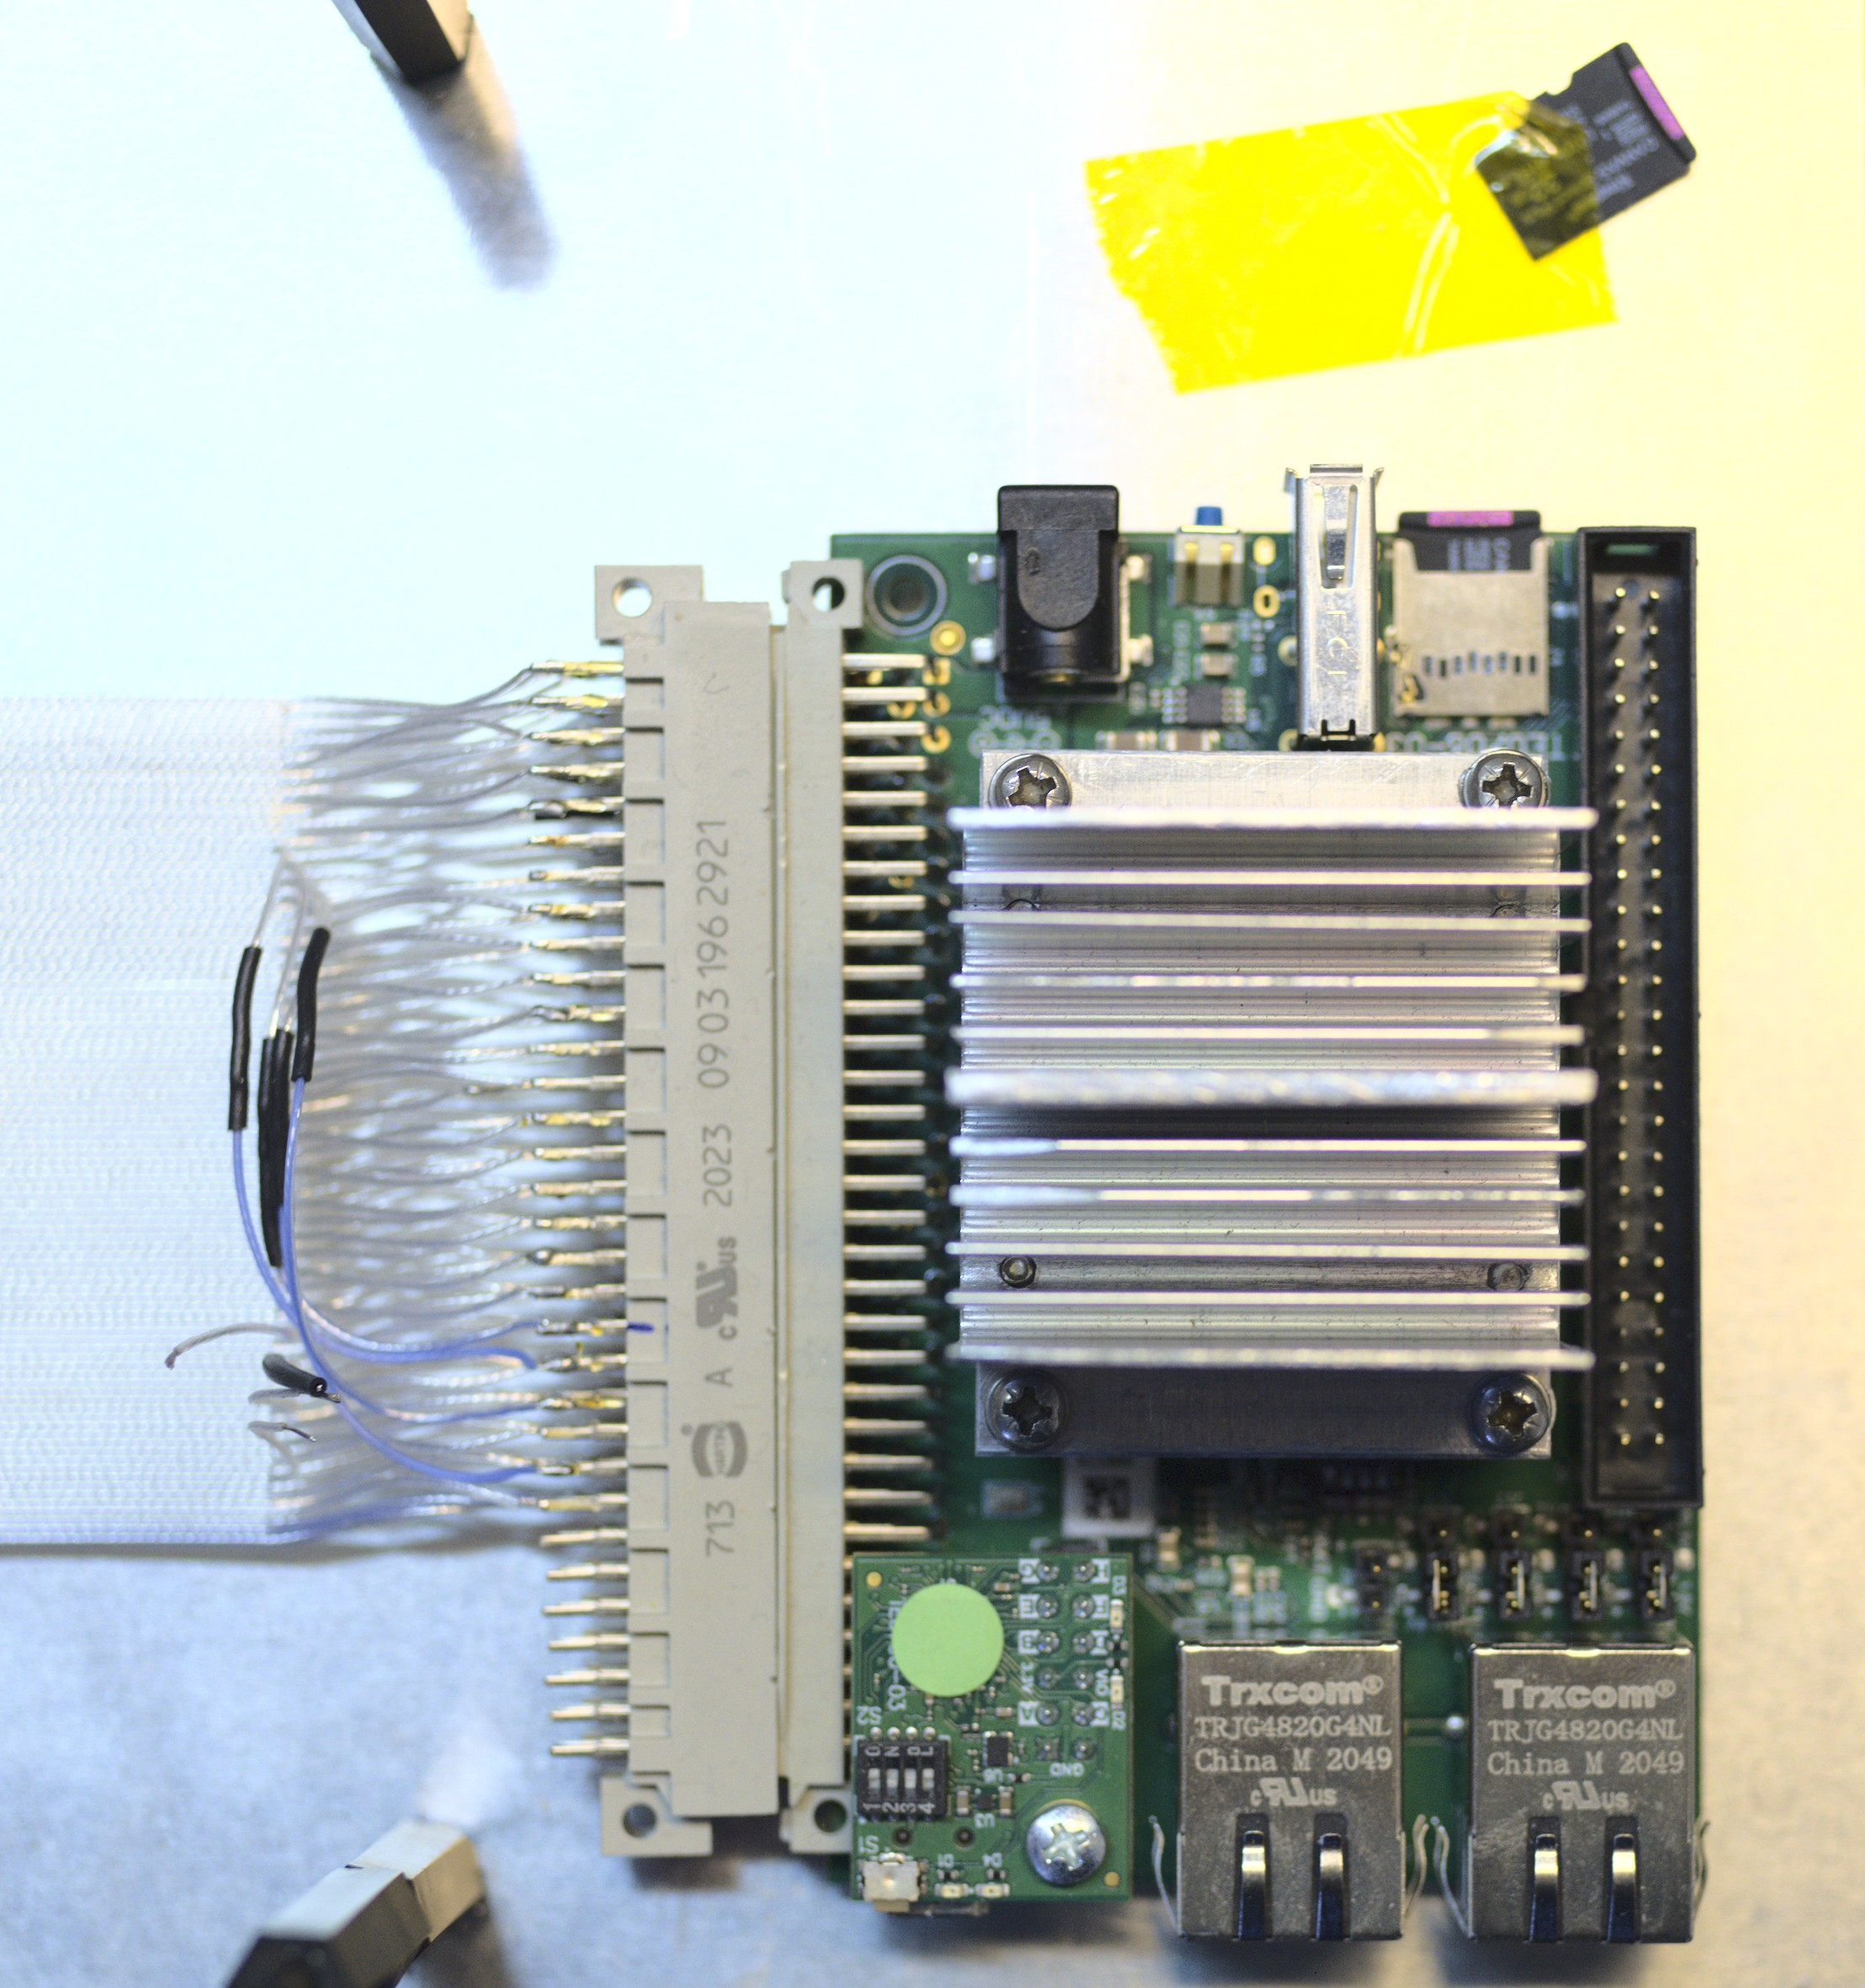
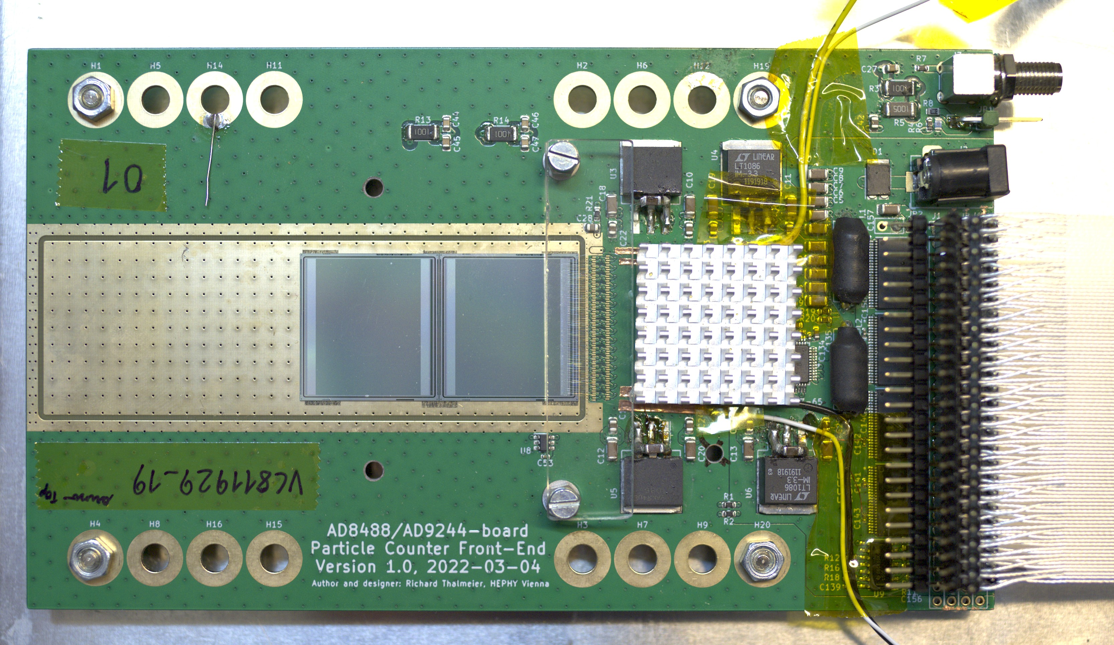
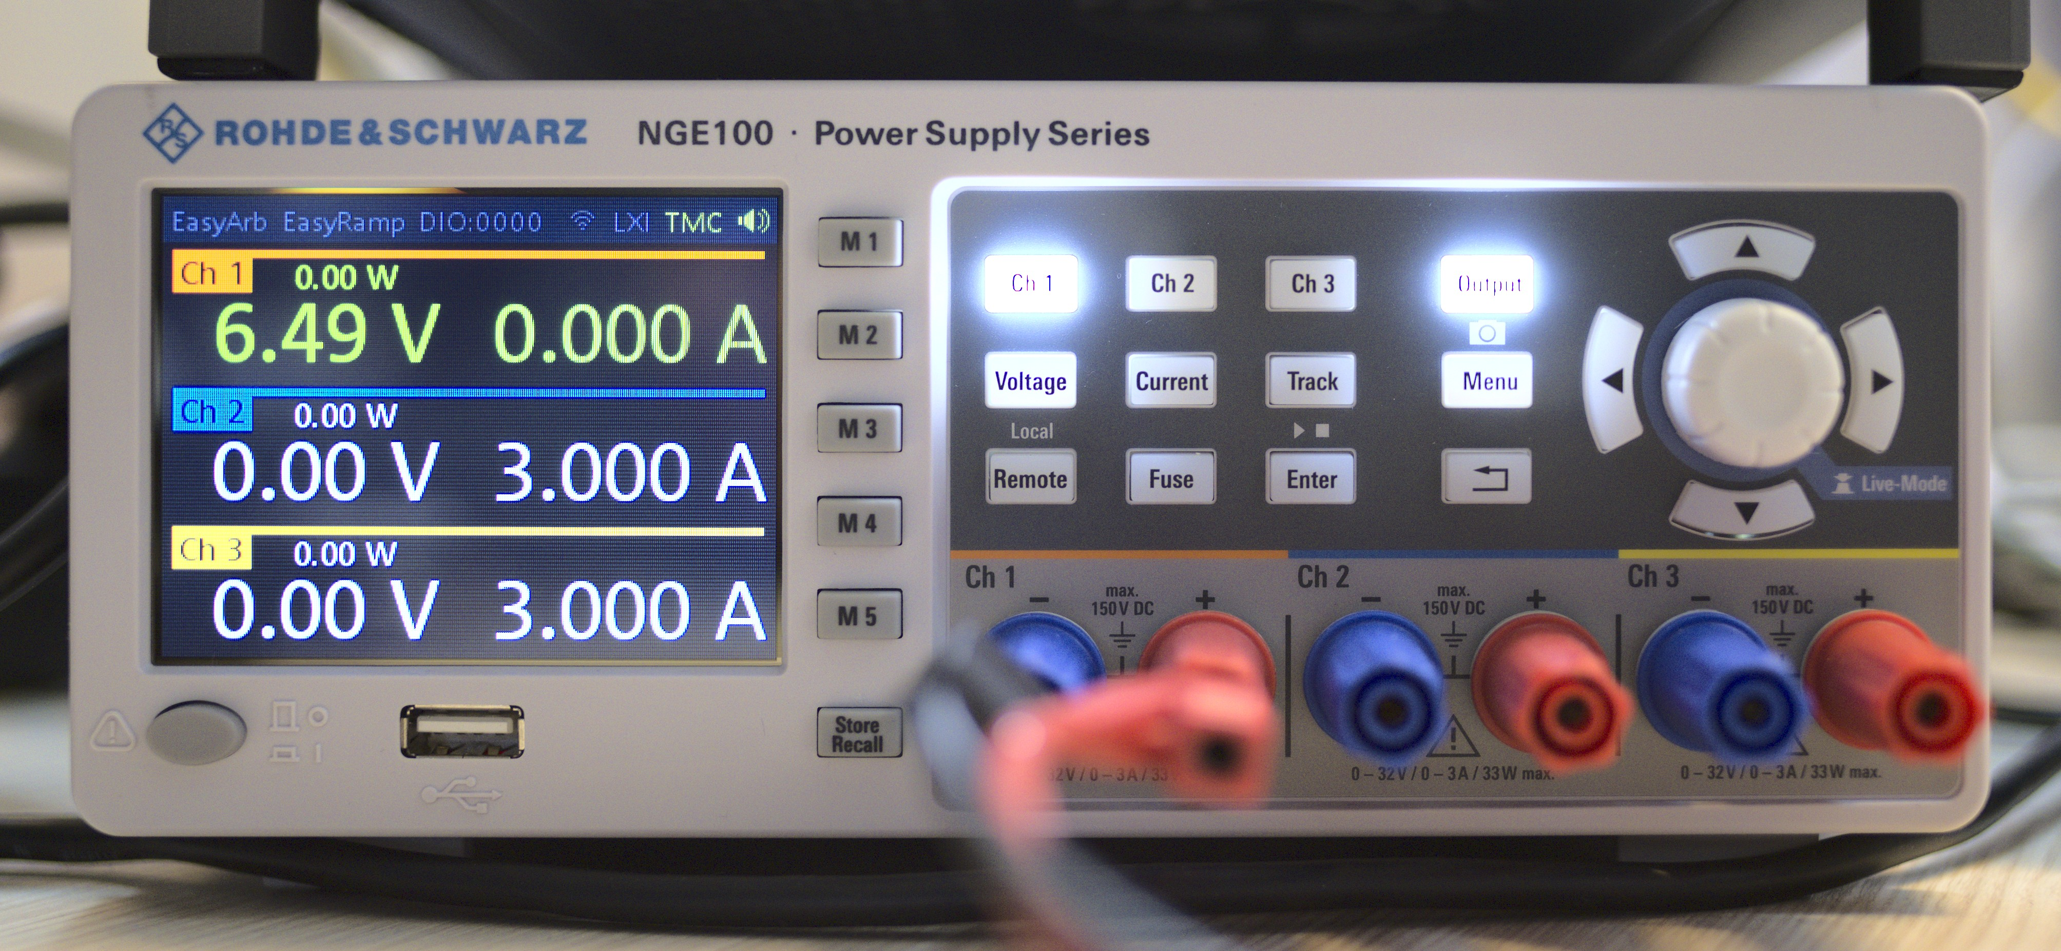
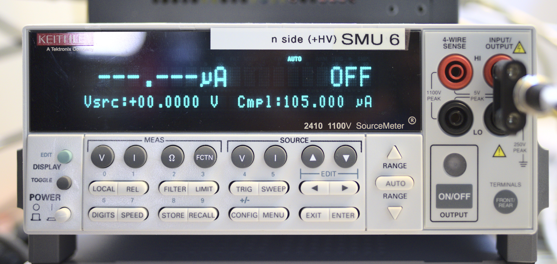
Prototype Measurement Setup
Other firmware
Detector: Silicon or SiC
AD8488
AD9244 ADC
Trenz TE0820 FPGA board (Zync Ultrascale+ FPGA)
Firmware
Data Out
LV Supply
HV Supply
9

Slide 10
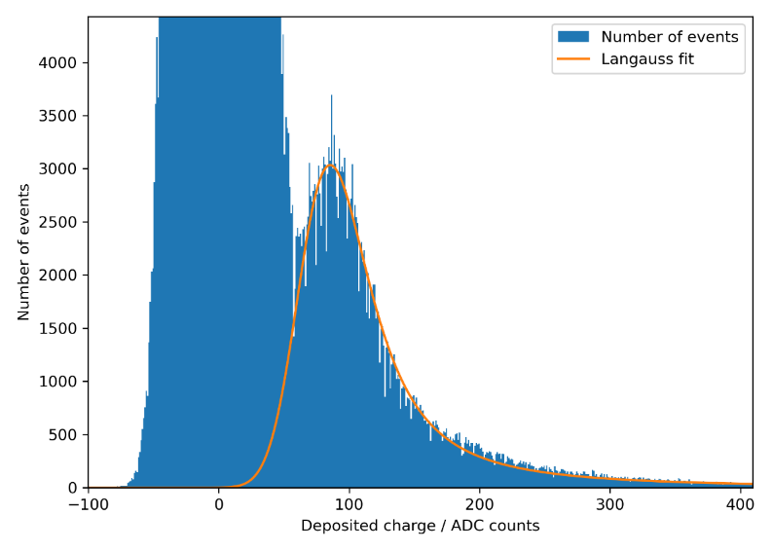
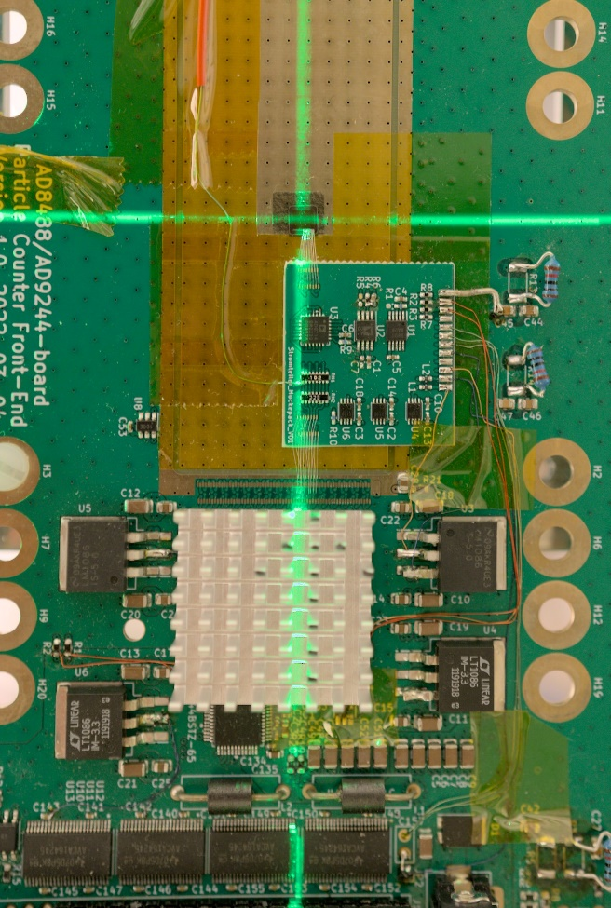
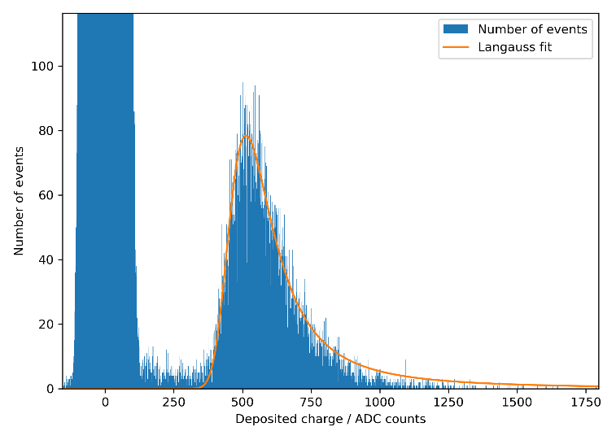
Single Particle Detection
800 MeV protons single particle detection using SiC detector with 50 µm epi. SNR: 4.7
Improvement is expected from the new wafer run using SiC with 100 µm epi.
SiC strip detector
Noise
Signal
Charge to voltage converter
62.4 MeV protons single particle detection
Noise
Signal
10

Slide 11
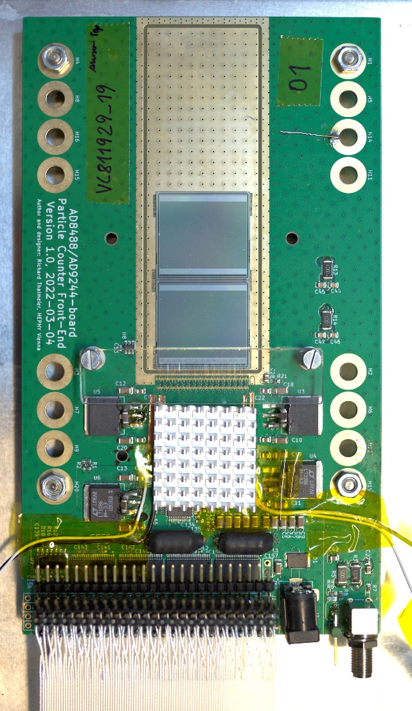
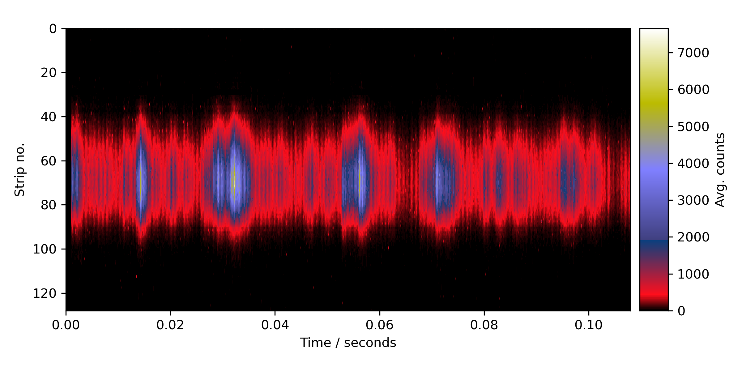
Clinical Beams: Cross-Section
Proton 252.7 MeV, full rate
Using a silicon sensor due to lack of large SiC sensors
11

Slide 12
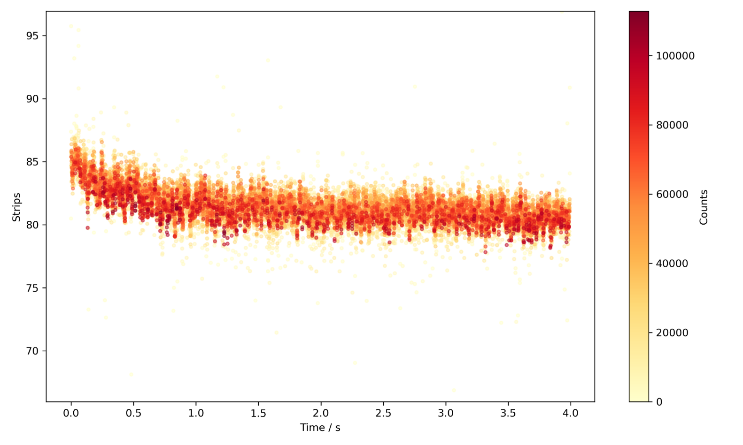
Clinical Beams: Center of Mass
Center of mass, 402MeV carbon, resampled to 3.7kHz
Using a silicon sensor due to lack of large SiC sensors
12

Slide 13
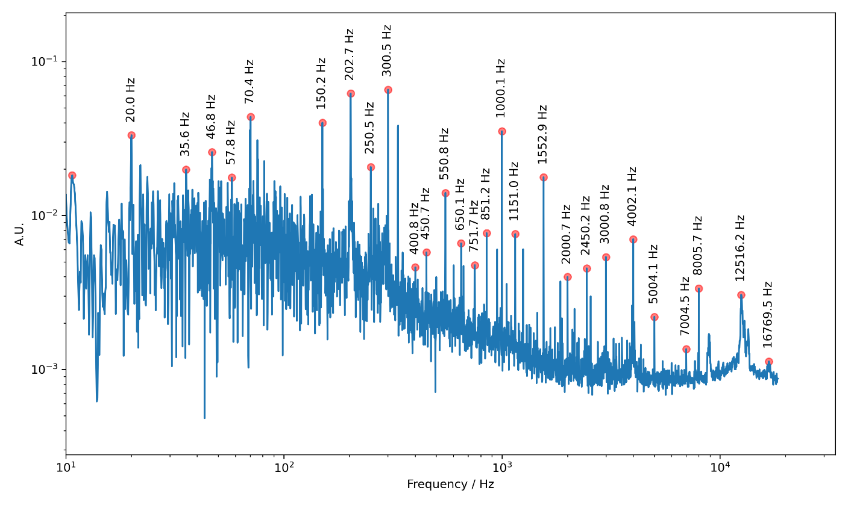
Clinical Beams: Center of Mass, FFT
Fourier transform of the center of mass,
Protons 62.4 MeV, full rate
13

Slide 14
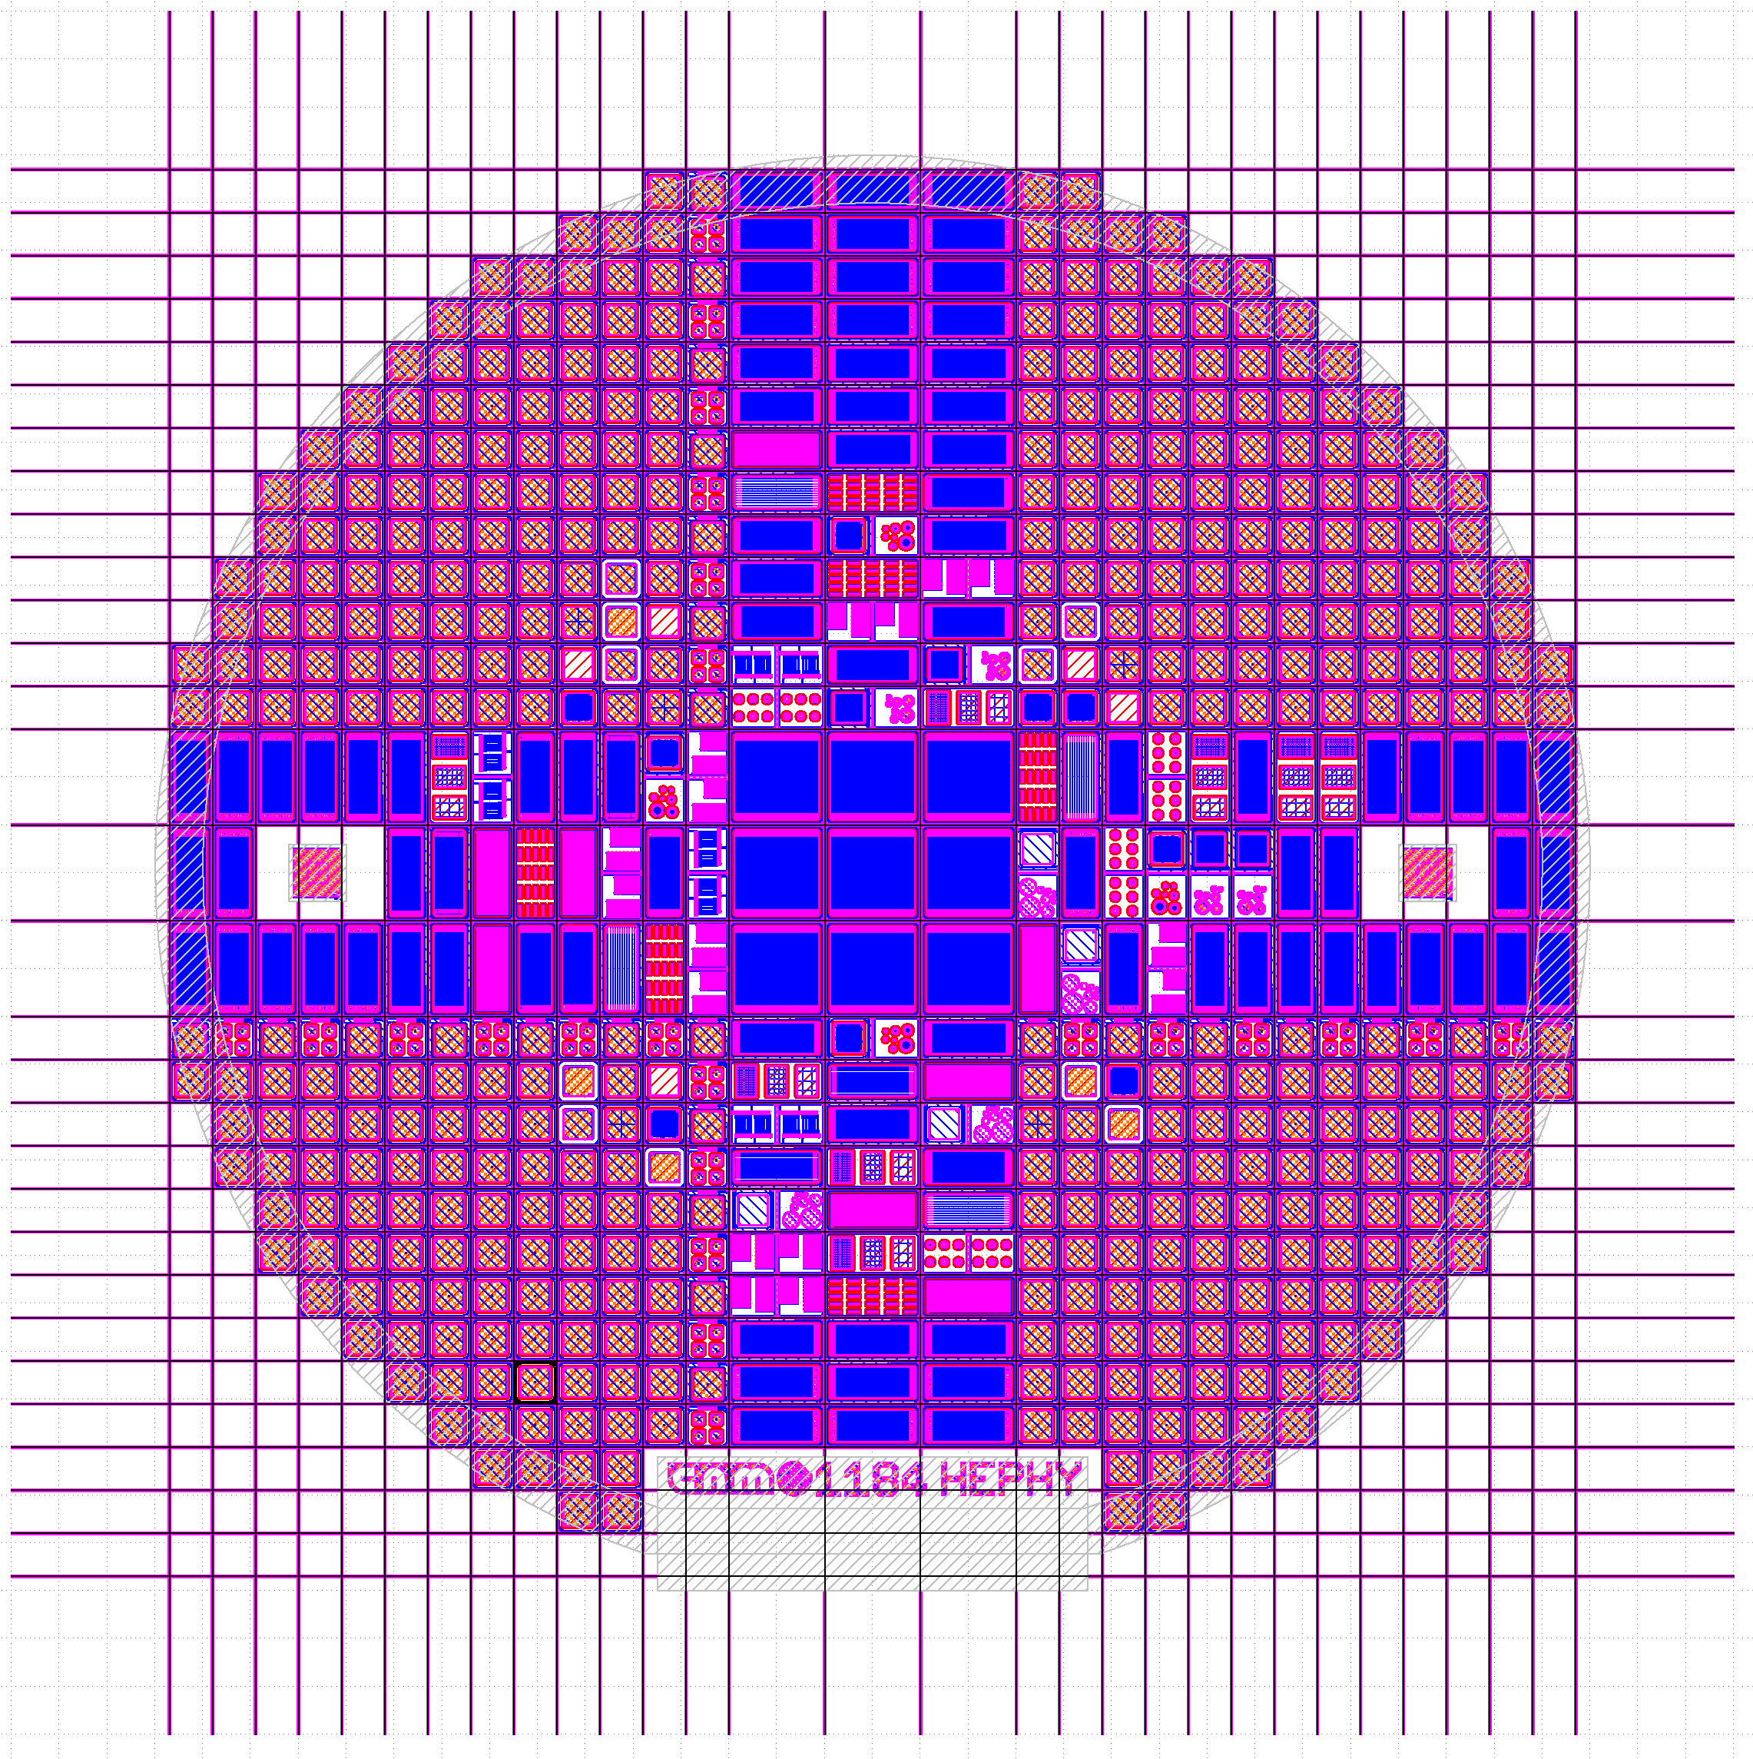
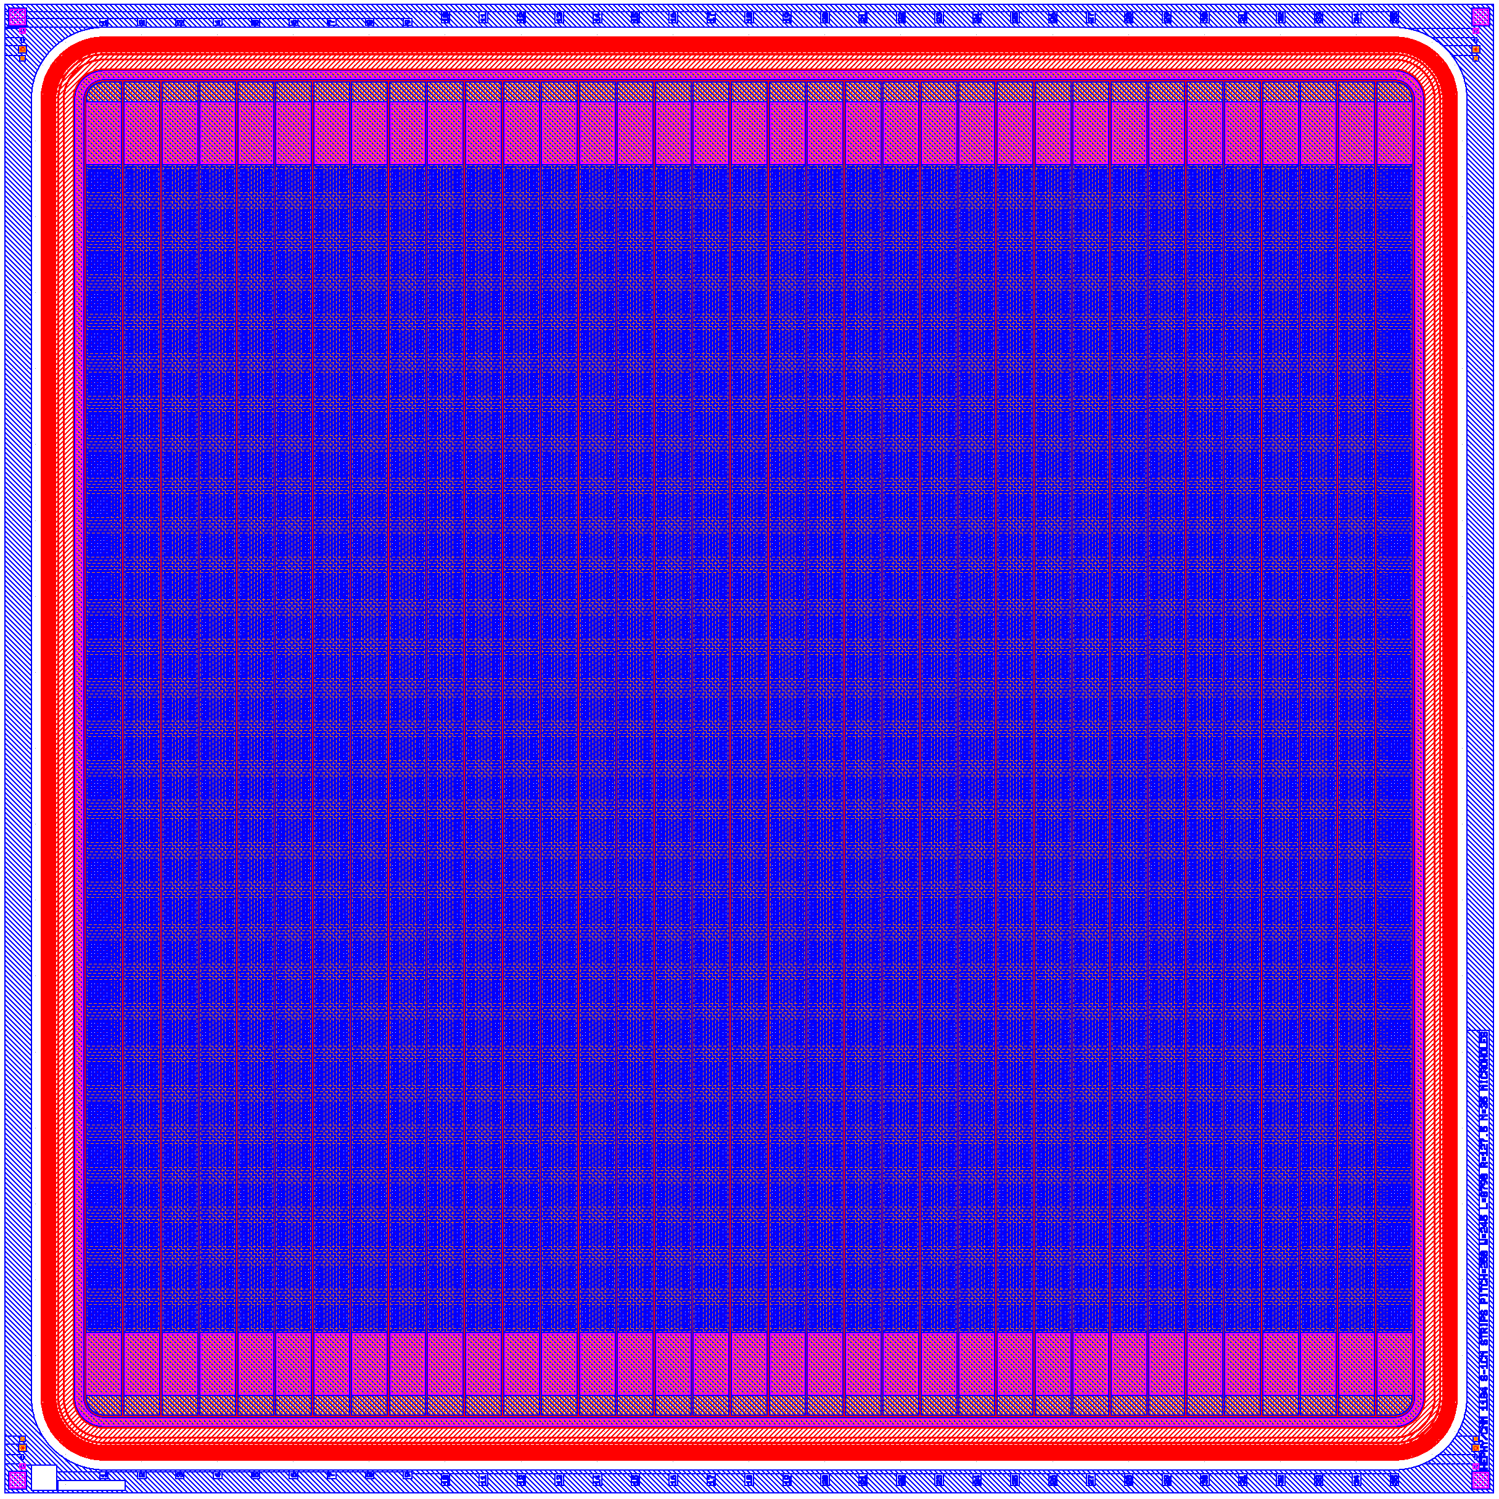
Prototype SiC Production Run
Sensor Demonstrator:
35 strips
Pitch: 250µm
Die area 1x1cm².
Guard structure has been optimized for high voltages using TCAD.
~300 pcs. pad detectors (various shapes): main vehicle for radiation hardness tests.
9 strip detectors 1x1 cm²
~70 smaller strip detectors 1x0.45 cm² in various shapes.
Structures for characterizing the process.
14

Slide 15
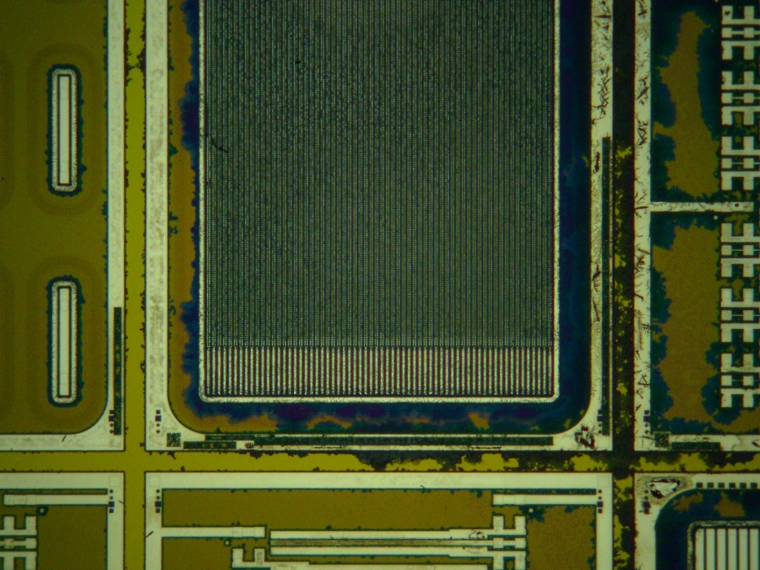
Prototype SiC Production Run
Tapeout in May 2023
Production by CNM
The first production run finished in the spring of 2024. No strip sensors were working due to metallization issues.
Process was modified adding an additional mask.
A second production run is ongoing.
Appeal to the community: There is a lack of SiC manufacturing capacity!
15

Slide 16
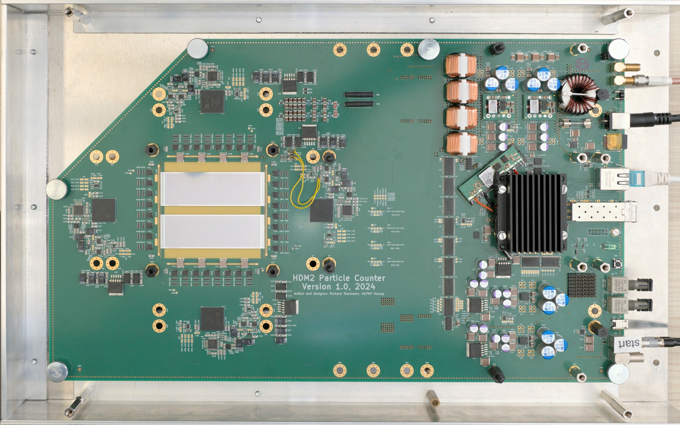
Full size device
Attenuators
Analog frontend
Detector Bias
24V power supply
Micro SD card for firmware
Ethernet for data and control
Sensor area
FPGA
SFP+ interface for future use
Analog frontend
Analog frontend
IO ports for future use
Analog frontend
Trigger interface for synchronization
16

Slide 17

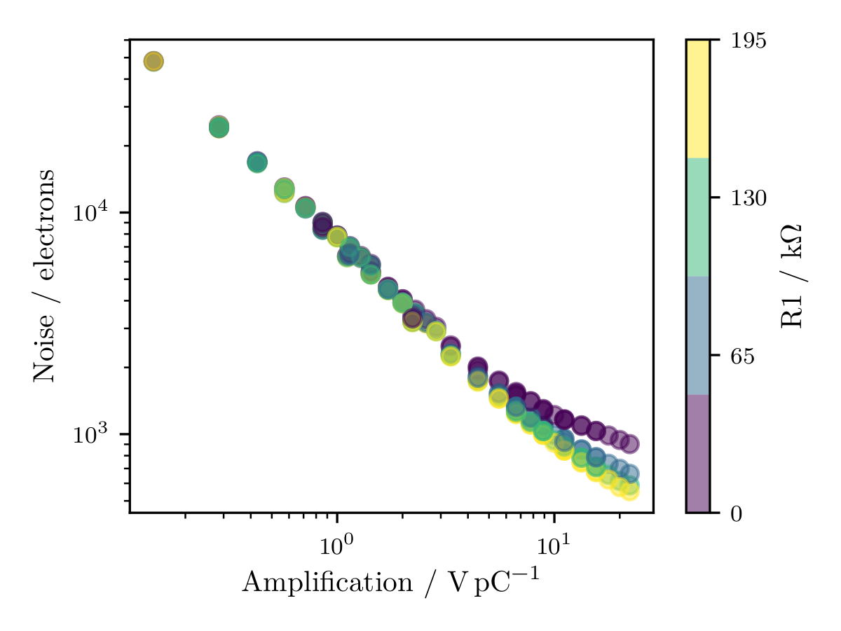
Full Size Device: Noise Performance
Can reach the same noise performance as 1st prototype.
ENC down to 600 e- allows for single particle detection
Attentuator array should extends input currents up to around 36 µA (To be tested).
17

Slide 18
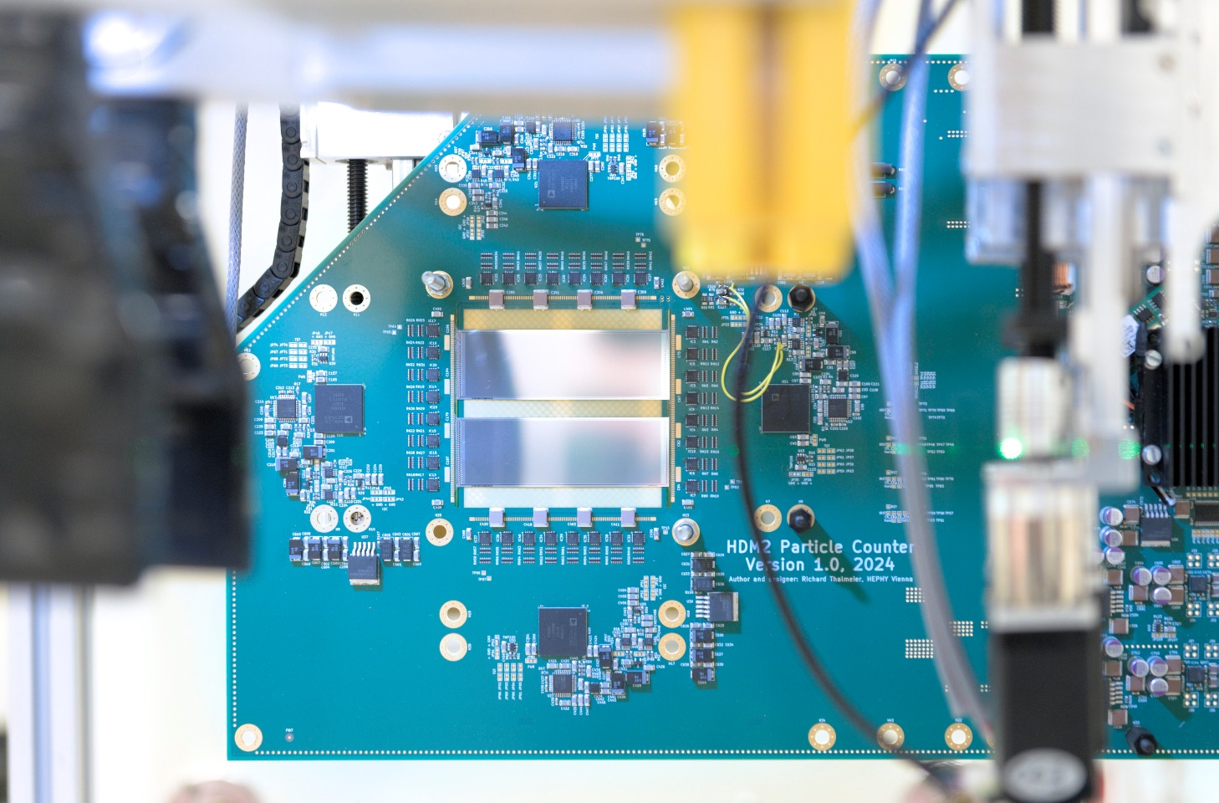
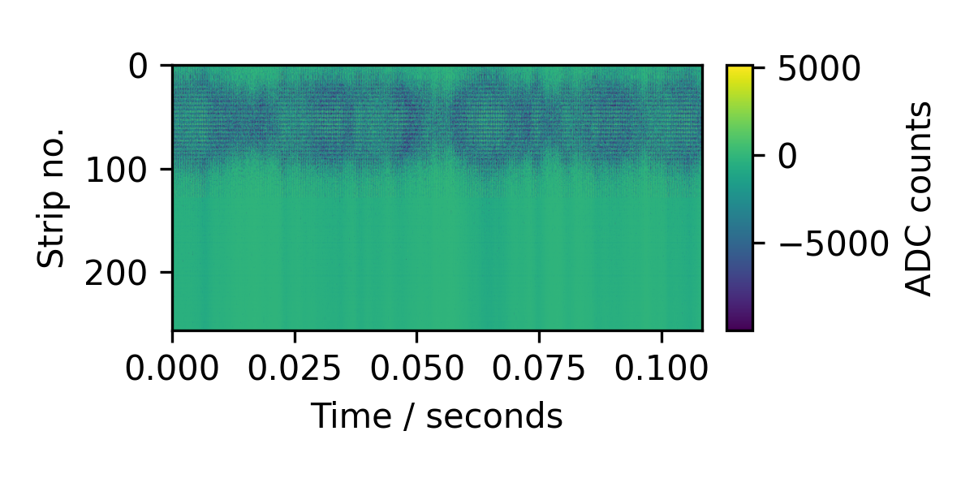
Full size device
First beam tests successful (using silicon sensors).
Some tweaking of the biasing circuit and improved software are still needed.
Need SiC sensors!
Below a 120 MeV carbon ion beam.
Full-size device mounted for testing at the MedAustron facility.
18

Slide 19
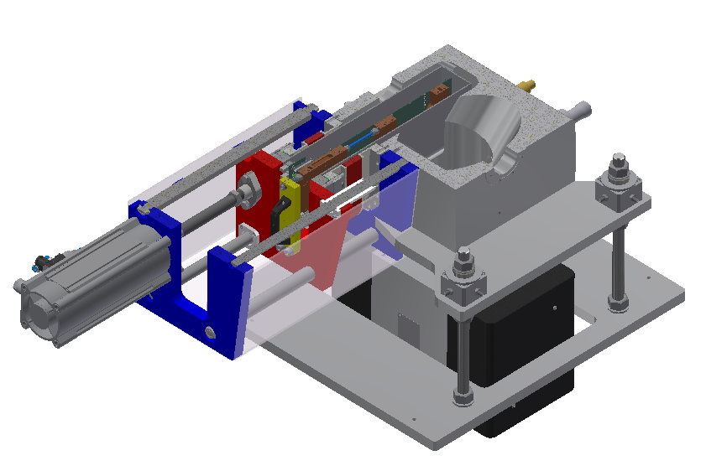
Feature Summary
512 channels readout (256 per direction)
0.25 mm channel pitch, total area 6.4 x 6.4 cm²
Configurable frontend amplification:
  Odd channels: Full range current from +/- 3.6 nA to +/- 1.8 µA
  Odd channels: ENC down to 600 e- for single particle detection
  Even channels: Full range current up to +/- 36 µA
37 kHz sampling in synchronous, 74 kHz in interleaving mode
Data and control signals transferred via TCP/IP for easy accelerator integration
Loss-less compression in FPGA reduces data rate
Insertion mechanism is being designed
19

Slide 20
Conclusions
The low dark current of Silicon Carbide simplifies the sensor readout circuit.
Using commercial off-the-shelf (COTS) components an ENC down to 600 e- and full range up to +/- 1.8 µA or even +/- 36 µA was attained.
Single particle detection was demonstrated, and beams at clinical rates were characterized.
Full-size demonstrator available. Beam-line insertion mechanism is being designed.
The unavailability of SiC sensors currently prevents the final device from being manufactured in the facility.
There is a lack of SiC manufacturing capacity!
20

Slide 21
Thank you for your attention!
simon.waid@oeaw.ac.at

Slide 22
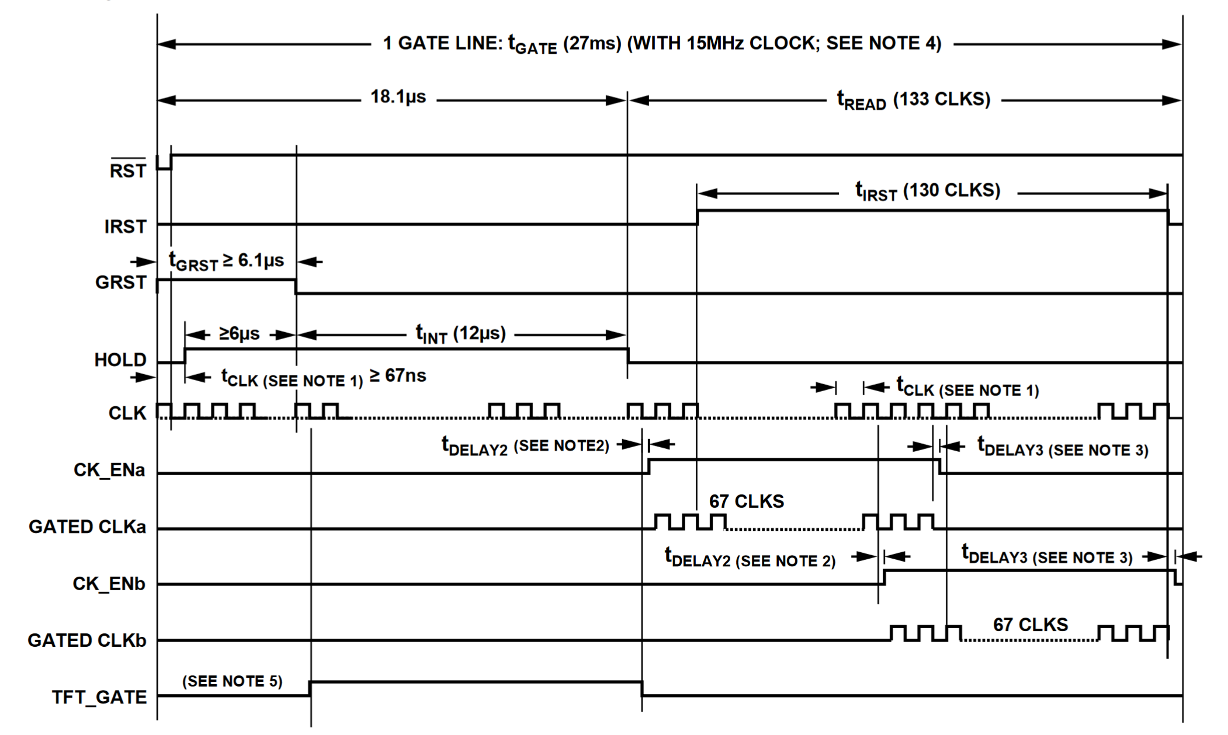
Readout

Slide 23
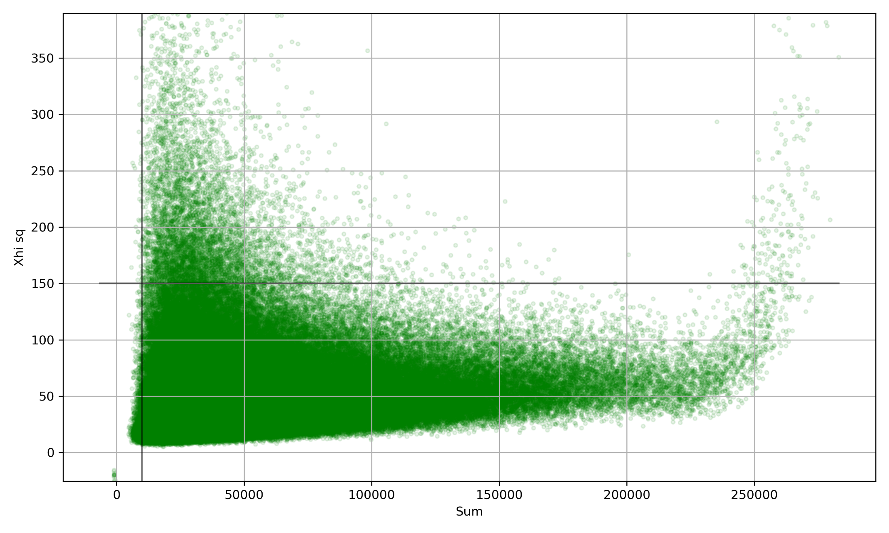
Searching for Saturation
252.7 MeV, filtering using test
Detector saturation
Noise dominates
Assume beam is Gaussian
Calculate center of mass, standard deviation and amplitude; Perform χ² test.

