Slide 1




Observation of bias-dependent position flipping of the electric field maximum in in neutron irradiated SiC diodes
20th Workshop TREDI, Trento, February 4, 2025
J. Duarte, M. Fernández, E. Navarrete, I. Vila Álvarez, D. Rosich,
C. Quintana
Instituto de Física de Cantabria (CSIC-UC)
R. Montero
Universidad del País Vasco

Slide 2
Outline
Setup and sample description
Brief recall of previous results of irradiated samples
TPA-TCT signal multiplication
Electron and hole lifetimes
Electric field study of the diodes after irradiation
Summary

Slide 3
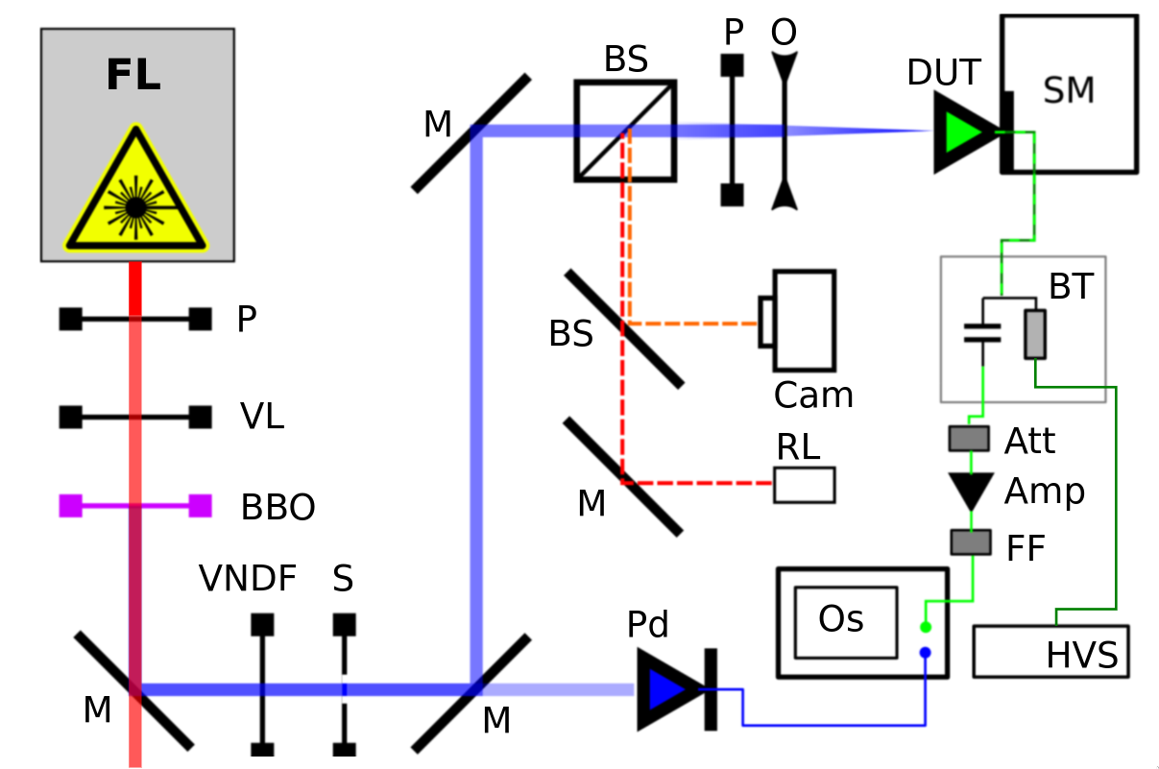
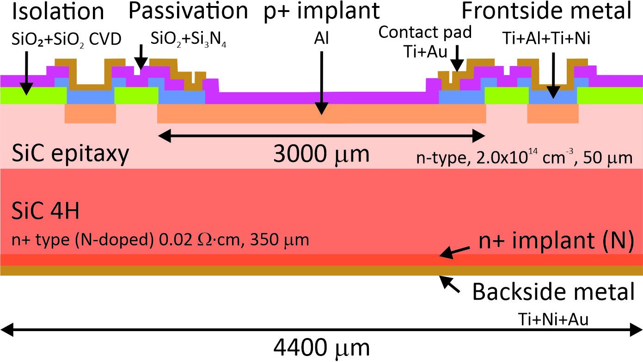

TPA-TCT setup and SiC samples
Samples:
IMB-CNM SiC planar pad diodes P in N
Non metallized top contact for laser illumination
Sample 1MW2 - non-irradiated
Sample F2W1 - 10¹⁵ n_{eq}/cm² at ATI in Vienna
TPA-TCT setup

Slide 4
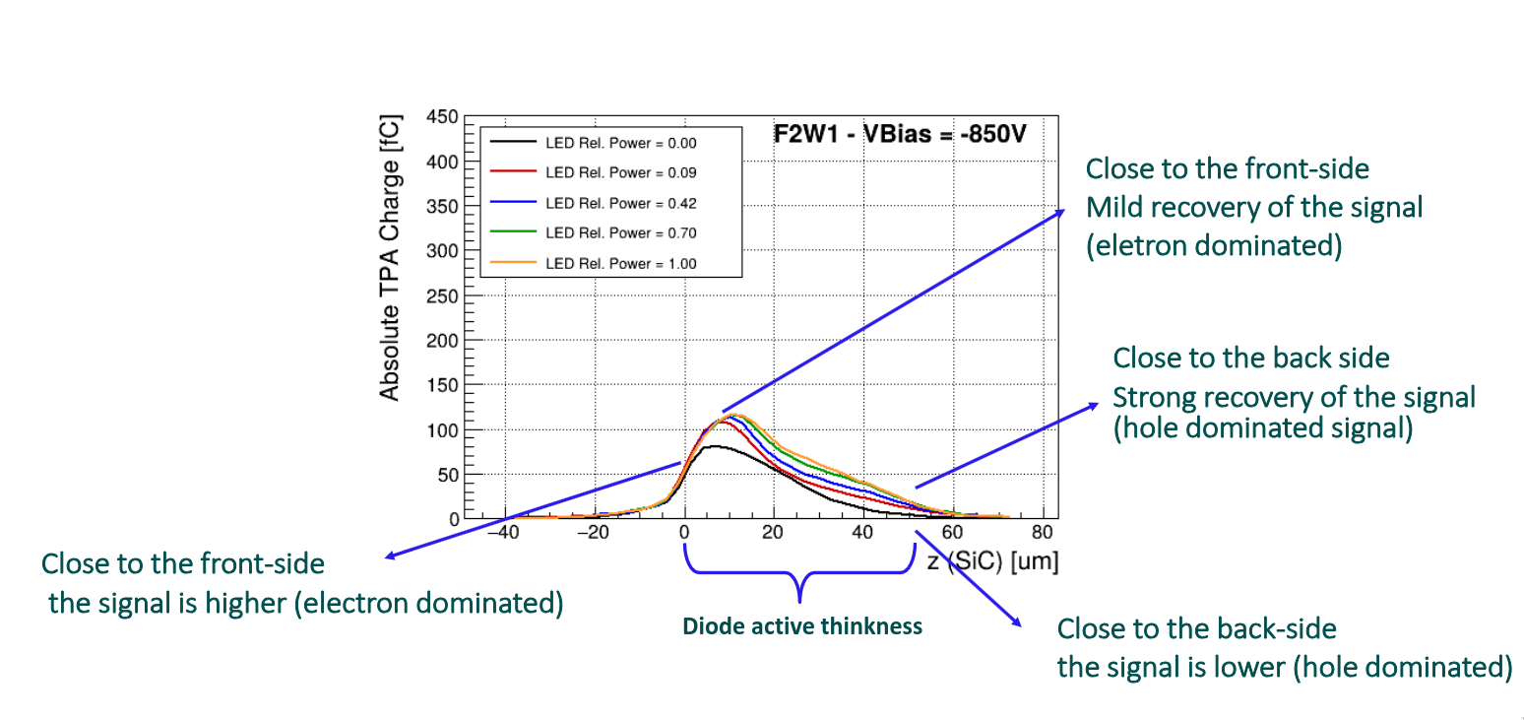
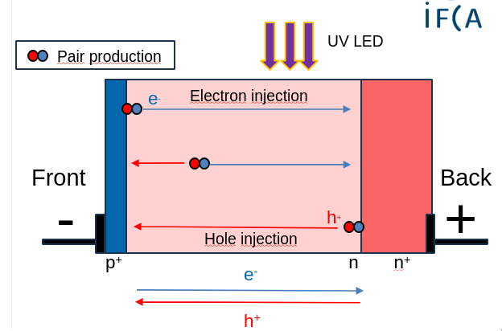
Optical injection in irradiated sample - reverse-biased operation
Irradiation significantly reduces the hole lifetime compared to the electron lifetime

Slide 5
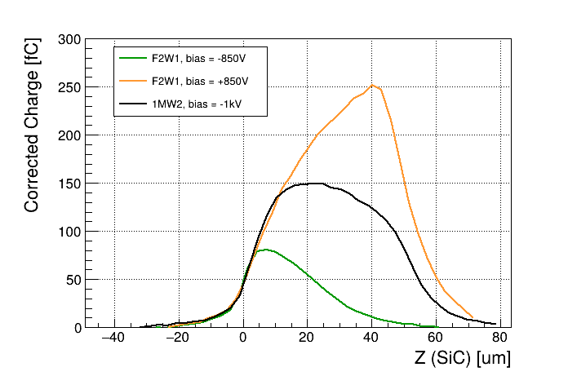
Charge multiplication in forward-biased irradiated sample
TPA-TCT z-scan of fresh and irradiated samples
Charge multiplication
Fully depleted after irradiation
Trapping on irradiated samples
Multiplication
Forward-biased irradiated
Reverse-biased fresh
Reverse-biased irradiated
Diode active thickness

Slide 6
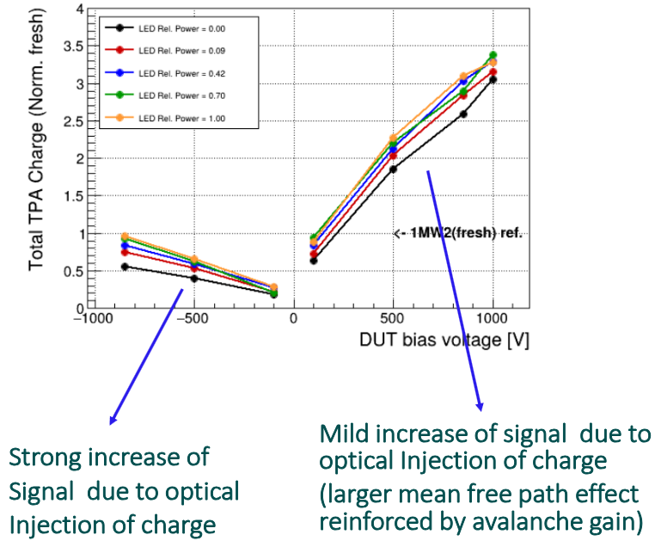
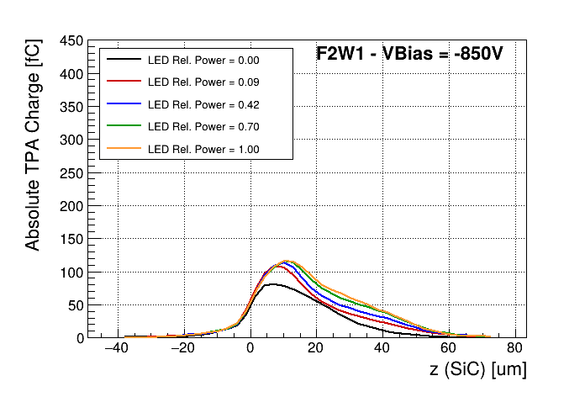
Forward-reverse comparison and signal recovery/multiplication
Hipothesis: Hole traps are to be partially filled by the (large) forward current, dominated by holes. Therefore, the optically injected carriers are not expected to have a significant impact on the signal.

Slide 7
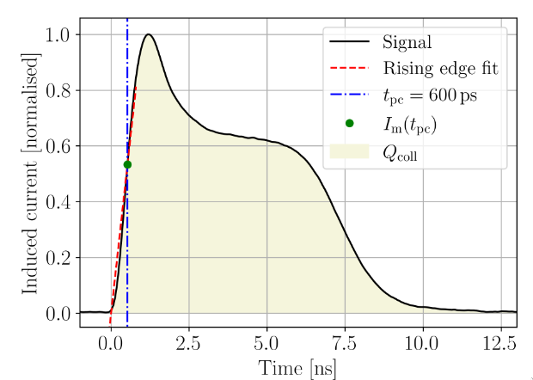

Electric field study
How could we explain the charge multiplication?
A possible answer: avalanche multiplication driven by a high electric field
For TPA-TCT:
Weighted Prompt Current method
Sebastian Pape Thesis - "Characterisation of Silicon Detectors Using the Two Photon Absorption – Transient Current Technique"

Slide 8
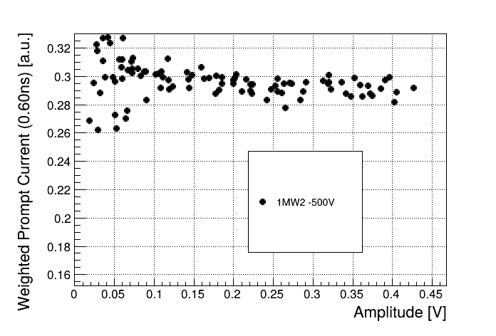
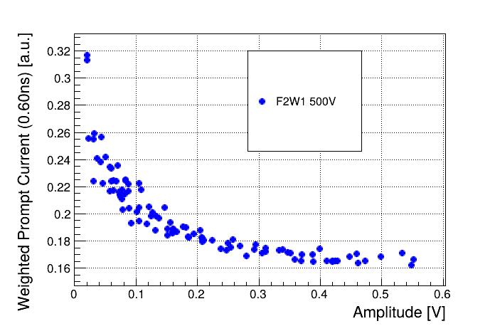
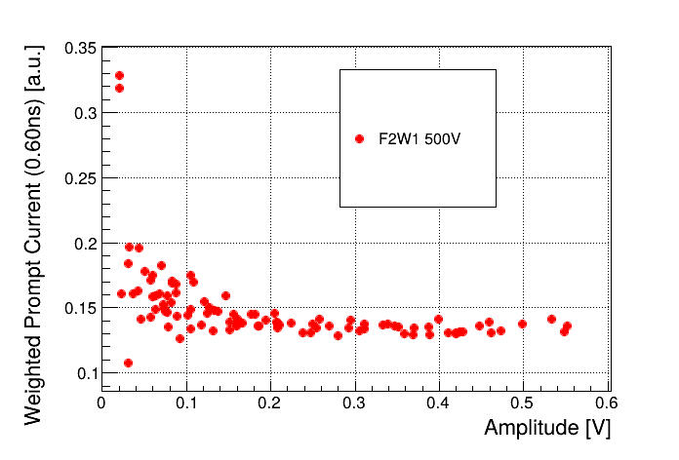
WPC as electric field estimator for irradiated samples
Intensity scan: Laser intensity is changed while focusing at the same depth (inside the sample). At that position the electric field does not change, so we would espect a constant WPC
Fresh Irradiated Irradiated SPA corr.
WPC strongly affected by the SPA component
Residual effects even after the SPA subtraction

Slide 9
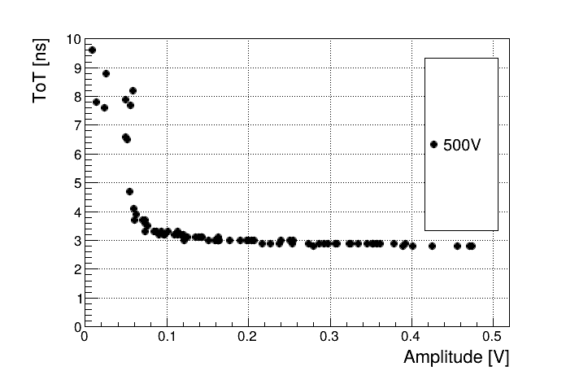
ToT as electric field estimator for irradiated samples
WPC of Irradiated SPA corr. ToT of Irradiated SPA corr.
No microplasma
=
No pulse duration broadening
ToT apears to be more robust than WPC against the changes in the signal amplitude

Slide 10
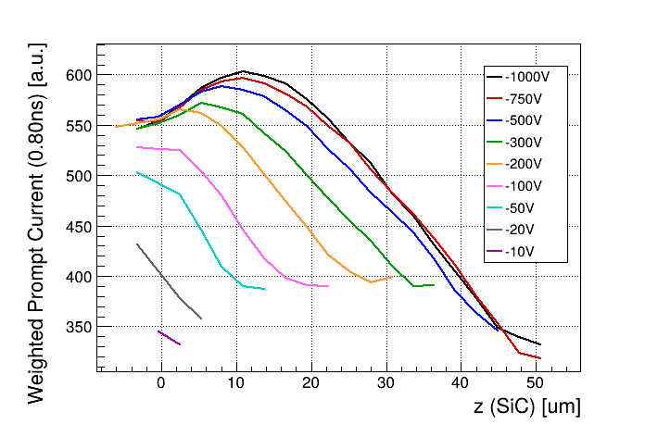
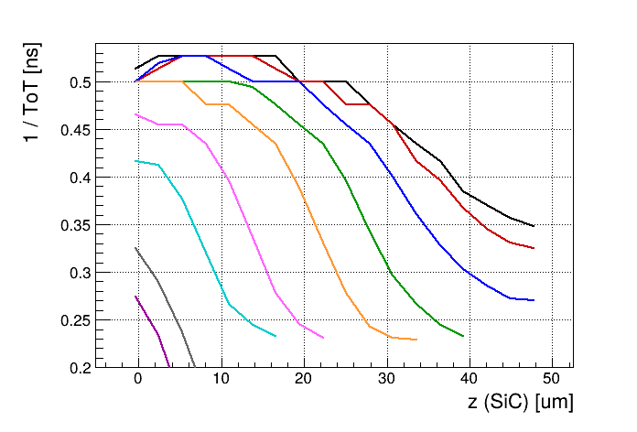
Electric field study on non-irradiated SiC sample: WPC vs 1/ToT
WPC 1 / ToT prop. To E field
SPA corrected
SPA corrected
1/ToT and WPC offer similar results, but 1/ToT seems to be less affected by systematics

Slide 11
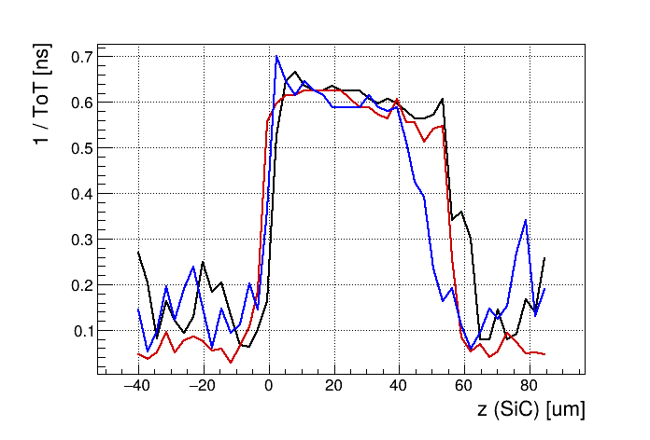

Electric field study on irradiated SiC sample: Reverse biasing
Under reverse biasing we have an increase of the electric field at front side
It seems compatible (kind of) with the behavior of a biased dielectric

Slide 12
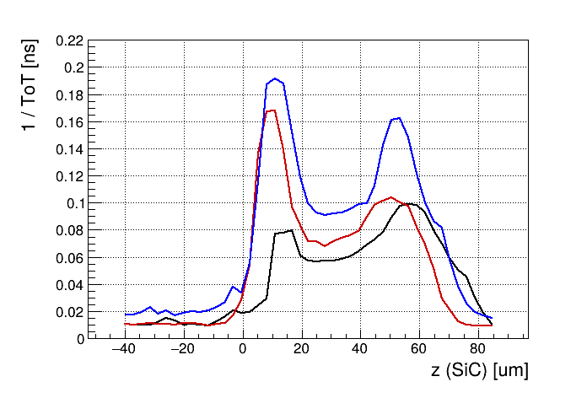
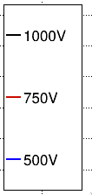
Electric field study on irradiated SiC sample: Forward biasing
Front peak maybe due to an artifact caused by low amplitude pulses
The higher the bias voltage the higher is the peak amplitude at the back side compared with the front side peak
The higher the bias the smaller electric field !!! (longer ToT)
1/ToT shows two peaks, and therir relation changes with bias voltage
As we increase the bias voltage signals seem to become more slower

Slide 13
Summary
We carried out the study of the electric field distribution on fresh and neutron irradiated pn SiC diodes to explain the observed signal multiplication
Electric field estimated using the 1/ToT method (more robust against SPA signal contamination)
Reverse bias (after irradiation): Presence of a stronger electric field at the front side
Forward bias (after irradiation): Presence of a back side peak whose amplitude relative to the front side peak increases with the bias

Slide 14
Backup

Slide 15
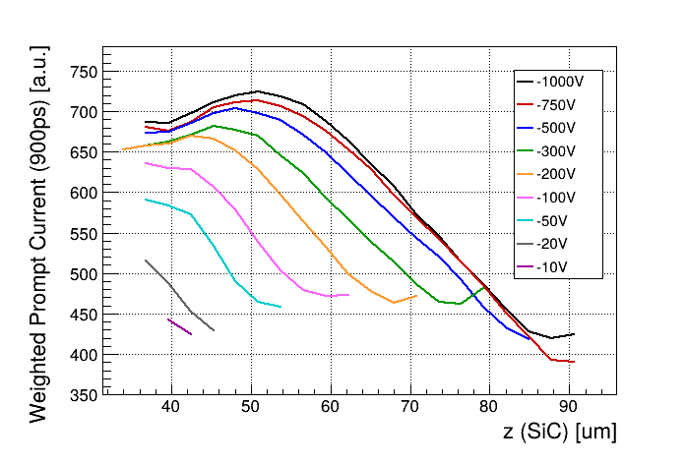
Electric field study on non-irradiated SiC sample
WPC
Front side
Drop or maximum shif in the WPC at surface
Extrange saturation effect

Slide 16
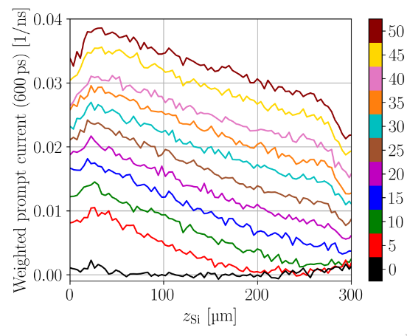
Electric field study on non-irradiated SiC sample
WPC
WPC – Silicon diode
Front side
Drop or maximum shif in the WPC at surface
Extrange saturation effect
^{Sebastian Pape Thesis}

Slide 17
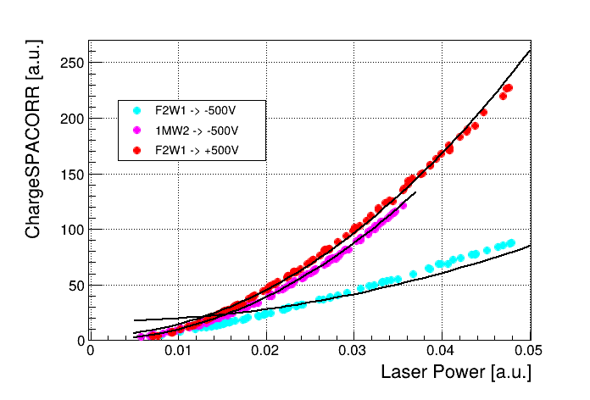
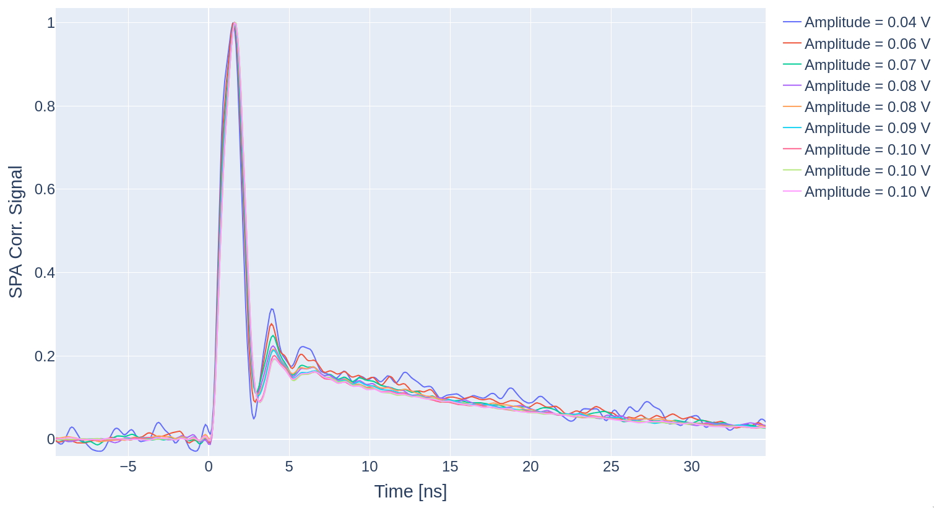
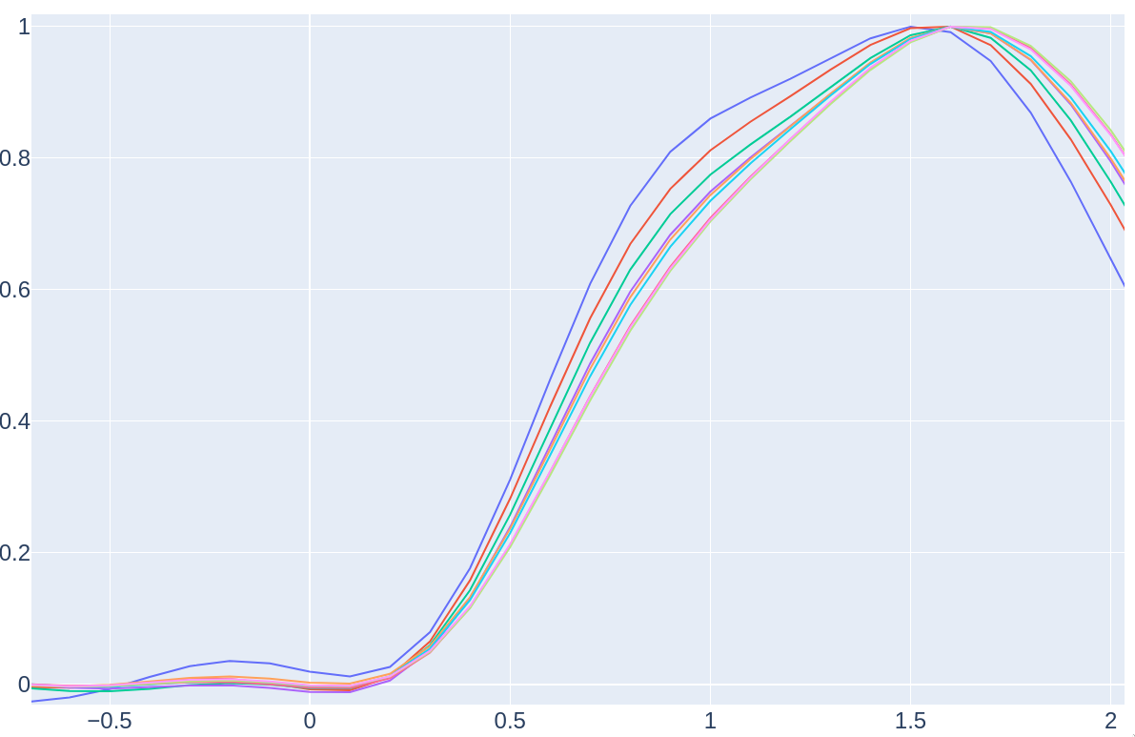
Plasma generation study
Three photon absorption
Two photon absorption
+500V
Pure quadratic fit
Plasma multiplication should decrease at higher electric fields
Irradiation damage should also decrease the plasma generation
Pulse energy should have an impact in the gain
No plasma effects can be appreciated in the signals of both, TPA and 3PA studies, nor in the relation between laser power and charge
No Plasma

Slide 18
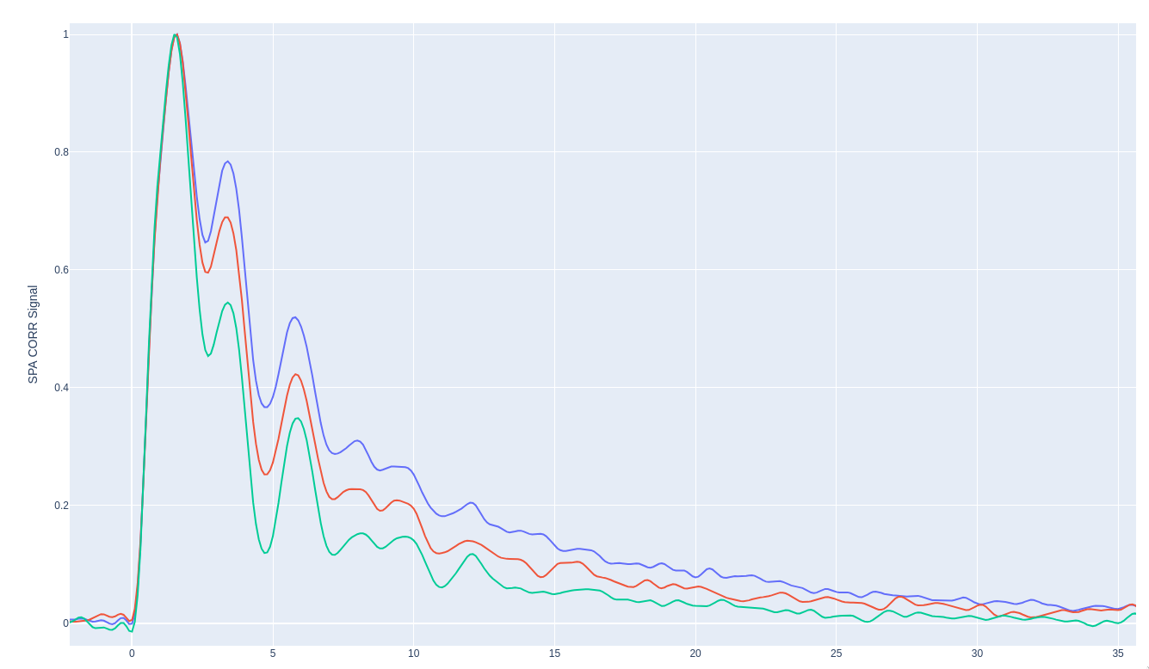
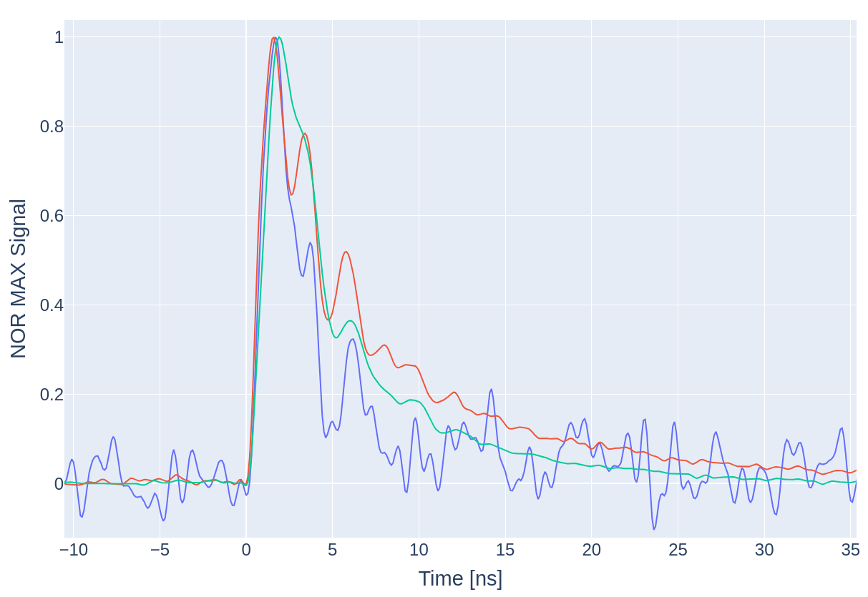
Forward biased irradiated sample WF comparison
Same position (mid) Same bias voltage (+1kV)
Front side
Mid
Back side
+500
+750
+1kV

