Slide 1
Technical Meeting on MQXFB07 Assembly:
Lessons learnt from previous magnets
P. Quassolo, S. Izquierdo, N. Lusa, S. Straarup, S. Triquet on behalf of all MQXFB team
11/09/2024
Technical Meeting MQXFB07 Assembly (September 11, 2024) · Indico (cern.ch)

Slide 2
Link to previous “lessons learnt”
A detailed description on the previous lessons learnt can be found in:
  Meeting held for MQXFB01:
  https://indico.cern.ch/event/971956/
  Meeting covering MQXFBMT3 experience:
  https://indico.cern.ch/event/1138192/
  Meeting held for MQXFB02:
  https://indico.cern.ch/event/1158577/
  Meeting held for MQXFB03:
  https://indico.cern.ch/event/1269409/
  Meeting held for MQXFB04:
  https://indico.cern.ch/event/1327153/
  Meeting held for MQXFB05:
  https://indico.cern.ch/event/1384769/
  Meeting held for MQXFB06:
  https://indico.cern.ch/event/1420904/
  Short recap provided in these slides, showing the main improvements.

Slide 3
Outline
Rods displacements, LVDT placement
Fibers drift
New keys 13.6 mm

Slide 4
Rods displacements, LVDT placement

Slide 5
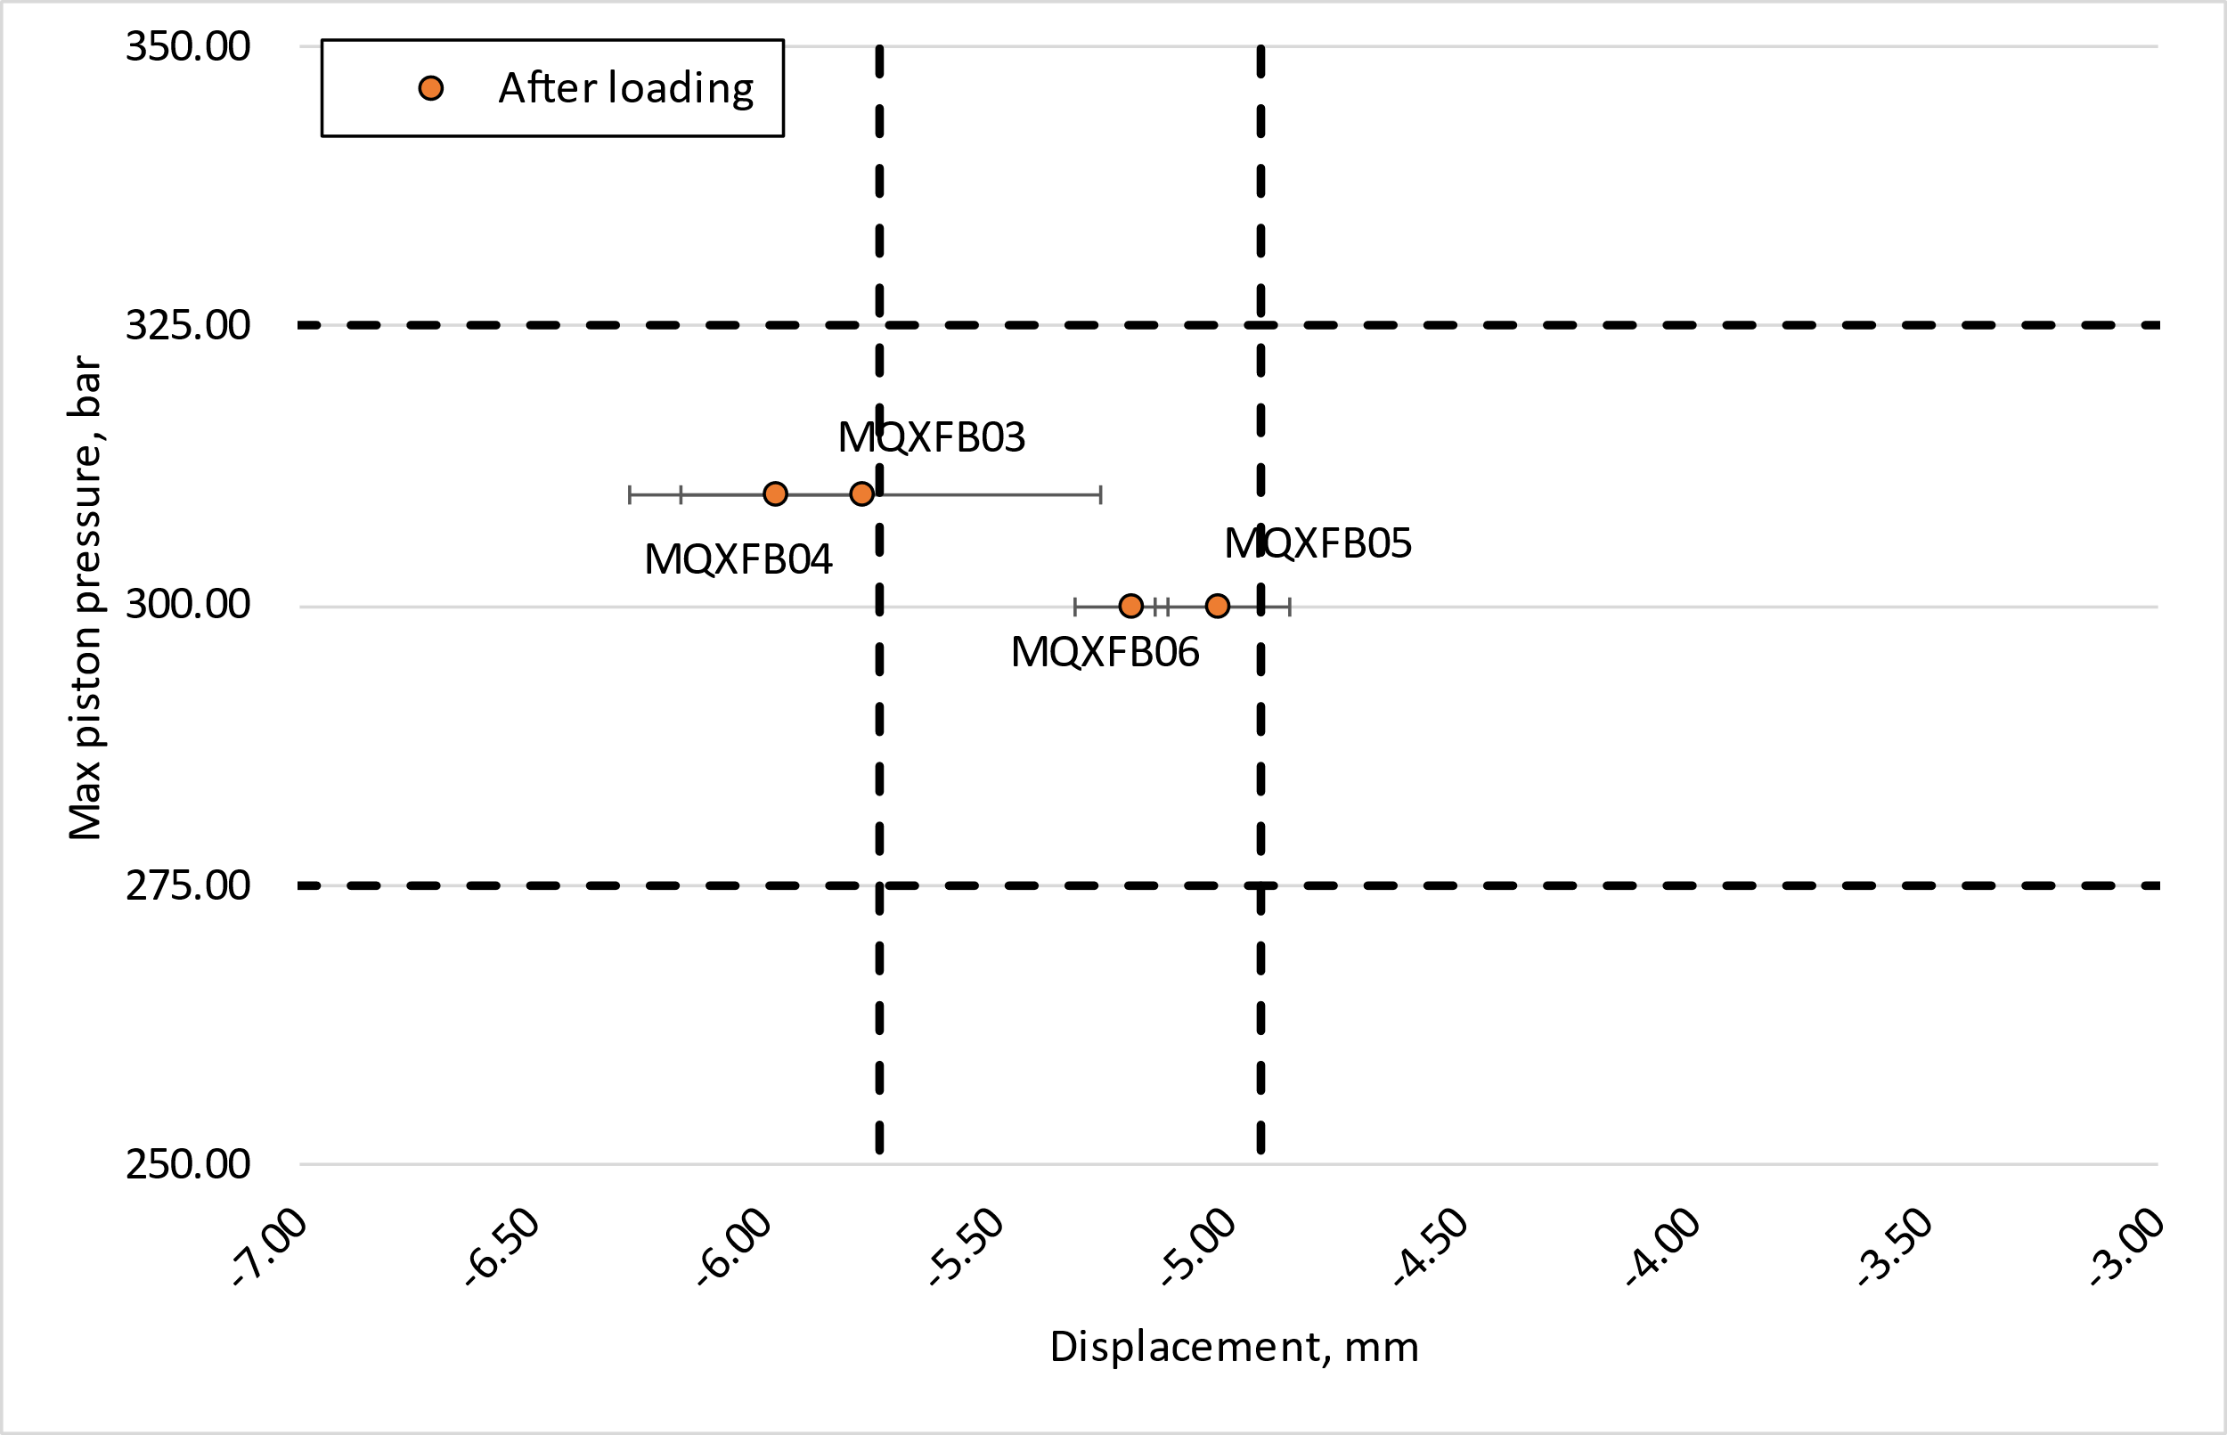
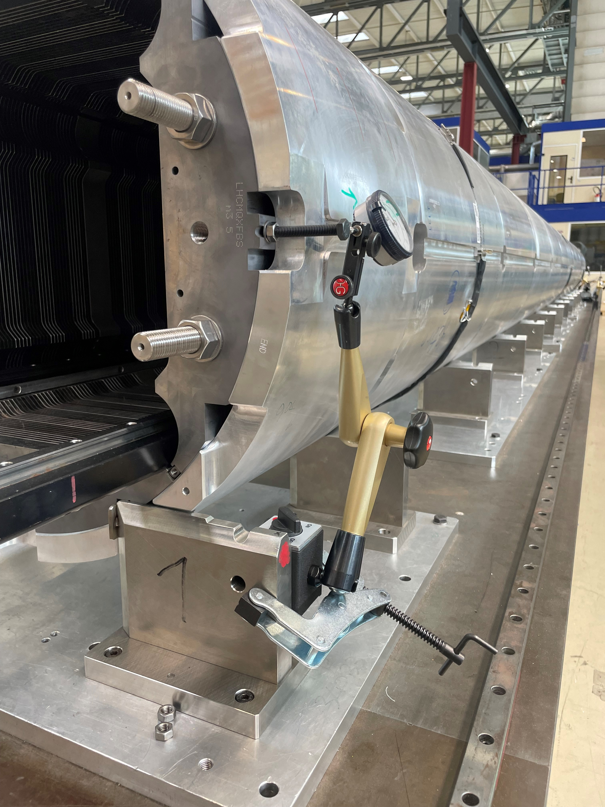
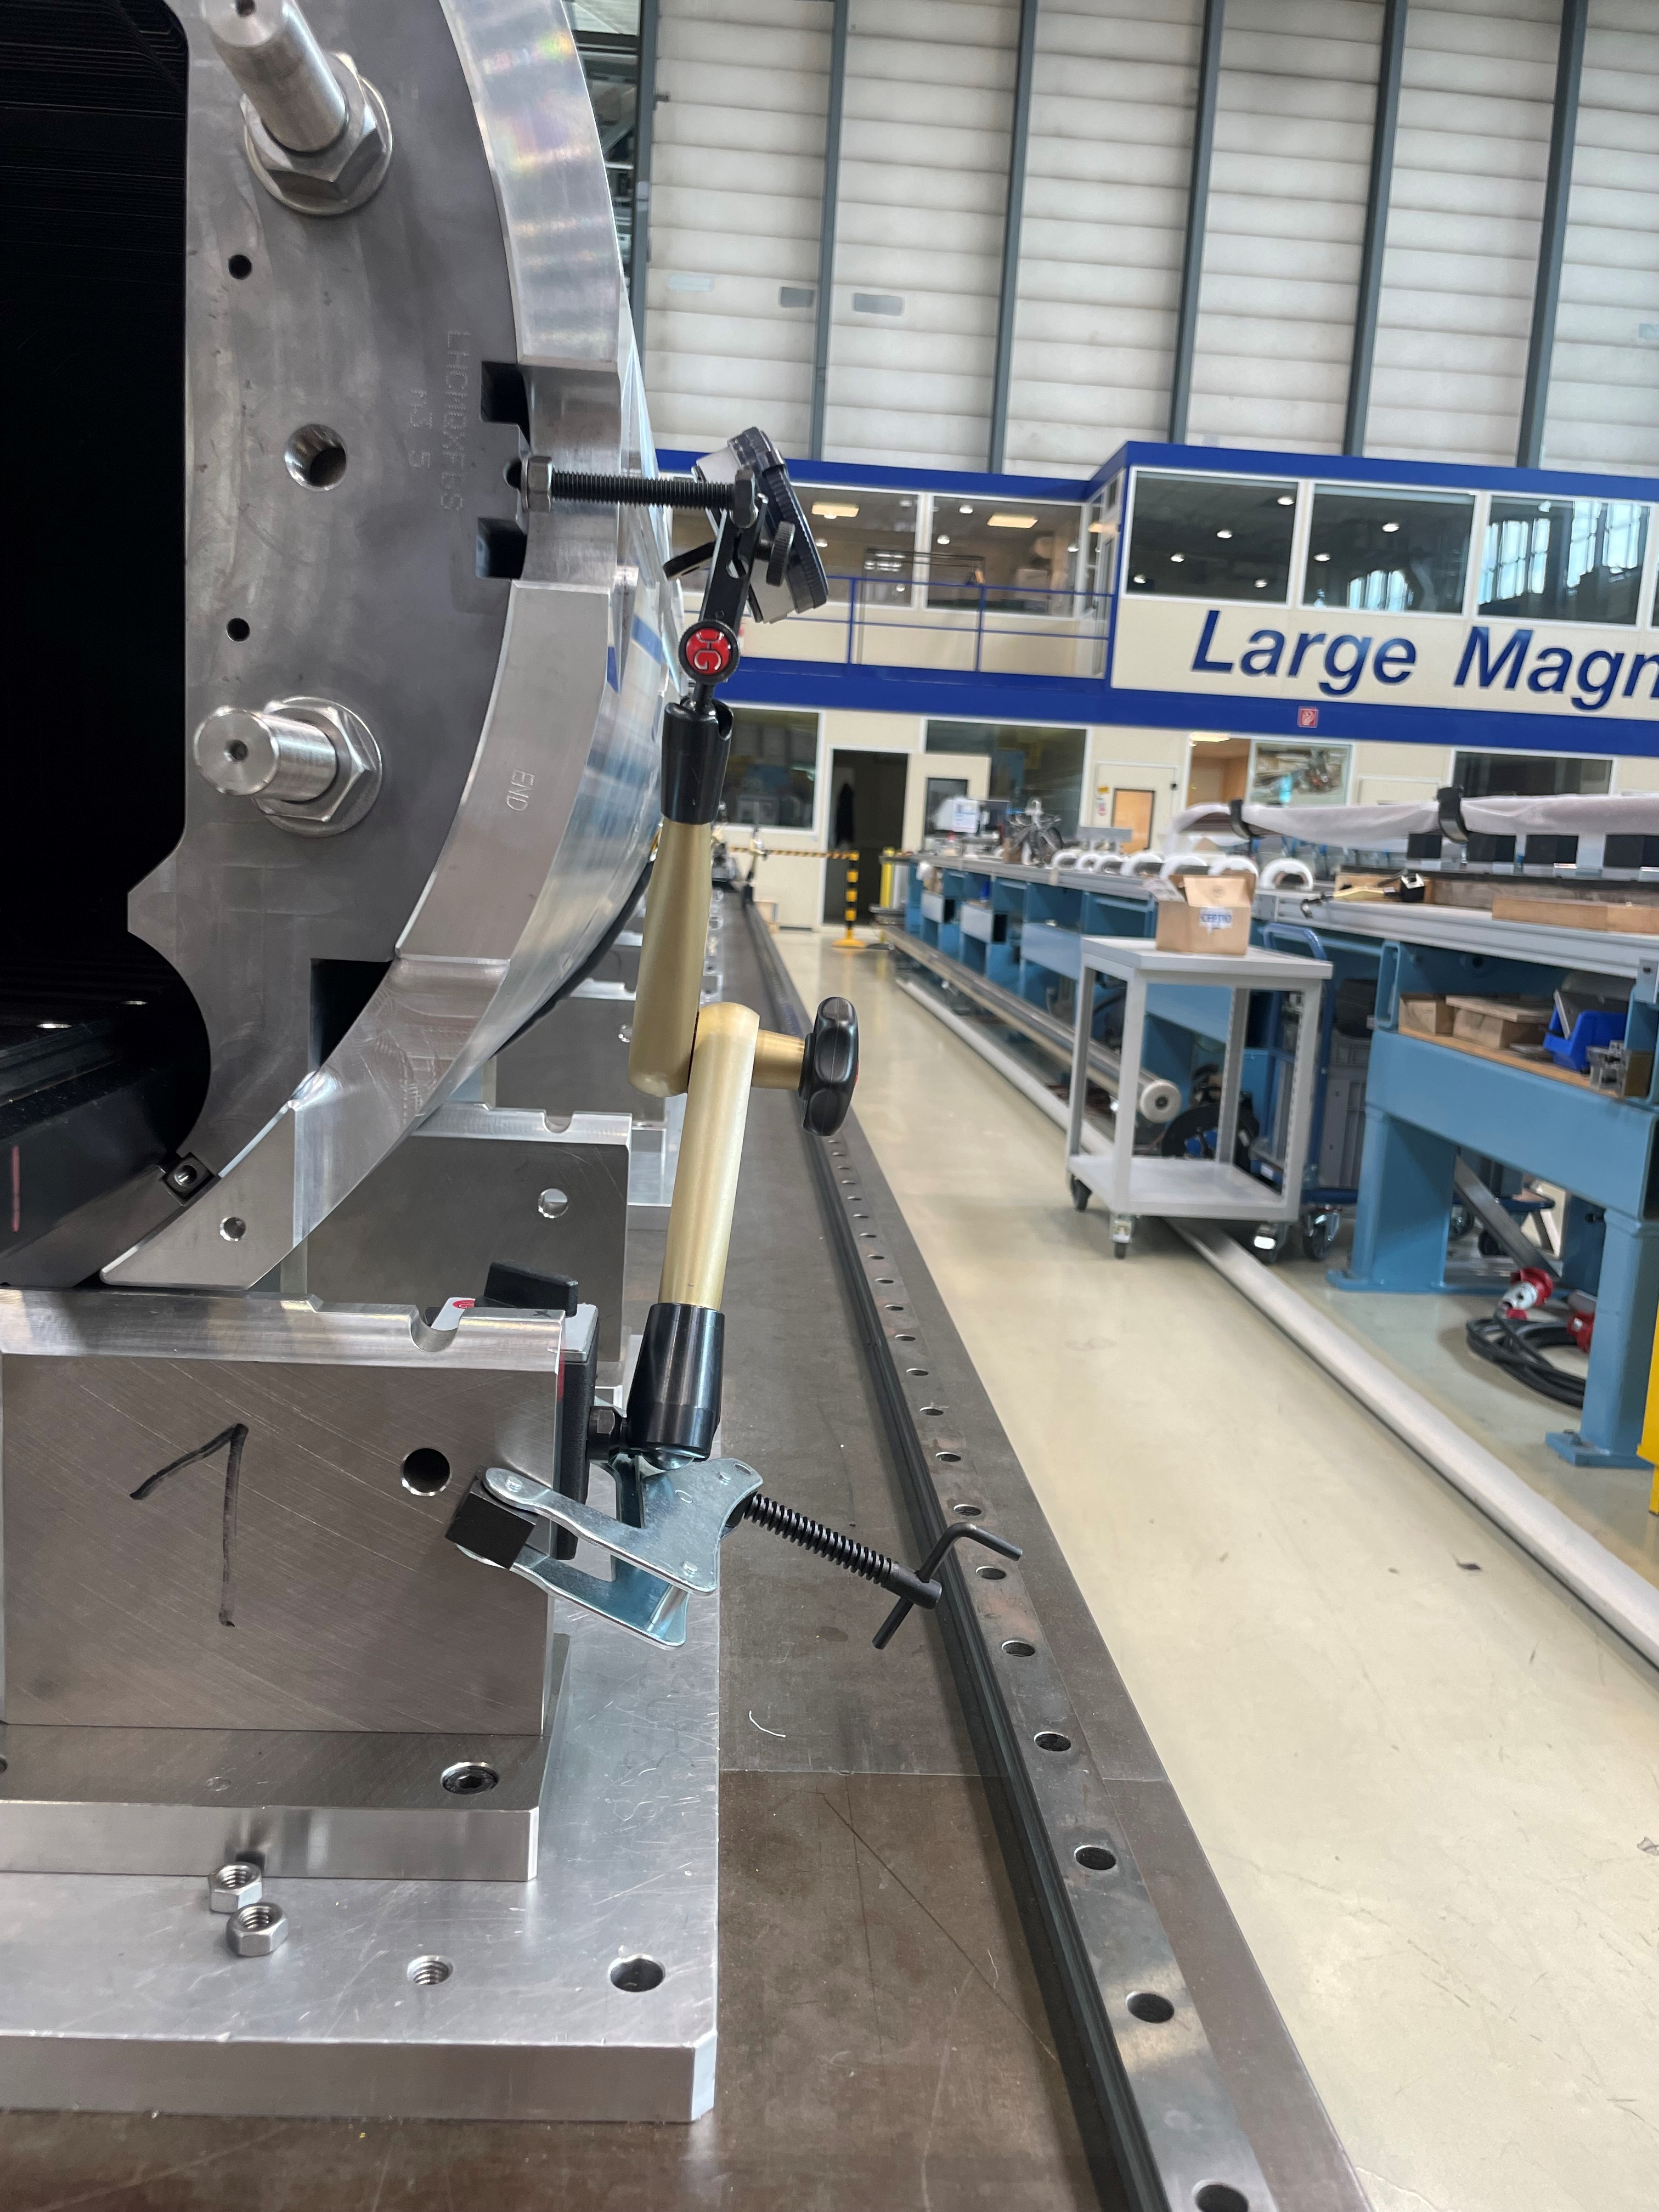
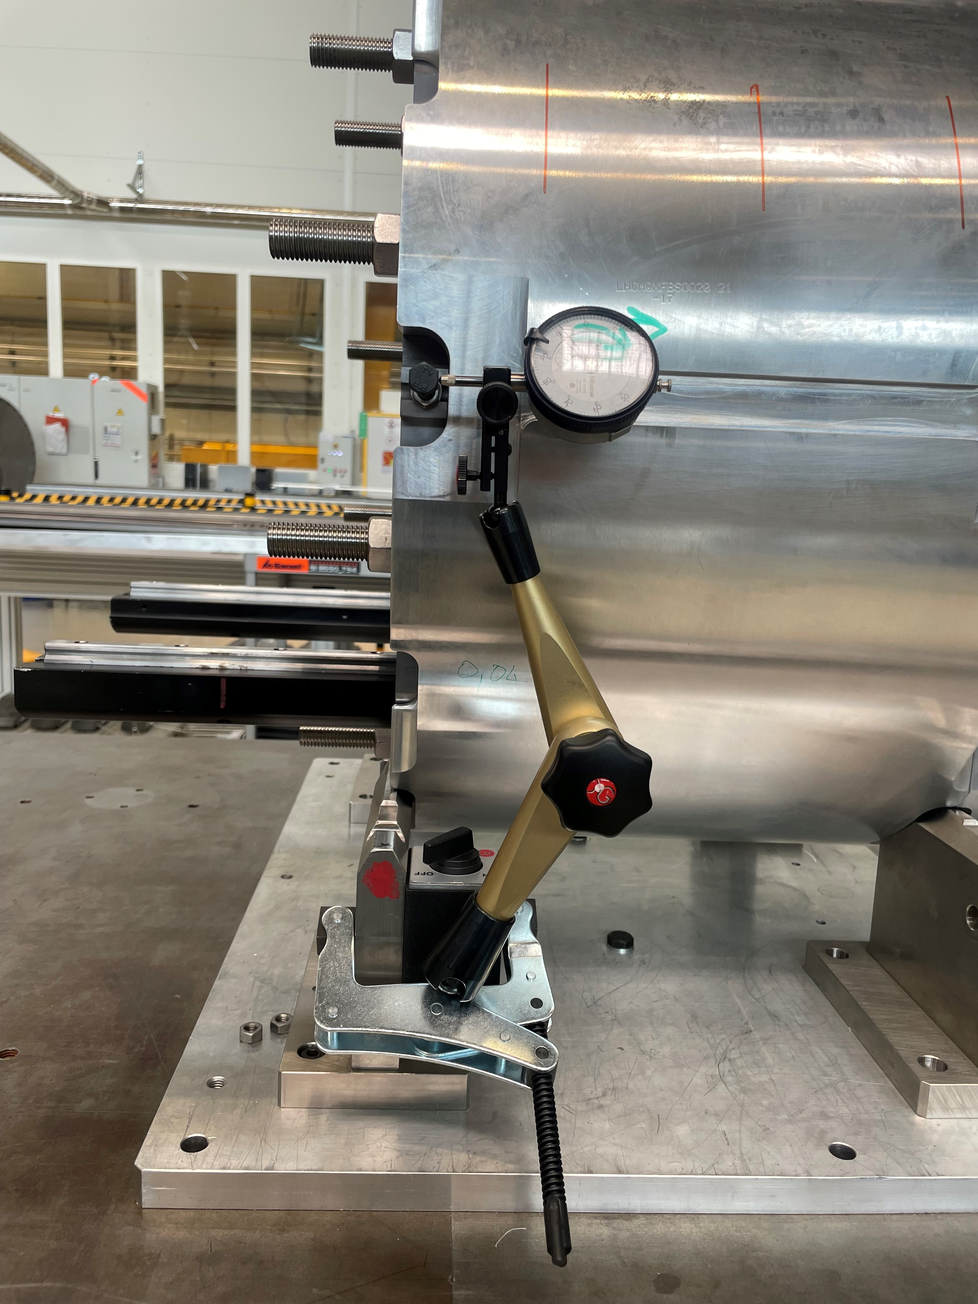
Rods displacements, LVDT placement
Rods instrumentation overview:
Strain gauges placed on the rods
LVDT used to monitor the rods displacement, they are a combination of LVDT used the rods and for end-plates and yoke. The combination of this measures is giving the actual rods displacement
Pressure sensor to monitor the piston pressure during loading
Strain target: 650 ± 50 µstrain after loading for MQXFB (for all the magnets we are in the ± 50 µstrain windows).
The equivalent targets for pressure and displacement to guarantee 650 ± 50 µstrain are:
Pressure target: 300 ± 25 bar
Displacement target: -5.33 ± 0.4 mm
Combing the targets of pressure and displacement, we can identify a ‘safe’ window to guarantee the strain target.
LVDT for B03, B04 and B06 are not perfectly in contact, B05 is the only representative measurement
Action taken: for magnet MQXFB07, the LVDT (both for end-plates and yoke) will be placed by side to measure the displacement of the screws connected to end-plates and yoke, as shown in the pictures below
For future assemblies, it will be sufficient to look at the pressure and the displacement graph, to guarantee the strain target

Slide 6
Fiber drift

Slide 7
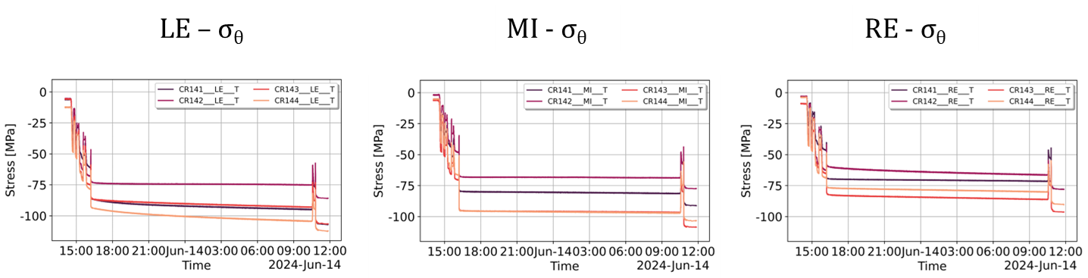
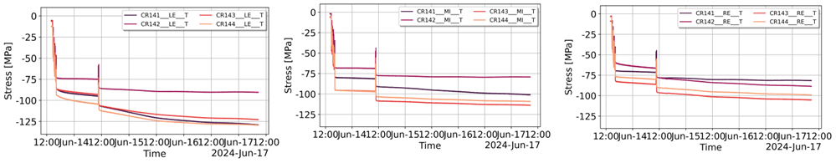
Fiber drift
The loading of B06 was divided in two days:
First day: that ended with the insertion of key 13.8 mm
Second day: insertion of the last key 13.85 mm
Between key 13.8 and 13.85 we assume that there was a drift in the fibers (unsual increase of strain/stess in the pole) with a major effect in the LE.
After a 72h, the same behavior was registered. The delta strain after 72h is more than 100 𝝁𝒎/𝒎 (usually is negligible).
Action taken: the data have been corrected subtracting what we assume is the drift effect.
After loading
After 72h

Slide 8
New keys 13.6 mm

Slide 9
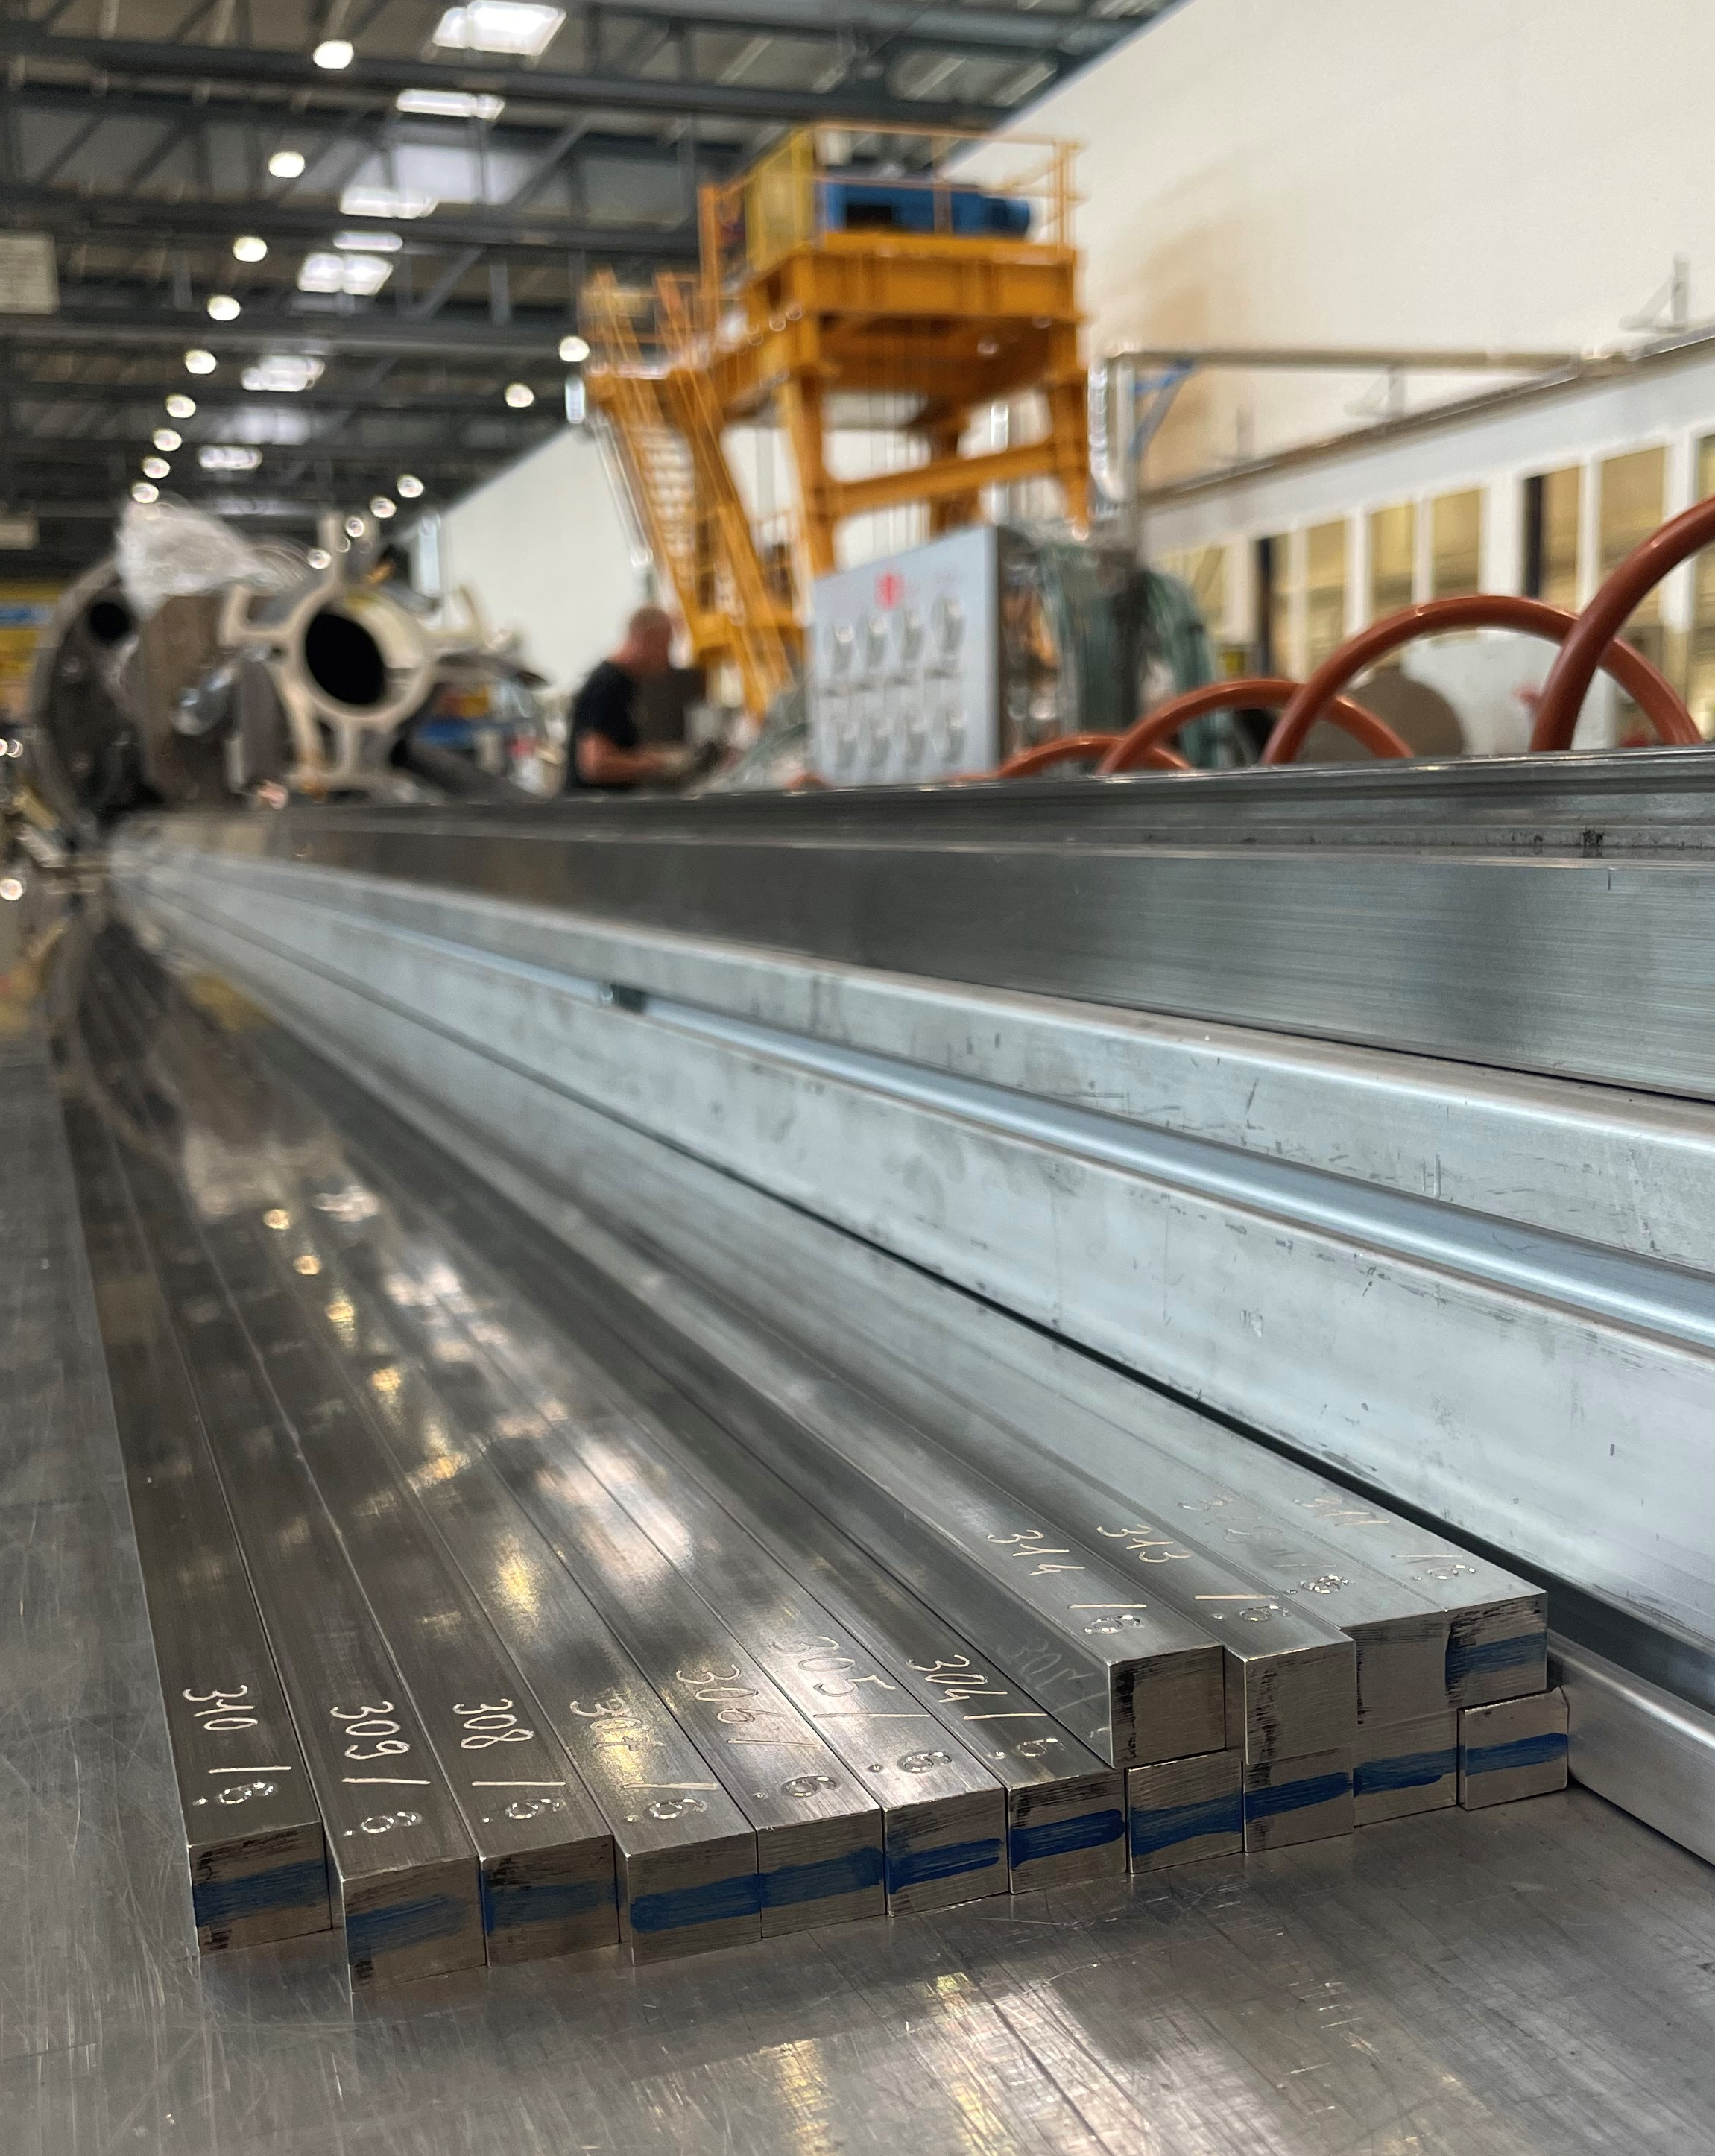
New keys 13.6 mm
During the loading of B03, the final keys used were 13.6 mm, usually used as tooling keys.
For the next magnets, keys 13.6 mm have been “re-worked” from existing keys and most of them are twisted.
During the loading of the magnets B04,B05 and B06, the insertion of keys 13.6 mm was very difficult due to the twisting.
For this reason, a set of keys 13.6 mm has been machine and it’s now ready for loading of magnet B07!!!!

Slide 10
Thank you!

